Slide 1
Dividing MOBY data
Thresholds:
Similar brightness defined as ±5% ΔR_{rs}brightness
Similar AVW defined as ±1 nm ΔAVW.
This is pretty strict for spectral shape adherence, and we can probably relax this.
Dissimilar spectra are defined as exceeding ±5% ΔR_{rs}brightness and ±1 nm ΔAVW
Thus, we can divide the validation data into 9 distinct categories:
Comparisons of MOBY to MODIS-Aqua are categorized by higher/similar/lower brightness, and bluer/similar/greener spectral shapes.

Slide 2
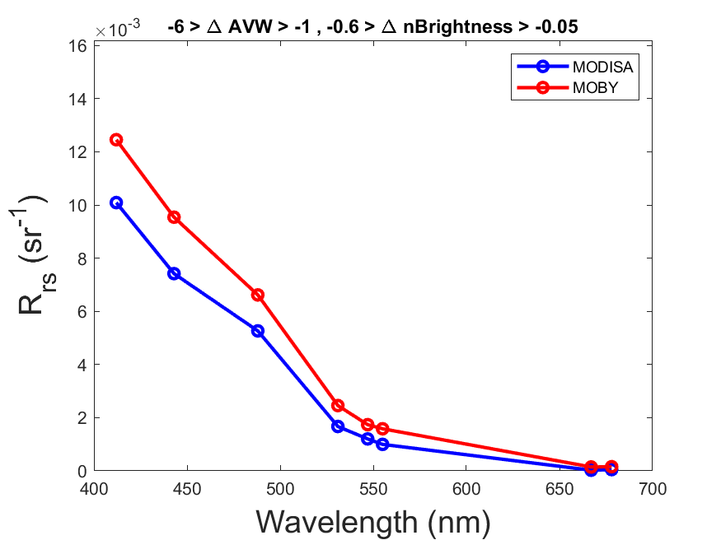
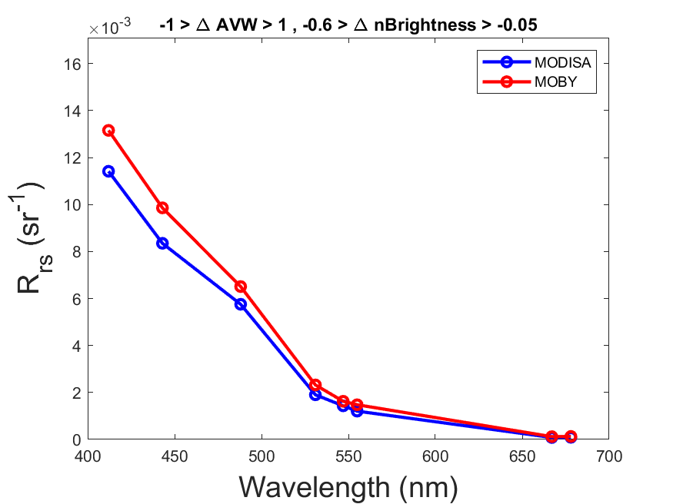
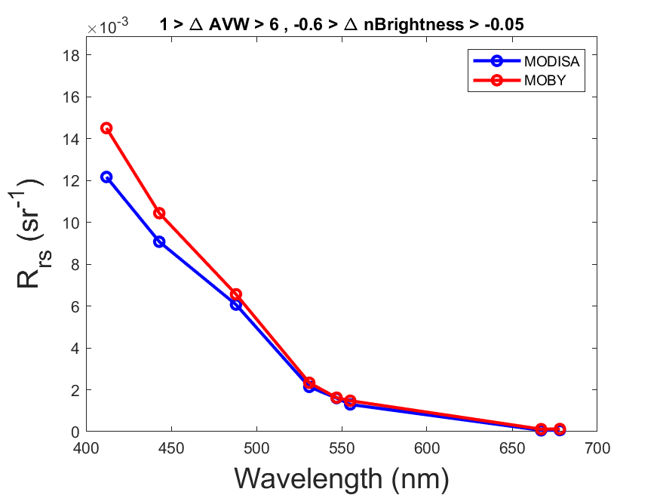
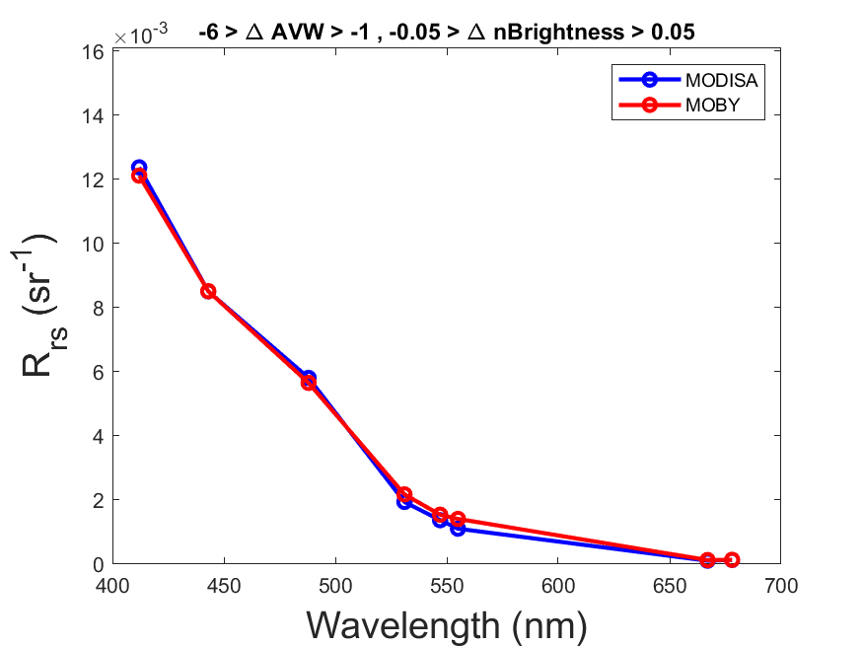
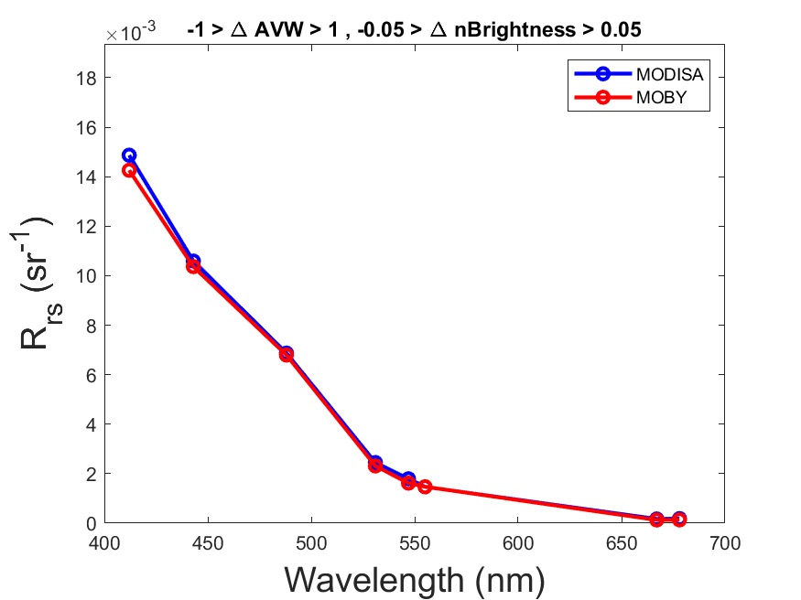
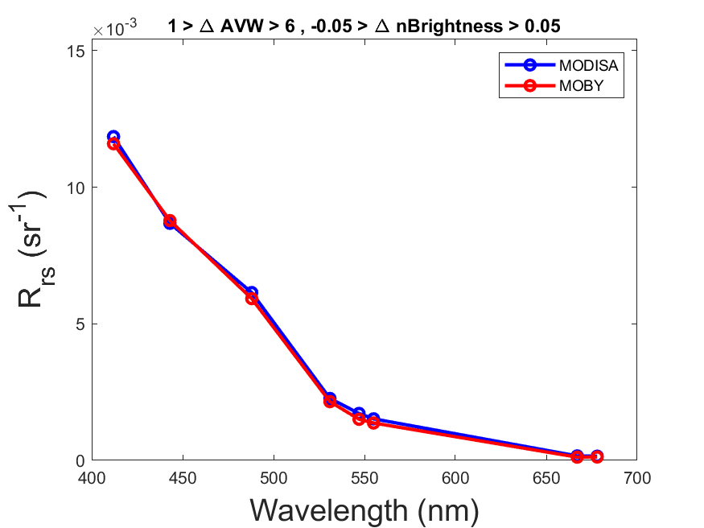
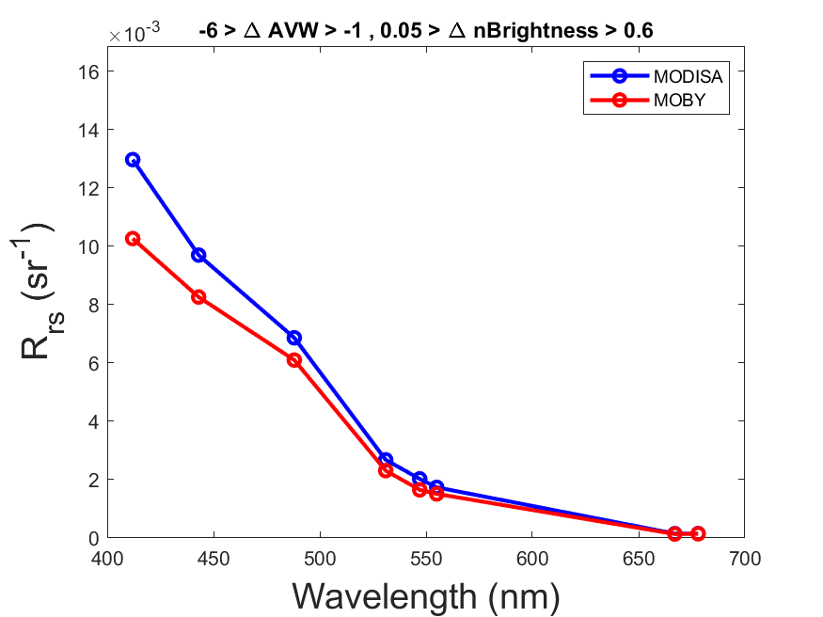
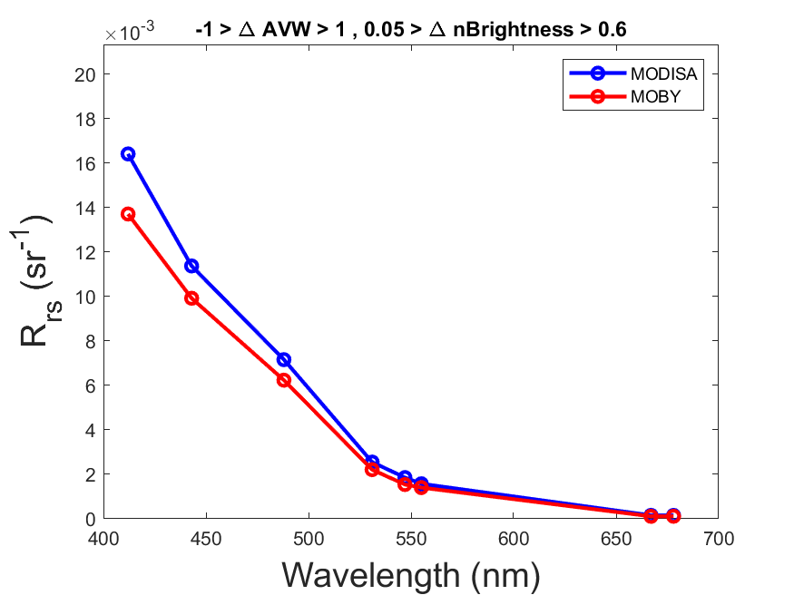
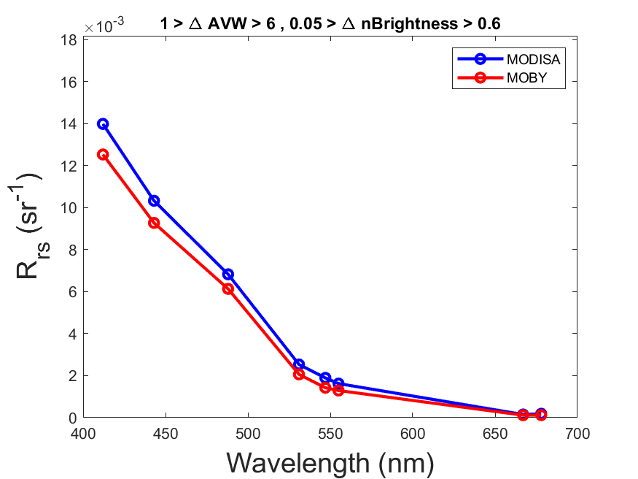
10%
11%
0.5%
MOBY Brighter
7%
23%
8%
MOBY
Greener
MOBY
Bluer
MOBY Darker
4%
21%
16%
Relative to MODIS-Aqua

Slide 3
Some initial observations
For 38% of the MOBY validation dataset, the total spectrum is within ±5% ΔR_{rs}brightness (meaning the magnitude of all R_{rs} values are closely aligned across the entire spectrum).
When one spectrum is >5% brighter than the other, it is more likely that MODIS-Aqua is brighter than MOBY (40%), as opposed to MOBY being brighter than MODIS-Aqua (22%).
For 24% of the dataset, MOBY is slightly blue-shifted relative to MODIS-Aqua.
For 21% of the dataset, MOBY is slightly green-shifted relative to MODIS-Aqua.
NOTE: For color-shifts, most are subtle color shifts, larger shifts in color (defined as > 3nm AVW) account for only 6.4% of the data. We can adjust this threshold.
When the intensity of a MOBY spectrum is lower than that of MODIS-Aqua, it is 4x more likely to be blue-shifted rather than green-shifted (relative to MODIS). Conversely, when the intensity of a MOBY spectrum is greater than that of MODIS-Aqua, it is 20x more likely to be green-shifted rather than blue-shifted (relative to MODIS).
On average, MOBY R_{rs} is brighter at higher solz
On average, MOBY R_{rs} is green-shifted (relative to MODIS-Aqua) at higher senz
On average, MOBY R_{rs} is green-shifted (relative to MODIS-Aqua) at higher cv

Slide 4
On average, MOBY R_{rs} is brighter at higher solz

Slide 5
On average, MOBY R_{rs} is green-shifted (relative to MODIS-Aqua) at higher senz

Slide 6
On average, MOBY R_{rs} is green-shifted (relative to MODIS-Aqua) at higher cv

