Slide 1
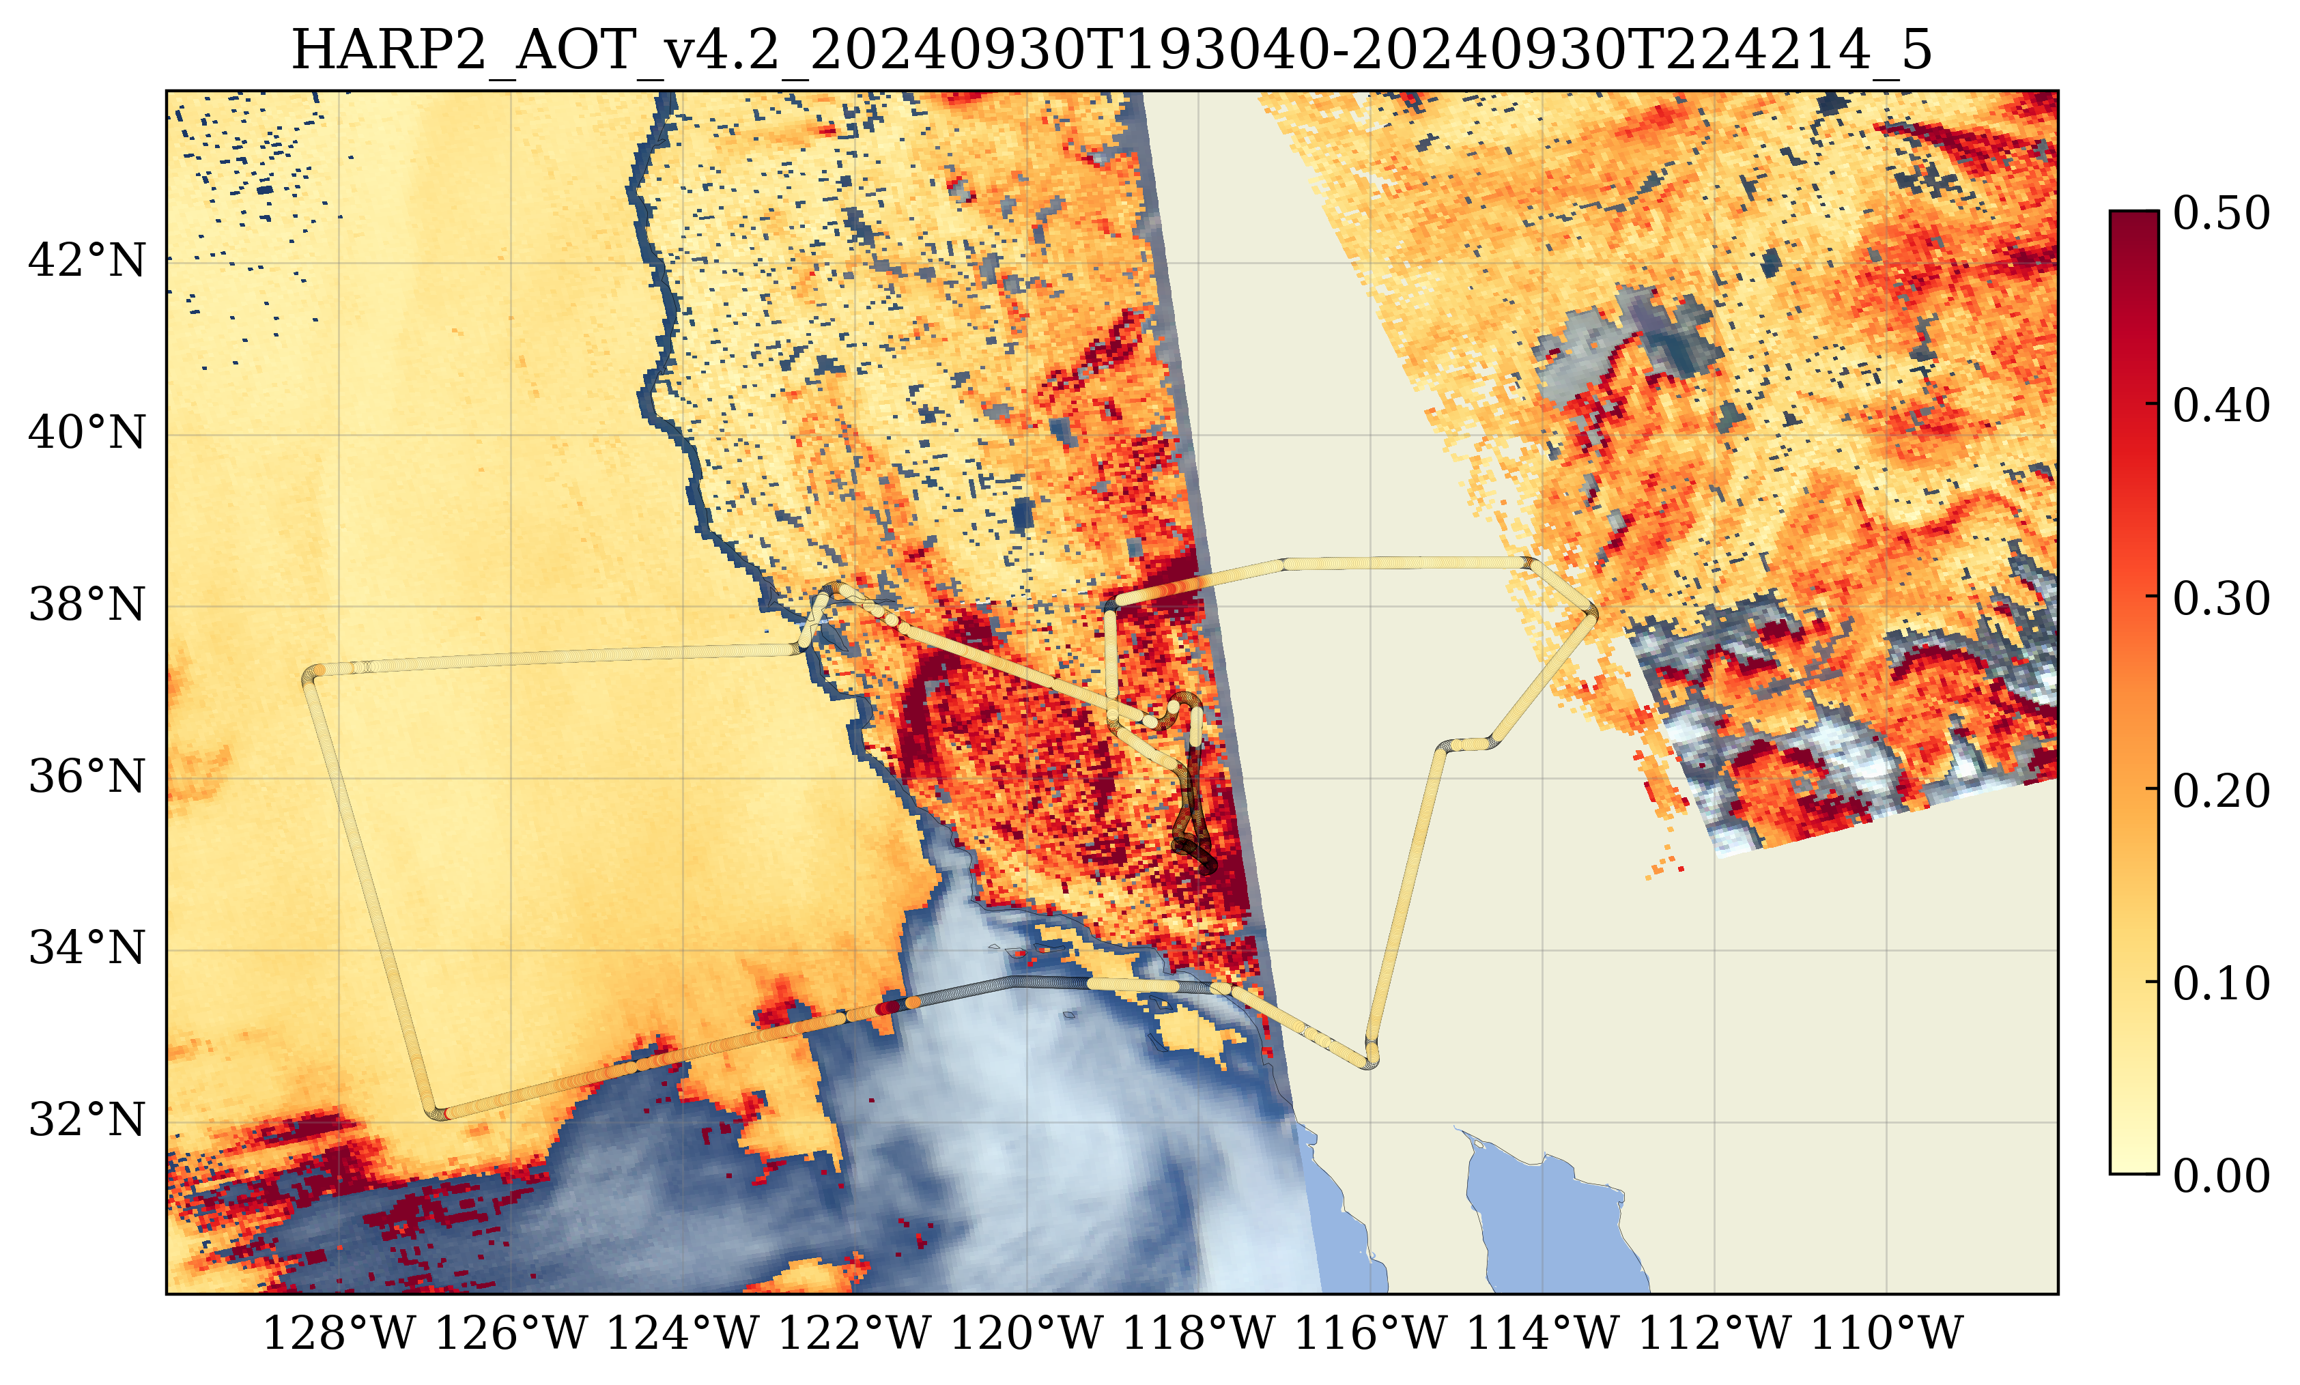
V4.0 gitlab

Slide 2
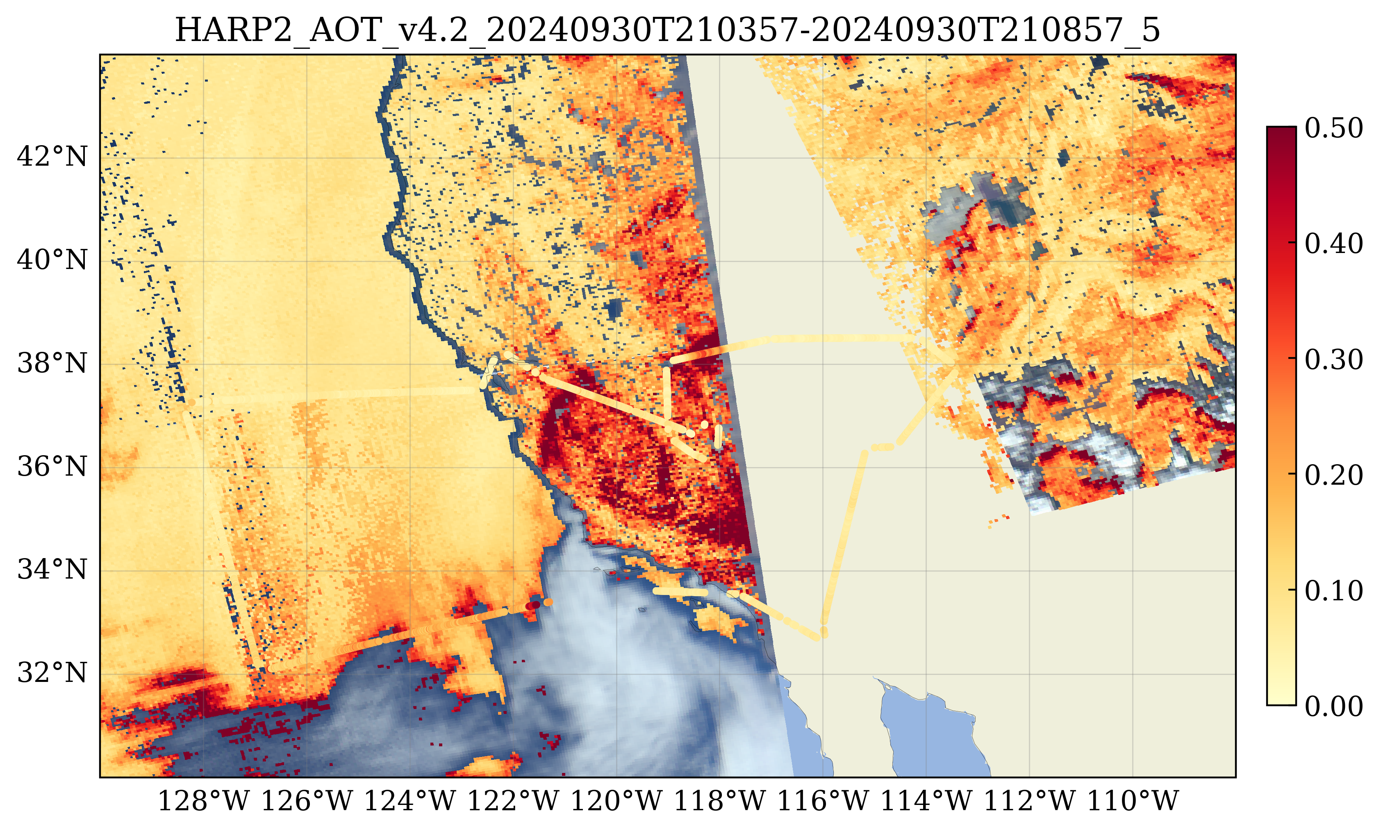
V4.0 public
Ocean seems noisier:
May due to the use of larger AOD range in the NN training with the rtsos_public code.
AOD over land seems increase a bit when switching rtoss in gitlab to rtsos_public

Slide 3
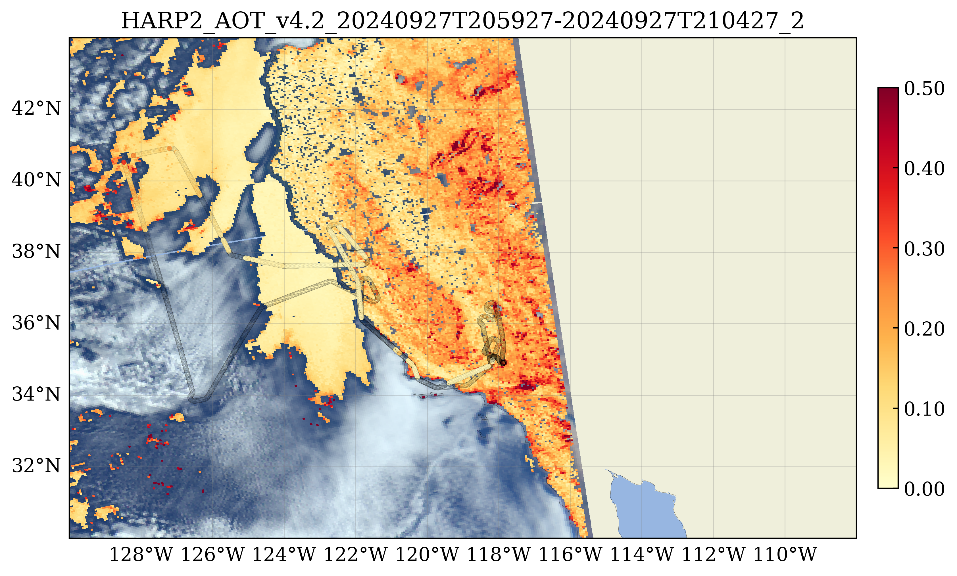
V4.0 gitlab

Slide 4
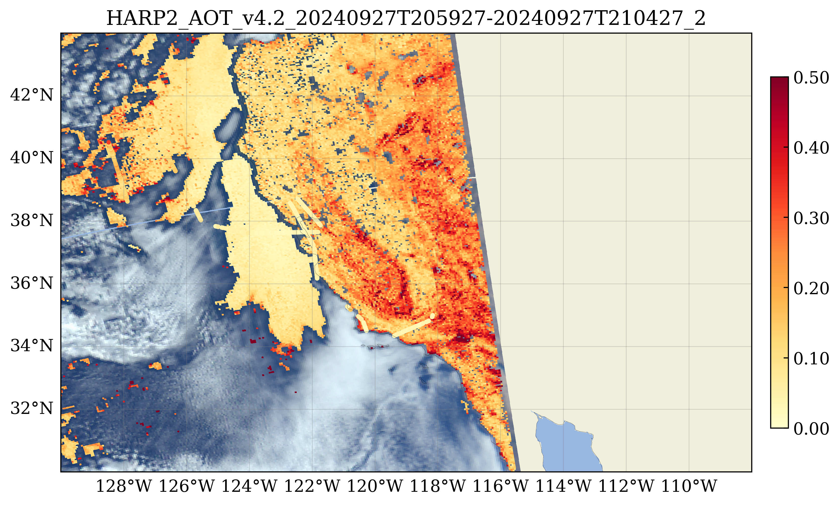
V4.0 public
Same behavior over land and ocean

