Slide 1
PACE polarimerer L2 prelim studies: cross sensors and algorithms
Meng Gao, Jun 17 2025
Note: analysis is prelim based on one scene and limited region.

Slide 2
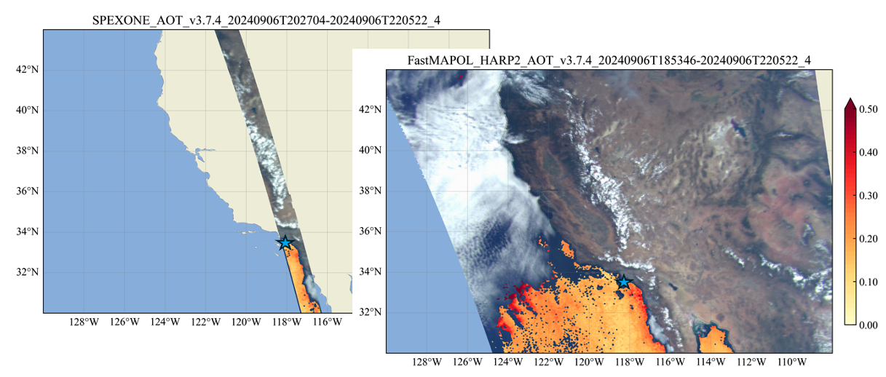
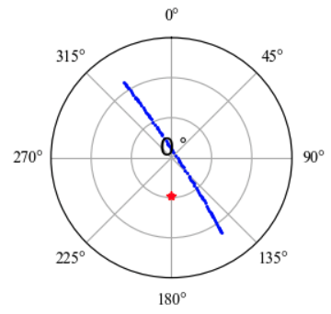
PACE HARP2 and SPEXone Scene
Time stamp: 20240906T202704
AERONET SeaPRISM (* pixel: 124,_252)
View geometry: blue dots
Anti-Solar point: red
USC_SEAPRISM
(33.56, -118.12)

Slide 3
20240906T202704 (wind speed)

Slide 4
20240906T202704 (chla)

Slide 5
20240906T202704 (aot)

Slide 6
20240906T202704 (aot_fine)

Slide 7
20240906T202704 (aot_coarse)

Slide 8
20240906T202704: chi2

Slide 9
20240906T202704: nv_ref

Slide 10
20240906T202704: nv_dolp

Slide 11
Fitting performance
FastMAPOL retrieval on SPEXone
Fit SPEXone using FastMAPOL retrieval

Slide 12
Fitting performance using FastMAPOL L2
chi2<1.5
nv_ref=20
nv_diolp=20
no 2.5% reduction yet
FastMAPOL SPEXone (1r, 4b)
Notes:
(before 2.5% correction)

Slide 13
Fitting performance using FastMAPOL L2
chi2<1.5
nv_ref=20
nv_diolp=20
FastMAPOL SPEXone (1r, 4b)
Notes:
(before 2.5% correction)

Slide 14
Fitting performance using FastMAPOL L2 (percentage)
chi2<1.5
nv_ref=20
nv_diolp=20
FastMAPOL SPEXone (1r, 4b)

Slide 15
Fitting performance
FastMAPOL retrieval on SPEXone data
Fit HARP2 using FastMAPOL retrieval

Slide 16
Fit HARP2 data using FM SPEXone retrievals

Slide 17
Fit HARP2 data using FM SPEXone retrievals

Slide 18
Fit HARP2 data using FM SPEXone retrievals

Slide 19
Fit HARP2 data using FM SPEXone retrievals (percentage)

