Slide 1


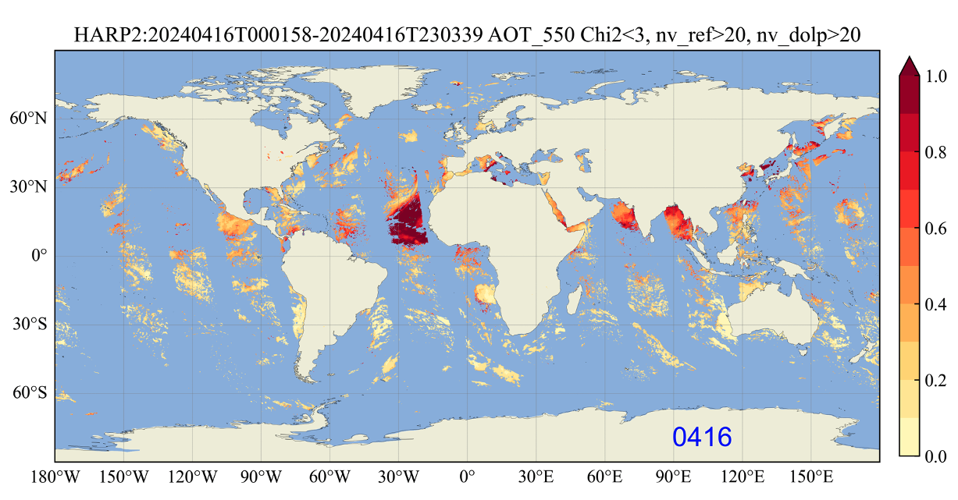
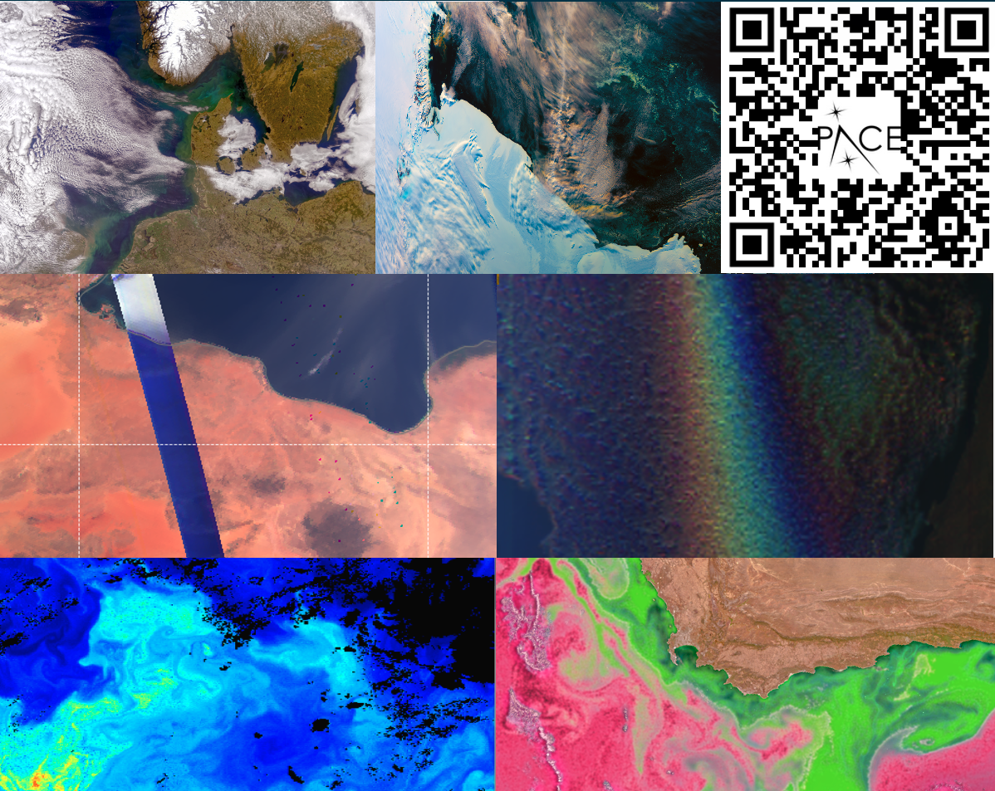
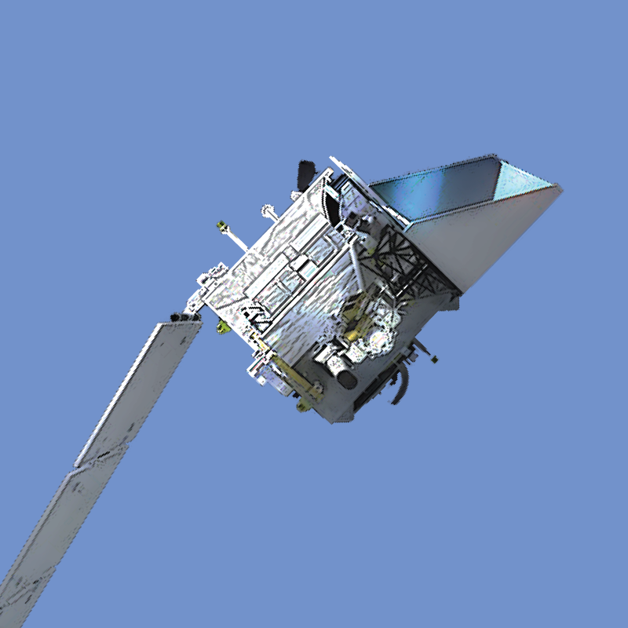
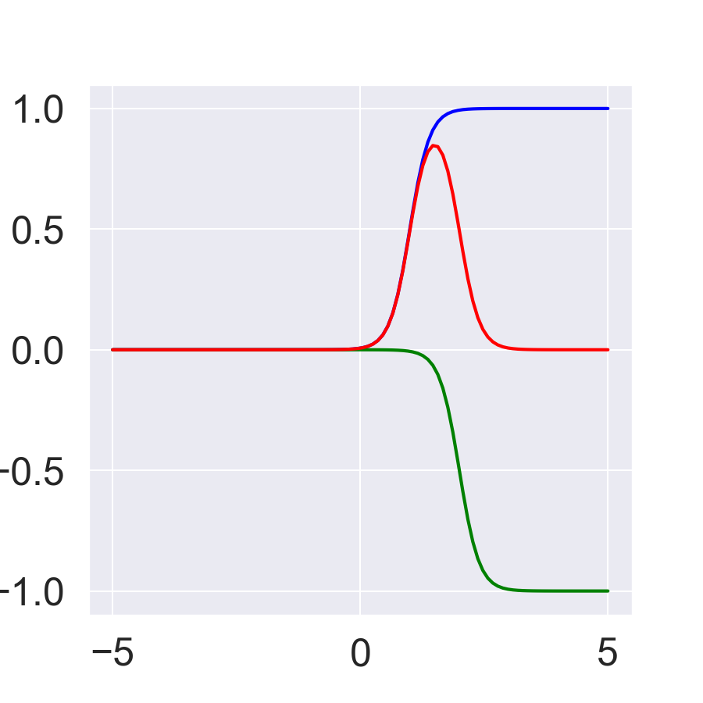
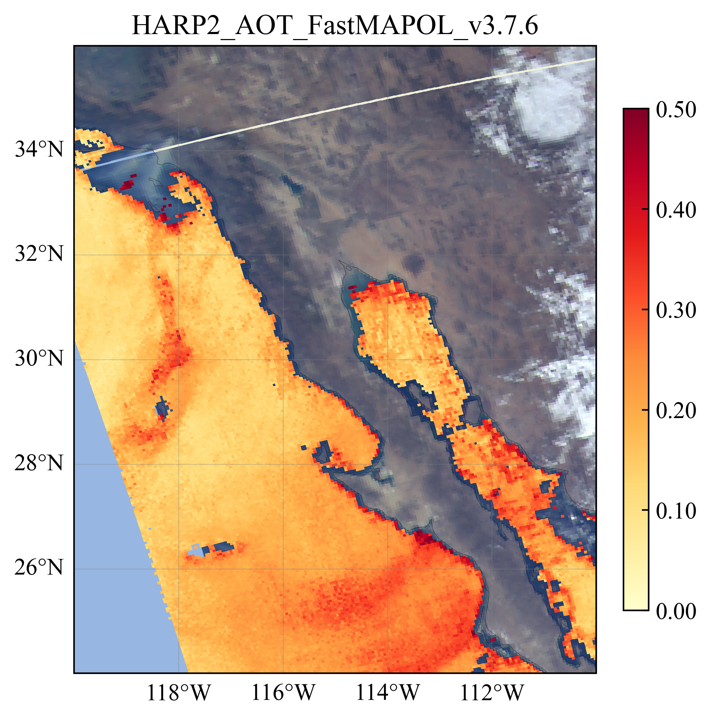
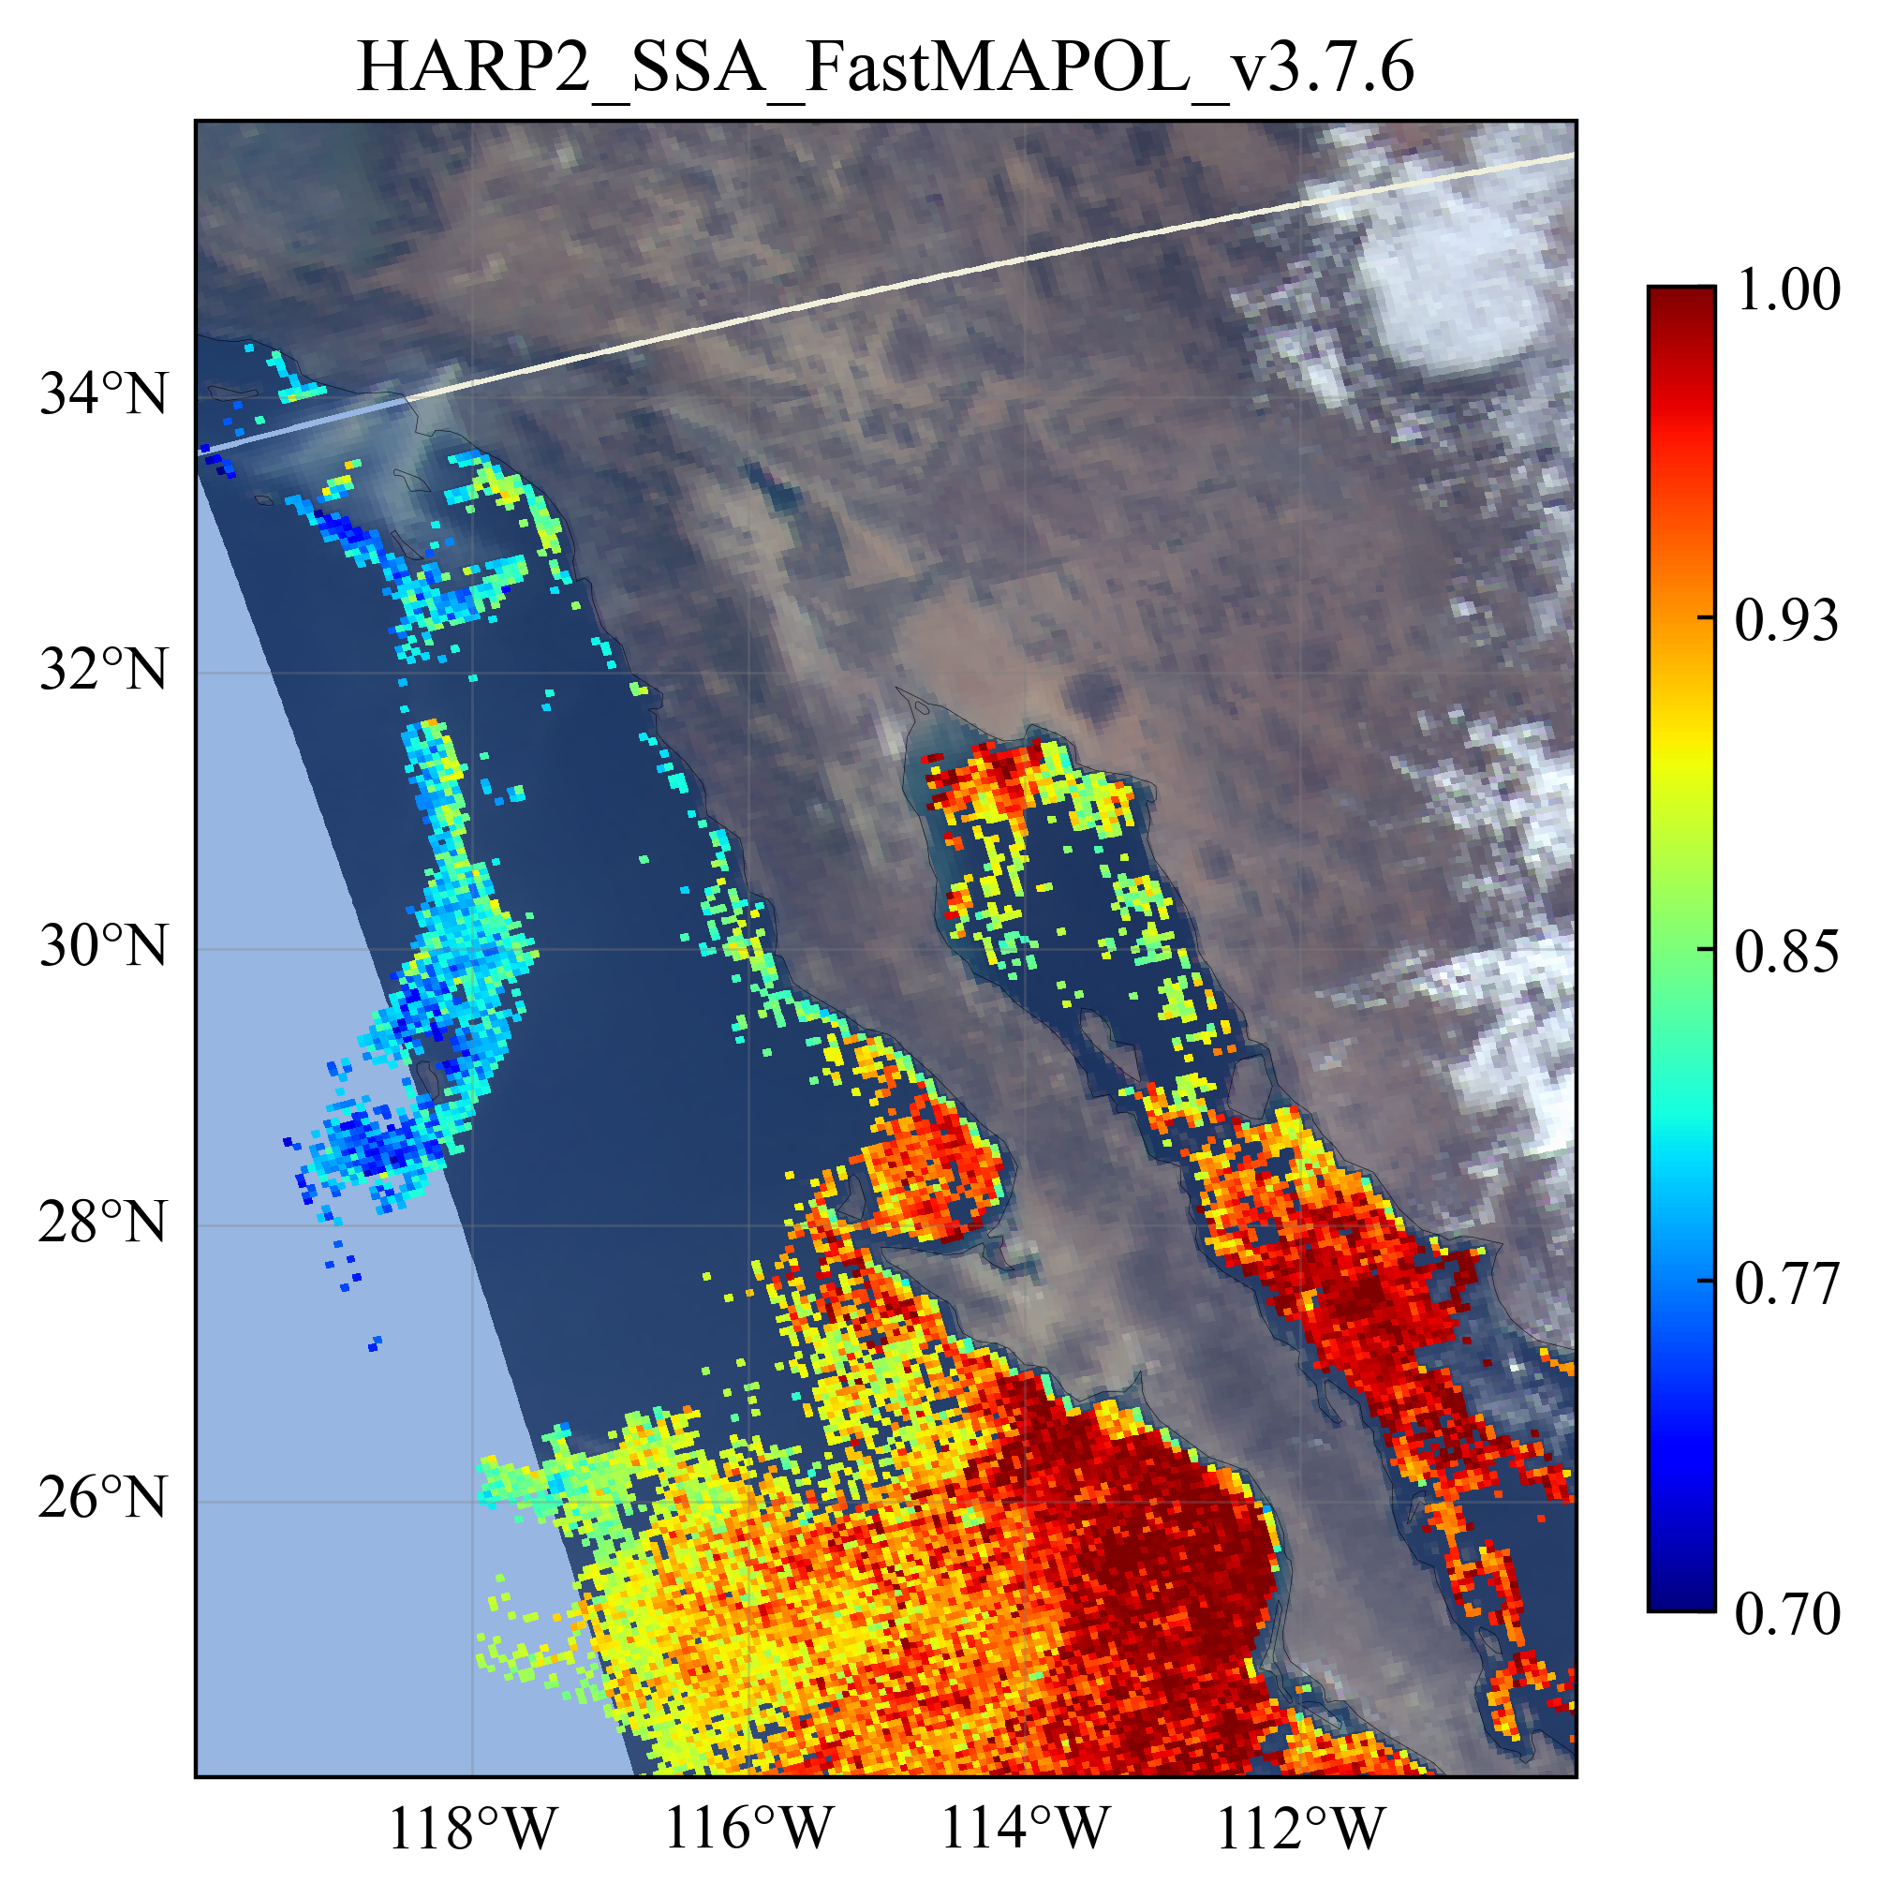
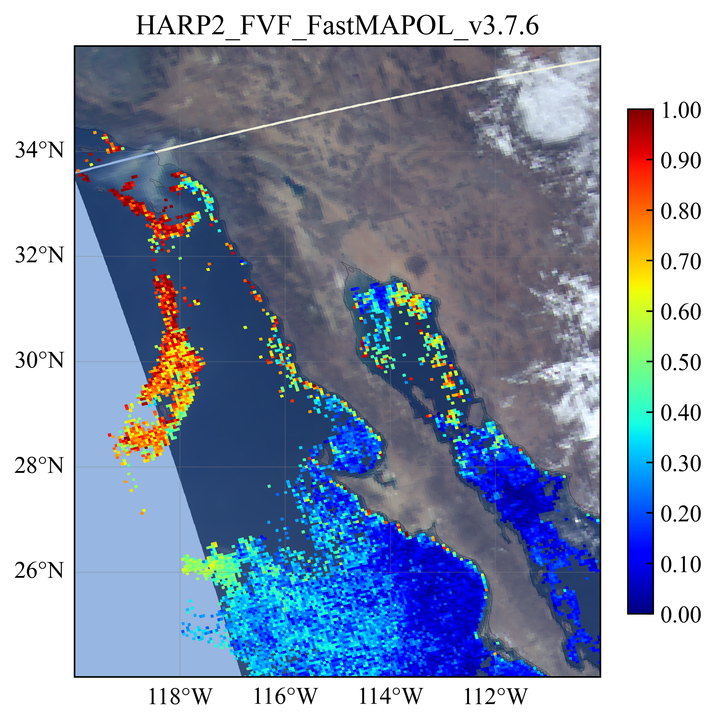
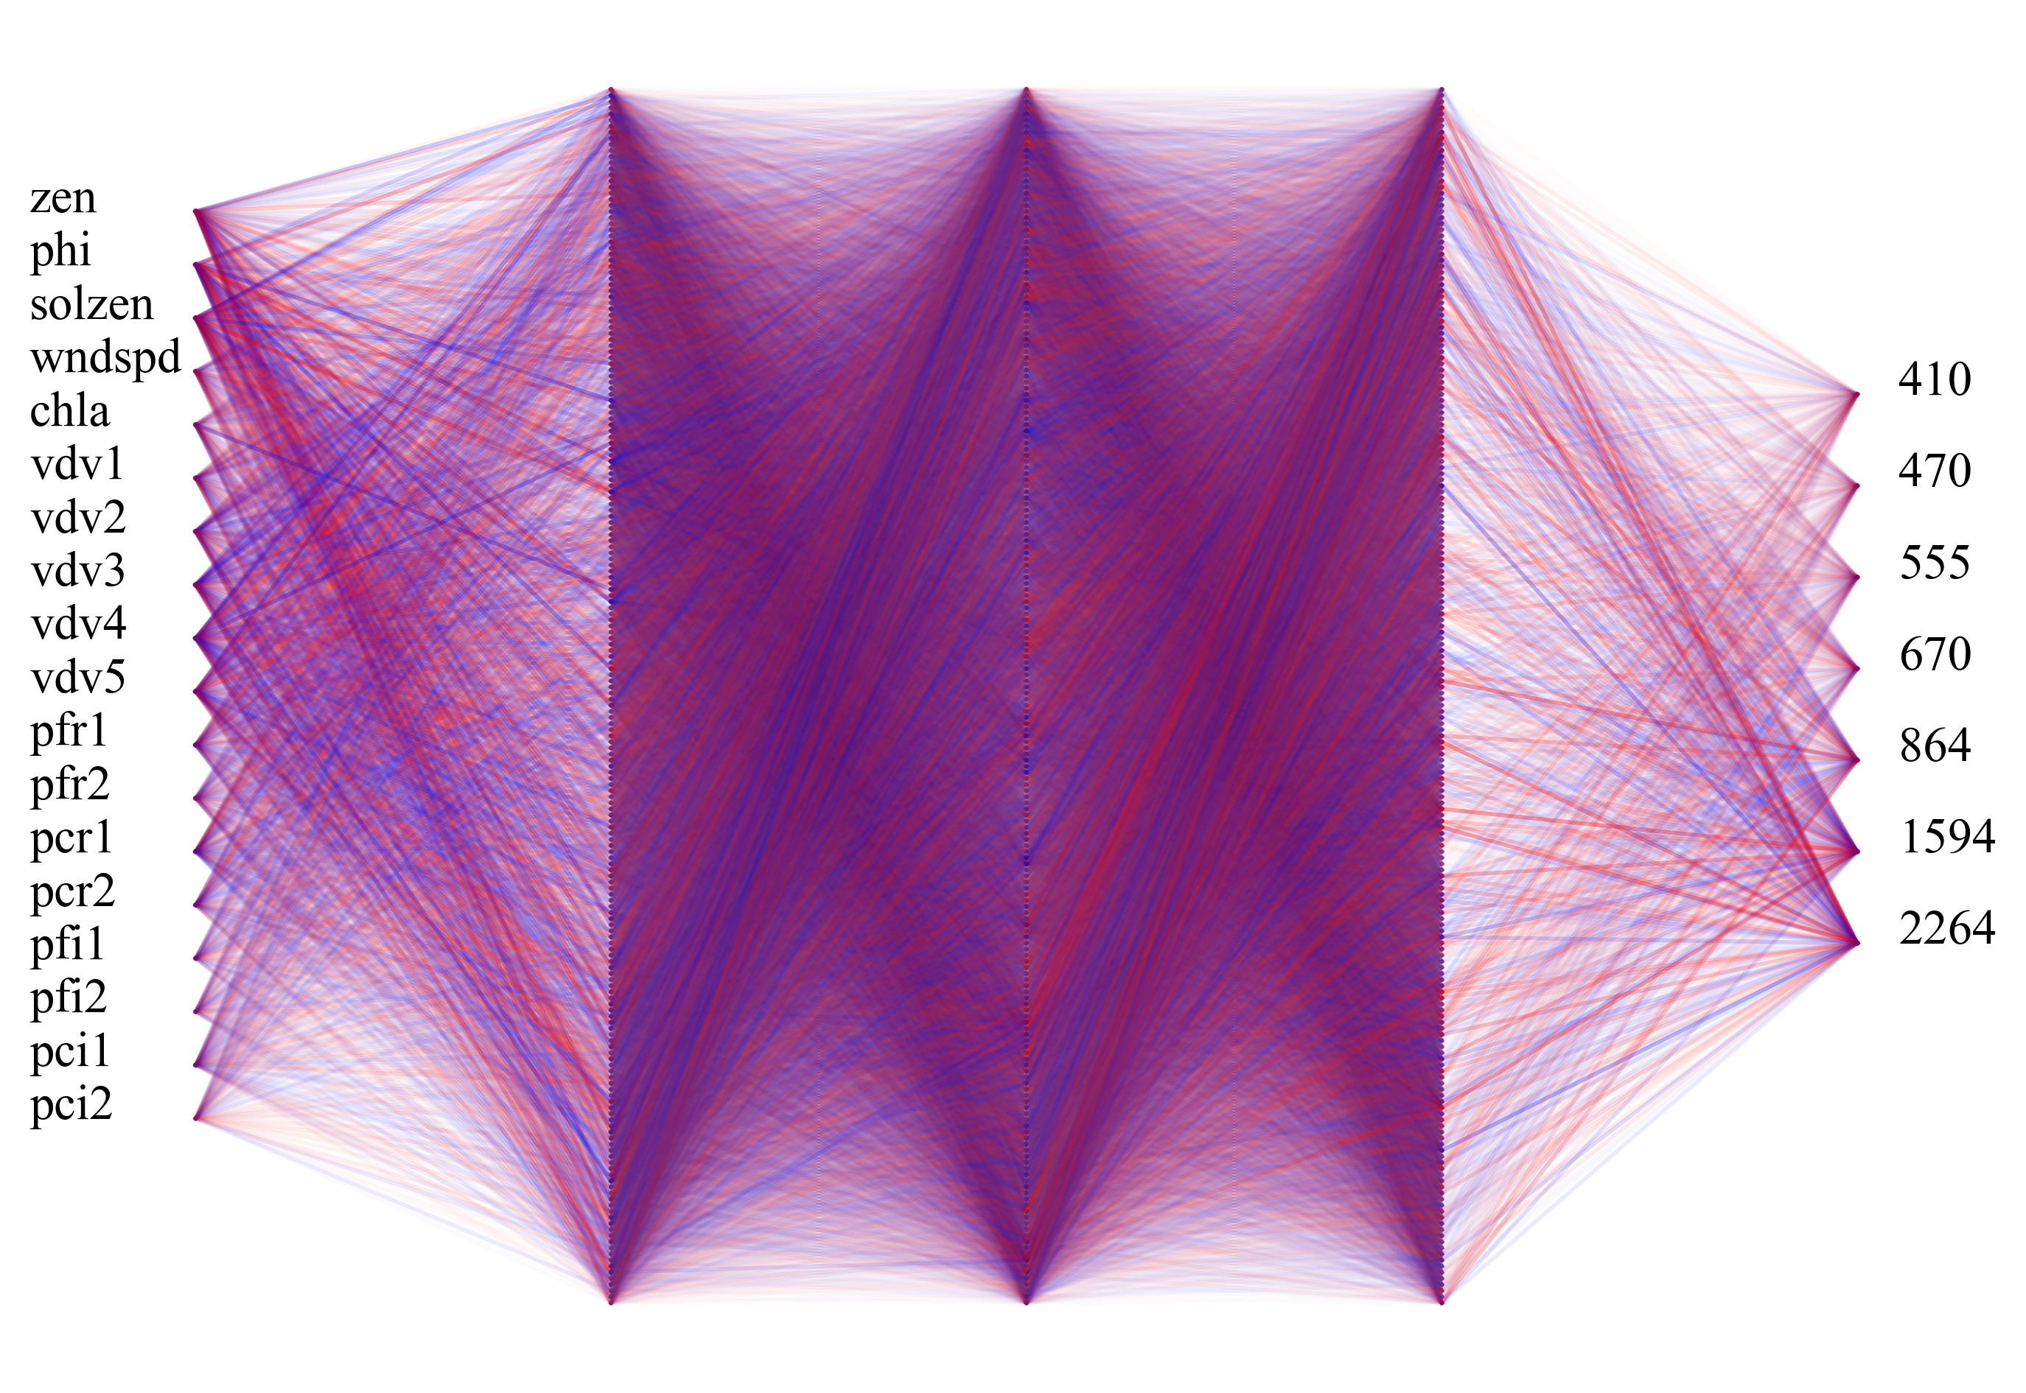
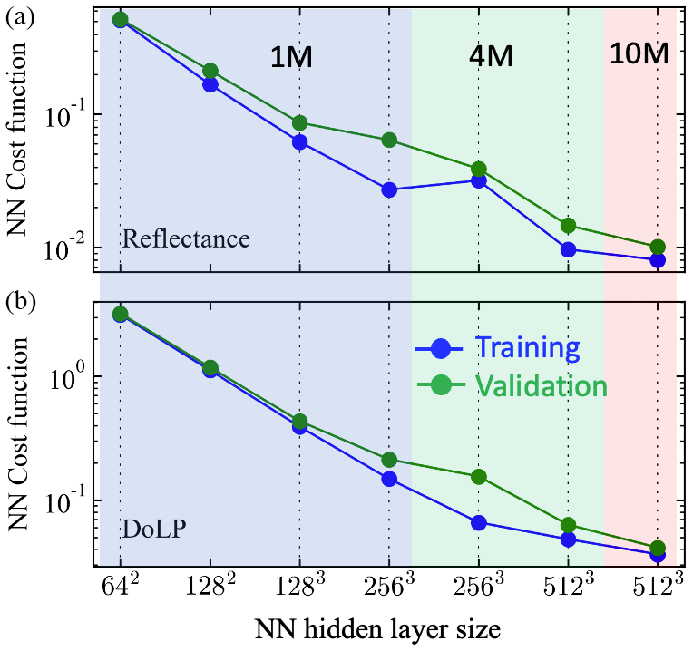
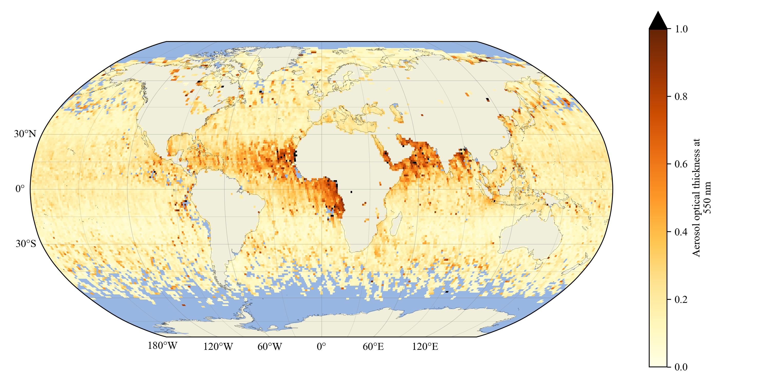
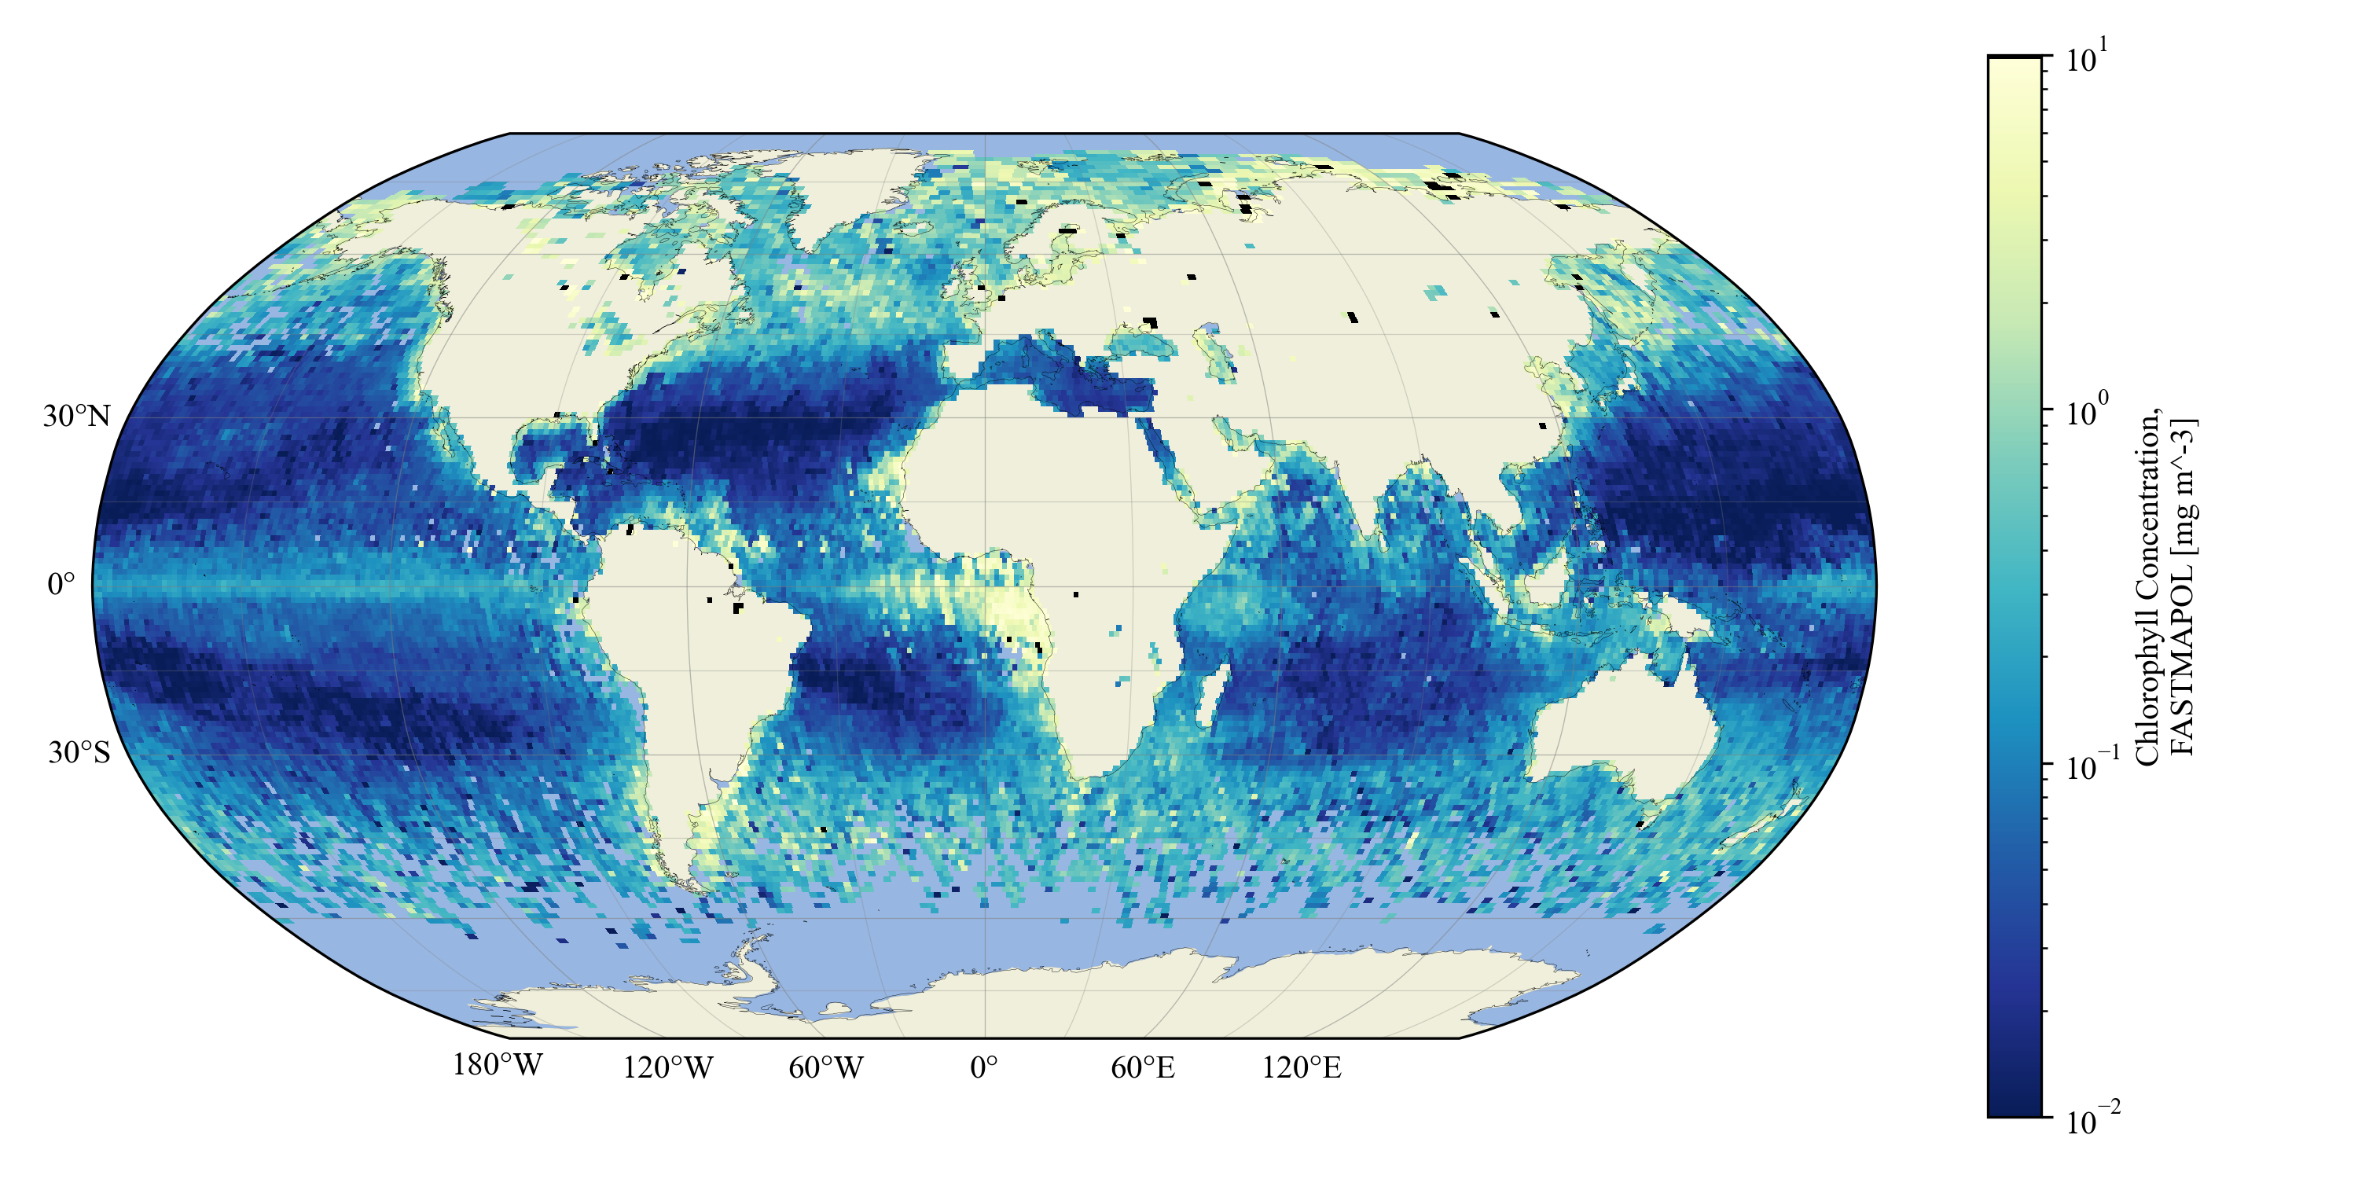
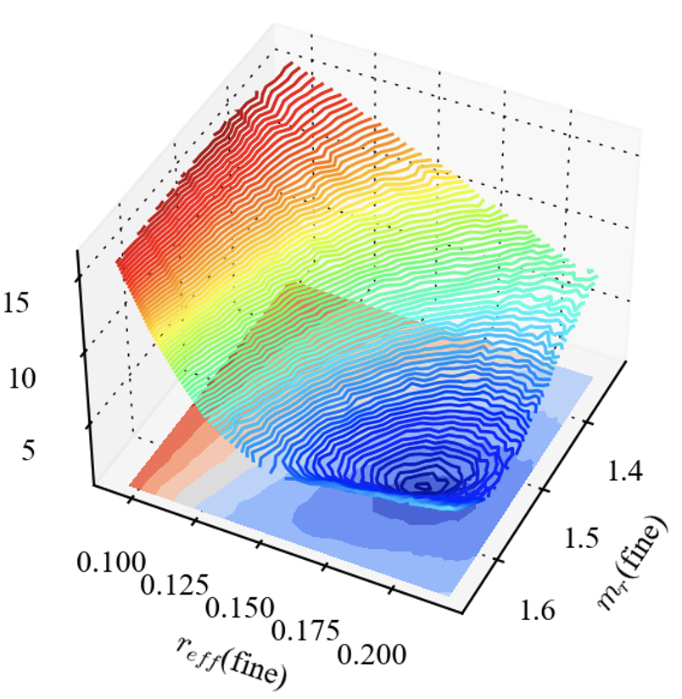




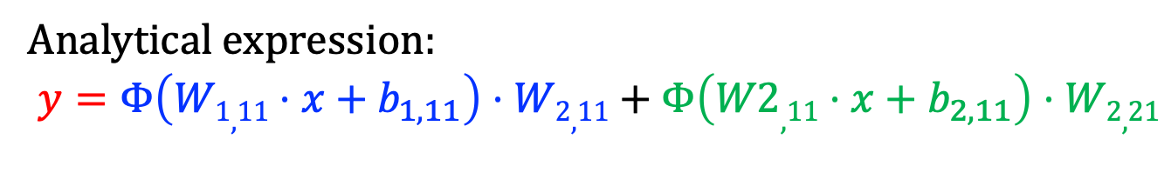





Deep and cheap machine learning for efficient satellite remote sensing: a NASA PACE polarimeter story
Meng Gao^{1,2}, Kirk Knobelspiesse¹, Bryan Franz¹, Peng-Wang Zhai³ , Kamal Aryal³ , and PACE team (¹NASA Goddard Space Flight Center, Code 616, Greenbelt, Maryland 20771, USA, ²Science Systems and Applications, Inc., Greenbelt, MD, USA, ³University of Maryland, Baltimore County, Baltimore, MD 21250, USA)
NASA PACE data has been released for all three instruments: OCI, HARP2 and SPEXone (https://pace.gsfc.nasa.gov/)
Why does deep and cheap Neural Network(NN) work well?
Global PACE HARP2 retrieval example (daily)
Deep neural network can represent any function mathematically.
The success of deep learning also depends on physics: low polynomial orders, symmetry, locality, etc (Lin et al 2017, Journal of Statistical Physics )
A simple NN example (1 x 2 x1 ) to approximate a delta function, which can expand any function.
W_{1,11}=W_{1,12}=5
b_{1,2} = 2 b_{1,1} = -10
W_{2,11} = - W_{2,21}=1
$$W_{1,11}$$
$$b_{1,1}$$
$$W_{2,11}$$
y
$$x$$
$$y$$
$$W_{1,12}$$
$$b_{1,2}$$
$$W_{2,21}$$
Case study on LA fire (2025/01/09)
Analytical expression:
$$y=Φ\left(W1,11⋅x+b_{1,11}\right)⋅W2,11+Φ\left(W2,11⋅x+b_{2,11}\right)⋅W2,21$$
x
PACE polarimeters provide rich information
NN fits full physics polarimetric radiative transfer model with controllable accuracy and speed. Jacobian can be computed analytically through automatic differentiation.
The rich information content offers opportunities to retrieve aerosol microphysics and surface properties simultaneously with less assumptions.
AOD
absorption
size
Global PACE SPEXone retrieval example (season)
Summer (JJA): AOD(550nm)
https://pace.oceansciences.org/data_table.htm
NN performance depends on NN complexity, training data size, etc
Huge computational challenges in polarimetric data processing (~1000 forward calculation per pixel)
NN represents coupled atmosphere and ocean scatterings with high efficiency and accuracy. Greatly accelerate retrieval algorithm in PACE data production.
Summer (JJA): Chla
RT-> NN calculation
Retrieval speed per pixel with RT model:
Retrieval speed per pixel with NN model:
2 x 15x 7 x 10x 2s = 60min
2 x 1 x 10 x 0.01s = 0.2s
Finite difference
NN RT model
wavelength
Radiative transfer
(RT) model
Analytical Jacobians
iterations
iterations
FastMAPOL HARP2 and SPEXone aerosol and Chla products show interesting seasonal patterns.
wavelength
Large lookup table: 10^15 B ~ 10^6 GB
Small model size: 10 MB
Acknowledgements for the supports from NASA PACE project, HARP and SPEX teams. More info: meng.gao@nasa.gov
(FastMAPOL: Gao et al, AMT 2023)

