Slide 1
FastMAPOL: prelim results over land moving “Fast Multi-angle Polarimetric Ocean coLor algorithm” toward “Fast Multi-angle Polarimetric Ocean and Land algorithm”
Meng Gao, March 3, 2025
Thanks to Pengwang who implemented the PACE simulator land model

Slide 2
Surface model
BRDF: Ross-Li (6 parameters)
fiso: 4 parameters at HARP2 bands
fvol
fgeo
BPDF: (1 parameter)
Bpol
Total dimension of the forward model: 24

Slide 3
NN training data check: case 9 (440nm)

Slide 4
NN accuracy check: case 9

Slide 5
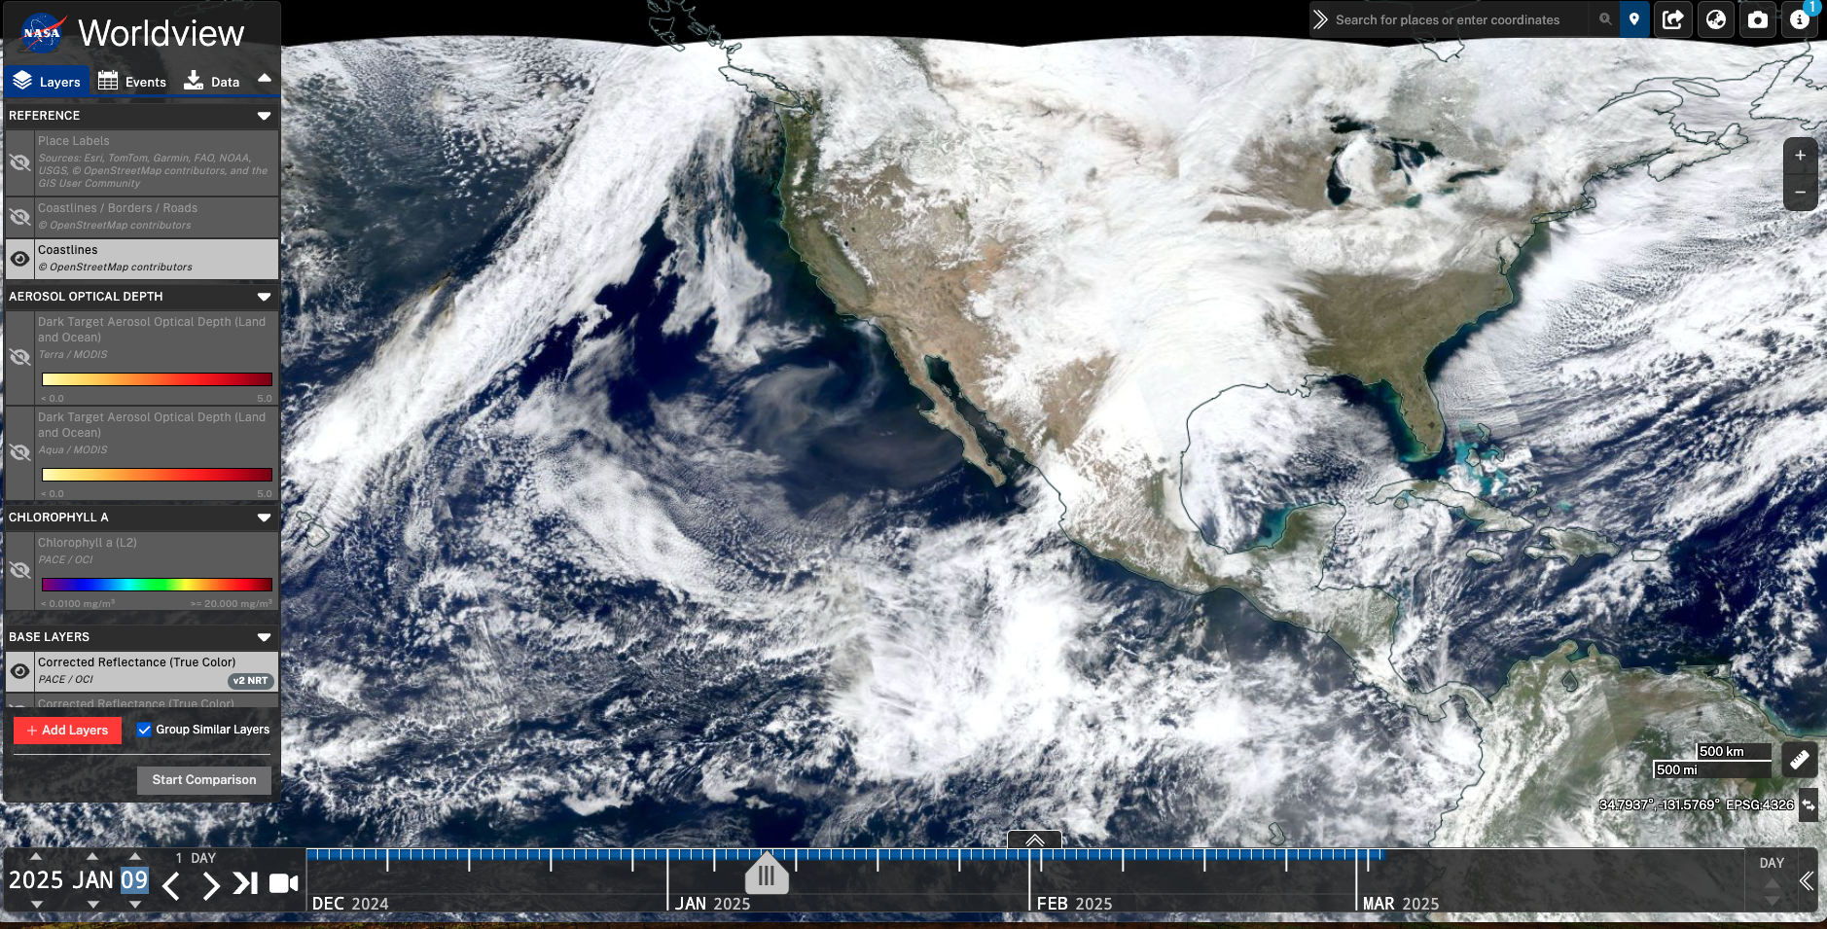
Cloud screening check: before

Slide 6
Cloud screening check: after

Slide 7
Forward model fitting check: pixel (5,13)
circle: forward model
+: real data
Ross-Li surface model work well except large angles
Polarization fitting work well !
PACE_HARP2.20250109T200519.L2.AER_LAND_FASTMAPOL_v3.7.7_land2.nc'

Slide 8
Forward model fitting check: pixel (20,13)
circle: forward model
+: real data
Ross-Li surface model work well except large angles
Polarization fitting work well !
PACE_HARP2.20250109T200519.L2.AER_LAND_FASTMAPOL_v3.7.7_land2.nc'

Slide 9
Forward model fitting check: pixel (15,43)
circle: forward model
+: real data
Ross-Li surface model work well except large angles
Polarization fitting work well !
PACE_HARP2.20250109T200519.L2.AER_LAND_FASTMAPOL_v3.7.7_land2.nc'

Slide 10
AOD

Slide 11
Quality flag: 0 high quality

Slide 12
Chi2

Slide 13
Nv_ref

Slide 14
Nv_dolp

