Slide 1
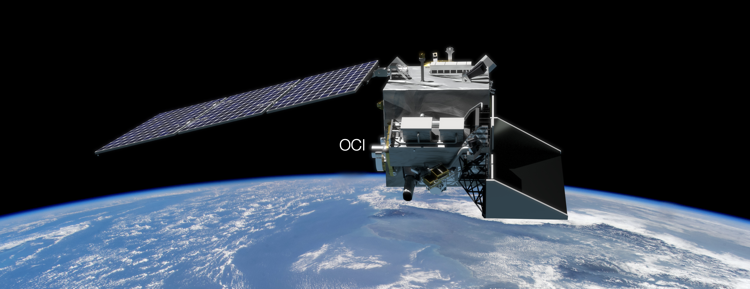

PACE application workshop, Sep 6-7, 2023
Simulated data for PACE multi-angle polarimeters
Meng Gao
SSAI/NASA GSFC Ocean Ecology Lab
Acknowledgment:
Kirk Knobelspiesse, Bryan Franz, Fred Patt, Martin Montes, Peng-Wang Zhai, Xiaoguang Xu, Vanderlei Martins,
Guangliang Fu, Otto Hasekamp, Brian Cairns,
Jeremy Werdell, etc

Slide 2
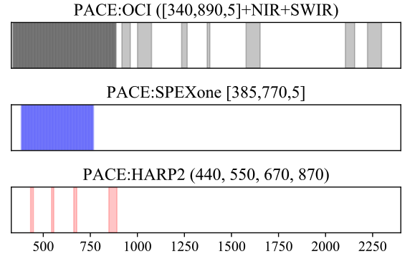
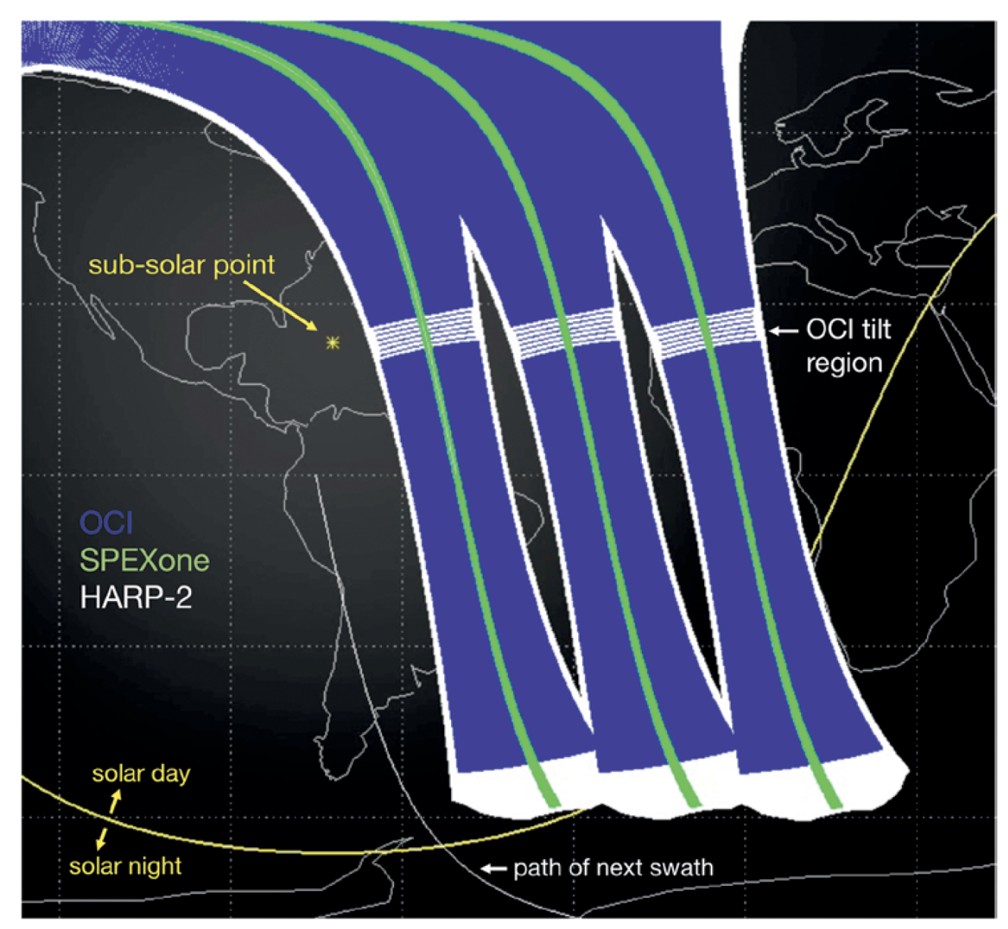
PACE instruments
OCI: Ocean Color Instrument:
– hyper-spectral wide swath
      340-890nm and seven SWIR bands.
      1500 km swath
SPEXone: SRON Spectro-Polarimeter for Planetary Exploration – hyper-spectral narrow swath
      385-770nm: 5 angles
      100 km swath (nadir)
HARP2: UMBC Hyper Angular Rainbow Polarimeter – hyper-angular wide swath
      440, 550, 870nm: 10 angles
      670nm: 60 angles
      1500 km swath (nadir)
PACE Orbits, Werdell et al, BAMS (2019)

Slide 3
PACE multi-angle polarimeters: simulated data summary
HARP2 and SPEXone simulations: One day, 15 orbits (March 21, 2022)
Spatial grids, view and solar geometry
Ancillary data: ozone, surface pressure, etc
Level 1: Reflectance and Polarization
Level 2: Aerosol and ocean color retrievals and uncertainties
Applications
Realistic data format, geometry, grids
Accurate physics including light scattering in both atmosphere and ocean
High quality for testing aerosol and ocean color retrieval algorithm
Coverage and Limitation:
HARP2: aerosol over ocean only; data over land are in development.
SPEXone: aerosol over land, ocean and cloud

Slide 4
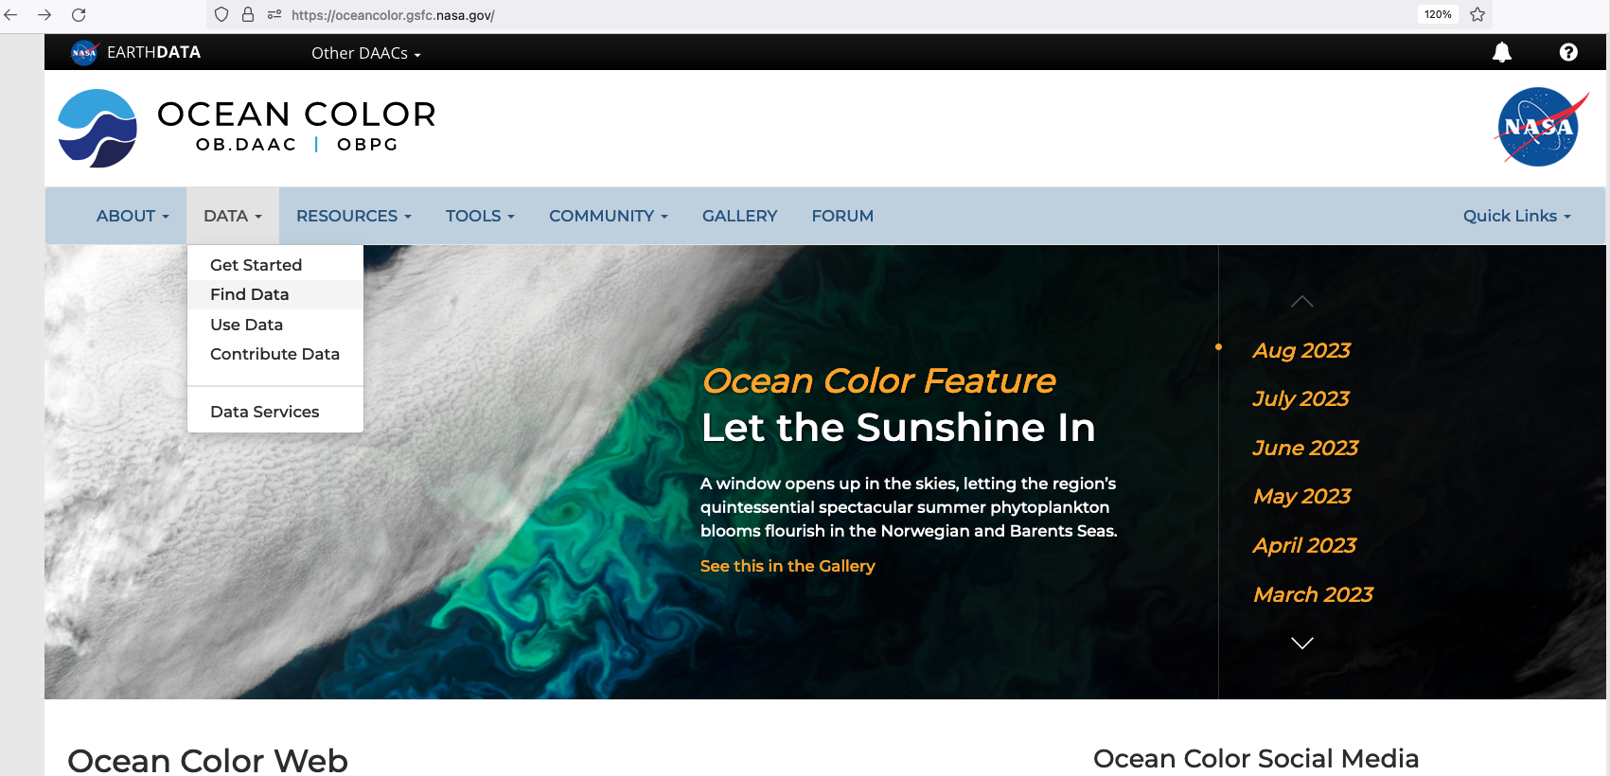
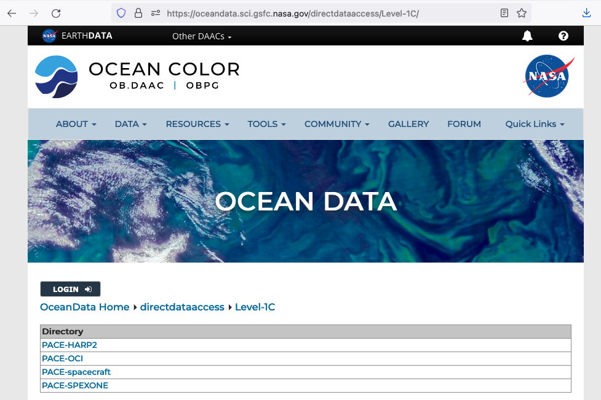

Access data through OB. DAAC
https://oceandata.sci.gsfc.nasa.gov/directdataaccess/Level-1C

Slide 5
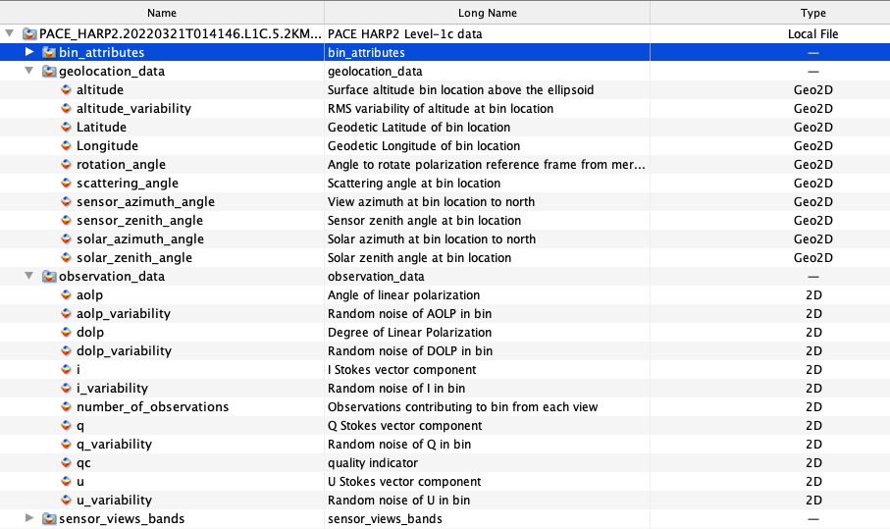
HARP2 L1C data example
Spatial grids
Geometry
Observation
Notes:
Visulziation:
Panoply: quick view of the 2D data
SeaDAS: New functions are being added
Python: advanced manipulations

Slide 6
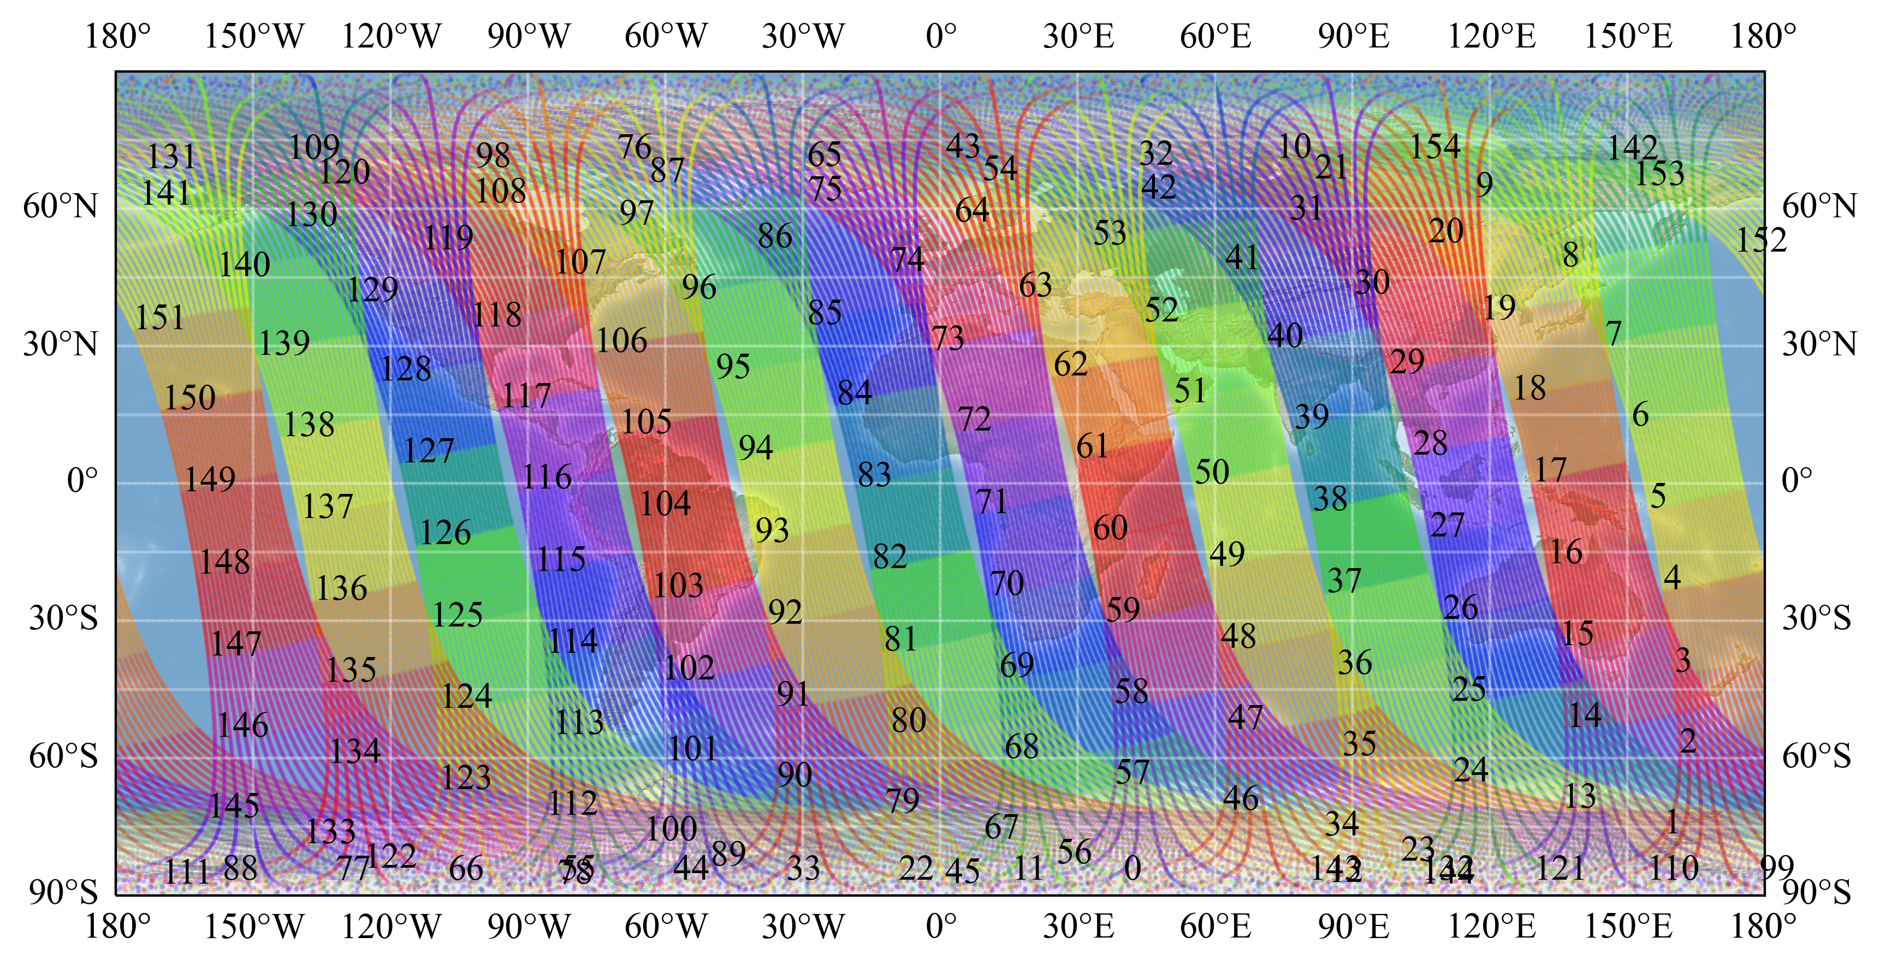
Understand PACE L1C common grids
L1C files are generated for OCI, HARP2, SPEXone and ancillary data on the ground under a common spatial grids.
Facilitate cross calibration, multiple sensor retrievals, and data synergy.
PACE L1C format (Kirk Knobelspiesse, Martin Montes, et al )
https://oceancolor.gsfc.nasa.gov/data/pace/PACE_L1C_Format_DRAFTv20210928.pdf

Slide 7
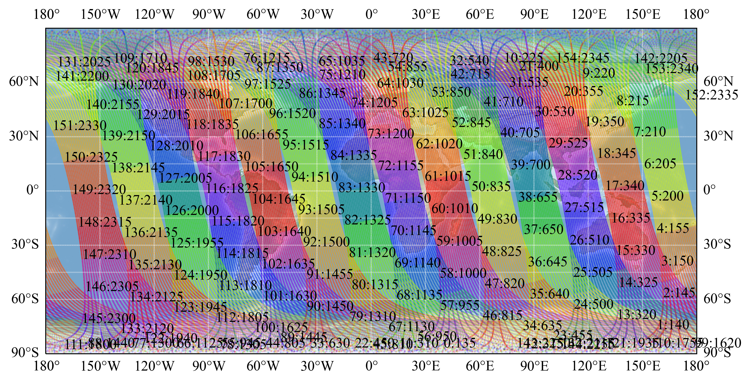
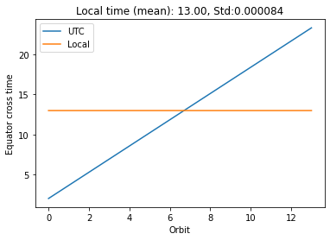
Understand PACE L1C common grids
Locate the granule of interest by looking at its starting time.
New grids are being updated to accommodate with OCI data.
Useful practice by checking equator local crossing time (1pm).
127:2005 -> PACE_HARP2.20220321T200500.L1C.5.2KM.V02.nc
PACE L1C format (Kirk Knobelspiesse, Martin Montes, et al )
https://oceancolor.gsfc.nasa.gov/data/pace/PACE_L1C_Format_DRAFTv20210928.pdf

Slide 8
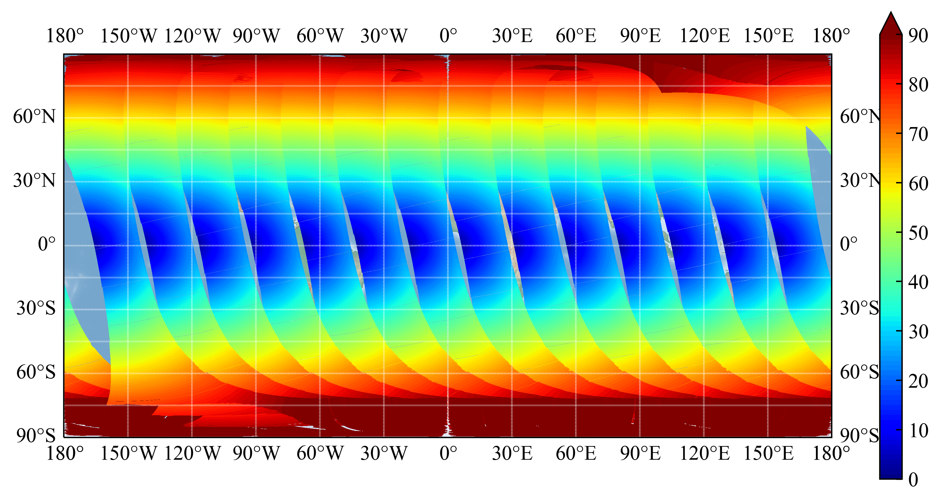
Solar zenith angle
Solar and viewing geometries are determined by the spatial grids, observation time and instrument characteristics. All information are available in the L1C files.

Slide 9
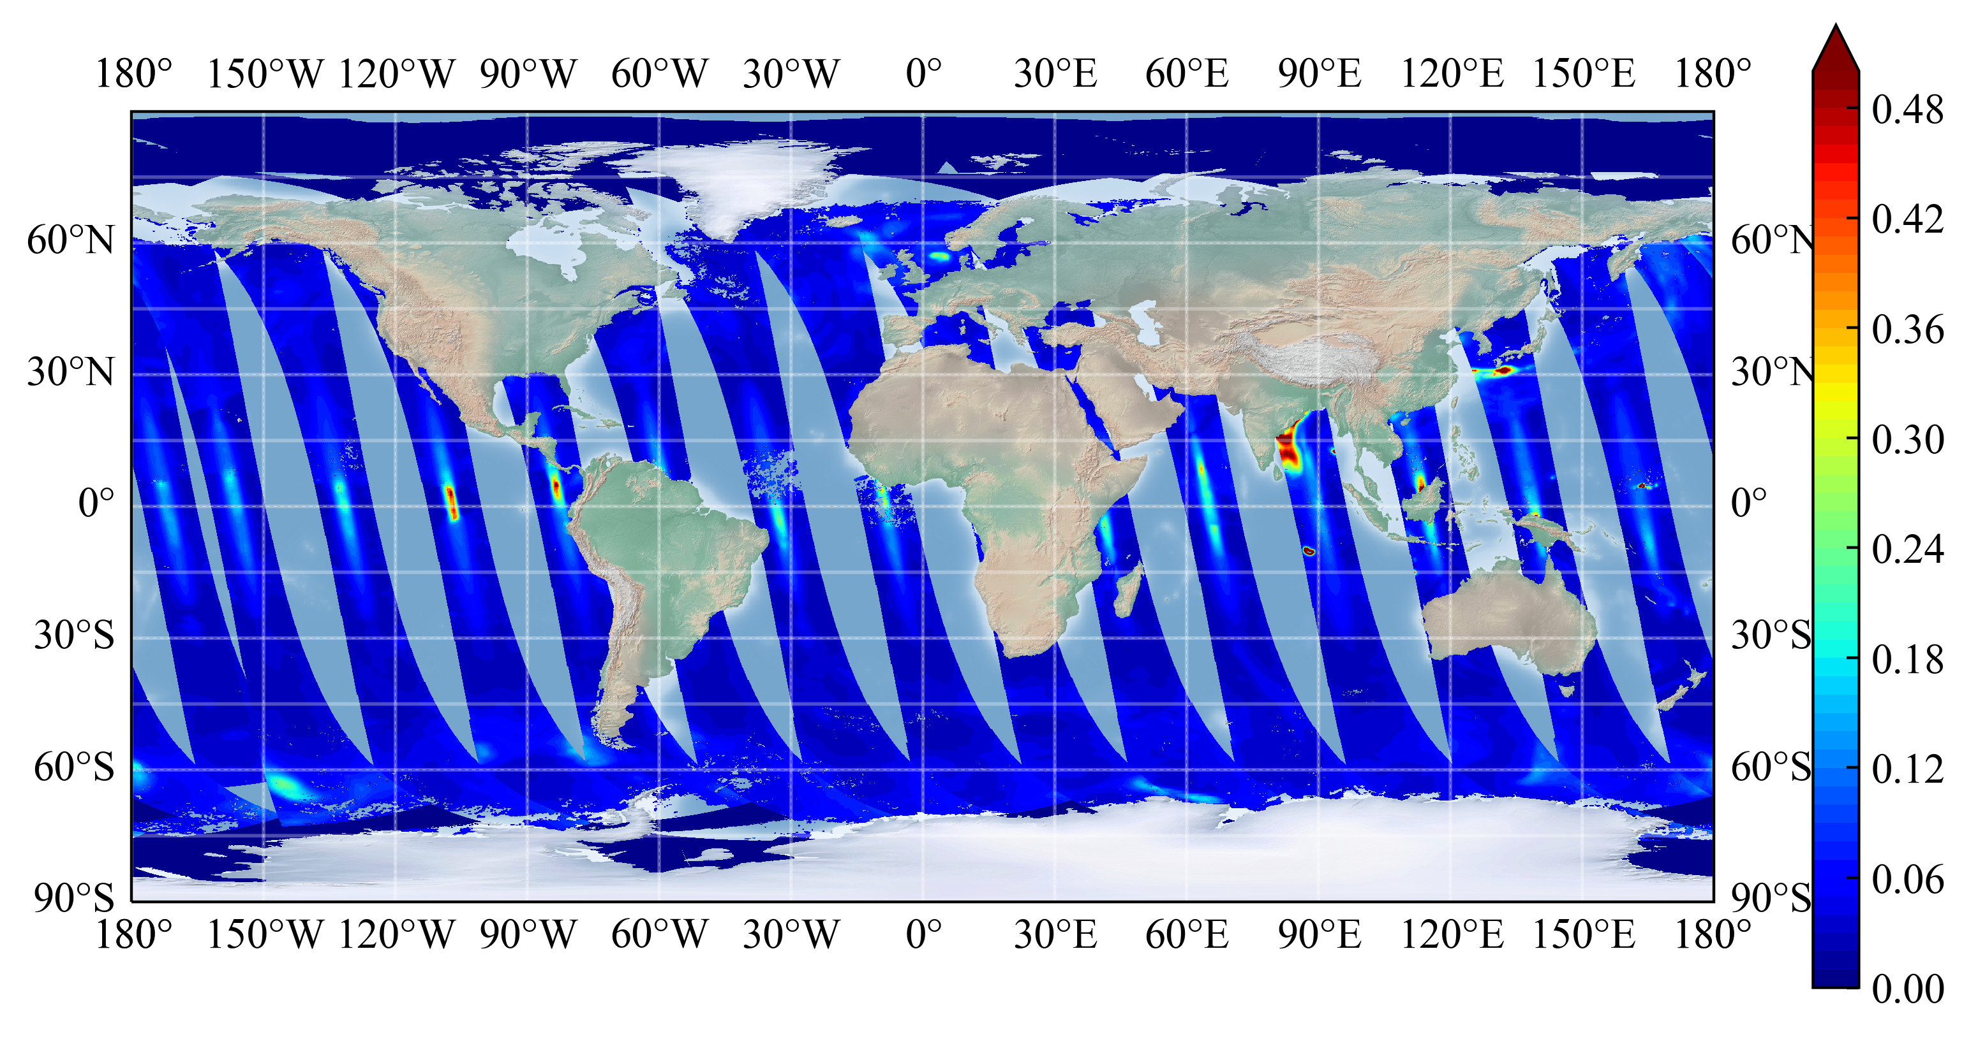


Light scattering simulations on HARP2
Geometry and template files from HARP team (Xiaoguang Xu, Vanderlei Martins, etc)
Inputs: aerosol, gas, ocean surface, sea water, CDOM, phytoplankton
Vector radiative transfer model (Pengwang Zhai)
Neural network forward simulations (PACE SDS)
Technical details
https://doi.org/10.5194/egusphere-2023-1843
Reflectance (550 nm)

Slide 10
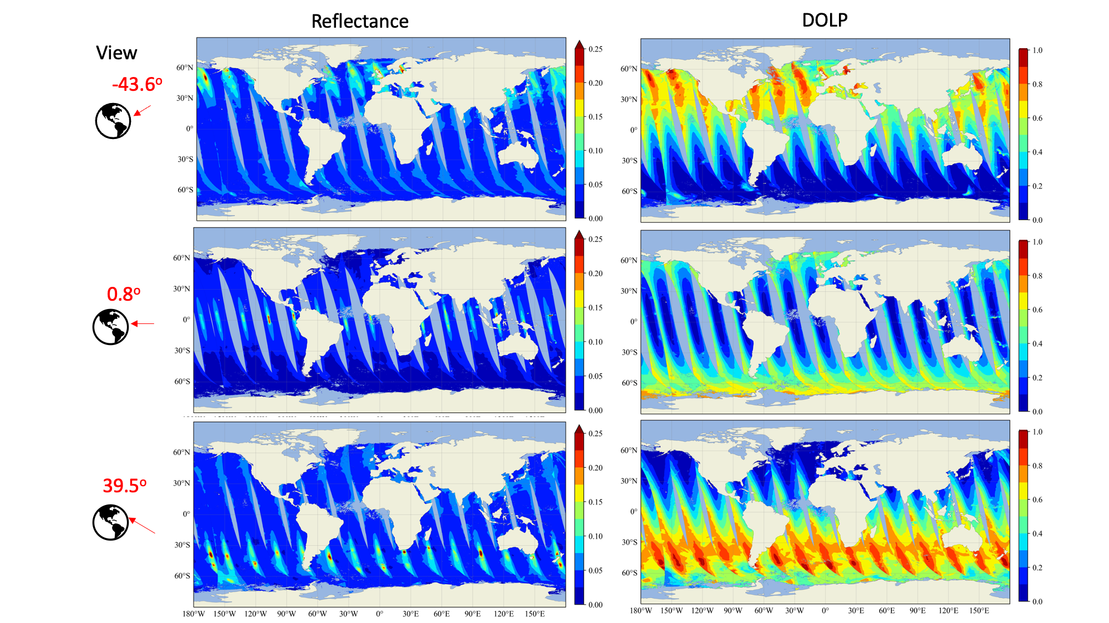
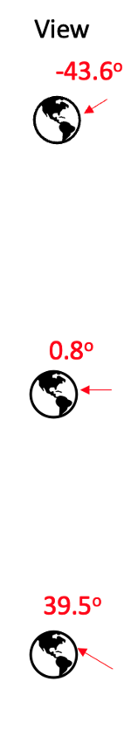
Light scattering simulations on HARP2
Angular, spectral and polarization measurements carry rich information on both atmosphere and ocean.

Slide 11
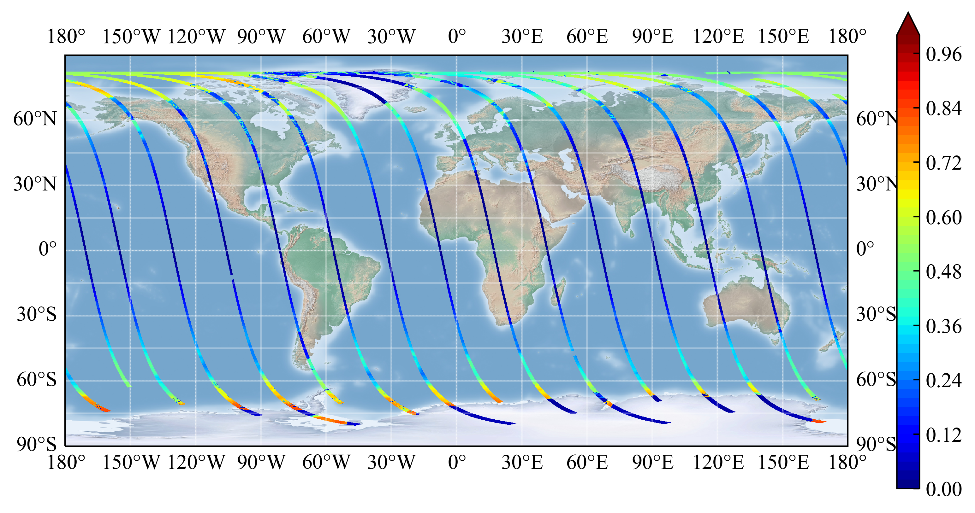
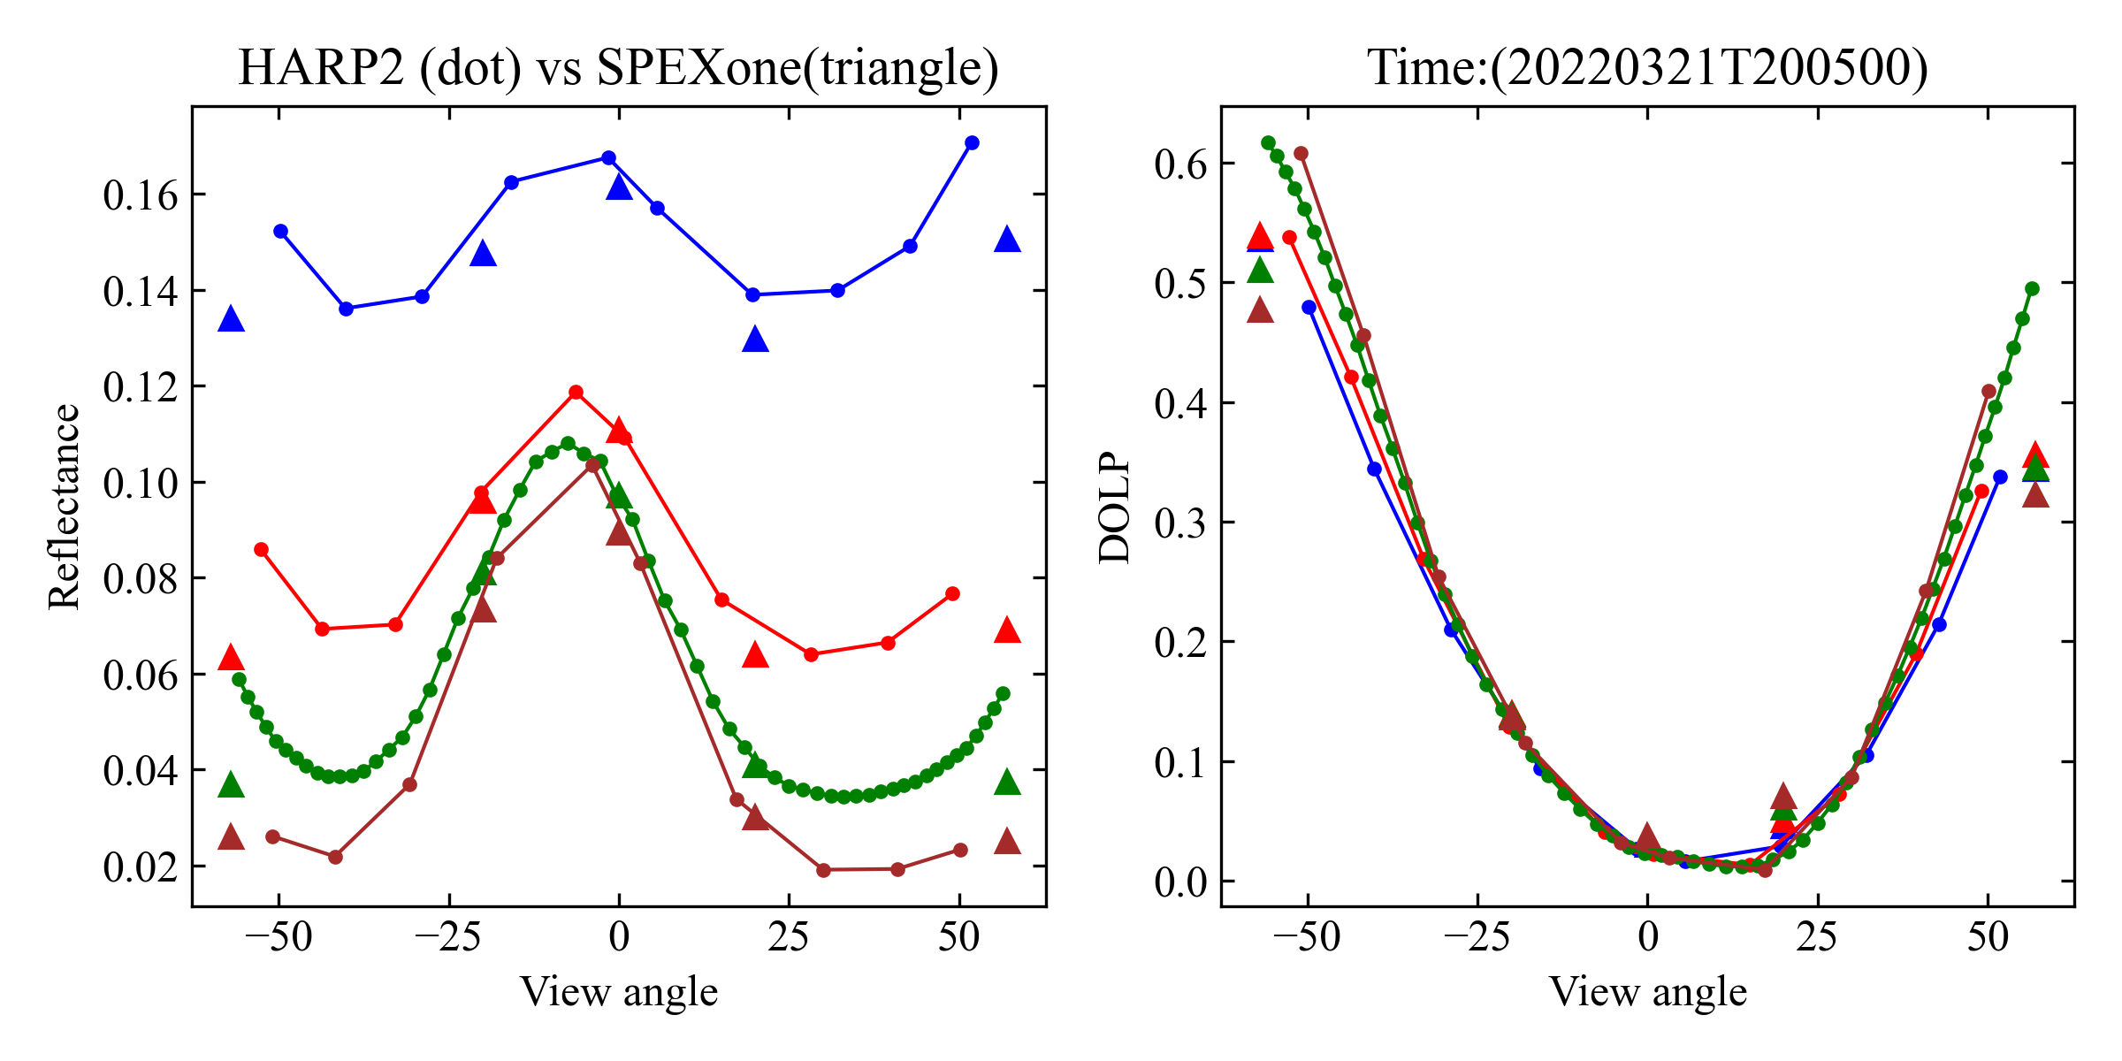
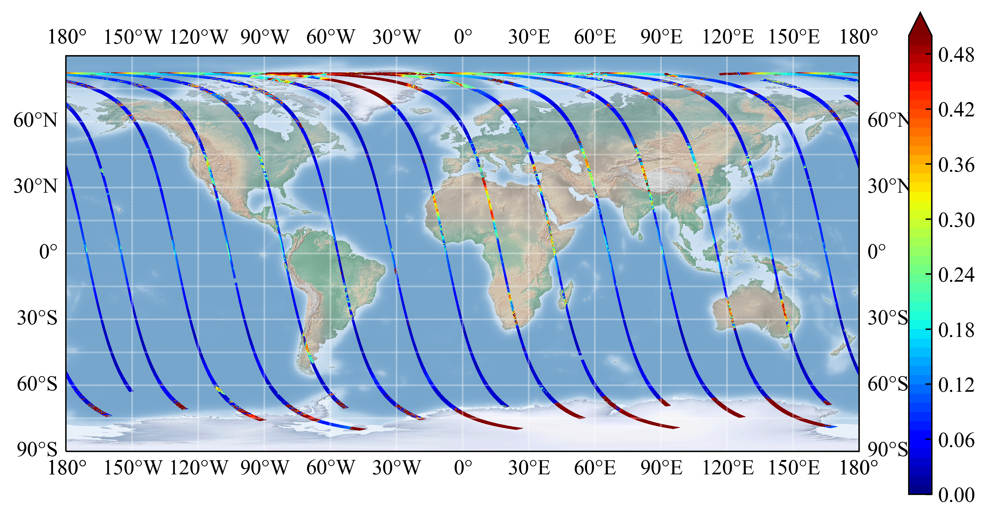
Light scattering simulations on SPEXone
Reflectance
Compare HARP2 and SPEXone simulations
440, 550,
670, 870nm
DoLP
Generated by SRON SPEX team (Guangliang Fu, Otto Hasekamp etc)
Technical details (https://oceancolor.gsfc.nasa.gov/data/pace/test-data/SPEXone-synthetic-data-description.pptx)

Slide 12
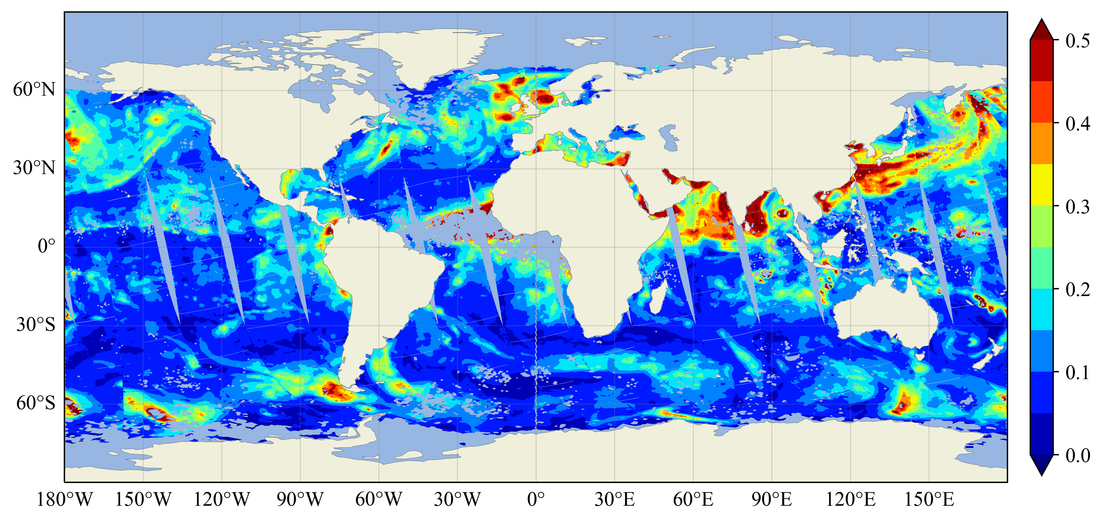
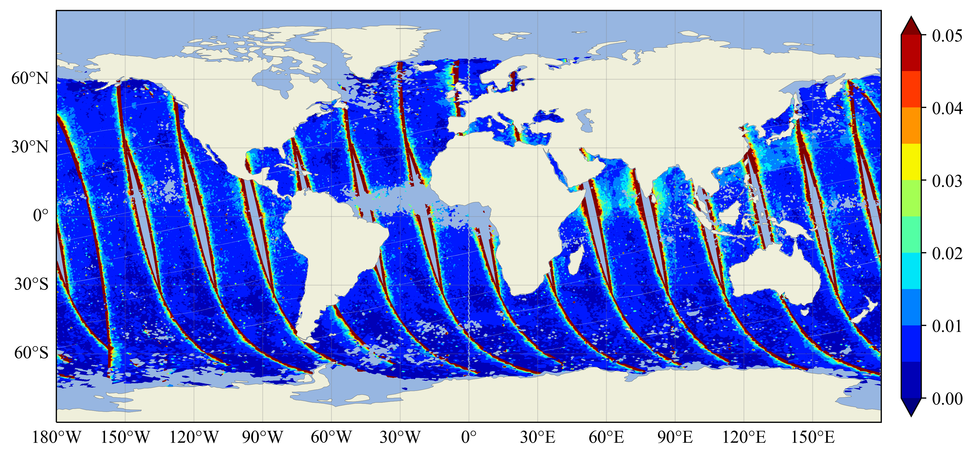
  Level-2 data processing
The Level 2 aerosol data products are produced based on the simulation data for both SPEXone (RemoTAP) and HARP2 (FastMAPOL).
Data will be shared soon (OB.DAAC) and available upon request.
More advanced L2 algorithms are under evaluation (PACE-MAPP, GRASP, etc)
AOD retrievals (HARP2 @ 550nm)
AOD retrieval uncertainty (HARP2 @550nm)
https://doi.org/10.5194/egusphere-2023-1843
Notes:
Uncertainties will assistant data synergy to gauge data quality.
Update on spatial grids will be included to accommodate OCI data.

Slide 13
PACE multi-angle polarimeters: simulated data summary
HARP2 and SPEXone simulations: One day, 15 orbits (March 21, 2022)
Spatial grids, view and solar geometry
Ancillary data: ozone, surface pressure, etc
Level 1: Reflectance and Polarization
Level 2: Aerosol and ocean color retrievals and uncertainties
Applications
Realistic data format, geometry, grids
Accurate physics including light scattering in both atmosphere and ocean
High quality for testing aerosol and ocean color retrieval algorithm
Coverage and Limitation:
HARP2: aerosol over ocean only; data over land are in development.
SPEXone: aerosol over land , ocean and cloud

