Slide 1
610 SED Director's Seminar, March 3, 2023
Enhancing PACE Multi-Angle Polarimeter Data Products: Deep Neural Networks for Aerosol and Ocean Color Retrieval
Meng Gao
SSAI, NASA Ocean Ecology Lab (616)
Acknowledgment:
NASA: B. A. Franz, K. Knobelspiesse ,B. Cairns, A. Ibrahim, A. Sayer, P. J. Werdell, Y. Hu, et al.
UMBC: P-W. Zhai, X. Xu , V. Martins; SRON: O. Hasekamp

Slide 2
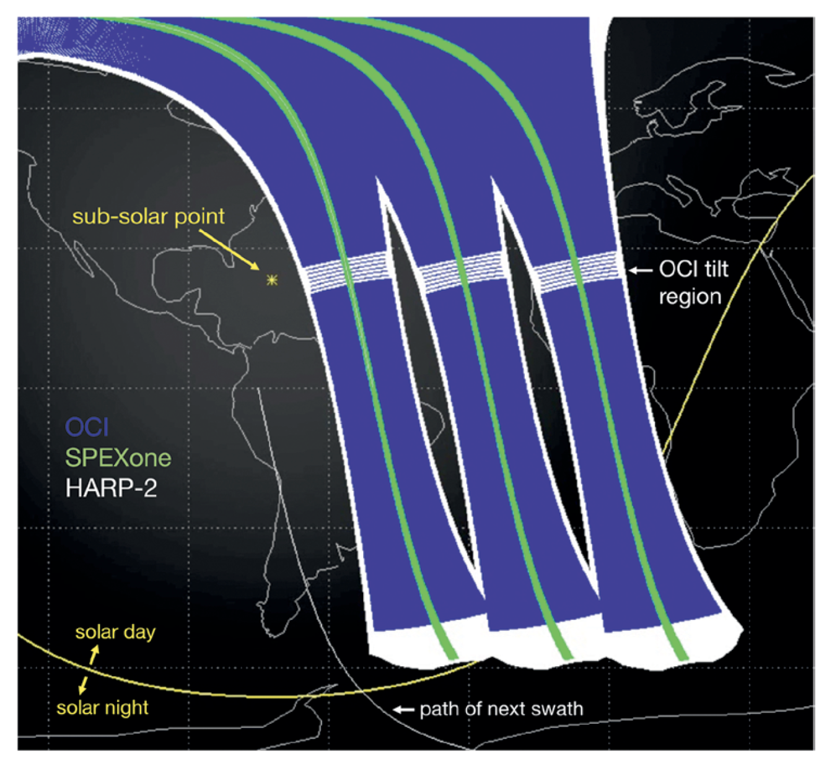
PACE sensors: OCI + 2 MAPs
Ocean Color Instrument (OCI):
340-890nm
7 SWIR bands
SPEXone: SRON Spectro-Polarimeter for Planetary Exploration
385-770nm
5 angles
HARP2: UMBC Hyper Angular Rainbow Polarimeter
60 angles: 670nm
10 angles: 440, 550, 870nm
PACE Orbits, Werdell et al, BAMS (2019)
Notes:
HARP2:
Wide swath: nadir 1,556 km
SPEXone:
385-770nm (400 radiance/50 polarization channels)
5 angles: 0°, ±20° and ±58°
Nadir swath 100km

Slide 3
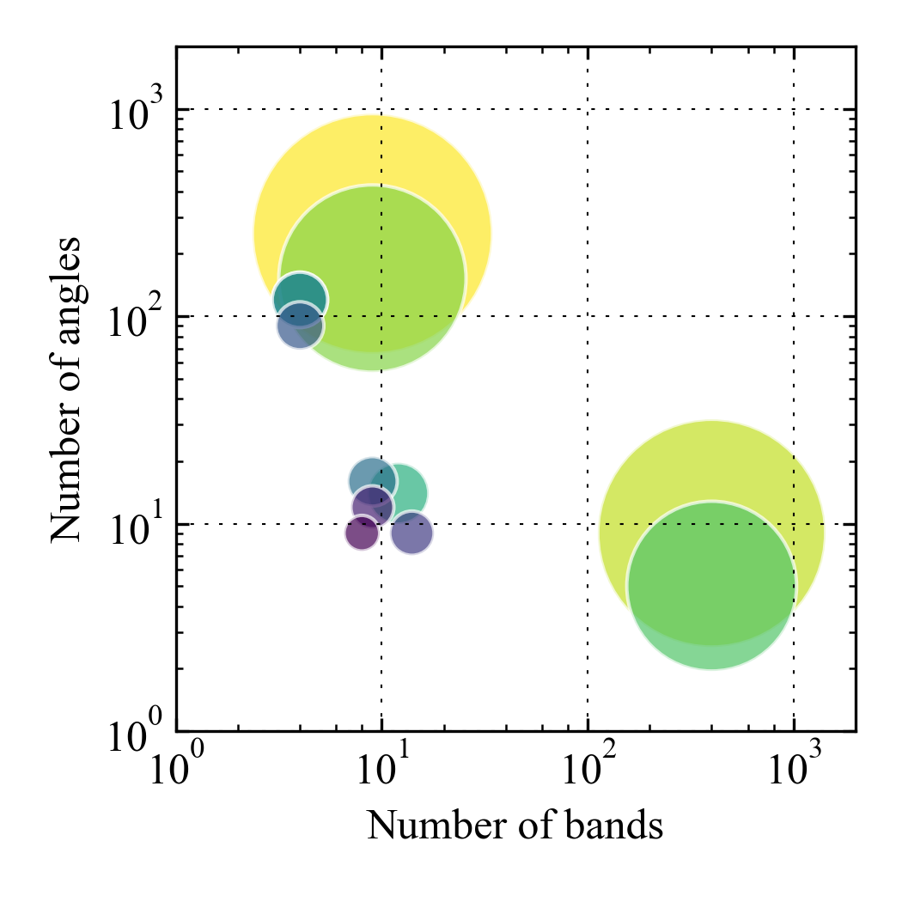
Multi-angle polarimeter (MAP)
Quiz: where are PACE polarimeters?

Slide 4
Multi-angle polarimeter (MAP)
Quiz: where are PACE polarimeters?
AirHARP (240)
HARP2(180)
SPEX Airborne
(4050)
SPEXone
(2250)

Slide 5
Multi-angle polarimeter (MAP)
APS (4500)
RSP is used to develop and validate the MAP retrieval algorithm.
RSP(2763)
AirHARP (240)
HARP2(180)
SPEX Airborne
(4050)
SPEXone
(2250)

Slide 6
Multi-angle polarimeter (MAP)
APS (4500)
Several MAPs are optimized for aerosol studies.
Hyper-angular instrument is optimized for both aerosol and cloud studies.
RSP(2763)
AirHARP (240)
HARP2(180)
POLDER-3(192)
POLDER-1/2
(144)
SPEX Airborne
(4050)
3MI(294)
AirMSPI(99)
MAIA(153)
SPEXone
(2250)

Slide 7
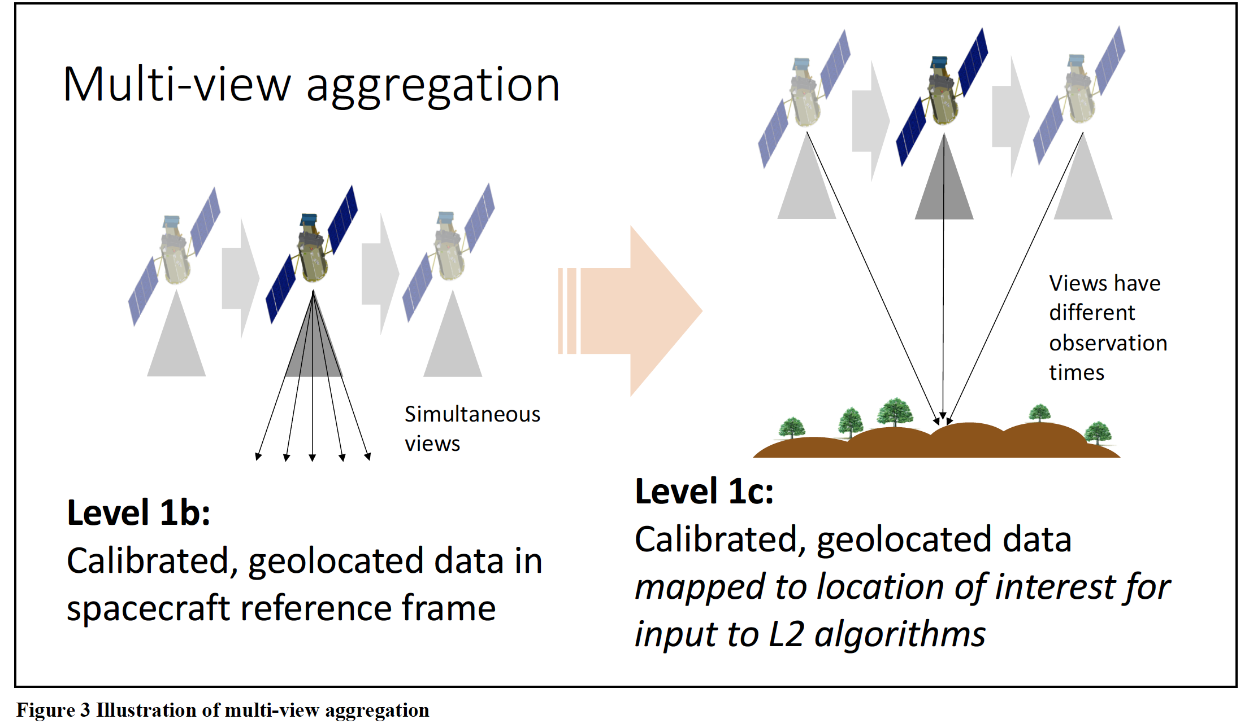
PACE common L1C data format
All three PACE sensors will be co-registered on the ground under a common spatial L1C grids.
Facilitate cross calibration, multiple sensor retrievals, and data synergy.
https://oceancolor.gsfc.nasa.gov/data/pace/format/

Slide 8
MAP helps aerosol retrievals
Improve microphysical properties such as size, refractive index
Assume no uncertainty in measurements

Slide 9
MAP helps aerosol retrievals
Add uncertainties to measurement.
Notes:
HARP2 retrieval cost function
Fine mode effective radius
refractive index (fine)

Slide 10
But, there are huge computational challenges in MAP processing
Retrieval speed per pixel:
Direct RT calculation
2x15 x 7 x 10 x 2s = 60min
Finite difference
wavelength
Radiative transfer (RT) model
iterations
Example on RSP retrieval (Gao et al, 2019 AMT, Combine RSP + SPEX )
Notes:
The parameters include aerosol, mirocphysical parameters, ocean parameters, etc
LUT is too large to be an option (10^15 B ~ 10^6 GB)

Slide 11
But, NN represents coupled atmosphere and ocean scatterings with high efficiency and accuracy.
Retrieval speed per pixel:
NN RT calculation
2x15 x 7 x 10 x 2s = 60min
2 x 1 x 10 x 0.01s =0.2s
Analytical Jacobians
wavelength
NN RT model
iterations

Slide 12
But, NN represents coupled atmosphere and ocean scatterings with high efficiency and accuracy.
Input: Geometry, Aerosol, Wind, Chl-a
Output:
Reflectance or DOLP

Slide 13
What NN can do for PACE MAP retrievals
Forward model (Gao et al, AMT 2021)
Jacobians (Gao et al, Frontiers 2021)
Aerosol optical property calculation (AMT 2021)
Ocean color atmospheric correction (AMT 2021)
Uncertainty (AMT 2022,EGUsphere (preprint))
FastMAPOL

Slide 14
Large volume synthetic data for production testing
Part of PACE SDS day in the life test.
HARP2 L1C simulation | 15 orbits (March 21, 2022)
NN froward model | Fully coupled atmosphere and ocean radiative transfer simulation (Zhai et al, Frontiers, 2022)
L1C geometry/grids | UMBC HARP team and PACE SDS team
Aerosol properties | GMAO MERRA2 reanalysis
Ocean properties | MODIS Ocean color product (Chla)

Slide 15
HARP2 L1C DOLP example
DOLP (440 nm)
+42º
March 21, 2022
15 orbits ~10 million pixels
https://oceandata.sci.gsfc.nasa.gov/directdataaccess/Level-1C/

Slide 16
HARP2 L1C DOLP example
DOLP (440 nm)
-40º
Information on the simulated data for other PACE instruments in L1C format:
https://oceandata.sci.gsfc.nasa.gov/directdataaccess/Level-1C/

Slide 17
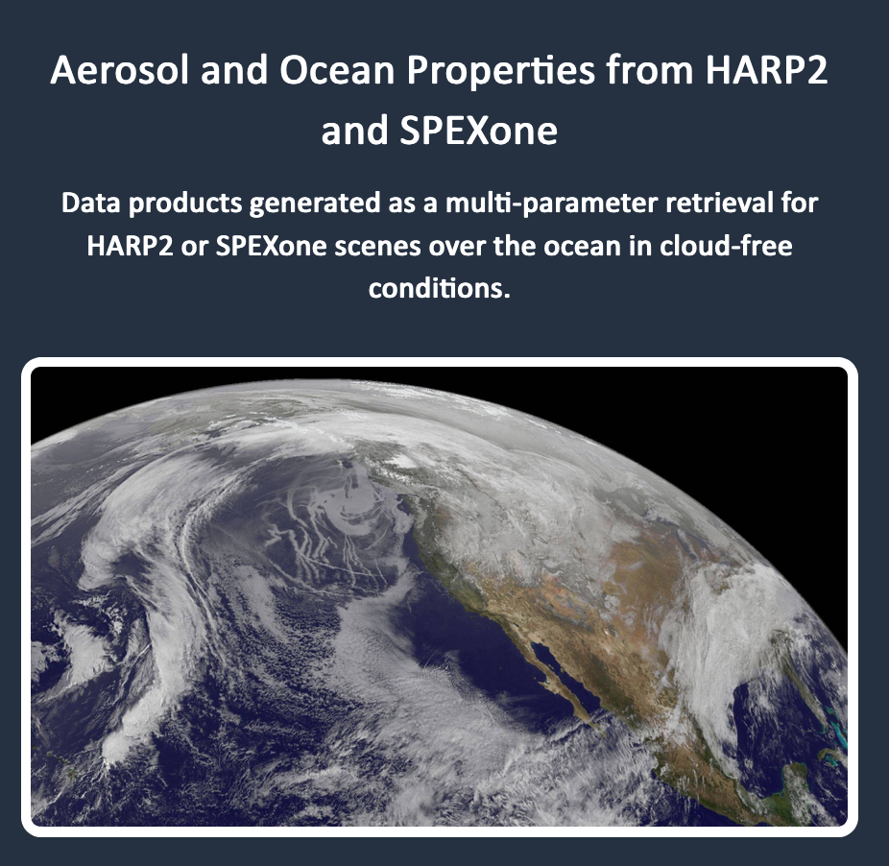
PACE HARP2 L2 retrievals
Data products:
Fine/coarse aerosol properties (size, refractive index, AOD, SSA etc)
Wind speed, Chl-a
Ocean color atmospheric correction (facilitate synergy with OCI)
Uncertainties
More details on MAP data product
https://pace.oceansciences.org/data.htm

Slide 18
Aerosol optical depth (AOD): Truth
AOD (550 nm)

Slide 19
Aerosol optical depth (AOD): L2 Retrieval
AOD (550 nm)

Slide 20
Aerosol optical depth (AOD): L2 Uncertainty
AOD (550 nm)
Uncertainty performance (AMT 2022,EGUsphere (preprint))

Slide 21
Remote sensing reflectance (Rrs): Truth
Rrs (440nm)

Slide 22
Remote sensing reflectance (Rrs): L2 Retrieval
Demonstrate atmospheric correction on HARP2 data
Assist hyperspectral PACE OCI atmospheric correction
Rrs (440nm)

Slide 23
Summary
We can process HARP2 data over ocean if PACE launch tomorrow.
Further improvement
Retrieval performance
Multi-angle data for cloud mask and ocean color
Integration with production system

