Slide 1
Keeping PACE with the NASA Plankton, Aerosol, Cloud, ocean Ecosystem mission
Jeremy Werdell
PACE Project Scientist
Feb 2022

Slide 2
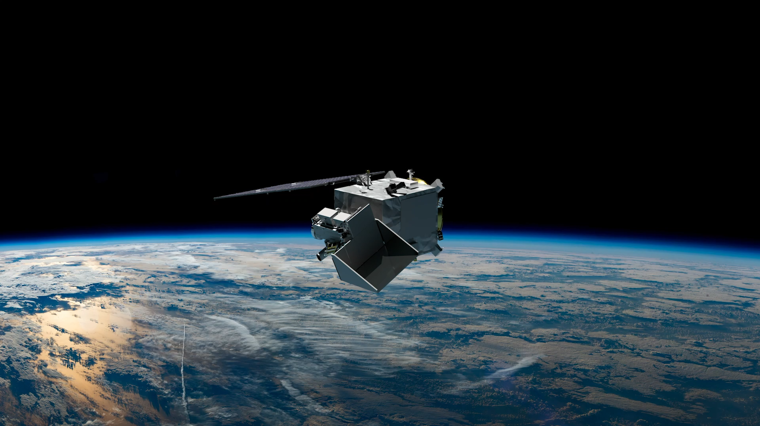

NASA Plankton, Aerosol, Cloud, ocean Ecosystem (PACE) mission
PACE will extend key systematic ocean color, aerosol, & cloud climate data records.
PACE will reveal the diversity of organisms fueling marine food webs & how ecosystems respond to change.
Looking at the ocean, clouds, and aerosols together will improve knowledge of the roles each plays in our planet.
Key characteristics:
Launch scheduled for 9 January 2024
676.5 km altitude
Polar, ascending, Sun synchronous orbit; 98º inclination
13:00 local Equatorial crossing
3-yr design life; 10-yr propellant
Managed by NASA Goddard Space Flight Center
3 instrument observatory:
Ocean Color Instrument (GSFC)
Hyperspectral scanning radiometer
HARP-2 (UMBC)
Multispectral hyper-angular polarimeter
SPEXone (SRON/Airbus)
Hyperspectral multi-angle polarimeter

Slide 3
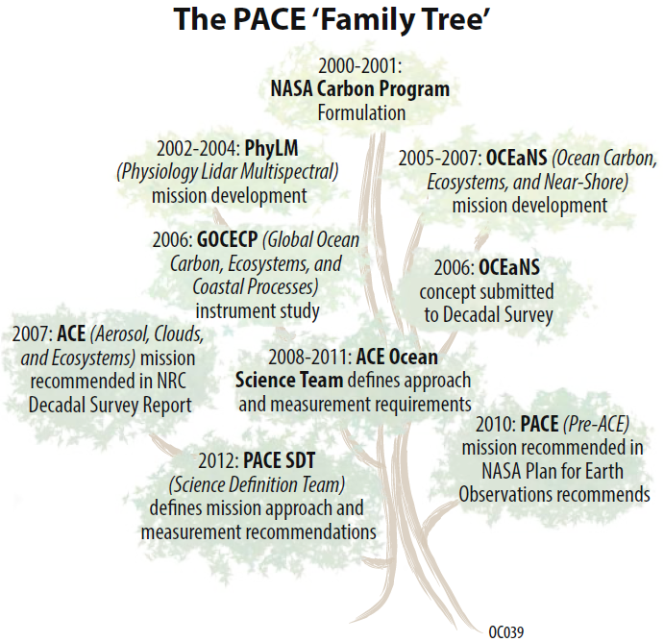
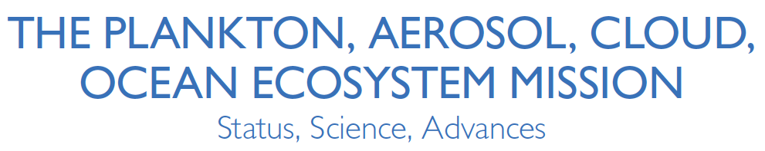
History:
2003-ish preliminary concept studies
2011 NASA Climate Change Initiative
2012 Science Definition Team
2014 first PACE science team
2015 mission directed to GSFC
Legacies:
CZCS, SeaWiFS, MODIS, VIIRS
MISR, POLDER

Slide 4
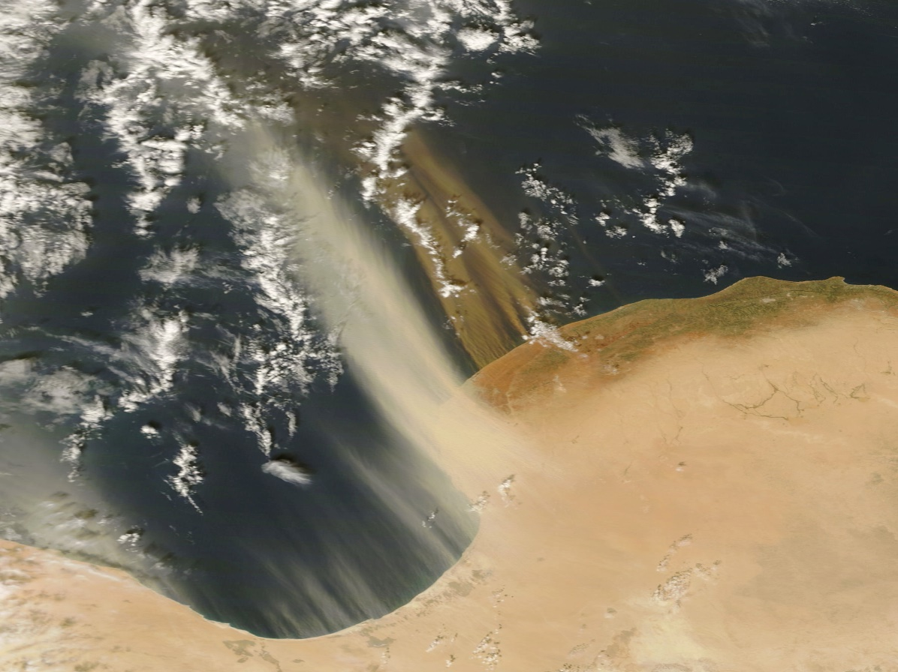
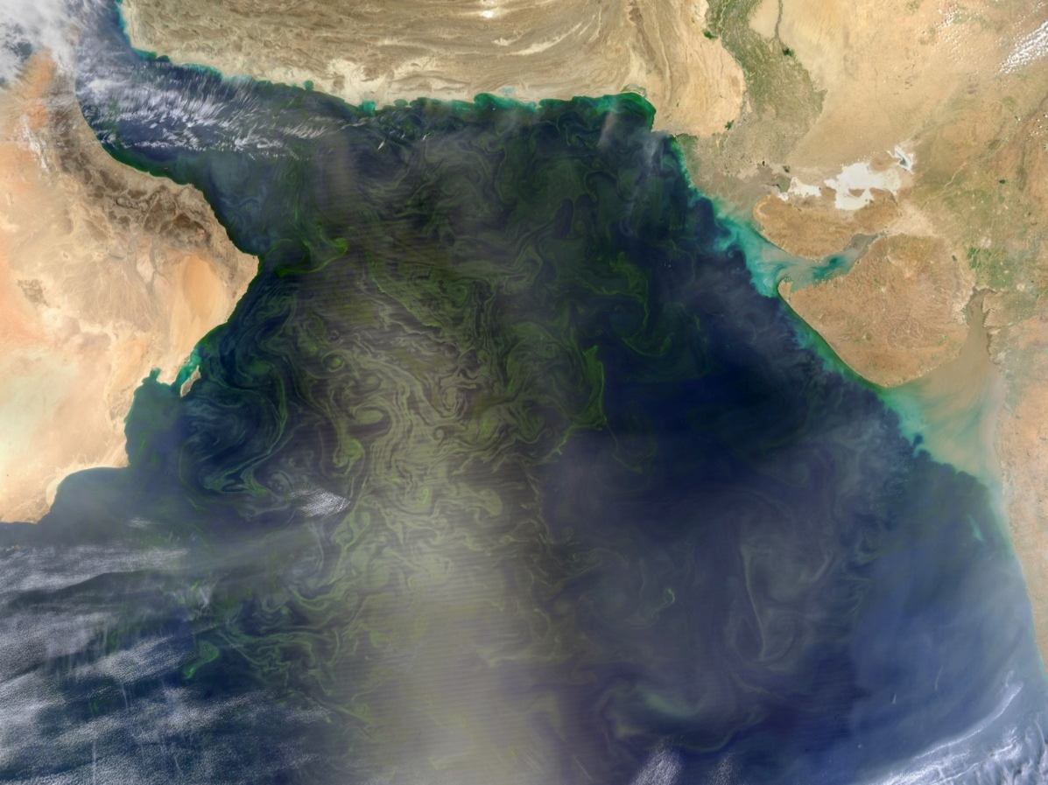
Extend key systematic ocean biological, ecological, & biogeochemical climate data records, as well as cloud & aerosol climate data records
Make new global measurements of ocean color that are essential for understanding the global carbon cycle & ocean ecosystem responses to a changing climate
Collect global observations of aerosol & cloud properties, focusing on reducing the largest uncertainties in climate & radiative forcing models of the Earth system
GSD of 1 ± 0.1 km² at nadir
Spectral range from 340-890 @ 5 nm
940, 1038, 1250, 1378, 1615, 2130, 2260 nm
Twice-monthly lunar calibration & onboard solar calibration (daily, monthly, dim)
Instrument performance requirements
Dark ocean vs. bright land & clouds
Different algal groups
Varied optical properties
Image stripes
Varied contrasts
Varied altitudes
Absorbing aerosols
Sun glint
Multi-angle polarimetry
Tilt ± 20º
Spectral range goal of 320-890 @ 5 nm
Improve our understanding of how aerosols influence ocean ecosystems & biogeochemical cycles and how ocean biological & photochemical processes affect the atmosphere

Slide 5
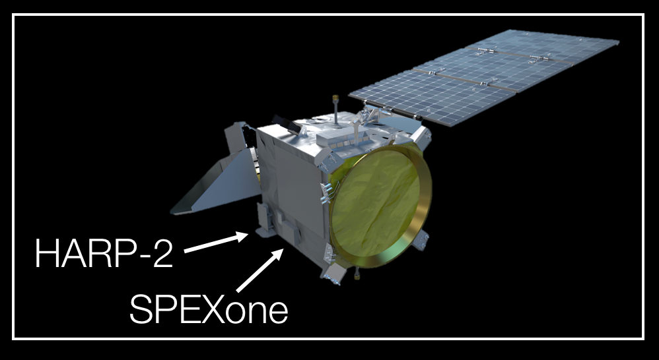
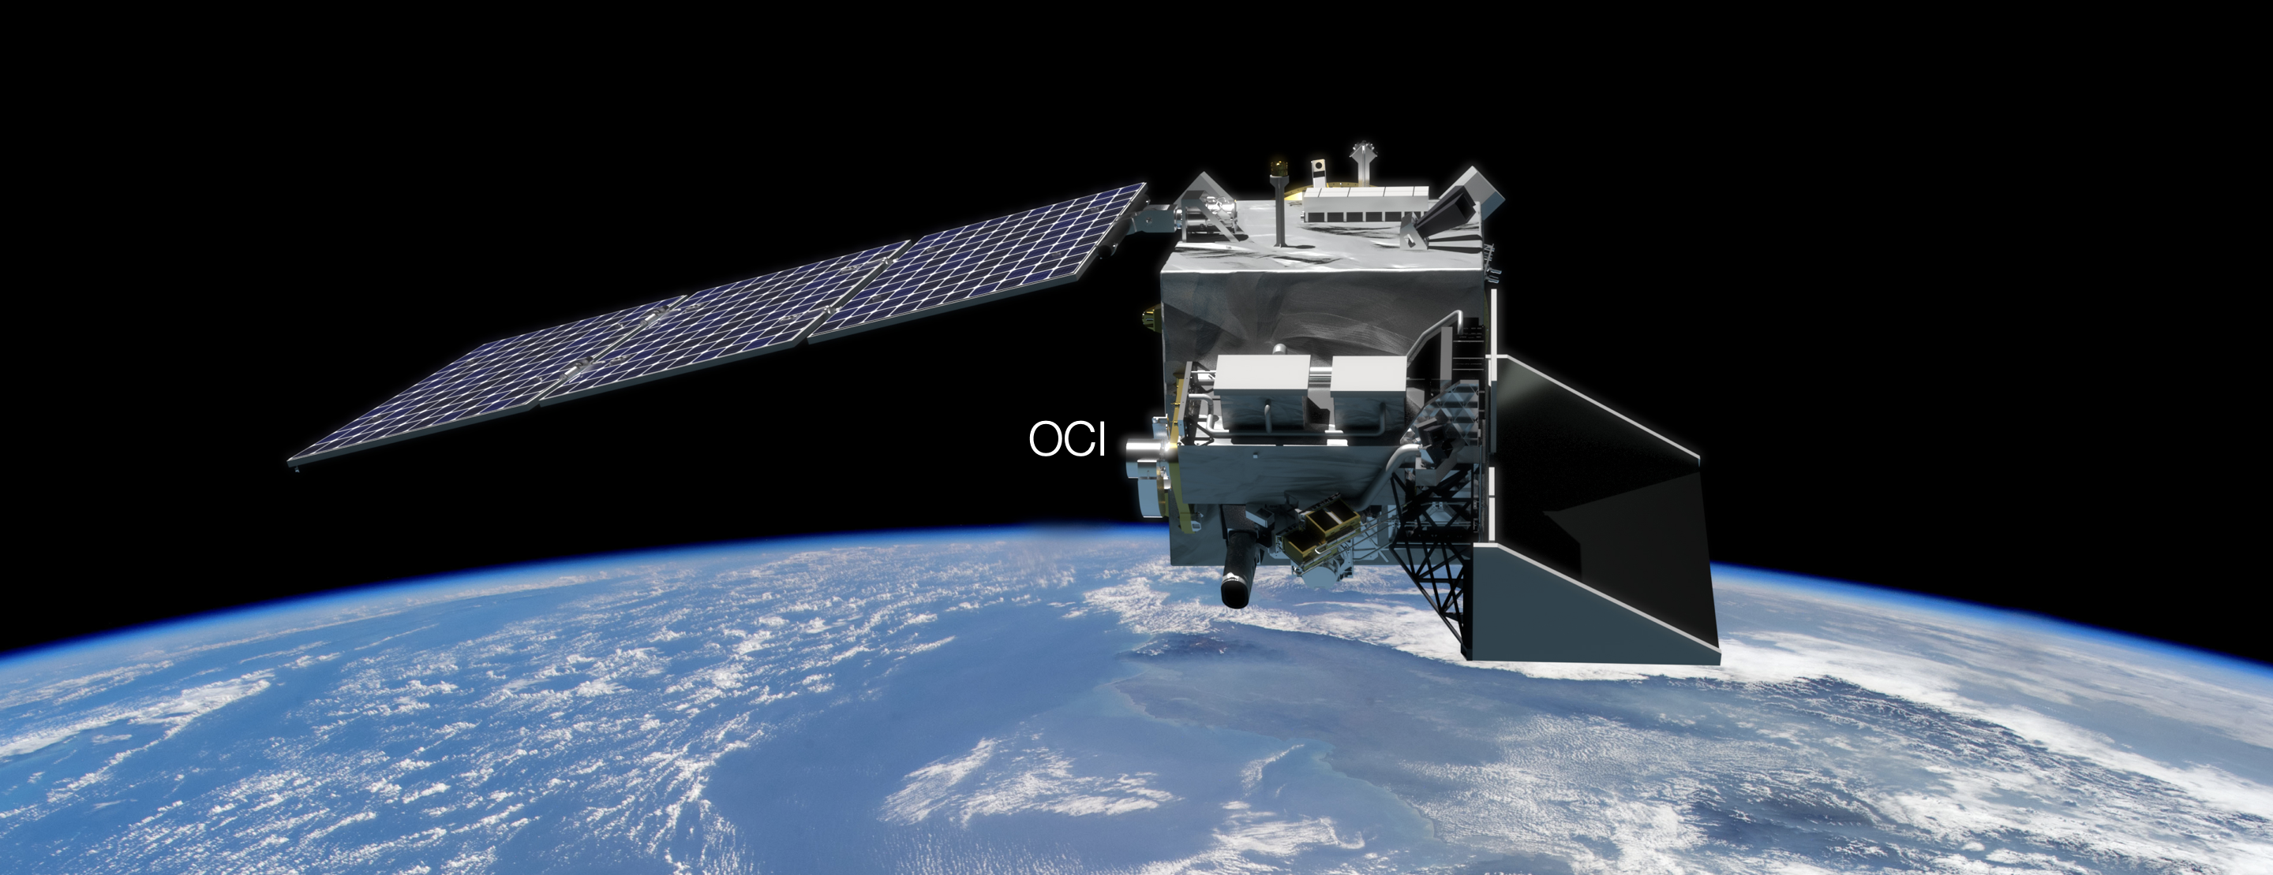
S-band antenna
solar array
thrusters
star trackers
Additional beauty shots of the PACE observatory can be found at: https://svs.gsfc.nasa.gov/12469

Slide 6
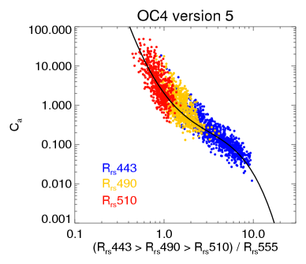
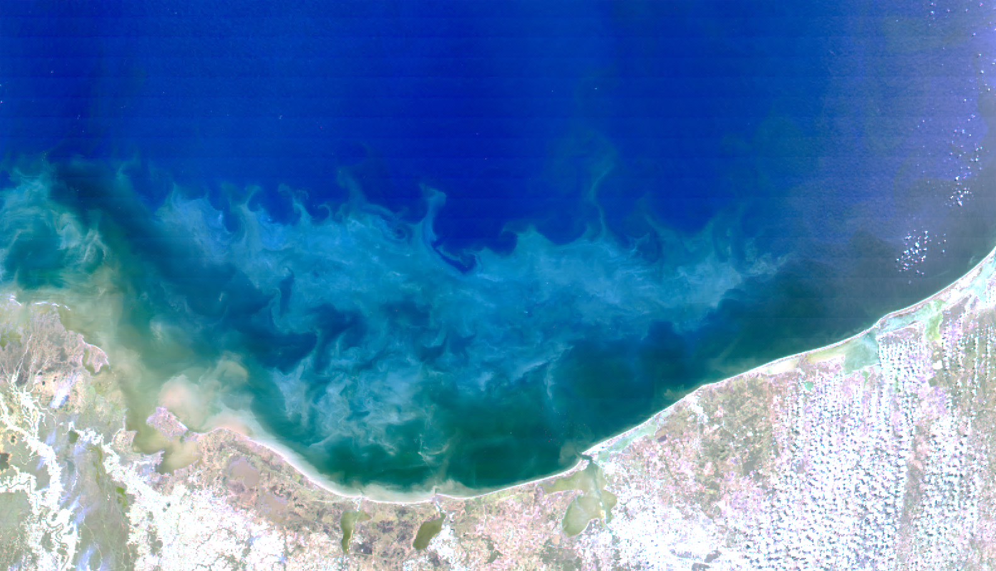
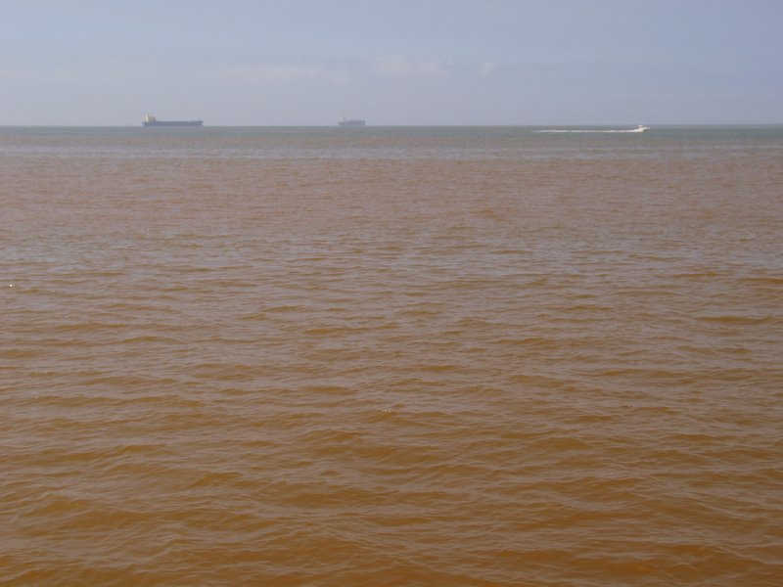
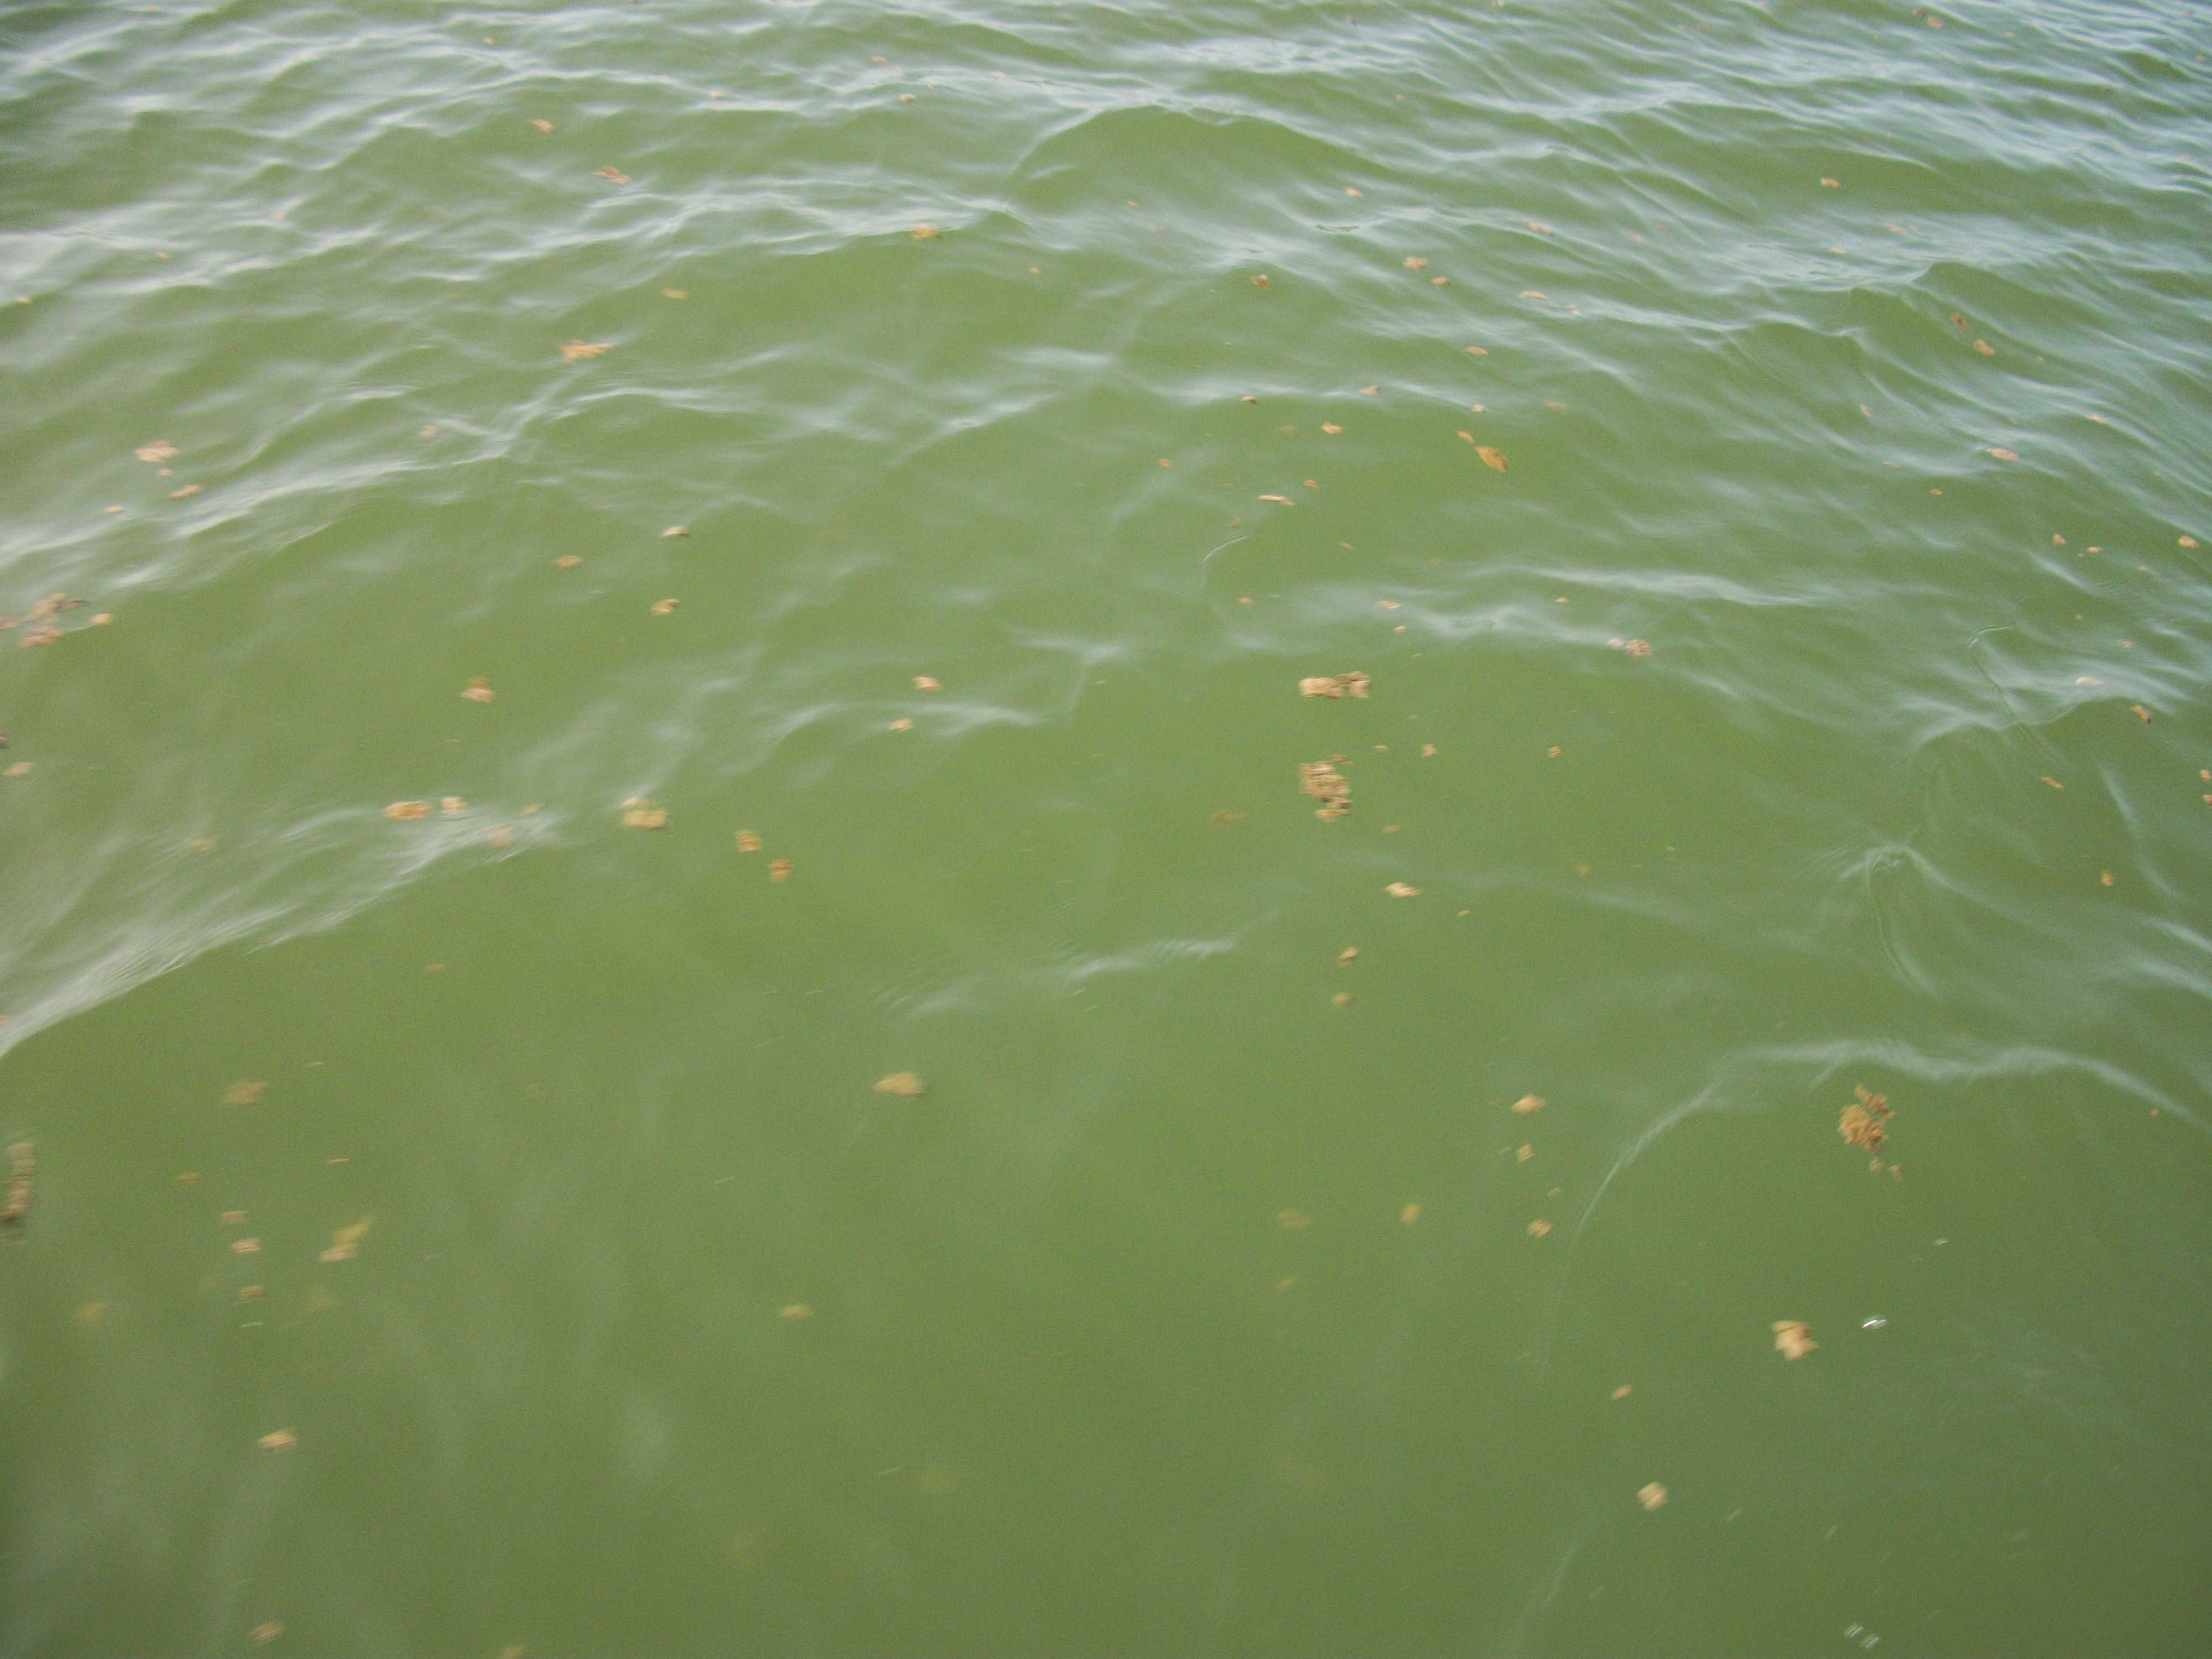

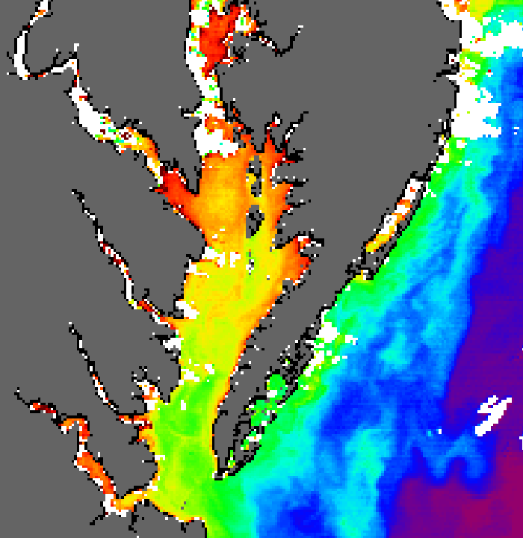
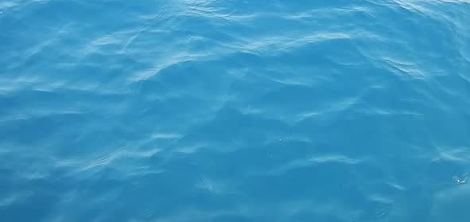
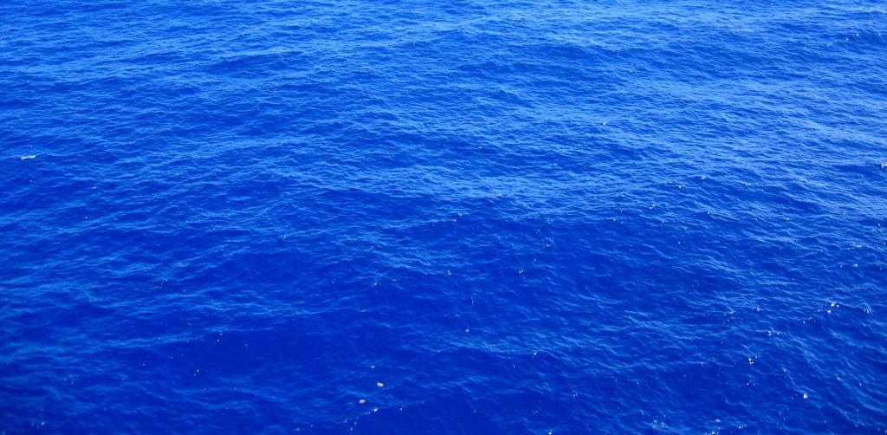
Water-leaving Radiance
What causes variation in the color of the ocean?
chlorophyll-a (mg m⁻³)
ratio of blue:green radiances
The color of the ocean is a function of light that is absorbed or scattered as a result of constituents in the water.
Phytoplankton and pigments
Dissolved organic matter
Detritus (fecal pellets, dead cells)
Inorganic particles (sediment)
Water absorption
blue green red
chlorophyll-a (algal biomass)

Slide 7
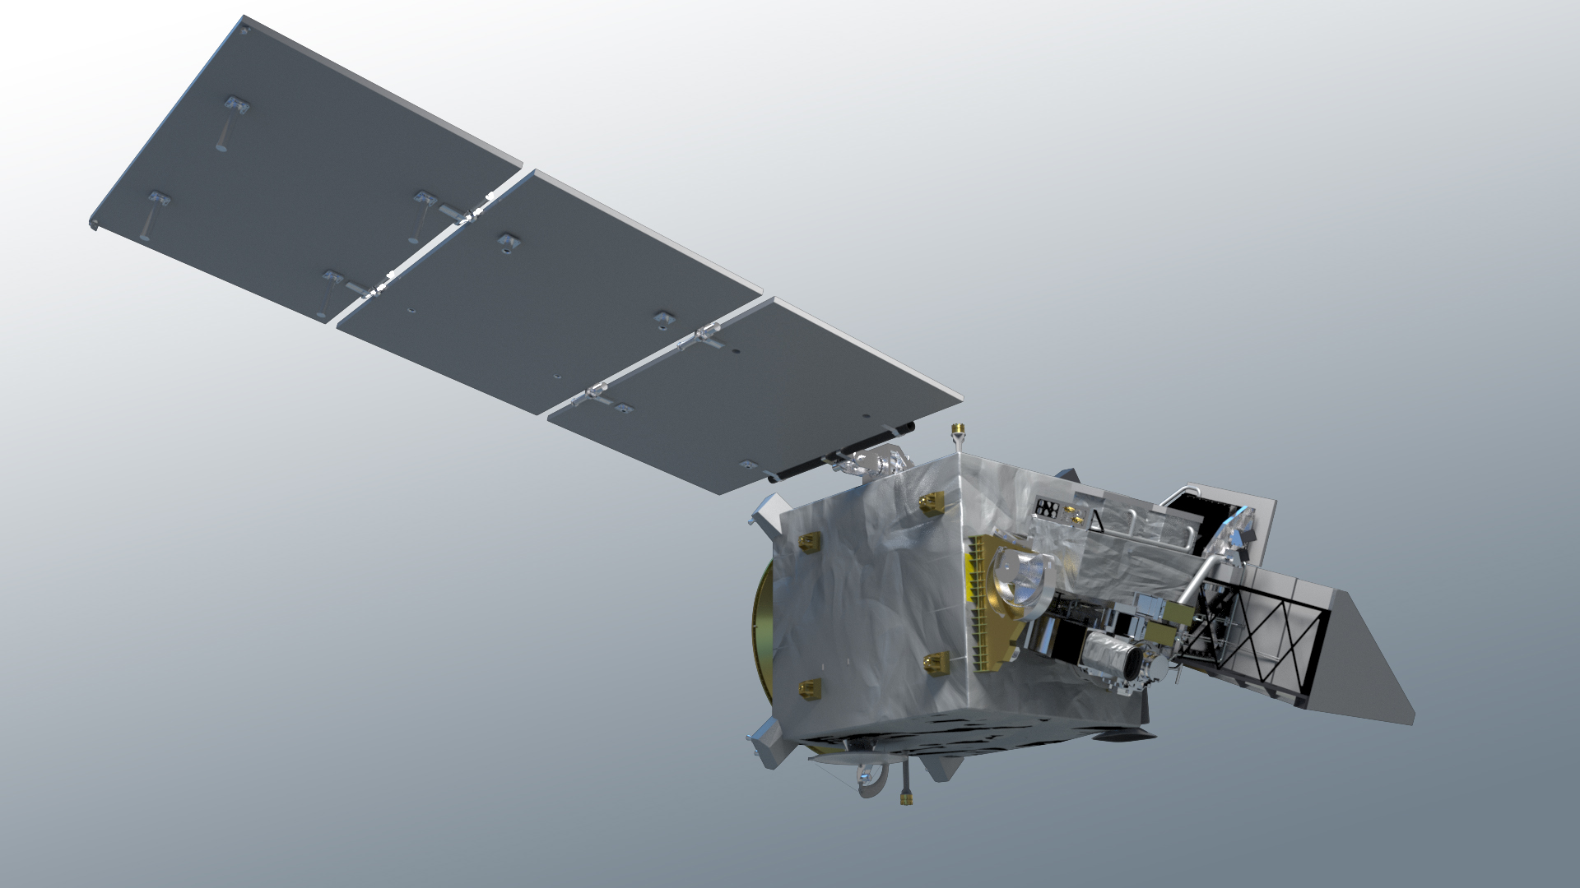
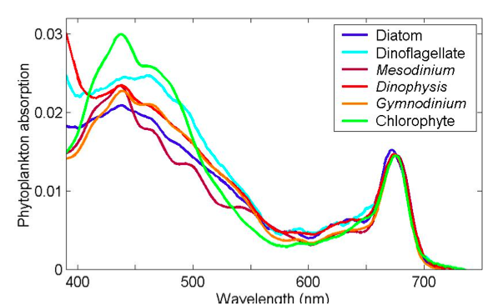
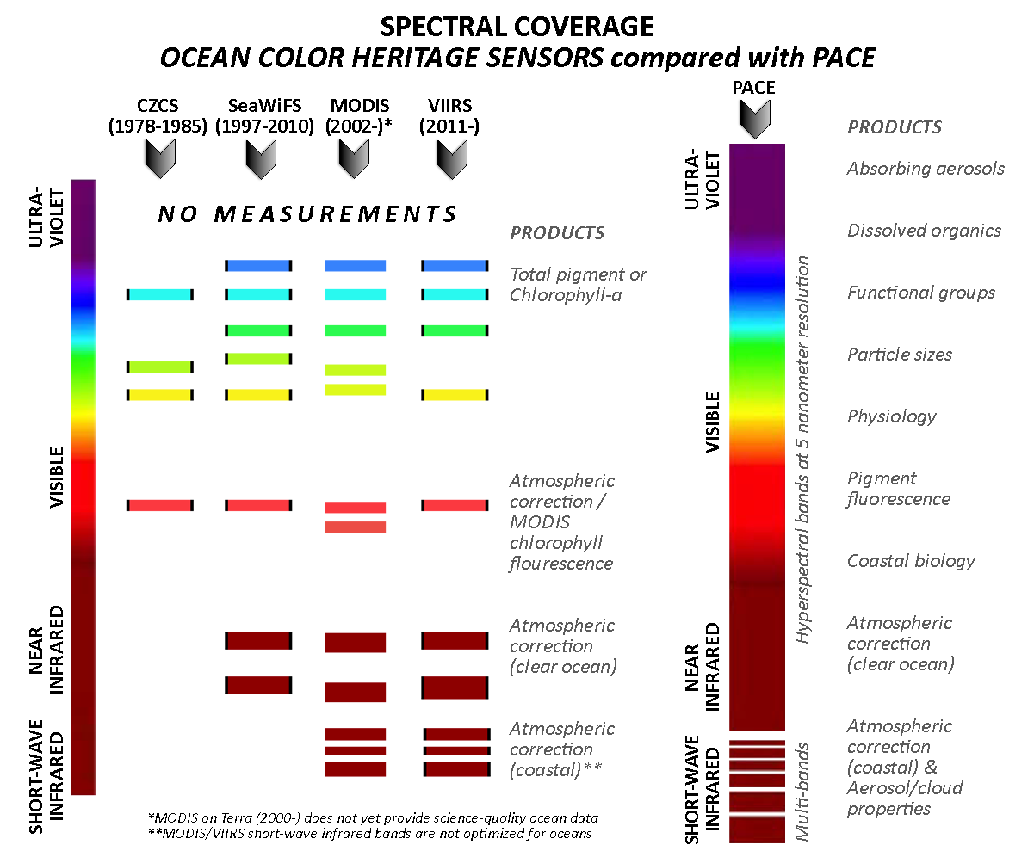
ocean color & the ocean color instrument
ocean color retrievals drive OCI’s design & performance requirements
hyperspectral scanning radiometer
(320) 340 – 890 nm, 5 nm resolution, 2.5 nm steps⁺
plus, 940, 1038, 1250, 1378, 1615, 2130, and 2250 nm
single science pixel to mitigate image striping
1 – 2 day global coverage
ground pixel size of 1 km² at nadir
± 20º fore/aft tilt to avoid Sun glint
twice monthly lunar calibration
daily on-board solar calibration
<0.5% total system error for VIS-NIR
SNRs optimized for ocean color science
simulated top-of-atmosphere data available (as of Apr)*
intent / goal is migration to advanced spectral matching and anomaly/derivative methods
+ with 1.25 nm steps in several spectral regions
* developed primarily for mechanical processing assessments

Slide 8
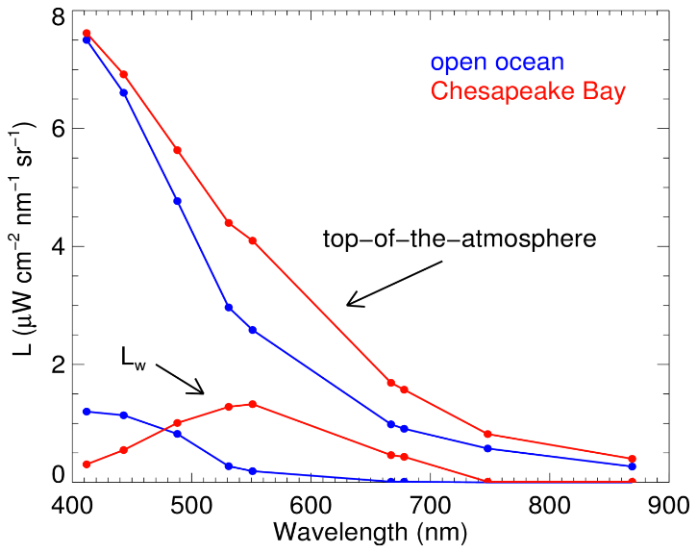
Ocean color atmospheric correction
t L_{water-leaving} = L_{total} - L_{Rayleigh} - L_{aerosols} - t L_{surface reflection}
the satellite views the spectral light field at the top-of-the-atmosphere
SATELLITE
TOP-OF-THE-ATMOSPHERE
NIR & SWIR bands used in atmospheric correction
knowledge of gaseous transmission (t) critical
1. remove atmosphere from total signal to derive estimate of light field emanating from sea surface (e.g., water-leaving reflectances)
320 nm for ozone!
the water signal is often less than 10% of the total signal measured by the satellite
SEA SURFACE
UV-visible-NIR bands used to derive ocean products
2. relate spectral water-leaving reflectances to a chlorophyll-a concentration (or another geophysical product of interest)
PHYTOPLANKTON
Notes:
Ozone one example of absorbing atmos. gas – one of several reasons for inclusion of 320 nm
Take home messages:
Our Level-1 req’s are based on a derived product
Much energy expended on NIR and SWIR performance
Much energy expended on UV-NIR & model performance
OCI will substantially improve #2
If improvements in #1 can be realized, this can be fed into OCI to relax req’s & add margin

Slide 9
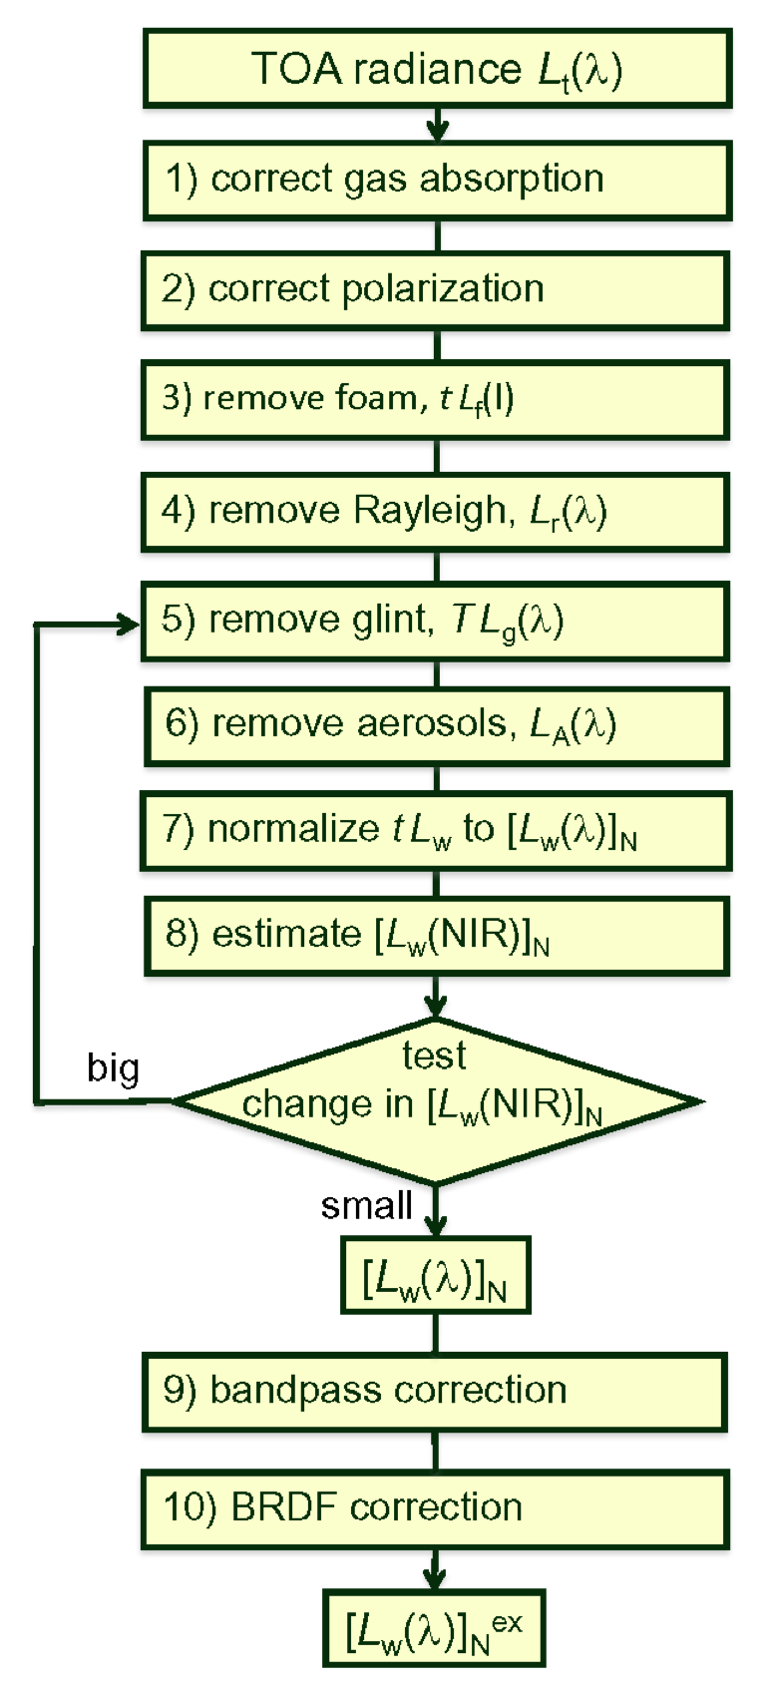
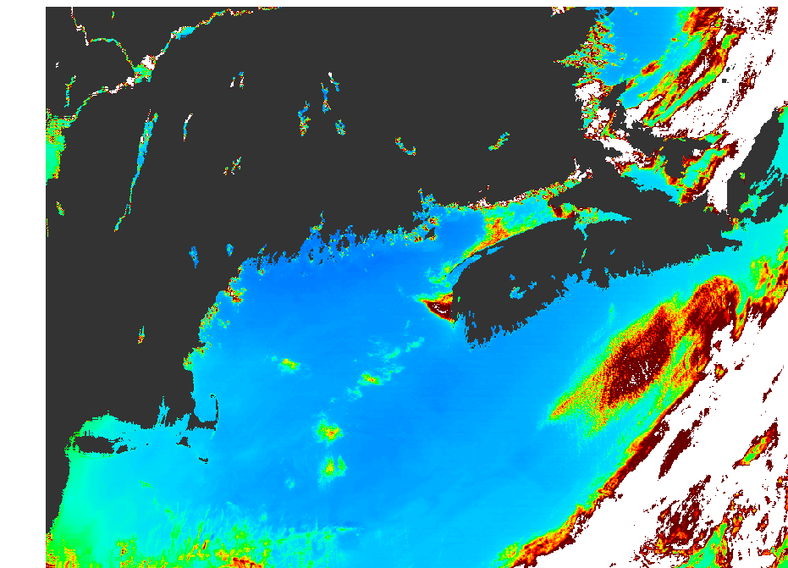
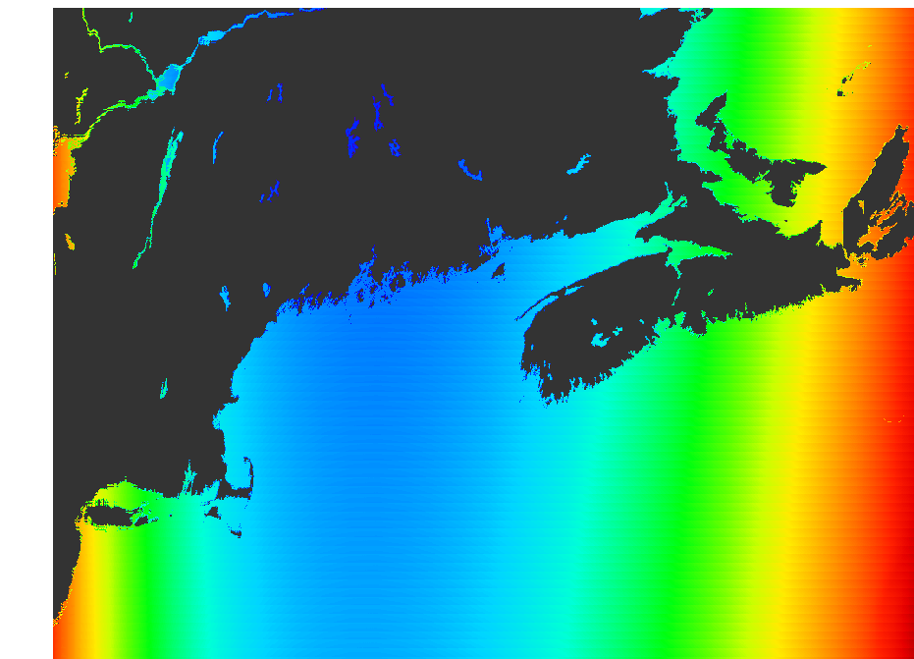
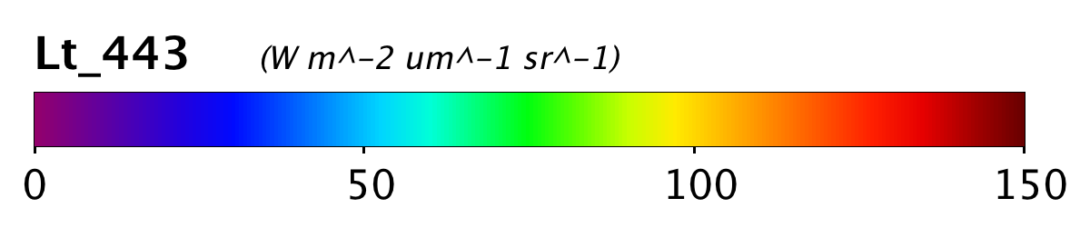
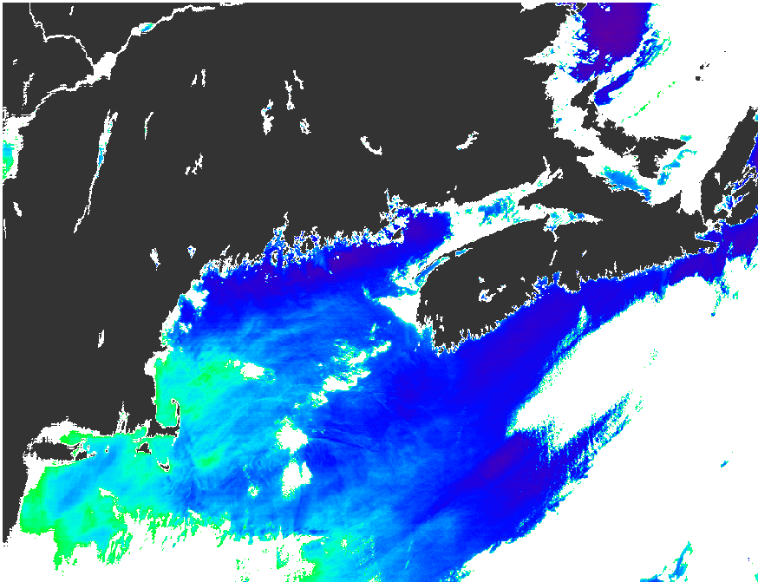
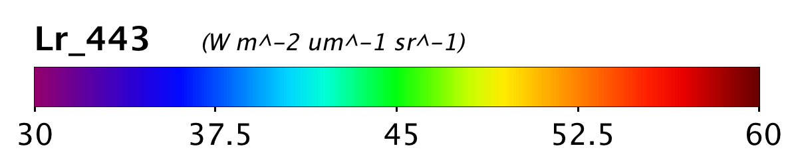
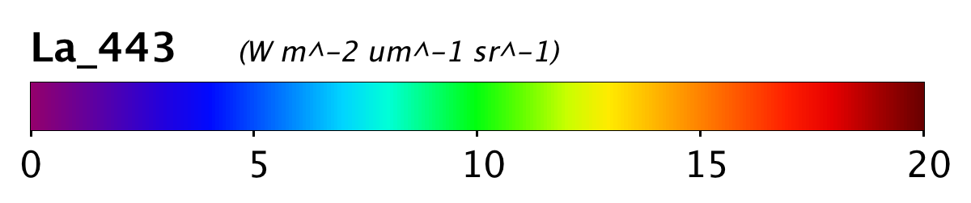
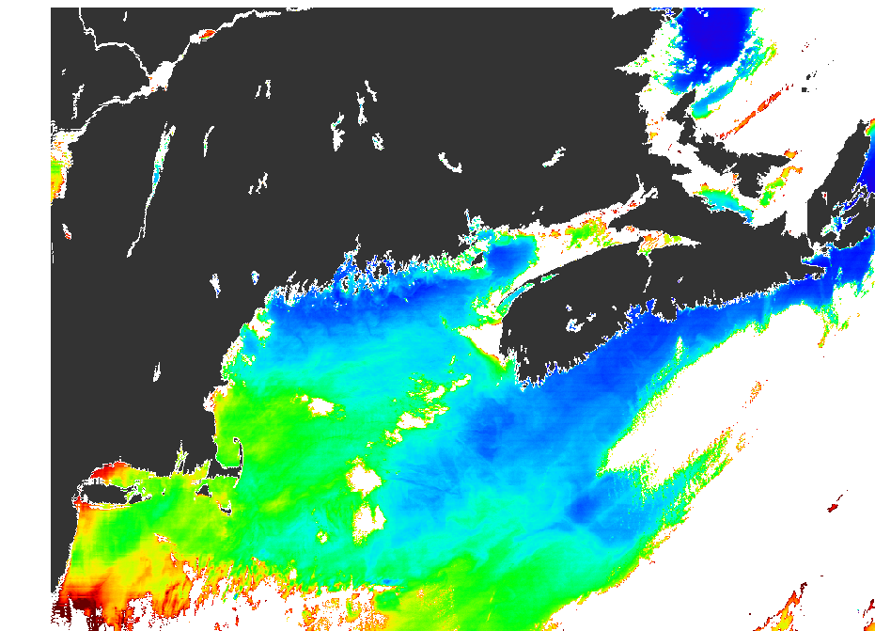
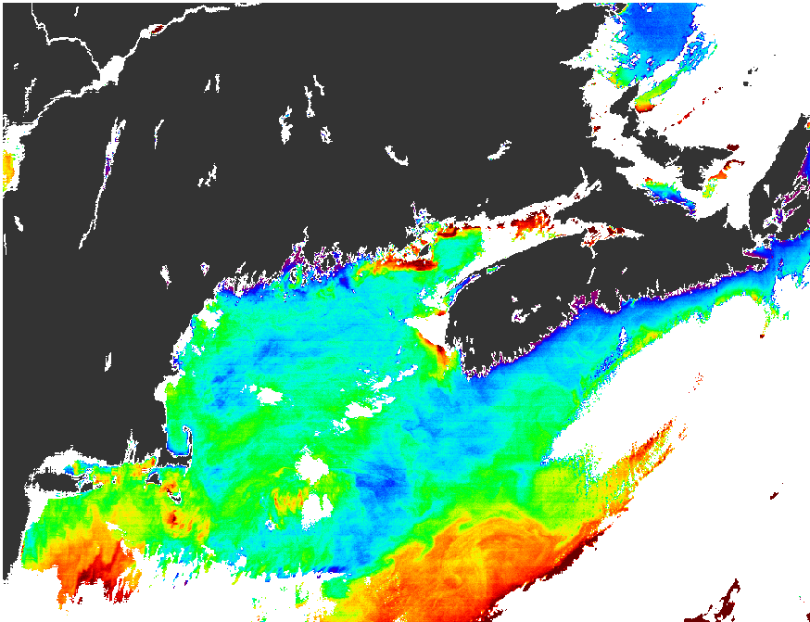
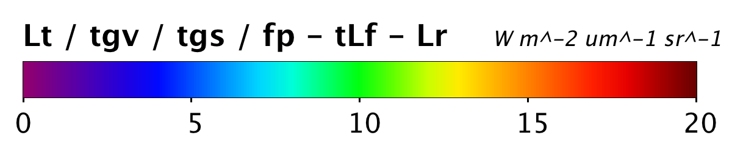
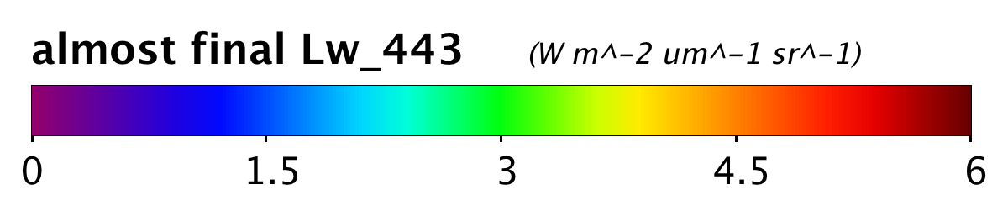
top-of-atmosphere @ 443 nm
aerosol reflectance @ 443 nm
Rayleigh reflectance @ 443 nm
SIGNAL
full
half
empty

Slide 10
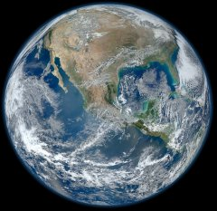
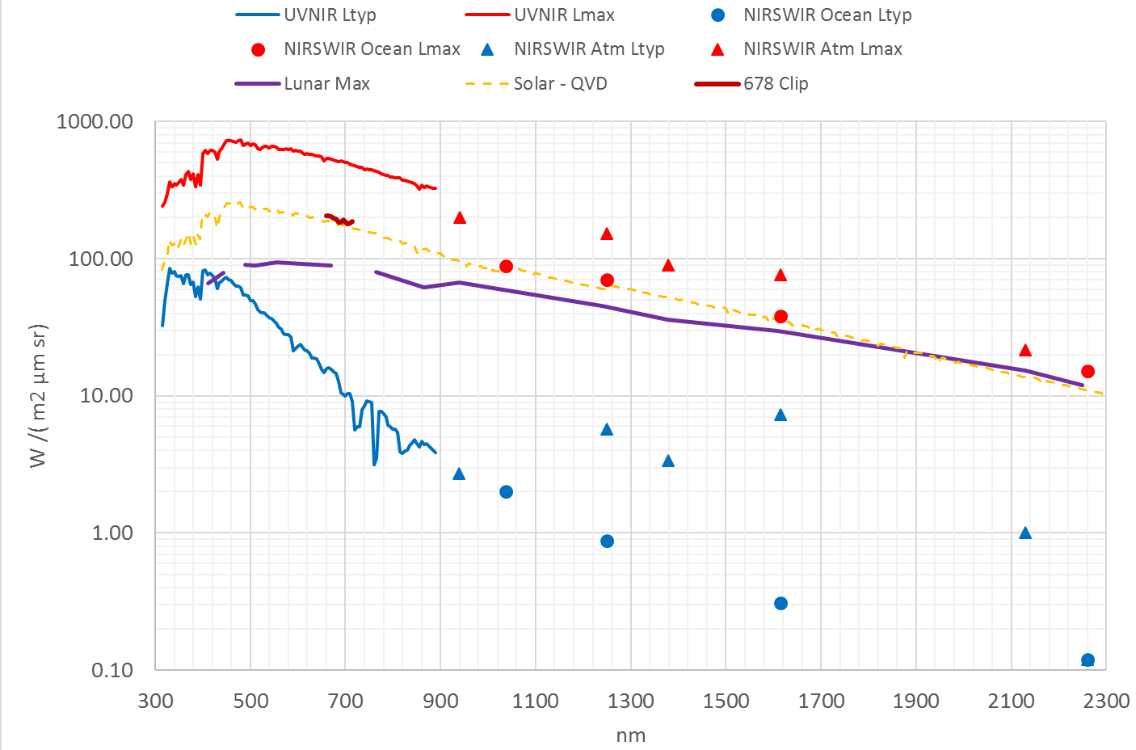
OCI Dynamic Range Requirements
Measure Radiance (Light) at TOA
Meet systematic & SNR req’s at L_{typ} Radiance
Do not saturate at L_{max} Radiance
Do not saturate Lunar and Solar Radiance
L_{max}: The 3-sigma radiance of ‘bright’ clouds
L_{typ}: The typical radiance of the ‘dark’ ocean
2 Orders of Magnitude Between L_{typ} and L_{max} Top of Atmosphere Radiance Requirements

Slide 11
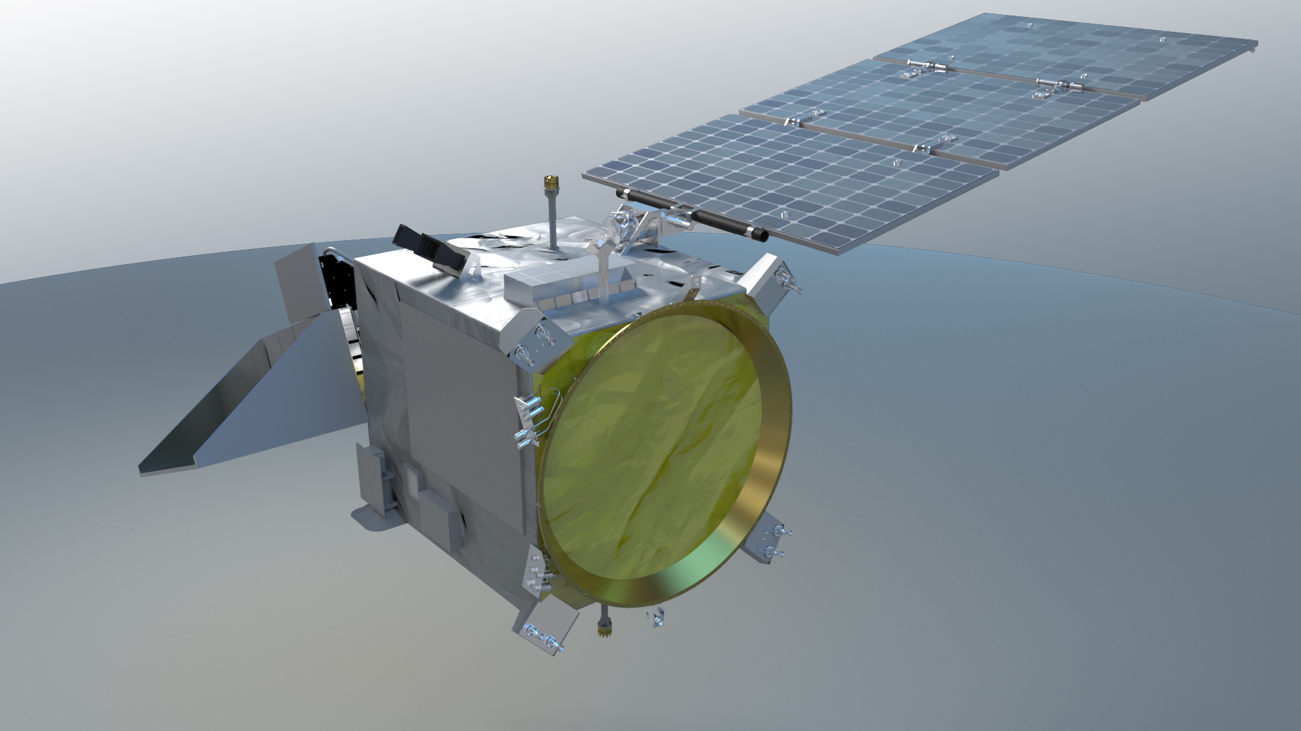
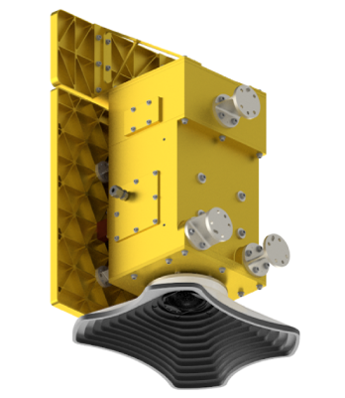
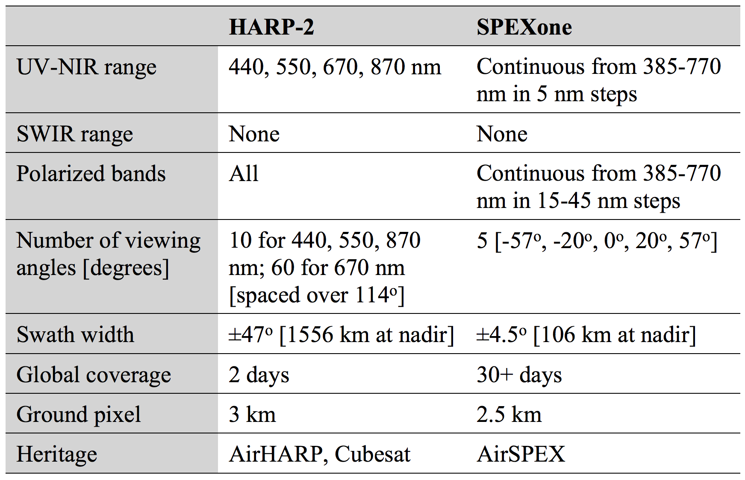
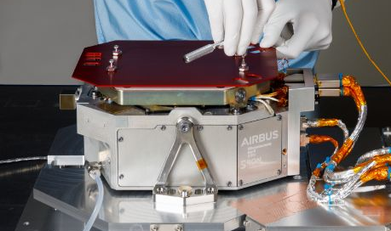
Update
Flight unit @ GSFC for environmental testing
Delivery to GSFC for I&T in Fall 2022
UMBC Hyper Angular Rainbow Polarimeter (HARP-2)
Update
SPEXone flight unit delivered to GSFC, with midpoint testing complete
16 orbits of simulated data available online
SRON/Airbus
Spectro-polarimeter for Planetary Exploration (SPEXone)

Slide 12
OCI-polarimetry synergy
Spectro-Polarimeter for Planetary Exploration (SPEXone)
Excellent for aerosol characterization
Addresses aerosol climate objectives beyond those required of OCI
Hyper Angular Rainbow Polarimeter (HARP2)
Excellent for cloud droplet size and ice particle shape/roughness retrievals
Provides cloud capabilities beyond those required of OCI
Wide swath ~matches OCI, offering potentially improved atmospheric correction
OCI + SPEXone + HARP2
Far greater information content than any current (& planned) instrument suite for ocean color, aerosol, & cloud observations
New data products: ocean color from multi-angle polarimetry, wind speed, etc.

Slide 13
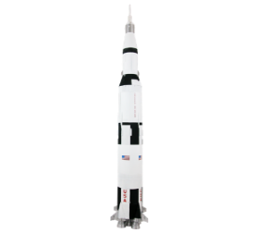
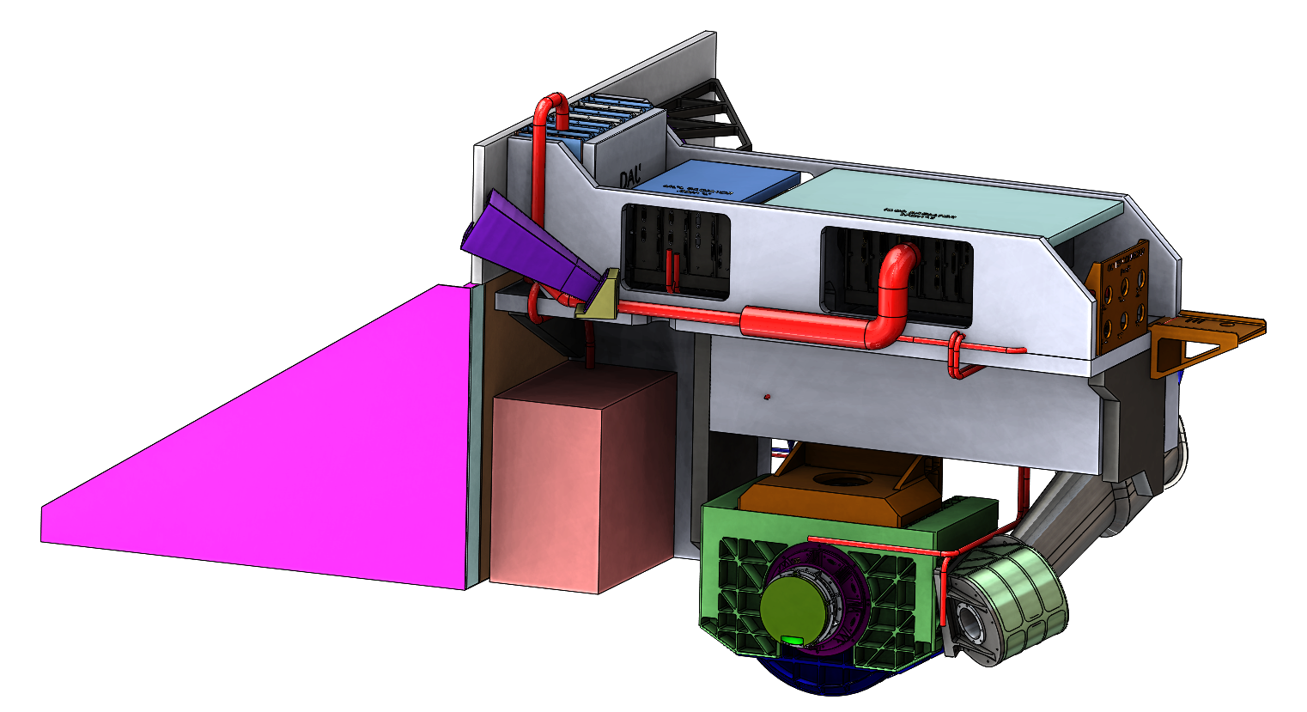
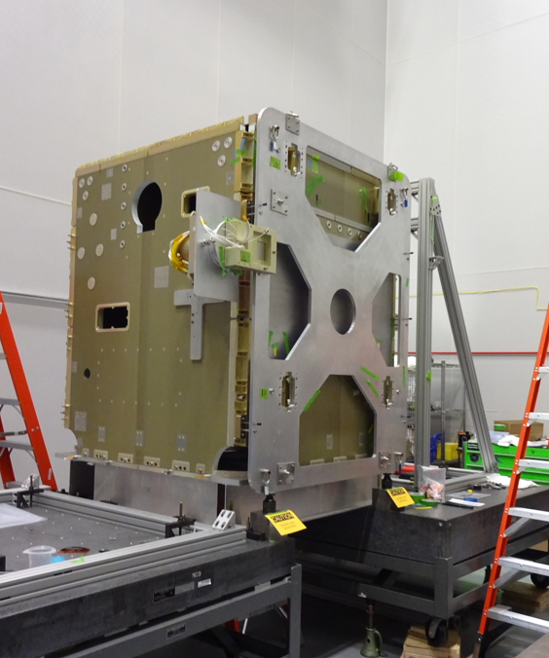
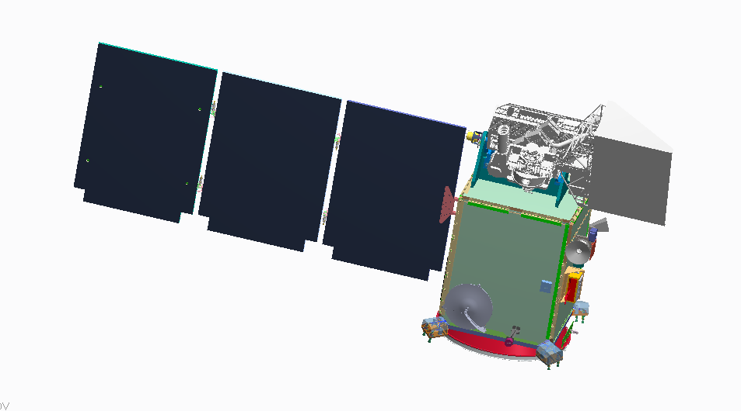
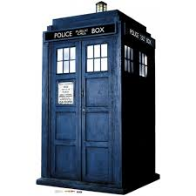
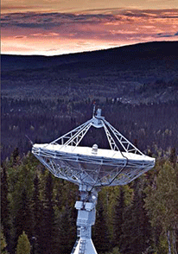
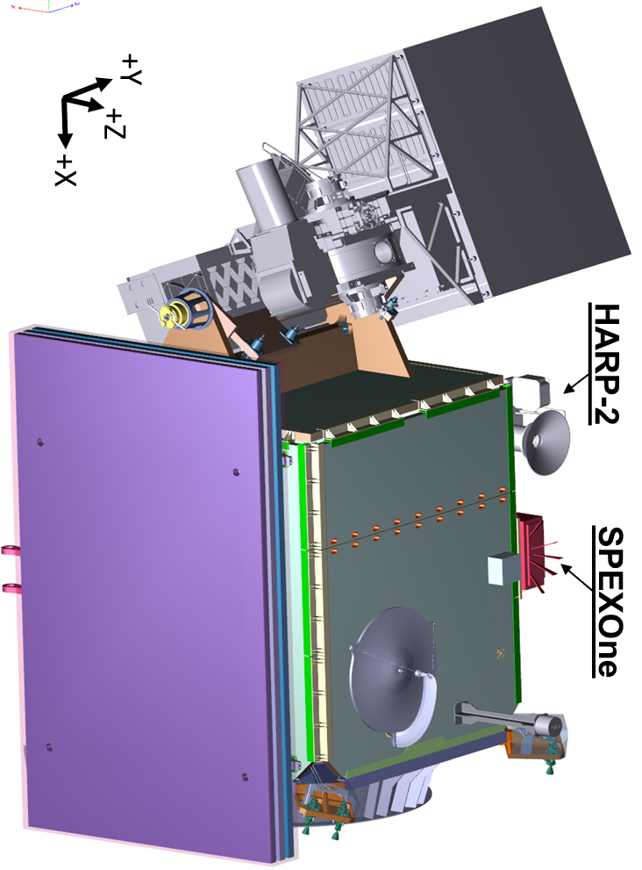
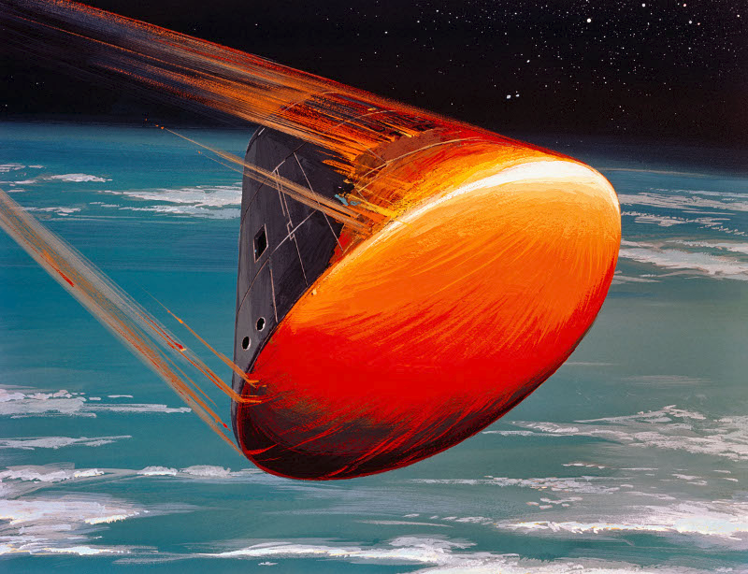

schedule
Phase C – final design & fabrication
all mission elements have passed Critical Design Reviews (CDRs)
all mission elements will have System Integration Reviews (SIRs)
engineering test units characterized; flight builds underway
Project & HQ science implementing science capabilities
Phase D – system assembly, integration, testing, & launch
put everything together & get it on orbit
Phase E – science operations
do amazing science!
We are here.
(Launch – 23 mos.)
OCI & Spacecraft
I&T
OCI
CDR
Observatory I&T
Spacecraft
PDR
Grd &
SDS
CDR
Phase A
Grd &
SDS
PDR
OCI
PDR
Mission
PDR
Mission
CDR & LV
Award
Launch Readiness Date (LRD) Jan. 9, 2024
Decommission
CY16
CY17
CY18
CY19
CY20
CY21
CY22
CY23
CY24
CY25
CY26
CY27
Phase A
Phase B
Phase C
Phase D
Phase E
Phase F

Slide 14
science community engagement
Current Science & Applications Team (SAT#2) intact through mid-2023
Next team (SAT#3) expected to be competed via NASA ROSES-23
PACE Validation Science Team (PVST) to be assembled ~6 months prior to launch (as of today, this would be ~mid-2023) via late ROSES-22 amendment
Preliminary focus on validation of threshold products (ocean color radiometry, AOT, clouds)
Evolution into validation of derived/advanced products, including polarimetry, & closure experiments
Separate but complementary PACE Post-launch Airborne eXperiment (PACE-PAX)
Two System Vicarious Calibration teams in the middle of their second year
Potential down-select from two teams to one later this year
Applications Program & Early Adopters

Slide 15
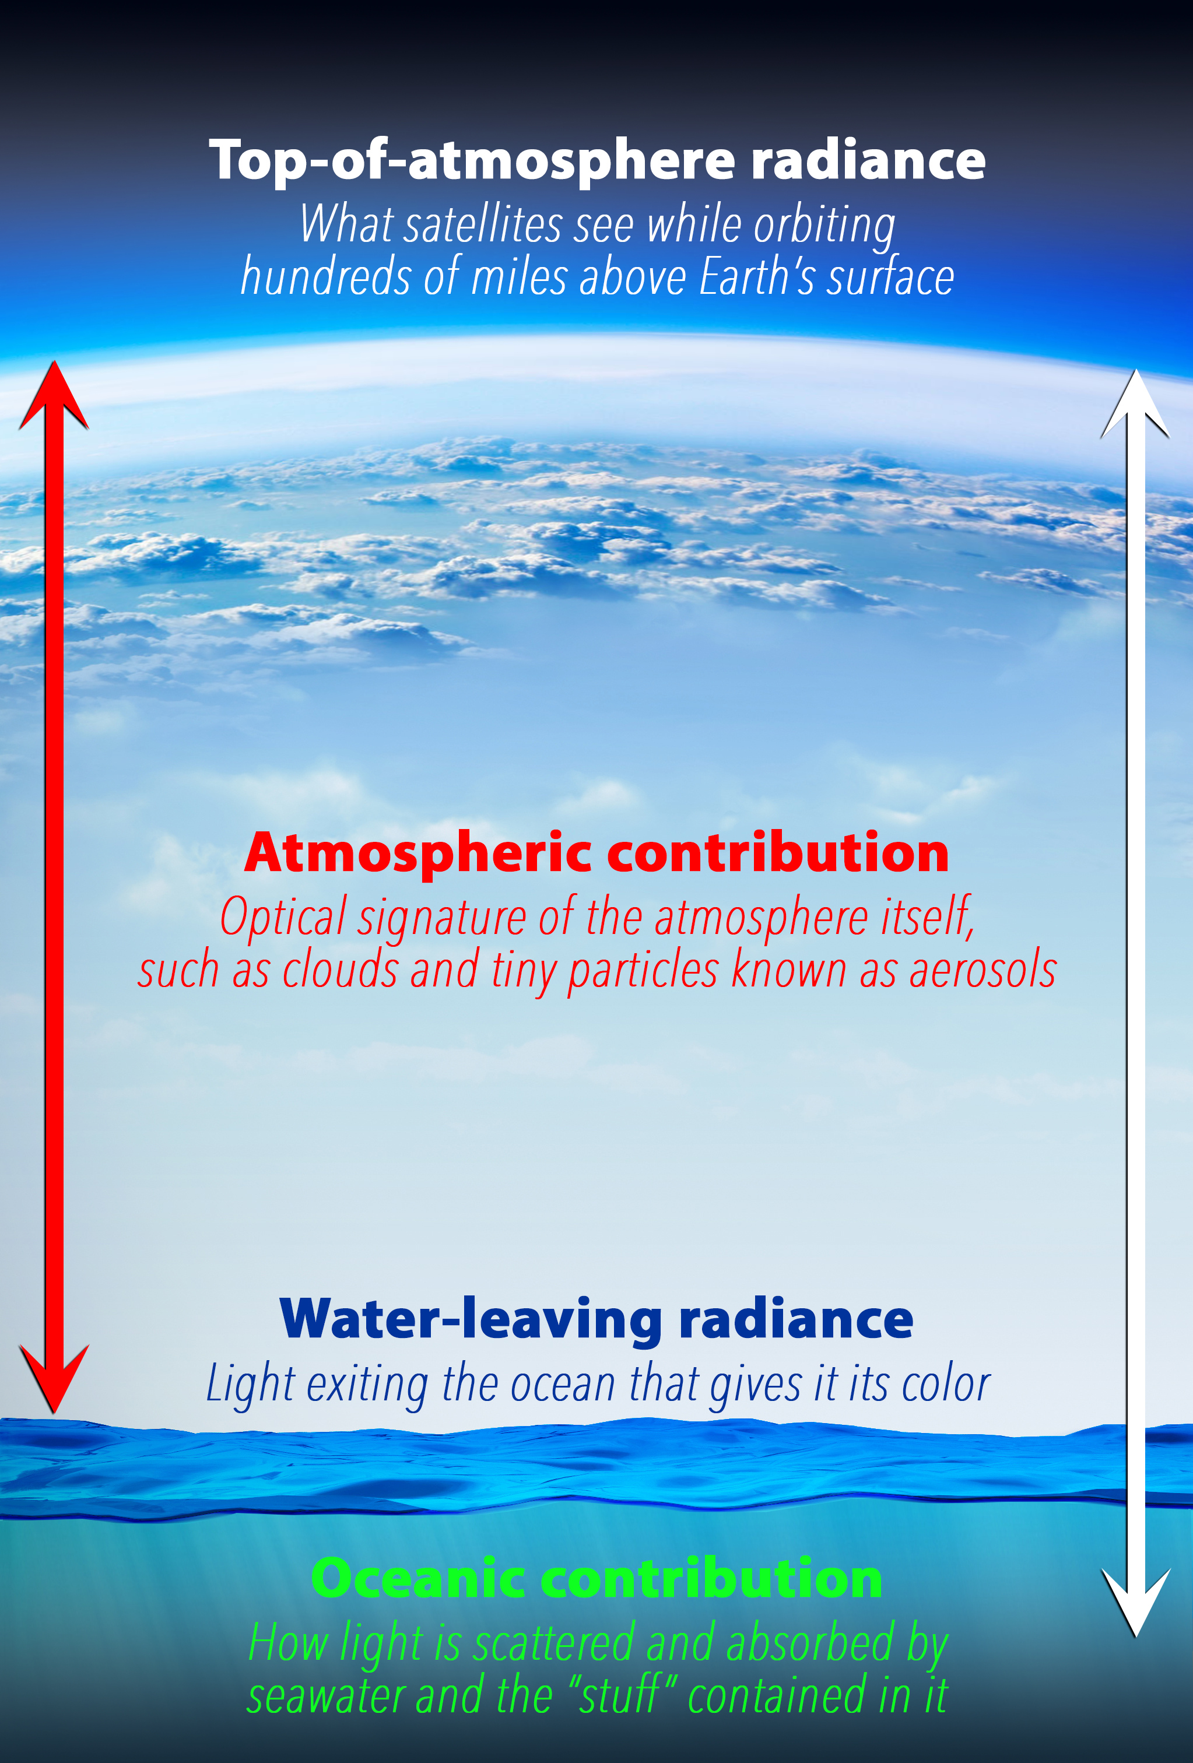
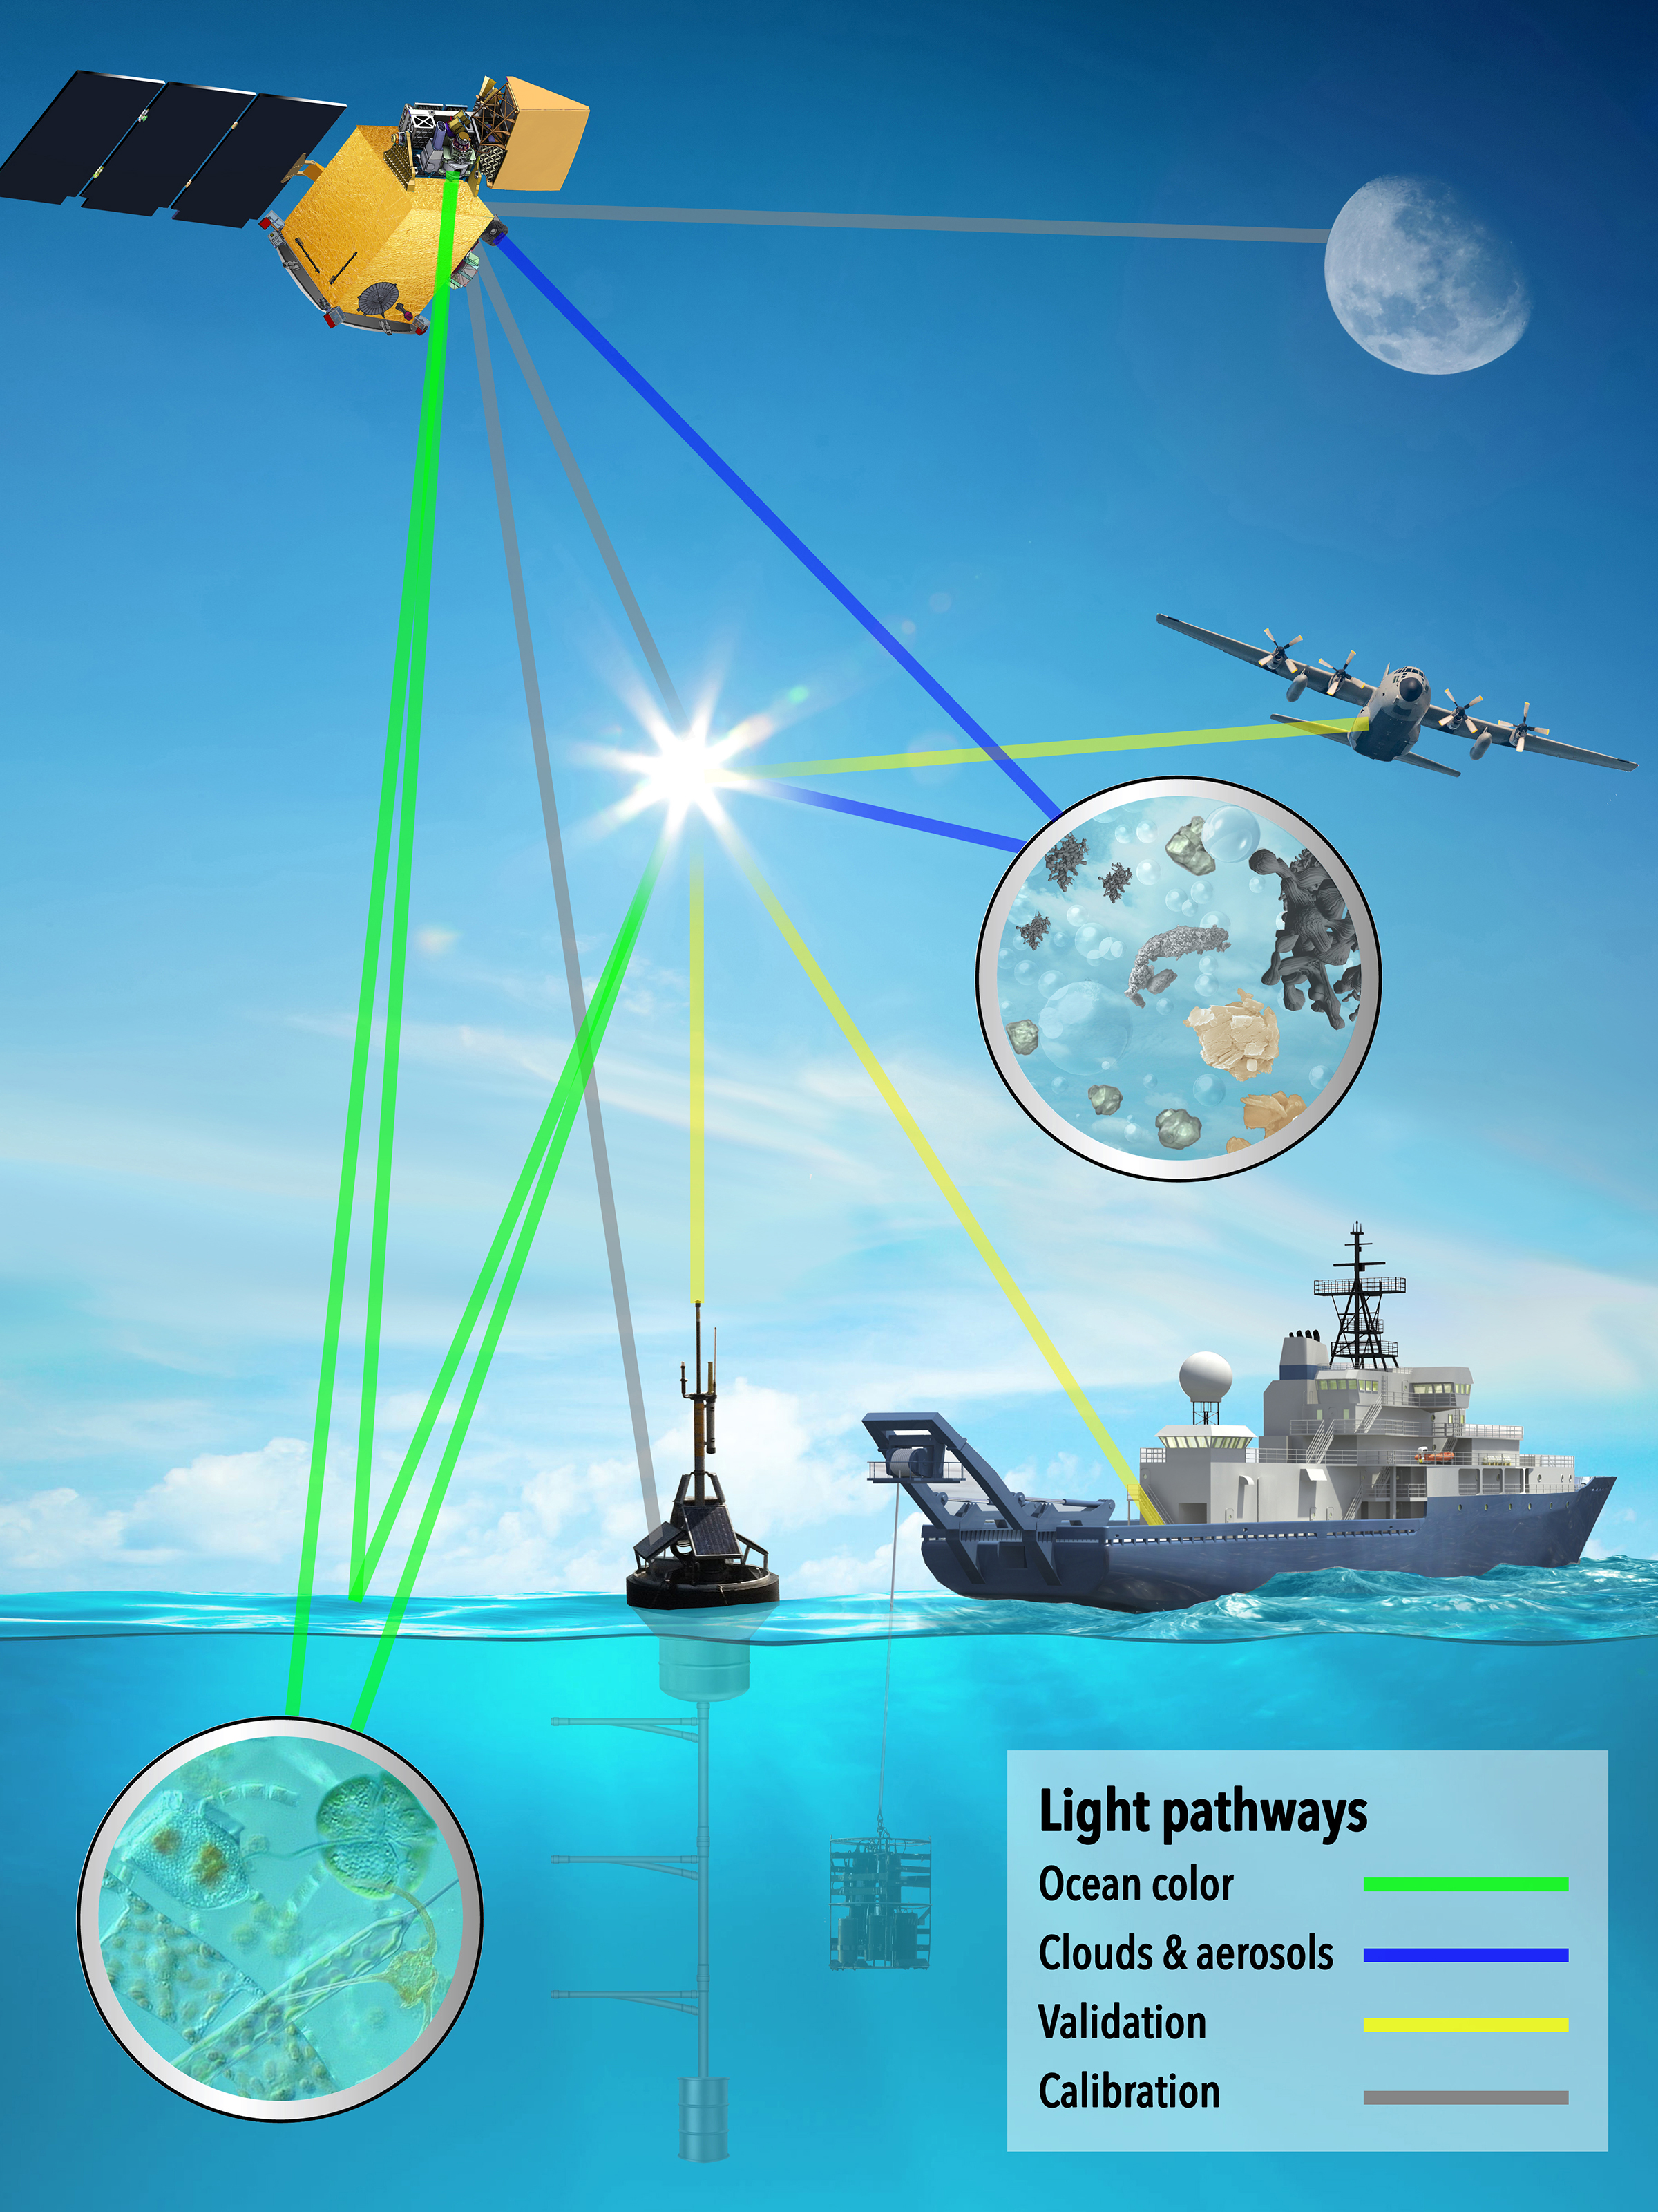
SAT data products (1)
concentrations of brown/black carbon
cloud optical depth
cloud height
cloud thickness
aerosol absorption aerosol optical depth
aerosol size distributions
aerosol heights & layers
cloud phase (liquid/ice)
droplet size distributions
ice crystal shapes
ocean reflectance
whitecap fraction
angular light distributions
oil slick detection

Slide 16
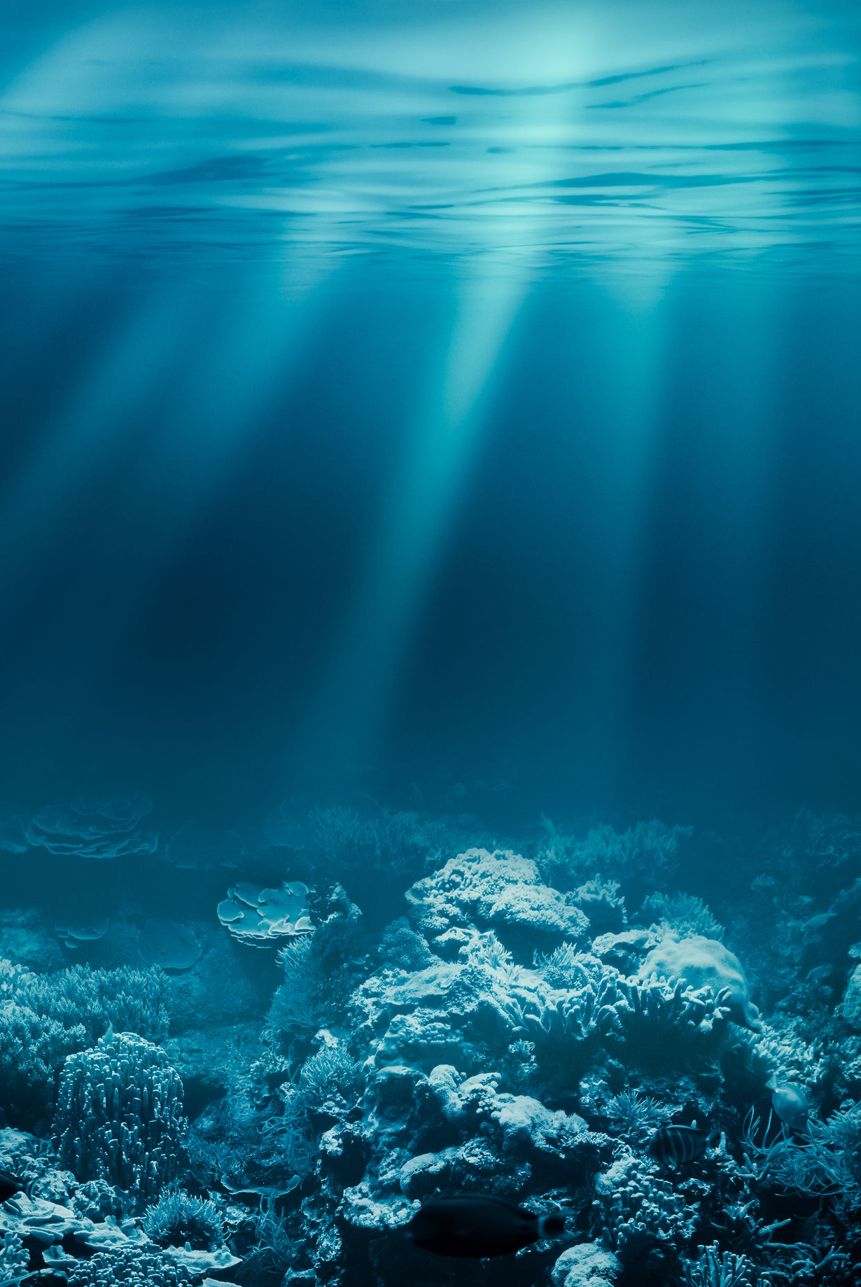
SAT data products (2)
light penetration
angular light distributions
index of refraction
photosynthetic pigments
fluorescence
plankton communities
light transmission
absorption properties
scattering properties
PAR: photosynthetically available radiation
concentrations of particulate carbon & suspended matter
bathymetry classifications
land albedo
vegetation indices

Slide 17
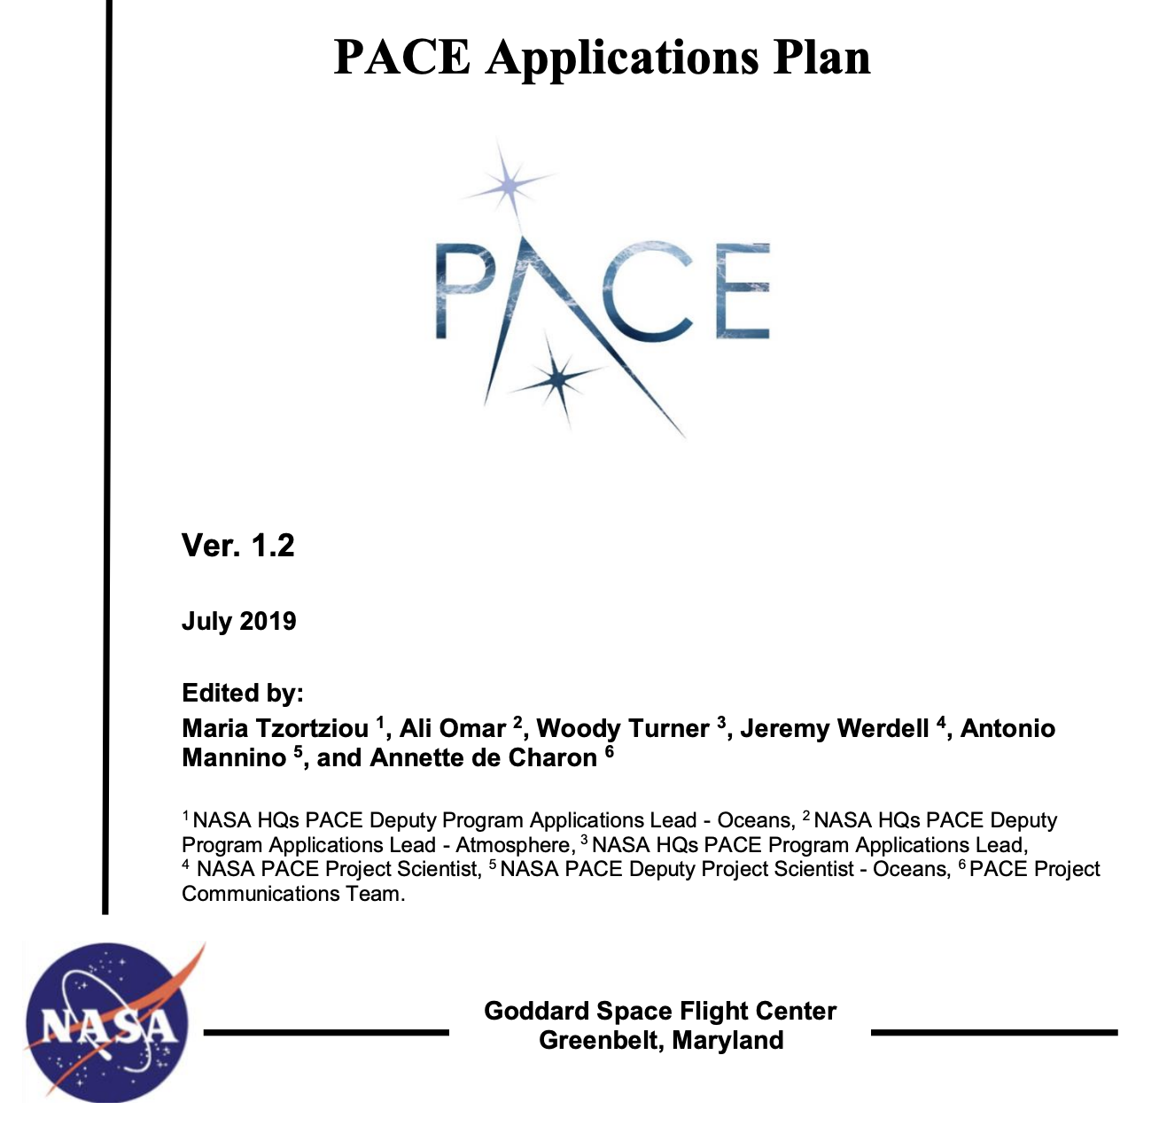
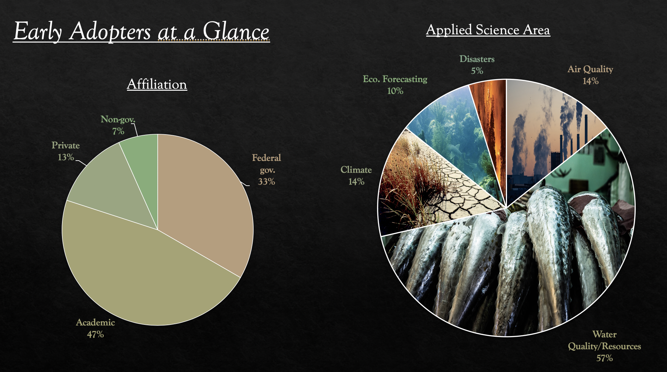
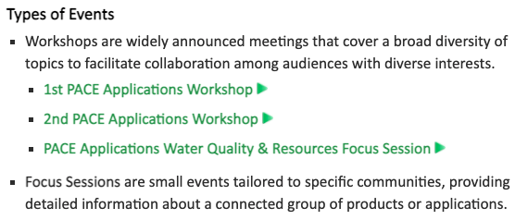
PACE Applications Program
~25 Early Adopter projects accepted as of July 2021
the PACE Applications Program began in mid-2019
2nd Workshop
15-16 Sep 2021
~750 registrants
~550 attendees
~70 countries
Join our Community of Practice! Visit the PACE Web site …

Slide 18
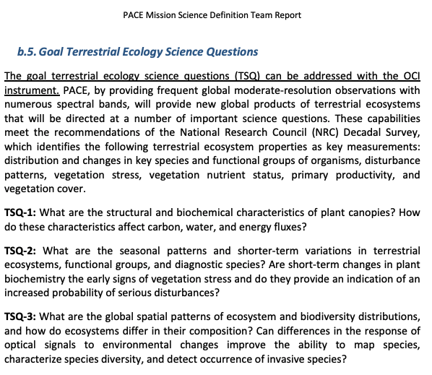





Slide 19




PACE data availability, formats & software
https://oceancolor.gsfc.nasa.gov
https://seadas.gsfc.nasa.gov

Slide 20








Useful info
resources &
useful info
data product descriptions + access to simulated data &
characterizations
PACE technical memos & other documents
https://pace.gsfc.nasa.gov
@NASAOcean

Slide 21
take away messages
what you should remembers since this was drinking from a fire hose
OCI: first ever truly global hyperspectral UV-NIR (+SWIR) measurements
the trade is, of course, spatial resolution
highly accurate multi-angle polarimetry for atmosphere + ocean retrievals
all data & software publicly available, with documentation
data latency will be ~3 to 12 hrs on average
simulated data available for OCI & SPEXone (to be periodically regenerated)
anticipating hosting training event(s)
Project is interested in terrestrial applications
Will pursue on a best-effort basis when resources are available
( Not required products )

Slide 22


