Slide 1
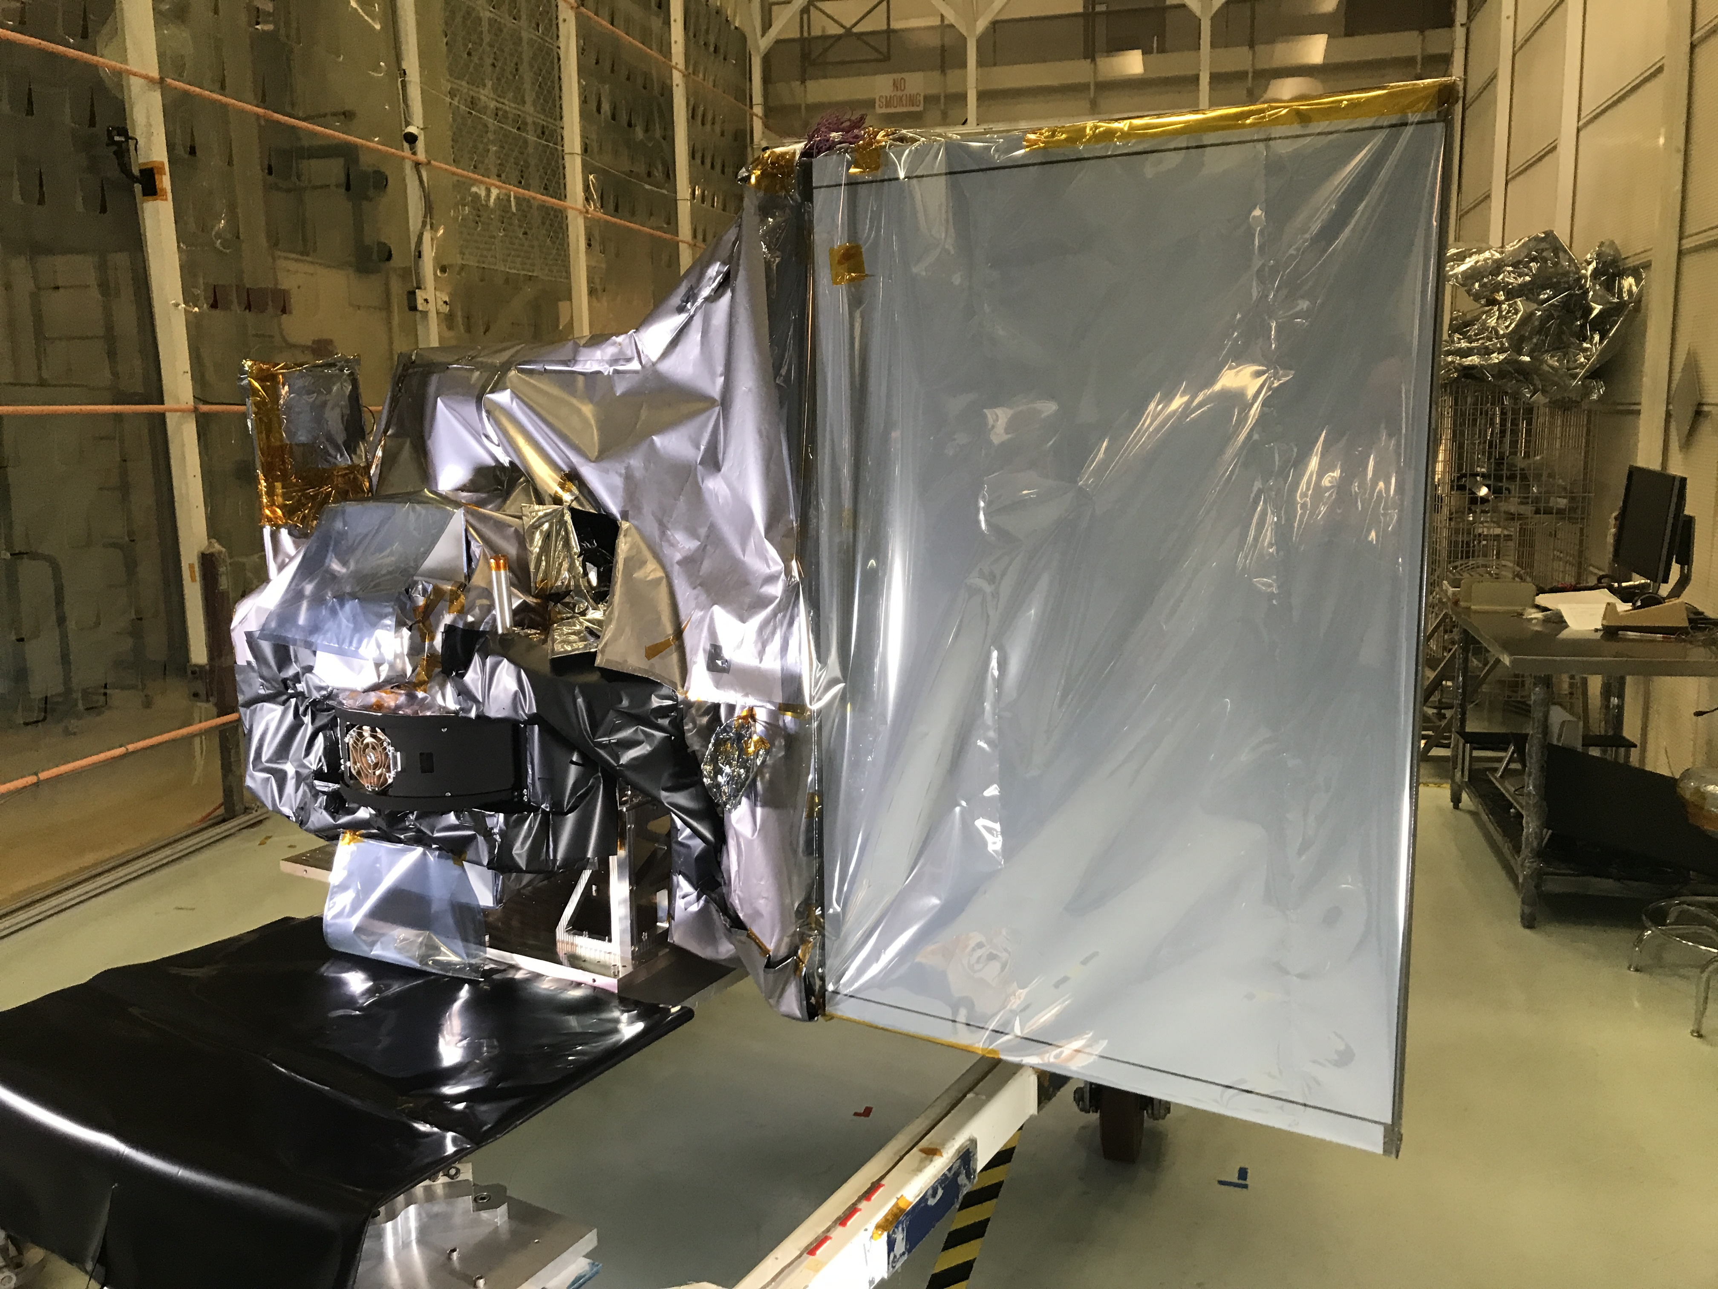
SAT update
July 2022
Spacecraft:
Integration continues (transponders, reaction wheel assemblies, etc.)
Completed integration of SPEXone!
OCI:
OCI is fully built!
Integration onto tilt mechanism underway
Thermal vacuum campaign begins in Aug
HARP2:
Rebuild of the flight instrument continues
Environmental test campaign planned for Aug; delivery in Oct

Slide 2
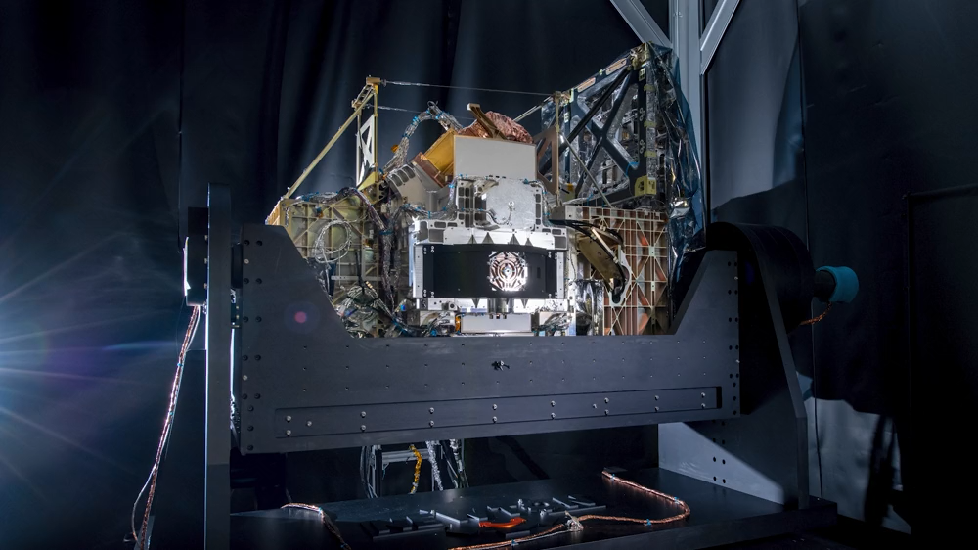
SAT update
July 2022

Slide 3
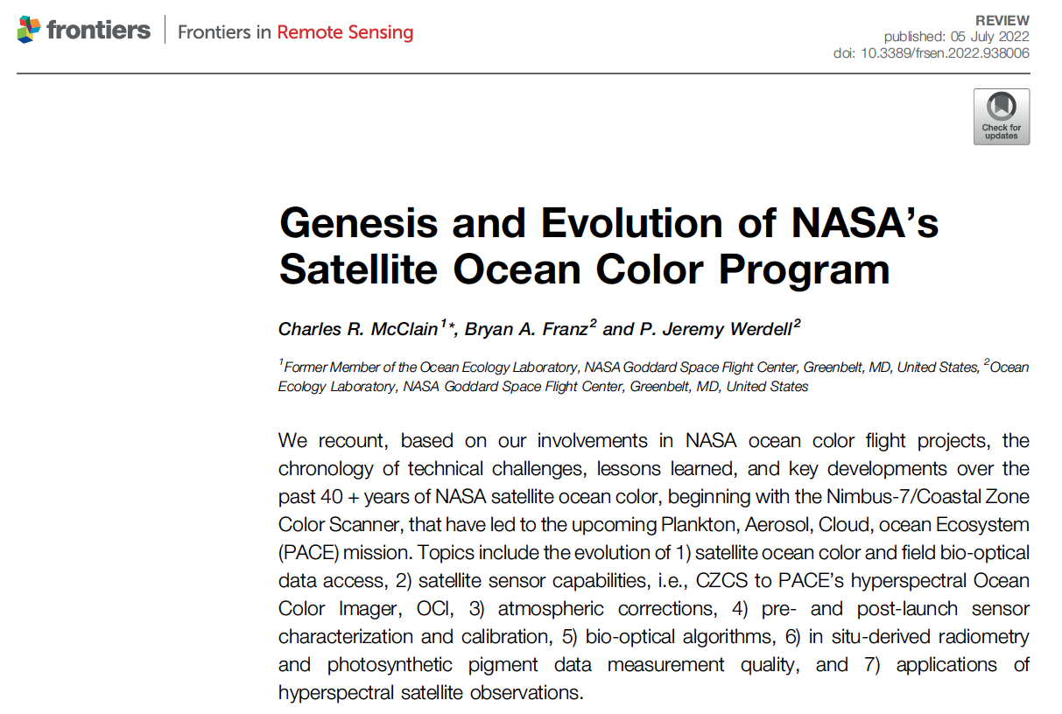
SAT update
July 2022

