Slide 1
PACE update to the
NOAA Modeling Board’s Enabling Observations in Models group
Jeremy Werdell
Cecile Rousseaux
Erin Urquhart Jephson
July 2022

Slide 2
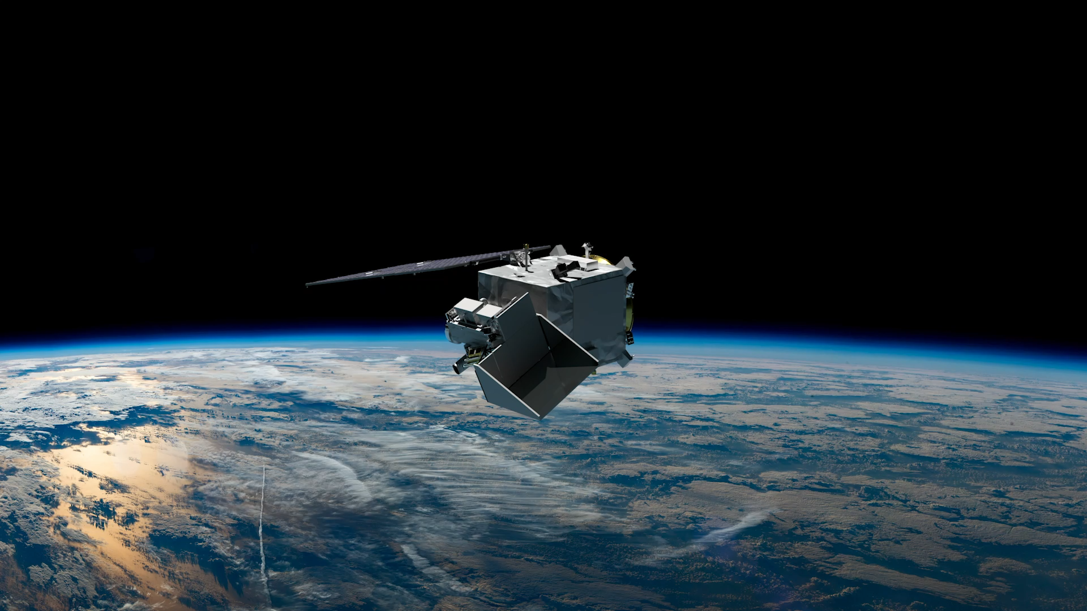

NASA Plankton, Aerosol, Cloud, ocean Ecosystem (PACE) mission
PACE will extend key systematic ocean color, aerosol, & cloud climate data records.
PACE will reveal the diversity of organisms fueling marine food webs & how ecosystems respond to change.
Looking at the ocean, clouds, and aerosols together will improve knowledge of the roles each plays in our planet.
Key characteristics:
Launch scheduled for 9 January 2024, Falcon 9 from KSC
676.5 km altitude
Polar, ascending, Sun synchronous orbit; 98º inclination
13:00 local Equatorial crossing
3-yr design life; 10-yr propellant
Data latency of 6-9 hrs on average (3-24 hrs full range)
3 instrument observatory:
Ocean Color Instrument (GSFC)
Hyperspectral scanning radiometer
HARP-2 (UMBC)
Multispectral hyper-angular polarimeter
SPEXone (SRON/Airbus)
Hyperspectral multi-angle polarimeter

Slide 3
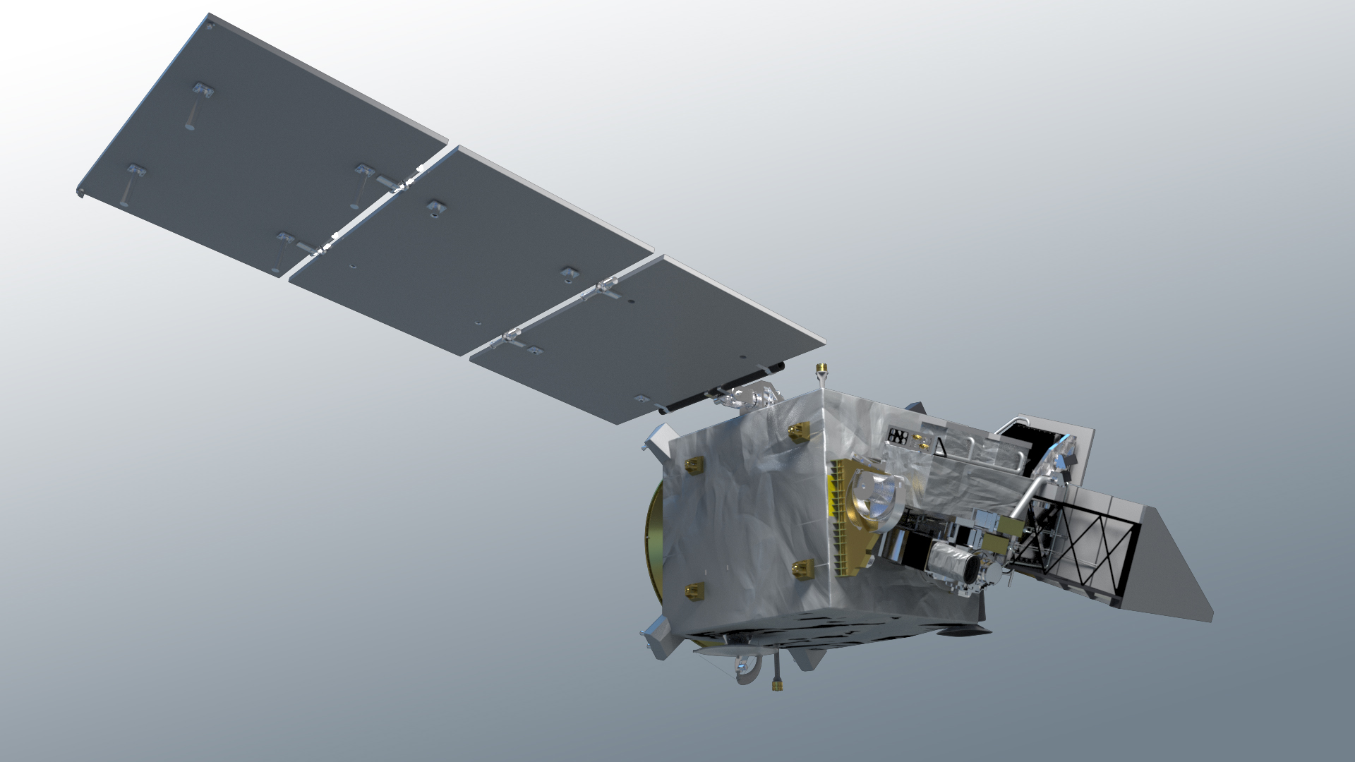
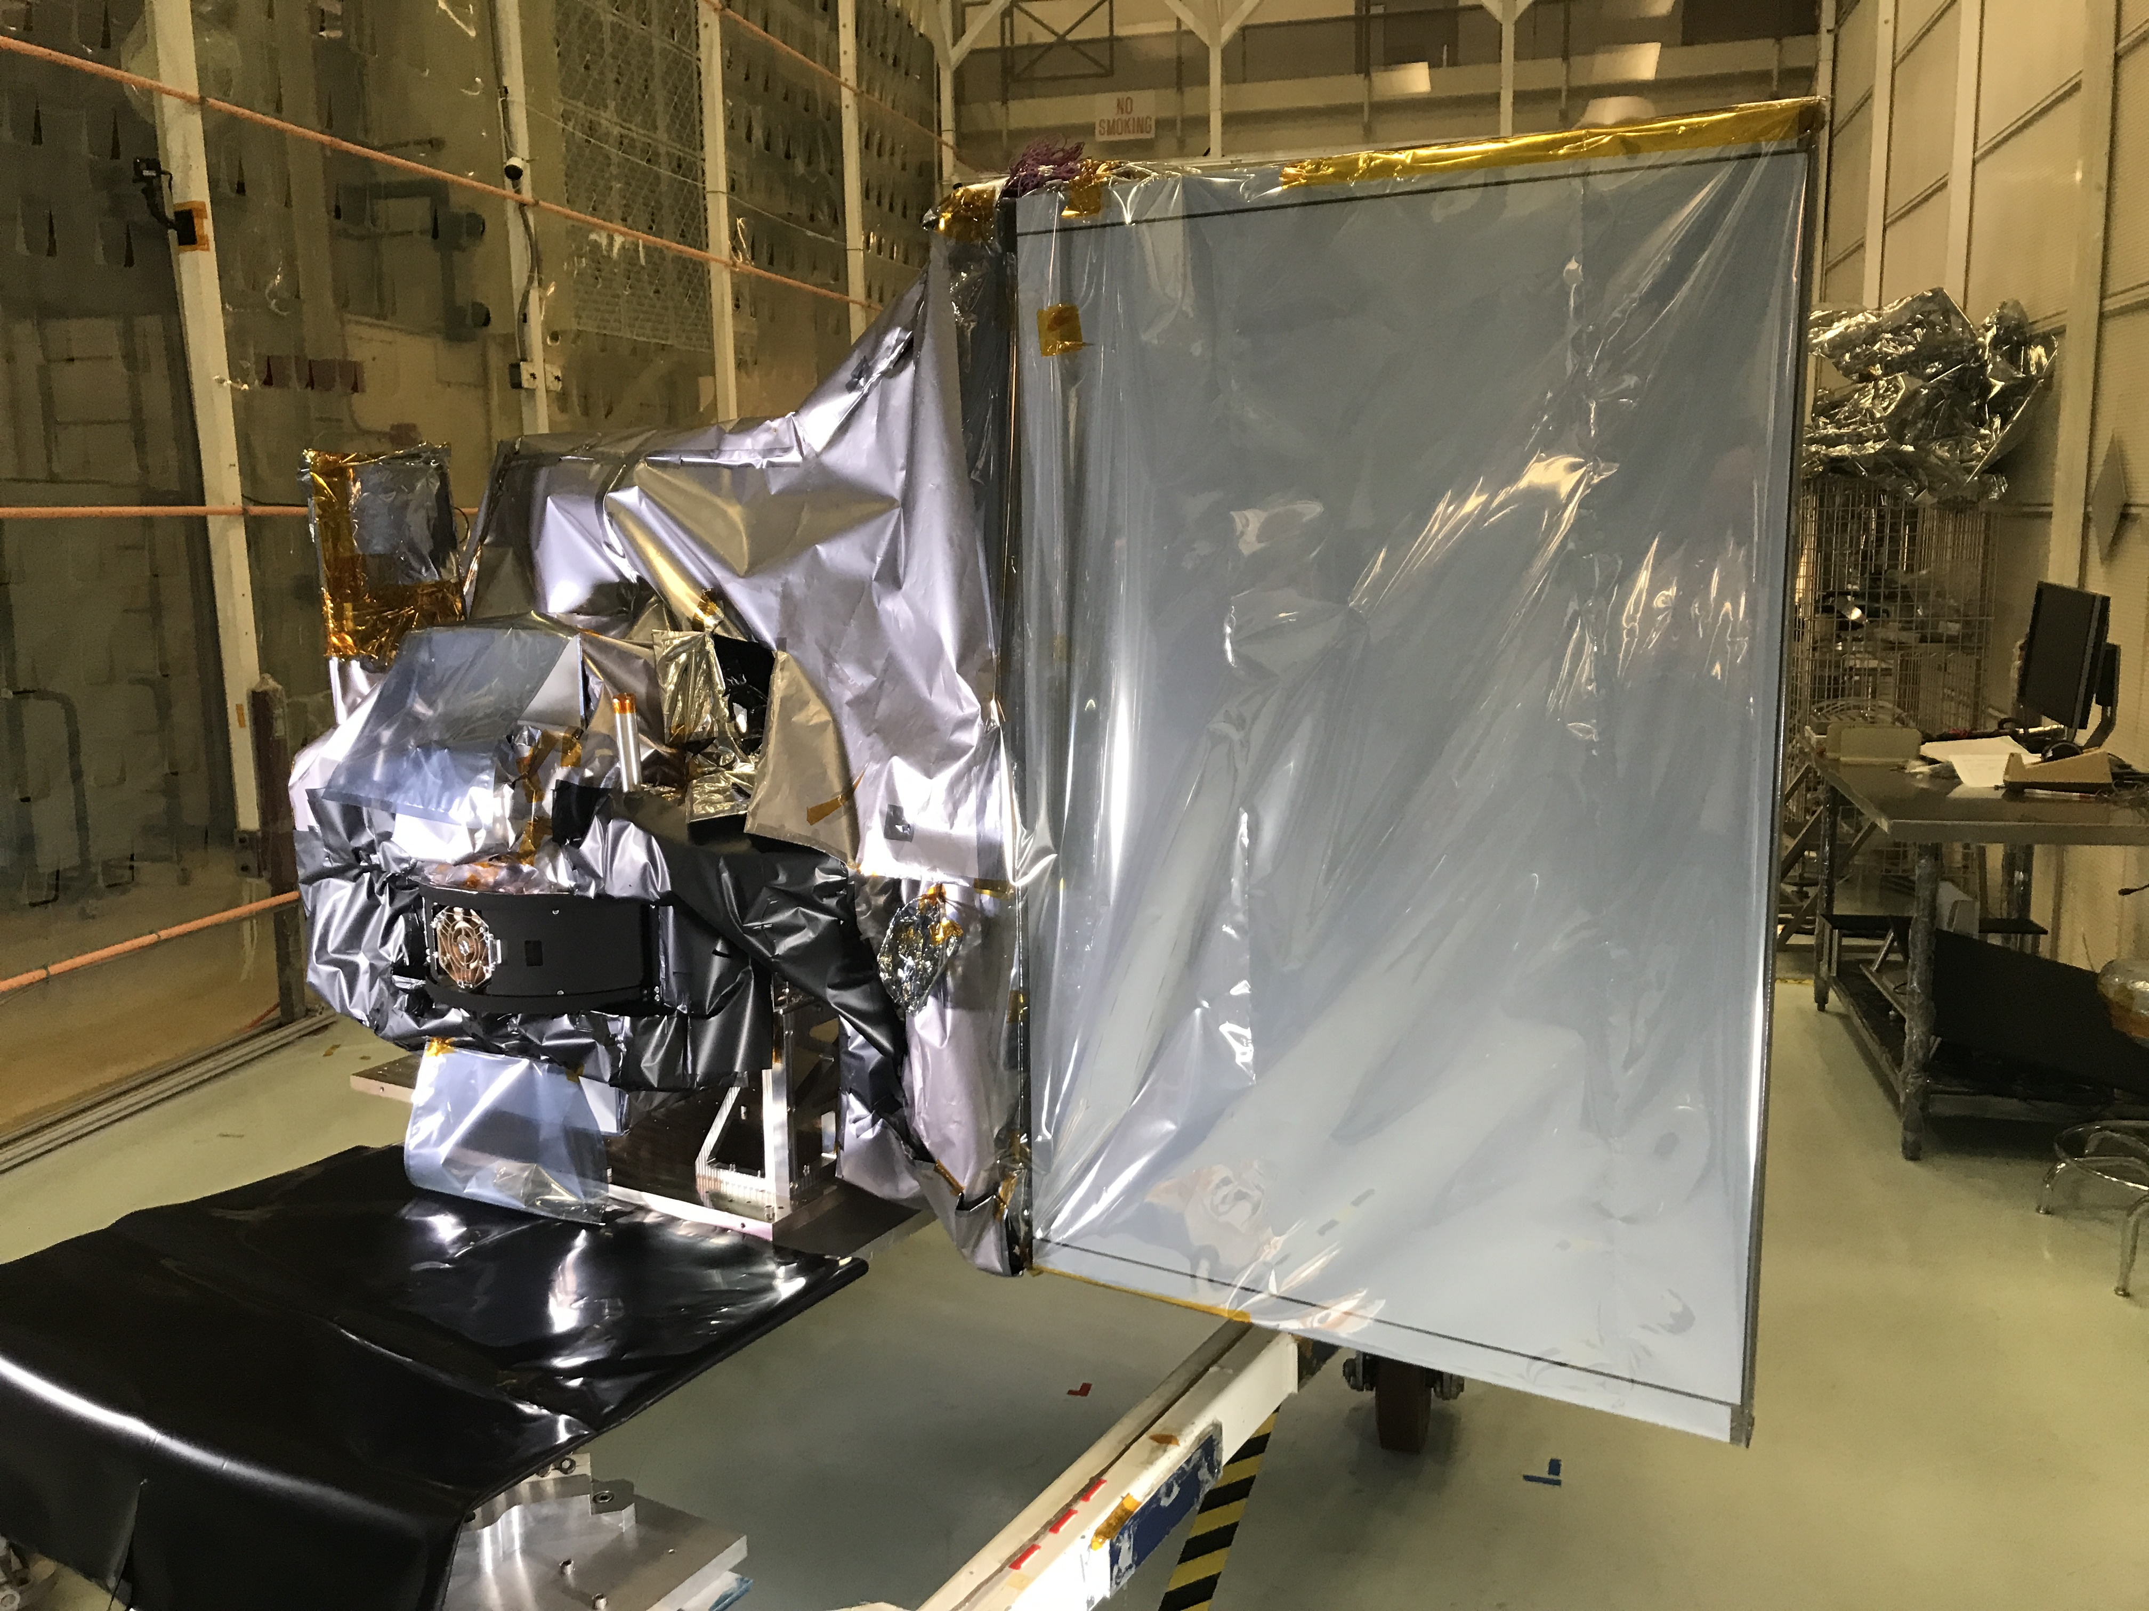
ocean color & the ocean color instrument
ocean color retrievals drive OCI’s design & performance requirements
hyperspectral scanning radiometer
(320) 340 – 890 nm, 5 nm resolution, 2.5 nm steps⁺
plus, 940, 1038, 1250, 1378, 1615, 2130, and 2250 nm
single science pixel to mitigate image striping
1 – 2 day global coverage
ground pixel size of 1 km² at nadir
± 20º fore/aft tilt to avoid Sun glint
twice monthly lunar calibration
daily on-board solar calibration
<0.5% total system error for VIS-NIR
SNRs optimized for ocean color science
simulated top-of-atmosphere data available
+ with 1.25 nm steps in several spectral regions
* developed primarily for mechanical processing assessments

Slide 4
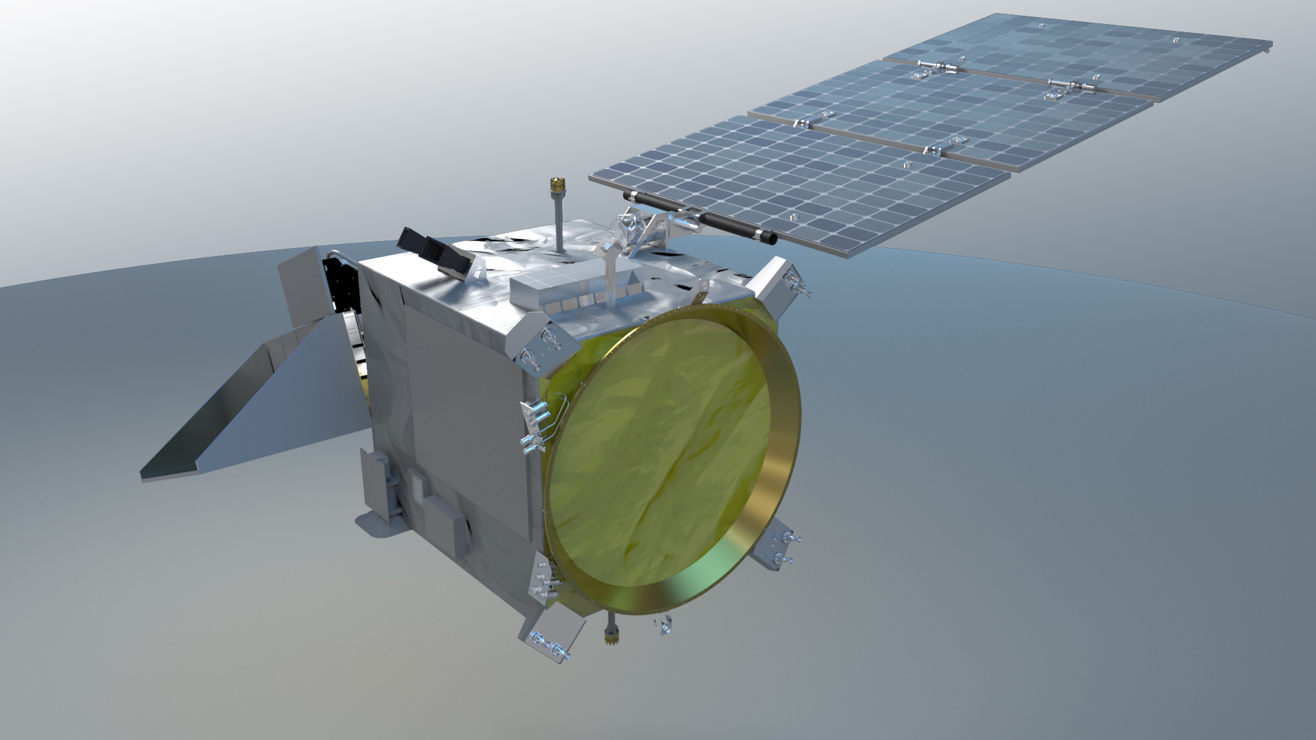
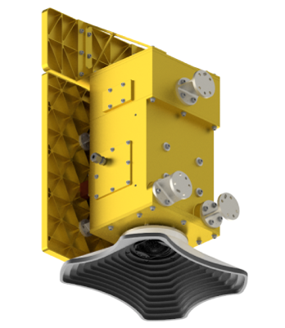
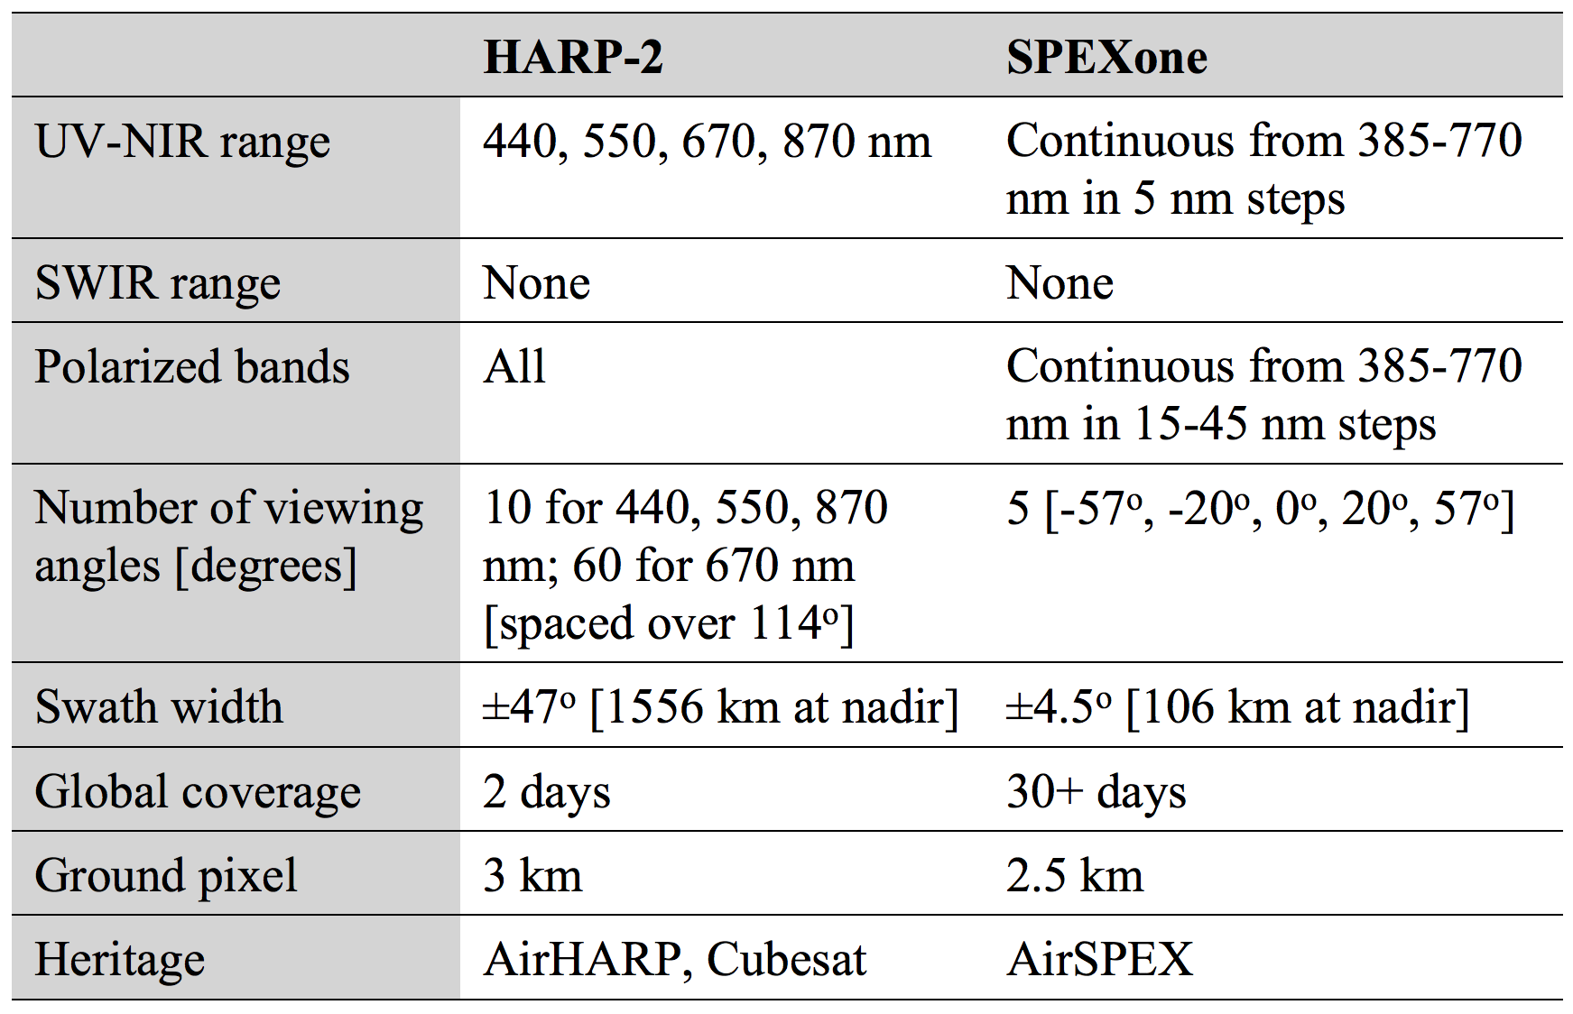
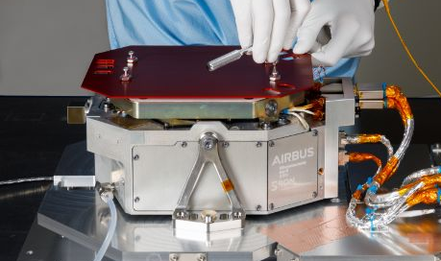
Update
Flight unit rebuild underway at UMBC
Delivery to GSFC for I&T in Fall 2022
UMBC Hyper Angular Rainbow Polarimeter (HARP-2)
Update
SPEXone fully integrated onto the spacecraft in June 2022
16 orbits of simulated data available online
SRON/Airbus
Spectro-polarimeter for Planetary Exploration (SPEXone)

Slide 5
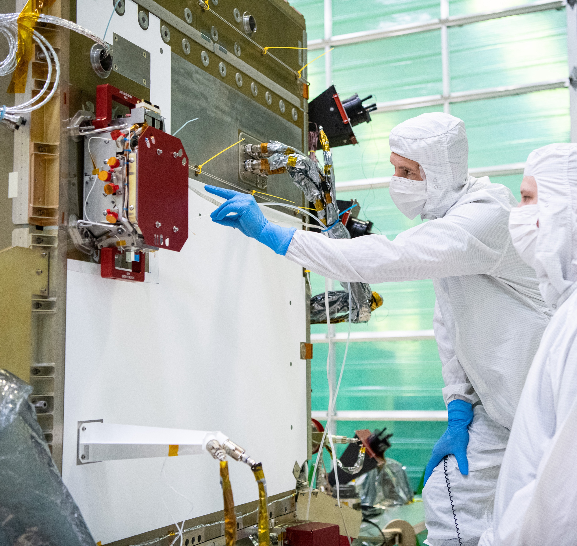
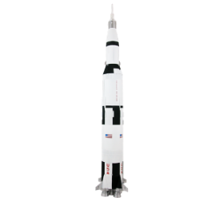
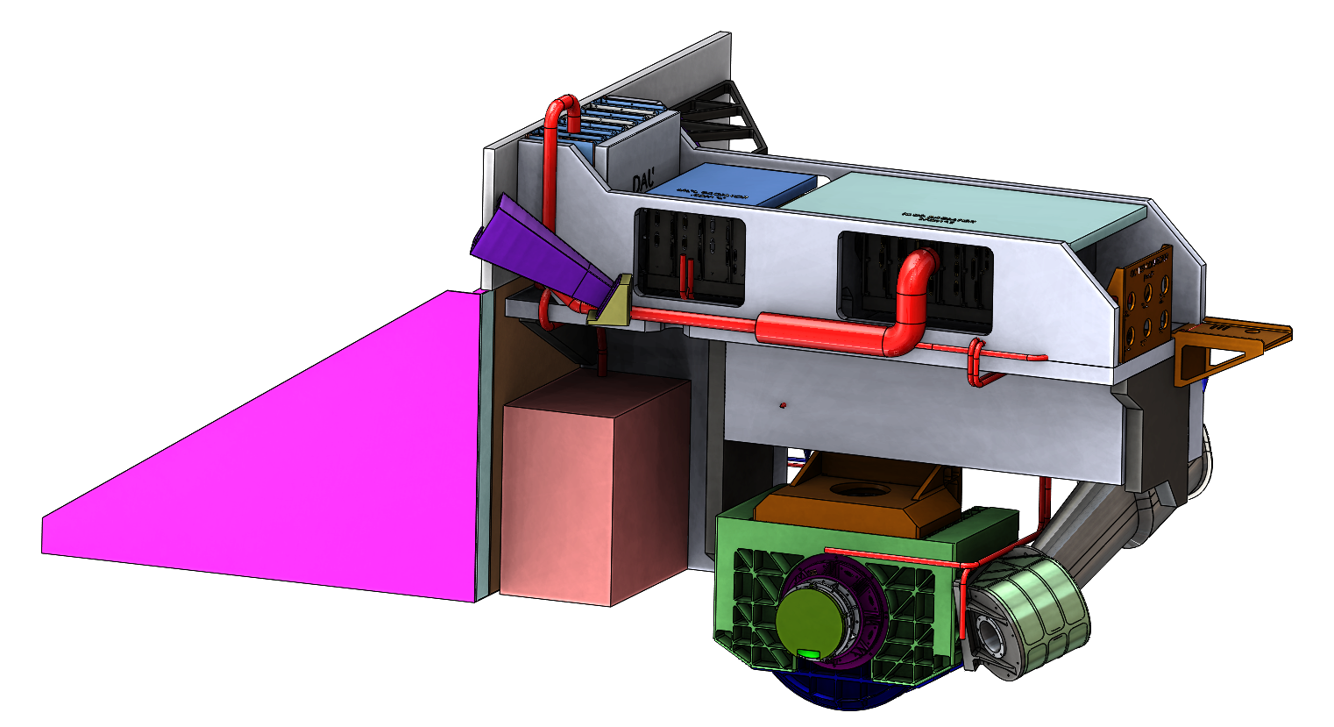
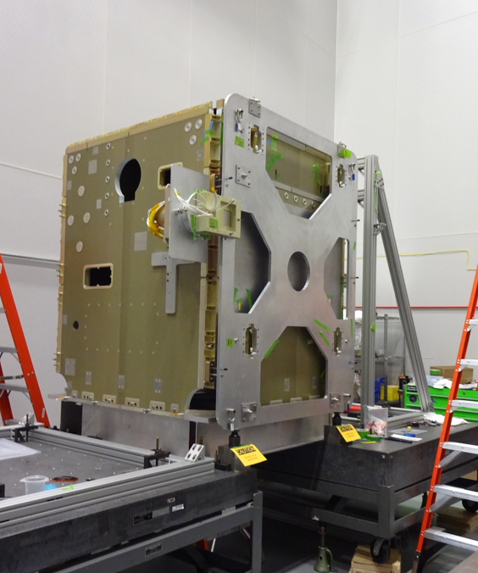
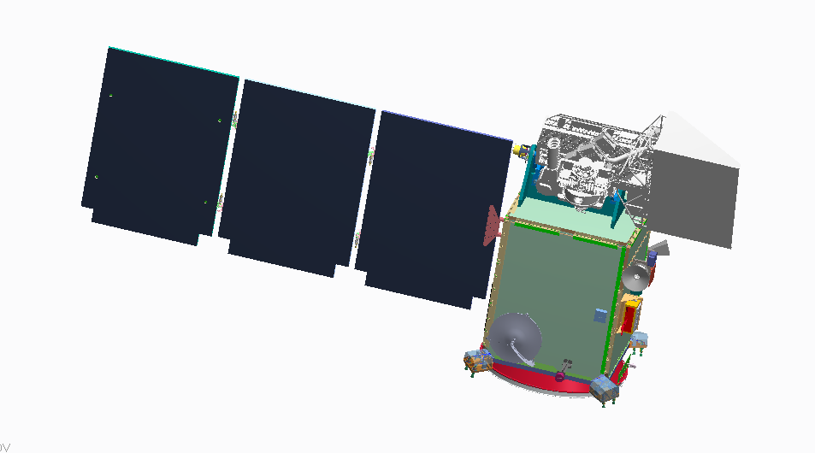
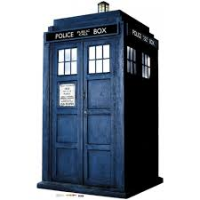
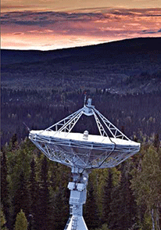
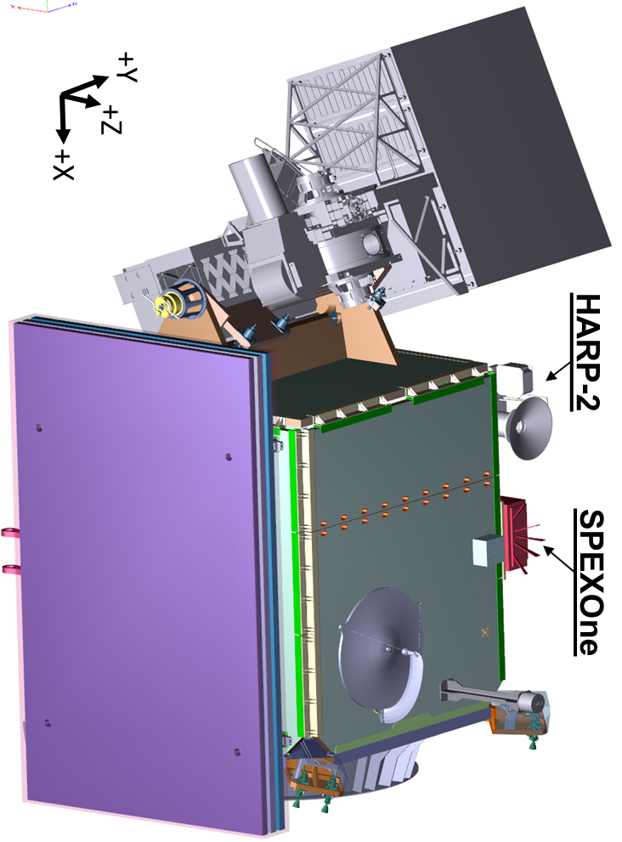
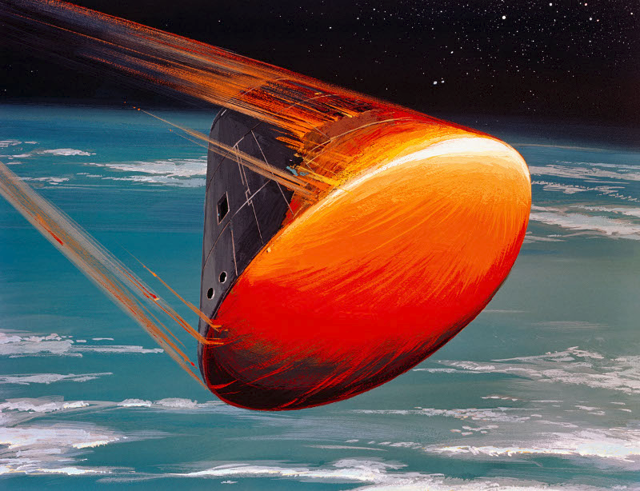

PACE mission update: where are we?
Phase C – final design & fabrication
all mission elements have passed Critical Design Reviews (CDRs)
all mission elements will have System Integration Reviews (SIRs)
engineering test units characterized; flight builds nearing completion
Project & HQ science implementing science capabilities
We are here.
(Launch – 18 mos.)
OCI & Spacecraft
I&T
OCI
CDR
Observatory I&T
Spacecraft
PDR
Grd &
SDS
CDR
Phase A
Grd &
SDS
PDR
OCI
PDR
Mission
PDR
Mission
CDR & LV
Award
Launch Readiness Date (LRD) Jan. 9, 2024
Decommission
CY16
CY17
CY18
CY19
CY20
CY21
CY22
CY23
CY24
CY25
CY26
CY27
Phase A
Phase B
Phase C
Phase D
Phase E
Phase F

Slide 6
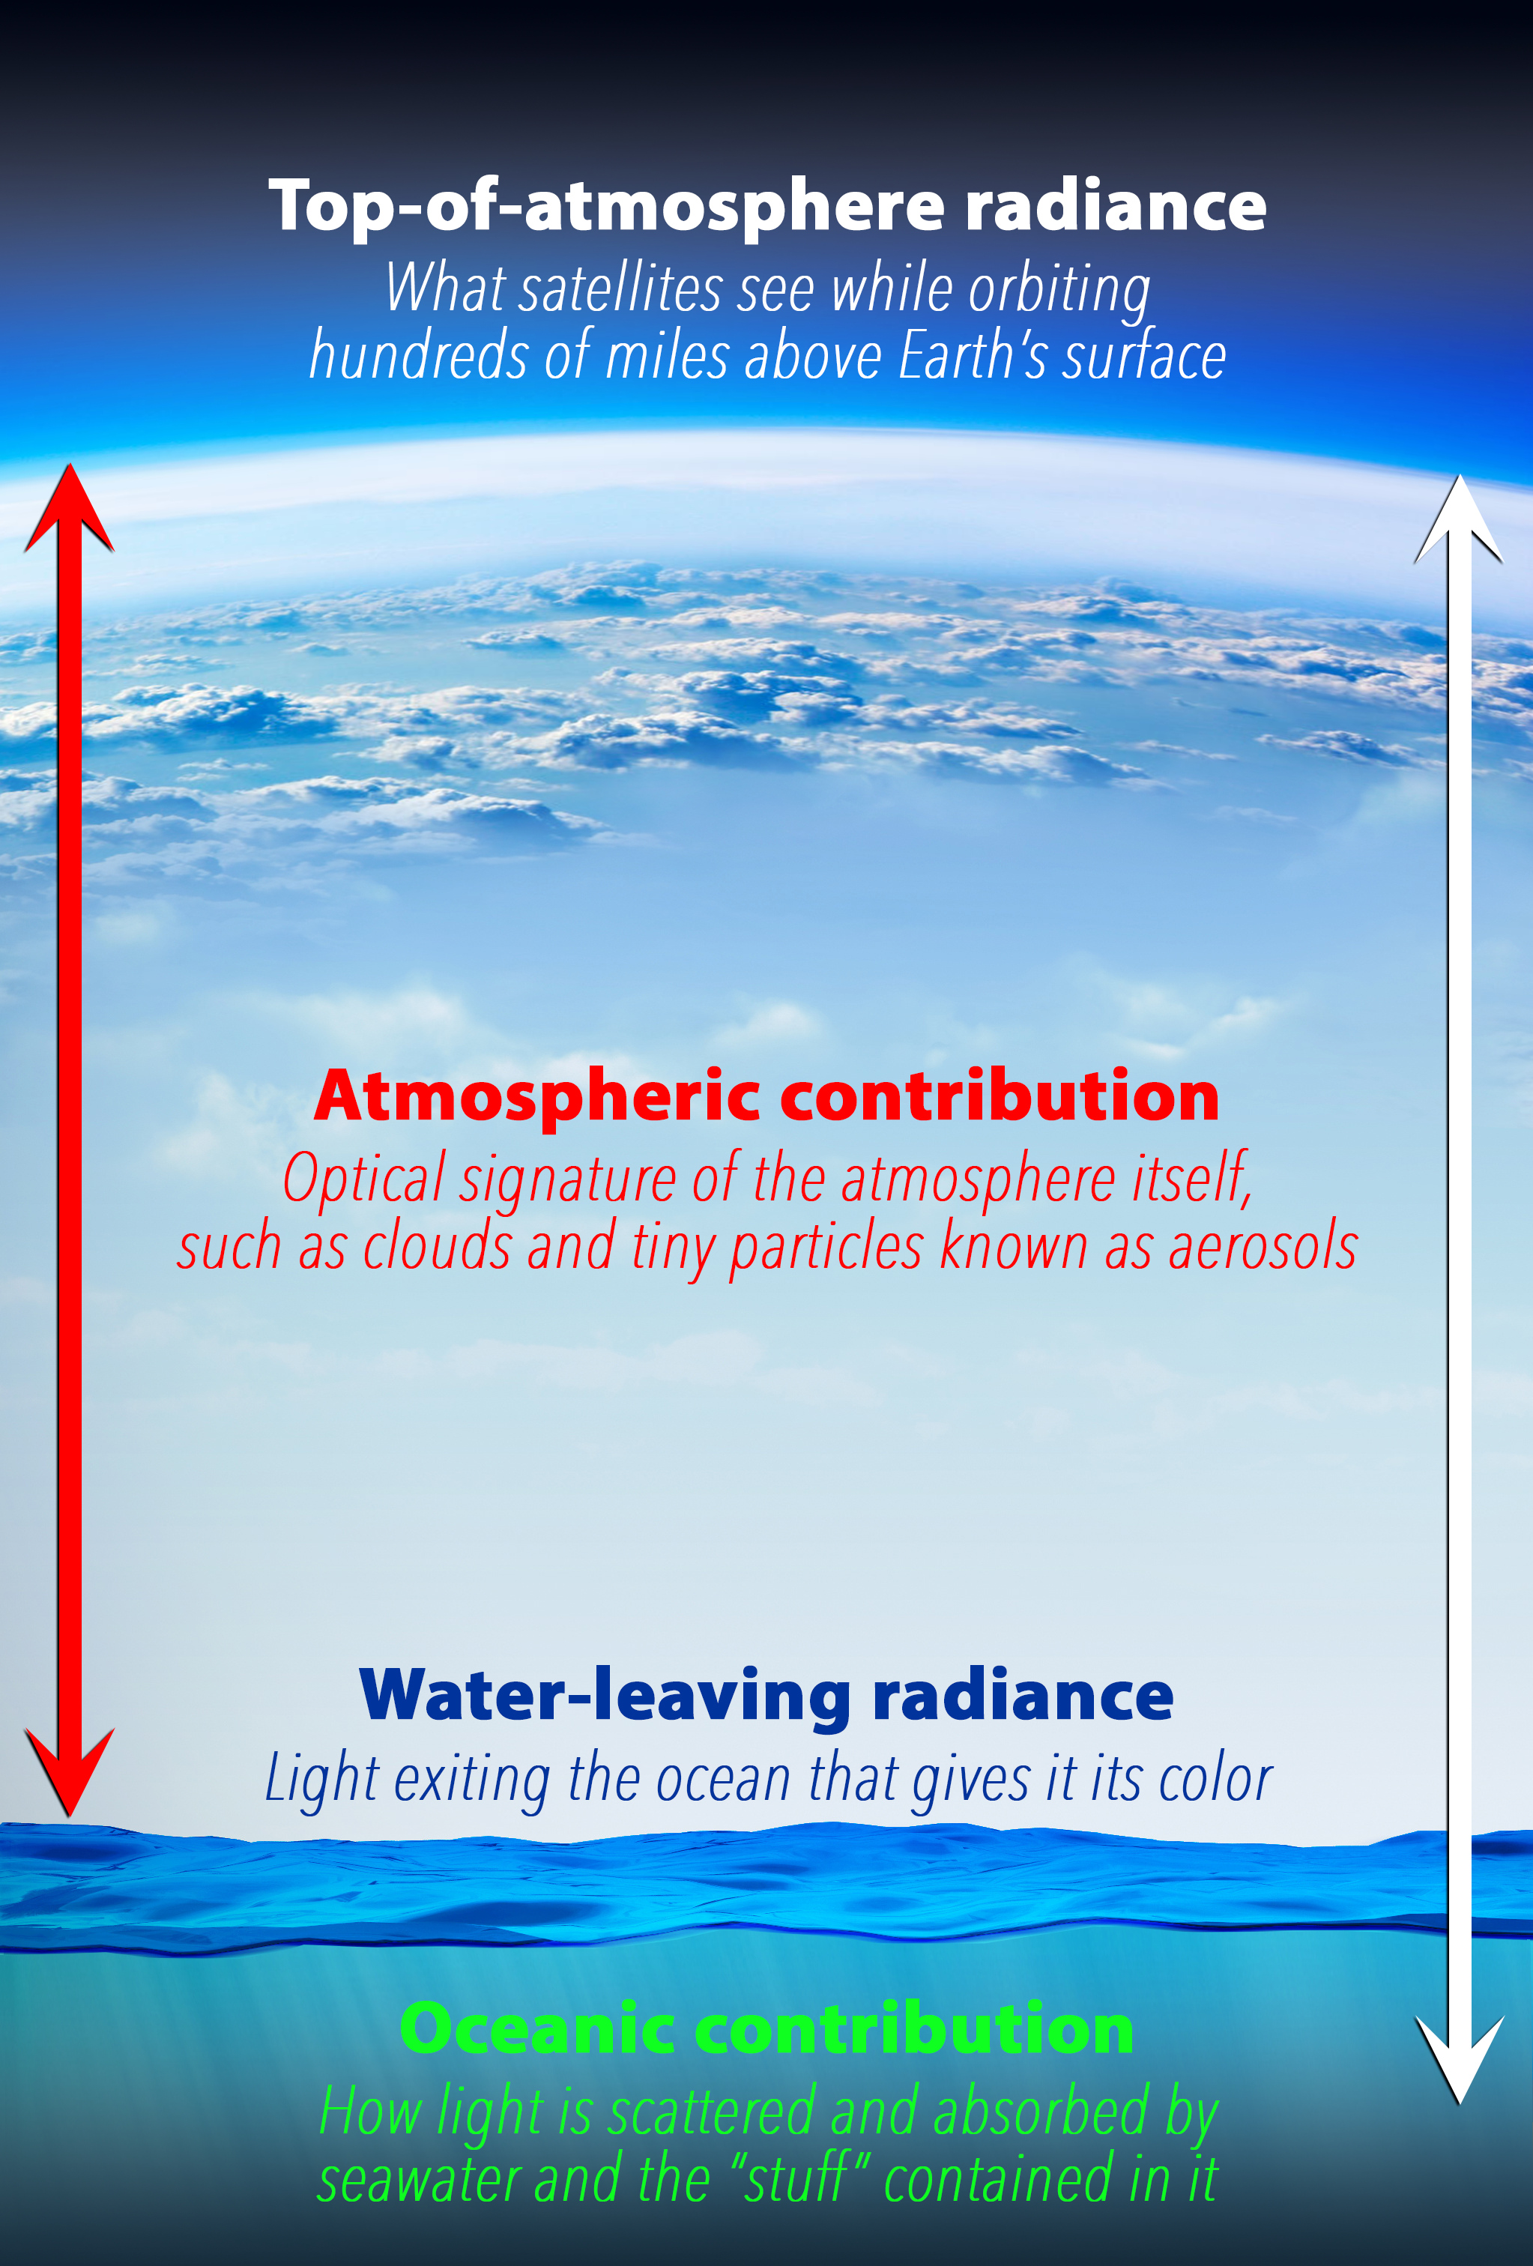
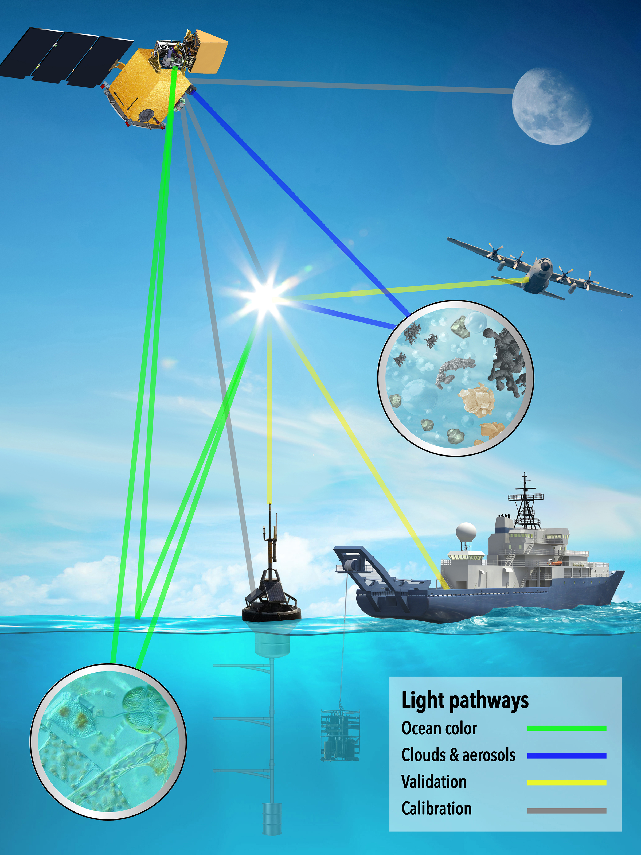
science data products (1)
concentrations of brown/black carbon
cloud optical depth
cloud height
cloud thickness
aerosol absorption aerosol optical depth
aerosol size distributions
aerosol heights & layers
cloud phase (liquid/ice)
droplet size distributions
ice crystal shapes
ocean reflectance
whitecap fraction
angular light distributions
oil slick detection

Slide 7

science data products (2)
light penetration
angular light distributions
index of refraction
photosynthetic pigments
fluorescence
plankton communities
light transmission
absorption properties
scattering properties
PAR: photosynthetically available radiation
concentrations of particulate carbon & suspended matter
bathymetry classifications
land albedo
vegetation indices

Slide 8
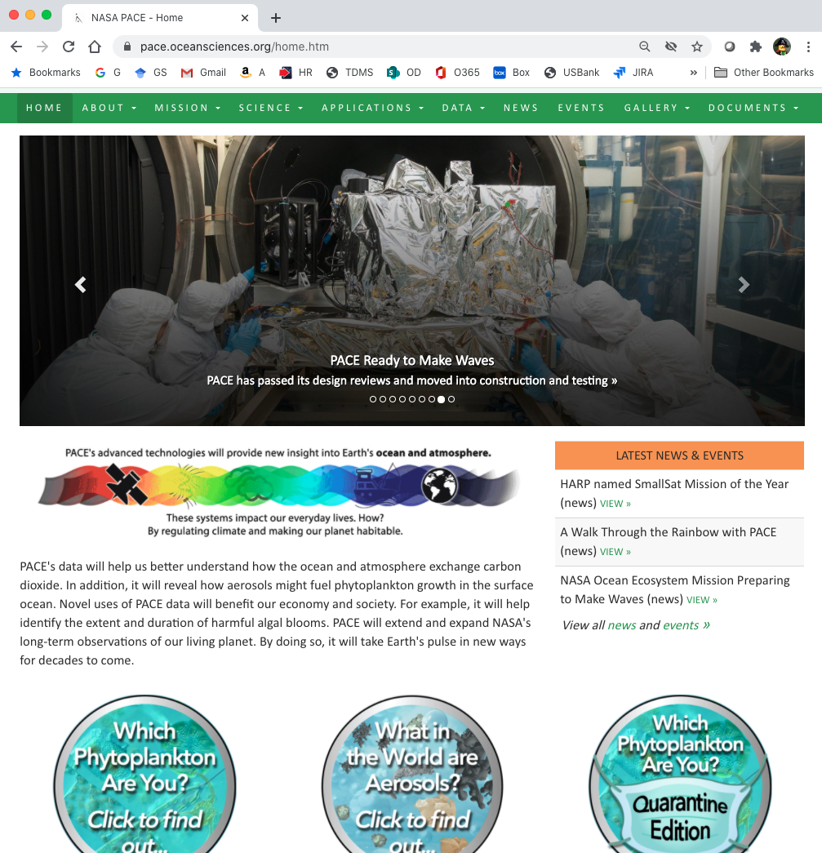


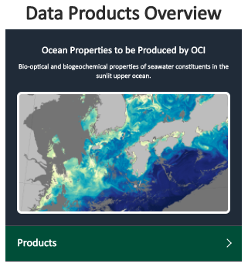
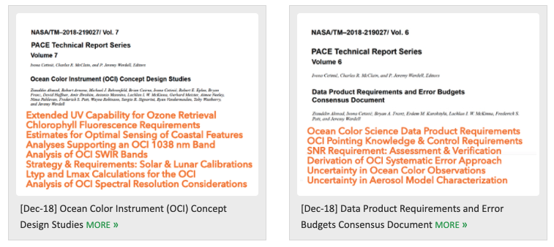



Useful info
resources &
useful info
data product descriptions + access to simulated data &
characterizations
PACE technical memos & other documents
https://pace.gsfc.nasa.gov
@NASAOcean

Slide 9
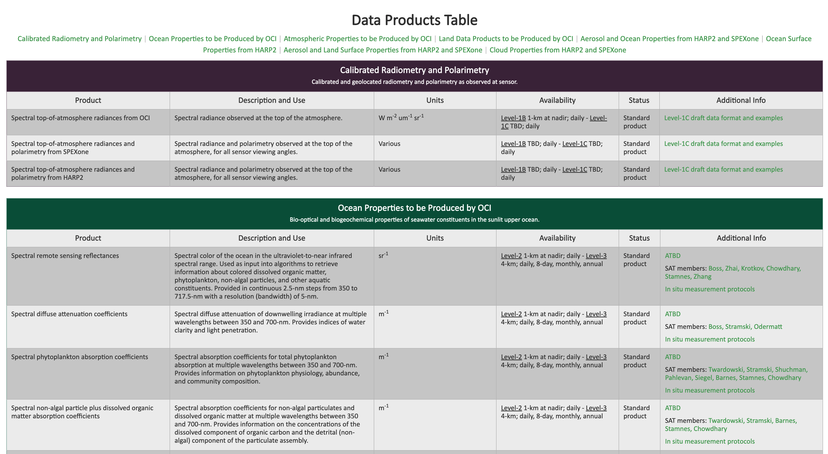

Slide 10





















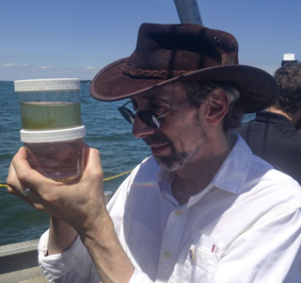

PACE Early Adopters (PACE’s Application Developers)
Aquaculture/Fisheries
Marine mammals & Climate
Mapping HABs Risk
Waterborne Pathogens
Air-sea exchange
Oil Spills
Aquaculture/Fisheries
Aerosols& Human Health
HABs Detection
Data Integration
Water Clarity-Waters Resources
Water Clarity-Water Resources
Wetland Ecosystems
Food Security
Mobile Apps & Decision Making
Data management
Air Quality & Human Health
HABs Monitoring
HABs Monitoring
Water Clarity & Ecosystem Health
Global Carbon Budget
Air Quality & Climate
HABs Monitoring
Data Integration

Slide 11
PACE Early Adopter Program: Sector & Applied Thematic Areas

Slide 12
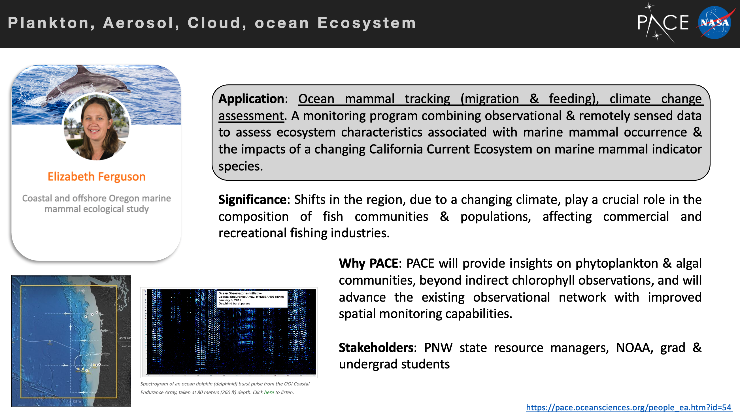

Slide 13
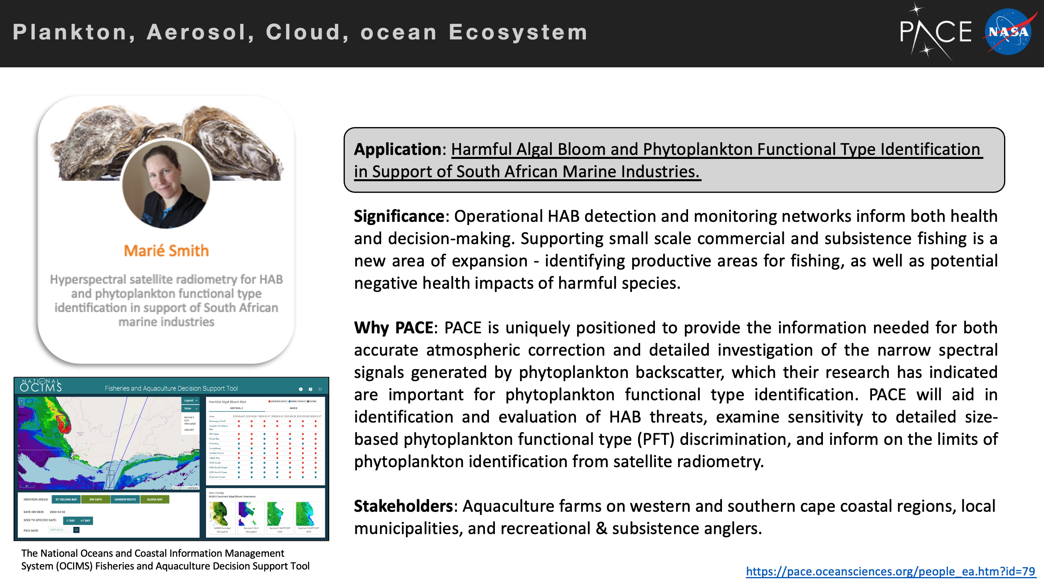

Slide 14
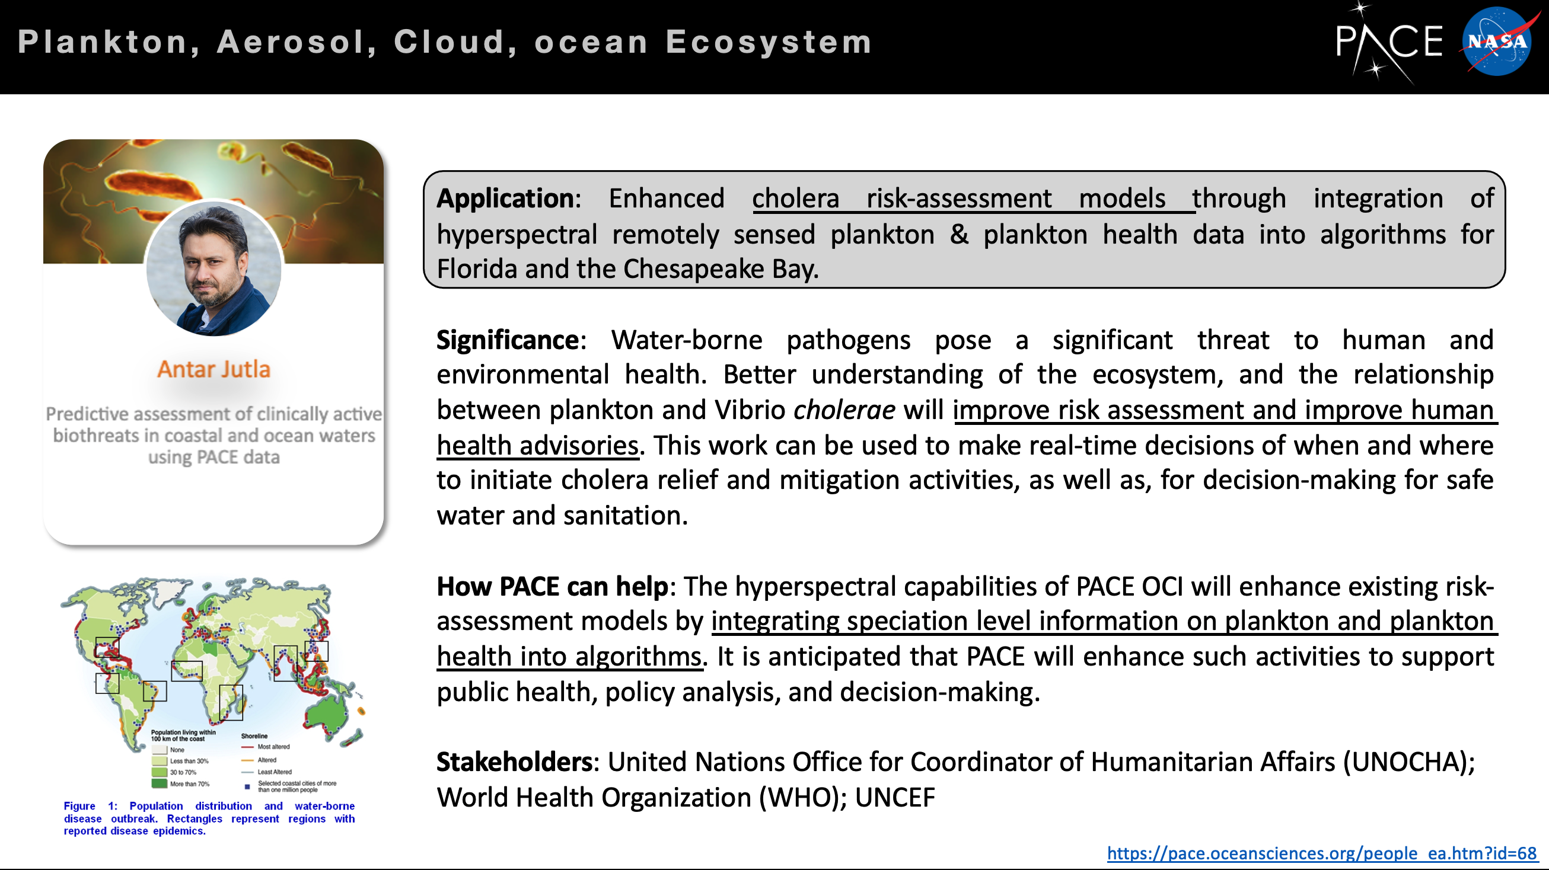

Slide 15
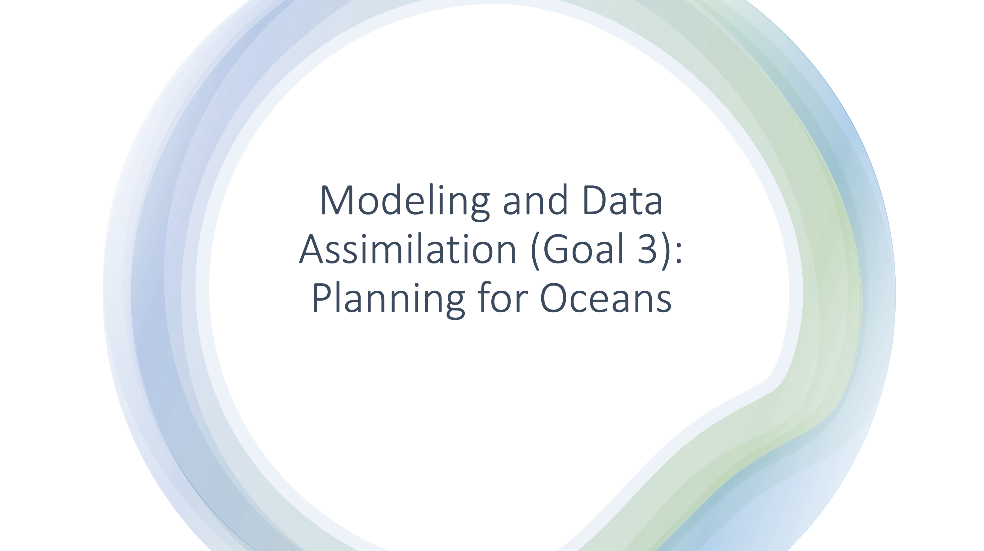
( activity begun as an outcome of the NOAA/NASA Strategic Meeting on May 29, 2020 )

Slide 16
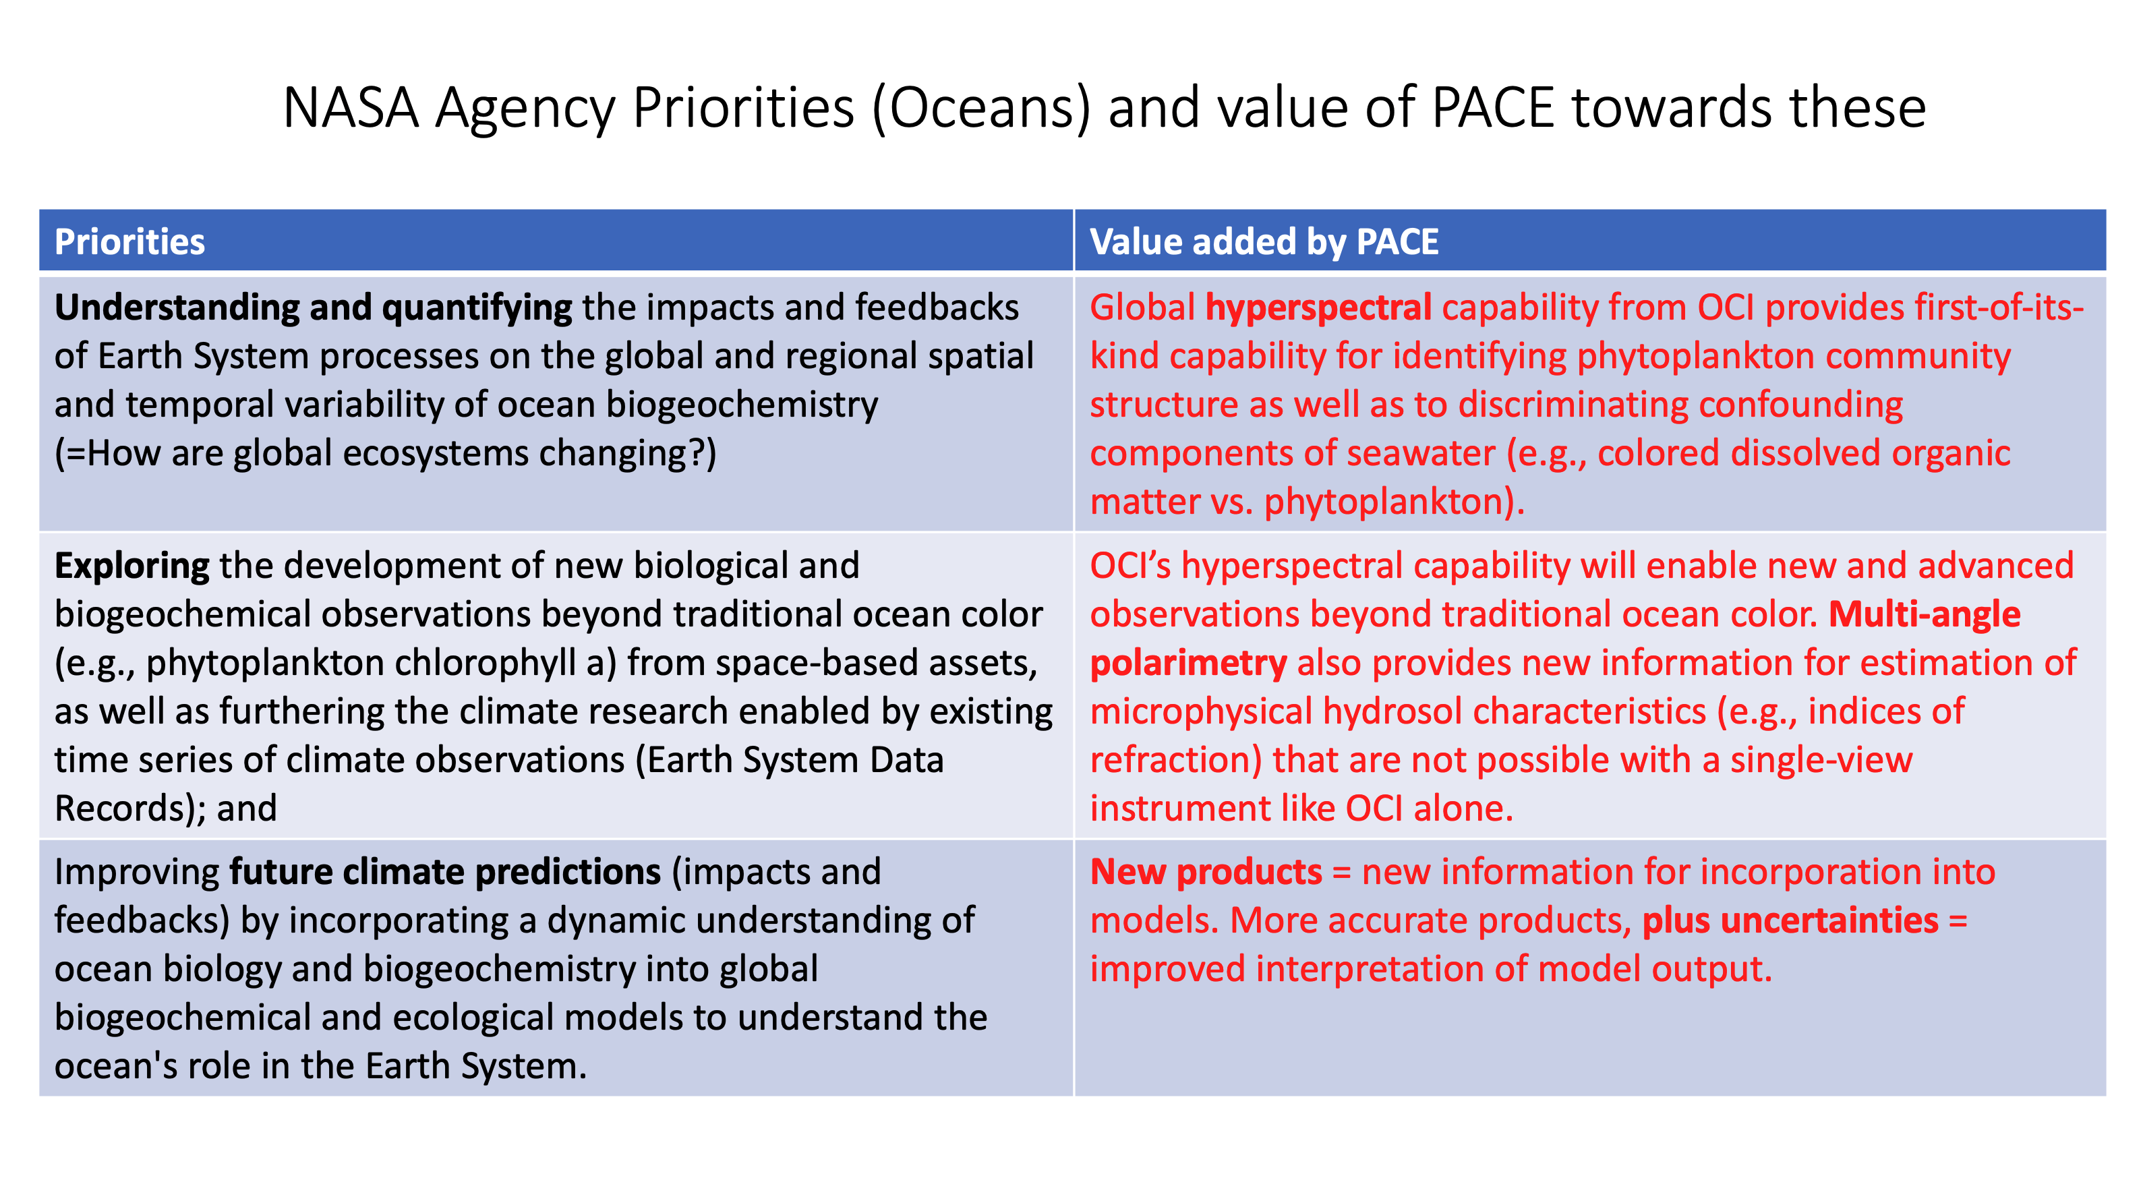

Slide 17
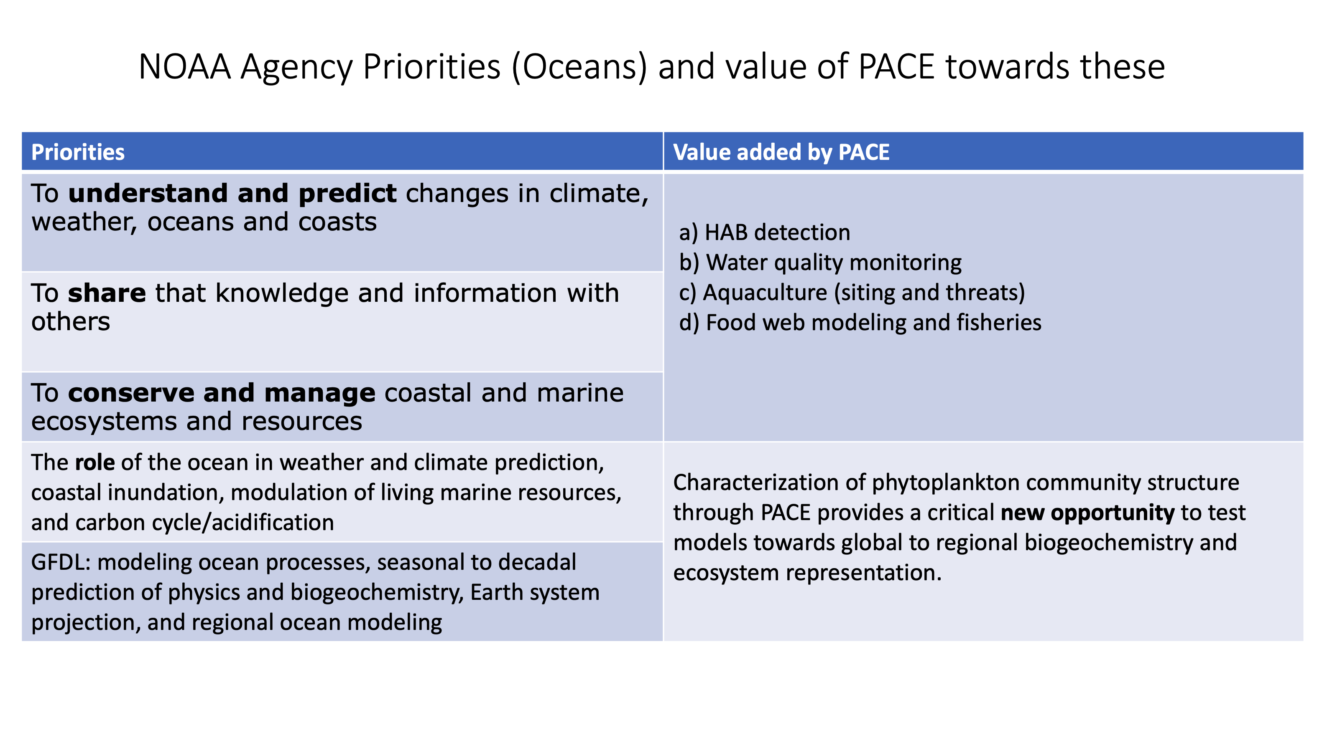

Slide 18
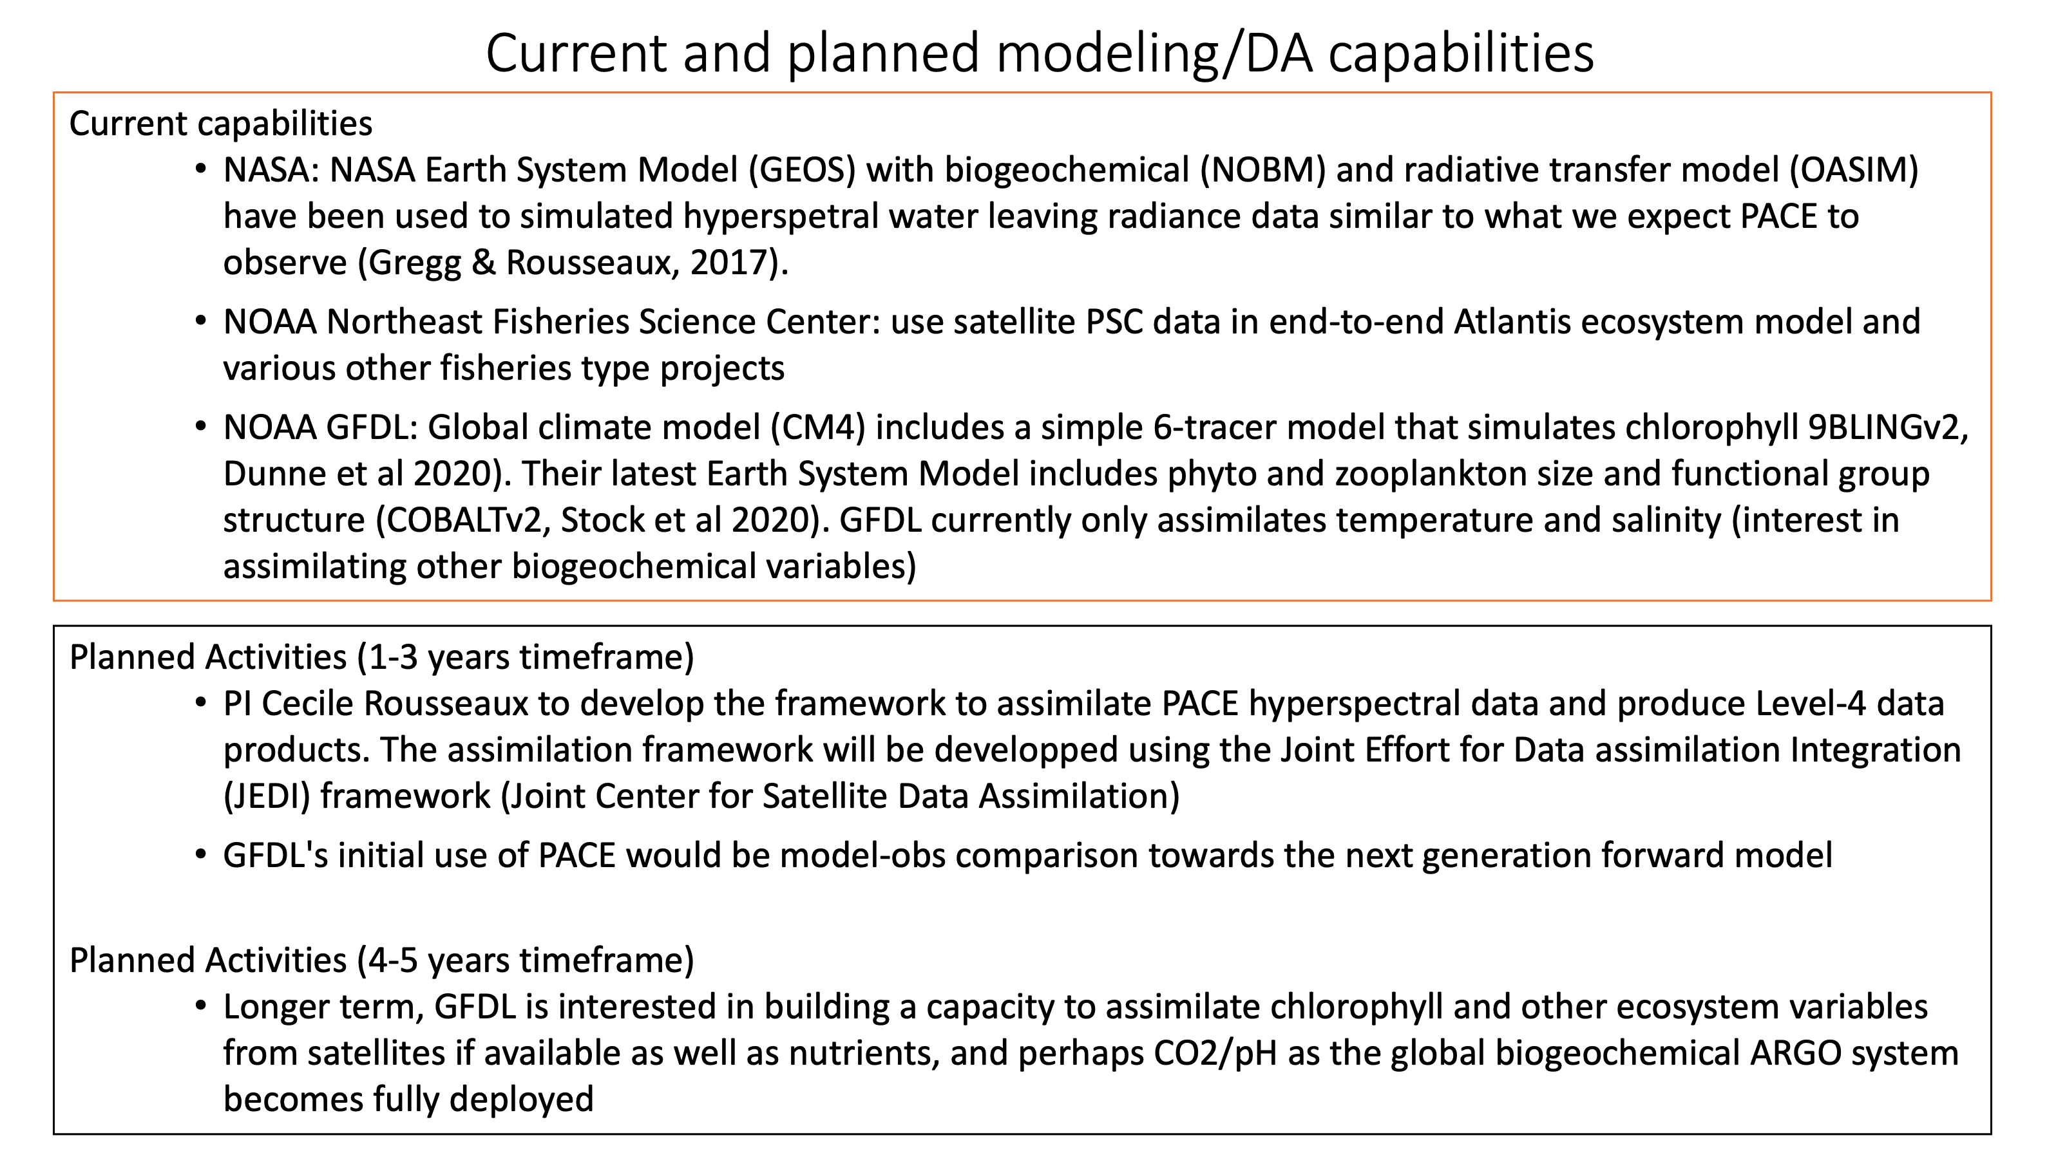

Slide 19
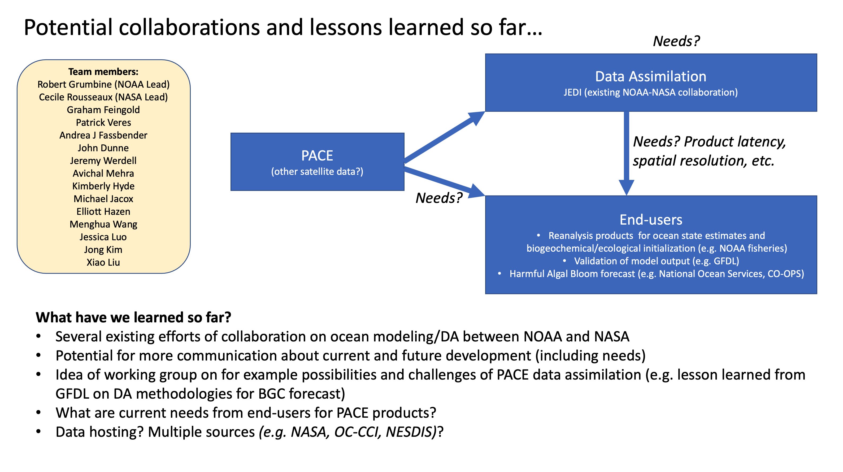

Slide 20
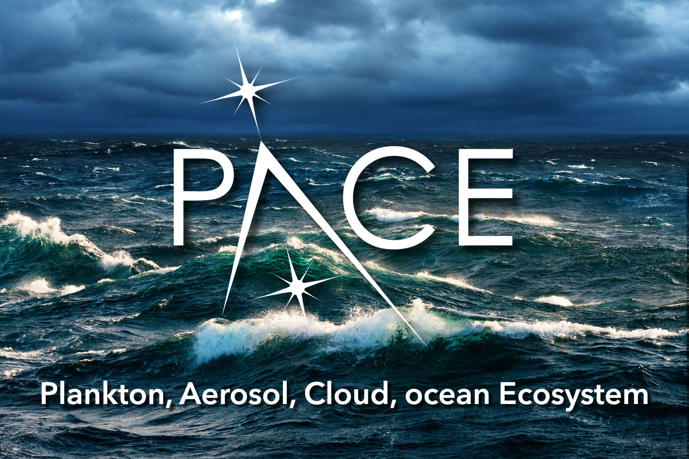

Slide 21
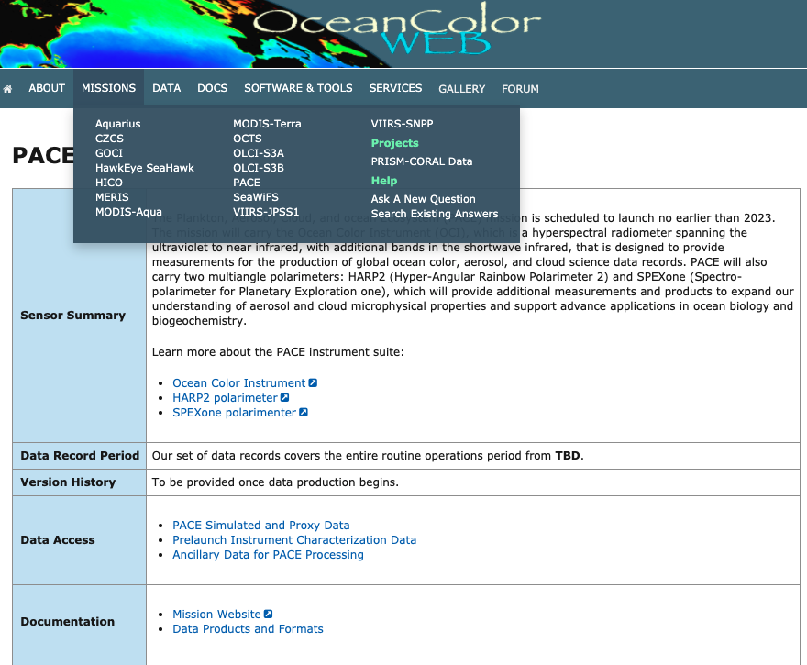
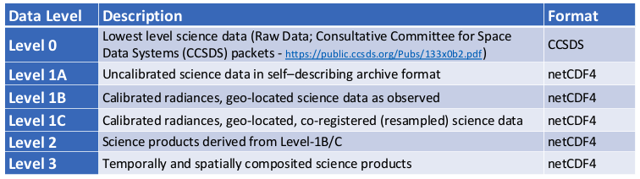
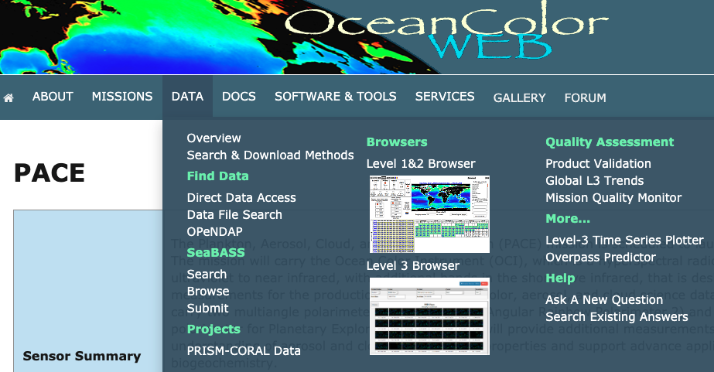
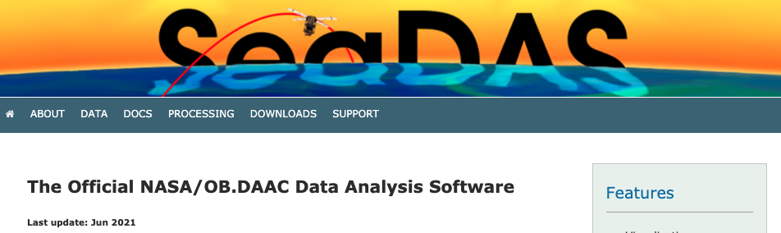
PACE data availability, formats & software
https://oceancolor.gsfc.nasa.gov
https://seadas.gsfc.nasa.gov

