Slide 1
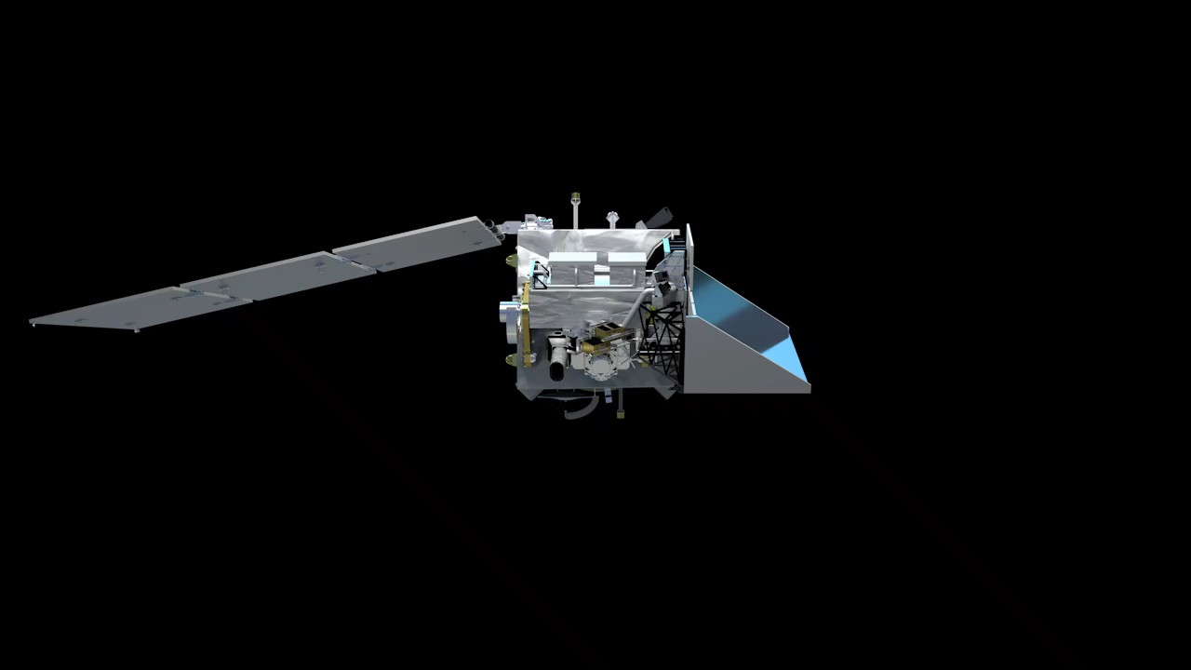
NASA Plankton, Aerosol, Cloud, ocean Ecosystem (PACE) mission
PACE will extend key systematic ocean color, aerosol, & cloud climate data records.
PACE will reveal the diversity of organisms fueling marine food webs & how ecosystems respond to change.
Looking at the ocean, clouds, and aerosols together will improve knowledge of the roles each plays in our planet.
Key characteristics:
Early 2024 launch
676.5 km altitude
Polar, ascending, Sun synchronous orbit; 98º inclination
13:00 local Equatorial crossing
3-yr design life; 10-yr propellant
Managed by NASA Goddard Space Flight Center
2 contributed multi-angle polarimeters:
HARP-2 (UMBC)
  4 visible-NIR bands
  Wide swath
  Hyper-angular
  2.5-km at nadir
SPEXone (SRON/Airbus)
    Hyperspectral UV-NIR
    Narrow swath
    5 angles
    3 km at nadir
The PACE Ocean Color Instrument (OCI):
340-890 nm @ 5 nm resolution in 2.5 nm spectral steps
Plus 940, 1038, 1250, 1378, 1615, 2130, & 2250 nm
2-day global coverage; 1-km² @ nadir
±20º fore/aft tilt to avoid Sun glint
https://pace.gsfc.nasa.gov
@NASAOcean

Slide 2
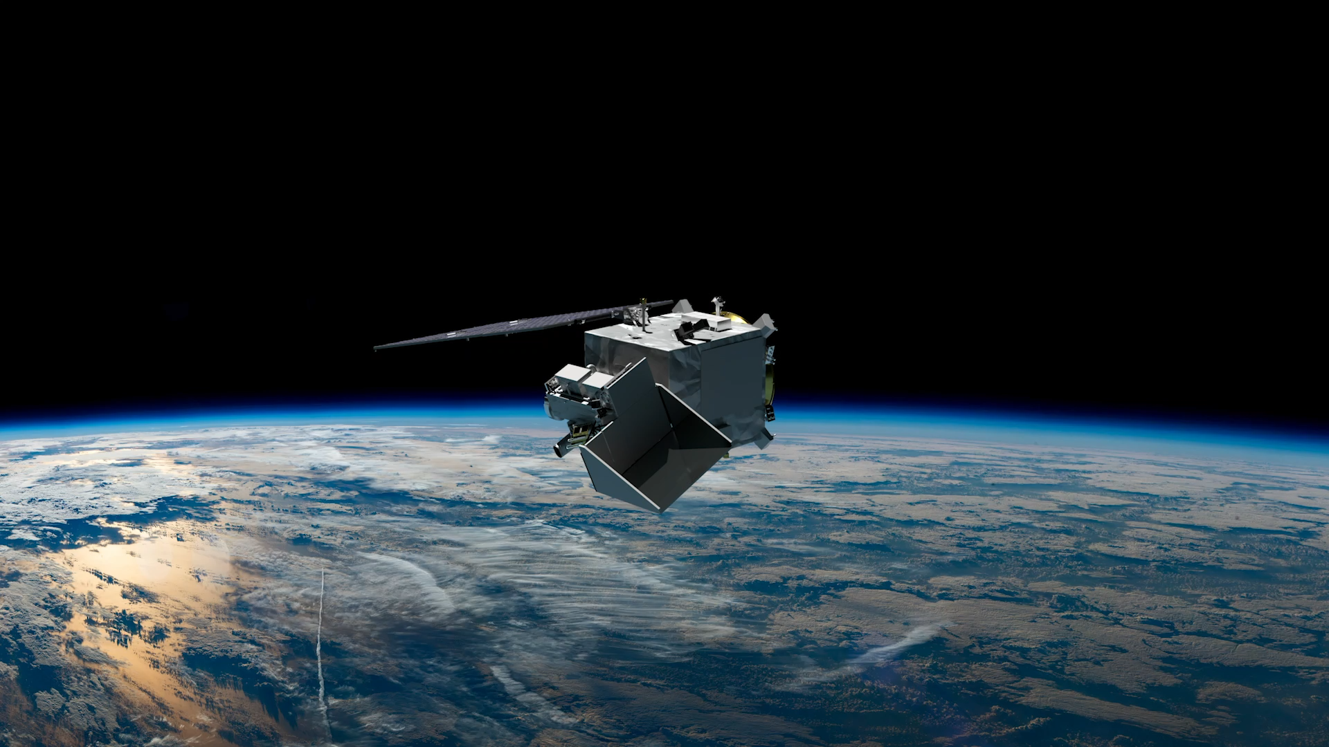
NASA Plankton, Aerosol, Cloud, ocean Ecosystem (PACE) mission
PACE will extend key systematic ocean color, aerosol, & cloud climate data records.
PACE will reveal the diversity of organisms fueling marine food webs & how ecosystems respond to change.
Looking at the ocean, clouds, and aerosols together will improve knowledge of the roles each plays in our planet.
Key characteristics:
Early 2024 launch
676.5 km altitude
Polar, ascending, Sun synchronous orbit; 98º inclination
13:00 local Equatorial crossing
3-yr design life; 10-yr propellant
Managed by NASA Goddard Space Flight Center
2 contributed multi-angle polarimeters:
HARP-2 (UMBC)
  4 visible-NIR bands
  Wide swath
  Hyper-angular
  2.5-km at nadir
SPEXone (SRON/Airbus)
    Hyperspectral UV-NIR
    Narrow swath
    5 angles
    3 km at nadir
The PACE Ocean Color Instrument (OCI):
340-890 nm @ 5 nm resolution in 2.5 nm spectral steps
Plus 940, 1038, 1250, 1378, 1615, 2130, & 2250 nm
2-day global coverage; 1-km² @ nadir
±20º fore/aft tilt to avoid Sun glint
https://pace.gsfc.nasa.gov
@NASAOcean

Slide 3
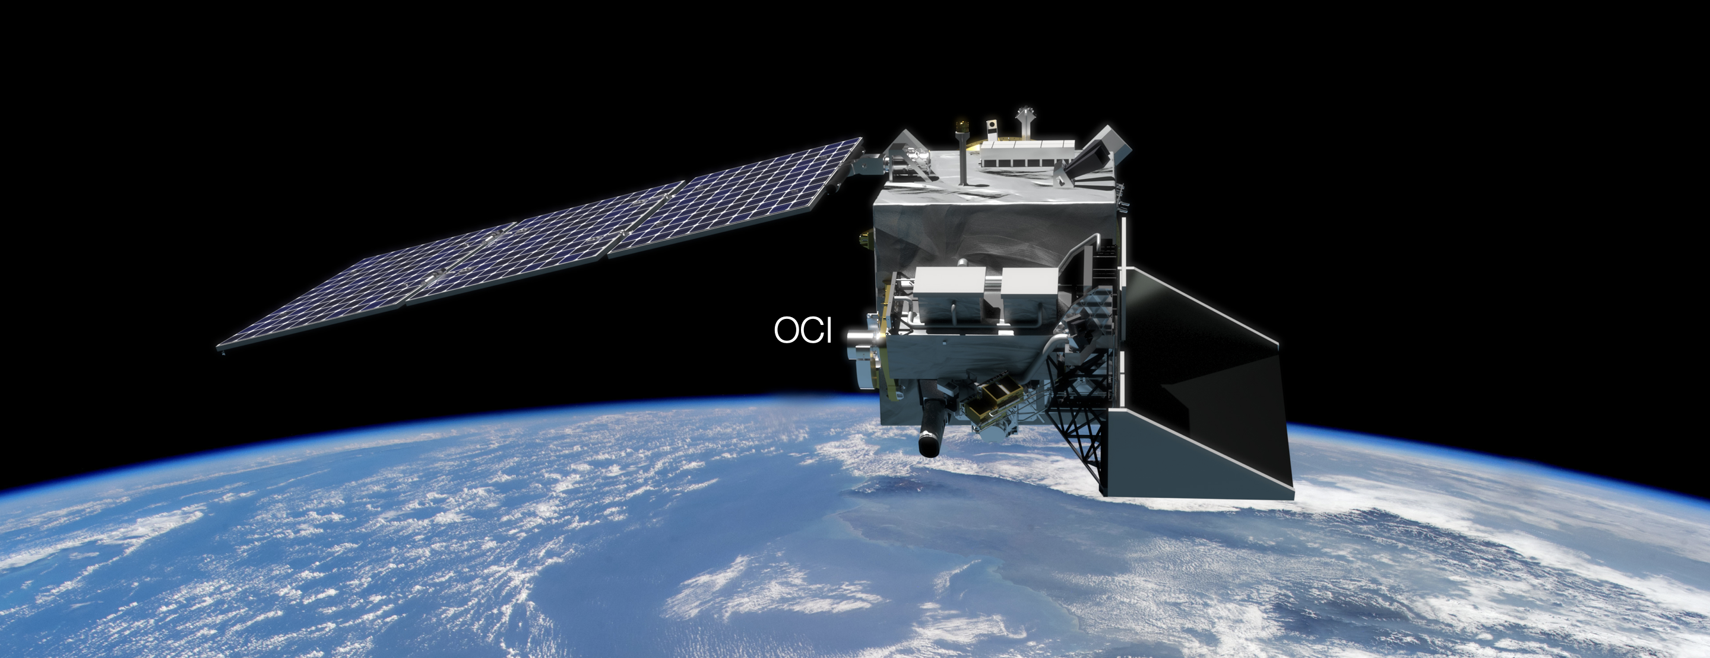
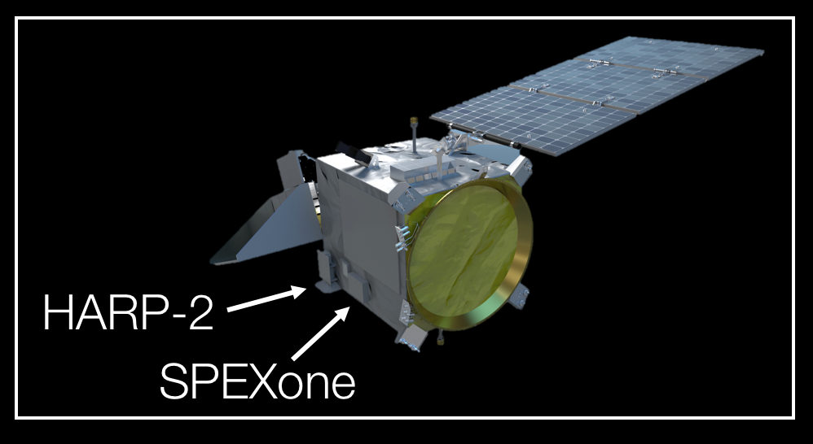
NASA Plankton, Aerosol, Cloud, ocean Ecosystem (PACE) mission
PACE will extend key systematic ocean color, aerosol, & cloud climate data records.
PACE will reveal the diversity of organisms fueling marine food webs & how ecosystems respond to change.
Looking at the ocean, clouds, and aerosols together will improve knowledge of the roles each plays in our planet.
Key characteristics:
Late-2023 launch
676.5 km altitude
Polar, ascending, Sun synchronous orbit; 98º inclination
13:00 local Equatorial crossing
3-yr design life; 10-yr propellant
Managed by NASA Goddard Space Flight Center
2 contributed multi-angle polarimeters:
HARP-2 (UMBC)
  4 visible-NIR bands
  Wide swath
  Hyper-angular
  2.5-km at nadir
SPEXone (SRON/Airbus)
    Hyperspectral UV-NIR
    Narrow swath
    5 angles
    3 km at nadir
The PACE Ocean Color Instrument (OCI):
340-890 nm @ 5 nm resolution in 2.5 nm spectral steps
Plus 940, 1038, 1250, 1378, 1615, 2130, & 2250 nm
2-day global coverage; 1-km² @ nadir
±20º fore/aft tilt to avoid Sun glint
https://pace.gsfc.nasa.gov
@NASAOcean

