Slide 1
S-NPP VIIRS Thermal Emissive Bands On-Orbit Performance and Calibration
Jeff McIntire, Chengbo Sun, Sergey Gusev, Vincent Chiang, and Jack Xiong
VCST, NASA/GSFC
Acknowledgements: VIIRS SDR Team Members
VCST Members
June 6, 2016
Notes:
<number>
<number>
<number>

Slide 2
Outline
  TEB Calibration
  On-orbit Performance
    BB performance
    Detector short-term stability and long-term response (F-factors)
    Detector noise characterization (NEdT)
    Trending during WUCD
    Uncertainty Estimates and Potential Improvements
      Improving M13LG calibration
      Average vs per-scan F-factor
    Conclusions
<number>
Notes:
<number>
<number>
<number>

Slide 3
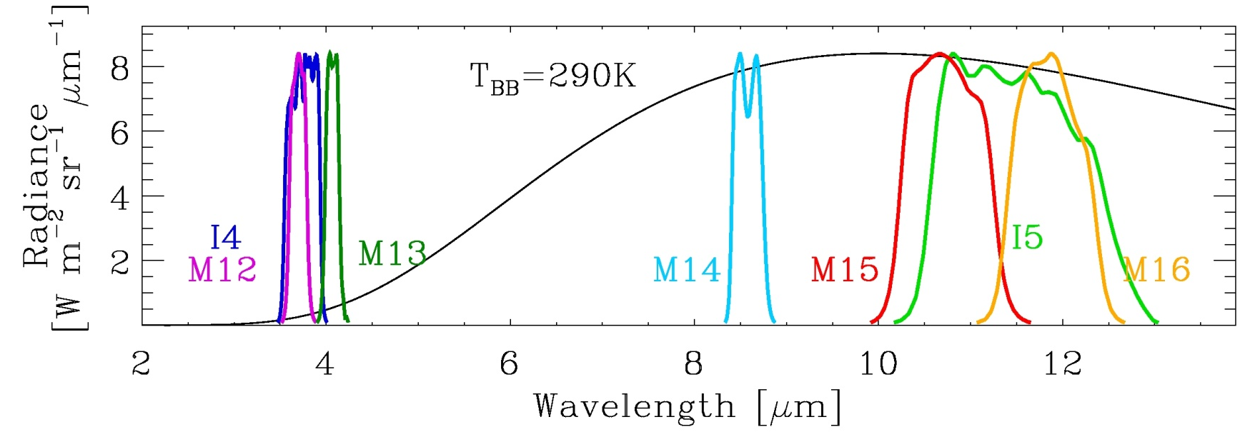
Thermal Emissive Bands (TEB)
5 M-bands and 2 I-bands, covering wavelengths from 3.7 to 12 μm
Band | I4 | I5 | M12 | M13 | M14 | M15 | M16
Wavelength [µm] | 3.74 | 11.45 | 3.70 | 4.05 | 8.55 | 10.76 | 12.01
Calibrated using an on-board blackbody (BB):
  Scaling factor “F-factor” is derived and applied each scan.
  Warm-up and cool-down (WUCD) cycles are performed quarterly to fully characterize TEB detector response, including offset and nonlinear terms.
<number>
Notes:
<number>
<number>
<number>

Slide 4
TEB Calibration Methodology
VIIRS Earth View radiance is retrieved following ATBD Eq. (116)
dn: detector response
c_{i}: calibration coefficients
RVS: response versus scan-angle
where the ΔL_{bg}(B,θ) is the background difference between the EV and SV path:
The F-factor is derived each scan for each band, detector, and HAM side:
Estimated BB radiance
Retrieved BB radiance
and the aperture radiance from the BB is:
<number>
Notes:
<number>
<number>
<number>

Slide 5
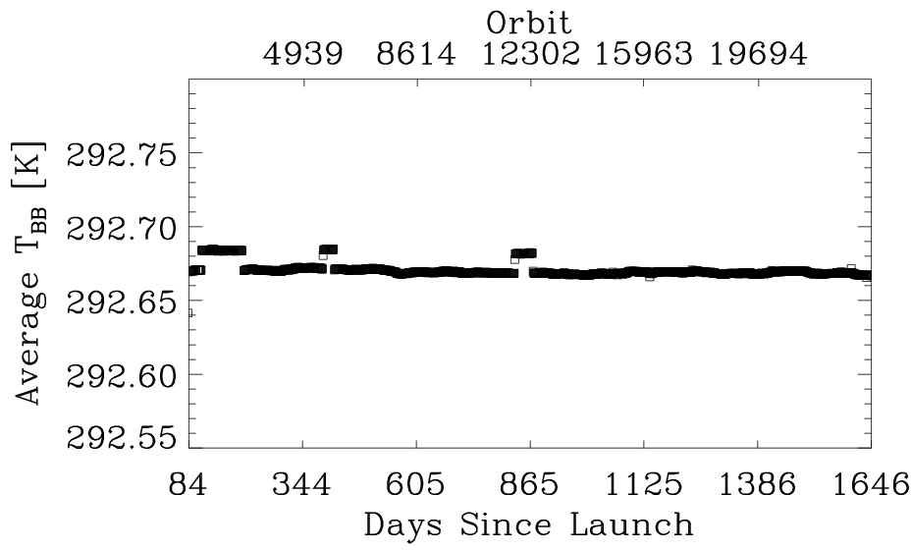
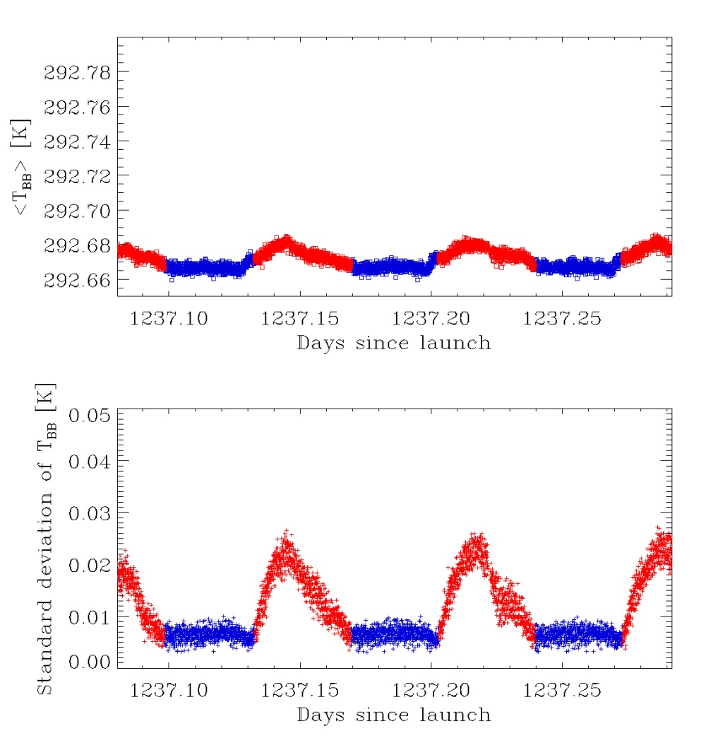
BB Performance
Long-term trend of daily-averaged T_{BB}
  Stable to within a few mK.
  ~15 mK offsets were due to the use of two different T_{BB} settings.
Day / Night
Short-term stability (scan-by-scan T_{BB}):
  Orbital variations of individual thermistors up to 40 mK
  Variations in average temperature ~ 20 mK
  Temperature difference between individual thermistors up to 60 mK
  BB uniformity meets the requirement with standard deviation less than 30mK
30mK uniformity requirement
<number>
Notes:
<number>
<number>
<number>

Slide 6
Detector Short-term Stability
Detector responses (F-factors) show small orbital variations:
±0.2 % or less on a per scan basis
±0.1 % or less on a per granule basis
Would using averaged F-factors improve SDR product?
F-factor orbital variations correlate with T_{BB} variations and instrument temperatures variations.
F-factor shown for orbits 22854 – 22858 for HAM side A.
<number>
Notes:
<number>
<number>
<number>

Slide 7
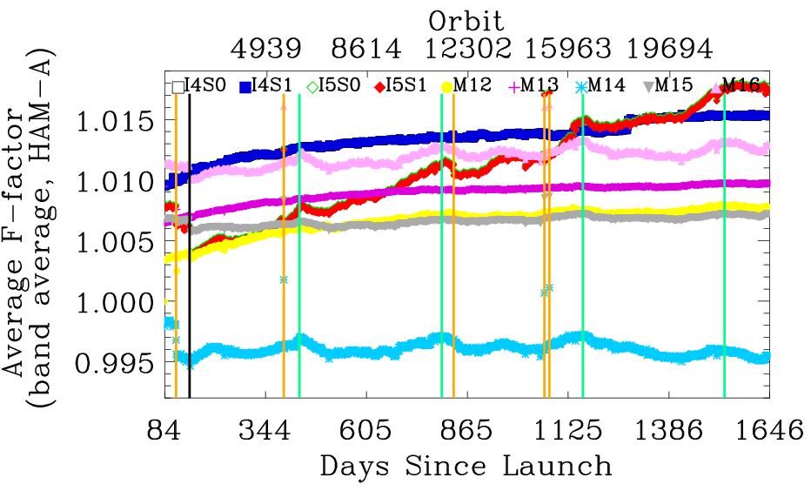
Detector Long-term Response
Daily average F-factor trend:
  From January 20, 2012 (orbit 1200) to May 1, 2016 (orbit 23361)
  I5 shows the most noticeable trend of ~1.4 %, while the rest of the bands are within 0.47 % (I4).
  Discontinuities in the trend are coincident with anomalies during which the cold FPA and/or instrument temperatures changed.
  Features in LWIR bands F-trend appear to coincide with the passage of the Earth through perihelion.
SC anomaly
20120324
Petulant anomaly
Earth in perihelion
Band | I4 | I5 | M12 | M13 | M14 | M15 | M16
Average F-factor: 03 26 2012 | 1.0105 | 1.0040 | 1.0035 | 1.0070 | 0.9946 | 1.0056 | 1.0101
Average F-factor: 03 26 2016 | 1.0153 | 1.0177 | 1.0077 | 1.0097 | 0.9952 | 1.0070 | 1.0126
Trend [%] | 0.47 | 1.36 | 0.42 | 0.26 | 0.06 | 0.14 | 0.24
<number>
Notes:
<number>
<number>
<number>

Slide 8
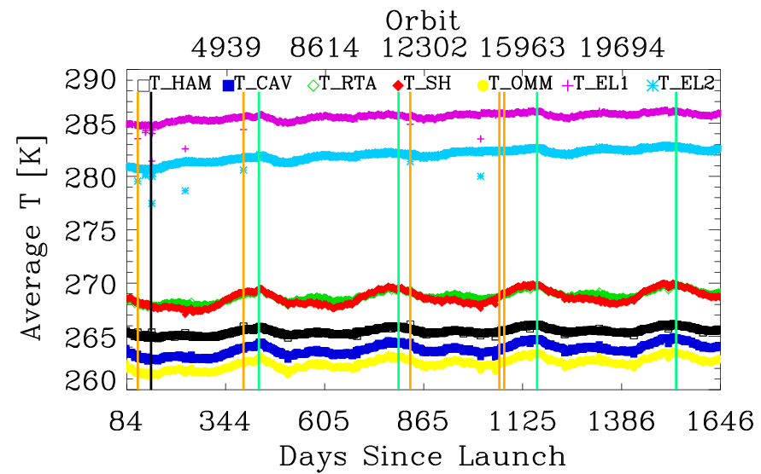
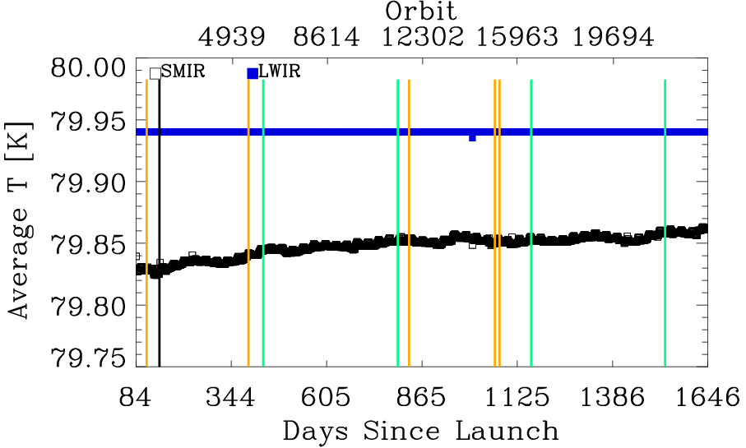
Instrument Temperatures Trend
  Discontinuities in the instrument temperatures trends coincident with discontinuities in the F-factor trends shown on previous slide.
  Features in instrument temperature trends appears to coincide with the passage of the Earth through perihelion. The F-factor for LWIR bands shows features at the same time.
  There is a small increasing trend of SMWIR focal plane temperature, which can explain the trend observed in MWIR bands (I4, M12, M13).
<number>
Notes:
<number>
<number>
<number>

Slide 9
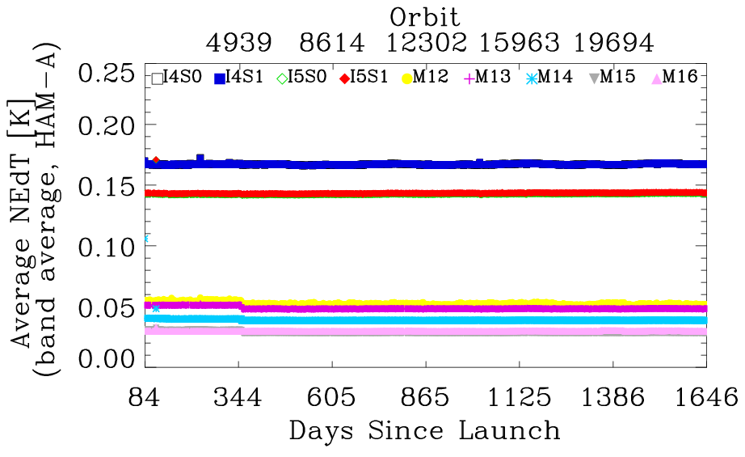
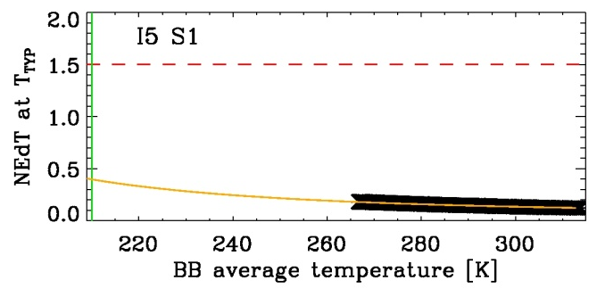
Detector Noise Characterization (NEdT)
NEdT routinely trended at 292.5 K: stable since the CFPA temperatures reached ~80 K (orbit 1200). Band averaged values are within 0.2 K for I bands and 0.07 K for M bands
NEdT at T_{TYP} derived periodically from BB WUCD data: stable and meeting the sensor design requirements by a wide margin:
<number>
Notes:
<number>
<number>
<number>

Slide 10
Detector Noise Characterization (NEdT)
Band | T_{TYP} [K] | NEdT at T_{TYP} [K]
Requirement | 02/12 | 03/13 | 03/14 | 03/15 | 03/16
I4 | 270 | 2.5 | 0.4 | 0.4 | 0.4 | 0.4 | 0.4
I5 | 210 | 1.5 | 0.4 | 0.4 | 0.4 | 0.4 | 0.4
M12 | 270 | 0.396 | 0.13 | 0.12 | 0.12 | 0.12 | 0.12
M13 | 300 | 0.107 | 0.04 | 0.04 | 0.04 | 0.04 | 0.04
M14 | 270 | 0.091 | 0.05 | 0.06 | 0.06 | 0.06 | 0.06
M15 | 300 | 0.070 | 0.03 | 0.03 | 0.03 | 0.03 | 0.03
M16 | 300 | 0.072 | 0.03 | 0.03 | 0.03 | 0.03 | 0.03
NEdT at T_{TYP} (derived from BB cool-down data)
Only February / March cool-down measurements listed
TEB bands continue to meet the sensor design requirements
<number>
Notes:
<number>
<number>
<number>

Slide 11
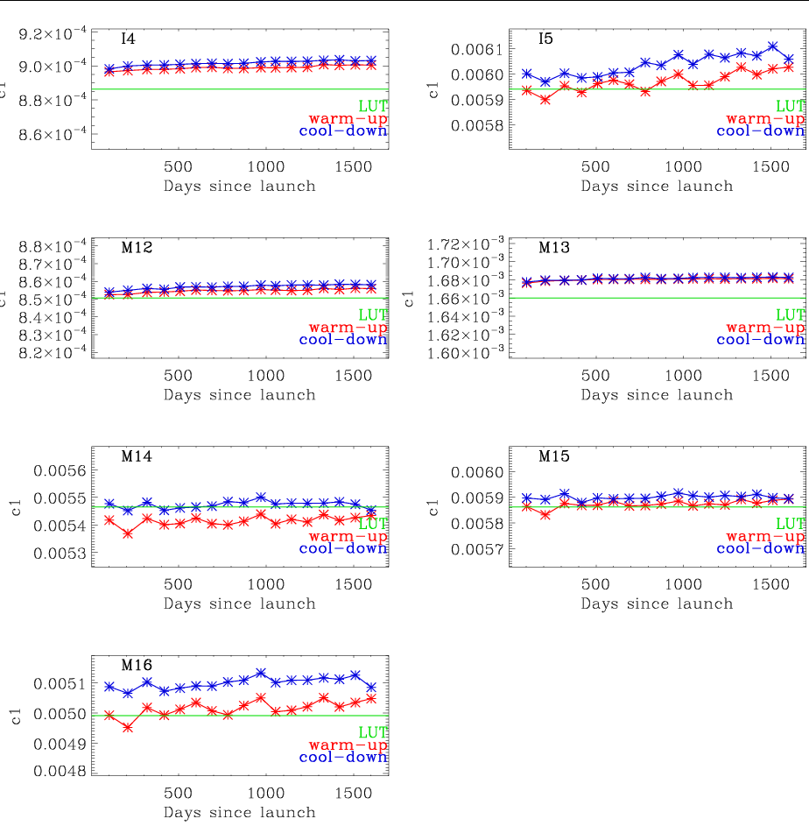
<number>
Calibration Coefficients – Band-average c₁
Band-average c₁ coefficients, as derived from the thirteen WUCD until March 2016, are shown in red (WU data), and blue (CD data) and compared to pre-launch (green). I5 c₁ starts to show noticeable trend, consistent with results from F-factor trending.
Band-average c₁ coefficients derived during WUCD cycles are within 1.9 % on average (at M16 CD) from pre-launch values.
An offset between WU and CD results is present through the thirteen WUCDs, most prominent for LWIR bands.
Y-range spans c_{1LUT} ±4% c_{1LUT}
Notes:
<number>
<number>
<number>

Slide 12
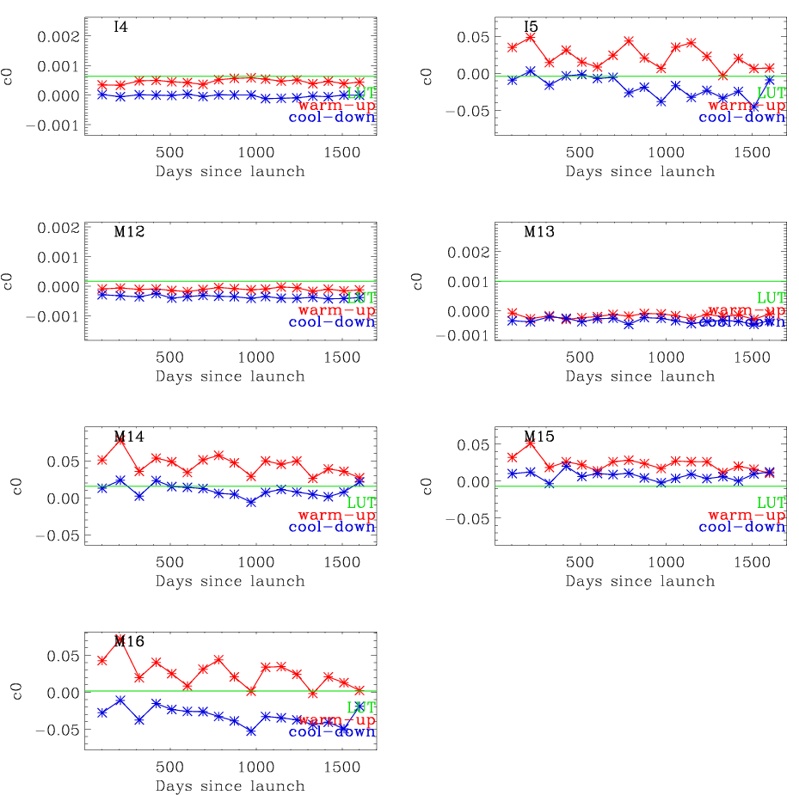
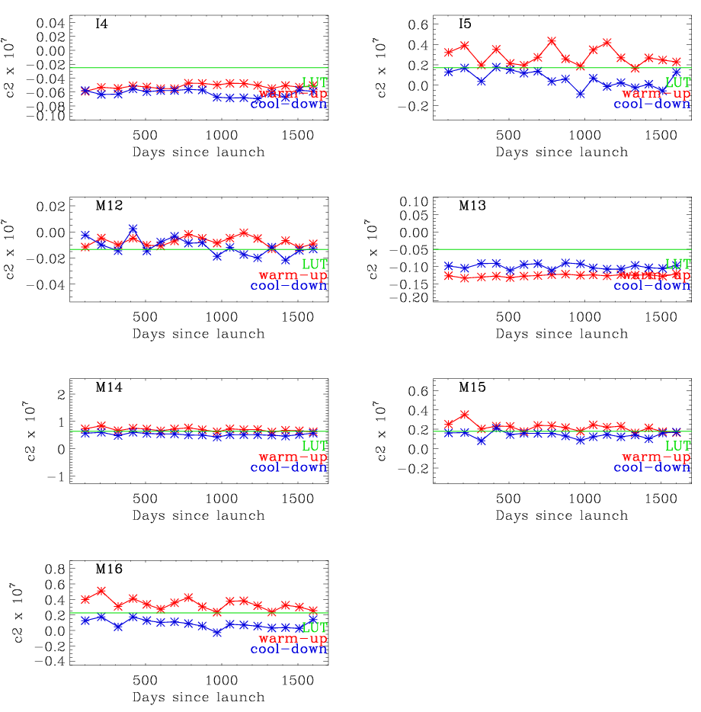
<number>
c₀ and c₂ Coefficients
Band average c₀
Band average c₂
Y-range spans: c_{0LUT} ±0.002 (MWIR),
c_{0LUT} ±0.1 (LWIR)
Y-range spans: c_{2LUT} ±3 x c_{2LUT}
Notes:
<number>
<number>
<number>

Slide 13
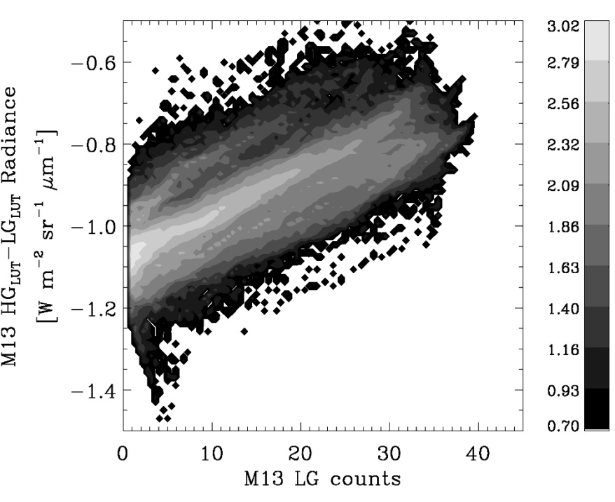
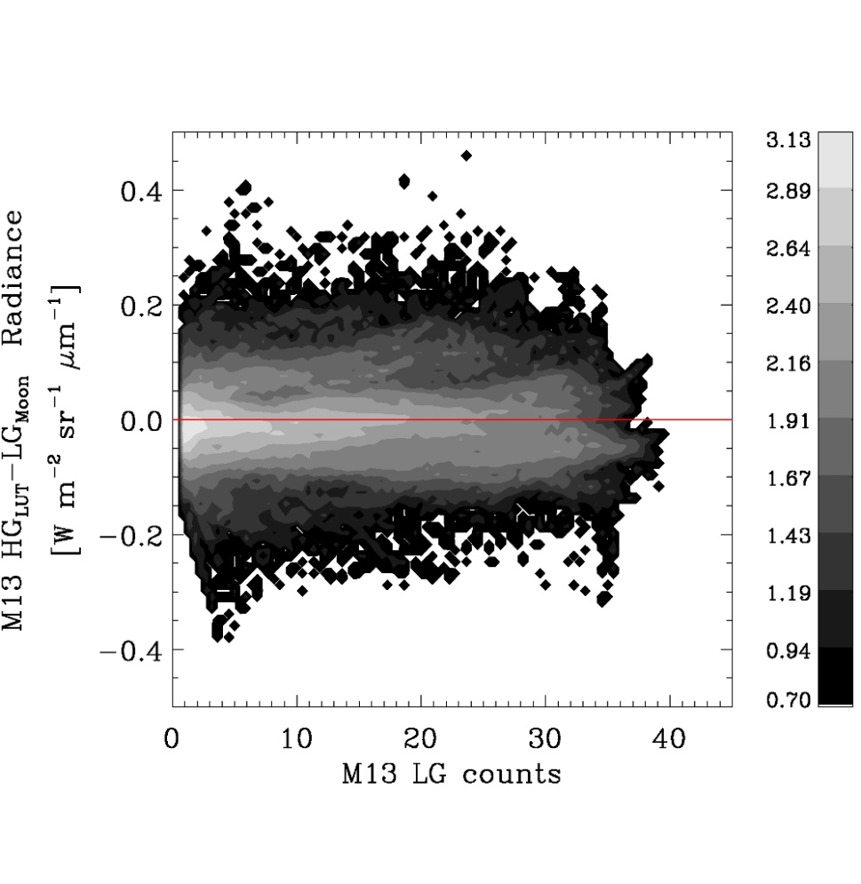
M13 LG Calibration
M13 low gain: No scan by scan F-factor correction
Prelaunch analysis differs between Government team (Aerospace and VCST) and sensor subcontractor – current LUT. Government team results are:
  c₁ = 0.142 - 7 % higher than LUT value c_{1LUT} = 0.132;
  c₀ = 0 - inconsistent with c_{0LUT} = 1.15
Proposal:
Update M13 low gain coefficients based on Government team pre-launch analysis, which is consistent with results from on-orbit calibration
On-orbit comparison of lunar images in M13 LG and M13 HG - supports Government team pre-launch results:
M13 LG c_{1LUT}, c_{0LUT}
M13 LG c₁=0.142, c₀=0
  c₁ = 0.142; 7 % higher than c_{1LUT} -consistent with Gov. team pre-launch
  c₀ = 0 consistent with Gov. team pre-launch
<number>
Notes:
<number>

Slide 14
F-factors Orbital Variation Reduction
F-factor orbital variations are present, on the order of ±0.05 – 0.1 %.
Changing the BB thermistor weighting can reduce the F-factor orbital variations. Using T3 and T6 yield less variation for most bands (except M12 and M13).
Improving the background model which would also reduce the F-factor orbital variations.
F-factor shown for orbits 22854 – 22858 for HAM side A.
<number>

Slide 15
Conclusions
S-NPP VIIRS on-orbit BB long-term (4+ years) performance is very stable. Short-term (orbital) temperature variations are present but within the uniformity requirement of 30 mK.
Detector response (F-factor) trending is stable, with I5 showing maximum band-average trend of 1 % followed by M12 and I4. Small orbital variations are present (±0.0.5 – 0.1 %).
No change is observed for TEB detector noise characteristics. NEdT at T_{TYP} is in compliance with the requirements.
Improvements: updates to M13 LG offset and linear coefficients to improve calibration; modifications to SDR code to apply average F-factor do not have significant impact.
<number>
Notes:
<number>
<number>
<number>

Slide 16
Back Up
<number>

Slide 17
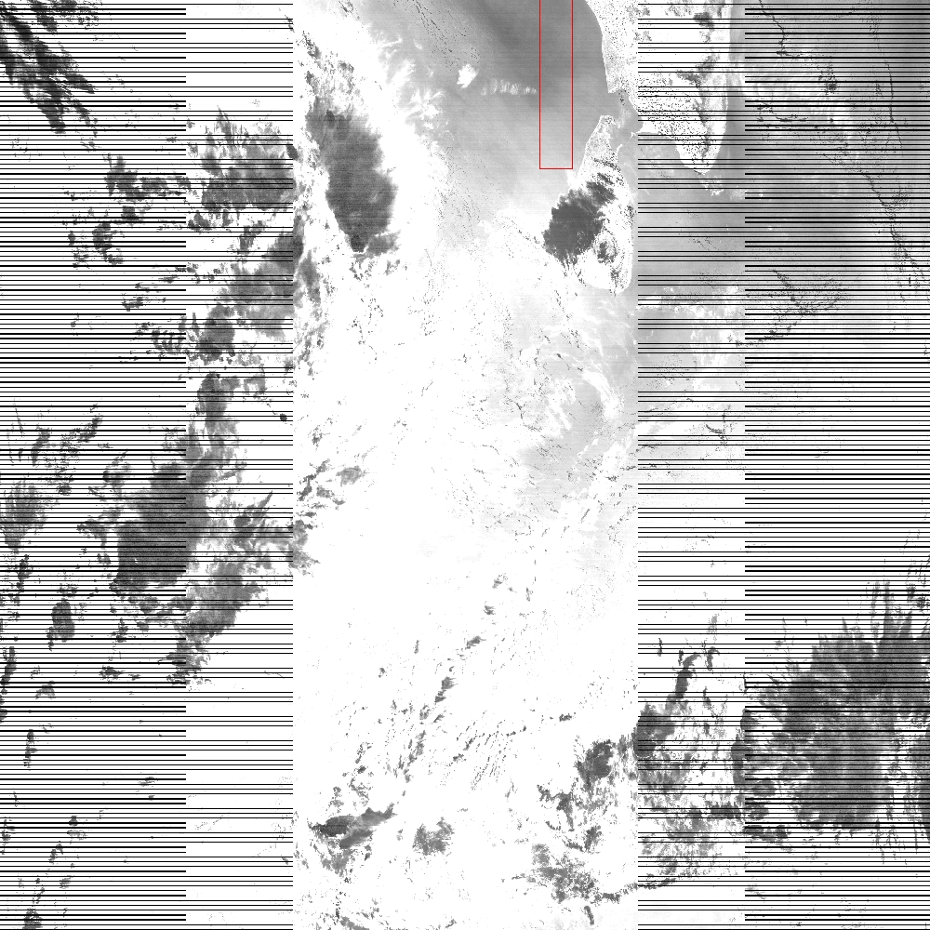
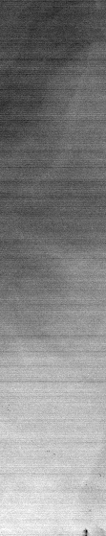

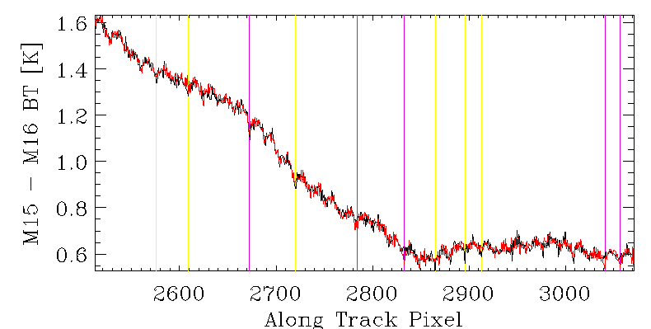
Effect of F-factor Noise
Evaluating the effect of using average F-factors
The VCST VIIRS SDR code was modified to apply average F-factors instead of per-scan F-factors for TEB calibration.
The F-factors for each band, detector, HAM side are averaged over 24 scans.
Using average F-factors does not significantly impact the SDR product.
Striping on the noise level affects SST products based on M15 and M16 brightness temperatures.
T(M15)-T(M16)
SDR: d20130121_t0736504_e0742307
Orig
Av.F
<number>

Slide 18
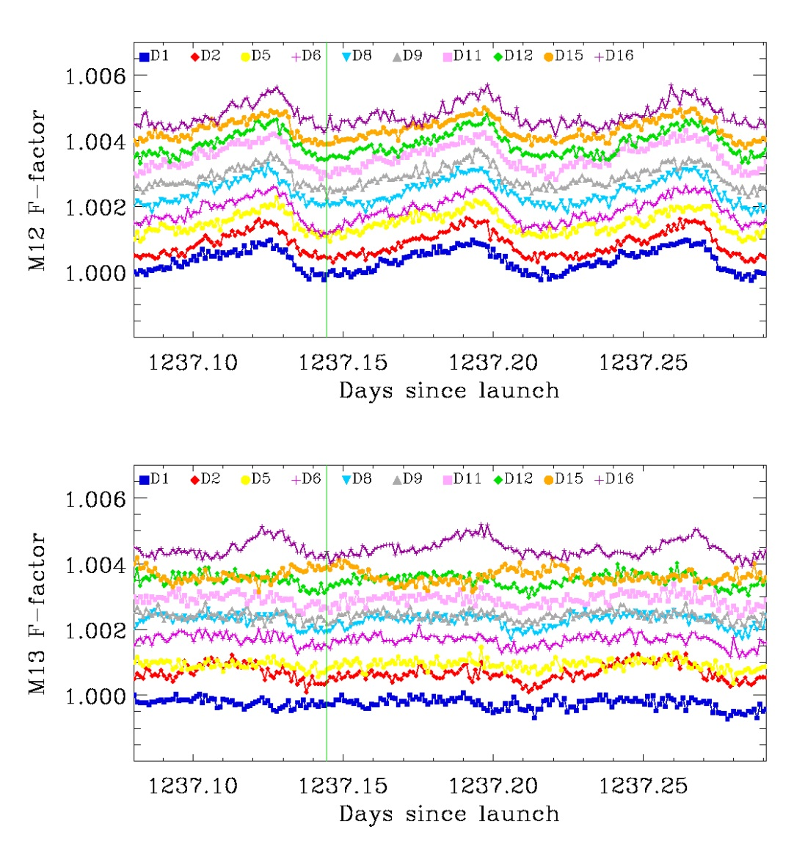
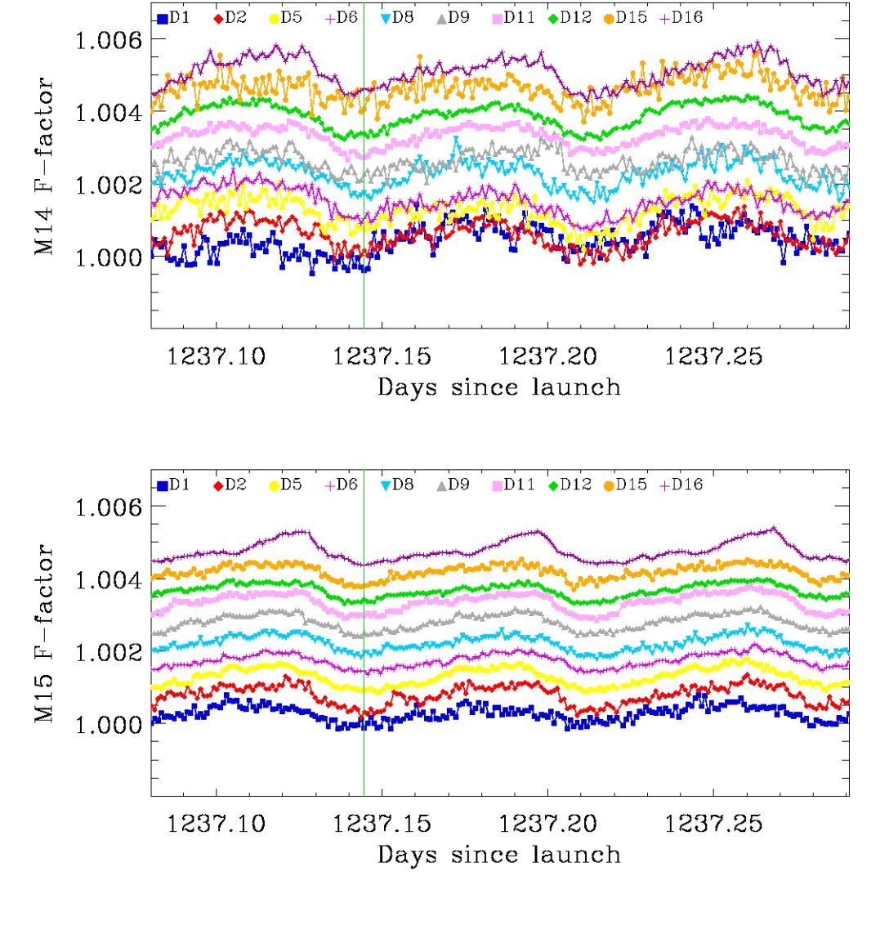
Short-term Stability- Individual Detectors
Orbits: 17553, 17554, 17555
Granule average (HAM A)
M16 (not shown) similar to M15; same D16 our of family behavior
* For clarity the F-factors are shifted.
<number>
Notes:
<number>
<number>
<number>

Slide 19
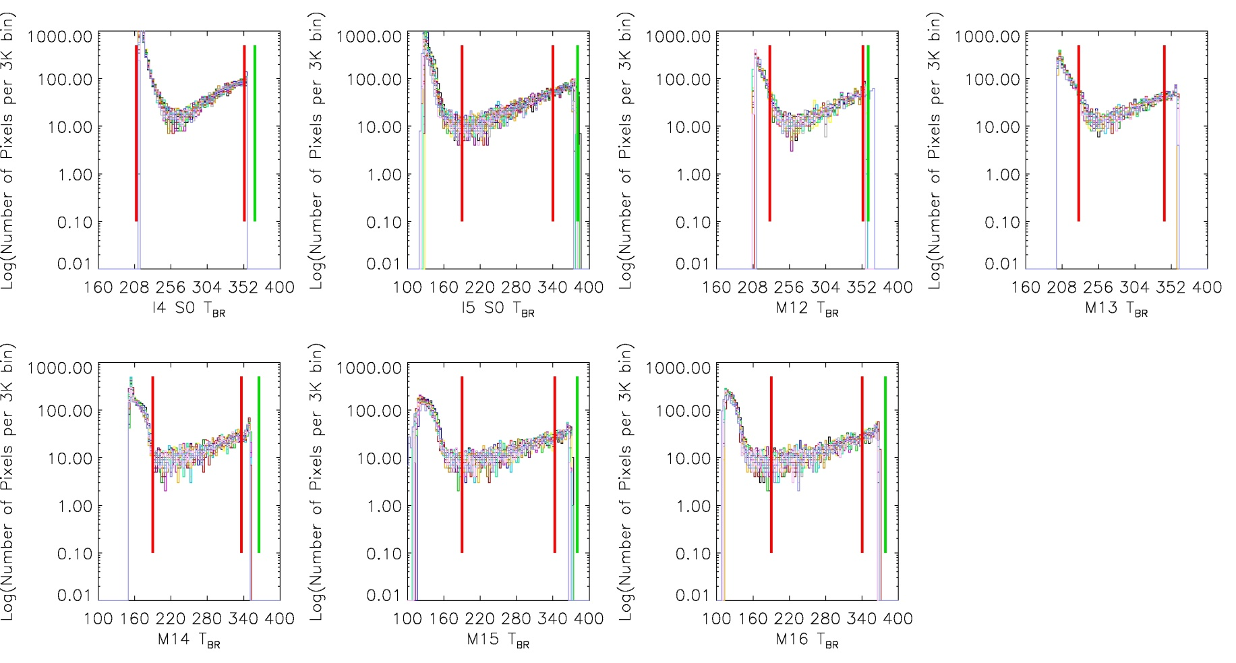
Dynamic Range Verification
Dynamic range verified using scheduled Lunar observations
  All detectors of all TEB bands meet the T_{MIN} (marginal non-compliance at I4) and T_{MAX} requirements
  For some detectors of some bands the radiance limits in the Radiance-to-Temperature LUT do not extend to the largest possible unsaturated radiance
Requirement
LUT limit
I4
I5
M12
M13HG
M14
M15
M16
<number>

Slide 20
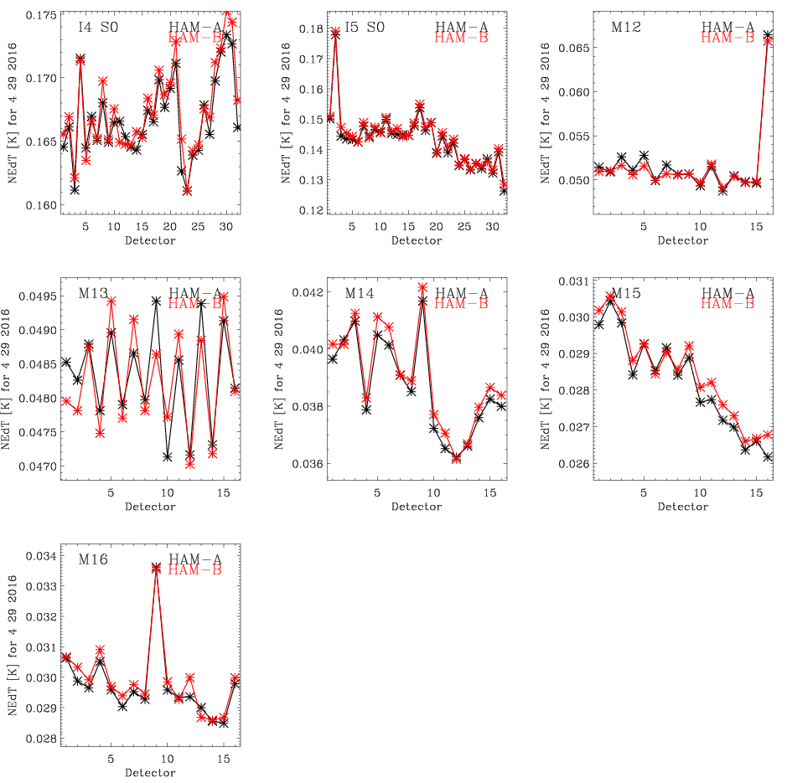
Detector Specific NEdT
Detector specific NEdT is stable throughout the mission.
<number>

Slide 21
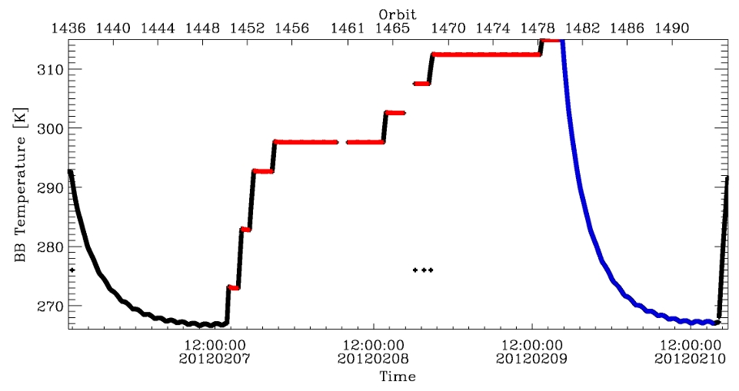
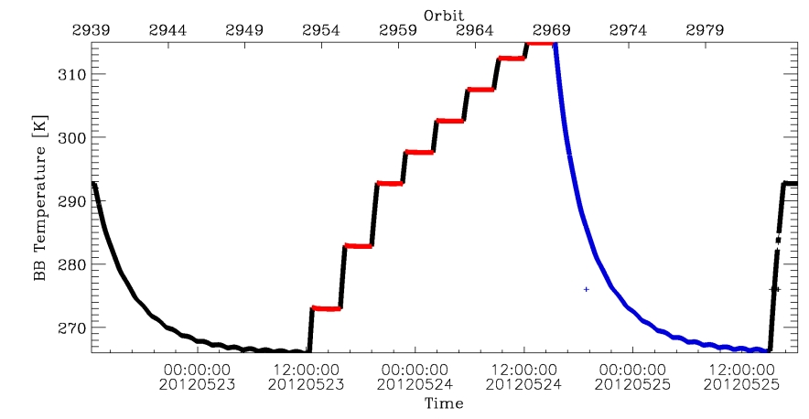
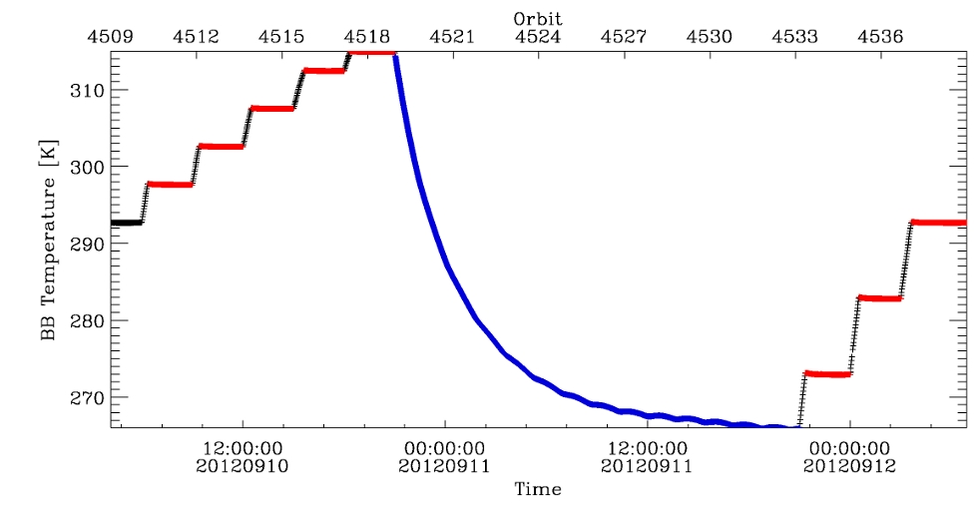
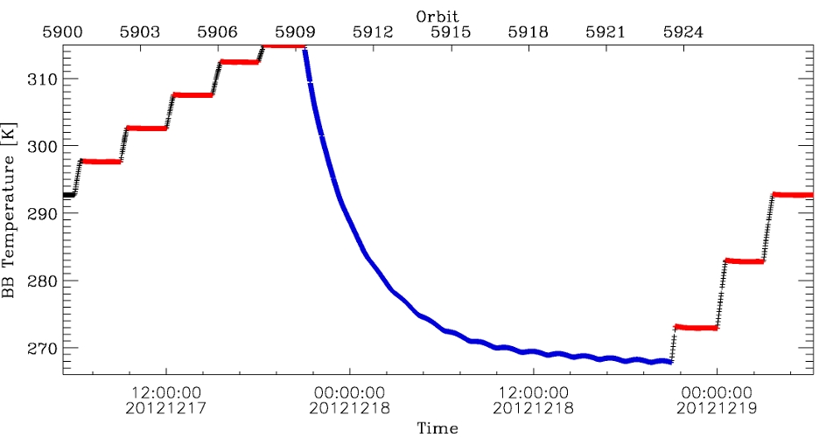
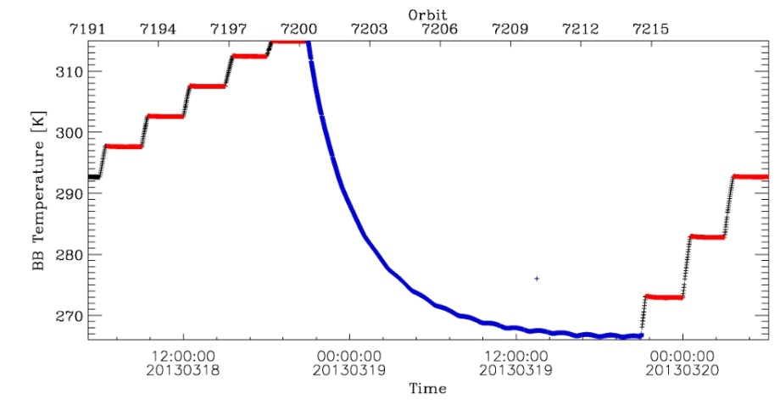
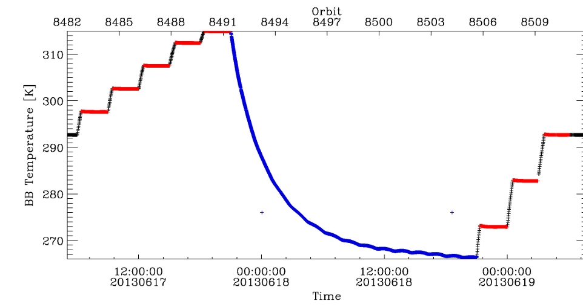
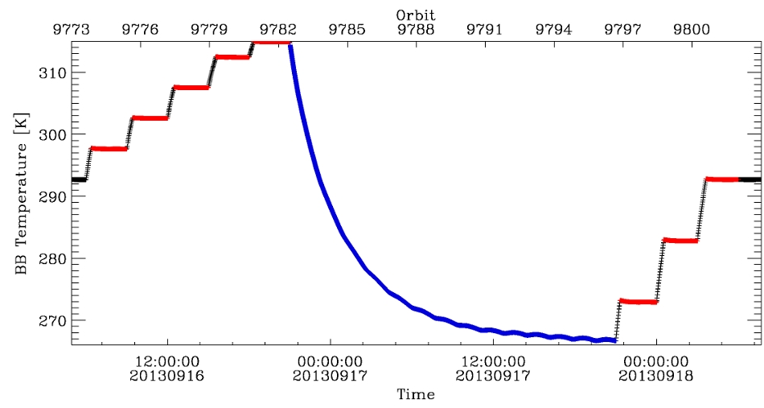
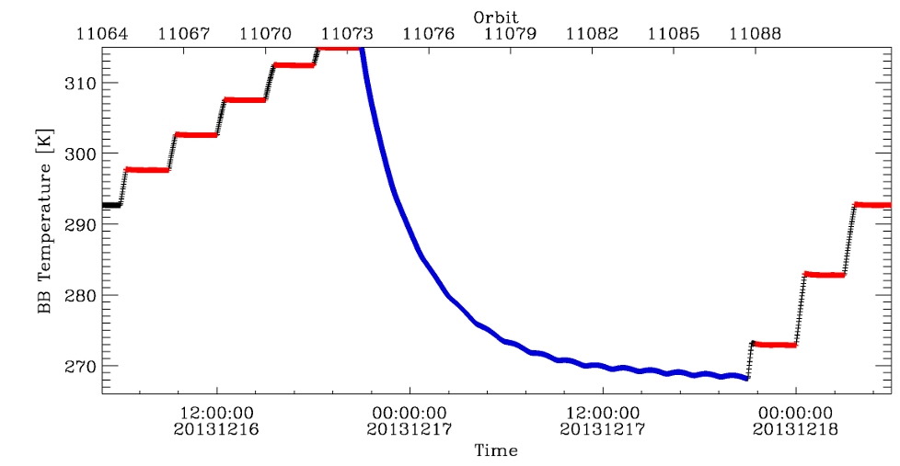
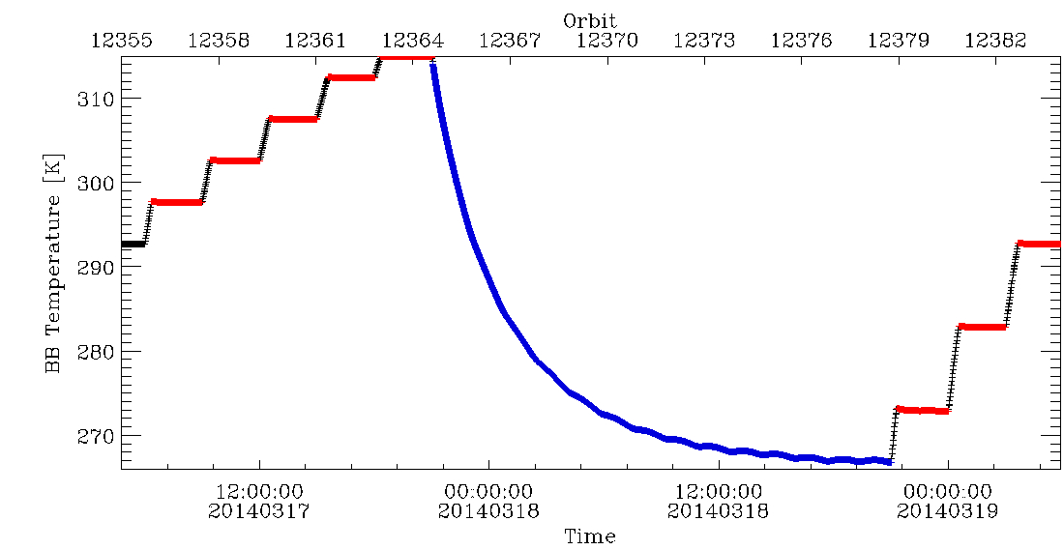
Warm-up Cool-down (WUCD) Cycles
WUCD cycles performed: Feb, May, Sep, Dec 2012; Mar, Jun, Sep, Dec 2013, Mar 2014
May 22 - 25 2012 ;
orb.: 2939 – 2984;
~46 orbits.
Sept. 10-12 2012 ;
orb.: 4509 – 4536;
~28 orbits.
Feb. 6 -10 2012;
orb.: 1436 – 1494;
~59 orbits.
Dec. 17-19 2012 ;
orb.: 5900 – 5928;
~29 orbits.
Mar. 18-20 2013 ;
orb.: 7191 – 7219;
~29 orbits.
June 17-19 2013 ;
orb.: 8482 – 8510;
~28 orbits.
Sept. 16-18 2012 ;
orb.: 9773 – 9801;
~28 orbits.
Dec. 16-18 2013 ;
orb.: 11064 – 11092;
~28 orbits.
Mar. 16-18 2014 ;
orb.: 11064 – 11092;
~28 orbits.
<number>
Notes:
<number>
<number>
<number>

Slide 22
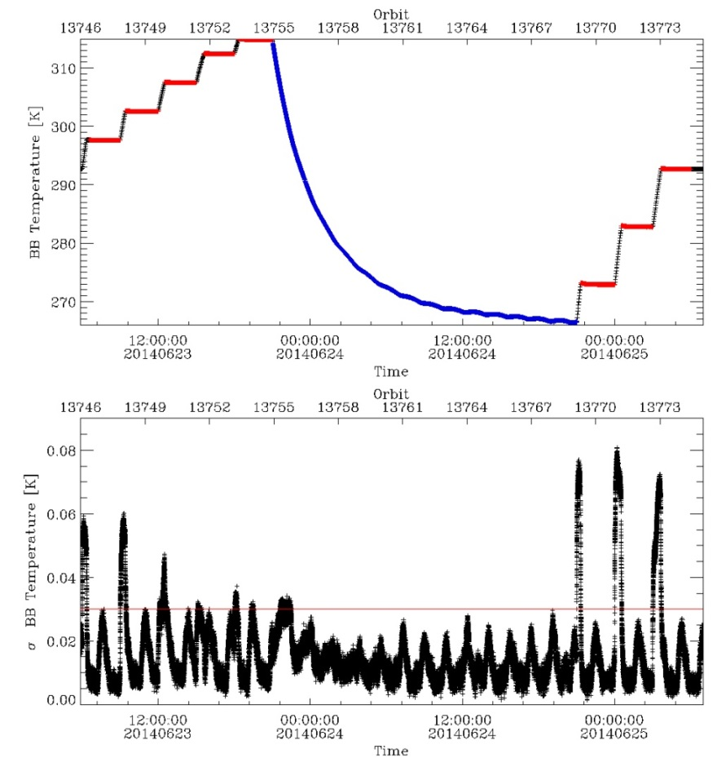
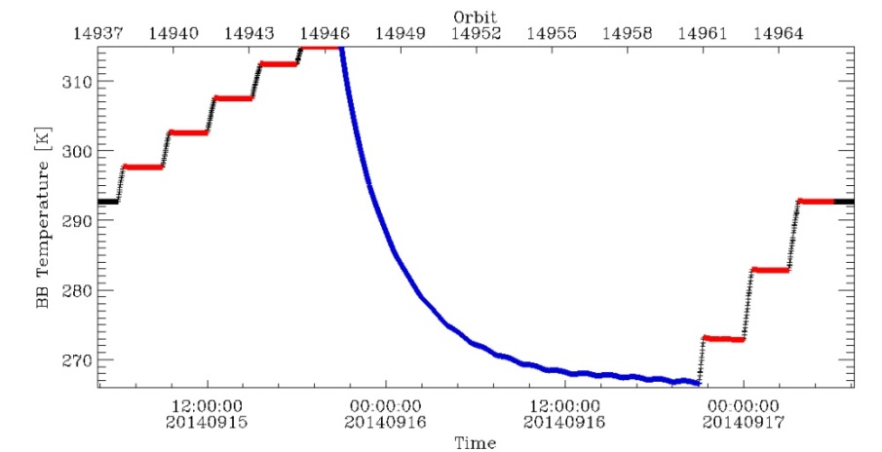

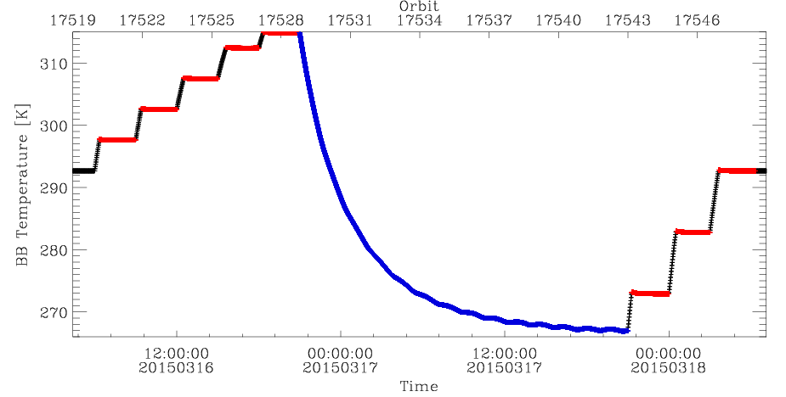
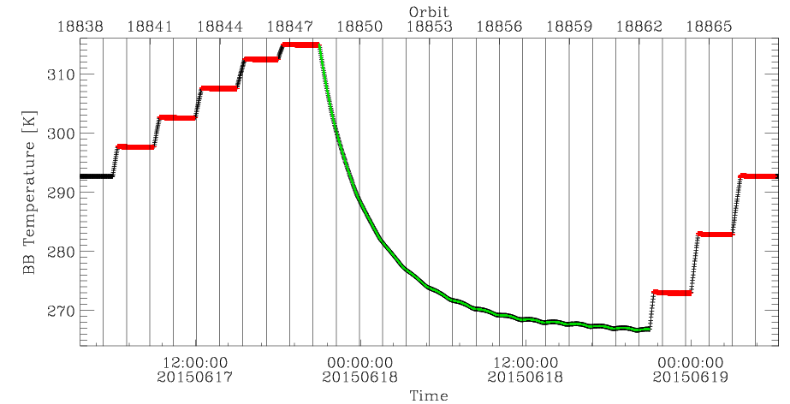
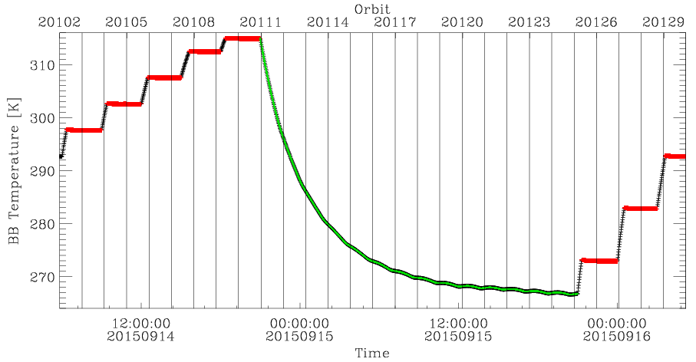
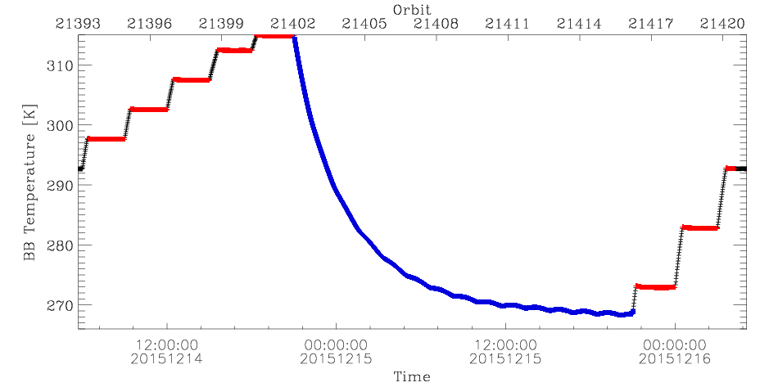
Warm-up Cool-down (WUCD) Cycles
WUCD cycles performed previously: Jun - Dec 2014, Mar - Dec 2015
June 23-25 2014 ;
orb.: 13746 – 13774;
~28 orbits.
Sept 17-19 2014 ;
orb.: 14937 – 14966;
~29 orbits.
Dec 15-17 2014 ;
orb.: 16228 – 16257;
~30 orbits.
Mar 16-18 2015 ;
orb.: 17519 – 17548;
~29 orbits.
June 17-19 2015 ;
orb.: 18838 – 18866;
~28 orbits.
Sept 14-16 2015 ;
orb.: 20102 – 20129;
~27 orbits.
Dec 14-16 2015 ;
orb.: 21393 – 21420;
~27 orbits.
<number>
Notes:
<number>
<number>
<number>

Slide 23
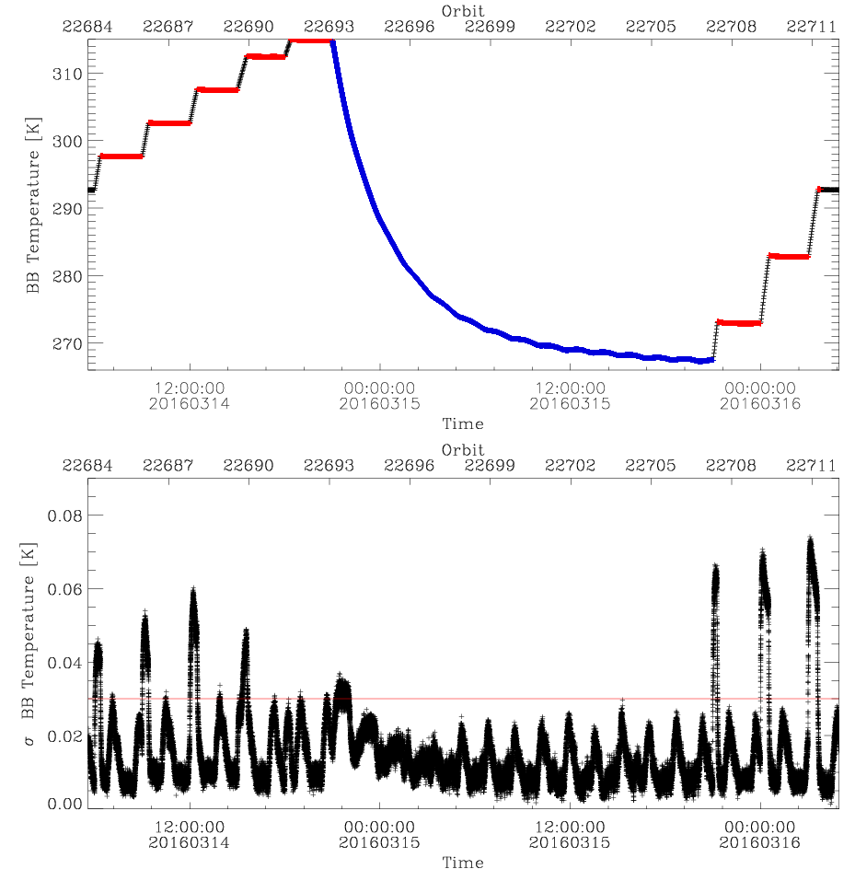
WUCD 14-16 Mar 2016 Data Selection
Warm-up:
Orbits: 22684 – 22693; 22708 – 22711
T_{BB} set to: 297.5K, 302.5K, 307.5K, 312.5K, 315.0K and 272.5K, 282.5K, 292.5K,
The scans used are highlighted in red.
Cool-down:
Orbits: 22693 – 22708.
T_{BB} range: 266.9 K to 315K;
The scans used are shown in blue.
<number>
Notes:
<number>
<number>
<number>

Slide 24
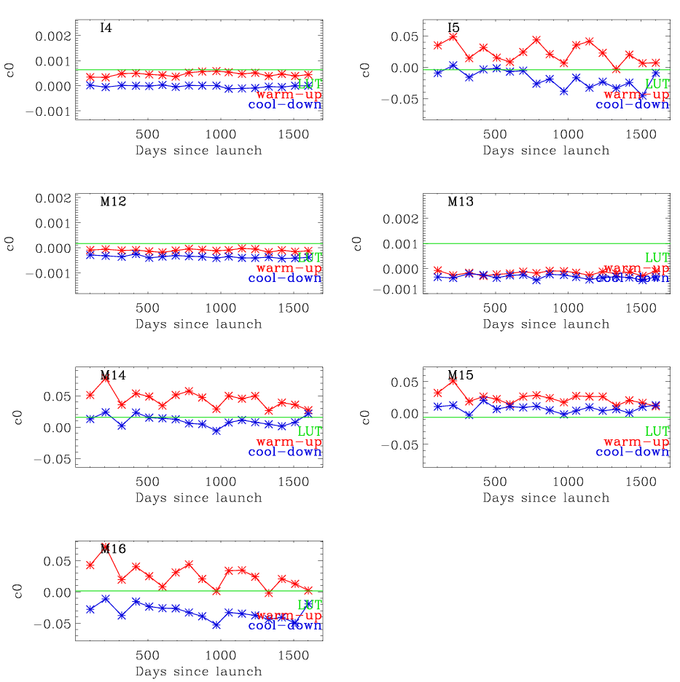
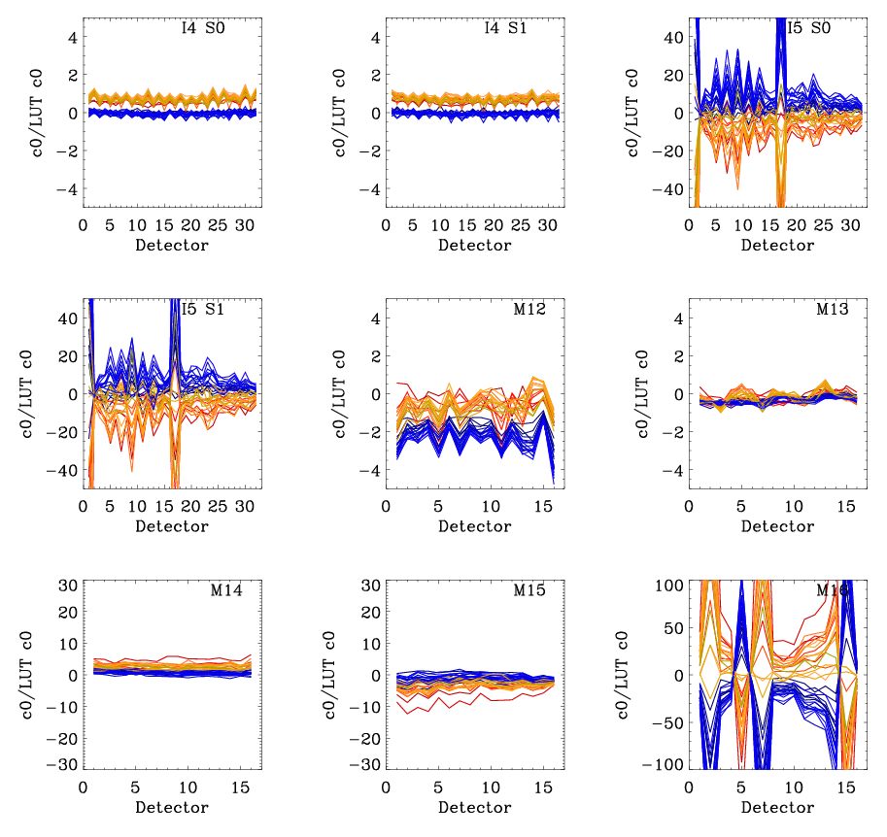
<number>
C₀ Coefficients
Band average c₀
Detector specific c₀/c_{0LUT}
Y-range spans: c_{0LUT} ±0.002 (MWIR),
c_{0LUT} ±0.1 (LWIR)
Notes:
<number>
<number>
<number>

Slide 25
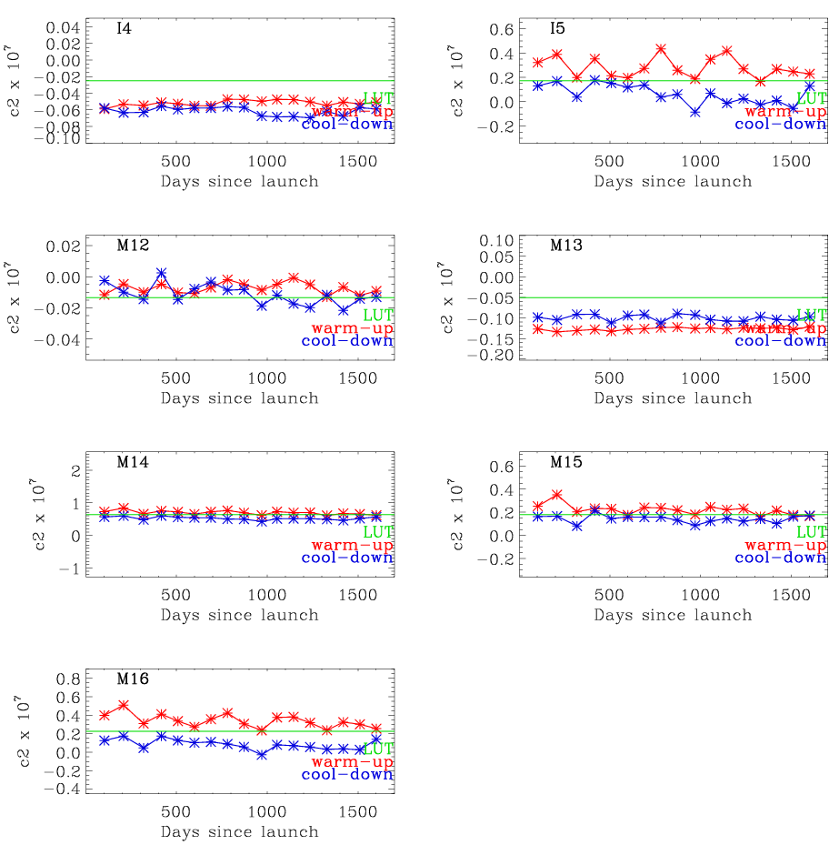
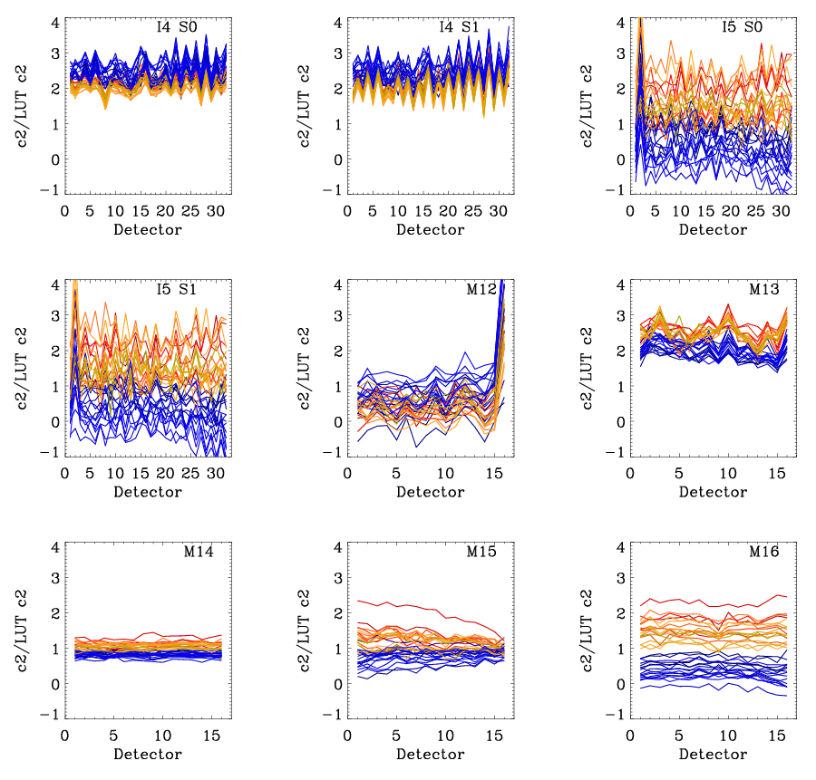
C2 Coefficients
Band average c₂
Detector specific c₂/c_{2LUT}
Y-range spans
c_{2LUT} ±3 x c_{2LUT}
<number>
Notes:
<number>
<number>
<number>

Slide 26
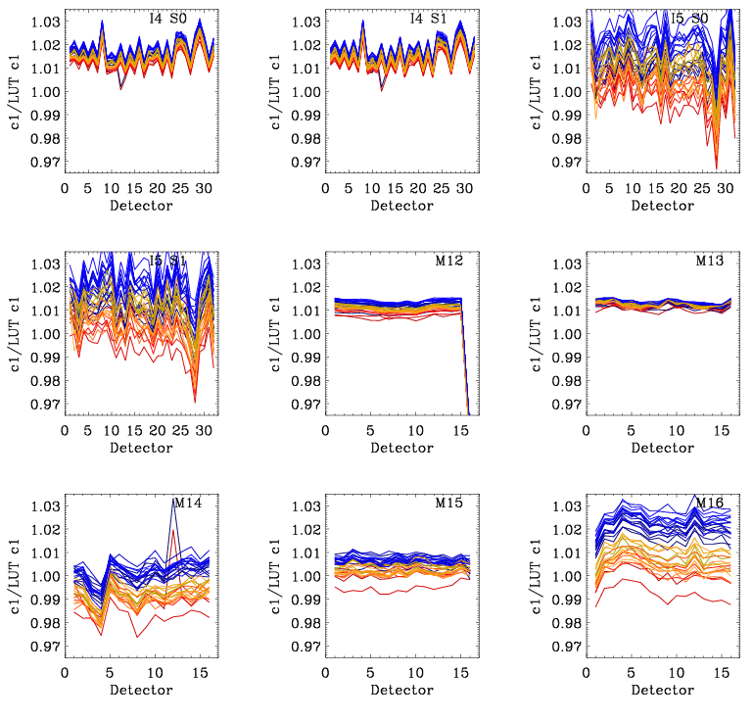
Calibration Coefficients – c1/LUT
Band average:100* (c1_{on-orbit}- c1_{LUT} )/c1_{LUT}:
 | I4 | I5 | M12 | M13 | M14 | M15 | M16
WU 02/12 [%] | 1.2 | -0.8 | 0.4 | 1 | -1.1 | -0.2 | -0.3
WU 05/12 [%] | 1.2 | -0.6 | 0.4 | 0.9 | -1.7 | -0.6 | -0.8
WU 09/12 [%] | 1.3 | 0.2 | 0.6 | 1.2 | -0.8 | 0.2 | 0.5
WU 12/12 [%] | 1.3 | -0.2 | 0.6 | 1.2 | -1.2 | 0.1 | 0.03
WU 03/13 [%] | 1.4 | 0.4 | 0.6 | 1.2 | -1.1 | 0.1 | 0.4
WU 06/13 [%] | 1.4 | 0.6 | 0.7 | 1.2 | -0.7 | 0.4 | 0.9
WU 09/13 [%] | 1.5 | 0.3 | 0.7 | 1.2 | -1.1 | 0.1 | 0.3
WU 12/13 [%] | 1.4 | -0.18 | 0.7 | 1.2 | -1.2 | 0.1 | 0.05
WU 03/14 [%] | 1.4 | 0.5 | 0.7 | 1.2 | -1.0 | 0.2 | 0.7
WU 06/14 [%] | 1.4 | 1.0 | 0.7 | 1.3 | -0.5 | 0.4 | 1.2
WU 09/14 [%] | 1.4 | 0.2 | 0.7 | 1.3 | -1.1 | 0.1 | 0.3
WU 12/14 [%] | 1.4 | 0.2 | 0.7 | 1.3 | -0.8 | 0.2 | 0.4
WU 03/15 [%] | 1.5 | 0.8 | 0.7 | 1.3 | -1.0 | 0.1 | 0.6
WU 06/15 [%] | 1.6 | 1.7 | 0.8 | 1.3 | -0.3 | 0.6 | 1.5
WU 09/15 [%] | 1.6 | 1.3 | 0.8 | 1.3 | -0.5 | 0.6 | 1.2
WU 12/15 [%] | 1.6 | 1.4 | 0.8 | 1.3 | -0.7 | 0.4 | 0.9
WU 03/16 [%] | 1.6 | 1.5 | 0.8 | 1.3 | -0.6 | 0.5 | 1.1
<number>
Notes:
<number>
<number>
<number>

Slide 27
Calibration Coefficients – c1/LUT
Band average:100* (c1_{on-orbit}- c1_{LUT} )/c1_{LUT}:
 | I4 | I5 | M12 | M13 | M14 | M15 | M16
CD 02/12 [%] | 1.5 | 0.6 | 0.6 | 1.2 | 0.2 | 0.4 | 1.6
CD 05/12 [%] | 1.6 | 0.5 | 0.7 | 1.3 | -0.6 | 0.3 | 1.1
CD 09/12 [%] | 1.6 | 1 | 0.8 | 1.7 | 0.3 | 0.9 | 2.2
CD 12/12 [%] | 1.6 | 0.7 | 0.8 | 1.2 | -0.2 | 0.3 | 1.6
CD 03/13 [%] | 1.7 | 0.8 | 0.9 | 1.3 | -0.1 | 0.6 | 1.8
CD 06/13 [%] | 1.7 | 1.1 | 0.9 | 1.3 | -0.01 | 0.5 | 2
CD 09/13 [%] | 1.7 | 1.1 | 0.9 | 1.3 | 0.05 | 0.6 | 2
CD 12/13 [%] | 1.7 | 1.7 | 0.9 | 1.4 | 0.4 | 0.6 | 2.2
CD 03/14 [%] | 1.7 | 1.6 | 0.9 | 1.3 | 0.3 | 0.7 | 2.4
CD 06/14 [%] | 1.8 | 2.3 | 1.0 | 1.3 | 0.6 | 0.9 | 2.8
CD 09/14 [%] | 1.8 | 1.6 | 1.0 | 1.4 | 0.2 | 0.7 | 2.2
CD 12/14 [%] | 1.8 | 2.3 | 1.0 | 1.4 | 0.3 | 0.7 | 2.4
CD 03/15 [%] | 1.9 | 2.1 | 1.0 | 1.4 | 0.2 | 0.8 | 2.4
CD 06/15 [%] | 1.9 | 2.4 | 1.0 | 1.3 | 0.3 | 0.7 | 2.5
CD 09/15 [%] | 2.0 | 2.2 | 1.0 | 1.4 | 0.3 | 0.8 | 2.4
CD 12/15 [%] | 1.9 | 2.8 | 1.1 | 1.4 | 0.2 | 0.6 | 2.4
CD 03/16 [%] | 1.9 | 2.0 | 1.0 | 1.4 | -0.2 | 0.5 | 1.9
<number>
Notes:
<number>
<number>
<number>

Slide 28
Uncertainty Estimates
EV retrieved radiance uncertainty propagated using standard NIST formulation (k=1)
Some uncertainty contributors determined pre-launch by the instrument vendor: RTA reflectance BB emissivity
Radiometric coefficient and RVS uncertainties determined from NASA pre-launch analysis
Uncertainties investigated for a range of input signal levels and scan angles
Total Uncertainty
Radiometric coefficients
Response
RVS
RTA reflectance
BB emissivity
Radiance (BB, SH, CAV, HAM, RTA)
Reflectance factors off BB
<number>

Slide 29
Comparison to Requirement [K]
Uncertainty specifications
Defined in terms of %, at particular uniform scene temperatures, converted to K
Estimates exceed the specification at lower scene temperatures for bands M12 and M13
Band | 267 K
I4 spec | 0.91
I4 estimate | 0.468
I5 spec | 1.4
I5 estimate | 0.226
Band | 190 K | 230 K | 270 K | 310 K | 340 K
M12 spec | --- | 0.92 | 0.13 | 0.17 | 0.21
M12 estimate | --- | 1.11 | 0.13 | 0.07 | 0.09
M13 spec | --- | 0.85 | 0.14 | 0.19 | 0.23
M13 estimate | --- | 1.01 | 0.14 | 0.07 | 0.10
M14 spec | 2.60 | 0.75 | 0.26 | 0.23 | 0.34
M14 estimate | 0.95 | 0.26 | 0.12 | 0.12 | 0.20
M15 spec | 0.56 | 0.24 | 0.22 | 0.28 | 0.34
M15 estimate | 0.42 | 0.18 | 0.12 | 0.13 | 0.19
M16 spec | 0.48 | 0.26 | 0.24 | 0.31 | 0.37
M16 estimate | 0.35 | 0.16 | 0.12 | 0.14 | 0.19
<number>

Slide 30
Comparison to Requirement [%]
Uncertainty specifications
Defined in terms of %, at particular uniform scene temperatures
Estimates exceed the specification at lower scene temperatures for bands M12 and M13
Band | 267 K
I4 spec | 5.00
I4 estimate | 2.55
I5 spec | 2.50
I5 estimate | 0.41
Band | 190 K | 230 K | 270 K | 310 K | 340 K
M12 spec | --- | 7.00 | 0.70 | 0.70 | 0.70
M12 estimate | --- | 8.98 | 0.71 | 0.27 | 0.32
M13 spec | --- | 5.70 | 0.70 | 0.70 | 0.70
M13 estimate | --- | 7.50 | 0.69 | 0.26 | 0.31
M14 spec | 12.30 | 2.40 | 0.60 | 0.40 | 0.50
M14 estimate | 4.82 | 0.84 | 0.28 | 0.21 | 0.29
M15 spec | 2.10 | 0.60 | 0.40 | 0.40 | 0.40
M15 estimate | 1.59 | 0.47 | 0.22 | 0.19 | 0.22
M16 spec | 1.60 | 0.60 | 0.40 | 0.40 | 0.40
M16 estimate | 1.24 | 0.37 | 0.21 | 0.18 | 0.20
<number>

Slide 31
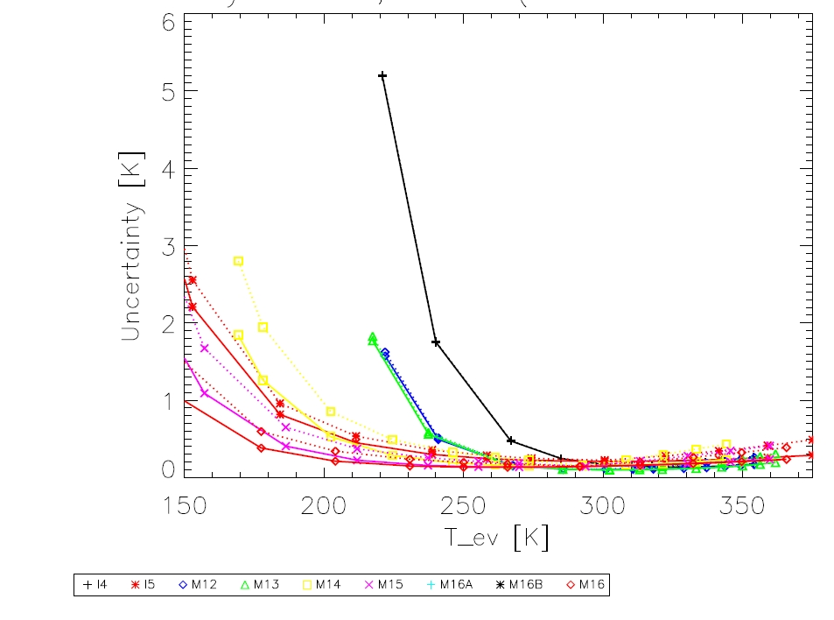
Uncertainty [K]
Uncertainty contributors:
Dominant for MWIR bands are the relative BB radiance uncertainty and the relative EV dn uncertainty (increasing rapidly with decreasing scene temperature).
The LWIR bands uncertainties are dominated by the c₀, RVS, and EV dn relative uncertainties, which increase with decreasing scene temperatures.
<number>

Slide 32
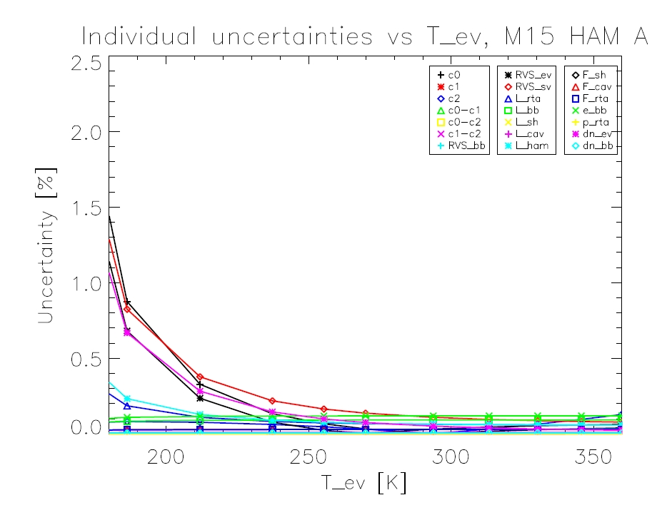
Uncertainty [K]
Uncertainty contributors:
Dominant for MWIR bands are the relative BB radiance uncertainty and the relative EV dn uncertainty (increasing rapidly with decreasing scene temperature).
The LWIR bands uncertainties are dominated by the c₀, RVS, and EV dn relative uncertainties, which increase with decreasing scene temperature.
<number>

Slide 33
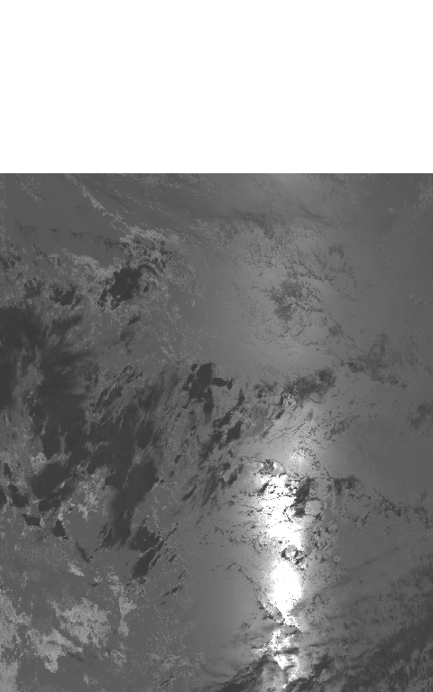
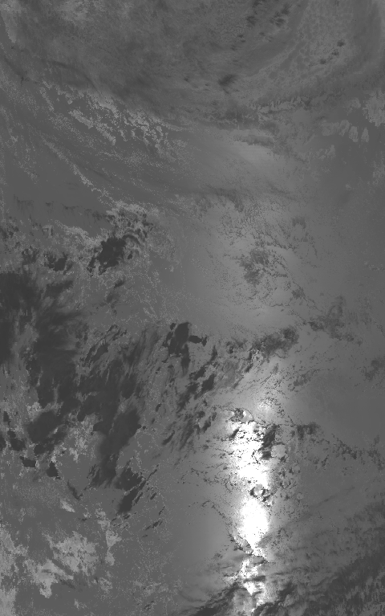
TEB Calibration when Moon in SV
Currently for TEB, Fill values are assigned in EV SDR when the Moon is in the SV.
Improved algorithm computes the mean and standard deviation of a 48-frame sample each scan. Then the outlier samples (Moon intrusion) with selected rejection scheme are identified and excluded from the SV average for background subtraction.
Before
After
Images of calibrated radiance from 4 consecutive Band M12 SDRs, generated with current SDR code (left) and modified (right) calibration algorithms (Data: Jan 22, 2013; Time 22:24:02). [Reference SPIE 2013, 8866-72]
<number>
Notes:
<number>
<number>
<number>

