Slide 1
End-to-End (E2E) Preliminary Results: Internal Review
April 19, 2010
J. McIntire and J. Xiong
NICST/NASA
This document might contain information under ITAR restrictions. Any dissemination to foreign nationals, whether in the US or abroad needs official program authorization.

Slide 2
E2E Test Overview
Objective: validate and assess RSB on-orbit system level calibration
SD view illuminated using collimator and EV view illuminated using SIS
T-SIRCUS used to feed both the SIS and collimator
Data taken at 5 different SD illumination angles for 742nm and 852nm
3 repeats made at the center configuration
Data taken in a 3 collect sequence (SD, EV, Dark) twice at each position and wavelength
SDSM mirror was rotating during first collect in each sequence
One set of data taken at 442nm (signals were too low)
Relative normalization provided using NIST source monitors for both SIS and collimator
2 monitors on the SIS and 1 on the collimator
Results are preliminary
Additional normalization factors due to (collimator) source uniformity need to be applied
To be provided by NGST (Jim McCarthy)
Preliminary analysis also conducted on-site by Aerospace (David Moyer)
Results were generally consistent

Slide 3
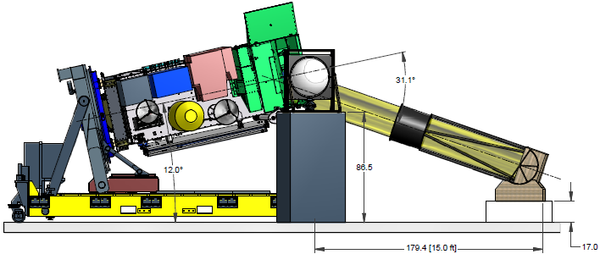
E2E Test Setup
3
SIS and Collimator Placement (side view)
Notes:
3

Slide 4
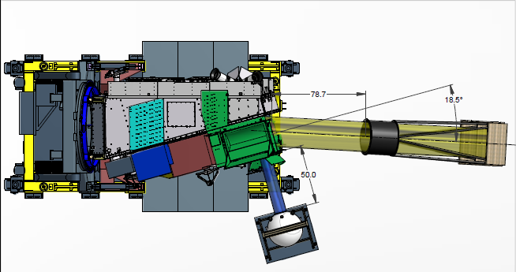
E2E Test Setup
4
SIS and Collimator Placement (top view)
Notes:
4

Slide 5
E2E Test Data
5
Date | Azimuthal | Declination | Bands | UAIDs | Collects
3/19/2010 | 22.52 | 16.31 | M6, M7 | 4742, 4744 | 1-6, 1-6
3/19/2010 | 13.64 | 16.87 | M7, M6 | 4746, 4747 | 1-6, 1-6
3/19/2010 | 30.09 | 16.34 | M6, M7 | 4749, 4750 | 1-6, 1-6
3/19/2010 | 22.37 | 16.44 | M7, M6 | 4751, 4752 | 1-6, 1-6
3/20/2010 | 22.38 | 16.52 | M6, M7 | 4753, 4754 | 1-3, 1-3
3/20/2010 | 30.44 | 15.21 | M7, M6 | 4755, 4756 | 1-6, 1-6
3/20/2010 | 13.63 | 15.07 | M6, M7, M2 | 4758, 4759, 4760 | 1-6, 1-6, 1-6
3 repeats at AZ~22.4º and DEC~16.5º
Notes:
5

Slide 6
Test Data Processing
Data Processing
90 M band samples used (970 - 1059)
OBC BB used as an offset
Source monitor data is matched to VIIRS data by timestamp
Monitor calibration method provided by NIST
SIS at HAM AOI of ~36º
SDSM data extracted using telemetry packets
Angles and wavelengths provided by NIST / Ball
Data quality sufficient and valid for E2E preliminary analysis

Slide 7
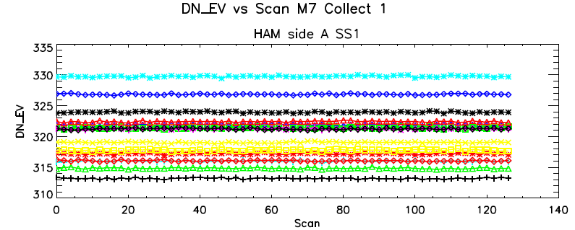
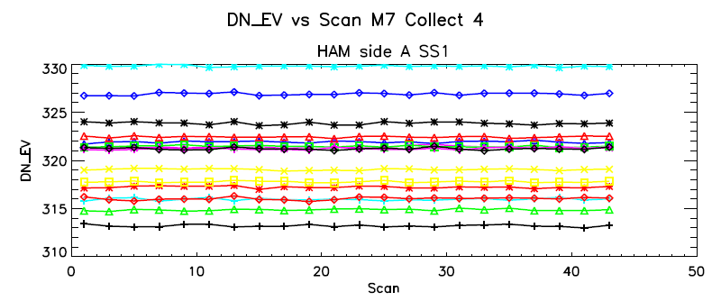
Data Quality
E2E test data collects contain 128 scans
4 collects are corrupt (missing scans): U3104750 collects 4 – 5 and U3104754 collects 1 – 2
However, the data in scans that are available appear valid
U3104750 collects 4-6 retained (average over available scans)
U3104754 collects 1-3 retained (average over available scans)
This is the third repeat at AZ~22.4º and DEC~16.5º for M7
U3104750
Healthy
Corrupted

Slide 8
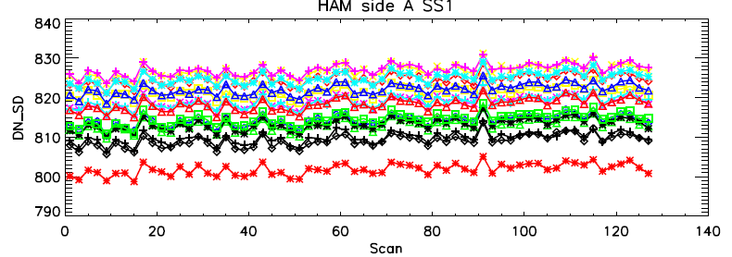
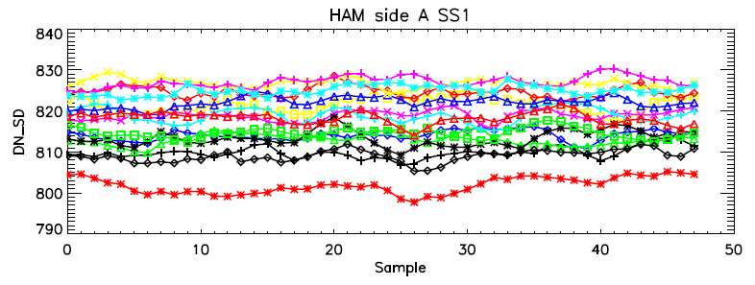
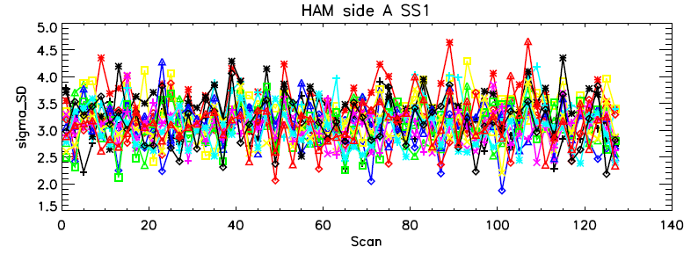
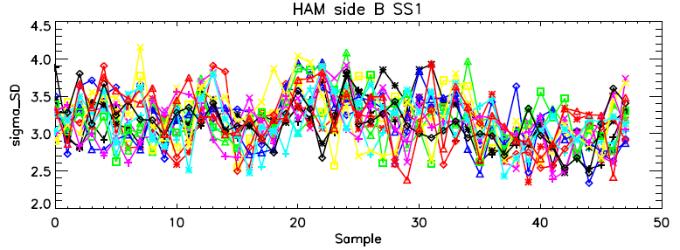
Data Stability (SD)
U3104752: M6 Collect 1
Average over samples
Average over scans
Temporal and spatial stability are generally comparable.
Difference in final dn less than 0.1.

Slide 9
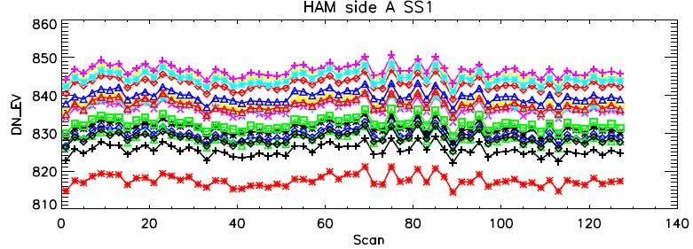
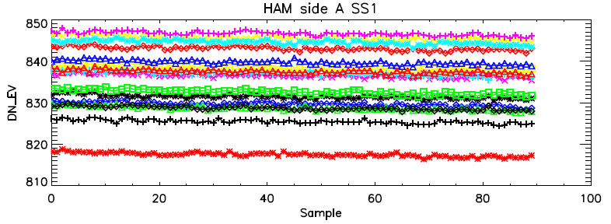
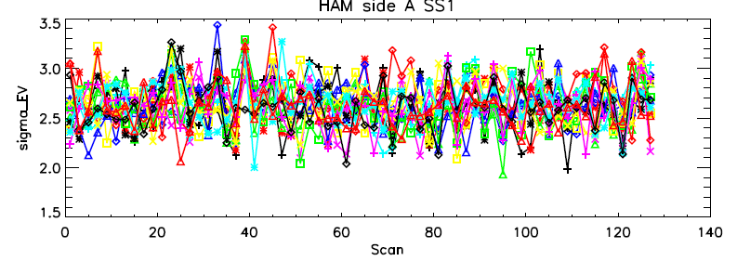
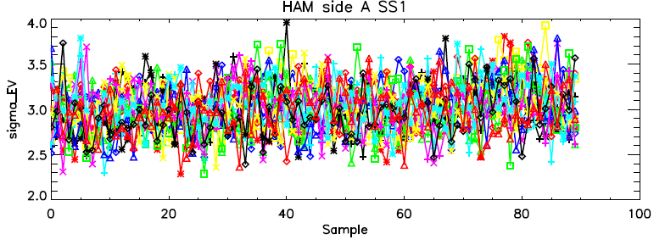
Data Stability (EV)
U3104752: M6 Collect 2
Average over samples
Average over scans
Spatial stability higher than temporal stability (average over samples first for better SNR in M6).
However, difference in final dn less than 0.1.

Slide 10
Source Monitor Output
Monitor data files provided by NIST
1) Each monitor output is measured in Volts
2) Subtract a background voltage
3) Divide by 10^(-gain) to convert signal to Amps
4) Use calibration coefficients to convert signal to radiance (or irradiance) at given wavelength
A) provided by NIST

Slide 11
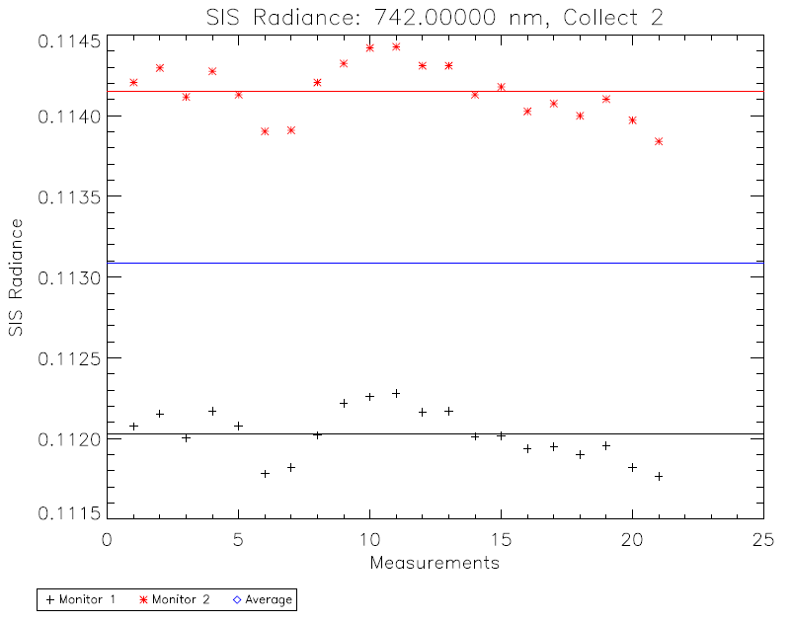
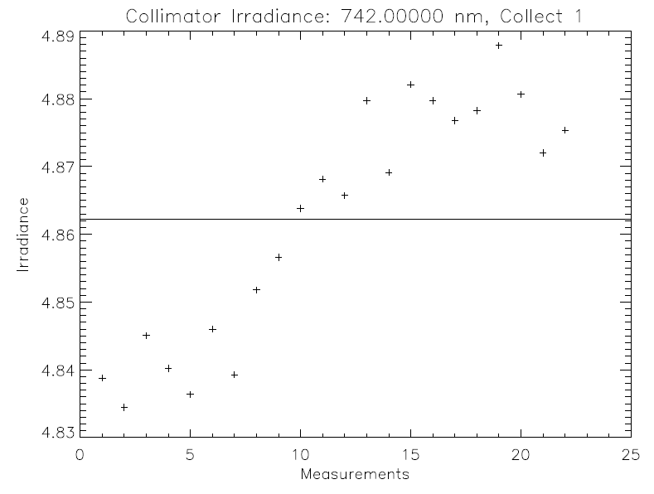
Source Monitor Stability (1)
U3104752: M6
SIS radiance monitors different by ~2% for M6
Individual monitors stable to within ~0.5%
Collimator irradiance monitor varies by up to ~2% for M6
Monitors take a measurement about every 10 s

Slide 12
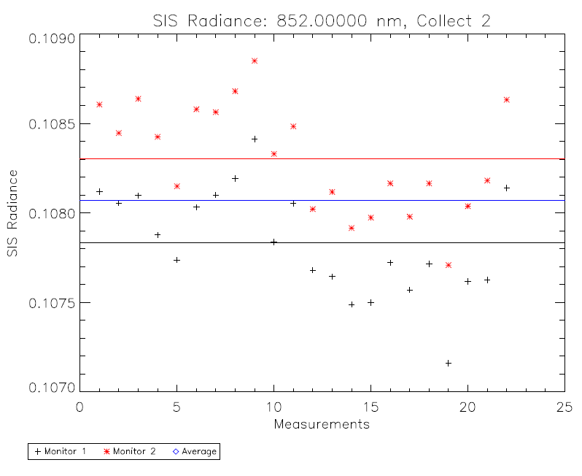
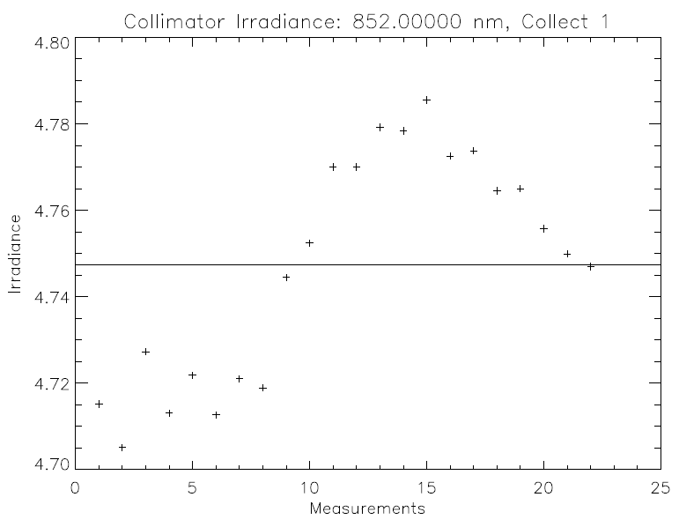
Source Monitor Stability (2)
U3104751: M7
SIS radiance monitors different by ~0.5% for M7
Individual monitors stable to within ~0.5%
Collimator irradiance monitor varies by up to ~2% for M7
Monitors take a measurement about every 10 s

Slide 13
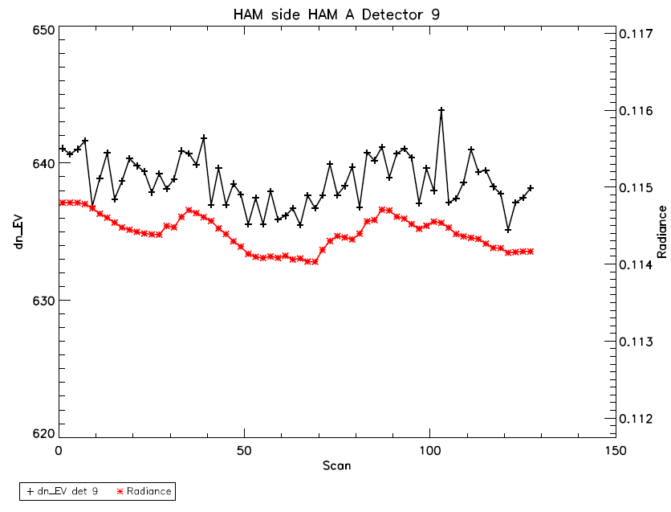
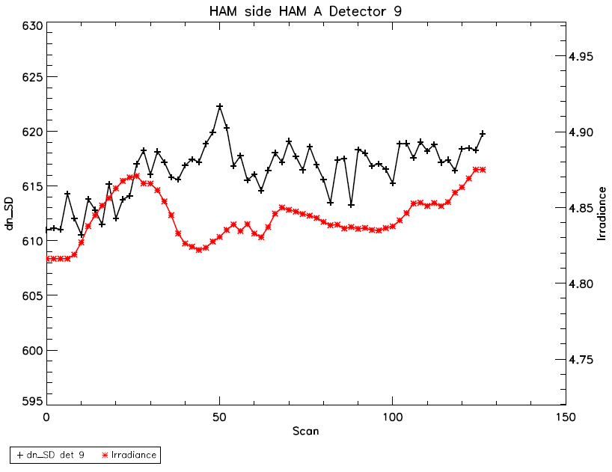
Source vs Response Tracking (1)
U3104752: M6
SIS radiance seems to more closely track VIIRS response than collimator irradiance over time

Slide 14
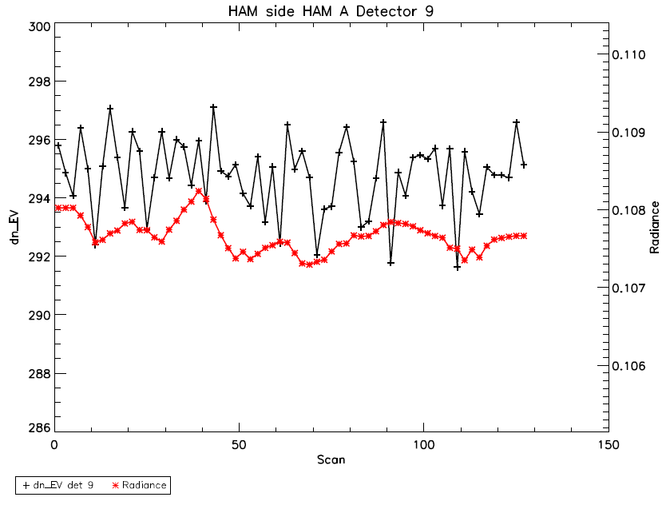
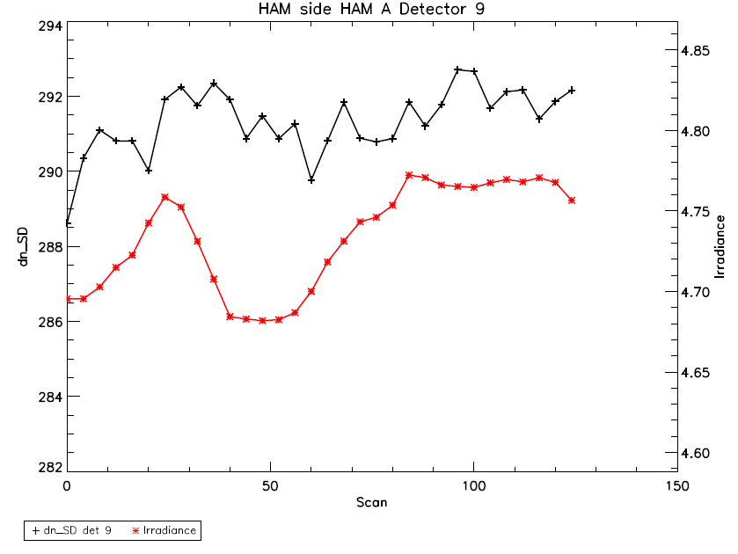
Source vs Response Tracking (2)
U3104751: M7
SIS radiance seems to more closely track VIIRS response than collimator irradiance over time

Slide 15
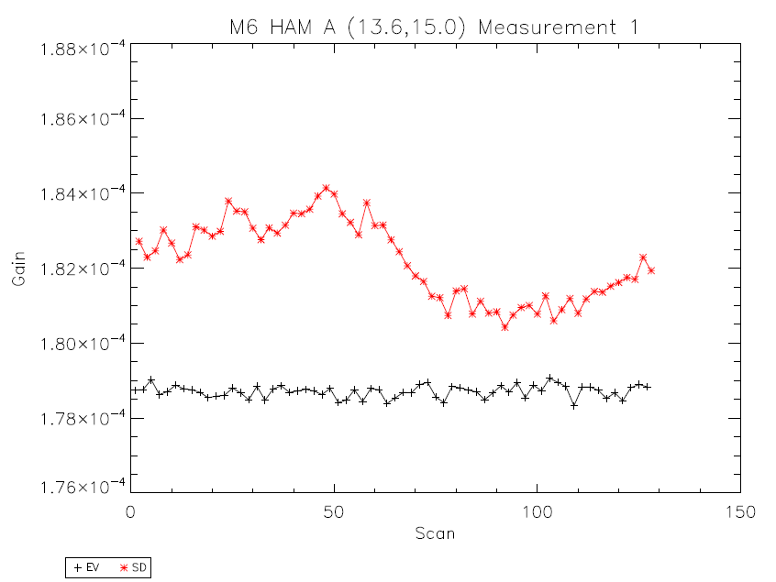
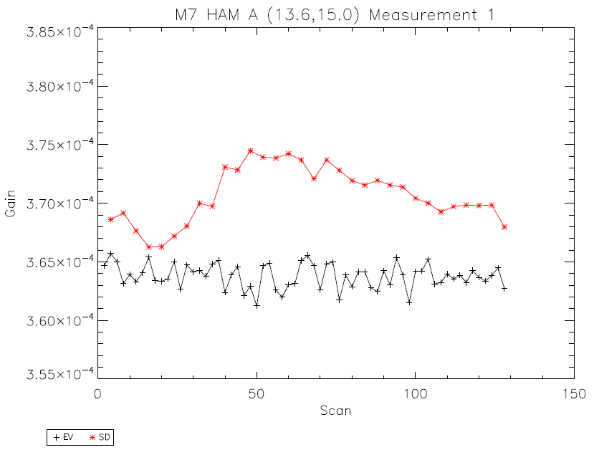
Gain Trending
Variation in SD gain generally larger than EV gain
Note that EV and SD data is from separate collects; gain ratio is the ratio of the average of each over collect
Detector 9 shown

Slide 16
SD/EV Gain Ratio Methodology
Compare measured ratio of gains from SD and Earth views.
E_{SD} – irradiance of collimator in SD view
L_{EV} – radiance of SIS in EV
τ_{SAS} – transmission of SAS screen
cosθ_{SD} – cosine of SD AOI
BRDF_{SD} – BRDF of SD at RTA AOR
RVS_{EV} – EV RVS at HAM AOI
dn_{EV} – dn in EV
dn_{SD} – dn in SD
Irradiance monitor used on collimator; non-uniformity of irradiance over SD view not yet fully included.
Two radiance monitors track the SIS radiance (monitor 2 is used here).

Slide 17
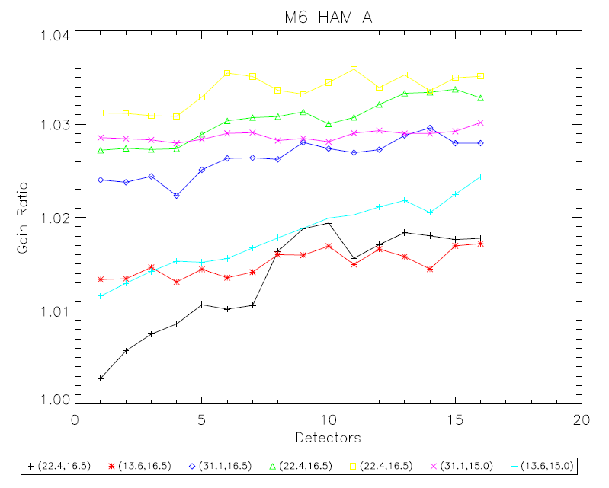
M6 gain ratio (SD/EV)
Gains are between 0.3% and 3.5% different between SD and EV.
HAM sides A and B are consistent.
Increase in gain ratio over detectors (up to 1.5%)

Slide 18
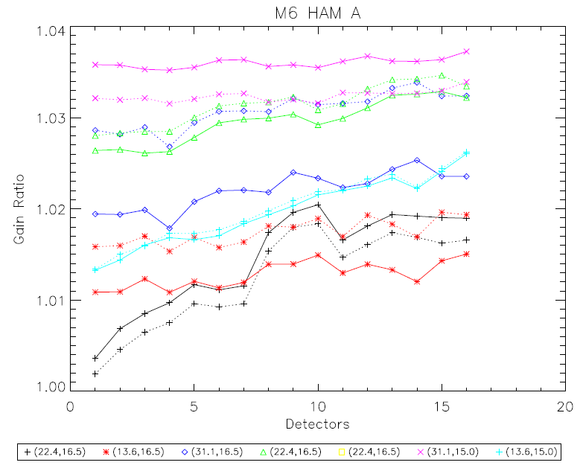
M6 gain ratio (SD/EV): Short Term Repeatability (1)
Solid line – first three collects
Dashed line – second three collects
Measurements agree to within ~1% (position 3 is the worst case)

Slide 19
M6 gain ratio (SD/EV): Short Term Repeatability (2)
 | SD irradiance | SD dn | EV radiance | EV dn | Gain ratio
(22.4,16.5) | 5.10 | 652.0 | 0.124 | 689.8 | 1.020
Repeat | 5.01 | 642.1 | 0.125 | 693.0 | 1.018
(13.6,16.5) | 4.87 | 618.4 | 0.111 | 617.3 | 1.014
Repeat | 4.88 | 617.4 | 0.111 | 619.7 | 1.018
(31.1,16.5) | 5.12 | 658.6 | 0.113 | 632.2 | 1.024
Repeat | 5.15 | 656.6 | 0.112 | 627.4 | 1.032
(22.4,16.5) | 4.85 | 618.5 | 0.114 | 636.9 | 1.030
Repeat | 4.84 | 616.4 | 0.114 | 638.7 | 1.032
(31.1,15.0) | 6.33 | 781.7 | 0.135 | 755.4 | 1.036
Repeat | 6.33 | 784.0 | 0.136 | 756.8 | 1.032
(13.6,15.0) | 6.55 | 804.3 | 0.142 | 794.9 | 1.020
Repeat | 6.53 | 802.3 | 0.142 | 790.8 | 1.021
Consider position 3
Collimator irradiance and SD dn do not always track well
Time dependent irradiance does not alter conclusion
Results for detector 9, HAM A only.

Slide 20
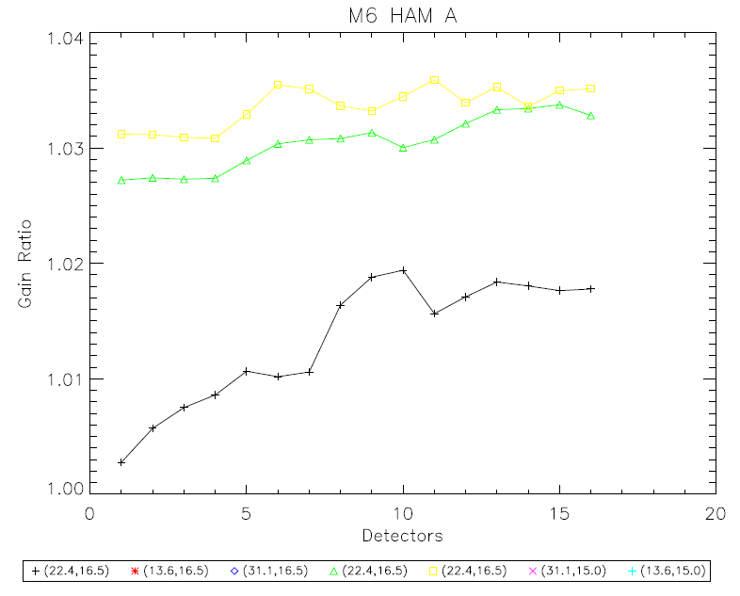
M6 gain ratio (SD/EV): Repeated Angle Measurements
Second and third repeats are roughly consistent.
First measurement ~2% less than the others.

Slide 21
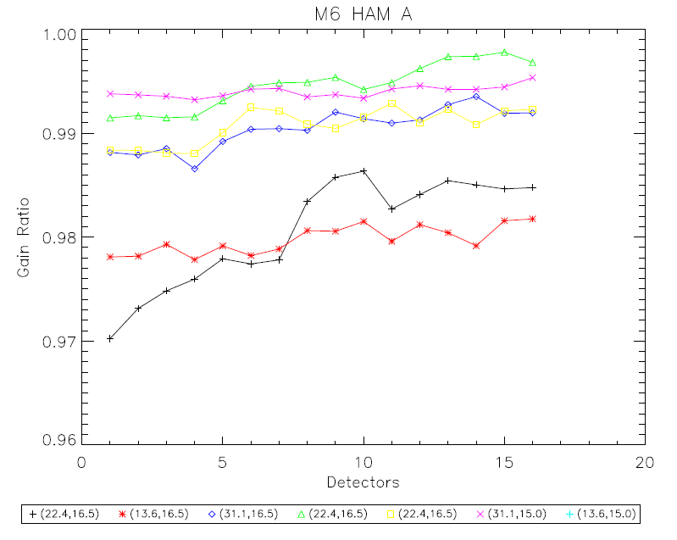
M6 gain ratio (SD/EV): Preliminary Collimator Correction Applied
Position | Collimator Correction Factor
1 | 0.967
2 | 0.965
3 | 0.966
4 | 0.964
5 | 0.958
6 | 0.959
7 | 0.930
Correction factors courtesy of Jim McCarthy (preliminary)
Position 7 is inconsistent (possibly measured 852 nm) and not used here
Preliminary correction only a middle detector
M6 gain ratio between 0.970 and 0.998 (before correction between 1.003 and 1.037)

Slide 22
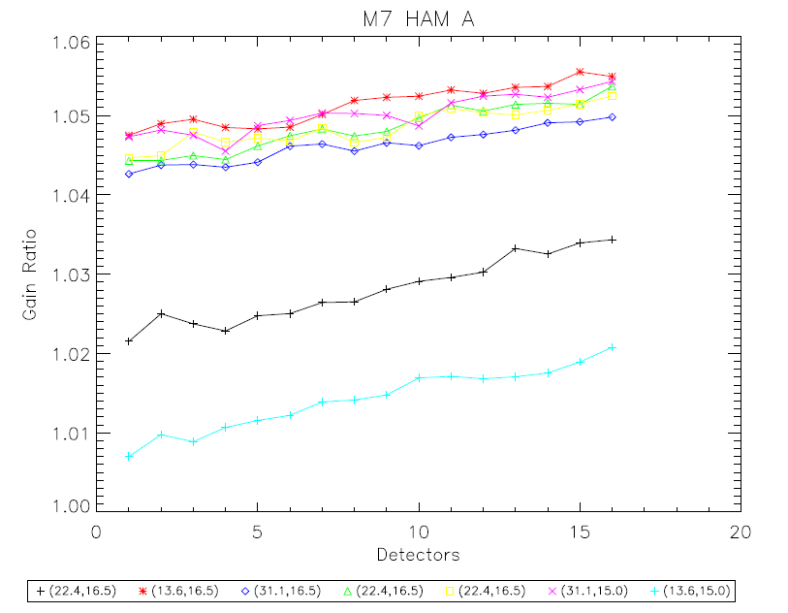
M7 gain ratio (SD/EV)
Gains are between 0.7% and 5.5% different between SD and EV.
HAM sides A and B are consistent.
Increase in gain ratio over detectors (up to 1.5%)

Slide 23
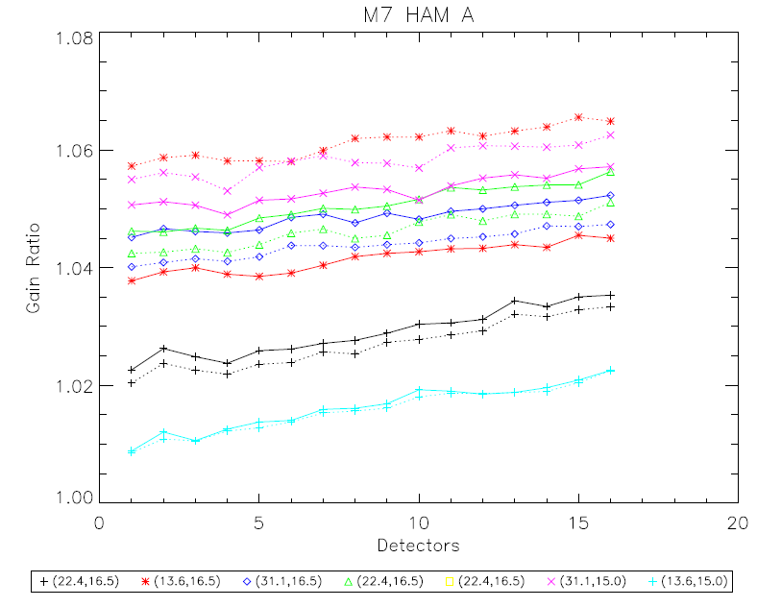
M7 gain ratio (SD/EV): Short Term Repeatability (1)
Solid line – first three collects
Dashed line – second three collects
Measurements agree to within ~2% (position 2 is the worst case)

Slide 24
M7 gain ratio (SD/EV): Short Term Repeatability (2)
 | SD irradiance | SD dn | EV radiance | EV dn | Gain ratio
(22.4,16.5) | 4.75 | 297.7 | 0.107 | 292.7 | 1.029
Repeat | 4.74 | 297.4 | 0.107 | 292.7 | 1.027
(13.6,16.5) | 4.72 | 286.2 | 0.108 | 295.2 | 1.042
Repeat | 4.76 | 283.7 | 0.107 | 292.7 | 1.062
(31.1,16.5) | 4.70 | 290.2 | 0.106 | 290.6 | 1.049
Repeat | 4.63 | 287.6 | 0.106 | 291.3 | 1.044
(22.4,16.5) | 4.74 | 291.2 | 0.108 | 296.7 | 1.050
Repeat | 4.72 | 291.4 | 0.108 | 294.8 | 1.046
(31.1,15.0) | 5.95 | 354.6 | 0.130 | 355.2 | 1.053
Repeat | 6.02 | 358.1 | 0.133 | 364.1 | 1.058
(13.6,15.0) | 6.12 | 369.1 | 0.130 | 354.4 | 1.017
Repeat | 6.12 | 369.9 | 0.129 | 351.9 | 1.016
Consider position 2
Collimator irradiance and SD dn do not always track well
Time dependent irradiance does not alter conclusion
Results for detector 9, HAM A only.

Slide 25
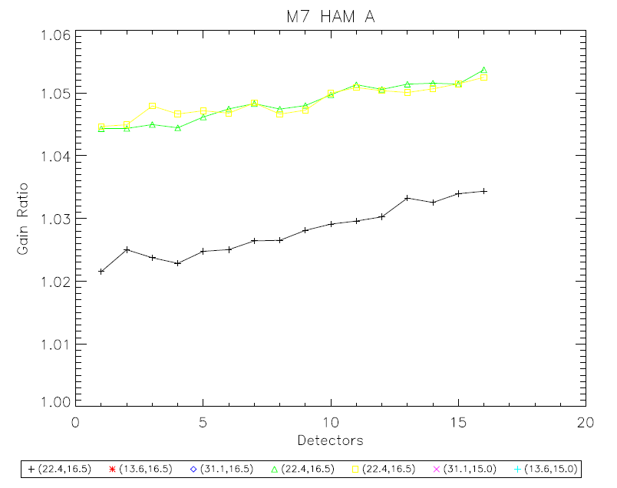
M7 gain ratio (SD/EV): Repeated Angle Measurements
Second and third repeats are consistent.
First measurement ~2% less than the others.

Slide 26
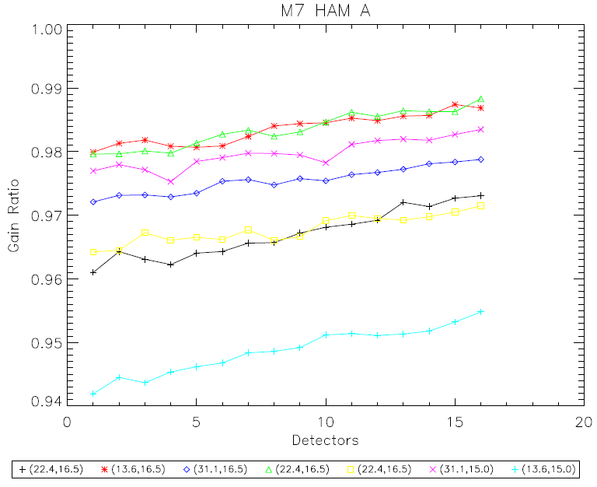
M6 gain ratio (SD/EV): Preliminary Collimator Correction Applied
Position | Collimator Correction Factor
1 | 0.940
2 | 0.937
3 | 0.933
4 | 0.936
5 | 0.924
6 | 0.926
7 | 0.933
Correction factors courtesy of Jim McCarthy (preliminary)
Preliminary correction only a middle detector
M6 gain ratio between 0.942 and 0.989 (before correction between 1.007 and 1.056)

Slide 27
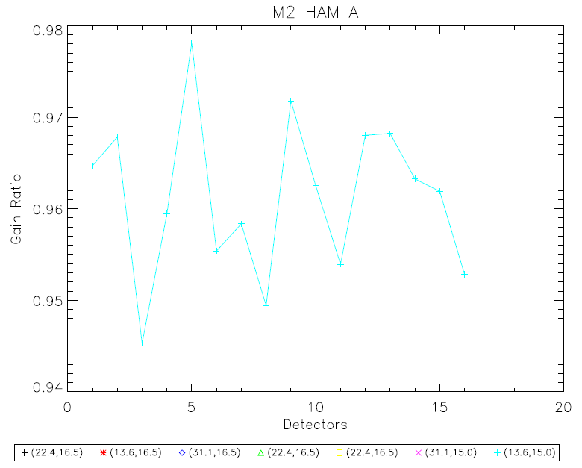
M2 gain ratio (SD/EV)
Gains are between 2% and 5.5% different between SD and EV.
Only measured at one position (AZ~13.6 DEC~15).
Signal is very low (dn_{SD}~6 and dn_{EV}~15).
M2 will not be considered further.

Slide 28
Uncertainty Estimate (in %)
 | Uncertainty (M6) | Uncertainty (M7)
Collimator irradiance
SIS radiance
SD AOI
BRDF | 1.09** | 1.09**
SAS screen transmission | 0.24** | 0.24**
RVS | 0.11 | 0.08
EV dn | 0.4 | 0.5
SD dn | 0.5 | 0.6
Total (RSS)
Uncertainties given in percent.
**Raytheon PVR

Slide 29
SDSM Background
SDSM – ratioing radiometer
Operates on a three scan cycle (SD, Solar, Dark)
SDSM position given by LRV 31003 and 31004
31003 indicates if the fold mirror is in home position (dark)
31004 indicates the position of the fold mirror (0 – dark, 28 – SD, 67 – solar)
Fold mirror directs light into an integrating sphere
Eight detectors (corresponding to M1-7 and 935 nm) inside the SIS
5 samples per detector per scan
LRV 11101 – 11140 extract the SDSM signal
11101 – 11108: sample 1 for detectors 1 – 8
Etc.
Comparison of the SD and Solar views allows for tracking changes in the BRDF

Slide 30
SDSM Ratio Methodology
Compare measured ratio of SD and Solar views in SDSM to calculated ratio.
Measured SDSM ratio is given by
Calculated SDSM ratio is given by
πsin²θ – solid angle of SDSM as viewed from the SD
τ_{SAS} – transmission of SAS screen
τ_{SDSM} – transmission of SDSM screen
cosθ_{SD} – cosine of SD AOI
cosθ_{SDSM} – cosine of SDSM AOI
BRDF_{SDSM} – BRDF of SD at SDSM AOR
Differences in irradiance in Solar and SD views not yet included.
Modulation in the SDSM SIS not yet included.

Slide 31
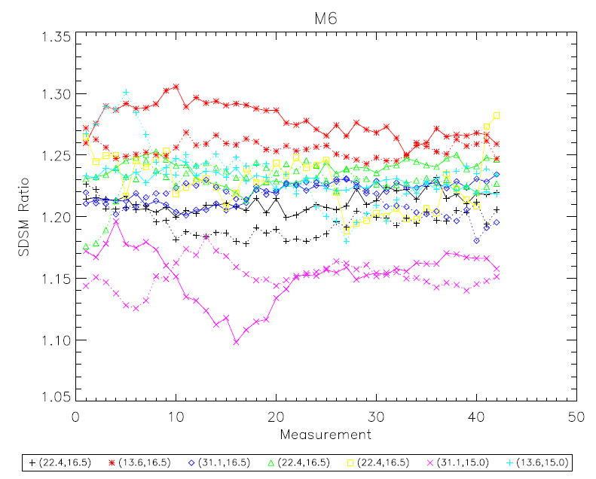
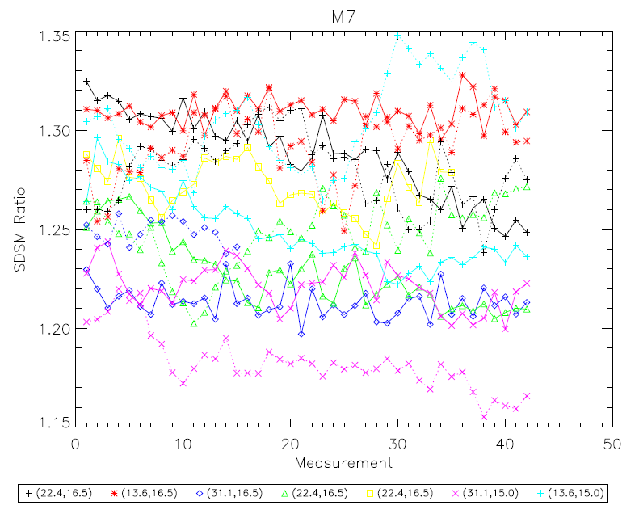
SDSM Ratio Stability
Solid lines – collect 1
Dashed lines – collect 4
Up to ~5% variation
Variation in solar view generally higher than in SD view

Slide 32
SDSM Ratio
Compare measured ratio of SD and Solar views in SDSM to calculated ratio.
Band | Wavelength | Azimuth | Declination | Measured Ratio | Calculated Ratio | Measured / Calculated
M6 | 742 | 22.52 | 16.31 | 1.204 | 1.212 | 0.993
M6 | 742 | 13.64 | 16.87 | 1.266 | 1.266 | 1.001
M6 | 742 | 30.09 | 16.34 | 1.217 | 1.190 | 1.023
M6 | 742 | 22.37 | 16.44 | 1.233 | 1.215 | 1.015
M6 | 742 | 22.38 | 16.52 | 1.228 | 1.218 | 1.008
M6 | 742 | 30.44 | 15.21 | 1.152 | 1.154 | 0.998
M6 | 742 | 13.63 | 15.07 | 1.233 | 1.229 | 1.003
Band | Wavelength | Azimuth | Declination | Measured Ratio | Calculated Ratio | Measured / Calculated
M7 | 852 | 22.52 | 16.31 | 1.284 | 1.207 | 1.064
M7 | 852 | 13.64 | 16.87 | 1.301 | 1.260 | 1.033
M7 | 852 | 30.09 | 16.34 | 1.231 | 1.185 | 1.039
M7 | 852 | 22.37 | 16.44 | 1.238 | 1.210 | 1.023
M7 | 852 | 22.38 | 16.52 | 1.272 | 1.213 | 1.049
M7 | 852 | 30.44 | 15.21 | 1.202 | 1.150 | 1.045
M7 | 852 | 13.63 | 15.07 | 1.276 | 1.224 | 1.043
Measured and calculated results agree to within 2.5% (M6) and 6.5% (M7).

Slide 33
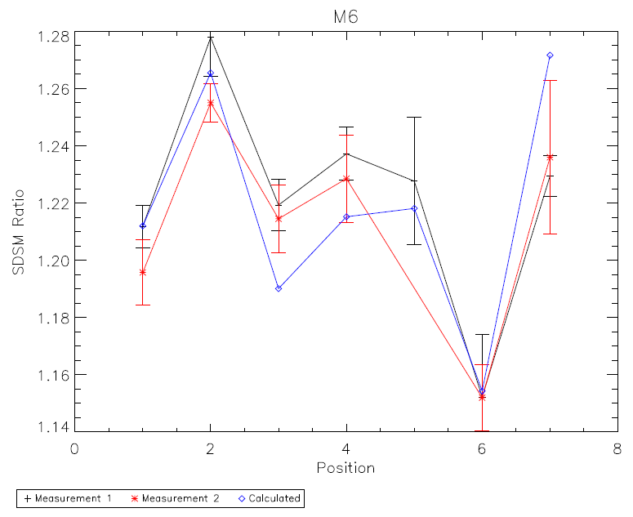
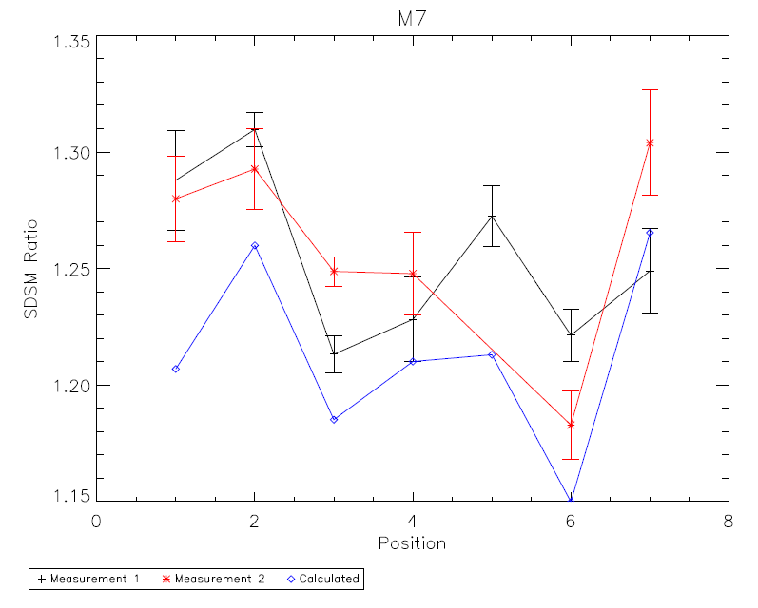
SDSM Ratio
Values shown with standard deviation
Measurement 1 – collect 1
Measurement 2 – collect 4

Slide 34
E2E Summary
SD / EV gain ratio is within 3.5% (M6) and 5.5% (M7) of one
Short term repeatability within 1% (M6) and 2% (M7)
Repeated positions consistent for second and third measurements and within 2% of first measurement
Preliminary collimator correction indicates ratio within 3.0% (M6) and 5.8% (M7)
SDSM measured and calculated ratios agree to within 2.5% (M6) and 6.5% (M7)
Results are preliminary
Collimator irradiance non-uniformity correction not yet fully applied
SDSM SIS modulation not yet applied

Slide 35
Backup Slides

Slide 36
SDSM Uncertainty Estimate (in %)
 | Uncertainty
SDSM screen transmission
SAS screen transmission | 0.24**
BRDF | 1.09**
SD AOI
SDSM AOI
SDSM SIS modulation
Solid angle of SDSM view of SD
Total (RSS)
Uncertainties given in percent.
**Raytheon PVR

