Slide 1
Cal/Val OPSCON Walk-Through and Rehearsal Plans
- VIIRS SDR Cal/Val Team -
Changyong Cao, Management Lead
Frank De Luccia, Technical Lead

Slide 2
Objectives
Identify operational scenarios for Cal/Val
Specify the infrastructure support required from GRAVITE and other assets
Identify needed Cross-team interactions with emphasis on EDR-SDR interactions
Identify interactions with external entities
Identify prioritized activities for Cal/Val Rehearsal

Slide 3
Team Structure and Membership
VIIRS SDR team comprised of members from six organizations
  NOAA STAR: Changyong Cao, Fuzhong Weng (SDR Chair), Mark Liu, Tim Chang
  Aerospace: Frank De Luccia, David Moyer, Scott Houchin, Kameron Rausch, Jason Cardema, Evan Haas, Christopher Florio, Patrick Yuen, Jeff Lipeles, Aaron Myrick, Zaven Petrosyan
  NASA: Jack Xiong (Instrument Scientist), Robert Wolfe, Hassan Oudrari, Jeff McIntire, Thomas Schwarting, Aisheng Wu, Shihyan Lee, Ning Lei, Mash Nishihama, Vincent Chiang
  University of Wisconsin: Chris Moeller
  MIT Lincoln Laboratory: Juliette Costa, Ed Bicknell
  NG: Lushalan Liao
Expect interaction with Raytheon Post-Delivery Support Team
= Present at workshop

Slide 4
VIIRS Task Categories
VIIRS SDR cal/val team will execute 50+ tasks falling into six broad task areas:
Functional Performance and Format (FPF) Evaluation: FPF tasks involve evaluating instrument functions and verifying the correctness of data formats. Tasks in this group are performed early in the mission, and will not be repeated unless the instrument suffers a catastrophic event.
Calibration System Evaluation (CSE): CSE tasks evaluate the performance of the onboard calibration system and update the calibration algorithm databases accordingly.
Image Quality Evaluation (IMG): IMG tasks evaluate the quantitative and qualitative spatial performance characteristics of the instrument.
Radiometric Evaluation (RAD): RAD tasks evaluate the radiometric performance of the data product algorithm. Radiometric evaluation will include evaluation of spectral characteristics since changes in these characteristics relative to the pre-launch baseline will mainly manifest themselves as in-band radiometric errors.
Geolocation Evaluation (GEO): GEO tasks evaluate the geolocation accuracy of the data product.
Performance and Telemetry Trending (PTT): PTT tasks evaluate long-term changes in the performance of both the instrument and the data product.

Slide 5
Team Member Task Assignments (1)

Slide 6
Team Member Task Assignments (2)

Slide 7
Team Member Task Assignments (3)

Slide 8
Operational Scenarios
VIIRS SDR cal/val activities are planned and executed as 50+ discrete tasks documented in VIIRS SDR Cal/Val Plan and appendix of OPSCON document
Operational scenario descriptions in the body of the OPSCON document describe cal/val activities in general terms per phase
  Pre-Launch preparation
  Early Orbit Checkout (EOC)
  Intensive Cal/Val (ICV)
  Long-Term Monitoring (LTM)
Tasks also fall into two distinct data flow scenarios, depending upon whether task is executed within GRAVITE environment or on Local Computing Facility of task lead
Tasks that generate LUT updates trigger two distinct scenarios for operationalization that should be rehearsed
  Fast track LUT changes supporting RSB calibration
  Non-routine LUT changes that require EDR impact evaluation

Slide 9
Data Flows
Data flows vary by organization
STAR data flows are driven by significant pulls of RDRs, OBC IPs and SDRs from GRAVITE and CLASS and large volumes of data from other satellites for inter-satellite comparisons
Aerospace and NG will execute tasks entirely within GRAVITE, minimizing large volume data flows
NASA will access data through the SDS and Land PEATE RDRs
UW and MIT LL will use GRAVITE as server and execute tasks at their LCFs

Slide 10
GRAVITE Usage
Aerospace and NG plan to execute tasks within GRAVITE environment
STAR, UW and MIT LL plan to use GRAVITE only as data server
NASA plans to acquire data from SDS and execute tasks on Land PEATE resources
Issue: Will VIIRS SDRs be available on GRAVITE for 34 day rolling window?
GRAVITE support team to perform reprocessing of SDRs on ADA with modified LUTs requested by EDR teams

Slide 11
SDS Usage
NASA plans to use data from the SDS, store data and execute tasks in the SDS NICSE and SDS VIIRS Land PEATE
UW plans to use data from the SDS, store data and execute tasks in the SDS VIIRS Atmosphere PEATE
SDS gets all of the RDR data from the NESDIS IDPS and all of the SDR and OBC data from NOAA CLASS (via the SDS SD3E)
SDS Usage: | As Data Server Only | As Primary Site of Data Processing | RDR Transfer Rate from SDS | OBC IP Transfer Rate from SDS | SDR Transfer Rate from SDS
NOAA STAR | No | No | Minimal | Minimal | Minimal
Aerospace | No | No | Minimal | Minimal | Minimal
NASA | No | Yes | Minimal | Minimal | Minimal
UW | No | Yes | Minimal | Minimal | Minimal
MIT LL | No | No | Minimal | Minimal | Minimal
NG | No | No | Minimal | Minimal | Minimal

Slide 12
Tools
Tools have been developed by each organization to execute their cal/val tasks
Tool inventories are documented in the OPSCON document per organization
Task leads and their support will run tools and maintain them
  Aerospace and NG will run tools on GRAVITE
  All other teams are running tools on their LCFs
Tools fall into two categories
  Utilities such as RDR readers, SDR readers, OBC IP readers and LUT readers/writers
  Custom tools for performing analysis specific to each task
    Many implemented in Matlab or IDL
Aerospace developed utilities will be made available to extended cal/val team through CasaNOSA distribution
Rehearsals will drive improvements to existing tools and identification and development of any missing tools

Slide 13
Cross-team Interactions
VIIRS SDR management lead and technical lead coordinate coordinate cross-team interactions with EDR team leads
  Weekly telecons
  Sharing of cal/val data products, tools, anomalies, cal/val findings
VIIRS SDR - Ocean EDR team interactions
  SDR gains/offsets that provide best SST performance will be provided by Ocean team to SDR team
    Assists in evaluation of non-routine LUT changes
  IR clear sky radiance monitoring (MICROS)
    Brightness temperatures (BTs) in VIISR SST bands will be evaluated for stability and consistency with corresponding BTs from AVHRR and MODIS
  SDR team is providing Mueller matrices for correcting VIIRS residual polarization to ocean color EDR team
VIIRS SDR – Land EDR team interactions
  SDR team provides measured transition levels for all dual gain bands
    M13 transition level of importance to Active Fire products
VIIRS SDR - CrIS SDR team interactions
  CrIS SDR data used for VIIRS spectral (RSR) validation (RAD-12)
  VIIRS Geolocation used by CrIS team as cross-check on CrIS Geolocation

Slide 14
Cross-Team Giver-Receiver Relationships
 | VIIRS SDR Team Provides
General items | Proposed LUT updates Modified SDRs – sampling DG band transition levels SDR quality and maturity status, RSRs, anomalies, …
CrIS SDR Team | VIIRS SDR Geolocation
Imagery EDR/VCM Team
Oceans EDR Team | Instrument polarization characteristics
Land EDR Team
Cloud/ Aerosol EDR Team
Cryo EDR Team
 | VIIRS SDR Team Receives
CrIS SDR Team | CrIS SDRs
Imagery EDR/VCM Team | Findings pertaining to Imagery artifacts (e.g., striping, banding, …) BBR
Oceans EDR Team | SST band gains/offsets SST band stability and consistency with other satellite data from MICROS
Land EDR Team | Surface reflectance from selected Aeronet sites (?)
Cloud/ Aerosol EDR Team
Cryo EDR Team

Slide 15
Interactions with Externals Entities
All teams will acquire IPs and SDRs from CLASS when not available on GRAVITE
  Communication and data acquisition mechanisms remain to be addressed
NASA will acquire data from SDS
Aerospace will execute most tasks using RDRs, IPs and SDRs available on GRAVITE during time window when available
  Need better definition of expiration period for IPs and SDRs (34 days?)
STAR may address near-real time issues working with NDE on NSOF

Slide 16
Cal/Val Rehearsal
  Readiness will be verified for all VIIRS SDR cal/val tasks prior to launch in one of two ways:
  Demonstration: Application of tools to proxy data sets using planned methodology to generate products of same type that will be generated on orbit
  Description of same or similar activity performed with same or similar tools on other programs
  Highest priority tasks targeted for demonstration in July/August rehearsals
    Tasks that verify functionality and key performance characteristics:
    Tasks that perform routine offline calibration and LUT updates
    Tasks that provide principal validation of SDR quality
  All other tasks that can be demonstrated will be demonstrated prior to launch
  Demo’s will be performed in conjunction with NCT4 and MR3 activities where feasible

Slide 17
Cal/Val Task Prioritization (1)

Slide 18
Cal/Val Task Prioritization (2)

Slide 19
Cal/Val Task Prioritization (3)

Slide 20
Cal/Val Task Prioritization (4)

Slide 21
RAD-15 TEB Response Characterization
Task Lead and Support
  Lead: David Moyer, Aerospace
  Support: Jeff McIntire, NICST; Vincent Chiang, NICSE
Objective
  To characterize and update the TEB radiometric response coefficients if detector performance deviates from the prelaunch values enough to affect EDR performance
Description
  Prerequisites and Conditions: SC Mode: Nominal, VIIRS Mode: Operational
  Methodology: Analyze OBC BB warmup/cooldown data in the OBC BB calibration sector at multiple OBC BB set points to determine the detector’s linear and nonlinear response characteristics.
  Necessary Tools:
    RDR Reader and LRV Extractor Tool
    Code for fitting VIIRS OBC BB radiance vs dn to determine TEB detector response.
    Code for updating TEB calibration coefficient LUTs using latest characterization.
Expected Results
  Calibration coefficients agree with the prelaunch warmup/cooldown coefficients.
  Updates to LUTs performed to track detector response changes.
Related Tasks
  None

Slide 22
RAD-15 TEB Response Characterization
Rehearsal Description
  Data Sets Used
    OBC BB warm-up data from SC TVAC data or synthesized
    RDR OBC BB warmup and cooldown regions in P72 or P72+ SVview data
    RDR telemetry packets in P72 or P72+ data
  Tools Used
      RDR data reader and LRV data extractor
      IDL code to fit the OBC BB radiance vs detector dn to characterize the detector response
      IDL code to update TEB gain coefficient LUTs
  Operations Performed
    Fit the OBC BB radiance vs dn to see if the TEB detector response has changed since prelaunch and update the a0 and a2 terms in the 2nd order fit if necessary. A look at the impact of the LUT changes in the SDR product will be performed to determine whether the new response values improve the SDR product.
  Rehearsal Products
  Computed TEB response coefficients using warmup data (“dummy” product only)
  LUT update and comparison with previous values (“dummy” product only)
Success Criteria
  Tools applied to data implement the task methodology as planned
  Rehearsal products simulate products expected from on-orbit task

Slide 23
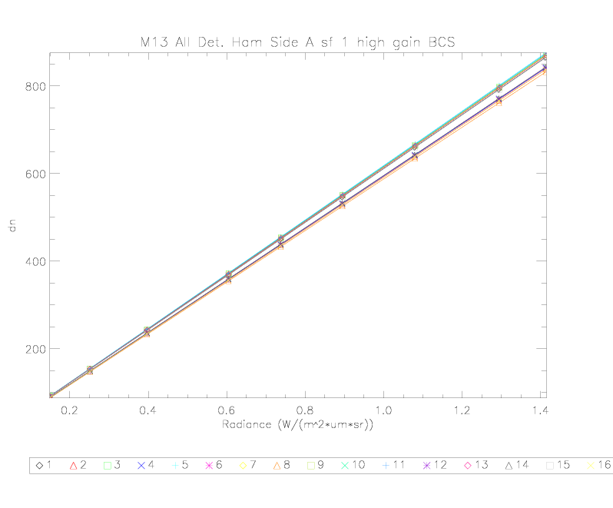
RAD-15 TEB Response Characterization
Example of dn vs OBC BB radiance used to characterize the detector response. Band M13, HAM A, high gain and all detectors is shown here.

Slide 24
VIIRS SDR Task RAD9: NPP/VIIRS Intersatellite Comparison with Aqua/MODIS
TASK LEAD:
  Changyong Cao, STAR
OBJECTIVE:
  To perform extended Simultaneous Nadir Overpass (SNO-x) SDR comparisons between VIIRS and MODIS bands at both high and low latitudes.
DESCRIPTION:
  Method and tool:
  1) Predict SNO-x events using two-line elements and orbital perturbation models (SGP4 and STK).
  2) Perform pixel-by-pixel collocation between the matching bands of VIIRS and MODIS.
  3) Perform correlation analysis with uncertainty estimates.
  Cal/Val phases: Sensor Checkout, ICV, and longterm monitoring
  Sensor mod and data type: All modes, and RDRs and SDRs.
Expected Results:
Radiometric consistency between VIIRS and MODIS for all matching bands within the sensor specification
Related tasks:
RAD8, RAD10, RAD12, RAD13
References:
see notes section
Notes:
References:
Cao, C., X. Xiong, A. Wu, and X. Wu, 2008, Assessing the consistency of AVHRR and MODIS L1B reflectance for generating fundamental climate data records, Journal of Geophysical Research, 1, 113, D09114, doi:10.1029/2007JD009363, 2008
Cao, C., M. Weinreb, and H. Xu, 2004, Predicting simultaneous nadir overpasses among polar-orbiting meteorological satellites for the intersatellite calibration of radiometers. Journal of Atmospheric and Oceanic Technology, 21, April 2004, pp. 537-542.
Cao, C., and A. Heidinger, 2002, Inter-comparison of the longwave infrared channels of MODIS and AVHRR/NOAA-16 using simultaneous nadir observations at orbit intersections
Proc. SPIE 4814, 306 (2002); doi:10.1117/12.451690

Slide 25
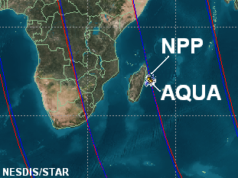
SNO-x between NPP and Aqua
Excellent SNO event: NPP is right on top of AQUA
SNOs between Aqua and NPP will occur at different latitudes, every 2-3 days,
Occasionally NPP can be right above Aqua even in the low latitudes for a large part of the orbit which leads to extended SNOs (or SNO-x), providing excellent opportunities for inter-comparisons (see figure on right)
Orbital parameters are from TLEs dated 01/25/03, assuming their orbits do not change over time. Results cross validated between STK and SGP4
Example SNO-x event between NPP and Aqua

Slide 26
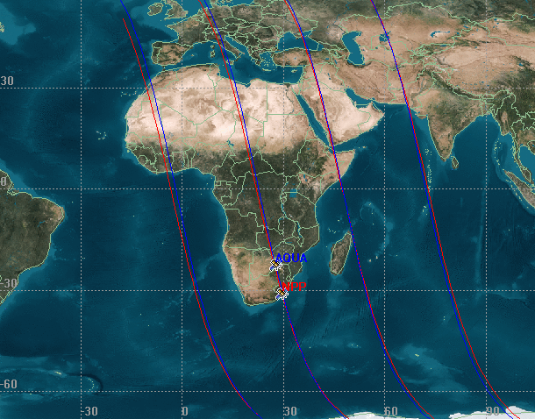
Extended Simultaneous Nadir Overpass (SNO-x)
-New Opportunities for NPP Inter-calibration
In an SNO-x event, NPP will fly on top of the AQUA for a large range of latitudes along-track, in contrast to the polar SNOs in traditional scenarios.
Inter-calibration at SNO-x will greatly reduce the uncertainties due to its larger range of observing conditions, along with new inter-calibration opportunities
Figure shows the NPP/AQUA orbit converging and diverging dynamics, due to their velocity differences
Orbital analysis show SNO-x opportunities for enhanced inter-satellite calibration

Slide 27
SNO-x Latitude Distribution for One Year
Criteria: within 100km nadir distance (nearly 1600 events found)
Note: uncertainties exist because the actual orbit may vary and change over time for the required accuracy

Slide 28
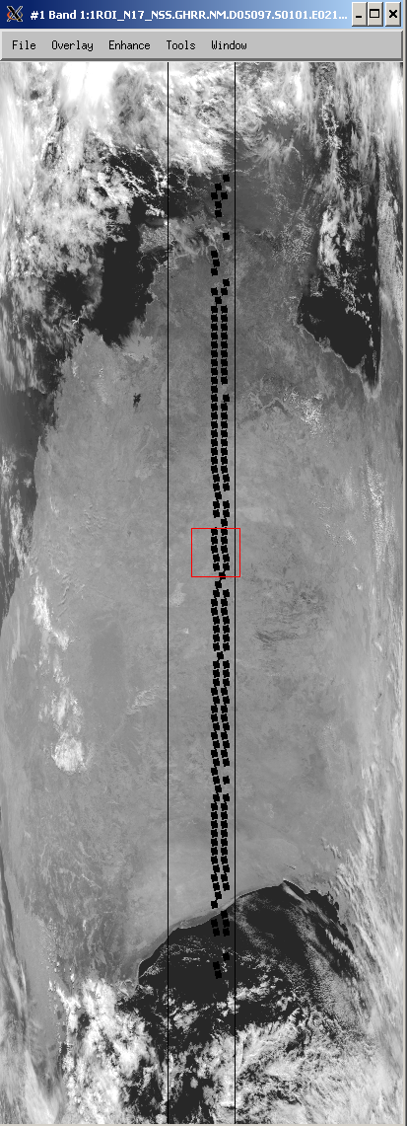
SNO-x Analysis Using Terra/MODIS and NOAA-17/AVHRR as Proxy (similar scenario)
Only scenes with SNO time difference <= 20 seconds and SNO latitudes < 70 degrees were considered.
The nadir lines intersect within 2⁰
N17 : +/- 10 deg
Terra
N17

Slide 29
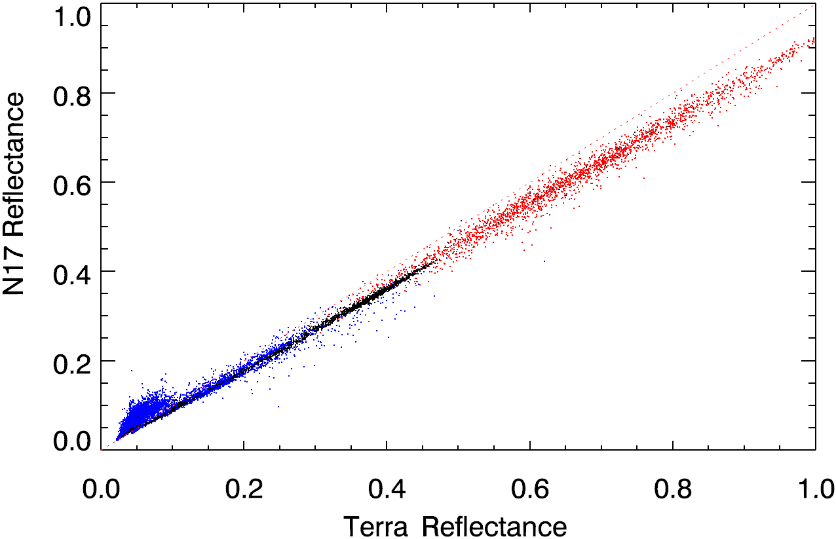
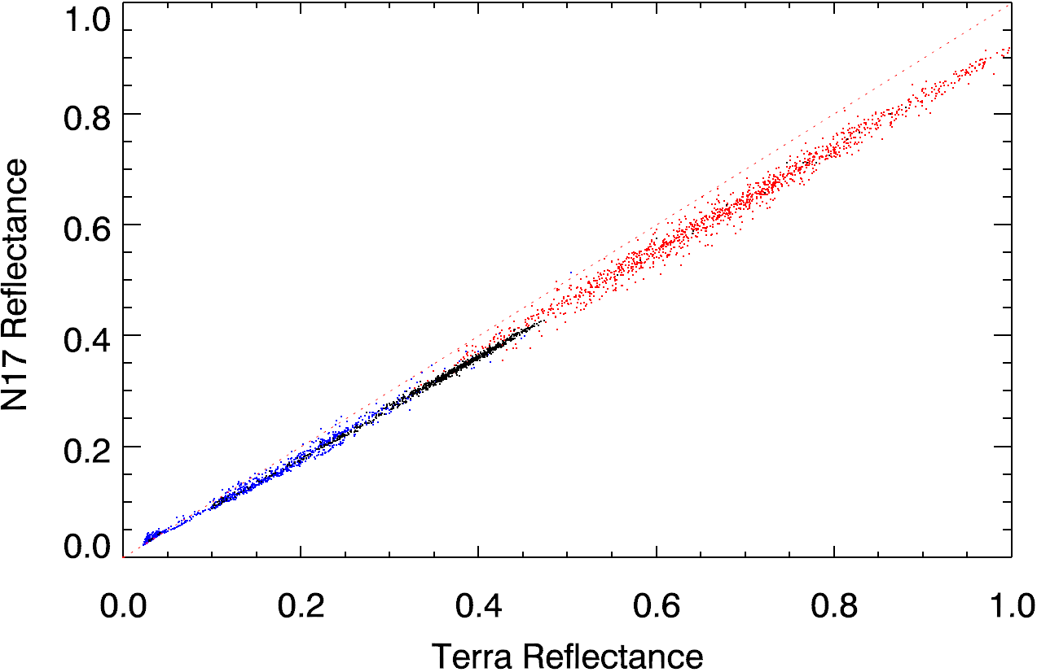
Sample Results from Correlation Analysis
46 SNO scenes (SNO time difference <= 20 seconds and latitude <70⁰) are used.
NOAA17/AVHRR reflectance lower than that of MODIS at high reflectance due to AVHRR calibration traceability (Cao et al., JGR, 2008)
Larger discrepancy (AVHRR higher) at low reflectance (< 5% reflectance) only partially resolved with cloud screening. RSR differences is also responsible.
Uncertainty of analysis (Residual stdev): Before screening: 1.69%, after: 1.04%
Sensor zenith angle and other trade studies also performed
11126 data points
Before cloud screening
Blue: Low Gain (AVHRR)
Red: High Gain (AVHRR)
Black: SNO orbit passing Africa
3303 data points
After cloud screening

Slide 30
VIIRS SDR Task PTT7: TELEMETRY TRENDING MONITORING
TASK LEAD:
  Fuzhong Weng, Ninghai Sun, and Changyong Cao, STAR
OBJECTIVE:
Provide near real time instrument telemetry monitoring to support VIIRS onboard calibration
Method and tool:
  1) Obtain OBC and related files.
  2) Process them to extract telemetry information.
  3) Make plots to put them on the website.
Cal/Val phases: Sensor Checkout, ICV, and longterm monitoring
Sensor mod and data type: All modes, and SDRs.
Expected Results:
Trending plots on the website
Related tasks:
PTT1-6
References:
Notes:
References:
Cao, C., X. Xiong, A. Wu, and X. Wu, 2008, Assessing the consistency of AVHRR and MODIS L1B reflectance for generating fundamental climate data records, Journal of Geophysical Research, 1, 113, D09114, doi:10.1029/2007JD009363, 2008
Cao, C., M. Weinreb, and H. Xu, 2004, Predicting simultaneous nadir overpasses among polar-orbiting meteorological satellites for the intersatellite calibration of radiometers. Journal of Atmospheric and Oceanic Technology, 21, April 2004, pp. 537-542.
Cao, C., and A. Heidinger, 2002, Inter-comparison of the longwave infrared channels of MODIS and AVHRR/NOAA-16 using simultaneous nadir observations at orbit intersections
Proc. SPIE 4814, 306 (2002); doi:10.1117/12.451690

Slide 31
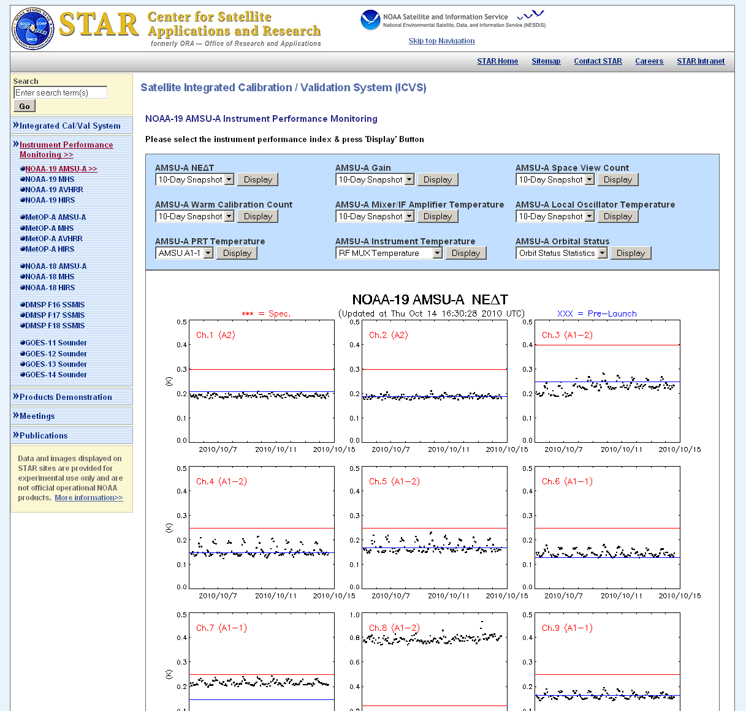
Instrument Performance Monitoring System (IPMS) Overview
  NOAA-19, MetOP-A, NOAA-18
  AMSU-A
  MHS
  AVHRR
  HIRS
  DMSP F-16, F-17, F-18 SSMIS
  GOES 11/12/13/14/15 Sounder

Slide 32
IPMS Overview - Parameters
 | AMSU-A | MHS | HIRS | AVHRR | SSMIS | GOES
Noise Equivalent Temperature Difference (NEΔT) | 15 Channels | 5 Channels | 20 Channels (NEΔN) | 3 IR Channels | N/A | 18 (NEΔN) 18 (NEΔT)
Gain | 15 Channels | 5 Channels | 20 Channels | 3 IR Channels | 24 Channels | N/A
Warm Load Calibration Count | 15 Channels | 5 Channels | 20 Channels | 3 IR Channels | 24 Channels | 18 Channels (internal)
Cold Space Calibration Count | 15 Channels | 5 Channels | 20 Channels | 5 Channels | 24 Channels | 18 Channels (internal)
Warm Load PRT Temperature | 3 per Unit (A1-1/A1-2/A2) | 5 Readings | 4 Warm 1 Cold | 4 Readings | 3 Readings | internal
Digital Housekeeping Telemetry | 45 | 24 | 20 | 12 | 28 | internal
Analog Housekeeping Telemetry | 27 | 18 | 16 | 22 | N/A | internal
Orbital Status/Statistics | QC/Calib. Flag | QC/Calib. Flag | QC/Calib. Flag | QC/Calib. Flag | N/A | N/A
Tb Bias | 12 Channels (internal) | 5 Channels (internal) | N/A | N/A | 24 Channels (internal) | 18 Channels (AIRS/IASI)

Slide 33
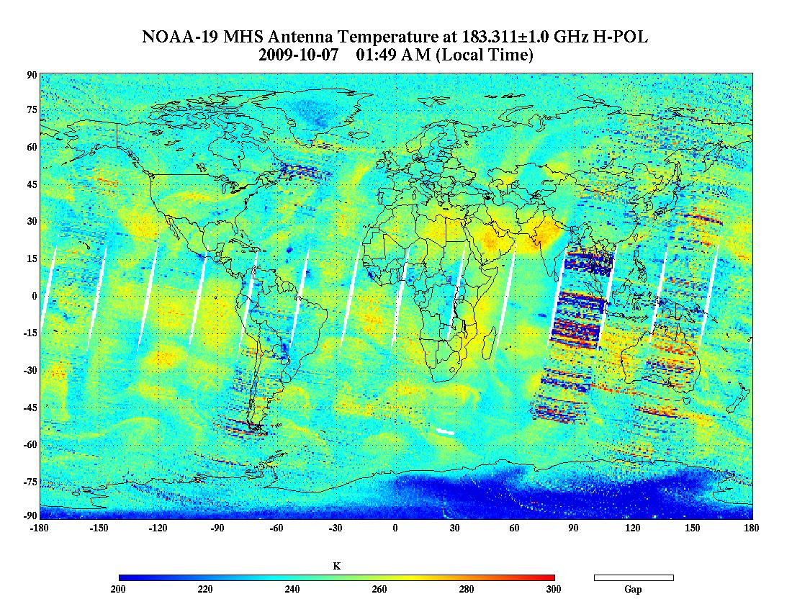
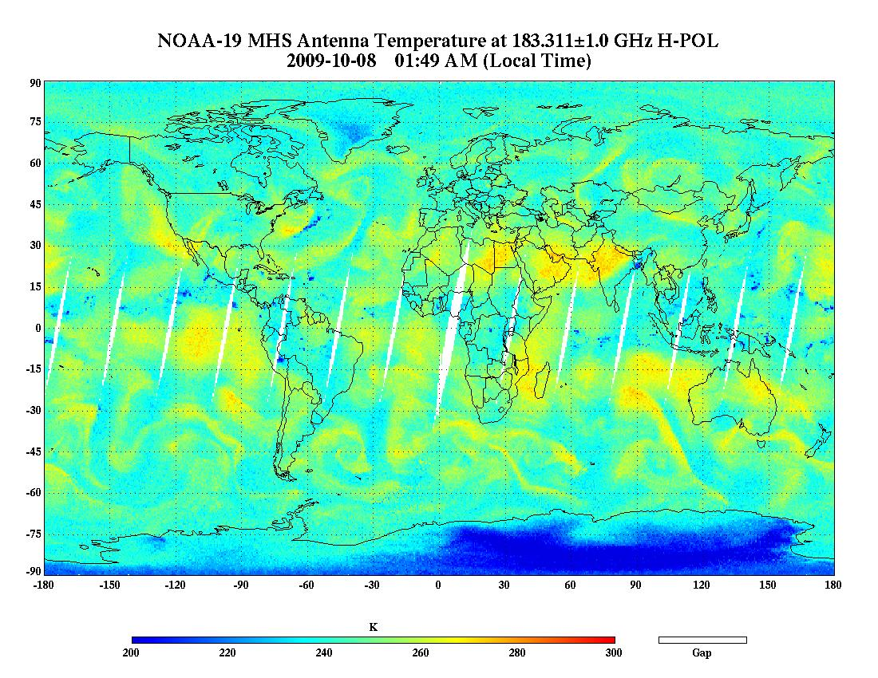
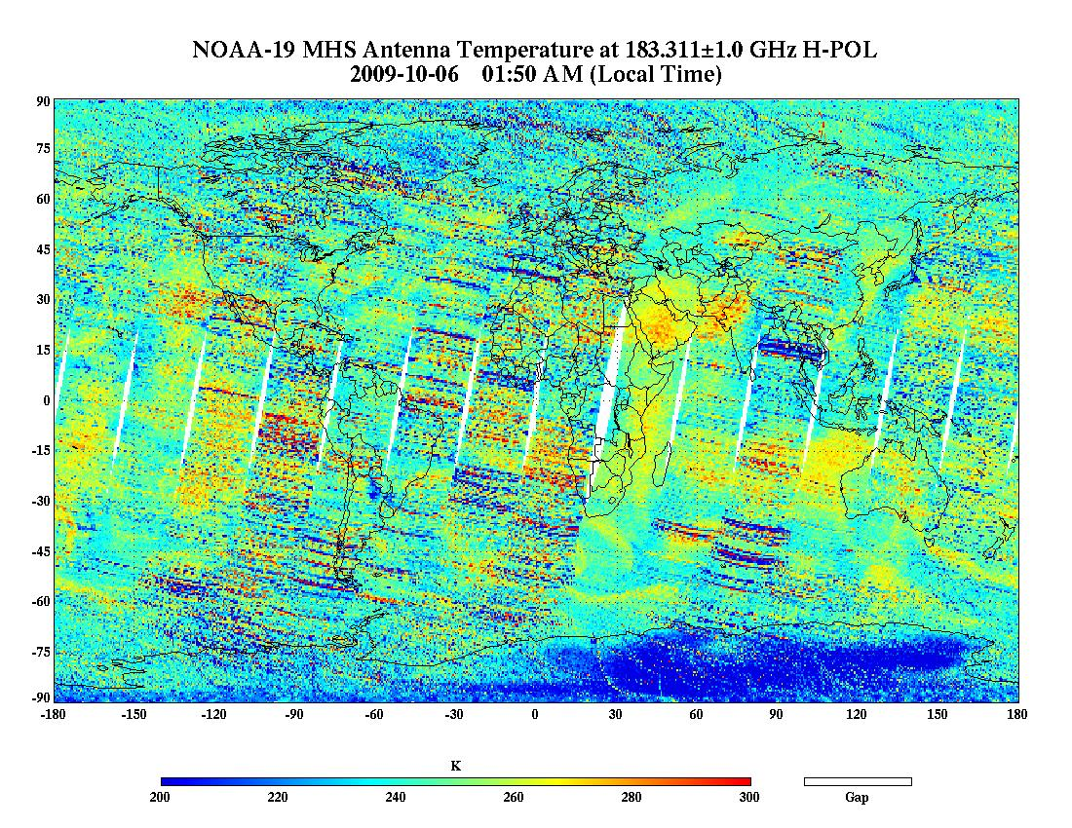
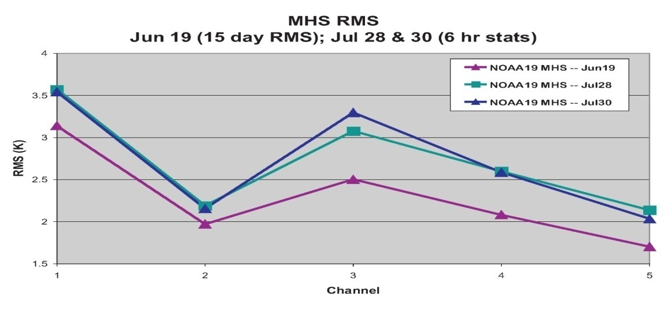
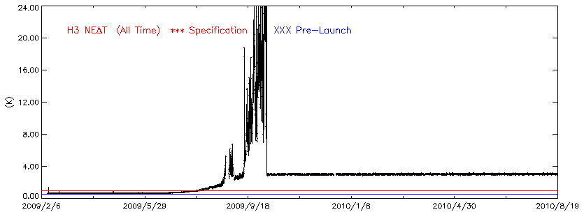
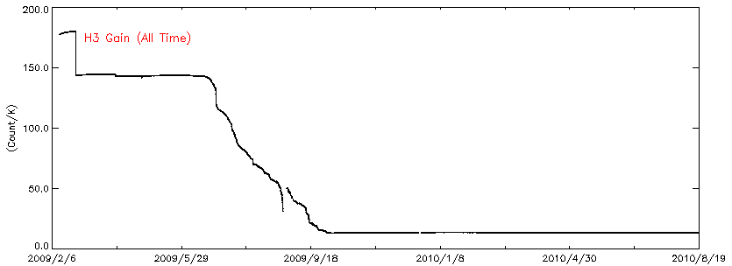
Examples

Slide 34
VIIRS F1 SDR/GEO
Cal/Val Rehearsal Plans for
Tasks GEO-1 through GEO-7
Mash Nishihama and Robert Wolfe
NASA’s
NPP Instrument Characterization Support Team (NICST) and
NPP Science Data Segment (SDS)
NPP Instrument Characterization Support Element (NICSE)
May 31, 2011

Slide 35
NCSE/GEO Task Lead and Support Personnel
- Lead: Robert Wolfe
- Support: Mash Nishihama, Gary Lin, Sue gao
Experience in Geolocation Error Analysis for NCT3 Part2
Files received from Land PEATE
• 288 (I-band) aggregated geolocation files (hdf4),
• 287 (I-band) aggregated SDR files (hdf4),
• 283 (M-band)aggregated SDR files (hdf4),
• 176 GeoMatch residual files (hdf5)
Note:
1. No. of scans in an aggregated file varies from 96 to 192 scans,
2. During the pairing process of SDR and geolocation files, quite
a few missing granules were discovered. Some files did nit have
corresponding Geo or SDR filers.
3. 120 pairs of files (Geo & SDR) are selected from 288 Geo and 287
SDR files for quick-look Geo/SDR check by generating gridded
images and found quite a few bad SDR images.

Slide 36
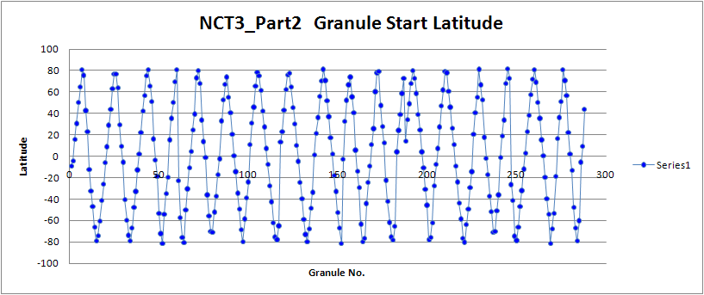
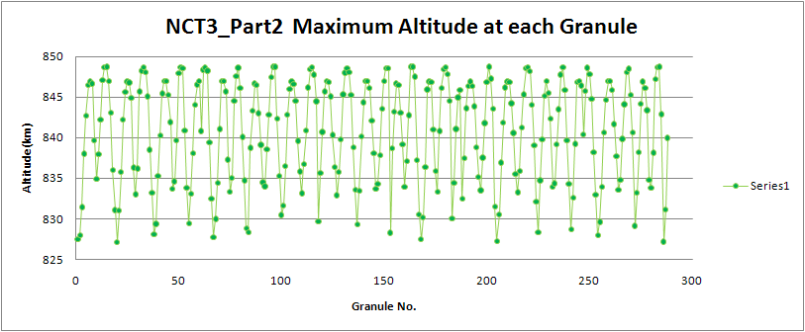
GEO-1: Spacecraft Ephemeris and Attitude Data Analysis
• Spacecraft position and velocity information was extract from 288 geolocation files, and latitude and height values were calculated.
Figure 1.
Figure 2.
Note: The extraction tool for ephemeris/attitude from HK telemetry is under development and s/c
information was extracted from Geo files.

Slide 37
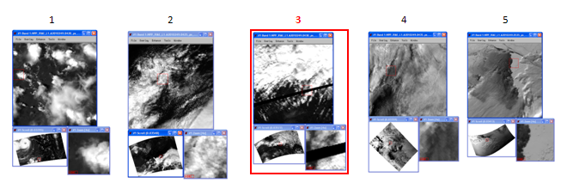
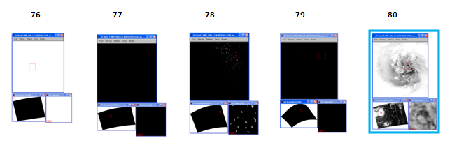
GEO-3: Assess Geolocation/SDR
• Methodology
- Use VIIRS_SwathToGrid program to generated gridded image
from Geo and SDR and to find artifacts and geolocation error
• Some images and Artifacts
- Some missing scans, repeated images from image 1
corresponds to image 80
- Completely missing or almost dark images.

Slide 38
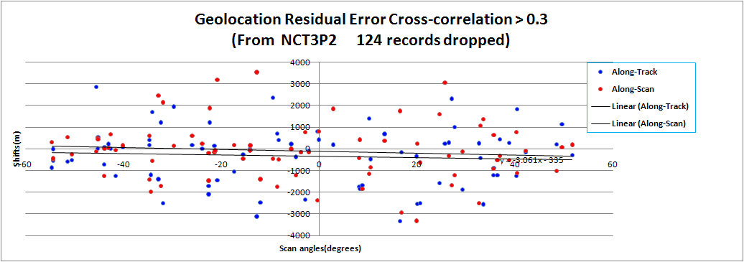
GEO-4/5/6 /7: Generate simulated image from TM chips and perform
cross-correlation with subset of SDR, estimate residuals and generate
statistics
- 176 geolocation residual files (generated by Land PEATE) were merged and along-track/scan shifts are reported with statistics.
- Along-track/scan shifts are displayed in the figure below and in tabular form (next slide).

Slide 39
Geolocation control point statistics (from NCT3P2)
213 files merged_for NCT3P2
Production Date: Tue Apr 12 17:15:23 2011 Begin/End Time: 557987772.058120 2010-09-07T04:35:56.748358Z 2010-09-08T20:59:53.101065Z (UTC)
Start S/C Postion: -1014018.625000 2492926.750000 6681745.500000 End S/C position: -2624232.000000 -4618233.000000 4866102.500000 (m)
S/C Start/End Postion: lon: 112.134441 lat: 68.178992 h: 843650.609378 lon: -119.606664 lat: 42.662354 h: 835366.254991
No. ChipID Scan No M_side Time ZoneNo Corr Track_shift Scan_shift Total_shift Scan_angle(degs)
0 1059 59 255 2010-09-07T19:16:48.133787Z 1 0.4194 -873.0198 308.0962 925.7898 -54.6896
1 1016 33 255 2010-09-07T19:16:01.688167Z 1 0.3757 -537.4605 -473.9741 716.5998 -54.4360
2 1415 33 255 2010-09-07T19:16:01.688167Z 1 0.3194 -14.0549 -439.6263 439.8509 -54.4324
3 1060 62 255 2010-09-07T19:16:53.492913Z 1 0.1300 822.1531 25.4219 822.5460 -54.2378
4 1082 52 255 2010-09-07T19:16:35.629196Z 1 0.0758 822.6992 50.7858 824.2652 -53.9949
5 2811 32 255 2010-09-08T12:41:32.054846Z 1 0.0295 -151.7143 -72.9641 168.3478 -53.9521
: : : :
120 3862 162 255 2010-09-07T17:50:15.186873Z 3 0.4108 -154.5511 -153.7178 217.9798 -3.7786
121 1524 53 255 2010-09-07T10:57:19.771703Z 3 0.1623 -28.6445 -463.3785 464.2630 -3.2643
122 2065 64 255 2010-09-07T10:57:39.423495Z 3 0.3010 -2335.3537 765.6947 2457.6748 -2.8411
123 1525 48 255 2010-09-07T10:57:10.845283Z 3 0.9594 -84.0152 -149.9477 171.8804 -2.1447
124 1526 58 255 2010-09-07T10:57:28.711364Z 3 0.0942 628.8309 -660.3896 911.8897 -1.6947
125 3332 45 255 2010-09-07T06:12:35.582650Z 3 0.4678 795.5372 -2381.6952 2511.0459 -0.3661
126 3741 57 255 2010-09-08T09:27:24.175934Z 3 0.4209 417.6488 810.6166 911.8826 -0.0661
127 3331 48 255 2010-09-07T06:12:40.945070Z 3 0.1246 -217.5737 166.1565 273.7632 0.4482
128 3743 52 255 2010-09-08T09:27:15.251235Z 3 0.0504 295.9611 -19.9233 296.6310 1.3750
129 3745 58 255 2010-09-08T09:27:25.975921Z 3 0.5630 195.1358 1845.4709 1855.7588 2.8161
130 3925 29 255 2010-09-07T11:16:32.013156Z 3 0.2333 1517.5447 -543.2441 1611.8486 3.3732
131 3924 29 255 2010-09-07T11:16:32.021100Z 3 0.1038 -1.6126 236.3646 236.3701 5.0340
: : : :
194 3275 117 255 2010-09-07T04:39:26.261705Z 1 0.1827 1062.6775 435.7197 1148.5360 46.4592
195 2115 128 255 2010-09-07T17:25:04.173172Z 1 0.1556 980.5594 289.9688 1022.5354 47.9163
196 3281 111 255 2010-09-07T04:39:15.553571Z 1 0.2529 148.5783 -316.8444 349.9512 48.4520
197 3195 114 255 2010-09-08T07:59:29.265993Z 1 0.3639 208.5267 -1026.0744 1047.0492 48.5288
198 3965 86 255 2010-09-08T19:28:34.271212Z 1 0.5227 1134.8603 65.4652 1136.7469 49.6395
199 3191 112 255 2010-09-08T07:59:25.699714Z 1 0.2551 -150.9697 2.8082 150.9958 49.9020
200 3961 90 255 2010-09-08T19:28:41.426946Z 1 0.4663 -300.5576 187.5587 354.2784 51.7181
201 2434 66 255 2010-09-07T17:23:13.450099Z 1 0.2010 1417.6730 22.8189 1417.8566 54.3449
STATISTCS
+++++++++++++++++++++++++++++++++++++++++++++++++++++++++++++++++++++++++++++++++++++++
RMS(m) Mean(m) Sigma(m) RMS(m) Mean(m) Sigma(m)
Track Dir Track Dir Track Dir Scan Dir Scan Dir Scan Dir
------------- ------------- ------------ ----------- ------------ ----------
1085.8539 -104.0350 1080.8586 1009.5666 -30.3248 1009.1110
================================================================================================

Slide 40
Rehearsal Plan
- GEO-1 Access Raw and/or Verified RDR and read out APID 11 (spacecraft ephemeris/attitude) and perform analysis (if a tool available – see note 1).
- GEO-2 Extract RTA/HAM encoder data from Raw and/or Verified RDR and make analysis on scan profile and look for artifacts (if a tool available – see note 1).
- GEO-3 Analysis of geolocation file by itself or with SDR. Compare internal scan geometry with Landsat scene (if tool available – see note 2).
- GEO-4/5/6/7
Perform geolocation error analysis running GeoMatch/Merge Display programs.
Notes:
1. A tool to read a raw RDR and extract RTA/HAM encoder data is under consideration.
2. A tool to insert a Landsat scene in a SDR like image using geolocation in under developed.

Slide 41
Issues/Concerns
Can’t demo very high priority solar cal tasks without ADL 3
  Solar cal code missing from earlier ADL versions of VSDRP
  Request beta version of ADL 3 VIIRS code
  If not available, demo of these tasks will be delayed
EDR-SDR interactions not defined for some EDR disciplines
Readiness of GRAVITE to host cal/val demonstrations in July
  VPN access provided early enough to allow demo of data pulls and tasks to be executed on GRAVITE
  Availability of Matlab/IDL licenses
  Uniform configuration on all machines
Competition for limited Matlab and IDL floating licenses on GRAVITE (3 each?) may be major issue if teams other than Aerospace are using same licenses
  If Aerospace can’t perform tasks efficiently within GRAVITE environment, fallback is to use GRAVITE as data server only and perform tasks on LCF

Slide 42
Back-Up

Slide 43
CSE-2 OBC BB Temperature Uniformity
Task Lead and Support
  Lead: David Moyer, Aerospace
  Support: Jeff McIntire, NICST; Vincent Chiang, NICSE
Objective
  To evaluate OBC BB performance by looking at the thermistor temperature uniformity under multiple VIIRS thermal gradients and BB temperature set points.
Description
  Prerequisites and Conditions: SC Mode: Nominal, VIIRS Mode: Operational
  Methodology: Trend operation day and night thermistor telemtry under different VIIRS thermal loads and OBC BB warmup/cooldown data to investigate thermistor uniformity.
  Necessary Tools:
    LRV Data Extractor
    Code for plotting thermistor temperatures vs time
Expected Results
  Uniformity agrees with prelaunch TVAC data where thermal loading was simlar.
  Unexpected thermistor gradients indicating OBC BB temperature nonuniformity due to thermistor failure or unexpected thermal loading of the OBC cavity.
Related Tasks
  RAD-15 TEB Radiometric Calibration

Slide 44
CSE-2 OBC BB Temperature Uniformity
Rehearsal Description
  Data Sets Used
    RDR telemetry values in P72 engineering packets
      Operational day for larger VIIRS thermal gradients
      Operational night for low VIIRS thermal gradients
      Operation night for warmup/cooldown data for different OBC BB set temperatures
  Tools Used
      LRV data reader
      IDL code to plot the thermistor temperatures vs time to evaluate uniformity (not available yet)
  Operations Performed
    Look at OBC BB temperature values over time to see if the control of the BB is stable and the thermal loading from the OBC BB cavity does not affect the radiometric performance of the BB
  Rehearsal Products
  Trending of the OBC BB thermistor data over time showing thermal variablility of the OBC BB
  Trending of the OBC BB thermistor data during the OBC BB warmup/cooldown to see uniformity over OBC BB at multiple set points.
Success Criteria
  Tools applied to data implement the task methodology as planned
  Rehearsal products simulate products expected from on-orbit task

Slide 45
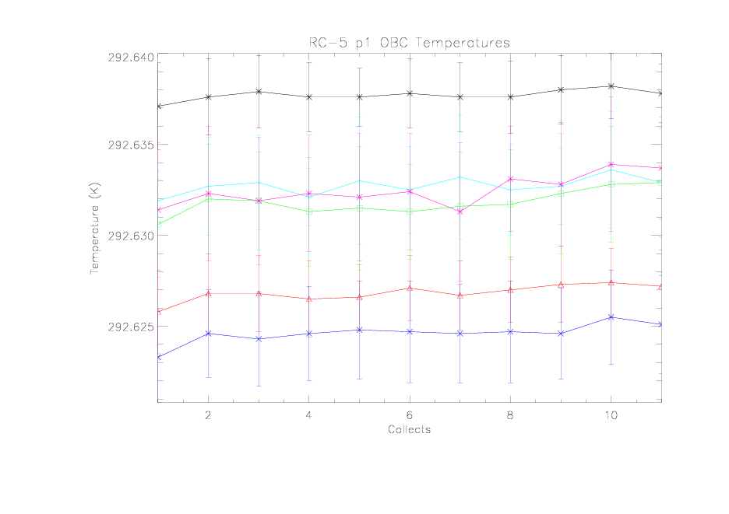
CSE-2 OBC BB Temperature Uniformity
Time trend of OBC BB thermistor data with uncertainty bars containing the scan averaged variations.

Slide 46
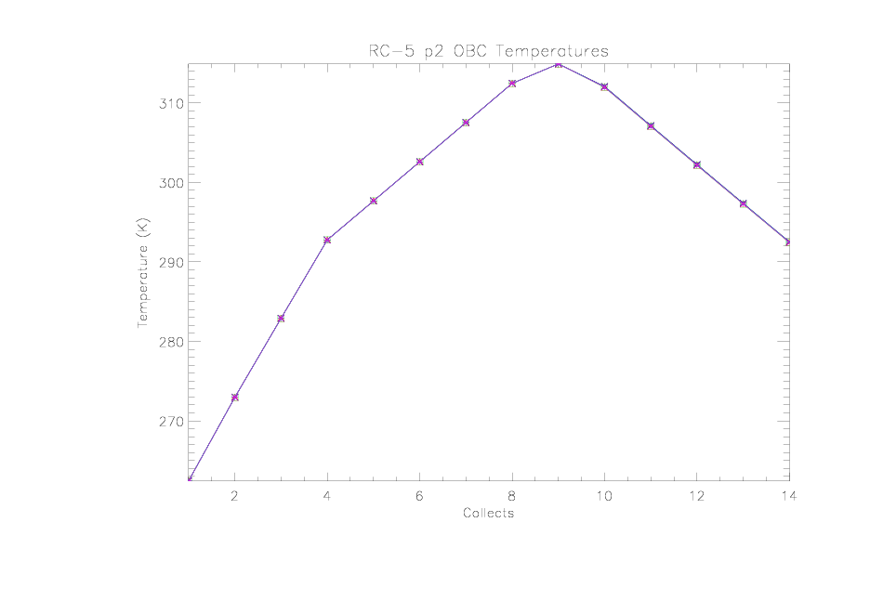
CSE-2 OBC BB Temperature Uniformity
Time trend of OBC BB warmup cooldown thermistor data with uncertainty bars containing the scan averaged variations.

Slide 47
IMG-1 Crosstalk, Ghosting and Echo Investigation
Task Lead and Support
  Lead: David Moyer, Aerospace
  Support: Gary Lin, NICSE; Thomas Schwarting, NICST; Shihyan Lee, NICST
Objective
  To search for evidence of crosstalk, echoes, and ghosts in high-contrast scenes, and to characterize artifacts to the extent feasible
Description
  Prerequisites and Conditions: SC Mode: Nominal, VIIRS Mode: Operational
  Methodology: Analyze scenes containing sharp edges in the track or scan directions to identify and characterize crosstalk, echoes, or ghosts. Compare findings with artifacts identified in pre-launch testing.
  Necessary Tools:
    SDR Reader with Visualization
    Code for plotting radiance vs sample number
Expected Results
  Anomalous features associated with known effects (e.g., crosstalk) correlate to pre-launch observations
  Unexpected anomalous features characterized and possible mechanisms identified
Related Tasks
  RAD-2 Crosstalk from Emissive Bands to Reflective Bands
  IMG-3 Moon Echo and Ghost Check

Slide 48
IMG-1 Crosstalk, Ghosting and Echo Investigation
Rehearsal Description
  Data Sets Used
    SDR coastal and island regions in P72 earth view data
      Operational day for the RSBs and TEBs to investigate detector-to-detector effects
      Operational night for TEB → RSB and TEB → TEB effects
  Tools Used
      SDR data reader
      IDL code to plot the detector radiance vs sample to look for anomalous responses (not available yet)
  Operations Performed
    Look for features in low radiance regions that are viewed simultaneously with bright radiance regions (exploit band-to-band timing delays)
  Rehearsal Products
  Identification of anomalous features in images (“dummy” product only)
  Quantification of crosstalk magnitude and correlation with pre-launch crosstalk images (“dummy” product only)
Success Criteria
  Tools applied to data implement the task methodology as planned
  Rehearsal products simulate products expected from on-orbit task

Slide 49
FPF-4 Dual Gain Band and DNB Transition Verification
Task Lead and Support
  Lead: Kameron Rausch, Aerospace
  Support: Dave Moyer and Christopher Florio , Aerospace; Ning Lei, NASA NICST
Objective
  Determine radiance levels at which transitions occur on a per detector basis
  Verify that the transitions are within the Sensor Spec required ranges
  Verify continuity of retrieved radiance across the gain transition
    Quantify and report any discontinuities
Description
  Prerequisites and Conditions: SC Mode: Nominal, VIIRS Mode: Operational
  Methodology: Generate gain state map from gain bits and correlate with retrieved radiances
  Necessary Tools:
    SDR Reader
    Code to generate gain bit vs scene radiance plots
Expected Results
  A table giving the radiances where the gain transition from high-to-low and also from low-to-high occur, including compliance/non-compliance flag
  A table giving the observed discontinuities in radiance across gain transitions or upper bounds on any discontinuity
Related Tasks
  RAD-25

Slide 50
FPF-4 Dual Gain Band and DNB Transition Verification
Rehearsal Description
  Data Sets Used
    SDR values in P72 data
      Large sets of contiguous data which hopefully will have many radiance levels near the gain transition.
  Tools Used
    SDR reader
    Matlab code to plot gain bit vs. scene radiance
  Operations Performed
    Determine the radiance at which transitions occur
  Rehearsal Products
  A table giving the radiances where the gain transition from high-to-low and also from low-to-high occur, including compliance/non-compliance flag
  A table giving the observed discontinuities in radiance across gain transitions or upper bounds on any discontinuity
Success Criteria
  Tools applied to data implement the task methodology as planned
  Rehearsal products simulate products expected from on-orbit task

Slide 51
FPF-4 Dual Gain Band and DNB Transition Verification
Plot gain bit vs. retrieved scene radiance to determine the radiances where bands transition from one gain mode to another.

Slide 52
FPF-4 Dual Gain Band and DNB Transition Verification
Final Product
Table listing transition radiances for all dual gain bands (per detector)

Slide 53
CSE-4 , Temporal Analysis of SD Signal Over Polar Region
Task Lead and Support
  Lead: Kameron Rausch, Aerospace
  Support: Jack Xiong, Junqiang Sun, Ning Lei, NASA NICST
Objective
  Analyze solar calibration data as a function of time to determine the optimal averaging period for solar diffuser data to support reflective band calibration
  Determine the optimal averaging period throughout the year
Description
  Prerequisites and Conditions: SC Mode: Nominal, VIIRS Mode: Operational
  Methodology: Generate time series of SD signal and calibration scale factors from the SDR Calibration IP. Verify that scale factors calculated by IDPS and output in Solar Diffuser files are correct. Use different filtering and data smoothing approaches to generate tentative calibration gain updates for reflective bands. Apply the tentative scale updates to select uniform scenes to find the approach that generates the best SDR product. The best SDR product is defined as the product that does not have unphysical variation in the overlap region from orbit to orbit and has best agreement with available ground truth
  Necessary Tools:
    SDR Reader with Visualization
    LUT reader and writer
    Matlab code for trending data

Slide 54
CSE-4 , Temporal Analysis of SD Signal Over Polar Region
(cont.)
Expected Results
  Report documenting the analysis approach and optimal time averaging approach for use of SD data
  Periodic recommended scale factor (F-factor) LUT updates to be provided to the formal algorithm Change Process (fast track)
Related Tasks
  CSE-5 Temporal Analysis of SDSM Data

Slide 55
CSE-4 , Temporal Analysis of SD Signal Over Polar Region
Rehearsal Description
  Data Sets Used
    Solar Calibration End-to-end test performed at SC level in early 2010
      Solar port illuminated in this testing
  Tools Used
    Vdext
    lrvextractor
  Extract SD data, calculate scale factors (F-factors) and trend F-factors. Apply artificial slope to data if needed to simulate temporal change
  Rehearsal Products
  Low order polynomial fit of SD scale factor (F-factor) versus time.
  Candidate F-factor LUT updates generated and handed over to Change Process receiver
Success Criteria
  Tools applied to data implement the task methodology as planned
  Rehearsal products simulate products expected from on-orbit task

Slide 56
CSE-4 , Temporal Analysis of SD Signal Over Polar Region
Simulated plot of calculated F-parameters along with the trend. If calculated F-parameter deviates from the current LUT value by more than established threshold, then F-parameters in LUT are updated.

Slide 57
RAD-25 , Dual Gain Anomaly (DGA) Flagging Verification
Task Lead and Support
  Lead: Kameron Rausch, Aerospace
  Support: Shihyan Lee, NASA NICST
Objective
  Search for evidence of increased DN noise and response non-linearity which occurs near 10% of the gain transition.
Description
  Prerequisites and Conditions: SC Mode: Nominal, VIIRS Mode: Operational
  Methodology: Analysis of scene data with radiances in expected DGA region and/or application of NG proposed histogram method
  Necessary Tools:
    RDR Reader with Visualization
    TBD Matlab code
Expected Results
  Anomalous features associated with known effects (e.g., crosstalk) correlate to pre-launch observations
  Unexpected anomalous features characterized and possible mechanisms identified
  New DGA limits proposed for LUT updates, as needed
Related Tasks
  N/A

Slide 58
CSE-4 , Dual Gain Anomaly Flagging Verification
Rehearsal Description
  Data Sets Used
  Tools Used
    RDR data reader
    Matlab
  Operations Performed
    TBD
  Rehearsal Products
  TBD
Success Criteria
  TBD

Slide 59
VIIRS FPF-1: Noise Measurement Prior to RTA Scanning
TASK LEAD:
  Aerospace [Christopher Florio]
OBJECTIVE:
  To measure detector noise for all detectors in all bands and gain states under dark conditions before initiation of RTA rotation.
DESCRIPTION:
Methodology: Calculate standard deviation of dark counts prior to starting RTA rotation. Compare results with pre-launch measurement as well as on-orbit noise measurements with the RTA scanning.
Necessary Tools:
  RDR extractor
  Calibrator View Visualization and Analysis
  EV RDR Visualization and Analysis
EXPECTED RESULTS:
Dark noise measurement reported and compared to pre-launch fixed RTA measurements and subsequent on-orbit measurements with RTA scanning.
PREREQUISITES & CONDITIONS:
SC Mode: Nominal. VIIRS Mode: Diagnostic, RTA rotation not initiated, nadir door closed.
Notes:
References:
Taylor et al., Analysis of CrIS Flight Model 1 Radiometric Linearity and Radiometric Noise, CALCON 2008.
Tobin, D., H. Revercomb, L. Strow, S. Hannon, H. Motteler Analysis of Cross-track Infrared Sounder (CrIS) Prelaunch Test Data: OSA Topical Meeting on Fourier Transform Spectroscopy; Alexandria, Virginia, 31 January – 3 February, 2005.
Tobin et al., NPOESS Atmospheric Sounder Testbed - Interferometer (NAST-I) Detector Nonlinearity Characterization and Correction, February 1999 AIRS Science Team Meeting, Santa Barbara, CA.

Slide 60
VIIRS FPF-1: Noise Measurement Prior to RTA Scanning
REHEARSAL DESCRIPTION:
  Data Sets Used
    RDR in P72 Earth sector Diagnostic data used prior to the initiation of the RTA, with the nadir door closed.
    RDR in P72 calibration sector Diagnostic data used prior to the initiation of the RTA, with the nadir door closed.
  Operations Performed
    Calculate noise [dn] measurements (prior to RTA scanning & w/ nadir door closed) across all dimensions (detector, bands, gain states)
  Tools Used
    RDR data extractor (not available yet)
      noise.pro (IDL Code) → auxiliary_noise.pro
SUCCESS CRITERIA:
  Successful if the on-orbit noise levels appears to be unchanged, relative to the pre-launch measurements.
  Unsuccessful if variations from pre-launch measurements are significant enough to affect the EDR product performance

Slide 61
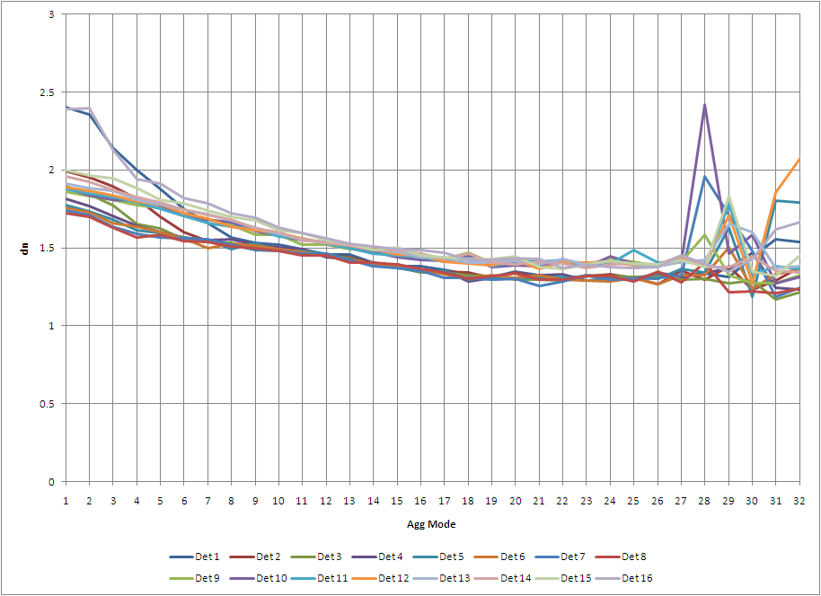
VIIRS FPF-1: Noise Measurement Prior to RTA Scanning
REHEARSAL PRODUCTS:
Tables/Plots of Noise Measurements [dn], Spanning Parameter Spaces

Slide 62
VIIRS FPF-2: Operability, Noise, SNR Verification w/ Nadir Door Closed
TASK LEAD:
  Aerospace [Christopher Florio]
OBJECTIVE:
To verify detector operability, noise, and SNR of all detectors in all bands and gain states with telescope scanning and nadir door closed.
DESCRIPTION:
Methodology: Perform all elements of ICV-1 (see below) but with the nadir door closed. Correlation of SD signals with EV albedo is excluded.
Necessary Tools:
  RDR extractor
  Calibrator View Visualization and Analysis
  EV RDR Visualization and Analysis
EXPECTED RESULTS:
Data products generated for all detectors, all bands, and all gain states. Dead/inoperable detector maps and metadata updated, if necessary.
PREREQUISITES & CONDITIONS:
SC Mode: Nominal. VIIRS Mode: Diagnostic, RTA rotating, nadir door closed.
Notes:
References:
Taylor et al., Analysis of CrIS Flight Model 1 Radiometric Linearity and Radiometric Noise, CALCON 2008.
Tobin, D., H. Revercomb, L. Strow, S. Hannon, H. Motteler Analysis of Cross-track Infrared Sounder (CrIS) Prelaunch Test Data: OSA Topical Meeting on Fourier Transform Spectroscopy; Alexandria, Virginia, 31 January – 3 February, 2005.
Tobin et al., NPOESS Atmospheric Sounder Testbed - Interferometer (NAST-I) Detector Nonlinearity Characterization and Correction, February 1999 AIRS Science Team Meeting, Santa Barbara, CA.

Slide 63
VIIRS FPF-2: Operability, Noise, SNR Verification w/ Nadir Door Closed
REHEARSAL DESCRIPTION:
  Data Sets Used
    RDR in P72 Earth sector Diagnostic data used following the initiation of the RTA, with the nadir door closed.
    RDR in P72 calibration sector Diagnostic data used following the initiation of the RTA, with the nadir door closed.
  Operations Performed
    Generate noise & mean signal [dn] measurements (w/ nadir door closed) for across all dimensions (detector, bands, gain states)
    Look at scan imagery of multiple views to ensure operability to locate dead pixels
  Tools Used
    RDR data extractor (not available yet)
      noise.pro & signal.pro → auxiliary_noise.pro
      scanning_visualization.pro
SUCCESS CRITERIA:
  Successful if the sensor is functioning such that noise and signal-to-noise calculations can be generated for each component of the instrument.
  Unsuccessful if noise metrics for a particular detector/band/gain-state cannot be determined, given all possible sensor data.

Slide 64
VIIRS FPF-2: Operability, Noise, SNR Verification w/ Nadir Door Closed
REHEARSAL PRODUCTS:
See FPF-1

Slide 65
VIIRS FPF-7: Calibrator Visual Inspection
TASK LEAD:
  Aerospace [Christopher Florio]
OBJECTIVE:
  To qualitatively verify correct operation of the on-board calibrating system
DESCRIPTION:
Methodology: Generate and visually inspect images from all calibrator views and report any anomalous patterns, e.g., striping or other artifacts. Verify that the signal levels at the OBCBB and SD views are as expected.
Necessary Tools:
  RDR extractor
  Calibrator View Visualization and Analysis
  Telemetry Probes-Encoder, Temperatures, SDSM
EXPECTED RESULTS:
Methodology and results documented.
PREREQUISITES & CONDITIONS:
SC Mode: Nominal, VIIRS Mode: Operational
Notes:
References:
Taylor et al., Analysis of CrIS Flight Model 1 Radiometric Linearity and Radiometric Noise, CALCON 2008.
Tobin, D., H. Revercomb, L. Strow, S. Hannon, H. Motteler Analysis of Cross-track Infrared Sounder (CrIS) Prelaunch Test Data: OSA Topical Meeting on Fourier Transform Spectroscopy; Alexandria, Virginia, 31 January – 3 February, 2005.
Tobin et al., NPOESS Atmospheric Sounder Testbed - Interferometer (NAST-I) Detector Nonlinearity Characterization and Correction, February 1999 AIRS Science Team Meeting, Santa Barbara, CA.

Slide 66
VIIRS FPF-7: Calibrator Visual Inspection
REHEARSAL DESCRIPTION:
  Data Sets Used
    RDR in P72 calibration sector OBC BB Operational Day data
    RDR in P72 calibration sector OBC BB Operational Night data
    RDR in P72 calibration sector SDSM Operational Day data
    RDR in P72 calibration sector SDSM Operational Night data
  Operations Performed
    Look at scan imagery of OBC and SDSM views, in an attempt to visualize any anomalous behavior and assess expected signal levels.
  Tools Used
    RDR data extractor (not available yet)
      scanning_visualization.pro
SUCCESS CRITERIA:
  Successful if image captures, of the sensor calibration views, show no anomalies which are significant enough to affect performance.
  Unsuccessful if, during a visual inspection of the OBC or SDSM view scan collections, unexpected artifacts appear.

Slide 67
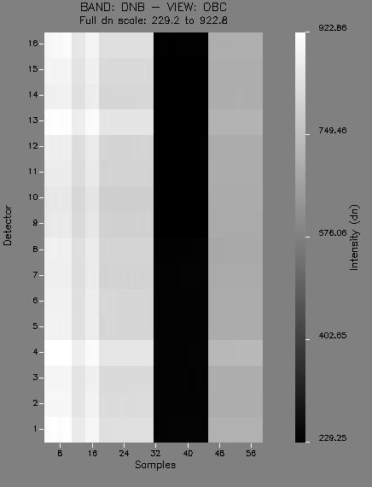

VIIRS FPF-7: Calibrator Visual Inspection
REHEARSAL PRODUCTS:
Calibration Sector OBC & SDSM Visualization Imagery

Slide 68
VIIRS PTT-1: Operability, Noise, SNR Verification
TASK LEAD:
  Aerospace [Christopher Florio]
OBJECTIVE:
  To verify detector operability, noise, and SNR of all detectors in all bands and gain states; to verify the absence of artifacts in calibration view data. Task repeated through the life of the sensor to monitor performance.
DESCRIPTION:
Methodology: Calculate mean and noise for raw counts (expressed as the DN) for all calibration views (OBCBB, SD, SV) and mean and noise for offset corrected counts for OBCBB and illuminated SD views; compare results with pre-launch measurements; update dead/inoperable detector map and associated metadata or quality flags, if necessary; calculate SNR for OBCBB and SD data, the latter when SD is illuminated by the Sun; generate and evaluate histograms of calibration view data, reporting any anomalous patterns, e.g., bifurcation; generate the autocorrelation function for calibration view samples to identify any correlated noise effects.
Necessary Tools:
  RDR extractor
  Calibrator View Visualization and Analysis
EXPECTED RESULTS:
Data products generated for all detectors, all bands, and all gain states; dead/inoperable detector maps and metadata updated, if necessary.
PREREQUISITES & CONDITIONS:
SC Mode: Nominal, VIIRS Mode: Operational
Notes:
References:
Taylor et al., Analysis of CrIS Flight Model 1 Radiometric Linearity and Radiometric Noise, CALCON 2008.
Tobin, D., H. Revercomb, L. Strow, S. Hannon, H. Motteler Analysis of Cross-track Infrared Sounder (CrIS) Prelaunch Test Data: OSA Topical Meeting on Fourier Transform Spectroscopy; Alexandria, Virginia, 31 January – 3 February, 2005.
Tobin et al., NPOESS Atmospheric Sounder Testbed - Interferometer (NAST-I) Detector Nonlinearity Characterization and Correction, February 1999 AIRS Science Team Meeting, Santa Barbara, CA.

Slide 69
VIIRS PTT-1: Operability, Noise, SNR Verification
REHEARSAL DESCRIPTION:
  Data Sets Used
    RDR in P72 calibration sector OBC BB Operational Day data
    RDR in P72 calibration sector OBC BB Operational Night data
    RDR in P72 calibration sector SDSM Operational Day data
    RDR in P72 calibration sector SDSM Operational Night data
    RDR in P72 calibration sector SV Operational Day data
    RDR in P72 calibration sector SV Operational Night data
  Operations Performed
    Perform offset correction on all (detector, bands, gain states) calibration sectors.
    Generate noise & mean signal [dn] measurements for offset-corrected and non-offset-corrected data.
    Compare results with pre-launch calculations.
    Look at scan imagery of cal views to ensure operability to locate dead pixels.
    Determine autocorrelation function between calibration view samples.
  Tools Used
    RDR data extractor (not available yet)
      noise.pro & signal.pro → auxiliary_noise.pro
      scanning_visualization.pro
SUCCESS CRITERIA:
  Successful if the sensor is functioning such that noise and signal-to-noise calculations can be generated for each component of the instrument, throughout its lifetime.
  Unsuccessful if noise metrics for a particular detector/band/gain-state/cal-view cannot be determined, given all possible sensor data.

Slide 70
VIIRS PTT-1: Operability, Noise, SNR Verification
REHEARSAL PRODUCTS:
See FPF-1

Slide 71
VIIRS PTT-2: RDR Histogram Analysis
TASK LEAD:
  Aerospace [Christopher Florio]
OBJECTIVE:
  To verify normal digitization performance.
DESCRIPTION:
Methodology: Accumulate data over multiple orbits to generate histograms in raw count (digital number; DN) space and then look for underfilled and overfilled DN bins. The underfilled bins will manifest as downward “dip” deviation from the continuous histogram curve. The overfilled bins will manifest as upward “spike” deviations from the continuous histogram curve. In image analysis, a histogram showing such anomalous features is referred to as “hairy” histogram and is often an indication of an analog/digital (A/D) problem. The analysis can be enhanced by calculating the expected mean expected DN range based on model predictions and calibration coefficients and comparing the expected range to the observed DN range.
Necessary Tools:
  RDR extractor
  RDR EV Visualization and Analysis
EXPECTED RESULTS:
Report documenting either absence or presence of digitization error.
PREREQUISITES & CONDITIONS:
SC Mode: Nominal, VIIRS Mode: Operational
Notes:
References:
Taylor et al., Analysis of CrIS Flight Model 1 Radiometric Linearity and Radiometric Noise, CALCON 2008.
Tobin, D., H. Revercomb, L. Strow, S. Hannon, H. Motteler Analysis of Cross-track Infrared Sounder (CrIS) Prelaunch Test Data: OSA Topical Meeting on Fourier Transform Spectroscopy; Alexandria, Virginia, 31 January – 3 February, 2005.
Tobin et al., NPOESS Atmospheric Sounder Testbed - Interferometer (NAST-I) Detector Nonlinearity Characterization and Correction, February 1999 AIRS Science Team Meeting, Santa Barbara, CA.

Slide 72
VIIRS PTT-2: RDR Histogram Analysis
REHEARSAL DESCRIPTION:
  Data Sets Used
    RDR in P72 Earth sector Operational Day data over several orbits
    RDR in P72 Earth sector Operational Night data over several orbits
  Operations Performed
    Gather raw digital number (DN) values from multiple data sets, of varying signal levels.
    Generate histograms for all data to examine the distribution of the sensor’s EV data, amongst the bins of potential output values.
  Tools Used
    RDR data extractor (not available yet)
      histogram_ev.pro
SUCCESS CRITERIA:
  Successful if the allocation of digital numbers (DN) appears to follow a particular distribution, depending on the nature of the data collected.
  Unsuccessful if a histogram of the digitization shows numbers or bins (multiple numbers) which are underfilled/overfilled, indicating A/D anomalies.

Slide 73
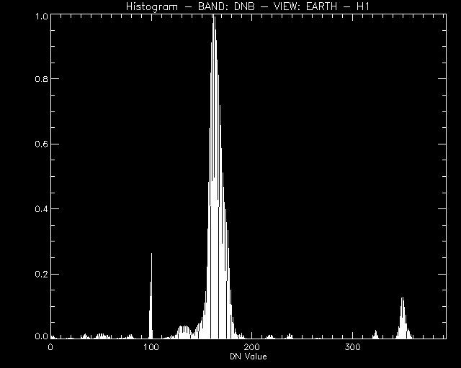
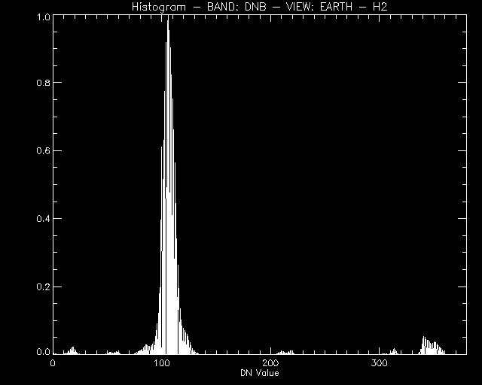
VIIRS PTT-2: RDR Histogram Analysis
REHEARSAL PRODUCTS:
Plotted Histograms of Generated Digital Numbers

Slide 74
VIIRS PTT-3: Noise and SNR for Uniform EV Scenes
TASK LEAD:
  Aerospace [Christopher Florio]
OBJECTIVE:
To calculate signal standard deviation from uniform Earth view (EV) scenes; to evaluate the signal-to-noise ratio (SNR); and to calculate noise/SNR for calibrator views and at various radiance levels.
DESCRIPTION:
Methodology: Determine noise by calculating the standard deviation of the signal observed while viewing a uniform scene. Earth scenes must be selected taking into account inherent noise, which underestimates SNR. A radiance level can be obtained with a solar diffuser (SD) view, removing ripple from the data to avoid contributions to noise calculations. Space view (SV) data can be replaced by nighttime EV reflective band data for additional samples for statistical calculation of dark noise. This approach must be used infrequently because diagnostic mode data must be collected, or the VIIRS day/night transition table must be changed.
Necessary Tools:
  SDR Visualization and Analysis
EXPECTED RESULTS:
Accumulated data set of noise and SNR values.
PREREQUISITES & CONDITIONS:
SC Mode: Nominal, VIIRS Mode: Operational
Notes:
References:
Taylor et al., Analysis of CrIS Flight Model 1 Radiometric Linearity and Radiometric Noise, CALCON 2008.
Tobin, D., H. Revercomb, L. Strow, S. Hannon, H. Motteler Analysis of Cross-track Infrared Sounder (CrIS) Prelaunch Test Data: OSA Topical Meeting on Fourier Transform Spectroscopy; Alexandria, Virginia, 31 January – 3 February, 2005.
Tobin et al., NPOESS Atmospheric Sounder Testbed - Interferometer (NAST-I) Detector Nonlinearity Characterization and Correction, February 1999 AIRS Science Team Meeting, Santa Barbara, CA.

Slide 75
VIIRS PTT-3: Noise and SNR for Uniform EV Scenes
REHEARSAL DESCRIPTION:
  Data Sets Used
    SDR in P72 Earth sector Operational Day data for multiple scenes of uniform radiance
    SDR in P72 Earth sector Operational Night data for multiple scenes of uniform radiance
    SDR in P72 calibration sector SDSM Operational Day data for multiple scenes of uniform radiance
    SDR in P72 calibration sector SDSM Operational Night data for multiple scenes of uniform radiance
    SDR in P72 calibration sector SV Operational Day data for multiple scenes of uniform radiance
    SDR in P72 calibration sector SV Operational Night data for multiple scenes of uniform radiance
  Operations Performed
    Determine raw radiance levels from SDSM view and dark noise levels from SV.
    Utilize calibrated signal and noise values to generate noise and SNR measurements, across a series of EV scenes, with uniform radiance levels.
  Tools Used
    SDR data extractor (not available yet)
      noise.pro & signal.pro → auxiliary_noise.pro
        Noise [dn] & SNR Measurements (multiple scenes of uniform radiance)
SUCCESS CRITERIA:
  Successful if noise and signal-to-noise (SNR) measurements can be generated, using the appropriate data sets, for a series of scenes of uniform radiance.
  Unsuccessful if for any Earth-View (EV) scene of uniform radiance, the noise or SNR cannot be calculated, given all available EV and calibration view data.

Slide 76
VIIRS PTT-3: Noise and SNR for Uniform EV Scenes
REHEARSAL PRODUCTS:
See FPF-1

Slide 77
VIIRS PTT-4: DNB Offset Verification
TASK LEAD:
  Aerospace [Christopher Florio]
OBJECTIVE:
  Verify that DNB offset Algorithm Support Function (ASF) performs properly.
DESCRIPTION:
Methodology: The DNB HGS stage nominally sends down the average output of the HGA and HGB CCD arrays. However, it will send down either HGA or HGB if a radiation effect is detected in one of the arrays. DNB calibration data always sends down separate data for HGA and HGB; however, the EV data are always the combined HGS data. The current plan is to provide a single HGS calibration by averaging the gain computed independently for HGA and HGB from the SD and SV data, but using a single HGS offset computed from the merged HGS data over dark scenes. The ASF function will compute the HGS offset from the merged HGS data on a regular basis. This task will execute this ASF function during the EOC mission phase in both the forced HGA and HGB mode to verify any differences between the two, and to verify that there is no performance degradation from computing a single, combined offset. This task will also provide a verification of the HGA/HGB on-board offset tables that were computed during thermal vacuum testing. This task requires a forced VIIRS downlink of either HGA or HGB data instead of the average of HGA and HGB.
Necessary Tools: [TBD]
EXPECTED RESULTS:
[TBD]
.
PREREQUISITES & CONDITIONS:
SC Mode: Nominal, VIIRS Mode: Operational
Notes:
References:
Taylor et al., Analysis of CrIS Flight Model 1 Radiometric Linearity and Radiometric Noise, CALCON 2008.
Tobin, D., H. Revercomb, L. Strow, S. Hannon, H. Motteler Analysis of Cross-track Infrared Sounder (CrIS) Prelaunch Test Data: OSA Topical Meeting on Fourier Transform Spectroscopy; Alexandria, Virginia, 31 January – 3 February, 2005.
Tobin et al., NPOESS Atmospheric Sounder Testbed - Interferometer (NAST-I) Detector Nonlinearity Characterization and Correction, February 1999 AIRS Science Team Meeting, Santa Barbara, CA.

Slide 78
VIIRS PTT-4: DNB Offset Verification
REHEARSAL DESCRIPTION:
  Data Sets Used
    RDR in P72 Earth sector Operational Day data used by the ASF to compute a single HGS from the merged HGS data over dark scenes.
    RDR in P72 calibration sector SDSM Operational Day data used by the ASF to compute a single HGS from the merged HGS data over dark scenes.
    RDR in P72 calibration sector SV Operational Day data used by the ASF to compute a single HGS from the merged HGS data over dark scenes.
  Operations Performed
    Inspect both visual (scan imagery) and tabular generations of Day-Night Band (DNB) offset high gain data.
  Tools Used
    RDR data extractor (not available yet)
      scanning_visualization.pro
SUCCESS CRITERIA:
  Successful if it is found that the Algorithm Support Function (ASF) can properly verify differences in HGA & HGB DNB data and compute an average offset.
  Unsuccessful if the ASF is unable to properly generate a combined DNB HGS offset, from the necessary EV and cal view data.

Slide 79
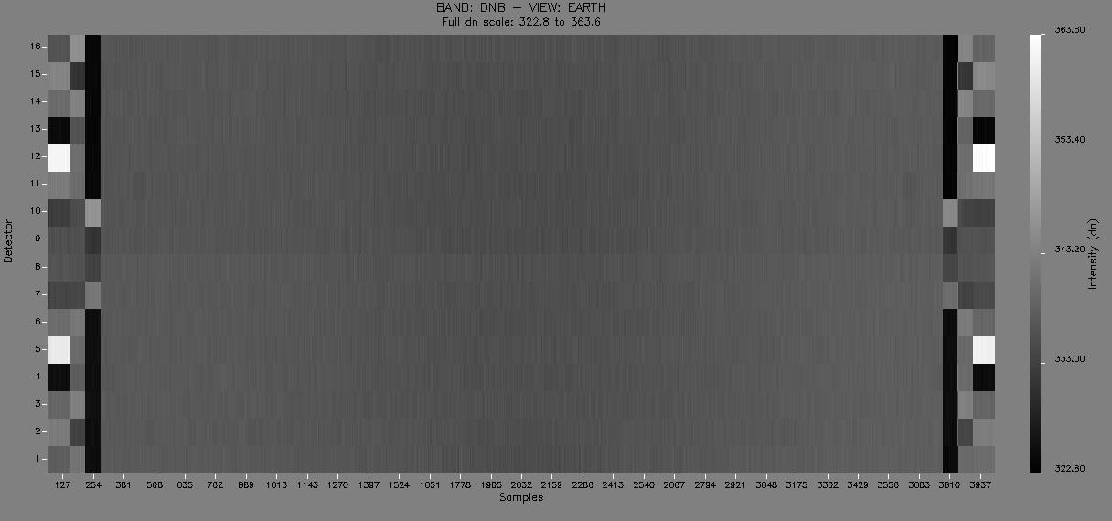
VIIRS PTT-4: DNB Offset Verification
REHEARSAL PRODUCTS:
DNB Offset Visualization Imagery

Slide 80
VIIRS PTT-5: Electronic Gain Measurement
TASK LEAD:
  Aerospace [Christopher Florio]
OBJECTIVE:
To determine the sensitivity of the electronic gain to variations in sensor electronic and thermal state.
DESCRIPTION:
Methodology: Run the pre-launch test SI-5 in “add mode”. In this mode, the detectors are disconnected from the readout integrated circuit (ROIC), and a ramped test signal is injected into the ROIC. Gain is inferred from sensor response to the known ramped signal.
Necessary Tools:
  RDR extractor
  Calibrator View Visualization and Analysis
EXPECTED RESULTS:
Gain measurements and test conditions documented.
PREREQUISITES & CONDITIONS:
SC Mode: Nominal, VIIRS Mode: Diagnostic (?)
Notes:
References:
Taylor et al., Analysis of CrIS Flight Model 1 Radiometric Linearity and Radiometric Noise, CALCON 2008.
Tobin, D., H. Revercomb, L. Strow, S. Hannon, H. Motteler Analysis of Cross-track Infrared Sounder (CrIS) Prelaunch Test Data: OSA Topical Meeting on Fourier Transform Spectroscopy; Alexandria, Virginia, 31 January – 3 February, 2005.
Tobin et al., NPOESS Atmospheric Sounder Testbed - Interferometer (NAST-I) Detector Nonlinearity Characterization and Correction, February 1999 AIRS Science Team Meeting, Santa Barbara, CA.

Slide 81
VIIRS PTT-5: Electronic Gain Measurement
REHEARSAL DESCRIPTION:
  Data Sets Used
    Instrument-level wideband data files from VIIRS SI-5 calibration sector Diagnostic data used in the measurement of the sensor’s response to a ROIC injection of a ramped test signal.
  Operations Performed
    Plot sensor response to a ramped signal injected into the ROIC, for all non-DNB bands.
    Compare with results received during instrument-level testing.
  Tools Used
    VIIRS data extractor
      si_5_explorer.pro
SUCCESS CRITERIA:
  Successful if the electronics gain can be inferred from the sensor’s response to a ramped test signal, both on-orbit and pre-launch.
  Unsuccessful if the sensor’s response to the signal injected into the ROIC significantly differs from previous data sets, such that the gain cannot be inferred.

Slide 82
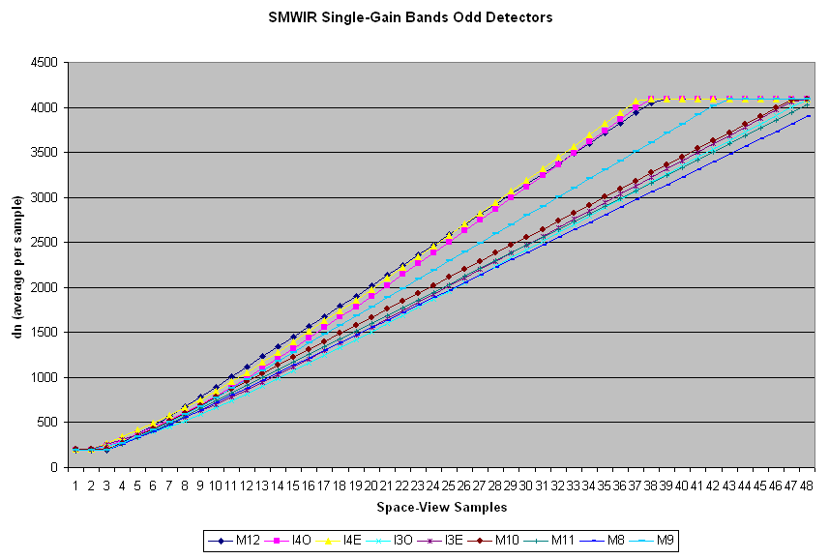
VIIRS PTT-5: Electronic Gain Measurement
REHEARSAL PRODUCTS:
Sensor Response Plots, for a ROIC injection of a Ramped Test Signal.

