Slide 1
HyperCP Setup Instructions
Dirk Aurin
NASA/GSFC

Slide 2
Git
Git is an open-source software revision control system that allows developers to coordinate on projects and end users to stay up to date with the latest revisions
GitHub is a browser-based staging area for git-managed software (referred to as repositories in git). Using git, repositories can be cloned to your local computer.
Command line git comes installed on Linux and macOS but needs to be installed on Windows (downloads available at https://git-scm.com/)
When using git, software is easily kept up to date using the “pull” command.
If git cannot be installed or used for any reason, the software repository can be downloaded (rather than cloned) from GitHub with all code (open source) or as a bundled package release with an executable file and environment.

Slide 3
Python and Conda
Python is an open-source programming language that has rapidly grown in popularity in recent years thanks to its clarity, accessibility, and flexibility. It supports object-oriented computing (HyperCP is object-oriented)
HyperCP is written in Python so you will need it installed. Linux and macOS come with Python installed by default, but Windows will require you install it.
There are many ways to install Python but we recommend using a package manager. Anaconda (https://www.anaconda.com/) is now license-based, but conda-forge (https://conda-forge.org/download/) is not.
Configuring your Python environment to run HyperCP will be difficult without a conda. The bundled release package is a possible fallback.

Slide 4
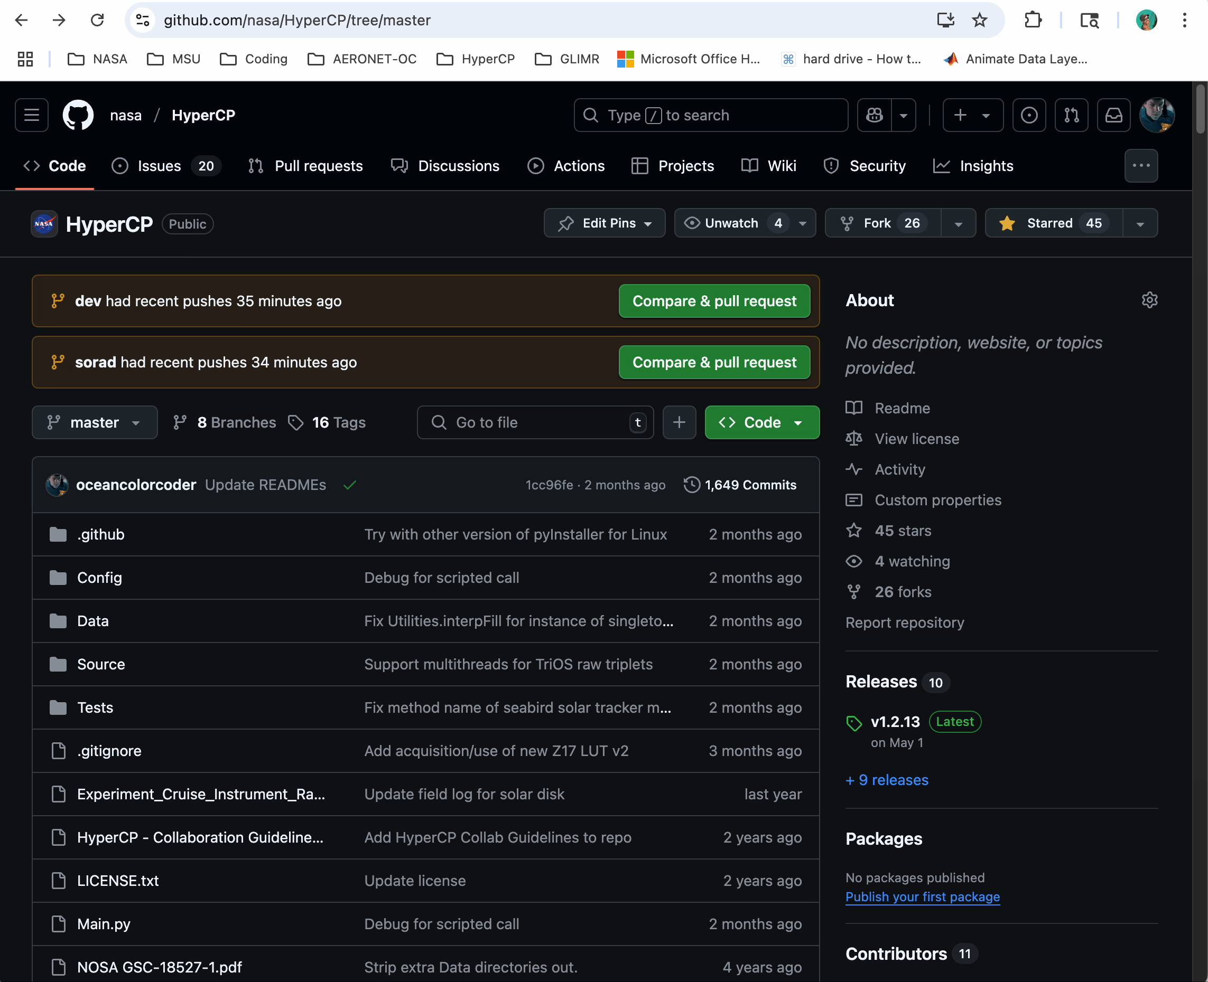

Cloning, download, or package release
https://github.com/nasa/HyperCP
Cloning link or full download
Bundled release packages for Win, Linux, MacOS
[Embedded video]

Slide 5
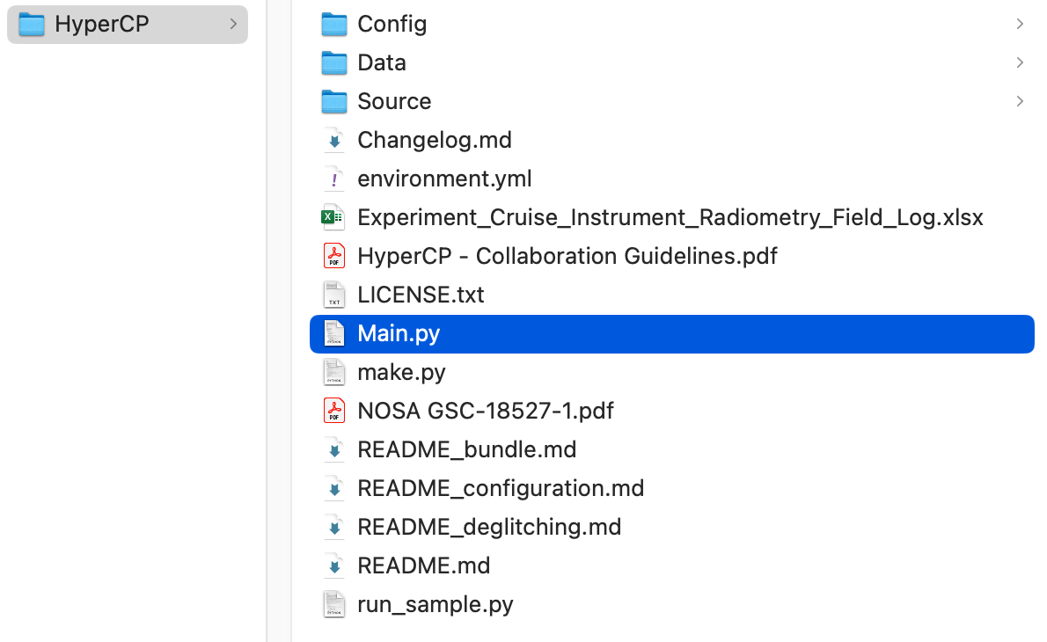
Setting Up HyperCP
Once you have git and Python set up, you are ready to clone HyperCP and then initialize a dedicated environment in which to run it
From a directory where you want HyperCP installed (it will create a subdirectory of that name) type:
git clone --depth 1 https://github.com/nasa/HyperCP.git
the remote repository is thereby established and named “origin” by default (see git remote –v for details)
Without git, you can download a Zip file from https://github.com/nasa/HyperCP under the Code button
Without git or conda, the bundled release will work.
HyperCP will now consist of a directory structure:
You will be prompted for additional data downloads as described below

Slide 6
Git Remotes and Branches
“Remotes” are repositories on servers (in contrast to local repos on your machine) such as GitHub or GitLab. Each remote has a name and address.
“Branches” are copies of the repository used to aid in development. The most stable recent branch is typically called “master” or “main”. Branches such as “dev” are used in development.
By default, your new local repository should have a remote (“origin”) and and one branch (“master”)
To make your life easier when pulling updates from the NASA repository on GitHub, you can assign the default remote and branch to use with pull and push commands:
git push --set-upstream [remote_name] [branch_name]
…after which you can simply type “git pull” to get updates before using HyperCP each time

Slide 7
Setting Up HyperCP
To initialize a conda environment for HyperCP (a place where all necessary software dependencies are sourced), from the terminal type:
conda env create -f environment.yml
Follow the prompts. This could take several minutes.
This will automatically activate the new environment, but you will need to activate it again later when opening a new terminal before launching HyperCP. Type:
conda activate hypercp
To update HyperCP with the latest version in the master branch (recommended before each use), type:
git pull

Slide 8
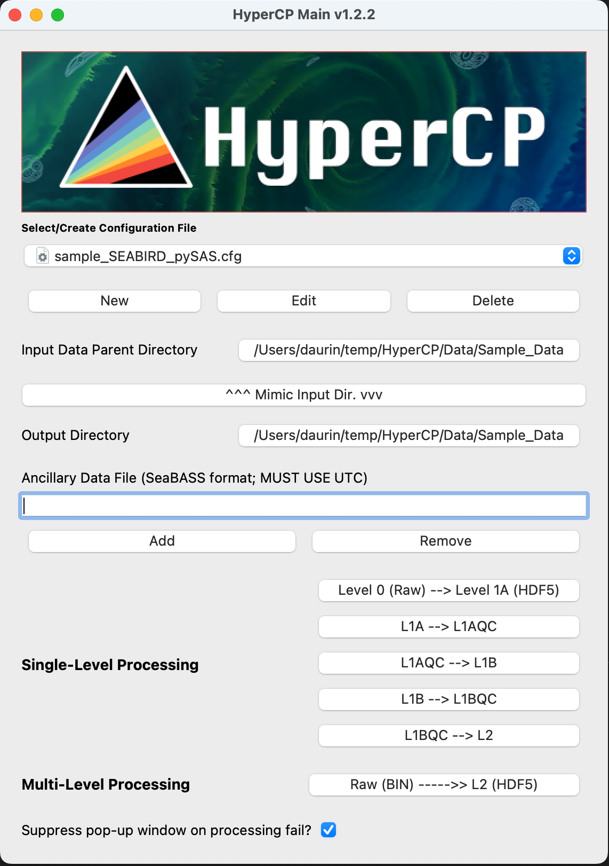
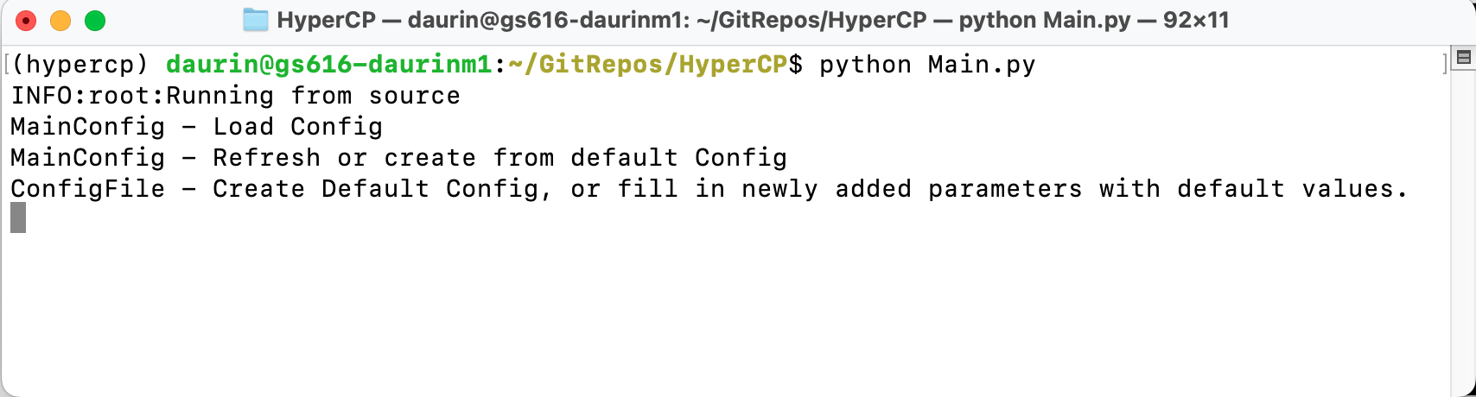
Setting Up HyperCP
The final step to initialize HyperCP after installation is the download of additional databases and look-up-tables (LUTs) totally ~3.2 GB. (If these are provided to you locally, you can copy them to the HyperCP/Data directory. Otherwise, the first time HyperCP is launched, they will download automatically.)
To launch HyperCP, navigate to the HyperCP directory and type:
python Main.py

Slide 9
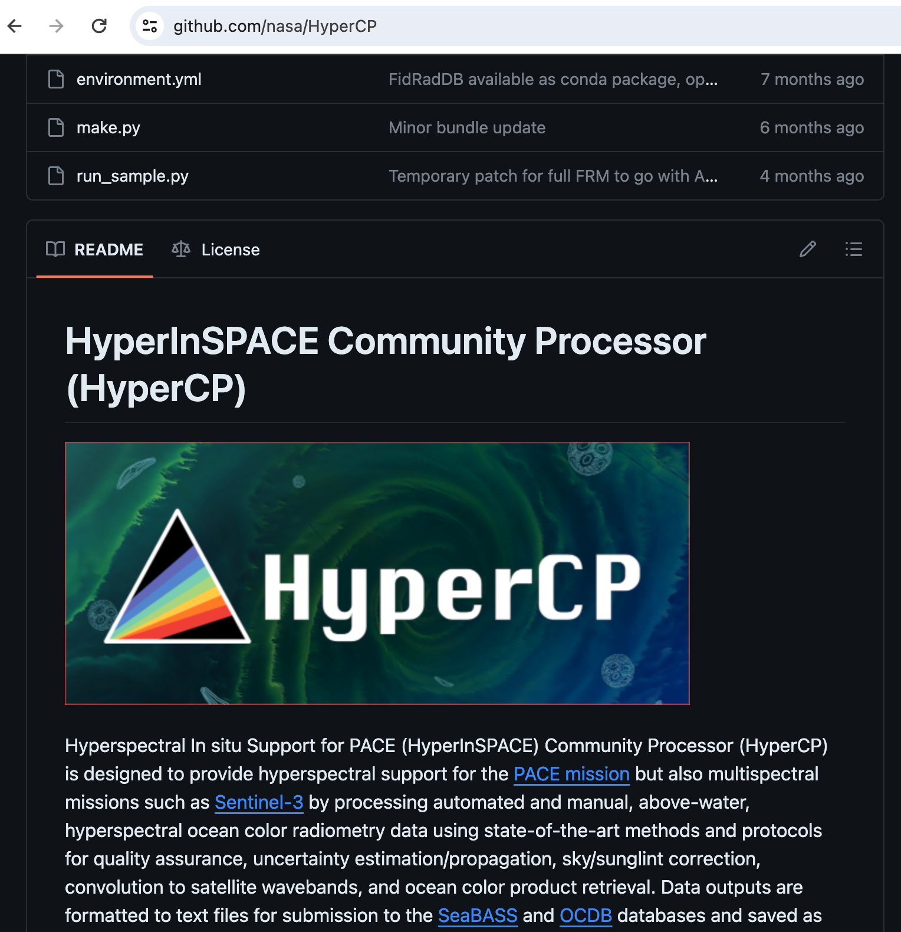
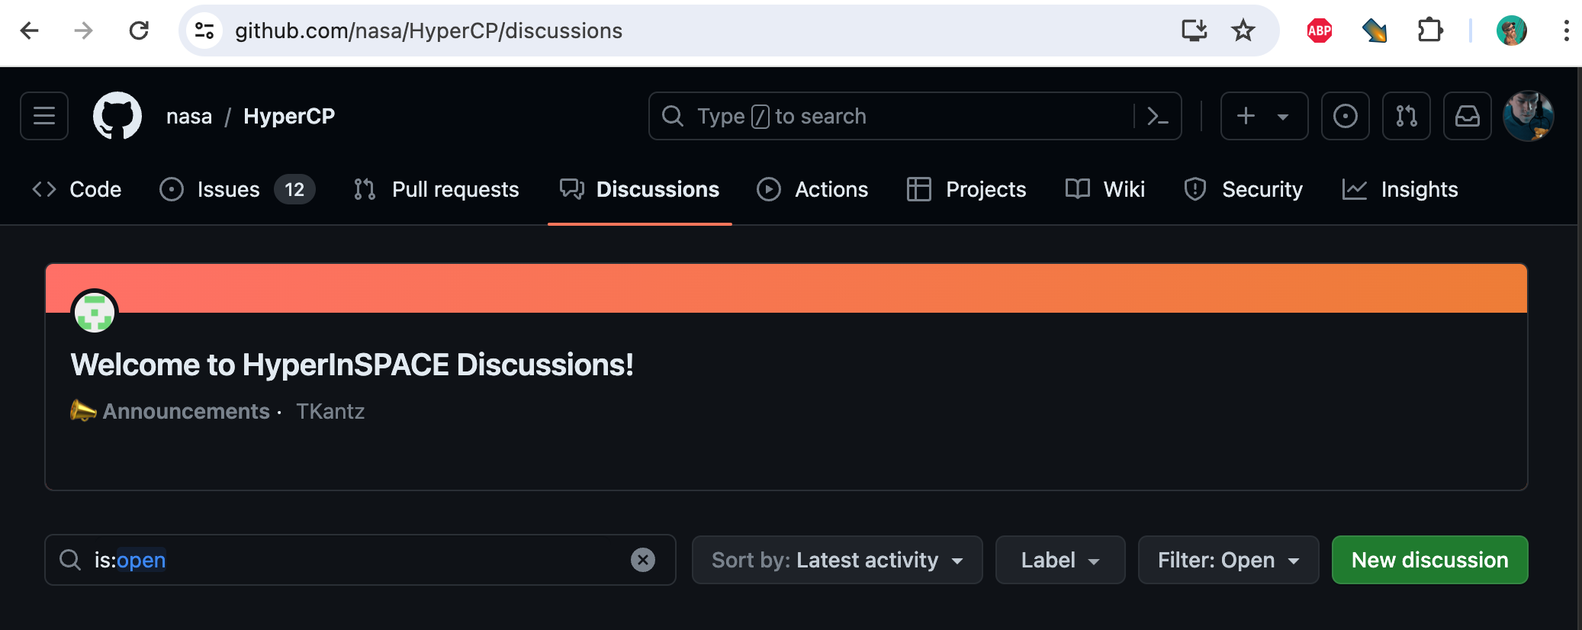
End HyperCP Setup
These instructions are available for later reference in the README.md at
https://github.com/nasa/HyperCP
For support, please reach out on GitHub in the Discussions tab, or, for bugs, the Issues tab.

