Slide 1
Understanding Natural Variability of VSFs and Its Impact on Biogeochemical Retrieval from Ocean Color
Xiaodong Zhang: University of North Dakota
Deric Gray: Naval Research Lab
Wayne Slade: Sequoia Scientific, Inc.
Notes:
Key elements of this proposed study are: 1) natural variability of VSFs, with new instrument capability and recent measurements in coastal and oceanic waters
2) New ways to understand this natural variability
3) Impart new understanding to biogeochemical retrieval from ocean color

Slide 2
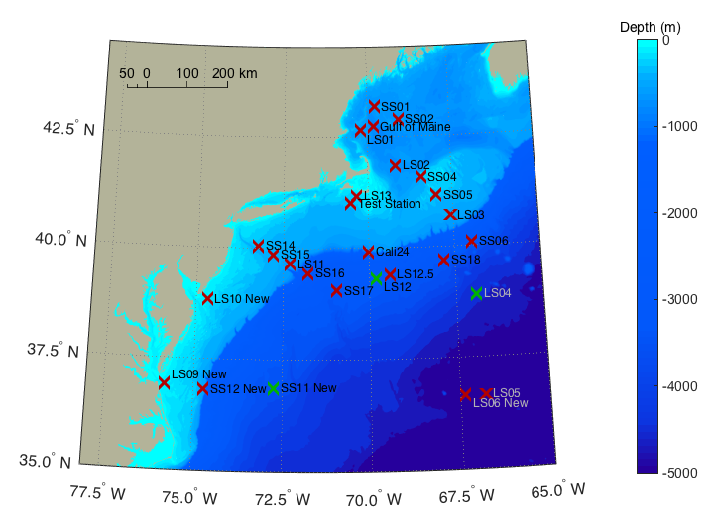
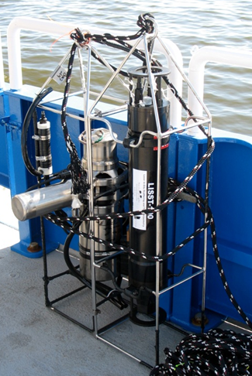
1. Spatial and temporal variability of VSFs
LISST, 532 nm, 32 angles 0.07 – 13.9°
VSM, 532 nm, 0.6:0.3:177.3°
MVSM, 8 wavelengths, 0.5(10):0.25:179°
ECO-VSF, 3 wavelengths, 100, 125, 150°
HydroScat, 6 wavelengths, 140°
Ac-9 or ac-s
LISST+MVSM: 532 nm, complete VSFs 0.07 – 179°
MVSM, ECO, HS6: Spectral b_{b}
ac meters: Spectral c and a

Slide 3
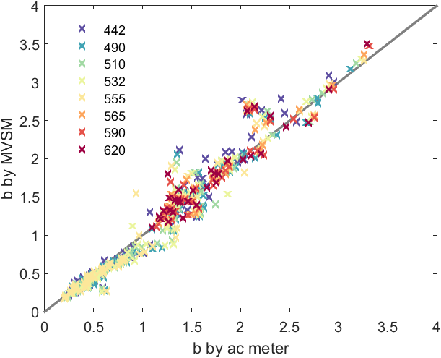
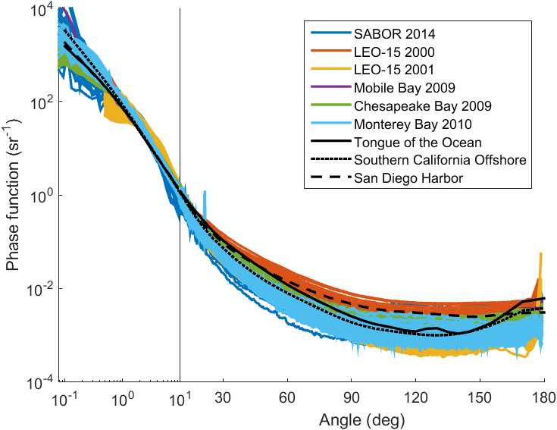
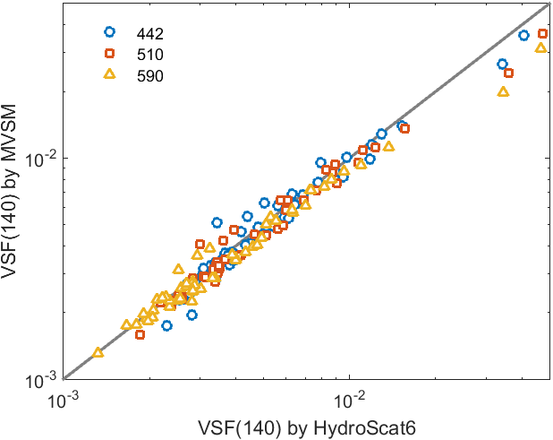
IOP agreement between different instruments:
R > 0.96
RMSD < 10%

Slide 4
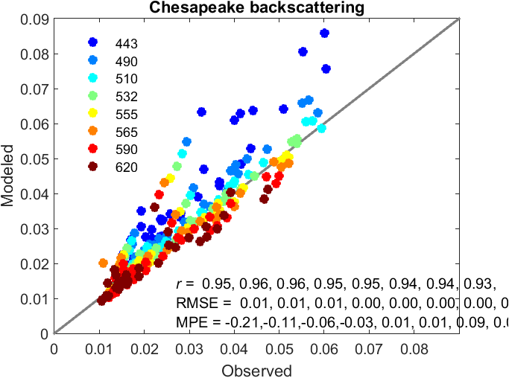
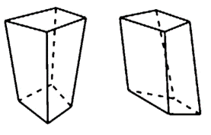
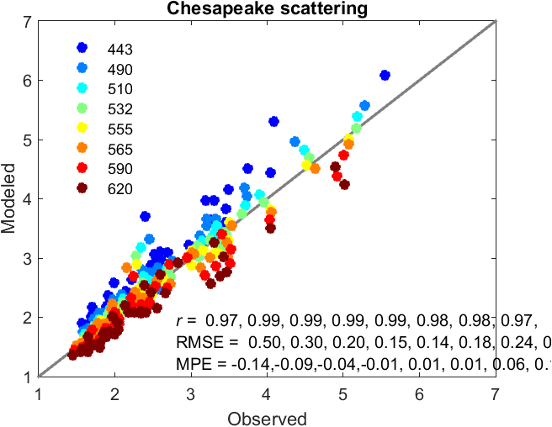
2. Biogeochemical sources of b_{b}: A combination of inverse- and forward-modeling approach by analyzing measured VSFs
VSF-Inverse modeling at 532 nm
Particle size distributions
Forward modeling at other wavelength
Oceanic particles comprise of sub-populations, each follows log-normal distribution and of the same composition (refract. Index) Zhang et al. (2011)
Sub-populations represent different biogeochemical stocks. Zhang et al. (2012; 2013; 2014), Czerski et al. (2011), Twardowski et al. (2012).
Assumptions

Slide 5
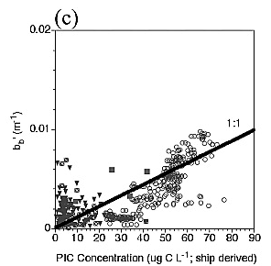
b_{b} has been empirically related to many things
b_{b} vs. PIC
b_{b} vs. POC
b_{b} vs. Phytoplankton-C
Balch et al. (2005)
Martinez-Vincente et al. (2013)
Stramski et al. (2008)
Behrenfeld et al. (2005)
b_{b} vs. SPM
b_{b} slope vs. PSD slope
Lorthiois et al. (2012)
Kostadinov et al (2012)

Slide 6
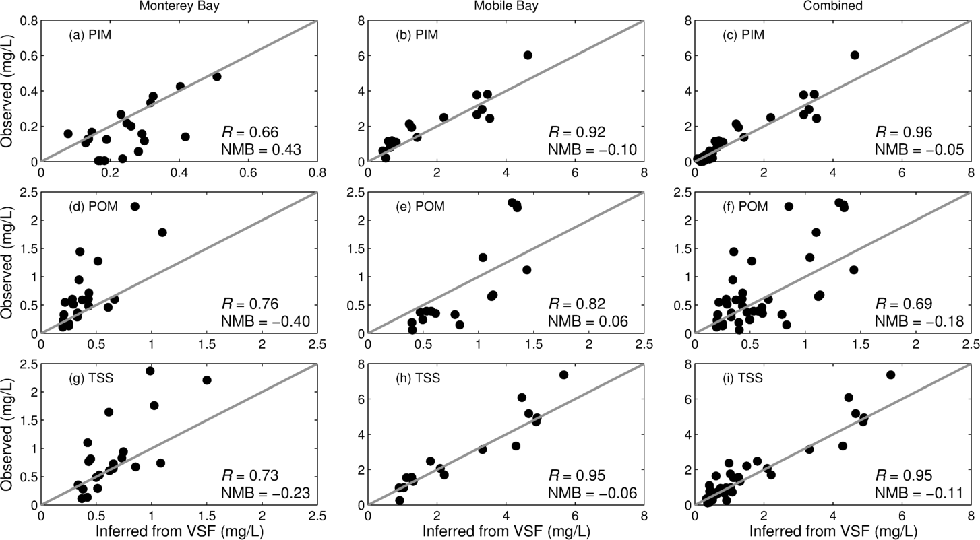
Question: what contribute to b_{b}?
Dissolved vs. Particulate
Particles
0.2 µm
Zhang and Gray (2015)
Zhang et al. (2014)

Slide 7
In coastal waters, “dissolved” portion of particles scatter light much greater than pure seawater and contribute 30-80% of total b_{b}
D09: Dall’Olmo et al. (2009) equatorial Pacific ocean
SW05: Stramski and Wozniak (2005) simulated colloidal scattering
Next step: Analyzing SABOR data

Slide 8
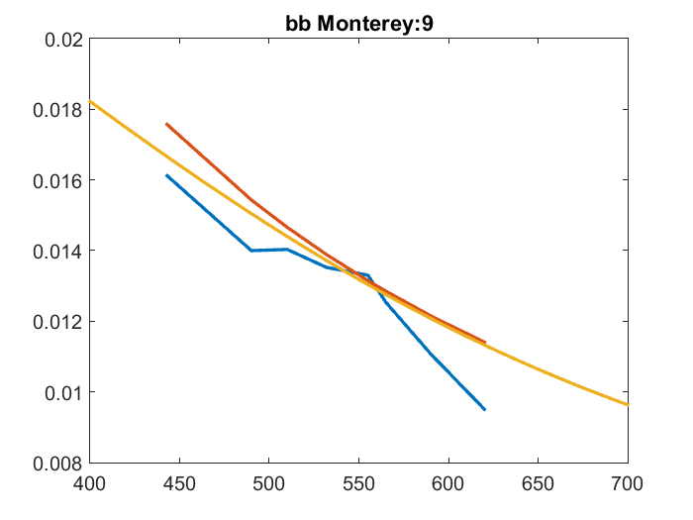
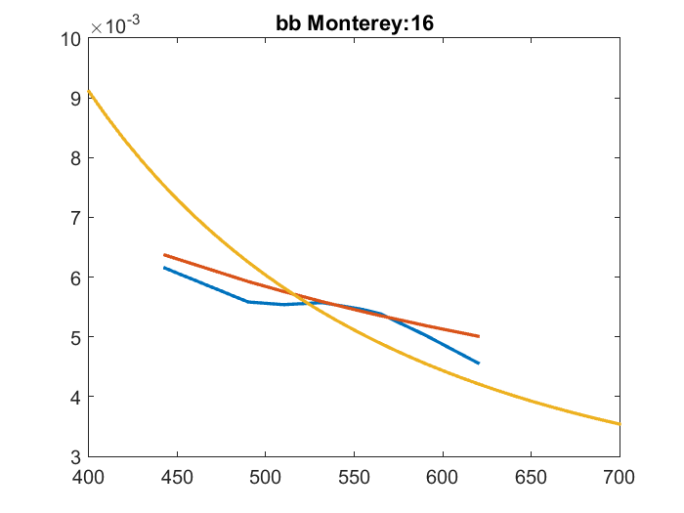
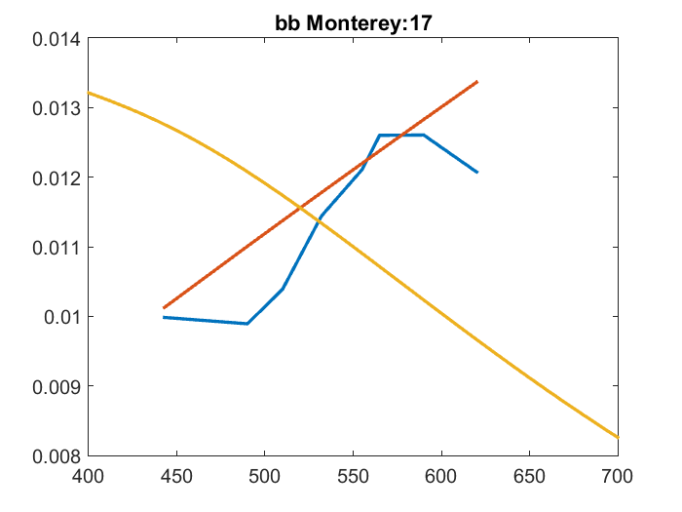
Simulated vs. measured spectral b_{b}
Most cases like this
Dinoflagellate bloom

Slide 9
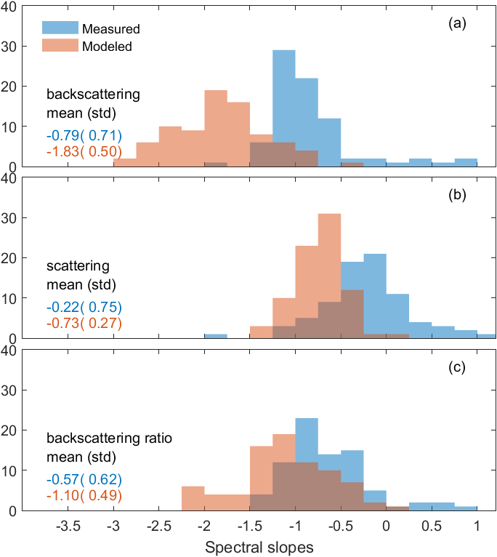
Simulated vs. measured spectral b, b_{b}, b_{b} ratio
In general, simulation overestimate spectral slopes of b_{b}, slight overestimation in spectral slopes for b and bb ratio
In forward modeling, I assumed
Refractive index does not change with wavelength. While this is ok for real part of the index, it is NOT ok for imaginary part of the index.
Next step
To account for absorption, i.e., change in imaginary part of the refractive index, in forward modelling for phytoplankton-type and very small (dissolved) particles.

Slide 10
An unexpected challenge in using measured VSFs with HydroLight:
To ingest measured VSFs, HL does this things
  Estimate VSFs at 0.1:0.1:180 through interpolation or extrapolation with a user provided function
  Estimate VSF slope at smaller angles using the measurements at 0.1 and 0.2 deg assuming
  Analytically integrate VSF between 0 and 0.1 using the above equation and between 0.1 and 180 numerically.
This only works if m < 2; otherwise you get negative integration value between 0 and 0.1, which in turn lowers the estimate b, increases bb ratio.

