Slide 1
PACE Cloud Team Investigators
GSFC
Steve Platnick* (PI)
Kerry Meyer [USRA]
U. Wisconsin/CIMSS
Steve Ackerman/Rich Frey*
Andy Heidinger [NOAA], Andi Walther
U. Colorado/LASP
Odele Coddington*
Peter Pilewskie
Sebastian Schmidt
UMBC
Zhibo Zhang, Frank Werner, Dan Miller
* in attendance
Notes:
Budget note
No support for GSFC PI & co-I
Reduced support for U. Wisconsin

Slide 2
Proposal Overview
Understand OCI/A cloud product information content and retrieval uncertainty vs. VIIRS/MODIS products. Make use of VIIRS/MODIS MODAWG algorithms and NPP Atmosphere SIPS infrastructure.
Cloud mask/detection [Leads: Ackerman, Frey]
Cloud-top retrievals w/A-band and 940/1380 nm (OCI+) water vapor bands [Leads: Heidinger, Meyer]
Cloud thermodynamic phase discrimination information content [Leads: Coddington, Schmidt, Pilewskie]
Cloud optical thickness and effective particle radius [Leads: Platnick, Coddington]
Liquid water cloud optical retrieval sensitivity to spatial resolution using obs (eMAS, ASTER) and model (LES) data [Leads: Zhang, Meyer]
Participate with the Project/ST on instrument specs, trade studies, etc. as they pertain to cloud retrievals and information content from OCI(/A) [Lead: Platnick]
Notes:
CU: information content and retrievals using their GENRA code, a Bayesian/Shannon IC approach.
“GEneralized Nonlinear Retrieval Analysis”
Should mention lack of IR but should consider constellation flying
Proposed a combination of empirical (eMAS, ASTER [~20m]) and theoretical studies. Zhibo already has new LES files from Andy Ackerman, and has been talking with him to see if we can get mixed-phase Arctic clouds runs. Frank Werner (arriving to UMBC in late January) can work on empirical analysis.
Whether we have any leverage on the ocean color imager instrument specs will ultimately depend on cost-capped realities. But we can play in the OCI+/A academic sandbox regardless. What we learn in this study can always be used for future instrument concepts.

Slide 3
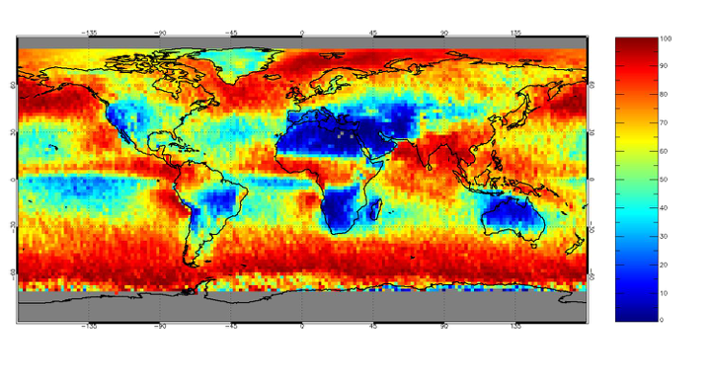
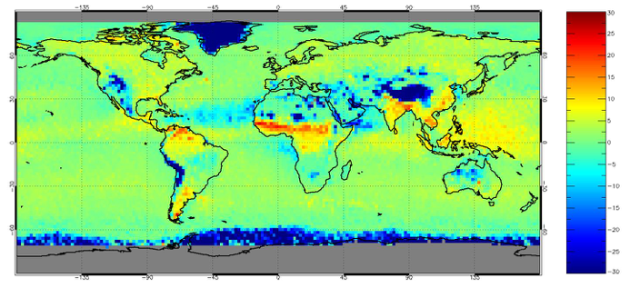
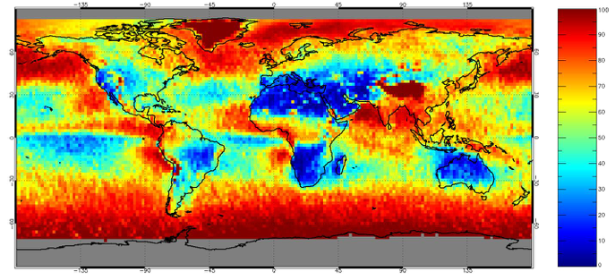
OCI Cloud Detection Study: Glint Obs. Removed
MYD06: all tests
MYD06: VNIR tests only –
1.38, 0.86 (ocean), 0.65 (land), & 0.86/0.65
MYD06 all - VNIR (±0.30)
Notes:
cloud test flags (< 50% confidence of clear sky = “cloudy”). Values from collocated CALIOP/MODIS data so there is no sun-glint present.

Slide 4
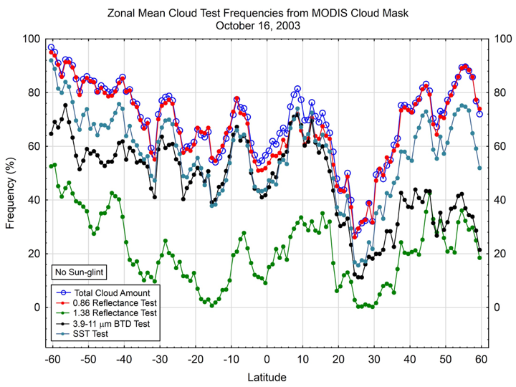
OCI Cloud Detection Study
Notes:
1.38µm: OCI+

Slide 5
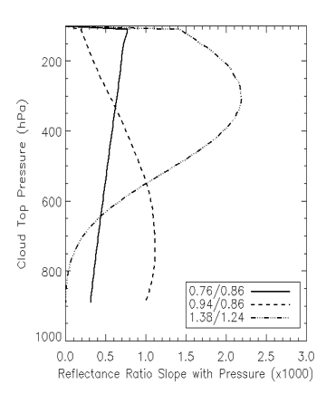
A-Band Cloud Height Study
OCI/OCI+ includes 3 channels with atmospheric absorption:
0.76 μm (O2 A-Band, 5nm bandwidth)
0.94 μm (weak H2O)
1.38 μm (strong H2O)
Retrievals use reflectance ratio involving these and nearby window channels.
O2 A-band likely greatest information content due to low forward model uncertainty (well mixed absorber in contrast to H2O)
Channels are also sensitive to the geometrical thickness of the cloud and to the presence of multiple layers.
Optimal Estimation (OE) retrieval using the three ratios shown in the figure used to retrieve Cloud Pressure and Cloud Pressure Thickness.
Cloud pressure weighting functions span the Troposphere
COT = 10
CER = 20 μm
dP = 100 hPa
μ = 1.0
μo = 0.8
Notes:
940nm and 1.38µm: OCI+
IDL-based OE code

Slide 6
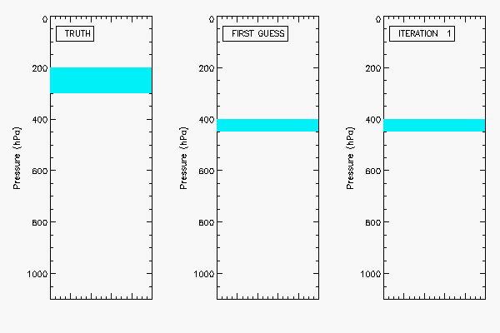
A-Band Cloud Height – Example Synthetic Retrieval
Single layer cloud example
truth: COT=6, p=200-300 hPa
retrieved p: 265-296 hPa

Slide 7
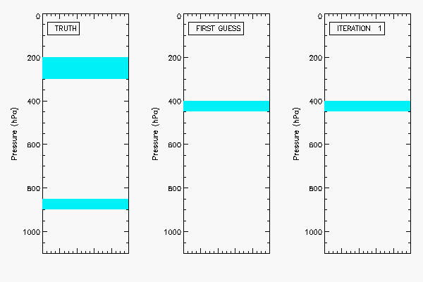
A-Band Cloud Height – Example Synthetic Retrieval
Multiple layer cloud example
upper cloud: COT=2, p=200-300 hPa
lower cloud: COT=2, p=850-900 hPa
retrieved p (assuming single layer): 410-472 hPa

Slide 8
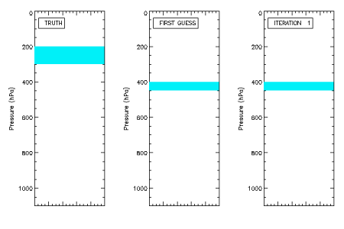
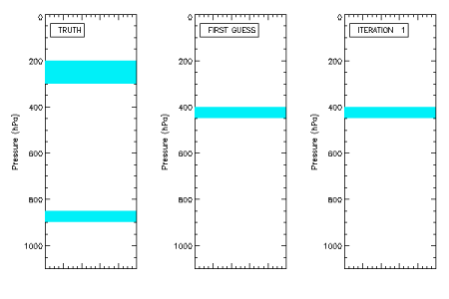
A-Band Cloud Height - Example Retrievals
single layer cloud example
truth: COT=6, p=200-250 hPa
retrieved p: 265-296 hPa
*** gif ANIMATION not active ***
multilayer cloud example
upper cloud: COT=2, p=200-250 hPa
lower cloud: COT=2, p=850-900 hPa
retrieved p (assuming single layer): 410-472 hPa
Notes:
940nm and 1.38µm: OCI+
IDL-based OE code

Slide 9
A-Band Cloud Height - Summary
Preliminary OE synthetic retrieval code developed using SCRAD (Heidinger) fast radiative transfer code for OCI A-band and H2O channels.
Spectral information may be insufficient to uniquely separate effects of cloud top pressure and cloud pressure thickness.
Forward model parameters (B) have following estimated impact (++ = very high –> o= low): Cloud optical thickness (+), Cloud effective radius (o), Water vapor profile (++), Surface (o)
Forward model uncertainty can be added to observation error covariance:
In PACE era, 10-min full-disk multispectral geostationary observations will be available and we are considering exploring the synergy of geostationary IR observations.
Notes:
sep took out: “Using a finer resolution O2 A-band (1 or 2nm) improved results but not significantly and this being studied further.”

Slide 10
Cloud Retrieval Information Content Study
Year 2 Activities
Paper in preparation. Will include new metrics of information content as applied to cloud retrievals.
Extend information content analysis to: different land surfaces, range in solar zenith and imager viewing angles.
Year 1 Accomplishments
Derive cloud retrieval information content for a broad range in: cloud optical thickness (0.5 to 160), effective particle radius (2-30 μm for liquid cloud and 5-60 μm ice cloud).
Analysis performed for an ocean surface and different OCI/OCI+ spectral combinations.
Findings: The 2.25 μm in addition to the 2.13 μm channel always improves probability of cloud phase discrimination.
Notes:
1.38µm: OCI+

Slide 11
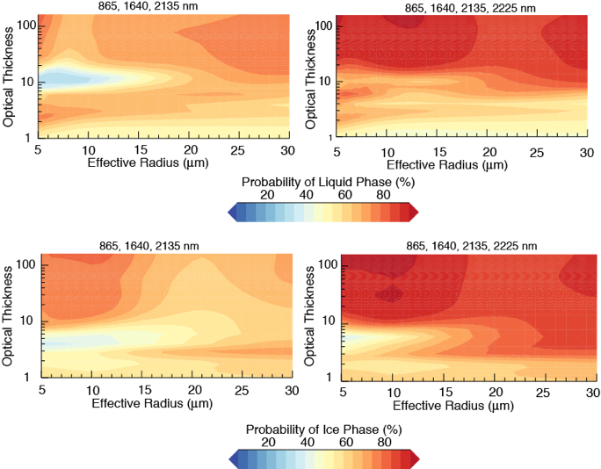
Cloud Phase Information Content Study
Adding OCI+ 2.25 μm channel (right panels) always improves probability of phase discrimination for both liquid (top) and ice clouds (bottom).
Notes:
1.38µm: OCI+

Slide 12
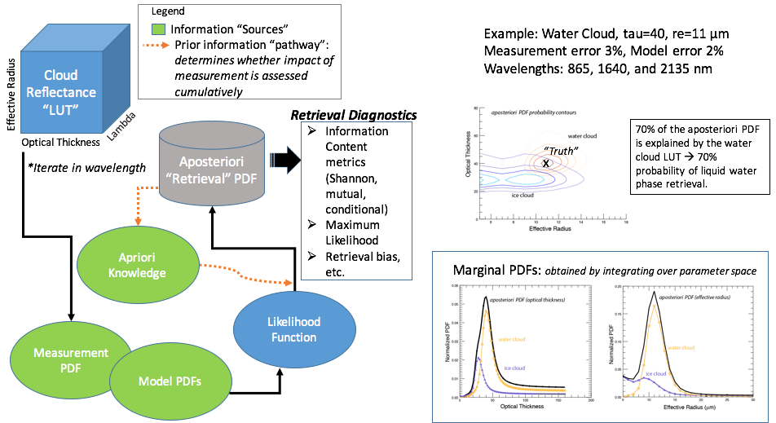
Cloud Phase Information - Backup 1
Notes:
1.38µm: OCI+

Slide 13
Cloud Phase Information - Backup 2
Notes:
1.38µm: OCI+

Slide 14
Cloud Phase Information - Backup 3
Notes:
1.38µm: OCI+

Slide 15
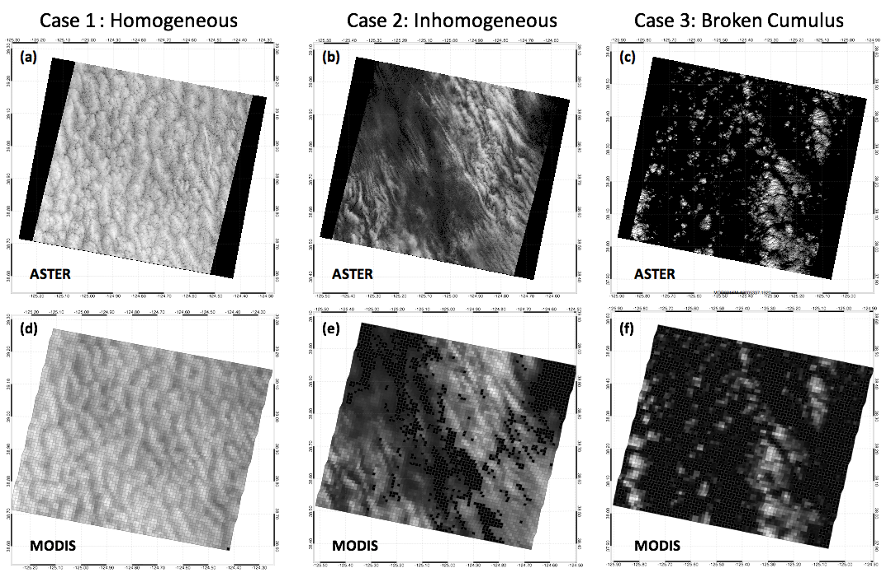
Spatial Resolution Sensitivities for Liquid Water Clouds
Cloud detection and retrievals of COT and CER are influenced by sensor spatial resolution due to sub-pixel heterogeneities
Approach: ASTER observations vs. MODIS (new), large eddy simulation (LES) stratocumulus simulations (ongoing)
Fig. 1: (a) Single channel RGB composite of atmospherically corrected VNIR reflectances sampled by ASTER on 05/13/2003 off the coast of California. (b) Same as (a) but sampled on 06/10/2005. (c) Same as (a) but sampled on 12/03/2005. (d)-(f) Same as (a)-(c) but from VNIR reflectances sampled by MODIS. Selected Scenes show varying degrees of cloud inhomogeneity.
from F. Werner et al., AGU 2015
Notes:
horizontal photon transport can be important at high resolutions
PP bias (non-linearities of PP retrievals) important at low/moderate resolutions

Slide 16
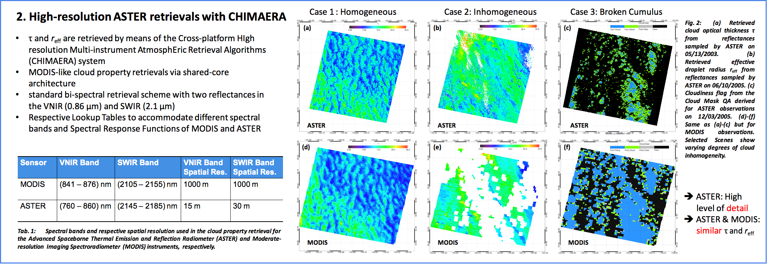
Imager Spatial Resolution Studies
ASTER vs. MODIS
COT retrievals: 0-30 scale Cloud detection
from F. Werner et al., AGU 2015
Notes:
1.38µm: OCI+

Slide 17
Backup Slides

Slide 18
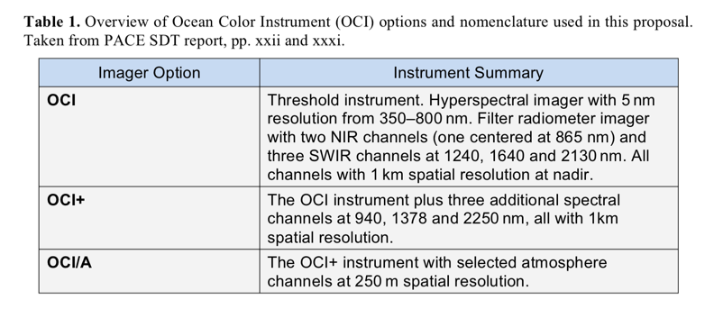
Assumed Viable OCI Imager Options
Notes:
OCI/A in the SDT report is what Carlos called TWE but w/out polarimeter.
Should mention lack of IR but should consider constellation flying

Slide 19
Rationale
Understanding the extent to which the PACE imager can be used to produce relevant and stable cloud products is of strategic importance to NASA ESD.
Satellite cloud climate data record generation from solar spectral channels is challenging due to the need for exacting reflectance stability over multiple decades.
Imager stability requirements for ocean color applications demonstrated to sub-percent level for SeaWiFS using lunar observations. Similar capabilities for OCI defined in the PACE SDT report, in addition to stringent requirements for other radiometric/spectral specifications essential for establishing climate records.
Notes:
CDR: Ability to generate CDRs w/MODIS (Terra & Aqua) to the level needed to detect likely cloud property trends is yet to be demonstrated. The same is true of VIIRS (“demonstrated”).

Slide 20
Key Assumption and Scope
OCI imager options for cloud/aerosol work that were presented in the PACE SDT report are viable
No 3MI polarimeter studies
“Though our team [Z. Zhang] has theoretical and practical experience with polarimetric cloud retrievals, we have not explicitly budgeted for additional studies due to continued uncertainty regarding a PACE polarimeter.”
Notes:
key word: budgeted

Slide 21
Potential ST Collaborations
Detection and impact of thin cirrus on ocean color and aerosol retrievals [Cloud Team Liaisons: Ackerman, Platnick, Meyer]
O2 A-band studies [Cloud Lead: Heidinger]
Project/ST OCI trade studies w.r.t. cloud products
Sub-group participation
RT/simulations [Coddington, Heidinger, Platnick].
Cloud team plans include:
State variables: previously developed ECMWF ERA-40 land/ocean, latitude zone climatologies for cloudy profiles
A-band: Jurgen Fischer code used for MERIS A-band studies, also LBLRTM
Observations (needs to include cloud scenes!)
PICARD cloud/aerosol hyperspectral pushbroom imager data from ER-2 in late spring 2015 [Lead: Platnick]
OCO-2 for A-band obs [Lead: Heidinger]
Notes:
ERA climatologies from Wind et al. (2010). 60 levels Within each latitude belt, profiles are chosen from regions that had cloud fraction (CF) > 0.85 to match the conditions of interest. Profiles were separated further by land and ocean using the ECMWF land fraction flag with threshold set at 0.5. Starting with these averaged profiles, we set relative humidity to 100% for the specific levels that contained clouds in our simulations.

Slide 22
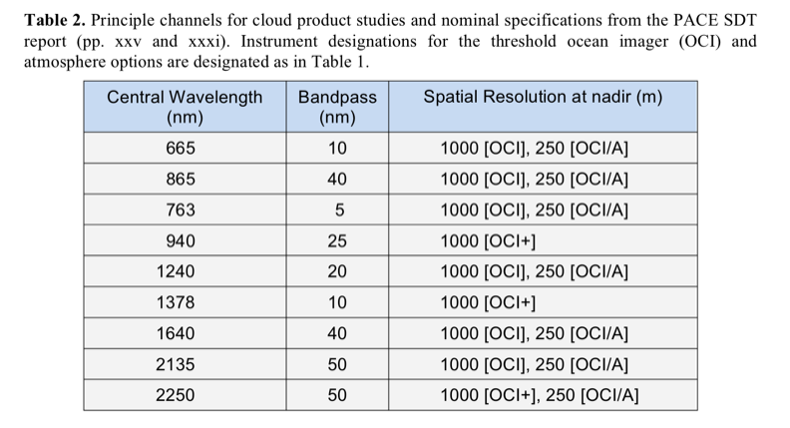

Slide 23
