Slide 1
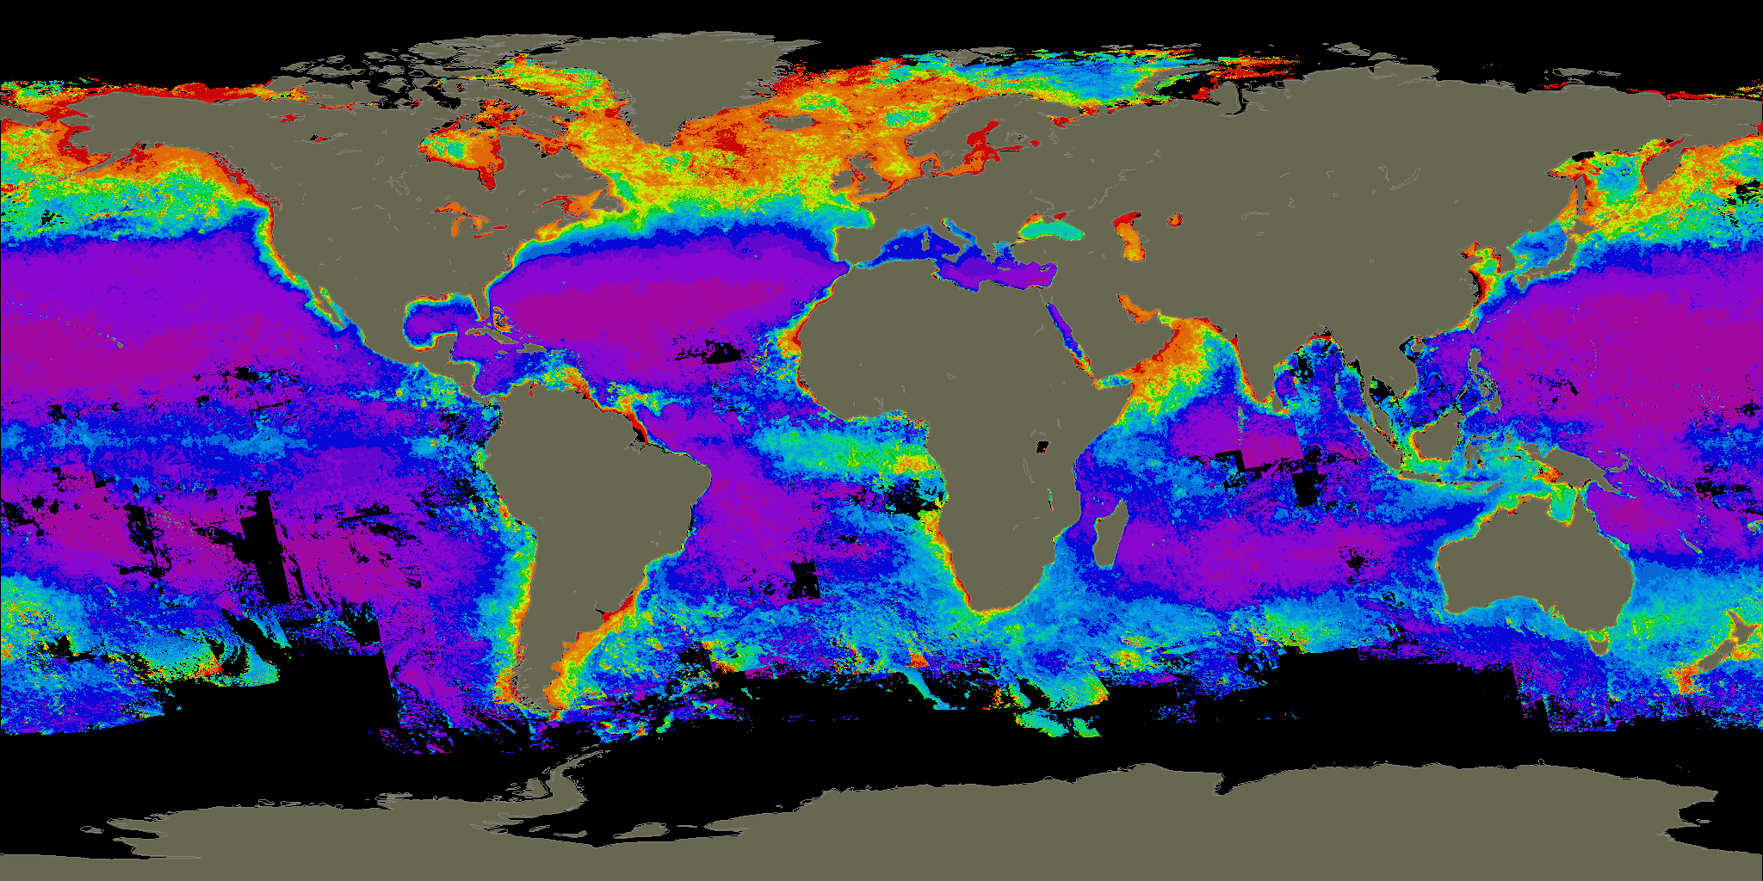
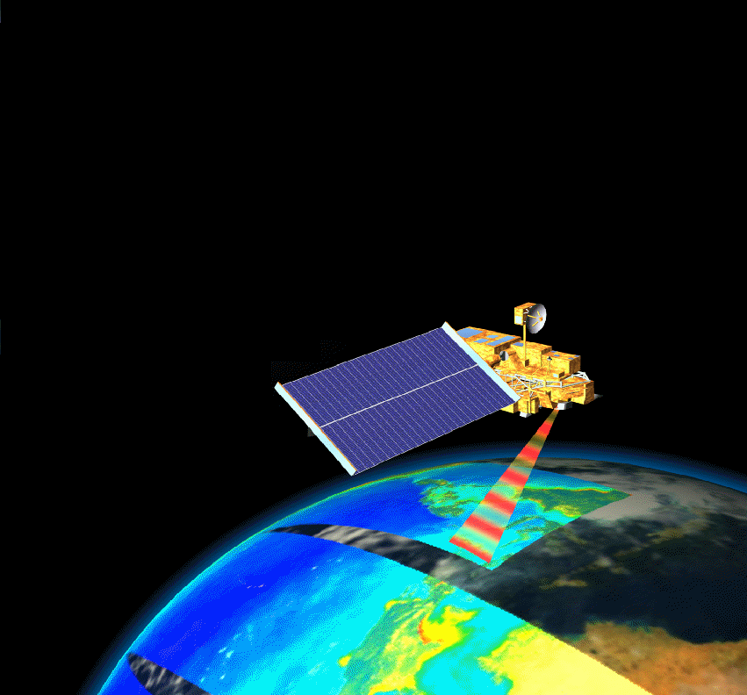
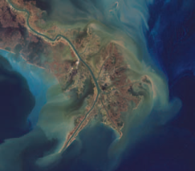


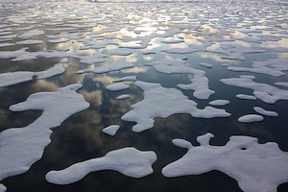
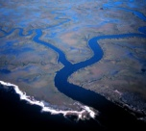
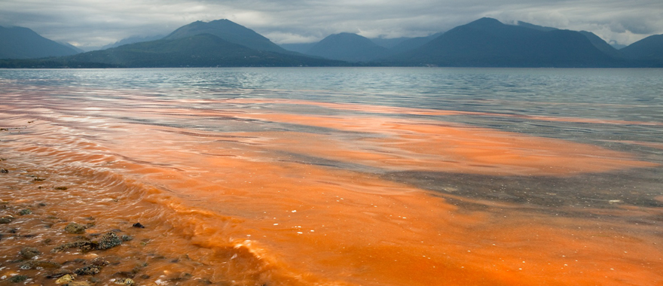
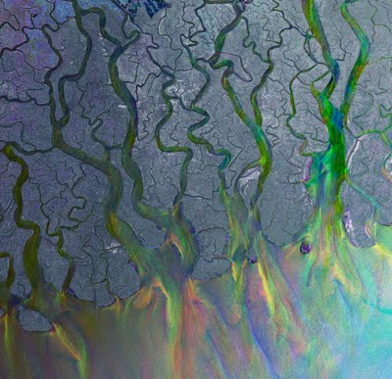
PACE
How can we do our Science
in a way that will maximize its utility
Ali Omar (NASA LARC)
Maria Tzortziou (CCNY/GSFC)

Slide 2
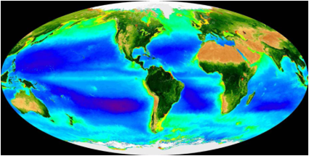
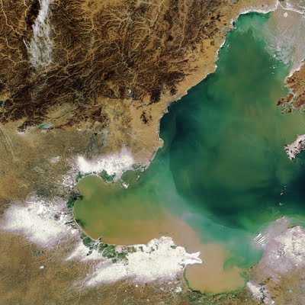
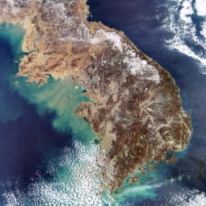
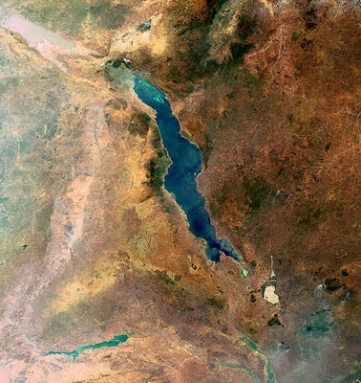
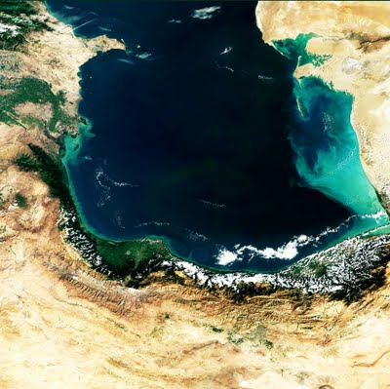
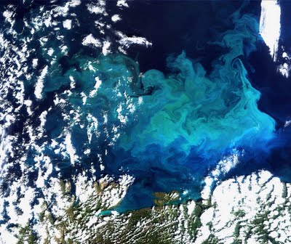
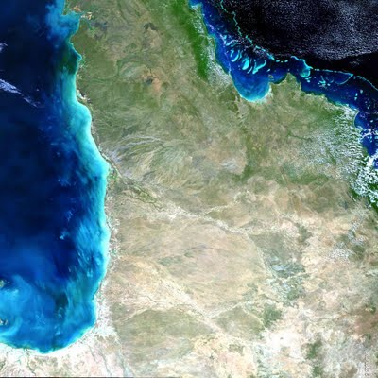
PACE observations: Utility, Applications ,and Societal Benefits
PACE Science Team Workshop
January 14-16 2015, Maryland
2007 report Earth Science and Applications from Space: National Imperatives for the Next Decade (commonly referred to as the Decadal Survey) specifically calls for: ‘societal needs help to guide scientific priorities more effectively and that emerging scientific knowledge is actively applied to obtain societal benefits’
“The funding of scientific research is almost always justified in terms of the potential for achieving beneficial societal outcomes”
Supply
Demand
Supply of knowledge & information
Need to use this information/knowledge
“The neglected heart of science policy: reconciling supply of and demand for science”,
by Daniel Sarewitz and Roger Pielke, Environmental Science & Policy 10 (2007) 5-16

Slide 3
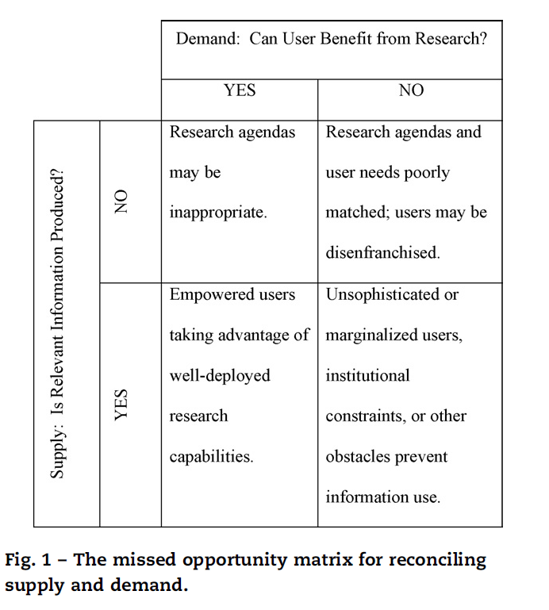
PACE observations: Utility, Applications ,and Societal Benefits
PACE Science Team Workshop
January 14-16 2015, Maryland
Sarewitz and Pielke, Environmental Science & Policy 10 (2007) 5-16

Slide 4



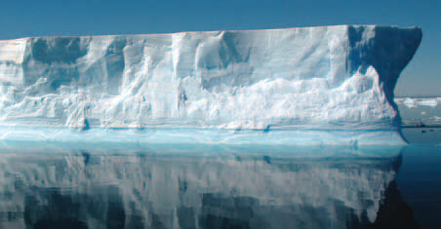




PACE observations: Utility, Applications ,and Societal Benefits
PACE Science Team Workshop
January 14-16 2015, Maryland
The NASA Applied Sciences Program promotes and funds activities
that discover and demonstrate innovative uses and practical benefits of NASA’s Earth science resources
Air Quality & Health
Agriculture
Ecosystems
Climate
Weather
Water Resources
Ecological Forecasting
Disasters

Slide 5
NASA Applied Sciences Architecture
Results of
NASA Earth
Science Research
Societal Needs
Management
Decisions
Technology
Valley of Death
Policy
Decisions
Missions /
Observations
Data and
Archives
Applied Sciences
Program
Forecasting
Research
and Analysis
Response
& Recovery
Models /
Predictions

Slide 6
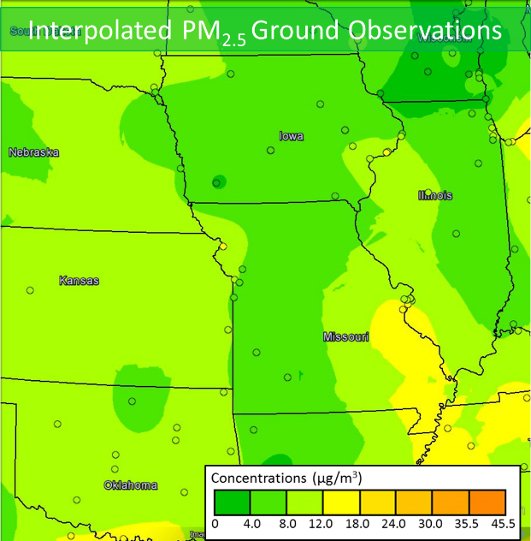
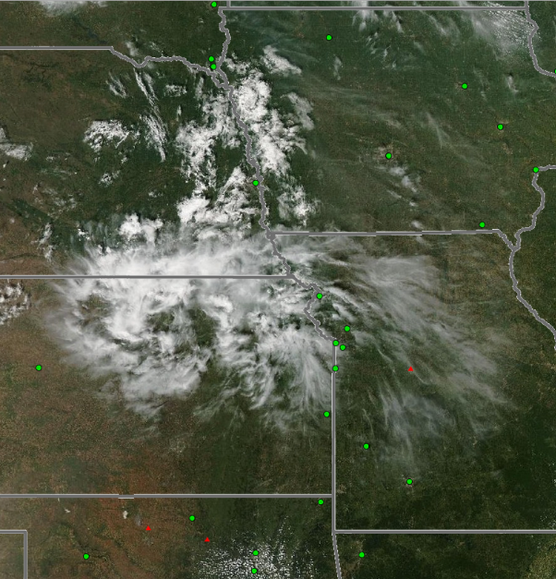
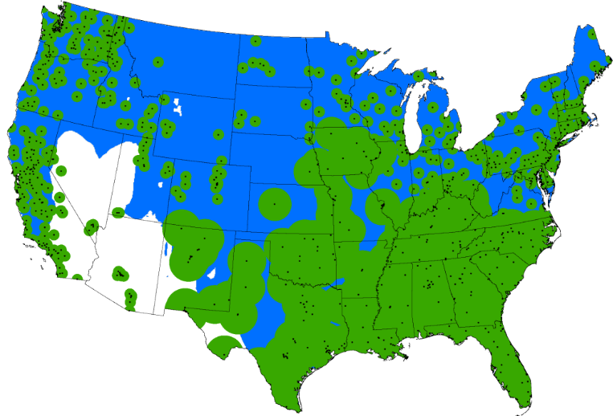
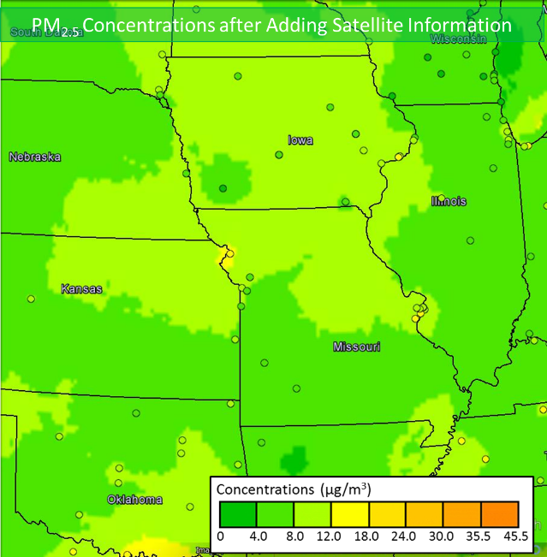
Improving EPA’s AirNow Air Quality Index Maps with NASA Satellite Data
PM2.5 FROM GROUND BASED DATA
GROUND-BASED + SATELLITE
COVERAGE OF AIR QUALITY
Northern Missouri fires - Sept. 4, 2013
GOOD AQ
NE
IA
KS
PM2.5 GROUND+SATELLITE DATA
MO
Green areas are ground-based PM_{2.5} monitor coverage and the blue areas are AirNow Satellite-based PM_{2.5} coverage. White areas have neither satellite nor ground based coverage.
In the Missouri fires case (see http://www.youtube.com/watch?v=ycYp2-XtoxE) the addition of satellite data leads to the forecast of a poorer air quality index
POOR AQ
“This is the best tool I have seen so far that integrates satellite data with information from ground monitors.”
Cassie McMahon,
Minnesota Pollution Control Agency
Notes:
First Column: If we estimated the concentration of particulate material (PM) from ground monitors (the small dots on the far left figure) the area of coverage would be limited only to the areas shaded green. The MODIS Satellite coverage, shown by the blue areas, helps to fill most of the gaps (but not all) –nearly half of the uncovered population (18.1 million) now have AQ information. Some of the white areas are because the surface albedo is so high that the MODIS retrievals are saddled with large uncertainties.
Second and Third Column: A case study showing the problem (the fire image) , the solution (PM2.5 from ground based data), and NASA’s contribution (PM2.5 from Ground + Satellite Data). In the nominal solution because the ground monitors in this region are very few, the interpolated PM2.5 data shows relatively good Air Quality (AQI of 0 – 4). The addition of satellite data shows that the Air Quality as a result of the
Fires is poorer at AQI = 4-8.0; This shows a case where the satellite data has real value in producing an Air Quality Index that actually protects the public from harm by allowing them make decisions
that protect their health and wellbeing. If the satellite data were not there, the would be no indication of this poorer air quality.
Yellow box : Testimonial from a user at the Minnesota pollution Control Agency

Slide 7
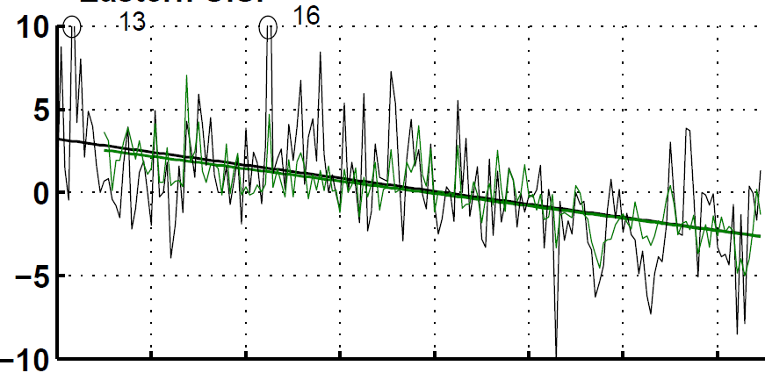
SeaWiFS and MISR AOD give insight into PM_{2.5} trend
1999-2012
Both instruments radiometrically stable
CALIOP unavailable before 2006
  cannot use on long-term AOD-PM_{2.5} relationship
In Situ
Eastern US
PM_{2.5} Anomaly (μg m⁻³)
SeaWiFS & MISR
Satellite-Derived
In Situ
In Situ (1999-2012): 0.37 ± 0.06 μg m⁻³ yr⁻¹
Satellite-Derived (1999-2012): 0.36 ± 0.13 μg m⁻³ yr⁻¹
Apply relative change to 2001-2010 mean PM_{2.5}
→ consistent magnitude and trend
-2 -1.5 -1 -0.5 0 0.5 1
PM2.5 trend [μg/m³/yr]
Boys et al., ES&T, 2014

Slide 8
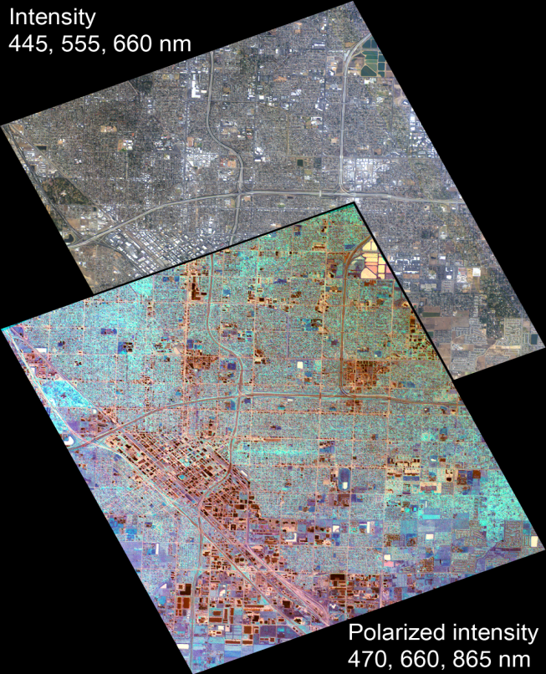
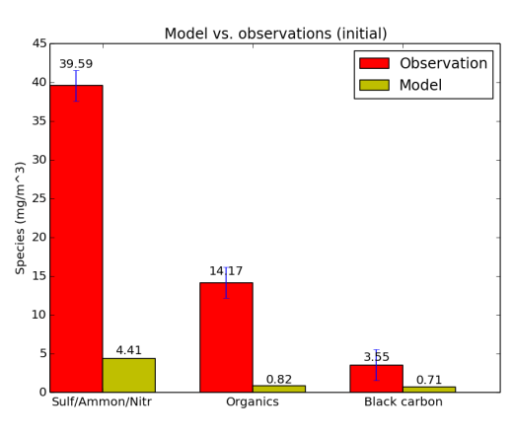
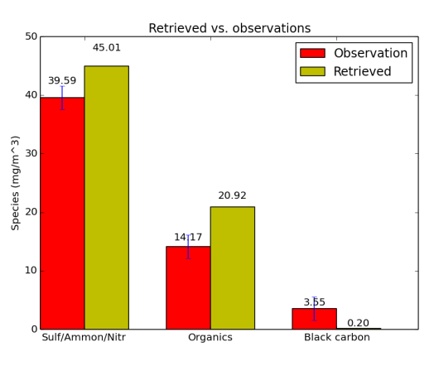
Case study: Constraining PM_{2.5} speciation over Fresno with AirMSPI polarimetric data
Fresno
Applied Science Goal: associate different types of airborne particles with adverse health outcomes
PM exposure is projected to become the world’s leading environmental cause of premature deaths (Organisation for Economic Co-operation and Development, 2012)
Retrieved AOD by component
1/6/2012
WRF-Chem speciated PM 2.5
Retrieved speciated PM 2.5
Multi-angular polarimetric observations combined with high-resolution WRF-Chem model predictions are promising tool for retrieving PM_{2.5} by particle species

Slide 9
Main Proposed Objectives
PACE Science Team Workshop
January 14-16 2015, Maryland
Objective #1:
Bring an applications-oriented perspective so that the new products developed by PACE (IOPs a_{phyt} , a_{NAP} , a_{CDOM} , b_{b} , atmospheric products) are linked to specific applications questions.
Objective #2:
Assess and achieve consensus recommendations within the Science Team on the spectrum of applications we can address with PACE IOP measurements and retrieval approaches.
Objective #3:
Working both with the users community and with other members of the PACE ST, assess what is the accuracy in IOPs needed for specific applications by the users and how this relates to the accuracy of the IOPs products & retrievals recommended by the PACE ST.
Objective #4:
Address key issues related to applications from PACE, particularly requirements for spatial resolution in coastal waters and spatial coverage, and how these related to the capabilities of IOPs retrievals recommended by the PACE ST.

Slide 10
Main Proposed Objectives
PACE Science Team Workshop
January 14-16 2015, Maryland
PACE Science Team Applications Sub-Group:
Steve Ackleson (CASE II waters)
Emmanuel Boss (global datasets)
Heidi Dierssen (cyanobacteria, suspended sediments, floating vegetation, floating plastics etc)
Deric Gray (NRL, military applications, diver visibility, etc)
Olga Kalashnikova (polarization, atmosphere)
Robert Levy (Air Quality, Atmospheric composition)
Dave Miller (NRL, military applications etc)
Ali Omar (Air Quality)
Mike Ondrusek (NOAA, operational, water quality, fisheries)
Steve Platnick (clouds, climate)
Lorraine Remer (aerosols, air-quality)
Mike Twardowski (WETLabs, wide range of users)
Maria Tzortziou (Coastal systems)

Slide 11
Main Proposed Objectives
PACE Science Team Workshop
January 14-16 2015, Maryland
Highlight Atmosphere & Ocean Applications relevant to PACE
Relevant to PACE = 1. BOTH advanced ocean color AND atmospheric products
2. Spatial coverage: Global (both open ocean and coastal waters)
3. Spectral resolution: Hyper-spectral IOPs and atmospheric products
4. Spectral range: Extended UV-VIS-NIR with SWIR bands
5. Temporal Resolution: Daily retrievals
6. Spatial resolution: Threshold: 1 km (at nadir), Goal?

Slide 12
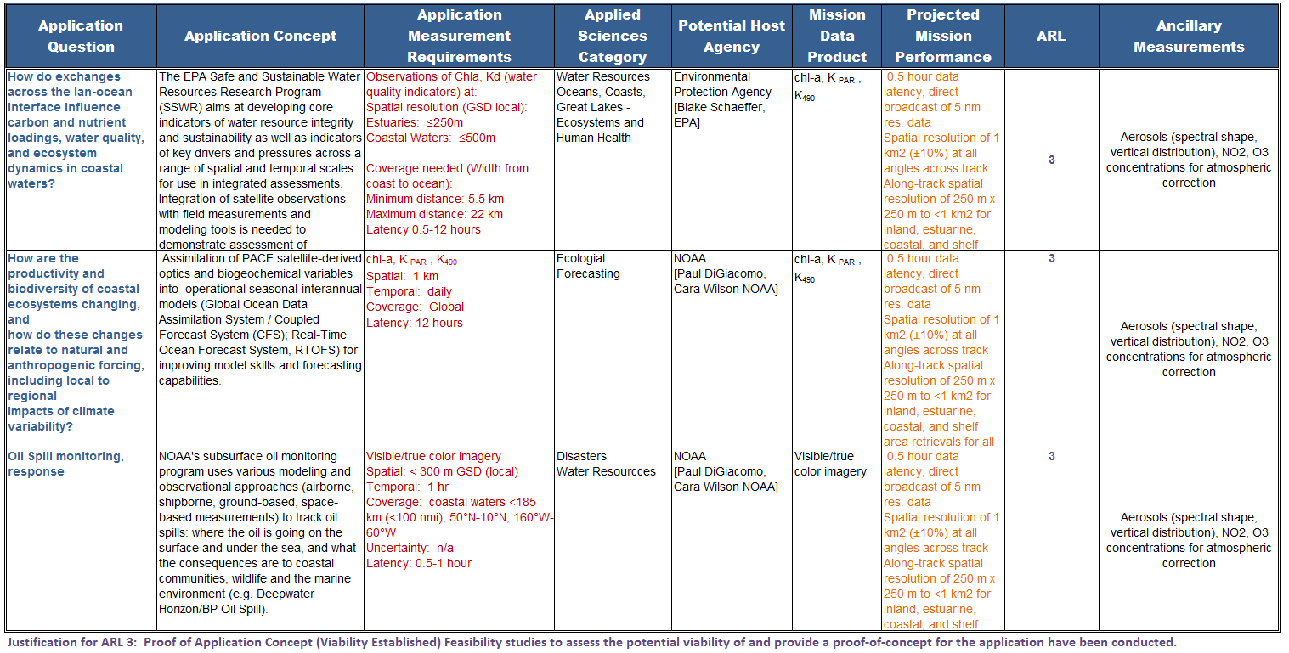
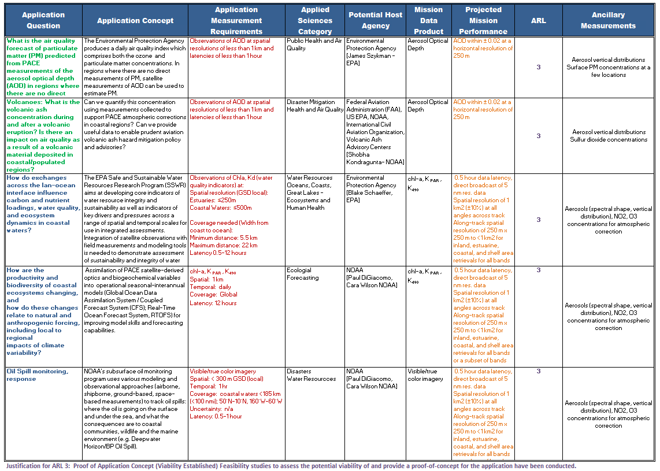
PACE Applications Traceability Matrix (ATM)
PACE Science Team Workshop
January 14-16 2015, Maryland
Applications Traceability Matrix
(with input/requirements from user community representatives, e.g., NOAA, EPA, USGS, FAA)

Slide 13
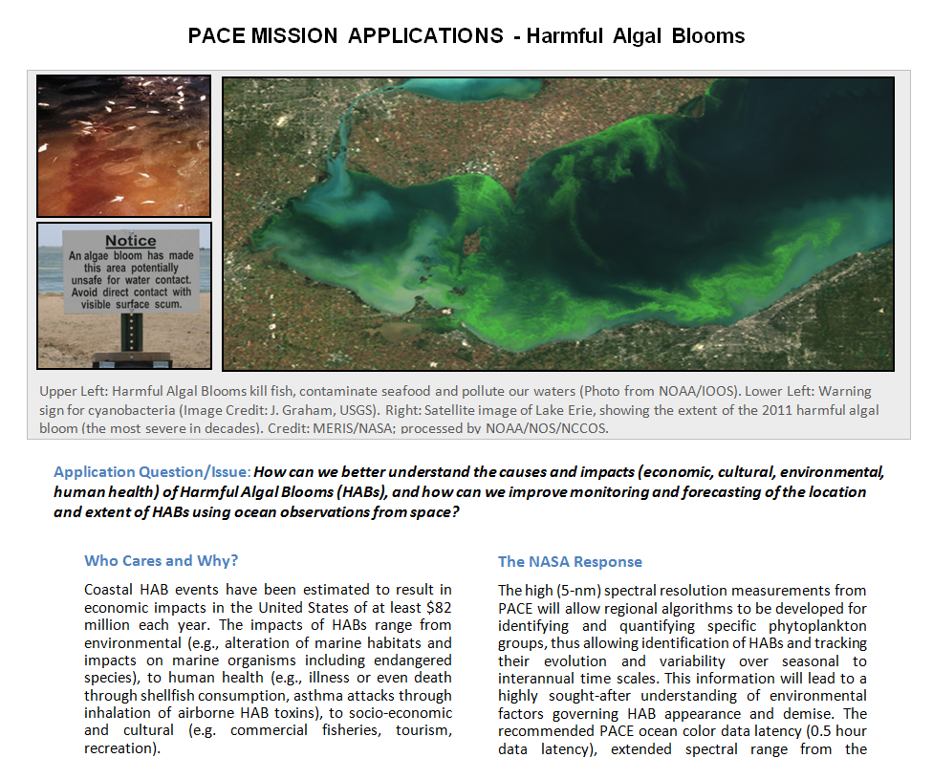
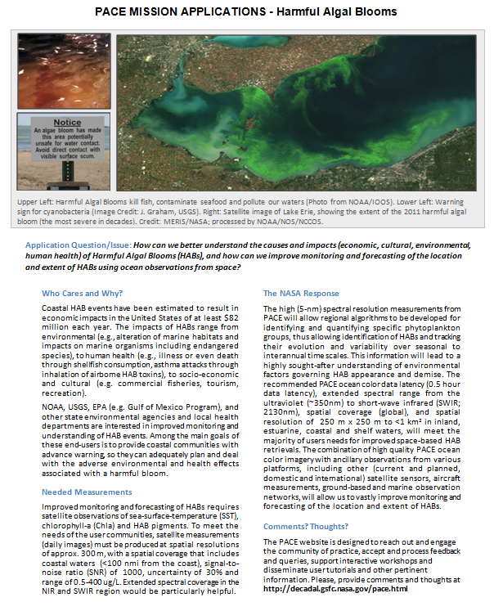
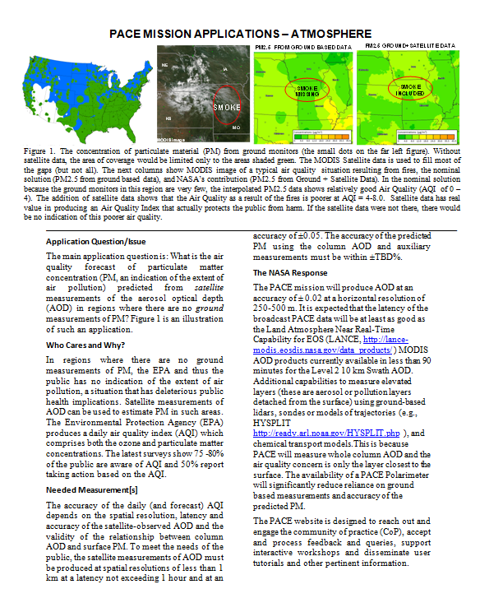
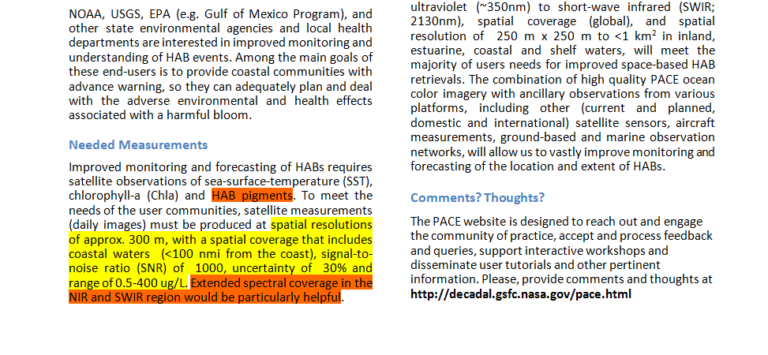
PACE Applications White Papers
PACE Science Team Workshop
January 14-16 2015, Maryland
White Papers – PACE Applications
(from PACE/ACE Deputy Program Application Leads (DPAs) Ali Omar (NASA LaRC) & Maria Tzortziou (UMD))
For example:
development of White Papers and posting these papers on PACE website
What “applications” would we like to highlight on PACE White Papers?

Slide 14
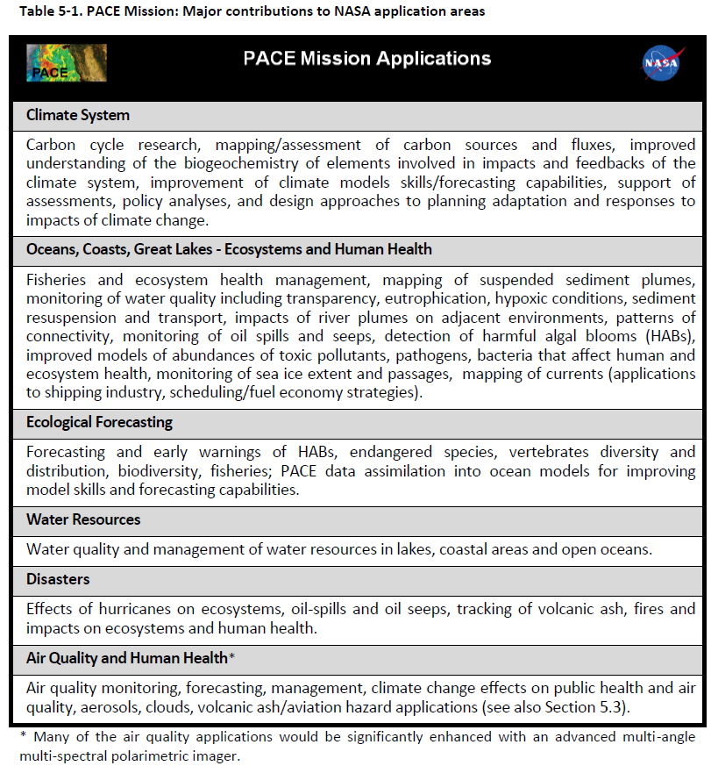
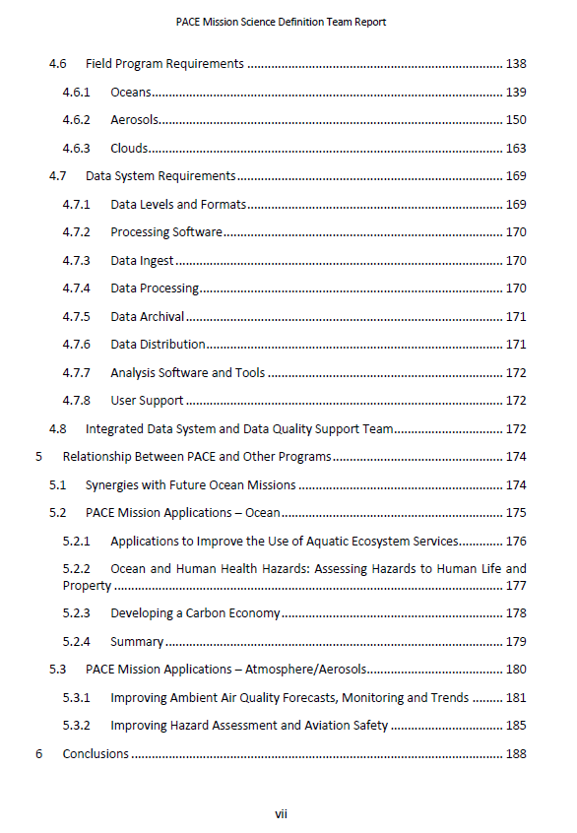
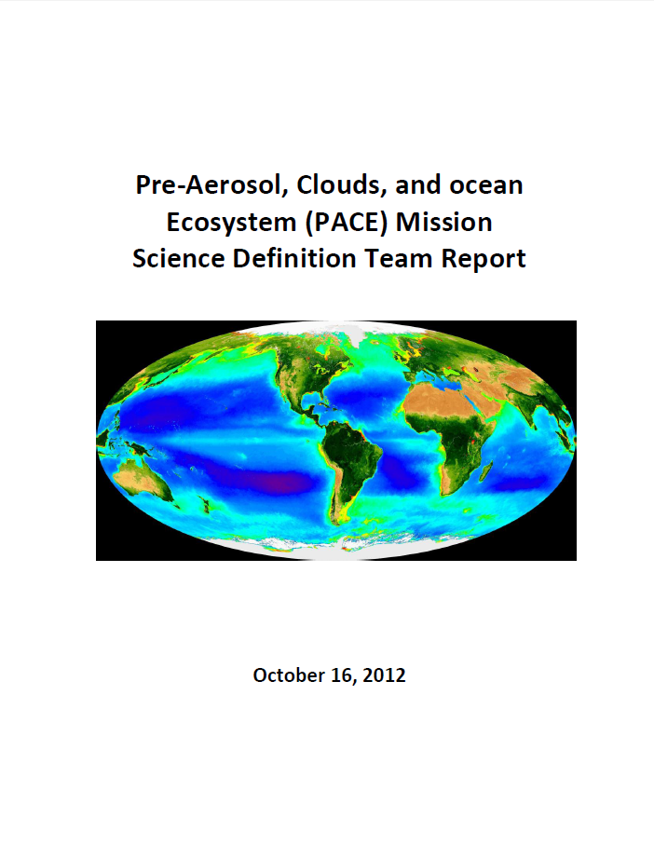
PACE observations: Utility, Applications ,and Societal Benefits
PACE Science Team Workshop
January 14-16 2015, Maryland
PACE SDT Report, Oct 2012
PACE Mission Applications
Table 5-1, pg. 175-188

Slide 15
PACE observations: Utility, Applications ,and Societal Benefits
PACE Science Team Workshop
January 14-16 2015, Maryland

Slide 16
PACE observations: Utility, Applications ,and Societal Benefits
PACE Science Team Workshop
January 14-16 2015, Maryland

Slide 17

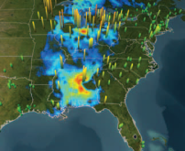
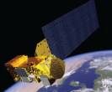



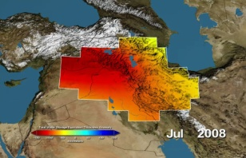
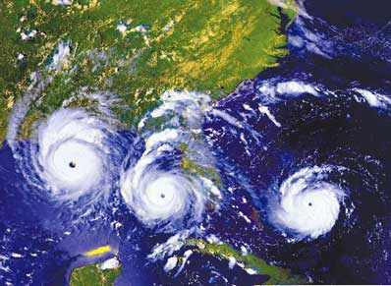
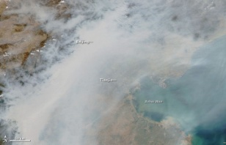
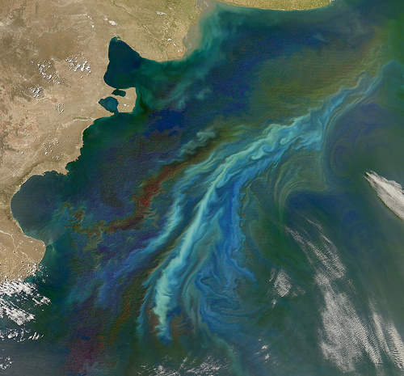
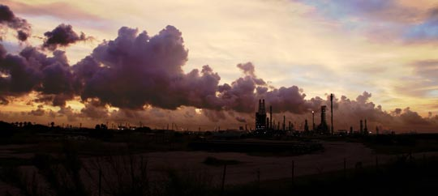


PACE Pre-Aerosol, Clouds, & ocean Ecosystem
APPLICATIONS
Overview
PACE Home
Mission Objectives
Status Updates
Science
Applications
Instrument
Data
People
Publications
Education and Outreach
News
The overall goal of the PACE applications program is to identify potential user communities and areas of applications for this future NASA mission, to ensure that the product suite and delivery mechanisms maximize the usefulness of the data.
Relevance to NASA’s Applied Sciences Program
  Overview
The NASA Applied Sciences Program (ASP) promotes and funds activities to discover and demonstrate innovative uses and practical benefits of NASA Earth science data, scientific knowledge, and technology.
  Ocean
  Atmosphere
The ASP, in coordination with the PACE Applications Working Group and the PACE Science Team will partner with public and private organizations on ways to apply data from PACE and its scientific findings in their decision-making activities and services, helping to improve the quality of life and strengthen the economy.
PACE observations will benefit a broad spectrum of public groups, including operational users in various tribal, local, state, federal, and international agencies; policy implementers; the commercial sector; scientists; educators; and the general public. The combination of high-quality, global atmospheric and oceanic observations provided by the PACE mission will provide direct benefits to society in the following major NASA application areas:
  Applications Traceability Matrix (ATM)
  Early Adopters Program
  Applications Working Group
  Data Products & User Tools
  Calendar
    Solicitations
    Workshops
    Field Campaigns & Cal/Val Activities
  Publications/Presentations
  About Us
  Related Links
Oceans
Water Resources
Disasters
Climate
Ecological Forecasting
Human Health & Air Quality
Follow Us …

Slide 18
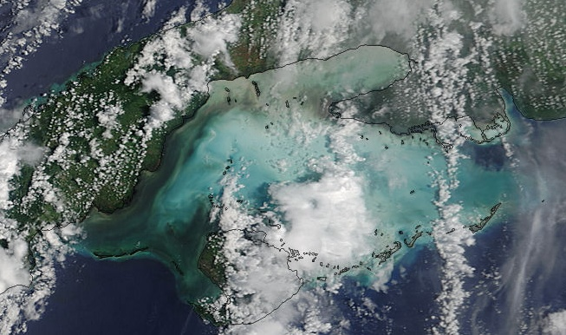
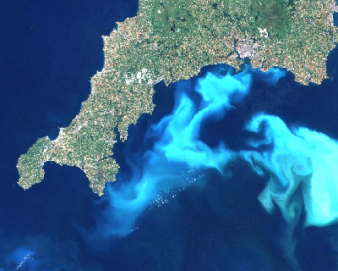
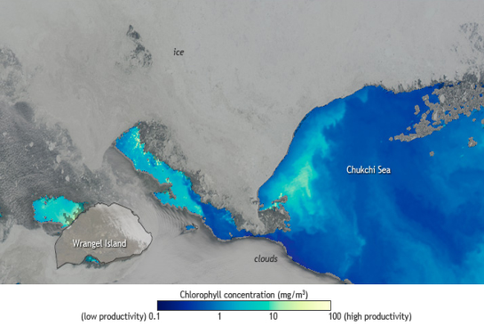
PACE Pre-Aerosol, Clouds, & ocean Ecosystem
APPLICATIONS
Ocean
PACE Home
Mission Objectives
Status Updates
Science
Applications
Instrument
Data
People
Publications
Education and Outreach
News
Gulf of Batabano, Cuba, after the passage of Hurricane Charley – MODIS 500m resolution
The PACE mission will make near-daily observations across the globe, with more frequent measurements at high latitudes. These observations will provide dynamic maps of a number of critical parameters that are needed to understand the location, status, variation, and trends in important ecosystem services.
Many applications in coastal, estuarine, and inland waters require high spectral and high spatial resolution space-based observations to resolve the complex optical signals and biogeochemical processes typically characterizing these environments. The medium (1 km) to high (250 to 500 m) spatial resolution observations from PACE will be particularly advantageous for research and societal applications in lakes, estuarine, and coastal environments, where environmental properties and the distribution of resources change rapidly over shorter distances than in the open ocean.
  Overview
  Ocean
  Atmosphere
  Applications Traceability Matrix (ATM)
  Early Adopters Program
Coccolithophores bloom, off the SW UK - MODIS
  Applications Working Group
  Data Products & User Tools
  Calendar
    Solicitations
    Workshops
    Field Campaigns & Cal/Val Activities
Climate System
Read More
  Publications/Presentations
  About Us
Oceans, Coasts, Great Lakes – Ecosystems and Human Health
Read More
  Related Links
Ecological Forecasting
Read More
Bloom in the Chukchi Sea (07/10/2011)- MODIS
Water Resources
Read More
Disasters
Read More
Follow Us …

Slide 19
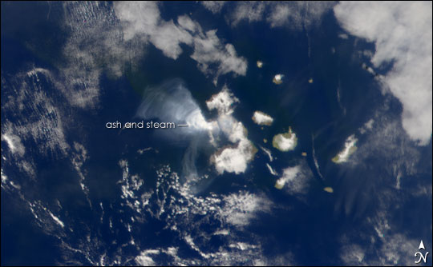
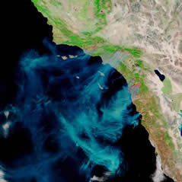
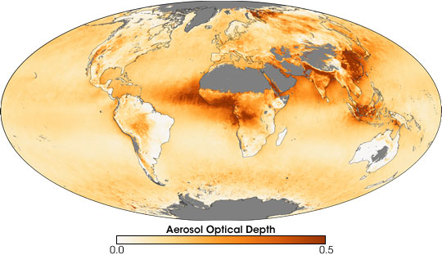
PACE Pre-Aerosol, Clouds, & ocean Ecosystem
APPLICATIONS
Atmosphere
PACE Home
Mission Objectives
Status Updates
Science
Applications
Instrument
Data
People
Publications
Education and Outreach
News
Fernadina Volcano, Galapagos Islands - SeaWiFS
The PACE Mission focuses on understanding ocean ecology and the global carbon cycle and how it affects and is affected by climate change. These data will extend observations of ocean ecology, biogeochemical cycling, and ocean productivity begun by NASA in the late 1990s. To achieve these objectives, enhanced methods of atmospheric correction are required to account for the effects of absorbing and scattering aerosols in the Earth’s atmosphere—signals that mask or alias ocean-color retrievals. These auxiliary atmospheric measurements will augment NASA’s satellite observations of aerosols and clouds. Many of the applications outlined below presuppose an advanced multi-directional, multi-polarization, and multispectral imager (3MI).
Aerosol measurements with a 3MI-like instrument can augment retrievals by other NASA satellites and provide direct benefits to society. Potential applications of the PACE data include better assessments of local and regional air quality (a public health application) and improved characterization of hazards for issuing disaster warnings (a public safety application).
  Overview
  Ocean
  Atmosphere
Southern California Wildfires- MODIS
  Applications Traceability Matrix (ATM)
  Early Adopters Program
  Applications Working Group
  Data Products & User Tools
  Calendar
    Solicitations
    Workshops
    Field Campaigns & Cal/Val Activities
  Publications/Presentations
  About Us
  Related Links
Improving Ambient Air Quality Forecasts, Monitoring and Trends
Read More
Improving Hazard Assessment and Aviation Safety
Read More
Follow Us …
MODIS Annual mean AOD for 2006

Slide 20
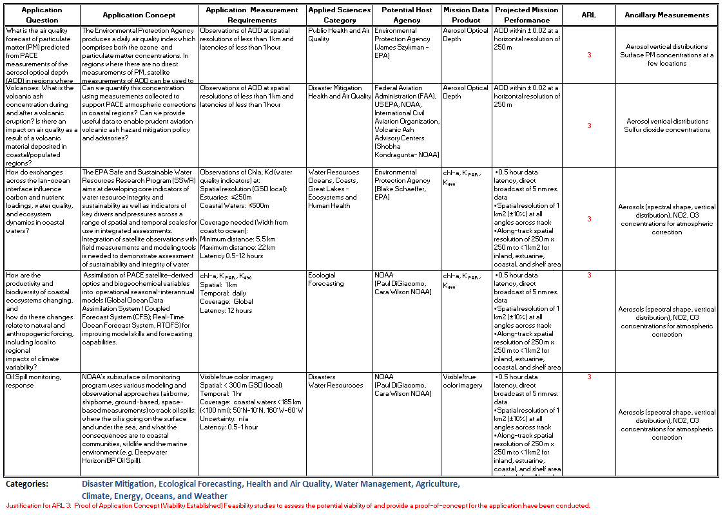

PACE Pre-Aerosol, Clouds, & ocean Ecosystem
APPLICATIONS
Applications Traceability Matrix (ATM)
The mission’s Applications Traceability Matrix (ATM) provides an overview of what potential applications, and includes information on application concepts and readiness levels, relevant data products and performance, identification of specific users, potential host agencies and points of contact.
The PACE ATM was developed by the PACE Applications Team, based on the information provided in the PACE Science Traceability Matrix (STM), following interactions with both the mission Science Definition Team and the Users’ community.
PACE Home
Mission Objectives
Status Updates
Science
Applications
Instrument
Data
People
Publications
Education and Outreach
News
  Overview
  Ocean
  Atmosphere
  Applications Traceability Matrix (ATM)
  Early Adopters Program
  Applications Working Group
  Data Products & User Tools
  Calendar
    Solicitations
    Workshops
    Field Campaigns & Cal/Val Activities
  Publications/Presentations
  About Us
  Related Links
Follow Us …

Slide 21
PACE Pre-Aerosol, Clouds, & ocean Ecosystem
APPLICATIONS
Early Adopters Program
The PACE Early Adopters (EA) Program will promote applications research to provide a fundamental understanding of how PACE data products can be scaled and integrated into organizations' policy, business and management activities to improve decision-making efforts.
What is an “Early Adopter”? PACE Early Adopters are defined as those groups and individuals who have a direct or clearly defined need for PACE-like data, who have an existing application, new ideas for novel PACE-related applications, and who are planning to apply their own resources (funding, tools, personnel, facilities, etc) to demonstrate the utility of PACE data for their particular system or model. The Early Adopter will use preliminary data products that will become standard products for the PACE mission. The goal of this designation is to accelerate the use of PACE products after launch of the satellite by providing specific support to Early Adopters who commit to engage in pre-launch research that would enable integration of PACE data in their applications. Activities that emphasize an end-user connection will be most relevant. Projects would be completed with quantitative metrics prior to launch.
Characteristics of the PACE EA program are:
Each EA will be partnered with at least one PACE Science Team member who is developing a mission product that the EA would like to use/integrate into an application tool.
The PACE EAs will participate in the implementation of the PACE Mission Applications Plan by taking lead roles in PACE applications research, meetings, workshops, and related activities.
The EA program is an unfunded activity formalized through an early data access agreement (i.e., simulated PACE data) between the mission and the participating organization.
Early Adopters will be nominated by the PACE Applications Working Group (AWG) from a pool of users after reviewing for relevance, availability of science team partners, and anticipated application.
PACE Home
Mission Objectives
Status Updates
Science
Applications
Instrument
Data
People
Publications
Education and Outreach
News
  Overview
  Ocean
  Atmosphere
  Applications Traceability Matrix (ATM)
  Early Adopters Program
  Applications Working Group
  Data Products & User Tools
The Early Adopter
will receive access to developmental products
and interaction with the product developer enabling them to be among the first to integrate the new PACE products into
their systems.
  Calendar
    Solicitations
    Workshops
    Field Campaigns & Cal/Val Activities
The Science Team member
will gain a partner who can evaluate products and offer feedback from a functionality perspective as well as potential calibration and validation information.
  Publications/Presentations
  About Us
  Related Links
Follow Us …

Slide 22
PACE Pre-Aerosol, Clouds, & ocean Ecosystem
APPLICATIONS
Applications Working Group
PACE Home
Mission Objectives
Status Updates
Science
Applications
Instrument
Data
People
Publications
Education and Outreach
News
The PACE Applications Working Group (AWG) will actively participate and be involved with the mission concept teams and the mission science team in the development of the PACE mission and production/distribution of products relevant to applications and scientific aspects of the mission that have a direct impact on applications. Currently, the PACE AWG consists of five members: the PACE Mission Applications Coordinators for ocean and atmosphere applications areas, the PACE Mission Applications Program Lead, and the PACE Mission Program Scientists.
The AWG will organize the relevant PACE applications communities and support organizations’ and communities’ efforts to imagine, articulate, and anticipate possible applications. The AWG will lead the mission’s efforts to identify potential partnerships and collaborators and organize sufficient meetings/events/workshops to support the applications communities at a national level for the mission.
The AWG will be the link between the mission and the applications communities relevant to the mission, communicating information about the mission to applications audiences across the range of relevant applications areas, and bringing the interests and concerns of the applications communities back to the mission development process at NASA. The AWG will present the needs of the applications communities at the science team meetings. It will advise relevant program managers at the Applied Science Program (ASP) about high impact PACE applications and publicize highlights of PACE applications.
  Overview
  Ocean
  Atmosphere
  Applications Traceability Matrix (ATM)
  Early Adopters Program
  Applications Working Group
  Data Products & User Tools
  Calendar
    Solicitations
    Workshops
    Field Campaigns & Cal/Val Activities
  Publications/Presentations
  About Us
  Related Links
Follow Us …

Slide 23
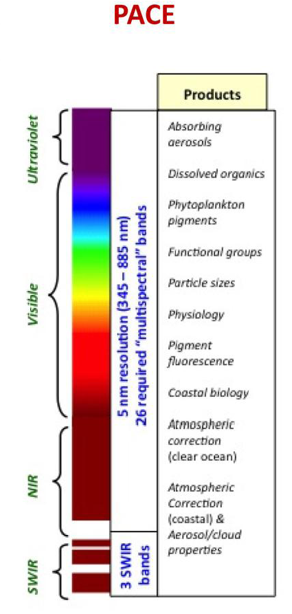
PACE Pre-Aerosol, Clouds, & ocean Ecosystem
APPLICATIONS
Data Products & User Tools
PACE Home
Mission Objectives
Status Updates
Science
Applications
Instrument
Data
People
Publications
Education and Outreach
News
PACE Data Products
The PACE mission will provide the frequent global synoptic observations from space that are required to improve our quality of life by helping assess the status of our natural and man-made resources. The PACE mission will provide unprecedented spectral (hyperspectral) and spatial (250 m to 1 km) extended records on conditions that affect the ecology and biogeochemistry of our planet. The opportunity to provide polarimetric measurements with the PACE mission offers the possibility to further extend data records on clouds and aerosol composition and dynamics.
These measurements (see PACE Science Traceability Matrix, STM) will provide a unique capability to help understand changes that affect our ecosystem services; implement science-based management strategies of coastal, marine and inland aquatic resources; and support assessments, policy analyses, and design approaches to planning adaptation and responses to impacts of climate change (from PACE STD Report: Pace Mission Applications).
  Overview
  Ocean
  Atmosphere
  Applications Traceability Matrix (ATM)
  Early Adopters Program
  Applications Working Group
  Data Products & User Tools
  Calendar
    Solicitations
    Workshops
    Field Campaigns & Cal/Val Activities
  Publications/Presentations
  About Us
  Related Links
User Tools
Follow Us …

Slide 24
PACE Pre-Aerosol, Clouds, & ocean Ecosystem
APPLICATIONS
Calendar
PACE Home
Mission Objectives
Status Updates
Science
Applications
Instrument
Data
People
Publications
Education and Outreach
News
Solicitations
Read More
Workshops
Read More
  Overview
Field Campaigns & Cal/Val Activities
Read More
  Ocean
  Atmosphere
  Applications Traceability Matrix (ATM)
  Early Adopters Program
  Applications Working Group
  Data Products & User Tools
  Calendar
    Solicitations
    Workshops
    Field Campaigns & Cal/Val Activities
  Publications/Presentations
  About Us
  Related Links
Follow Us …

Slide 25
PACE Pre-Aerosol, Clouds, & ocean Ecosystem
APPLICATIONS
Publications/Presentations
PACE Home
Mission Objectives
Status Updates
Science
Applications
Instrument
Data
People
Publications
Education and Outreach
News
■ PACE SDT Report [Oct 16, 2012] – Applications Section on pg 175-187
http://dsm.gsfc.nasa.gov/pace_documentation/PACE_SDT_Report_final.pdf
■ Science Definition Team (SDT) Meeting [March 2012] http://dsm.gsfc.nasa.gov/PACEmtg2_Mar2012.html
■ “Applications of Future NASA Decadal Missions for Observing Earth’s Land & Water Processes” by Luvall JC, Hook S, Brown ME, Tzortziou M, Carroll M, Escobar VM, Omar A, presented at the 2013 HyspIRI Science Symposium, NASA Goddard Space Flight Center, 29-30 May 2013.
Provide link
■ "NASA Future Ocean Color Satellite Missions and Applications to Studies of Extreme Weather Events and Impacts on Urban Coastal Ecosystems", by Tzortziou M., Mannino A., Omar A., presented at the Climate and Extreme Weather Impacts on Urban Coastal Communities Workshop, NOAA CREST / CCNY CUNY, 5-6 June 2013.
Provide link
  Overview
  Ocean
  Atmosphere
  Applications Traceability Matrix (ATM)
  Early Adopters Program
  Applications Working Group
  Data Products & User Tools
  Calendar
    Solicitations
    Workshops
    Field Campaigns & Cal/Val Activities
  Publications/Presentations
  About Us
  Related Links
Follow Us …

Slide 26
PACE Pre-Aerosol, Clouds, & ocean Ecosystem
APPLICATIONS
About Us
The applications team consists of:
• Maria Tzortziou: DPA - Applications Coordinator for PACE Ocean Applications
• Ali Omar: DPA - Applications Coordinator for PACE Atmosphere Applications
Woody Turner: PA - PACE Applied Science, NASA HQs
Paula Bontempi: PACE Program Scientist, NASA HQs
Hal Maring: PACE Program Scientist, NASA HQs
PACE Home
Mission Objectives
Status Updates
Science
Applications
Instrument
Data
People
Publications
Education and Outreach
News
  Overview
  Ocean
The PACE Applications Team was formed in 2012 to develop and facilitate the efforts of the PACE Applications Program to connect science to society. The Team operates under the direction of the PACE Program Scientists. Specific activities for the applications efforts include:
❖ Develop a list of applications foci for the PACE mission.
❖ Develop the PACE Applications Website.
❖ Develop the PACE Applications Traceability Matrix.
❖ Establish an Early Adopter program to demonstrate societally relevant applications to proposed data products.
❖ Establish an Applications Working Group to expand applications outreach.
❖ Attend and represent the PACE mission applications efforts at selected community meetings and workshops.
❖ Host interactive workshops and develop user tutorials to engage the community of practice and potential.
❖ Develop cross mission activities to establish connections between the PACE and other NASA missions communities
  Atmosphere
  Applications Traceability Matrix (ATM)
  Early Adopters Program
  Applications Working Group
  Data Products & User Tools
  Calendar
    Solicitations
    Workshops
    Field Campaigns & Cal/Val Activities
  Publications/Presentations
  About Us
  Related Links
Contact us:
Maria Tzortziou
UMD/ESSIC, NASA/GSFC
Greenbelt, MD, 20771, USA
Office: 301-614-6048
Email: Maria.A.Tzortziou@nasa.gov
Ali H. Omar
NASA LARC
Hampton, VA, 23681, USA
Office: 757-864-5128
Email: ali.h.omar@nasa.gov
Woody Turner
NASA Headquarters
Washington, DC, 20546, USA
Office: 202-358-1662
Email: woody.turner@nasa.gov
Follow Us …

Slide 27
PACE Pre-Aerosol, Clouds, & ocean Ecosystem
APPLICATIONS
Related Links
PACE Home
Mission Objectives
Status Updates
Science
Applications
Instrument
Data
People
Publications
Education and Outreach
News
■ NASA Applied Science Program: http://appliedsciences.nasa.gov/
■ ICESat-2 Applications: http://icesat.gsfc.nasa.gov/icesat2/apps-ov.php
■ SMAP Applications: http://smap.jpl.nasa.gov/applications/
■ GEO-CAPE Applications: http://geo-cape.larc.nasa.gov/applications.html
■ NASA Decadal Survey Missions: http://dsm.gsfc.nasa.gov/index.html
■ PACE Decadal Survey mission website: http://dsm.gsfc.nasa.gov/PACE.html
■ ACE Decadal Survey mission website: http://dsm.gsfc.nasa.gov/ACE.html
■ GEO-CAPE Decadal Survey mission website: http://geo-cape.larc.nasa.gov/
■ HyspIRI Decadal Survey Mission website: http://dsm.gsfc.nasa.gov/HyspIRI.html
■ ICESat II Decadal Survey Mission website: http://dsm.gsfc.nasa.gov/ICESat2.html
■ NASA Science: http://science.nasa.gov/
■ NASA Science Missions: http://science.nasa.gov/missions/
■ NASA Carbon Cycle & Ecosystems: http://cce.nasa.gov/cce/index.htm
■ International Ocean color Coordinating Group (IOCCG): http://www.ioccg.org/
■ SERVIR: https://www.servirglobal.net/default.aspx
■ DEVELOP: http://develop.larc.nasa.gov/
  Overview
  Ocean
  Atmosphere
  Applications Traceability Matrix (ATM)
  Early Adopters Program
  Applications Working Group
  Data Products & User Tools
  Calendar
    Solicitations
    Workshops
    Field Campaigns & Cal/Val Activities
  Publications/Presentations
  About Us
  Related Links
Follow Us …

Slide 28
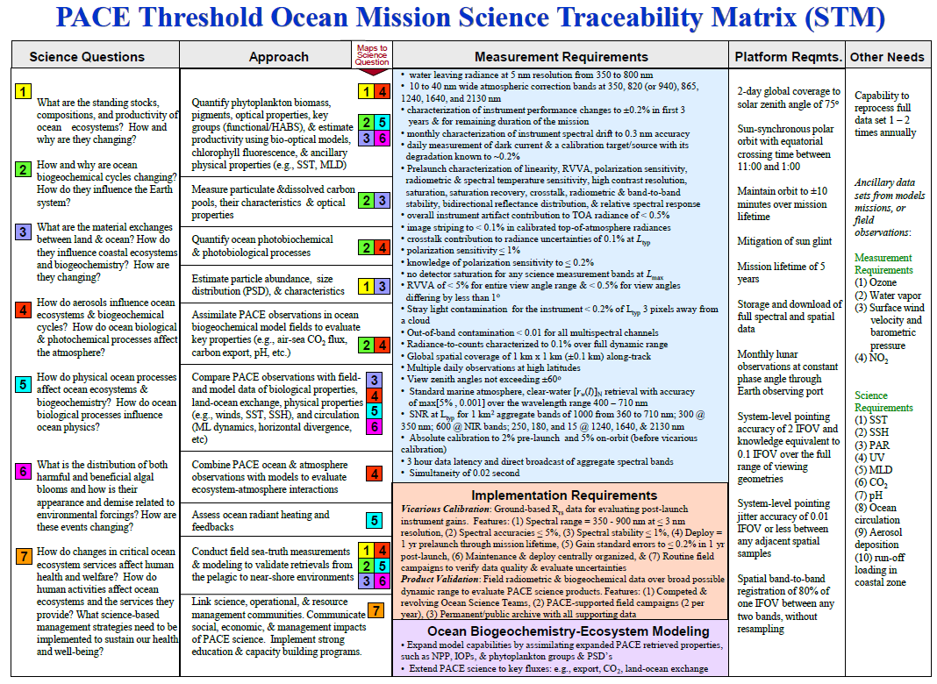
PACE Pre-Aerosol, Clouds, & ocean Ecosystem
Mission
Science Traceability Matrix (STM)
PACE Home
Mission Objectives
Status Updates
Science
Applications
Instrument
Data
People
Publications
Education and Outreach
News
  Overview
  Ocean
  Atmosphere
  Applications Traceability Matrix (ATM)
  Early Adopters Program
  Applications Working Group
  Data Products & User Tools
  Calendar
    Solicitations
    Workshops
    Field Campaigns & Cal/Val Activities
  Publications/Presentations
  About Us
  Related Links
Follow Us …

Slide 29
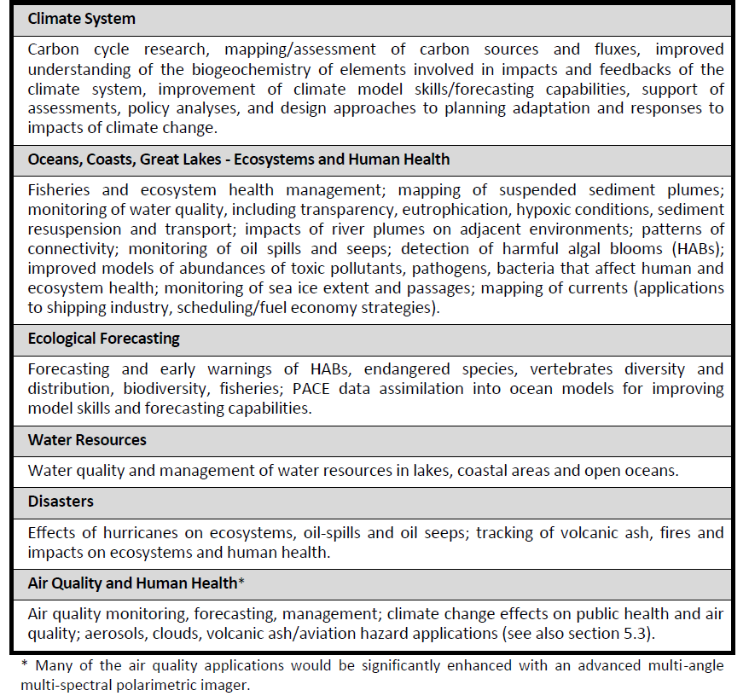
PACE Pre-Aerosol, Clouds, & ocean Ecosystem
APPLICATIONS
PACE applications
PACE Home
Mission Objectives
Status Updates
Science
Applications
Instrument
Data
People
Publications
Education and Outreach
News
  Overview
  Ocean
  Atmosphere
  Applications Traceability Matrix (ATM)
  Early Adopters Program
  Applications Working Group
  Data Products & User Tools
  Calendar
    Solicitations
    Workshops
    Field Campaigns & Cal/Val Activities
  Publications/Presentations
  About Us
  Related Links
Follow Us …

Slide 30
PACE Pre-Aerosol, Clouds, & ocean Ecosystem
APPLICATIONS
PACE applications
PACE Home
Mission Objectives
Status Updates
Science
Applications
Instrument
Data
People
Publications
Education and Outreach
News
  Overview
  Ocean
  Atmosphere
  Applications Traceability Matrix (ATM)
  Early Adopters Program
  Applications Working Group
TBD
  Data Products & User Tools
  Calendar
    Solicitations
    Workshops
    Field Campaigns & Cal/Val Activities
  Publications/Presentations
  About Us
  Related Links
Follow Us …

