Slide 1
Development of datasets and algorithms for hyperspectral IOP products from the PACE ocean color measurements
Principal Investigator: ZhongPing Lee
Co-Investigator: Michael Ondrusek
NOAA/NESDIS/STAR
Collaborator: Nicholas Tufillaro
Oregon State University

Slide 2
Objectives:
Development of a hyperspectral dataset. Compile a hyperspectral (350 - 700 nm, 5 nm resolution) R_{rs}-IOPs dataset for the community to use. In particular, this dataset will ensure a closure between the measured R_{rs} and the modeled R_{rs} using in situ IOPs -- a hyperspectral R_{rs}-IOPs dataset with closure (HyRIDc).
b. Algorithm revision. This will include
  i) improve the determination of SS_{IOP} from remote sensing for different water bodies,
  ii) extend the QAA and HOPE algorithms to include measurements in the UV (350-400 nm) and expanding IOP products to absorption coefficients of specific pigments (e.g., chlorophyll-a, -b, -c, and phycocyanin).
c. Test and evaluation of the revised algorithms with HICO measurements.
Results from these efforts will provide desired tools and knowledge, and contribute to "consensus and community-endorsed paths forward for the PACE sensor(s)".

Slide 3
Approach for HyRIDc :
(R_{rs}, K_{d})
(a&b_{b})

Slide 4
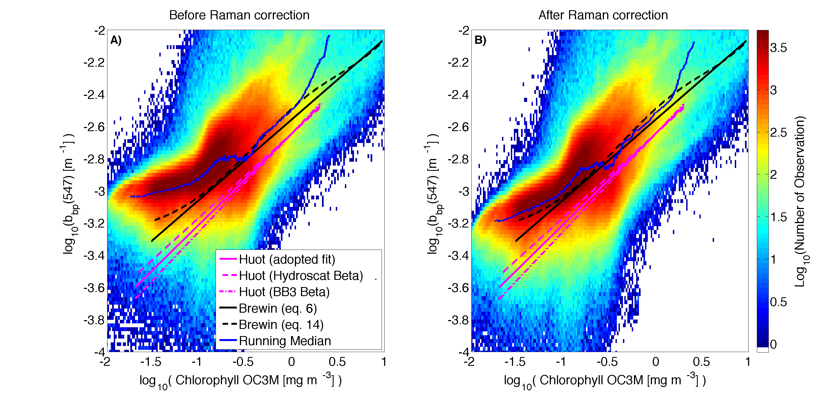
Relevant recent results:
"Effective hyperspectral absorption coefficient of "pure" seawater in the 350-550 nm range" will be published in Appl Opt.
a_{w} [m⁻¹]
a_{w} [m⁻¹]
Closure of bbp after Raman correction.
Wavelength [nm]
Wavelength [nm]
3. “Retrieval of phytoplankton and CDM absorption coefficients from remote sensing reflectance with an ultraviolet (UV) band” will be published in Appl Opt.

