Slide 1
Understanding Natural Variability of VSFs and Its Impact on Biogeochemical Retrieval from Ocean Color
Xiaodong Zhang: University of North Dakota
Deric Gray: Naval Research Lab
Wayne Slade: Sequoia Scientific, Inc.
Notes:
Key elements of this proposed study are: 1) natural variability of VSFs, with new instrument capability and recent measurements in coastal and oceanic waters
2) New ways to understand this natural variability
3) Impart new understanding to biogeochemical retrieval from ocean color

Slide 2
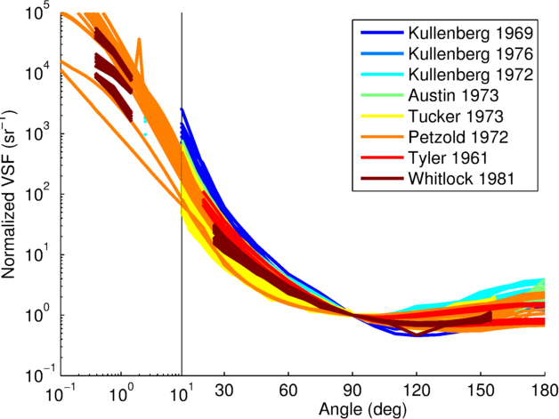
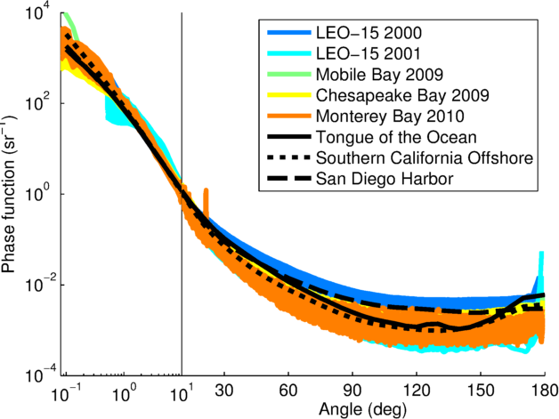
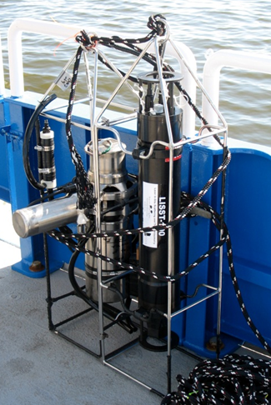


Unprecedented spatial, temporal, and angular resolution of VSFs in the natural environment
Significant variation in VSFs measured by MASCOT at 20 Hz during 30 min of active wave breaking
VSM + LISST, Gray and Weidemann:
8 wavelengths @ 0.25°, >600 angles
LISST-VSF, Sequoia:
S11: 0.1 – 150°
S12 and S22: 15 - 150°
MASCOT, WETLabs, 20 Hz, 10°, 17 angles

Slide 3
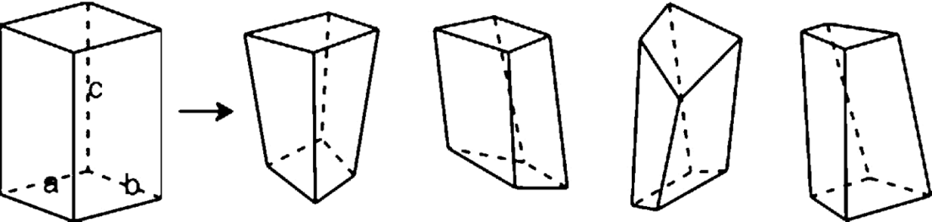
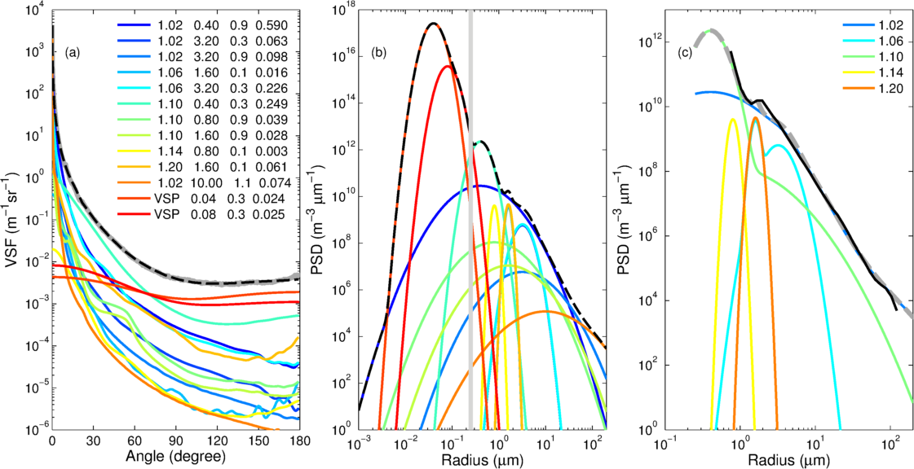
A new way to understand VSFs: an inversion approach (Zhang et al. 2011; 2012; 2013; 2014. Czerski et al. 2011. Twardowski et al. 2012)

Slide 4
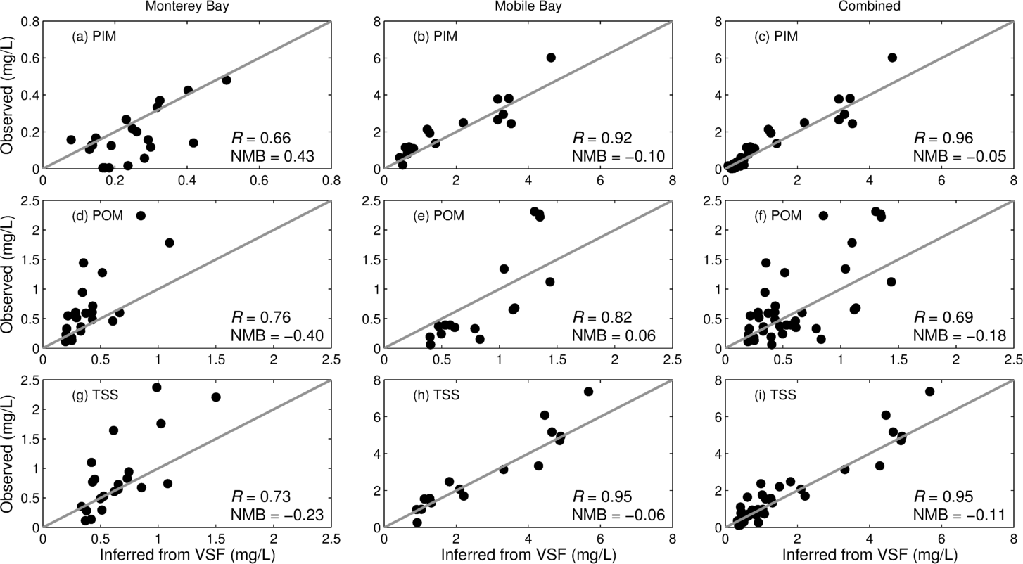
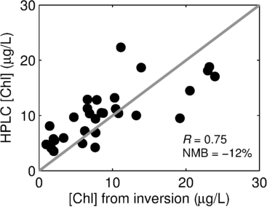
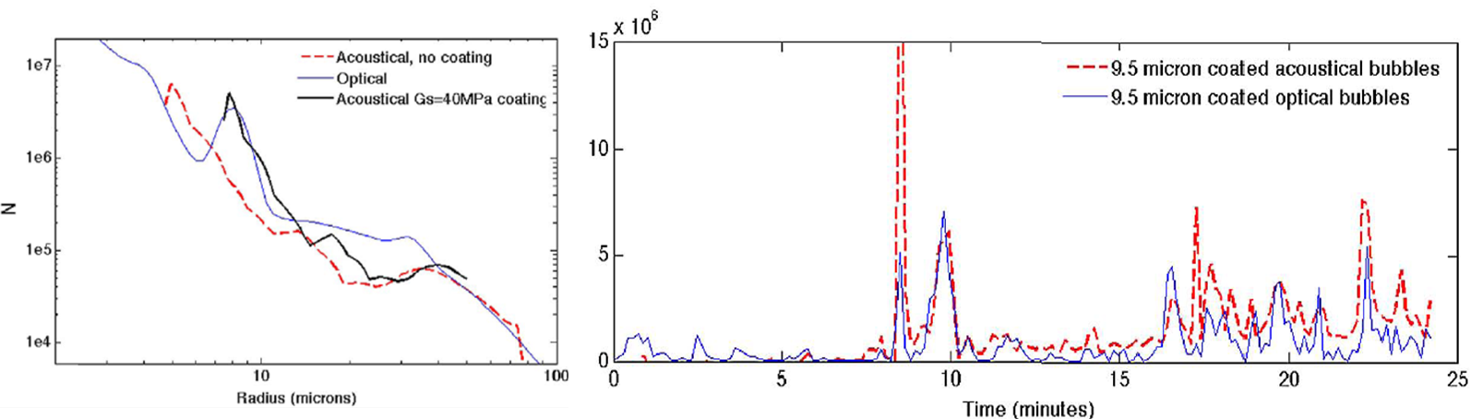

Slide 5
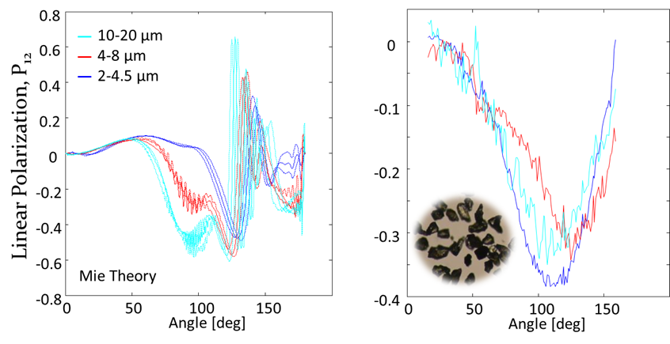
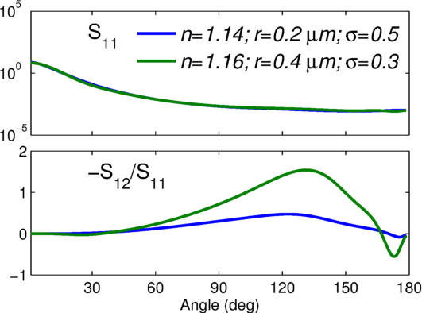
Proposed work under PACE
Spatial and temporal variability of VSFs
  Additional LISST-VSM data
  New LISST-VSF data, particularly S₁₂ and S₂₂
  Concurrent measurements: ac-meter, ECO-VSF, HS-6, etc.
BRDF
Inversion of VSFs to identify biogeochemical stocks that contribute significantly to the observed VSFs
  Include polarization
Forward modeling to evaluate how different biogeochemical stocks contribute to spectral b_{b}

Slide 6
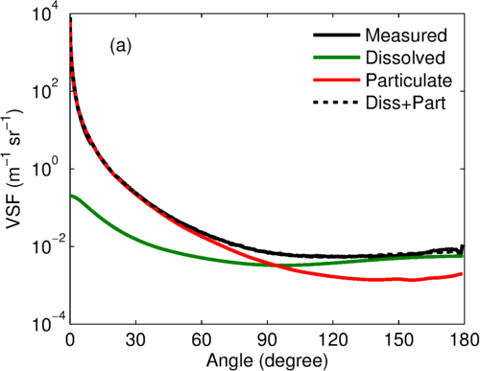
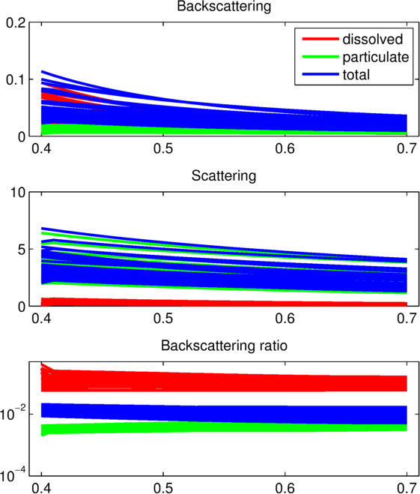
An example to illustrate the proposed work
Inversion
Forward modeling
Validation

Slide 7
Connections with other groups
VSFs dataset – IOPs data
Inversion technique – IOP inversion
  Polarization
  The general technique can also be applied to absorption inversion
BRDF – Atmospheric group
Ultimate scientific question to be addressed
  Biogeochemical origin in spectral b_{b}

