Slide 1
PACE Applications to Case II Waters:
Quantifying the Uncertainty in Inherent Optical
and Water Constituent Properties and the
Impact On Remotely Sensed Ocean Color
Steven Ackleson & Wesley Moses
Naval Research Laboratory, DC.
OBJECTIVES
1) Quantify uncertainty in the measurement of Case II water inherent optical and constituent properties.
2) Characterize the potential impact of in situ parameter uncertainty on PACE Case II product algorithm development and validation for proposed threshold and optional sensor configurations.
The work will consist primarily of an analysis of existing (largely unpublished) in situ observations and airborne and spaceborne hyperspectral data.

Slide 2
TASKS
Assemble, test, and distribute data sets
In situ IOP and AOP
Airborne HIS
SeaBASS Format
Characterize uncertainty through analysis of in situ data
Examinations of known relationships
Tests of closure
Examine effects of environmental variability
Correlation scales between sensors
Impact of sensors on local environment
Sub-pixel variability
Sub-Group Formed to
address this topic
Investigate uncertainty impact on RS algorithm development
IOP uncertainty propagation through ocean/atmosphere system
Contribution by system noise

Slide 3
DATA: In Situ & Hyperspectral Remote Sensing
Location Date Optics Water
LEO-15, NJ 08/2001 IOPs, AWR, HIS
Looe Key, FL 10/2002 IOPs, AWR, HIS
Monterrey Bay, CA 04/2003 IOPs, HIS
Chesapeake Bay 03/2004 IOPs, AWR, HIS
Chesapeake Bay & OBX, NC 08/2004 IOPs, AWR, HIS
Ft. Lauderdale, FL 06/2005 IOPs, AWR, HIS
Long Island Sound 05/2005 IOPs, AWR SPM, Chl, POC
East Sound, WA 09, 2005 IOPs, AWR, HIS
Houma, LA 02, 2006 IOPs, AWR
Ft. Lauderdale, FL 06, 2007 IOP, AWR, HIS
Mobile Bay, AL 02, 2009 IOP, AWR, HIS
Chesapeake Bay 10, 2009 IOP, AWR, HIS
Los Angeles, CA 04, 2011 IOP, AWR, HIS
Marathon, FL 09, 2012 IOP, HIS
Long/Block Island Sound 2013-14 IOP SPM, POC, PSD
San Francisco Bay 06, 2014 IOP, AWR SPM, POC
Chesapeake Bay 08, 2014 IOP, AWR, HIS SPM, Chl
Patapsco River, MD 12, 2014 IOP, AWR SPM, Chl, POC
IOP = Inherent Optical Properties (a_{p+g}, a_{g}, c_{p}, b_{b})
AWR = Above-Water Radiometry
HIS = Hyperspectral Imaging Spectrometry

Slide 4
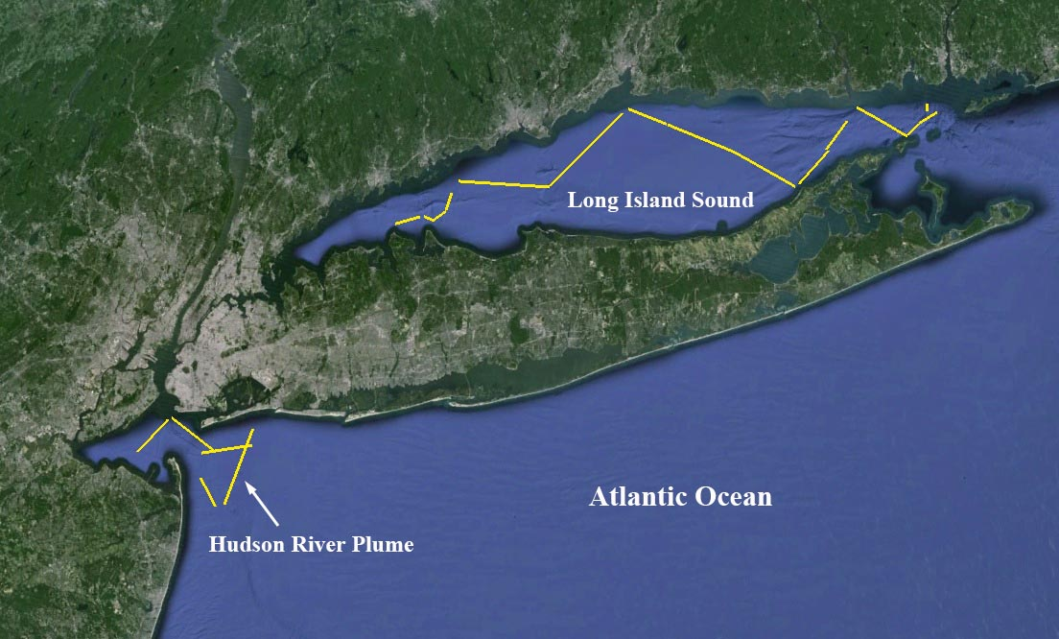
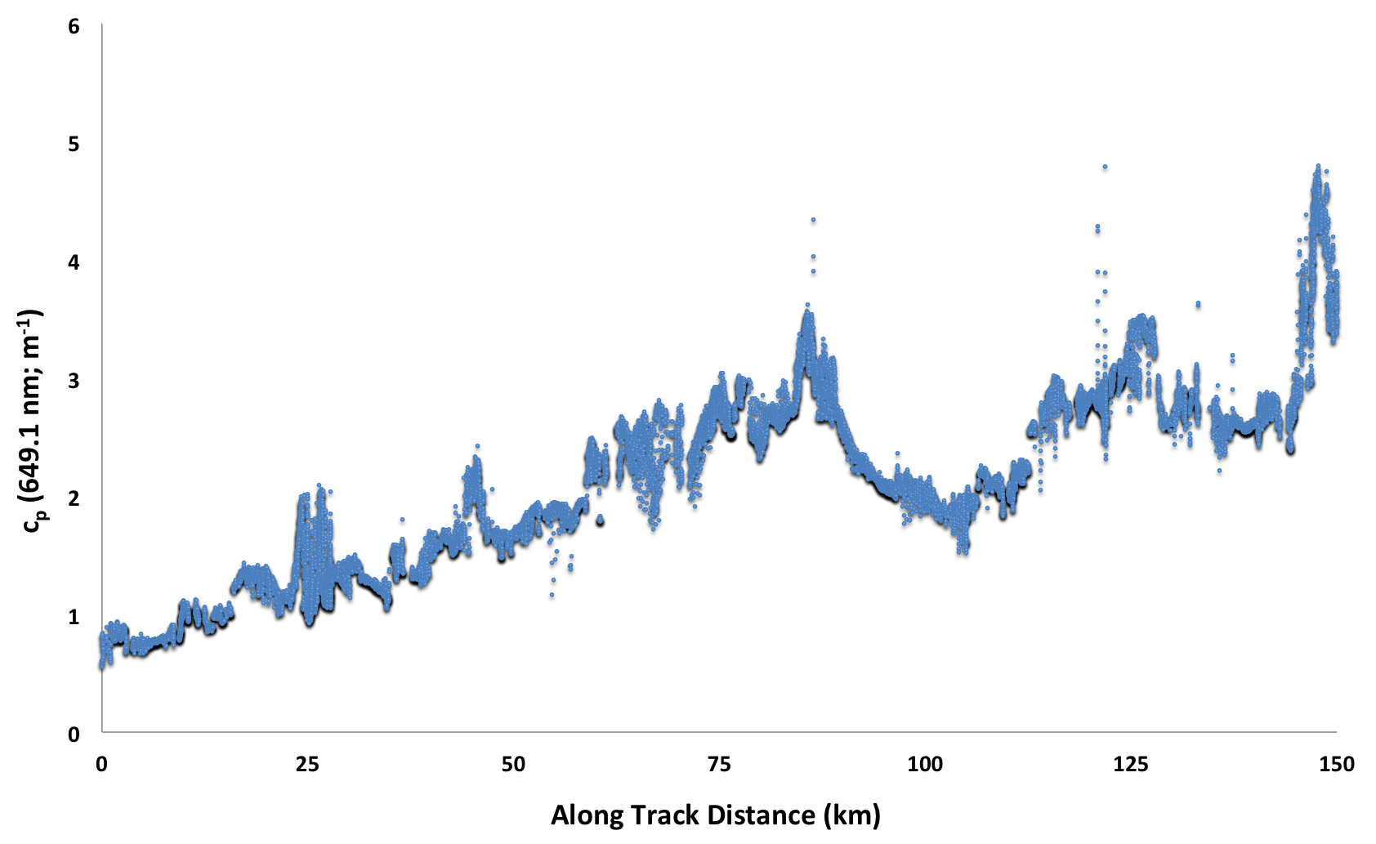
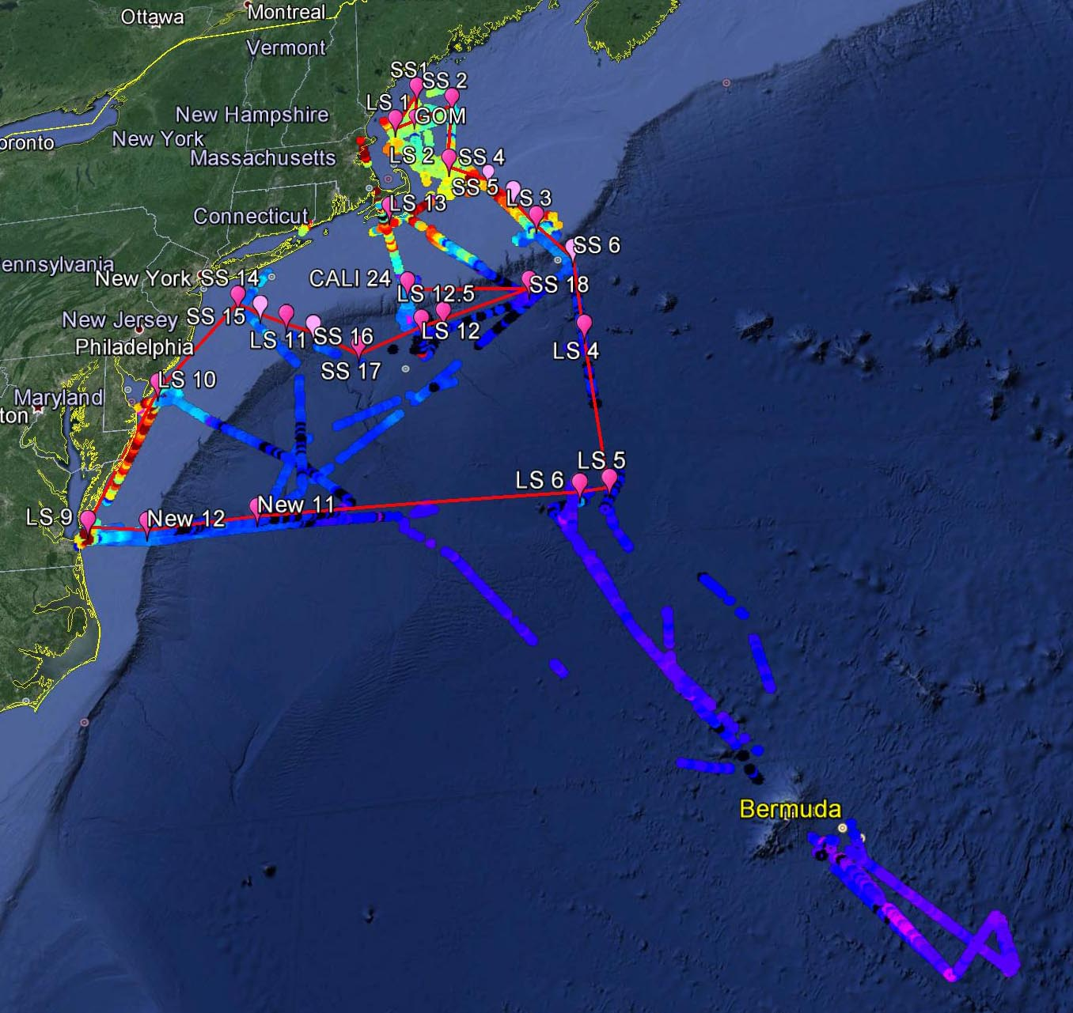
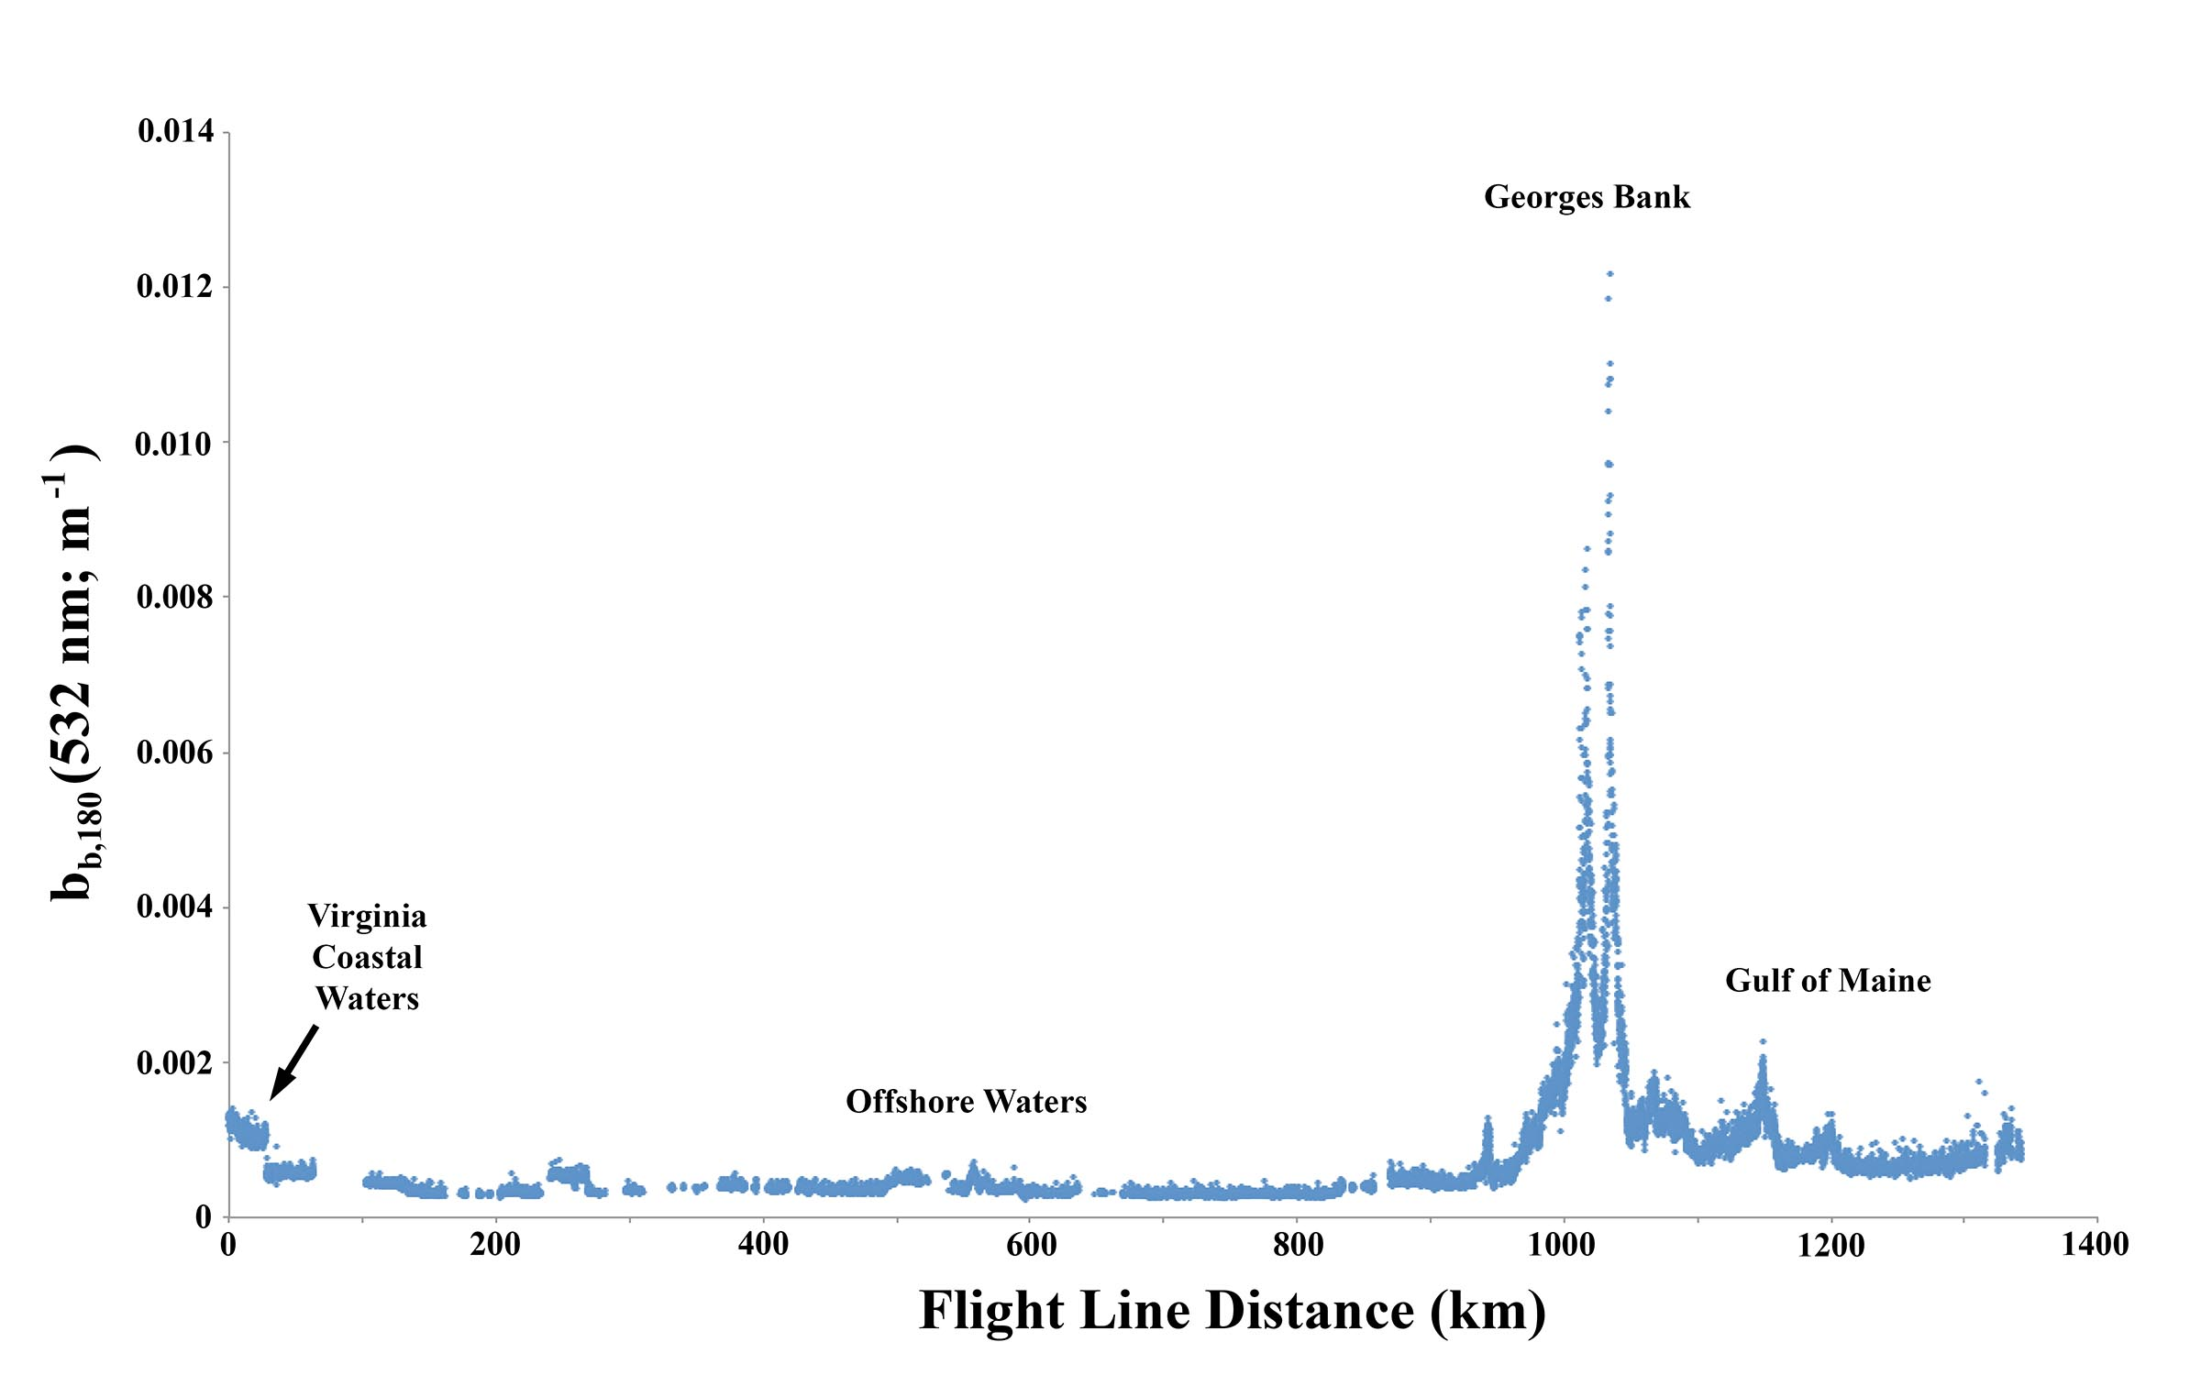
Sub-Pixel Variability
Along-Track IOP observations collected in LIS with an instrumented Acrobat towed platform, May 2005 (M. Twardowsky).
Δx = 6.3 m
Along Track Distance; Δx = 6.3 m)
Airborne LIDAR measurements of b_{b} and k_{sys} collected by the NASA Langley High Spectral Resolution LIDAR Project
(C. Hostetler).
Δx = 50 m
Along Track Distance; Δx = 50 m)

Slide 5
EXPECTED COLLABORATIONS
PRIMARY (Projects that directly address uncertainty associated with IOP measurement)
Collin R. Quantifying Uncertainties in Phytoplankton Absorption Coefficients ...
Emmanuel B. A Global Database of High Horizontal Resolution IOPs ...
Dariusz S. Quantifying the Spectral Absorption Coefficients ...
James S. Improving IOP Measurement Uncertainties ...
Xiaodong Z. Understanding Natural Variability of VSFs ...
SUB-GROUP: Environmental Methodologies
S. Ackleson (lead), E. Boss, M. Ondrusek, C. Roesler, W. Slade, J. Sullivan
POTENTIAL (Projects that are impacted by uncertainty associated with IOP measurement)
Susanne C. Derivation of Inherent Optical Properties ...
Robert F. Bayesian Methodology for Atmospheric Correction ...
ZhongPing L. Development of Datasets and Algorithms ...
Greg M. Improved Satellite Ocean Color Retrievals of Ocean IOPs ...
Michael T. Improving Retrieval of IOPs from Ocean Color ...

