Slide 1
Evaluation of UV atmospheric correction in the presence of absorbing aerosols, and quantification of enhancements provided by multi-angle, polarimetric and oxygen A-band observations
PI: Olga Kalashnikova (JPL)
Co-Is: Feng Xu (JPL), Anthony Davis (JPL), Felix Seidel (JPL), Michael Garay (JPL)
Collaborators: David Diner (JPL), and Oleg Dubovik (LOA)

Slide 2
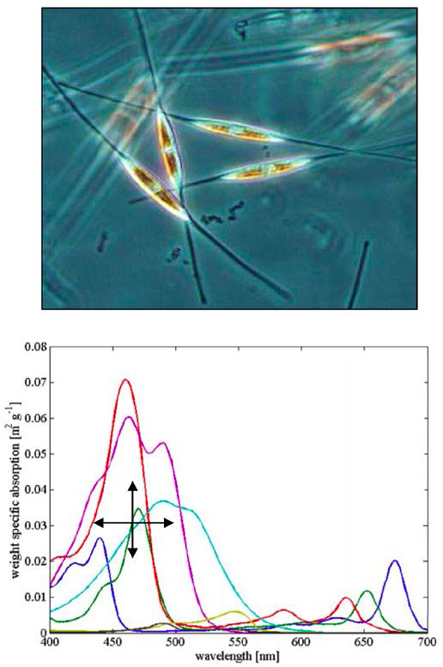
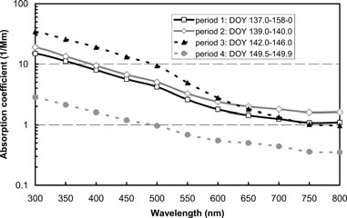
PACE opens new vistas in aquatic biology…
Example absorption spectra for phytoplankton pigments.
Blue and near-UV spectra from the OCI will measure accessory (non-chlorophyll) pigments, separate chlorophyll and colored dissolved organic matter, and characterize phytoplankton taxonomy.
…but atmospheric interference makes this challenging
Extrapolated from data reported by Omar et al. [2005] and Chakrabarty et al. [2010]
Dust;
SAMUM-1 field campaign
From Muller et al., 2008

Slide 3
What we proposed to do?
Objective 1: Refine the requirements for a PACE imager with combined multiangular, UV to shortwave infrared, oxygen A-band, and polarimetric sensing capabilities for atmospheric correction in presence of absorbing aerosols.
Objective 2: Assess the practicality of the requirements for polarimeter observations in compensating for the effects of absorbing aerosols.
Objective 3: Quantify the added value of the polarimeter to the PACE ocean color spectrometer for simultaneous characterization of mineral dust properties and determination of how ocean ecosystems respond to dust deposition.

Slide 4
Coupled aerosol/surface retrieval code
Model characteristic | JPL code implementation
Forward RT calculation method | Markov Chain + Doubling/Adding (MarCh)
Aerosol size model | Multi-bin, bimodal
Particle shape | Spherical
Refractive index | Mode dependent
Land surface model | Modified RPV + Fresnel microfacet distribution
Ocean surface model | Cox-Munk + bio-optical (in development/testing)
Language | Matlab (for development), C++*
Linearized for optimization | Calculated from Jacobians
Optimization approach | Levenberg-Marquardt
F. Xu, A. B. Davis, S. V. Sanghavi, J. V. Martonchik and D. J. Diner (2012). Linearization of Markov chain formalism for vector radiative transfer in a plane parallel atmosphere/surface system. Appl. Opt. 51, 3491-3507.
F. Xu, A. B. Davis, and R. A. West (2011). Markov chain formalism for vector radiative transfer in plane-parallel atmosphere overlying a surface of bidirectional reflectivity. Opt. Lett. 36, 2083-2085.
F. Xu, A. B. Davis, R. A. West, and L. W. Esposito (2011). Markov chain formalism for polarized light transfer in plane-parallel atmospheres, with numerical comparison to the Monte Carlo method. Opt. Express 19, 946-967.

Slide 5
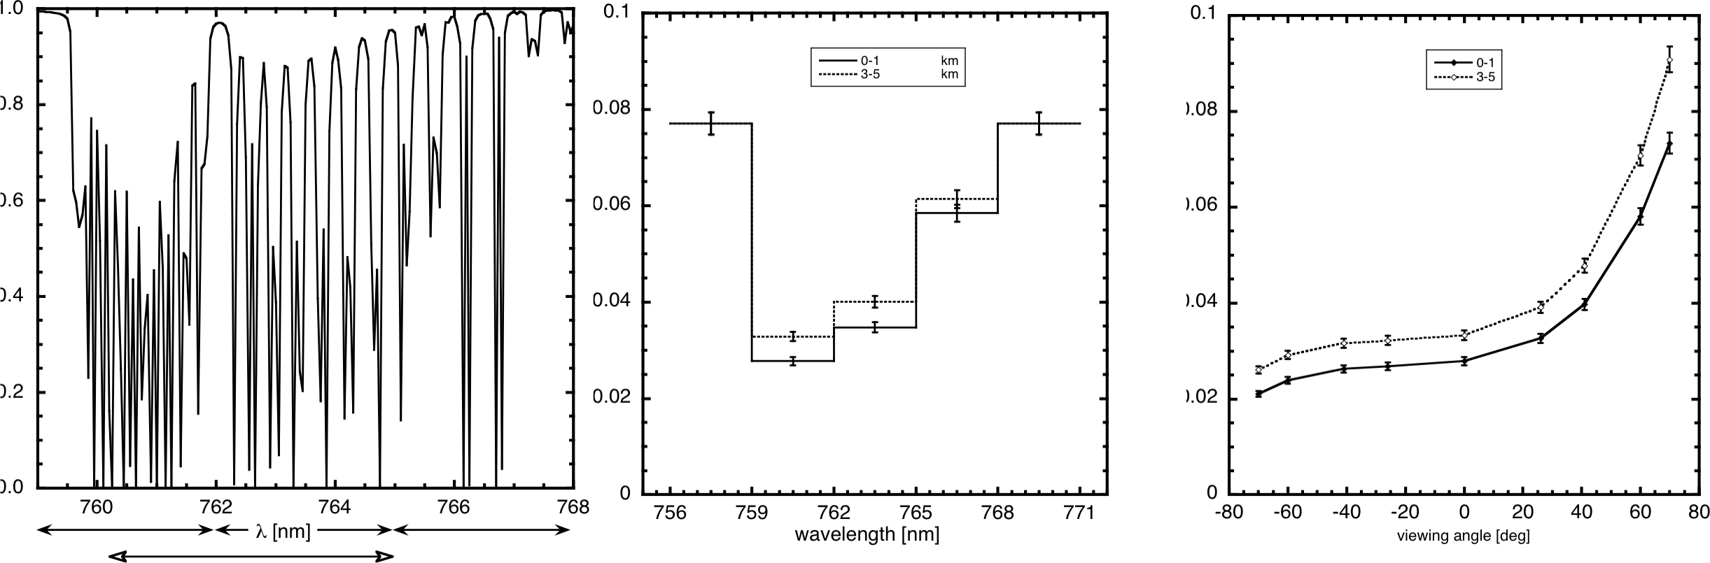
A-band analysis
AC correction requires determining not only the amount but also the height of absorbing aerosols embedded in the background of Rayleigh scattering molecules [Duforêt et al., 2007].
Left: Synthetic reflectivity spectrum at TOA in the O₂ A-band at 0.05 nm resolution, normalized (DOAS-style) to continuum level; spectral coverage by OC hyperspectral sensor (3 pixels) and single “polarimeter” channel are indicated. Middle: Spectral signals (in arbitrary units) at 3 nm resolution for an optically thin dust layer in the 1–2 and 3–5 km zones, assuming the sun is 60º from zenith and nadir viewing. Right: Same as middle panel but for the multi-angle “polarimeter” signal where we see that at the same noise level (assumed to be 3%), the two aerosol layer elevations are easier to distinguish, using error magnitude as a unit of signal distance (in the spirit of the Z-score).

Slide 6
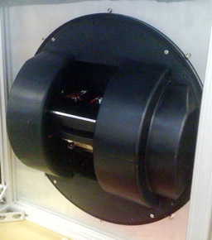
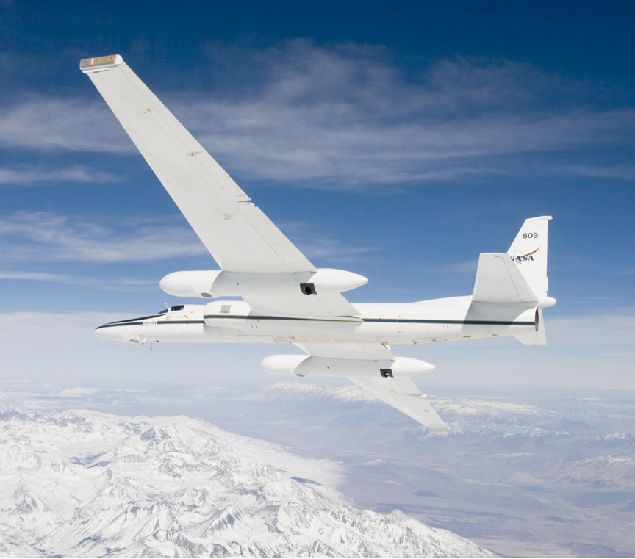
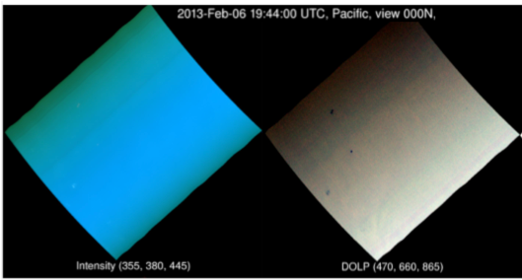
Using AirMSPI to explorer value of polarimeter for PACE
Because AirMSPI has UV bands, polarization, and multi-angle viewing, we can use selected channels to explore the sensitivity of different channel/angle combinations to normalized water leaving radiance (Lwn) and the necessary corrections for atmospheric effects.
Spectral bands | 355, 380, 445, 470*, 555, 660*, 865*, 935 nm (*polarized)
Flight altitude | 20 km
Multiangle viewing | Between ±67º using single-axis gimbal
AirMSPI data acquired over the USC SeaPRISM AERONET-OC site on the Eureka platform on 6 Feb 2013

Slide 7
How do we connect to larger group?
PACE ocean science requires unprecedented retrieval methods to characterize:
B. Mitchell, UCSB: Retrieving UV-absorbing mycosporine amino acids, algal proteins, and particle size distributions is needed to specify phytoplankton functional groups and plankton ecosystem structure.
non-chlorophyll pigments and phytoplankton taxonomy (with UV wavelengths)
Ecosystems in coastal regions, estuaries, tidal wetlands, and lakes, where water spectra are unlike the open ocean
S. Maritorena, UCSB: Dissolved organic matter and absorbing aerosols both absorb in the UV, which may limit the ability to differentiate them.
H. Dierssen, U. Conn: New methods are needed to avoid confusion of NIR backscatter from whitecaps, floating vegetation, and sediments with aerosols.
Multiangle polarimetry distinguishes atmosphere and surface scattering and absorption from the UV-VNIR
→ The polarimeter provides major risk reduction for PACE science

