Slide 1
Improving IOP measurement uncertainties for PACE ocean color remote sensing applications
PI: Jim Sullivan
Co-I’s: Mike Twardowski & Tim Moore
Collaborators: David McKee & Rudy Rӧttgers
IOPs: absorption (a) and VSF (β) for cal-val
Notes:
IOPs needed for in-situ validation

Slide 2
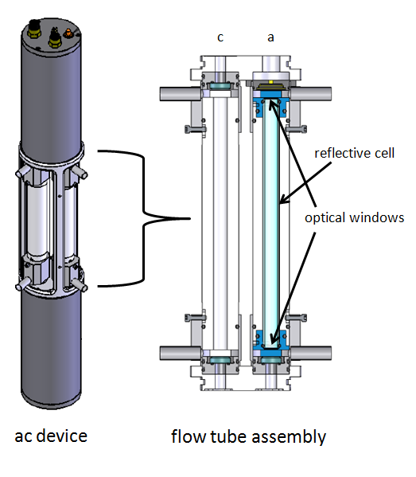
1. Quantify and improve uncertainties (scattering error) in absorption measurements using ac devices.
TIR = 41.7°
π (180°)
ɛ = ∫ 2π sin(θ )β (θ )d θ
θ_{TIR} (41.7°)
Currently ~ 5 to 6 correction
methods in use
Most assume little to no a_{g} & a_{p} at a reference λ
No community consensus
Notes:
Ideally, all scattered light should be collected in the absorption measurement.

Slide 3
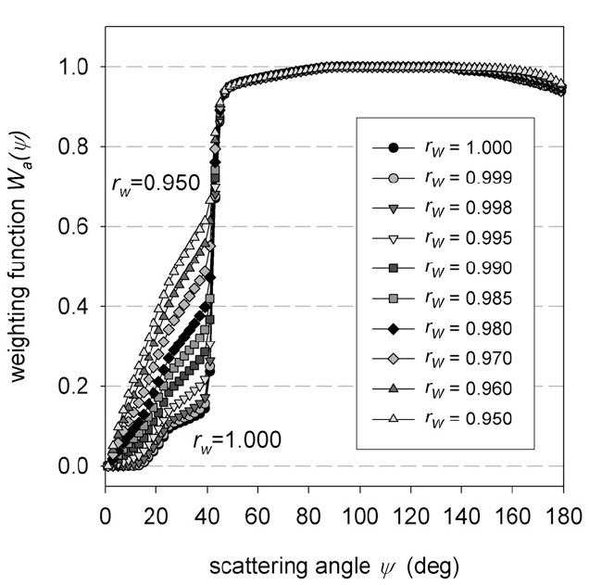
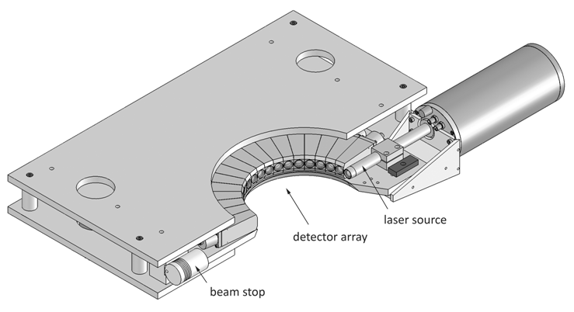
1. Quantify and improve uncertainties (scattering error) in absorption measurements using ac devices.
Independent correction with VSF measurements
All current correction methods will be compared , uncertainties estimated, with independent validation of best correction.
Reflectivity of new and aged flow cells will be quantified in lab.
Notes:
McKee et al. 2013

Slide 4
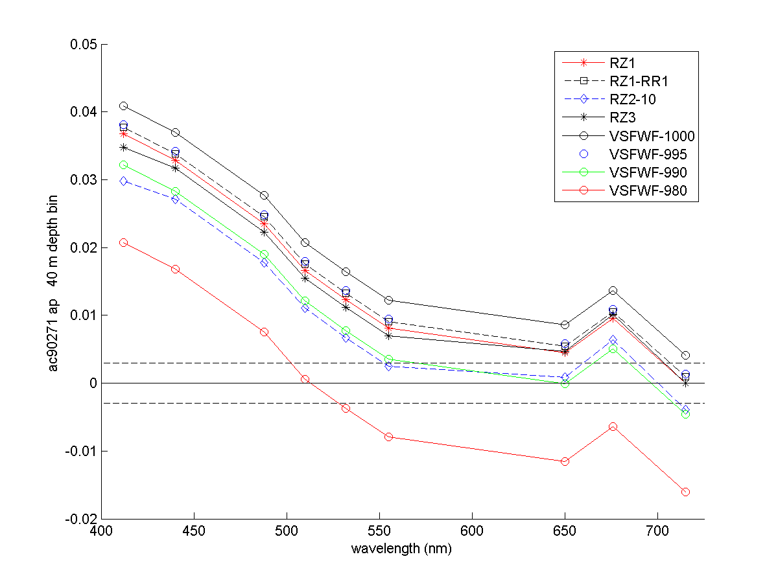
Results!
NASA SABOR cruise (13 yr. old ac9)

Slide 5
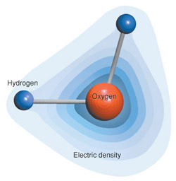
2. Determine uncertainties associated with different values of the depolarization ratio for pure seawater backscattering (b_{bsw}).
b_{bsw} (λ) = F( T, S, pressure, δ )
b_{bsw} is ~ 80 - 95% of the water leaving signal in large swaths of the oceans
Pure seawater backscattering values (b_{bsw}) as currently parameterized in SeaDAS compared to b_{bsw} values of Zhang et al. (2009) calculated at two different depolarization ratio (δ) values: 0.039 and 0.09 (Farinato & Rowell 1976, Morel 1974 respectively) and at 20°C and 36 PSU.
b_{bsw} (λ) | 412 | 443 | 488 | 547 | 667
SeaDAS no T/S | 0.003327 | 0.002438 | 0.001611 | 0.000989 | 0.000425
Zhang (δ = 0.09) | 0.003192 | 0.002340 | 0.001552 | 0.000960 | 0.000420
Zhang (δ = 0.039) | 0.002920 | 0.002140 | 0.001420 | 0.000878 | 0.000384
We will conduct an uncertainty analysis on retrieval products similar to Werdell et al. 2013 (T/S dependence) using different δ values (and appropriate T/S) for several SAA algorithms (QAA, GSM, GIOP)
~ 3 - 4% lower
~ 10 - 12% lower
Notes:
Best guess is 0.039

Slide 6
Group Synergies:
Environmental methodologies – best practices for community
Improving uncertainties in ac validation data sets
(SeaBASS, TARA, etc.)
Validation of ac corrections with independent measurements
Dariusz, Collin, Rudy & David (joint cruise planned)…
Depolarization ratio work with Xiaodong
Understand uncertainties in retrievals related to uncertainties in pure water backscattering

