Slide 1
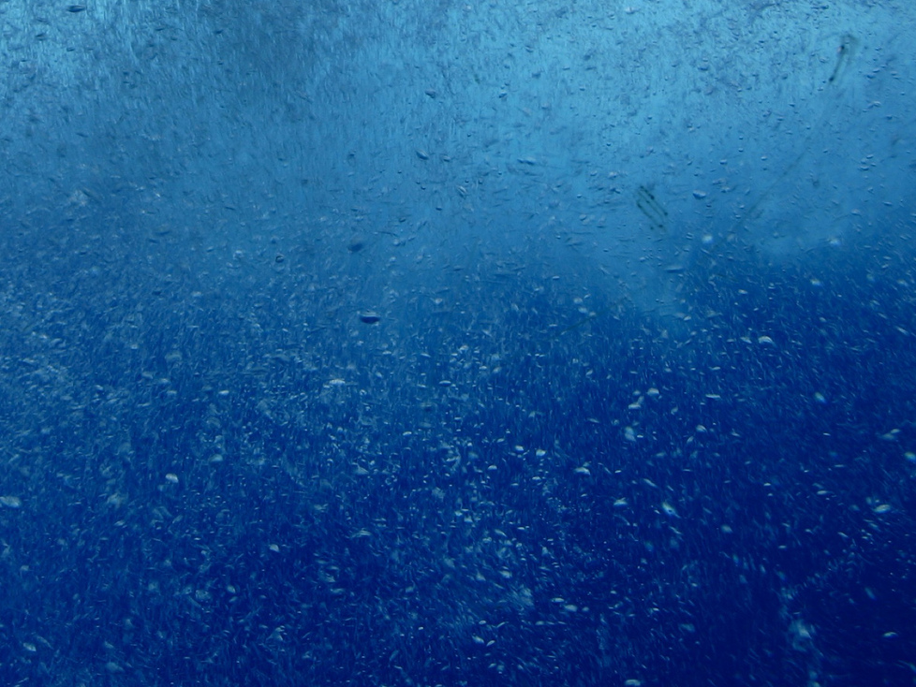
PACE Science Team:
Atmospheric Correction over
Bright Water Targets with Non-negligible Radiances in the Near Infrared
Heidi Dierssen, UCONN
Kate Randolph, Ph.D. student/Postdoc
Brandon Russell, Ph.D. student
Shungu Garaba, Postdoc
Photo by Bill Lindsay

Slide 2
What causes “Bright Water”
Whitecaps & Foam
Calcite (PIC): Coccoliths
Cyanobacteria, Trichodesmium,
Red Tides
Sea Ice
Sediment
(turbid water)
Bubbles
Floating Plastics etc..
Seafloor
(Optically Shallow)
Floating Vegetation

Slide 3
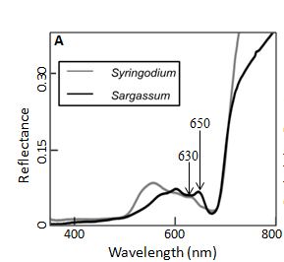
Floating Vegetation: Seagrass Wrack
Red Edge of Reflectance
Dierssen et al. submitted RSE

Slide 4
What can appear like “Bright Water”, but isn’t water at all
Thin Clouds
Land/Ocean Adjacency
Atmospheric dust
Sun Glint

Slide 5
Current NASA AC processing removes highly reflective waters
Glint & Mod. Whitecap removed
Low/Moderate
Remains
Low Residual
Remains
Mod High
Backscattering Removed
Very High
Removed
Glint, Whitecap, and Rayleigh first
Cloud Mask
Aerosol Retrieval
Errors are not simple “quantitative” numbers.
Error of Omission excluding from one category
Error of Commission adding this stream to another category

Slide 6
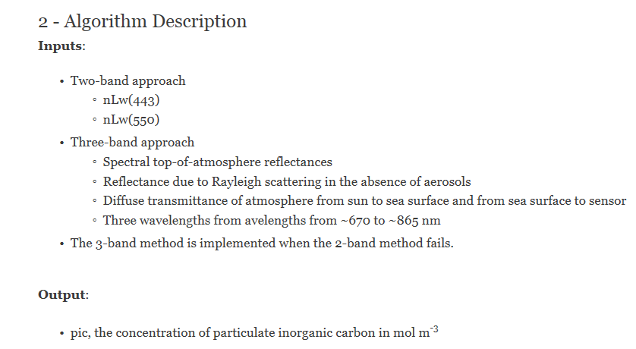
Particulate Inorganic Carbon Alternate Approaches

Slide 7
Example of “Bright Water” being masked

Slide 8
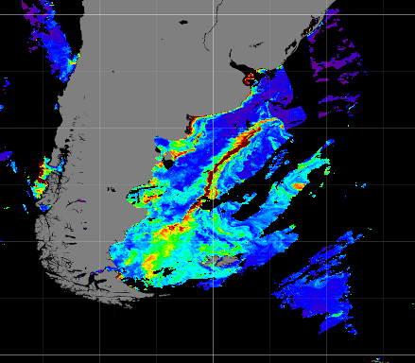
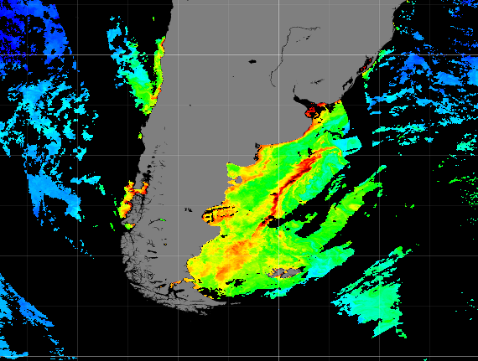
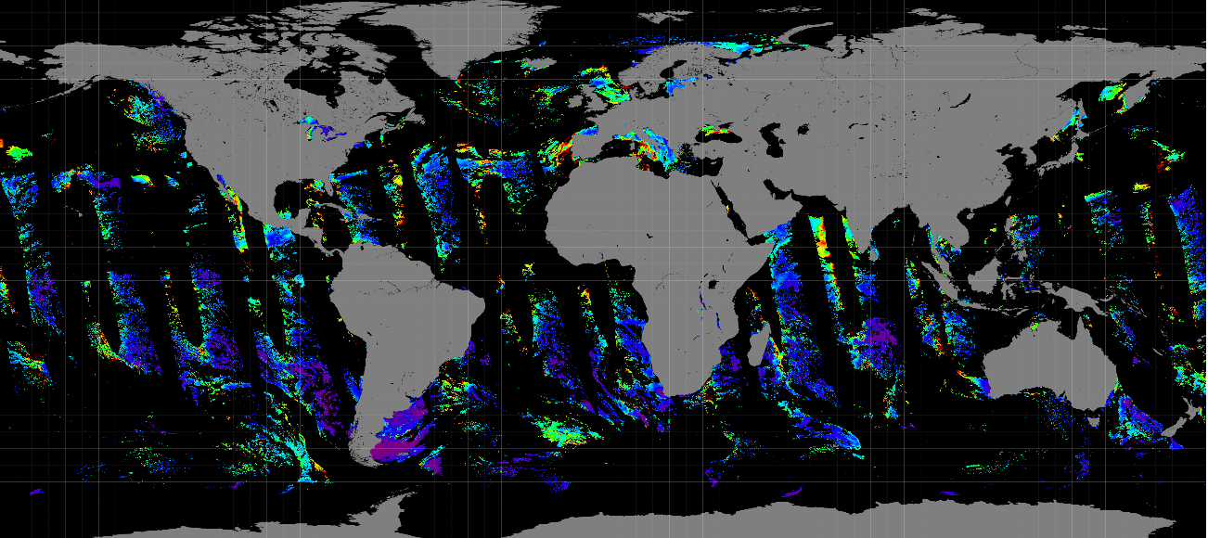
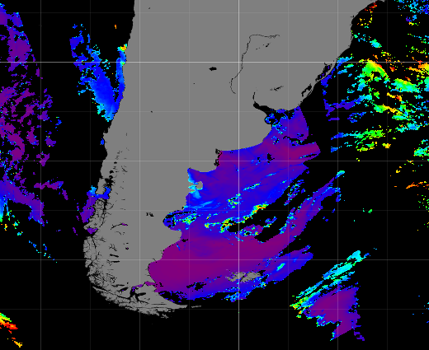
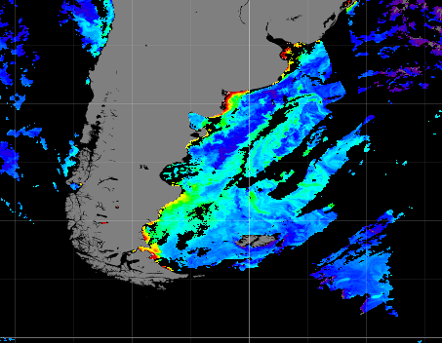
Fluorescence Line Height
Chlorophyll
PIC
Aerosol Optical Thickness 865 nm

Slide 9
Windspeed is not an accurate predictor of Whitecap coverage
Photo by Scott Freeman
Field Experiments:
UCONN
Rrs (350-2500 nm) above water
In-water reflectance
LISST
Critical angle backscattering
Data from Chris Zappa

Slide 10
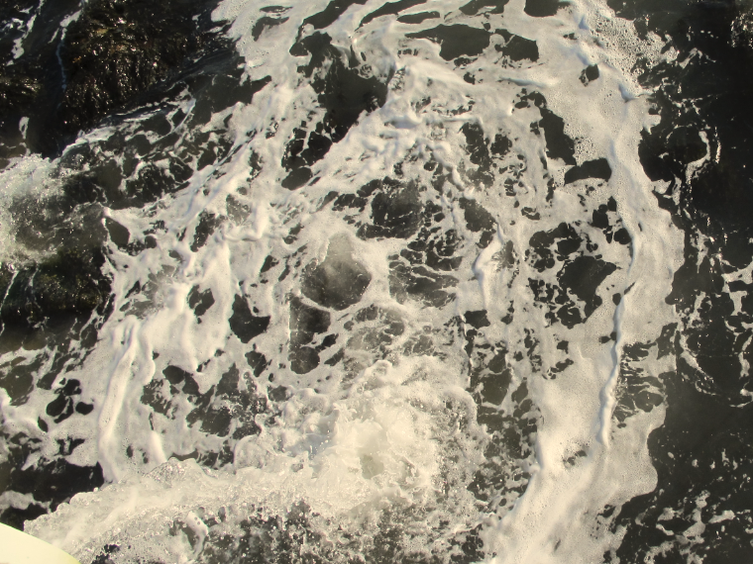
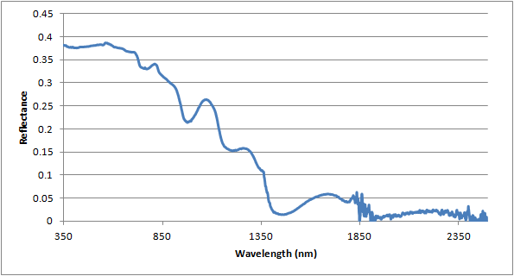
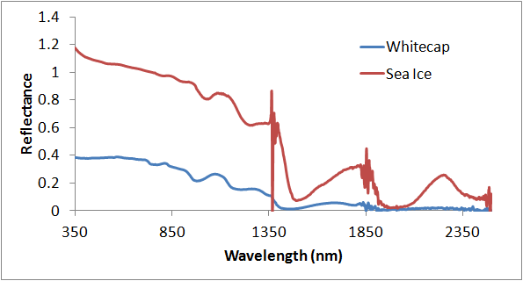
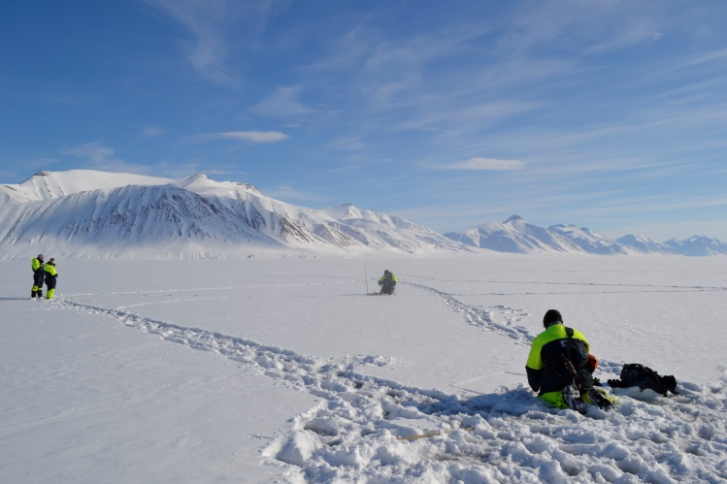
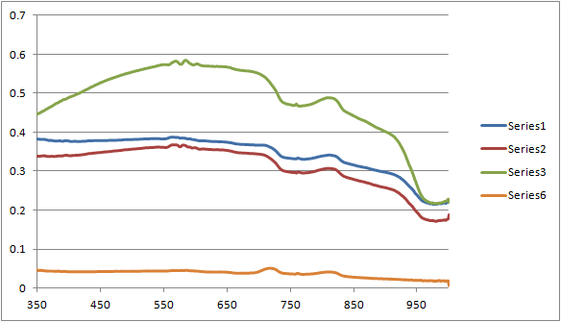
Wood Fjorden Svalbard
760-780 nm oxygen absorption feature

Slide 11
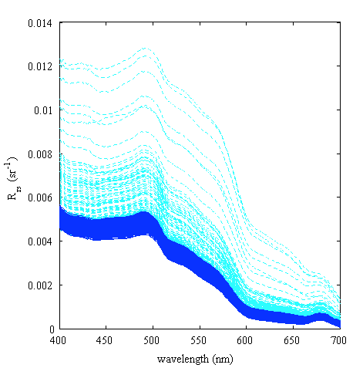
Bubbles separate from whitecaps
Strongly enhance the upwelling irradiance field (Stramski and Tegowski, 2001)
(2) Bubble mediated gas transfer of low solubility gases (Broecker, 1983; Woolf & Thorpe, 1991)

Slide 12
Bubbles (Stage B whitecaps)

Slide 13
Implement more nuanced masks and screens
Identify spectral features early:
Vegetation
Red Edge Reflectance (all concentrated vegetation)
Chlorophyll fluorescence peak
Sediments
Glint using water, oxygen or other absorption features
“White” objects need to be discriminated
Whitecaps, Sea Ice, PIC

