Slide 1
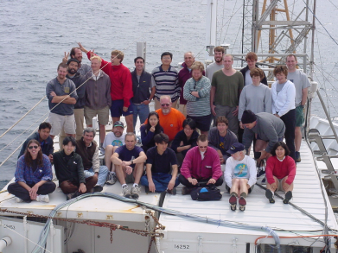
Improved Satellite Ocean Color Retrievals of Ocean
Inherent Optical Properties and Biogeochemical Properties Utilizing the Capabilities of PACE
B. Greg Mitchell and Mati Kahru
Scripps Institution of Oceanography
Alexander Vasilkov
Science Systems and Applications, Inc.
>100 years experience! BGM> 2 yrs at sea!
PACE Science Team Meeting
14-16 January, 2015
ACE Asia Massive Gobi Dust Event
Aircraft Track
R/V Ron Brown

Slide 2
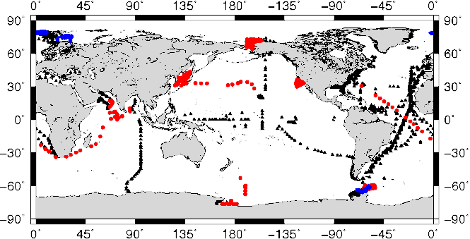
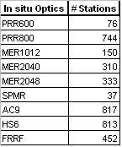
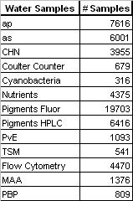
DATA!
Via collaborations with CalCOFI, JGOFS, AMLR, SIMBIOS, ONR JES, CCE LTER
Rrs PRR800 UV-Vis, 19-λ
MER2040 12-λ,
ap, ad, aph as 300-800 nm
2 AC9 – parallel, unfiltered
HS6, FRRF
All Water Samples except TSM
Chl-a = 0.05
Chl-a = 10,

Slide 3
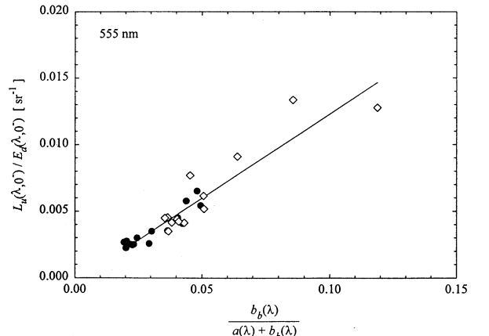
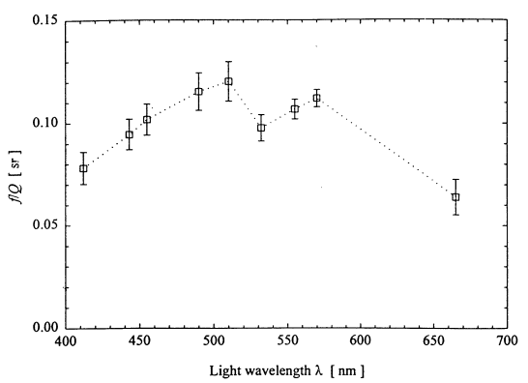
Data →MODELS!
JGOFS Southern Ocean
Reynolds, Stramski and Mitchell (2001) JGR 106(C4) 7125-7138
Rrs(λ) = f/Q [bb(λ) /[ a(λ) + bb(λ) ]]
Hyperspectral extension applied to ACE-ASIA data
A.
Evidence of absorption dampening exponential shape of bb
1:1
Slope=0.6

Slide 4
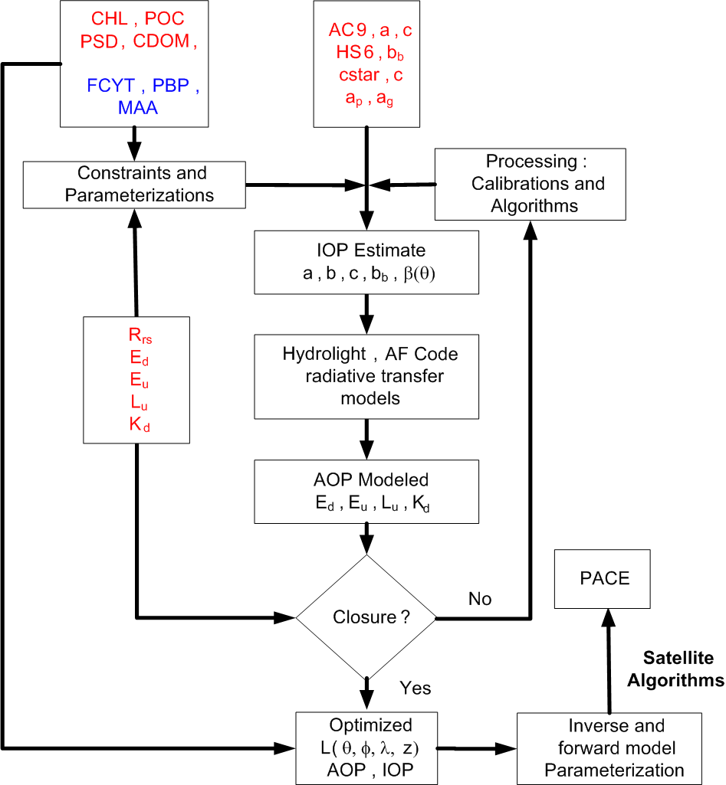
How do you see yourself fitting with the
PACE ST objectives and with the larger group?
e.g. Engage Search for Ocean Color Holy Grail
Data, QC, Details
IOP/AOP methods and processing
Forward Model parameterization
Inverse Modeling

