Slide 1
A Global Database of High Horizontal Resolution IOPs for Validation of Remotely Sensed Ocean Color
Boss E. in collaboration with B. Balch, G. Dall’Olmo, A. Manino, N. Nelson, W. Slade, M. Twardowski & T. Westberry
Objectives
Develop a coherent framework to process optical data collected with in-line systems.
Provide a geographically extensive and coherent database of hyperspectral and spectral IOPs collected in-line which includes an assessment of uncertainties.
Evaluate how IOPs measured with in-line system compare to those measured with profiling packages when at stations (are there biases?).
Evaluate the utility of adding discrete samples to further increase the utility of IOP retrievals.
Answer: characteristics of sub-satellite-pixel variability in IOPs in the ocean?

Slide 2
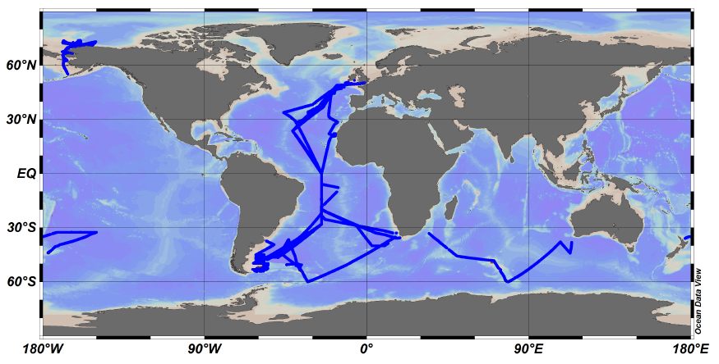
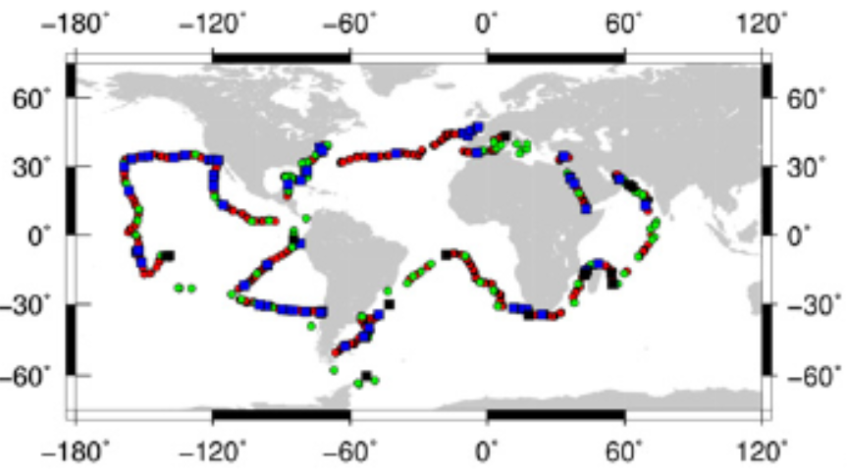
Approach
Two day workshop in March 2015: agree on common processing strategy.
Assemble and reprocess the data (Umaine).
Conduct match-ups with in-water instruments.
Prepare and publish a protocol for in-line optical data collection and procession.
Data: GPS, TSG, (hyper-) spectral particulate absorption and attenuation, backscattering, dissolved absorption
More than 400,000km of continuous IOP data (more than half hyper-spctral)

Slide 3
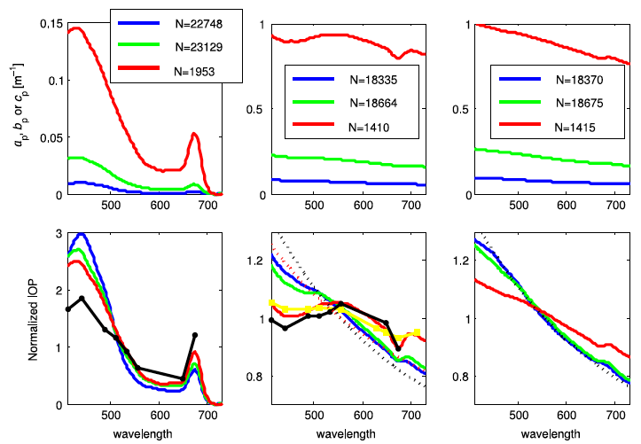
Some preliminary results
Likely shape of particulate IOPs:
Boss et al., 2013

Slide 4
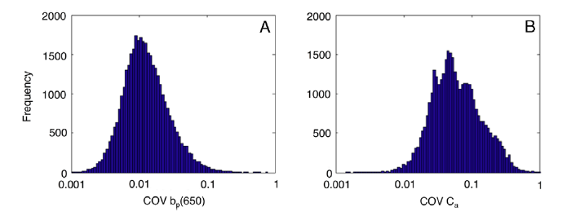
Some preliminary results
Sub-pixel variability in IOPs:
Werdell et al., 2013

Slide 5
Interaction/Contribution to the PACE-ST
Large data-set combining in-water radiometry and IOPs + uncertainties due to methodology.
Characterization of IOP variability in general (necessary to optimize eigen-functions for inversions).
Characterization of sub-pixel variability in IOPs (necessary for uncertainties budgets). (Add spectrum, distance from shore, depth, latitude, etc’)
Where we need help from the PACE-ST
Optimal scattering correction for WETLabs ac-instruments.

