Slide 1

Dariusz Stramski and Rick A. Reynolds
Quantifying the Spectral Absorption Coefficients of Phytoplankton and Non-Phytoplankton Components of Seawater from in Situ and Remote-Sensing Measurements
Scripps Institution of Oceanography
University of California San Diego
PACE Science Team Meeting
Hyattsville, 14–16 January 2015

Slide 2
Objectives
IOP METHODOLOGY: Develop consensus recommendations for improved methodology for hyperspectral measurements of particulate absorption coefficient.
Develop a protocol with reduced and quantified uncertainties for an improved filter-pad approach with center-mounted samples within an integrating sphere (IS).
Quantify uncertainties and develop improved protocols for traditional filter-pad methods: transmittance T and transmittance-reflectance T-R.
IOP INVERSION: Develop a retrieval algorithm for partitioning the total absorption coefficient of seawater into the contributions of phytoplankton, nonalgal particles, and colored dissolved organic matter (CDOM) with a key novel aspect of separating nonalgal particles from CDOM.

Slide 3
Water molecules
CDOM
Suspended particles
Mass concentration
SPM, POC, Chl
Size distribution
PSD
Composition
POC/SPM, PFTs
Inherent Optical Properties
a(λ)
b_{b} (λ)
a_{w}(λ) + a_{ph}(λ) + a_{d}(λ) + a_{g}(λ)
b_{bw}(λ) + b_{bp}(λ)
Remote-sensing reflectance
R_{rs}(λ)

Slide 4
Water molecules
CDOM
Suspended particles
Mass concentration
SPM, POC, Chl
Size distribution
PSD
Composition
POC/SPM, PFTs
Inherent Optical Properties
a(λ)
b_{b} (λ)
a_{w}(λ) + a_{ph}(λ) + a_{d}(λ) + a_{g}(λ)
b_{bw}(λ) + b_{bp}(λ)
Measurement methodology
Remote-sensing reflectance
R_{rs}(λ)

Slide 5
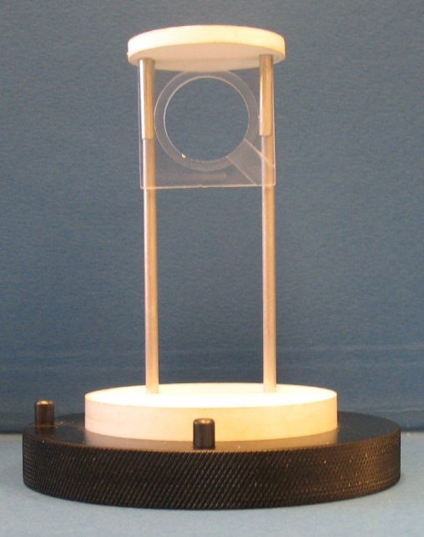
Determinations of pathlength amplification factor (β) for different configurations of filter-pad method

Slide 6
β-experiments
Sample | Filtration volume [ mL ] |  |  |  |  |  | Sample description
 | IS |  |  |  | T | R
S01 | 5 | – | – | – | 5 | 5 | Seawater, SIO Pier
S02 | 3 | 7 | 15 | 23 | 15 | – | Red tide formed by Lingulodinium polyedrum SIO Pier
S03 | 9 | 19 | 41 | – | 41 | 41 | Particle-laden sea ice, Arctic
S04 | 3 | 9 | 15 | – | – | – | A mixture of four cultures: Nannochloropsis, Chlorella vulgaris, Thallasiosira pseudonana, and Porphyridium
S05 | 5 | 10 | 17 | 25 | 25 | 25 | Seawater, Imperial Beach Pier (IBP)
S06 | 9 | 14.5 | – | – | 14.5 | 14.5 | Seawater, offshore of San Diego
Unpublished

Slide 7
Water molecules
CDOM
Suspended particles
Mass concentration
SPM, POC, Chl
Size distribution
PSD
Composition
POC/SPM, PFTs
Inherent Optical Properties
a(λ)
b_{b} (λ)
a_{w}(λ) + a_{ph}(λ) + a_{d}(λ) + a_{g}(λ)
b_{bw}(λ) + b_{bp}(λ)
Partitioning algorithm
Remote-sensing reflectance
R_{rs}(λ)

Slide 8
Partitioning of the Absorption Coefficient of Seawater
Pure Seawater
Phytoplankton
Non-algal Particles
CDOM
Colored Dissolved Organic Matter
Total a(λ) = a_{w}(λ) + a_{ph}(λ) + a_{d}(λ) + a_{g}(λ)
a_{dg}(λ)
Total non-water a_{nw}(λ)
Notes:
Background
Absorption of total absorption of seawater can be think of it as comprising four components, blah blah.
For biological and biogeochemical researches, people are more interested in absorption by individual components than the total amount.
However, it is relatively easier to estimate total absorption coefficient than the individual components.
Therefore numerical models that could partition total absorption coefficient into individual components play an important role in extending our observational capabilities.
Pure seawater absorption coefficient can be deemed as a known parameter, especially when concurrent measurement of temperature and salinity are available.
The spectral shapes of ad and ag are similar, therefore often modeled indiscriminately as the sum, adg.
Therefore the problem of partitioning a really breaks down to the equivalent problem of partitioning anw into aph and adg.

Slide 9
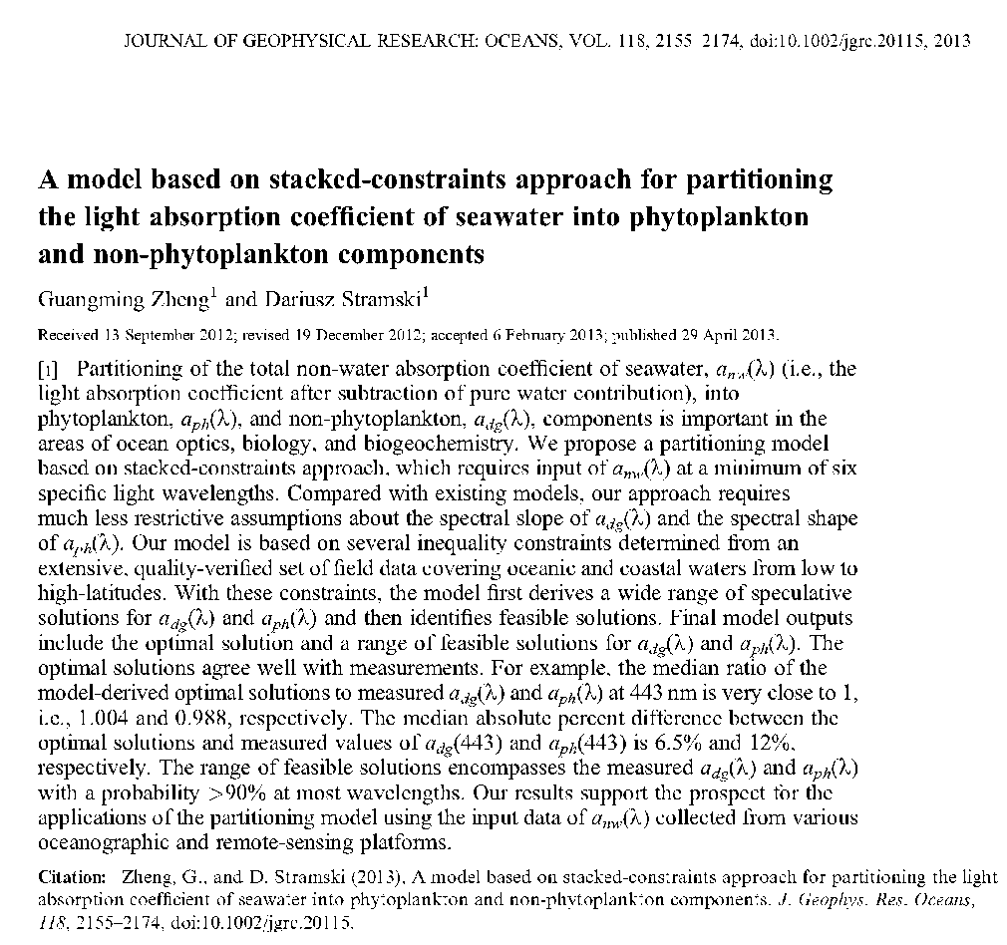
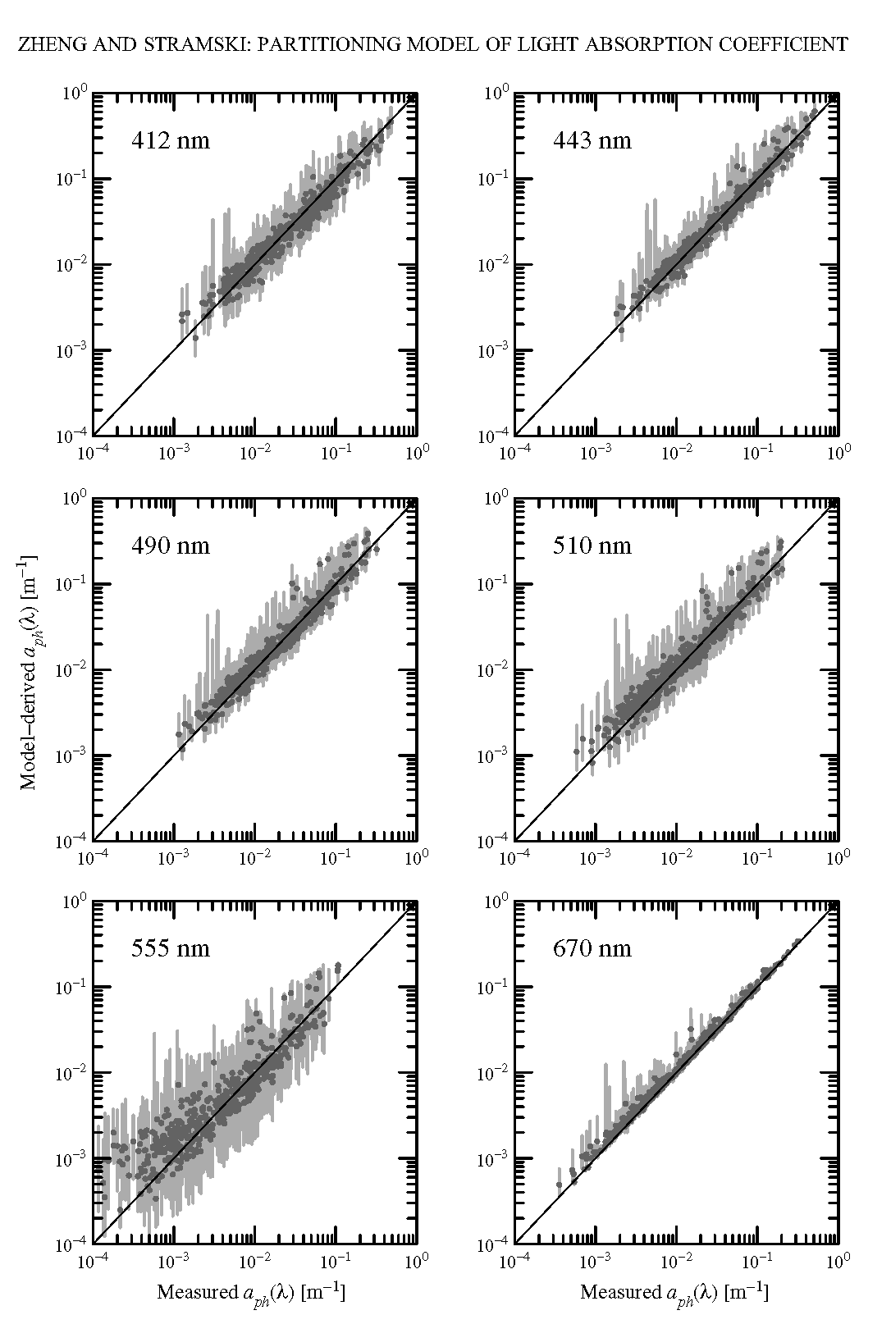
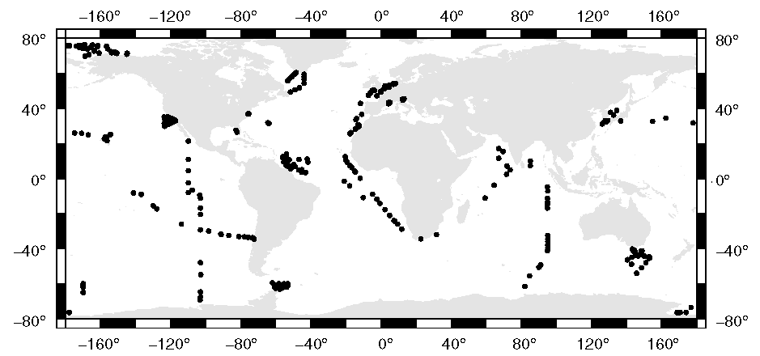

Slide 10
MBS Algorithm
Matrix B
Matrix C
Step 2
Calculate
S and A
Step 2
B_{i,j} = (x_{i}, y_{j})
C_{i,j} = (S_{i,j}, A_{i,j})
Step 3
Derive a large number of speculative solutions.
Step 1
Step 2
#3
{x_{i}} = {y_{j}} =
{0.01, 0.02, … 1}
Input:
a_{nw}(λ)
Step 3
Calculate
a_{dg}(λ) and a_{ph}(λ)
#1, #2
Step 3
Output:
Optimal Solution
Range of Feasible Solutions
Inequality Constraints
Matrix D
D_{i,j} = (a_{dg}(λ)_{i,j}, a_{ph}(λ)_{i,j})
Step 4
First identifies all feasible solutions, then finds optimal solution and quantifies range of feasible solutions.
Step 5
#4 - #8
Matrix A
Satisfy constraints
#4 - #8
?
Step 4
Feasible Solutions
Yes
Stacked-Constraints Algorithm
Notes:
The flowchart of our algorithm starts from two set of numbers for x and y, respectively.
These numbers represent all possible values of the two band ratios, aph(412):aph(443), and aph(510):aph(490).
The combinations of values in these two sets gives matrix C, therefore matrix C more or less represents all possibilities of the actual pairs of x and y.
Next, we start from each and every element of matrix C, Cij, and derive solutions first for S and A for adg, then adg and aph, using the modified BS algorithm.
In these two steps, a large number of speculative solutions are derived.
In Step 4, we check each speculative solution if it is physically possible, by applying the constraints #4 through #8.
If all constraints are satisfied, the speculative solution is considered feasible, otherwise, it is discarded.
A matrix of feasible solutions contains solutions such that each of them has an equal probability of being closest to the actual measured values.
In the last step, determine the final optimal solutions chosen as the median of the feasible solutions. We also determine the range of variation of feasible solutions defined as the 10th and 90th percentiles of all feasible solutions.
The median was chosen as the optimal solution because it gives the best error statistics compared to other statistical descriptors based on feasible solutions, such as mean, mode, and several other percentiles.
The 10th and 90th percentiles are chosen for the range of variation because the probability that the actual value falls within this interval is generally higher than >90% for most wavelengths.

Slide 11
Activities in 2015
IOP METHODOLOGY:
Stramski, D., R. A. Reynolds, J. Uitz, and G. Zheng, Correction for pathlength amplification in measurements of particulate absorption coefficient in the visible spectral region with a filter-pad method, Applied Optics.
IOP INVERSION:
Zheng, G., D. Stramski, P. M. DiGiacomo, A model for partitioning the light absorption coefficient of natural waters into phytoplankton, non-algal particulate, and colored dissolved organic components: A case study for the Chesapeake Bay, Journal of Geophysical Research – Oceans.

