Slide 1
Quantifying uncertainties in phytoplankton absorption coefficients for accurate validation of the PACE ocean color sensor: moving towards satellite retrieved phytoplankton functional types (PFTs)
Collin Roesler
Department of Earth and Oceanographic Science
Bowdoin College

Slide 2
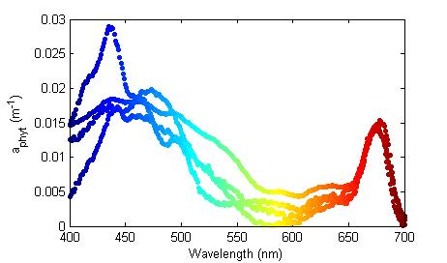
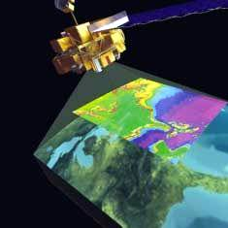
So in thinking about my project objectives I worked my way backward
Invert ocean color signal to retrieve hyperspectral phytoplankton absorption coefficients
Requires capability to validate with uncertainties
http://wamis.meraka.org.za/modis-basics

Slide 3
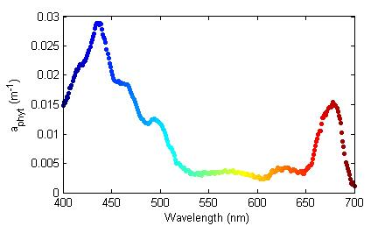
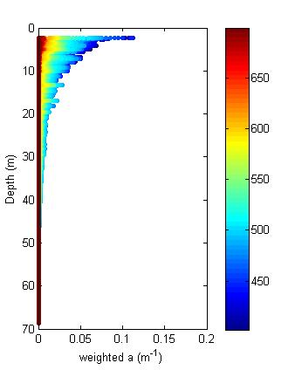
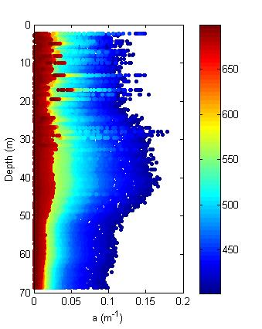
Step 1. Retrieved phytoplankton absorption spectrum validated against exponentially-weighted profile of spectral phytoplankton absorption
Collaboration
Ackleson
2. K_{d}(λ,z)
3. Profile a(λ)
Environmental considerations
Spatial temporal scales
4. No scattering error
5. Phytoplankton signal extracted

Slide 4
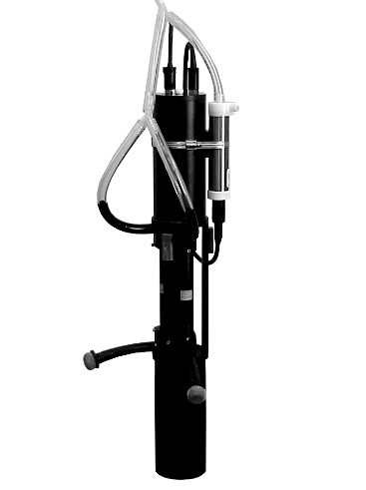
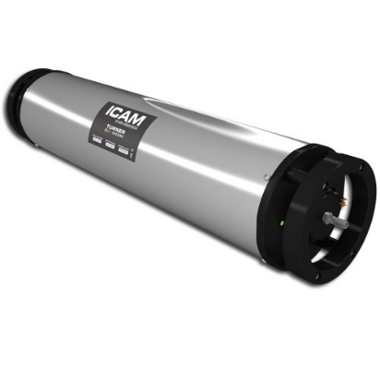
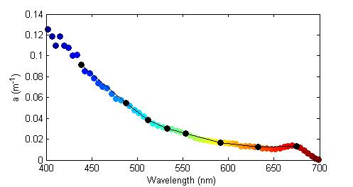
Step 4. Profile of hyperspectral absorption with minimized scattering error, quantified uncertainty
Hyperspectral, but scattering error
WETLabs acs
No scattering error, but multispectral
Turner ICAM
Collaboration
Twardowski, Sullivan, Boss

Slide 5
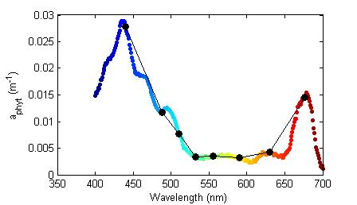
Step 5. Extract phytoplankton absorption signal from total absorption from existing (and new) models, quantifying model uncertainties
Collaboration
Stramski, Reynolds
a_{T} = a_{w}+ a_{phyt} + a_{nap} + a_{cdom}

Slide 6
Step 6. Validate model estimation against in situ phytoplankton absorption spectra determined spectrophotometrically on glass fiber filter pads, quantifying uncertainty in QFT
Collaboration
Stramski, Reynolds
Mitchell?
7. filter pad absorption configuration
scattering error
beta correction
8. Retrospective reprocessing

Slide 7
Conclusions
Pigment-based Phytoplankton Functional Types
Hyperspectral Phytoplankton Absorption Coefficients
Modeled from in situ profiles of total absorption
spectrophotometric analysis
discrete filter pad samples,
Uncertainties in PFT approach
Uncertainties in situ measured absorption
Uncertainties phytoplankton absorption models
Uncertainties spectrophotometric analysis
Environmental Uncertainties
Measurement Uncertainties
Scattering loss Uncertainties
Amplification Uncertainties

