Slide 1
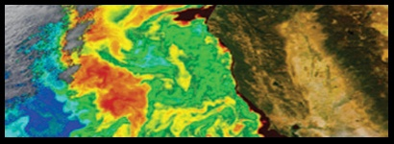
PACE
APPLICATIONS OF THE PACE MISSION ATMOSPHERIC DATA
Ali H. Omar (NASA Langley)
Collaborator: Maria Tzortziou (NASA/CCNY)
Groups/Subgroups: Atmospheric Correction, Applications, Atmospheric by-products

Slide 2
PACE Aerosol Measurements
OCI Only
Aerosol Optical Depth (τ_{λ})
Aerosol Optical Depth Angstrom Exponents [α = -log(τ_{λ1} /τ_{λ2})/ log (λ₁/λ₂)]
Main Applications: Particulate Material (PM) concentrations –Air Quality Indices (PM + Ozone)
Limited information about aerosol type – Air Quality Forecasting
Some information about aerosol transport – Exceptional Event Flagging
OCI + Polarimeter (Multi-directional, Multi-spectral, Multi-polarization)
Aerosol Optical Depth, α, Absorption
Aerosol Type - Aerosol Size/Shape, Refractive Indices, Number
Aerosol Vertical Resolution – Plume height
Main Applications: Air Quality Indices (PM + Ozone)
Air Quality Forecasting
Regional and Inter-hemispheric Transport– Exceptional Event Flagging
and Demonstration
Disaster Monitoring – Extreme events, Wildfires, Volcanoes, Dust Storms
(cf. Waquet et al, 2010; Dubovik et al, 2011; Hasekamp et al, 2011)
Notes:
The Ångström exponent is inversely related to the average size of the particles in the aerosol: the smaller the particles, the larger the exponent. Thus, Ångström exponent is a useful quantity to assess the particle size of atmospheric aerosols or clouds, and the wavelength dependence of the aerosol/cloud optical properties. For example, cloud droplet, usually with large sizes and thus very smaller Ångström exponent (nearly zero), is spectrally neutral, which means, e.g., the optical depth does not change with wavelength. This exponent is now routinely estimated by analyzing radiation measurements acquired on Earth Observation platforms

Slide 3
Proposed Activities
Identify existing applications that can be augmented by the PACE measurements
Determine new applications that can be developed using PACE measurements
Quantify the uncertainties of the data that will be used for these applications
Assess and interpret the impact on applications of resolution, and accuracy requirements of the PACE data (also, possibly latency)
Facilitate collaboration between science team members and the applications user community
Provide data to early adopter communities to test their applications prior to the launch of PACE
Achieve consensus on the applications outcomes of the proposed activities
Estimate of the value of PACE data to society (cf. Macauley, 2007)
Macauley, M. K., and D. Diner (2007), Ascribing societal benefit to applied remote sensing data products: an examination of methodologies based on the Multi-angle Imaging SpectroRadiometer experience, J. Appl. Rem. Sens, 1(1), 013538-013538-013520.
Notes:
**bearing in mind that the uncertainty thresholds for scientific investigations may be different from those for societal benefit applications

Slide 4
Upcoming Activities (2015)
Identify key stakeholders and engage them in decisions about data, availability, and formatting within the parameters of mission capabilities
Develop communication plans and tools. Present material on key applications areas at meetings relevant to PACE mission
Foster the capacity building geared toward the use of PACE data and successor missions
Develop Application Traceability Matrices and White Papers for Applied Sciences Program Applications areas (HABs and Air Quality Applications)
Suggestions for the identification, development, and dissemination of PACE applications from PI teams. The goal is to reach a consensus on the applications outcomes (and their uncertainties) by the end of the duration of the award.
Notes:
(Climate, Oceans/ Coasts/ Lakes, Ecological Forecasting, Water Resources, Disasters, Air Quality and Human Health)

Slide 5
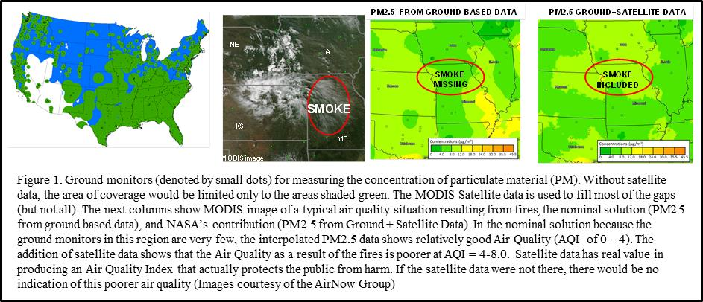
PACE MISSION APPLICATIONS – AIR QUALITY
Application Question/Issue
What is the air quality forecast of particulate matter concentration (PM, an indication of the extent of air pollution) predicted from satellite measurements of the aerosol optical depth (AOD) in regions where there are no ground measurements of PM? Figure 1 is an illustration of such an application.
Who Cares and Why?
In regions where there are no ground measurements of PM, the EPA and thus the public has no indication of the extent of air pollution, a situation that has deleterious public health implications. Satellite measurements of AOD can be used to estimate PM in such areas. The Environmental Protection Agency (EPA) produces a daily air quality index (AQI) which comprises both the ozone and particulate matter concentrations. The latest surveys show 75 -80% of the public are aware of AQI and 50% report taking action based on the AQI.
Needed Measurement(s)
The accuracy of the daily (and forecast) AQI depends on the spatial resolution, latency and accuracy of the satellite-observed AOD and the validity of the relationship between column AOD and surface PM. To meet the needs of the public, the satellite measurements of AOD must be produced at spatial resolutions of less than 1 km at a latency not exceeding 1 hour and at an accuracy of ±0.05. The predicted PM using the column AOD and auxiliary measurements must be within ±(1 μg/m³+42%)[c.f. van Donkelaar 2012]
The NASA Response
The PACE mission will produce AOD at an accuracy of ± 0.02 at a horizontal resolution of 250-500 m. It is expected that the latency of the broadcast PACE data will be at least as good as the Land Atmosphere Near Real-Time Capability for EOS (LANCE, http://lance-modis.eosdis.nasa.gov/data_products/ ) MODIS AOD products currently available in less than 90 minutes for the Level 2 10 km Swath AOD. Additional capabilities such as ground-based lidars, sondes or models of trajectories (e.g., HYSPLIT http://ready.arl.noaa.gov/HYSPLIT.php ), and chemical transport models are required to identify elevated layers. This is because PACE will measure whole column AOD and the air quality concern is only the layer closest to the surface. The availability of a PACE Polarimeter will significantly reduce reliance on ground- based measurements and enhance accuracy of the predicted PM.
Comments? Thoughts?
The PACE website is designed engage the community of practice (CoP), accept and process feedback and queries, support interactive workshops and disseminate user tutorials and other pertinent information. Comments and feedback can be posted at http://decadal.gsfc.nasa.gov/pace.html where there is also a list of contacts.

Slide 6
Applications Traceability Matrix
Application Question | Application Concept | Application Measurement Requirements | Applied Sciences Category | Potential Host Agency | Mission Data Product | Projected Mission Performance (SDR) | ARL | Ancillary Measurements
What is the air quality forecast of particulate matter (PM) predicted from PACE aerosol optical depth (AOD) in regions where there are no direct measurements of PM | In regions where there are no direct measurements of PM, satellite measurements of AOD can be used to estimate PM. The EPA produces a daily air quality index which comprises both the ozone and particulate matter concentrations | Multi- spectral observations of AOD at spatial resolutions of less than 1 km and latencies of less than 1-3 hours | Public Health and Air Quality | Environmental Protection Agency [James Szykman - EPA] | Multi-spectral AOD | AOD to ± 0.02 at a horizontal resolution < 1km | 3 | Aerosol vertical distributions Surface PM concentrations at a few locations
Volcanoes: What is the volcanic ash concentration during and after a volcanic eruption? Is there an impact on air quality as a result of a volcanic material deposited in coastal/populated regions? | Quantify concentration using measurements collected to support PACE atmospheric corrections and useful data to enable prudent aviation volcanic ash hazard mitigation policy and advisories? | Observations of AOD at spatial resolutions of less than 1 km and latencies of of 1-3 hours | Disaster Mitigation Health and Air Quality | Federal Aviation Administration (FAA), US EPA, NOAA, International Civil Aviation Organization, Volcanic Ash Advisory Centers [Shobha Kondragunta- NOAA] | Multi-spectral AOD | AOD within ± 0.02 at a horizontal resolution of < 1km | 3 | Aerosol vertical distributions Sulfur dioxide concentrations
Applied Sciences Category: | Disaster Mitigation, Ecological Forecasting, Health and Air Quality, Water Management, Agriculture, Climate, Energy, Oceans, and Weather
Justification for Application Readiness Level 3: Proof of Application Concept (Viability Established) Feasibility studies to assess the potential viability of and provide a proof-of-concept for the application have been conducted.

