Slide 1
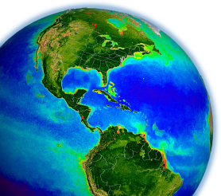
NASA OBPG
Satellite Ocean Color Update
Bryan Franz
and the
Ocean Biology Processing Group
NASA Goddard Space Flight Center
Ocean Biology & Biogeochemistry Program Meeting
8-9 May 2023
College Park, MD

Slide 2
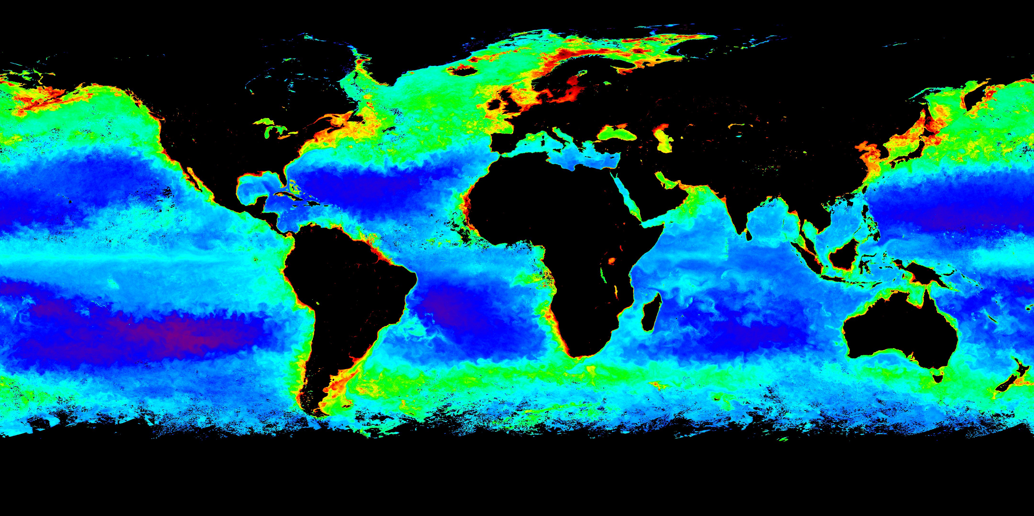
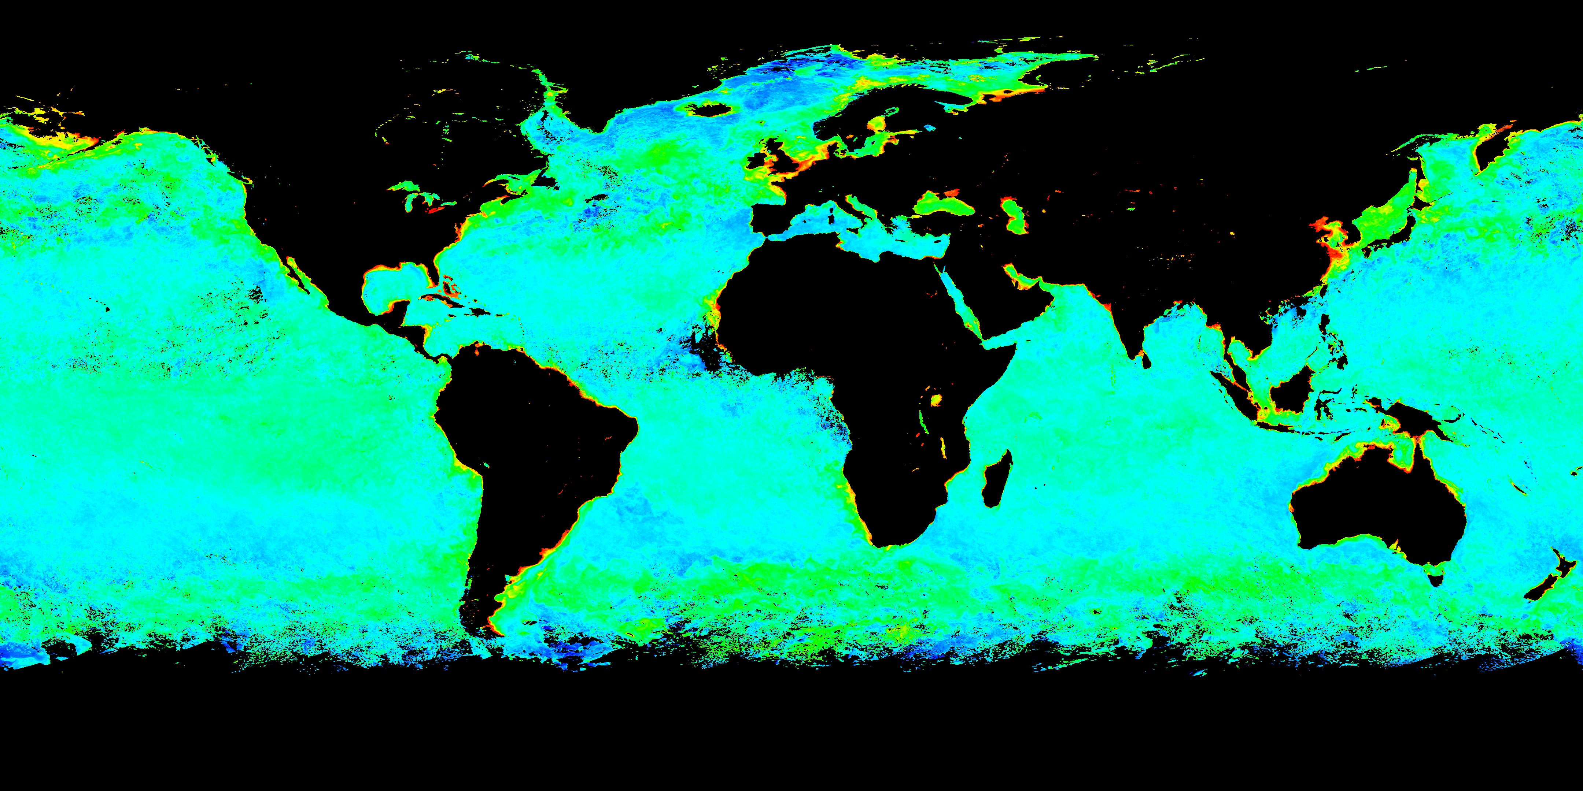
NASA Ocean Biology Processing Group & OB.DAAC
calibration, validation, software development, (re)processing, and distribution for a multitude sensors
Global Processing & Distribution
VIIRS/JPSS2 (USA)
VIIRS/JPSS1 (USA)
VIIRS/SNPP (USA)
MODIS/Aqua (USA)
MODIS/Terra (USA)
OLCI/S3A (Europe)
OLCI/S3B (Europe)
SeaWiFS (USA)
MERIS (Europe)
OCTS (Japan)
CZCS (USA)
Regional Processing & Distribution
Hawkeye (USA)
GOCI (South Korea)
HICO (USA)
JPSS-2 VIIRS Ocean Color Products Now Available!
April 2023
Phytoplankton Chlorophyll
April 2023
Particulate Backscatter

Slide 3
R2022 Multi-mission Ocean Color Reprocessing
Missions:
  VIIRS (SNPP, J1, J2), MODIS (Aqua, Terra), OLCI (S3A, S3B), SeaWiFS, MERIS, OCTS, CZCS
Changes:
instrument and vicarious calibration updates
updates to ancillary data sources
  from NCEP/TOMS-OMI/etc. to MERRA-2 assimilation product
updates to atmospheric correction methods and tables
  multi-scattering aerosol selection, extended AOT range, improved/expanded absorbing gas corrections, Rayleigh hi-solz bug
updates to pure seawater optical properties (nw, aw, bbw)
  apply temperature & salinity dependence (e.g., Werdell et al. 2013), bug in pure-water aw/bbw (off by few nm)
updates to masks and flags
  reduced straylight flagging/masking (Hu et al. 2019, JGRO), absorbing aerosol flag based on MERRA-2 transport model
updates to derived product algorithms
  Chl coefficient update (Hu et al. 2019, JGRO; O'Reilly and Werdell, 2019), PIC, PAR, etc.

Slide 4
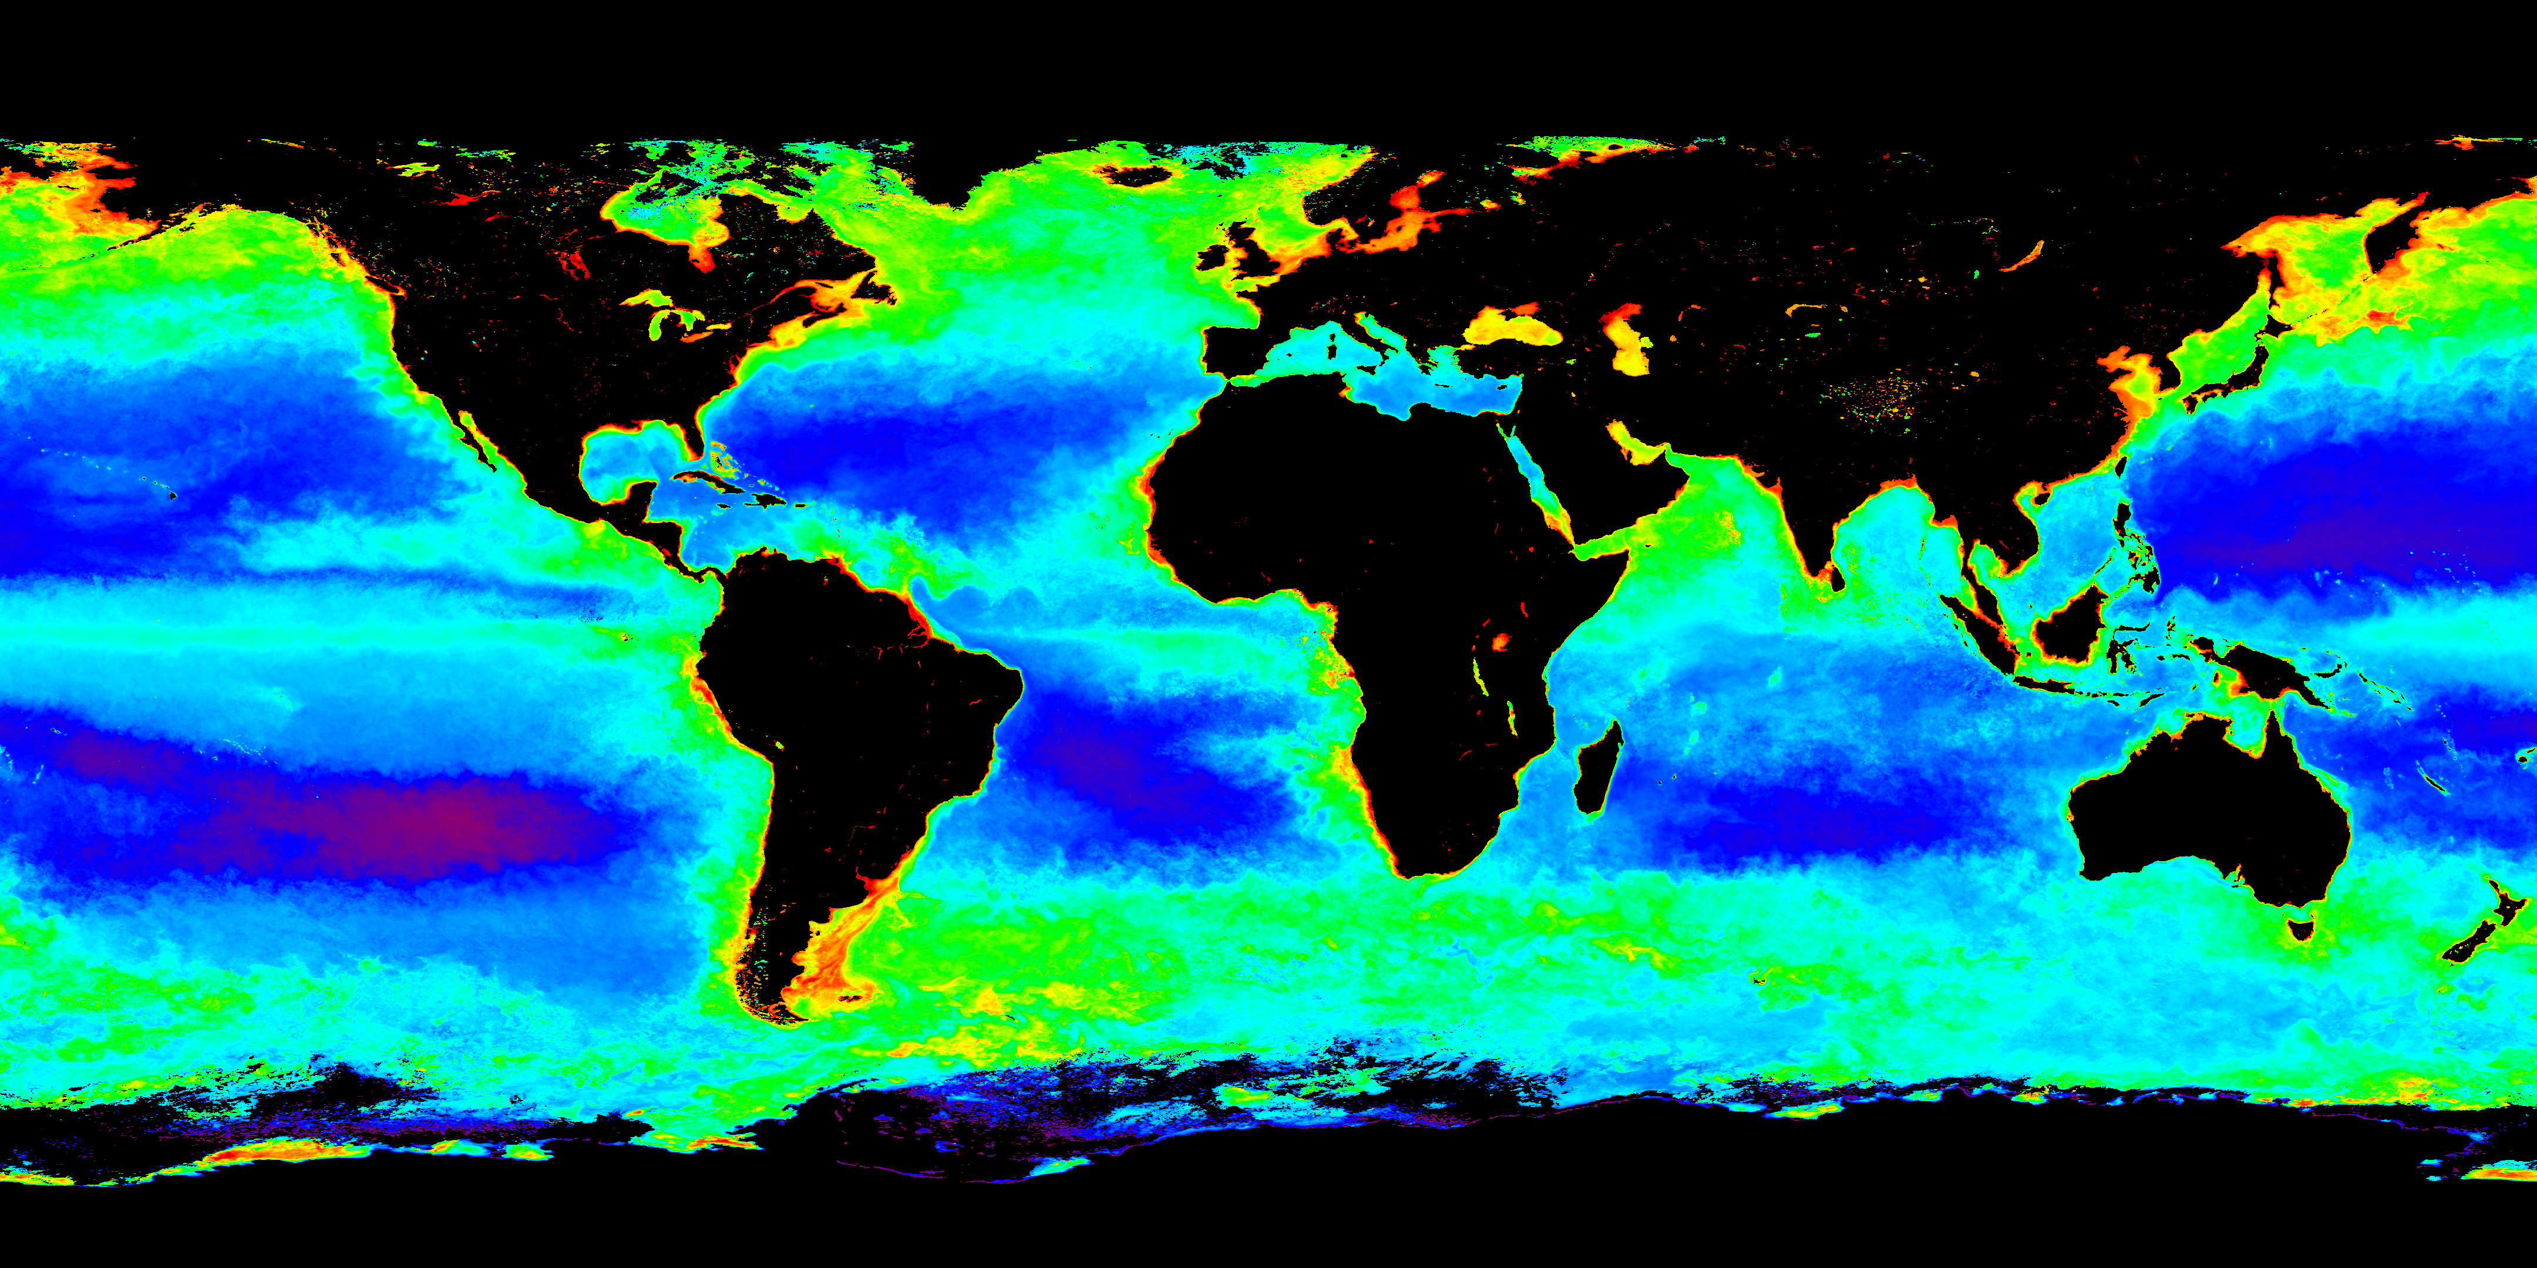


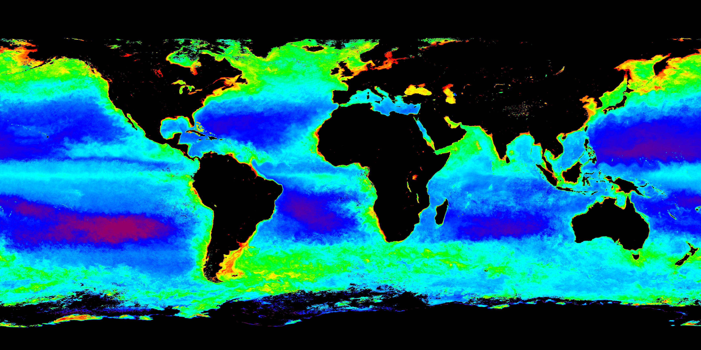
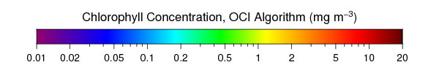
Seasonal Mean Chlorophyll Concentration for 2022
Boreal Fall 2022
Boreal Fall 2022
VIIRS
JPSS-1
SNPP
Boreal Fall 2022
Boreal Fall 2022
MODIS
Aqua
Terra

Slide 5

Seasonal Mean Chlorophyll Concentration for 2022
Boreal Fall 2022
Boreal Fall 2022
OLCI
Sentinel-3A
Sentinel-3B
Boreal Fall 2022
Boreal Fall 2022
MODIS
Aqua
Terra

Slide 6
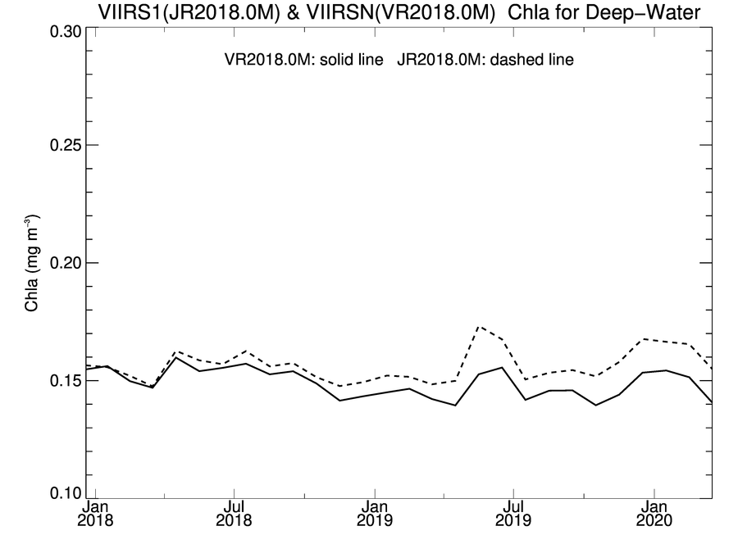
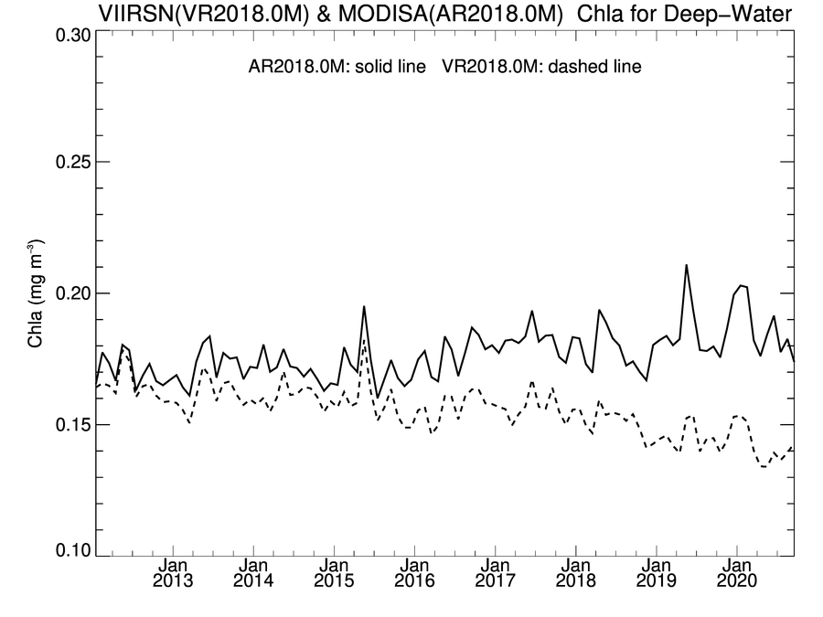
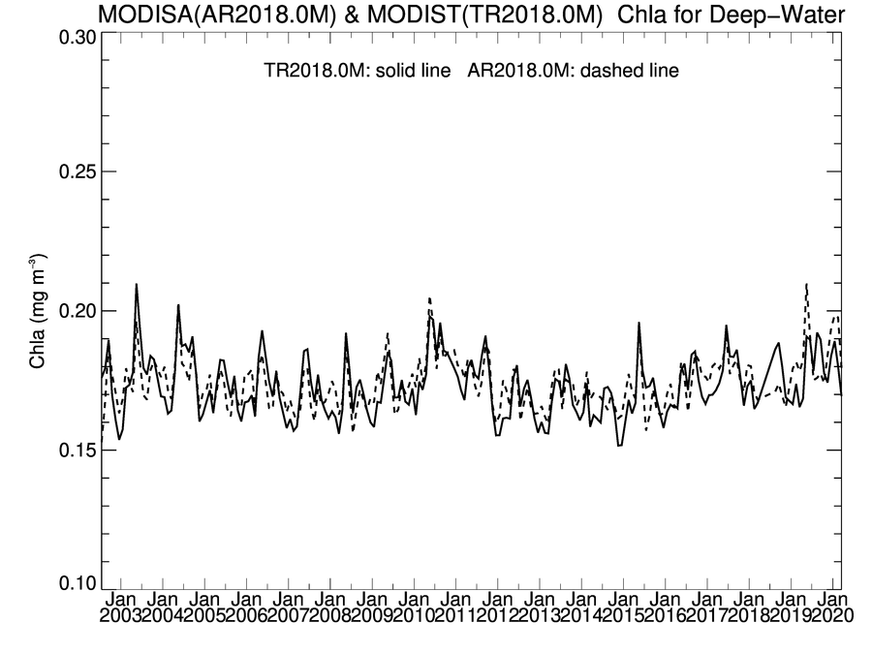
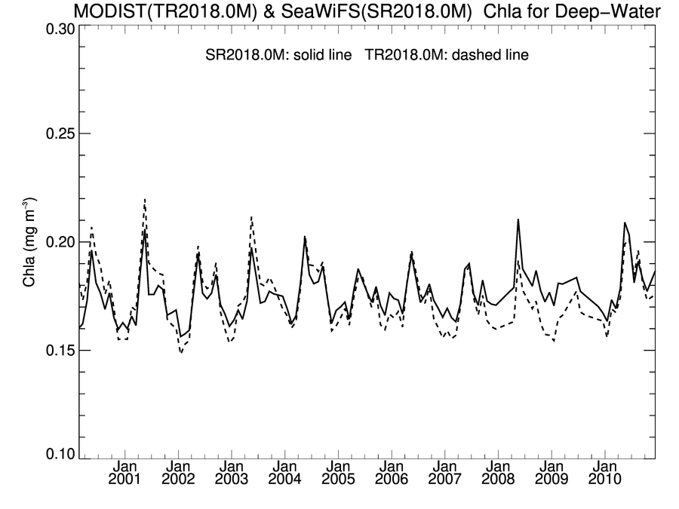
R2018 Global Deep-Water Chlorophyll Trends
Comparison trends over common mission lifetime
VIIRS/SNPP shows negative trend relative to VIIRS/JPSS1 & MODIS/Aqua
SeaWiFS, MODIS/Terra, MODIS/Aqua in good agreement, with short-term deviations
VIIRS/JPSS1 & VIIRS/SNPP
VIIRS/SNPP & MODIS/Aqua
Chl (mg m⁻³)
Chl (mg m⁻³)
MODIS/Aqua
VIIRS/JPSS1
VIIRS/SNPP
VIIRS/SNPP
MODIS/Aqua & MODIS/Terra
MODIS/Terra & SeaWiFS
Chl (mg m⁻³)
Chl (mg m⁻³)

Slide 7
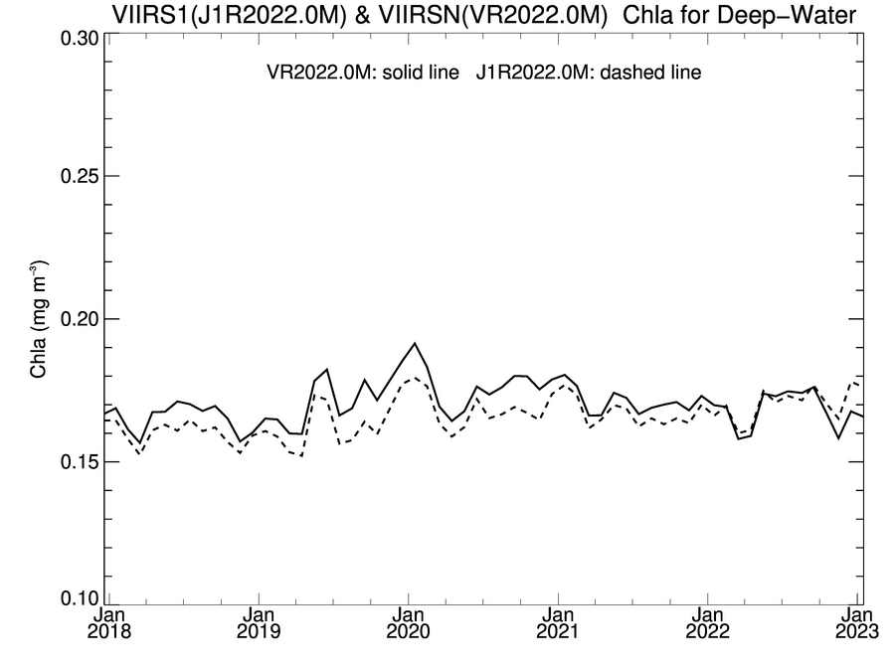
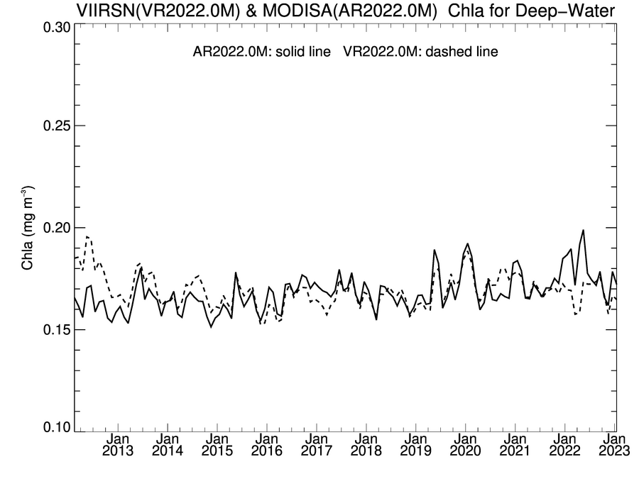
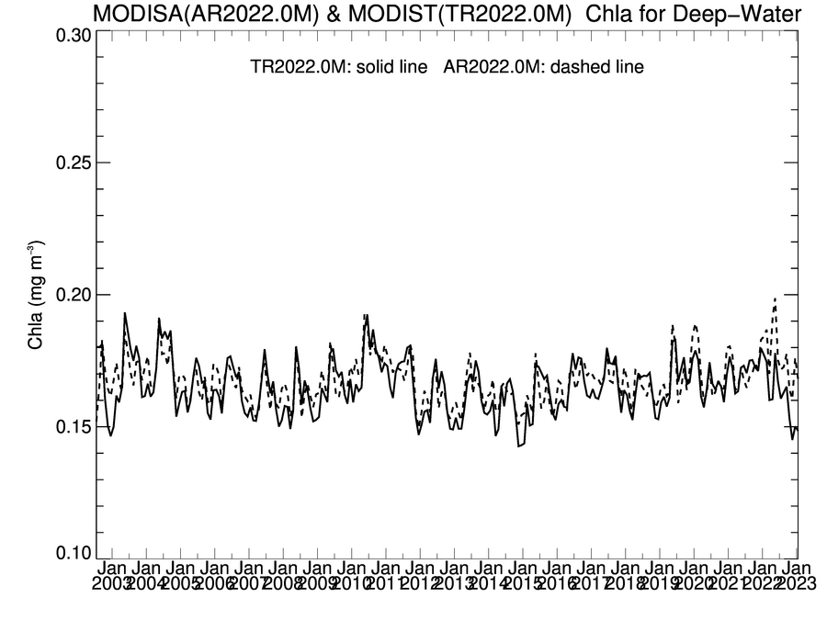
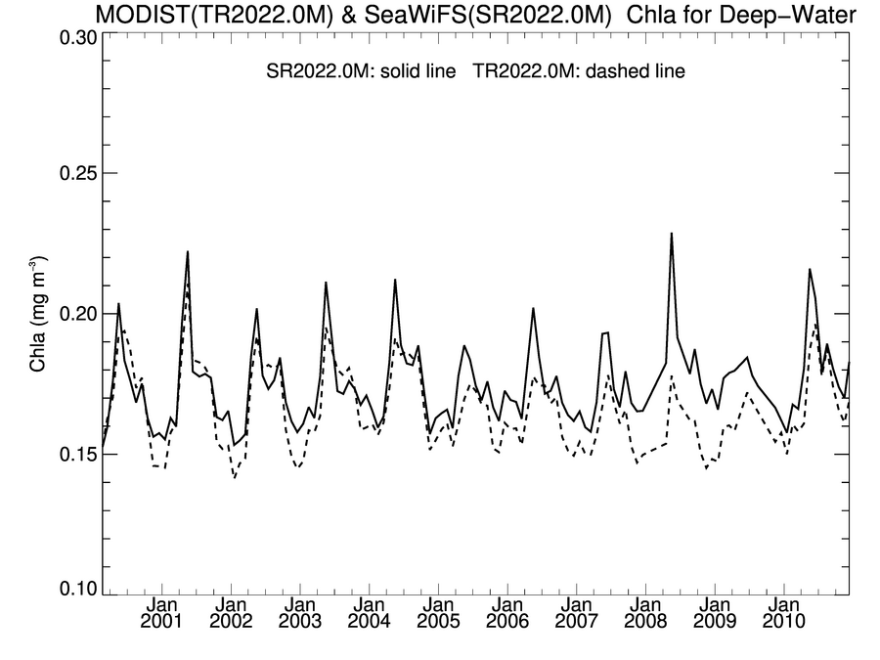
R2022 Global Deep-Water Chlorophyll Trends
Comparison trends over common mission lifetime
VIIRS/SNPP now in good agreement with VIIRS/JPSS1 & MODIS/Aqua
SeaWiFS, MODIS/Terra, MODIS/Aqua still in good agreement, with short-term deviations
VIIRS/JPSS1 & VIIRS/SNPP
VIIRS/SNPP & MODIS/Aqua
Chl (mg m⁻³)
Chl (mg m⁻³)
MODIS/Aqua
VIIRS/JPSS1
VIIRS/SNPP
VIIRS/SNPP
MODIS/Aqua & MODIS/Terra
MODIS/Terra & SeaWiFS
Chl (mg m⁻³)
Chl (mg m⁻³)

Slide 8
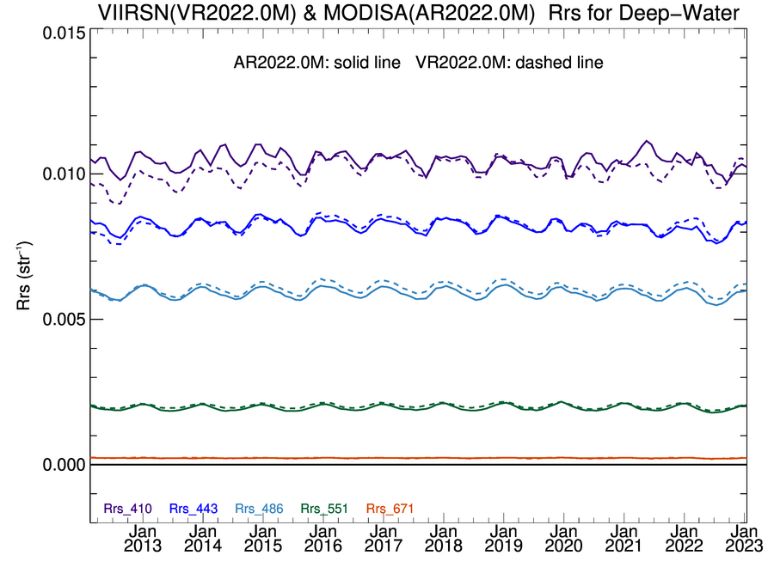
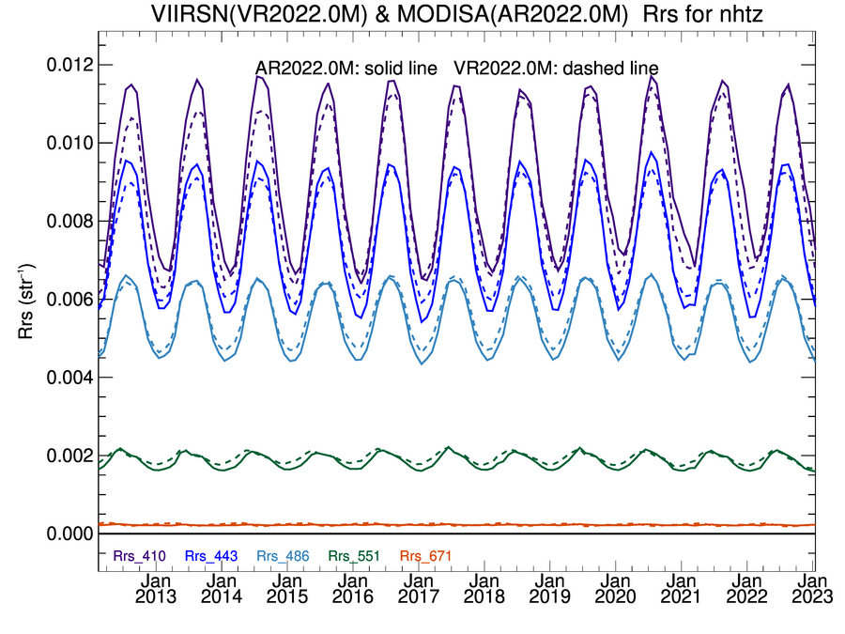
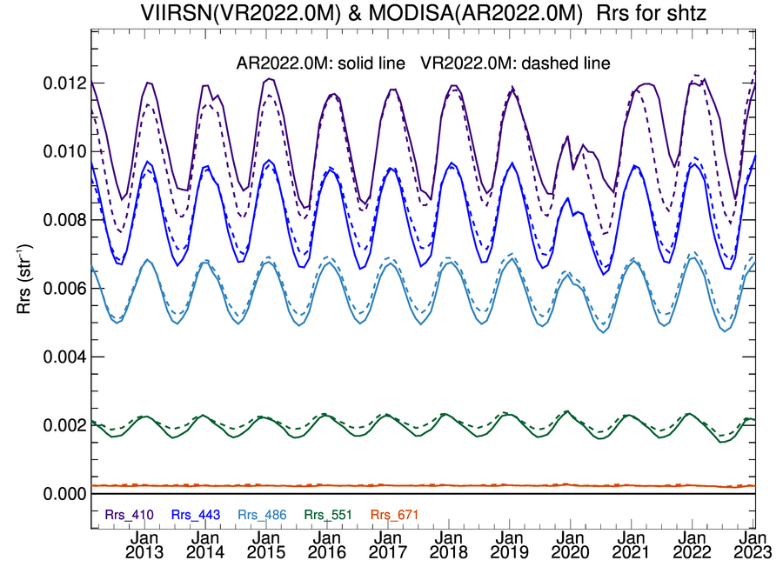
R2022 Deep-water Rrs, MODIS/Aqua & SNPP/VIIRS
+Northern & Southern Hemisphere Temperate Zone
Rrs (sr⁻¹)
Rrs (sr⁻¹)
NH
MODIS/Aqua & VIIRS/SNPP in very good agreement!
Deviation in blue prior to 2016 likely residual error from tungsten oxide contamination on VIIRS mirror
Deviations at 412nm SH post-2020 are TBD (MODIS issue)
Rrs (sr⁻¹)
SH

Slide 9
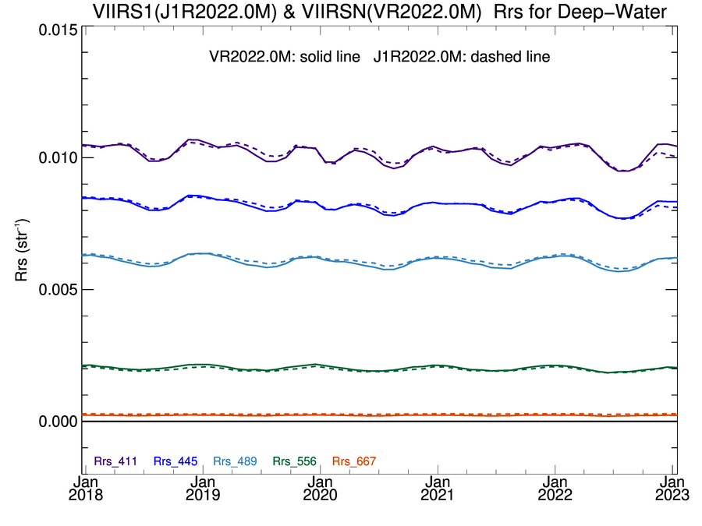
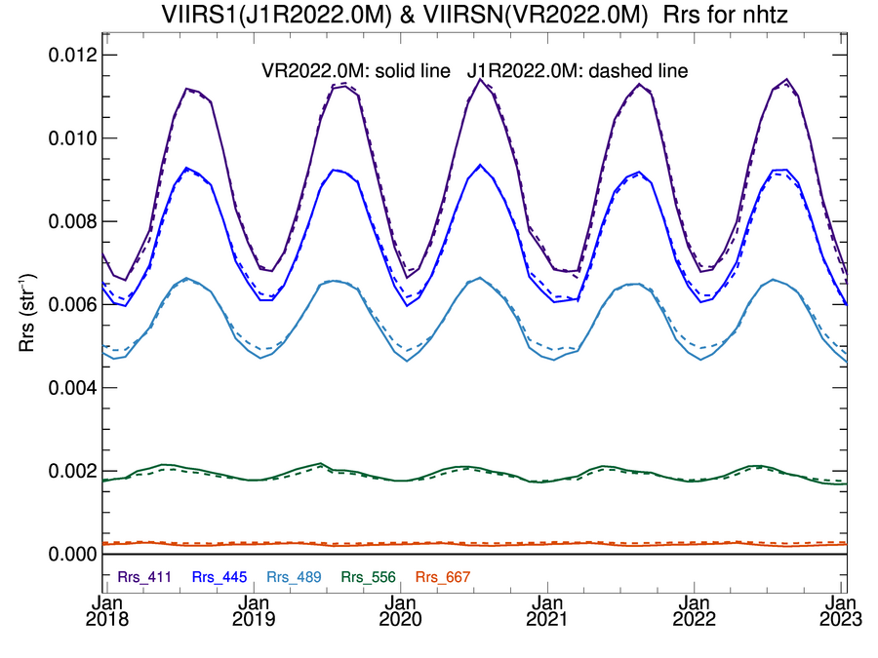
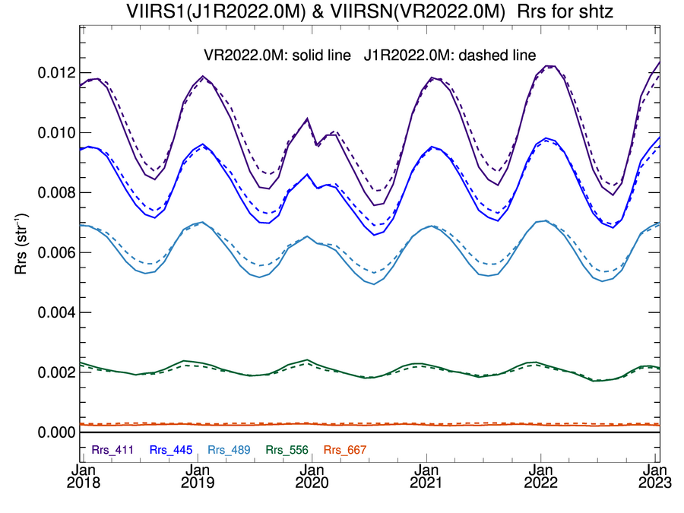
R2022 Deep-water Rrs, SNPP/VIIRS & J1/VIIRS
+Northern & Southern Hemisphere Temperate Zone
Rrs (sr⁻¹)
Rrs (sr⁻¹)
NH
Rrs (sr⁻¹)
VIIRS/SNPP & J1 in excellent agreement
Artifact near Jan 2020 in SH is Australian fires
SH

Slide 10
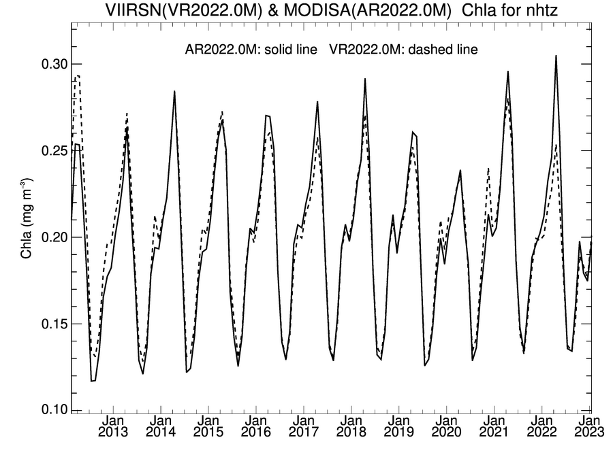
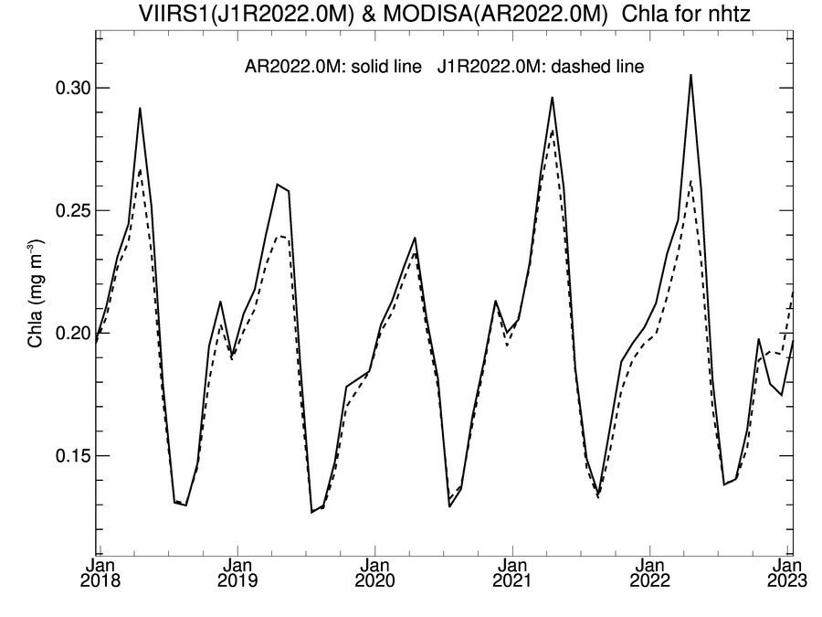
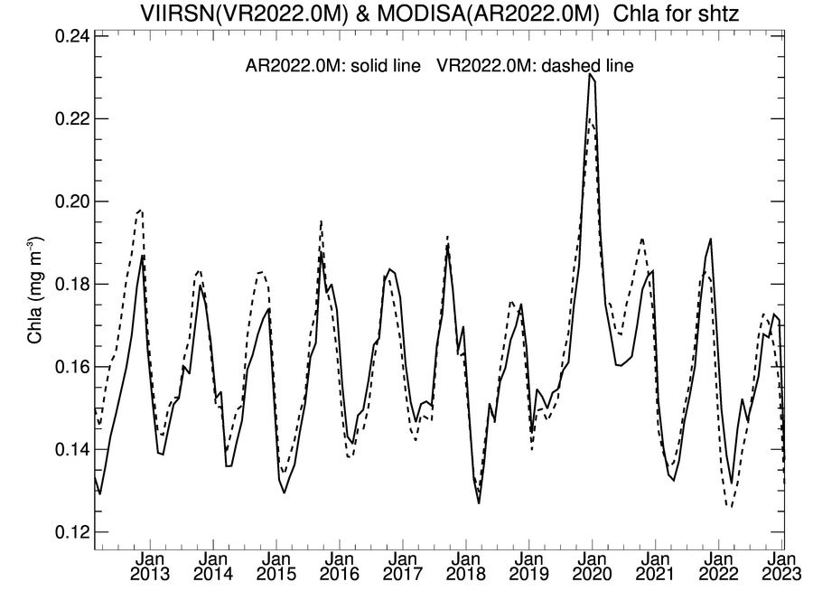
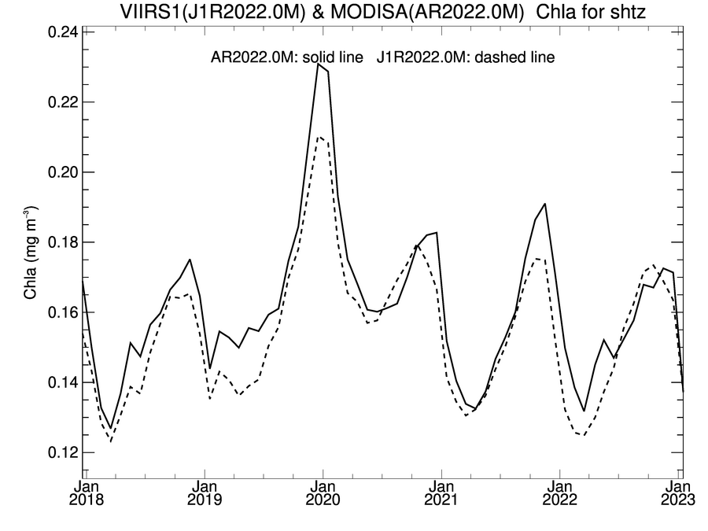
R2022 Hemispherical Deep-water Chlorophyll Trends
Northern & Southern Hemisphere Temperate Zone
Excellent agreement demonstrates that the consistently-processed VIIRS time-series can be used to extend the ocean color data record established with SeaWiFS and MODIS for many key parameters.
SH peak in Jan 2020 captures phytoplankton blooms generated by Australian fires.
MODIS/Aqua & VIIRS/SNPP
MODIS/Aqua & VIIRS/J1
Chl (mg m⁻³)
NH
NH
Chl (mg m⁻³)
SH
SH

Slide 11
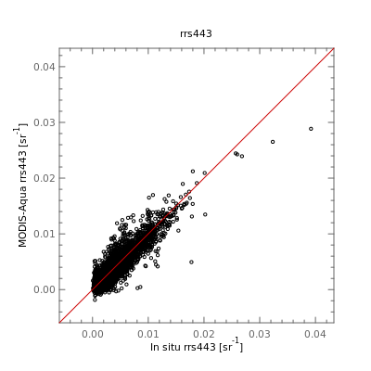
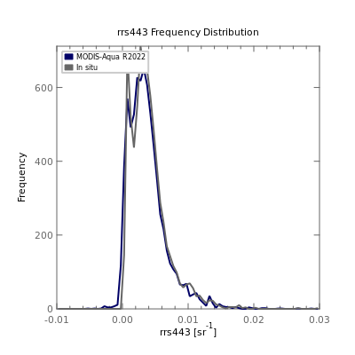
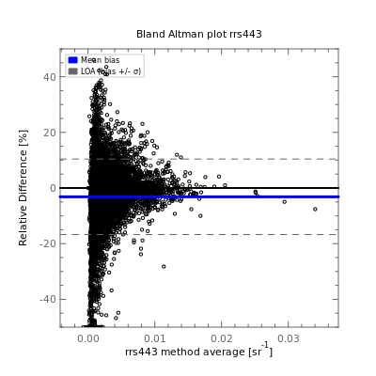
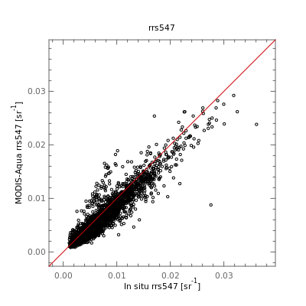
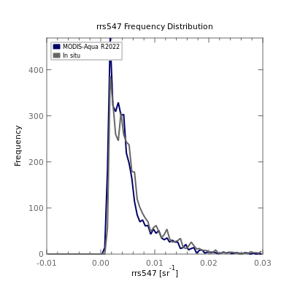
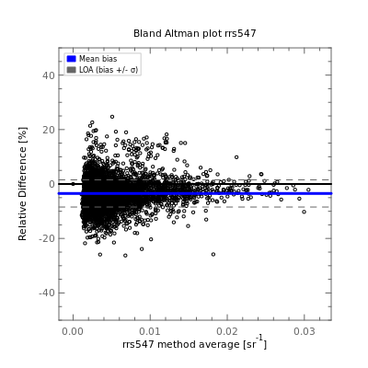
R2022 MODIS/Aqua Rrs Validation
Rrs (443) Scatter
Rrs (443) Freq. Dist.
Rrs (443) Bland Altman
Comparison against AERONET-OC and SeaBASS in situ measurements.
Very good agreement in most bands.
Negative mean relative bias of < 5% in most bands (Bland Altman).
Rrs (547) Scatter
Rrs (547) Freq. Dist.
Rrs (547) Bland Altman
https://seabass.gsfc.nasa.gov/search_results/val

Slide 12
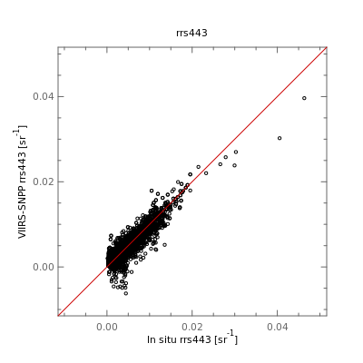
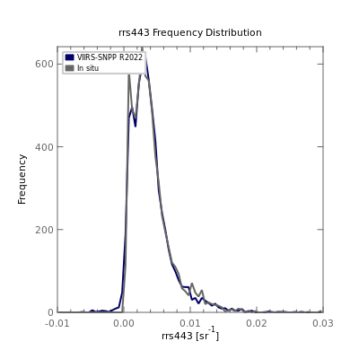
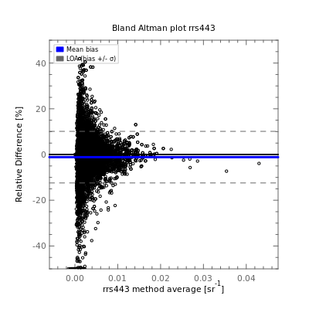
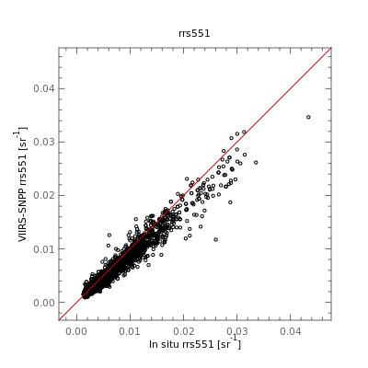
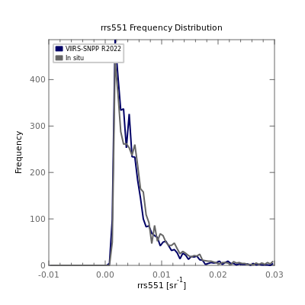
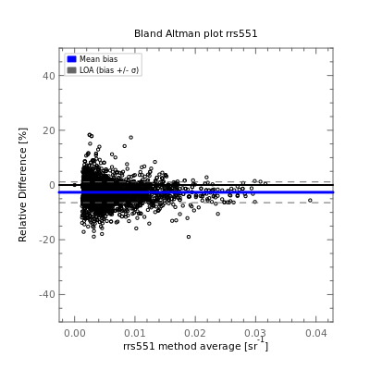
R2022 VIIRS/SNPP Rrs Validation
Rrs (443) Scatter
Rrs (443) Freq. Dist.
Rrs (443) Bland Altman
Comparison against AERONET-OC in situ measurements.
Very good agreement in most bands.
Negative mean relative bias of < 5% in most bands (Bland Altman).
Rrs (551) Scatter
Rrs (551) Freq. Dist.
Rrs (551) Bland Altman
https://seabass.gsfc.nasa.gov/search_results/val

Slide 13
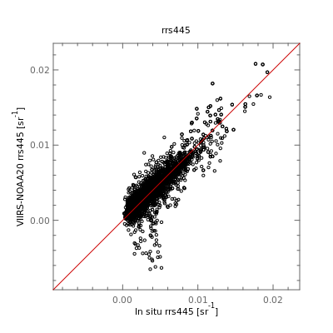
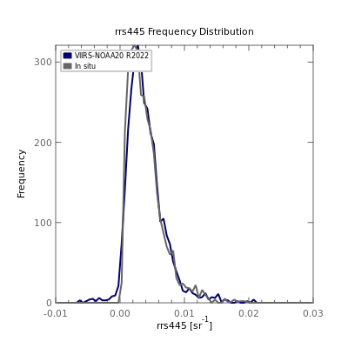
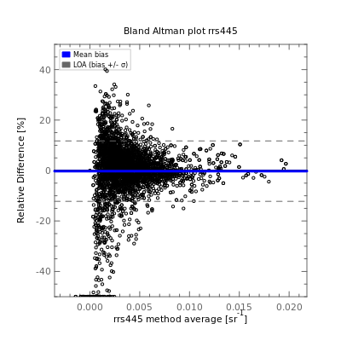
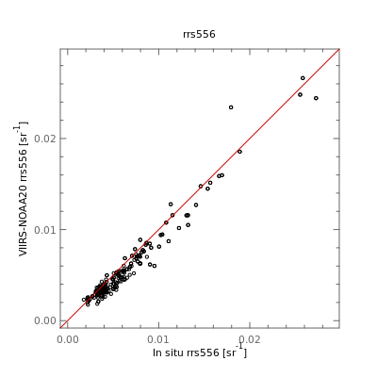
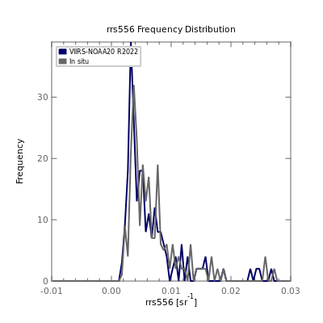
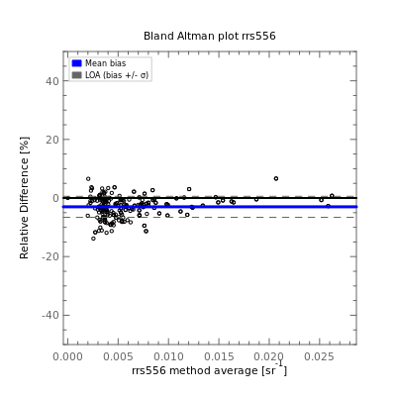
R2022 VIIRS/JPSS1 Rrs Validation
Rrs (445) Scatter
Rrs (445) Freq. Dist.
Rrs (445) Bland Altman
Comparison against AERONET-OC in situ measurements.
Very good agreement in most bands.
Negative mean relative bias of < 5% in most bands (Bland Altman).
Rrs (556) Scatter
Rrs (556) Freq. Dist.
Rrs (556) Bland Altman
https://seabass.gsfc.nasa.gov/search_results/val

Slide 14
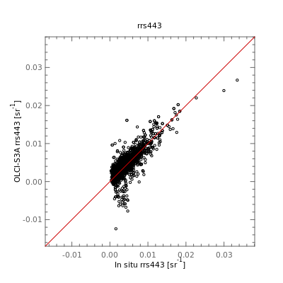
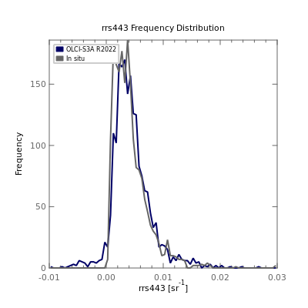
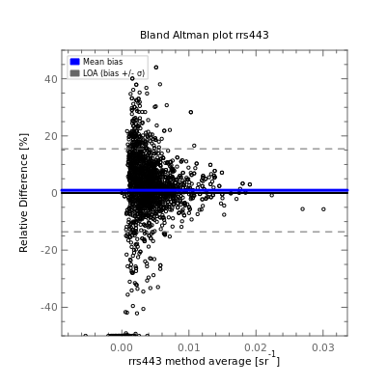
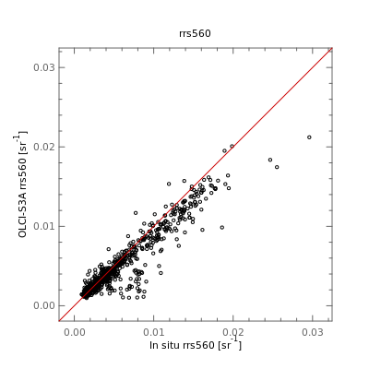
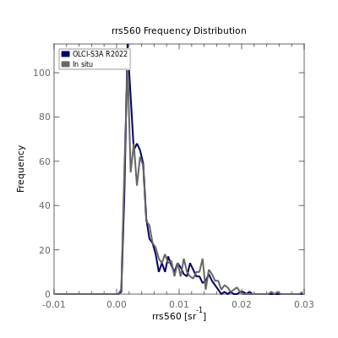
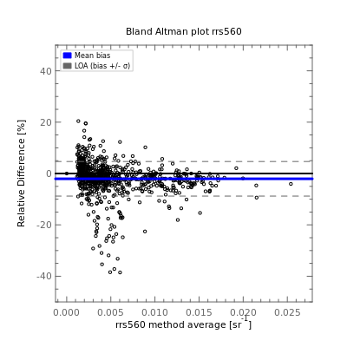
R2022 OLCI/S3A Rrs Validation
Rrs (443) Scatter
Rrs (443) Freq. Dist.
Rrs (443) Bland Altman
Comparison against AERONET-OC in situ measurements.
Very good agreement in most bands.
Negative mean relative bias of < 5% in most bands (Bland Altman).
Rrs (560) Scatter
Rrs (560) Freq. Dist.
Rrs (560) Bland Altman
https://seabass.gsfc.nasa.gov/search_results/val

Slide 15
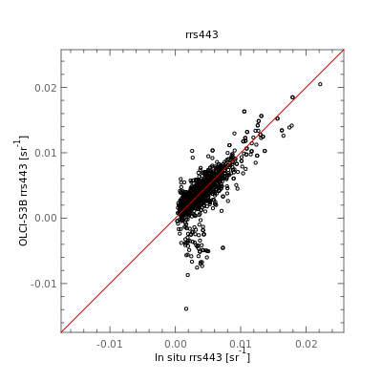
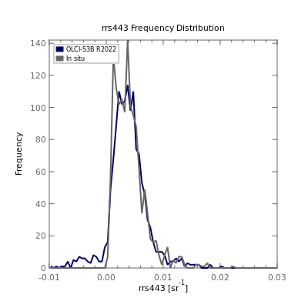




R2022 OLCI/S3B Rrs Validation
Rrs (443) Scatter
Rrs (443) Freq. Dist.
Rrs (443) Bland Altman
Comparison against AERONET-OC in situ measurements.
Very good agreement in most bands.
Negative mean relative bias of < 5% in most bands (Bland Altman).
Rrs (560) Scatter
Rrs (560) Freq. Dist.
Rrs (560) Bland Altman
https://seabass.gsfc.nasa.gov/search_results/val

Slide 16
Anomalous results observed in 2022
2022 Seasonal Cycle and SeaWiFS-MODISA Climatology
SeaWiFS-MODISA Time-Series and
De-seasonalized Anomalies
Chl (mg m⁻³)
C_{phyto} (mg m⁻³)
NH
Chl (mg m⁻³)
NH
EQ
EQ
C_{phyto} (mg m⁻³)
SH
SH
B.A. Franz, I. Cetinic, M. Gao, D.A. Siegel, and T.K. Westberry (2023). Global ocean phytoplankton [in State of the Climate in 2022]. BAMS, in review.

Slide 17
Impact of 2022 Hunga Tonga Eruption
Rrs (green) Seasonal Cycles in South Pacific Gyre
OMPS Stratospheric Aerosol
MODIS/Aqua
MODIS/Terra
VIIRS/SNPP
VIIRS/JPSS1
OLCI/S3A
OLCI/S3B
NH
SH
All ocean color missions showing large deviation in Rrs through 2022, largest % diff in green-red.
Issue believed to be atmospheric correction error due to unmodeled stratospheric aerosols.
Operating assumption is that ocean reflectance (Rrs) is underestimated because the correction for ozone absorption does not account for scattering by high-altitude aerosols.
B.A. Franz, A. Sayer, I. Cetinic, A. Ibrahim, manuscript in development

Slide 18
Seasonally Varying Bias in Rrs
MODIS/Aqua
VIIRS/SNPP
SeaWiFS
MODIS/Aqua
VIIRS/SNPP
SeaWiFS
412
412
443
443
490
490
550
550
MOBY
Satellite
670
670
K. Bisson, E. Boss, P.J. Werdell, A. Ibrahim, R. Frouin, M.J. Behrenfeld, (2021). Seasonal bias in global ocean color observations. Appl. Opt.

Slide 19

Monthly Mean Rrs Ratio: MODIS/Aqua vs MOBY
R2022 reprocessing did not resolve the seasonal bias in MODIS/Aqua Rrs.
Slight improvement in green-red.

Slide 20

Monthly Mean Rrs Ratio: MODIS/Terra vs MOBY
MODIS/Terra shows much less seasonal variability than MODIS/Aqua (R2018 or R2022).
Algorithms and calibration methods are same. Primary difference is that we cross calibrate Terra to Aqua and SeaWIFS to derive time-varying RVS and polarization sensitivity.

Slide 21

Summary
JPSS-2 VIIRS ocean color products are now available through OB.DAAC.
R2022 ocean color reprocessing completed for all missions. VIIRS Rrs time series from SNPP and JPSS-1 in good agreement with MODIS, indicating that VIIRS can be used to extend the SeaWIFS-MODIS time series for many key OC parameters.
R2022 Rrs (and Chl) results are in good agreement with in situ measurements for all missions, with Rrs bias < 5% (typically negative) in all bands.
All ocean color missions are showing anomalous trends in Rrs through 2022 due to atmospheric correction error associated with unresolved stratospheric aerosols from the Hunga Tonga eruptions of Jan 2022.
Still investigating apparent seasonal bias in Rrs. Polarization sensitivity appears to be a contributing factor, but TBD.

Slide 22

Thank You
Back-up

Slide 23

MODIS-Aqua Daily Chlorophyll – R2018
Includes 5 X 7 STRAYLIGHT masking of Level-2 pixels around bright targets

Slide 24

MODIS-Aqua Daily Chlorophyll – R2022
Includes 3 X 3 STRAYLIGHT masking of Level-2 pixels around bright targets

Slide 25

Multi-Scattering Epsilon (MSEPS) Atmospheric Correction
Step 2
Estimate the optical depth at the longest high radiometric quality band for each relative humidity aerosol model set
Step 3
From (multi-scattering) Epsilon, find the closest aerosol fine mode fractions (FMF).
TOA reflectance
Step 1
Rayleigh, gas, and glint correction
R_{rs} ,𝝉_{a} , Ångström
Step 5
Calculate the weighted mean of the models to get the final aerosol reflectance and diffuse transmittance
Step 4
Calculate the spectral aerosol reflectance for the closest models in relative humidity and FMF space
Ahmad, Z. and B. Franz (2018), Uncertainty in aerosol model characterization and its impact on ocean color retrievals, in PACE Technical Report Series, Volume 6: Data Product Requirements and Error Budgets (NASA/TM-2018 - 2018-219027/ Vol. 6).

Slide 26



R2022 MODIS-Aqua Chl Validation
Chl Scatter
Chl Freq. Dist.
Chl Bland Altman
MODIS-Aqua Chlorophyll in good agreement with in situ measurements
Mean positive relative bias < 5%
https://seabass.gsfc.nasa.gov/search_results/val

Slide 27



R2022 VIIRS-SNPP Chl Validation
Chl Scatter
Chl Freq. Dist.
Chl Bland Altman
MODIS-Aqua Chlorophyll in good agreement with in situ measurements
Mean positive relative bias < 5%
https://seabass.gsfc.nasa.gov/search_results/val

Slide 28






OLCI-S3A vs MODIS-A, R2022 Global Deep-Water Trends
Oligotrophic
Mesotrophic
Eutrophic
Rrs (sr⁻¹)
Chl (mg m⁻³)

Slide 29






OLCI-S3B vs MODIS-A, R2022 Global Deep-Water Trends
Oligotrophic
Mesotrophic
Eutrophic
Rrs (sr⁻¹)
Chl (mg m⁻³)

Slide 30




Monthly Mean SST for March 2023
March 2023
VIIRS
JPSS-1 VIIRS coming soon.
SNPP
March 2023
March 2023
MODIS
Aqua
Terra

