Slide 1
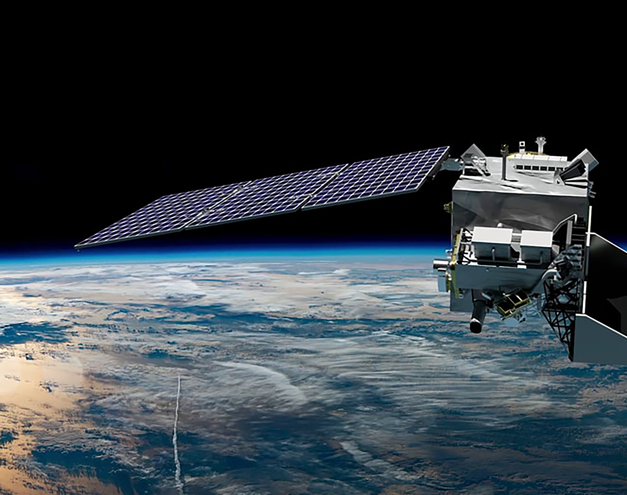


PACE Applications
Advancing PACE environmental & societal relevance globally
Maria Tzortziou, PACE Deputy Program Application Lead-Oceans
Erin Urquhart, PACE Project Applications Coordinator
Natasha Sadoff, PACE Project Applications Deputy Coordinator
City College of New York
NASA Goddard Space Flight Center
Science Systems & Applications, SSAI

Slide 2
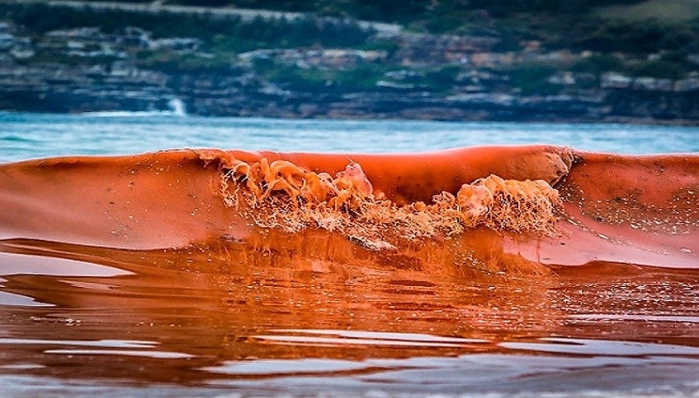
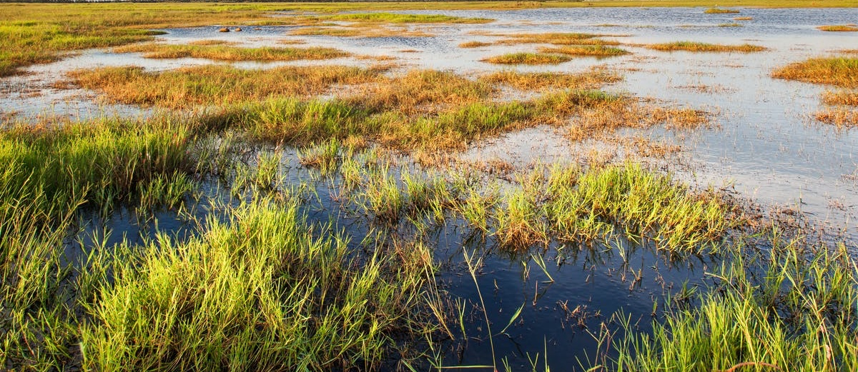
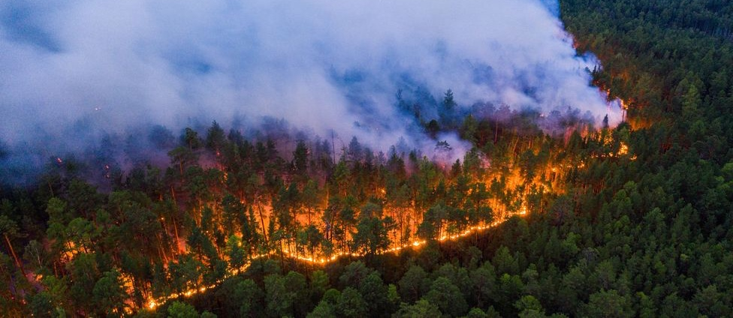
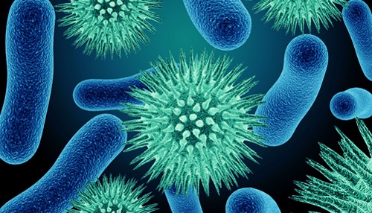

PACE Interdisciplinary Applied Science Objectives
fisheries
biodiversity
HABs
oil leaks
food security
wetlands
terrestrial ecosystems
land use & change
air quality
human health
disasters
climate
resource management
ecological forecasting
pathogens
water quality

Slide 3

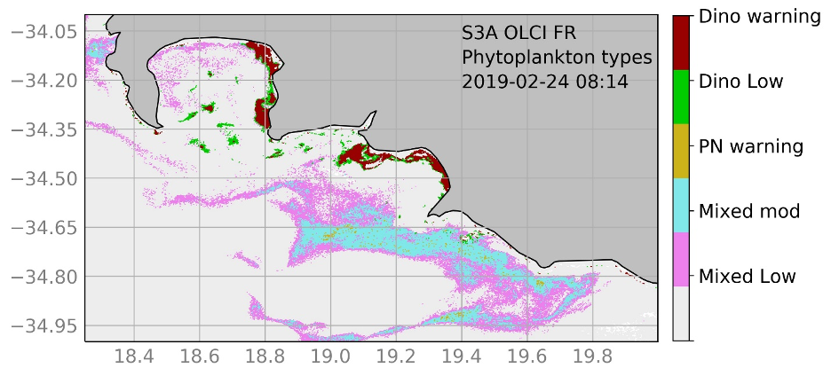
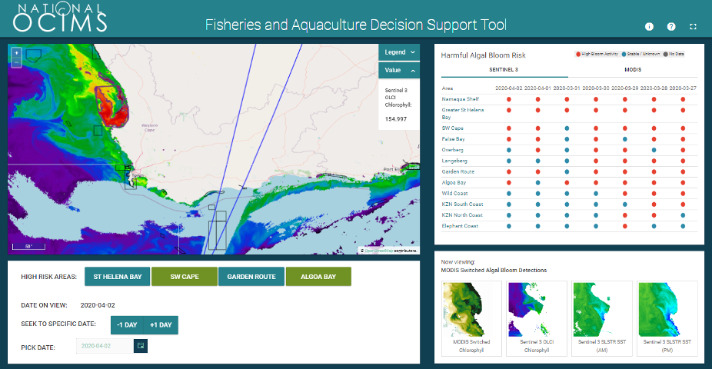
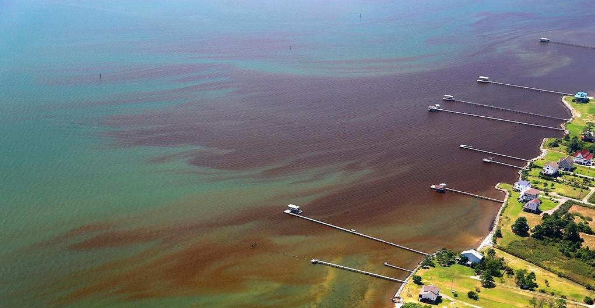
PACE Applications- Water Resources
Informing Applications with PACE Data: Monitoring and Managing Marine Ecosystems
PACE will provide phytoplankton community composition data for understanding ocean ecosystems, which can benefit and/or inform:
  Health and citing of fisheries and aquaculture
  Monitoring of marine food webs
  Monitoring of aquatic biodiversity
  Monitoring of ecosystem health
Top: Existing phytoplankton type products for potential HAB detection in the southern Benguela will be improved by PACE.
Middle: The National Oceans and Coastal Information Management System (OCIMS) Fisheries and Aquaculture Decision Support Tool will incorporate PCC from PACE.
Left: HAB conditions discolor coastal waters. (Photo courtesy of Wolfgang Volgelbein, VIMS)

Slide 4

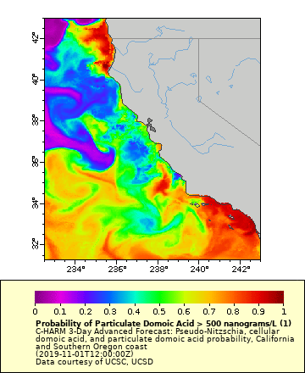
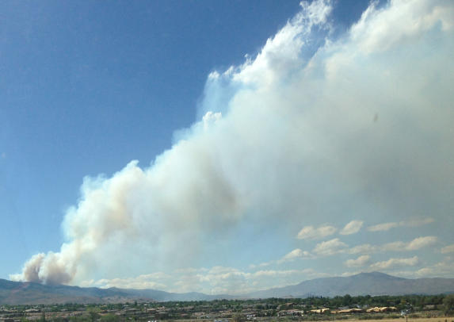
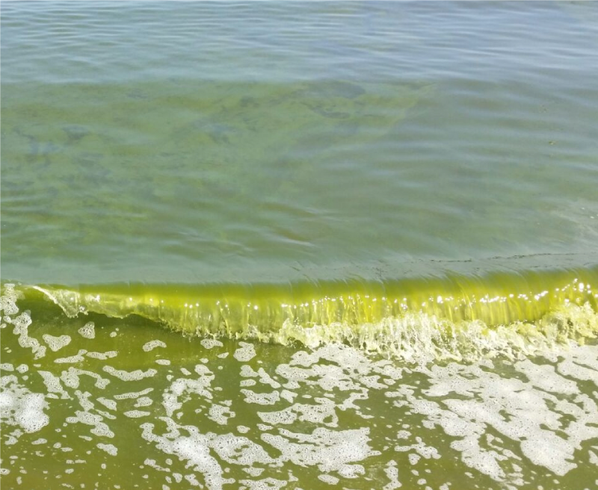
PACE Applications- Disasters
Informing Applications with PACE Data: Monitoring and Managing Disasters
Applicable across application areas, PACE will provide data on that can inform disaster risk management, including reduction, mitigation, and response of disasters such as:
Wildfire smoke (aerosol data)
Volcanic ash emissions pre- or post-eruption (aerosol, SO2 data)
Harmful algal blooms and fish kills/hypoxia (phytoplankton, chlorophyll data)
Oil seeps and spills (optical properties, reflectance)
Hurricane/weather monitoring (cloud data)
Left: Smoke plume rising over Reno, Nevada.
Middle: Thick blooms of green Noctiluca scintillans threaten water quality, public health, tourism, and the operations of many coastal industries in Oman.
Right: Animation showing the probability of particulate Domoic Acid concentration greater than 500 nanograms per liter in seawater off the U.S. west coast during Nov 2019. Reds and oranges indicate higher probabilities while purples and blues show lower probabilities.

Slide 5

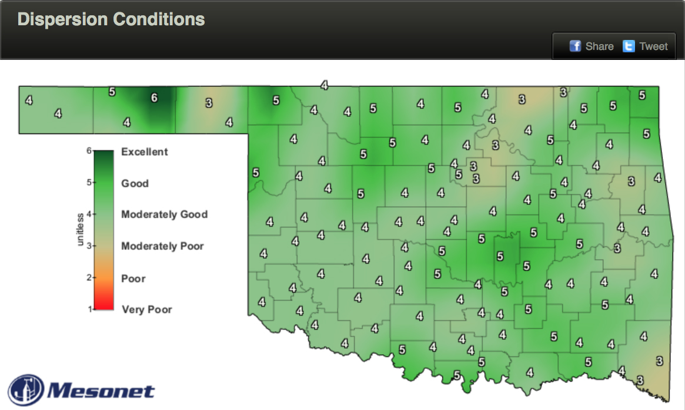
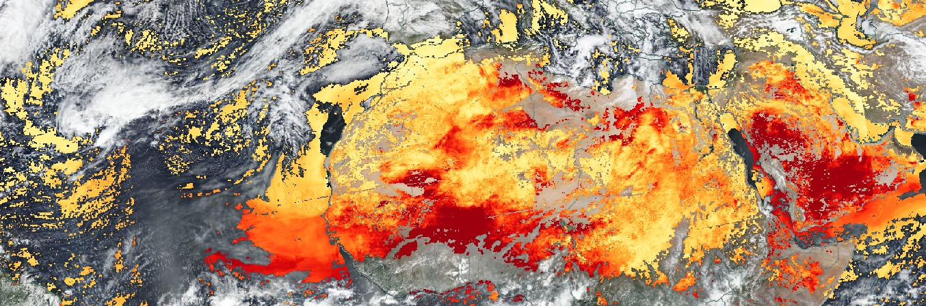
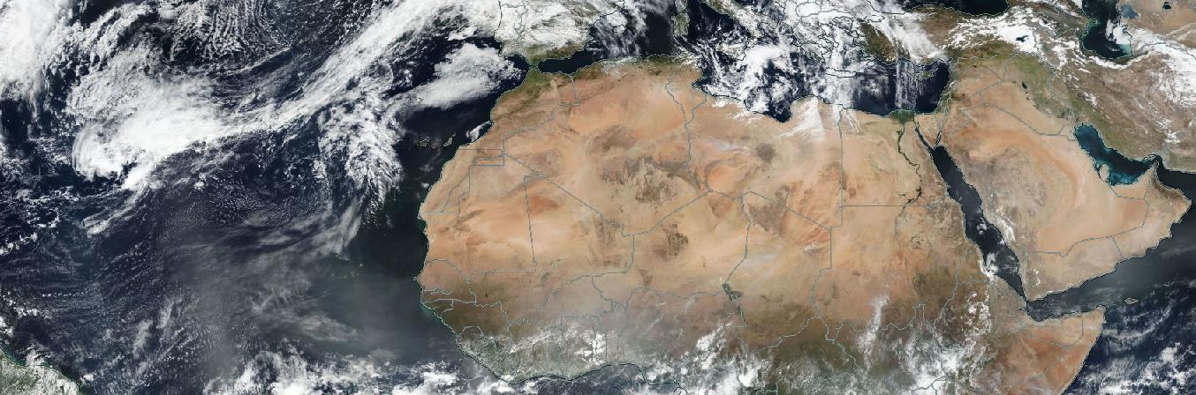
PACE Applications- Health & Air Quality
Informing Applications with PACE Data: Monitoring and Managing Air Quality
PACE will provide aerosol measurements (such as total column aerosol amount, aerosol layer height, and aerosol optical depth) for understanding air quality and its impacts on human health, which can benefit and/or inform:
Estimating particulate matter (PM) for air quality advisories
The impact of aerosols on the climate
The location, altitude, and magnitude of particulate matter such as wildfire smoke or volcanic ash
Top: Mesonet map showing dispersion conditions over Oklahoma, or the ability of the atmosphere to dilute airborne particles (i.e. smoke, pollution, pesticides). Higher dispersion means faster atmospheric dilution is likely.
Bottom: PACE will extend MODIS and VIIRS heritage aerosol optical depth retrievals.

Slide 6

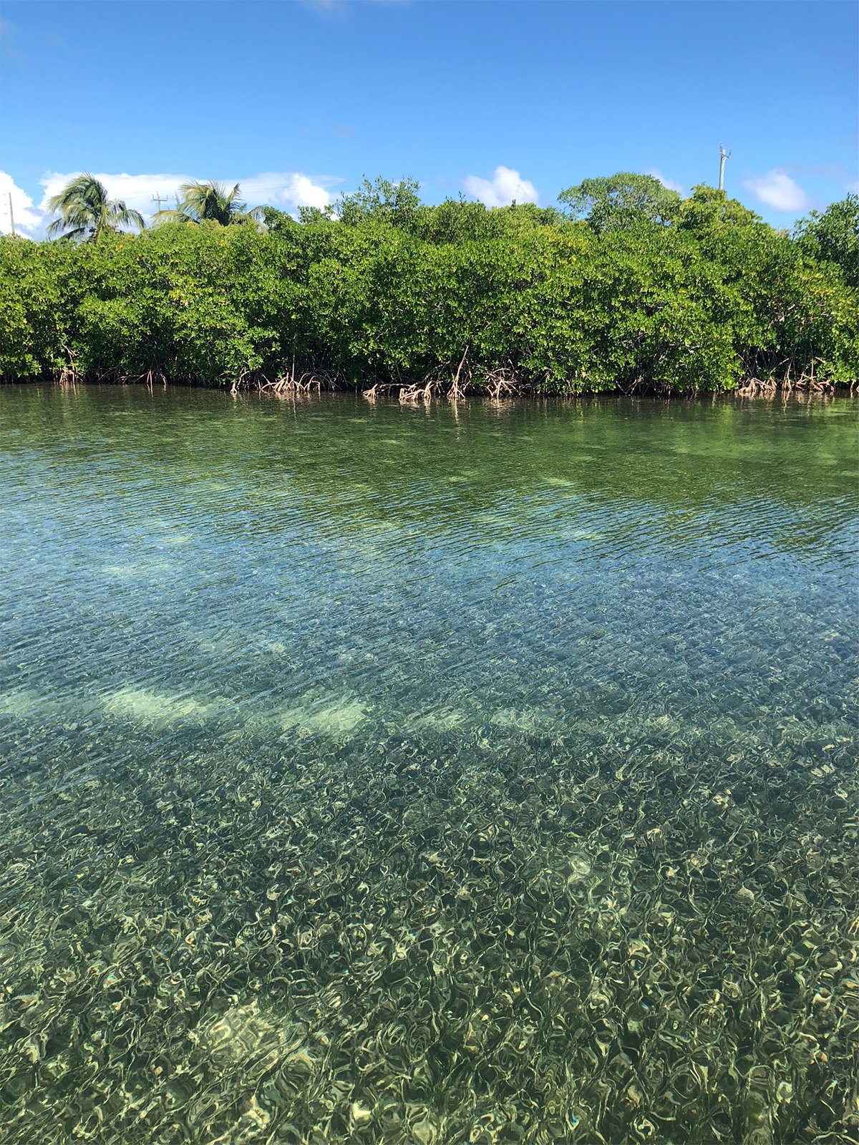
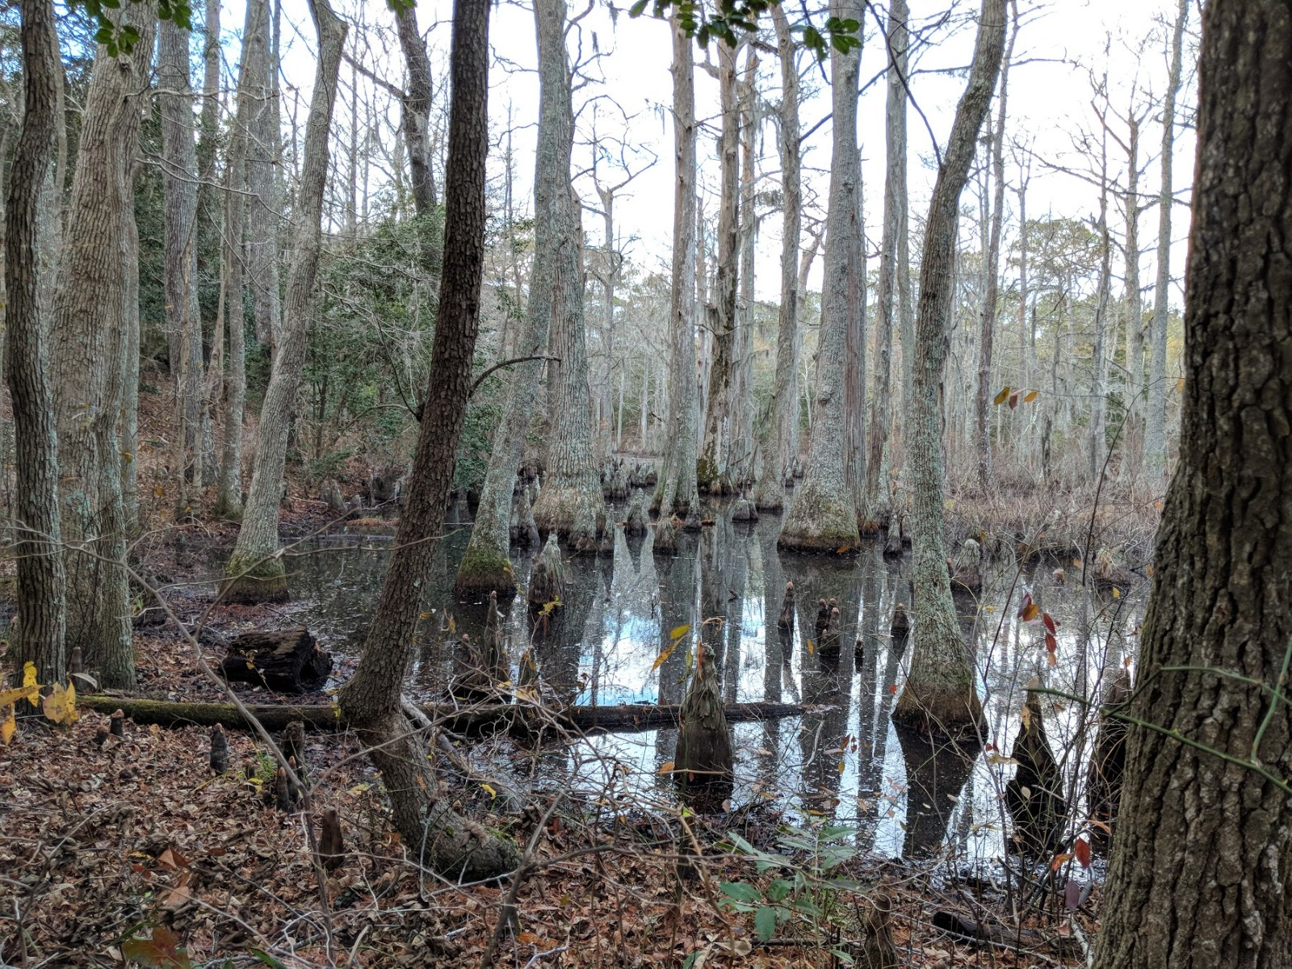
PACE Applications- Terrestrial/Land
Informing Applications with PACE Data: Monitoring and Managing Terrestrial Ecosystems
PACE will provide data on surface vegetation, including surface reflectance, BRDF, and NDVI, which can describe dynamics of key terrestrial vegetation biochemical and functional characteristics. This can benefit and/or inform:
Monitoring of wetland ecosystem health
Monitoring of forest health
Monitoring of agricultural practices and ecosystem health
Understanding impacts from land to coastal environments
Left: Researchers will utilize PACE data to understand ecosystem changes in different regions of the world.
Right: Bald Cypress Swamp, First Landing State Park, Virginia Beach, VA.

Slide 7
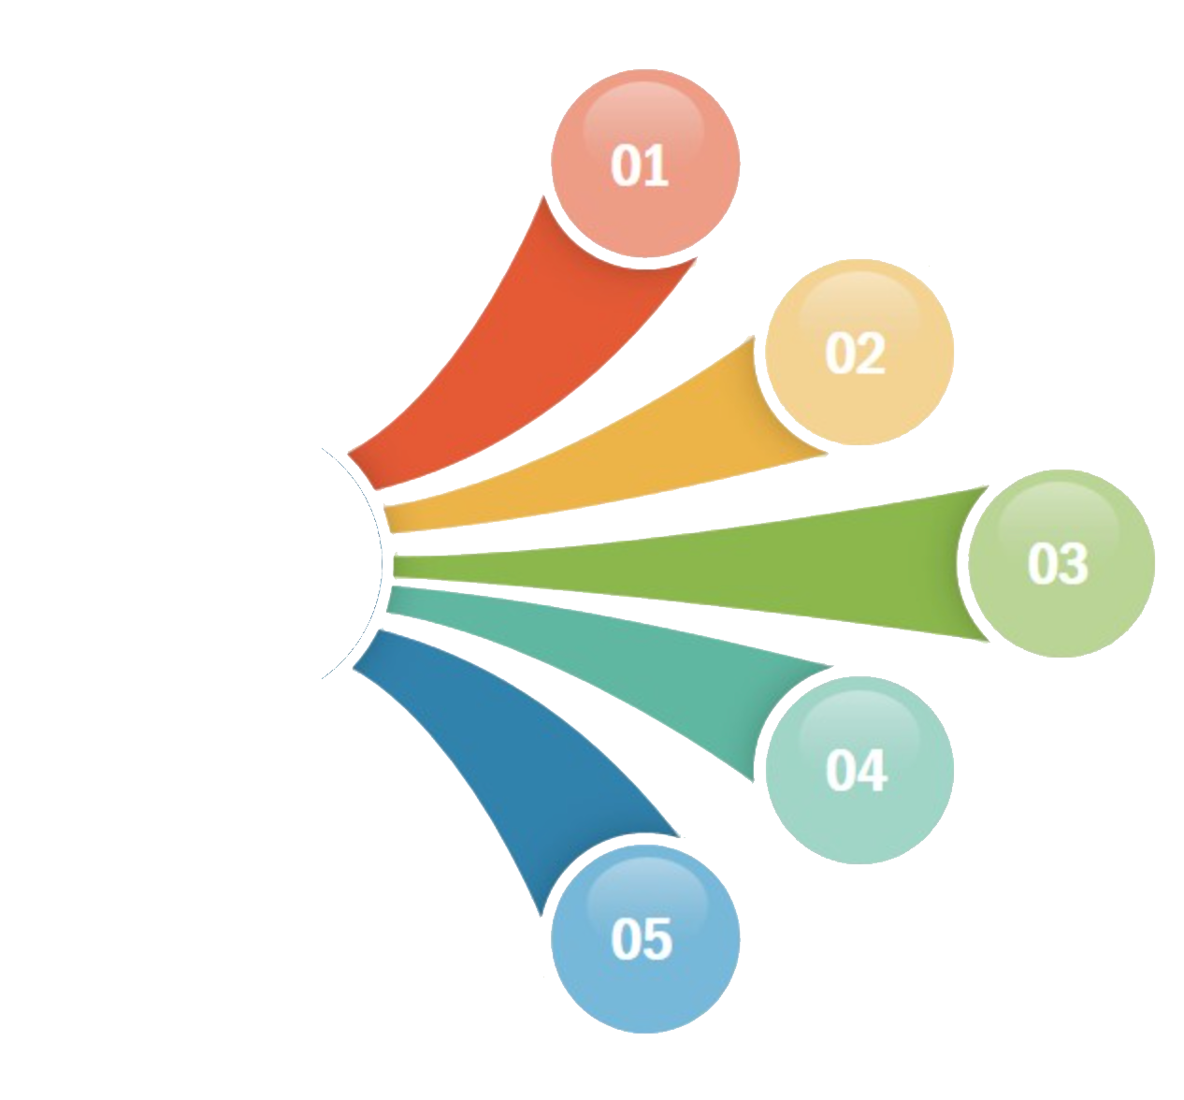
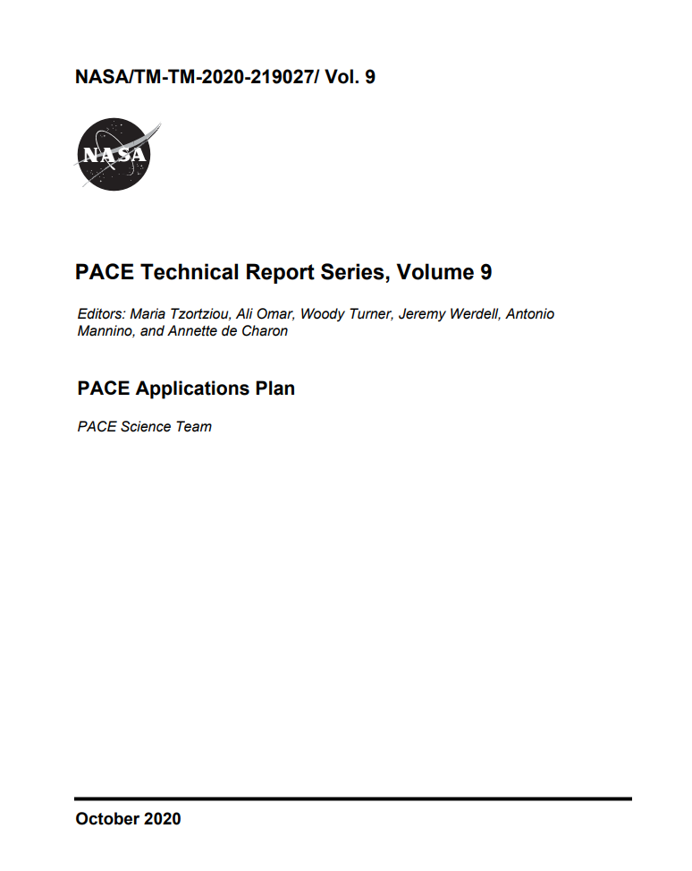
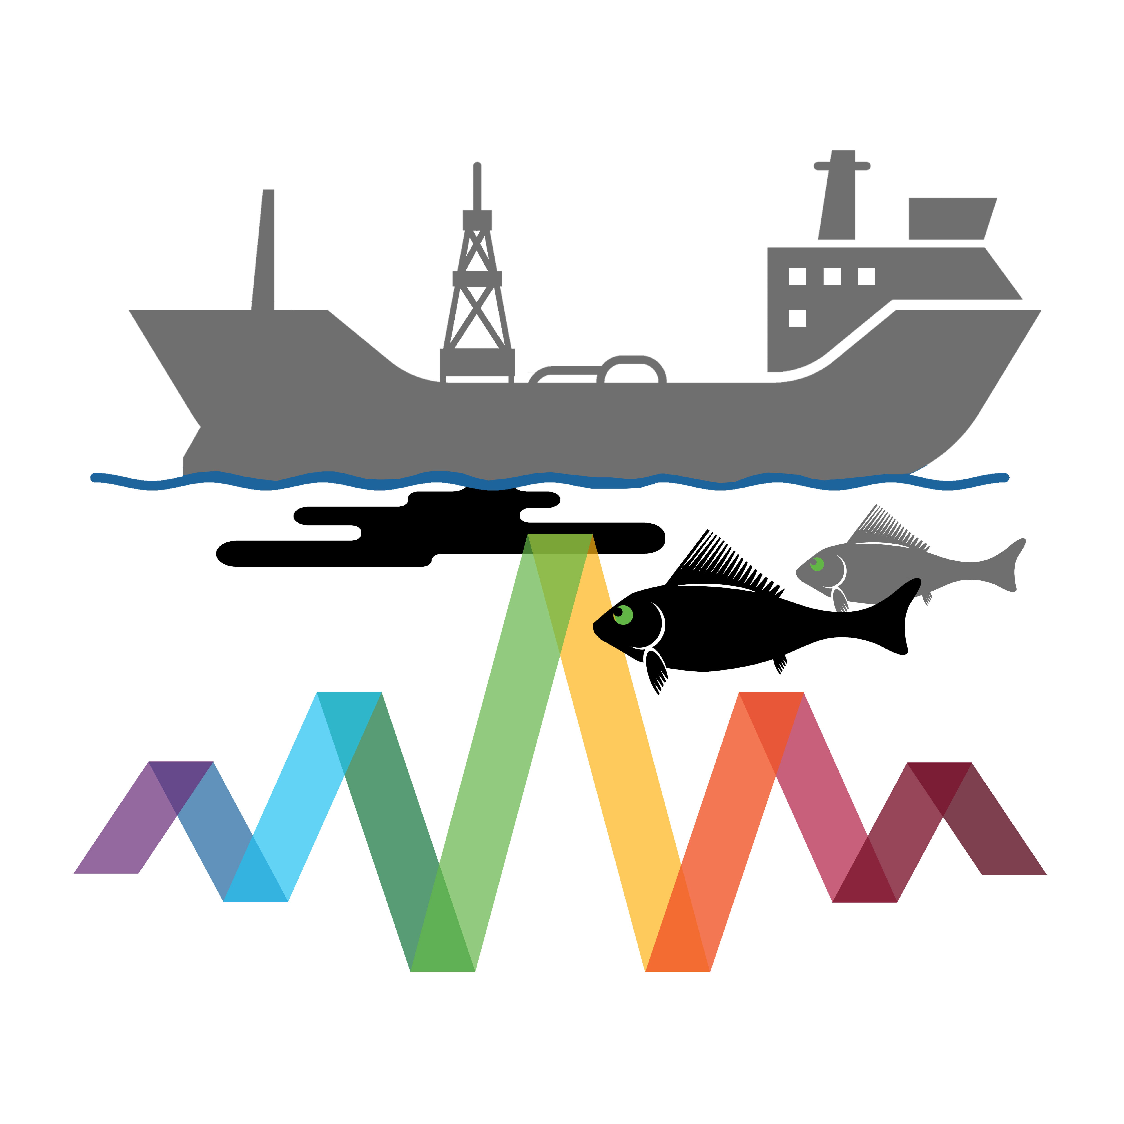

PACE Applications Program
PACE Applications Program
The goal of the PACE Applications Program is to foster new partnerships and out-of-the-box thinking that will generate inventive solutions that aid society.
Address community user needs & concerns with PACE data products
Grow relevance & sustainability of PACE
Demonstrate the societal value & utility of PACE
https://pace.oceansciences.org/applications.htm

Slide 8
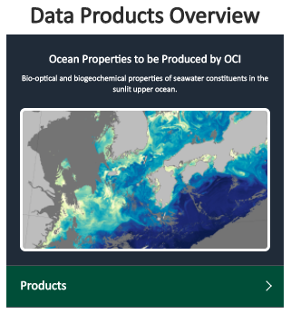
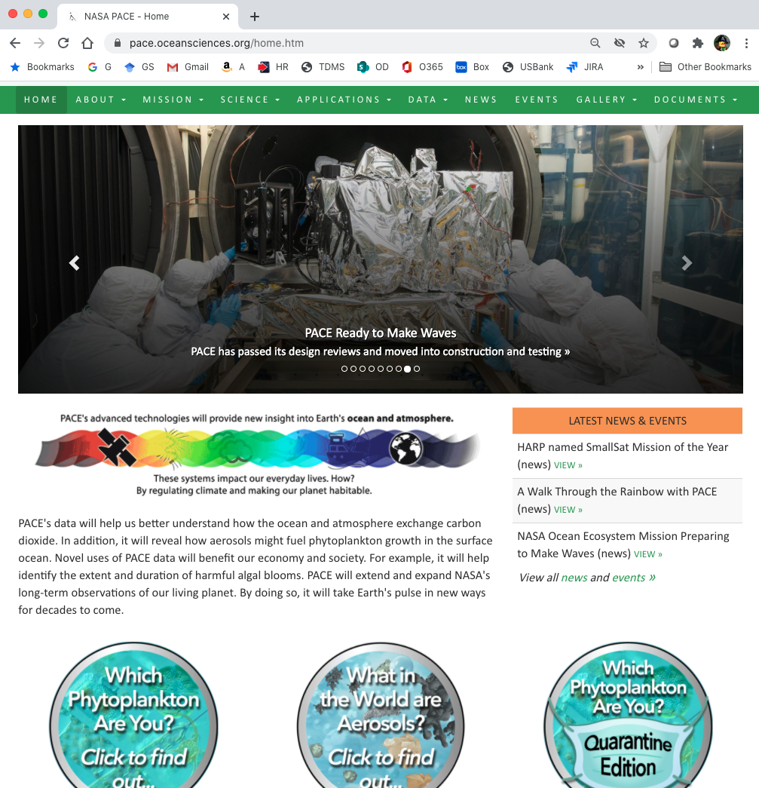
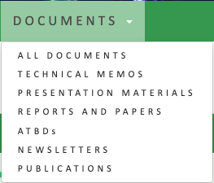
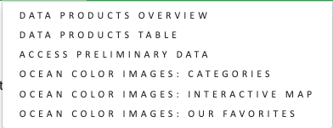
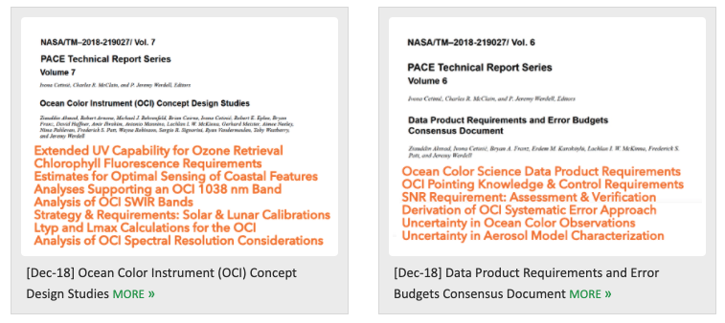



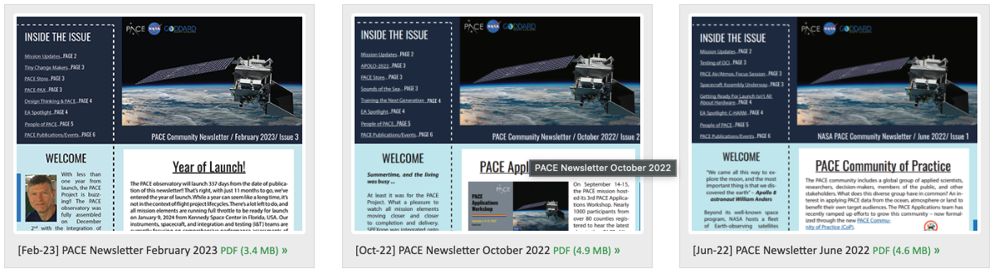
PACE Mission Resources
Data product descriptions + access to simulated data &
characterizations
PACE technical memos & other documents
PACE Community Newsletters
https://pace.gsfc.nasa.gov
@NASAOcean

Slide 9
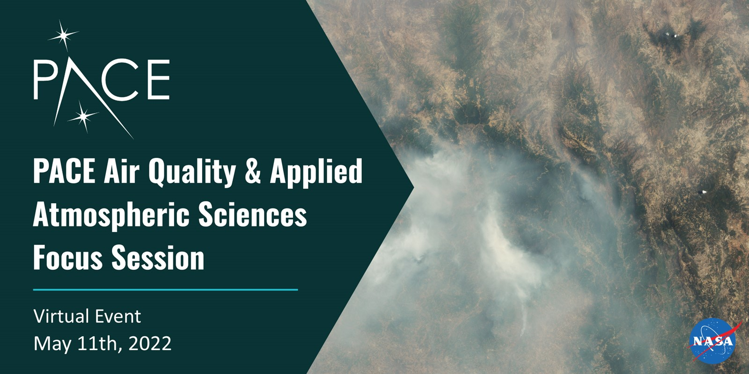



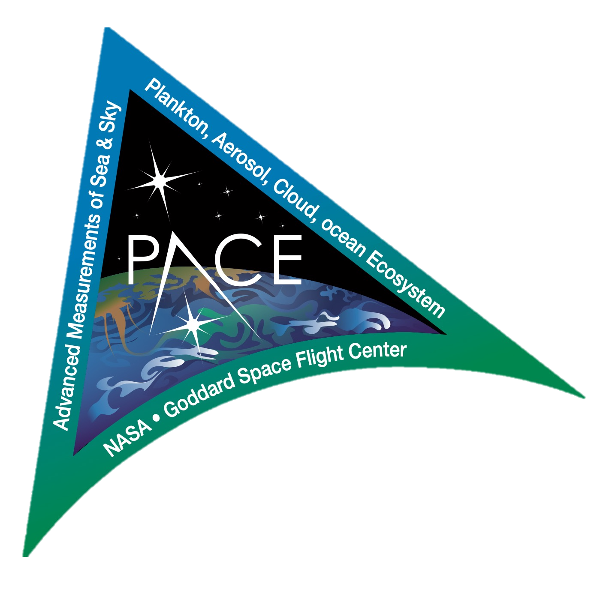


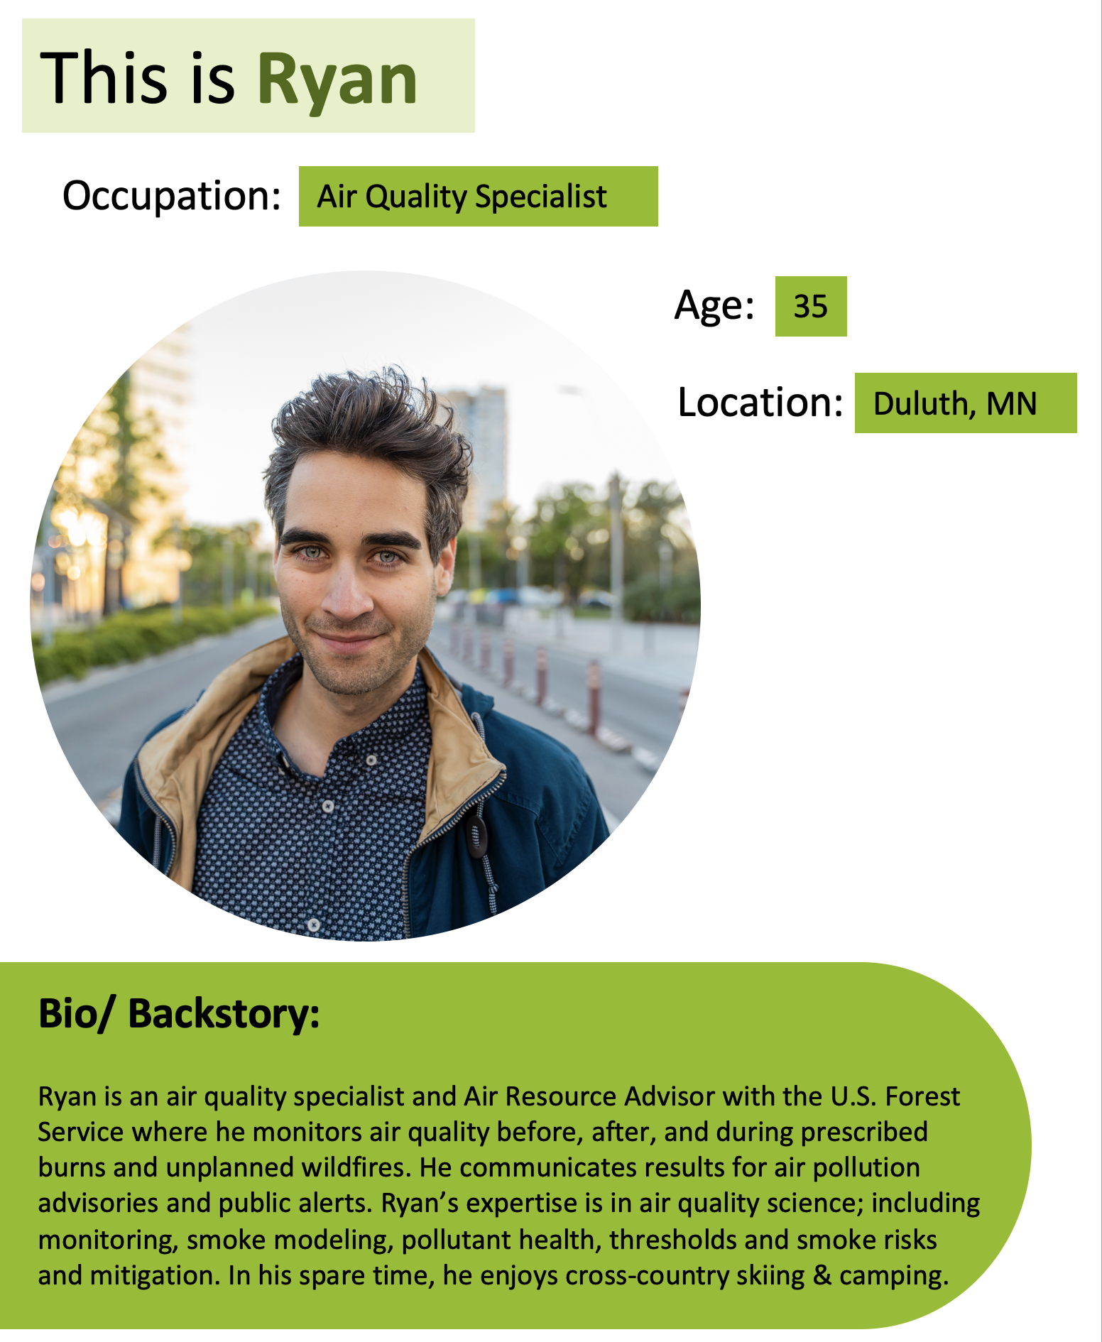
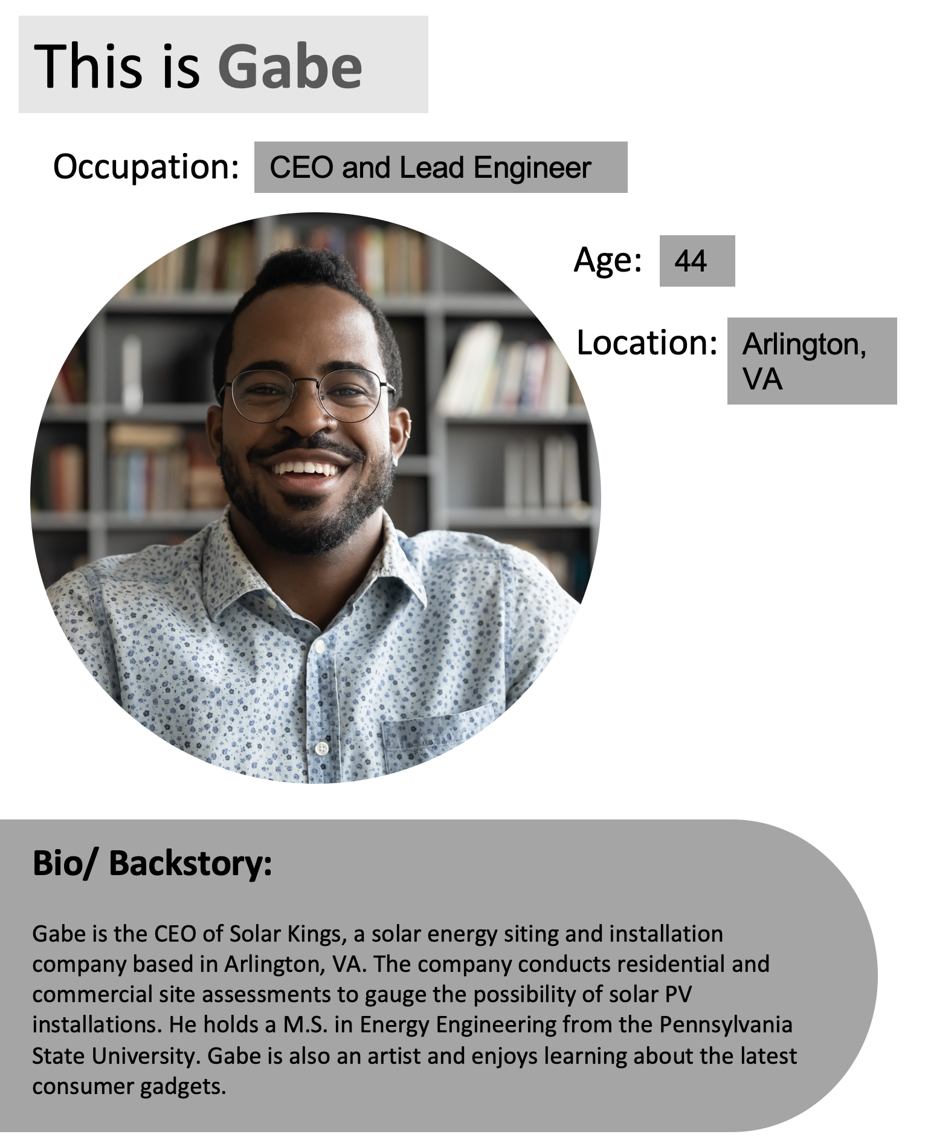
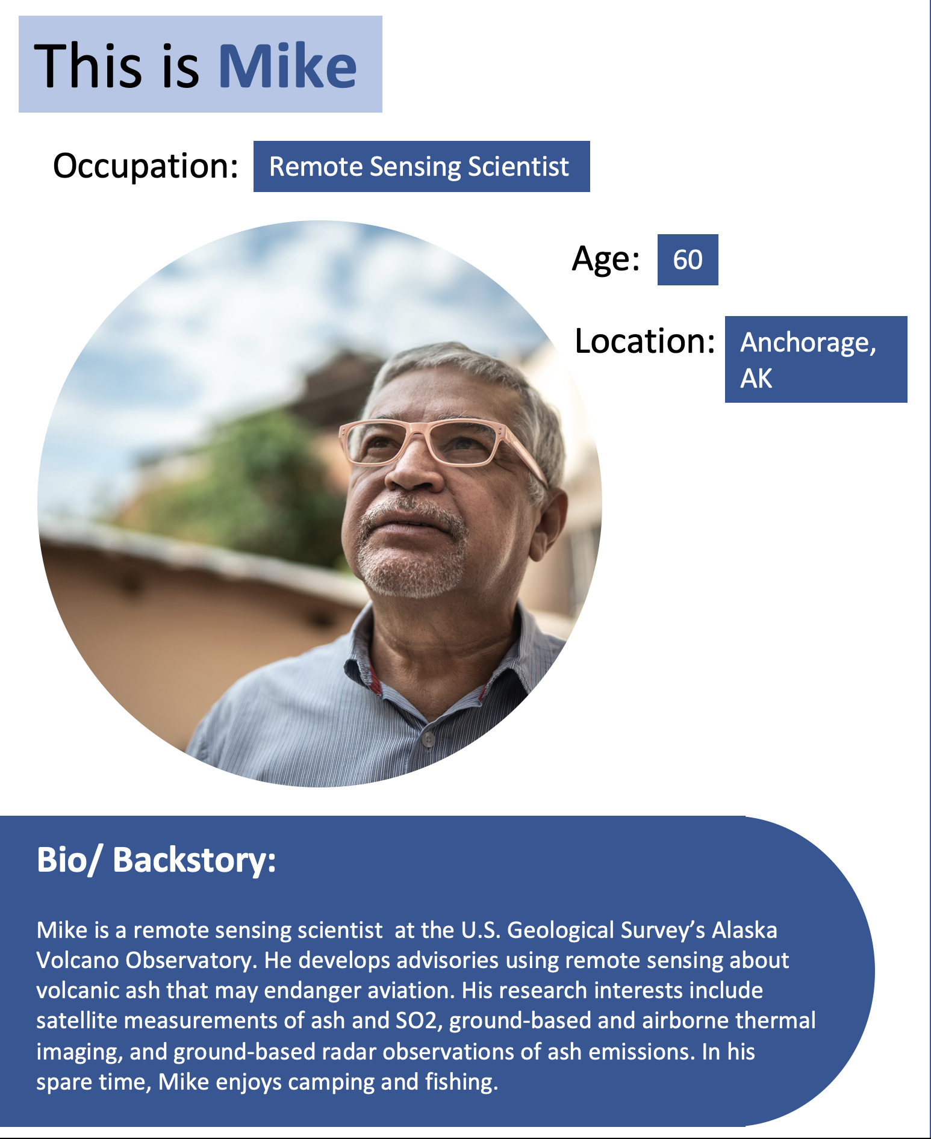
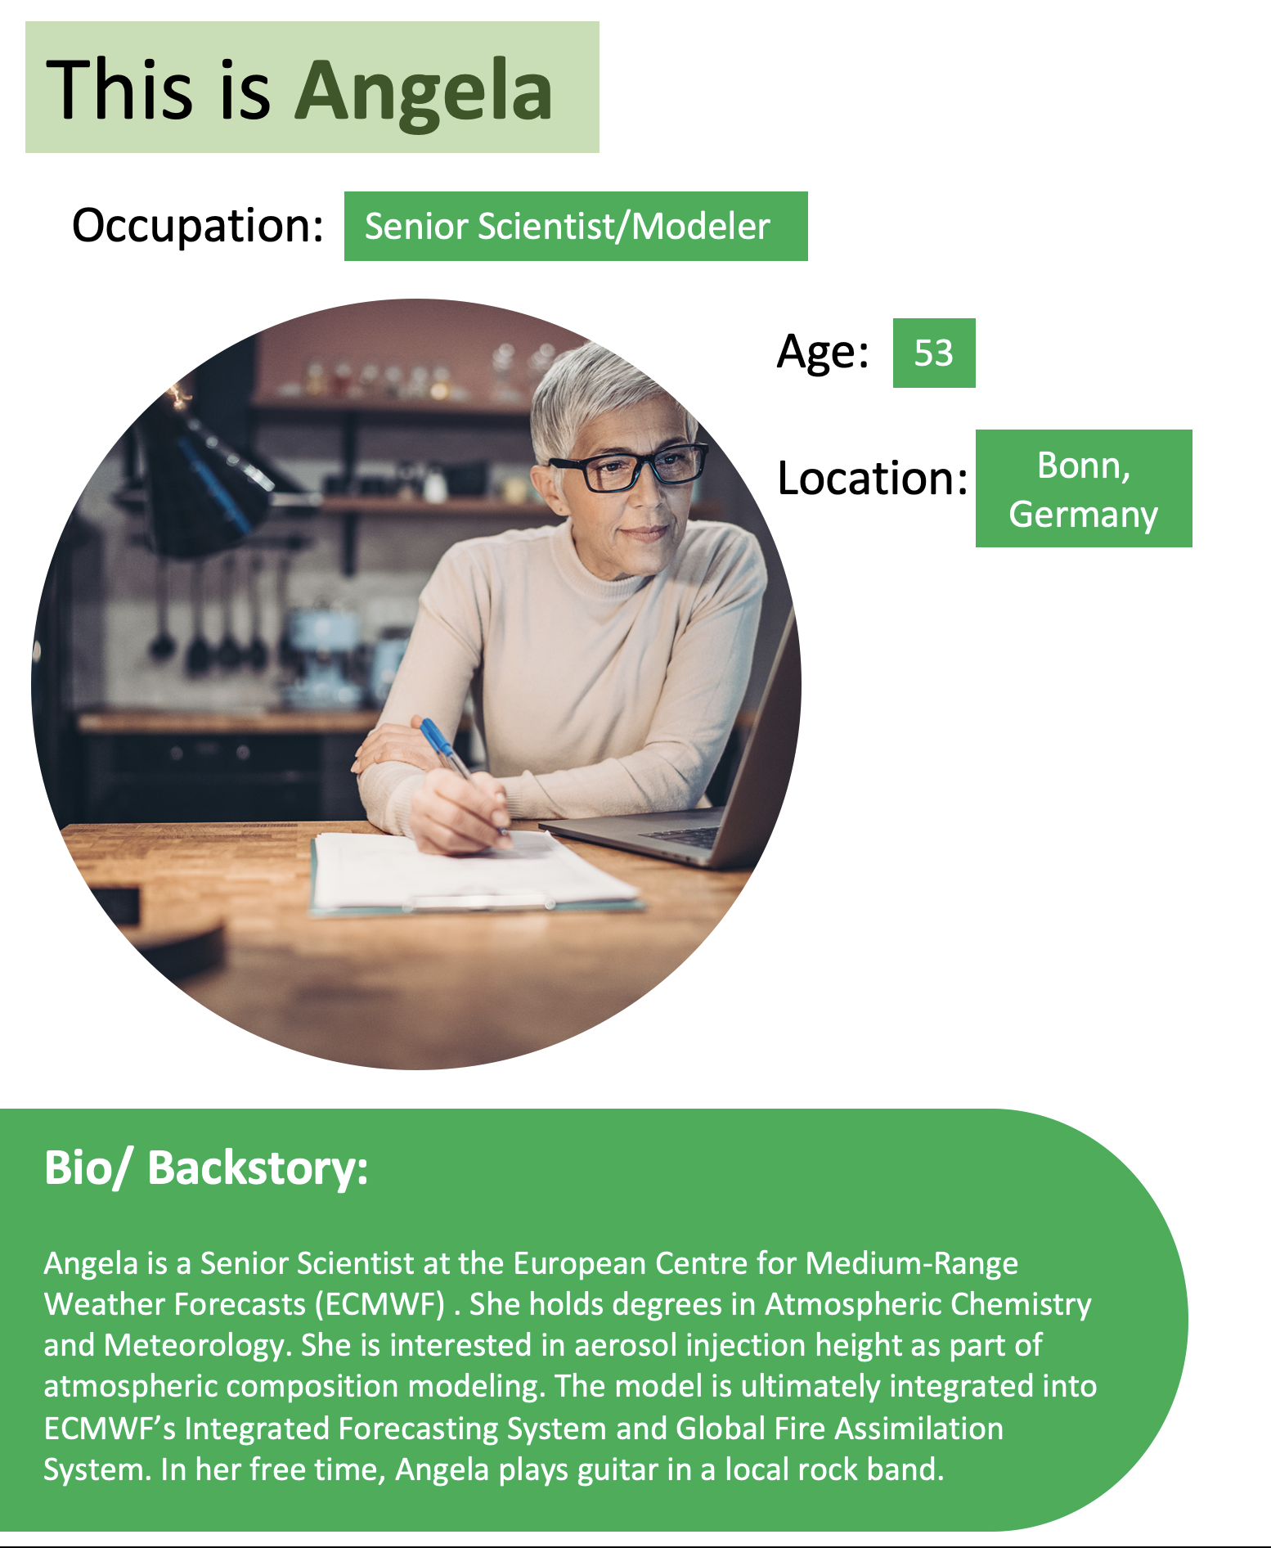
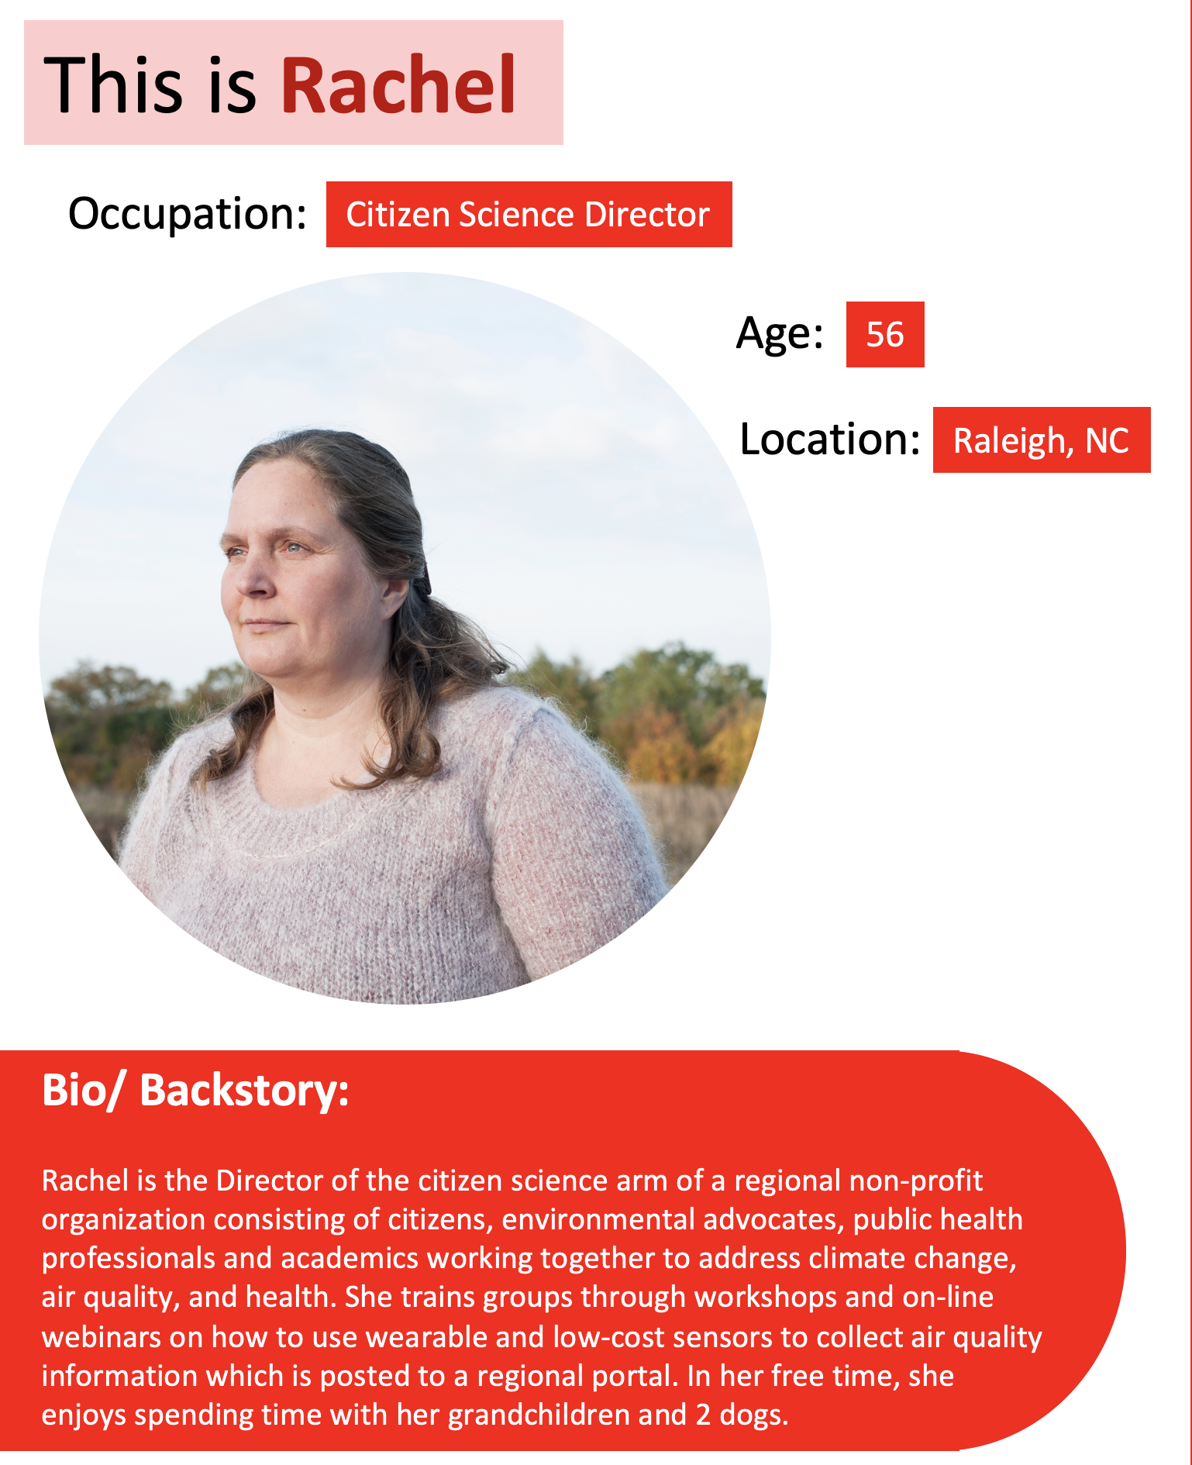
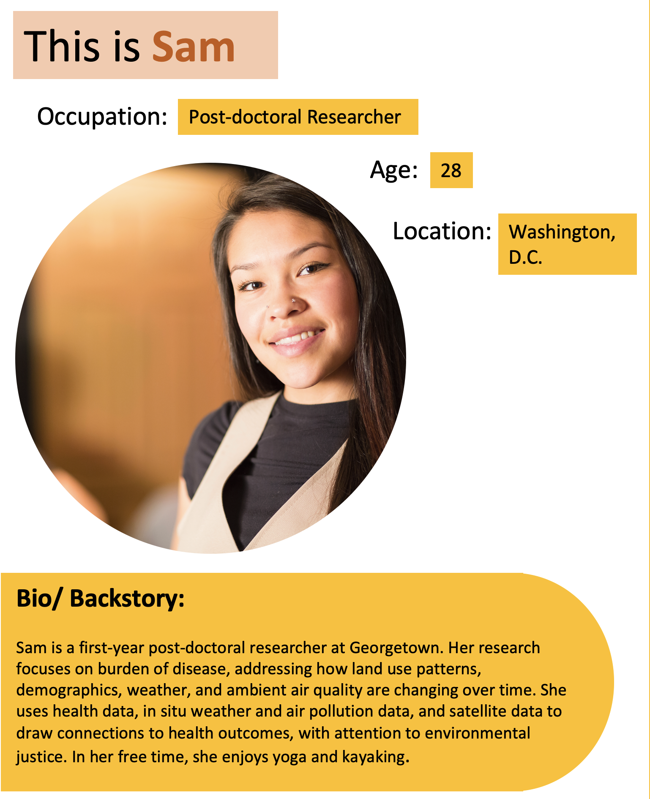
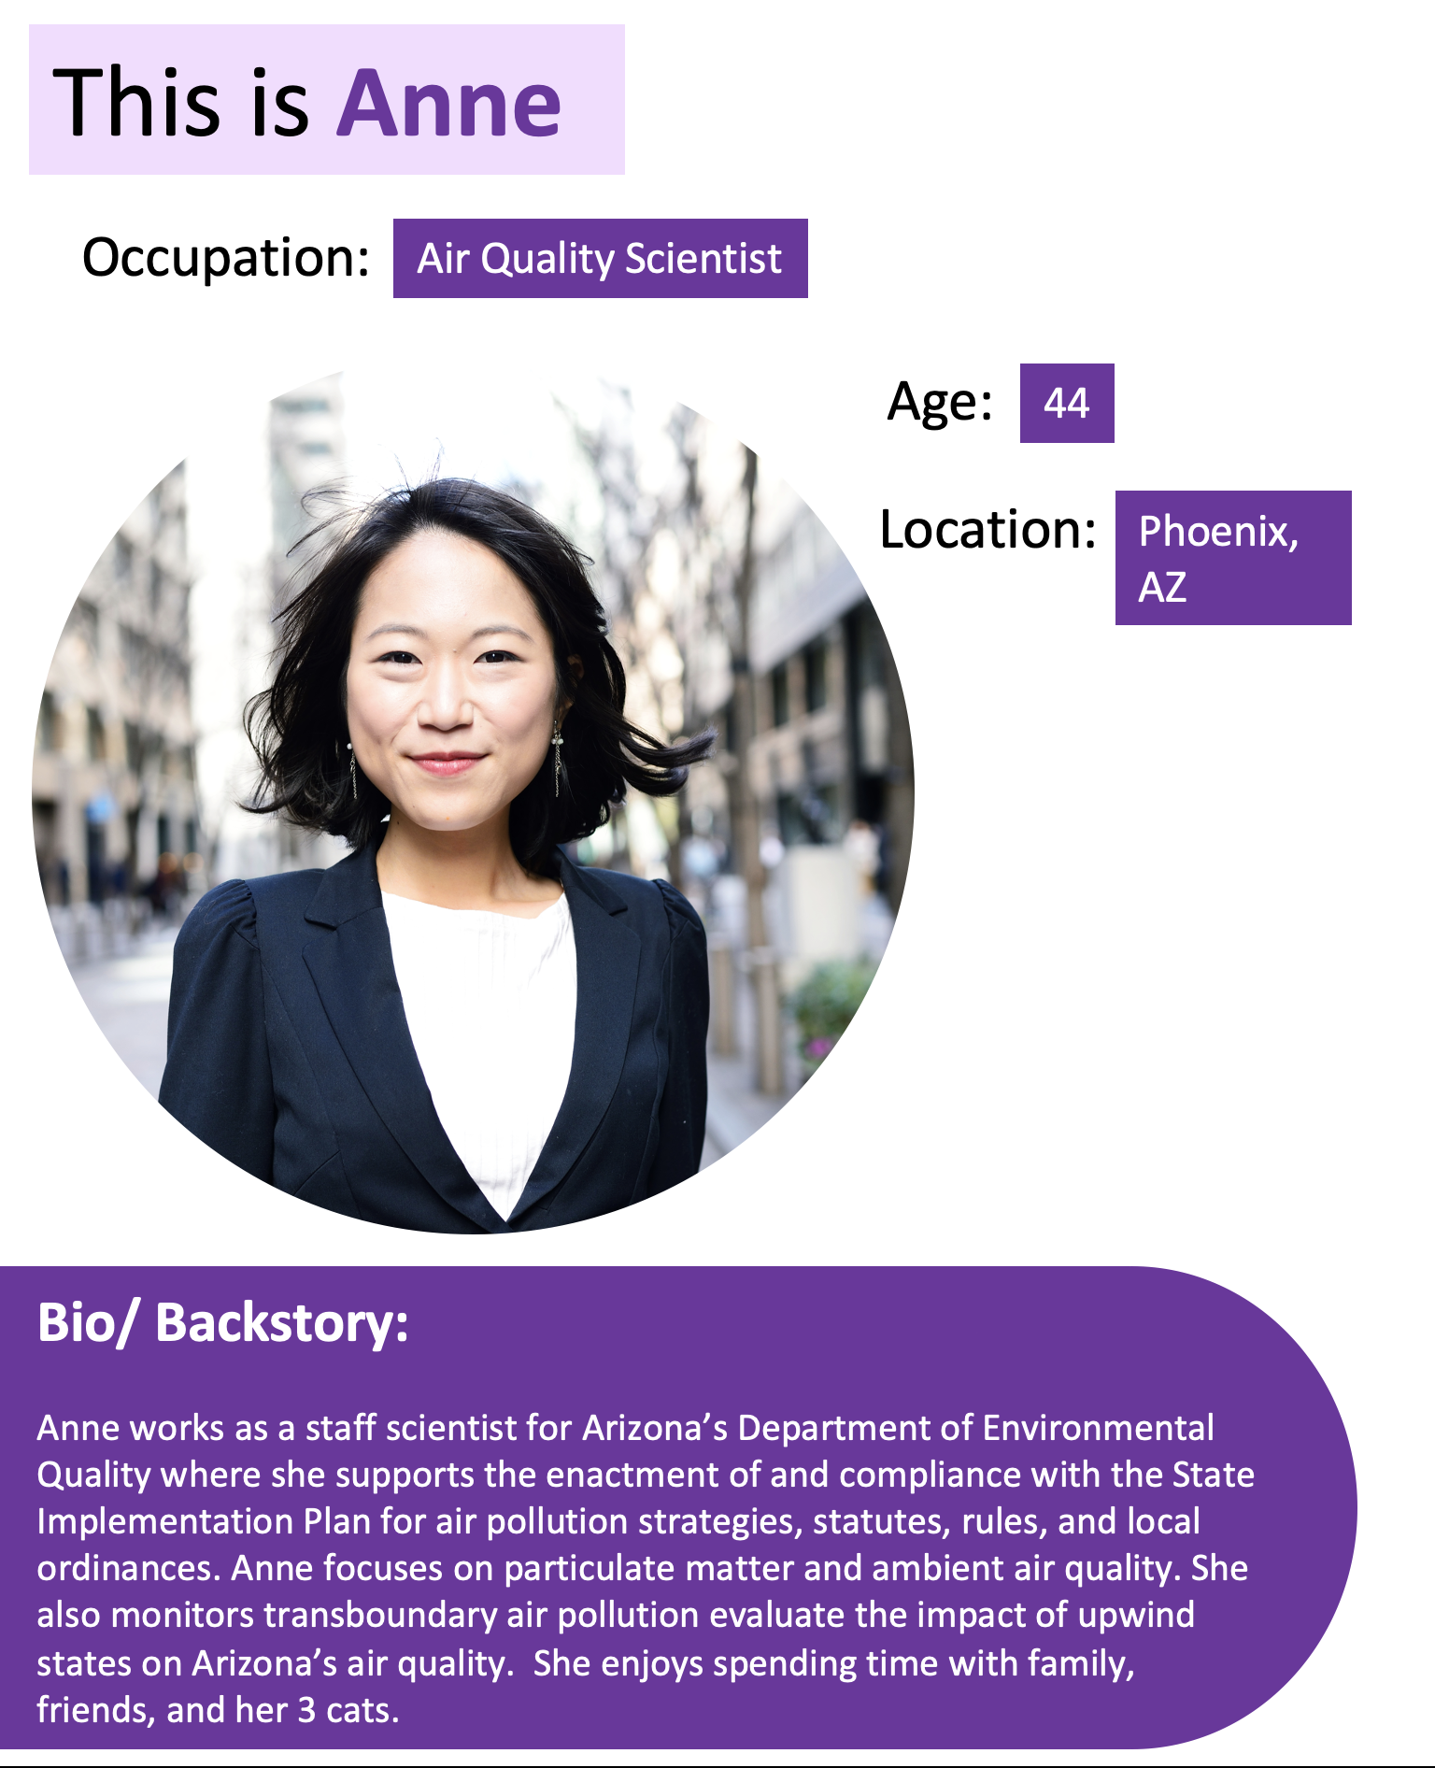
PACE Applications Program
PACE Applications Program (a year in review)
https://pace.oceansciences.org/events_more.htm?id=51

Slide 10
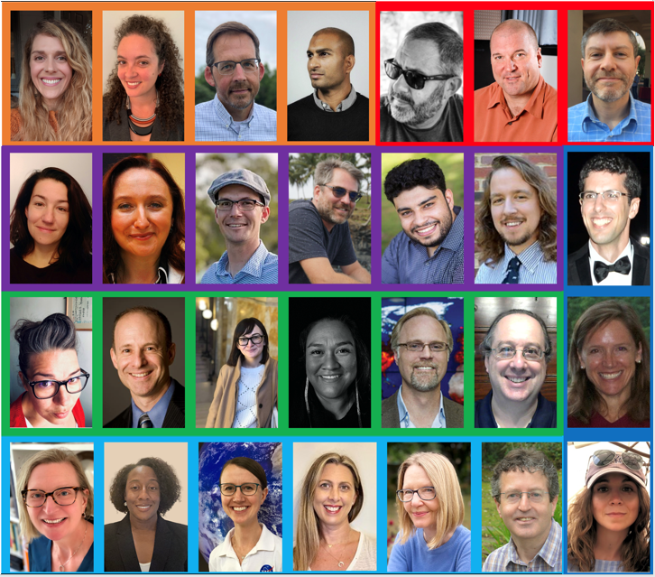
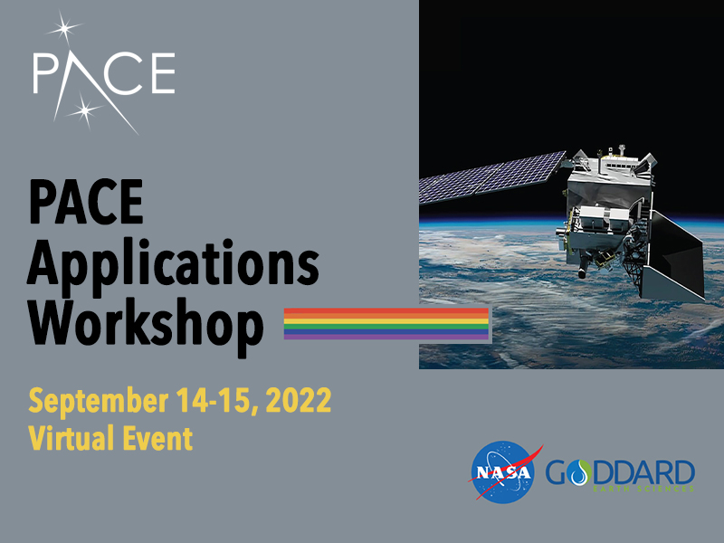



PACE Applications Program
PACE Applications Program (a year in review)
Workshop Sessions
~1000 attendees
85 countries
Advancing Applications Readiness
PACE Mission/Science
PACE Project Science Updates
Community Involvement & Co-production
Accessible & Useable Data Services/Tools
Building Synergies for Water/Disaster Sector
https://pace.oceansciences.org/events_more.htm?id=55

Slide 11
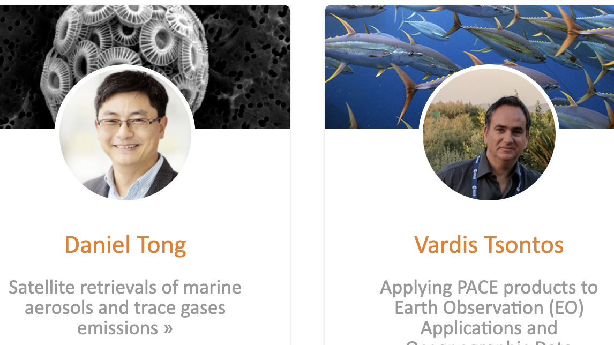

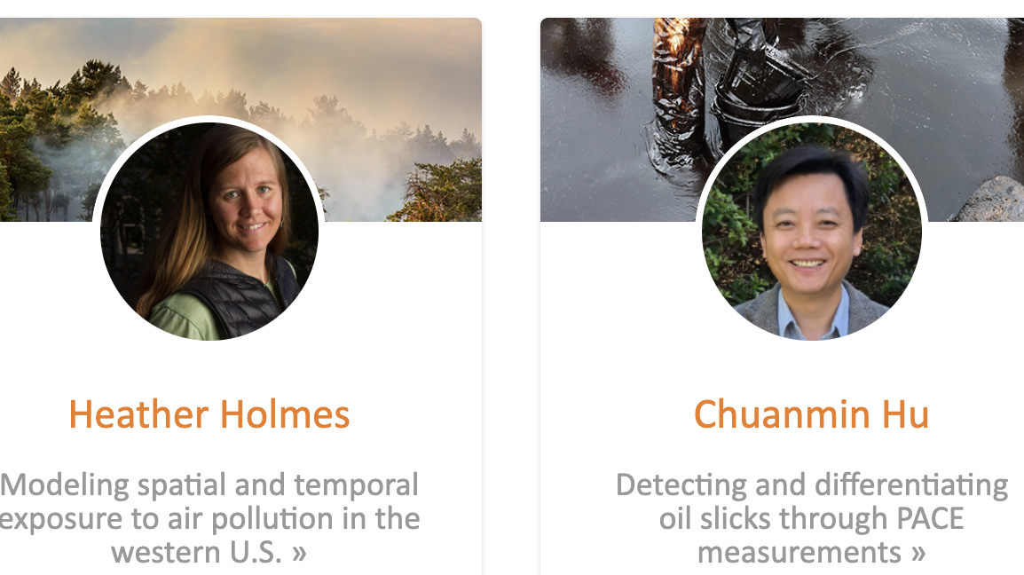
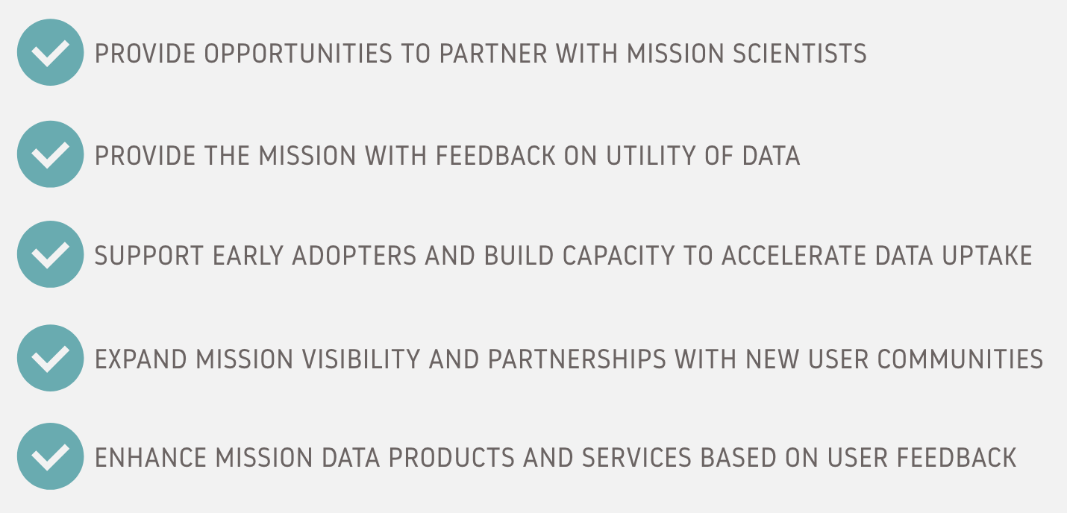
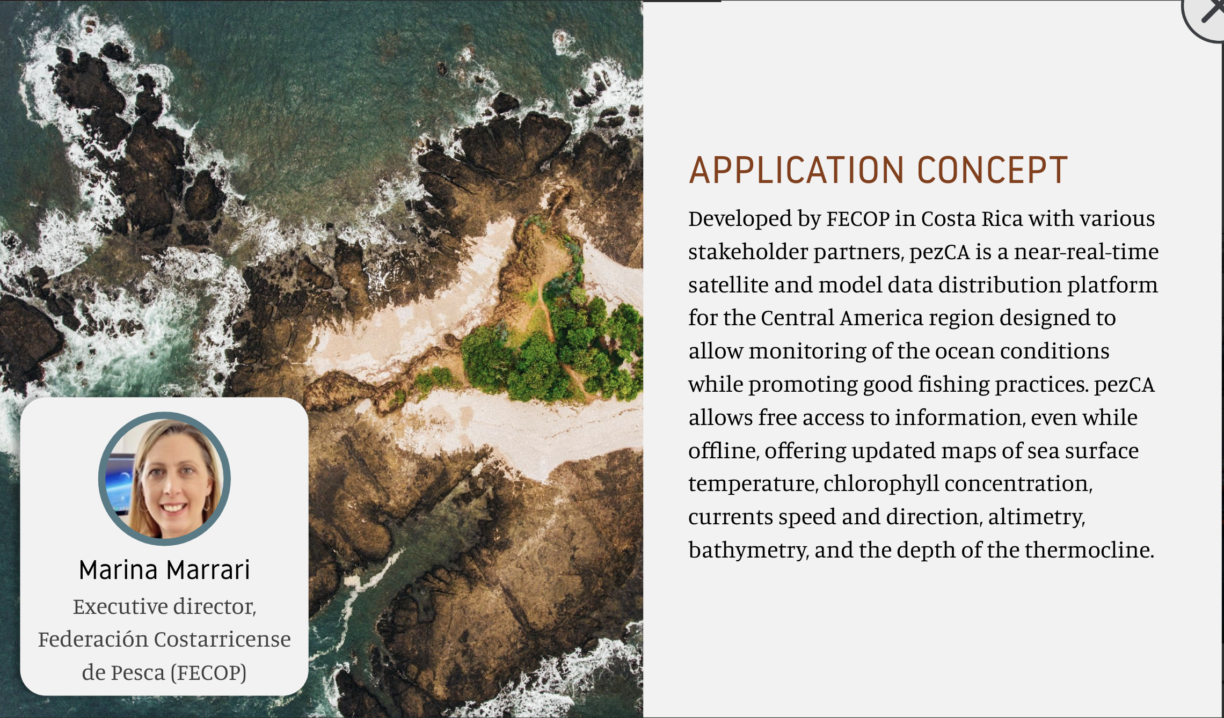
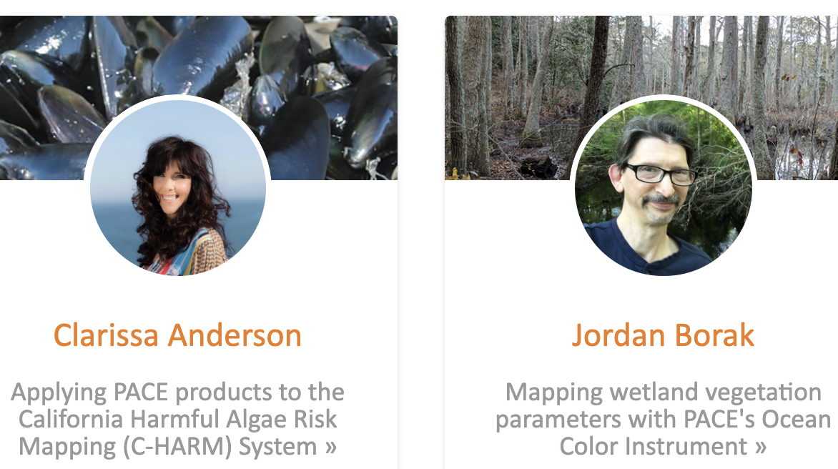
PACE Early Adopter Program
The PACE Early Adopter program promotes applied science and applications research designed to scale and integrate PACE data into policy, business, and management activities that benefit society and inform decision making.
GOALS:

Slide 12
PACE Early Adopter Program: Thematic Areas and Sectors

Slide 13
PACE Applications – Looking forward
Looking forward… year of launch!
Trainings and tutorials to prepare the PACE community for data access, analysis, and visualization with PACE data
Community conversations around thematic areas to further identify and build out innovative applications areas (and develop white papers and case study documents)
End-user engagement to continue to build out the PACE Community of Practice and prepare for the Community of Potential post-launch

Slide 14
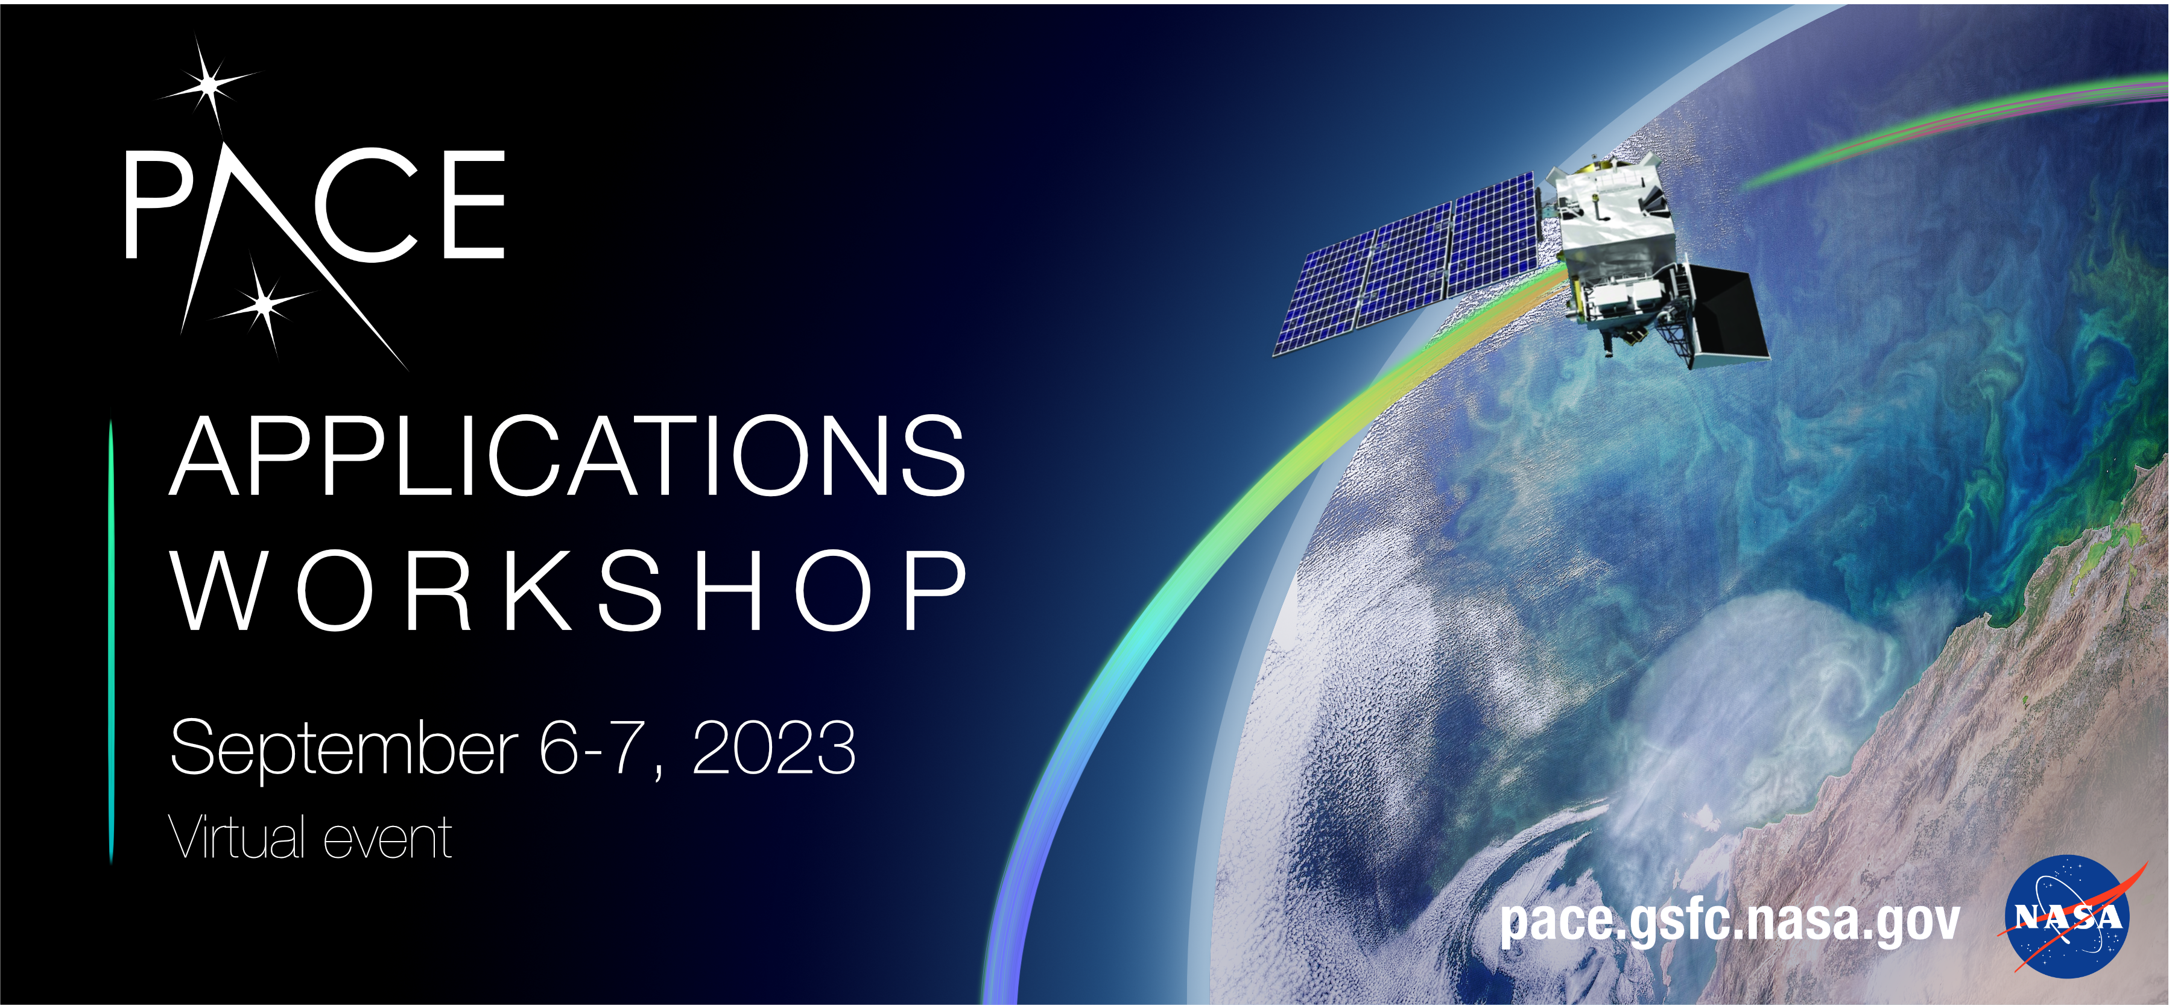

Get Involved!!
Registration opens June 6th
CONTACT the PACE Applications Team:
PACE-applications@oceancolor.gsfc.nasa.gov
https://pace.gsfc.nasa.gov

