Slide 1
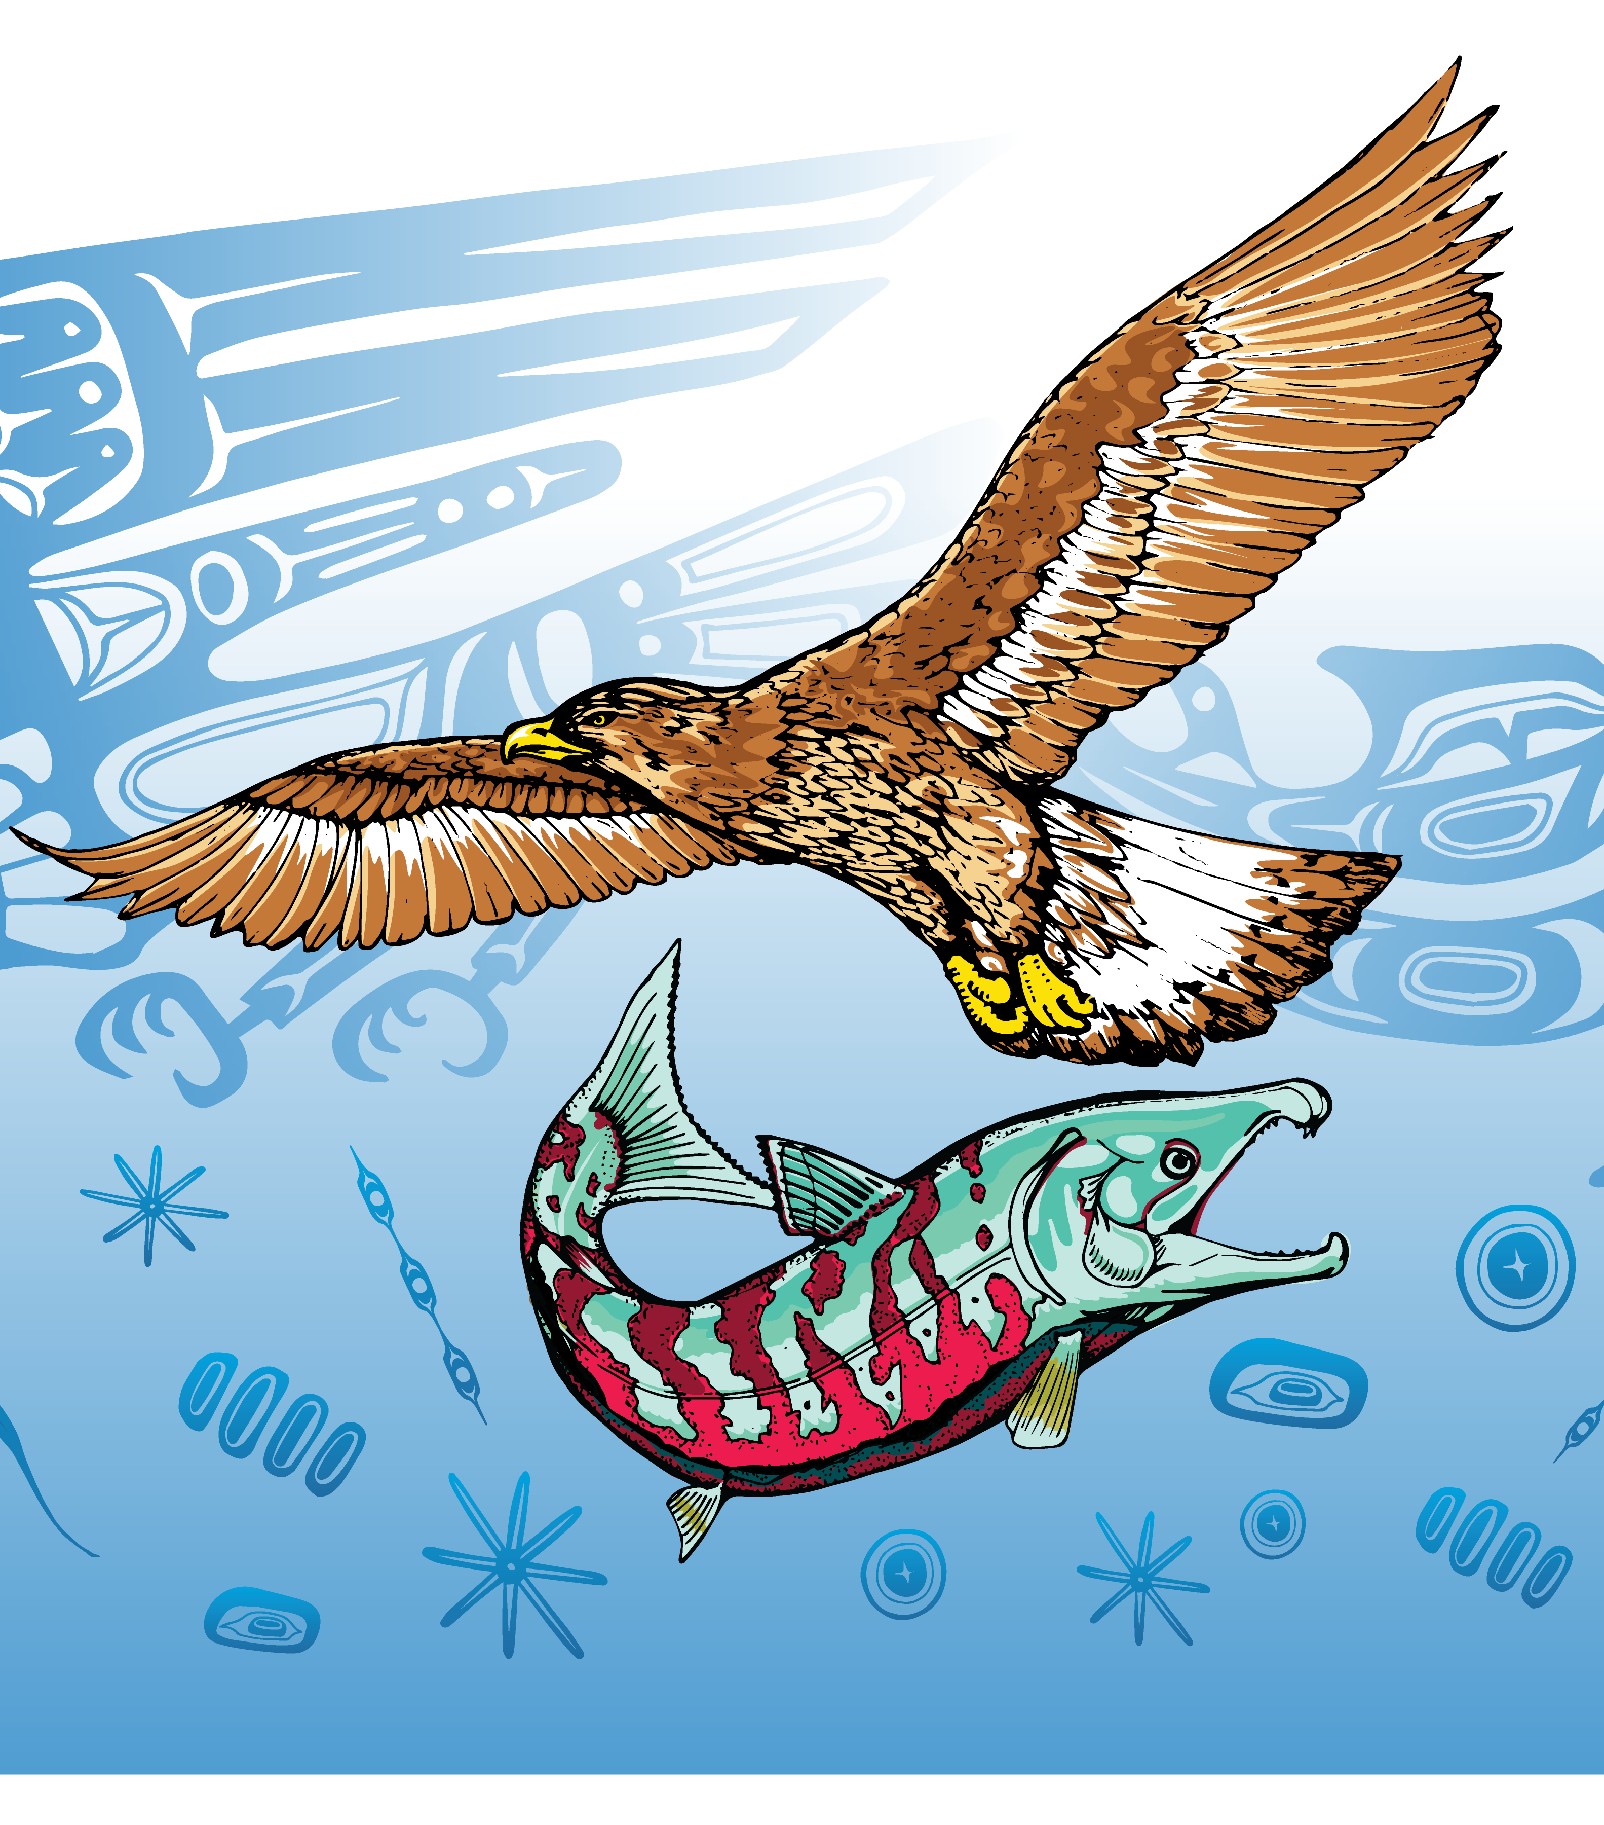
Engaging Students and Stakeholders in Predictions of Harmful Algal Blooms
Dr. Misty Peacock, Salish Sea Research Center, Northwest Indian College
Dr. Raphael Kudela, Ocean Sciences, University of California Santa Cruz
NASA OBB and MUREP Meeting
May 10th, 2023

Slide 2
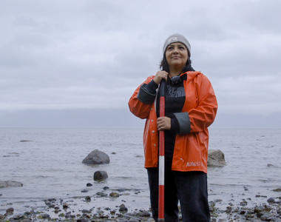
Indigenous Peoples
Indigenous peoples are inheritors and practitioners of unique cultures and ways of relating to people and the environment.
- United Nations

Slide 3
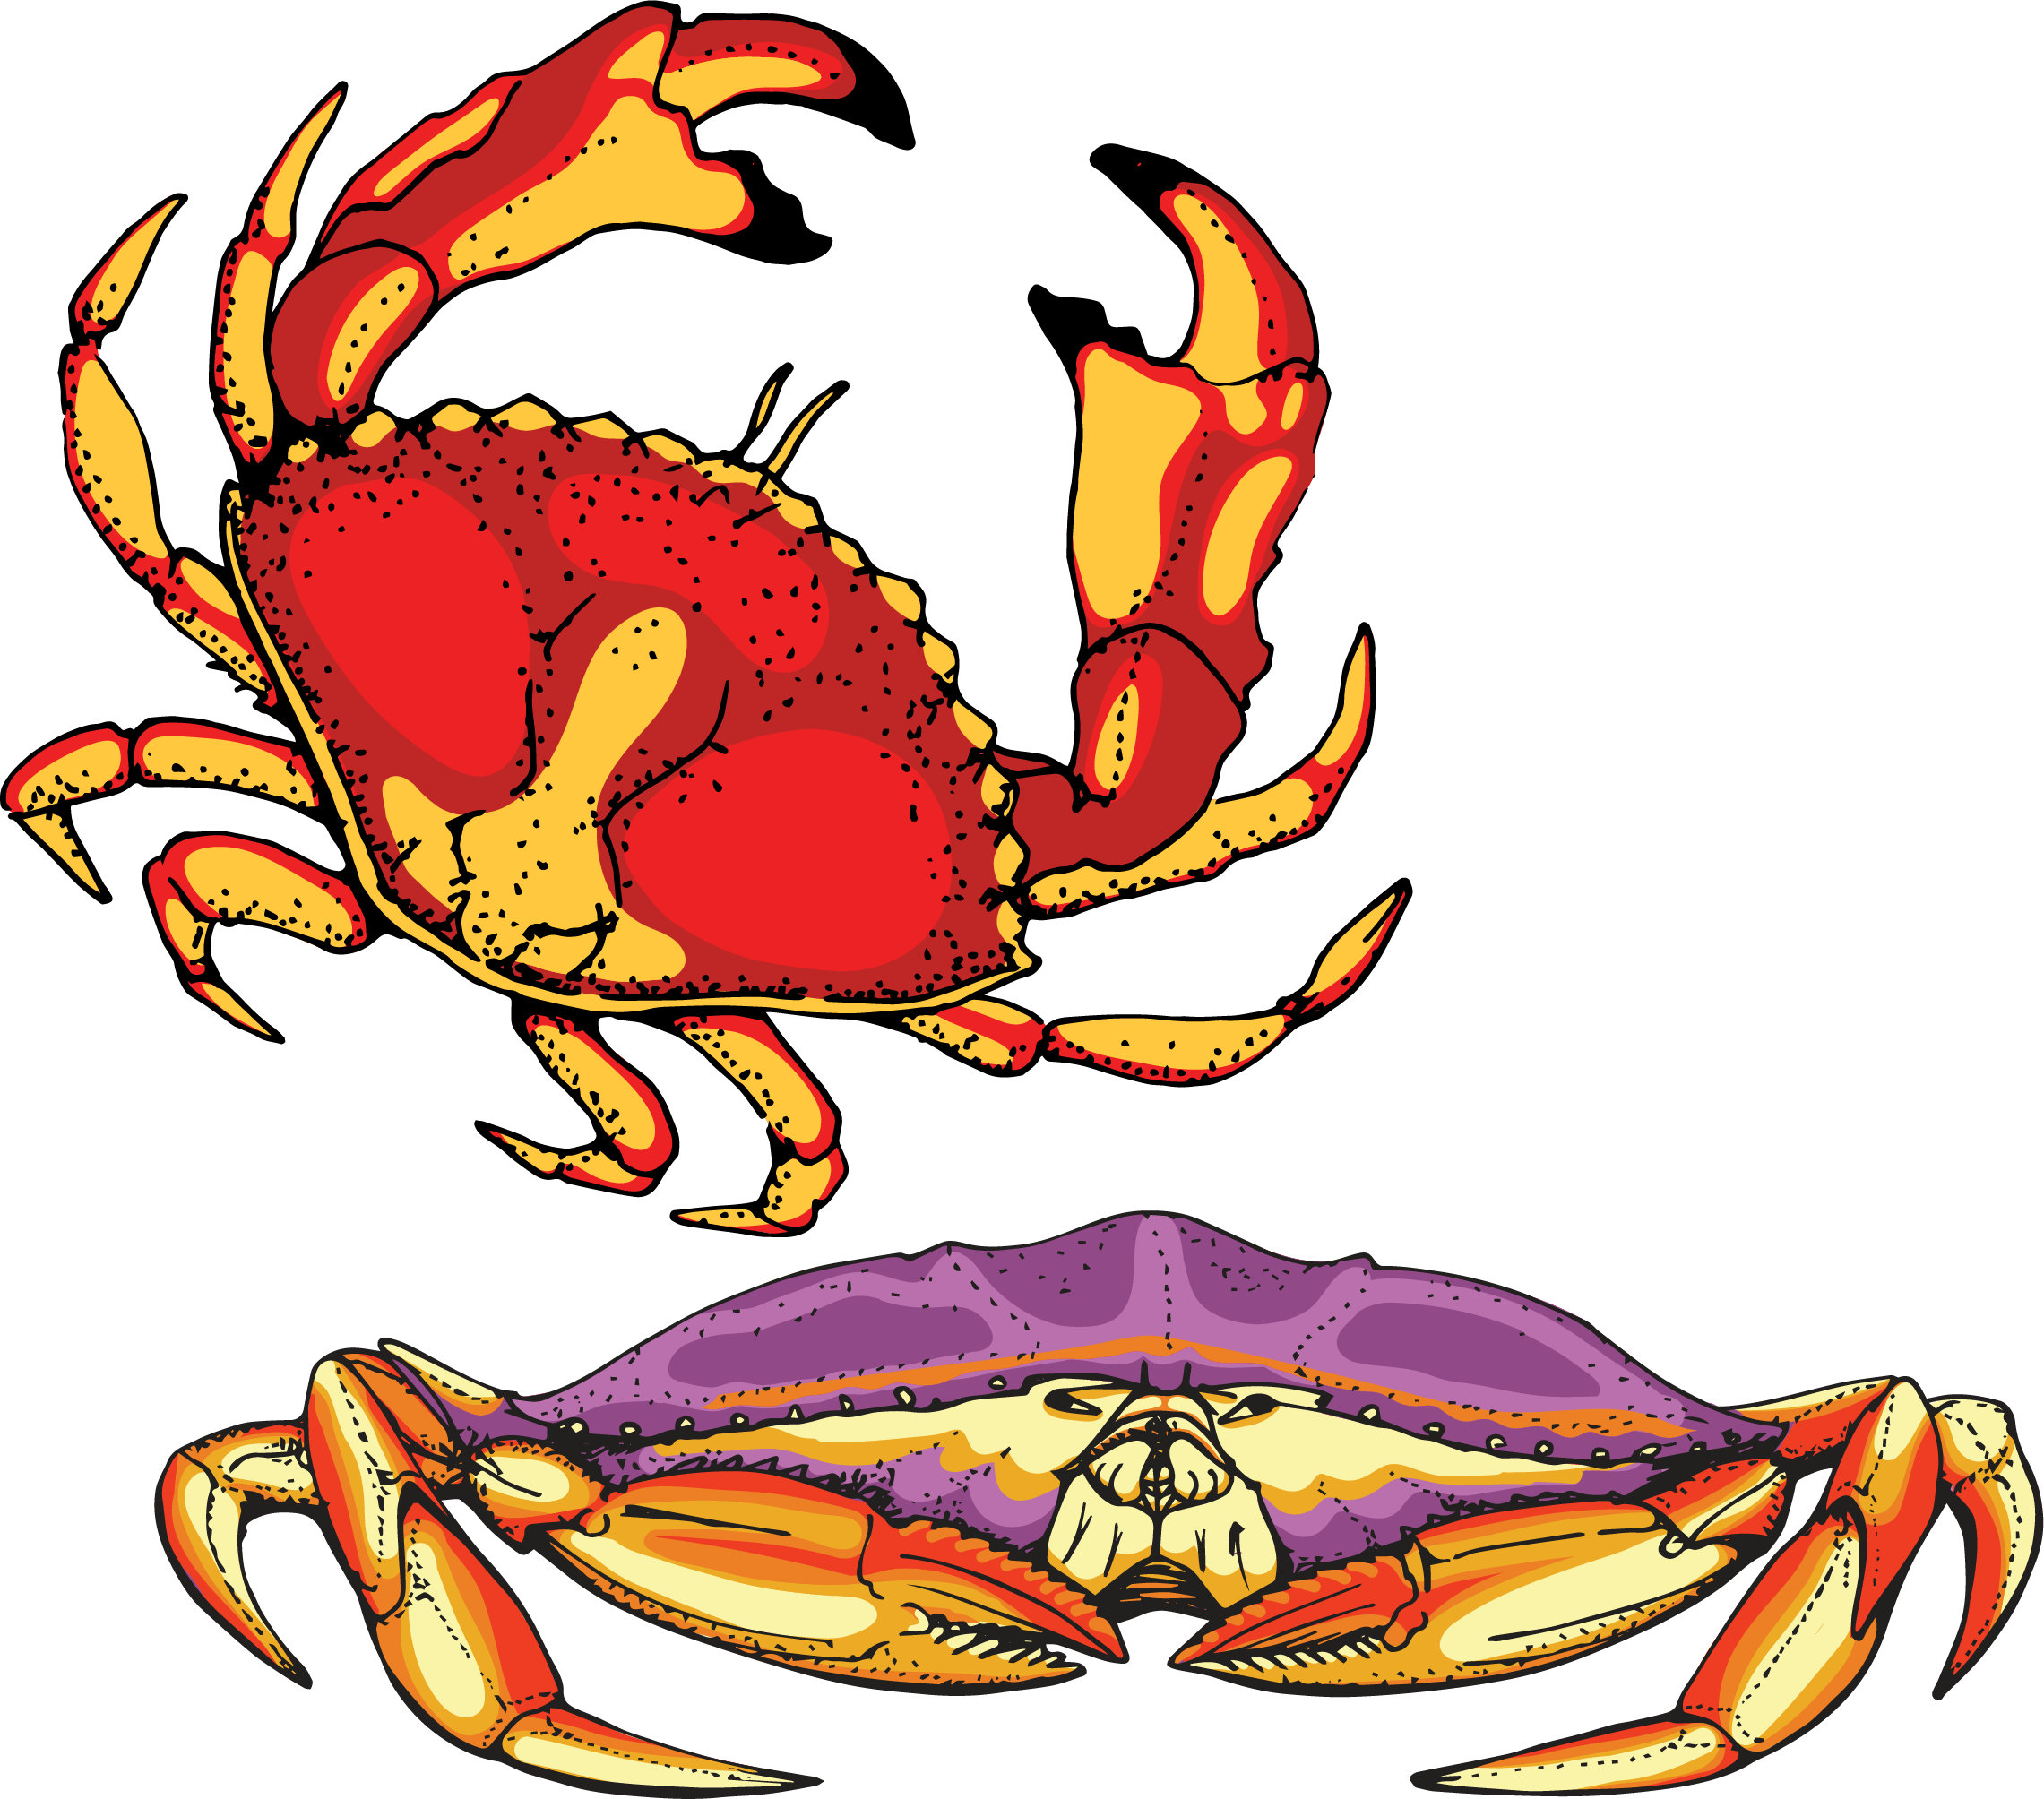
Subsistence and Commercial Harvesting
Crabs and clams are the most lucrative economic harvests
Tribal nations rely on a combination of Traditional Ecological Knowledge (TEK) and real-time monitoring to guide shellfish and crab harvests
Complex economic and cultural impacts when harvests are delayed or closed
Subsistence harvests are a way to engage in ones’ culture and practice sovereignty

Slide 4
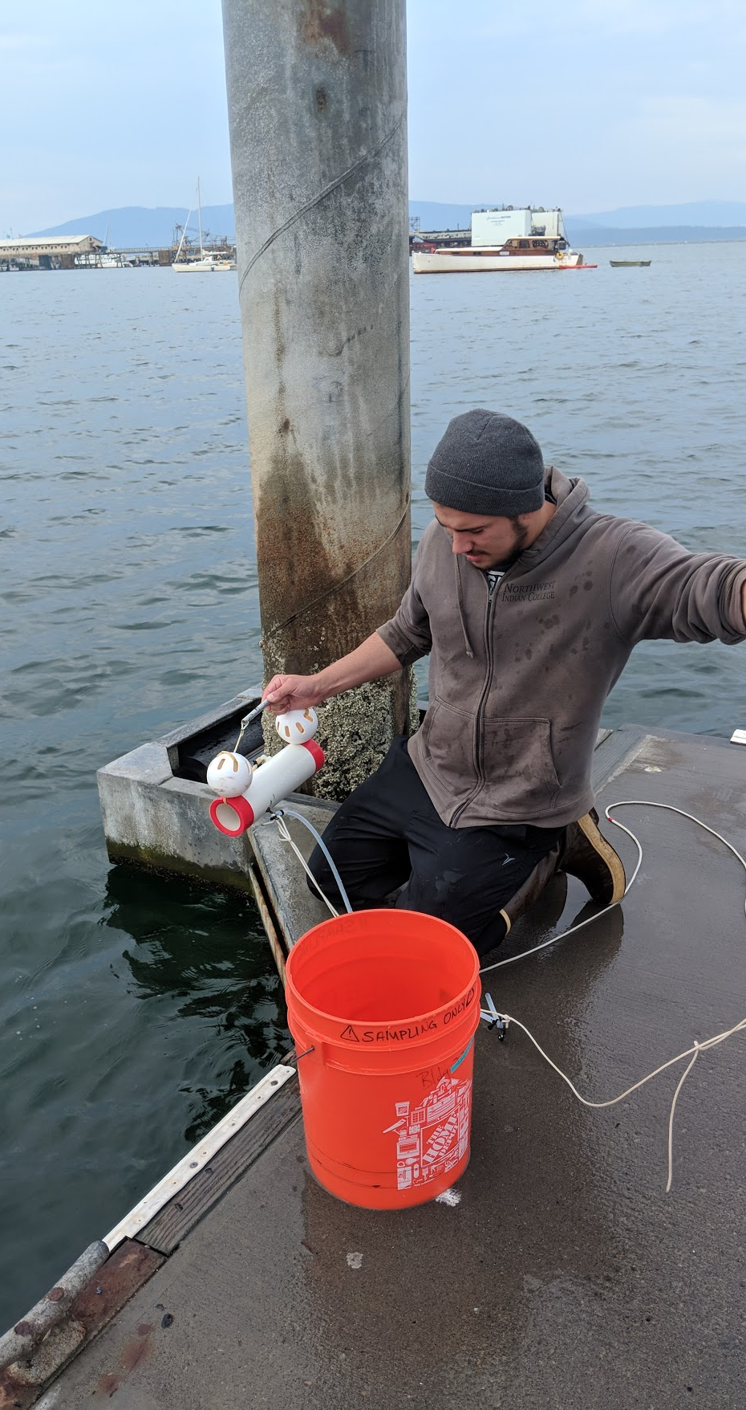
Approach Stakeholders for Shared Projects
Science: concern of emergent harmful algae and biotoxins in the Salish Sea, monitoring for climate change, domoic acid and Dungeness crab
Management and Policy: safe seafood for the community, preparing for the future
Cultural: tribal nation’s ability to practice sovereignty and make policy decisions

Slide 5
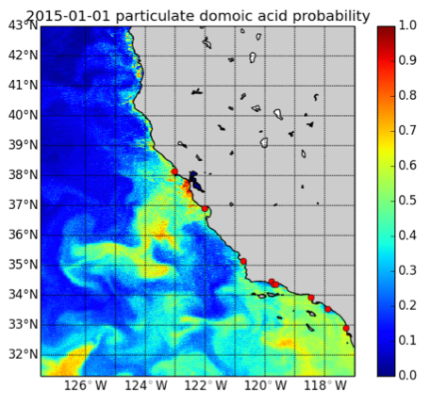
Practice Science that Serves Community Wants
California Harmful Algae Risk Mapping System (C-HARM)
Used by community crabbers, fishers, marine mammal centers, boaters, and kayakers
Accessible to the public
Interactive data portal

Slide 6
Lessons Learned from the Operational C-HARM model in California
• Transitioning ocean color sensors (MODIS to VIIRS) introduces some differences in model output
• The West Coast Ocean Forecasting System (WCOFS) has biased salinity, which influences model performance for prediction of particulate domoic acid
• C-HARM is very good to excellent in California, but the northern California Current System (CCS) has different responses, so a one-size-fits-all model is not optimal

Slide 7
Our Approach:
Initial focus is on pDA (we have a dataset of >5000 in situ observations for the PNW)—will follow on with cellular DA and cell abundance, but much more limited data tuning the generalized linear models for the PNW (ongoing effort)
Switch to OC-CCI for ocean color products, while evaluating high-resolution (OLCI 300m) for near-coast and bays
Develop predictions for hindcast and nowcast that don’t rely on numerical ocean models (purely remote sensing product)
Very much a work in progress!

Slide 8
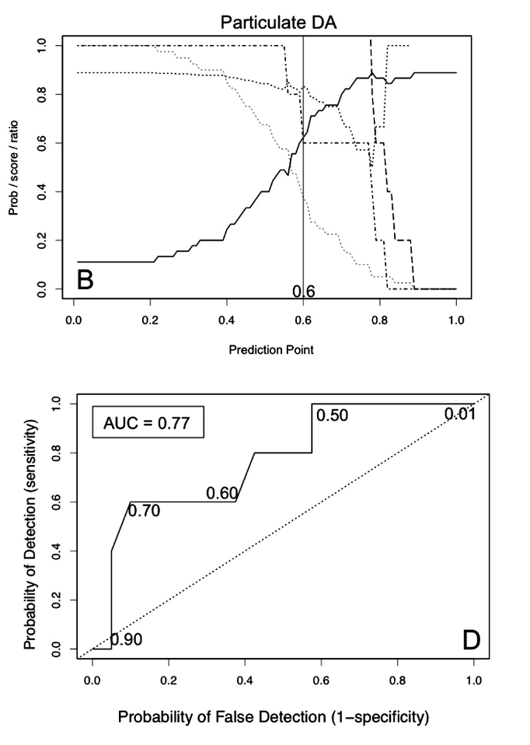
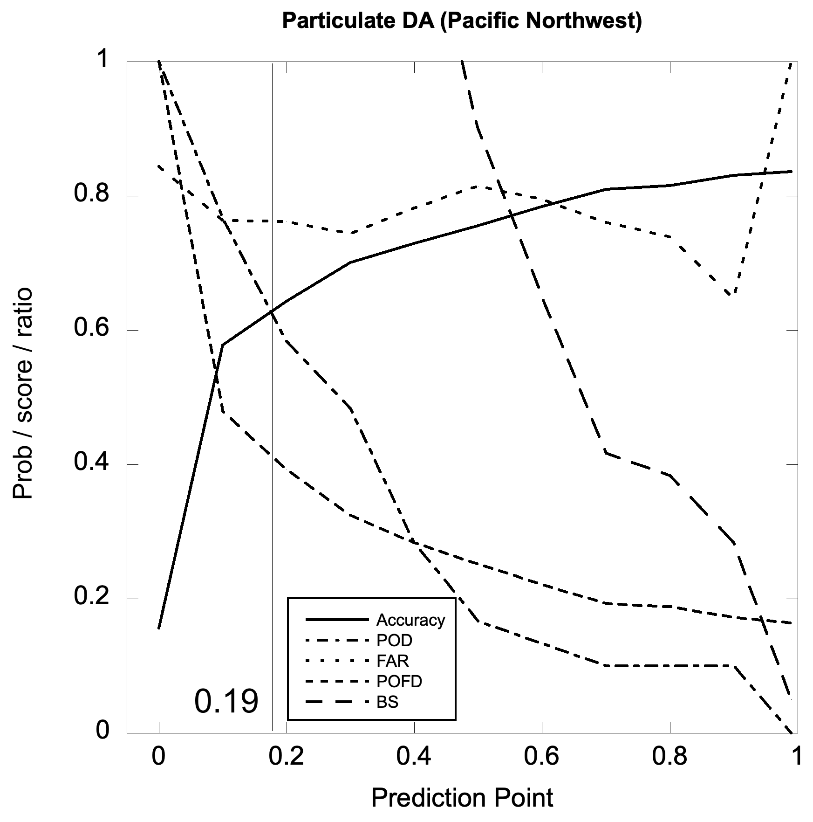
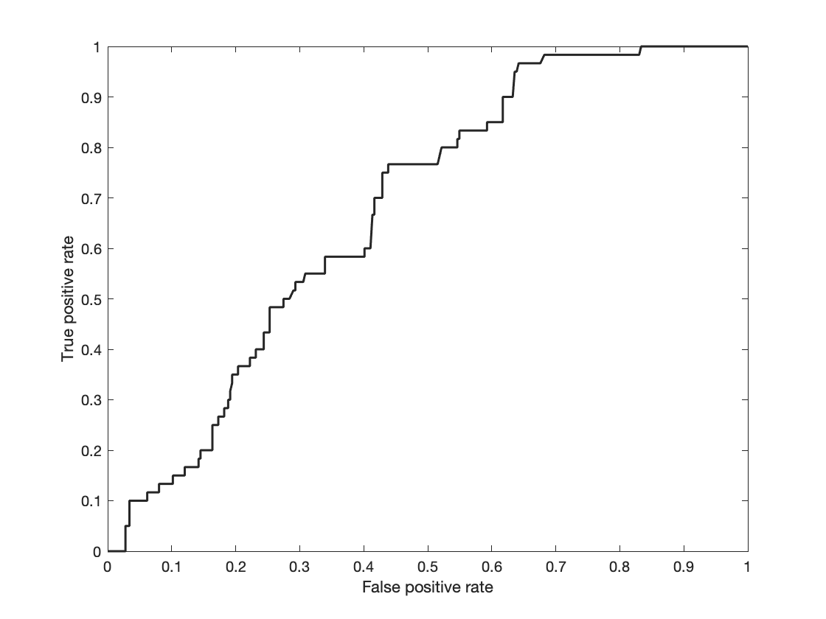
CA C-HARM MODEL
APPLIED TO PNW
Anderson et al. 2016 doi: 10.1016/j.hal.2016.08.006
AUC=0.6761

Slide 9
CA C-HARM MODEL
APPLIED TO PNW
CA-C-HARM has skill, but the prediction point is substantially different, suggesting retuning would improve performance
Anderson et al. 2016 doi: 10.1016/j.hal.2016.08.006
AUC=0.6761

Slide 10
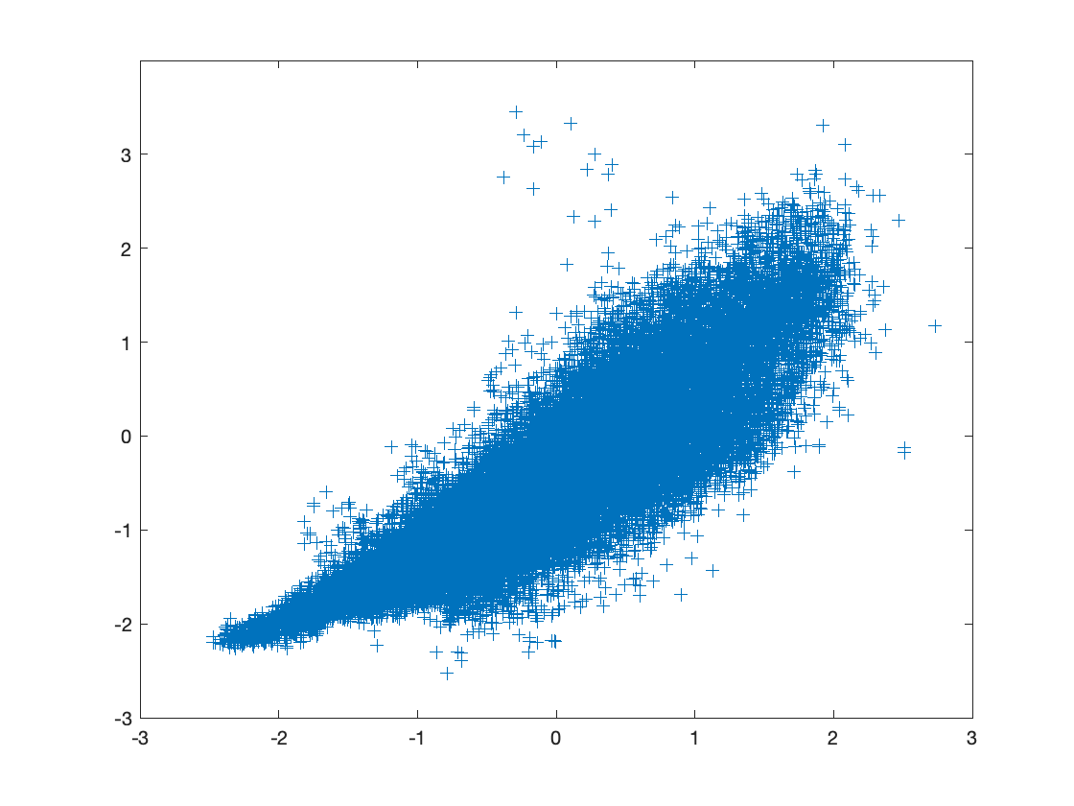
December 2022 (8-day)
Switching to OC-CCI provides more consistent ocean color data (and better cloud removal) and is more platform-independent than using any one satellite
OC-CCI
VIIRS
Matched Chla retrievals, 2022
VIIRS
OC-CCI

Slide 11
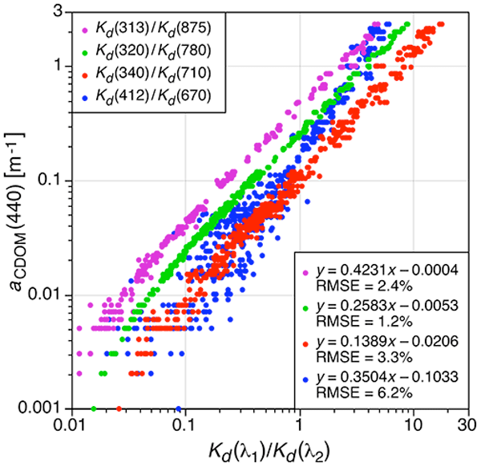
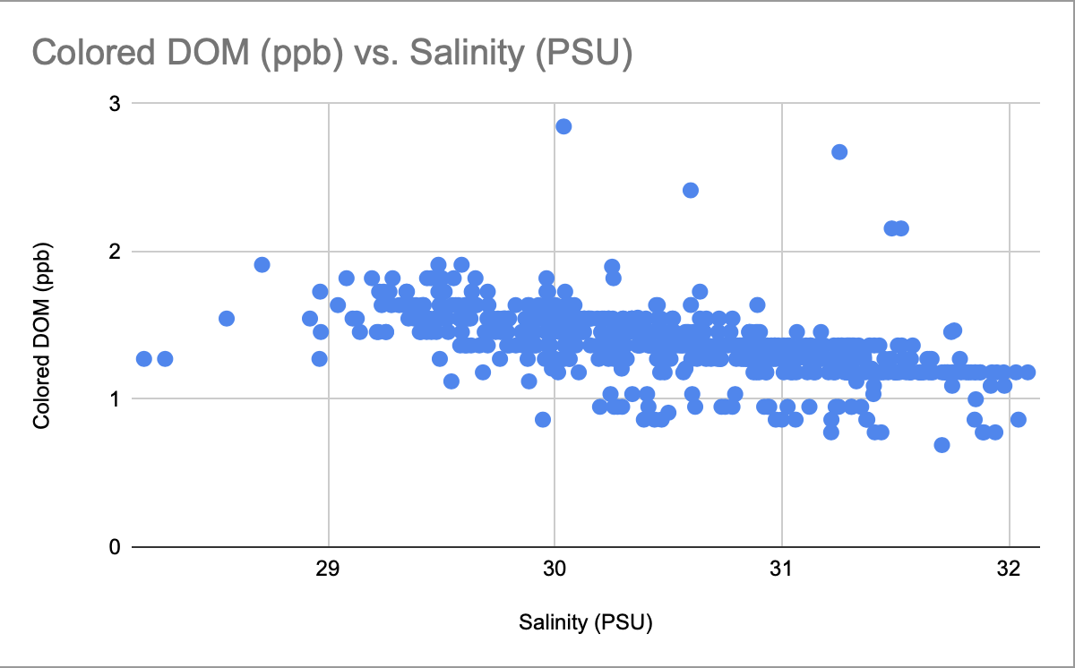
There is a good relationship between CDOM and salinity: could replace model salinity with remote sensing data based on Palacios et al. 2009, Hooker et al. 2020
6 months of data from OOI for coastal Washington
https://doi.org/10.5194/bg-17-475-2020

Slide 12
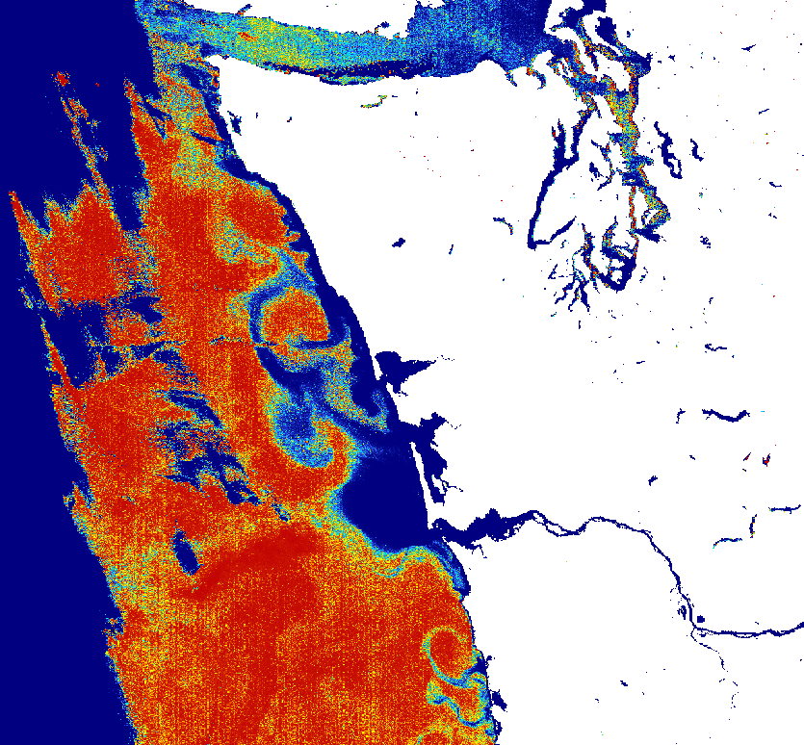
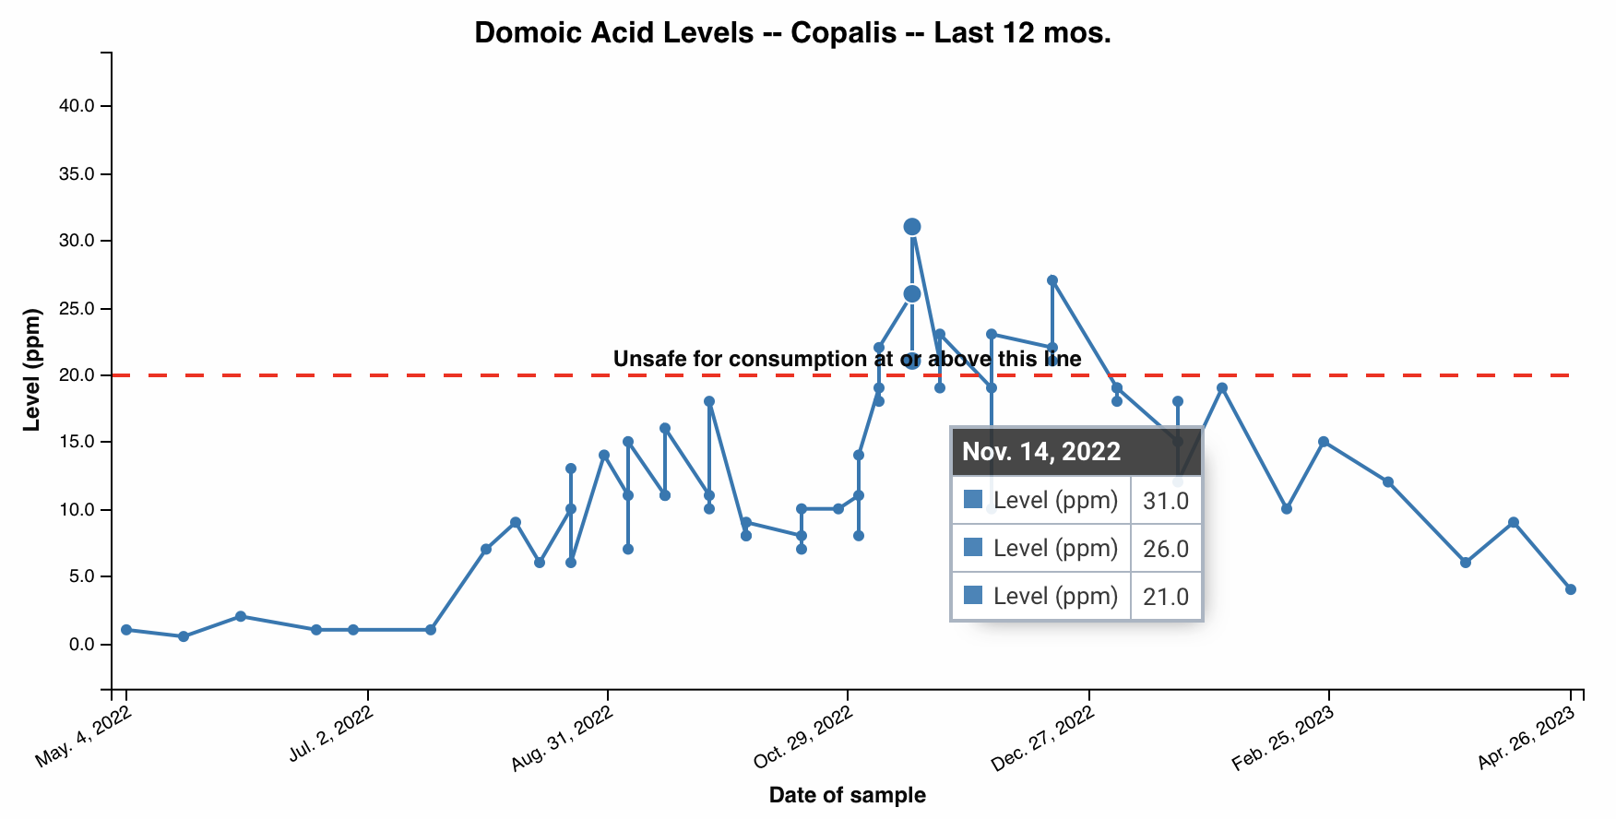
Large scale toxin event in Razor Clams, November 2022. Note that the Columbia River plume acts as a barrier to onshore transport when the plume is flowing northward. Preliminary model is sensitive to synthetic salinity values (may under-predict in the plume)
Probability of pDA > 500 ng/mL
November 19, 2022
Copalis
(Preliminary GLM, synthetic salinity, OLCI full-res)

Slide 13
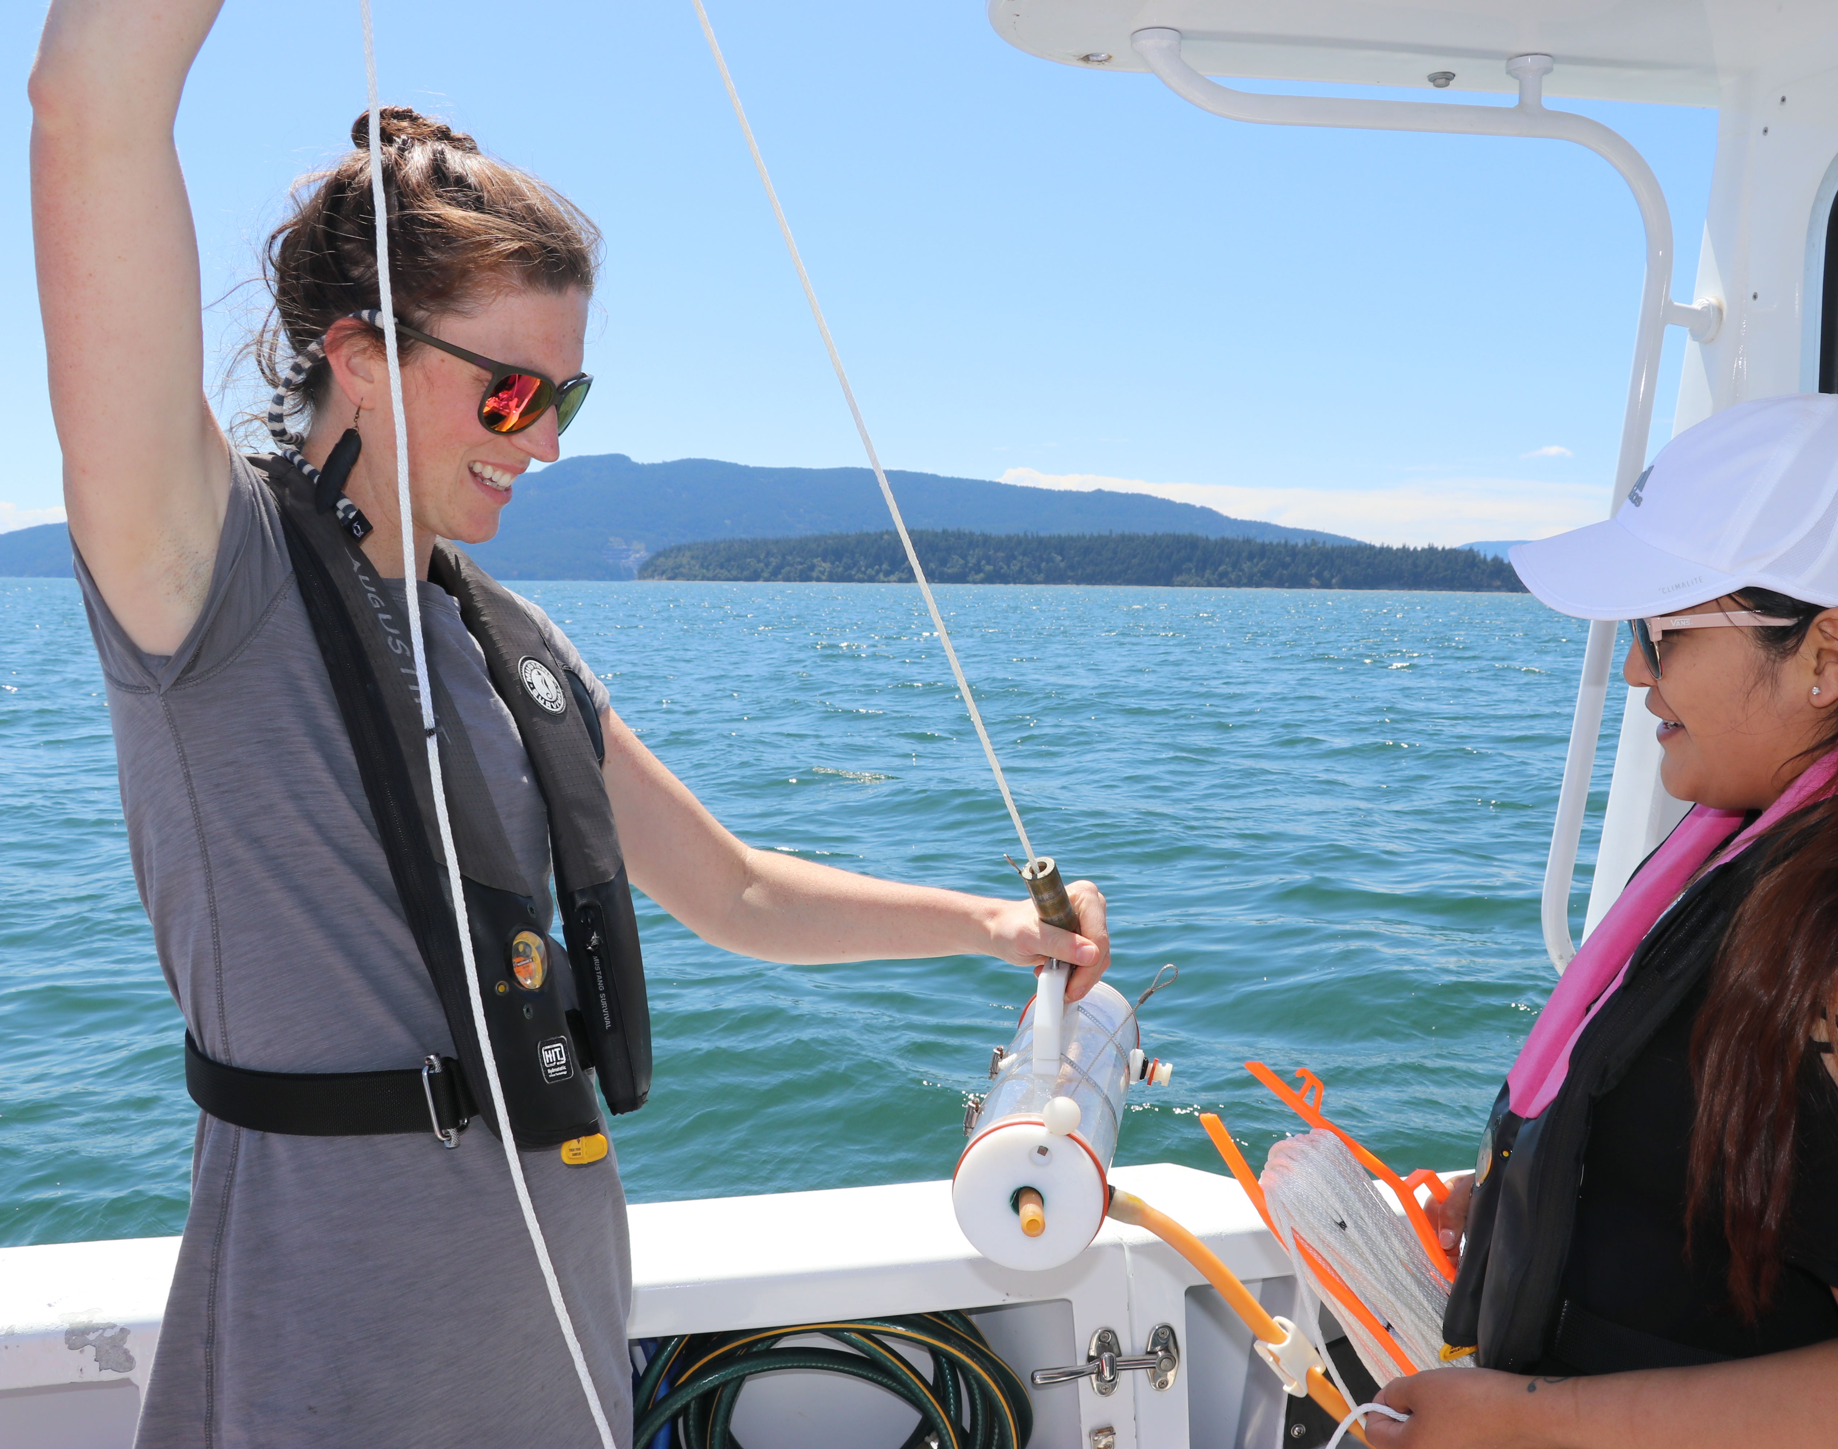
Salish Sea Research Center summer Undergraduate Research Experience
8-week paid internship program
10-15 Indigenous undergraduate students
Curated research projects
Research mentors
Required presentations

Slide 14
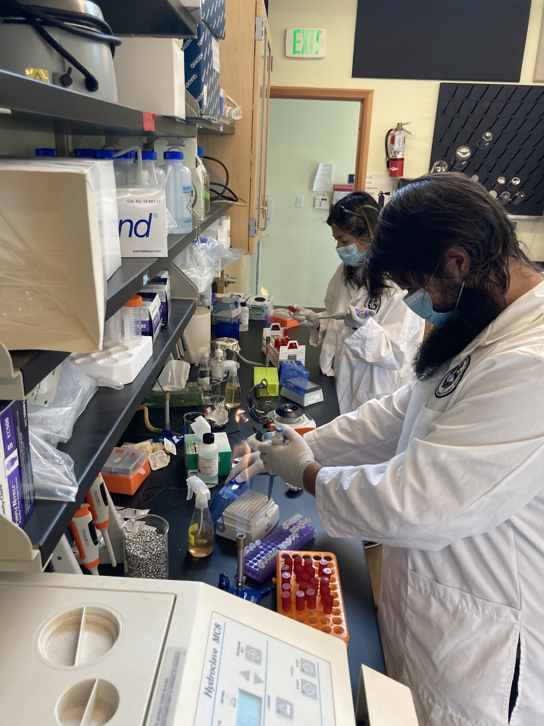
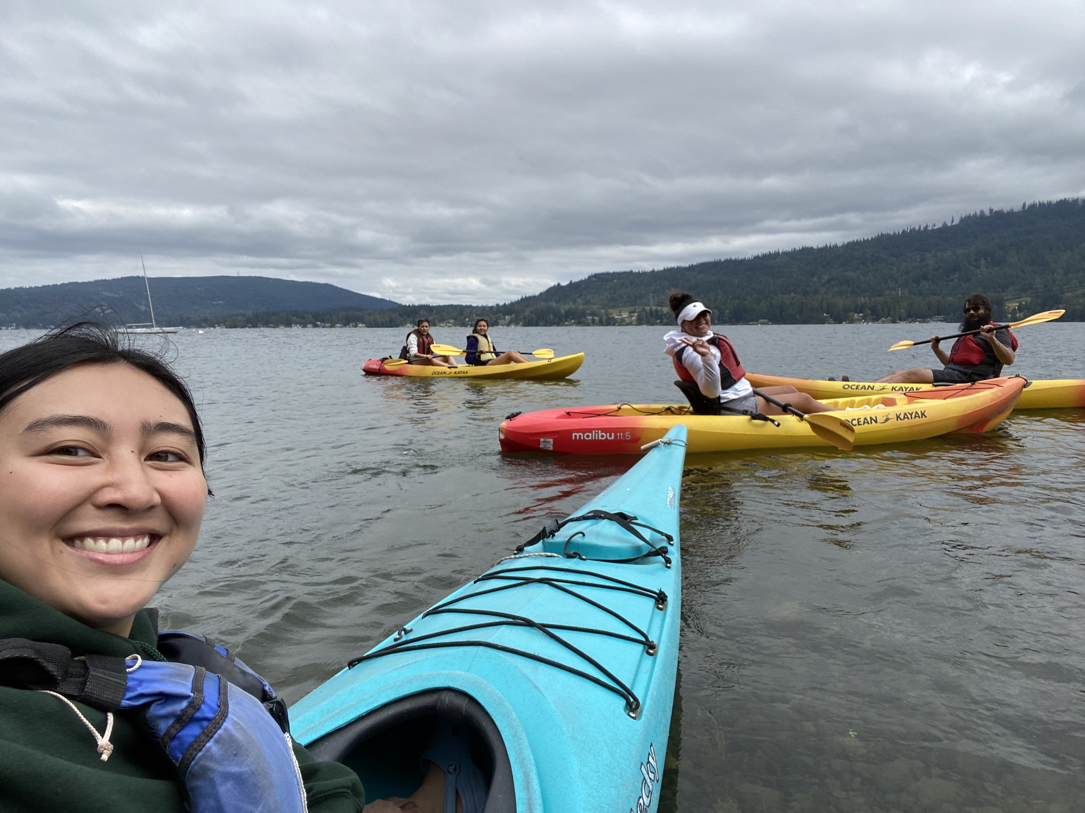
Nested Mentor Model

Slide 15
Approach Stakeholders for Shared Projects
Science: concern of emergent harmful algae and biotoxins in the Salish Sea, monitoring for climate change, domoic acid and Dungeness crab
Management and Policy: safe seafood for the community, preparing for the future
Cultural: tribal nation’s ability to practice sovereignty and make policy decisions

Slide 16
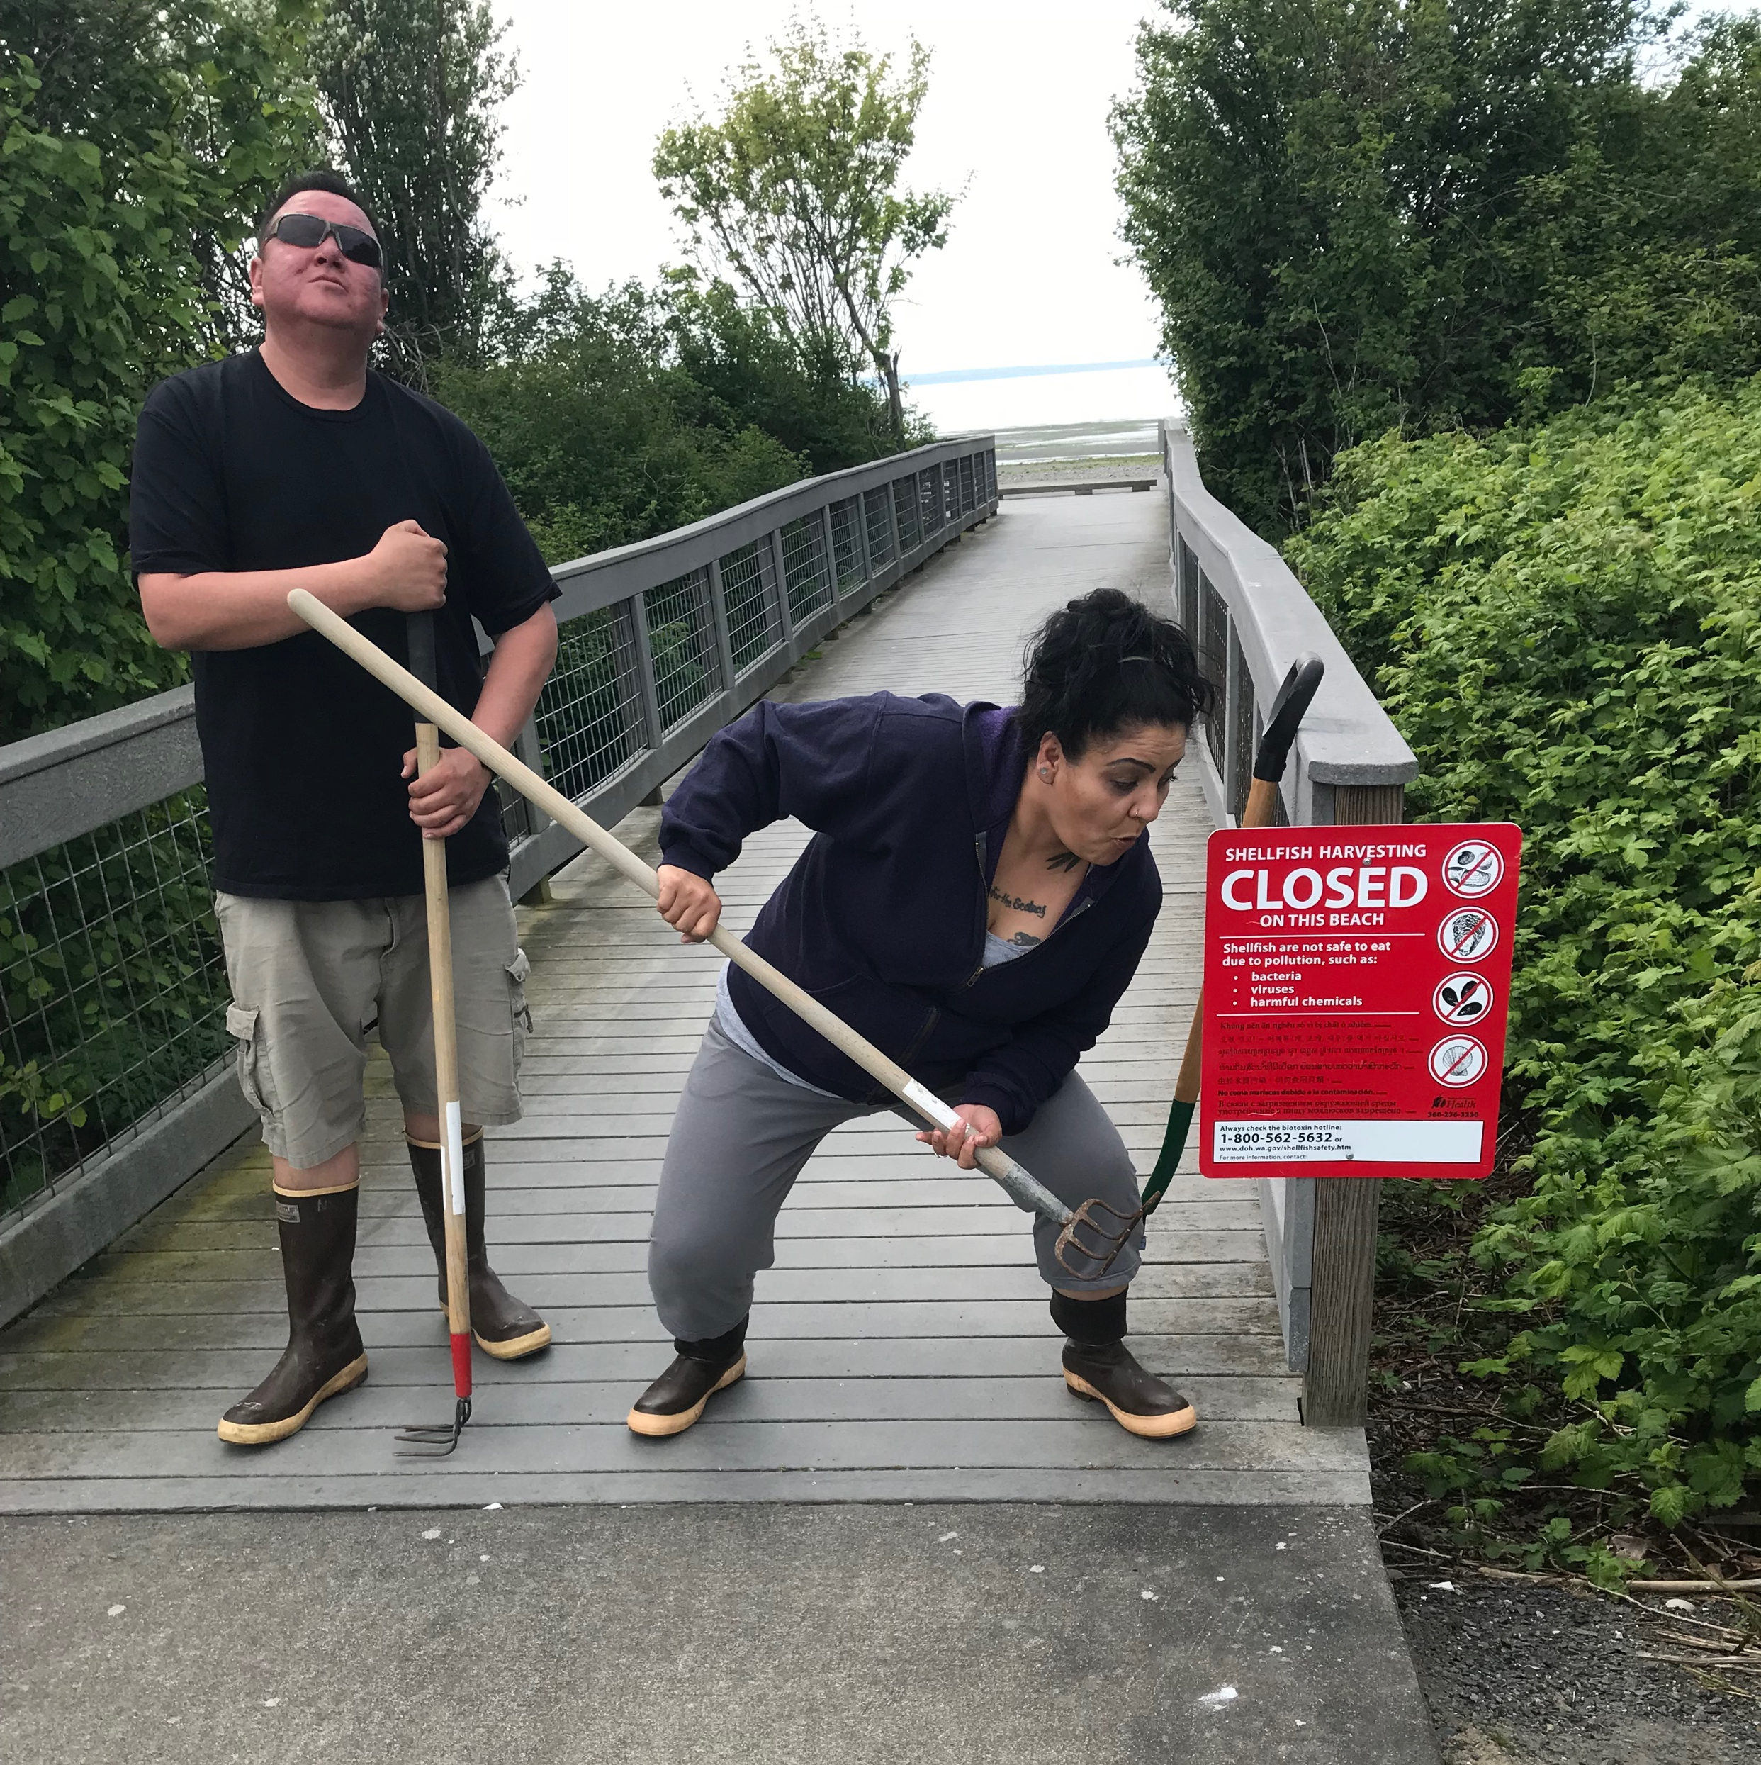
Management and Policy Decisions

Slide 17
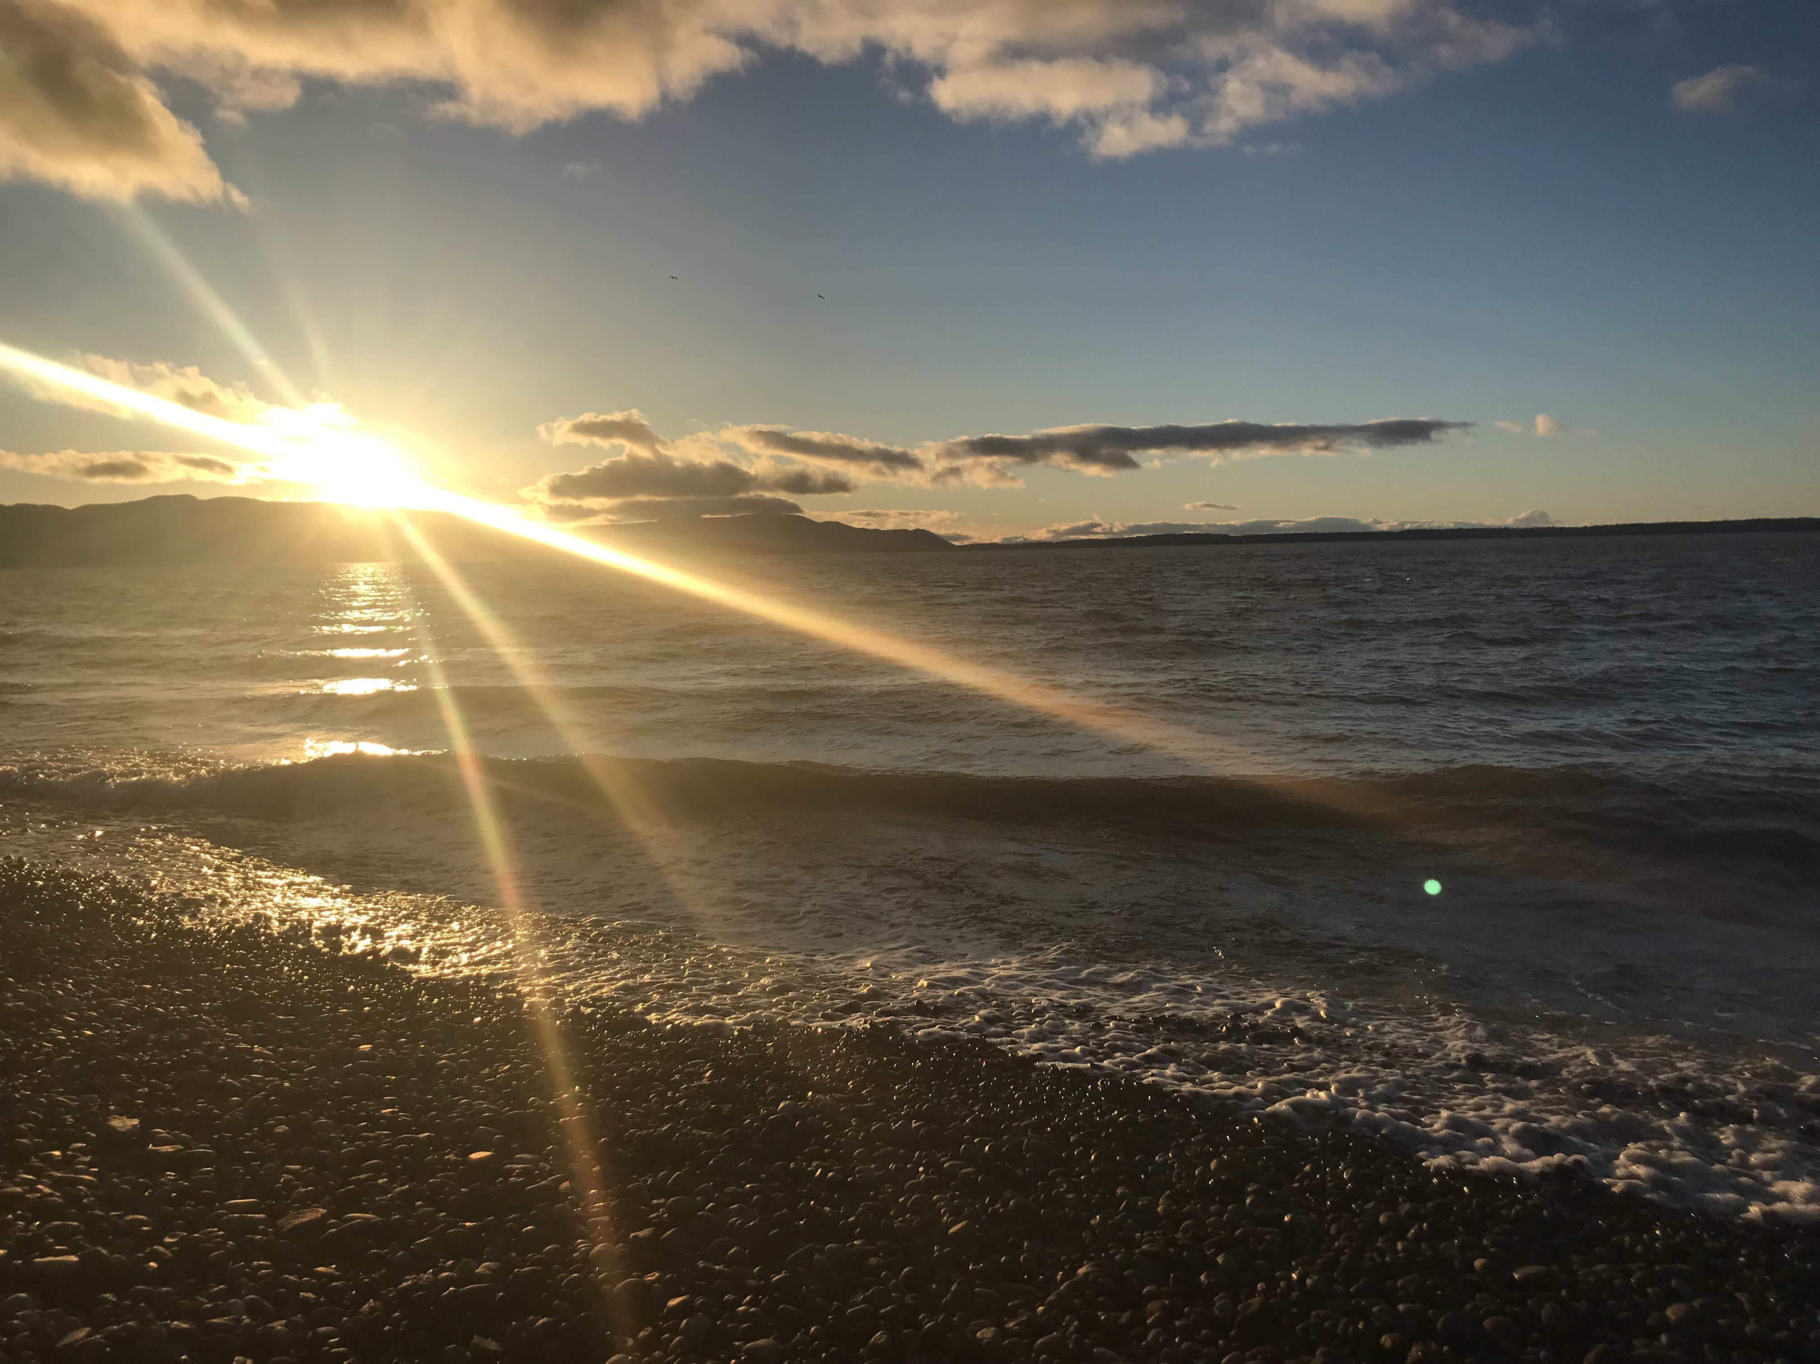
Hy’shqe (Thank You)
Questions?
Special thanks to the SSRC Lab, Student Interns, and LNR Researchers
NASA Award #NSSC21K1651

