Slide 1
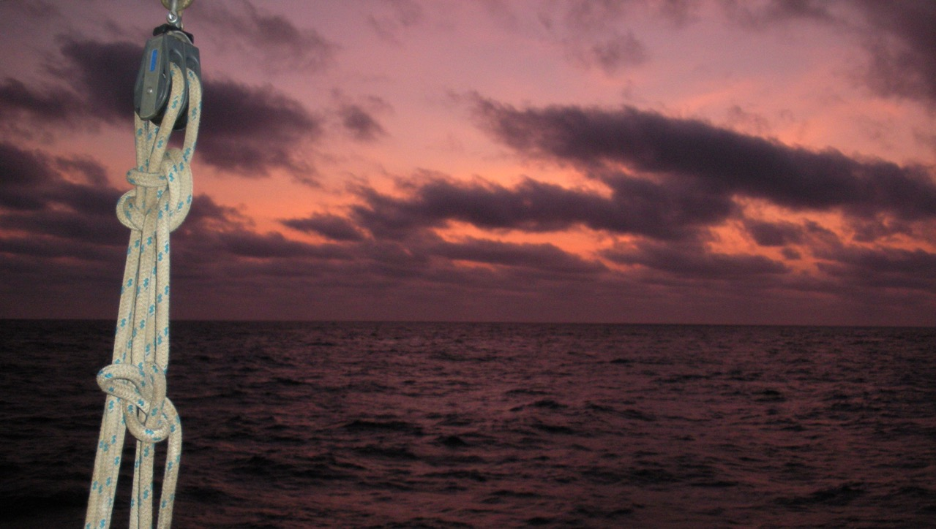
Focused mentoring and wider workshops to connect high school students with NASA science
IG: @geochemical.sensing.lab
FAU: Jordon Beckler, Hanna Bridgham, Veronica Ruiz-Xomchuk, Owen Silvera, Mason Thackston, Alberto Tonizzo, Tim Moore, Mike Twardowski
FAU High School: Tricia Meredith, Eric Morales, Arman Alexis, Ruby Aubin, Anirudh Venkat
Georgia Tech: Martial Taillefert
For OCRT (OBB) Meeting
04/9/23
MUREP-SMD
OCEAN

Slide 2
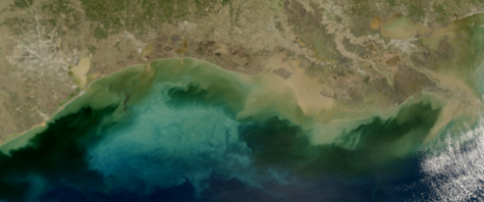
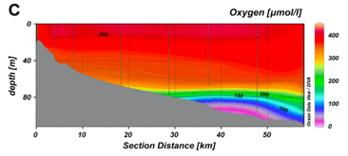
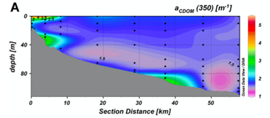
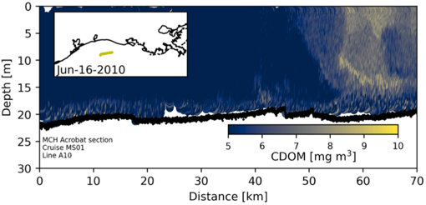
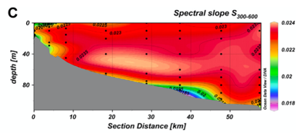
Background & Motivation
Introduction
Coastal CDOM dominated by fluvial inputs – sediment inputs often not considered.
Certain areas may concentrate DOC more than others…
Baltic Sea
Sediment-derived DOC can rival river DOC fluxes, (Alperin et al., 1999; Burdige & Komada 2015)
MODIS-aqua 1/24/19
Sediment CDOM flux measurements and/or coupled water column measurements are rare
(DiMarco & Zimmerle 2017)
(measured with fluorometer)
Kowalczuk et al., 2015
(other examples: Mississippi River discharges; Kowalczuk et al., 2015; Chen et al., 2004; DiMarco, 2009)
Is vertical mixing required to bring SDCDOM to surface?

Slide 3
Background & Motivation
Introduction
Coastal CDOM dominated by fluvial inputs – sediment inputs often not considered.
Certain areas may concentrate DOC more than others…
Baltic Sea
Sediment-derived DOC can rival river DOC fluxes, (Alperin et al., 1999; Burdige & Komada 2015)
MODIS-aqua 1/24/19
Does sediment-derived CDOM enter the water column and flux to the surface?
Can we detect SDCDOM using satellites?
Can we quantify sediment-derived carbon via proxy?
Sediment CDOM flux measurements and/or coupled water column measurements are rare
(DiMarco & Zimmerle 2017)
Xiao et al., 2013
(measured with fluorometer)
Kowalczuk et al., 2015
(other examples: Mississippi River discharges; Kowalczuk et al., 2015; Chen et al., 2004; DiMarco, 2009)
Is vertical mixing required to bring SDCDOM to surface?

Slide 4
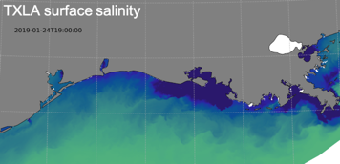
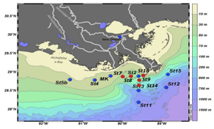
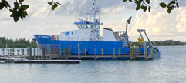
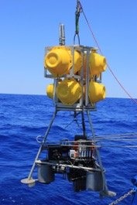
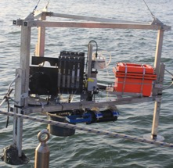
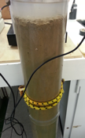
RADIATIVE TRANSFER MODELING WITH AND WITHOUT PERTURBATIONS
Satellite CDOM dominated by fluvial contribution
Satellite CDOM influenced by sediment-derived inputs
TXLA modeled hydrodynamics
+
Sediment fluxes
PERTURBED 1-D WATER COLUMN ABSORPTION /DOC
RECONSTRUCTED 1-D WATER COLUMN ABSORPTION / DOC
MEASURED WATER COLUMN ABSORPTION:
(CDOM & particle absorption)
5 cruises
oxycline
Benthic lander chamber incubations yield SEDIMENT FLUXES of DOC & hyperspectral CDOM;
Summer hypoxia
High benthic flux, low vorticity
Hurricane/Fall storm
Lower benthic flux, high vorticity
sediment cores provide DIFFUSIVE FLUXES & biogeochemical CONTEXT
We are learning best candidate locations are during upwelling fronts along ~50 m isobaths, away from the plume,

Slide 5
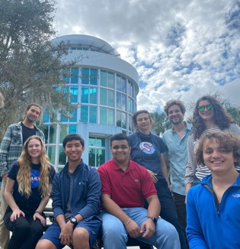
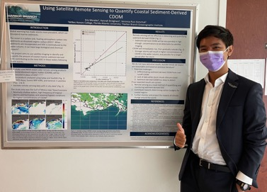
Mentoring overview
Postdocs & graduate students…
Partnership w/ FAU High School: 4x high school interns to date
1 @ 10 hrs/wk, 2 @ 5 hrs/wk; potential for hrs increase
Multiple internal research grants & presentations
Goals:
Hypothesis-driven in depth research
Remote sensing/biogeochemistry exposure
Career guidance
Programming & Data processing (Linux/python/Jupytr)
Literature search, grant writing, journal writing

Slide 6
Example intern tasks
Compile true color images
Compile stats (e.g. image counts, clouds, avg’s)
Labels, metadata, cross-referencing
Storm event database
RS matchups with closest-in-time in situ data
Algorithmic identification of CDOM “disconnected” from fluvial plume

Slide 7
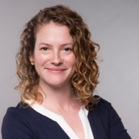
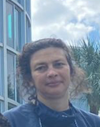
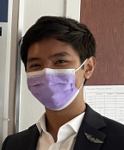
360 Feedback
Dr. Tricia Meredith (FAU Lab Schools Director of Research):
”Supportive mentorship key to grab student interest at critical time in their educational path and give them a taste of research in this area”
“Interns receiving transferrable skills in data science applicable to all STEM fields”
“The students like project contribution, role beyond a passive listener, and drives investment in learning
Collaboration successful because of our frequent communication and shared goals. Very lucky that our students get access!
Dr. Veronica Ruiz-Xomchuk (former project postdoc, presently Scientific Programmer for GMAO @ SAIC,):
“The project introduced me to remote sensing and was definitely key in the next step in my career“
“Challenge has been finding the right tools at the right level (challenging but reachable while generating appropriate outputs)”
”Workshop an opportunity to promote scientific exploration, not just following directions”
Eric Morales (current high school intern):
“Helped develop my passions and professional skills including coding, data analyses, coding, presenting, the scientific process”
“While still interested in medicine as a career, the image analysis techniques have added to my interest in radiology”
“very satisfied with the dynamic of working with Veronica and Hanna. Veronica was extremely patient despite my limited python knowledge, and has trained me to be confident in working with our code. Hanna is effective in communicating, and does not hesitate to give me feedback to help me improve my work“
“Only improvement I can think of concerns my work at the beginning of the project. Progress felt slow, and I felt that I did not have enough to do. There were many aspects of the project that had yet to be definitively decided on, so this was understandable.”

Slide 8
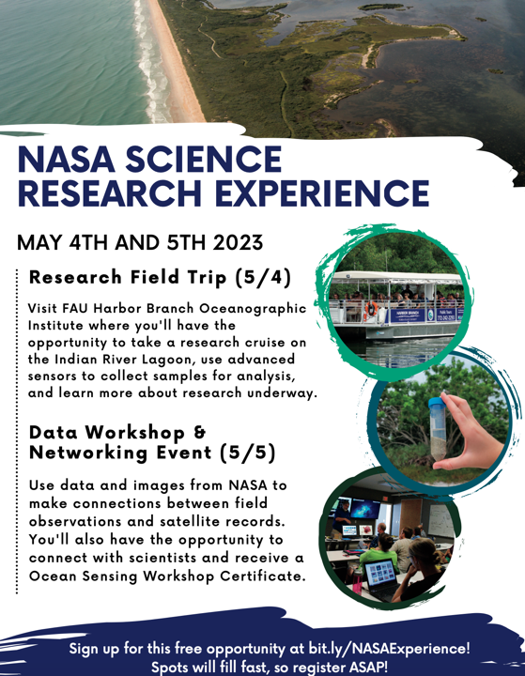
May 4 agenda – Research Field Trip
Research cruise: in situ continuous sensors, in situ measurements, water samples, sediment samples, reflectance measurements, ecosystem tour. Themes: Plume; mud/sand, stratification/hypoxia
Optics lab stations:
Decomposing white light
Color transmission
Color perception by us
Color perception by satellites
Particle light scattering
Fluorescence
Refraction, reflection, diffraction.
Converging and diverging lenses.
Light transmission thru sediment CDOM
HBOI tour: Submersibles, Optics test tank, Ocean Discovery Center…Gift shop!

Slide 9
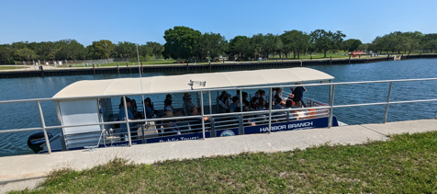
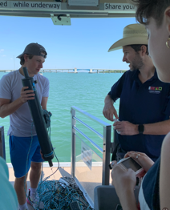
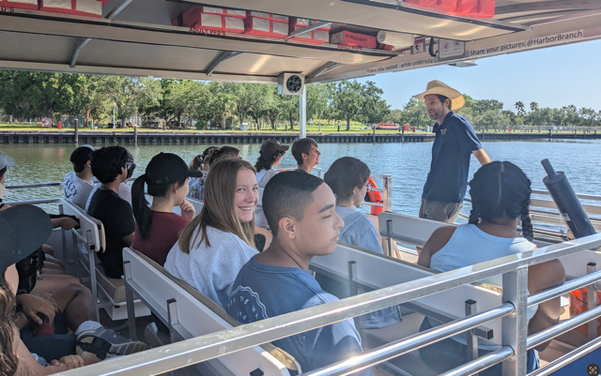
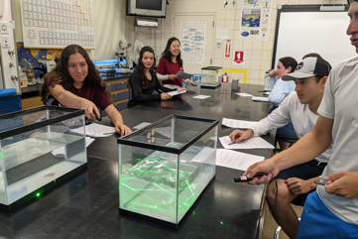
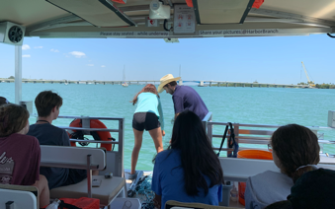
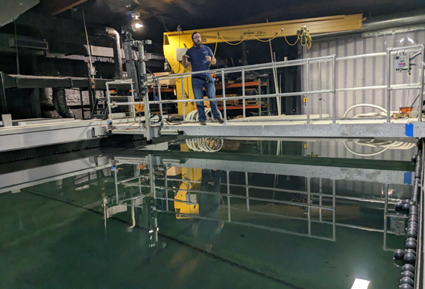
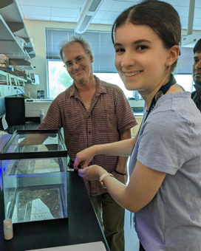
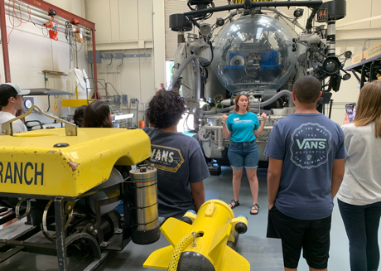

Slide 10
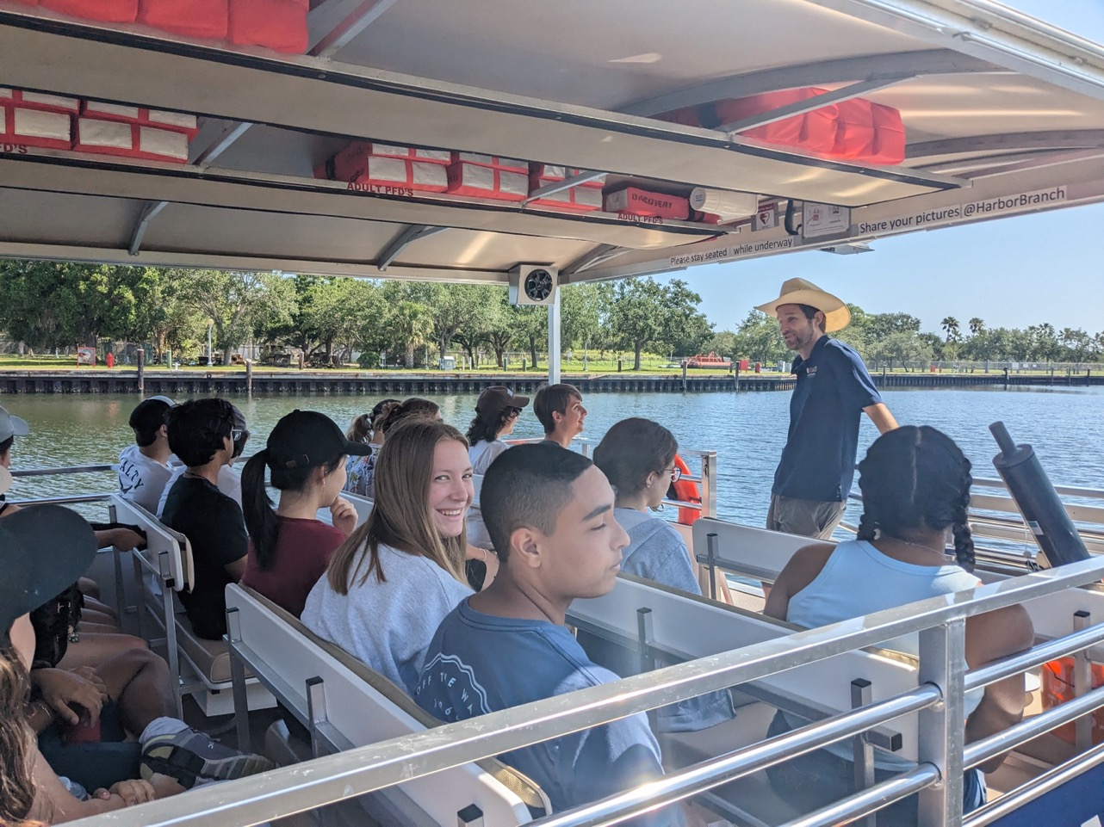
What was your favorite activity?
The boat!

Slide 11
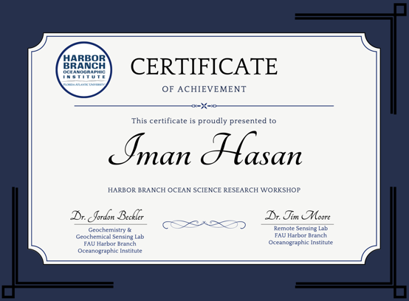
May 5 agenda – Data Workshop & Networking
OBB/remote sensing overview: Dr. Lorenzoni guest
Data examination: Samples/Measurements, Continuous measurement web data analysis
NASA Worldview activities:
True color, precipitation rate images (Hurricane Ian precipitation patterns, suspended carbonate/terrestrial sediments, CDOM runoff as carbon/freshwater proxy, Nutrient eutrophication, red tide)
Layers, bottom reflectance, L2 chlorophyll images (Florida Bay hydrology, seagrass loss patterns, multiple stressors, sediment nutrient eutrophication)
Explore Lake Erie Microcystis, Sargassum blooms, or topic of your choice; demonstrate results
Networking Lunch
Giavanni modules
Southern Ocean
Ocean Interannual variability: El Nino/La Nina
Upwelling & Phytoplankton productivity

Slide 12
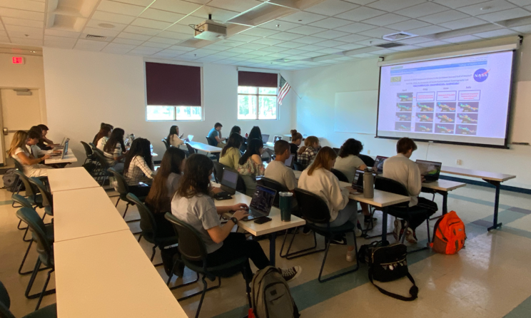
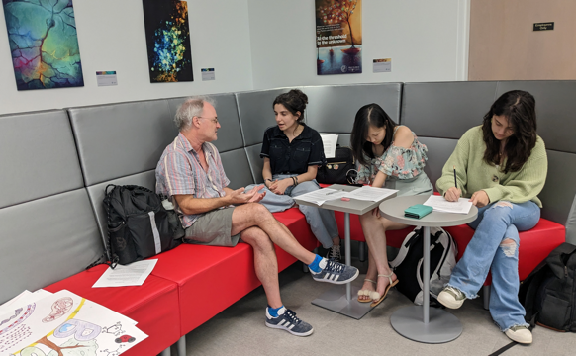
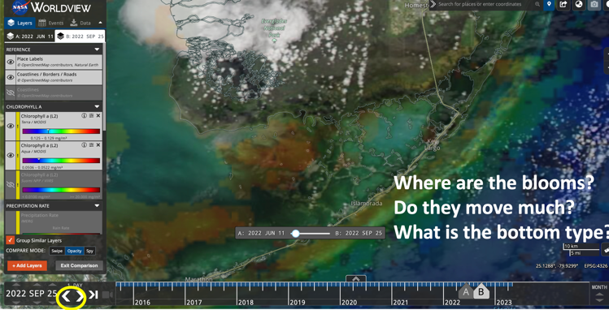
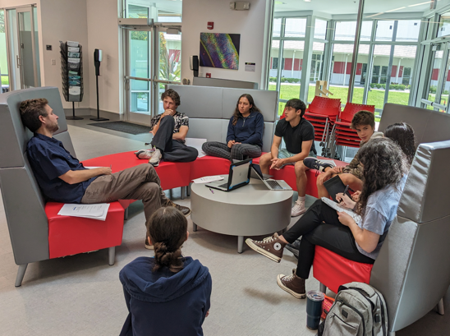

Slide 13
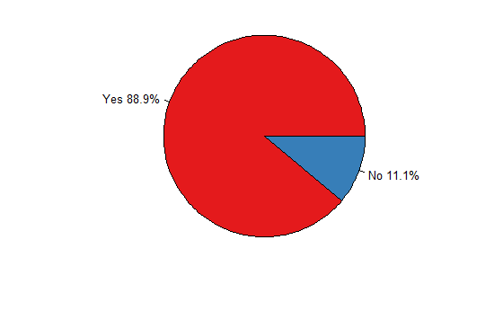
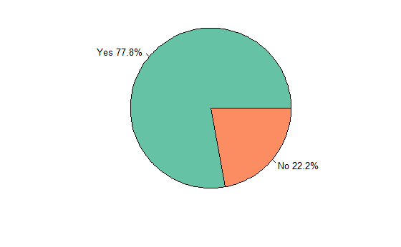
Are you more interested in thinking about a career in oceanography than you were before?
Are you more open to considering a career based around optics than you were before?

Slide 14
What did you learn that surprised you the most?
Workshop Day 2 Feedback
“Hurricanes impact sediment distribution across coastlines”
“The programs that were free to the public”
“I learned how to use and operate the Giovanni application to model different activities, which I was not aware of before. I also learned how to interpret related graphs and how these apply to different weather-related events.”
“How much nitrogen plays a factor in algae blooms.”
“That worldview and most NASA satellite information is free to the public!”
There are about 9000 objects in orbit at the moment!
“Learning about how the El Niño impacts weather conditions worldwide.”
“Different patterns with chlorophyll”
“The prime ocean environment for phytoplankton has colder temperatures (from upwelling). I would have thought it would be the opposite.”
“We learned a lot about the Southern Ocean that I didn’t know”
“That the Southern Ocean was independent from other oceans because of its current.”

Slide 15
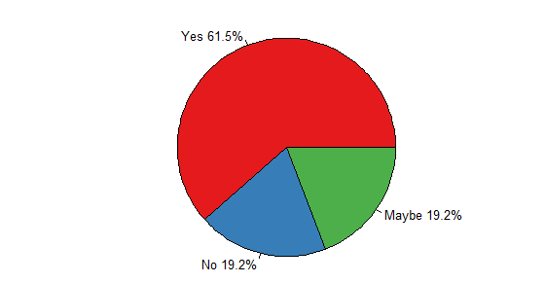
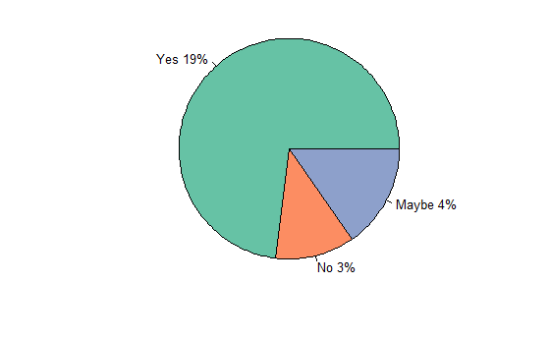
Are you more interested in a career in data-science?
Are you more interested in a career that uses NASA tools?

Slide 16
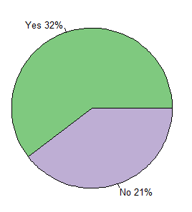
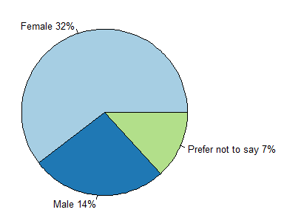
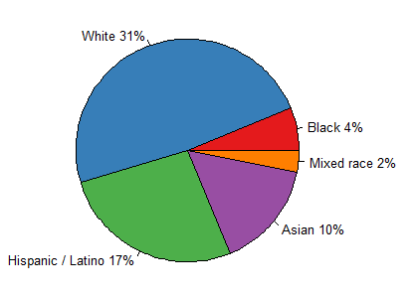
What is your gender?
Are you a member of an underrepresented community?
What group or groups best describe you?

Slide 17
Research conducted to date
Results
5x cruises completed with sediment core, benthic flux, water column
Analyses are completed. Hyperspectral CDOM, DOC, and dissolved Fe for 5 cruises (~975 pore water samples, 400 water column samples, 700 flux chamber samples).
Raw data processed and assembled (needs some cleanup, sample reruns, QC)
Forward reflectance modeling started using Spring 2022 cruise –perturbing with reasonable sediment CDOM
Remote sensing images generated/processed (annual/daily reflectance, CDOM)
Model scripts for identifying upwelling areas and inputting sediment CDOM tracers
Other study sites: Florida Bay (shallow, sediment dominated, geographic iron gradient), Indian River Lagoon estuary (Hanna fellowship), Lake Okeechobee

Slide 18
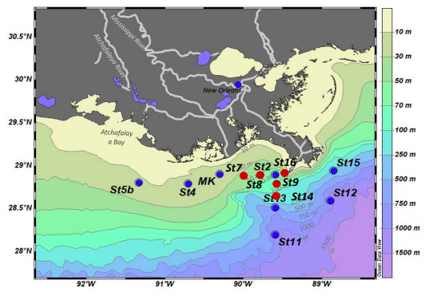
Have 10 other sites x 4 other cruises!
Seasonal and location dependent pore water absorption controls → depends on iron delivery/dissolution
DOC completely uncoupled to absorption due to Fe complexation
DOC may(?) be be estimated after independent Fe_{d} determination & deconvolution from absorption → in situ absorption-based sediment DOC monitoring may be difficult…
Or, direct absorption can estimate dissolved iron…

Slide 19
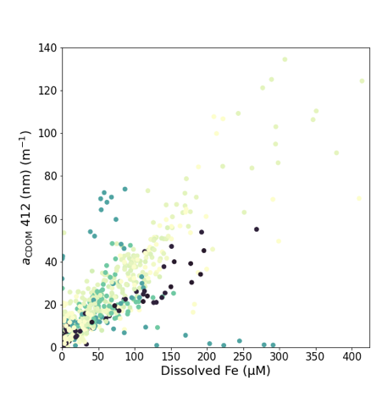
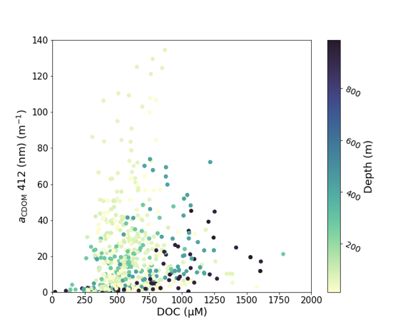
Sediment pore water water absorption dependence
Results

Slide 20
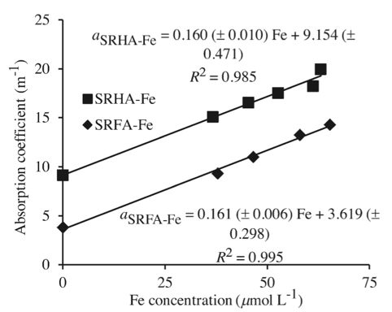
Sediment pore water water absorption dependence
Results
Xiao et al., 2013
At constant [DOC], increasing Fe_{d} enhances absorption
Is SDCDOM an explanation for Logozzo et al. 2022 finding that Fe(III) controls CDOM in river waters? Virtually all Fe-rich sediments show this.

Slide 21
Sediment pore water water absorption dependence
Results
Xiao et al., 2013
At constant [DOC], increasing Fe_{d} enhances absorption
Next question – does the sediment DOC and/or CDOM leave the sediment surface, potentially affecting water column optics?
Is SDCDOM an explanation for Logozzo et al. 2022 finding that Fe(III) controls CDOM in river waters? Virtually all Fe-rich sediments show this.

Slide 22
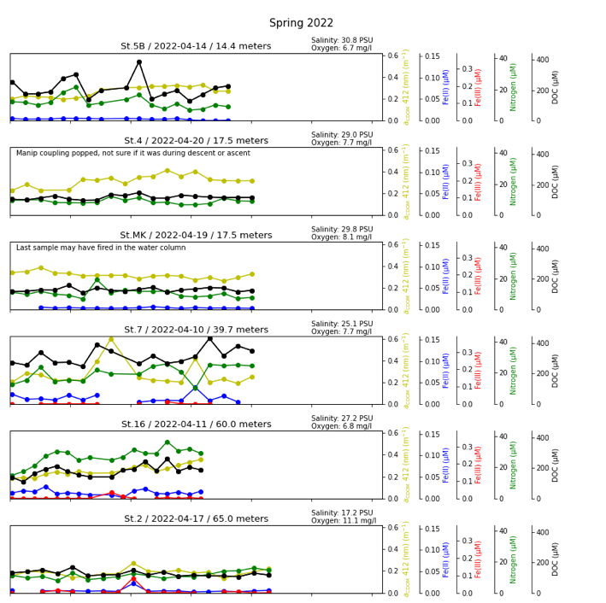
Benthic chamber flux time series
DOC & UV-VIS abs typically increase if chamber sealed
No apparent pattern with dissolved iron, but will rerun trace iron samples via ICP-MS
Will calculate fluxes from initial rates & create maps
Next question – is this ”fluxed” material transported to the surface?
4 other cruise data sets 2x this size…

Slide 23
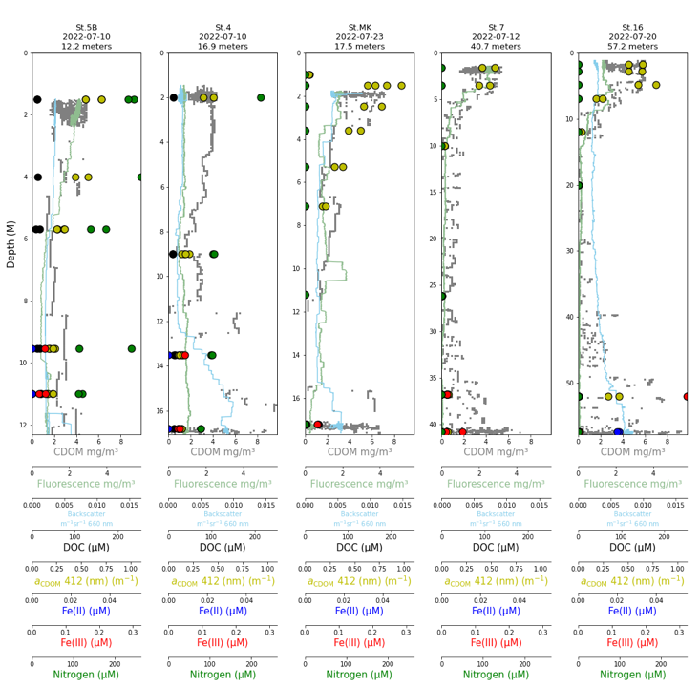
Water column CTD/Rosette
Bottom water occasionally shows high CDOM
Need to consider hydrodynamic context (in time) for upwelling & isolation from under river plume
Periodic upwelling seems required for surfacing. How do we approach identifying SDCDOM?
4 other cruise data sets 2x this size…

Slide 24
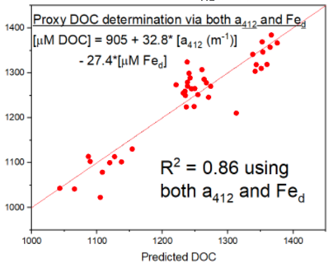
Next steps to identify sediment DOC at surface
Next steps
Account for inorganic background components & spectral fingerprinting
Flux chamber
Pore waters
Actual DOC (uM)
Benthic flux & hydrodynamic tracer inputs *for upwelling events*; then forward reflectance modeling of perturbations
DOC prediction using a₄₁₂ & Fe_{d} for Lake Okeechobee flux chamber samples

