Slide 1
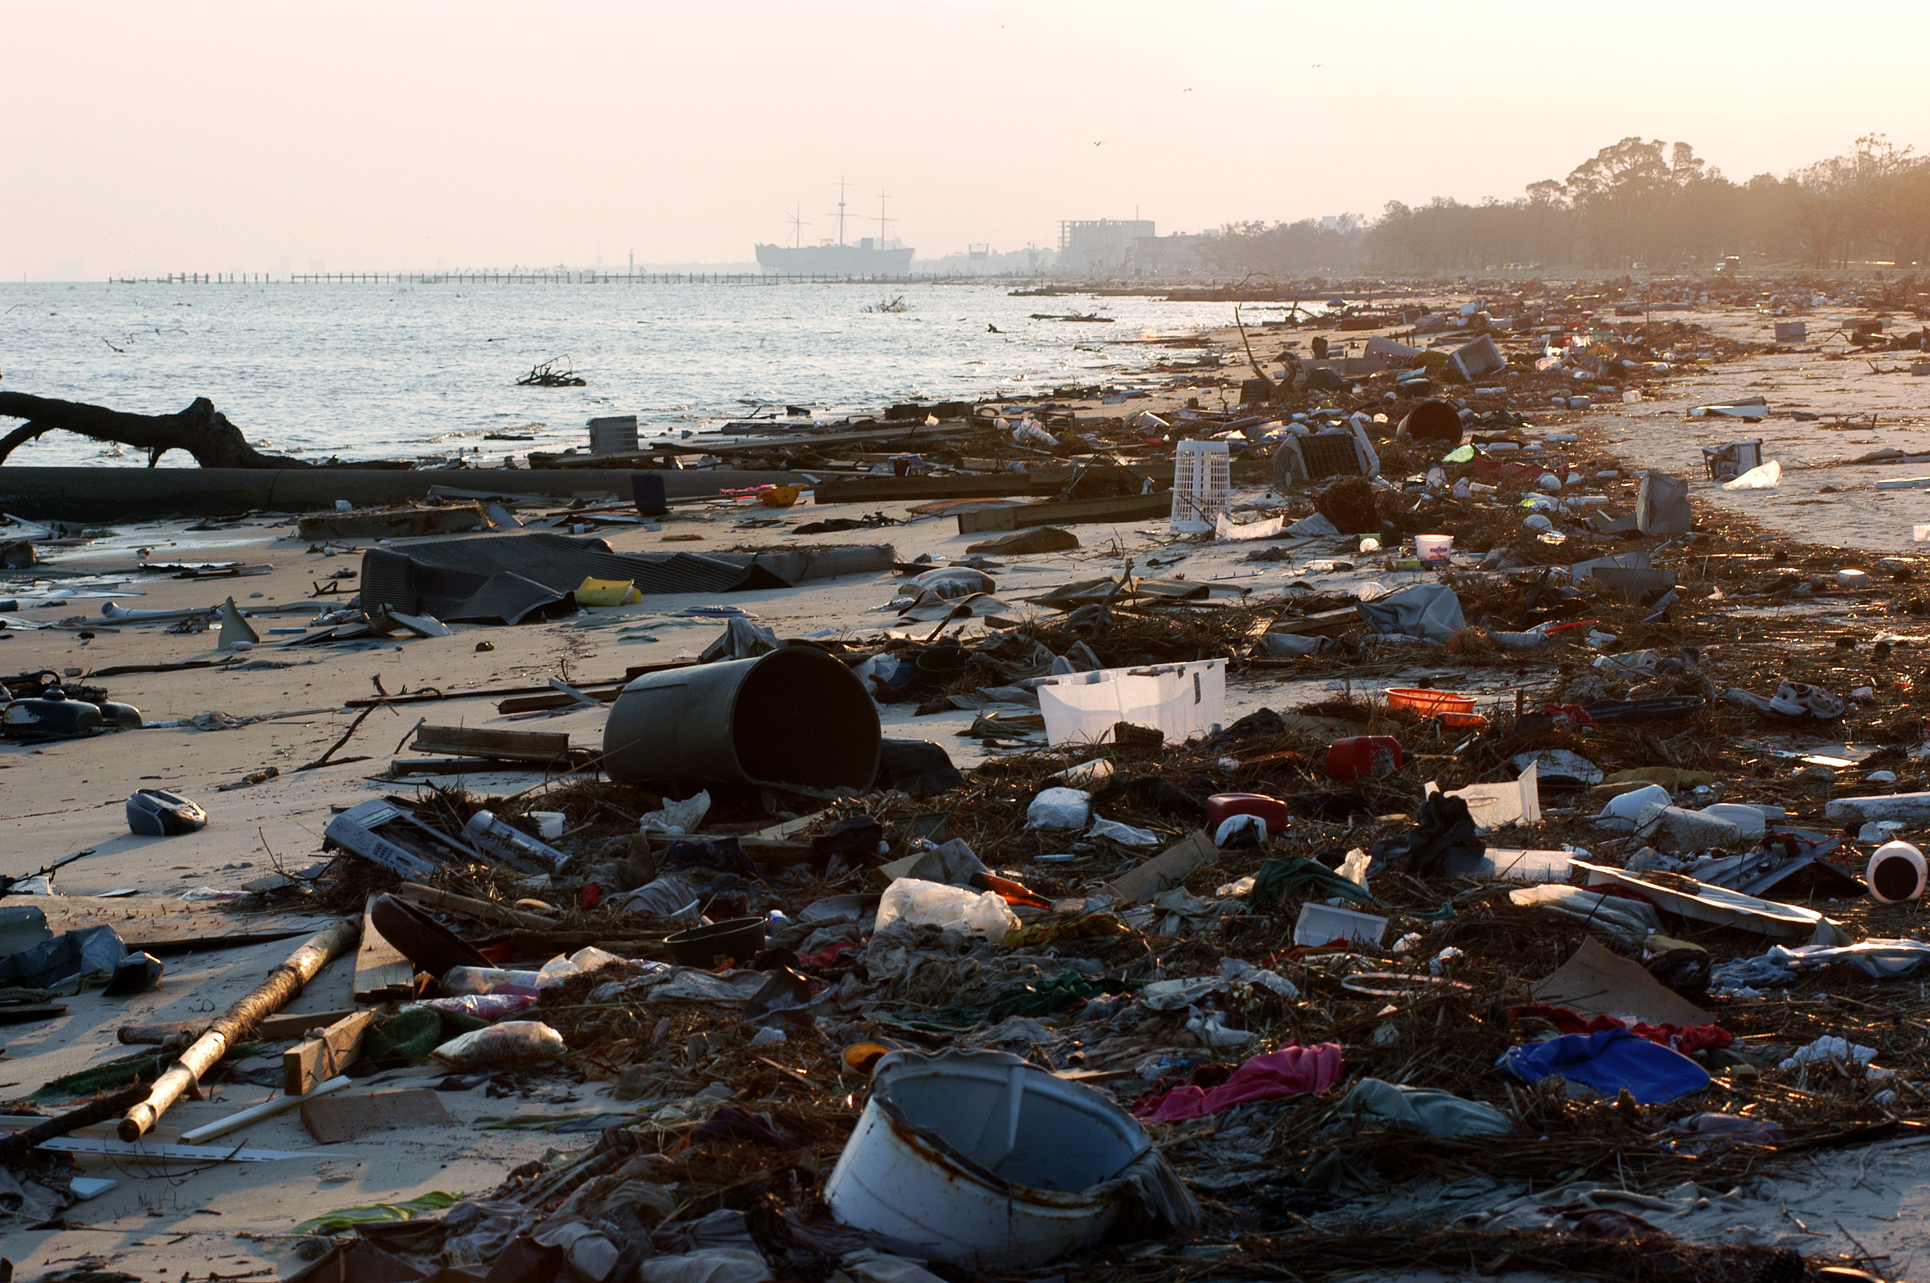
Optical remote sensing of marine debris:
What’s possible and how?
Chuanmin Hu, University of South Florida, huc@usf.edu
NASA Project: 80NSSC21K0422
Project team members and collaborators: Brian Barnes, Tanya Harrison, David English, Lin Qi, Menghua Wang, Heidi Dierssen, Shungu Garaba……

Slide 2
Outline
What are we talking about?
What’s possible?
How?

Slide 3
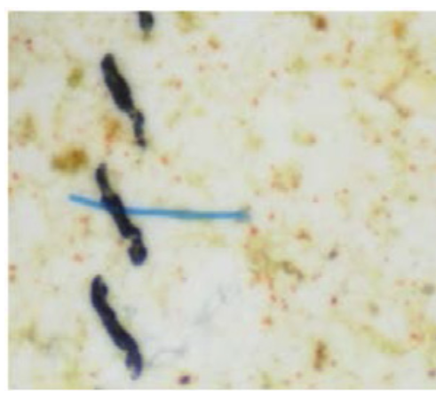
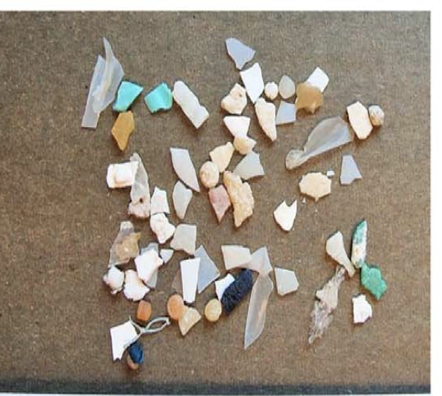
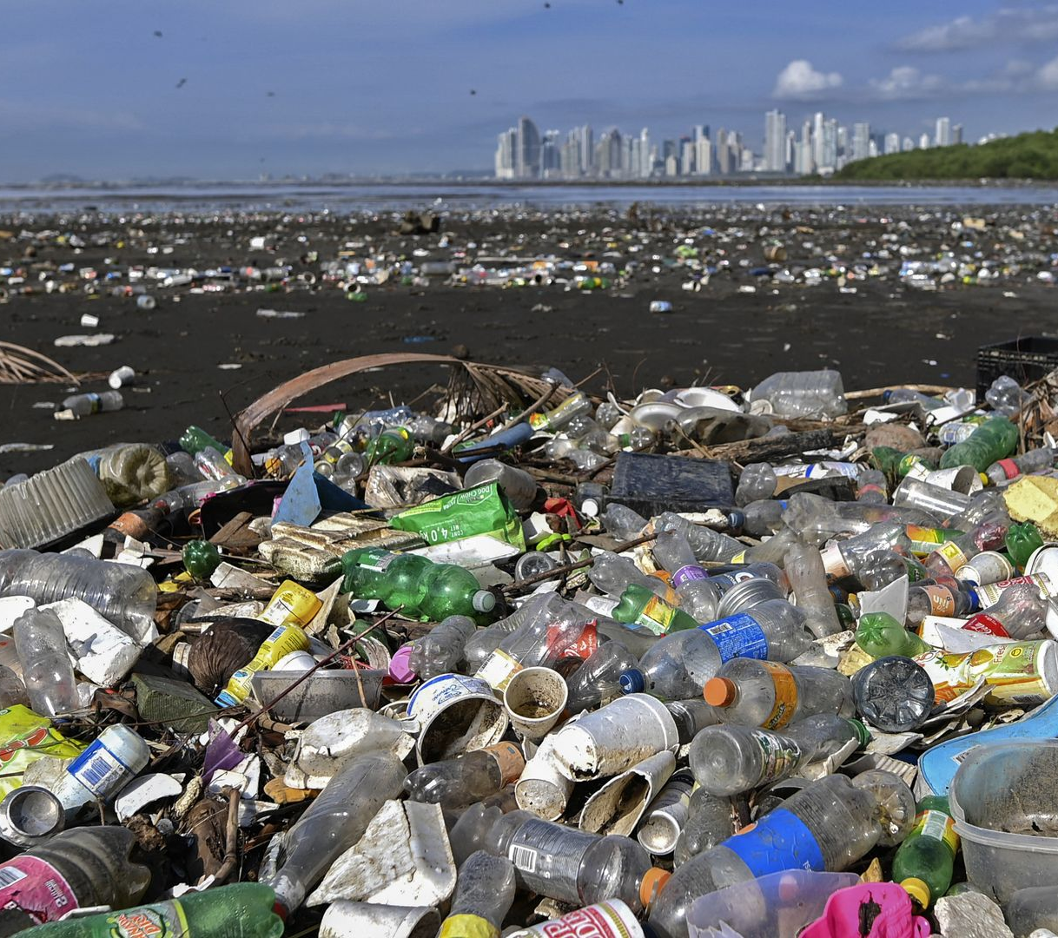
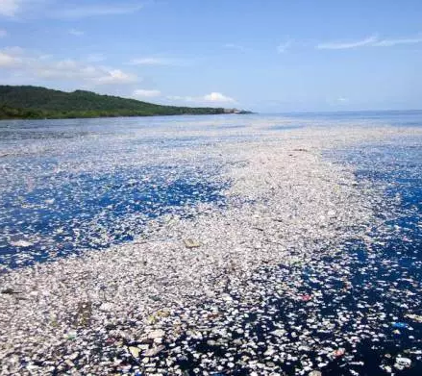
I. What are we talking about?
Subject => Marine debris (or marine litter):
Solid materials released to the marine environment from natural disasters (e.g., hurricanes, Tsunami) or human activities: Microplastic particles, plastic bags, plastic bottles, fishing gear, tree branches/leaves, driftwood, ……
Microplastic particles
Macroplastics
& other debris
Mixture
of everything
Microfibers (> 91%), mostly < 1 mm
Larger particles (< 5 mm)
0.5 mm
3.36 – 4.00 mm
Barrrows et al. (2018)
Garaba & Dierssen (2018)
Web source
Web source
Technique => Optical remote sensing: reflected sunlight in the vis-NIR range
Notes:
Subject: marine debris; Technique: optical remote sensing. Every year, many million tons of debris in various forms enter the ocean.
https://www.axios.com/2021/06/11/plastic-litter-global-ocean
https://repeatingislands.com/2017/11/26/floating-trash-islands-another-problem-for-caribbean/

Slide 4
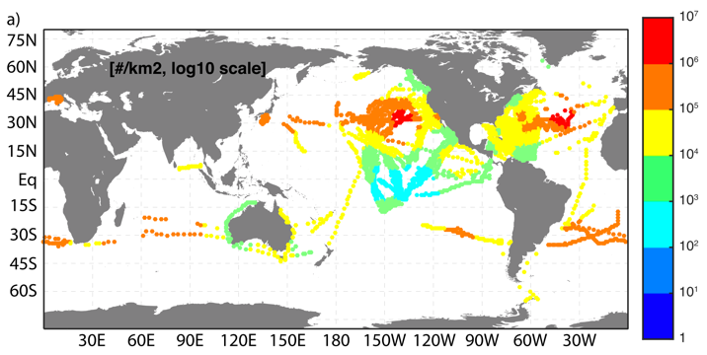
II. What’s possible?
Microfibers (11.8±24.0 particles L⁻¹, from 1,393 samples):
Difficult because the backscattering signals are embedded with other particles
Other microplastic particles (max 10 particles m⁻², from 11,854 surface trawls):
Difficult because their contribution to reflectance is << noise (Hu, 2021).
If all particles at maximum density are on the surface without overlapping each other, they cover 0.005% of a pixel
van Sebille et al. (2015)
Macroplastics and other macrodebris:
Possible if their contribution to reflectance is > 2 x noise. For SNR = 200, this means the detection limit is 0.2% of a pixel size. For MSI, the detection limit is 0.8%.

Slide 5
III. How?
Technical steps in optical remote sensing of marine debris and other floating matters
Is there “something”? (spatial anomaly)
What is that “something”? (spectral discrimination)
How much? (pixel unmixing)

Slide 6
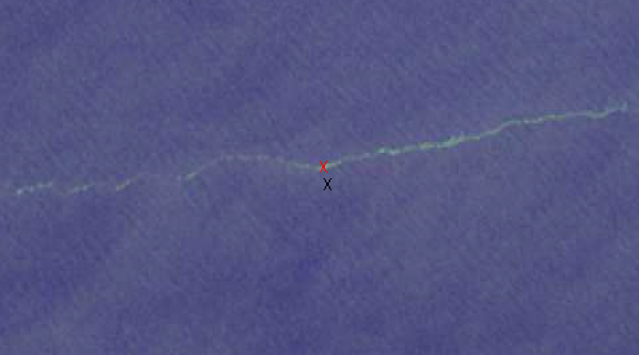
1) Is there “something”?
SW Caribbean Sea, Nov 29, 2015
Sentinel-2 (from Kikaki et al., 2020)
1 km
1 km
Florida Shelf, Feb 10, 2021
Sentinel-2 (from Hu, 2021)

Slide 7
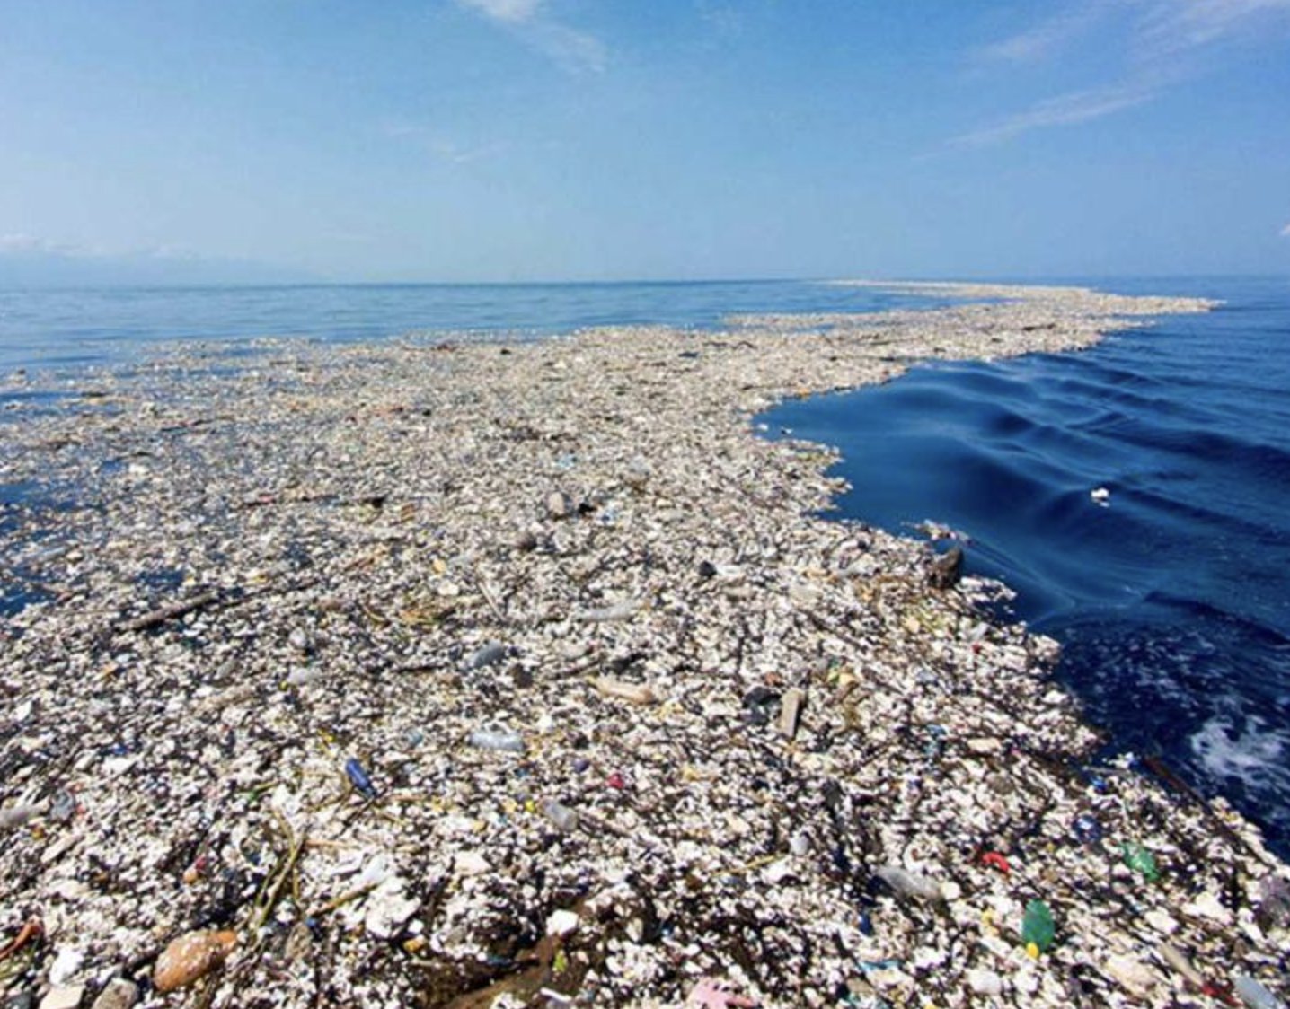
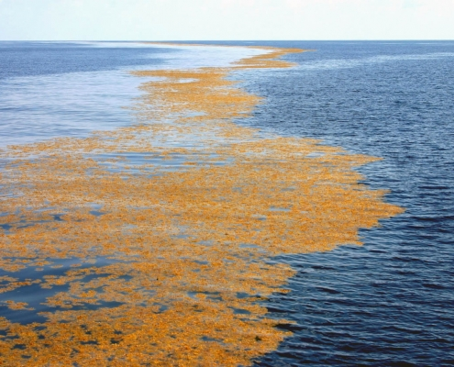
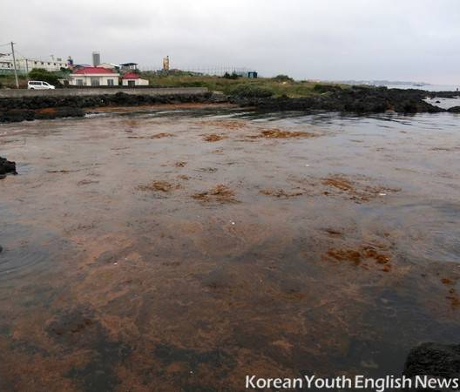
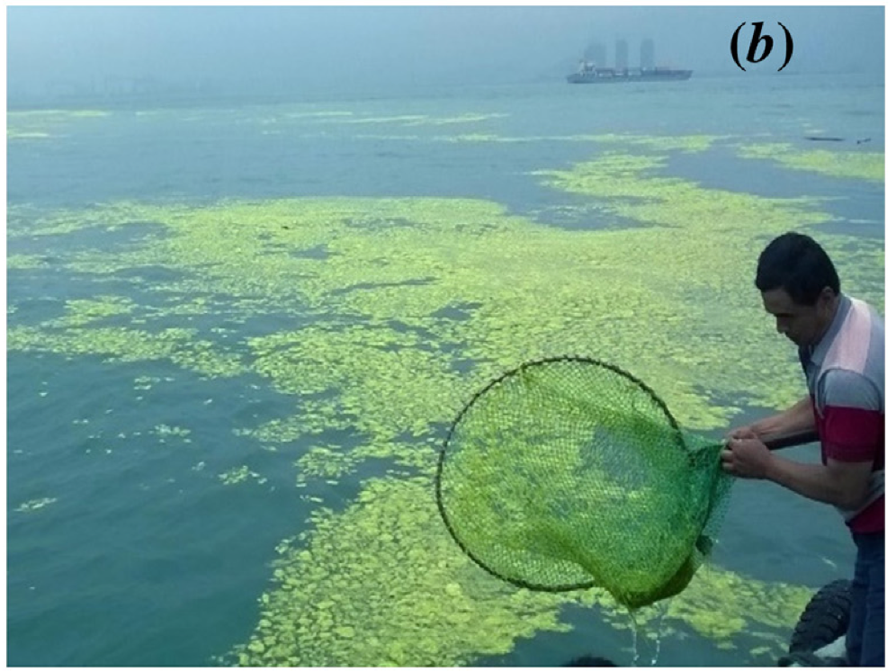
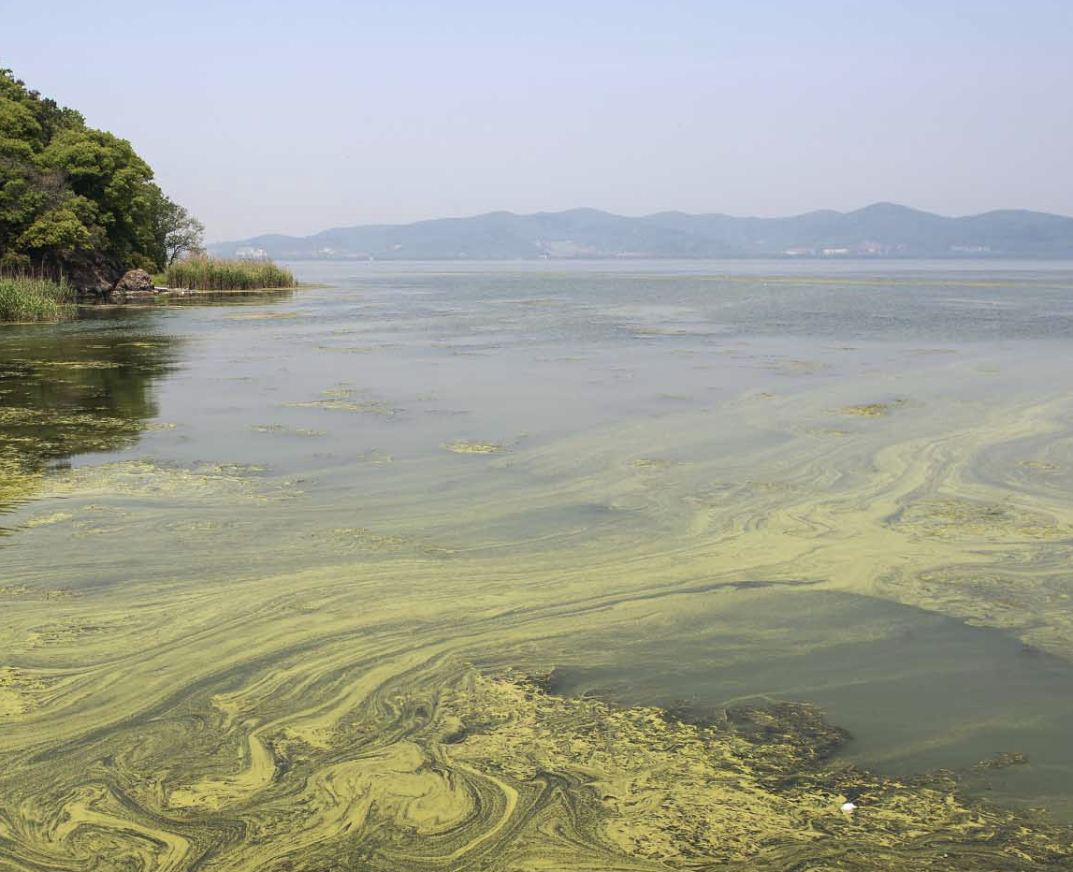
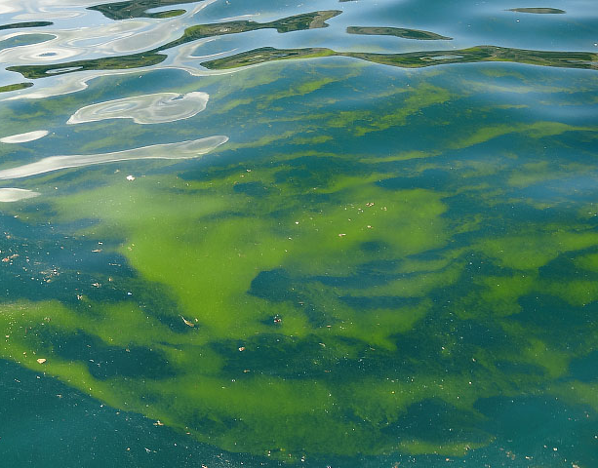
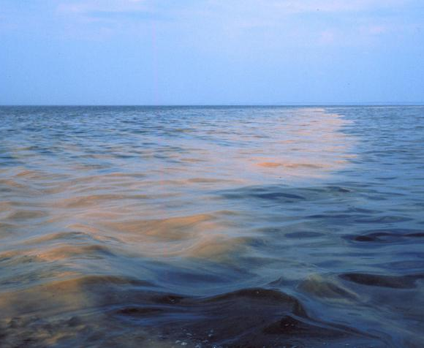
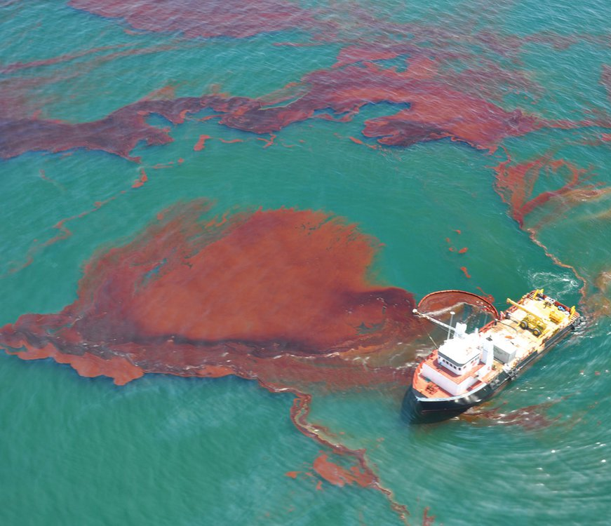
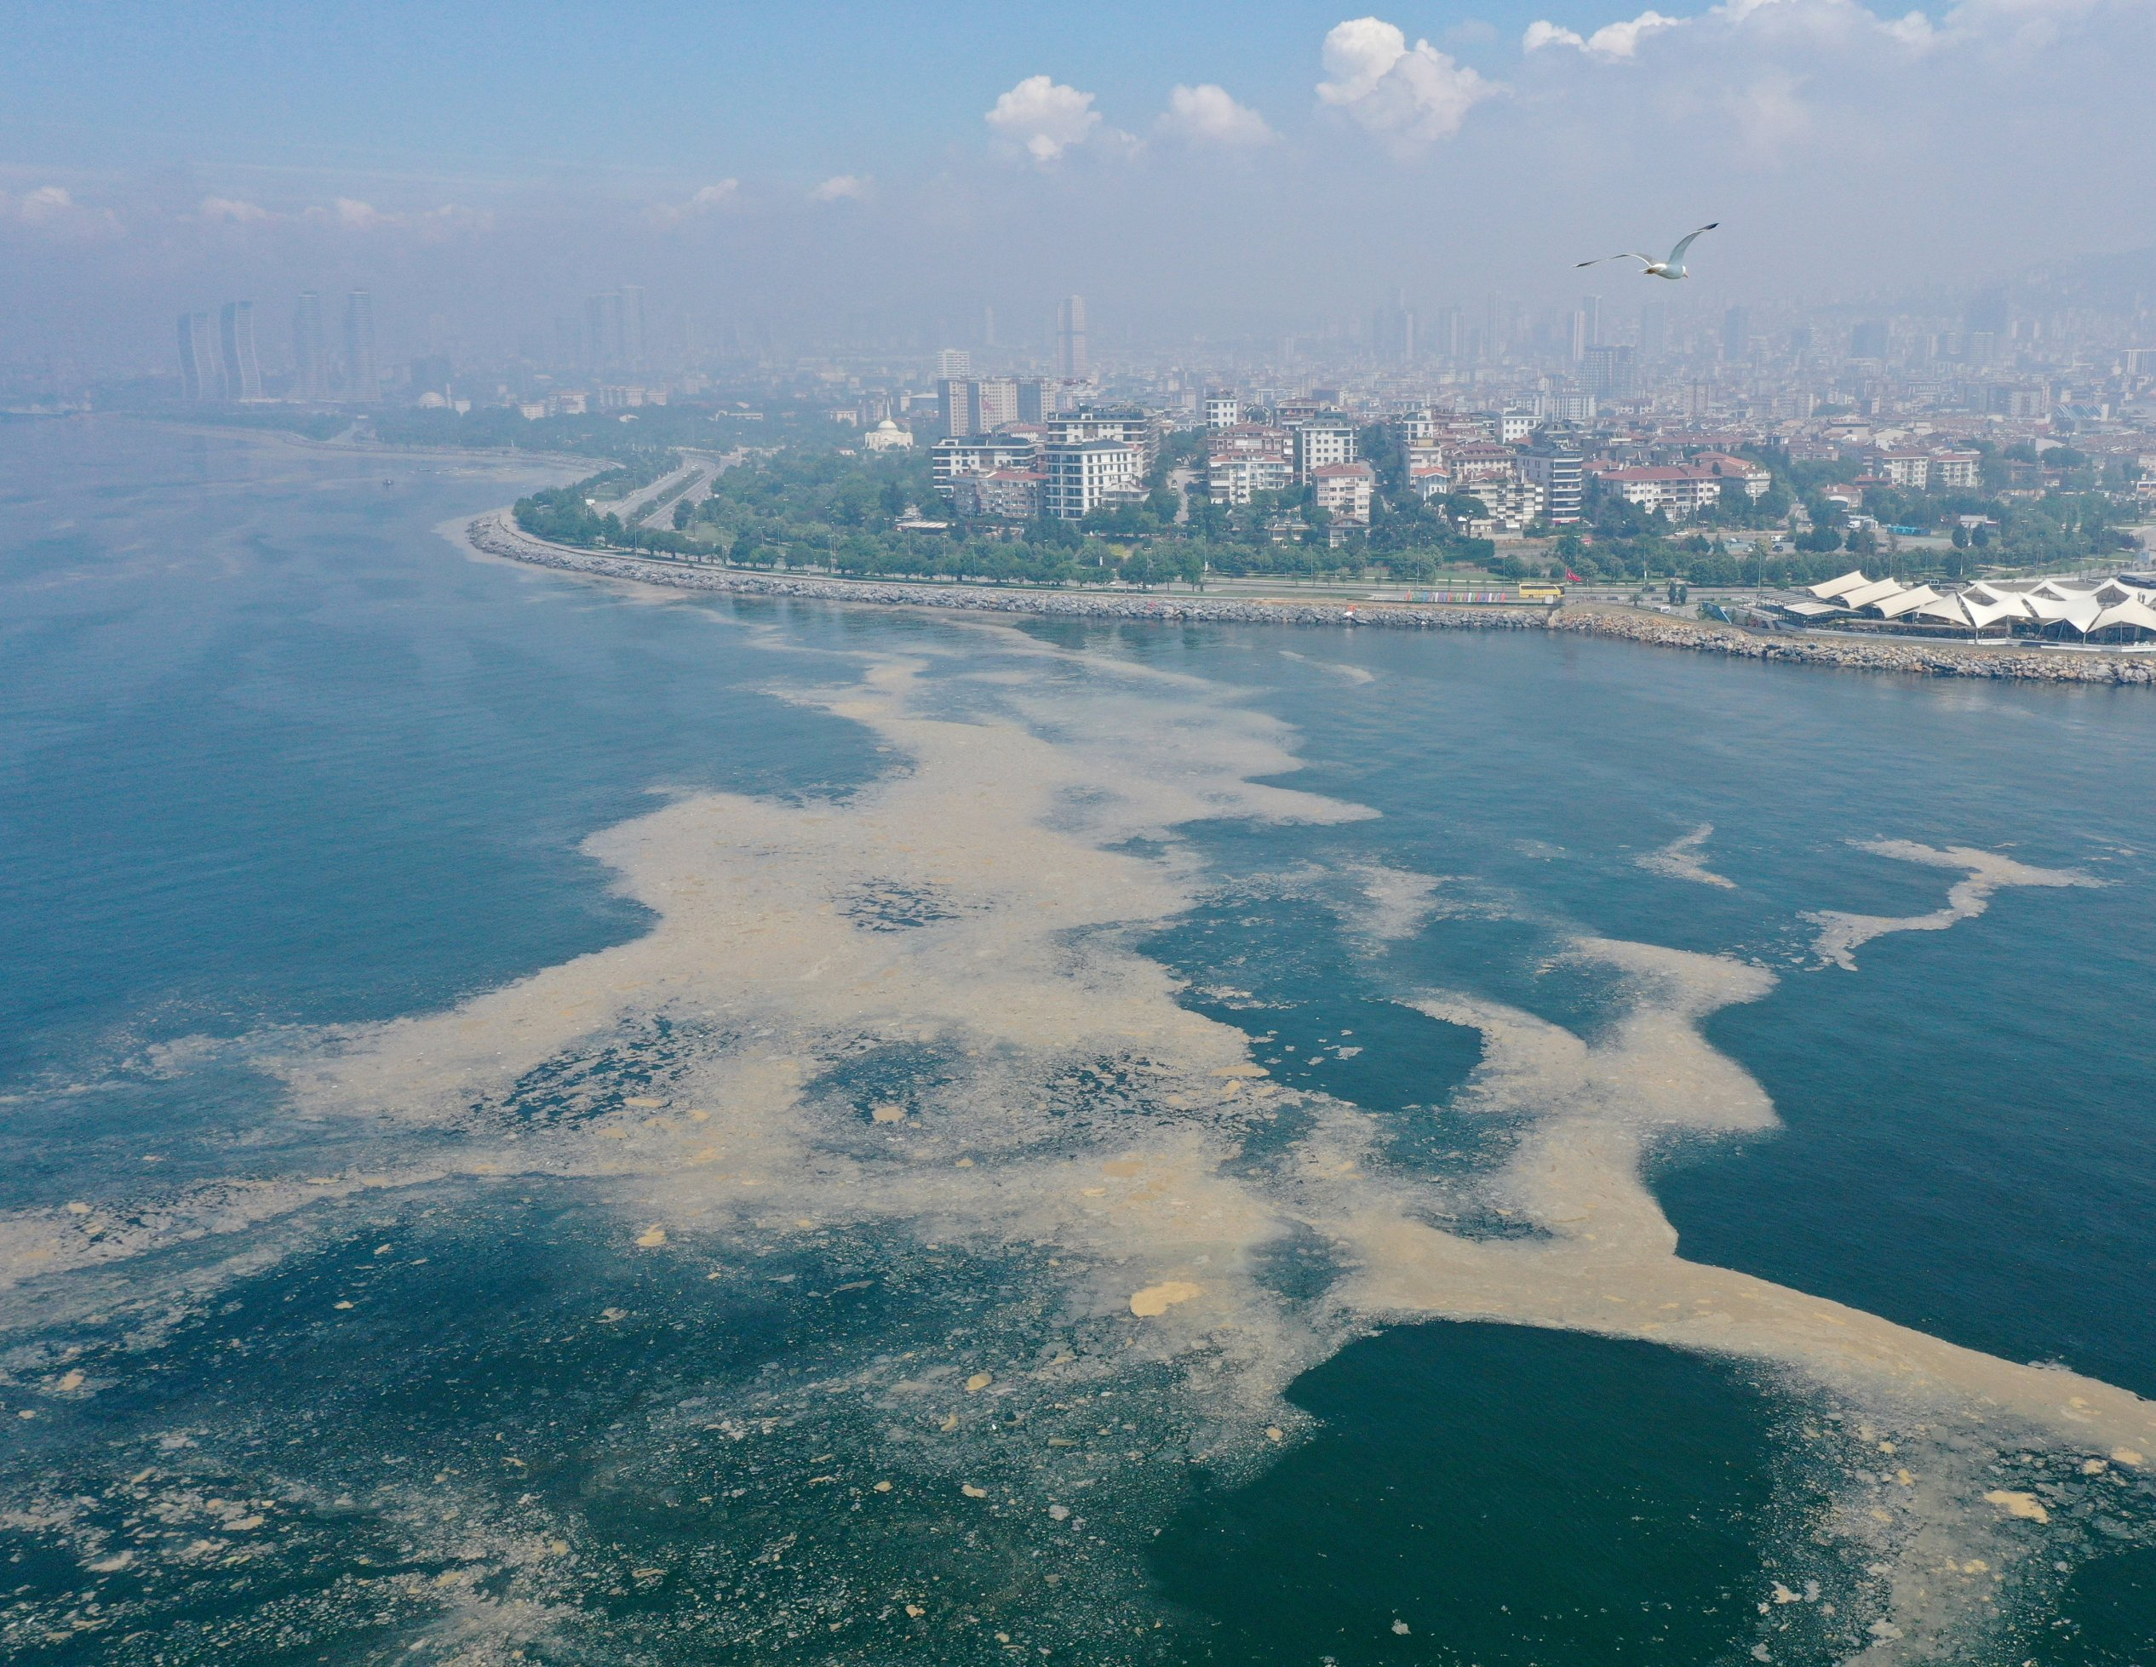
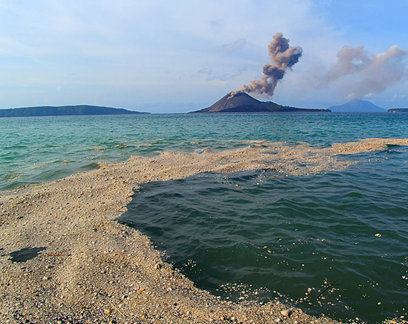
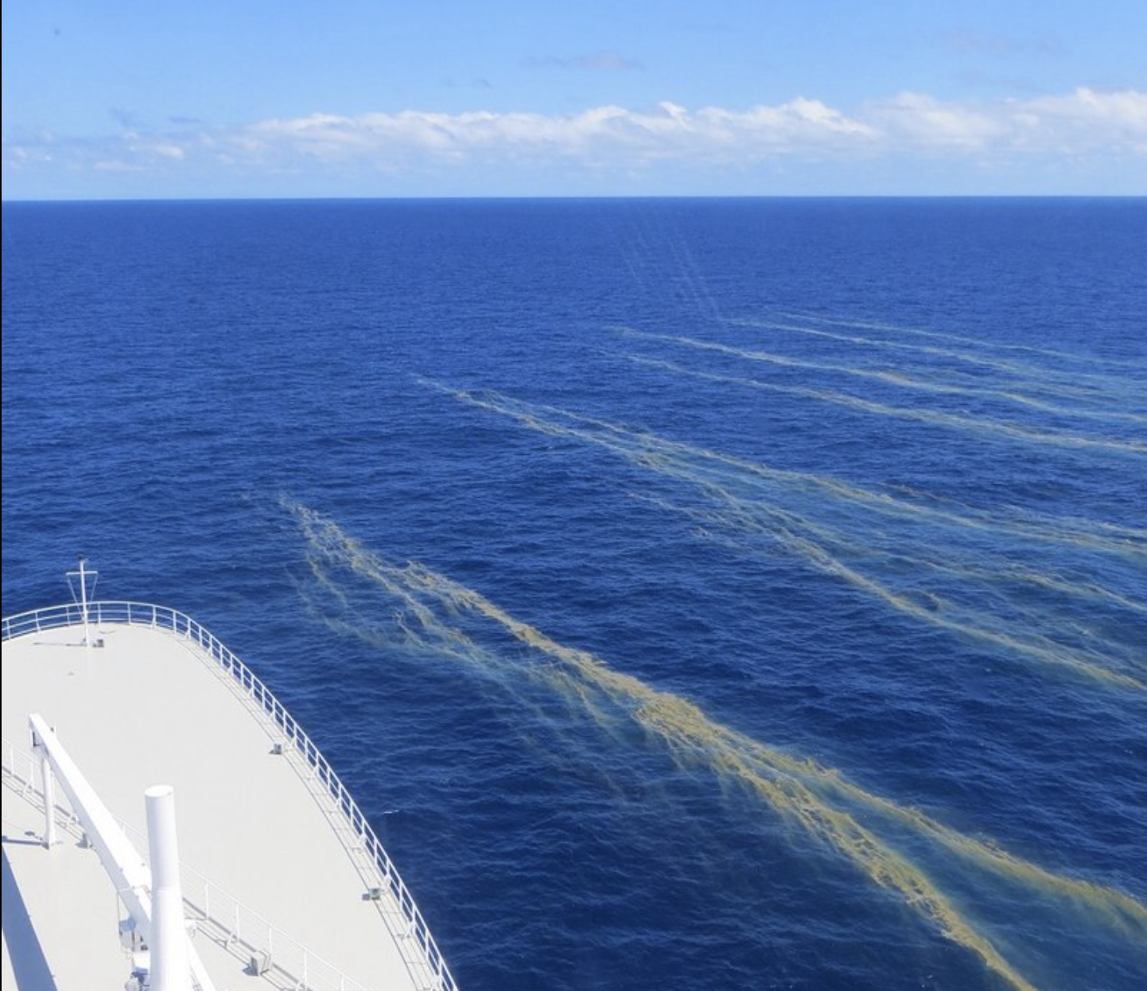
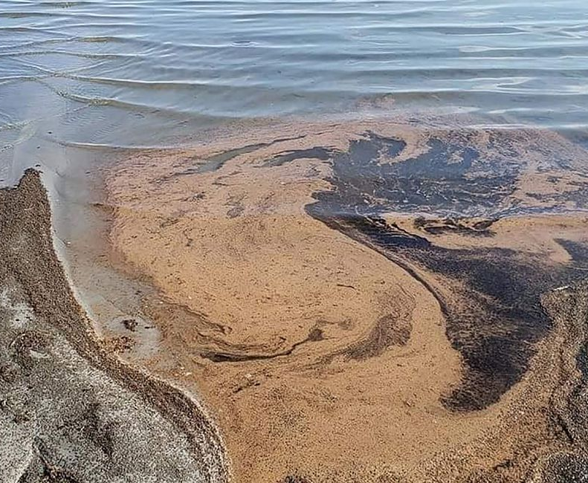
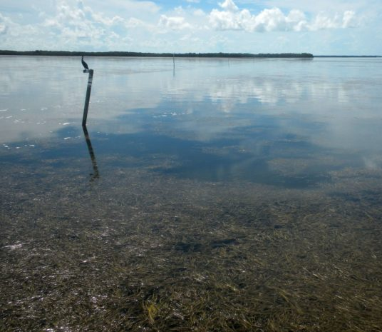
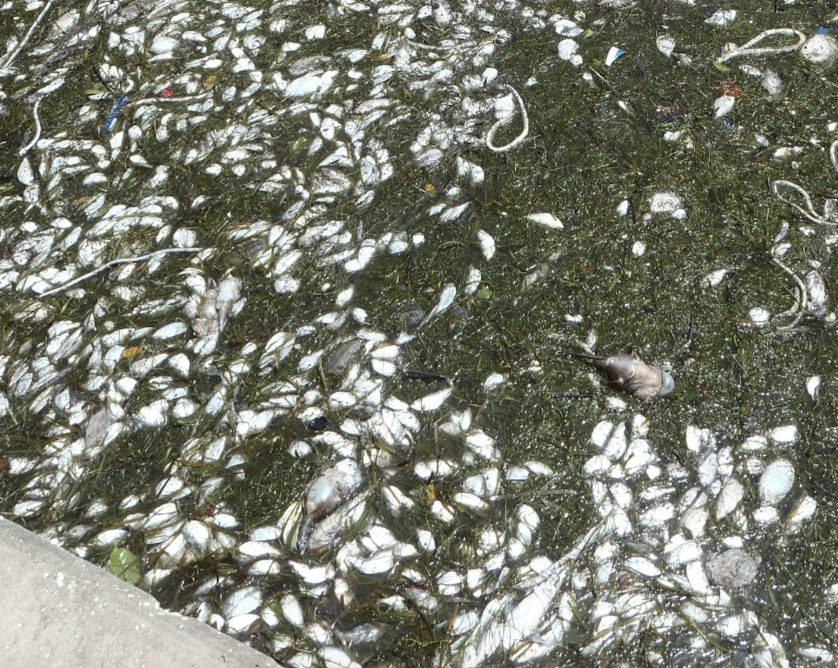
2) What is that “something”?
Marine litter
Sargasssum fluitains/natans
Sargasssum horneri
Ulva prolifera
Microcystis
Green Noctiluca
Red Noctiluca
Weathered oil
Sea snot
Pumice raft
Trichodesmium
Shrimp eggs
Dead seagrass
Dead fish
Dead fish & seagrass
Notes:
Whitecaps, shipwakes, pollen, etc

Slide 8
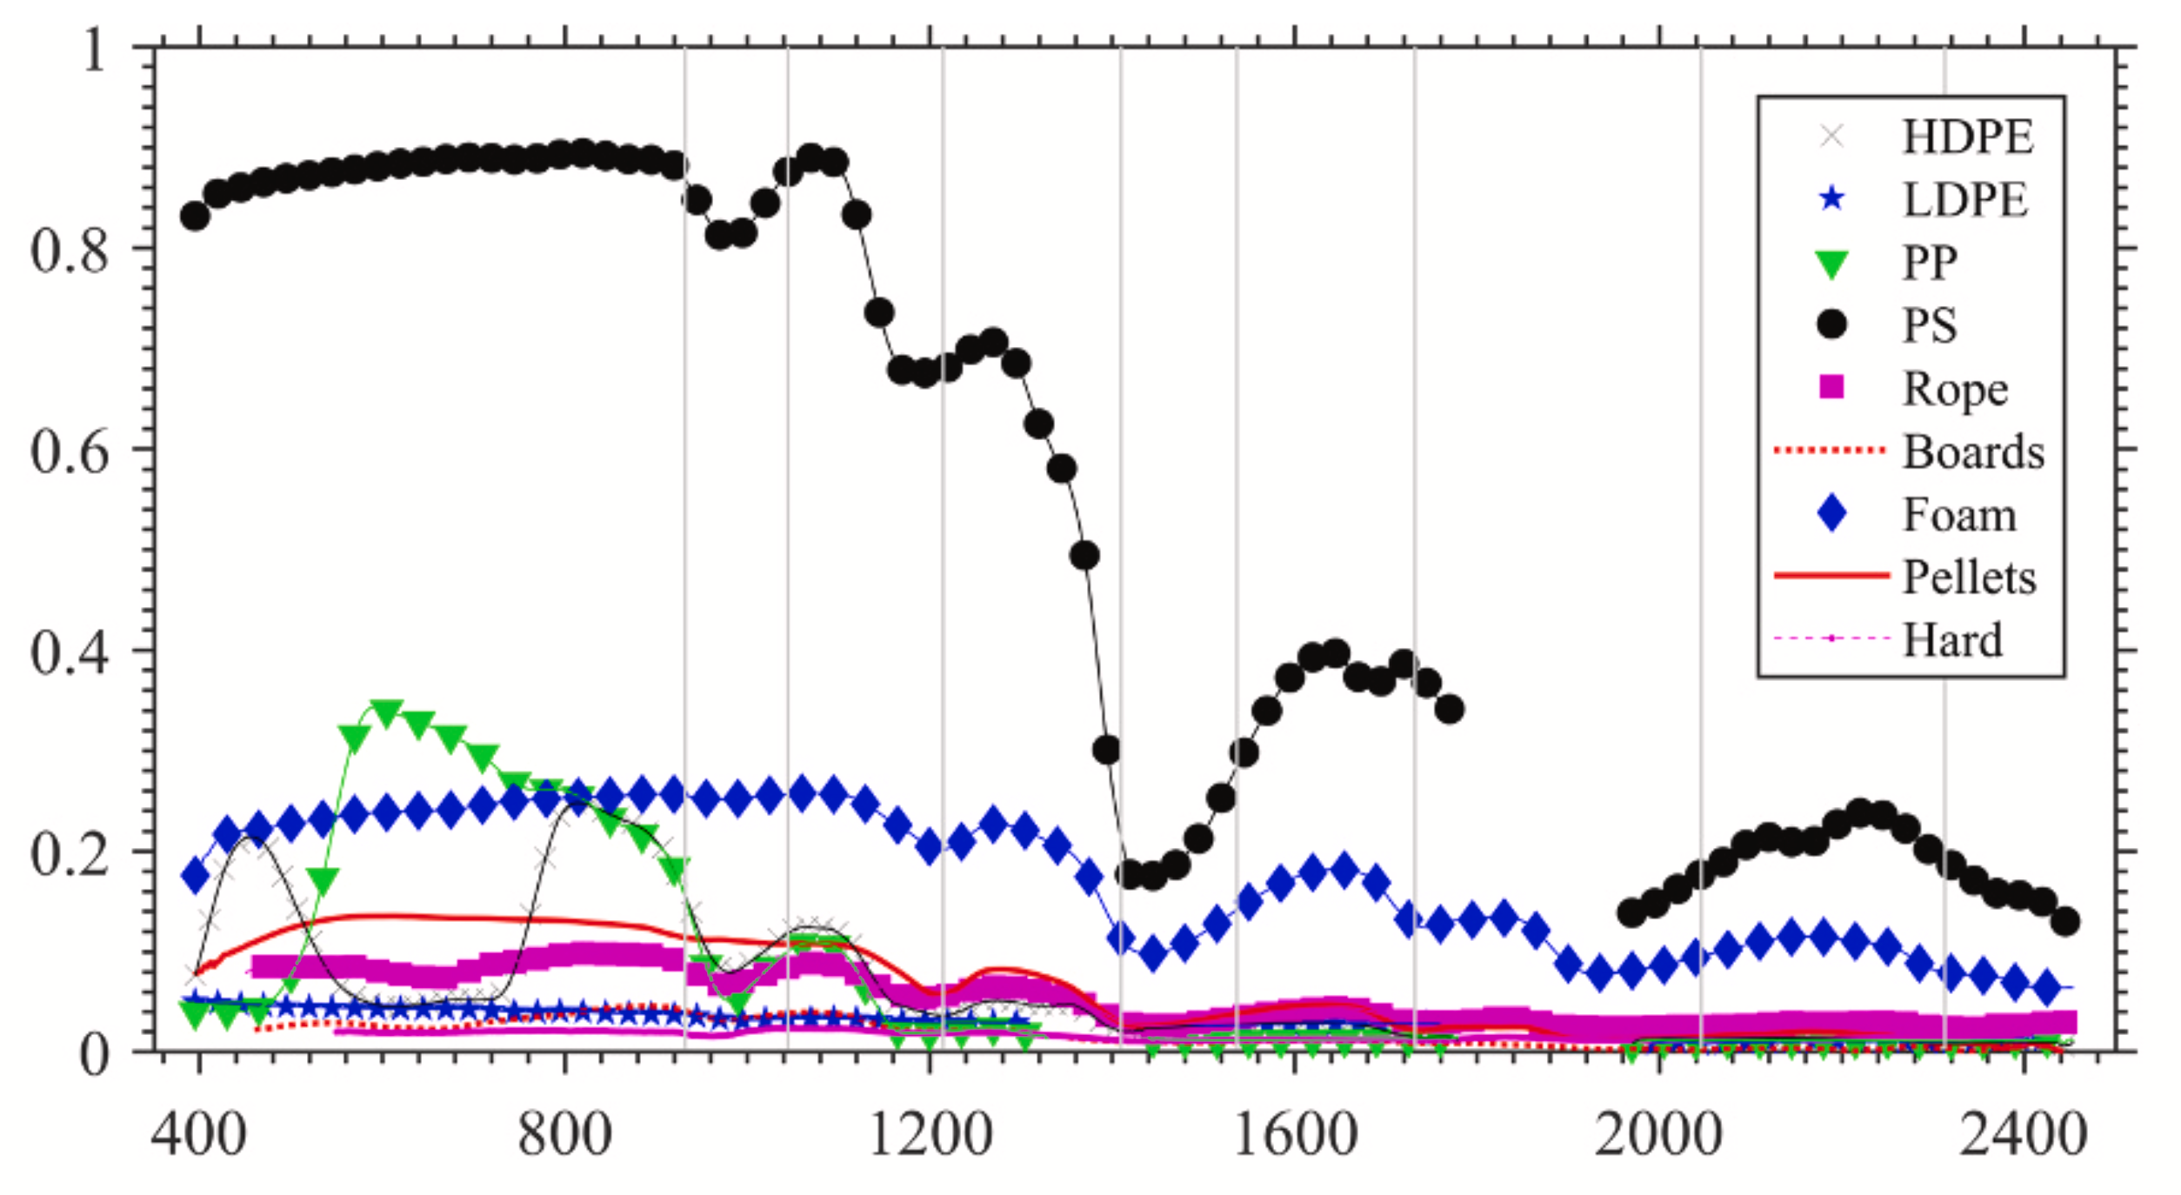
2) What is that “something”?
Do we have a spectral library for imaging spectroscopy?
Garaba et al. (2021)
Macroplastics & microplastics
Macroalgae & microalgae (scum)
Others (sea snot, pollen, shrimp egg…)

Slide 9
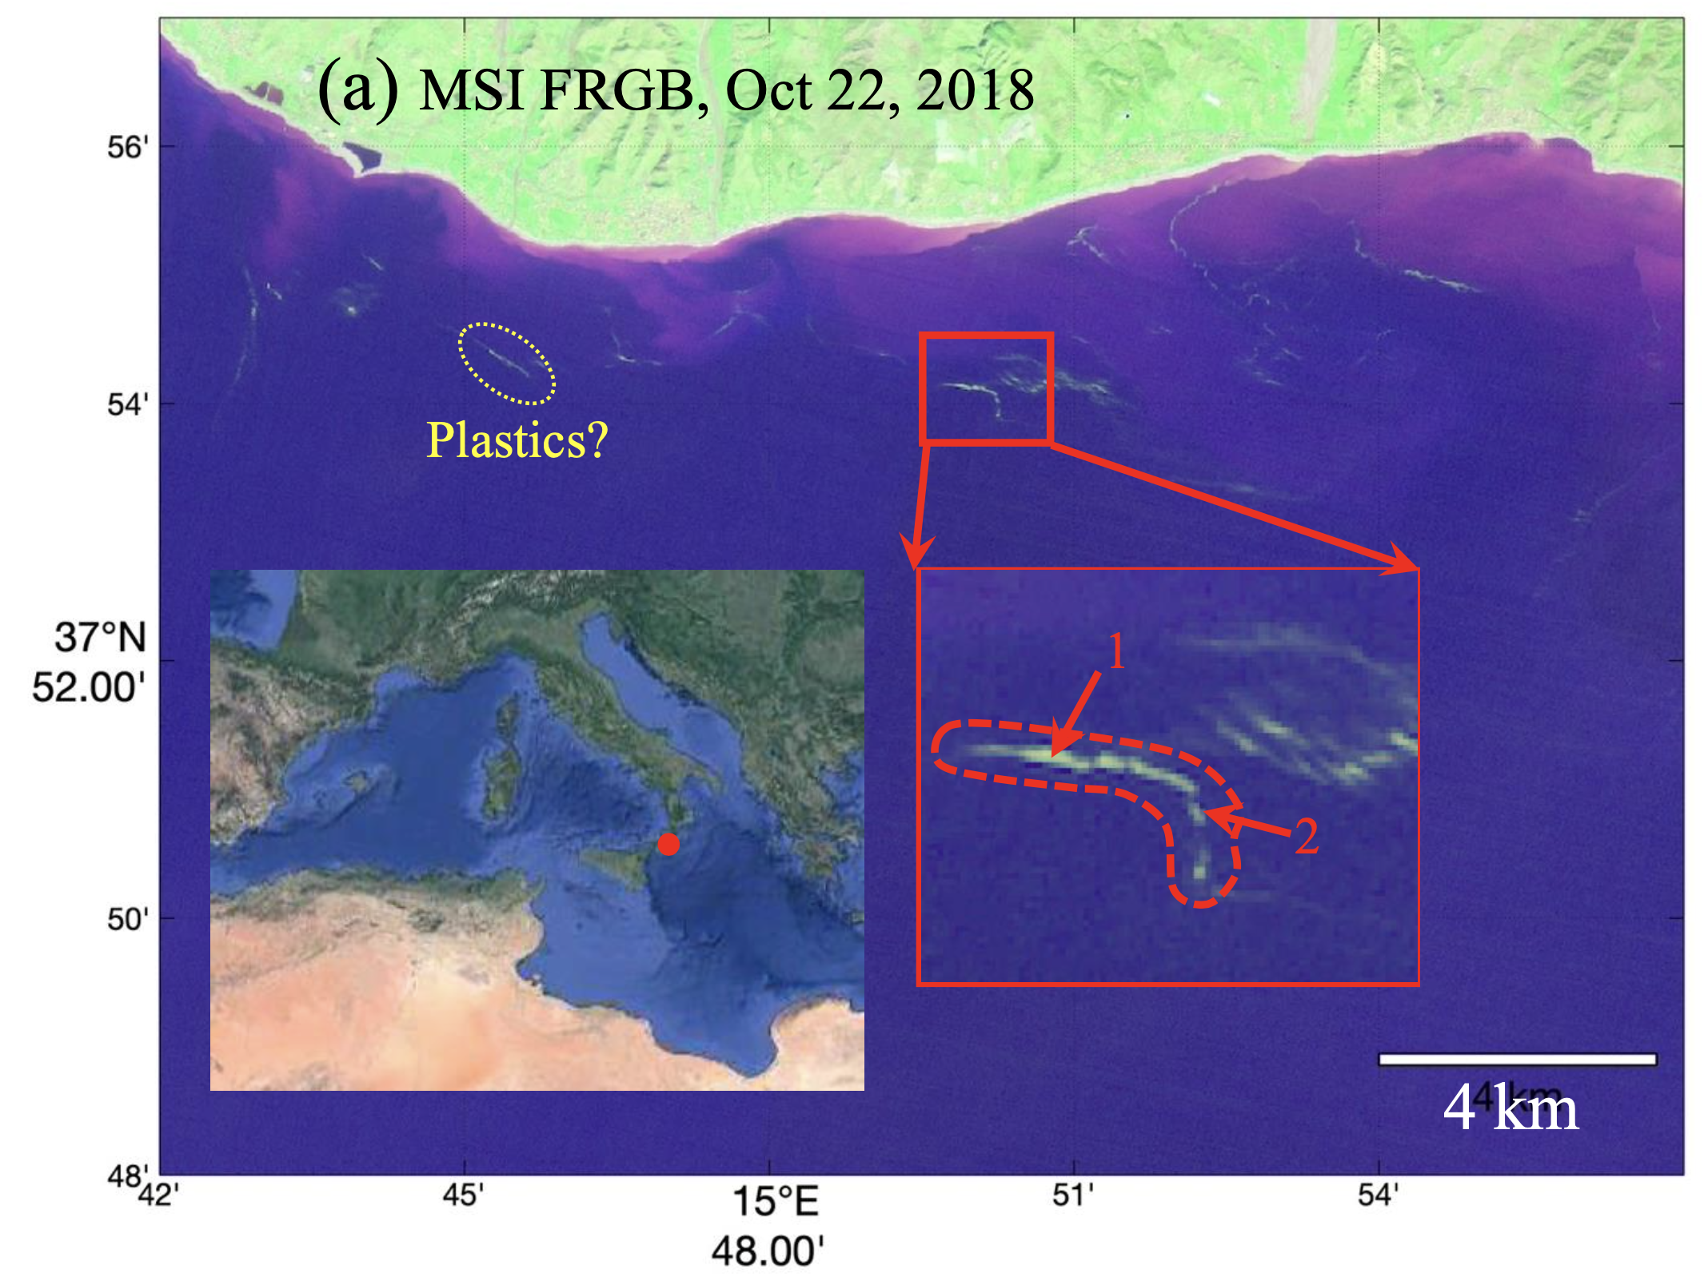
2) What is that “something”?
MSI demonsration: image features off Italy
Notes:
20 random pixels

Slide 10
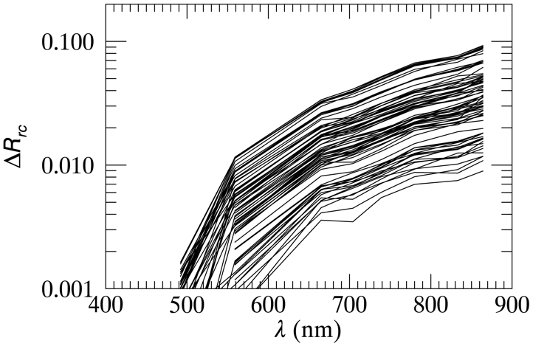
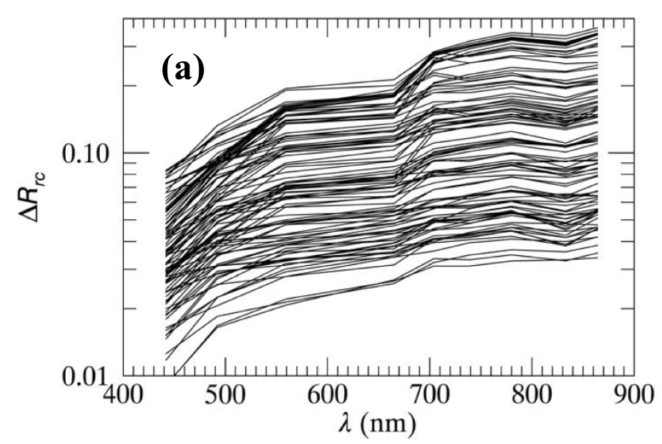
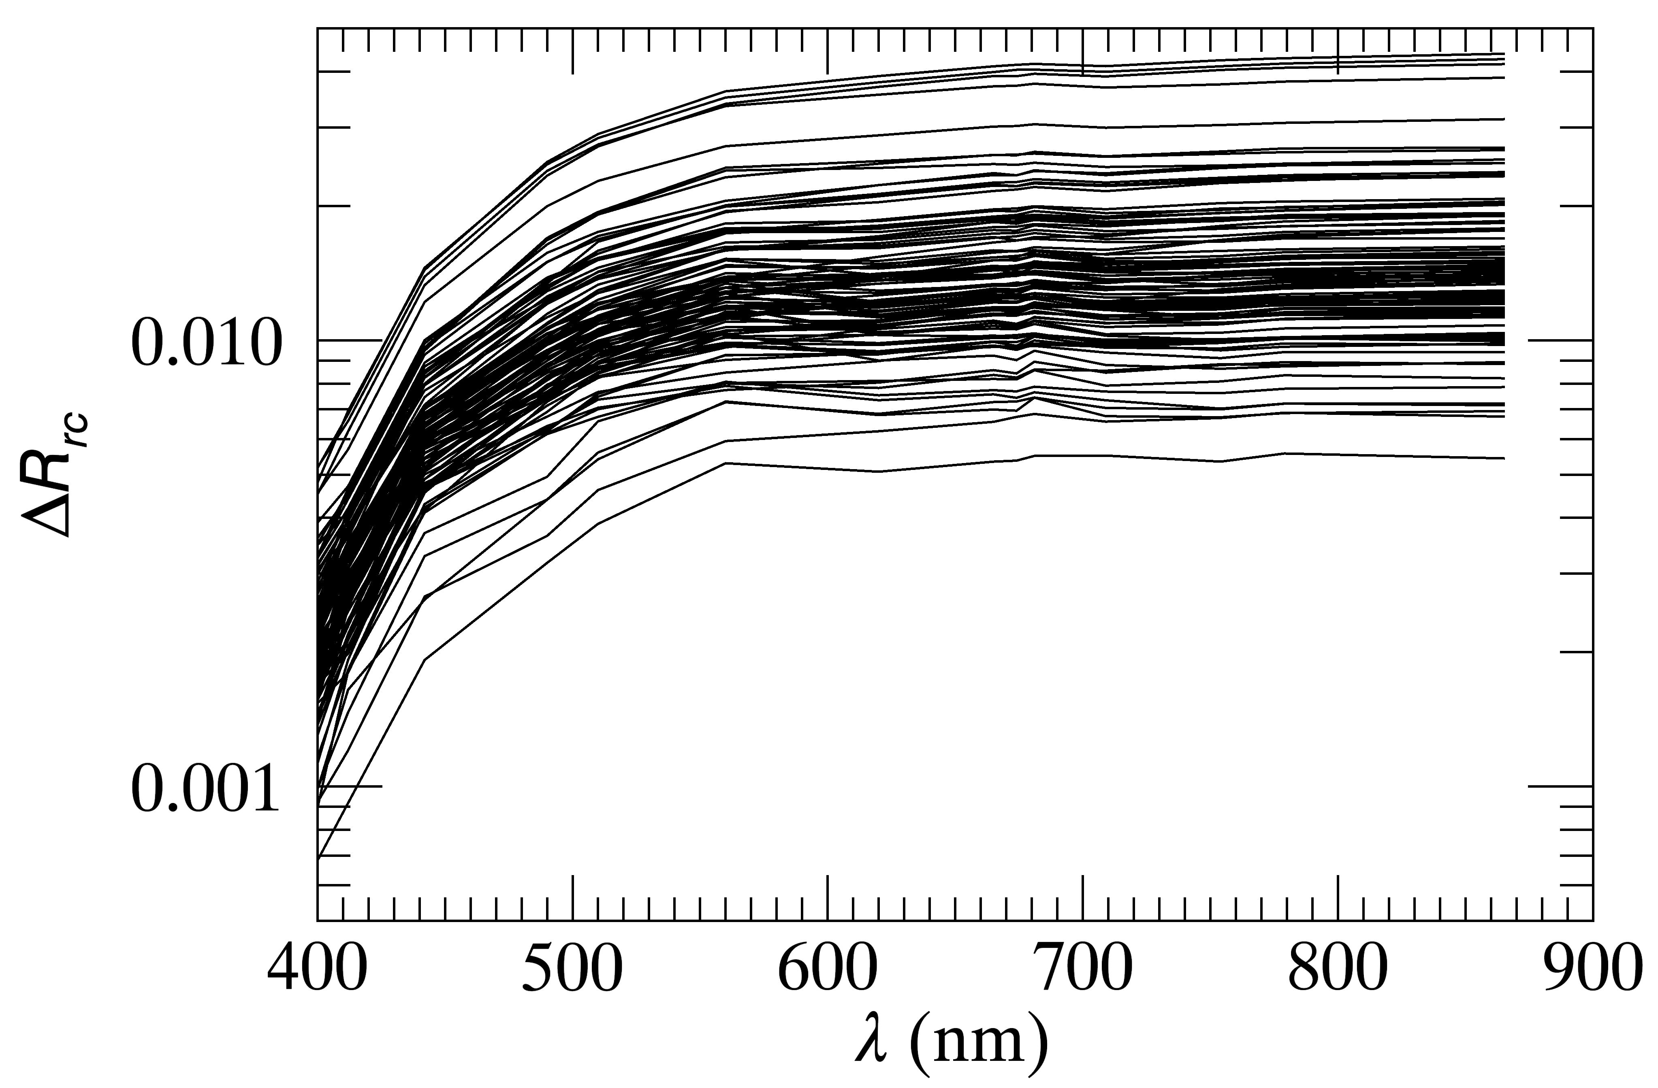
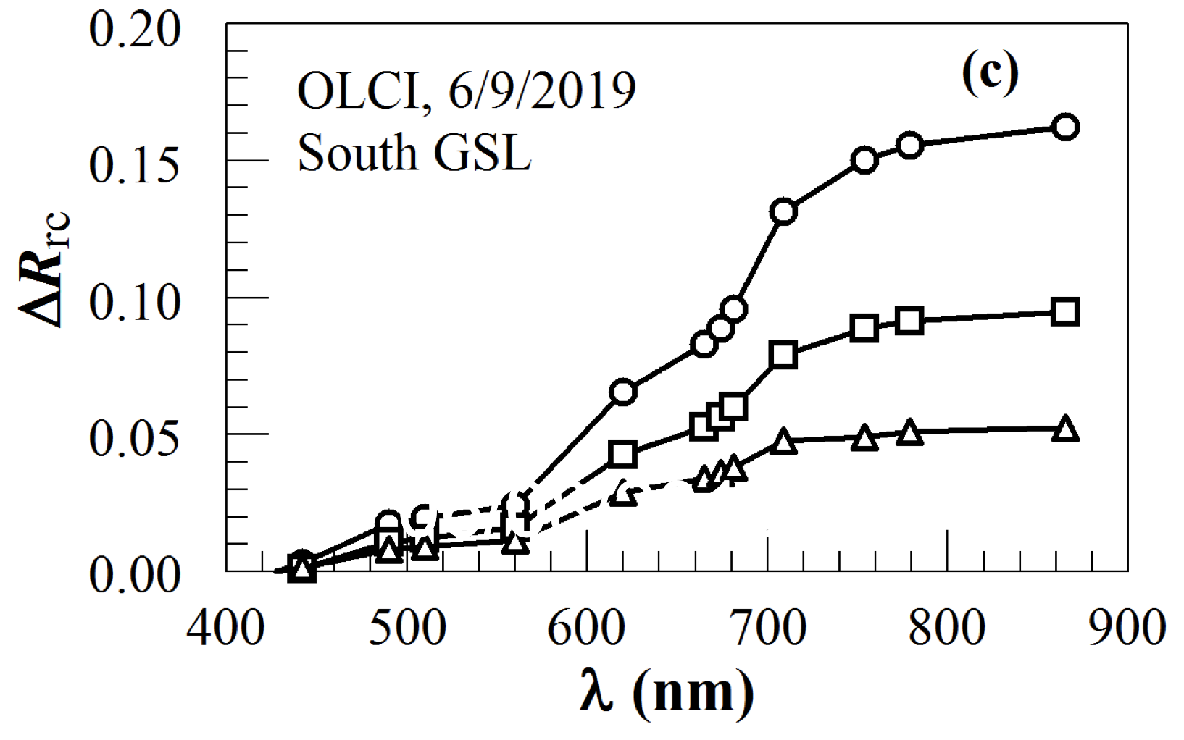
2) What is that “something”?
MSI demonsration: image features off Italy
Imaging spectroscopy:
Spectral differencing to regain spectral shape
Spectral averaging to remove cross-band mismatch
Driftwood
Same method applied elsewhere:
Sea snot
Shrimp egg
Pine pollen
Notes:
20 random pixels

Slide 11
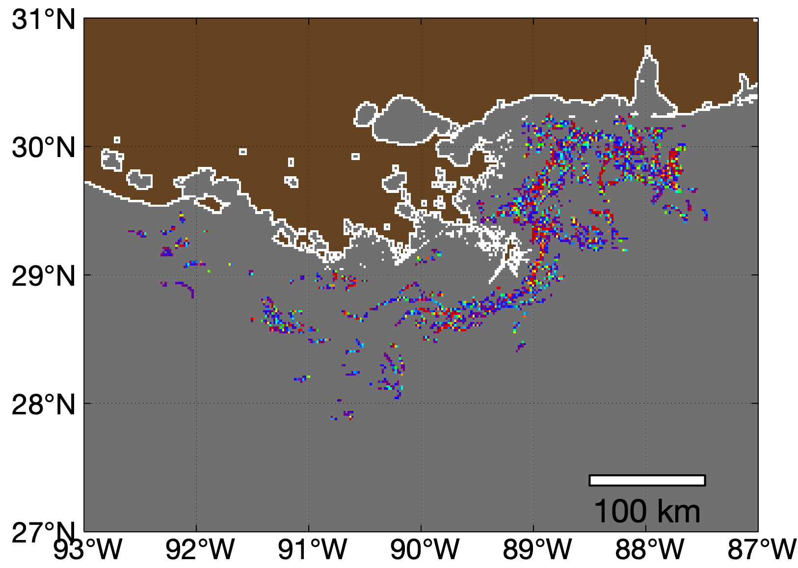
3) How much?
Determine χ (%) for each pixel, then map debris distribution
Mississippi River delta: mostly driftwood, with possibly small amount of plastics
50 m
25 m

Slide 12
Summary
What’s possible? Macrodebris (including macroplastics)
How? Spatial anomaly, spectroscopy, and spectral unmixing
Key requirements: Use ΔR and spectral averaging for spectral discrimination
Retrieved spectral shapes are nearly identical to those of field-measured endmember spectra
Challenge: Discriminate plastics from non-plastic non-vegetation floating matters
They are all spectrally “flat”
After all, not every bright pixel is debris, and not every debris pixel is plastics
These findings are for passive optical remote sensing from satellites only
Other remote sensing techniques (LIDAR, Radar, polarimetry) can also be used
Spatial morphology and other information can also help discriminate floating matter types
Detecting “something” is relatively easy
Discriminating that “something” is much more difficult

Slide 13
Backup slides

Slide 14
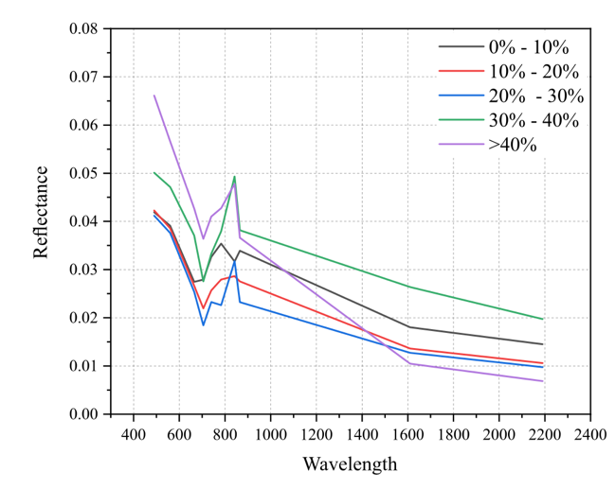
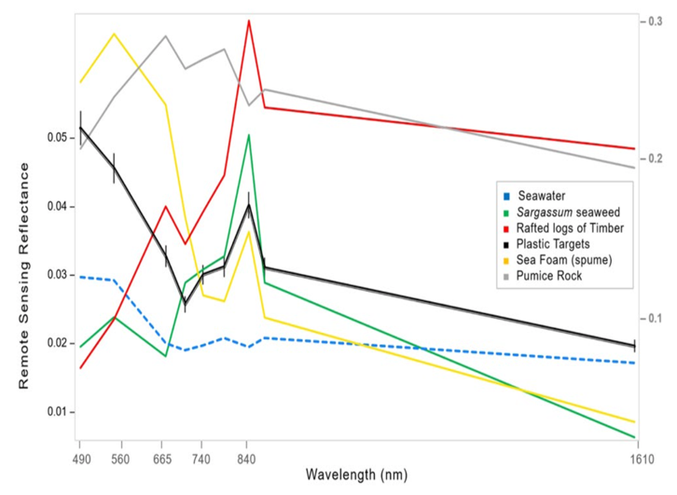
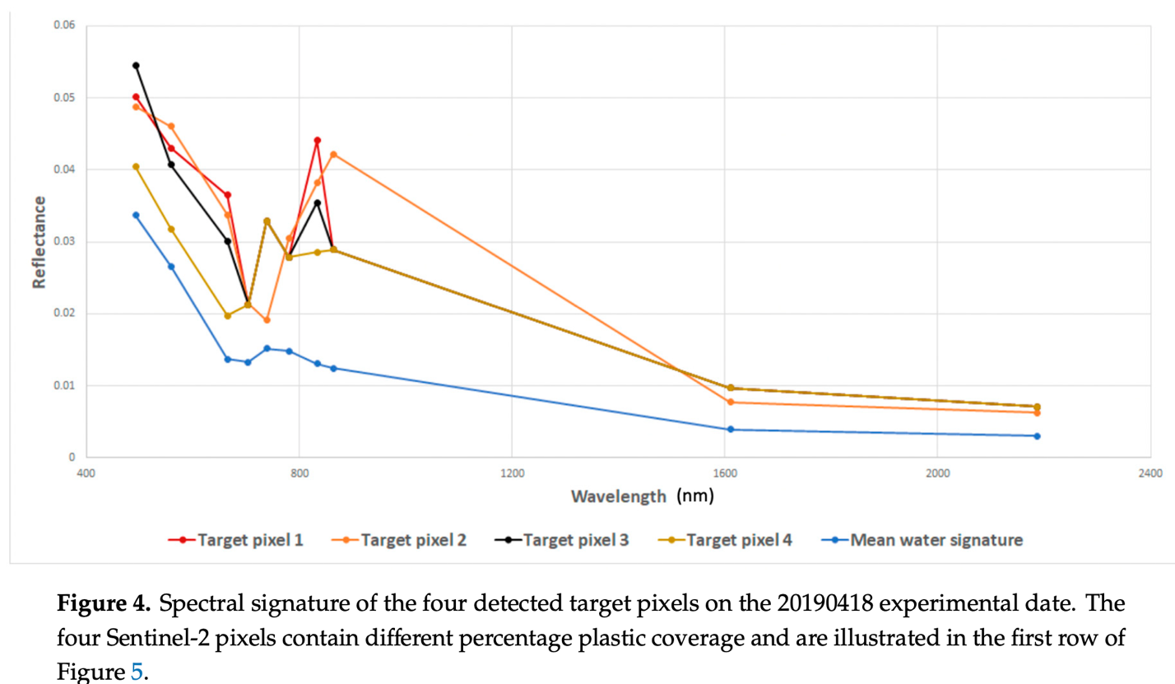
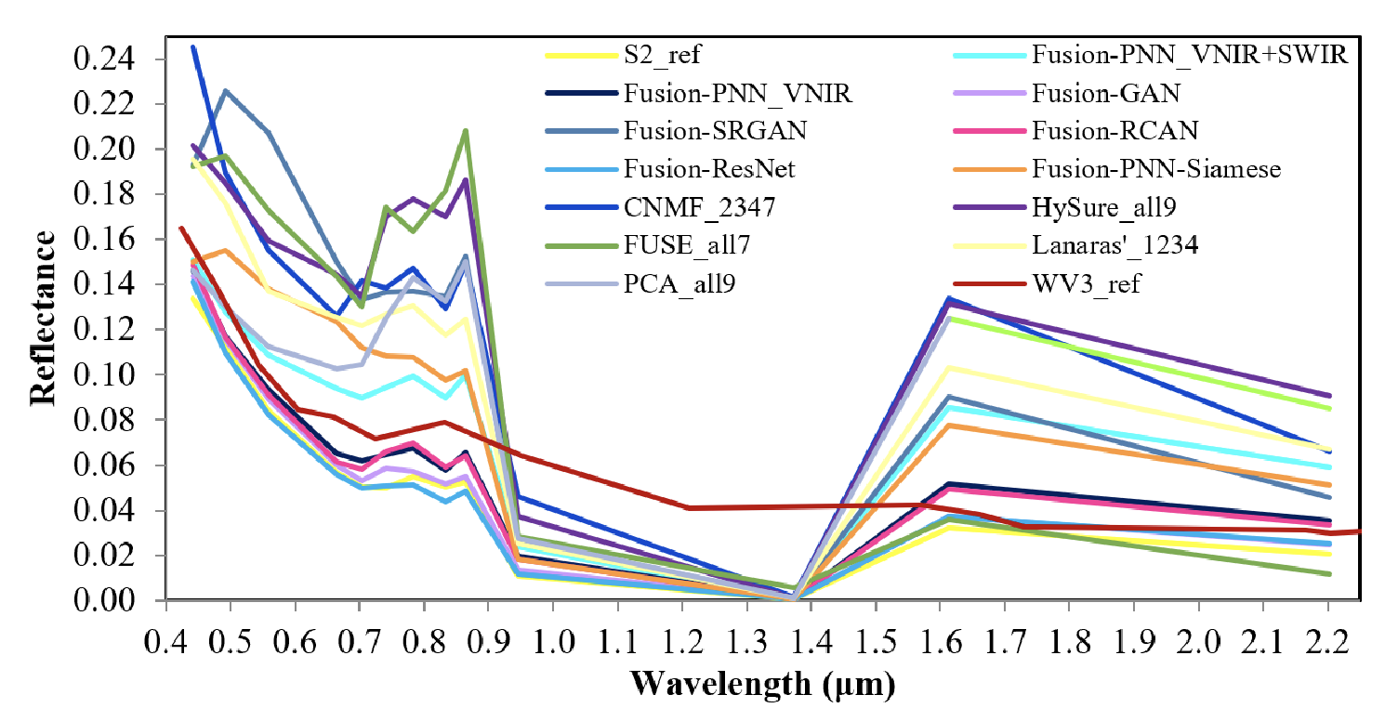
Spectral discrimination: How?
Spectral endmembers based on MSI pixels – spectral shapes appear distorted
Notes:
Left column: Sannigrahi et al. (2022), Ciappa (2021), Kremezi et al., (2022). Right column: Biermann et al. (2020), Topouzelis et al. (2020), Kikaki et al. (2022).
Why calling them distorted? No field data show any of these spectral types

Slide 15
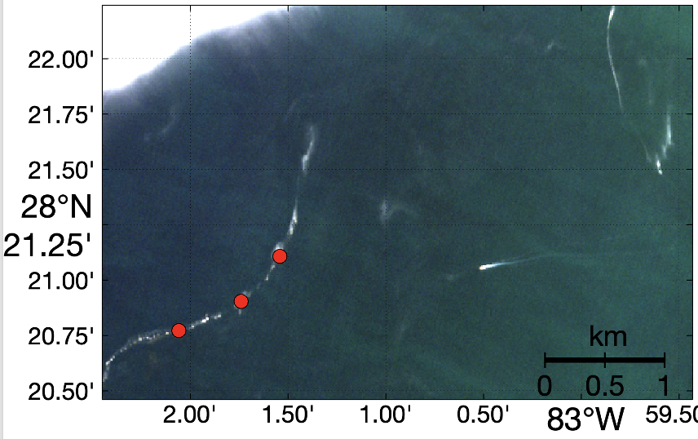
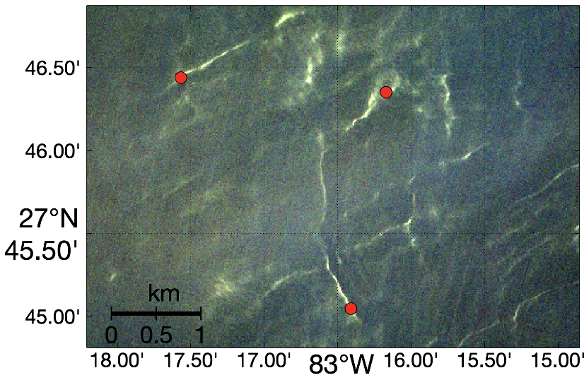
Technical steps in remote sensing of floating matters
What is that “something”?
However, it is still difficult to fingerprint marine plastics through spectroscopy alone
20%, 14%, 7%
20%, 14%, 7%
9%, 7%, 4%
9%, 7%, 4%
Hu (2021)

