Slide 1
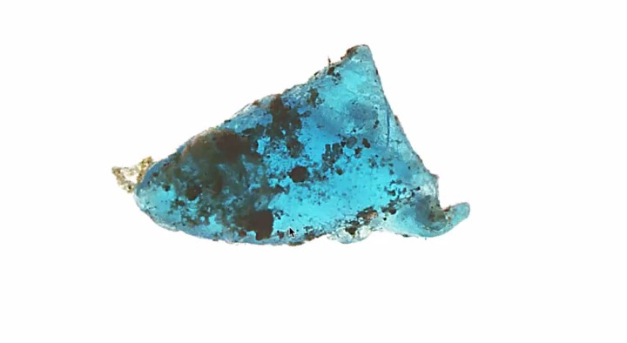

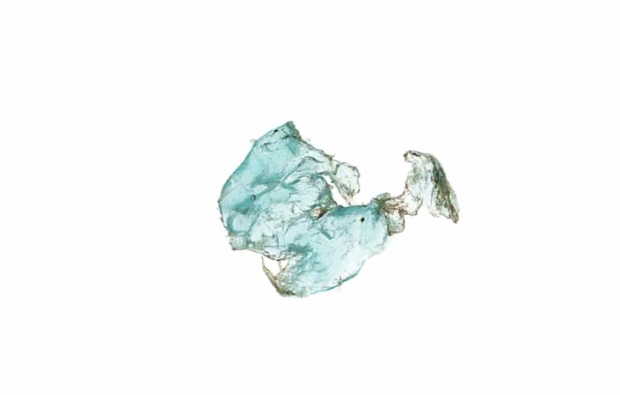

SQOOP: Spaceborne Quantification of Ocean micrO-Plastics
PI: Heidi M. Dierssen, University of Connecticut
Graham Trolley, M.S. Student, UCONN
Kirk Knobelspiesse, NASA GSFC
Amir Ibrahim, NASA GSFC
Jacek Chowdhary, Columbia University/ NASA GISS
Matteo Ottaviani, Terra Research Inc / NASA GISS
Oskar Landi, Photographer, Consultant
Lorraine Remer, Univ. Maryland Baltimore County
Shungu Garaba, Univ. Oldenburg
Photo Credit: Oskar Landi
Photo: Oskar Landi

Slide 2
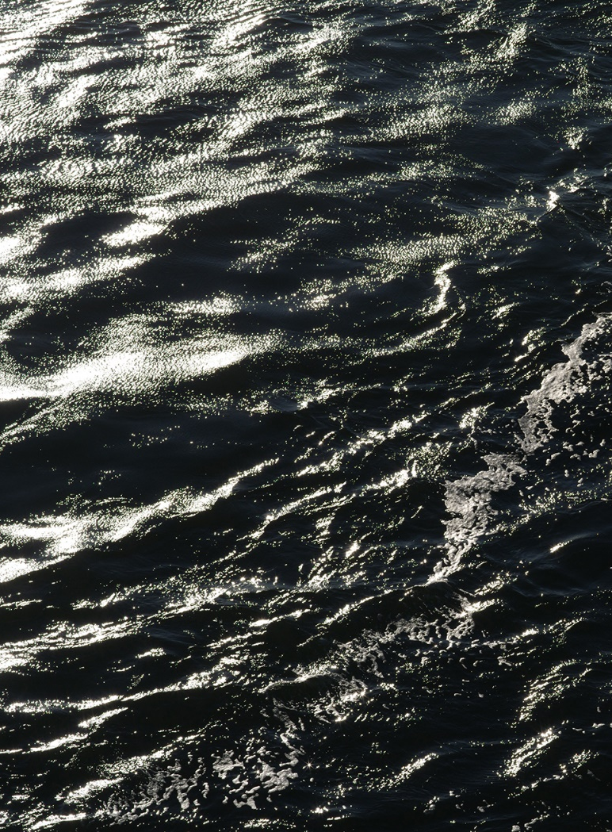
A QUEST…
From a radiative transfer perspective, it is still unclear at what concentrations surface floating microplastics will have a detectable influence on sea spectral reflectance & ocean refractive index.
a feasibility study of remote detection of surface microplastics:
  different surface particle properties
  uncertainties in atmospheric correction
  with multispectral and polarimetric approaches
Art/Science Collaboration
Photo Credit: Oskar Landi

Slide 3
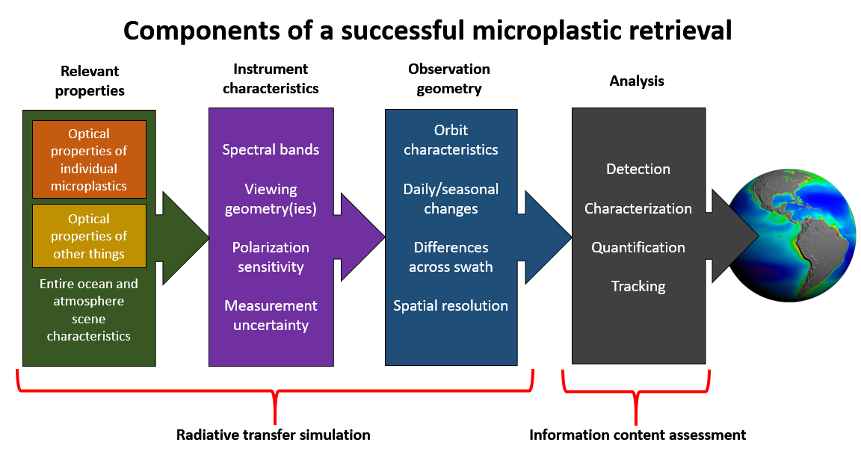
COMPLETED (VNIR Multi-spectral)
UNDERWAY (eGAP radiative transfer code)
COMPLETED (Rogers Method)

Slide 4
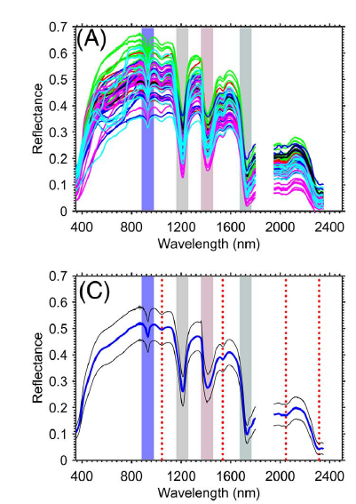
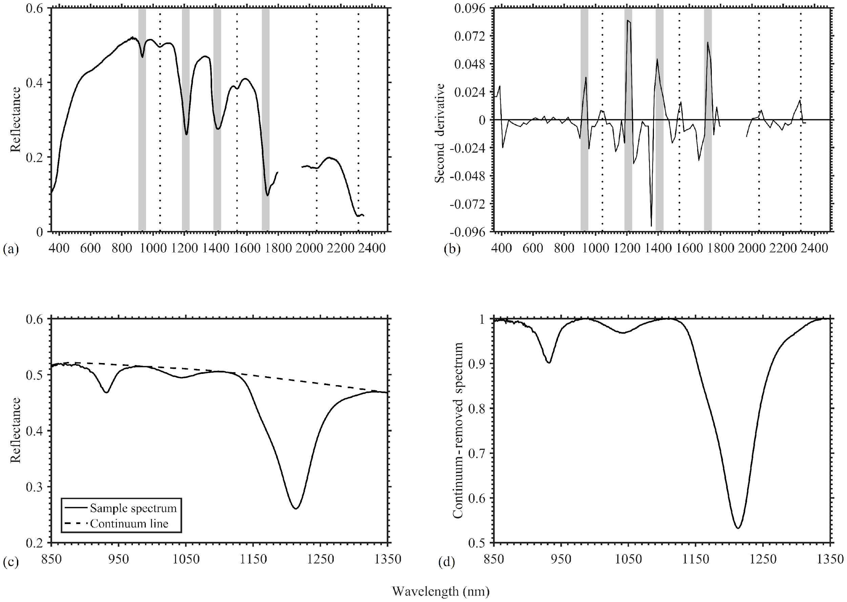
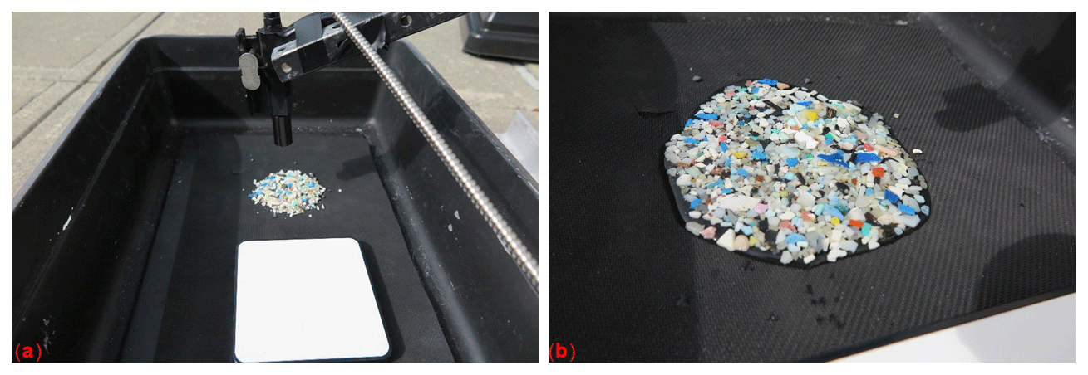
Historic Microplastic Reflectance
Garaba and Dierssen 2018
Dry Microplastics:
  absorption features at 931, 1215, 1417, and 1732 nm
Spectral measurements of aggregated microplastic pieces

Slide 5
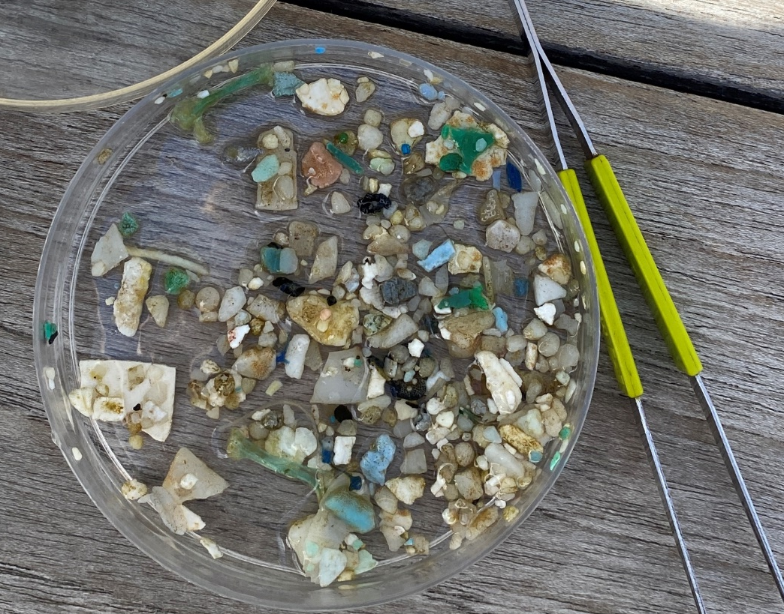
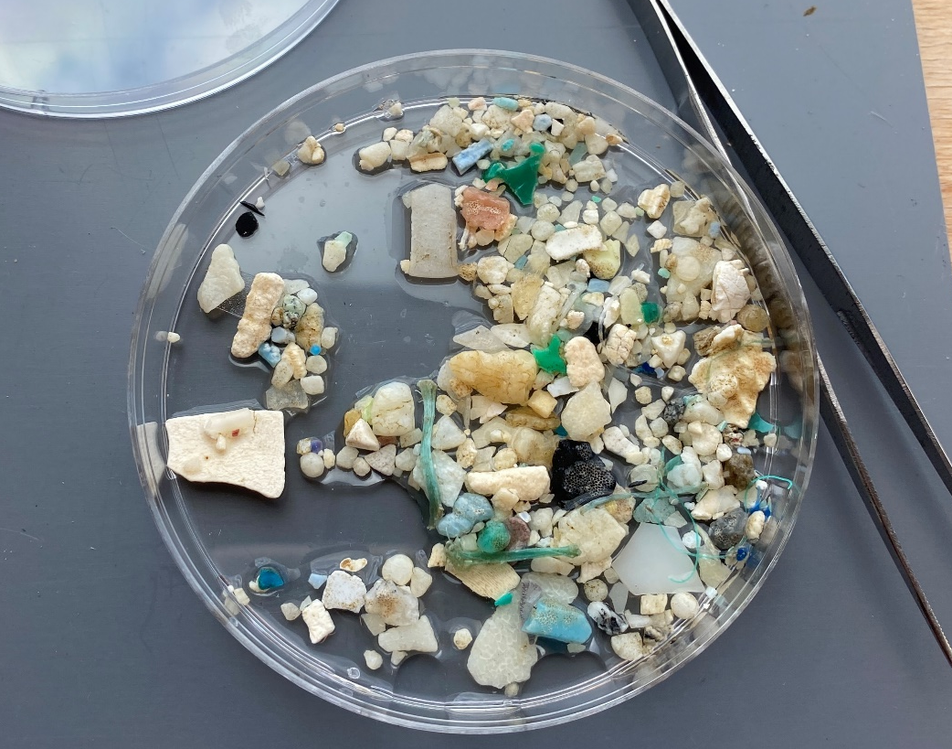
Questions
How does the presence of algal biofilms affect marine microplastic bulk spectra?
  Are the characteristic absorption features affected?

Slide 6

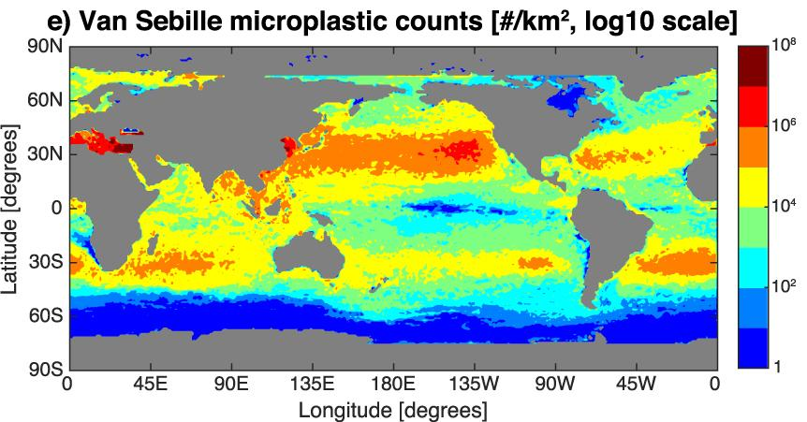
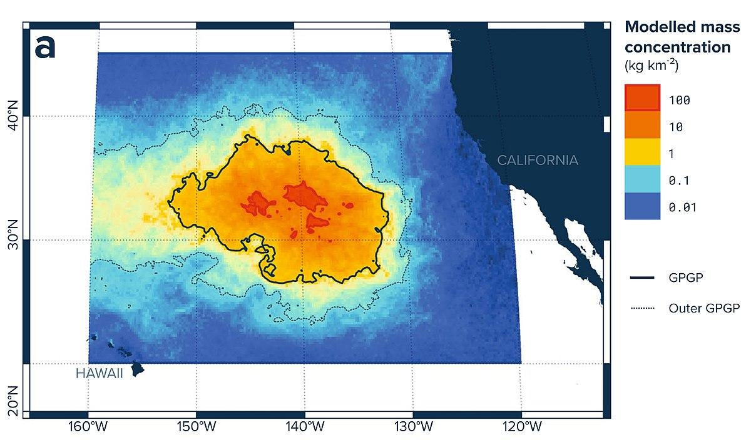
Microplastics
Plastic pieces less than 5 mm in size
Increasing in abundance in the world's oceans
Concentrated into subtropical gyres

Slide 7
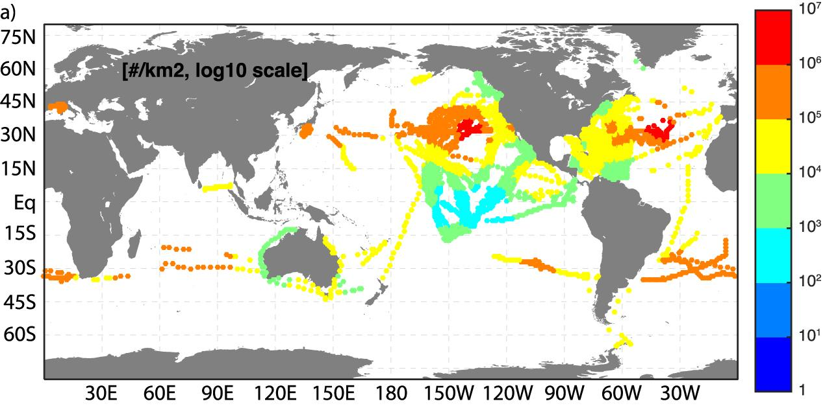
Field Measurements
27 field studies between 1971 and 2013 quantified plastic concentrations
11,854 total tows, or 1 datapoint every 1.3 days
Great Pacific Garbage Patch
  8% of the total mass
  94% of the estimated 2 trillion floating pieces
Van Sebille et al. 2015

Slide 8
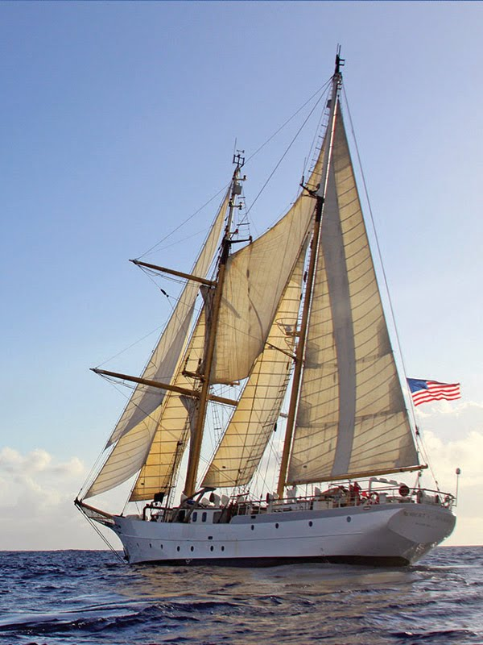
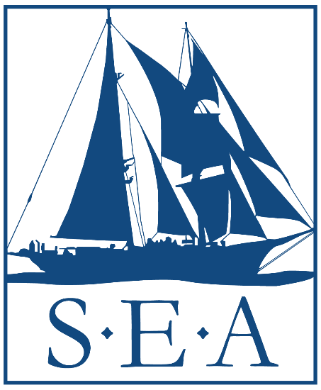
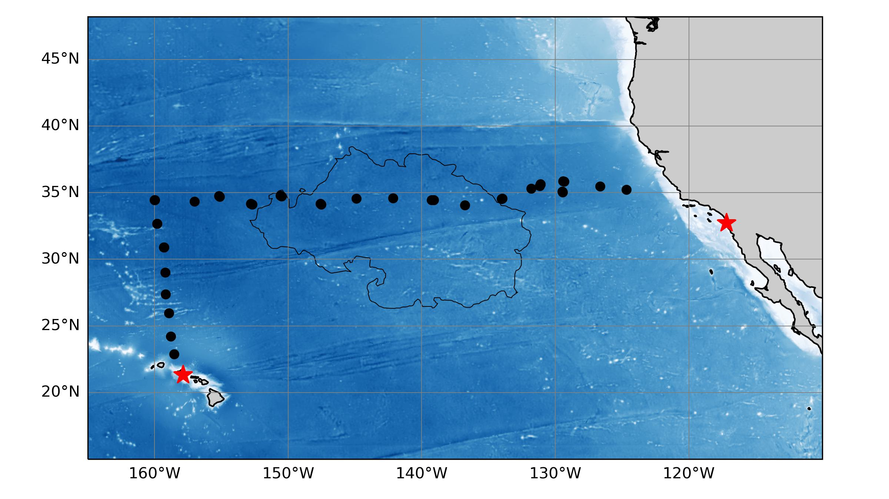
Field Work
Participated in SEA Summer cruise through the GPGP as a visiting scientist
Hawaii -> San Diego
June 25 -> July 24, 2022
Measured plastic spectra shortly after collection in order to capture biofilming

Slide 9
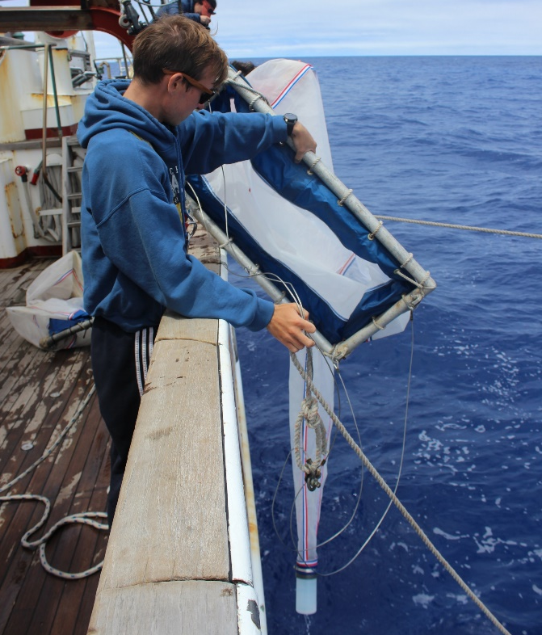
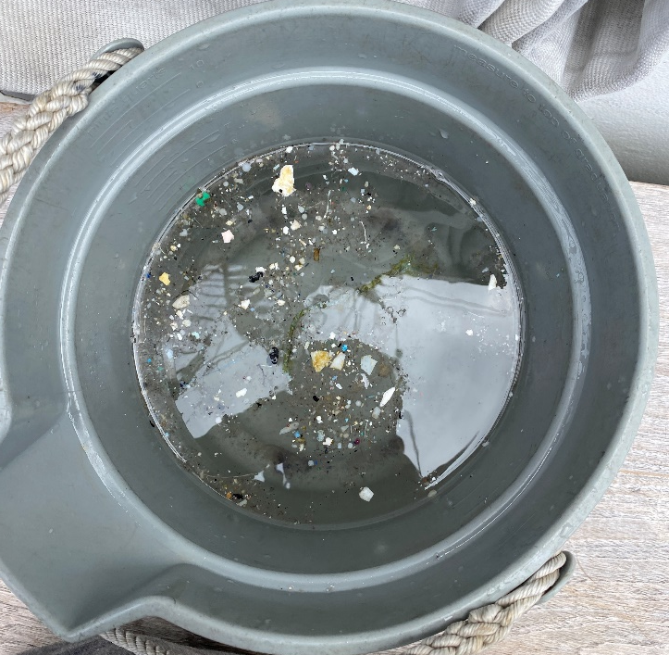
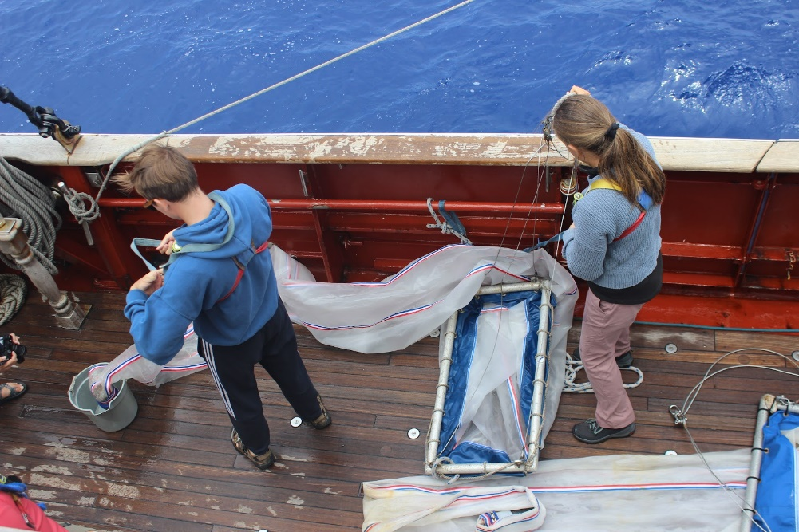
Plastic Collection
Plastics were collected during daily Neuston Net tows
Plastics were separated and kept wet until spectral measurement

Slide 10
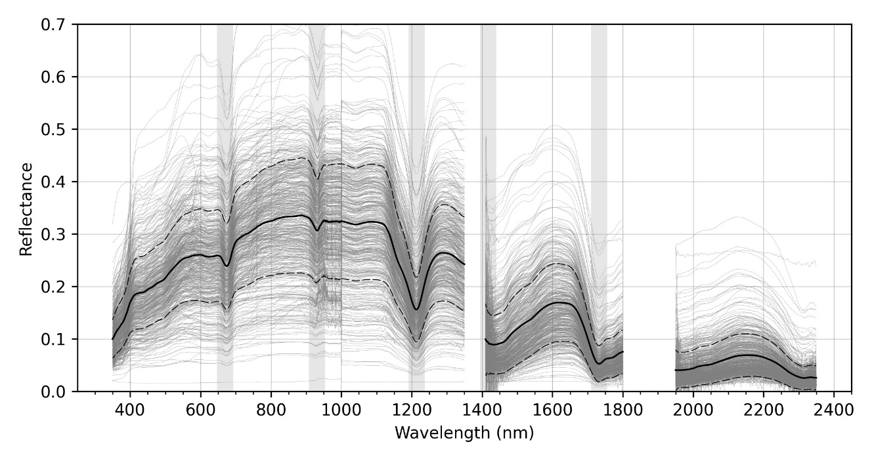
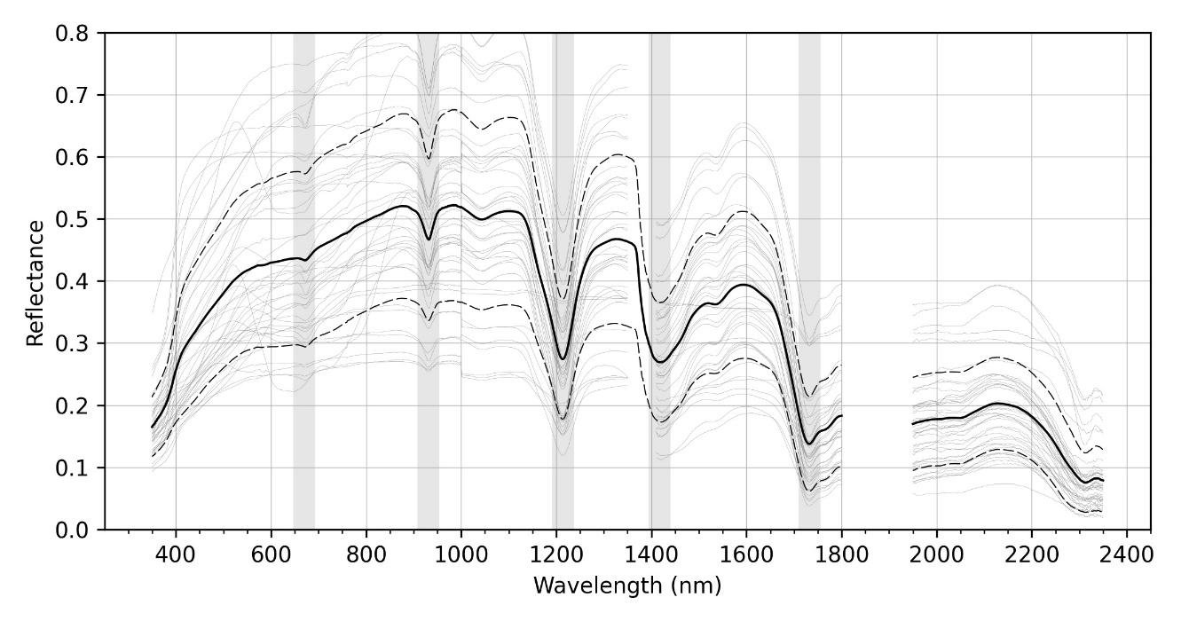
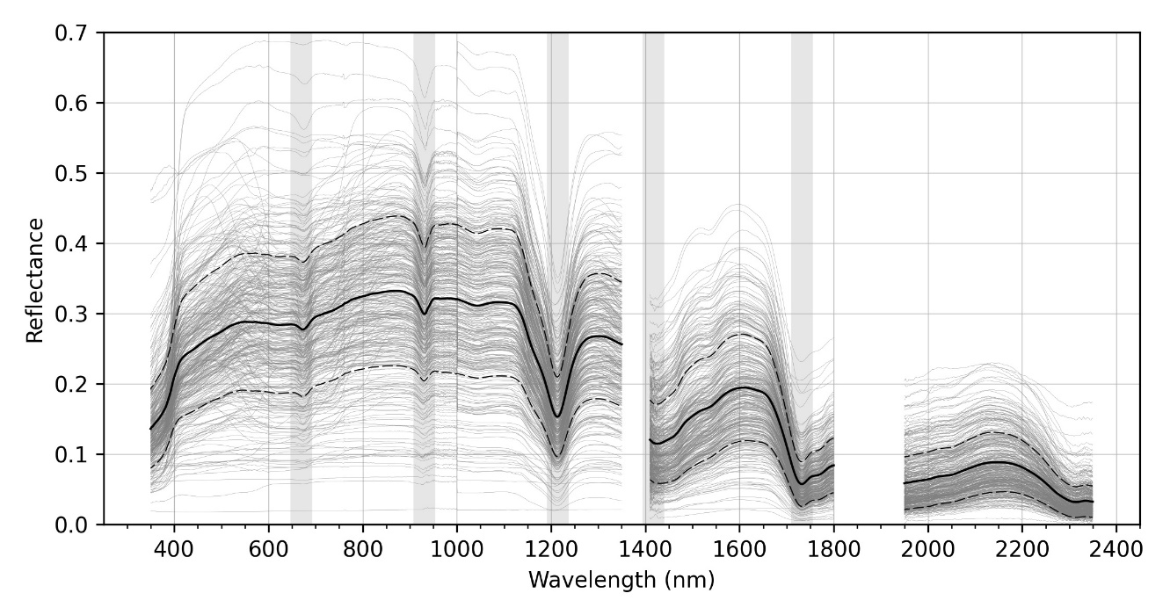
Results
Biofilmed
3 endmember spectra
Dry
Cleaned

Slide 11
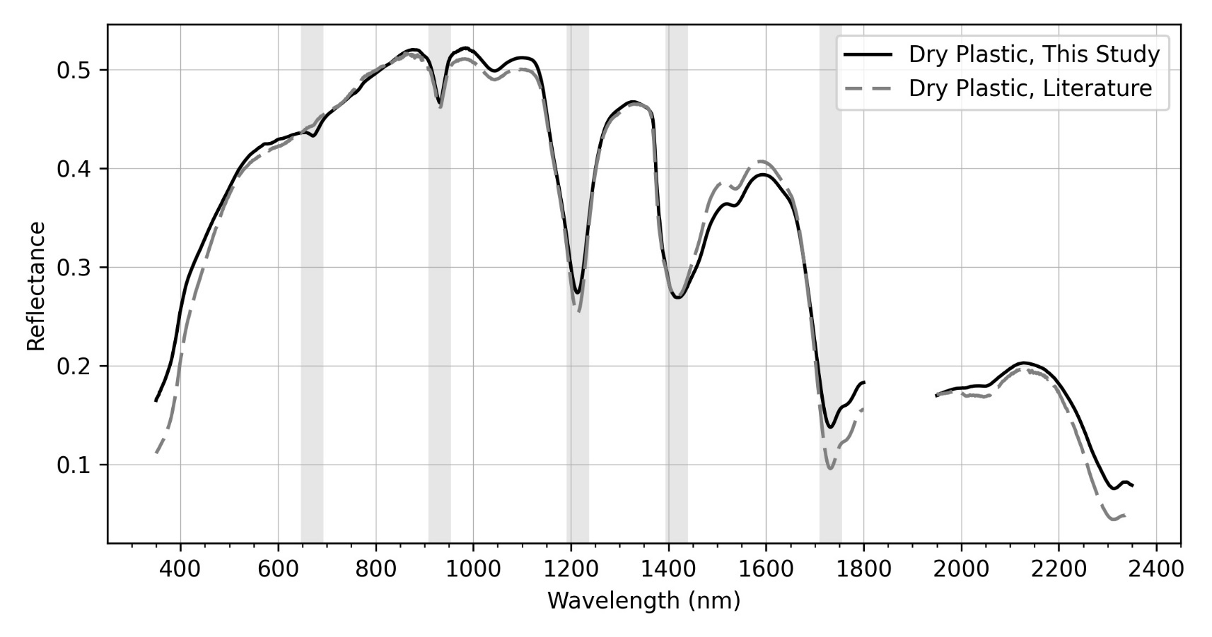
Analysis - Dry microplastics from GPGP
Dry endmember identical to Garaba and Dierssen (2018)

Slide 12
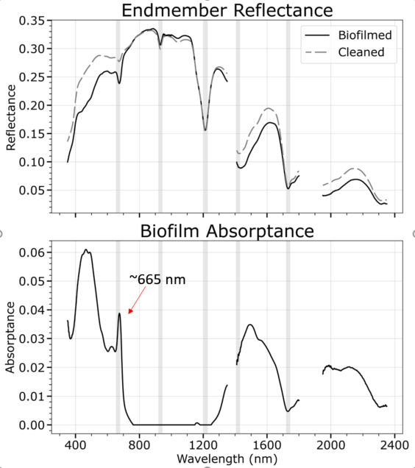
Analysis – Biofilmed vs cleaned
General shape + magnitude alignment (best in NIR)
  Spectral shape and magnitude changes significantly in VIS

Slide 13
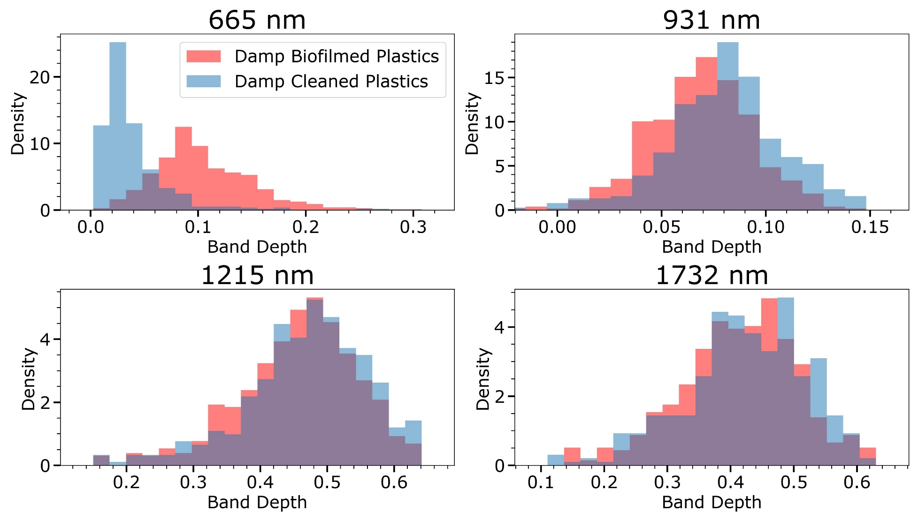
Band Depth
Biofilm influences visible, but not NIR/SWIR band depths
p<0.05
p<0.05

Slide 15
Simulation of TOA spectra (Amir Ibrahim)
Simulation for 13 channel sensor with following center wavelengths:
412, 443, 469, 488, 531, 547, 555, 645, 667, 678, 748, 859, 869nm
Tested for biofouled and non biofouled spectral reflectance
Simulations parameterized by:
    Windspeed [0.5, 5.0, 10.0]m/s
    Aerosol humidity [30.1, 70.0, 94.9]%
    Aerosol fine size mode fraction [0.01, 0.5, 0.95]
    Aerosol optical depth (869nm) [0.04, 0.07, 0.1, 0.15, 0.2, 0.3]
    Ocean chlorophyll-a concentration [0.05, 0.5, 2.0]
    Plastic fractional surface coverage [0.0001, 0.000278, 0.000774, 0.00215, 0.006, 0.0167, 0.0464, 0.129, 0.359, 1.0]
    Solar zenith angle [15, 30, 60]˚
    Relative solar-view azimuth angle [40, 110, 170]˚
    Sensor zenith angle [15, 30, 60]˚
Outputs:
    Individual parameter uncertainty estimates
    Retrieval error covariance matrix
    Overall metrics:
    Shannon Information Content (SIC) Degrees of Freedom for Signal (DFC)
    Plastic detection probability
    Fraction surface coverage required for at least 95% probability of detection (incorporates all plastic fractions)
Uncertainty: band specific relative error between 0.3% and 2.3%

Slide 16
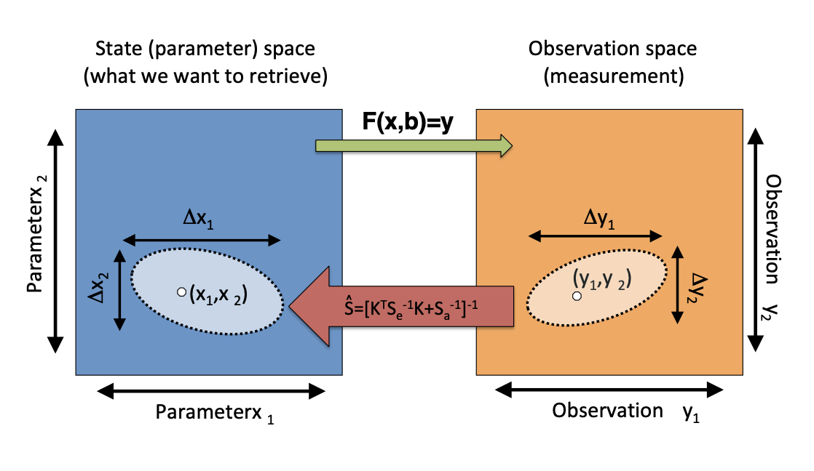
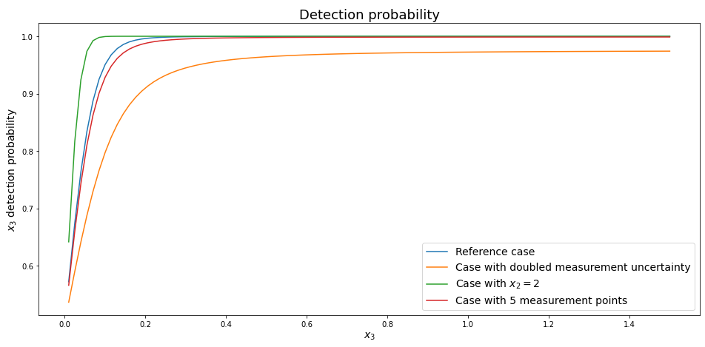
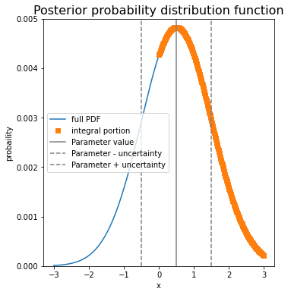
Basic details
For a given simulation, we have plastic fraction and uncertainty
Assume Gaussian distributed errors – fraction greater than 0 is probability of successful detection if plastic is present
Calculate probabilities for all plastic concentration. We record concentration needed for 95% probability of success.

Slide 17
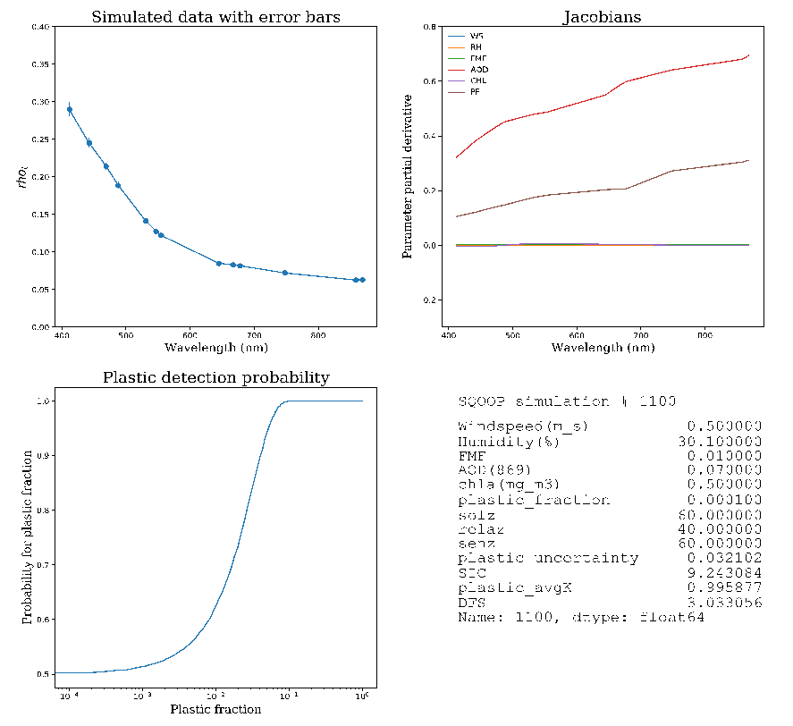
One example
Total simulations: 131,220
# scenes with various plastic concentration: 13,121

Slide 18
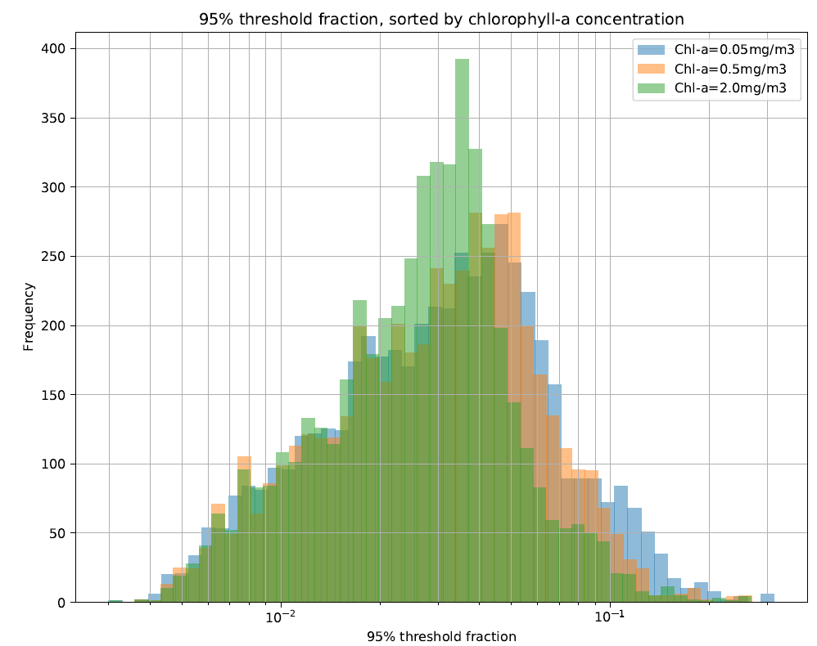
Dependence of detectability with different water column Chlorophyll-a
Detectability of Microplastics at TOA
Frequency
10⁻² 10⁻¹
Plastic fractional surface coverage

Slide 19
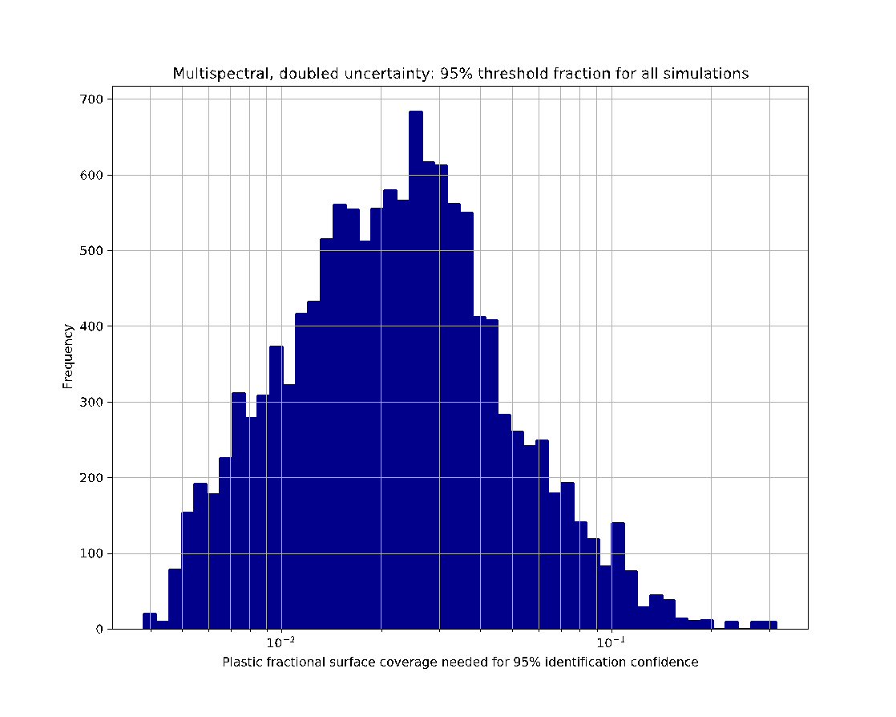
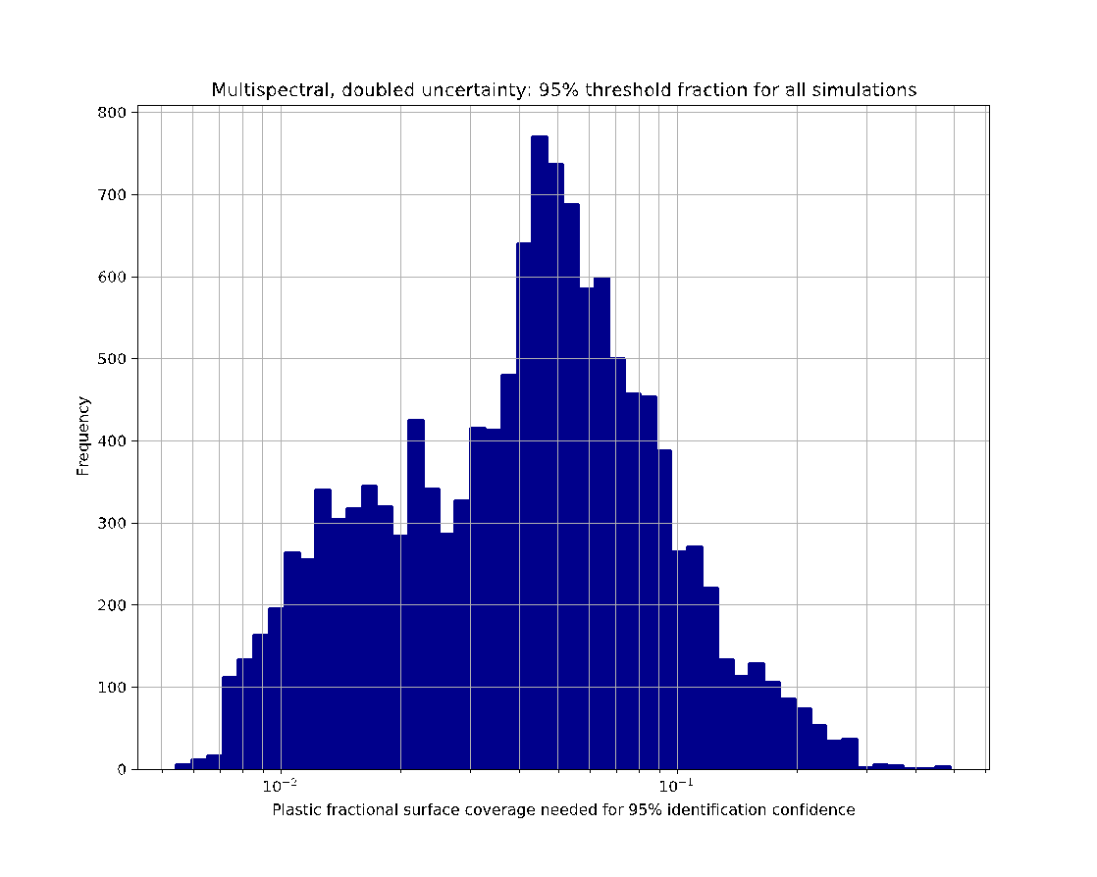
Biofouled microplastics are easier to detect!
Biofouled spectra
Non-biofouled spectra
10⁻² 10⁻¹
10⁻² 10⁻¹
Plastic fractional surface coverage
Plastic fractional surface coverage

Slide 20
Github: Information Content
Kirk Knobelspiesse
a python example notebook of how the Rodgers information content analysis works
Implementation of approach using simulation
Code to be uploaded
https://github.com/knobelsp

Slide 21
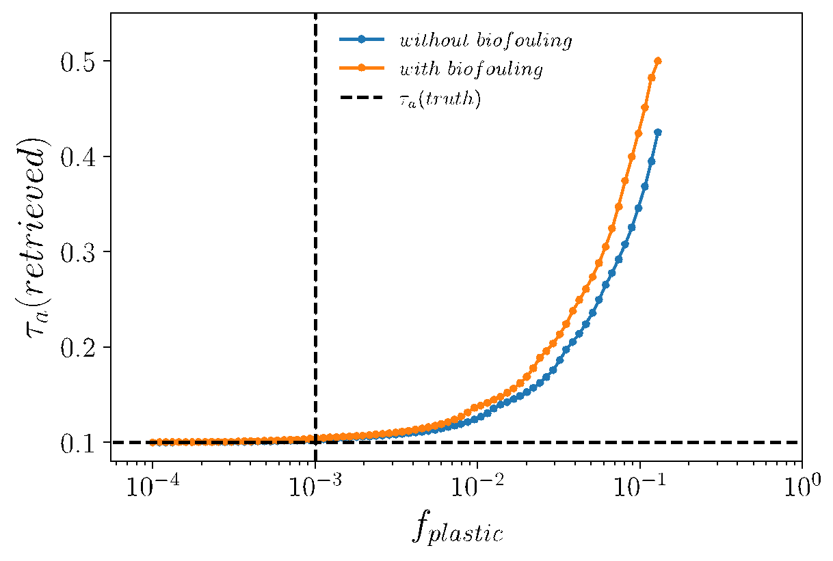
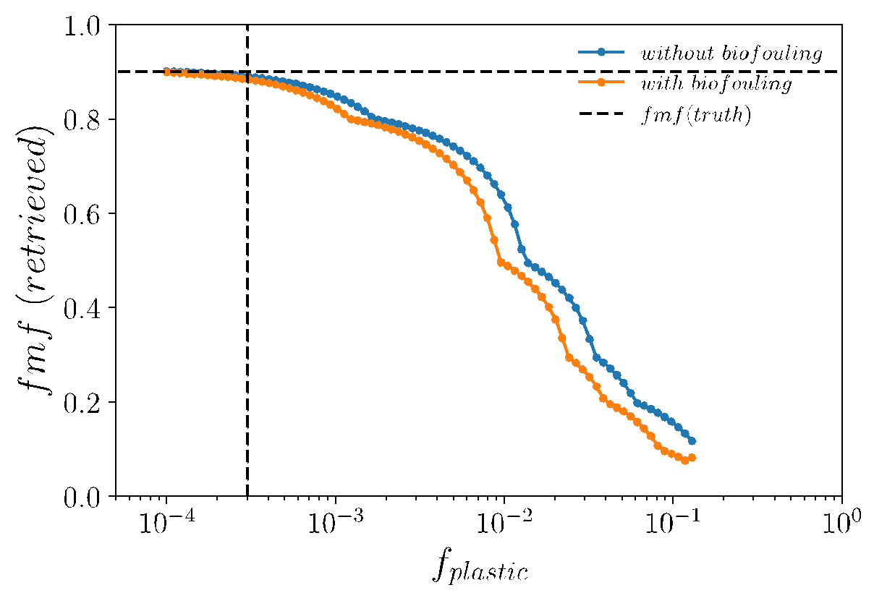
Influence of plastics on Aerosol Retrievals
Optimal Estimation (OE) atmospheric correction algorithm of Amir Ibrahim
Fine Mode Fraction (fmf)
Aerosol Optical Thickness (AOT)
5 x 10⁷ pieces/km²
Underestimate
Overestimate
1 x 10⁷ pieces/km²
Anomalous detection of plastics is likely to be observed more by looking at the fine mode fraction or the equivalent angstrom coefficient in the standard NASA products.
Presently the highest “average” concentrations are 1 x 10⁶ pieces/km²

Slide 22
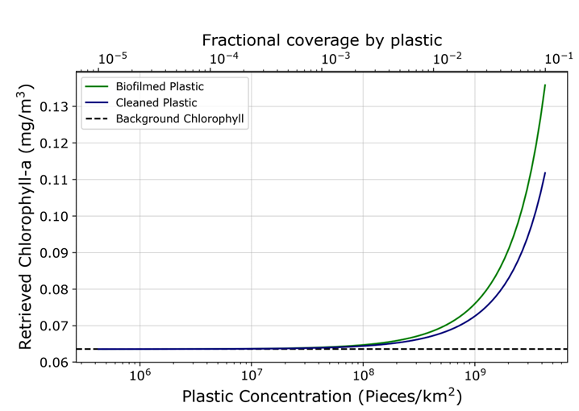
Impact of Microplastics on Chlorophyll Retrieval
Chlorophyll algorithm more sensitive to biofilmed plastic than cleaned plastic
Average measurements ~10⁶ pieces/km² in gyres
Suggest ~10⁸ pieces/km² (100 times more concentrated) to get significant Chl-a error

Slide 23
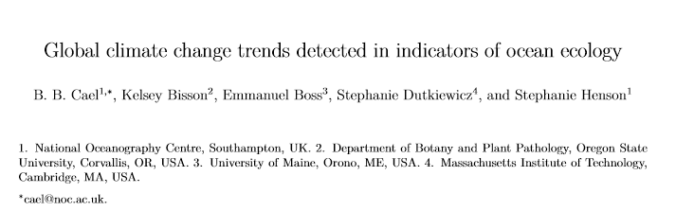
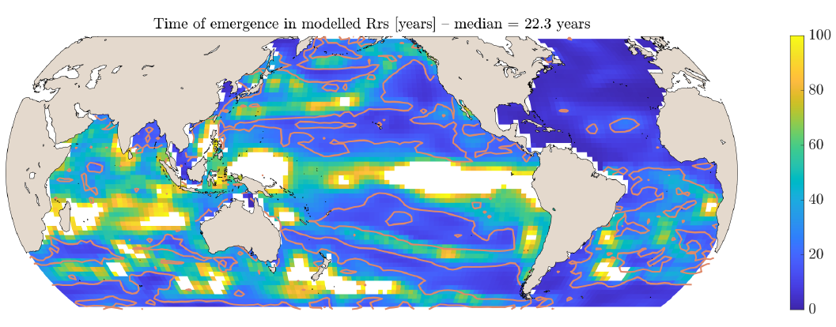


Slide 24
FINALIZING (eGAP radiative transfer code)

Slide 25
LOOKING FORWARD
Stay TUNED!!! Exciting thesis and papers coming out this year!
Graham Trolley’s presentation at IOCS meeting in FL November
Oskar Landi Science/Art Collaboration -- Exhibit Opening
  “Floating Points: Exploring the Plastosphere with NASA”.
  November 9, 2023 5:30 pm
  Alexey von Schlippe Gallery of Art, University of Connecticut.
THANK YOU

Slide 26
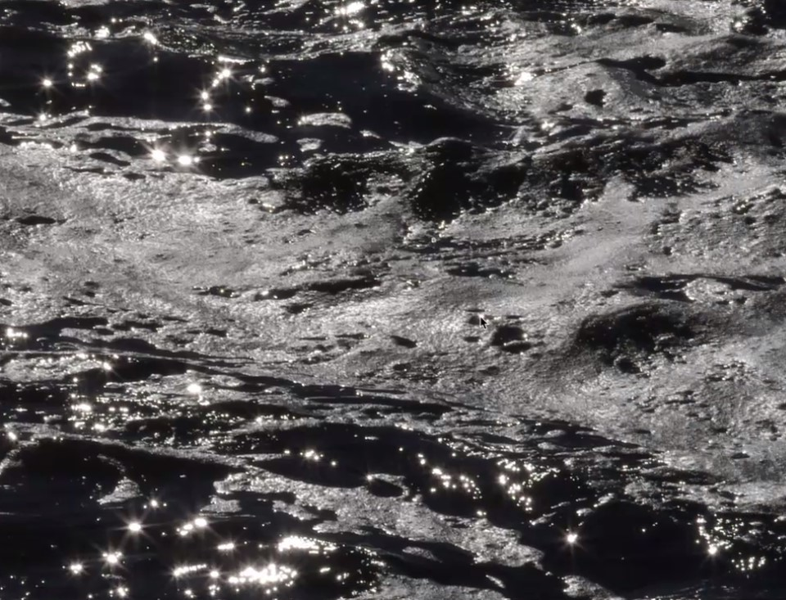
Photo Credit: Oskar Landi

