Slide 1



Toward Optical Characterization of Marine Microplastic Pollution
Robert J. Foster
Remote Sensing Division
US Naval Research Laboratory
Contributors:
Daniel Koestner*, Ahmed El-Habashi
*NRC post-doc
NASA Carbon Cycle & Ecosystems
Joint Science Workshop
May 8th, 2023
DISTRIBUTION STATEMENT A: APPROVED FOR PUBLIC RELEASE, DISTRIBUTION IS UNLIMITED

Slide 2
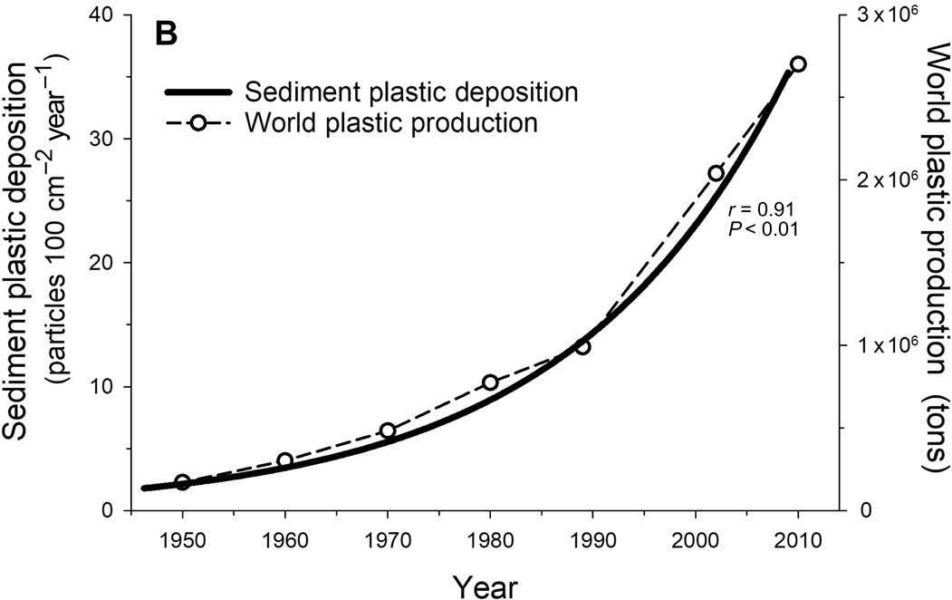


Microplastics in the environment
Persistent and seemingly ubiquitous.
Potentially toxic
Challenges in identification and uniqueness.
Need to be able to model them accurately.
microplastics
macroplastics
aircrafts
ships
Overarching motivation:
Improve radiative transfer simulations of microplastics in the ocean for applications
IOP libraries for microplastic samples are sparse (nonexistent?)
Brandon et al. 2019; Multidecadal increase in plastic particles in coastal ocean sediments
Data from coastal sediment cores from Santa Barbara basin
Focusing on Microplastics <300 µm in diameter
Notes:
Found in marine organisms, sediment, open ocean and coastal waters (even us!)
Potential for optics to play a diagnostic role here.
Plastics are an exponential problem

Slide 3
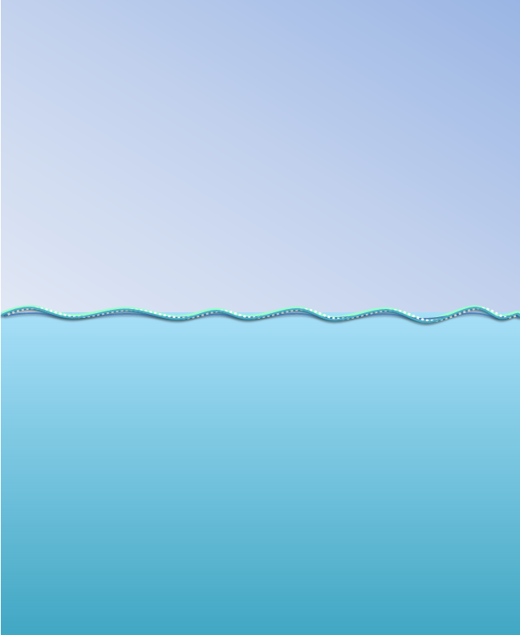
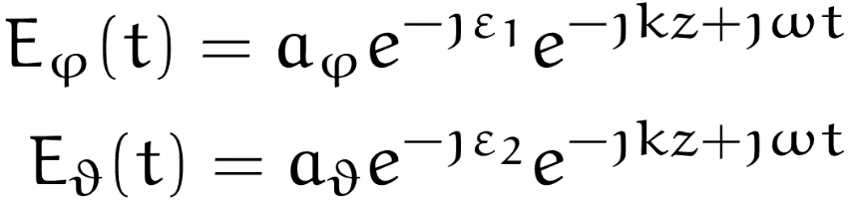
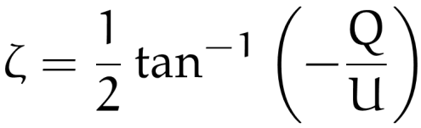
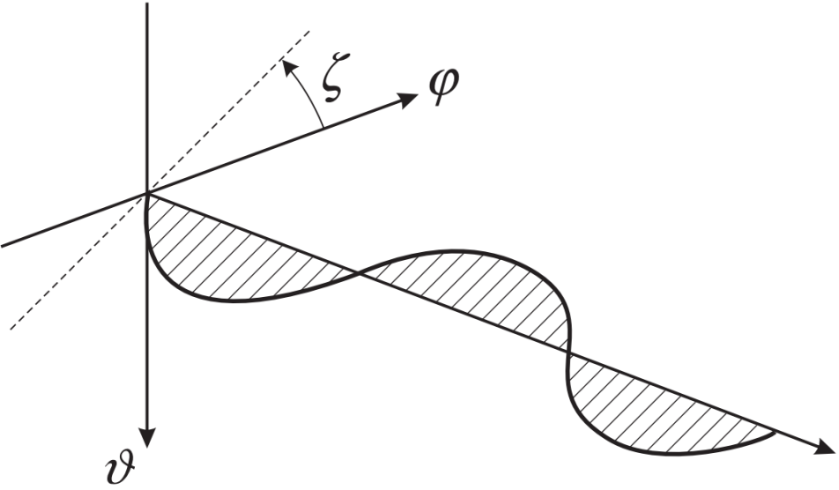
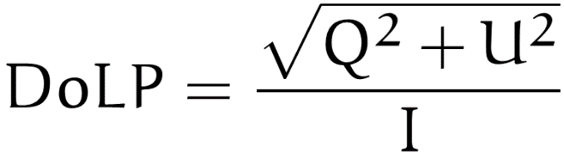





Polarization and Scattering Mueller Matrices
Plane wave solution of Maxwell’s equations
Scattered
Light
Incident Beam
Angle of Polarization
$$θ_{s}$$
$$\left[\begin{aligned}\begin{matrix}I \\ Q\end{matrix} \\ U \\ V\end{aligned}\right]$$
$$\left[\begin{matrix}β_{11} & β_{12} & 0 & 0 \\ β_{12} & β_{22} & 0 & 0 \\ 0 & 0 & β_{33} & β_{34} \\ 0 & 0 & {−β}_{34} & β_{44}\end{matrix}\right]$$
$$\left[\begin{aligned}\begin{matrix}I_{0} \\ Q_{0}\end{matrix} \\ U_{0} \\ V_{0}\end{aligned}\right]$$
Degree of Linear Polarization
$$=$$
Hydrosol Mueller matrix

Slide 4
Objectives
Present results of inherent optical properties of microplastic assemblages
Compare results with a selection of contrasting seawater samples
  Identify potential diagnostic features of microplastic samples
Simulate PACE-like observations with realistic microplastic concentrations.

Slide 5
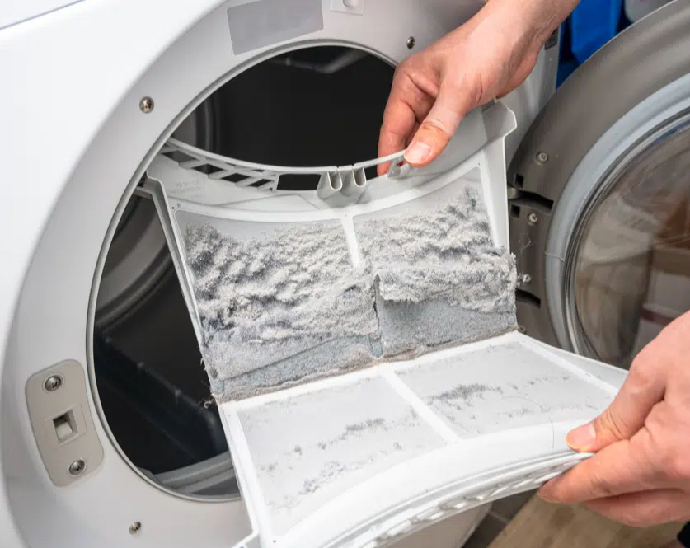
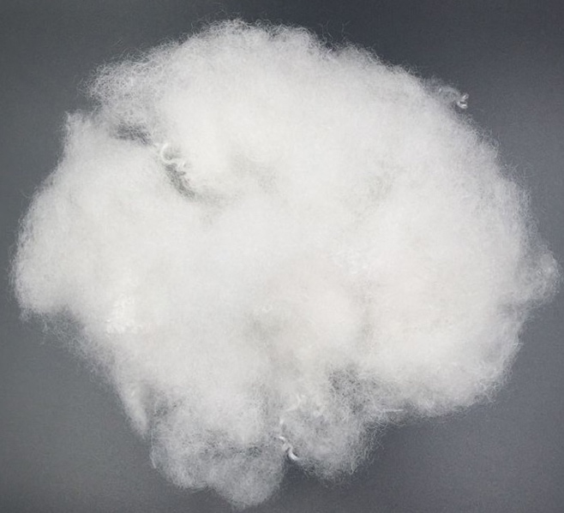
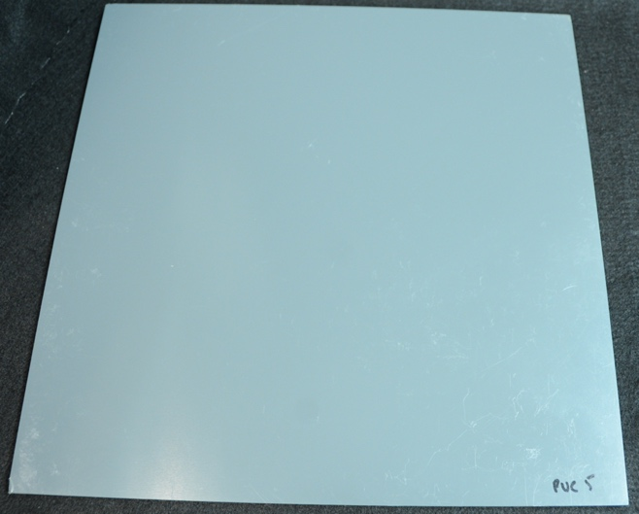
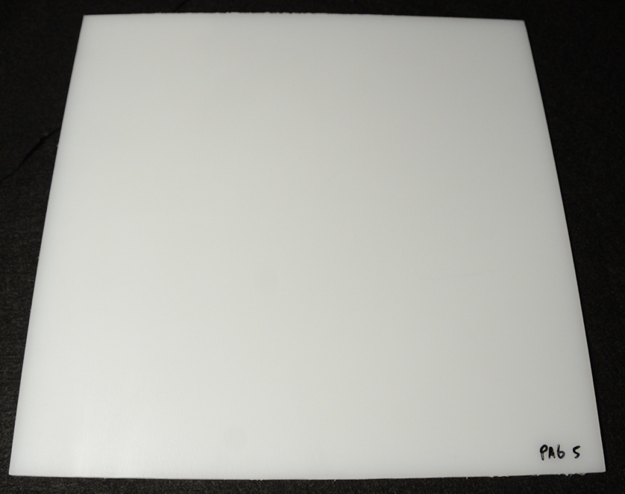
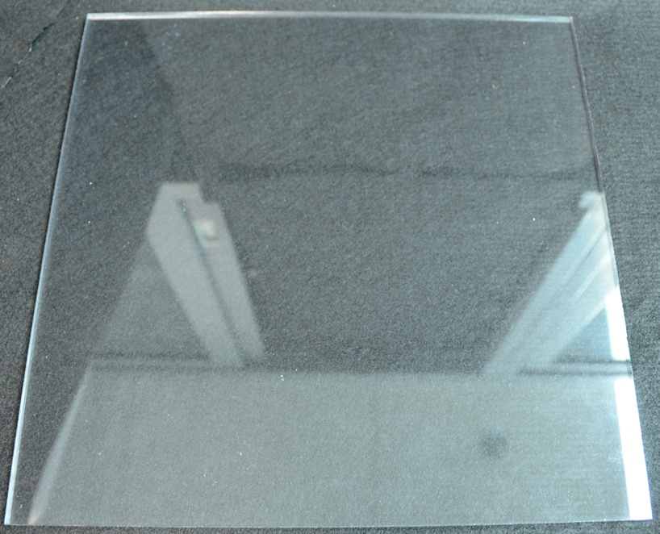
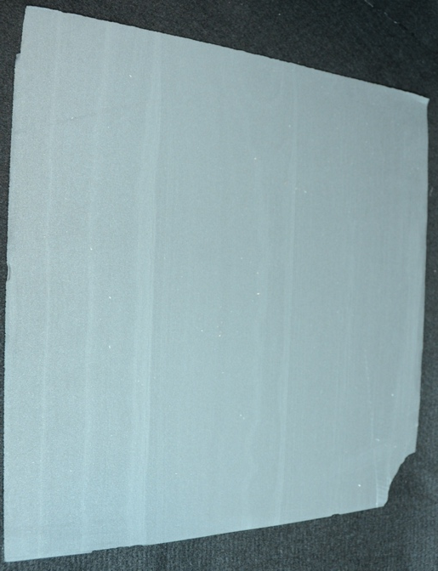
Samples
Five samples of commonly utilized industrial-grade plastic
Two additional samples representing other common pollutants
  Dryer Lint
  Polyester fiber filling for crafts/insulation
ID | Description | c_{p} (in chamber) [m⁻¹]
DL1 | Dryer Lint 1 – synthetic fabric only | 1.3
DL2 | Dryer Lint 2 – synthetic fabric only | 0.6
PA61 | Nylon shavings | 1.0
PEF1 | Polyester fiber clippings 1 – filling for crafts | 0.3
PEF2 | Polyester fiber clippings 2 – filling for crafts | 0.7
PETG1 | Polyethylene glycol shavings | 1.2
PP1 | Polypropylene shavings | 1.3
PS1 | Polystyrene shavings 1 | 2.5
PS2 | Polystyrene shavings 2 | 1.2
PSS2000 | Polystyrene spheres – 2 µm | 1.7
PSS200 | Polystyrene spheres – 200 nm | 0.9
PVC2 | Polyvinyl chloride shavings 2 | 0.3
DL
PEF
PVC
PA6
PETG
PS
Notes:
Not all samples were fully characterized with all measurements

Slide 6
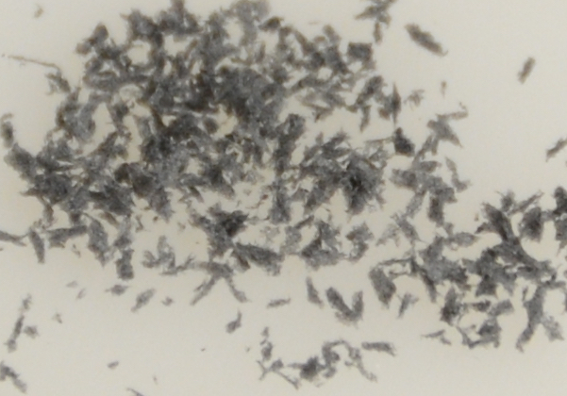
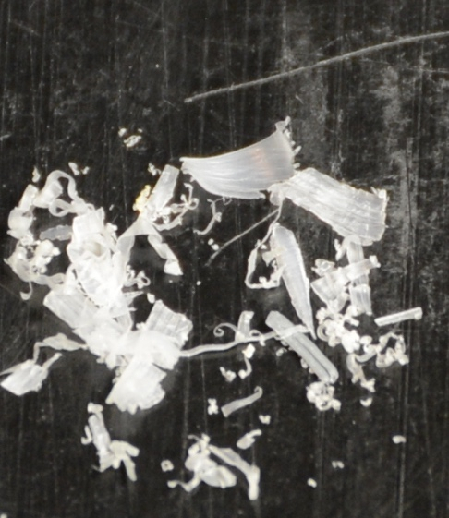
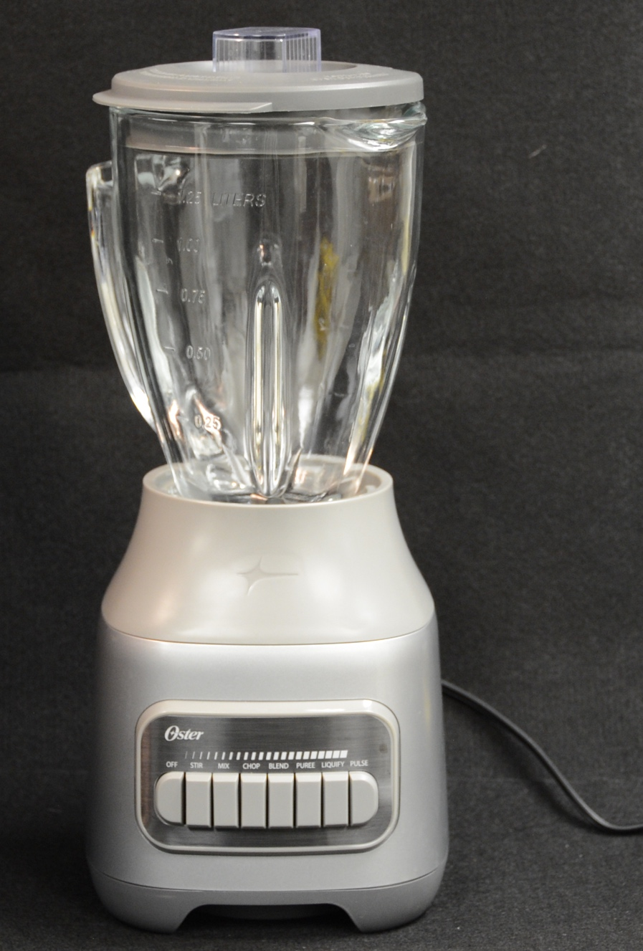
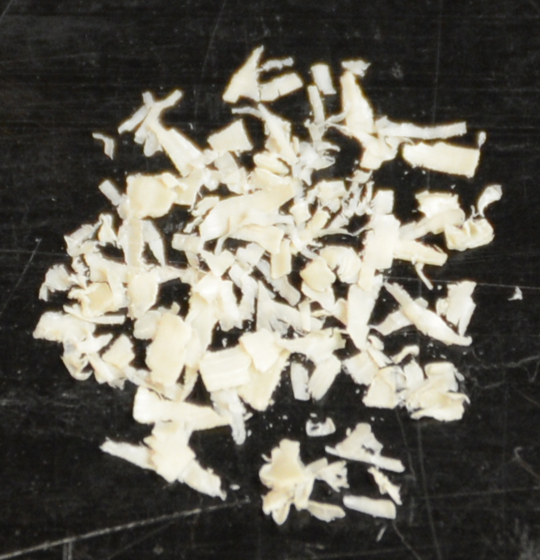
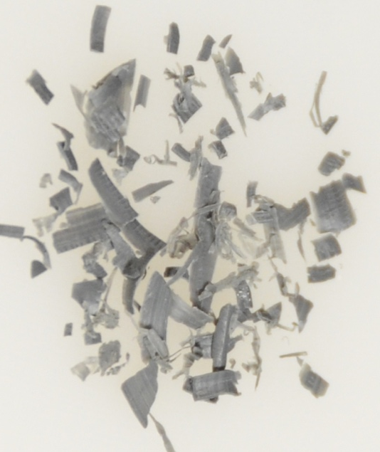
Sample preparation
Shave solid blocks
Blend on high for ~5–10 minutes with ~100 mL MQ and MQ ice cubes to generate small particles in suspension
  Ice cubes to prevent melting, overheating, and help pulverize
Break up PEF and DL samples into smaller fragments
  Did not blend PEF samples, gently broke up DL samples
~ 1–2 g
PA6 shavings
MQ
PS shavings
MQ
MQ
PVC shavings
MQ
MQ
MQ
PP shavings
Notes:
So this is where the fun part begins!

Slide 7
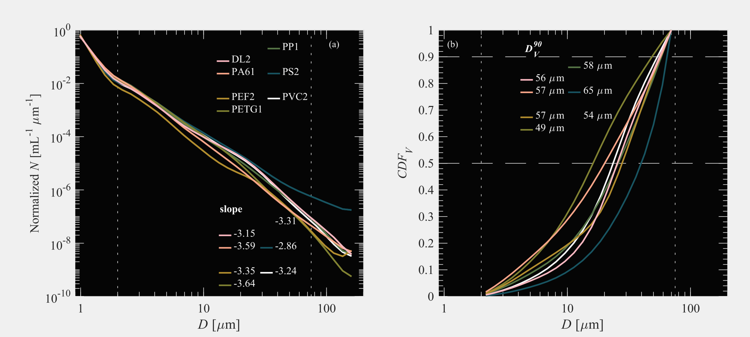
Particle Size Distributions of microplastic samples
Notes:
We use the ~2–80 µm size-range for parameterizing size distributions a few reasons but mostly for comparisons with some of the in situ seawater samples later on.

Slide 8
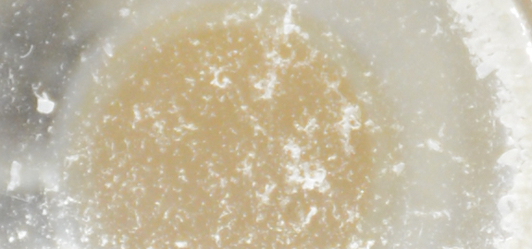
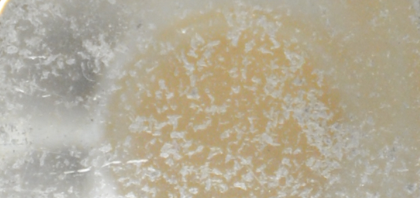
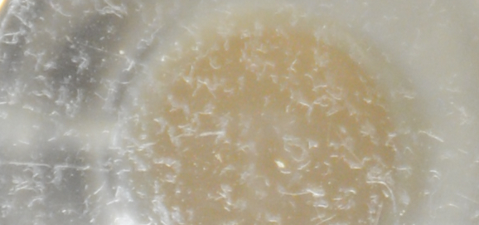
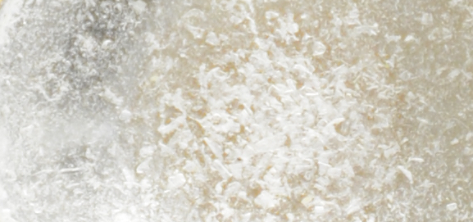
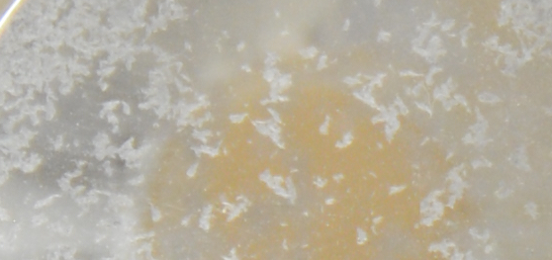
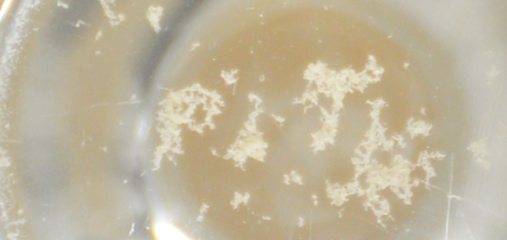
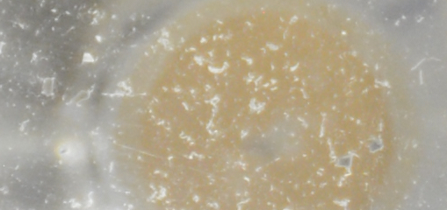
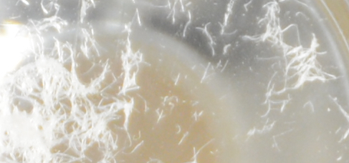
Master Suspensions
PA61
PS1
DL2
PETG1
PS2
PEF2
PP1
PVC2
Notes:
Images of the master suspensions which were diluted for measurements. For reference, the yellow cap is about 2 cm in diameter.

Slide 9
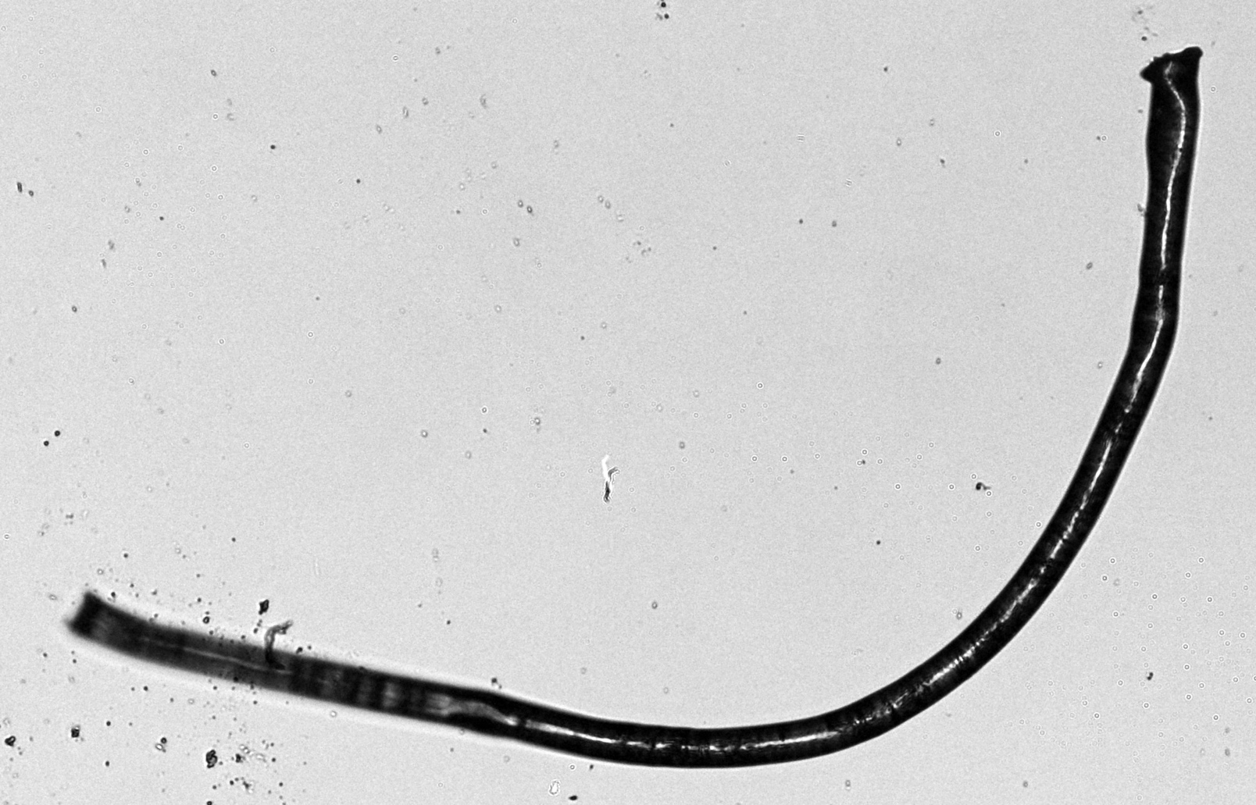
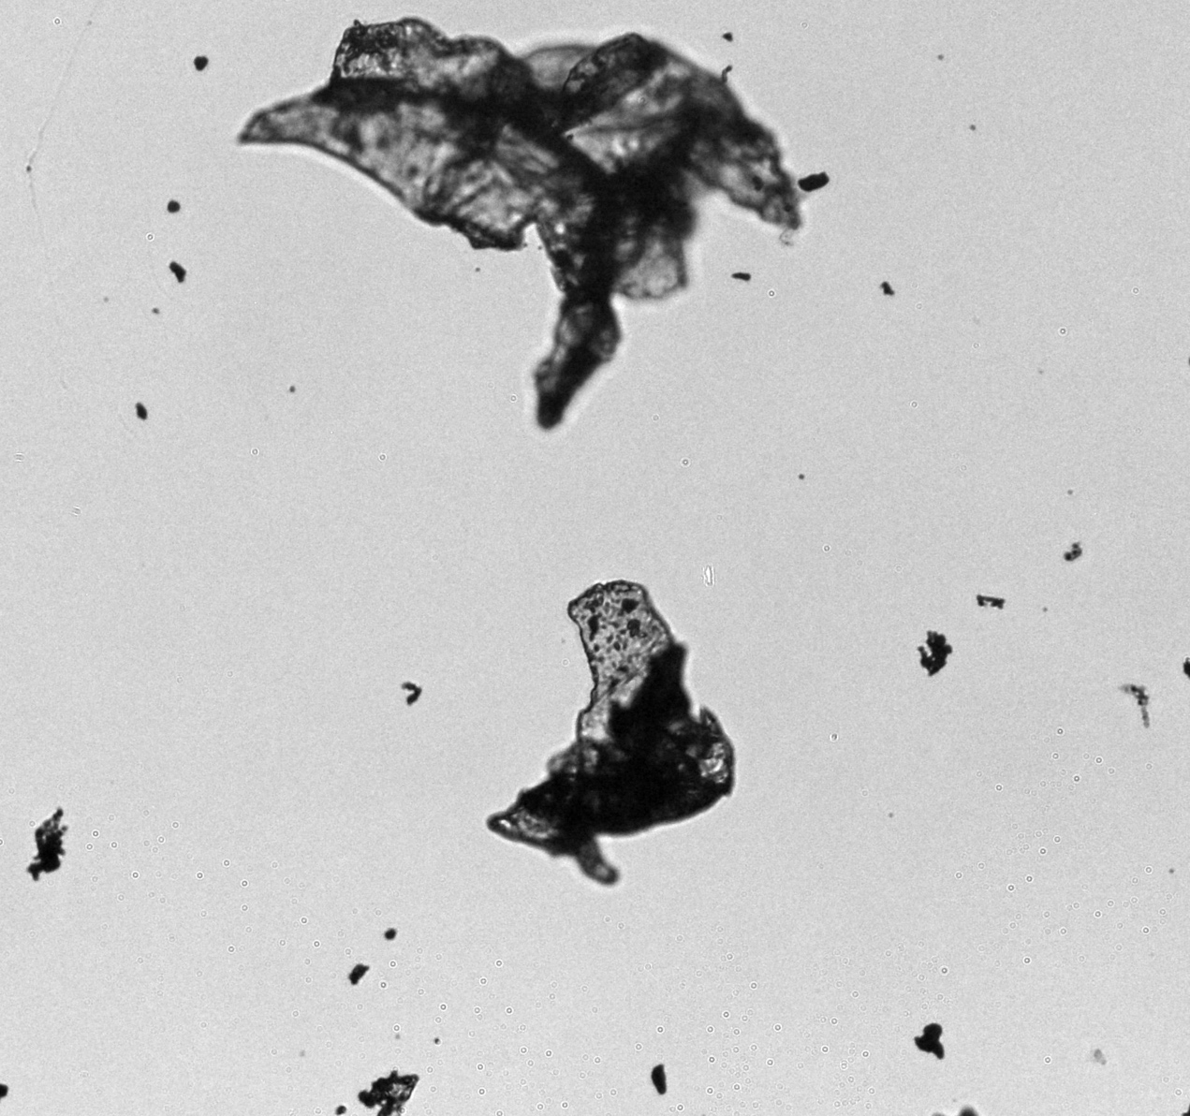
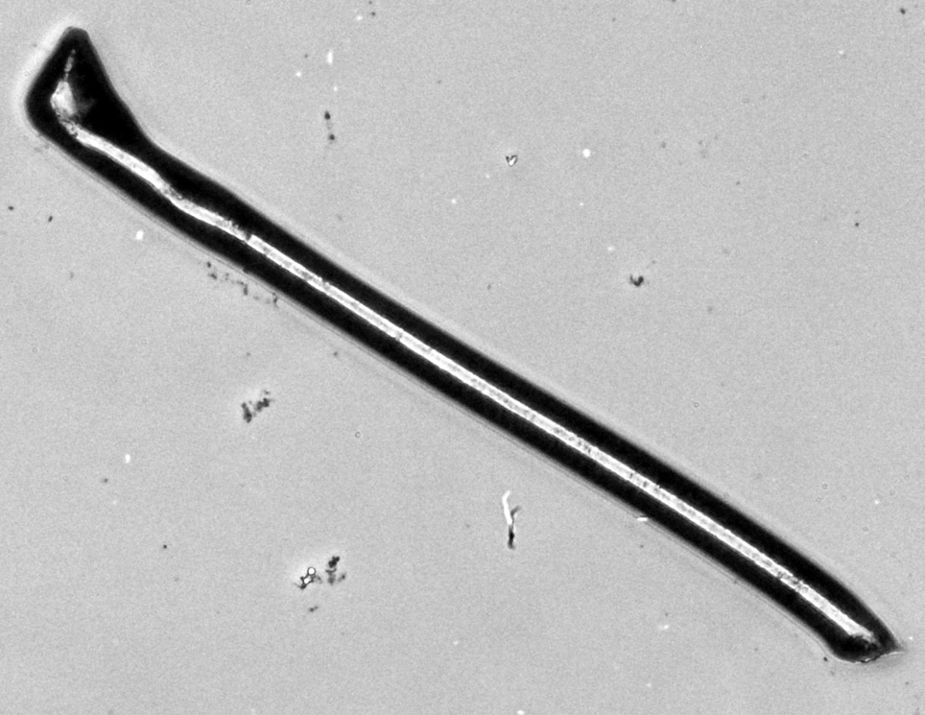
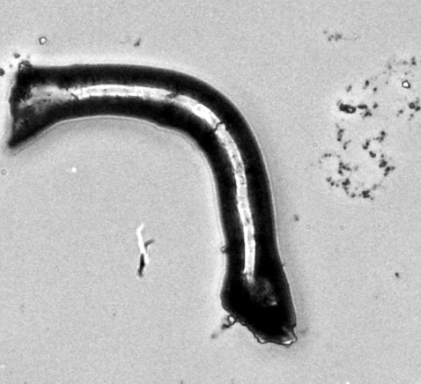
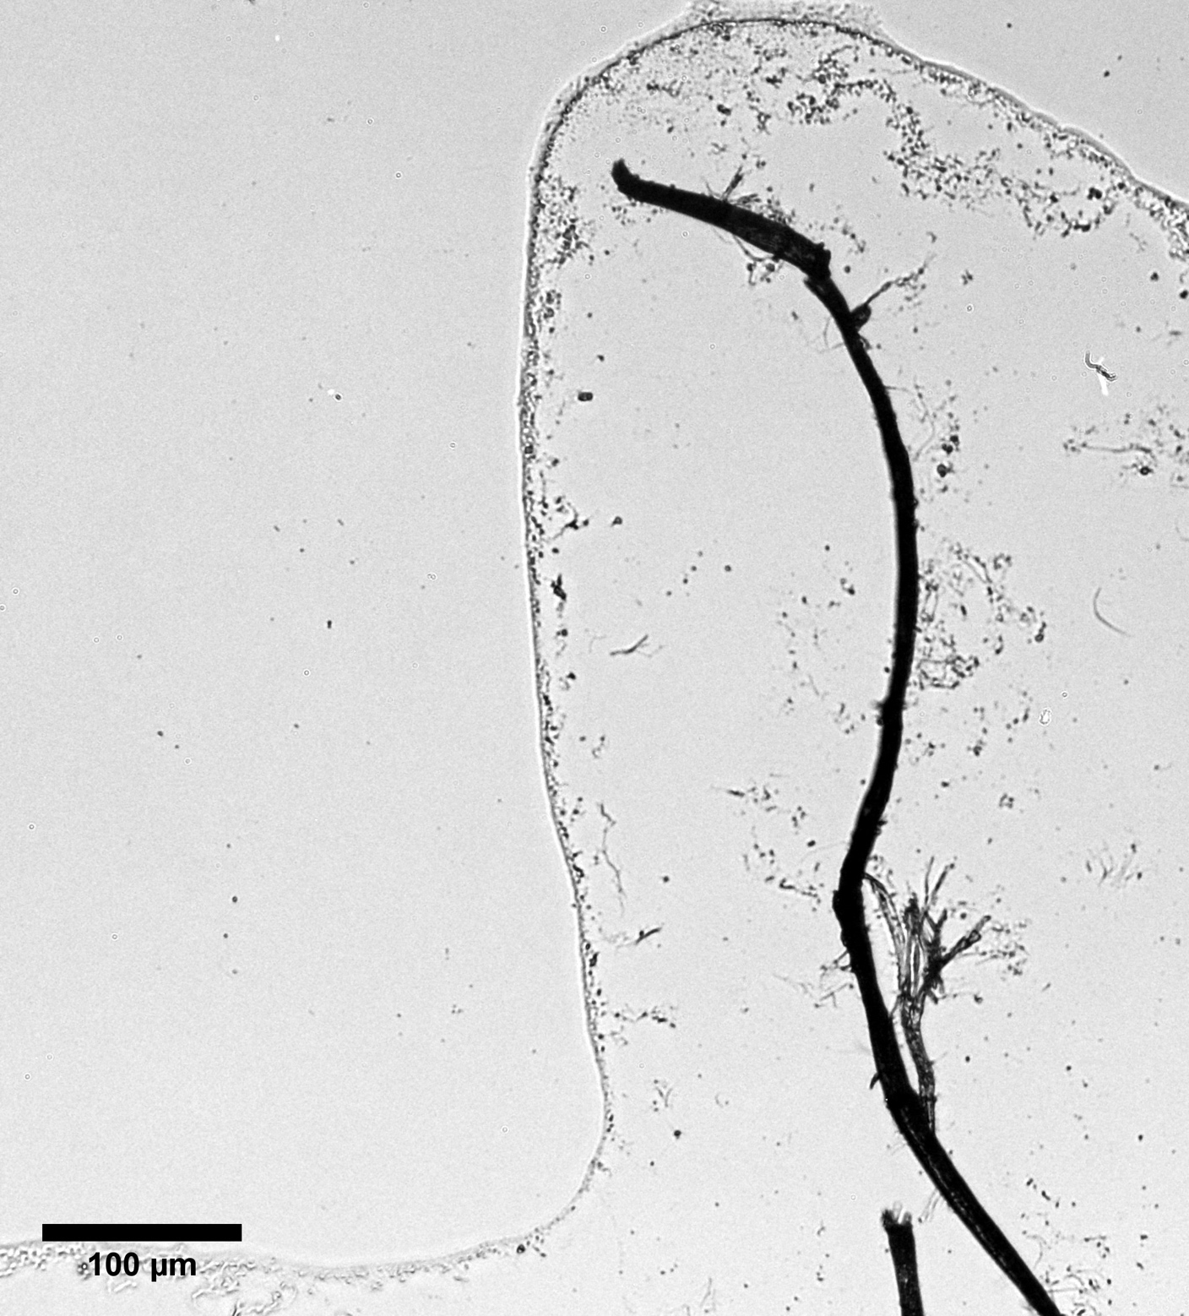
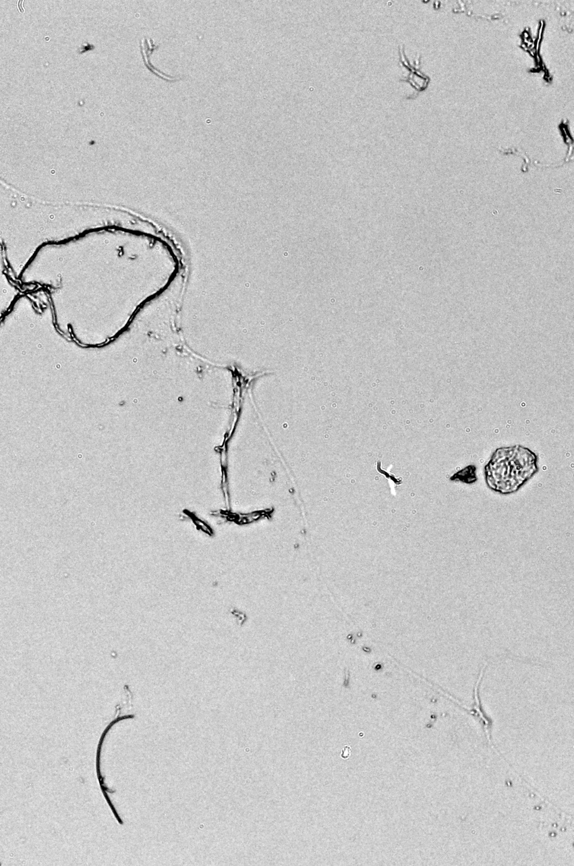
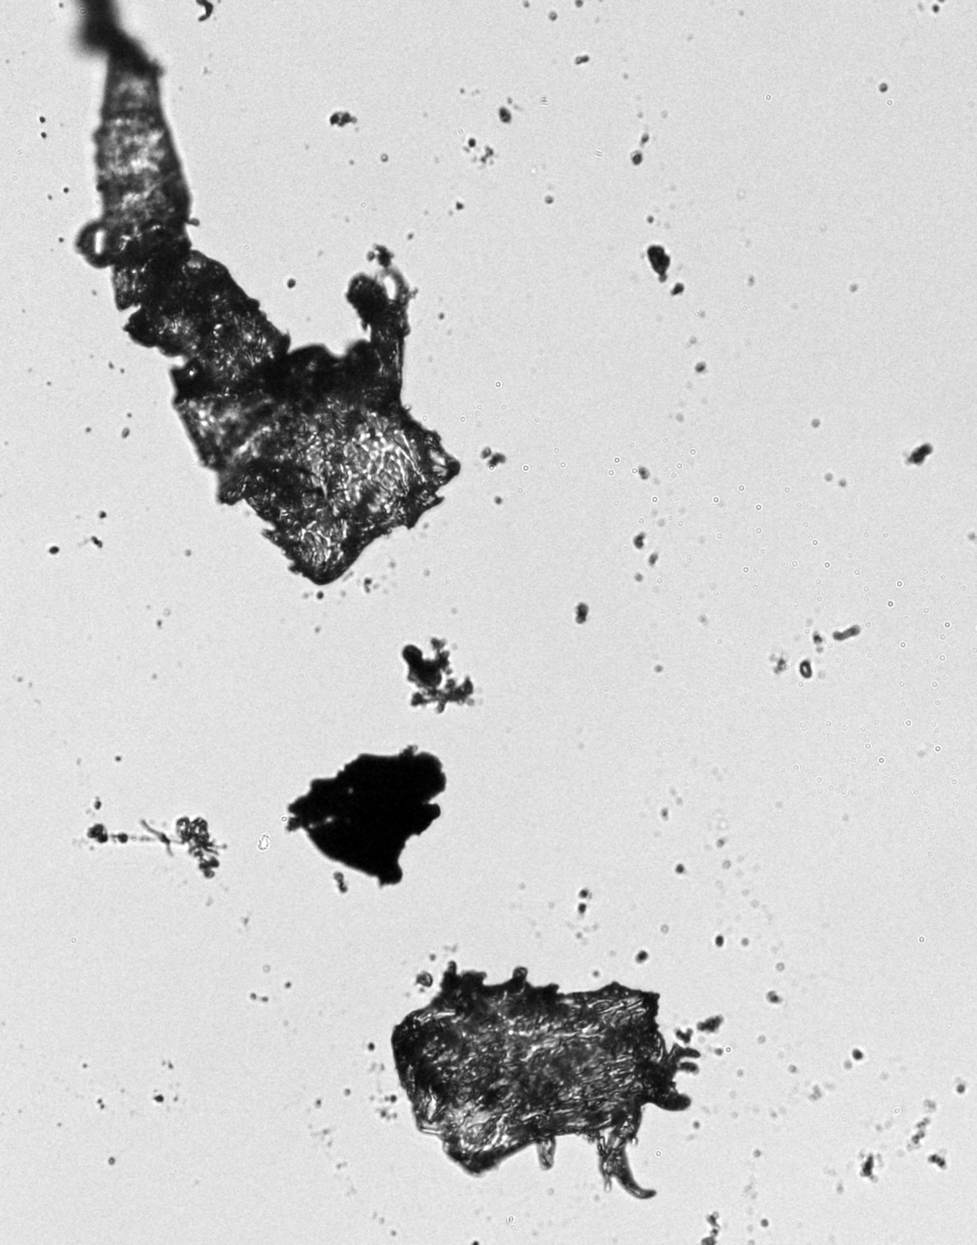
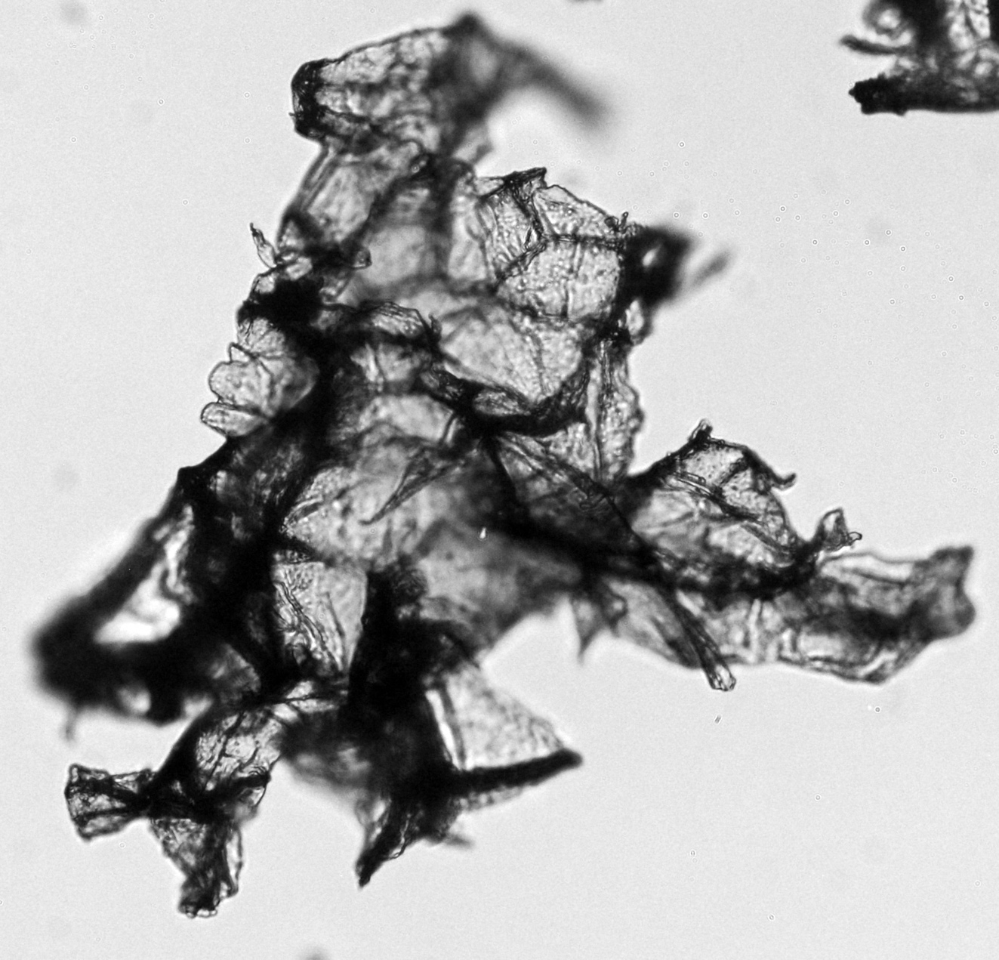
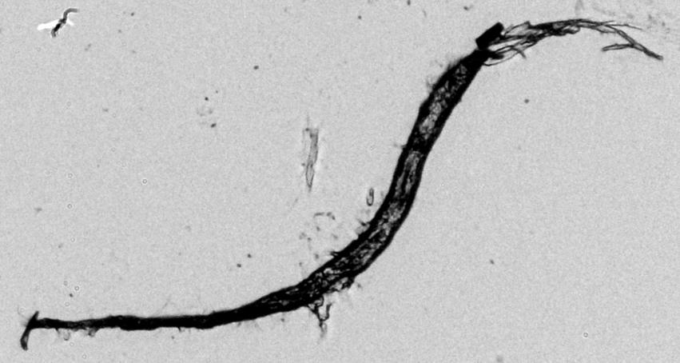
Microscope Images
PS1
DL2
PEF2
100 µm
PETG1
PS2
Notes:
Dryer lint tended to have more “rough” fibers while polyester fibers had “softer” or “rounder” edges. The sheet-based samples tended to be more irregularly shaped with lots of rough edges. Polystyrene particles tended to have some interesting dimensionality with folds while PETG, PA6, PP and PVC were more “solid” or “rigid”.

Slide 10
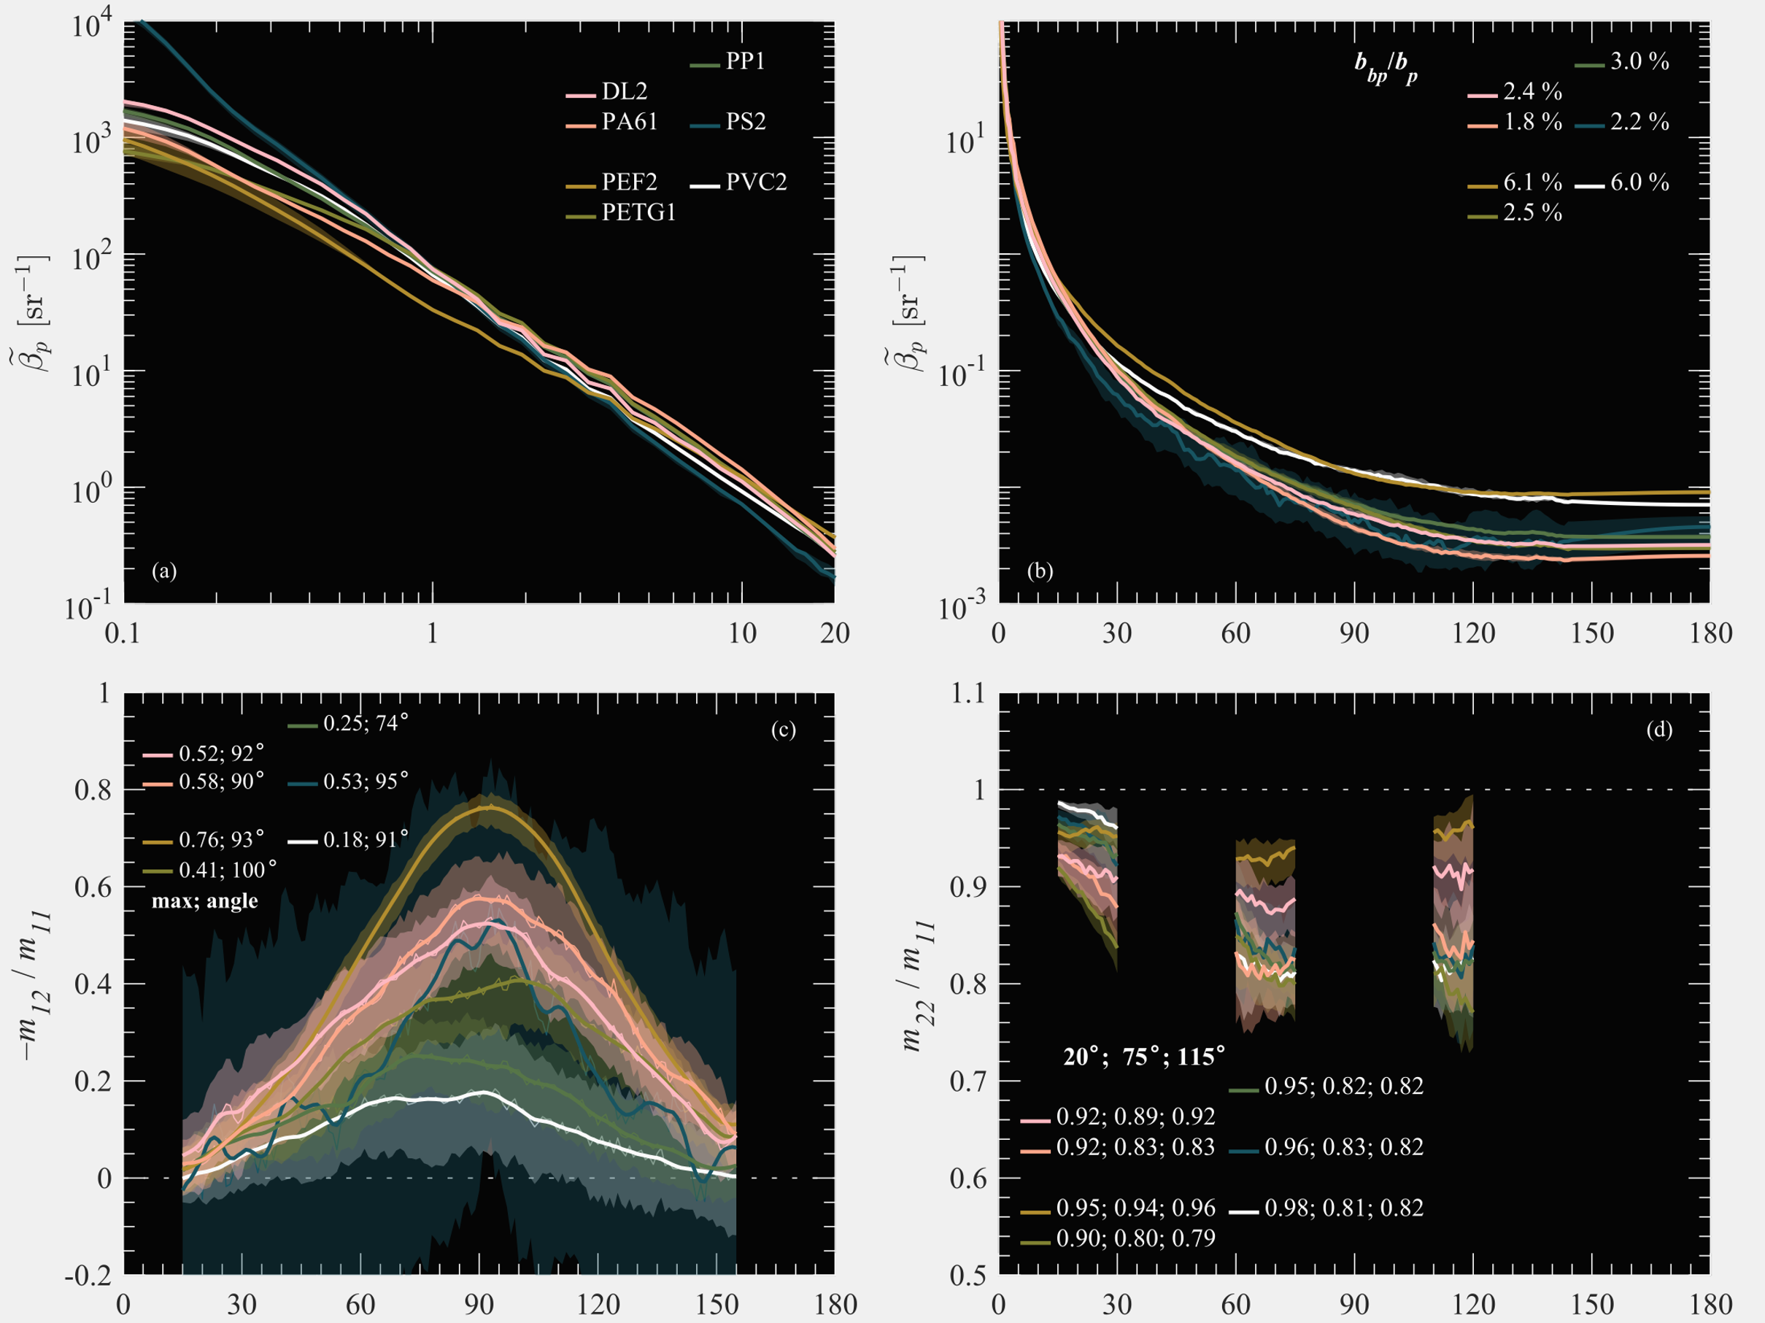
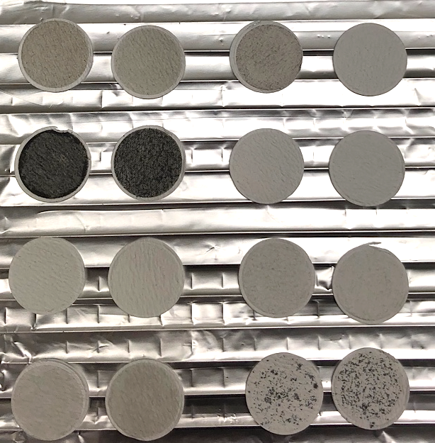
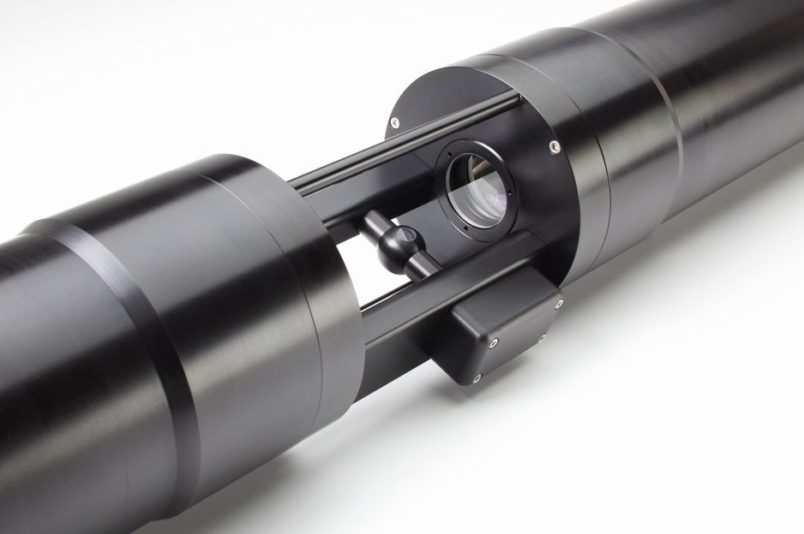

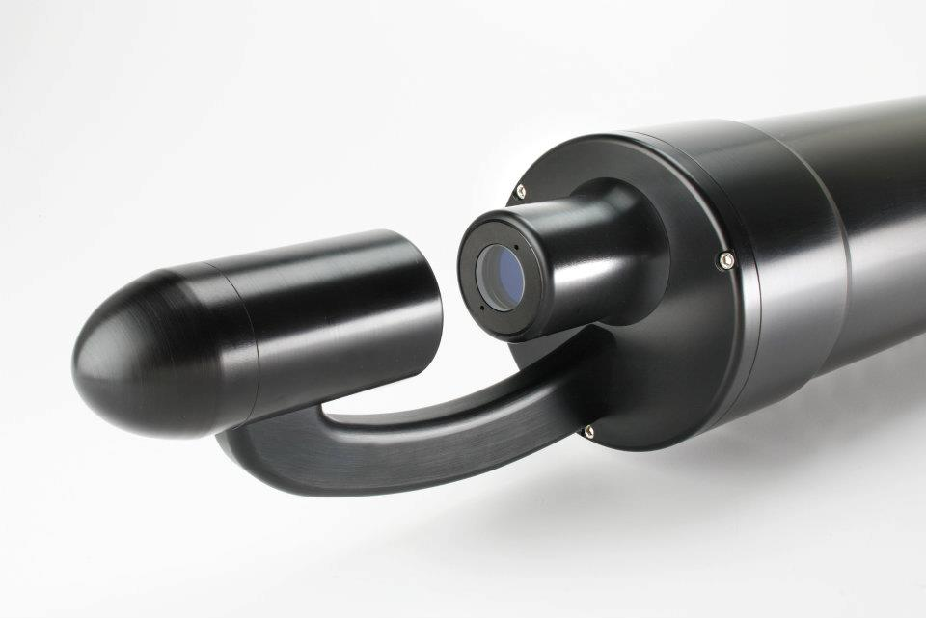
Measurements
GF/F filters for absorption and SPM
LISST-VSF – VSF, M₁₂ and M₂₂, PSD (ring inversion)
λ = 532 nm
LISST-HOLO – PSD and shape
ac-s – spectral attenuation and absorption
Notes:
Measurements were made with multiple dilutions were made to ensure single-scattering and assess reproducibility of sub-sampling from a master suspension. Measurements with the LISST-VSF were made in a black chamber with a stir bar on at low speed, changing directions every 30 seconds. This was found to be helpful to prevent too much particle settling. For each dilution, 4 sets of 50 measurements were made and about 10% were removed during quality control. For this presentation, I’ll be focusing on the median data from the ~180 measurements.
Absorption results are based on measurements with GF/F filters placed inside a 15-cm integrating sphere to best account for scattering losses while the ac-s was used mainly for estimating the spectral scattering slope from 400-700 nm.
Focus on concentration-independent results to compare effects of only differences in particle assemblages (e.g., composition, size distribution, shape)

Slide 11
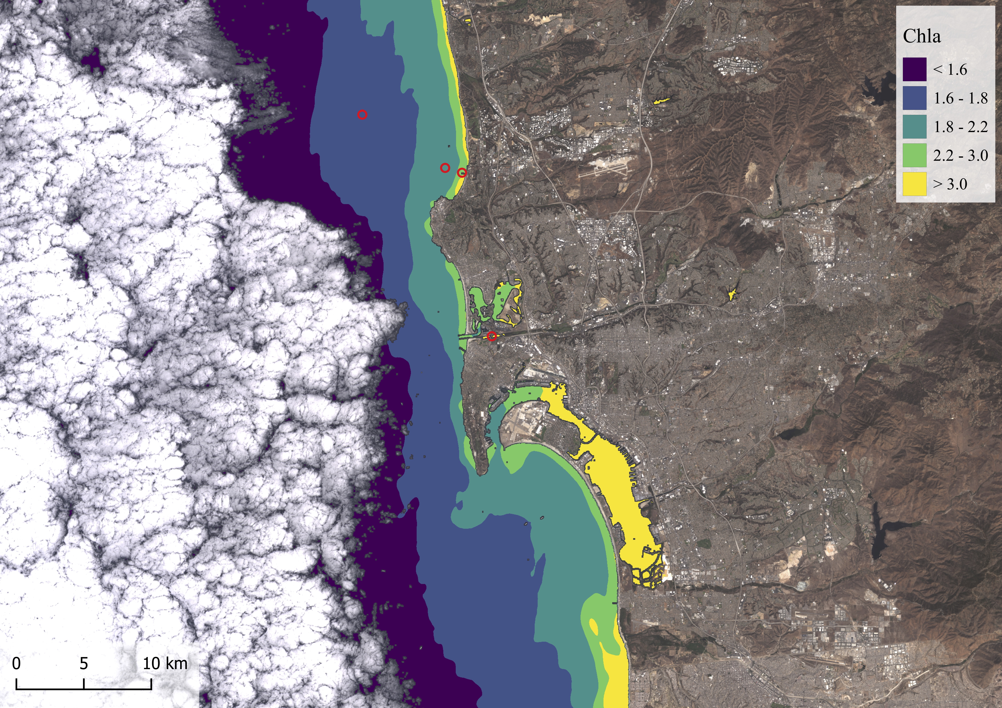
Do IOPs of microplastic samples differ from seawater?
Koestner, D., Stramski, D., & Reynolds, R. A. (2020). Polarized light scattering measurements as a means to characterize particle size and composition of natural assemblages of marine particles. Applied Optics, 59, 8314–8334
Koestner, D., Stramski, D., & Reynolds, R. A. (2021). Characterization of suspended particulate matter in contrasting coastal marine environments with angle-resolved polarized light scattering measurements. Applied Optics, 60, 11161–11179.
SD16 – 15 samples
PB1819,21 – 37 samples
How do microplastic samples compare with seawater samples?
Can we use optics as a diagnostic tool?
Notes:
2 extremes: glacial meltwater and a turbid lagoon sample, 37 samples from three years in Northern Alaska (mostly inorganic dominated assemblages), and 15 samples from San Diego coastal waters (mostly organic and algal-dominated assemblages)

Slide 12
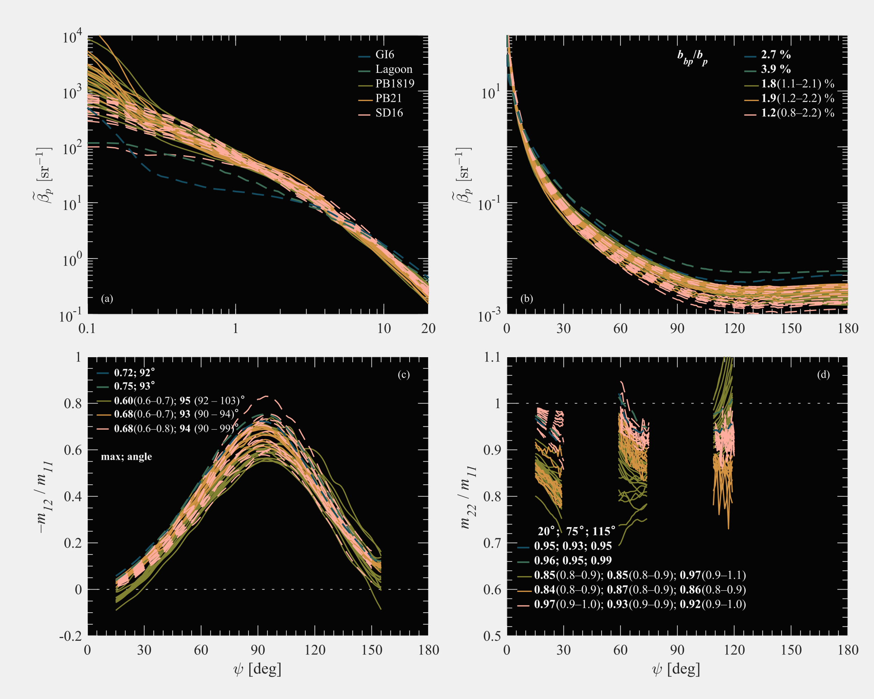
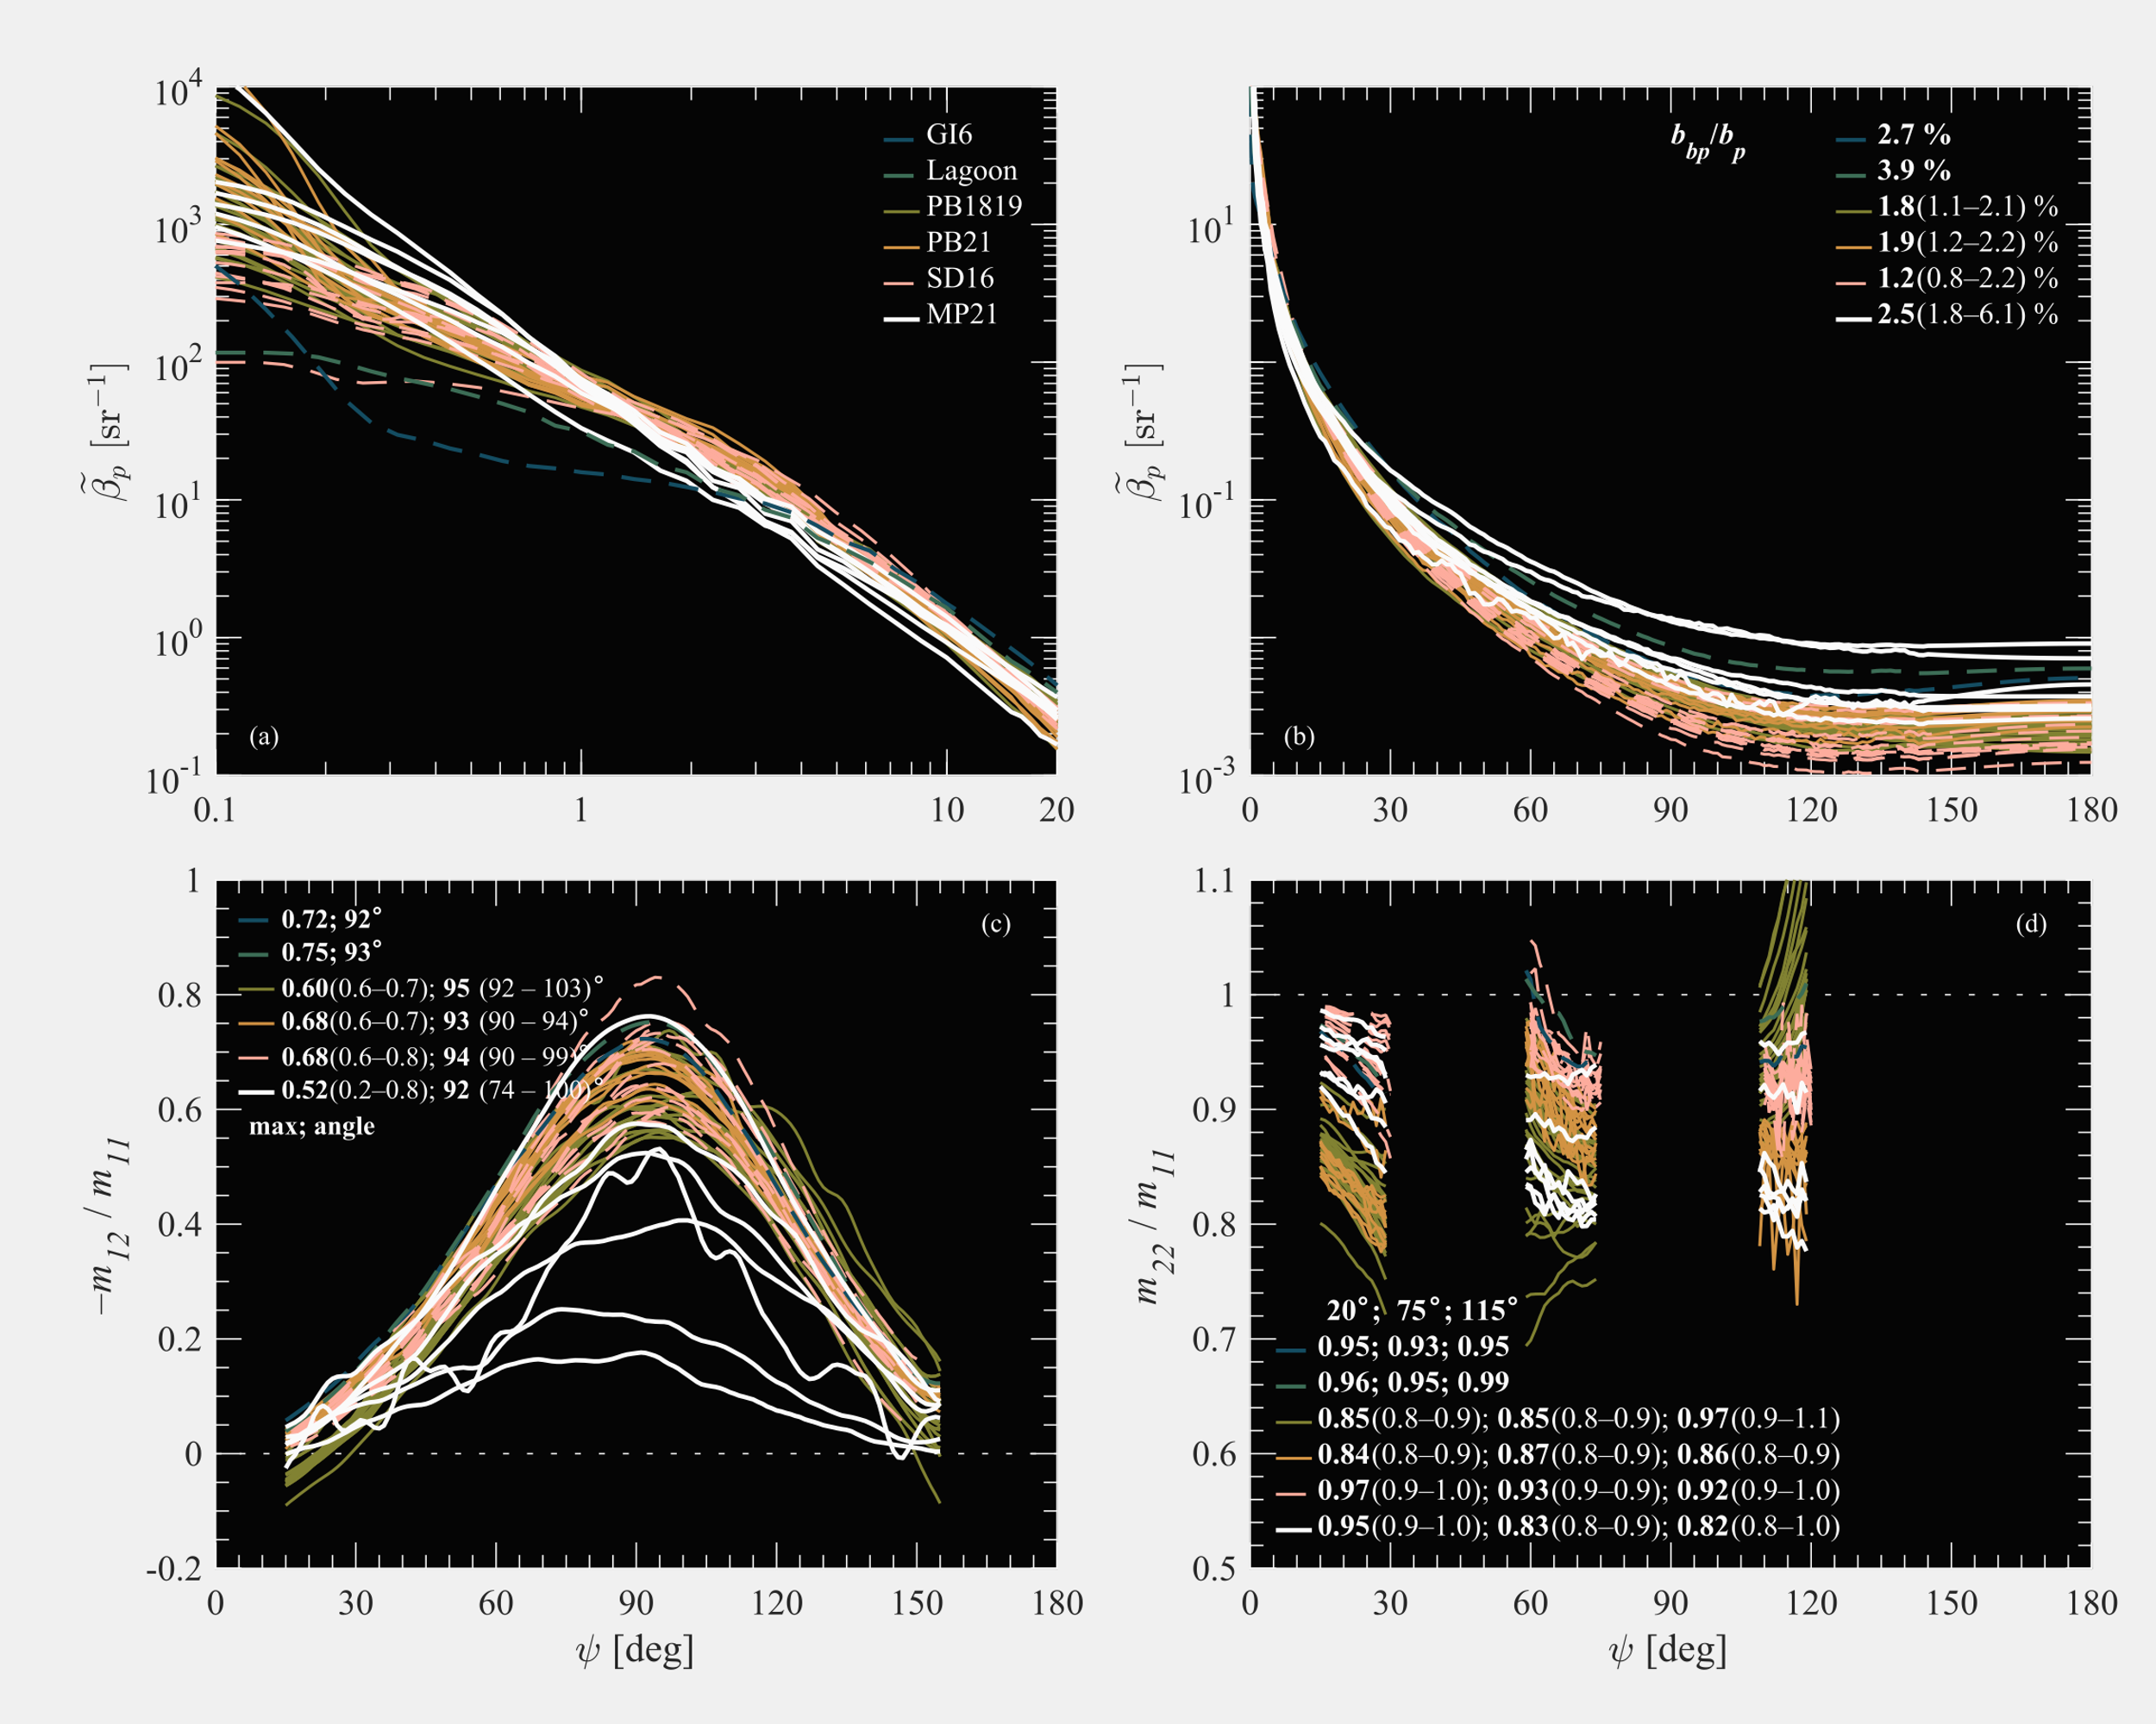
Scattering properties of seawater samples
Higher backscattering ratios than most samples
vs.
microplastic samples
Relatively lower values for side-angles around 75º and 115º
Lower values for most angles
Notes:
Describe other seawater samples first.

Slide 13
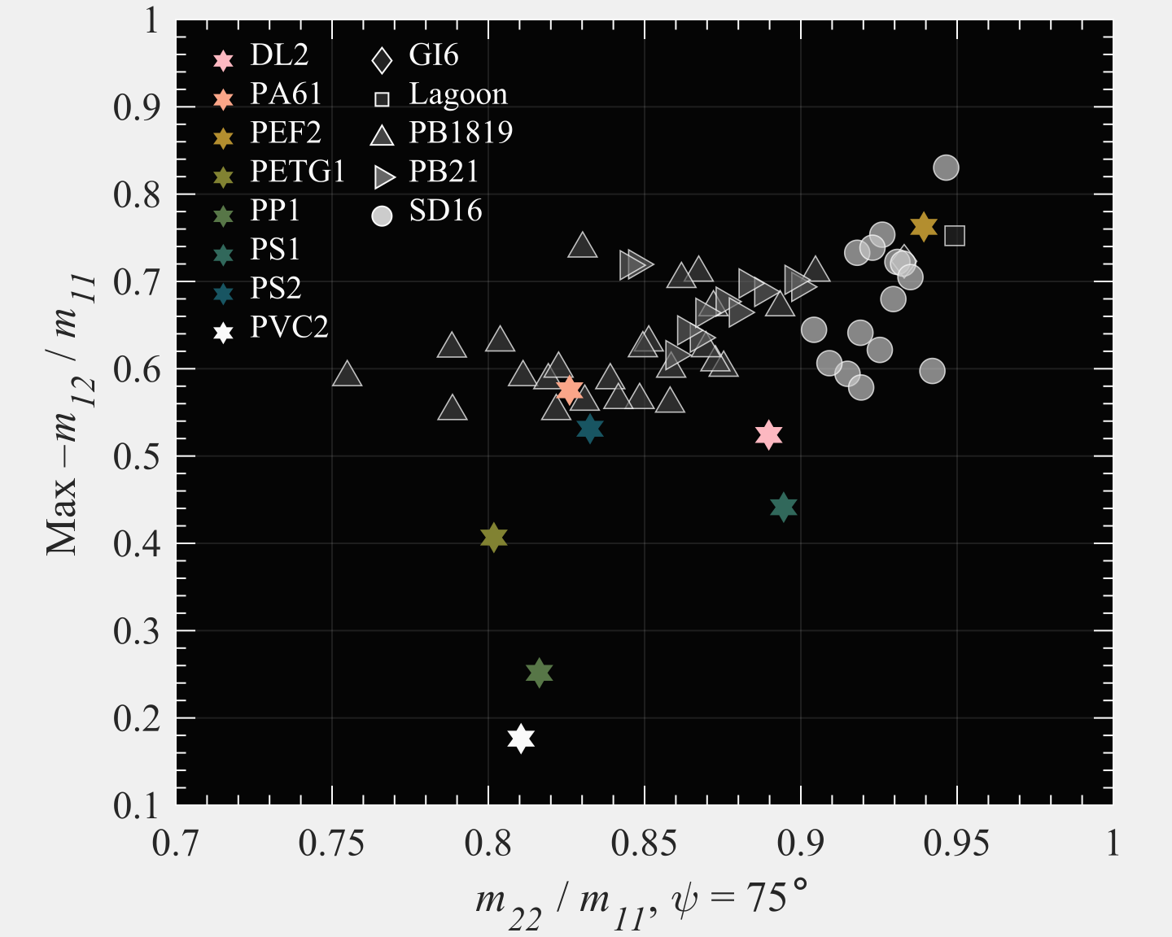
Linear depolarization at side-scattering angles
Notes:
Depolarization “matrix”. Most plastic samples fall in lower left quadrant which indicate noticeably strong depolarization in side-angles. Exception, PEF? Perhaps related to surface roughness?

Slide 14
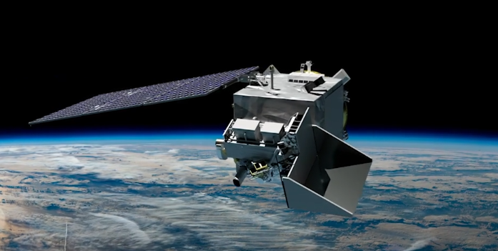
Simulating PACE-like observations of realistic microplastic concentrations
How detectable are microplastics (< 300 µm) in the open ocean?
Notes:
2 extremes: glacial meltwater and a turbid lagoon sample, 37 samples from three years in Northern Alaska (mostly inorganic dominated assemblages), and 15 samples from San Diego coastal waters (mostly organic and algal-dominated assemblages)

Slide 15
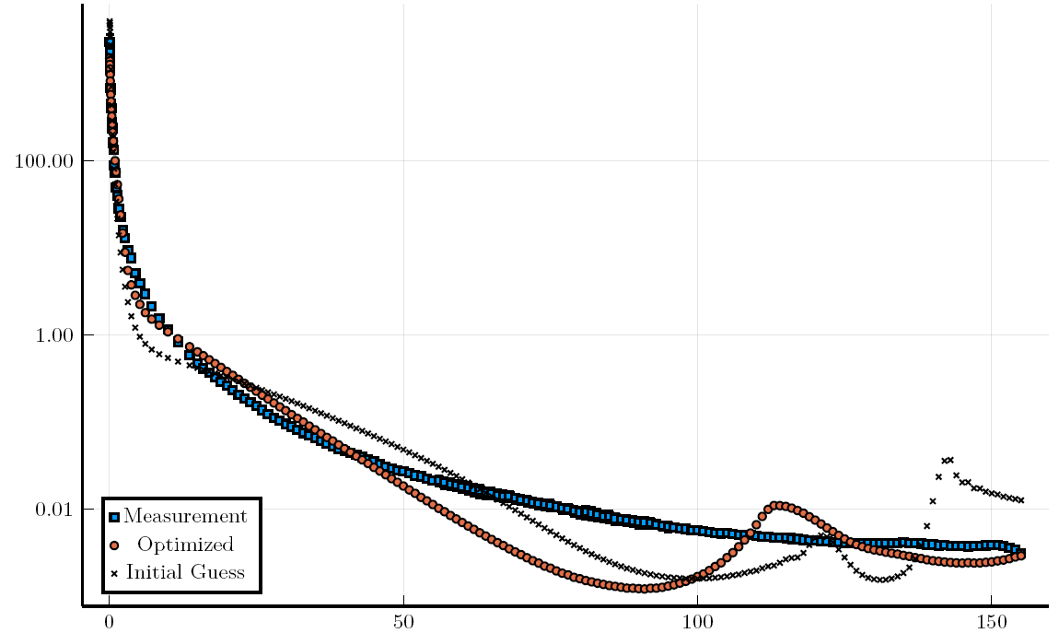
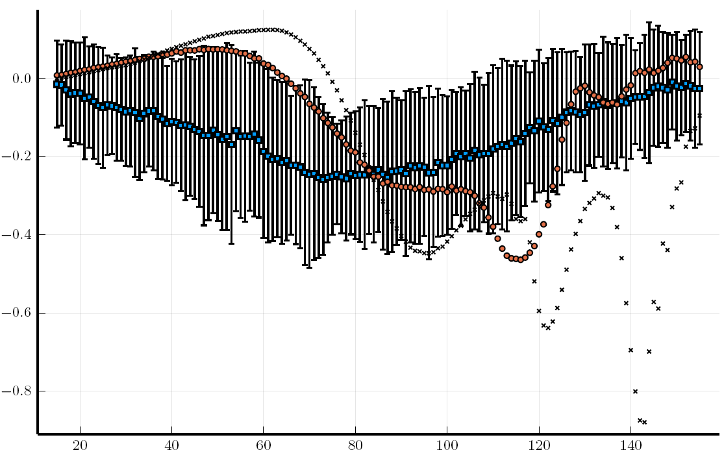
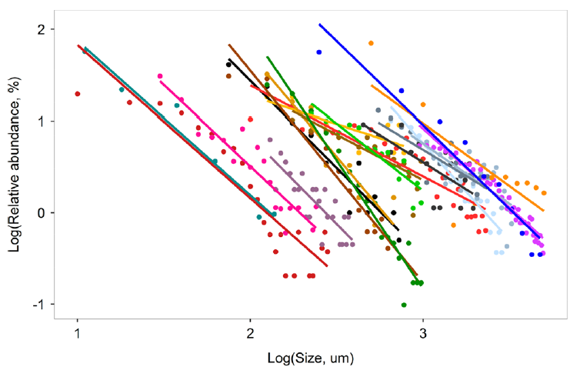
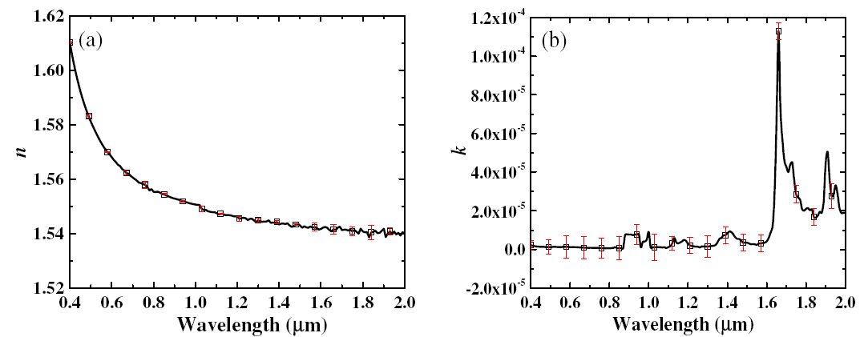
Scattering by Microplastics
Optimal Estimation-based fitting of theoretical phase matrices to measured ones
Particle Size Distribution
M11
-M12/M11
Scattering Angle
Mean exp. = -1.6
Complex Refractive Index of PET
Kooi & Koelmans, 2019
Spectral scattering cross-section and single scatter albedo computed with Lorenz-Mie theory
Mean microplastics concentrations reported at 6m depth by (Hansen et al, 2023) for 20 – 300 µm size range is 500-700 pc/m³.
Zhang et al, 2020

Slide 16
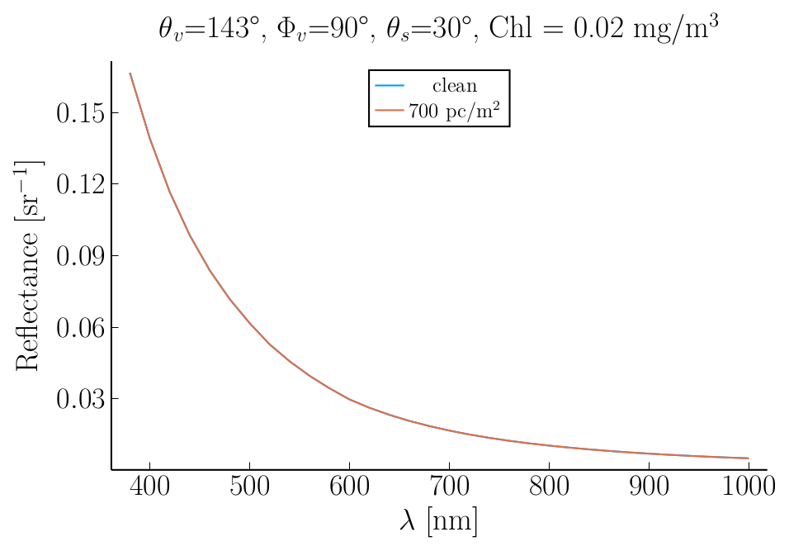

Simulation Results
Typical Case 1 Scene:
Wavelengths 380 - 1000 nm
Plastic Concentration (< 300 µm) = 700 pc/ m³
  Uniformly Distributed
Solar Zenith Angle = 30°
Chl Concentration = 0.02 mg/m³
  Refractive index = 1.04
  Junge Slope = 3.9
CDOM absorption (440 nm) = 0.1 m⁻¹
Phytoplankton Absorption and Scattering = “New Case 1 Model (Hydrolight)”
Aerosol Optical Depth (550nm) = 0.06
  Aerosol Angstrom Exponent = 1.56
  Aerosol Model: Shettle & Fenn Maritime, 65% humidity
Surface Wind Speed = 6 ms⁻¹
Top-of-Atmosphere Radiance & Polarization
Not detectable using radiance or polarization….
… but there’s more!

Slide 17



Positively buoyant plastics follow an exponential distribution with depth
Exponent = 0.8 – 3.0
(Reisser et al., 2015, Fig 3)
-5
-6
Number Concentration
Surface (left) down to 5m depth(right) for two wind speeds.
(Reisser et al., 2015, Fig 1)
Reisser et al., 2015, Fig 4.
Mean Concentration (20 – 300 µm) reported at 6m depth = 500-700 pc/m³
(Hansen et al., 2023)
Extrapolated to the surface, this results in concentrations of > 60,000 pc/m³

Slide 18




Simulation Results (with exponential profile)
Change in Radiance
(Wm⁻²µm⁻¹ sr⁻¹)
Change in DoLP
1 x 10⁻³
850 nm
850 nm
0.02%
-0.02%
5 x 10⁻⁴

Slide 19
Conclusions
Microplastics <300 µm
Can we use optics as a diagnostic tool?
  Microplastic particles have increased backscattering and decreased polarization compared to natural particles
Some microplastic samples appear most similar to extreme cases (e.g., glacial meltwater and certain nearshore environments)
  Appear most similar to mineral-like particles.
Extrapolating mean concentrations at 6m depth (500-700 pc/m³) to the surface based on observed profiles is enough to cause a detectable change in both radiance and polarization.
  A homogeneous profile is not detectable.
  There is a large uncertainty in this extrapolation.
  Unsure if the same profiles hold for small vs large plastic particles.

Slide 20



Thank you!
Special Topic: Frontiers in Ocean Observing: Emerging Technologies for Understanding and Managing a Changing Ocean
https://doi.org/10.5670/oceanog.2023.s1.15

Slide 21
Extras

Slide 22



Eccentricity
$$e=\sqrt{1−\frac{b^{2}}{a^{2}}}$$
b
a

Slide 23


Absorption properties of seawater samples
vs.
microplastic samples
Notes:
Plastics have relatively low mass-specific ap, particularly in blue region. This may be advantageous from a Rrs perspective.

