Slide 1
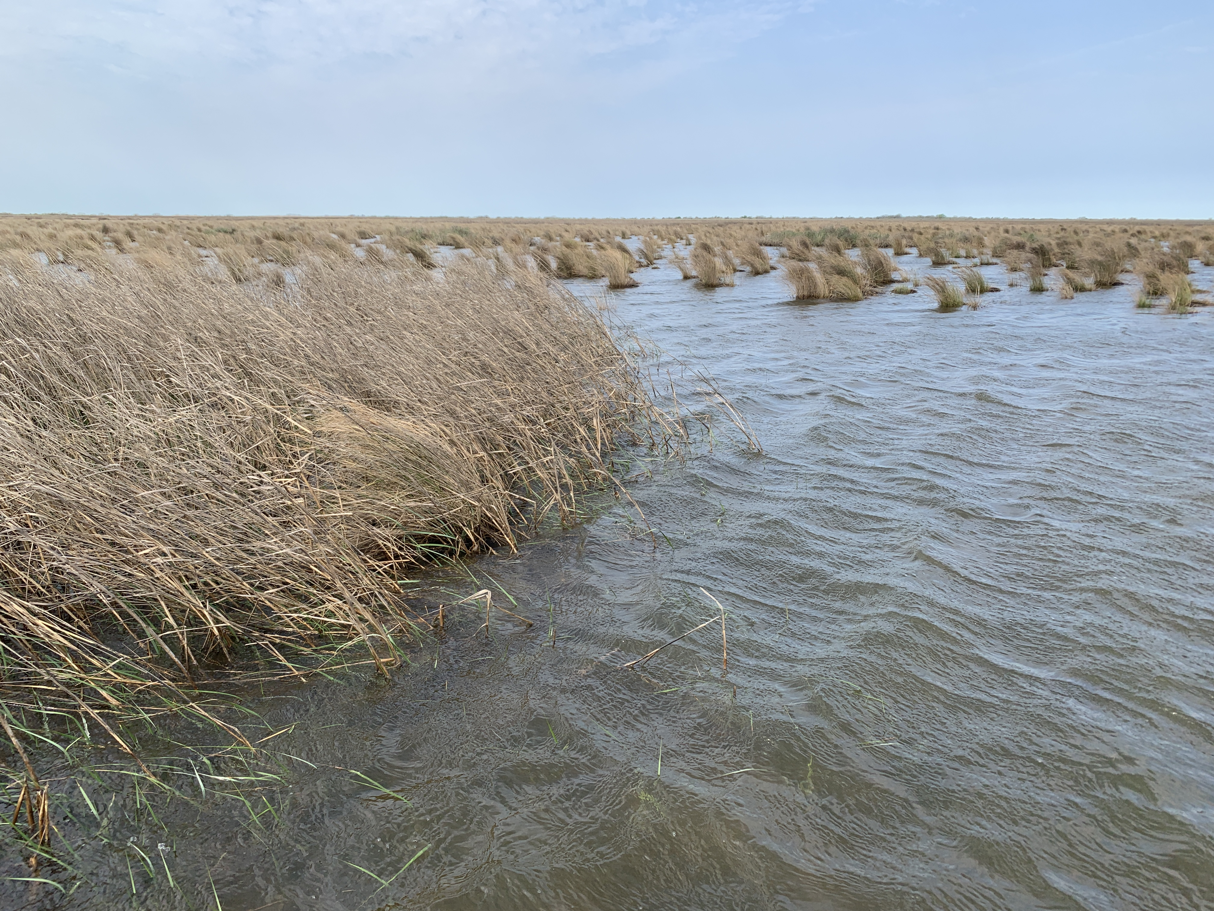
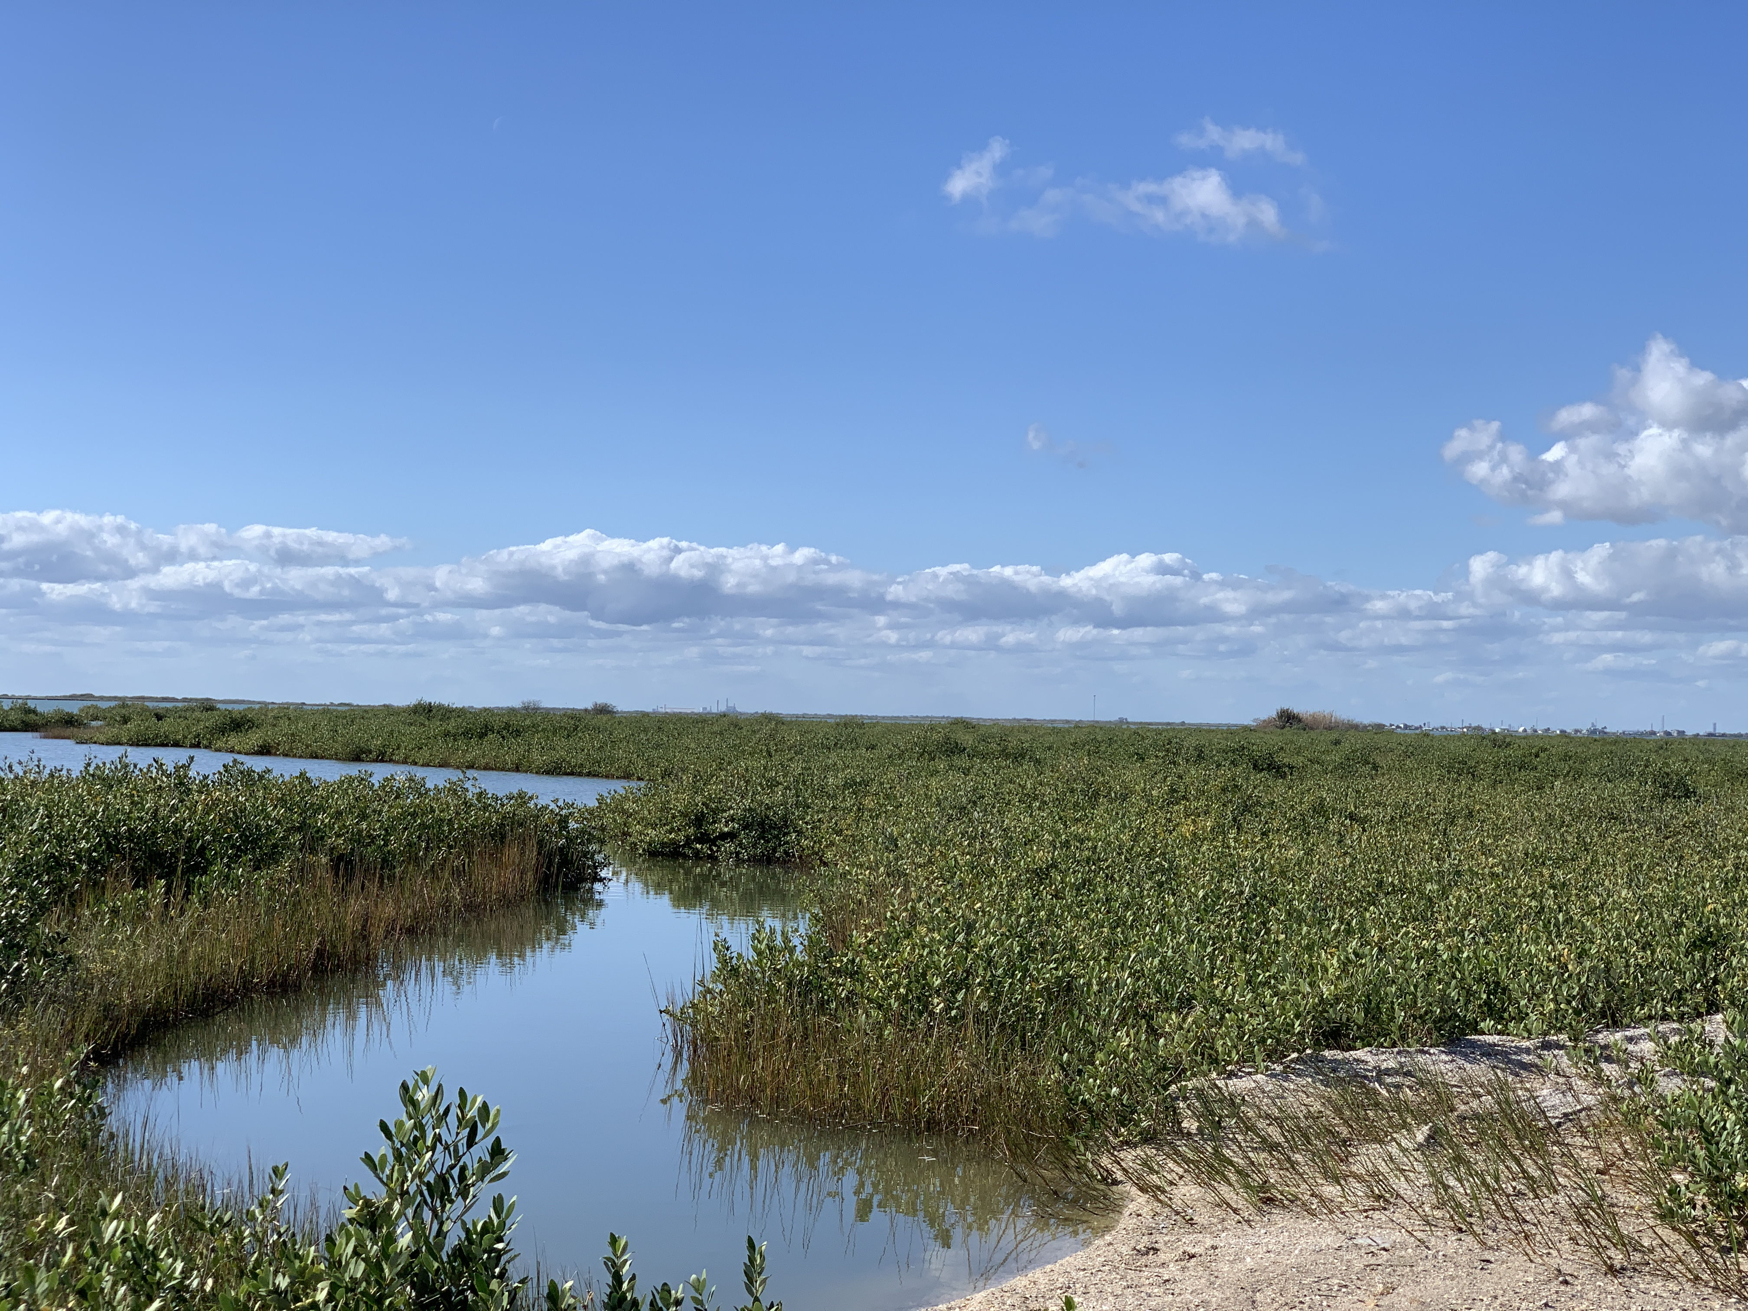
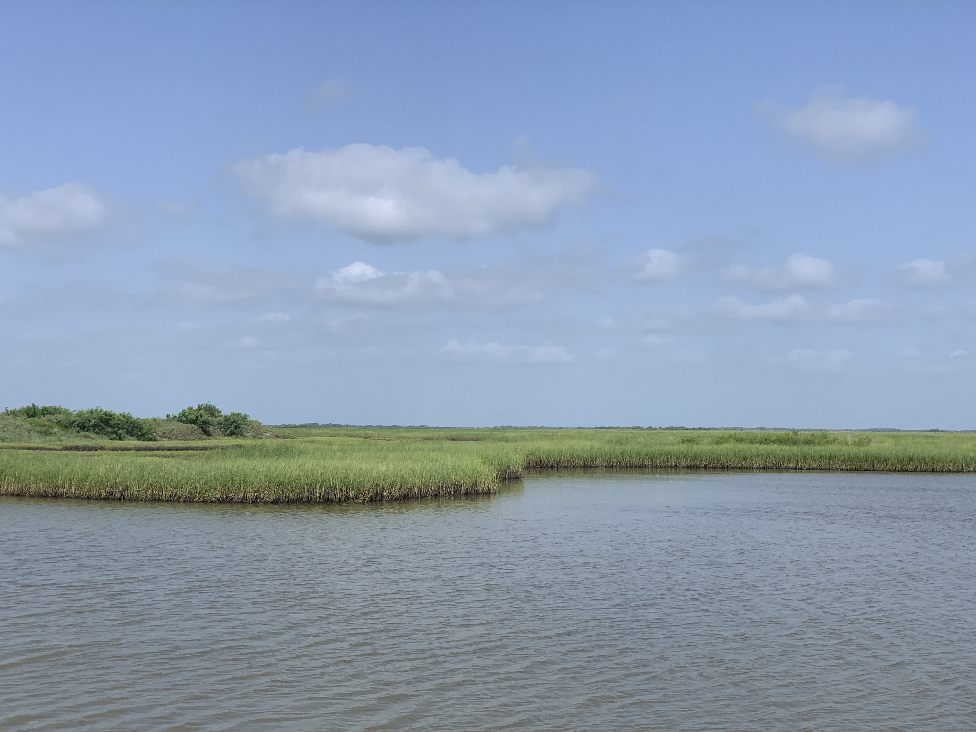
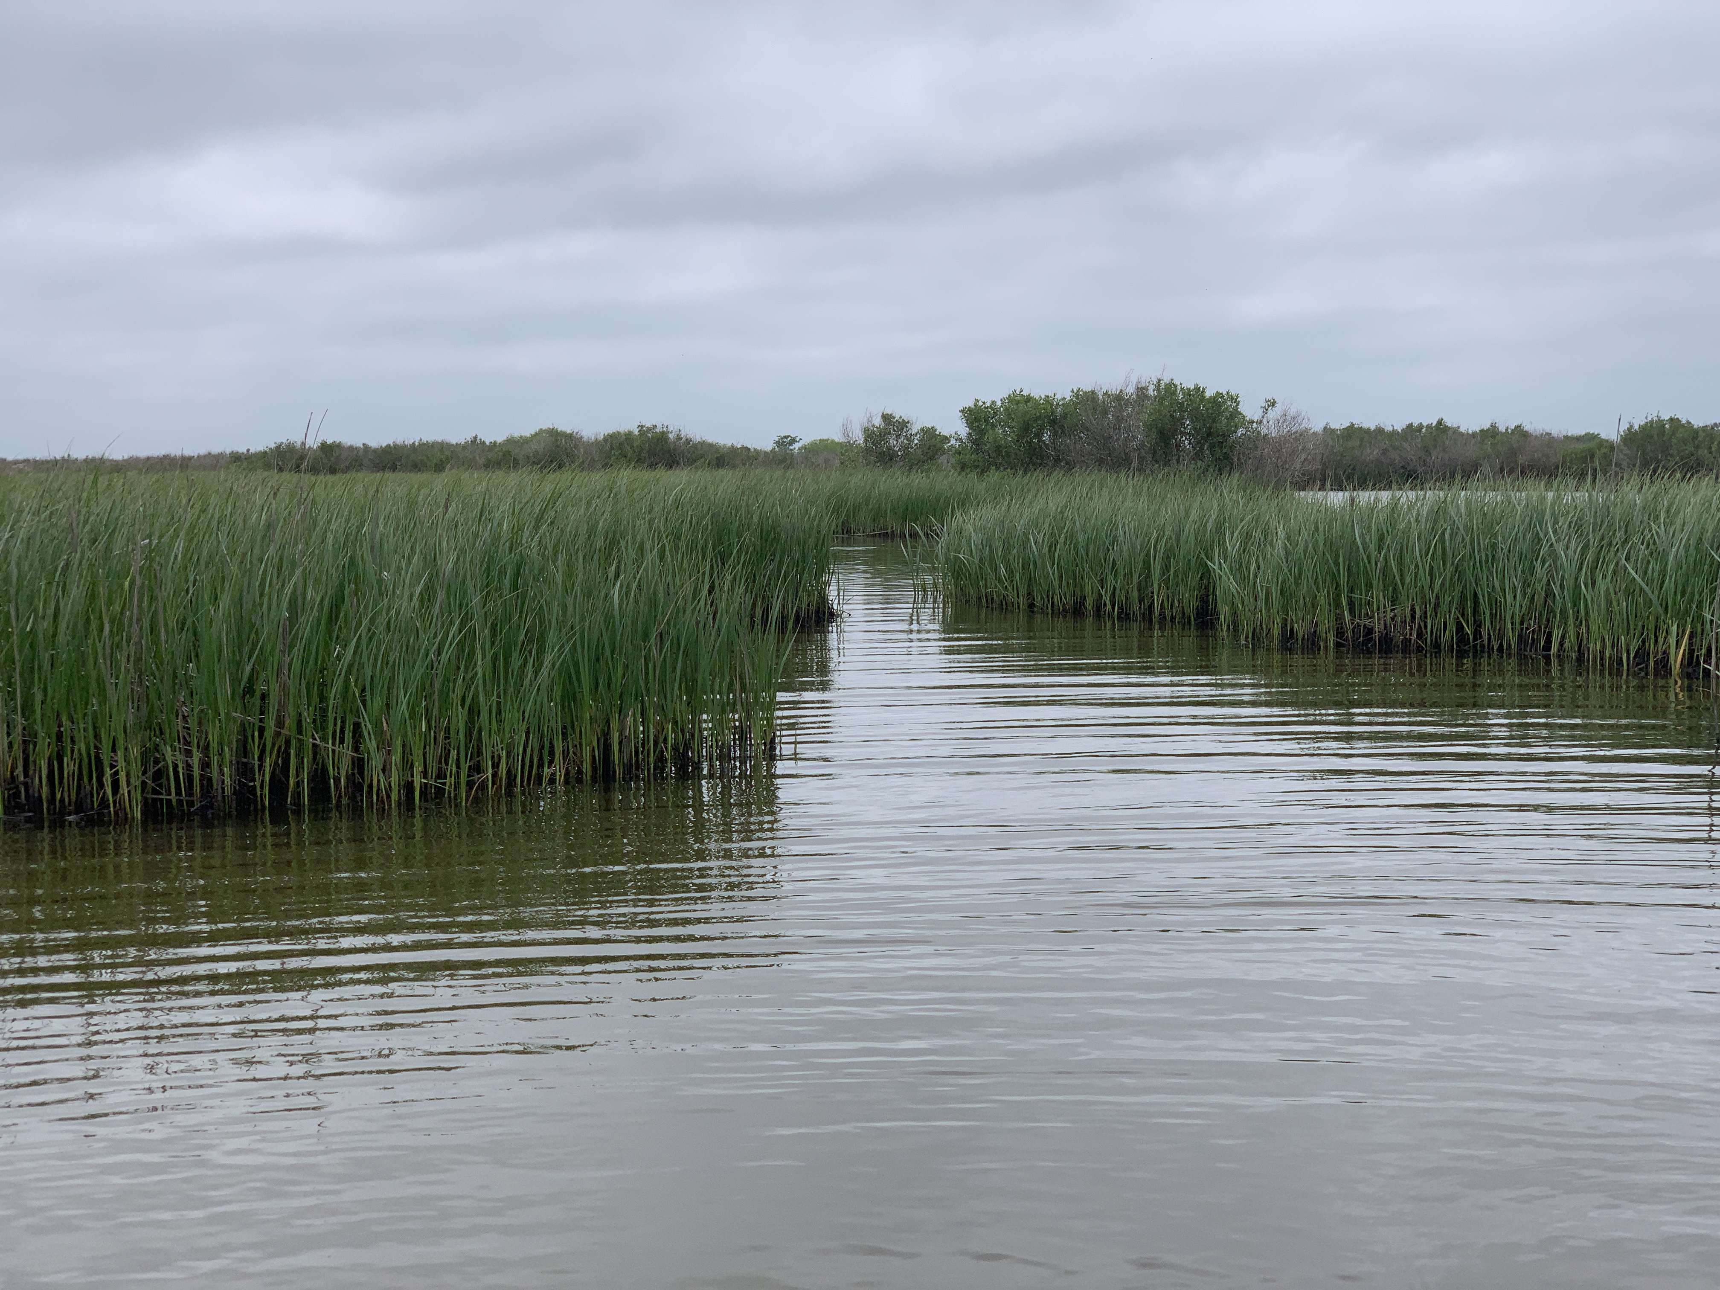
Scaling patterns and tradeoffs in ecosystem resistance and resilience
Josh Lerner^{1,2}, Rusty Feagin¹, Thomas Huff¹, Ray Najjar³, Maria Herrmann³, Jose Fuentes³
1 – Texas A&M University, Ecology and Conservation Biology Department
2 – Texas A&M University, Ecology and Evolutionary Biology Doctoral Program
3 – Pennsylvania State University, Department of Meteorology and Atmospheric Science

Slide 2
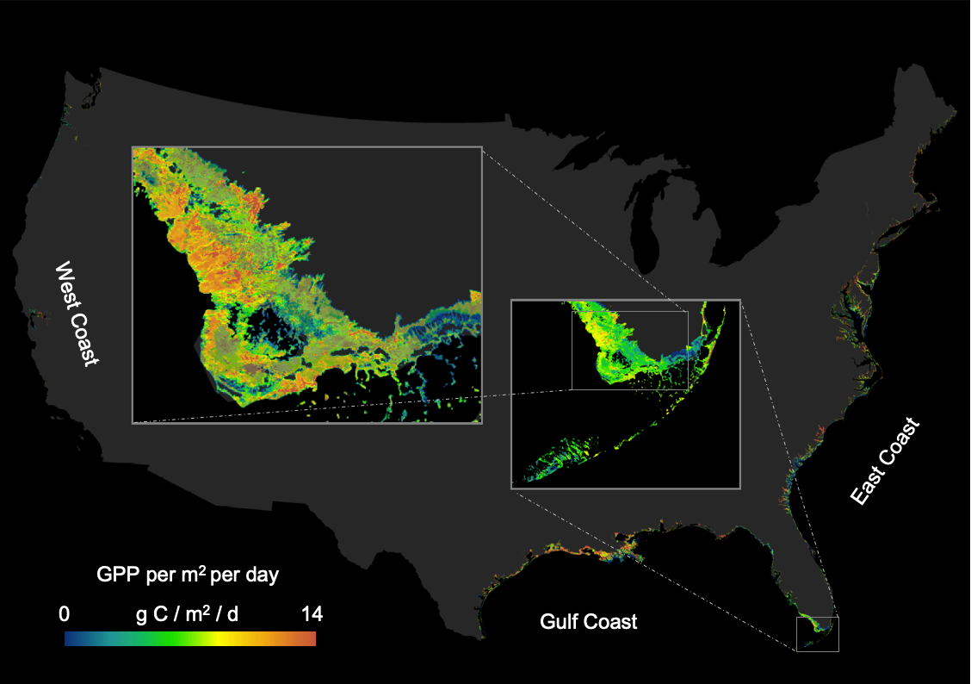
Tidal wetland gross primary production (GPP) dataset
EVI band of the MOD13Q1 MODIS-satellite product
R. A. Feagin, I. Forbrich, T.P. Huff, J.G. Barr, J. Ruiz-plancarte, J.D Fuentes, R.G. Najjar, R. Vargas, A. Vazquez-lule, L. Windham-Myers, K. Kroeger, E.J. Ward, G.W. Moore, M. Leclerc, K.W. Krauss, C.L. Stagg, M. Alber, S.H. Knox, K.V.R. Schafer, T.S., Bianchi, J.A. Hutchings, H.B. Nahrawi, A. Noormets, B. Mitra, A. Jaimes, A.L. Hinson, B. Bergamaschi, J. King, and G. Miao., Tidal wetland gross primary production across the continental United States, 2000–2019. Global Biogeochemical Cycles 34, (2020).
Notes:
-Tidal wetlands in this dataset consist of salt marshes, tidal freshwater marshes, tidal forested swamps, and mangrove forests.

Slide 3
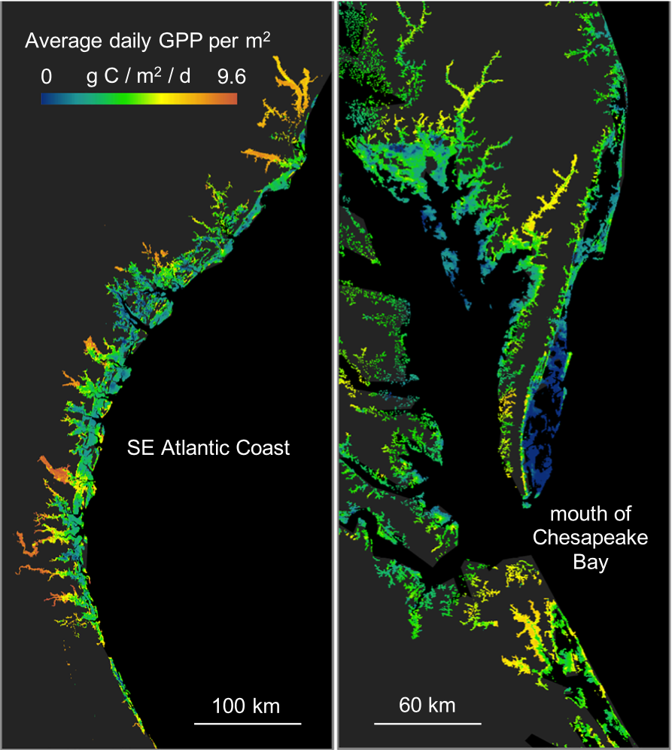
Feb. 18th, 2000 – Dec. 2nd, 2020
16-day return intervals
250-meter resolution
145,871 pixels with >90% QA, EVI, & wetland class purity filters

Slide 4
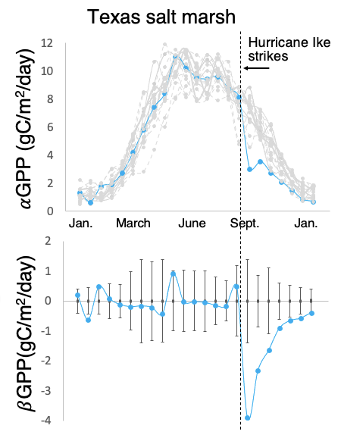

Standardize the time series data
2) Perturbation events: each time GPP leaves standard deviation boundary = 1,885,798 events
negative events (n = 875,845)
positive events (n = 1,009,953)
3) Effect size (E) and return time (R) of each event
$E$= -4.4 gC/m²/day
$R$= 7 epochs,
or 112 days

Slide 5
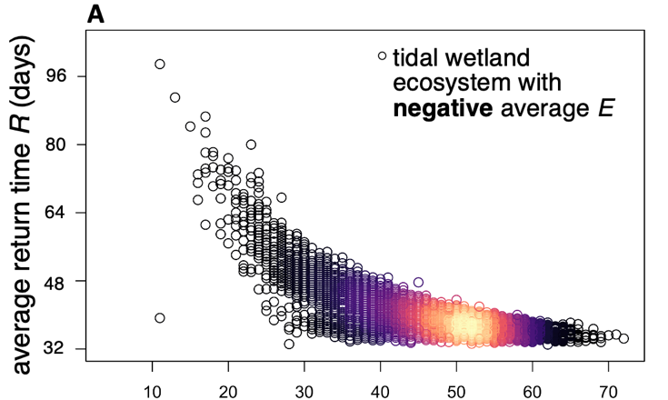
Tidal wetland locations with more negative perturbations were more resilient
Tidal wetland pixel location
number of -E events from 2000 - 2021
Notes:
Just 23% of pixel locations had a perturbation event…
....& ecosystems that are less resilient tended to be more resistant and have less perturbation.

Slide 6
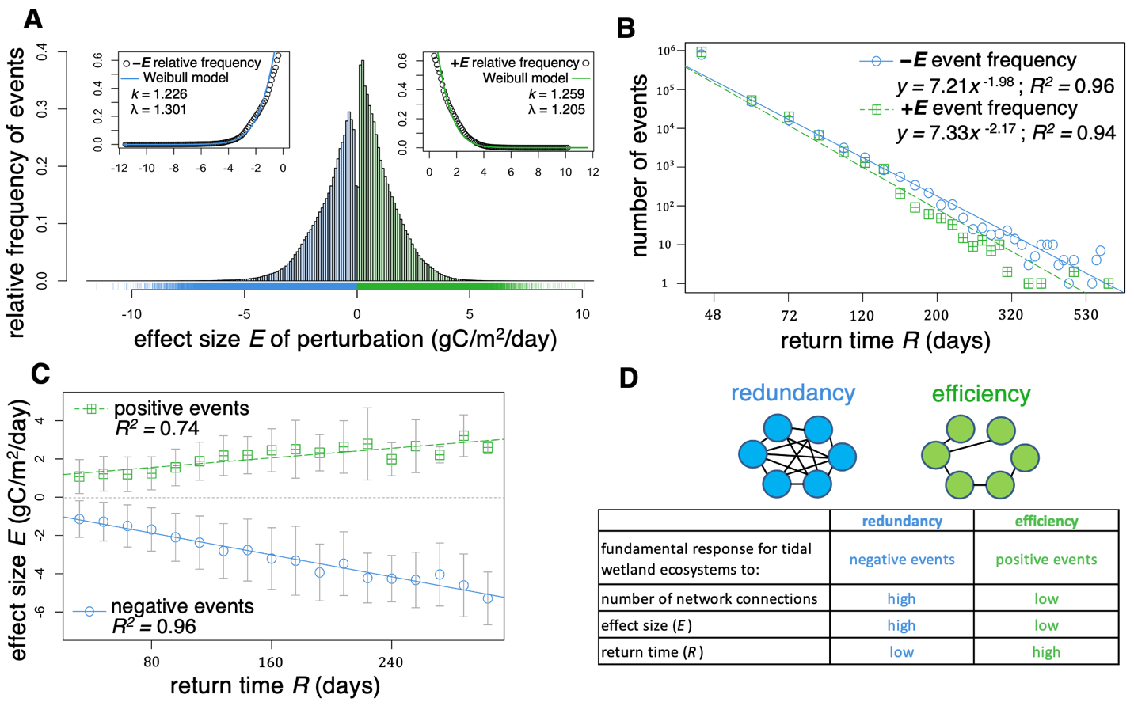
Effect size (E) frequency distribution is Weibull/exponential
Average -E of 1.22 gC/m²/day
Average +E of 1.12 gC/m²/day
Average E of all 1,885,798 perturbation events =
0.03 gC/m²/day
Long term balance where positive perturbations are more frequent than negative perturbations, but negative perturbations are larger in magnitude.
Notes:
These ecosystems appear to be acting as neutral transformers of energy, with balance across the entire biogeography of the continental US and 21 years of time.

Slide 7
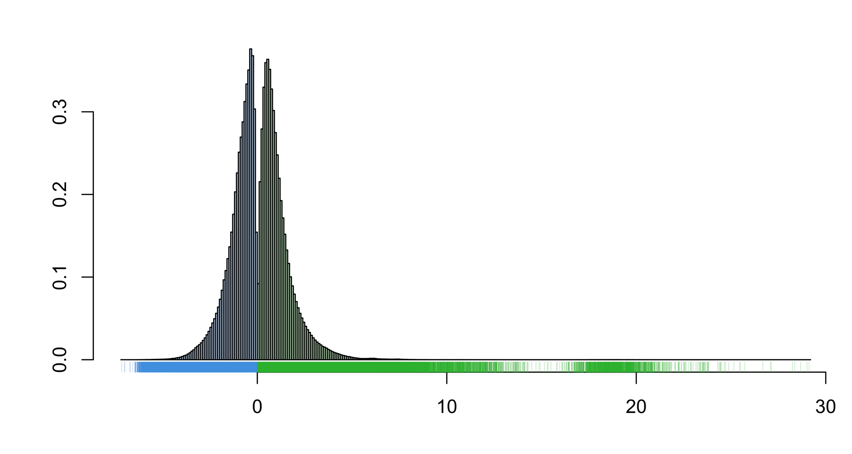
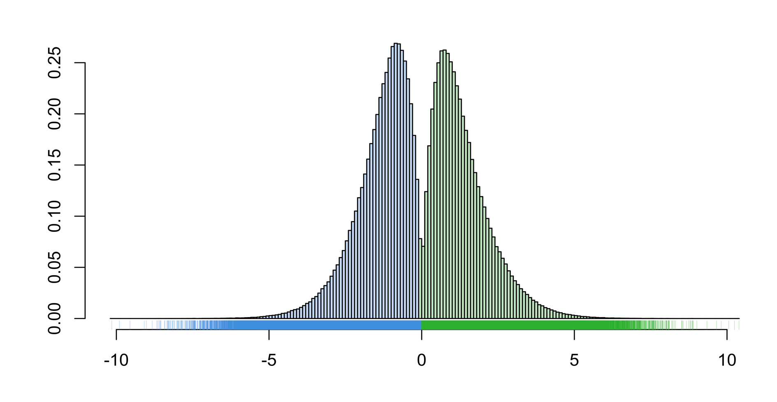
We then used MOD17 GPP timeseries (8-day product, 500 m resolution) for global mangroves, and global flooded grasslands & savannas.
Mangroves
Flooded grasslands and savannas
Relative frequency of events
Effect size (E) of perturbation events (gC/m²/day)
Opposite to tidal wetlands, flooded grasslands had more large positive events than large negative events.
Mangroves had more small negative events than tidal wetlands.

Slide 8
Tidal wetland return times (R) are power law distributed.
For events more than half a year in duration, negative events are nearly ten-fold more common than positive events

Slide 9
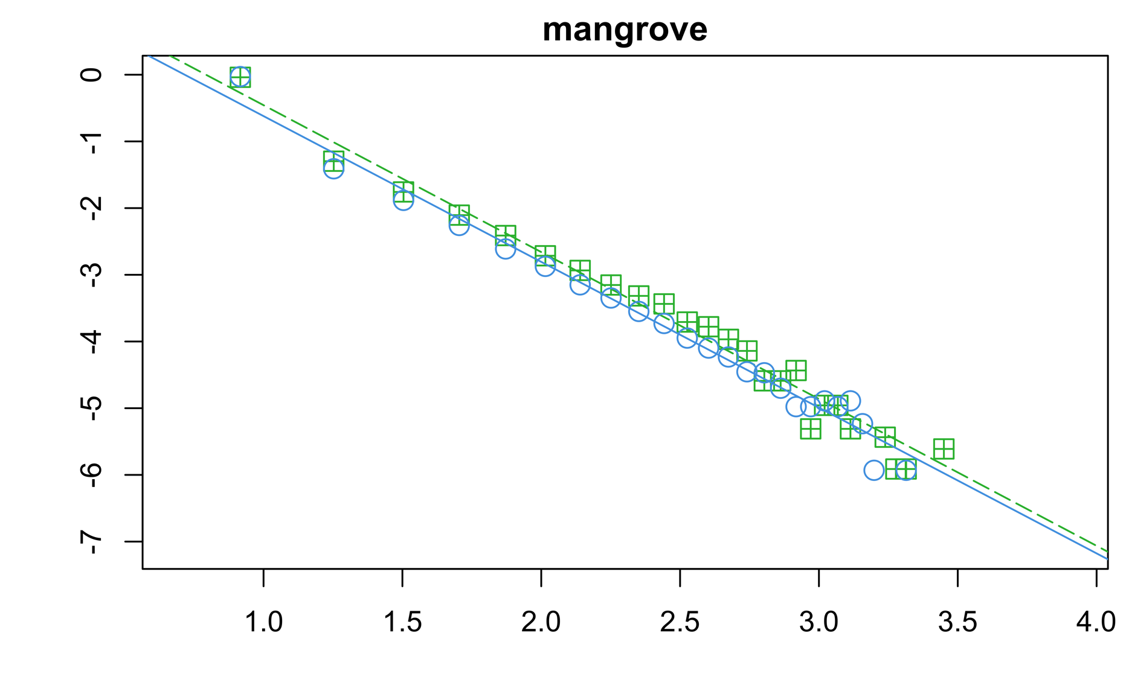
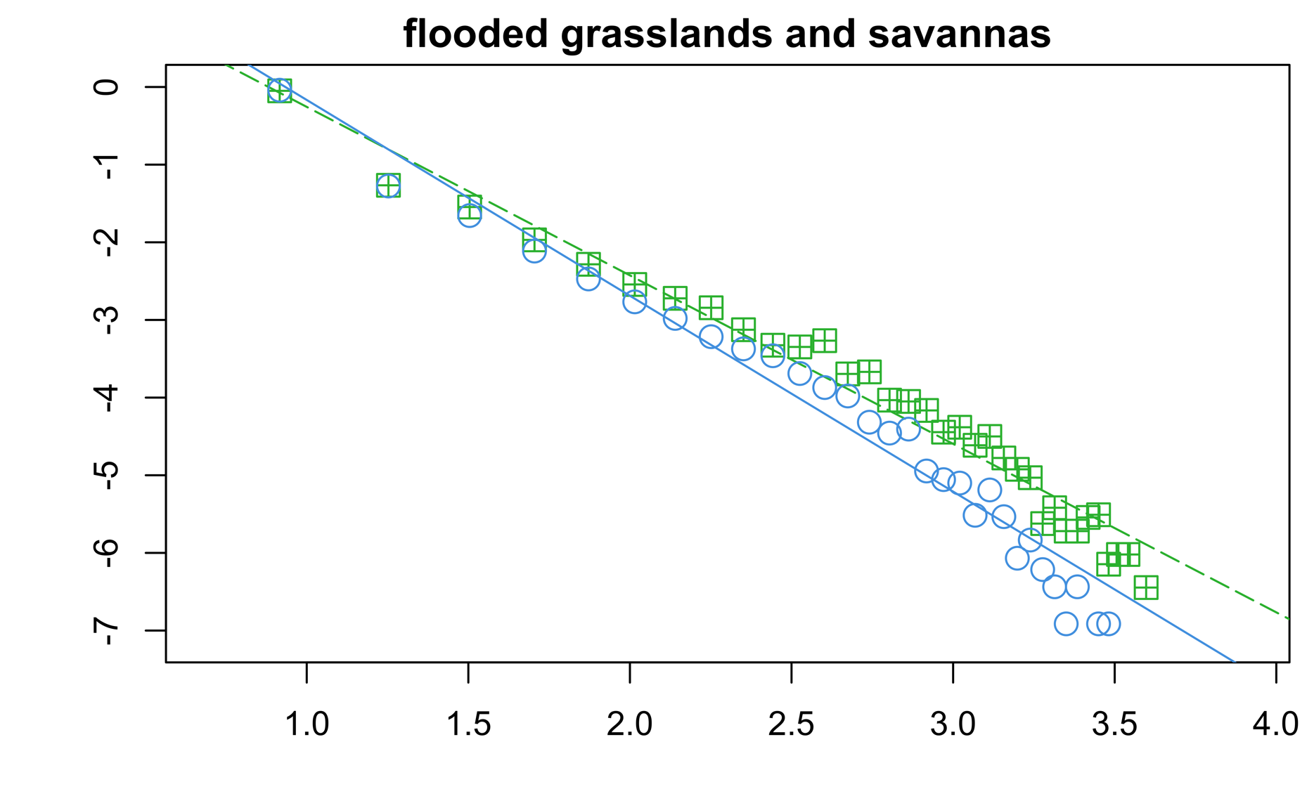


MOD13 U.S. Tidal Wetlands, MOD17 global mangroves, and flooded grasslands & savannas biomes all have the same power law slope.
1
+E event frequency
+E event frequency
10⁻¹
y = 1.75x ^{-2.20} ; R² = 0.98
y = 1.91x ^{-2.17} ; R² = 0.97
10⁻²
10⁻³
10⁻⁴
Relative frequency density
10⁻⁵
10⁻⁶
−E event frequency
−E event frequency
10⁻⁷
y = 1.57x ^{-2.19} ; R² = 0.98
y = 2.35x ^{-2.52} ; R² = 0.97
22
36
60
98
160
265
436
22
36
60
98
160
265
436
Return time of perturbation events (days)
Notes:
Long positive events are (nearly ten-fold) more common in flooded grasslands than long negative events….

Slide 10
Covariation between resistance and resilience suggests these key metrics of ecosystem stability functionally tradeoff.
Notes:
As resilience begins to decrease (and return times get longer), resistance to perturbation increases (and in turn, events become less frequent, but larger in magnitude when they do happen.)

Slide 11
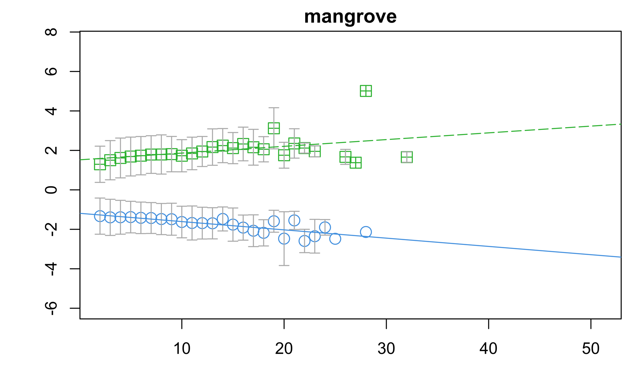
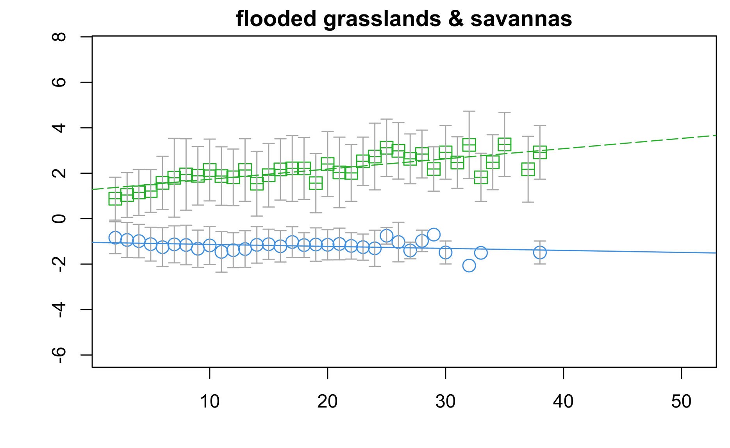
Tidal wetlands and mangroves are tuned more towards large negative events (redundancy), flooded grasslands are more tuned towards large positive events (efficiency).
y = 0.034x + 1.52 ; R² = 0.13
y = 0.045x + 1.28 ; R² = 0.60
Effect size (gC/m²/day)
y = -0.042x − 1.19 ; R² = 0.63
y = -0.009x − 1.04 ; R² = 0.08 (p = 0.06)
80
160
240
320
400
80
160
240
320
400
Return time (days)
Notes:
However, it seems that resistance and resilience tradeoff in differently in different systems…
Tidal wetlands and mangroves are better adapted to large negative events, a stability strategy we call redundancy, where ecosystems have more network connections (through water), and despite undergoing substantial reorganization, can quickly recover their function.
Whereas flooded grasslands and savannas are better adapted to large positive perturbations, a stability strategy we call efficiency, where ecosystems have fewer, but stronger network connections, which allows the system to amplify its dynamics to maximize productivity when resources are available.

