Slide 1
Estimating Carbon Fluxes using
Remotely Sensed River Discharges
Jaclyn Gehring¹, Aron Stubbins¹, Ed Beighley¹, Claire Griffin², Rob Spencer ³, Karen Frey ⁴
¹ Northeastern University, Boston, MA
² Southern Oregon University, Ashland, OR
³ Florida State University, Tallahassee, FL
⁴ Clark University, Worcester, MA
8 May 2023
NASA Carbon Cycle & Ecosystems
Joint Science Workshop
Ocean Biology & Biogeochemistry
Notes:
I am measuring water from space and how this impacts water fluxes

Slide 2
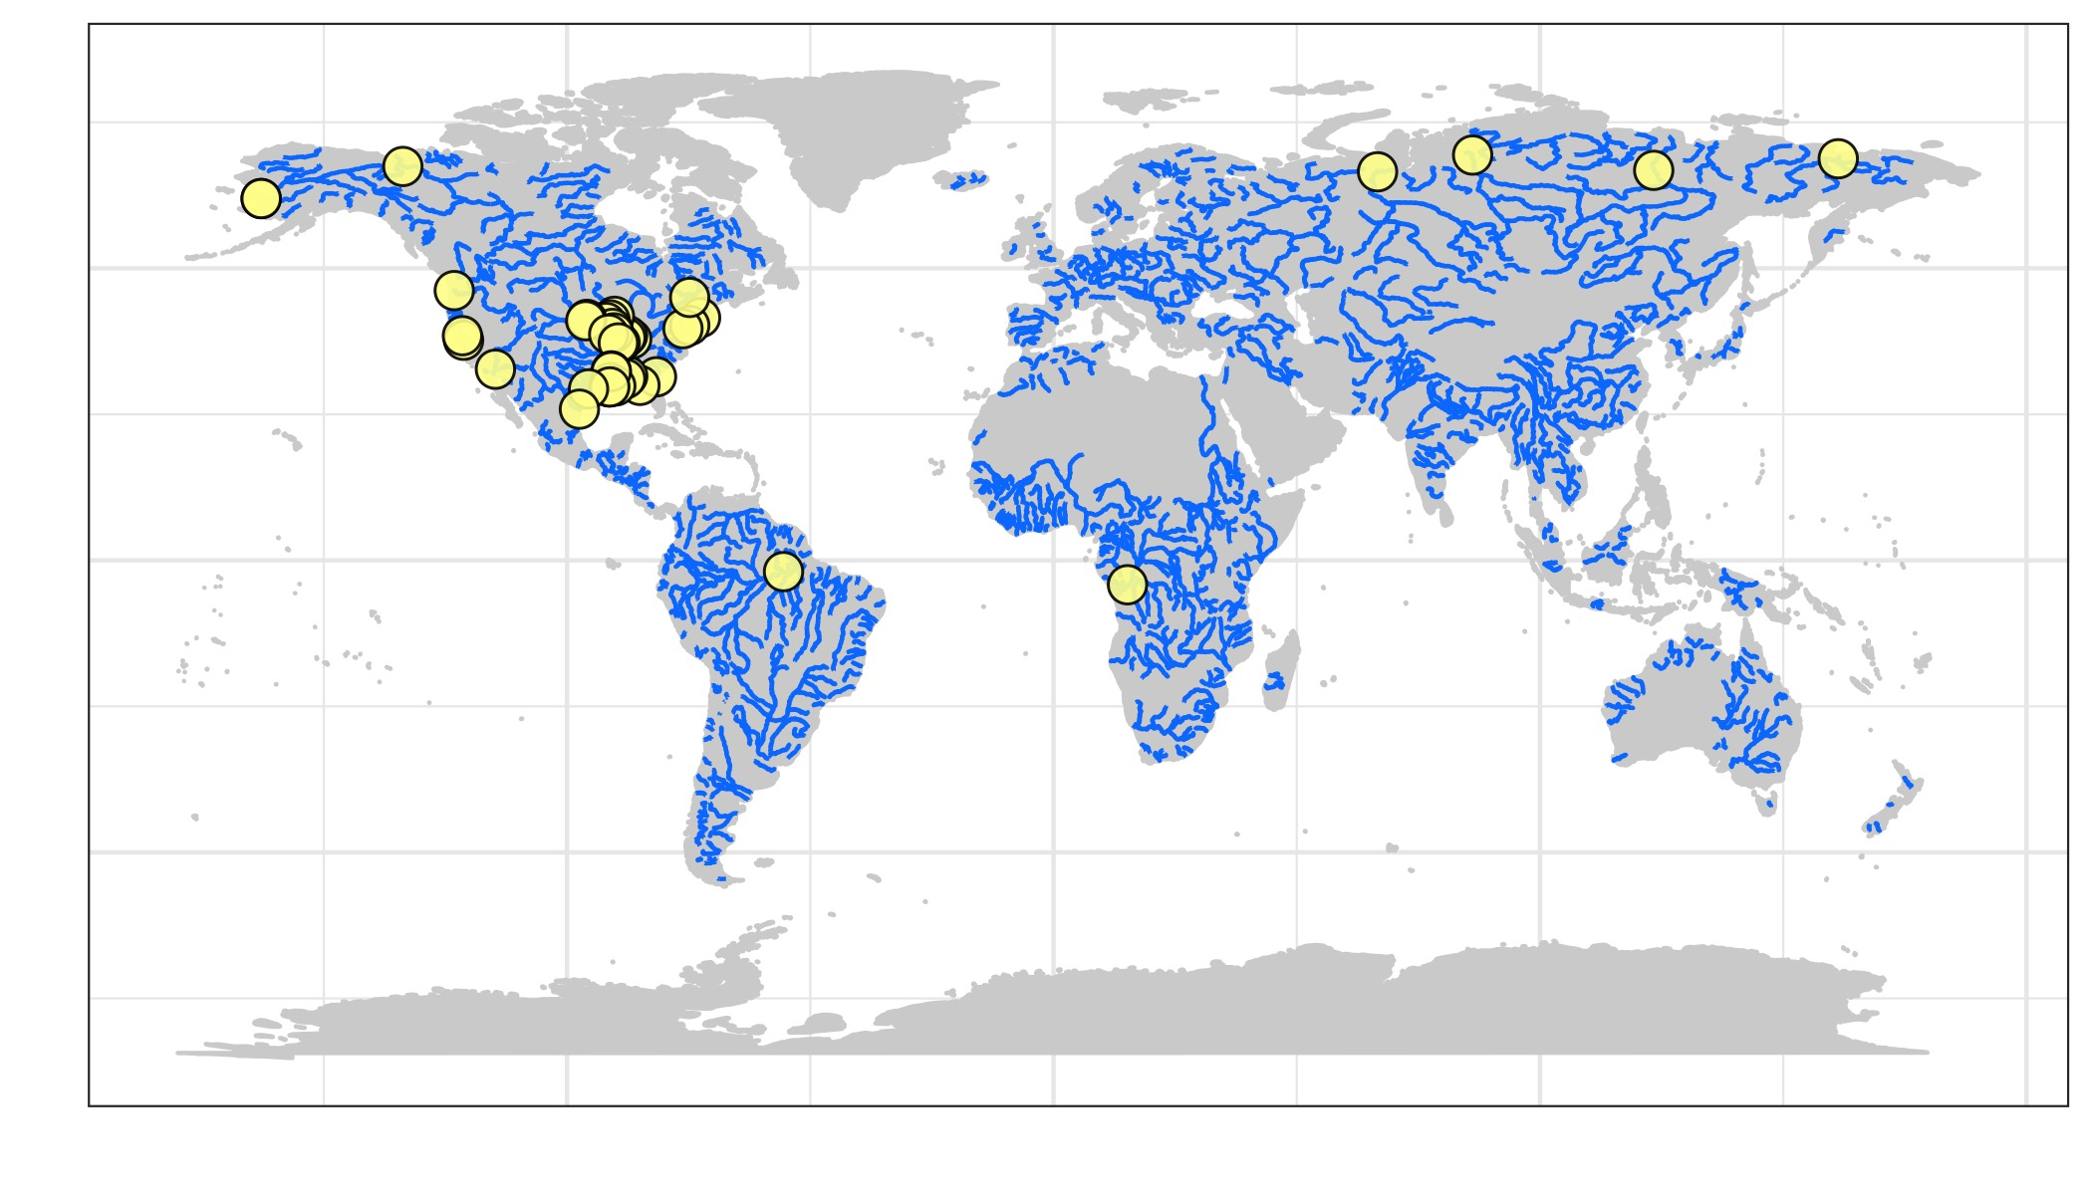
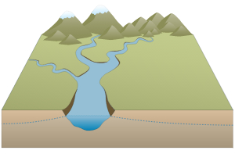
METHODS
ALTIMETRY
Measures water surface elevations
Resolution: varies by satellite, approximately 6-15 days
Sentinel-3A
GRACE/GRACE-FO
Gravimetry
Measures water storage changes
Resolution: Monthly
Poster Session 1: ID 1-54
Tuesday 5:00-7:00 pm
Notes:
GRACE = monthly, doesn’t capture big events
Altimeter = better temporal resolution, but not daily! → Might miss events

Slide 3
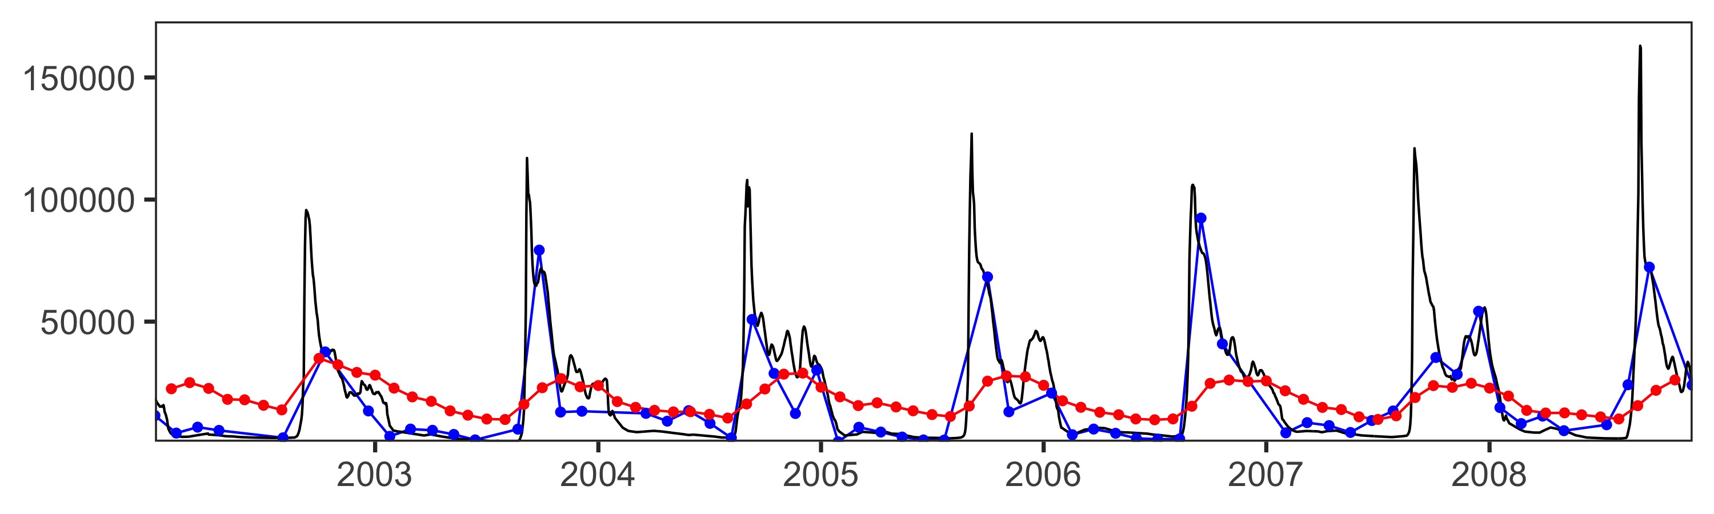
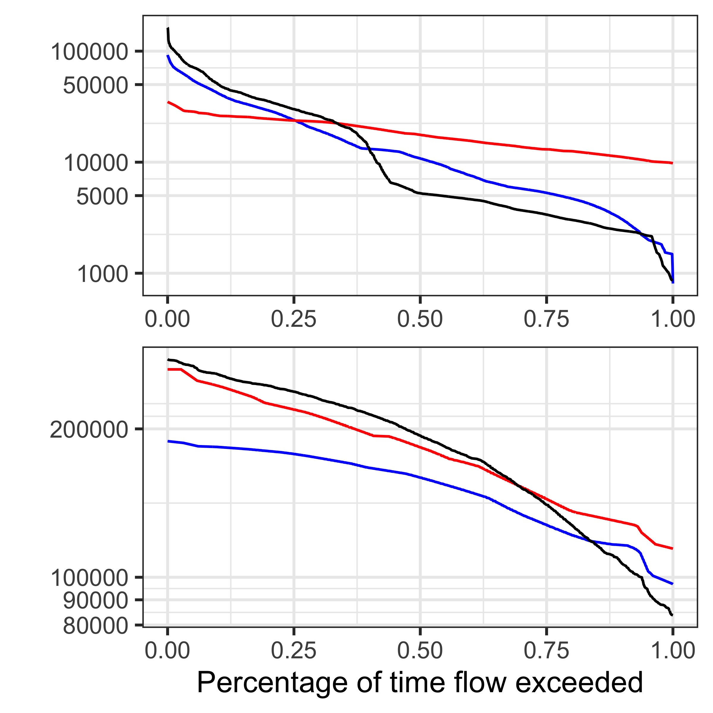
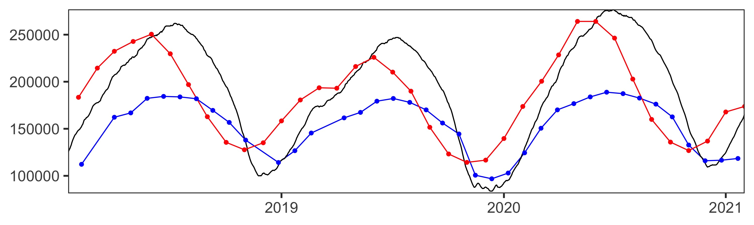
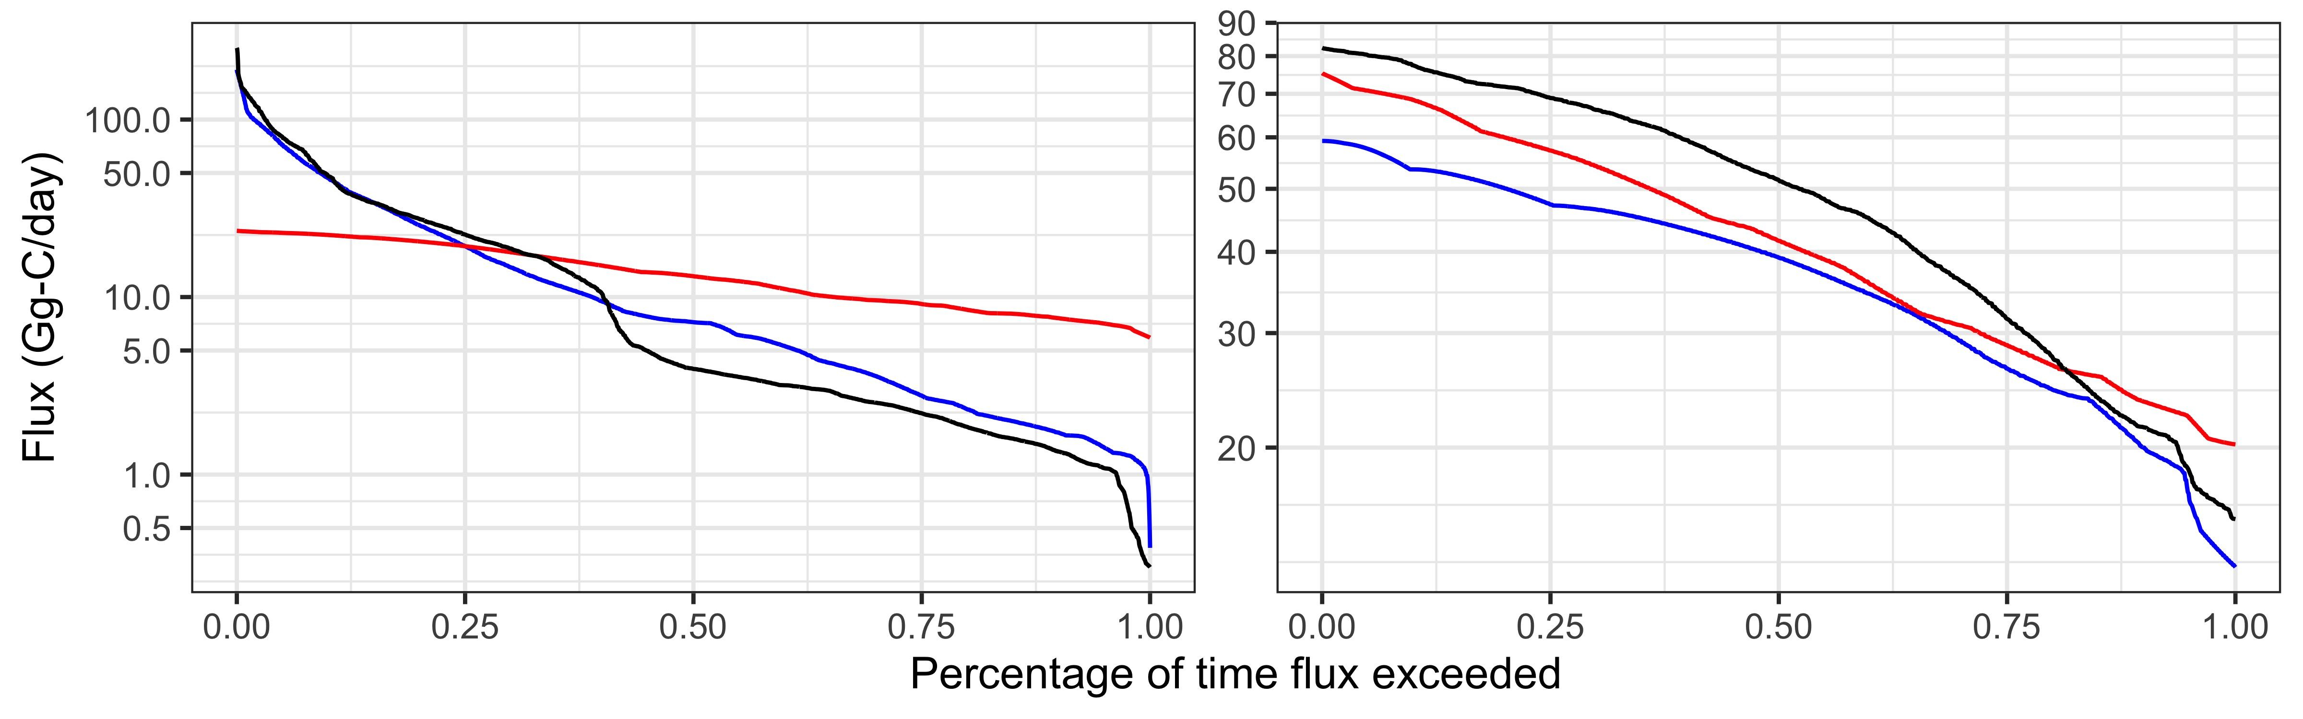
RESULTS
Lena River
Gauge Altimeter GRACE
Lena
Altimetry 91% of Annual Q
GRACE 104% of Annual Q
Discharge (m³/s)
Amazon
Amazon River
Gauge Altimeter GRACE
Altimetry 82% of Annual Q
GRACE 103% of Annual Q
Lena
Amazon
Altimetry 99% of Annual Flux
GRACE 77% of Annual Flux
Altimetry 75% of Annual Flux
GRACE 90% of Annual Flux
Poster Session 1: ID 1-54
Tuesday 5:00-7:00 pm
Notes:
Flow exceedance of DOC → temporal aspect creates issues for the Arctic for GRACE
Altimeter does not do well for the Amazon, GRACE is monthly so underestimates but is able to capture stable rivers

Slide 4
Come see my poster tomorrow!
Poster Session 1: ID 1-54
Tuesday 5:00-7:00 pm
THANK YOU!
Contact: gehring.j@northeastern.edu
NASA Carbon Cycle & Ecosystems
Joint Science Workshop
Ocean Biology & Biogeochemistry

