Slide 1
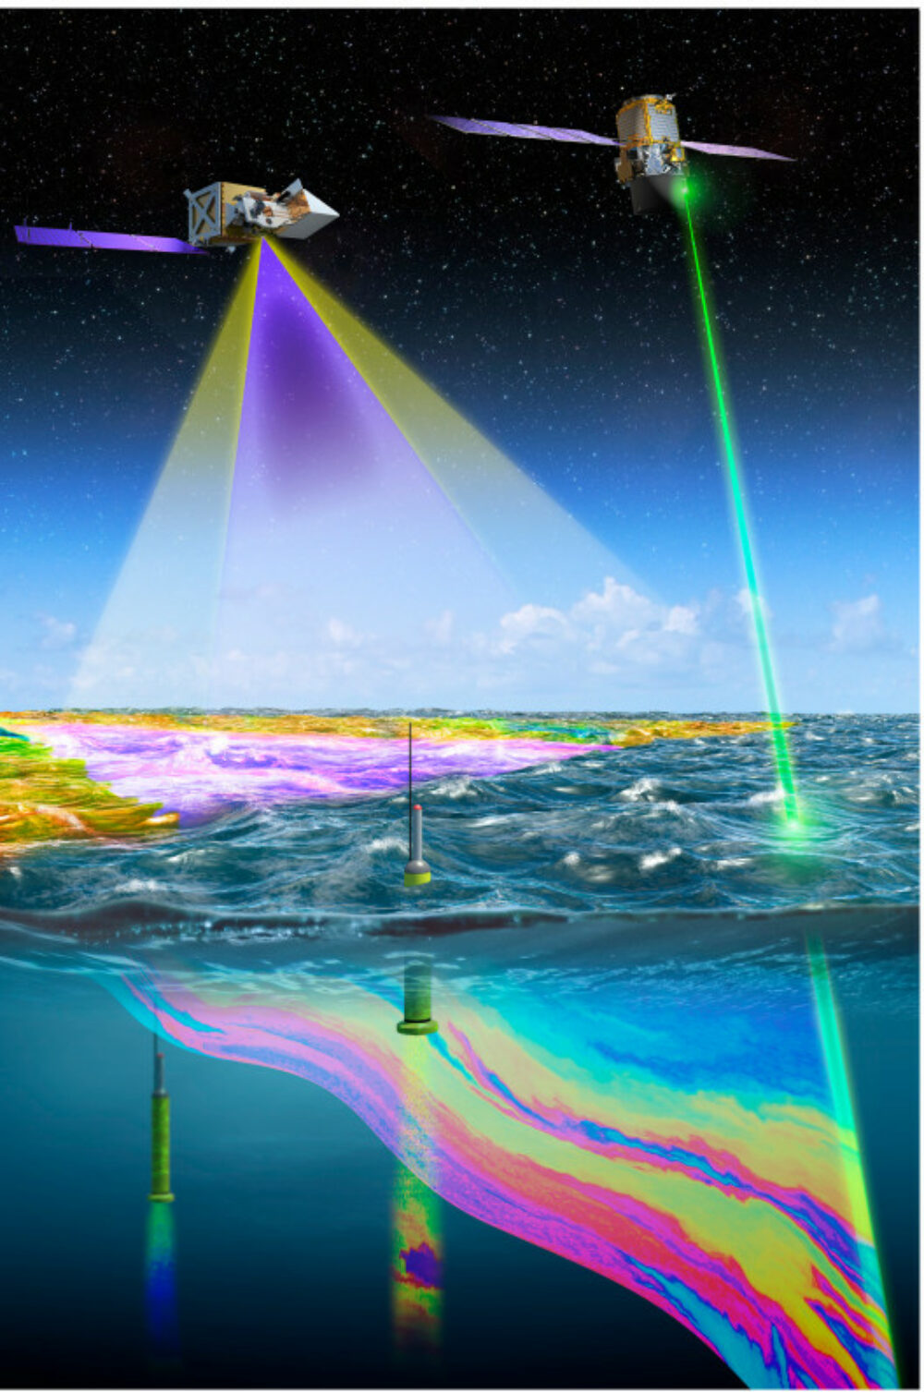
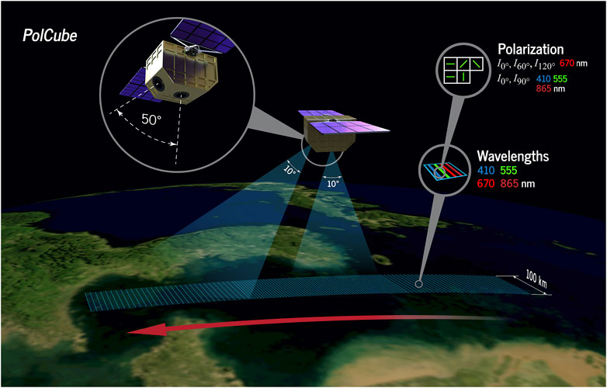
A Brief Introduction on CALIGOLA and POLCUBE, and Their Potential Ocean Measurement Capabilities
Michael Behrenfeld (OSU)
Paolo Di Girolamo, Davide Dionisi (ASI)
Laura Lorenzoni, Parminder Ghuman, Woody Turner (NASA HQ)
Snorre Stamnes, Vianni Cadenas, Ali Omar and Yongxiang Hu (NASA LaRC)
Cloud Aerosol Lidar for Global Scale Observations of the Ocean-Land-Atmosphere System - CALIGOLA

Slide 2
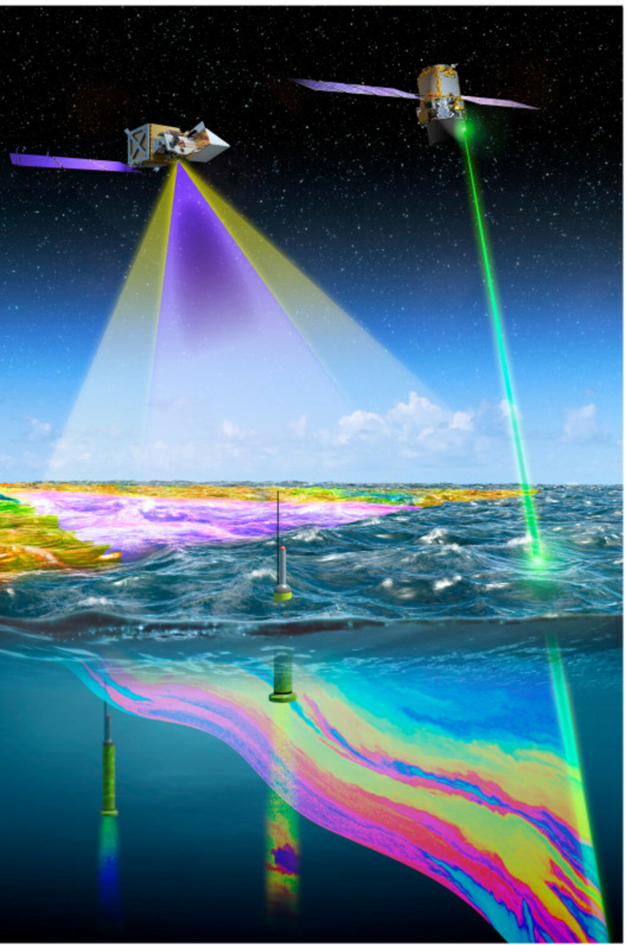
CALIGOLA: Cloud Aerosol LIdar for Global scale observations of the Ocean-Land-Atmosphere system
A space lidar mission started by Italian Space Agency (ASI)
Italy team and USA team (Laura Lorenzoni, Parminder Ghuman, Woody Turner, Mike Behrenfeld, Yongxiang Hu, …) are working on potential ASI/NASA partnership
Three wavelength laser (355 nm, 532 nm, 1064 nm)
Dual polarization backscatter channels (355, 532, 1064)
Ocean Raman scattering channels (317 nm, 404 nm, 450 nm)
Fluorescence channel (685 nm)
Orbit altitude: 400 km or 450 km; Telescope size: 0.7 m

Slide 3
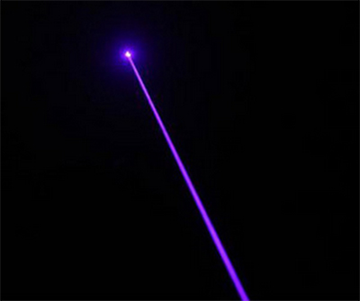
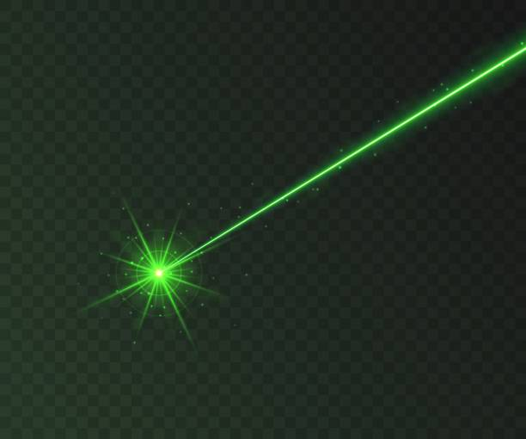
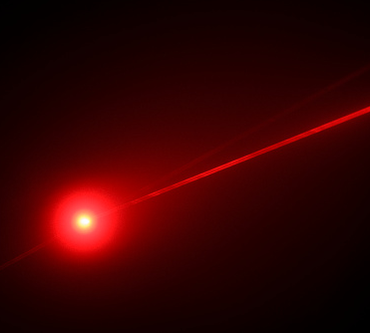
CALIGOLA will carry the most powerful laser in space
51 pulses each second (about 150 m horizontal distance between two pulses)
Laser energy / pulse: 200 mJ (355 nm), 50 mJ (532 nm) and 250 mJ (1064 nm)
Laser is built by Leonardo (heritage of lasers on Aeolus wind lidar, and EarthCare atmospheric lidar)

Slide 4
Comparisons of Ocean Measurements: CALIGOLA vs CALIPSO
 | CALIGOLA | CALIPSO
Vertical Resolution | 0.75 m | 22.5 m
Wavelengths | 355 nm, 532 nm | 532 nm
Polarizations | Co-polarization Cross-polarization | Cross-polarization
Raman Scattering Channels | Stokes (404 nm) Anti-Stokes (317 nm, 450 nm) | none
Fluorescence | Chlorophyll (685 nm) | none
Day/Night | Yes | Yes

Slide 5
Comparisons of backscatter performance:
CALIGOLA vs CALIPSO
Telescope solid angle: CALIGOLA 45% larger than CALIPSO [ 2.29e-12 Sr vs 1.58e-12 Sr ] (410 km orbit height)
Laser energy: CALIGOLA 355 nm has 5 times more energy; CALIGOLA 532 nm has 25% more energy
Detector QE: CALIGOLA 355 nm QE is 3.2 times of CALIPSO; CALIGOLA 532 nm QE is 2.2 times if CALIPSO
Atmospheric Attenuation: 355 nm is roughly 3 times more than 532 nm
Ocean Subsurface Backscatter at 355 nm is roughly 4 times more than 532 nm
Polarization: co-polarization signal is about 10 times that of cross polarization
Raman channels help (1) separating particulate and molecular backscatter; (2) removing attenuation
attenuated backscatter of particulate = attenuated backscatter signal – c1 * attenuated Raman signal
particulate backscatter profile = c2 * attenuated backscatter of particulate / attenuated Raman signal
CALIGOLA’s 355 nm co-polarization ocean signal strength / CALIPSO 532 nm cross polarization = 309
CALIGOLA’s 355 nm cross-polarization ocean signal strength / CALIPSO 532 nm cross polarization = 31
CALIGOLA’s 532 nm co-polarization ocean signal strength / CALIPSO 532 nm cross polarization = 40
CALIGOLA’s 532 nm cross-polarization ocean signal strength / CALIPSO 532 nm cross polarization = 4
More scientific information from CALIGOLA (e.g., particle size due to two wavelength contrast, …)

Slide 6
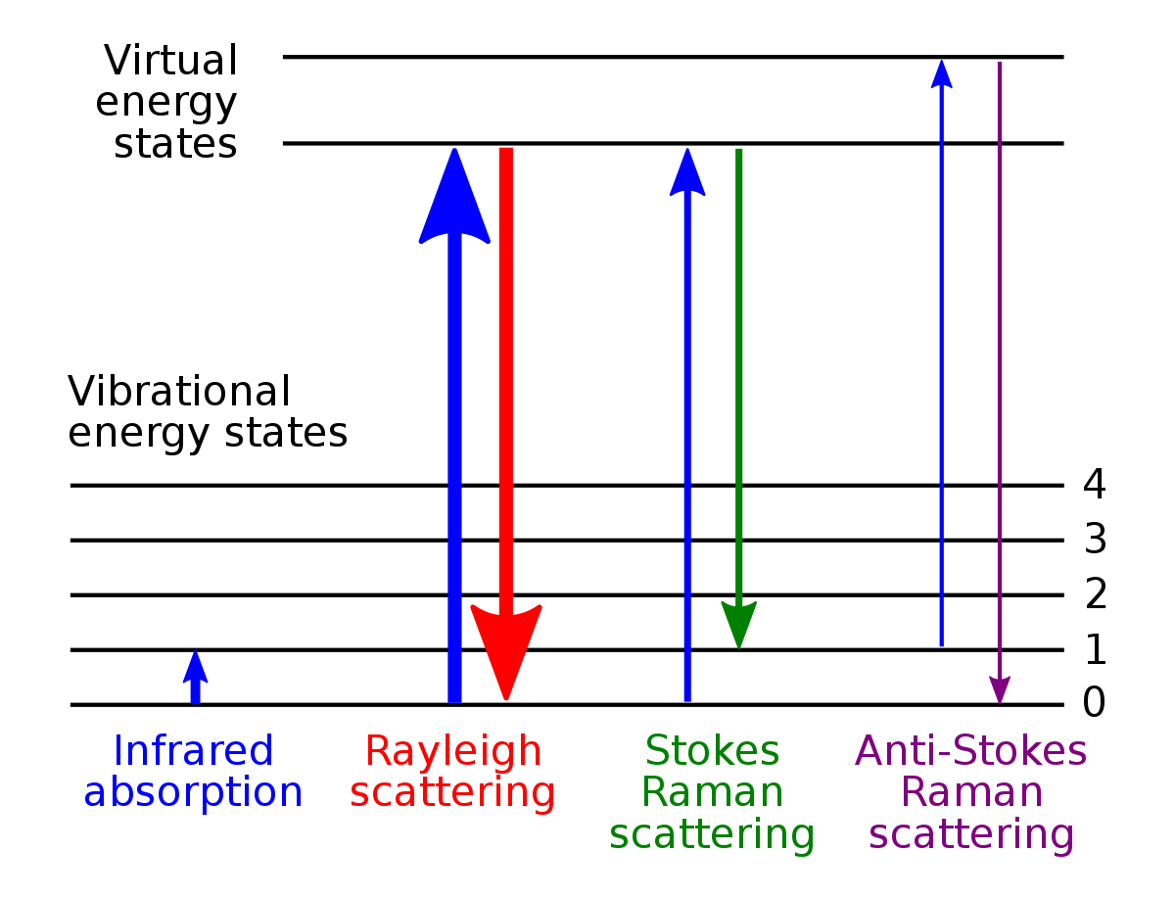
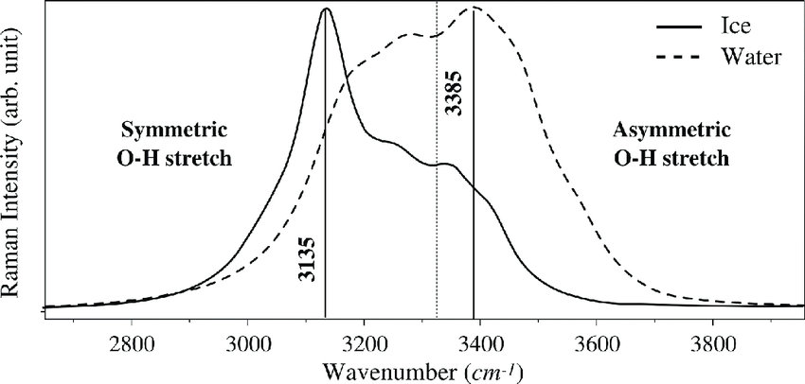
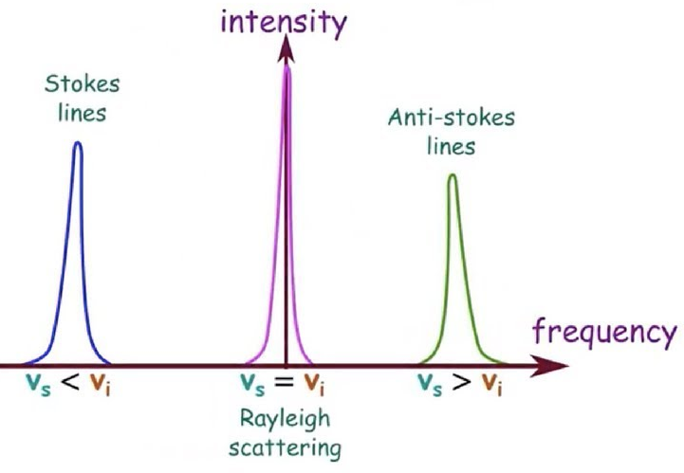
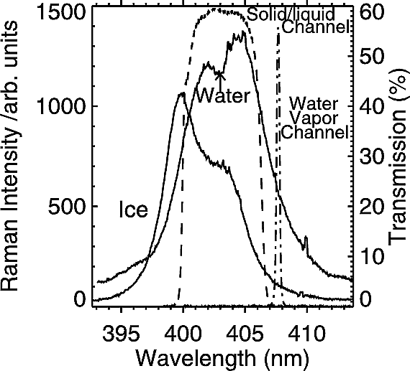
From Attenuated Backscatter to True Particulate Backscatter Profile: Raman Scattering of CALIGOLA plays similar role as Brillouin Scattering of HSRL
Raman backscatter coefficient is roughly 1/10 that of Brillouin (PW Zhai et al., 2015)

Slide 7
Backscatter + Raman (CALIGOLA) vs Backscatter (CALIPSO)
CALIPSO backscatter: need assumptions about Kd and depolarization to derive particulate backscatter coefficient at 532 nm
CALIGOLA: direct measurement of range resolved particulate backscatter coefficient profile using Backscatter signals / Raman signals at 355 nm and 532 nm, as well as diffuse attenuation coefficients and their wavelength dependence

Slide 8
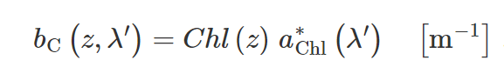
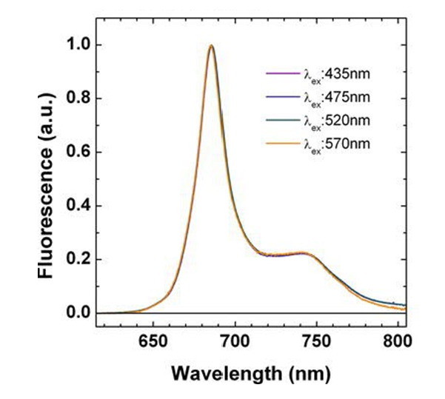
Laser Induced Chlorophyll Fluorescence ( 685 nm and 735 nm)
Measurement of chlorophyll profile Chl(z)
Vegetation (Biotic and abiotic stress )
Ocean Optics Web Book
Chappelle et al., 1984 (Applied Optics)

Slide 9
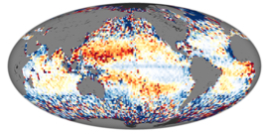
CALIGOLA will make high SNR Day and Night Measurements:
> vertical migrations of ocean animals (Behrenfeld et al., 2019)
> nutrient stress diagnostics through fluorescence yields

Slide 10
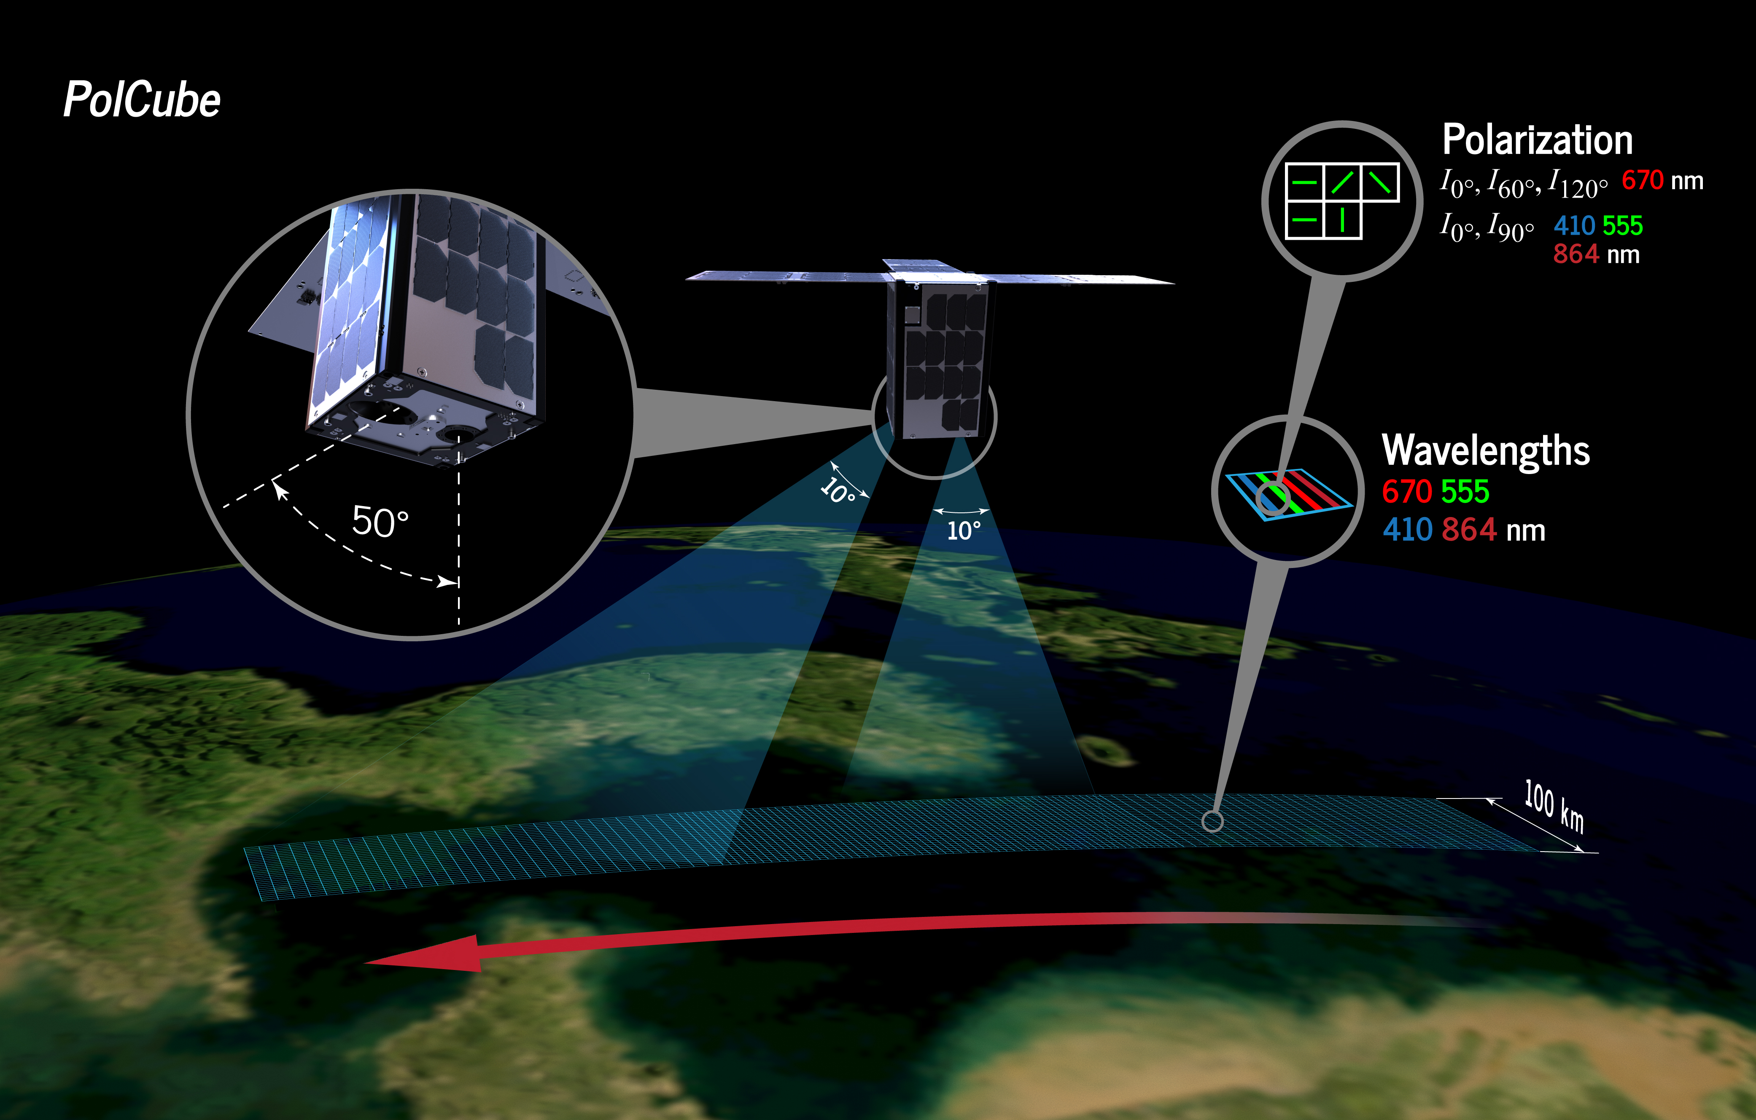
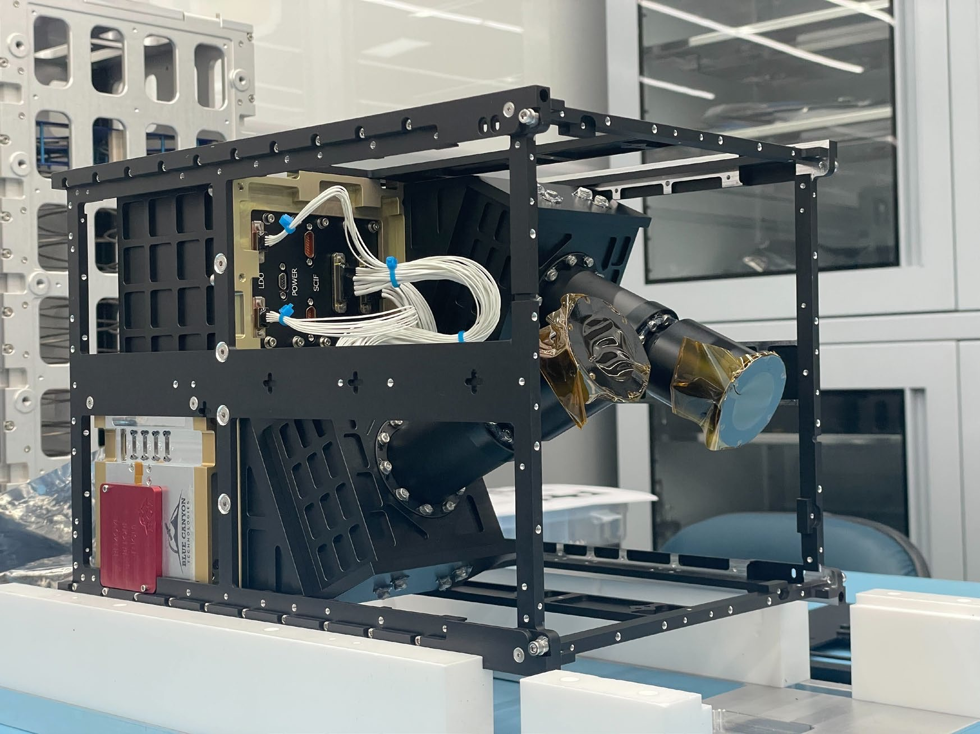
PolCube Overview
PolCube is a contributed, flight-ready instrument & spacecraft
  PolCube polarimeter instrument
  12U CubeSat bus
  High spatial and angular resolution polarization measurements at 410 nm, 555 nm, 670 nm, and 864 nm
  NASA side ( PI: Snorre Stamnes; Deputy-PI: Vianni Cadenas; Project Scientist: Y. Hu )
  Instrument + Satellite Bus will be delivered to NASA this year; launch date: TBD
Collaboration between NASA Langley with the Korea Astronomy and Space Science Institute (KASI) for Earth Science
  Based on the PolCam polarimeter onboard the Korean Pathfinder Lunar Observatory (KPLO) launching in August 2022
  Paid by Pusan city
  Focus: coastal water aerosol characterization
The PolCube 12U CubeSat
is built on heritage from the PolCam polarimeter on the KPLO lunar mission (NASA/South Korea)

Slide 11
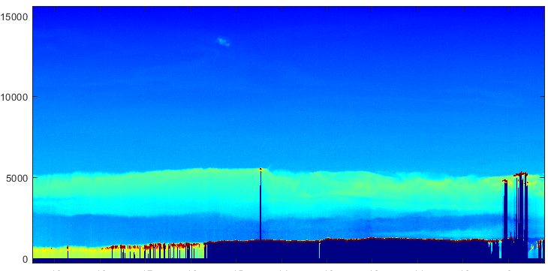
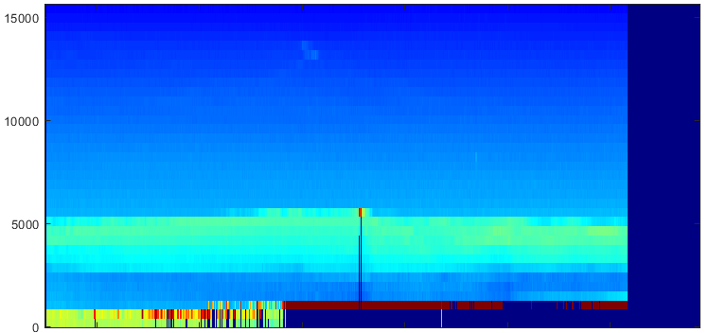
Potential OBB Relevance of PolCube:
(1) atmospheric correction; (2) IOP estimates
PolCube will be trained by collocated lidar (ICESat-2 and EarthCARE) measurements to derive lidar-like vertical images of aerosols and clouds
1. Improving atmospheric correction with better aerosol characterization, especially for coastal waters
  high spatial / angular resolution with targeted measurements of coastal waters
  accurate aerosol layer height
  detection of absorbing aerosols
  fine mode vs coarse mode aerosols
2. Improving IOP estimates for coastal waters with combined ocean/atmospheric retrievals
  improved CDOM estimates
  a/c ratios of absorption (a) and beam attenuation (c)
  lidar-like spectral water-leaving radiances
Airborne Lidar (HSRL) measurements
Lidar-like image derived from airborne polarimeter (RSP) measurements trained by collocated RSP+HSRL

Slide 12
Summary
CALIGOLA is potentially a joint ASI/NASA space lidar mission
CALIGOLA will have the most powerful laser in space, with UV, green and infrared wavelengths
Ocean measurement is a high priority of CALIGOLA, with its first ever lidar measurements of Raman and fluorescence in space to complement its high vertical resolution backscatter profile measurements
CALIGOLA also provides unique snow and vegetation measurements
POLCUBE is a joint S Korea / USA CubeSat mission, with high spatial/angular resolution, multi-wavelength polarimetric measurements
POLCUBE’s focus is coastal water aerosol characterization

