Slide 1
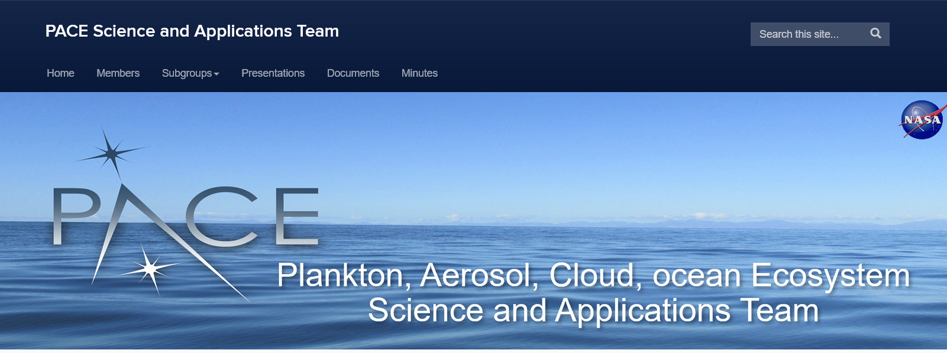

Pace Science and Applications Team
Heidi Dierssen
University of Connecticut
Science and Applications Team Lead

Slide 2
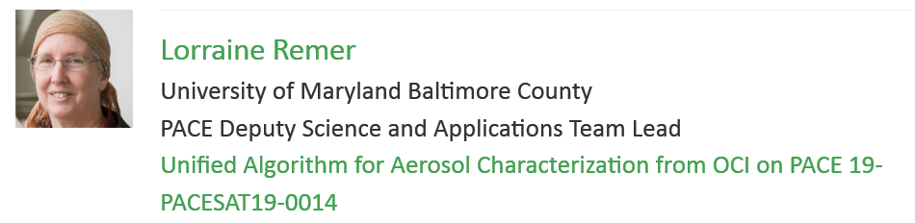
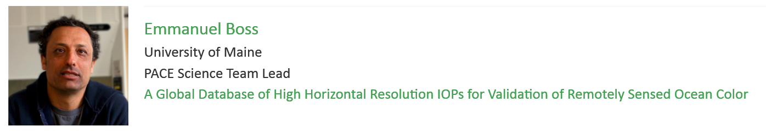
Gratefully Acknowledge
Past, Present and Future Deputy Team Lead
Past Science Team Lead

Slide 3
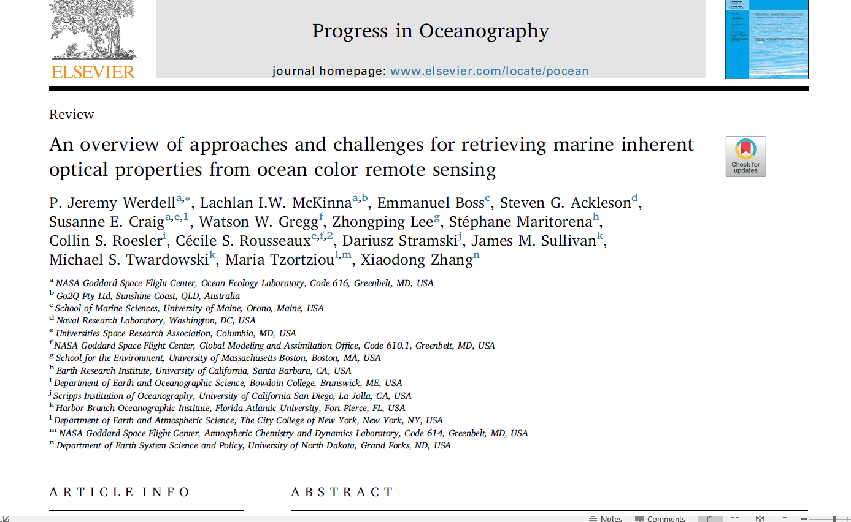
Achievements from past Science Team

Slide 4
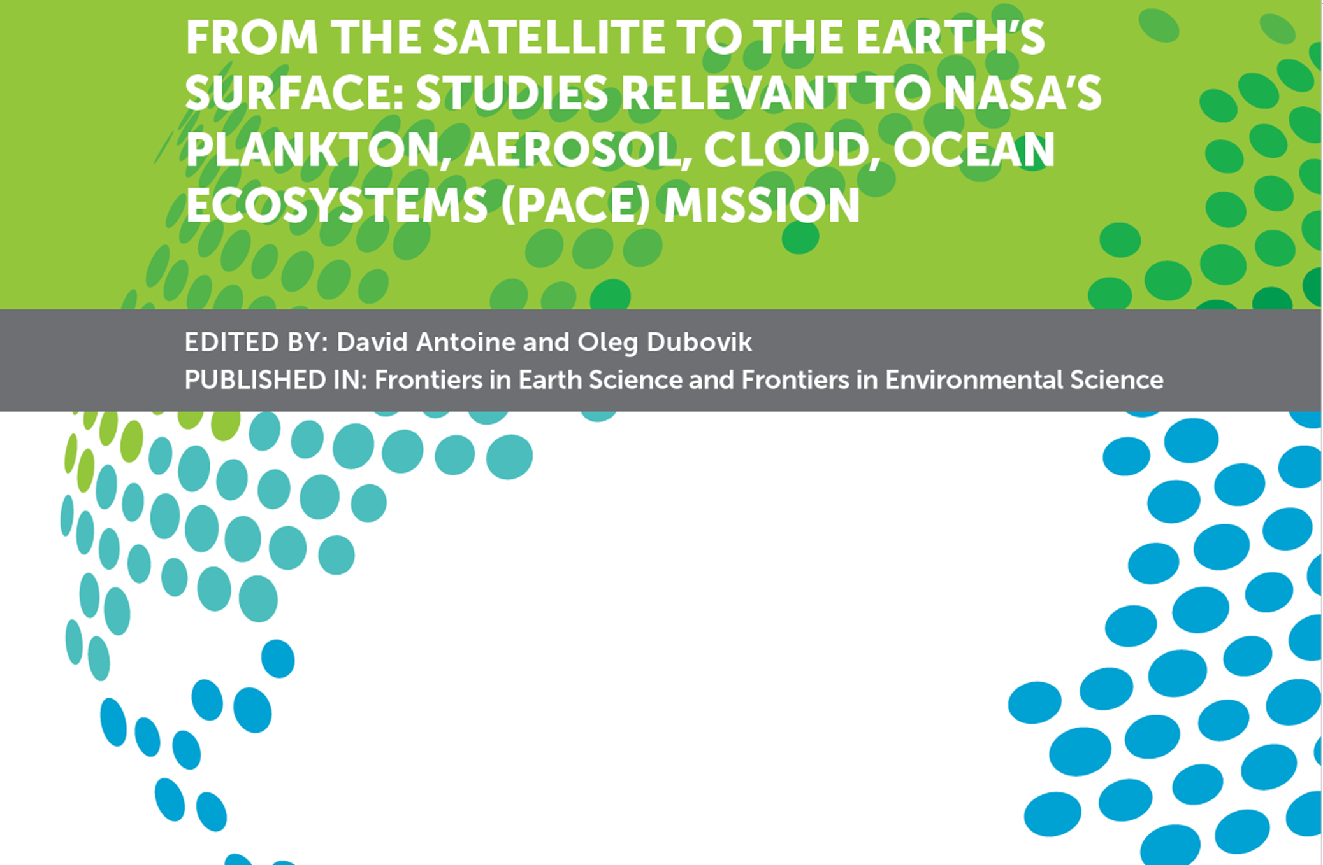
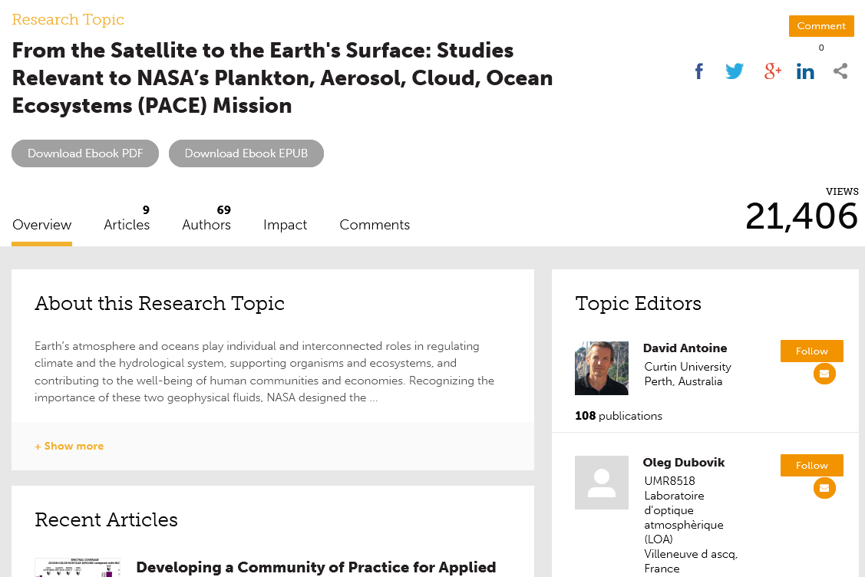

Slide 5
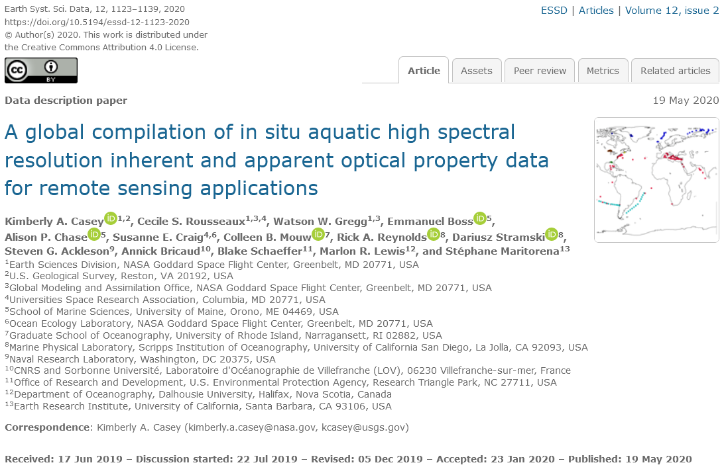
Hyperspectral Data Compilation

Slide 6
New PACE Science Team
Seeking:
“Diverse group of investigators who cumulatively bring end-to-end knowledge of different aspects of the breadth of basic and applied research and applications possible from the PACE observatory, as well as the scientific, algorithm, and modeling approaches of measurements and data products needed to address the science questions of the mission.”
Selected 24 Teams Covering Breadth of Research across Aquatic and Atmospheric Systems:
  Radiative transfer modeling
  Aquatic biogeophysics
  Atmospheric physics
    Aerosols
    Clouds
  (Land ecosystem )
Researchers span U.S. and international collaborators.

Slide 7
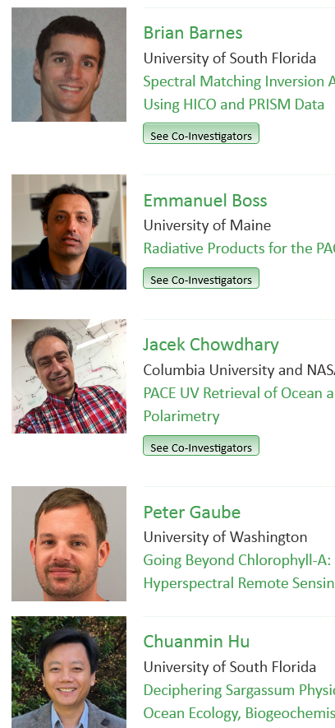
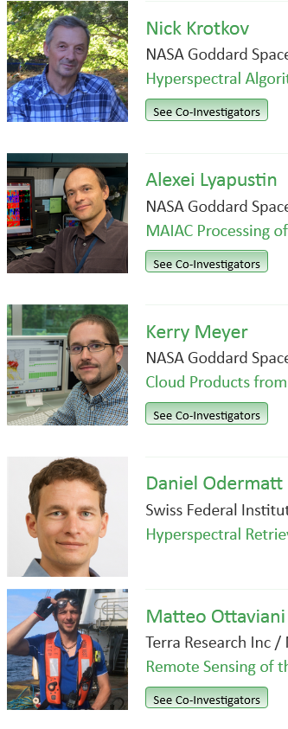
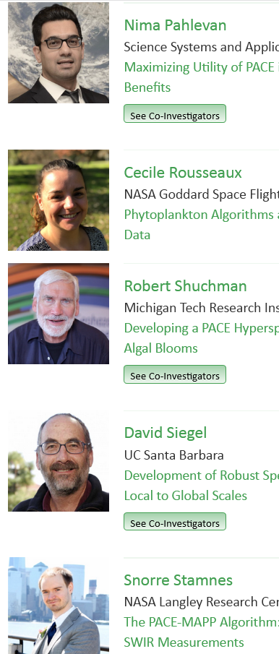
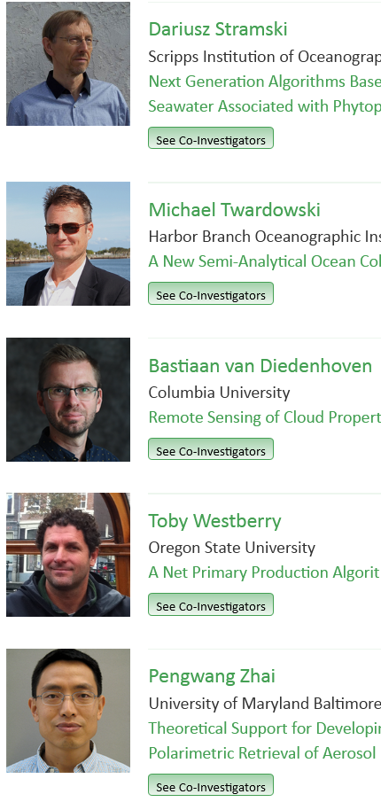
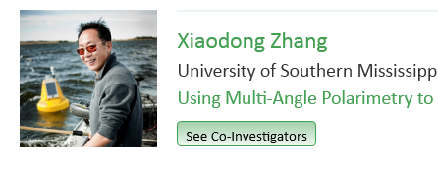
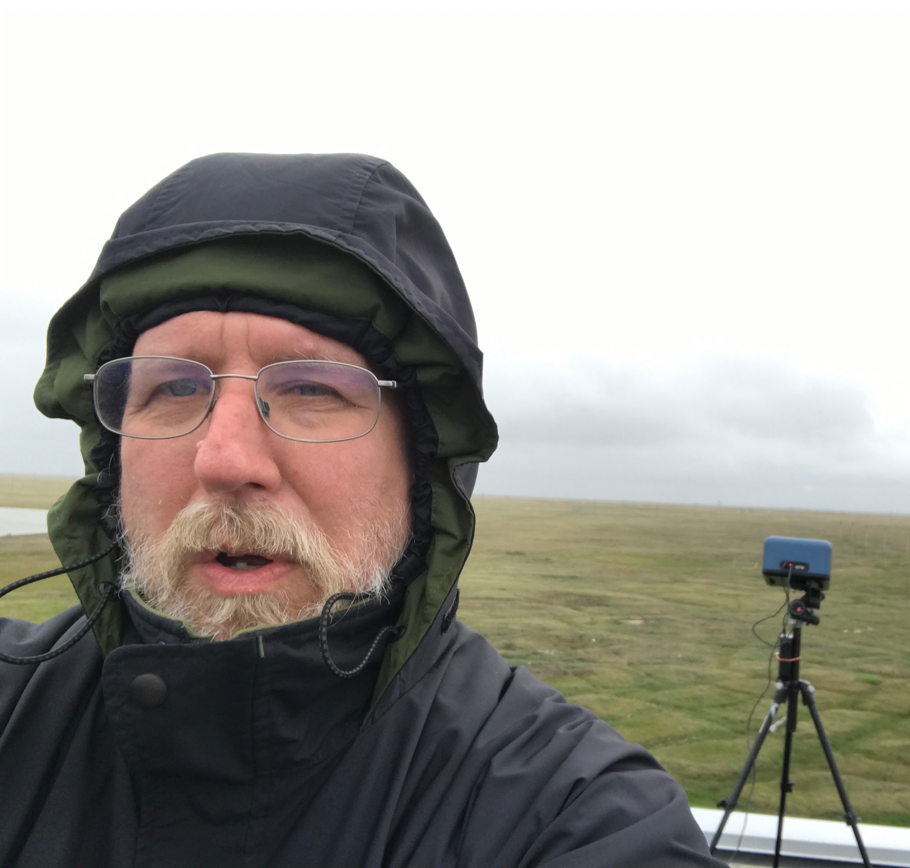
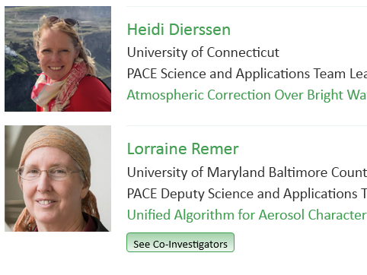
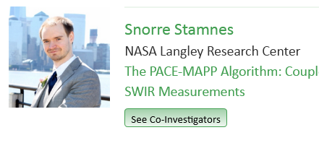
K. Fred Huemmrich
University of Maryland Baltimore County
Terrestrial Ecology Products from

Slide 8
New PACE Science and Applications Team (SAT) Goals
Development of PACE implementable algorithms that will be launched as Standard, Provisional, Test, or Special products.
  From RFP: “It is expected that any selected Principal Investigators (PIs) or teams selected for the PACE science and applications team will deliver an implementable approach or algorithm for a given data product pre-launch (LRD August 2022)”
Production of algorithm documentation to be available online (similar to ATBDs).
Collaboration with PACE Project Science team and Science Data Segment (SDS) to implement the approach or algorithm for a given data product pre-launch.
Assessment of algorithm performance, including spatial and temporal domain, out-of-scope conditions, and derivation and propagation of system-level uncertainties.
Contribution to development of protocols and strategies for pre- and post-launch science data product validation and reporting of algorithm performance post-launch.
Partnerships with end-user research and applied sciences through Early Adopters Program.
Communication to the public with news and updates on PACE research.

Slide 9
Science Data Product Maturity
Standard
Standard science data products (with associated standard algorithms) will be produced by the SDS and delivered to the NASA-assigned DAAC for permanent archival and distribution. For PACE, standard products will include all required mission products, as well as any additional products selected as standard through the process described in Section 2.5 of the PACE Science Data Product Selection Plan.
Provisional
All new products (or alternative algorithms) will be defined as provisional at start of production, and they will remain provisional until some level of validation has been performed, and until performance, documentation, and science value is deemed sufficient for reclassification as standard products.
Test
Test products are those that have been implemented by the SDS into production-capable science code, to enable assessment of resource requirements and feasibility for global production.
Special
Applications, region-specific products, alternative algorithms to be distributed by the DAAC but not necessarily produced by SDS.
New Products

Slide 10
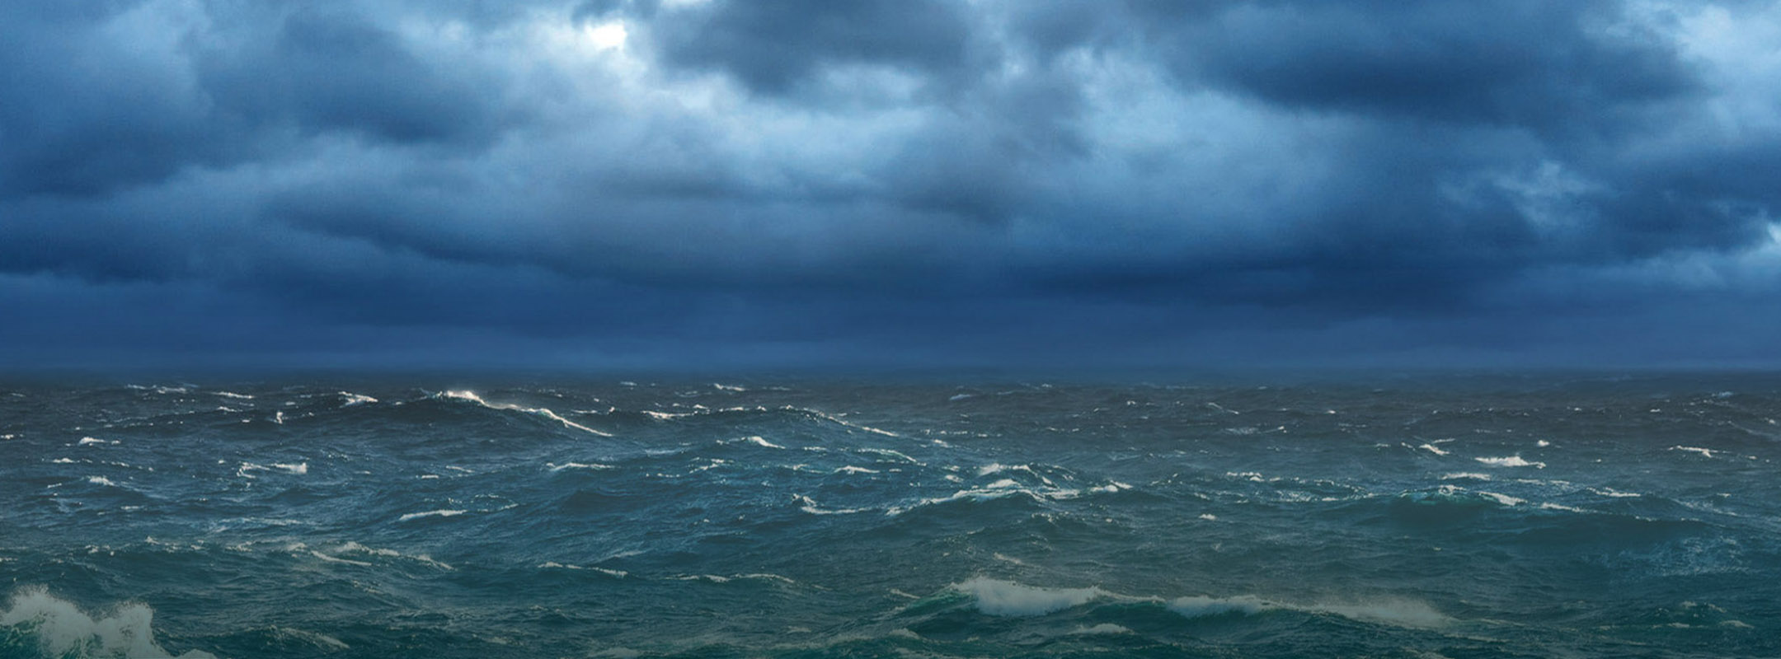
PACE SCIENCE 24 TEAMS BY TOPIC
https://pace.oceansciences.org/science_applications_team.htm
Clouds
Water Biophysics
Shallow Habitats
Floating Matter
Aerosols
Surface Physics
Phyto-Plankton Dynamics

Slide 11
Science Team
Chowdhary
Lyapustin
Ottaviani
Remer
Stamnes
Zhai
Clouds
Water Biophysics
Shallow Habitats
Floating Matter
Aerosols
Surface Physics
Phyto-Plankton Dynamics
Properties
Spectral Optical Depth
(water and land)
  Fine mode
  Sea Salt
  Dust
Spectral Absorption
Black Carbon Concentration
Brown Carbon Concentration
Aerosol Height
Aerosol Size Parameter
Aerosol Effective Radius
Column Water Vapor (land)

Slide 12
Science Team
Lyapustin
Meyer
Stamnes
van Diedenhoven
Clouds
Water Biophysics
Shallow Habitats
Floating Matter
Aerosols
Surface Physics
Phyto-Plankton Dynamics
Properties
Opaque Cloud Detection
Thin Cirrus Cloud Detection
Cloud Fraction
Cloud Top Pressure
Cloud Top Altitude
Cloud Top Thermodynamic Phase
Optical thickness
Physical thickness
Particle Effective Size
Cloud Droplet Size Distribution
Ice Crystal Shape
Ice Crystal Scattering

Slide 13
Science Team
Boss
Chowdhary
Dierssen
Krotkov
Lyapustin
Ottaviani
Twardowski
Zhai
Zhang
Clouds
Water Biophysics
Shallow Habitats
Floating Matter
Aerosols
Surface Physics
Phyto-Plankton Dynamics
Properties
Ocean Albedo R(λ)
Land Albedo R(λ)
Spectral Water-leaving Reflectance R_{w}(λ)
Polarization Parameters
Irradiance at Interface
  Photosynthetically Available Radiation E_{d}(0⁺,PAR)
  Downwelling Irradiance E_{d}(0⁺, λ)
Irradiance Below Water Surface
  Downwelling Irradiance E_{d}(0⁻,λ)
  Scalar Irradiance E_{o}(0⁻, λ)
Surface Index of Refraction
Bidirectional Reflectance Function (BRDF)
Whitecap Fraction/Factor

Slide 14
Science Team
Barnes
Boss
Chowdhary
Krotkov
Odermatt
Pahlevan
Stamnes
Stramski
Twardowski
Zhai
Clouds
Water Biophysics
Shallow Habitats
Floating Matter
Aerosols
Surface Physics
Phyto-Plankton Dynamics
Properties
Spectral Light Penetration
  Downwelling Attenuation Kd(λ), Kd(PAR)
  Scalar Attenuation Ko(λ)
Turbidity
  Suspended Particulate Matter (SPM)
  Nephelometric Turbidity Unit (NTU)
Vertical Stratification Properties
Spectral Inherent Optical Properties (Deep and Shallow)
  Absorption by Gelbstoff
  Absorption by Phytoplankton
  Absorption by Non-pigmented Particles
  Volume Scattering Function
  Backscattering
  Particulate and Bubble Backscattering
  Backscattering Ratio
Shallow Bathymetry

Slide 15
Clouds
Water Biophysics
Shallow Habitats
Floating Matter
Aerosols
Surface Physics
Phyto-Plankton Dynamics
Science Team
Gaube
Pahlevan
Rousseaux
Shuchman
Siegel
Westberry
Properties
Phytoplankton Pigment Concentration/Marker
  Chlorophyll-a
  Phycocyanin
  Etc..
Phytoplankton Composition
Net Primary Productivity
Fluorescence Line Height
Adaptive Maximum Chlorophyll Index

Slide 16
Clouds
Water Biophysics
Shallow Habitats
Floating Matter
Aerosols
Surface Physics
Phyto-Plankton Dynamics
Science Team
Barnes
Properties
Benthic Classification
  Coral
  Seagrass
  Shallow Algae
  Sediment
Benthic Condition
  Change over time

Slide 17
Clouds
Water Biophysics
Shallow Habitats
Floating Matter
Aerosols
Surface Physics
Phyto-Plankton Dynamics
Science Team
Hu
Ottaviani
Shuchman
Properties
Sargassum Dynamics
  Density
  Depth
  Carbon, nitrogen, phosphorous
  Sun-induced fluorescence
Oil Detection
Surface Scum Index

Slide 18

PACE SAT Working Groups
Whole Group Input
  Uncertainties/Metrics
    LEADS: Amir Ibrahim & Andy Sayer
  Validation Needs and Approaches
    LEAD: Heidi Dierssen
  Nomenclature
    LEAD: Aquatic (Frouin IOCCG)
      Atmospheric (TBD)
2. Subgroups span disciplines:
  Polarimetry – lead Kirk Knobelspiesse
  Ultraviolet – lead Lorraine Remer
  Phytoplankton Characterization – lead Cecille Rousseaux
  Synthetic Datasets – lead Jacek Chowdhary
  Inverse Modeling – lead Dariusz Stramski
  Bright Targets – lead Heidi Dierssen

Slide 19
PACE Product Uncertainties
PACE committed to providing pixel-by-pixel uncertainties
  Not perfect, but some measure of uncertainty is valuable for biogeochemical modeling and user applications.
Better job of flagging and/or masking out-of-scope conditions
  Optically shallow water
  Inland vs. Oceanic conditions
  Regional limits
Identifying conditions where algorithms have higher/lower uncertainties.
  High wind, types of clouds, “Case 2” conditions, seasonal uncertainties, etc…
Propagating radiometric data uncertainties through algorithms
  Approaches published like McKinna et al. 2019
  Monte Carlo methods
Estimating uncertainty in field/in situ data
  Precision vs. accuracy
Coordination of efforts to make consistent assumptions about common sources of uncertainty (e.g. sensor noise, absolute calibration).
Identify gaps in uncertainty budget.
  Solar constant variability, diffuse skylight reflection, etc..

Slide 20
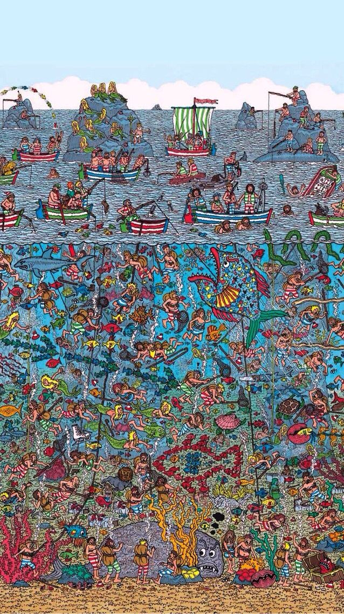
PACE SAT and Validation
Draft Validation Plan is currently being updated
Validation:
  hyperspectral radiometry and polarimetry
  atmospheric and aquatic products
  within 12 months of launch
Variety of sub-orbital validation data
  Aeronet/Aeronet-OC moorings
  Ship-based cruises
  Airborne campaigns
SAT will provide recommendations to the PACE Validation Science Team.
Innovative ideas about how to best validate satellite missions – biggest bang for buck

Slide 21
Stay Tuned for More Exciting Atmosphere-Aquatic Coupled Research:
  Polarimetry – new and refined products including ocean index of refraction of surface, VSF, BRDF,
  Ultraviolet – better tackling of ag, anap from surface glint /skylight and absorbing aerosols
  Phytoplankton Characterization – hoping to move towards some ancillary pigments and fractional phytoplankton groups
  Synthetic Datasets – providing databases for testing new approaches including Top-of-Atmosphere radiance for different in-water and atmospheric conditions and polarization parameters.
  Inverse Modeling – many different ways to solve, optimize, set priors, and propagate errors.
  Bright Targets – better approaches and Level 2 flagging of conditions like intense surface blooms of macro and microalgae, floating vegetation and debris, whitecaps, sea ice, cloud masking, etc…

Slide 22
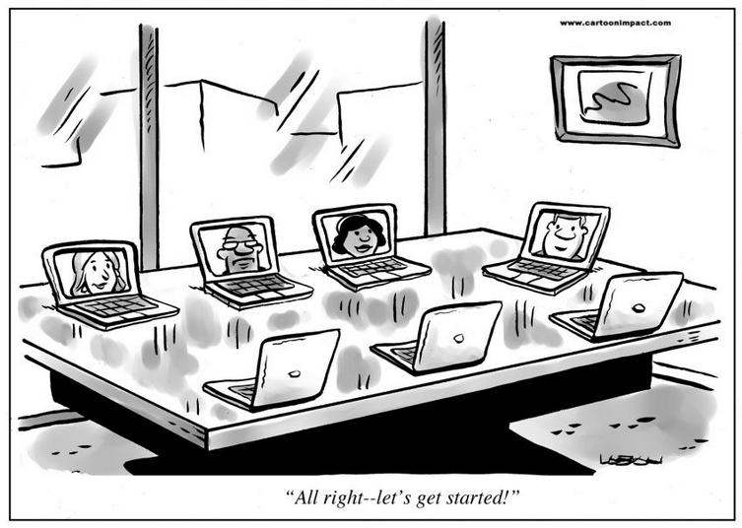
Virtual Meeting on June 2-3 2020
15 min recorded presentations have been uploaded from the groups.
Virtual connections will be reinforced ☺

Slide 23
Conclusions
Stay tuned!
PACE SAT is:
  Working across disciplines
  Trying to push boundaries of what has been done
  Putting out NEW products
  Quantifying Uncertainties
  Work to be transparent to the community with papers, presentations and interactions
Feel free to contact me if you have questions: heidi.dierssen@uconn.edu
Synergistic Efforts:
  Alliance for Coastal Technologies (ACT) hyperspectral working group
    Algorithm comparison
    Best Practices for Use of Hyperspectral Imaging in Coastal Environments
  IOCCG
    Hyperspectral task force
    Benthic Reflectance Working Group
      Hope to start
    Nomenclature
  HARP Cubesat Data
  Other hyperspectral missions (SBG, PRISMA, DESIS, etc..)

Slide 24
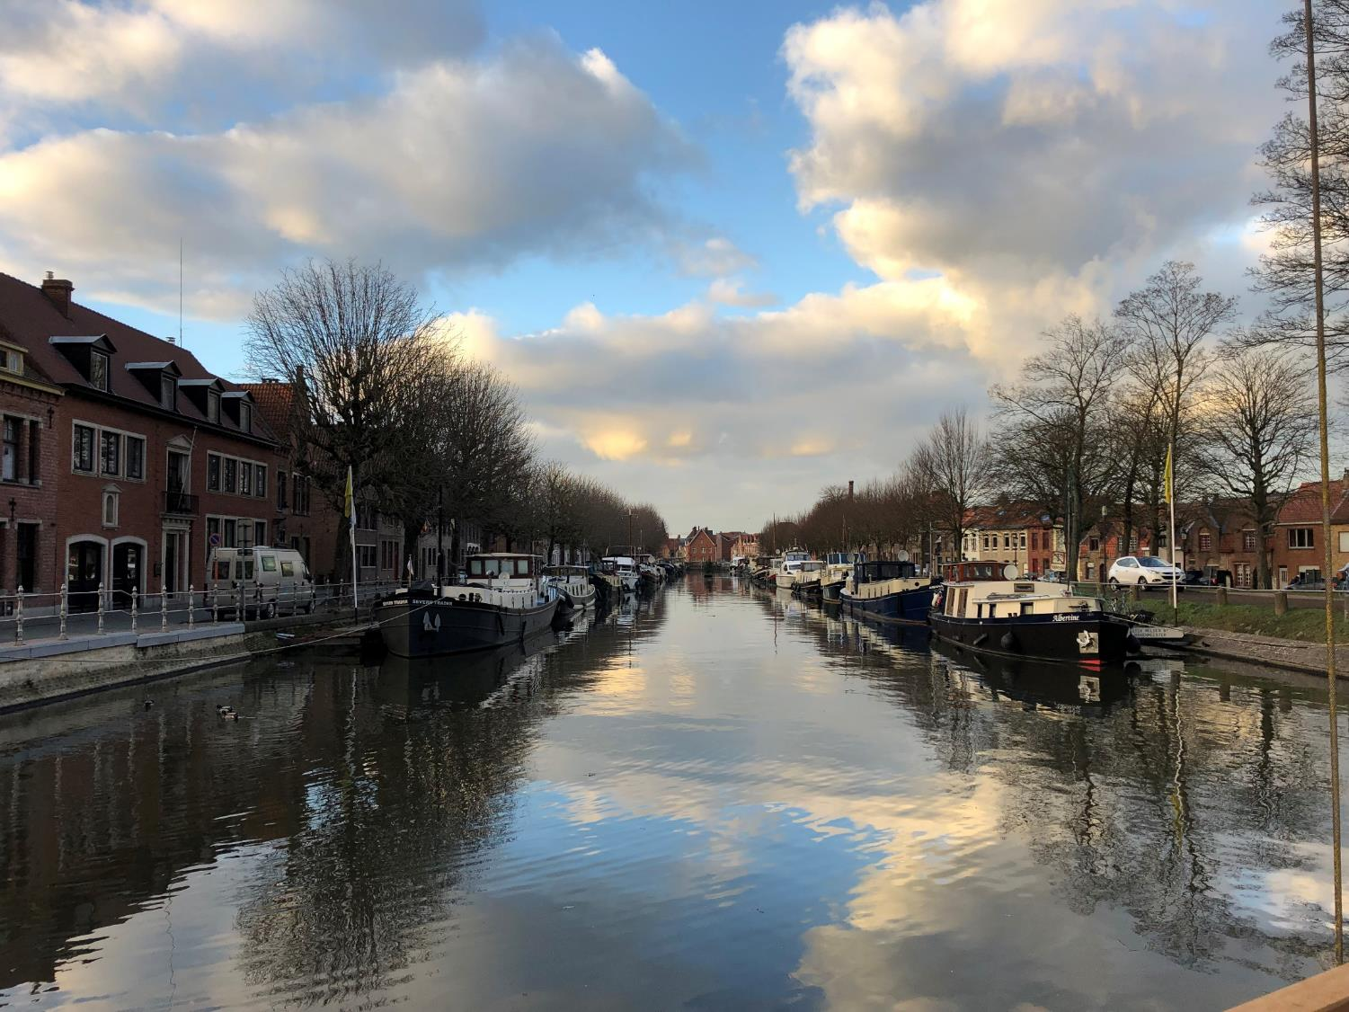
Dank u!

