Slide 1
the Plankton, Aerosol, Cloud, ocean Ecosystem (PACE) mission
Jeremy Werdell
NASA Goddard Space Flight Center
Virtual OCRT, 26 & 28 May 2020

Slide 2
PACE in the time of social distancing
Where we were (February-March) …
Successful completion of the mission Critical Design Review in Feb
Successful completion of a thermal vacuum campaign for the OCI engineering test unit
Spacecraft on track for the build-up of its structure and propulsion system this spring
Where we are (March-present) …
Project has been working from home since March 18th
There will be, at a minimum, a day to day slip of the Project launch schedule
Focus is on performing paperwork and analyses, and working with outside vendors
It appears that GSFC stage 4 will last until the end of July
Critical items identified if limited work gets approved in June to start ramping up

Slide 3
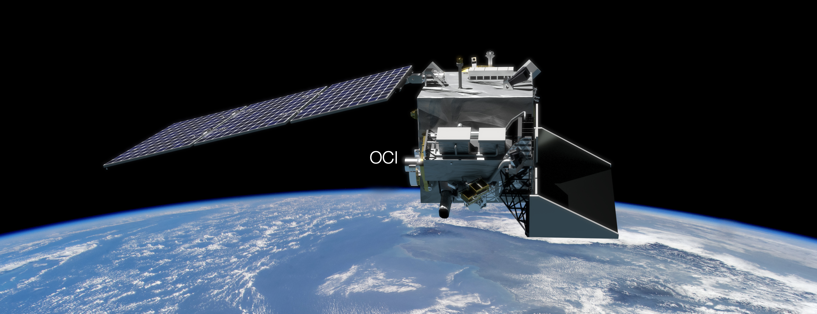
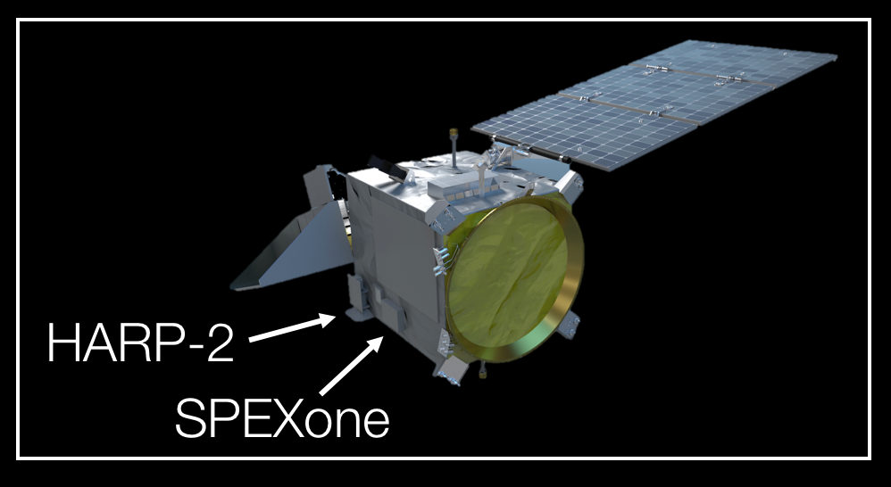
NASA Plankton, Aerosol, Cloud, ocean Ecosystem (PACE) mission
Primary hyperspectral radiometer:
Ocean Color Instrument (OCI) (GSFC)
2 contributed multi-angle polarimeters:
HARP2 (UMBC)
SPEXone (SRON/Airbus)
Key characteristics:
Winter 2022 launch (???)
676.5 km altitude
Polar, ascending, Sun synchronous orbit; 98º inclination
13:00 local Equatorial crossing
3-yr design life; 10-yr propellant
https://pace.gsfc.nasa.gov
@NASAOcean

Slide 4
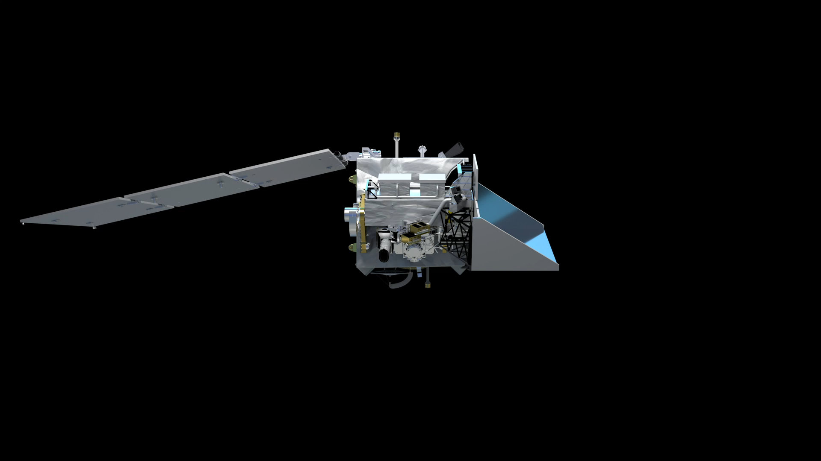
Notes:
General observatory overview

Slide 5
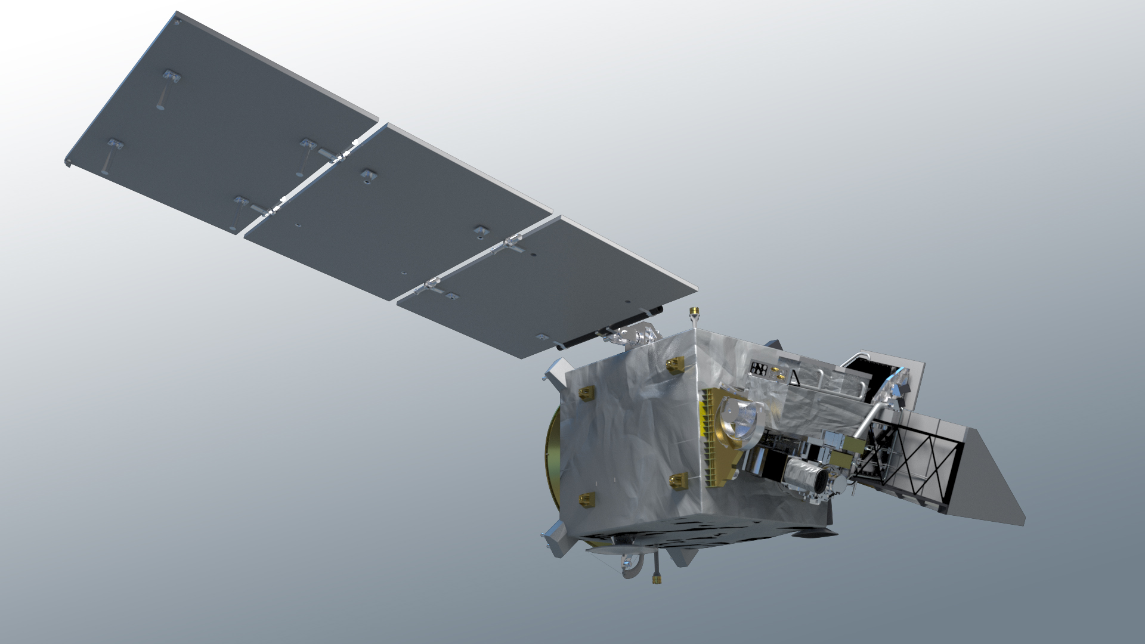
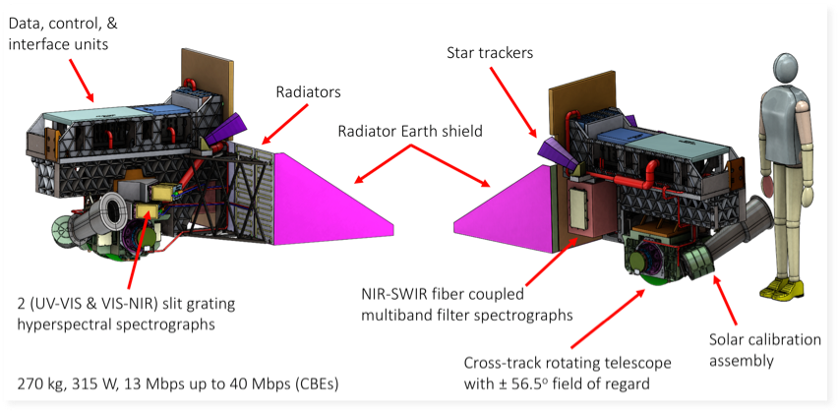
hyperspectral scanning radiometer
340 – 890 nm, 5 nm resolution, 2.5 nm steps
plus, 940, 1038, 1250, 1378, 1615, 2130, and 2250 nm
1 – 2 day global coverage
ground pixel size of 1 km² at nadir
± 20º fore/aft tilt to avoid Sun glint
twice monthly lunar calibration
daily on-board solar calibration
built at NASA Goddard Space Flight Center
Notes:
OCI overview part 1 – general characteristics

Slide 6
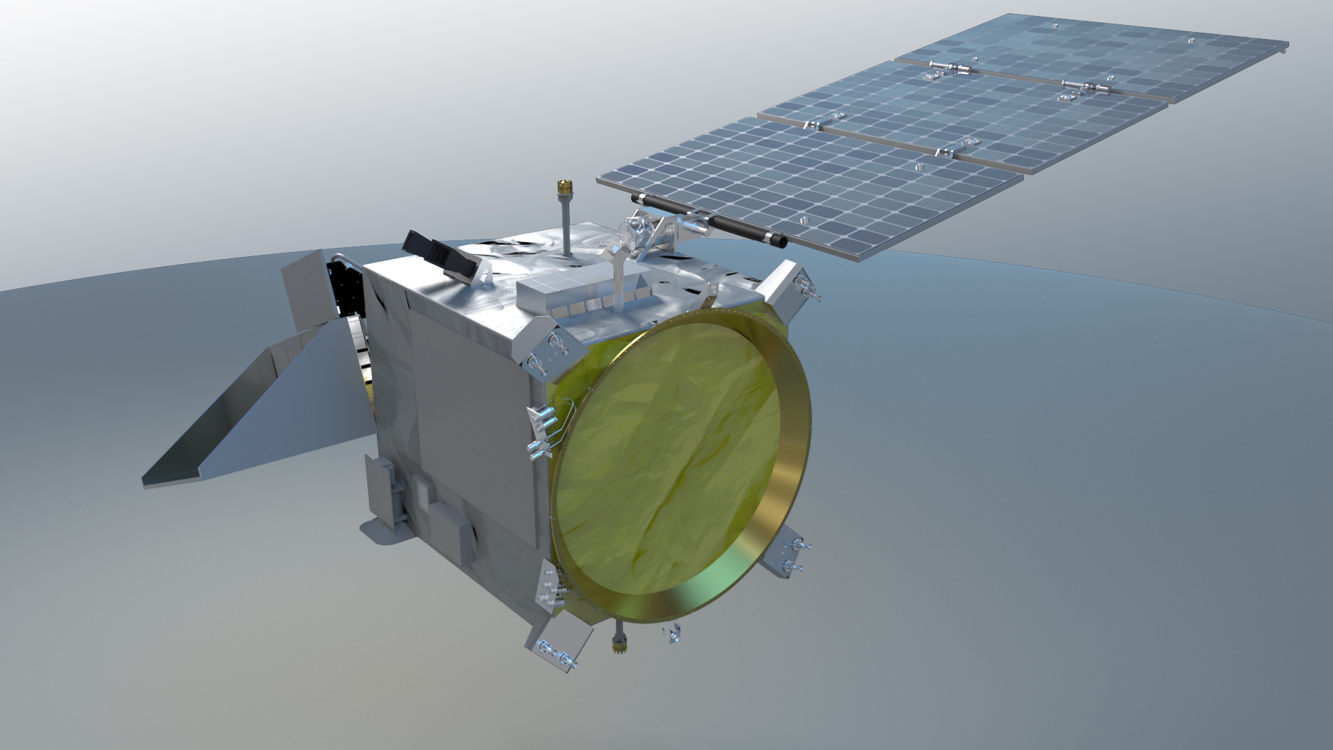
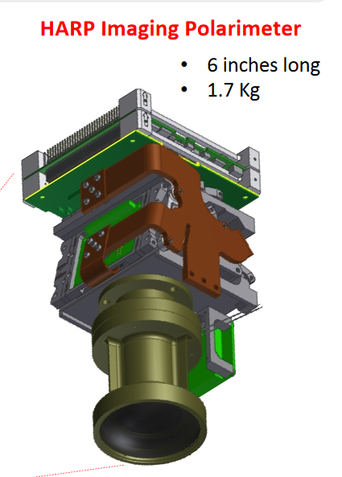
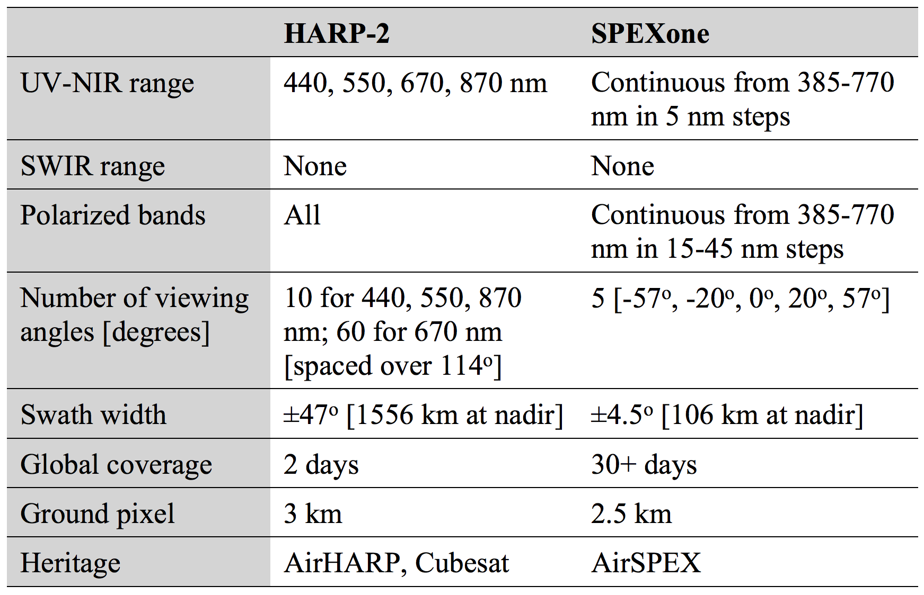
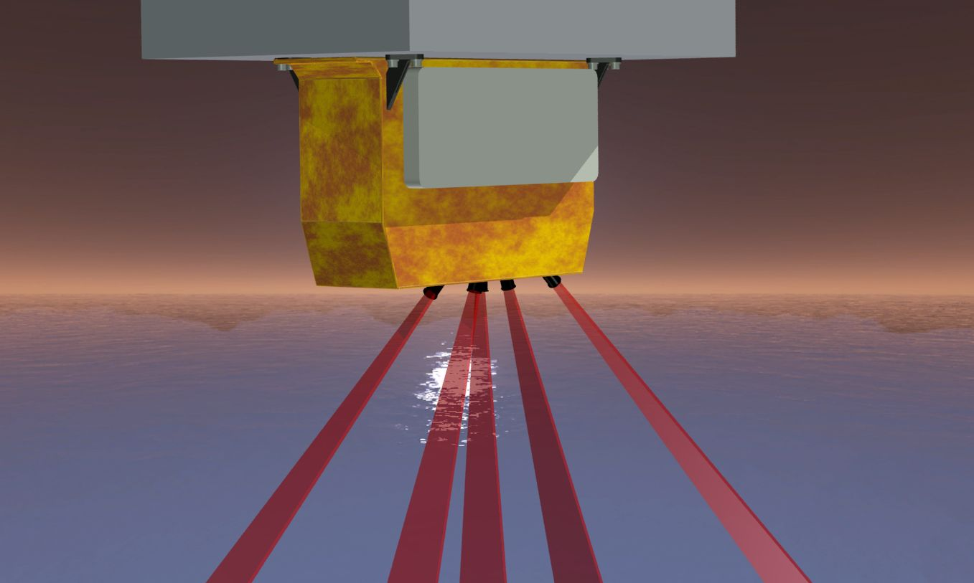
UMBC Hyper Angular Rainbow Polarimeter (HARP-2)
PACE polarimeters NOT in 2017 Decadal Survey Program of Record
SRON Spectro-polarimeter for Planetary Exploration (SPEXone)
Notes:
Polarimeter overview – Jeremy will go very quickly because Brian will cover in detail.
UPDATE POL TABLE

Slide 7
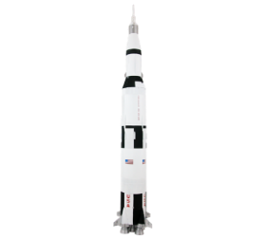
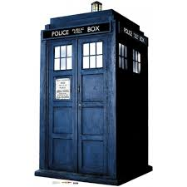
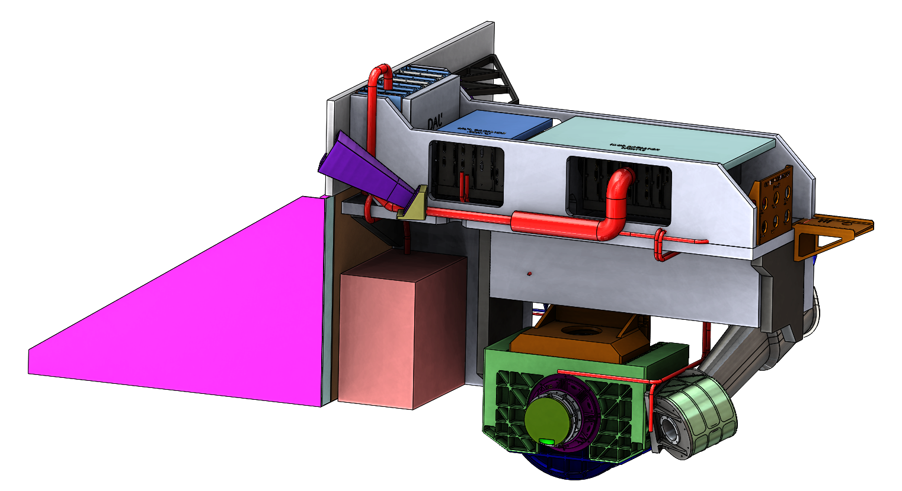
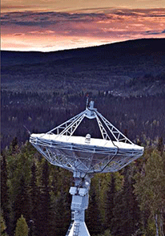
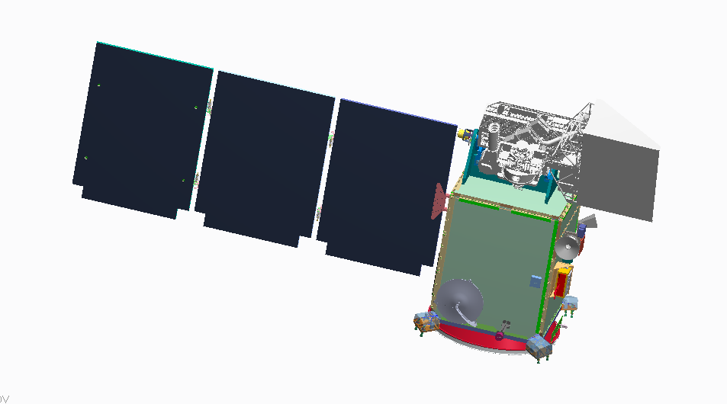
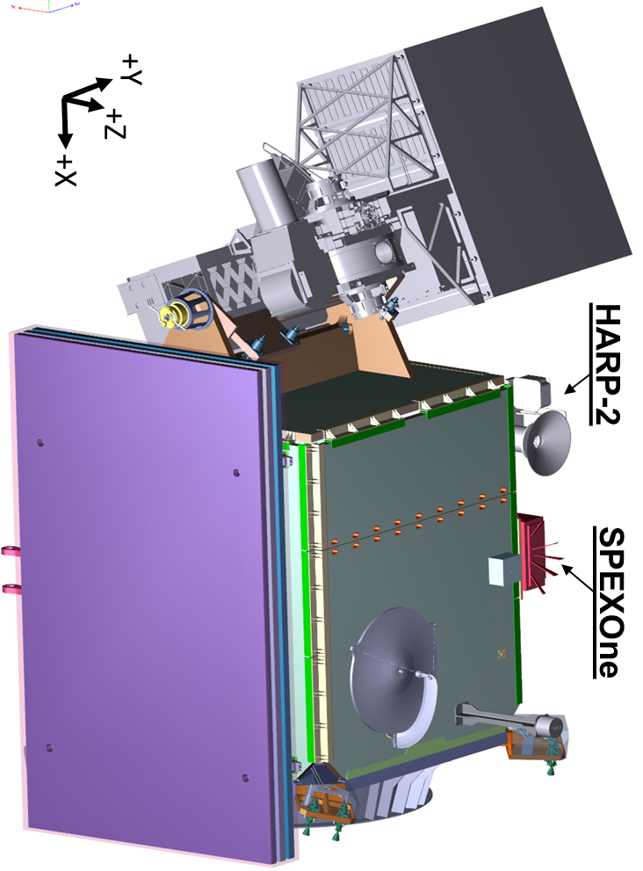

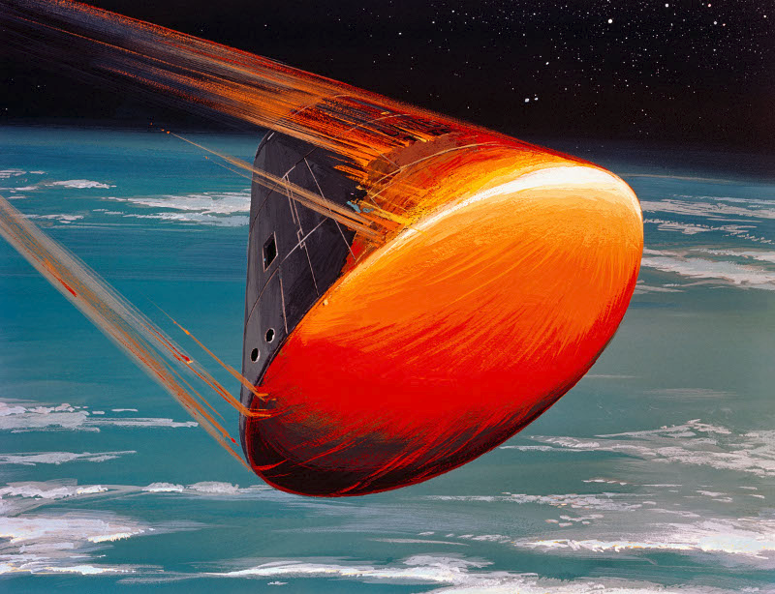
schedule & mission phases
Phase C – final design & fabrication
all mission elements have passed Critical Design Reviews (CDRs)
all mission elements will have System Integration Reviews (SIRs)
Project & HQ science implementing science capabilities
Phase D – system assembly, integration, testing, & launch
Phase E – science operations
We are here.
May 2020
(LRD-34 months)
OCI
CDR
Observatory I&T
Spacecraft
PDR
Grd &
SDS
CDR
Project Readiness
Date (PRD)
Dec. 2022
Phase A
Launch
Readiness
Date (LRD)
Mar. 2023
Grd &
SDS
PDR
OCI
PDR
Mission
PDR
Mission
CDR & LV
Award
Decommission
CY16
CY17
CY18
CY19
CY20
CY21
CY22
CY23
CY24
CY25
CY26
Phase A
Phase B
Phase C
Phase D
Phase E
Phase F
June 16, 2016
July 13, 2017
August 2019
October 2021
June 2023

Slide 8
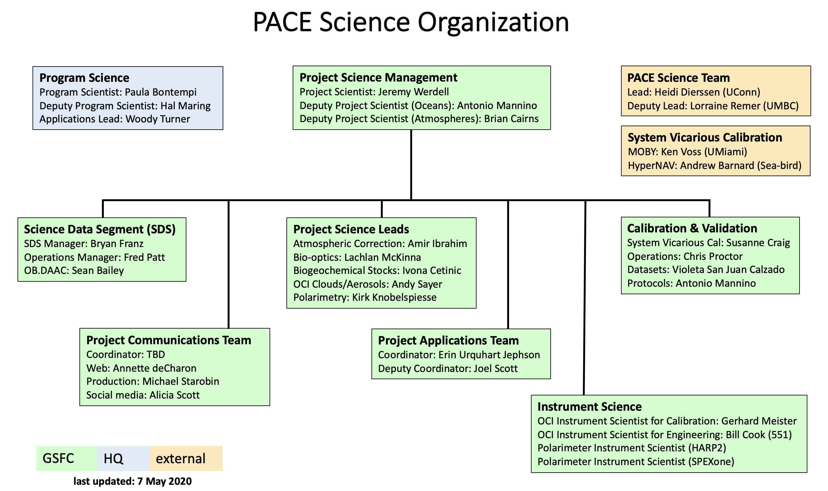
PACE science organization
Laura L.

Slide 9
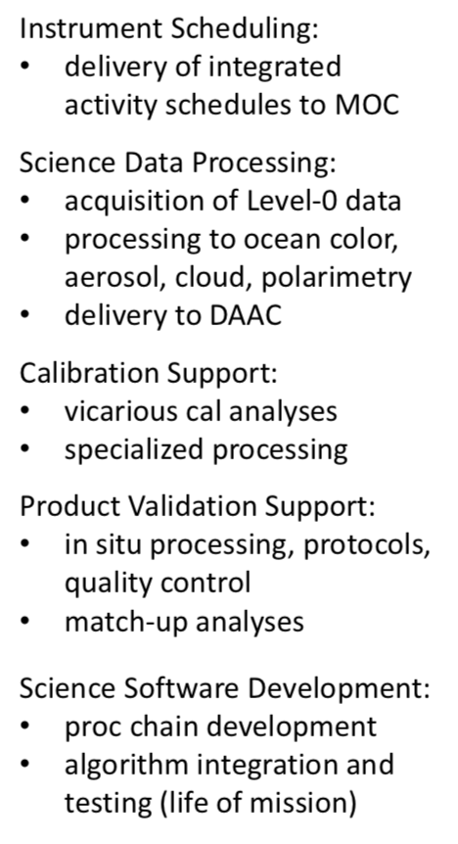
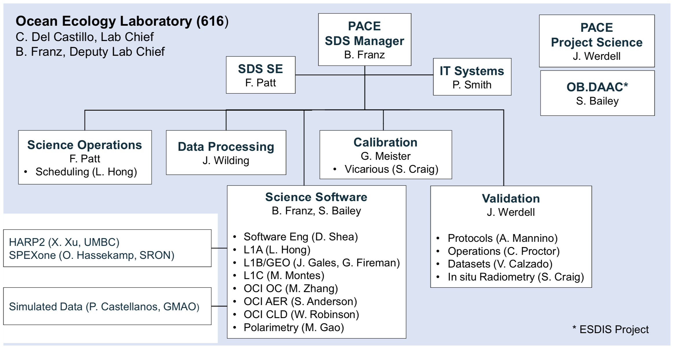
Science Data Segment (SDS) organization
Works within science organization on …

Slide 10
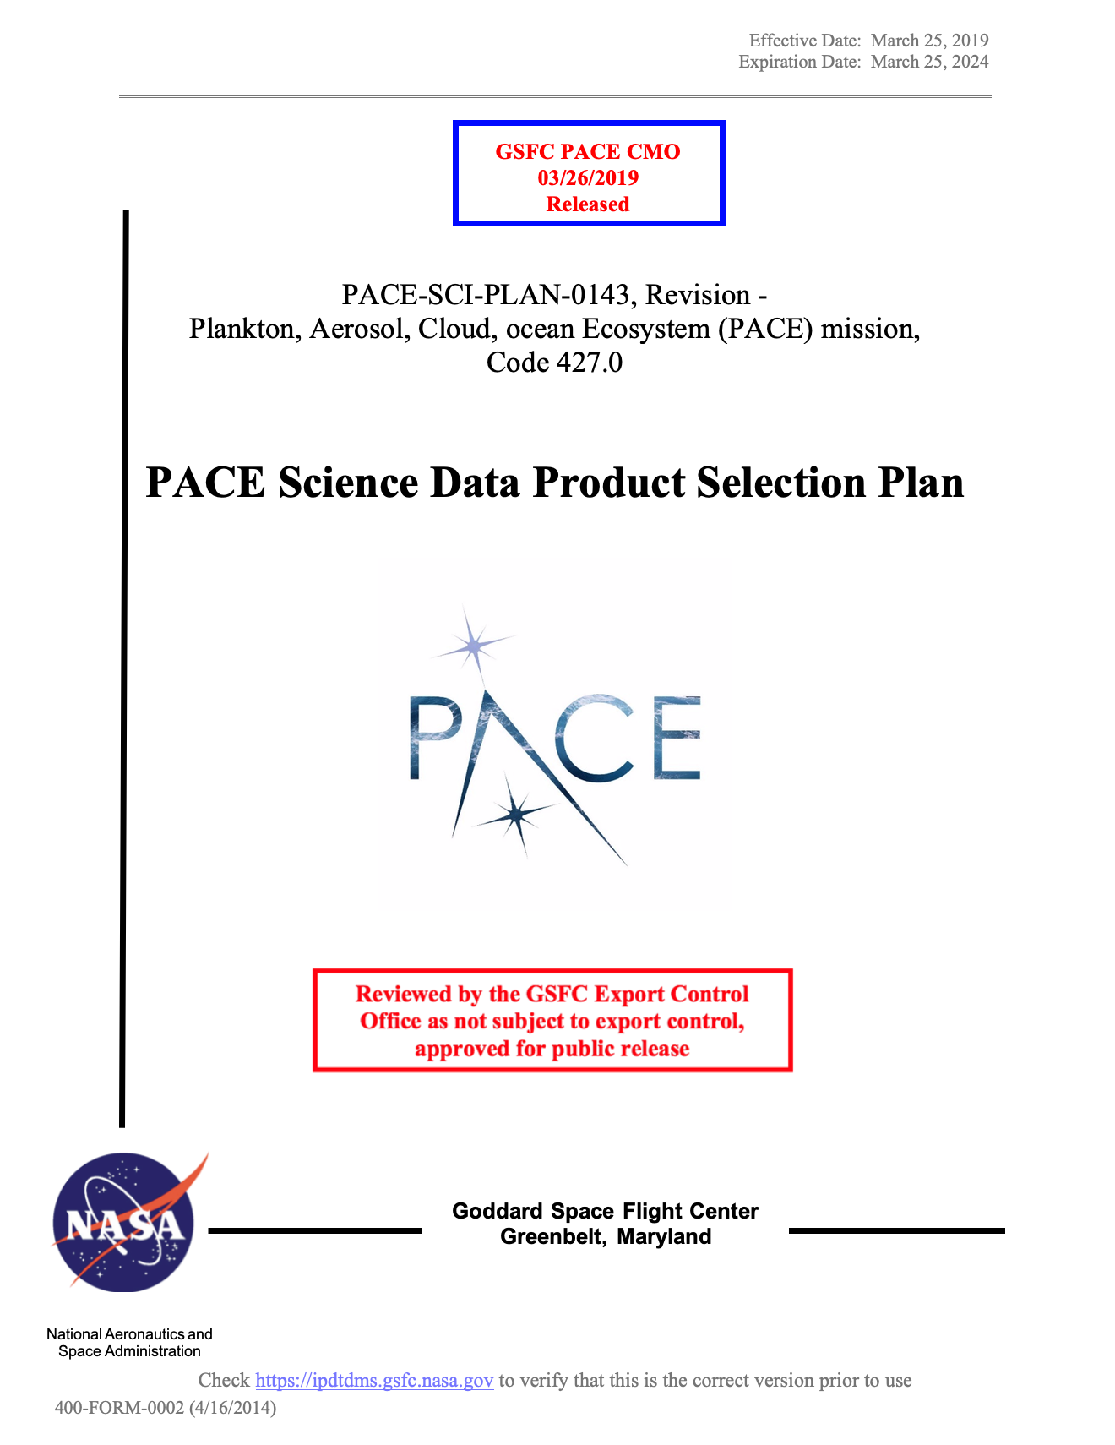
PACE science products
Required products with uncertainty requirements
Hyperspectral remote-sensing reflectances 2.5 nm spectral steps with 5 nm spectral resolution
Total aerosol optical depth at 380, 440, 500, 550 and 675 nm
Fraction of AOD(550) from fine mode aerosols over oceans
Cloud layer detection for optical depth > 0.3
Cloud top pressure of opaque (optical depth > 3) clouds
Optical thickness of liquid clouds
Optical thickness of ice clouds
Effective radius of liquid clouds
Effective radius of ice clouds
Other heritage & expected new / advanced data products
Phytoplankton community composition
Carbon stocks & primary production
Radiometric products (PAR, surface albedo, UV, others)
Aerosols properties
Land properties
Polarimetric products (atmospheres + oceans)
Applications products
…
Heritage approaches implemented, with goal of updating / replacing (e.g., SAT contributions)
these are required for mission success & drive OCI design
Additional required heritage products to be generated
Chlorophyll concentration
Spectral diffuse attenuation coefficients
Spectral absorption coefficients (phytoplankton, CDOM+NAP)
Spectral backscattering coefficients
Fluorescence line height
Water path of liquid, ice clouds
Shortwave radiative effect
Describes product and algorithm selection process

Slide 11
SPEXone and HARP2 science products
Mission requirement on science products from the two polarimeters is limited to Level-1C only (calibrated/geolocated/co-registered radiometery and polarimetry).
  Long ongoing conversation(s) on a common Level-1C format / grid
  Initial Level-1A to Level-1B/C provided by UMBC and SRON
Science goal is to produce aerosol and cloud products from the polarimeters, and to support atmospheric correction for ocean color retrievals.
  SRON has delivered & SDS is testing Level-2 software for aerosol retrievals from SPEX
  SDS/Project Science is developing / testing a Level-2 ocean/atmosphere retrieval algorithm for SPEX/HARP
  Expectation is that the SAT will develop retrieval algorithms

Slide 12
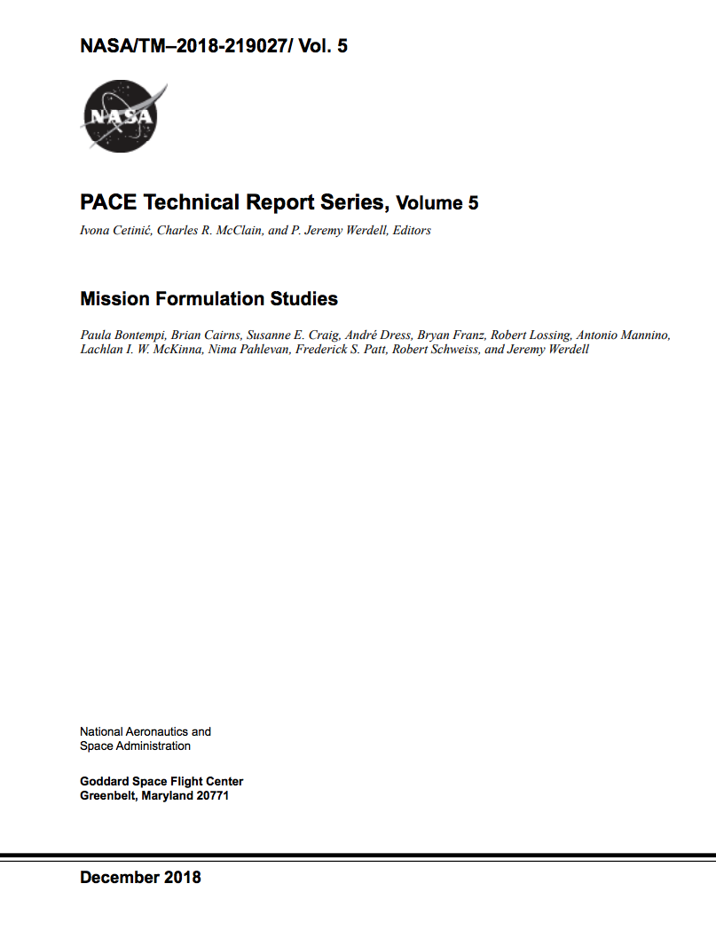
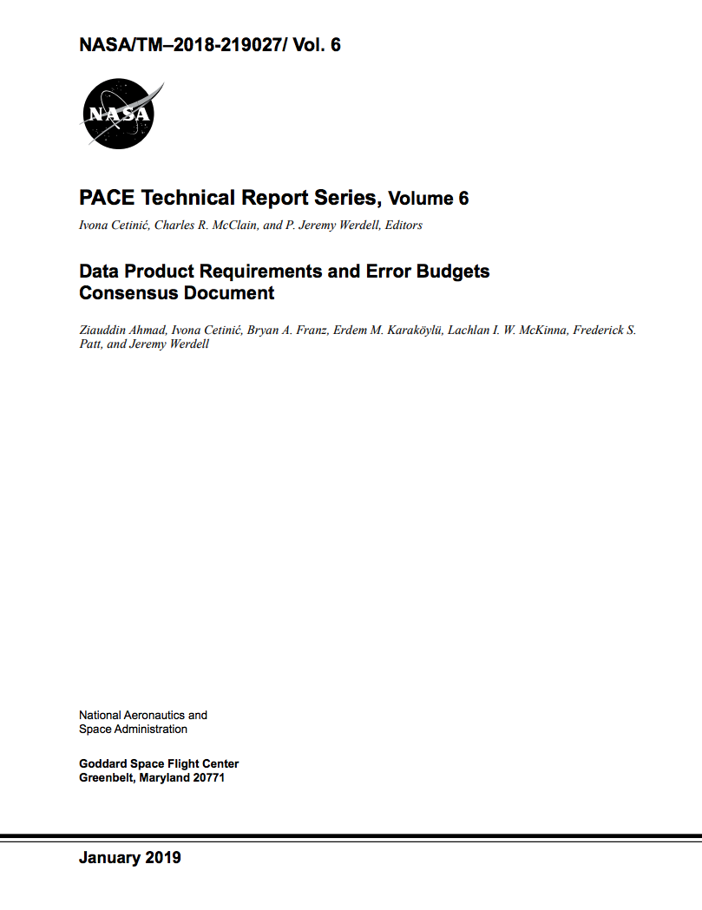
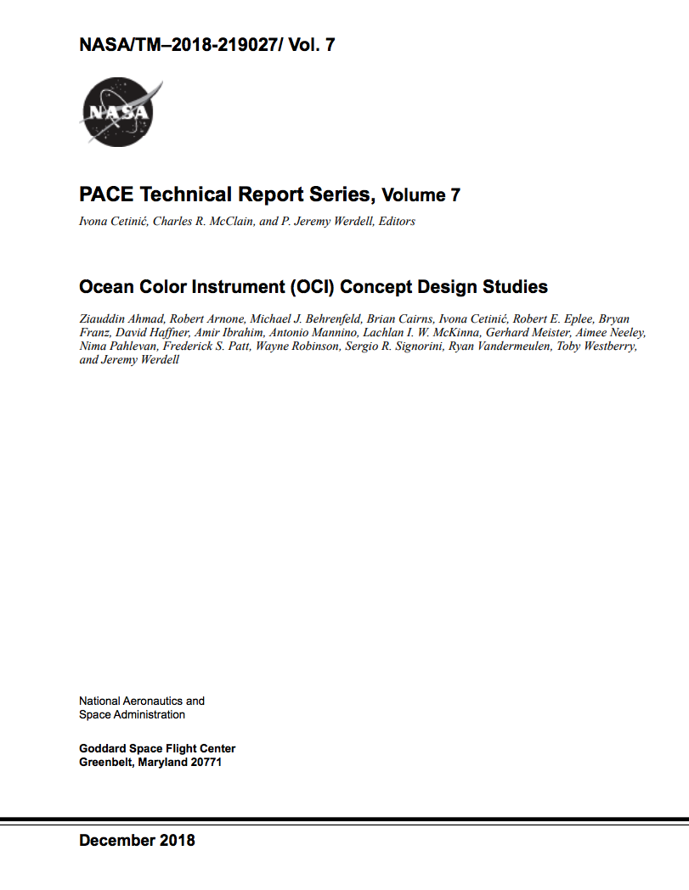
NASA Technical Memoranda
Coverage loss from Sun glint and instrument tilt
Data completeness
Pushbroom image striping artifacts
Pushbroom lunar calibration maneuver
Altitude reduction
IDL studies
A coastal camera (COCI)
Requirements overview
Geolocation
Random error (SNRs)
Systematic error
Model error (within atmospheric correction)
Geophysical model uncertainty propagation
UV capabilities
Fluorescence capabilities
Ground sample distance
SWIR band placement
Addition of 1038 nm
Solar calibration
Lunar calibration
Ltyp, Lmax
Spectral resolution
https://pace.oceansciences.org/documents.htm?id=memo
Notes:
Most analyses fully documented for anyone who wants to learn more.

Slide 13
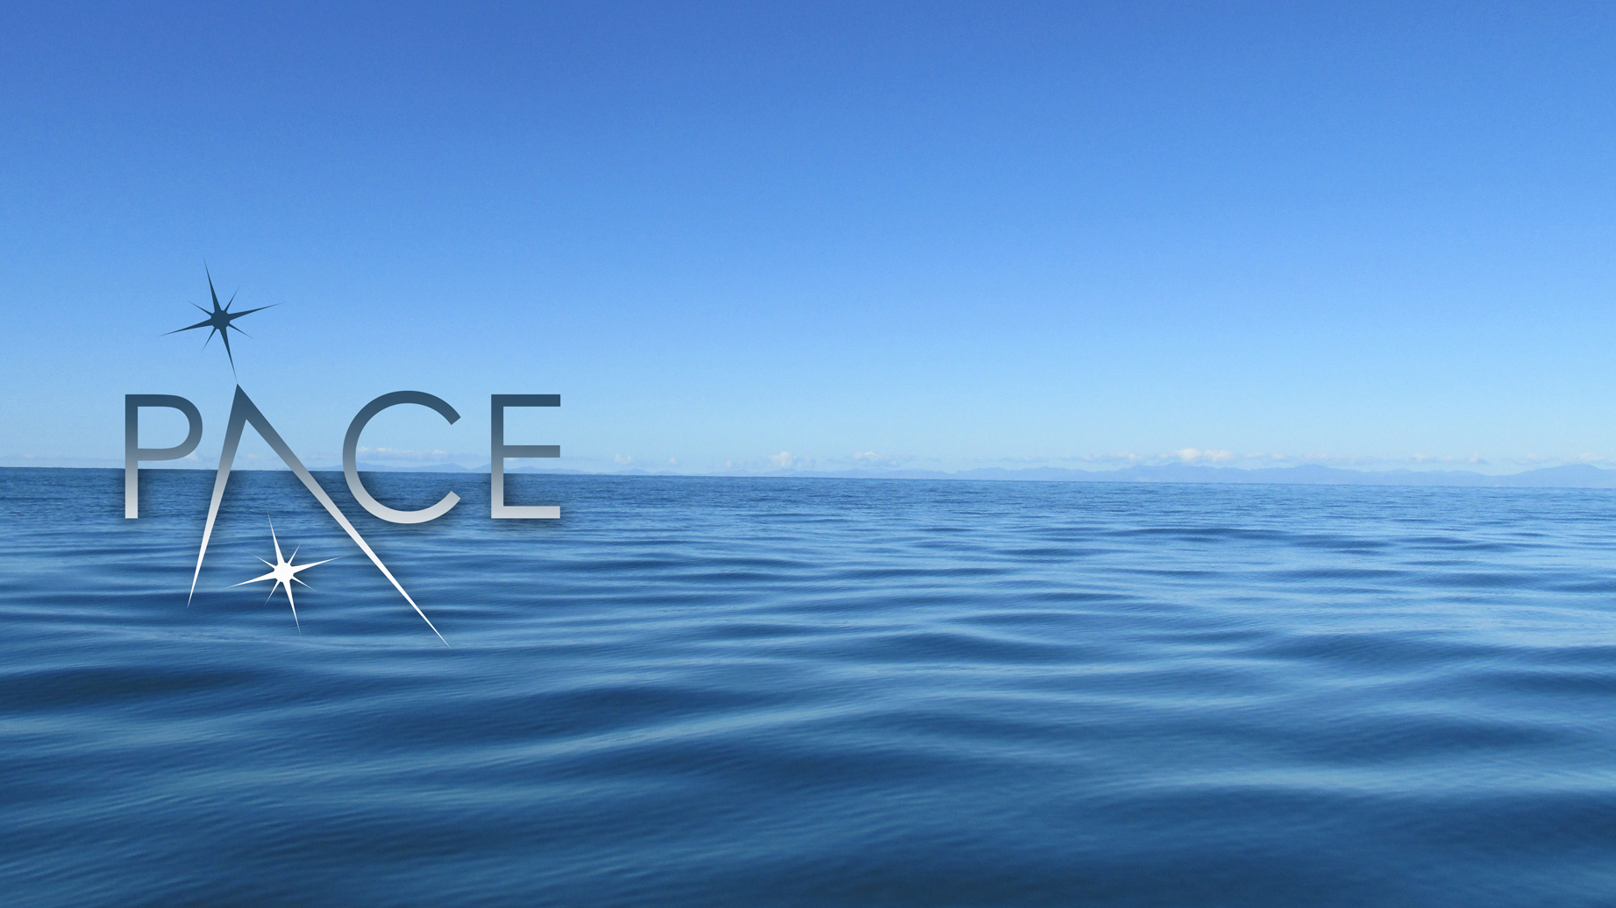
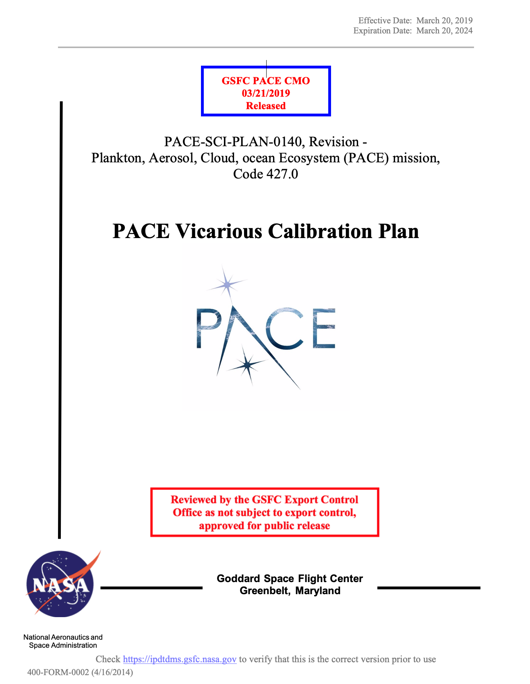
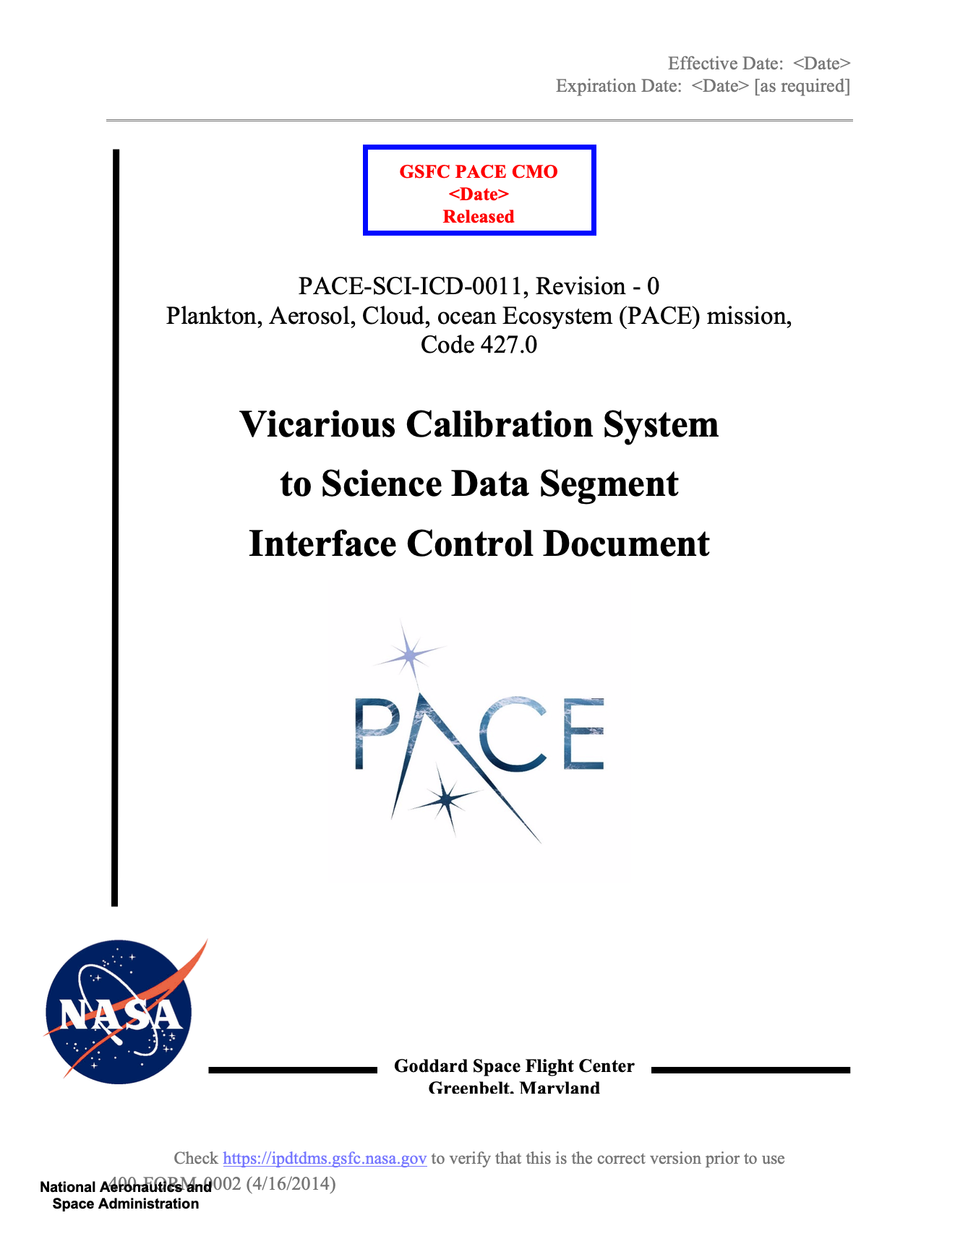
PACE System Vicarious Calibration (SVC)
ROSES 2018 A.48 (amendment 22 Feb 2019); Selection 18 July 2019; Start June 2020
    Implementation of MarONet for support of PACE Vicarious Calibration
    Ken Voss (University of Miami)
    Partners:
      Curtin University
      SJSU Moss Landing Marine Lab
      NIST$4.6M / 4 years
A new paradigm for ocean color satellite calibration and validation: highly accurate, low uncertainty, hyperspectral radiometric measurements from autonomous platforms (HYPERNAV)
Andrew Barnard (SeaBird Electronics)
Partners:
  UCSD Scripps Institute of Oceanography
  University of Maine
  Hellenic Centre for Marine Research (HCMR)M / 4 years
ammendment
down-select
launch
SVC schedule:
2019 2020 2021 2022 2023
TBR
TBR
today
dress rehearsal + site & system characterization

Slide 14

PACE Validation Science Team (PVST)
ROSES 2021 [TBD]
Perform validation experiments during mission ops for all data products (aerosol, cloud, ocean color), including validation of polarimetry data products as possible
Include airborne (as possible) & in situ measurements
International communities (e.g., the Copernicus Program) are investing in Fiducial Reference Measurements for Sentinel & coordination is critical
$TBD M / TBD years
TBR
today
selection
launch
PVST schedule:
2020 2021 2022 2023 2024
one-year organization, coordination, prep, dress rehearsal
ongoing validation

Slide 15
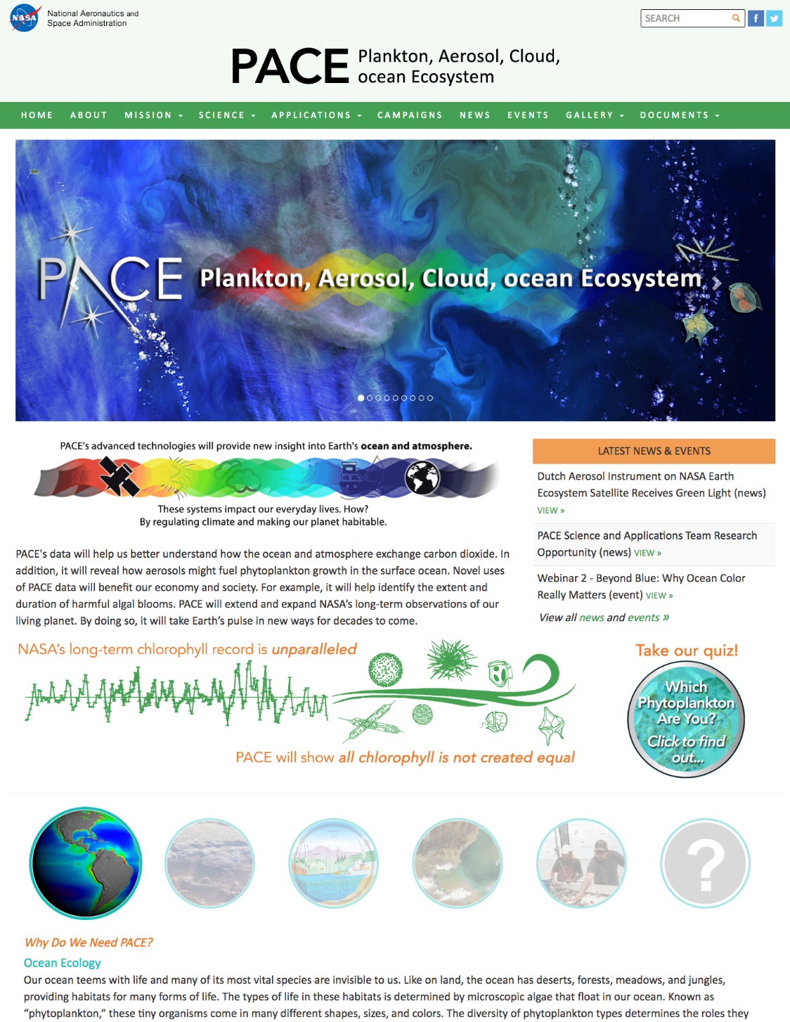
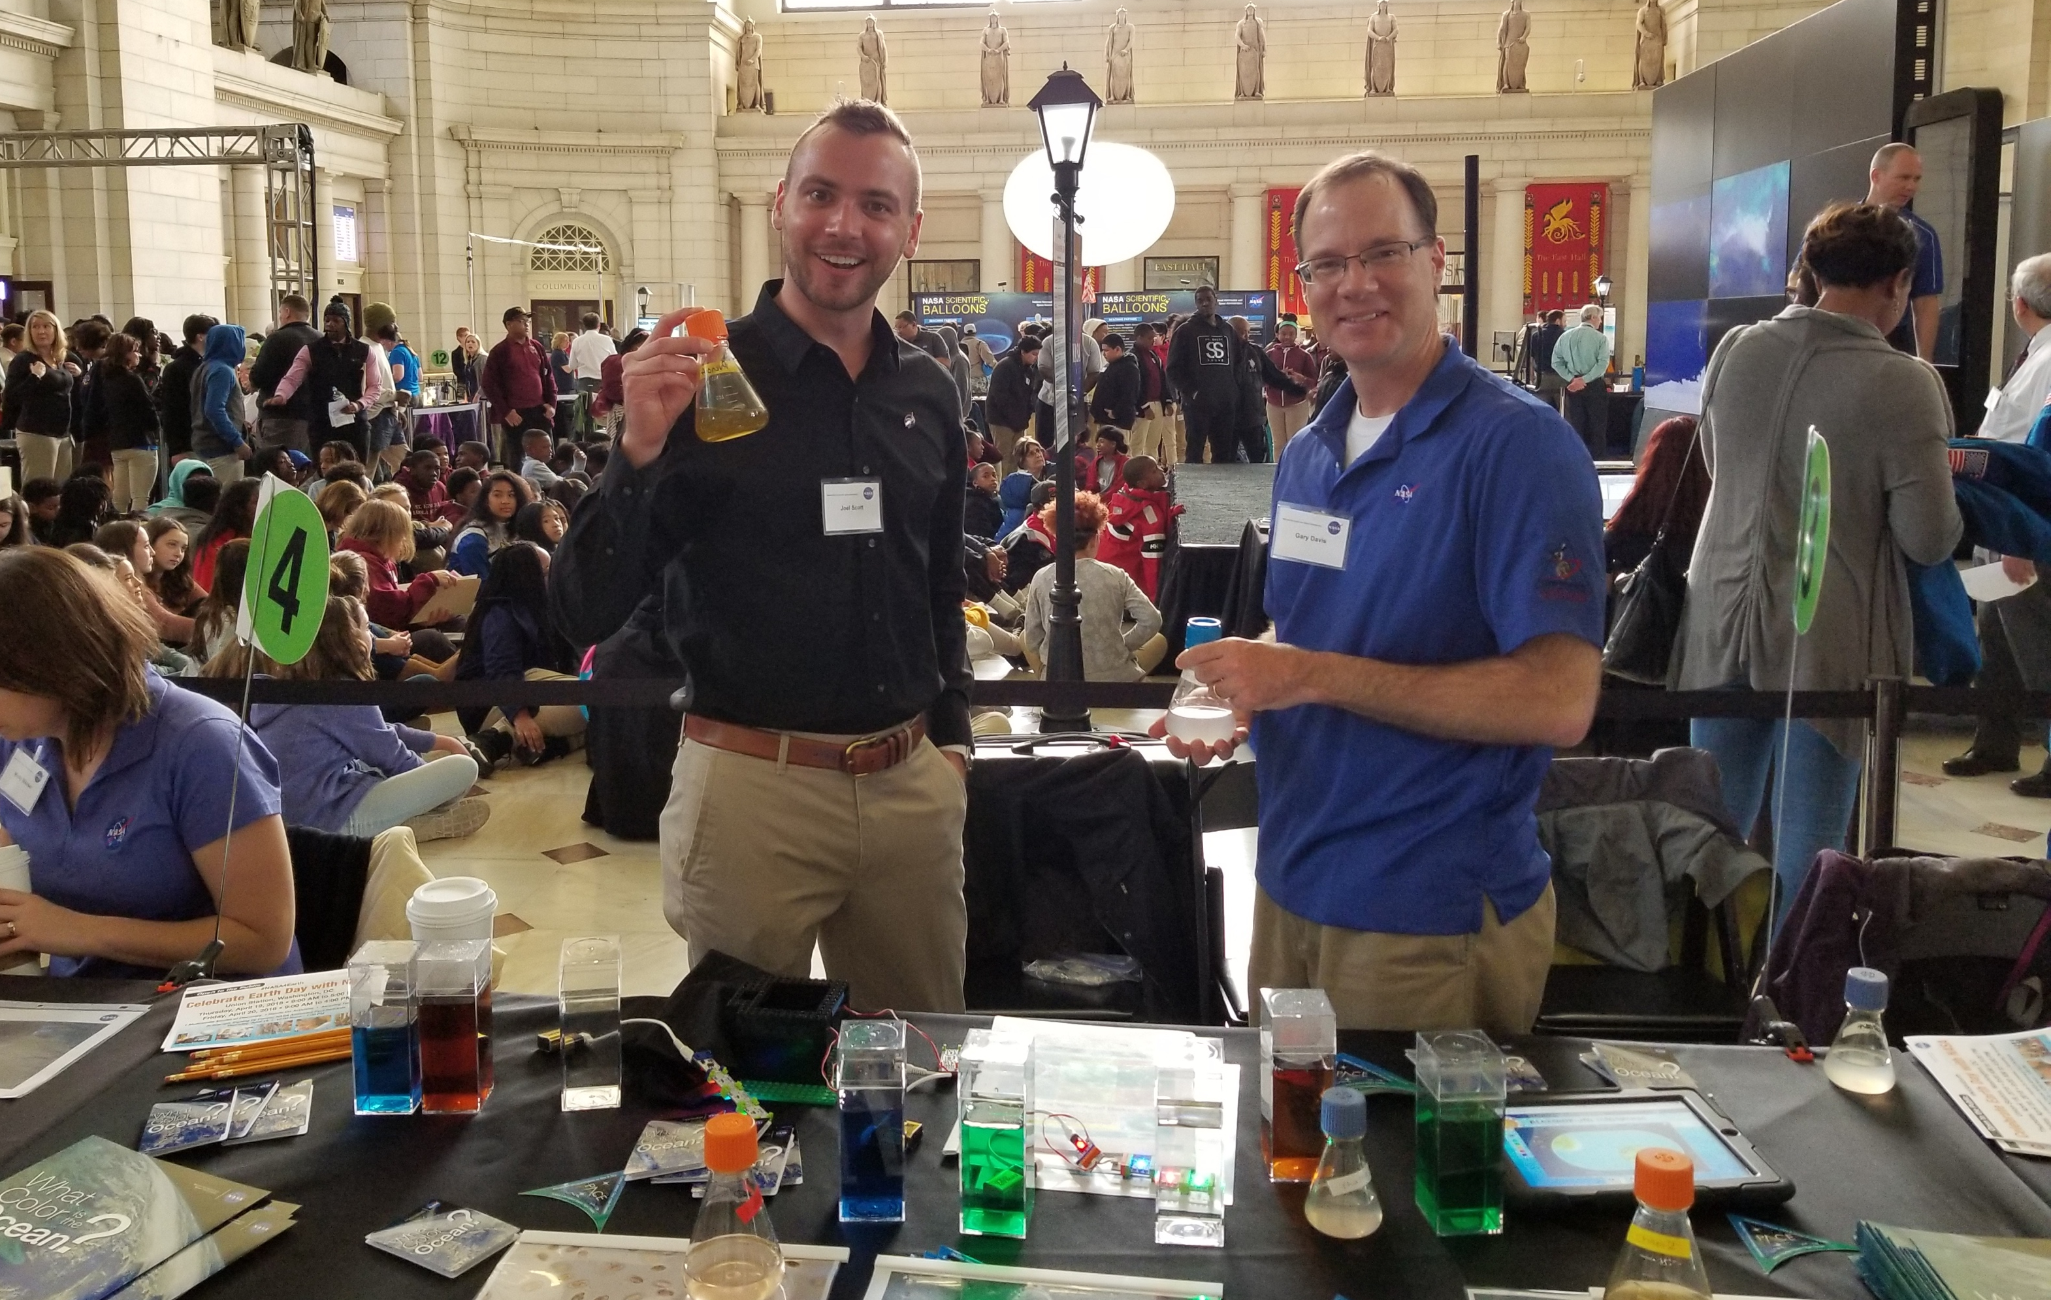
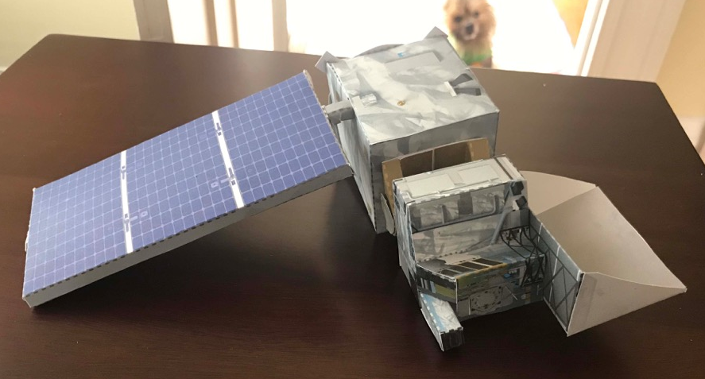
community engagement:
mission paper in Bulletin of American Meteorological Society
special issues in Frontiers in Earth Science, Remote Sensing
town halls at professional society meetings
booths at Union Station Earth Day, UMD Science Week, …
webinars
hyperwall events, GSFC visitor presentations
interviews, media events
interactive online material
online & social media presence:
https://pace.gsfc.nasa.gov
@NASAOcean (Twitter)
@NASAOcean (Facebook)

Slide 16
on the horizon …
OCI engineering test unit data analyses – current best estimates of instrument performance will be shared (~mid to late summer 2020)
simulated OCI data via a MODIS-based simulator & a NASA GMAO simulator – simulations will be shared (~early to mid summer 2020)
execute a full dress rehearsal for vicarious calibration & science data product validation beginning at least launch - 1 year using OLCI, VIIRS, &/or simulated data
engage with the system vicarious calibration team & SAT (Heidi D. talk next)
foster the PACE Applications Program & Early Adopters (Erin U.J. talk after Heidi)
engage with the community – access to information & data not limited to science teams & contributions of novel approaches/algorithms can be considered
Notes:
Short and sweet

Slide 17
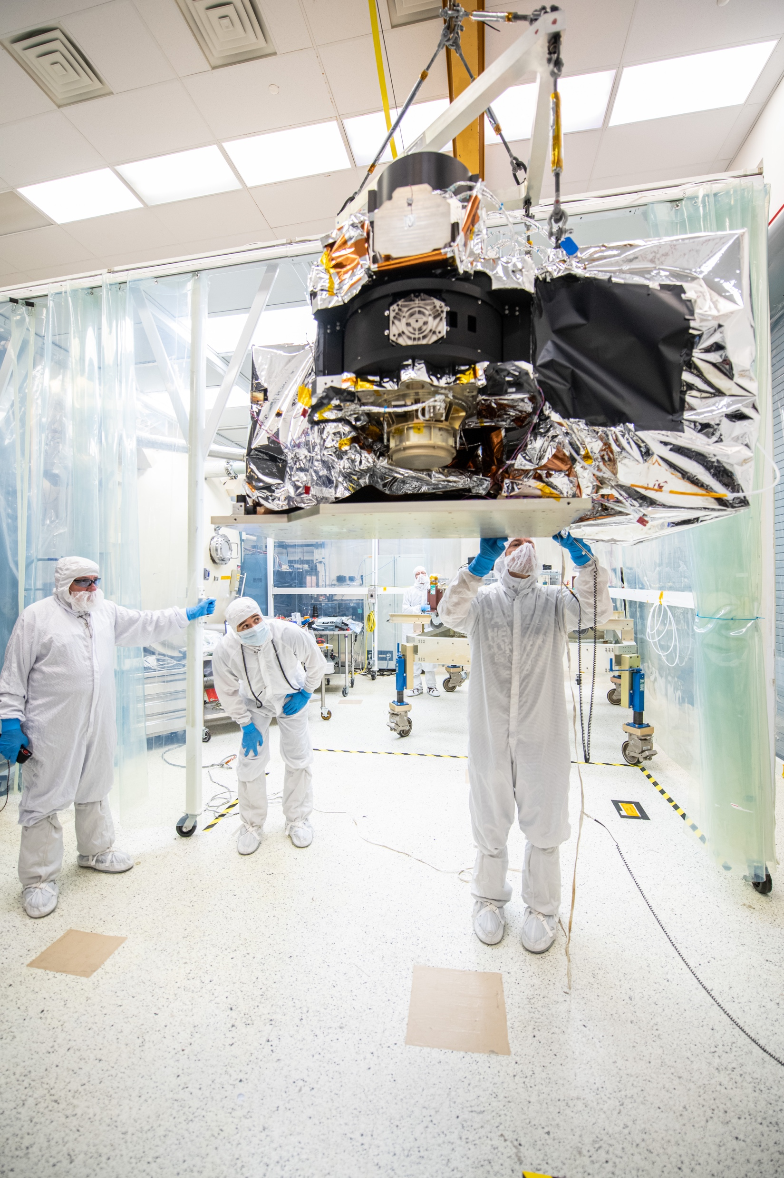
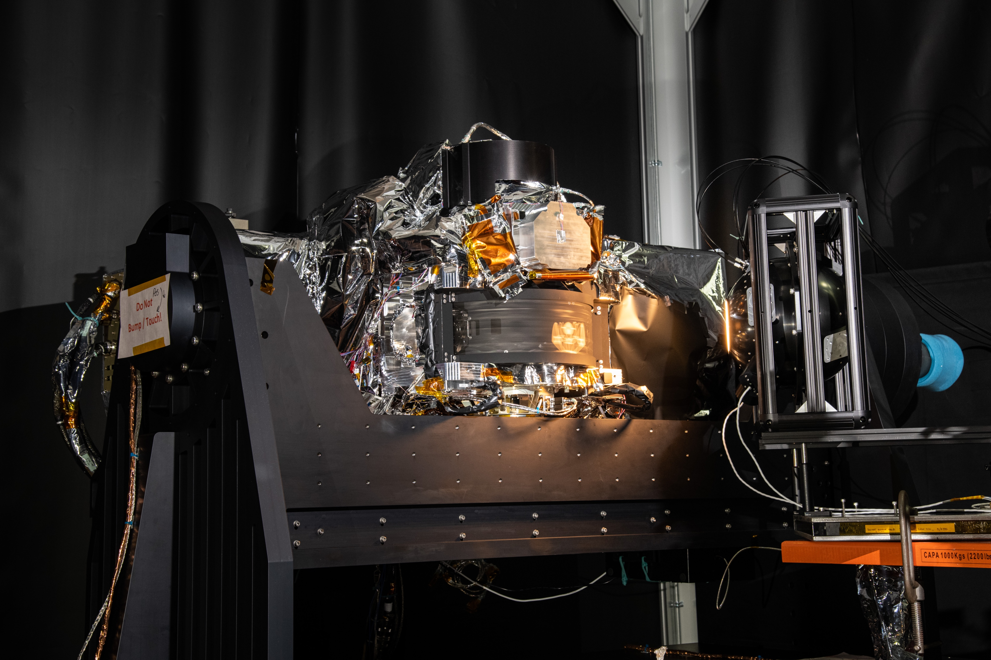
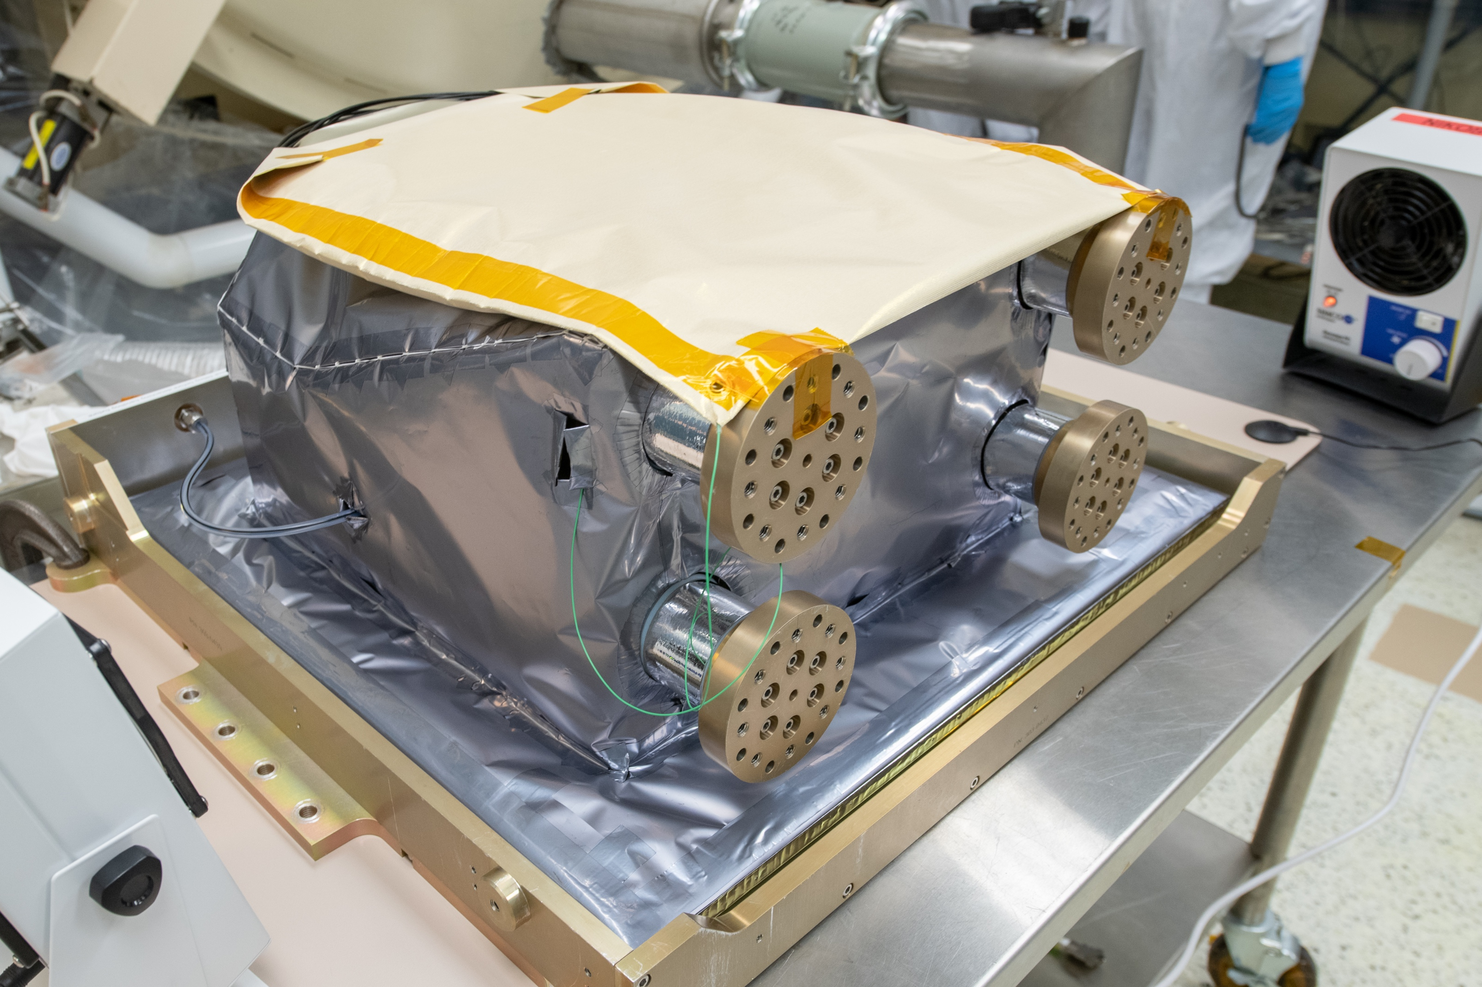
OCI Engineering Test Unit rotating telescope scanning across a calibration light source
OCI Engineering Test Unit on its way to thermal vac …
OCI Engineering Test Unit SWIR detecton assembley

Slide 18
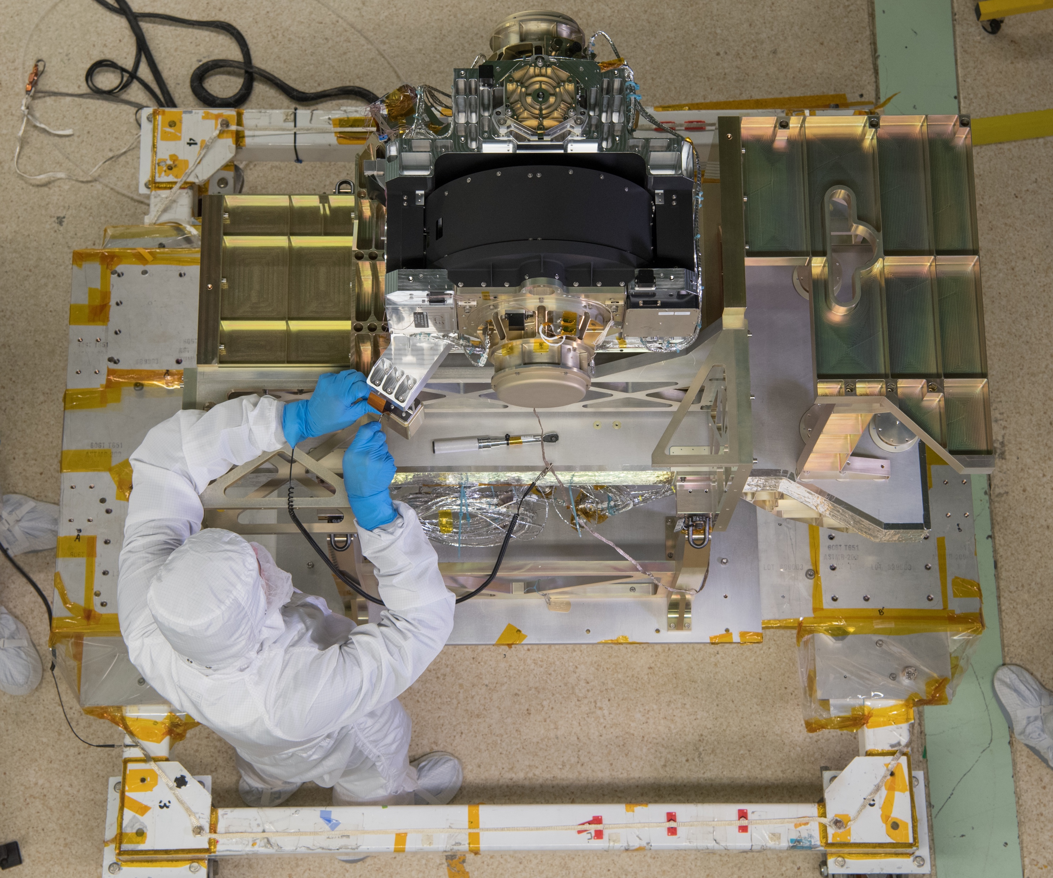
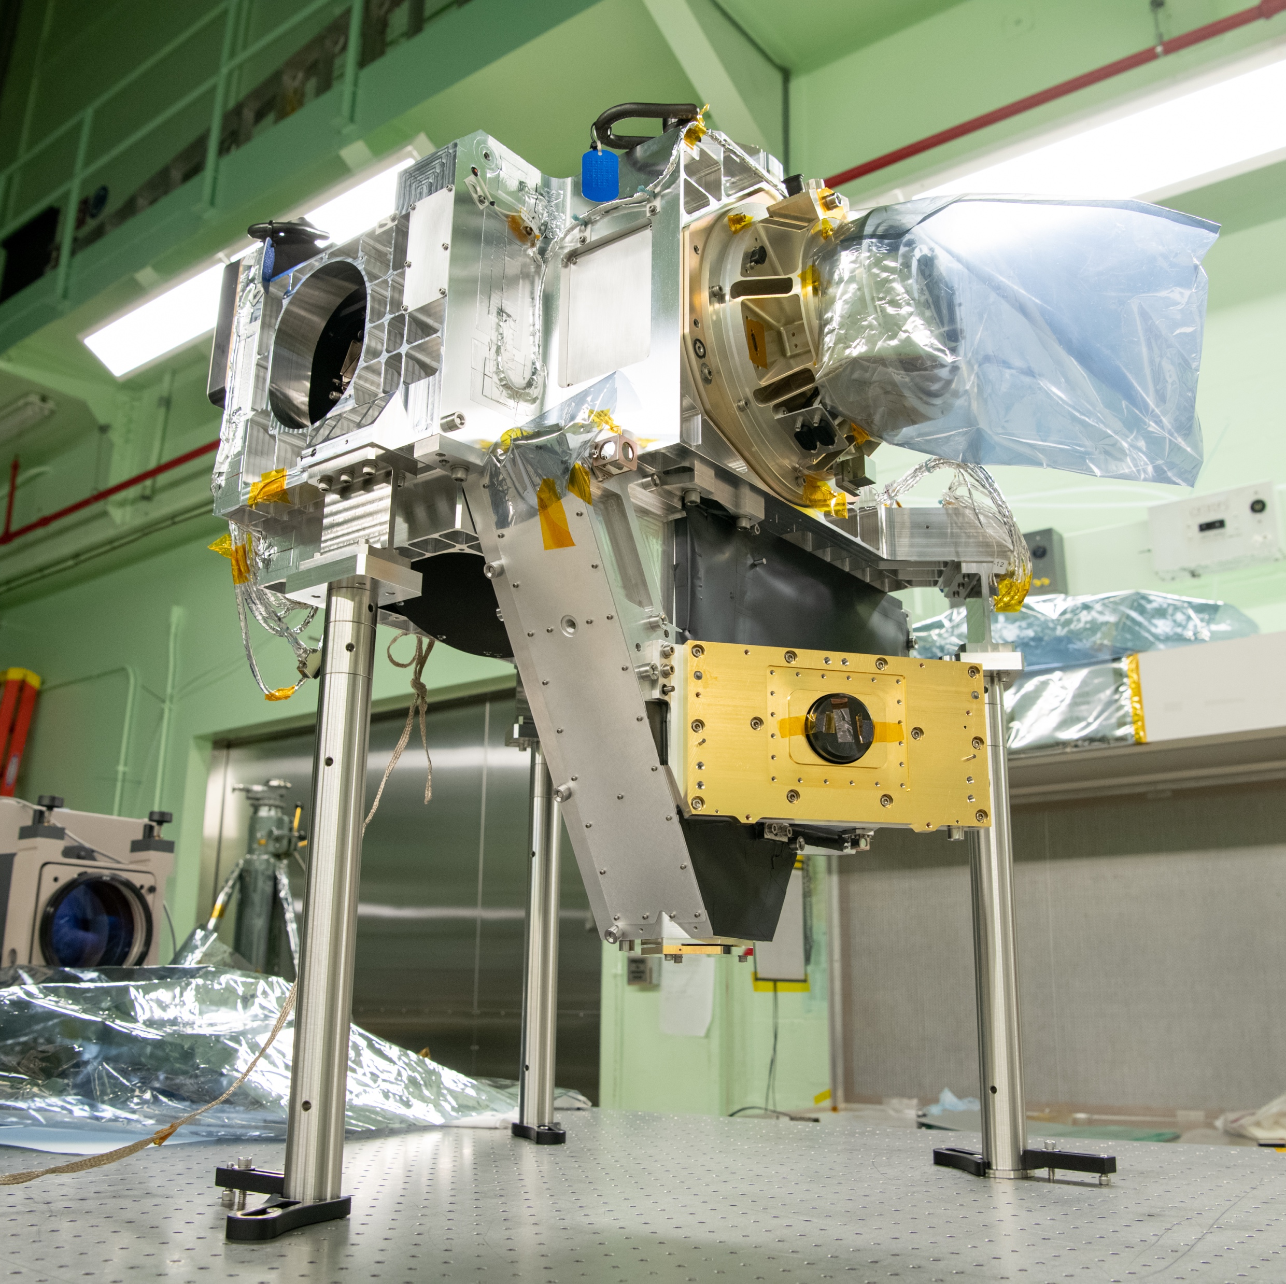
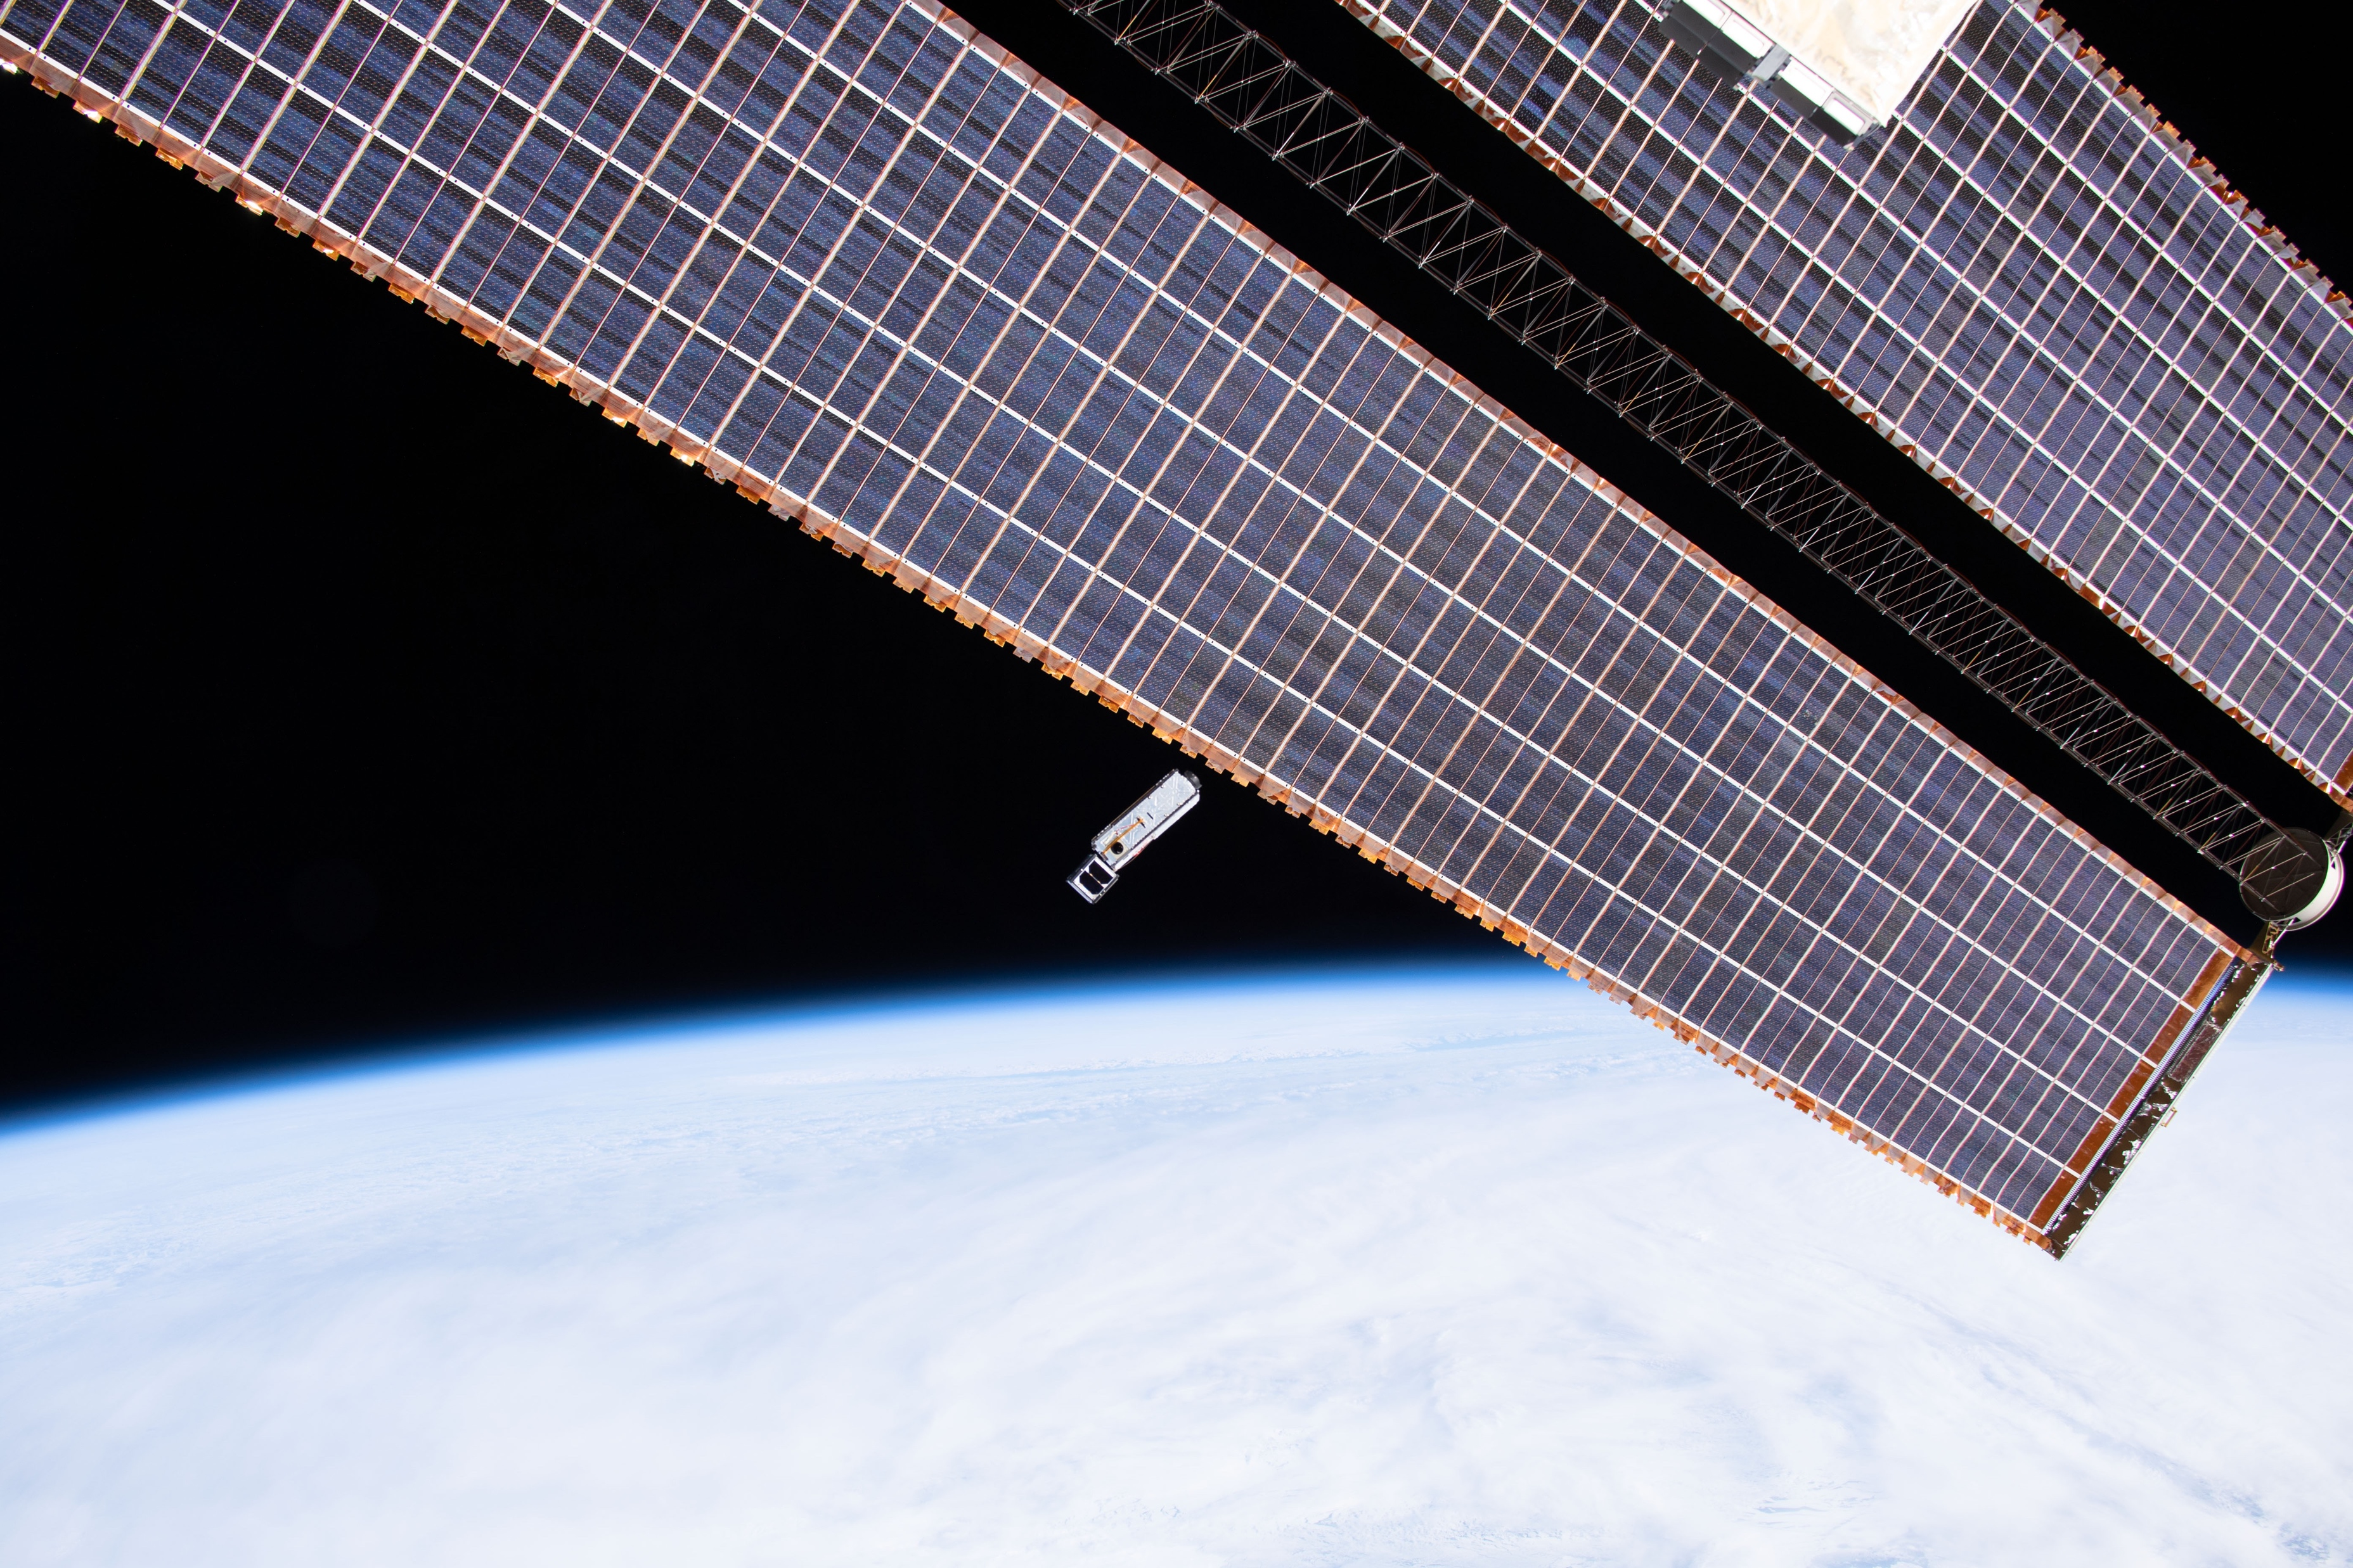
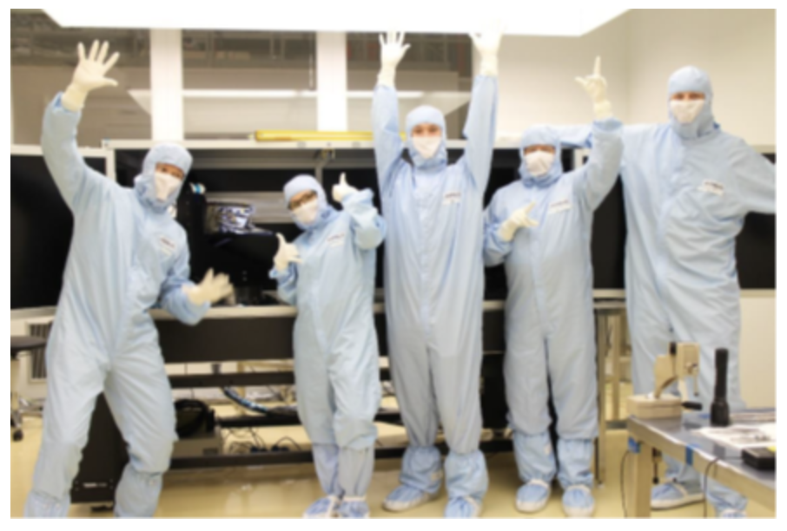
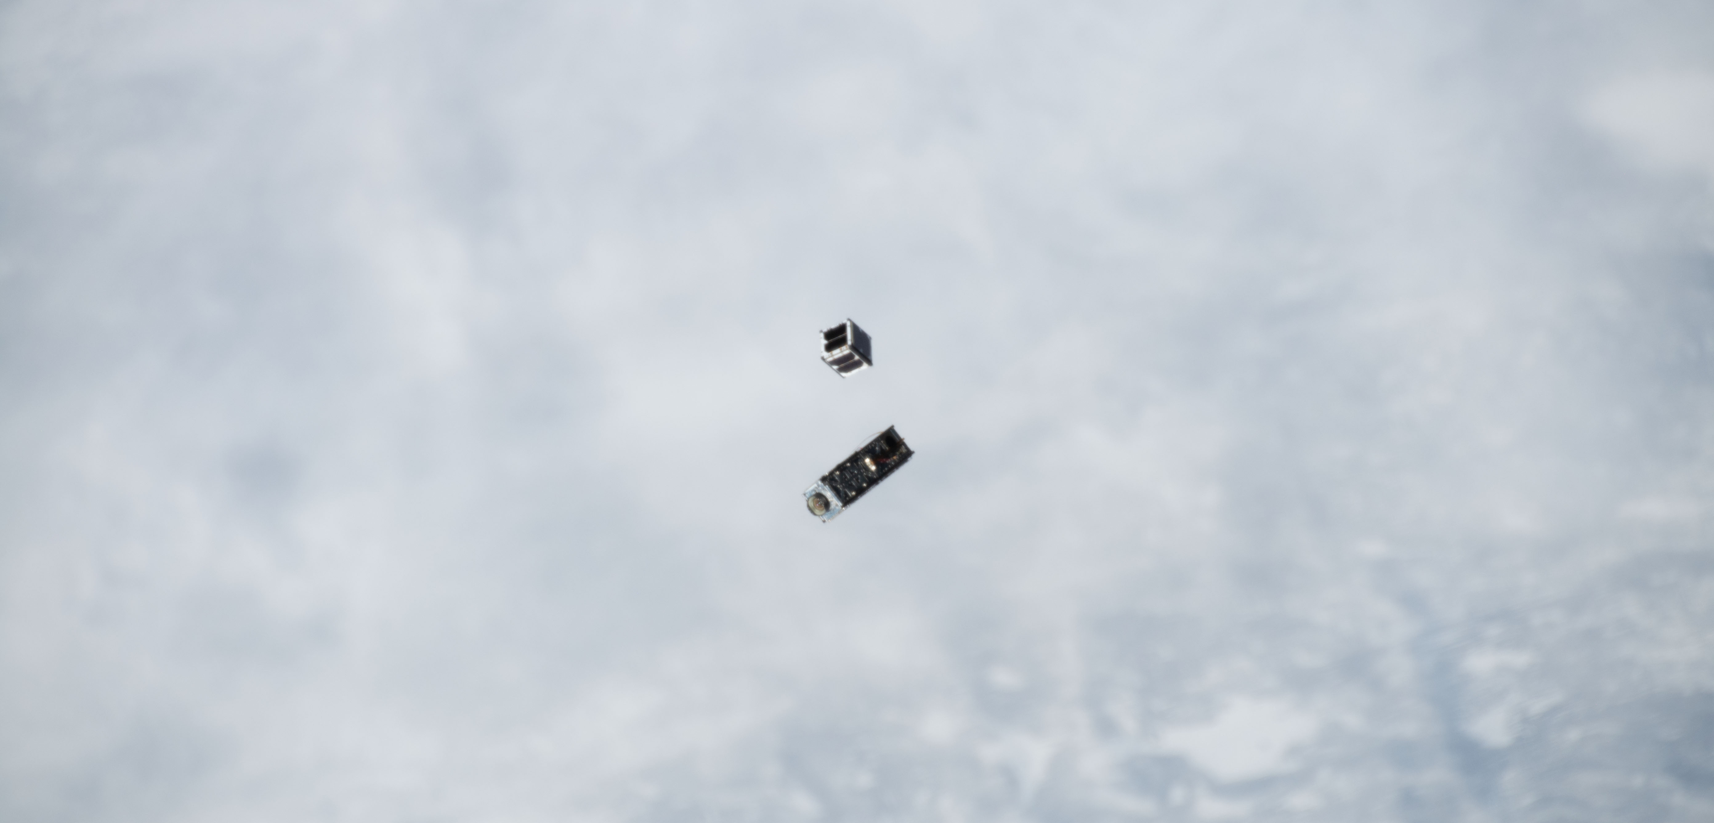
OCI Engineering Test Unit main optical bench
HARP CubeSat leaving the ISS
SPEXone team in the clean room

Slide 19
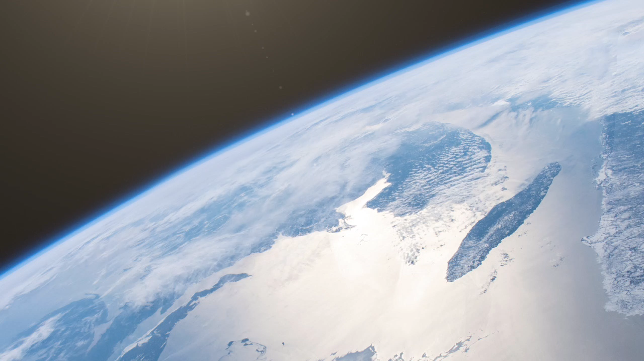

Slide 20
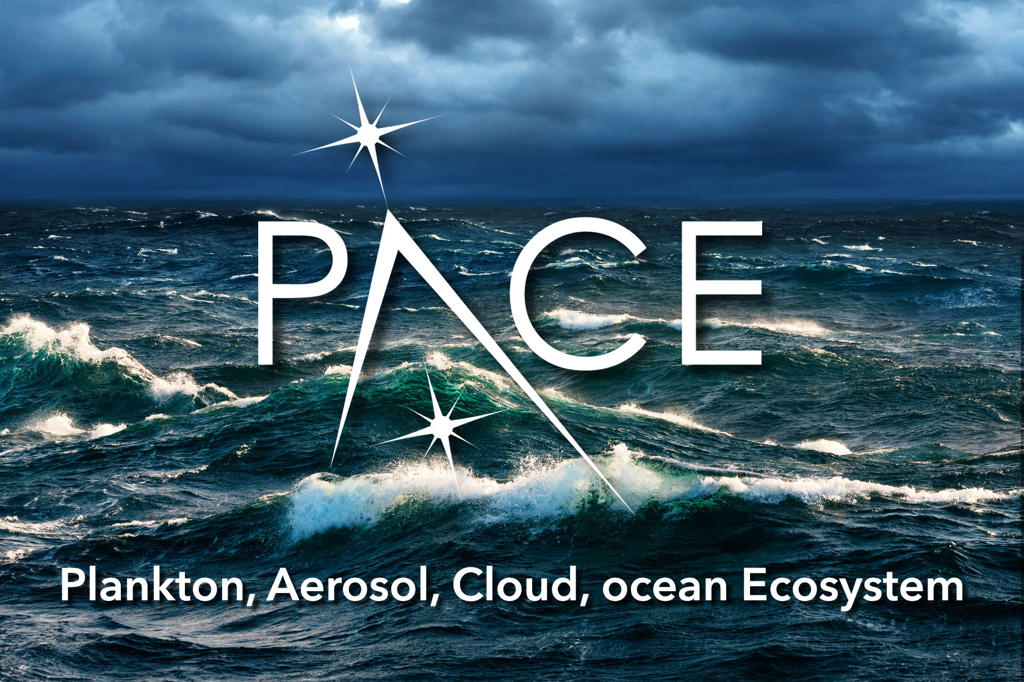
BACKUP

Slide 21
Battery
Solar Array
Drive
Star
Trackers
Solar Array
13 deg Cant
Bus
Radiator
22N Thrusters
S-Band
Antenna
+Y
+X
+Z
Notes:
Polarimeter overview – Jeremy will go very quickly because Brian will cover in detail.
UPDATE POL TABLE

Slide 22
science data product requirements, levels, & production
threshold scenario
required for mission success
baseline scenario
above-and-beyond threshold
Science Data Segment (SDS)
following guidance from Project (+ Instrument) Science
Level-2
derived geophysical science products, as observed
Level-3
science products, temporally / spatially composited
instrument
calibration
algorithms
science (geophysical)
algorithms
binning algorithms
Ocean Color
Ocean Color
Level 0
uncalibrated science data in a raw format
Level-1A
uncalibrated science data in an archive format
Level-1B
calibrated, geolocated science data, as observed
Aerosols
Aerosols
Clouds
Clouds
Level-1C
calibrated, co-registered (resampled) science data
System Vicarious Calibration Team
competed Science & Applications Team
HARP2
SPEXone
OCI

Slide 23
Threshold requirements to baseline capabilities
Ground sample distance of 1 ± 0.1 km² at nadir
Equatorial crossing between 11:00 to 13:00 local time
2-day to solar zenith ≤ 75º & sensor zenith ≤ 60º
Sun glint mitigation (<9% of the 2-day global coverage missed)
Once-monthly characterization of instrument stability, including lunar observations through the earth viewing port that illuminate all detector elements
Daily characterizations of OCI instrument changes using an independent, on-board capability that illuminates all detector elements
An OCI with center wavelengths from 350-820 nm at 5 ± 1 nm resolution
An OCI with bands centered on 865, 940, 1250, 1378, 1615, 2130, and 2260 nm at atmospheres performance levels
Multi-angle polarimeter(s)
18-month mission life
Ground sample distance of 1 ± 0.1 km² at nadir
Equatorial crossing between 11:00 to 13:00 local time
1-day to solar zenith ≤ 75º & sensor zenith ≤ 60º
Sun glint mitigation (<8% of the 2-day global coverage missed)
Twice-monthly characterization of instrument stability, including lunar observations through the earth viewing port that illuminate all detector elements
Daily characterizations of OCI instrument changes using an independent, on-board capability that illuminates all detector elements
An OCI with center wavelengths from 350-865 nm at 5 ± 1 nm resolution
An OCI with bands centered on 940, 1038, 1250, 1378, 1615, 2130, and 2260 nm at atmospheres and ocean performance levels
Multi-angle polarimeter(s)
36-month mission life
Data Product | Uncertainty
Water-leaving reflectances from 350 to 400 nm | 0.0083 or 30%
Water-leaving reflectances from 400 to 600 nm | 0.0024 or 6%
Water-leaving reflectances from 660 to 710 nm | 0.00084 or 12%
Total aerosol optical depth at 380 nm | 0.06 or 40%
Total aerosol optical depth at 440, 500, 550 and 675 nm over land | 0.06 or 20%
Total aerosol optical depth at 440, 500, 550 and 675 nm over oceans | 0.04 or 15%
Fine mode fraction of aerosol optical depth over oceans at 550 nm | ±25%
Cloud layer detection for optical depth > 0.3 | 40%
Cloud top pressure of opaque (optical depth > 3) clouds | 60 hPa
Optical thickness of liquid clouds | 25%
Optical thickness of ice clouds | 35%
Effective radius of liquid clouds | 25%
Effective radius of ice clouds | 35%
Data Product | Uncertainty
Water-leaving reflectances from 350 to 400 nm | 0.0057 or 20%
Water-leaving reflectances from 400 to 600 nm | 0.0020 or 5%
Water-leaving reflectances from 660 to 710 nm | 0.0007 or 10%
Total aerosol optical depth at 380 nm | 0.06 or 40%
Total aerosol optical depth at 440, 500, 550 and 675 nm over land | 0.06 or 20%
Total aerosol optical depth at 440, 500, 550 and 675 nm over oceans | 0.04 or 15%
Fine mode fraction of aerosol optical depth over oceans at 550 nm | ±25%
Cloud layer detection for optical depth > 0.3 | 40%
Cloud top pressure of opaque (optical depth > 3) clouds | 60 hPa
Optical thickness of liquid clouds | 25%
Optical thickness of ice clouds | 35%
Effective radius of liquid clouds | 25%
Effective radius of ice clouds | 35%
O(100) additional data products can be calculated from these core measurements
Notes:
Reiterate that baselines are “capabilities” not “requirements”
Point out that we’ll discuss “% tilt” later
Point out “high gain”

