Slide 1
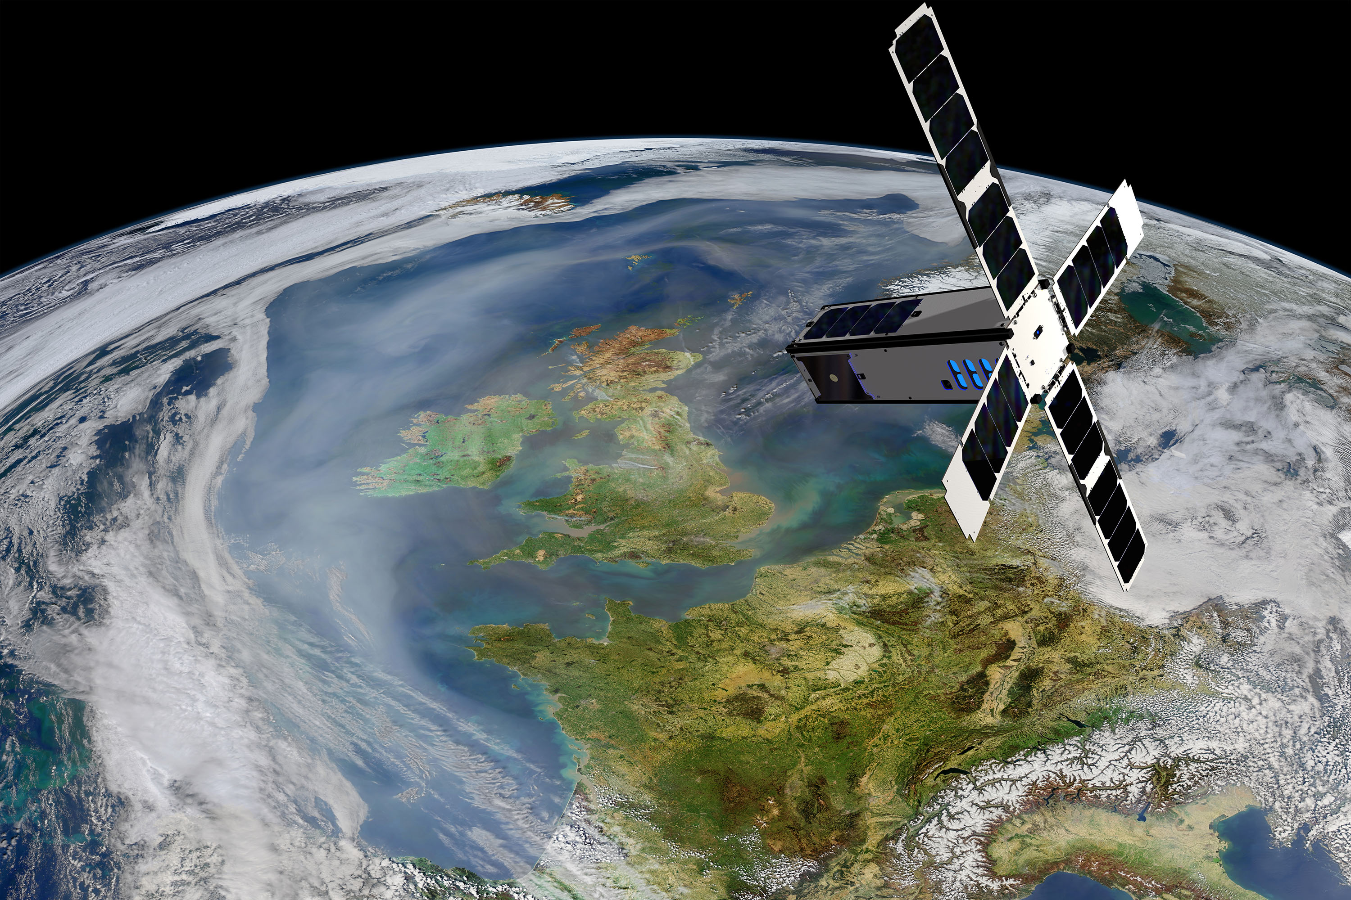
SeaHawk - HawkEye
Background, Overview and Status
28 May 2020
SOCON
Sustained Ocean Color Observation from Nanosatellites

Slide 2
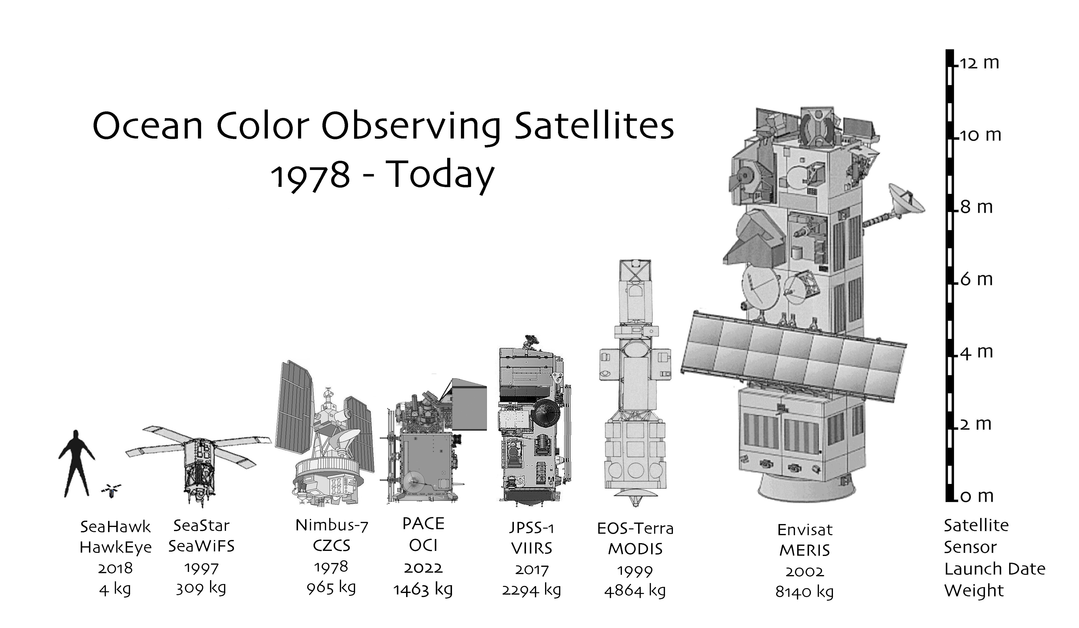
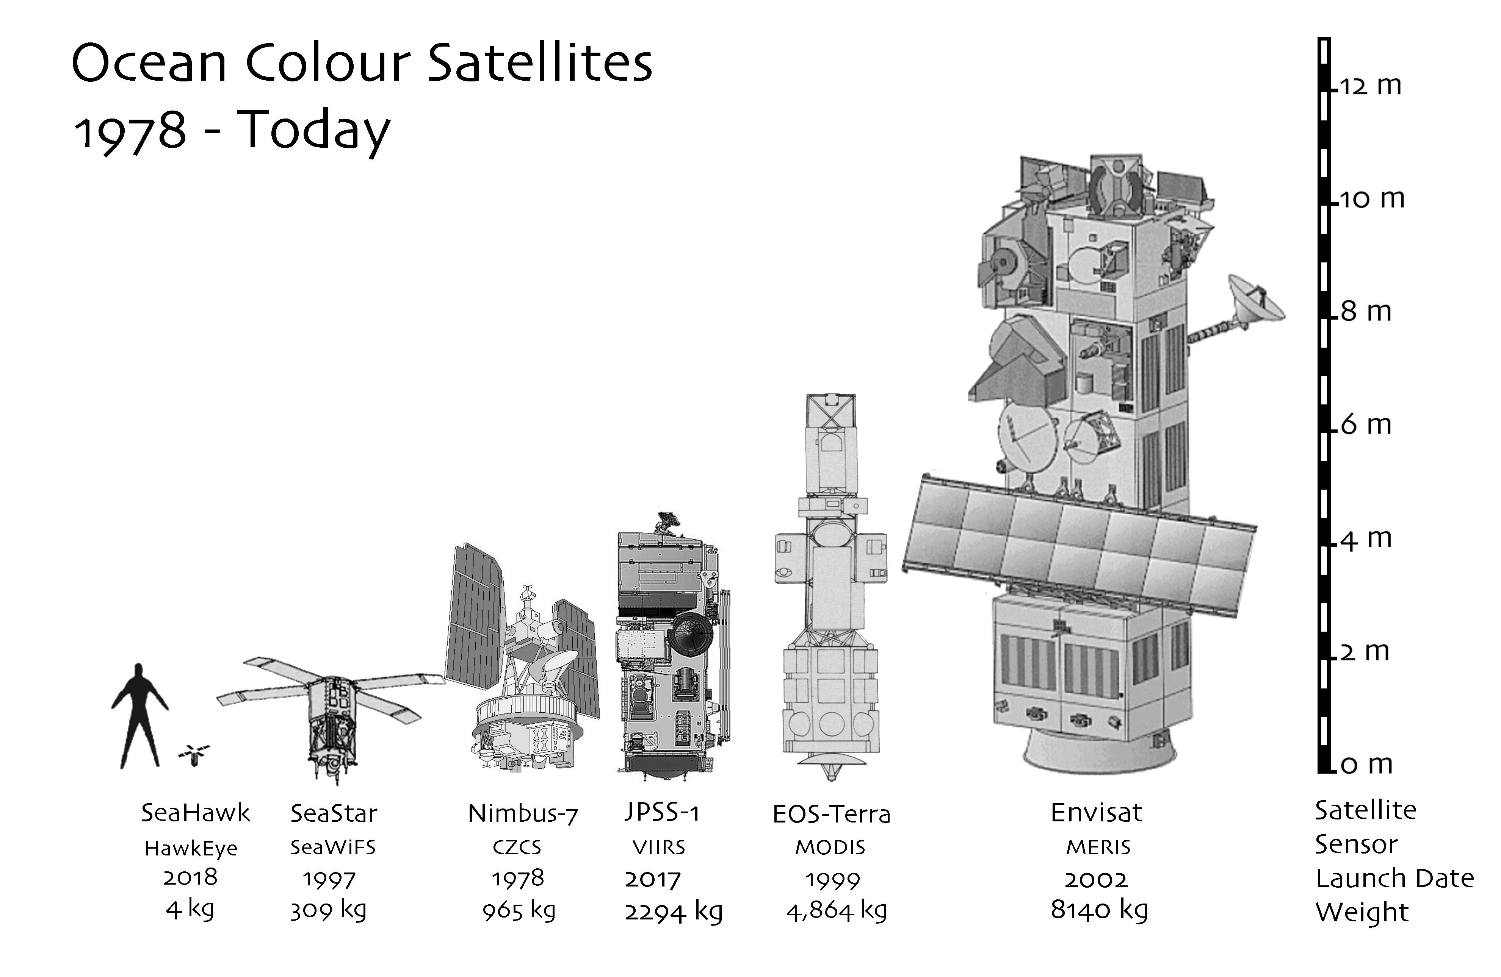

Slide 3
Goal:
Proof of Concept program to demonstrate whether it is possible to obtain high
quality, high resolution (~100m)
ocean color imagery using a low-cost
miniature ocean color sensor
carried aboard a CubeSat.

Slide 4
Program was funded (2015) by the Gordon and Betty Moore Foundation - Phase 1: Design and Construction of SeaHawk Satellite Bus and HawkEye Ocean Color Sensor
- Clyde Space (Scotland) provides the CubeSat bus named SeaHawk-1 and SeaHawk-2
- Alan Holmes and his team at Cloudland Instruments (Calif) provides the Hawkeye Sensors
The program is administered by Dr. John Morrison – UNCW
https://uncw.edu/socon/
NASA provided “advice and review” during the development phase and with formal NASA/HQ Space Act Agreement (2017), provides support for the collection, processing, calibration, validation, archive and distribution of the data (see backup for details)
A second Moore Foundation grant was awarded in June 2017 for Phase 2 to support the commercial launch and operations of both spacecraft and instruments for duration of 2 years each.

Slide 5
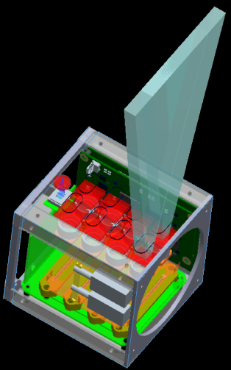
Key Mission Parameters
  Launched 3 December 2018 (3 weeks before government shutdown)
  Nominal orbital height = 585 km (- 1 km today)
  Sun-synchronous around 10:30am
  18 day repeat orbit (one satellite)
  Baseline orbital lifetime of 1 year (18-24 month)
  Image size of 200 x 600km of approximately 120 meter resolution - 100MB/scene)
  X-band downlink (Wallops & Alaska) data rate of 6 --> 100mbs
Flight
Direction
Nadir
Weight of instrument less than 1 kilogram
Total weight of spacecraft plus instrument less than 5 kilograms
Off-the-shelf CCD arrays used
Sensitivity comparable to SeaWiFS
  8 SeaWiFS Bands (see backup)
  Open intellectual property and knowledge sharing

Slide 6
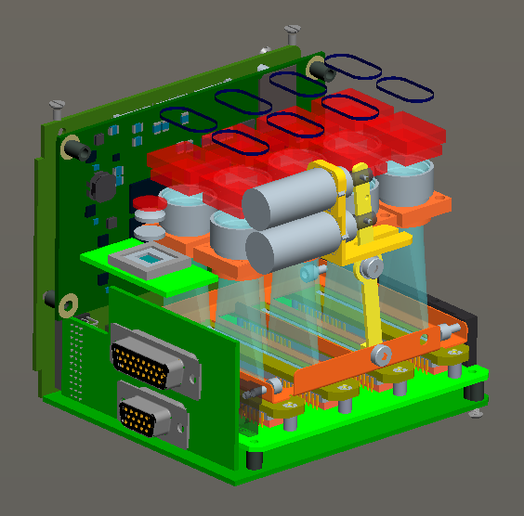
HawkEye
Science Apertures
Motherboard
Solenoids for shutter
Shutter Vane
CCD Board
Interface to
CubeSat
Analog
Board
Debug Port

Slide 7
Alan Holmes with HawkEye Units 1 & 2

Slide 8
SeaHawk Internal Configuration
Power Subsystem:
Clyde Space 3G EPS Motherboard with a Flex daughterboard
3G 30 Whr Clyde Space battery
Solar Arrays
Communications Subsystem:
VHF uplink at 1200 bps and UHF downlink at 9600 bps
Syrlinks X-band Transmitter (3-50Mbps / 6-100Msps)
On Board Computer:
Clyde Space on-board computer (OBC) provide up to 1.8 GB payload data storage
Attitude Determination & Control:
Clyde Space ADCS Motherboard
Sensors:
Course sun sensors
Three 2 Axis Digital Fine Sun Sensors
Magnetometers
Rate Gyroscopes
GPS
Actuators:
Three Axis Reaction Wheels
Three Axis Magnetorquers (MTQ)

Slide 9
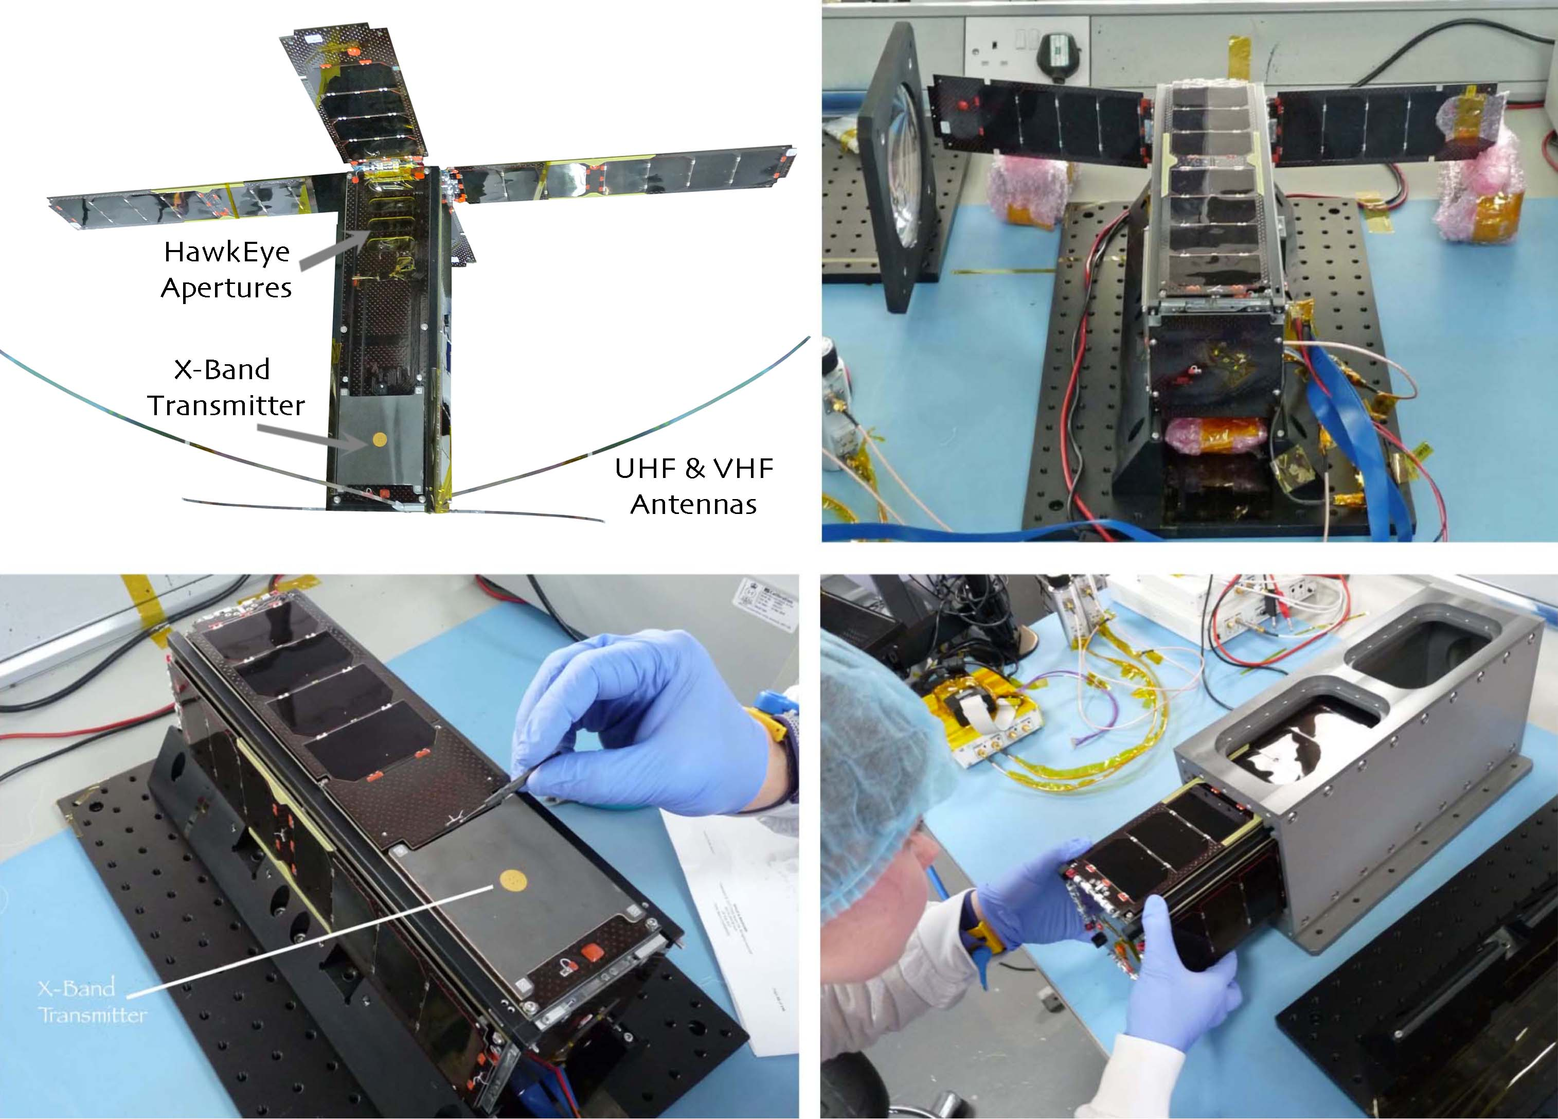

Slide 11
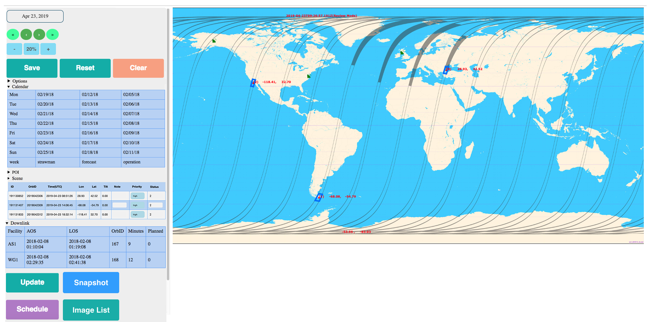
HawkEye Instrument
&
SeaHawk X-band Downlink Scheduling Tool

Slide 12
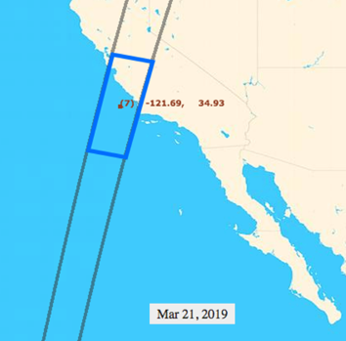
First Light
Sequence of Events:
20 March: x-panels deployed
HawkEye optics exposed
21 March: 1st image acquired
22 March: Wallops X-band downlink
50 mbps

Slide 14
Proof of Concept
CONFIRMED

Slide 15
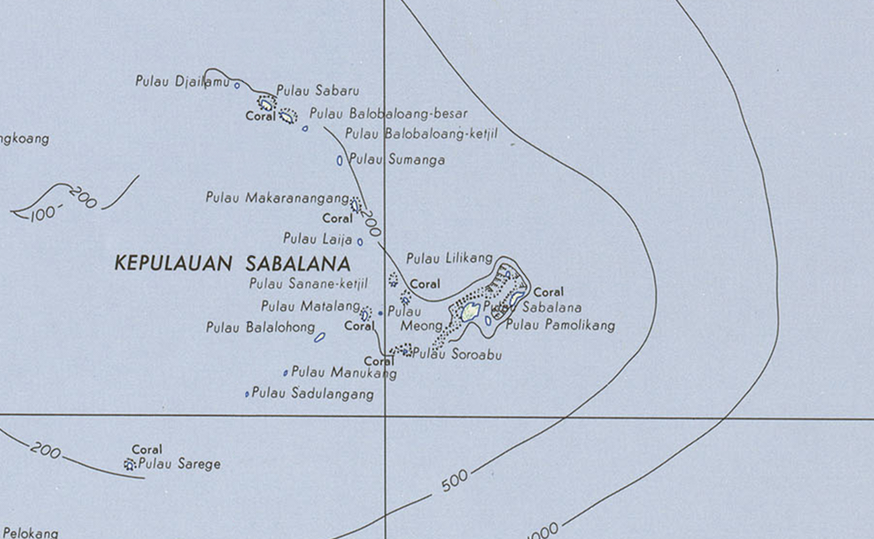
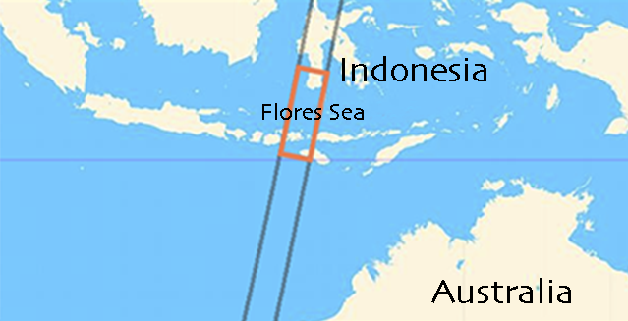
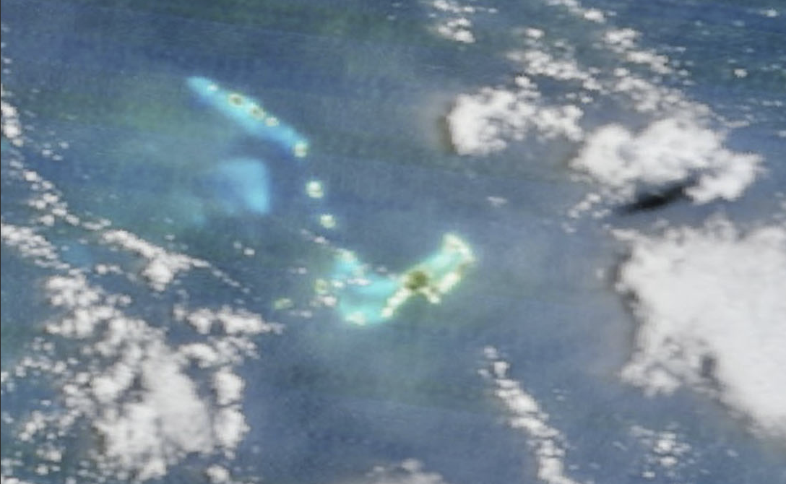
25 May 2019

Slide 16
MODIS/Terra
MODIS / Terra 25 May 2019 True Color

Slide 17
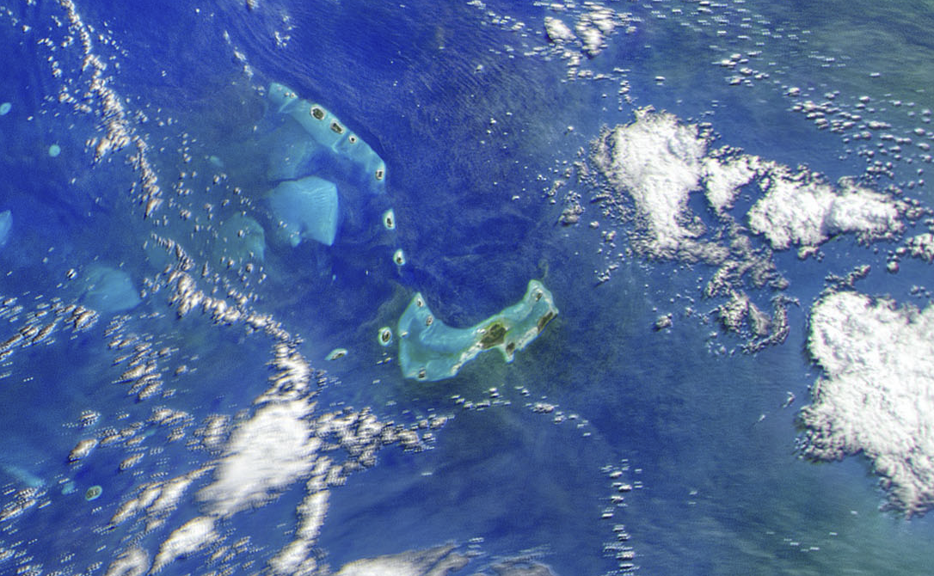
HawkEye / SeaHawk 25 May 2019 True Color

Slide 18
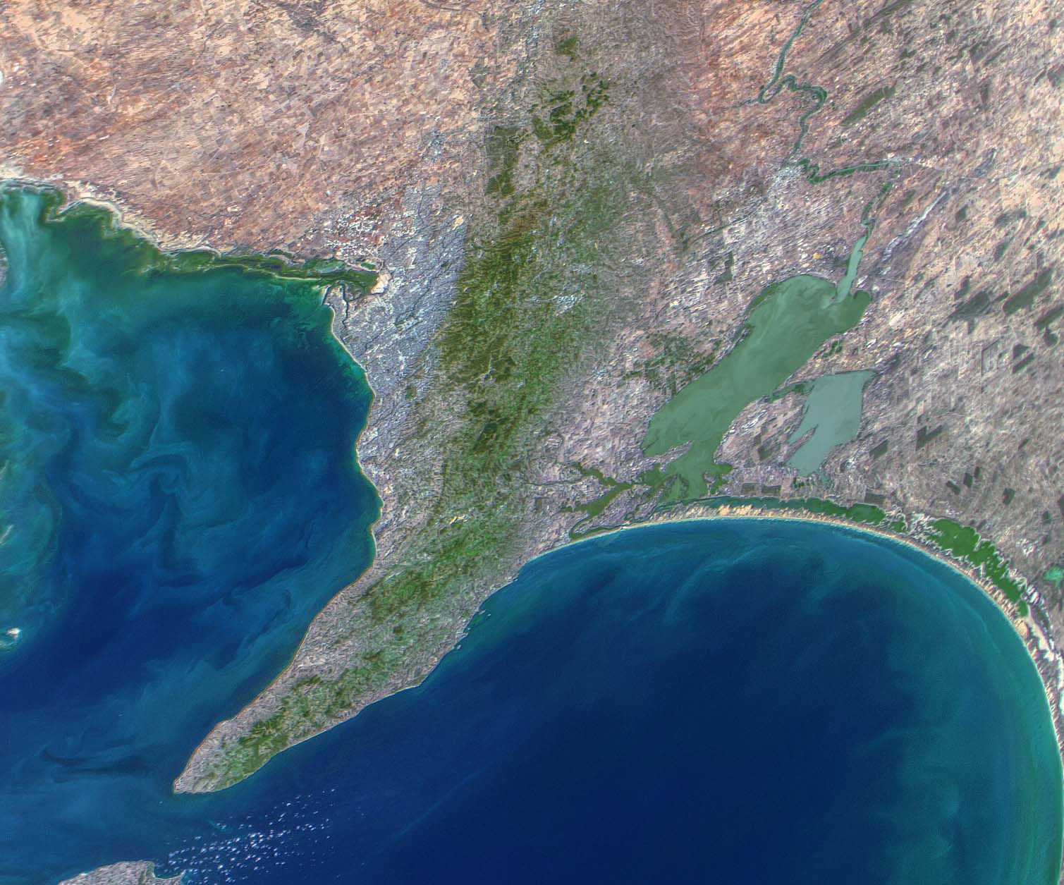
Adelaide, Australia

Slide 19
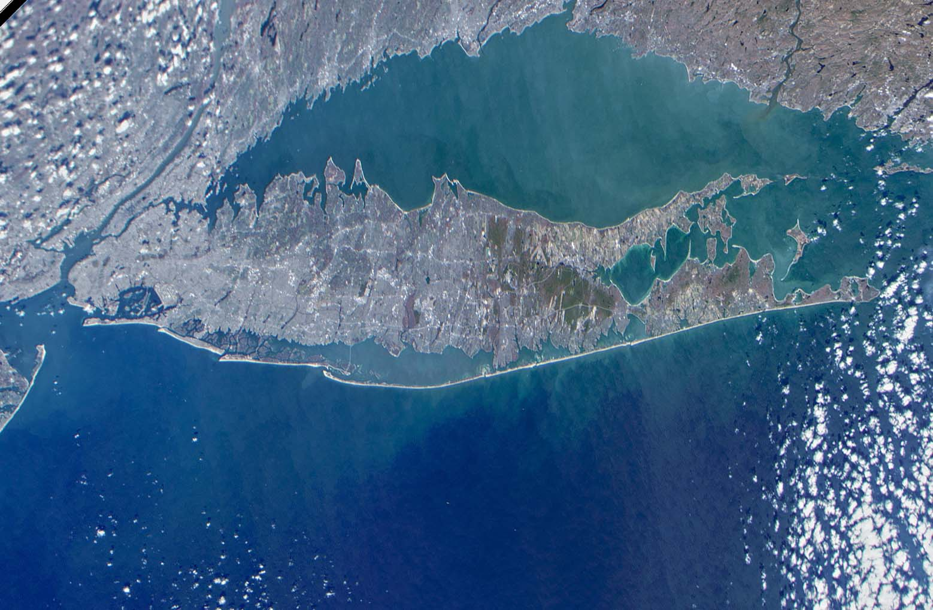
Long Island, New York

Slide 20
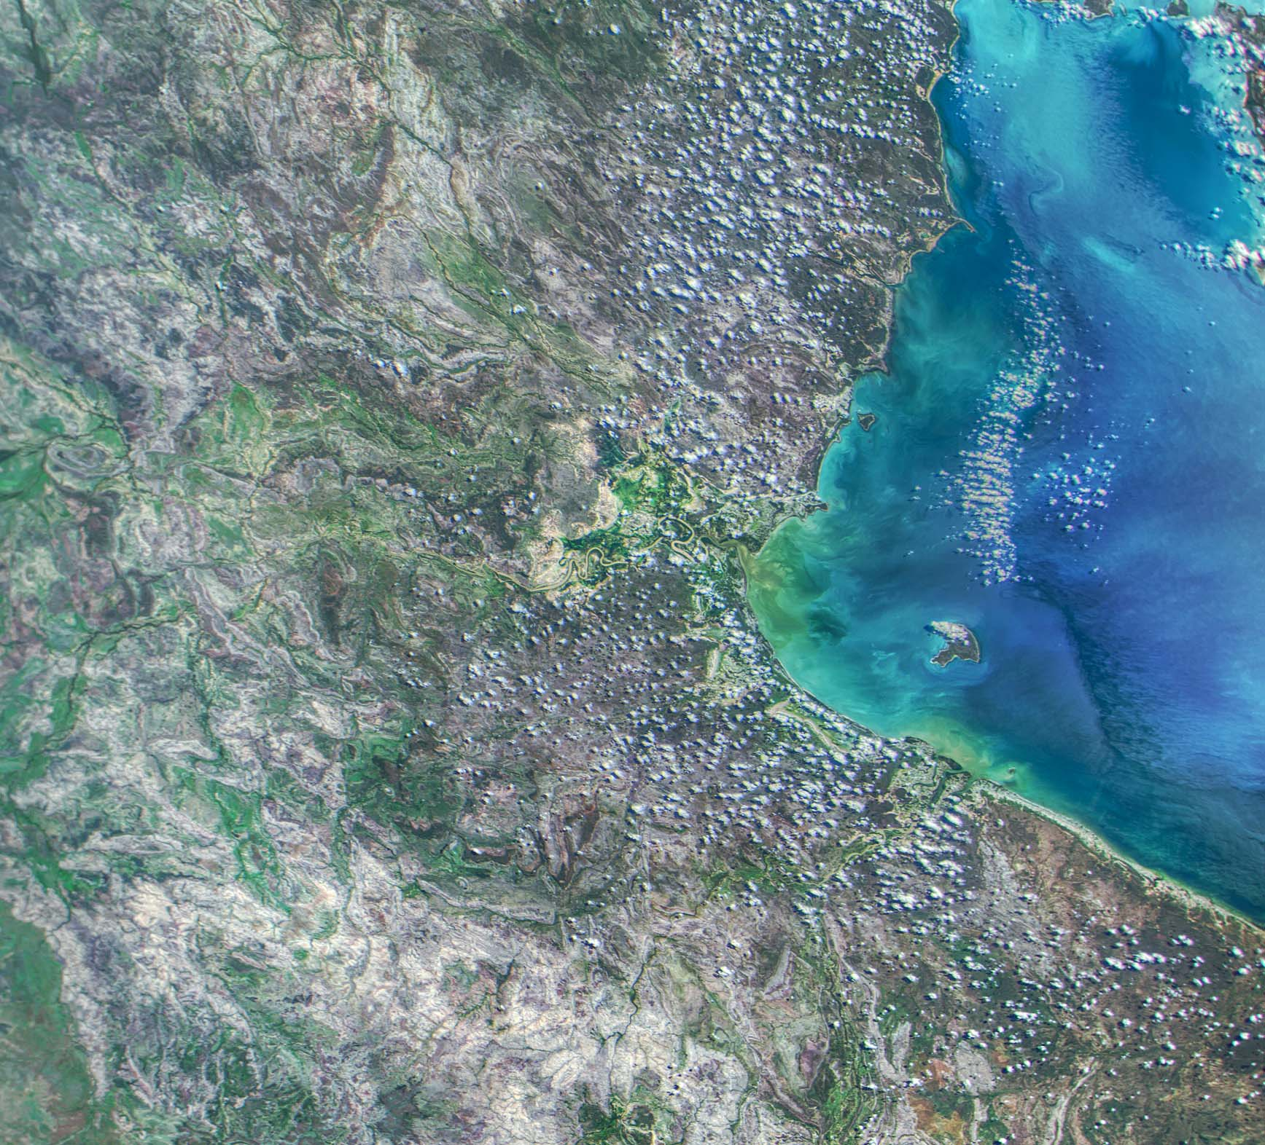
Gulf of
Carpentaria

Slide 21
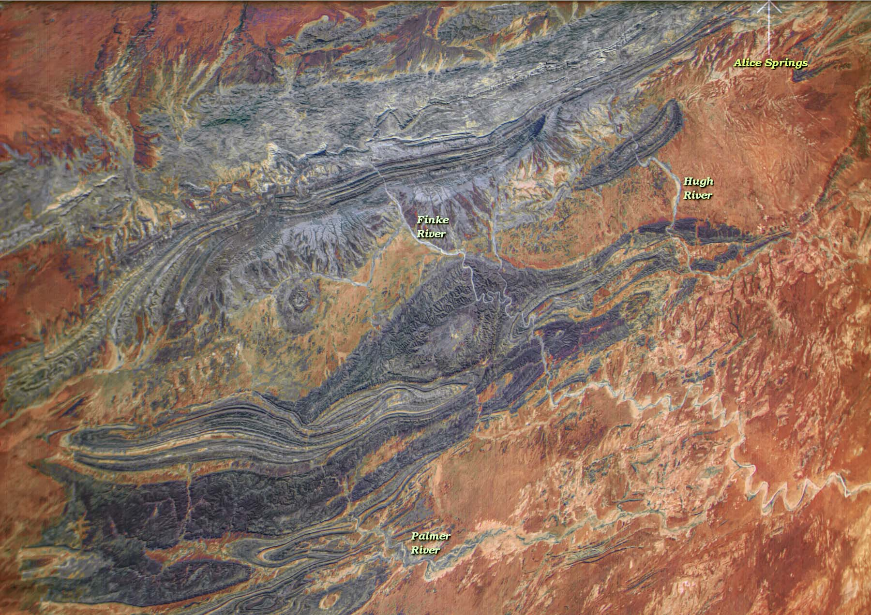
Northern Territory
Australia

Slide 22
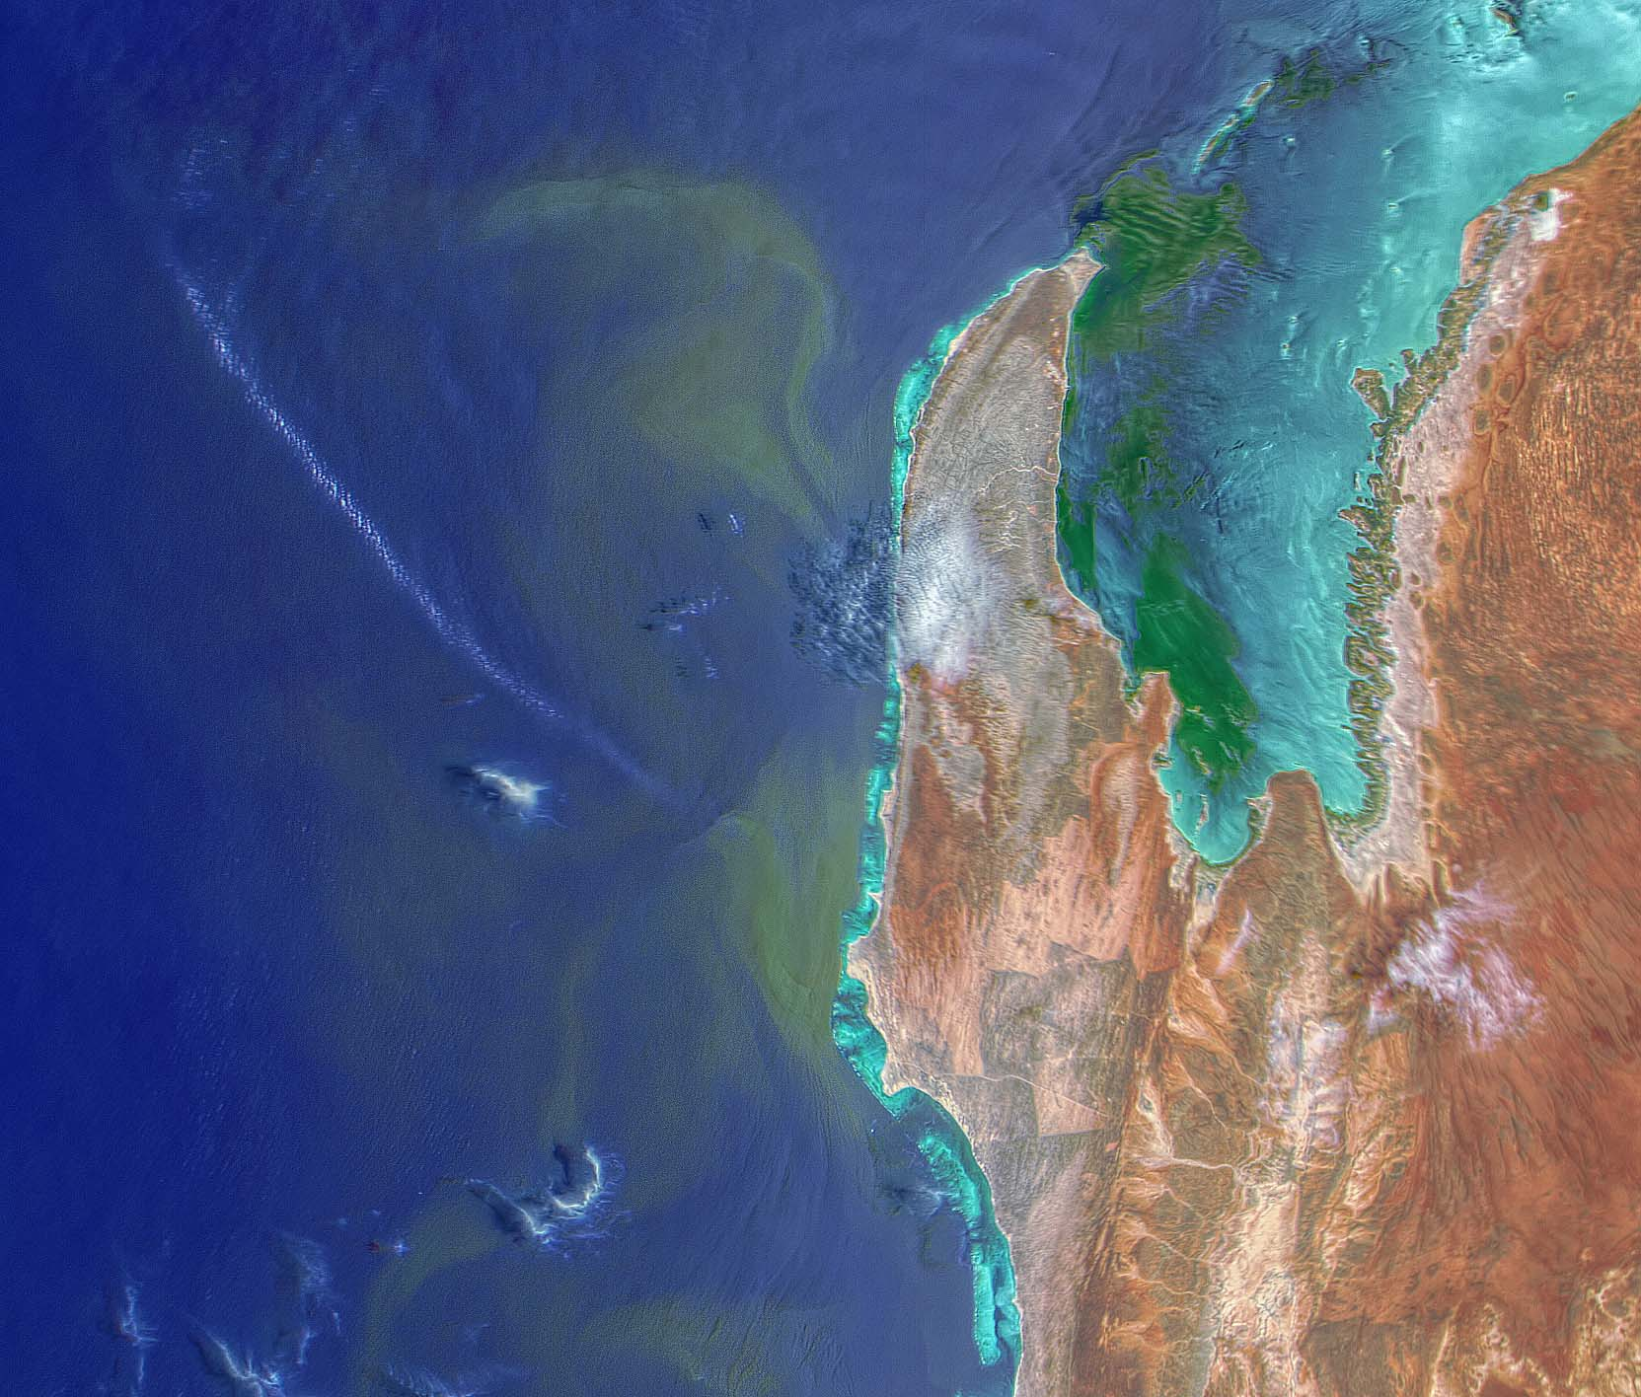
Exmouth
Western Australia

Slide 23
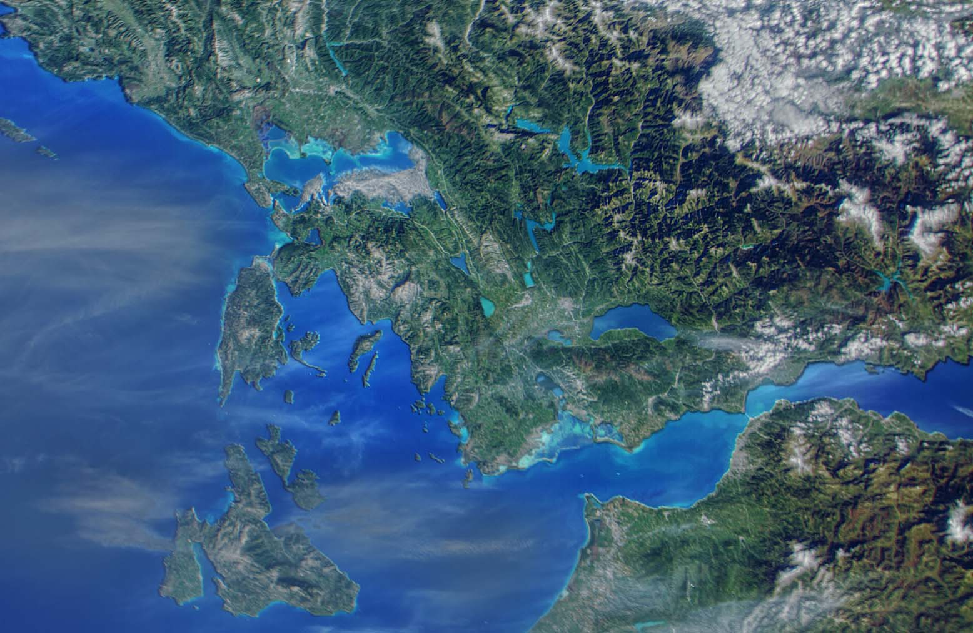
Western Greece

Slide 24
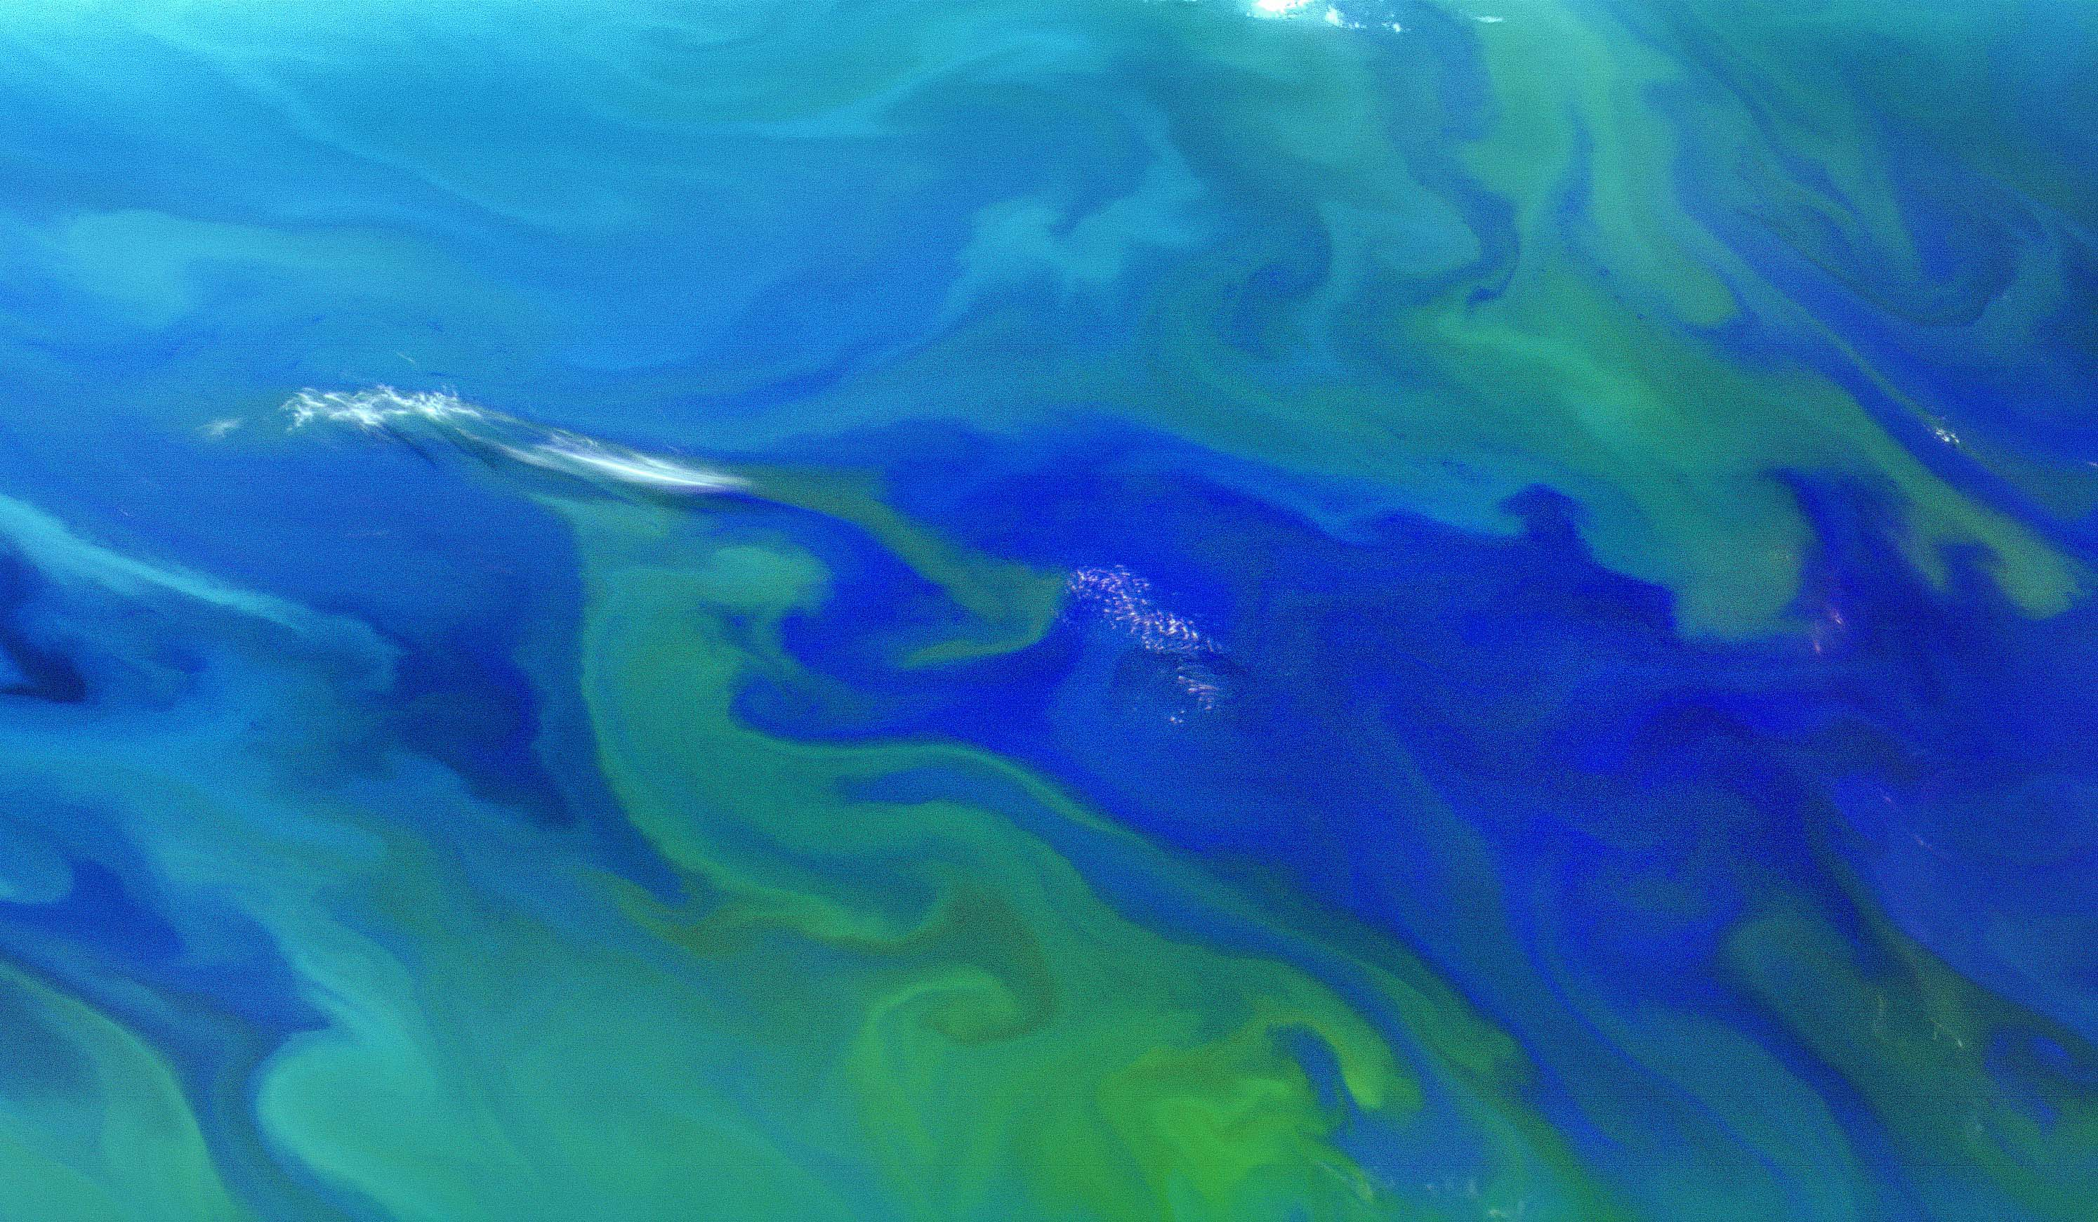
Chatham Rise
New Zealand

Slide 25
Current Status
Nearly 18 months of on-orbit operations
135 HawkEye images collected, downlinked and processed to Level-1a
27 successful x-Band data downlinks at NASA/Wallops (100mbps)
Automated data processing in place from downlink to Level-2
HawkEye instrument has shown no signs of on-orbit degradation
SeaHawk spacecraft has only lost 1 km of orbital altitude since launch.
No end of mission trends observed in spacecraft systems
As yet unresolved spacecraft stability issue believed related to the coupling between the onboard attitude sensors and the control system.
Chatham Rise
New Zealand

Slide 26
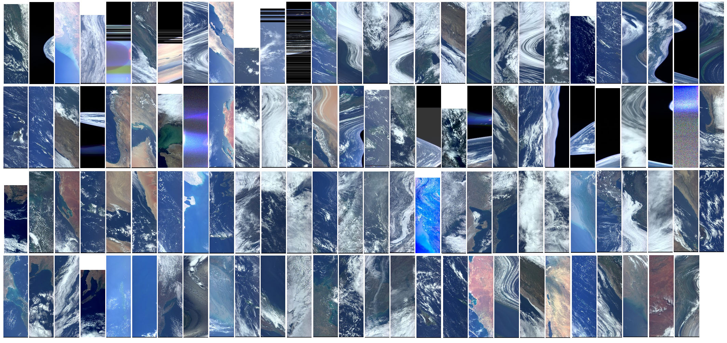
Chatham Rise
New Zealand

Slide 27
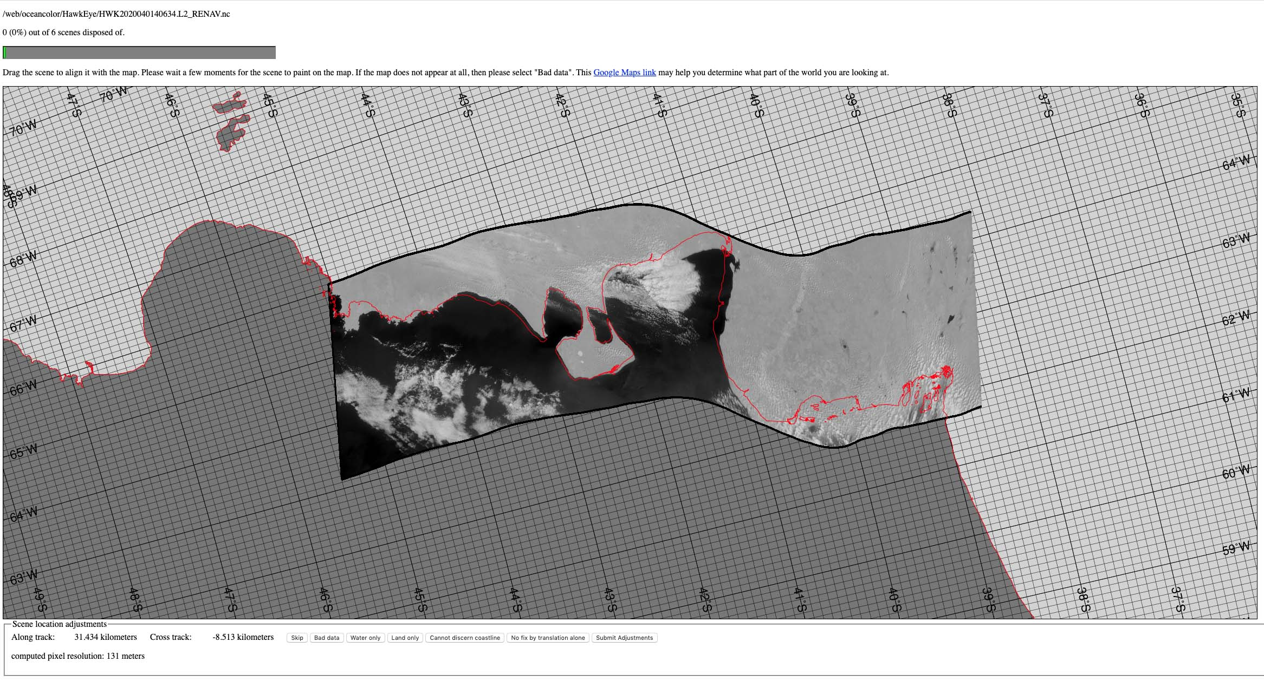
Renavigation tool to geolocate
imagery
Chatham Rise
New Zealand

Slide 28
NEXT STEPS
Identify and Verify Attitude Control root cause and implement required fix
Define revised Nominal Operations concept for SeaHawk-1
Verify and transition to Nominal Operations phase of mission
Begin soliciting image requests from the Community (see backup)
Release processing software in SeaDAS and data via OB.DAAC
Assemble all “Lessons Learned” from SeaHawk-1
  1. Hardware 2. Software 3. Concept of Operations 4. Testing
Develop workplan and schedule for SeaHawk-2 and path forward

Slide 29
HawkEye instrument fully assembled at Cloudland – California
and image from flight unit one scanning Santa Barbara
Finderscope Image 26 April 2016
5/27/20
29

Slide 30
BACKUP

Slide 31
INSTRUMENT DETAILS
The HawkEye Instrument is designed to capture an image of the oceans and earth with 120 meter per pixel resolution from a 575 km nominal orbit. Each image will have dimensions of 1800x 6000 pixels, 8 bands deep. The bands are similar to those used by the SeaWiFS instrument. The instrument is of push-broom design, with 4 linear array CCDs, each containing 3 rows of detectors, scanning the field of view as the satellite passes overhead. The instrument is designed to not saturate on either the land or clouds using a technique called bi-linear gain. The ground swath imaged will be approximately 216 x 720 km in extent (134 x 448 miles).
  Optical Design and Radiometric Considerations…
  Lessons from Prototype Testing…
  CCD University – How to implement a CCD…
  Mechanical Design…
  Electronics Design…
  Software Implementation…
HawkEye instrument fully assembled at Cloudland – California
and image from flight unit one scanning Santa Barbara
5/27/20
31
Presentations available at: http://cloudlandinstruments.com/?page_id=188

Slide 32
NONREIMBURSABLE SPACE ACT AGREEMENT BETWEEN
NASA/SMD and UNIVERSITY OF NORTH CAROLINA AT WILMINGTON
EFFECTIVE DATE 6/1/2017 EXPIRATION DATE 6/1/2022
  NASA Responsibilities:
  Mission Planning & Integration and NEN
  Coverage and loading analyses
  Networks Documentation and Reviews
  RF Compatibility Testing and Reports
  On-Orbit Services
  NEN Aperture Fees are based upon 4 passes per day
  NEN Mission Configuration and Test Services
  Ocean Biology Processing Group
  Prelaunch advisors to the HawkEye instrument and SeaHawk cubesat
  Develop Level 0-to-2 processing software
  Pre-launch characterization of the Hawkeye with Cloudland Instruments
  Instrument scheduling procedures with Clyde Space
  Downlink scheduling with NASA/NEN
  Data processing of the SeaHawk
  Archive and distribution of SeaHawk data to the research community
  Code 618 Calibration Facility
Use of NASA Portable integrating sphere for pre-launch calibration

Slide 33
135 Targets imaged by HawkEye
Monterey Bay
North Carolina Coast
India (Mumbai)
Cape Horn
Long Island
Tasmania
San Francisco
Gulf of Suez
Puerto Rico
Baja California
Flores Sea
Rio de la Plata
Southern CA
Gulf of Mexico
Lake Maracaibo
Cuba and Jamaica
New York Bight
Mid-Atlantic
South Atlantic Bight
Scotland
MOBY
Scotland
Lake Titicaca
Scotland
Scotland
Scotland
Lake Michagan
Samoa
West Coast Australia
Buenos Aires
Nova Scotia
India, Gulf of Khambhat
Catalina Islands
Yangtse River
Crete
Gulf of Maine
Eastern Long Island
MOBY
Townsville Australia
Galapagos
Ireland Northern Scotland
Lake Atitlan Guatamala
San Franciso and Monterey Bay
Outer banks
Chesapeake
Florida
Hawaii
MOBY Hawaii
Lake Titicaca
Galapagos
Eastern Med.
strait of Hormuz
Caspian Sea
Chesapeake
Western Australia
French Polynesia
Cook Straight - New Zealand
Java Sea
Red Sea
Cuba - Jamaica
Fiji - Center
Zaire Congo River
Fiji - West
Java Sea
Lake Malawi
Gulf of Aden (UFOs)
Peru Upwelling
Tahiti
Gulf of Aden
Cook Straight
Bangladesh
Panama
Ganges
Congo River
Ganges
Vietnam
Southwest Australia
South Africa
southwest australia
south georgia
Torres Straight
Shark Bay
Bali Sea
Gulf of Aden
Namibia
Bora Bora
Argentina
Aegean Sea
Chesapeake Bay
Christmas Island
Kerguelen Island
Orinoco Delta
Great Barrier Reef
Cameroon
Lake Baikal
Gulf of Khambhat
Western Nova Scotia
Valdes Peninsula
Baleric Sea
Gold Coast Australia
Sydney Australia
Ganges Mouth
Greece
San Franciso Bay
Japan
Red Sea
Big Island Hawaii
Sri Lanka
Adelaide Aust
Falklands
Spencer Gulf Aust
Western Black Sea
Andaman Islands
Cook Straight
Long Island Sound
Fraser Island Aust
Ganges
Samoa
Gulf of Tehuantepec
Kodiak
Gulf of Carpentaria
Tasmania
English Channel
Chesapeake Outer Banks
Big Island Hawaii
Samoa East
Northwest Australia
Southern Florida
Lake Titicaca
Israel – Jordan
French Polynesia
Coastal Peru
Gulf of Khambhat
Ayres Rock Aust
San Francisco
Chatham Rise
New Zealand

Slide 34
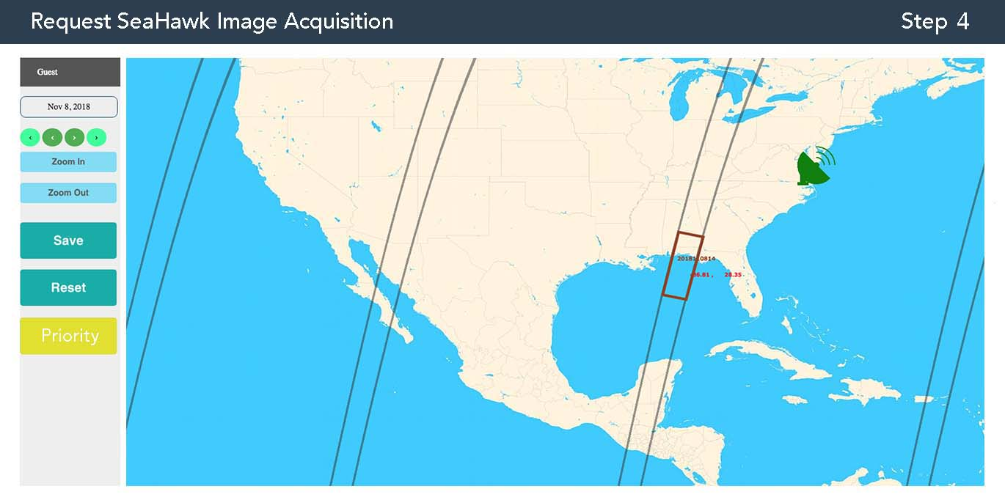
Image Acquisition Requests
https://uncw.edu/socon/image_request.html
Chatham Rise
New Zealand

