Slide 1
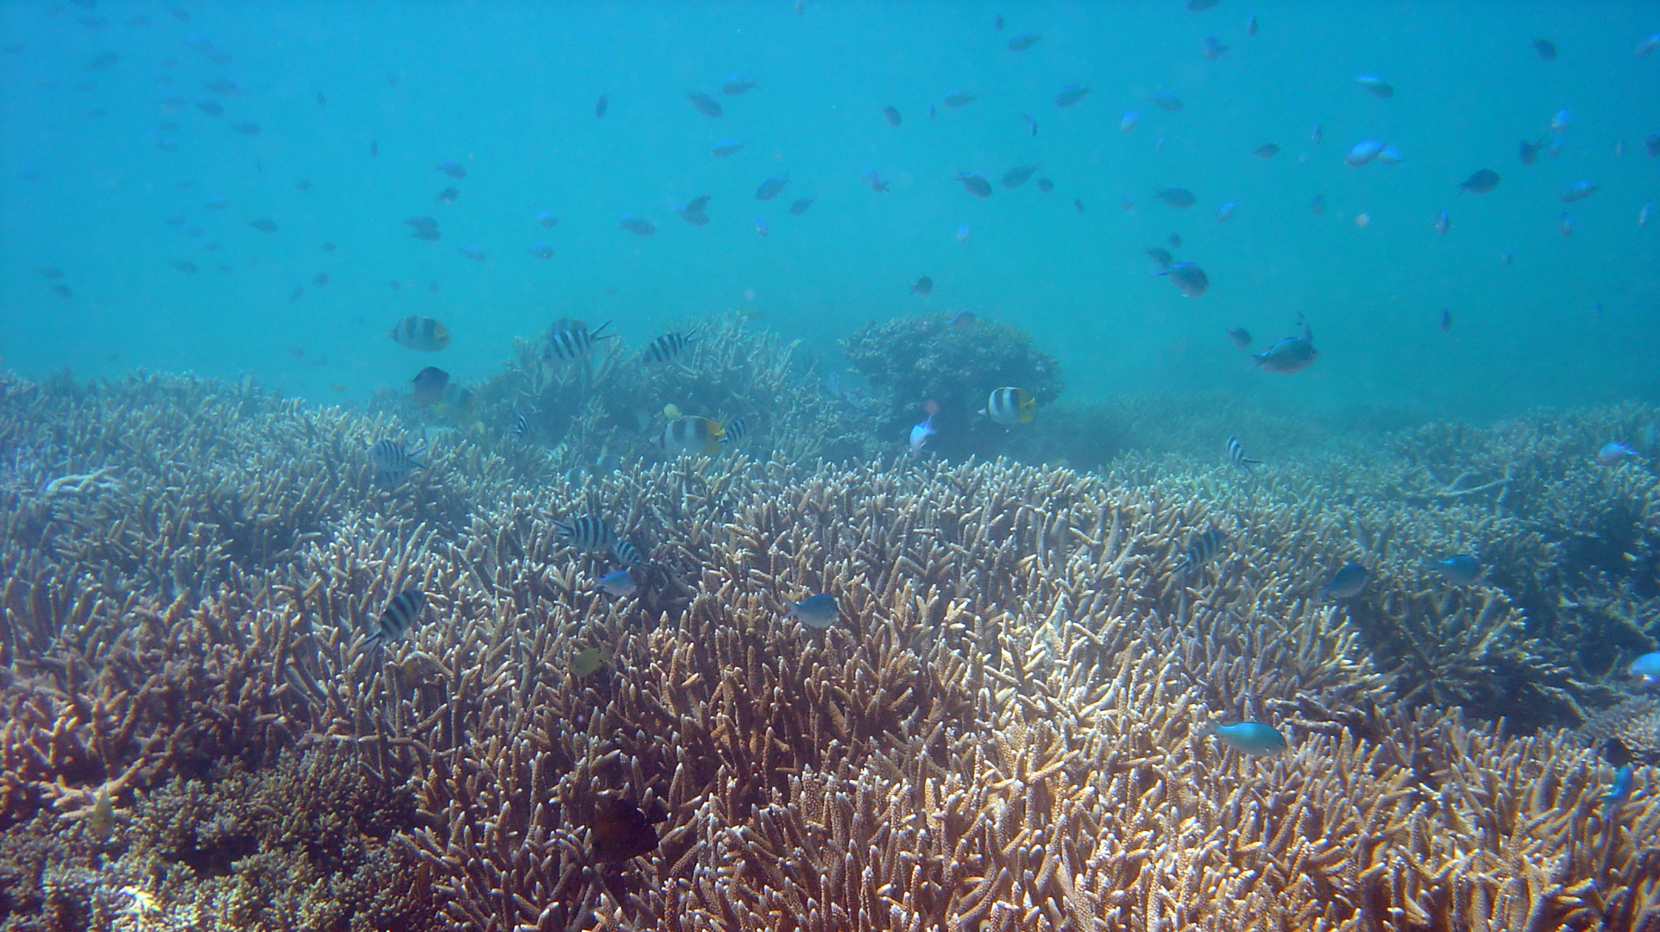



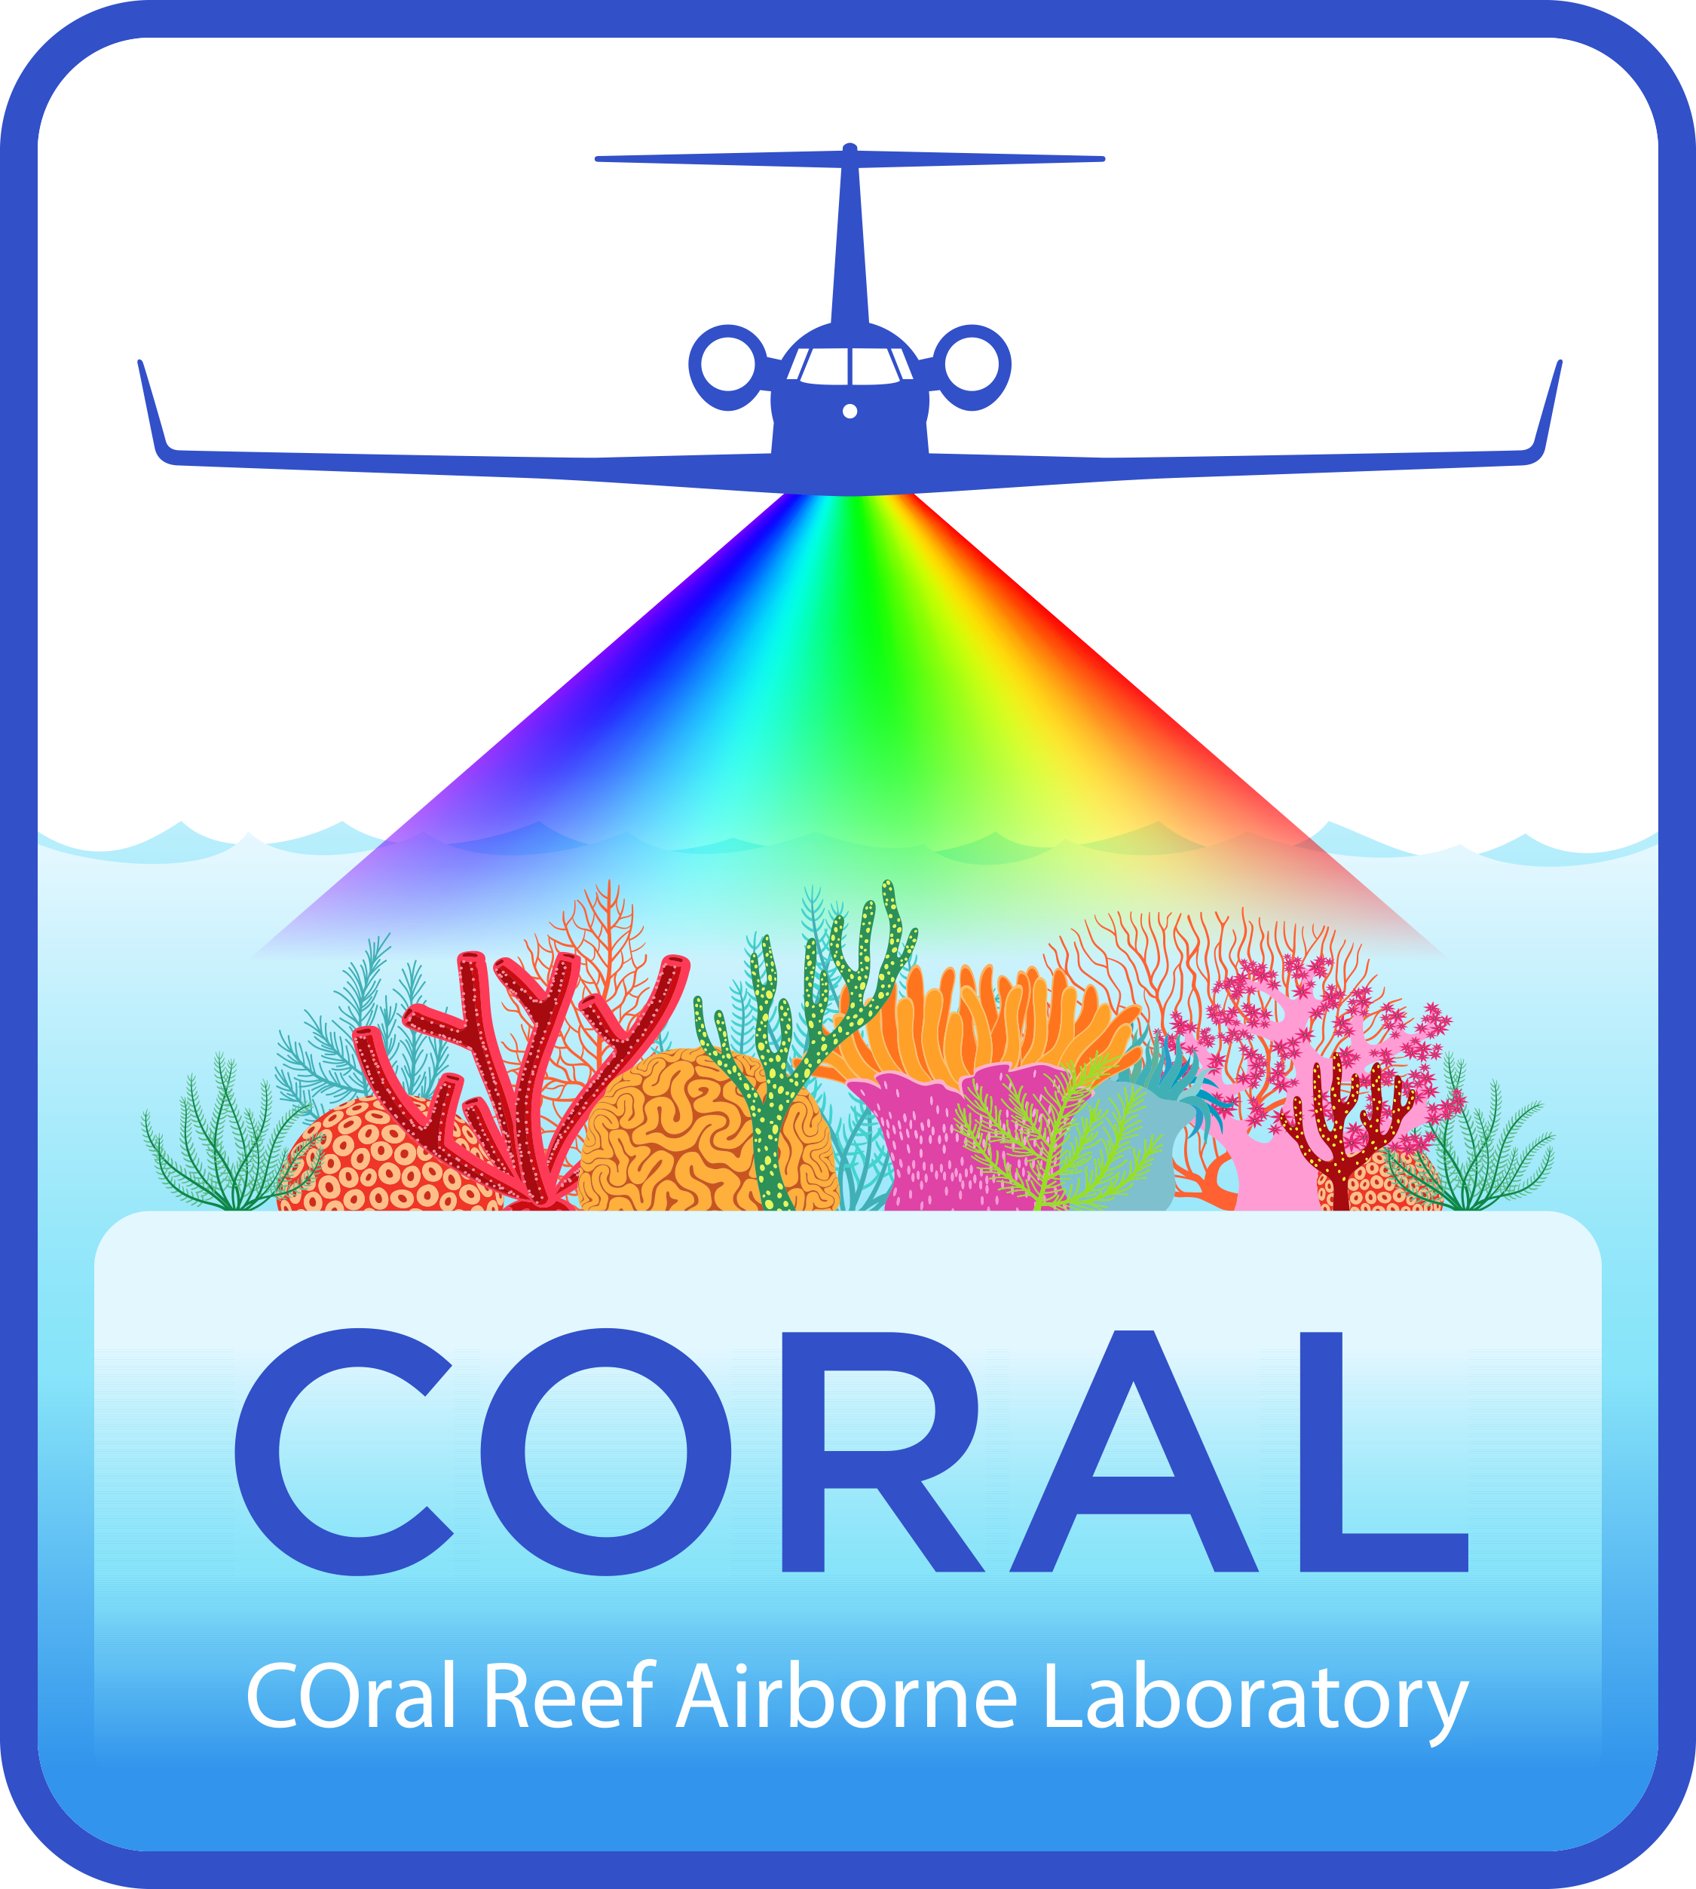
Principal Investigator:
Eric J. Hochberg (BIOS)
Project Manager:
William Mateer (JPL)
Michelle Gierach (JPL)
Project Scientist:
Michelle Gierach (JPL)
EVS-2 Mission Manager:
Jennifer Olson (LaRC)
Program Scientist:
Paula Bontempi (NASA HQ)
Data Availability

Slide 2
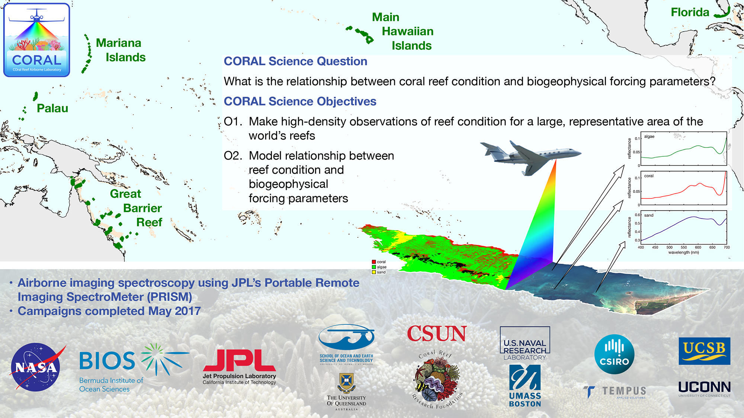

Slide 3
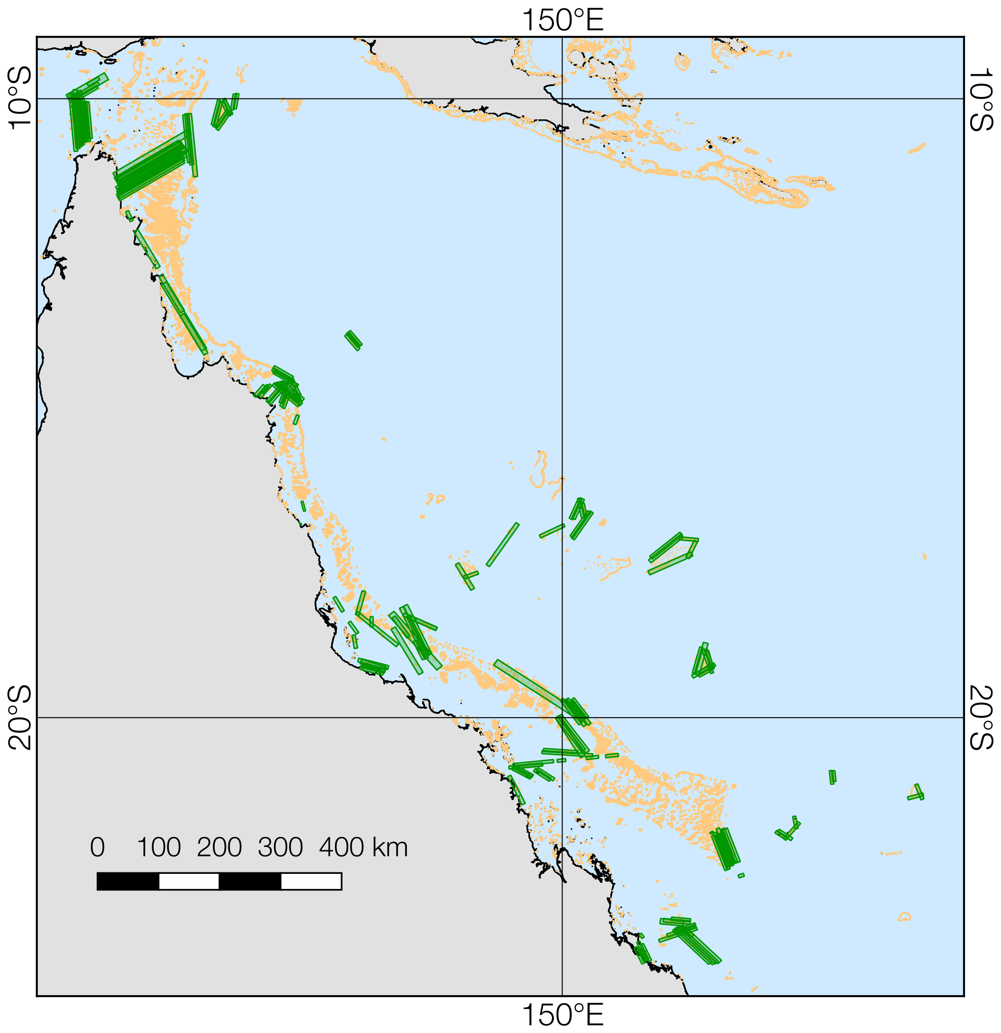
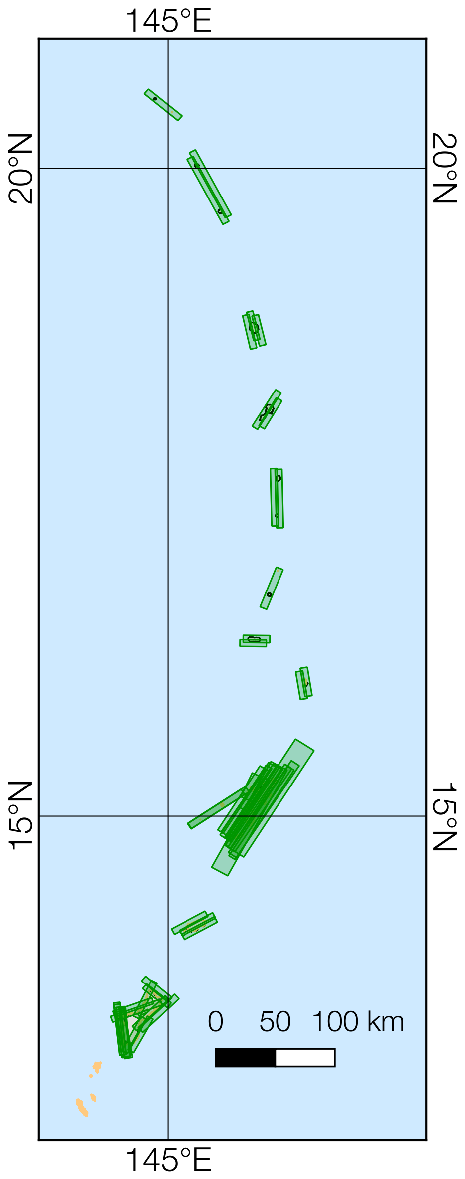
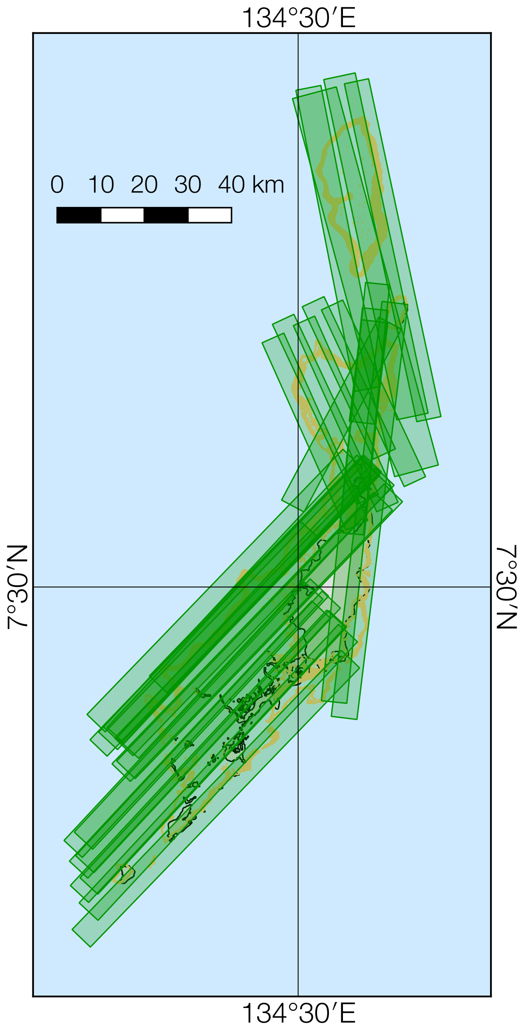

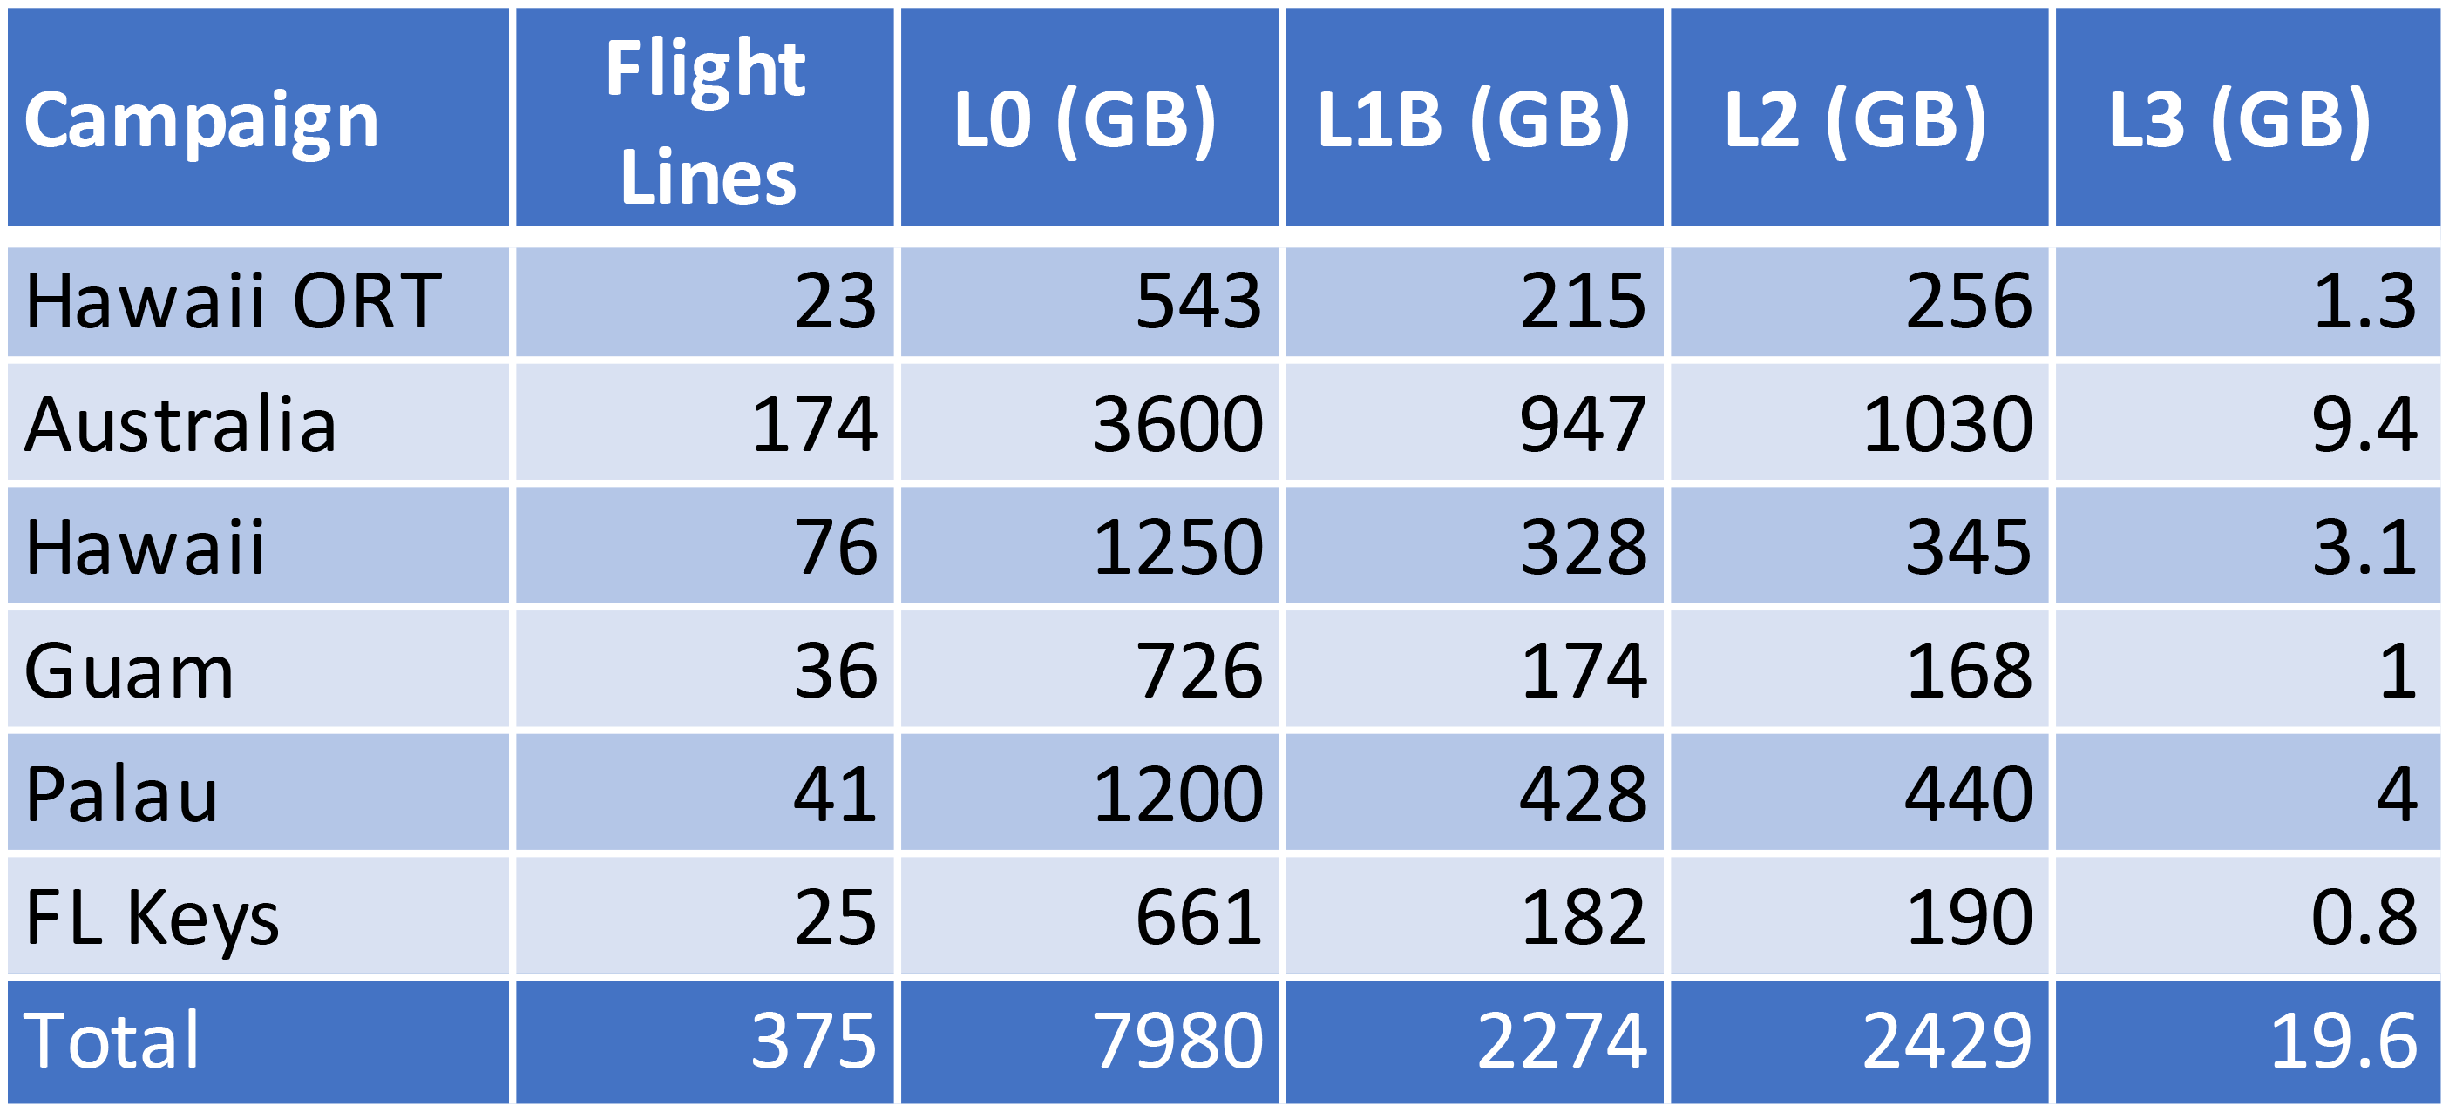
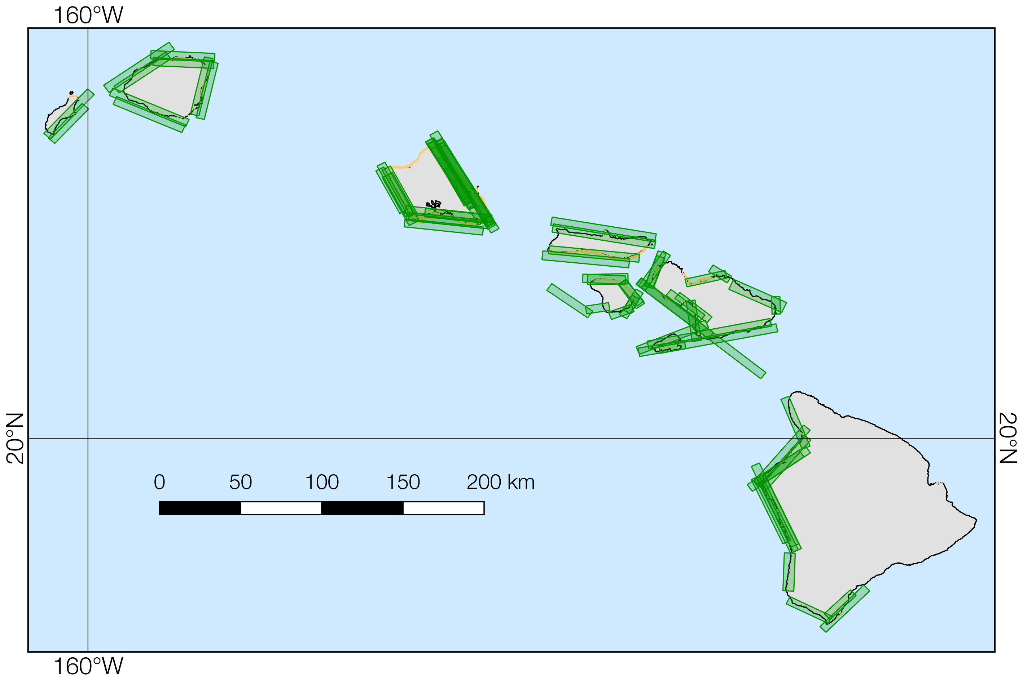
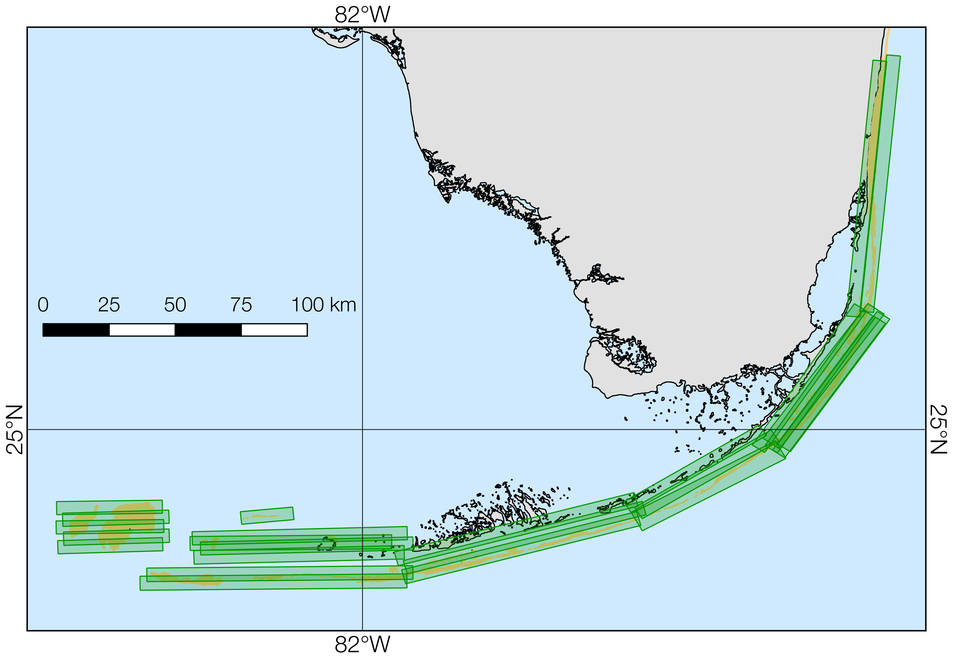
O1: Make high-density observations of reef condition for a large, representative area of the world’s reefs
Sep–Oct 2016
Apr 2017
May 2017
• All data publicly available!
Earth Surface Coverage
• 74,756.41 km²
Reef Coverage
• 10,000 km² (est.)
• ~2% world reef area
In-Water Validation
• All campaigns except Florida
Feb–Mar 2017
May 2017

Slide 4
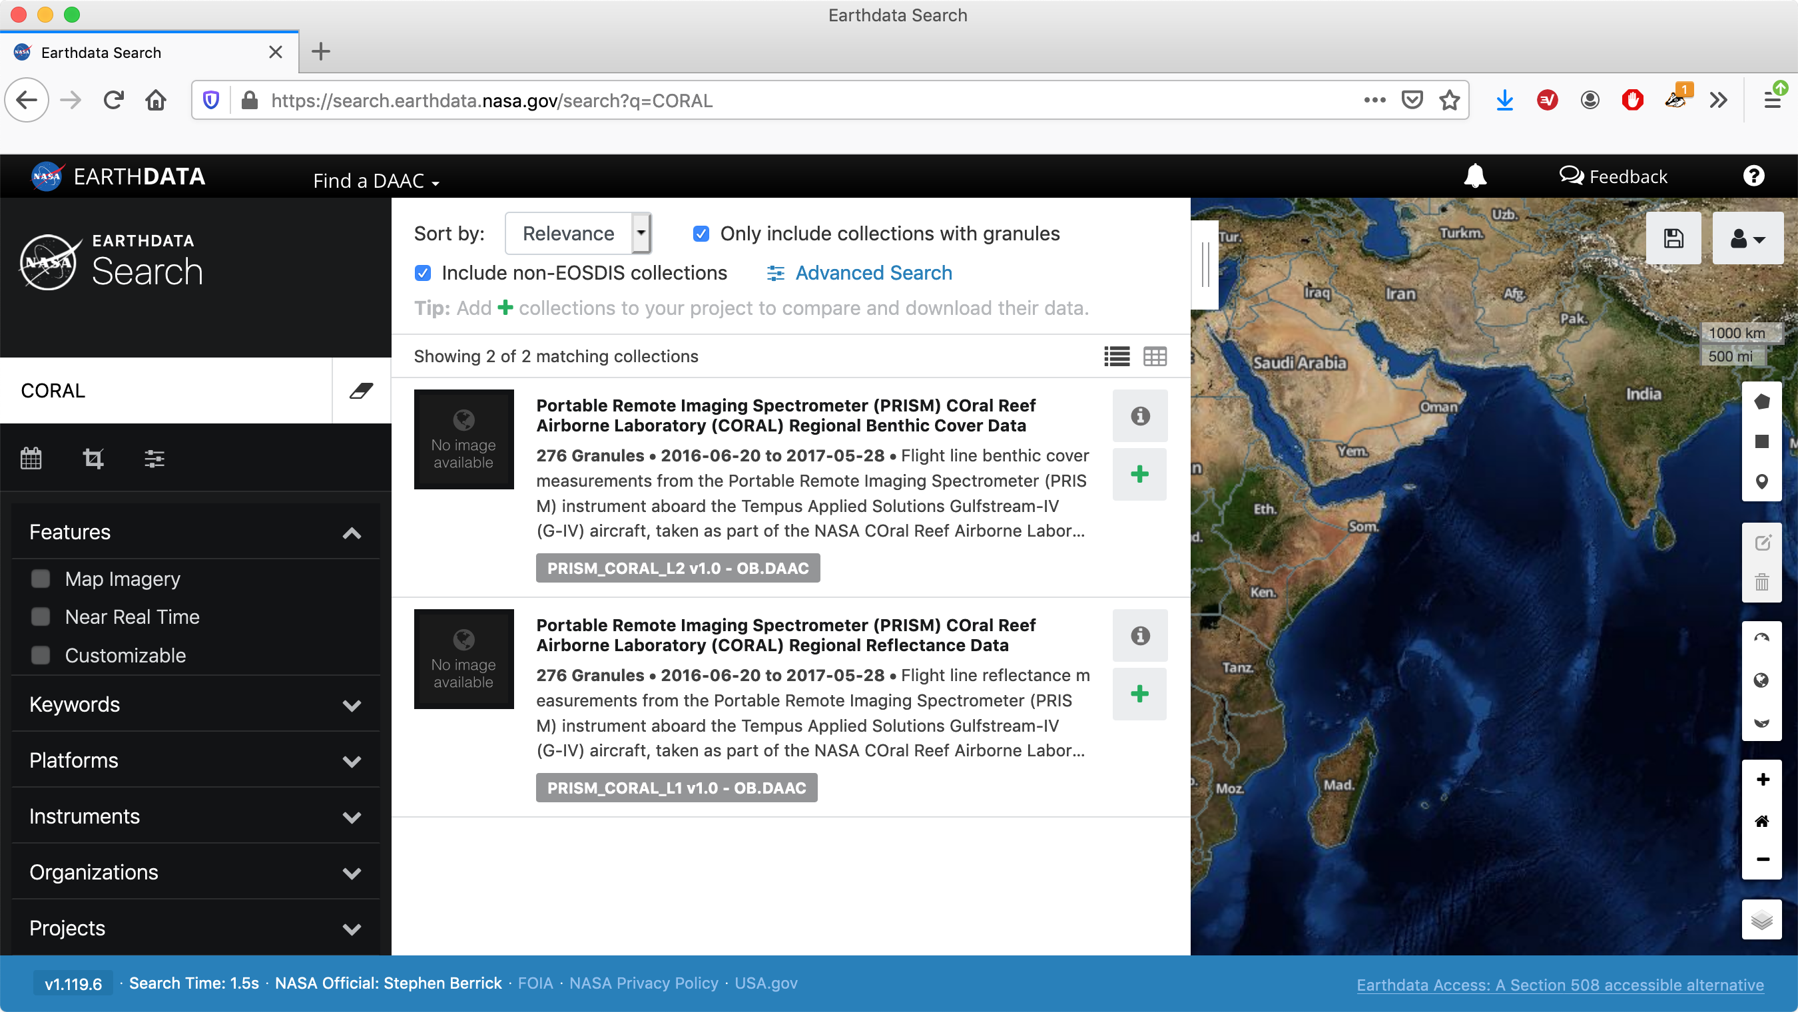

Slide 5
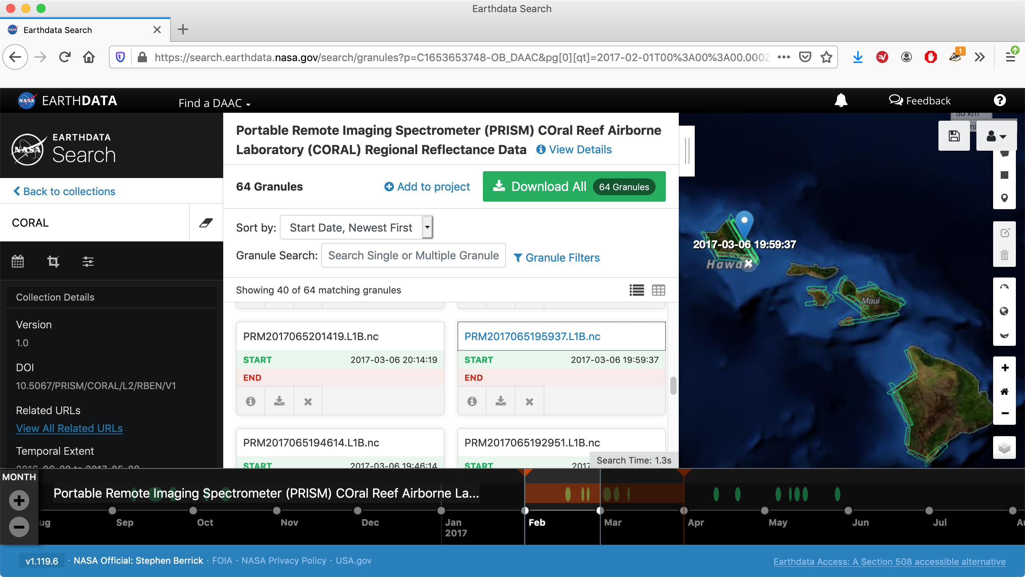

Slide 6


Slide 7
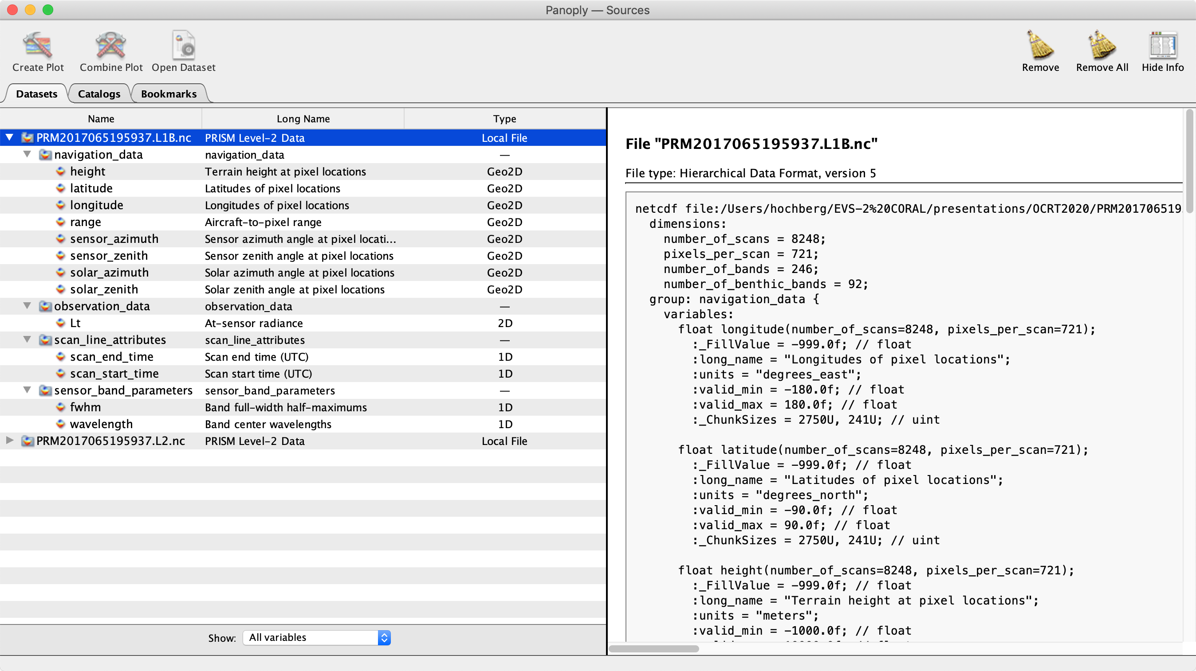

Slide 8
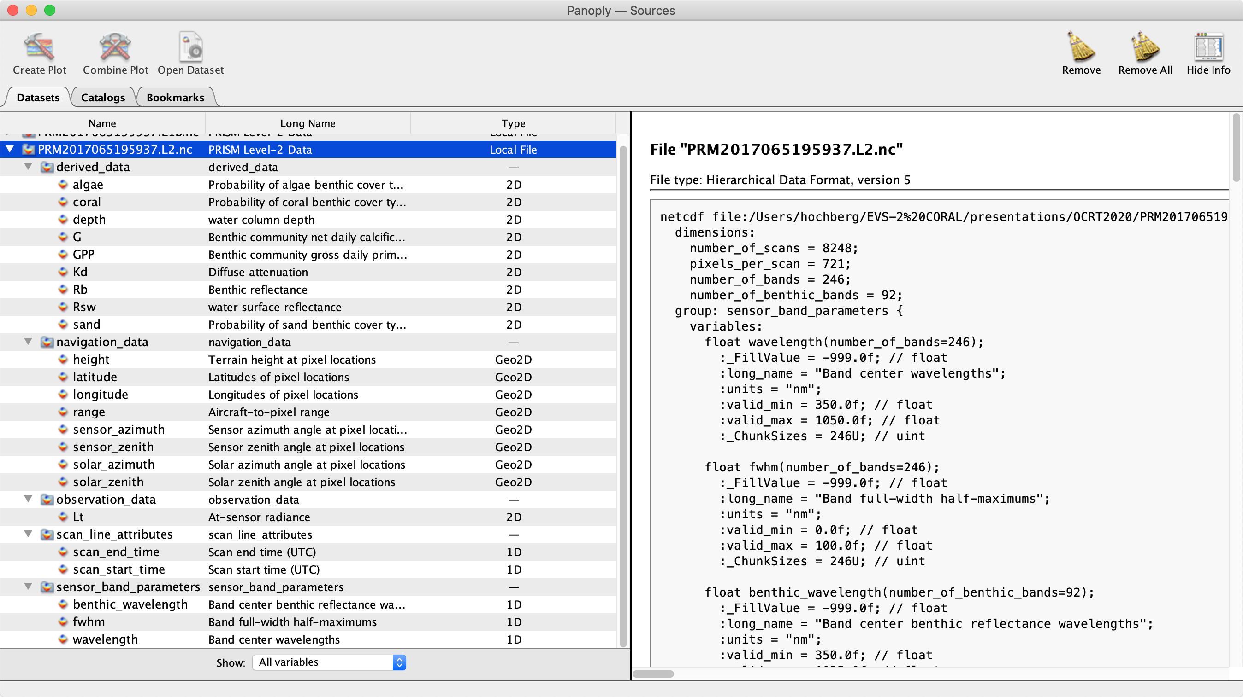

Slide 9
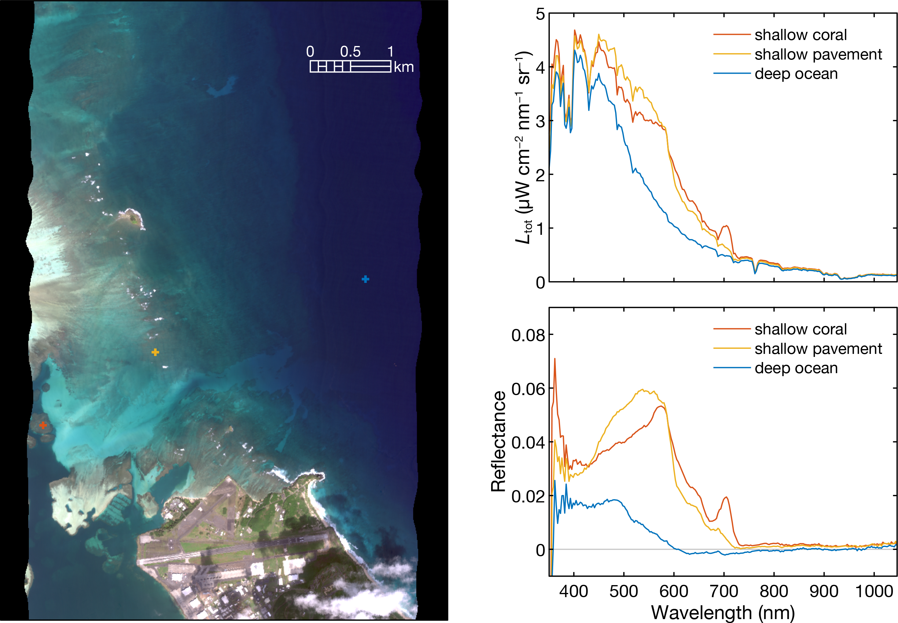
At-sensor radiance
&
Water-surface reflectance
Kaneohe Bay

Slide 10
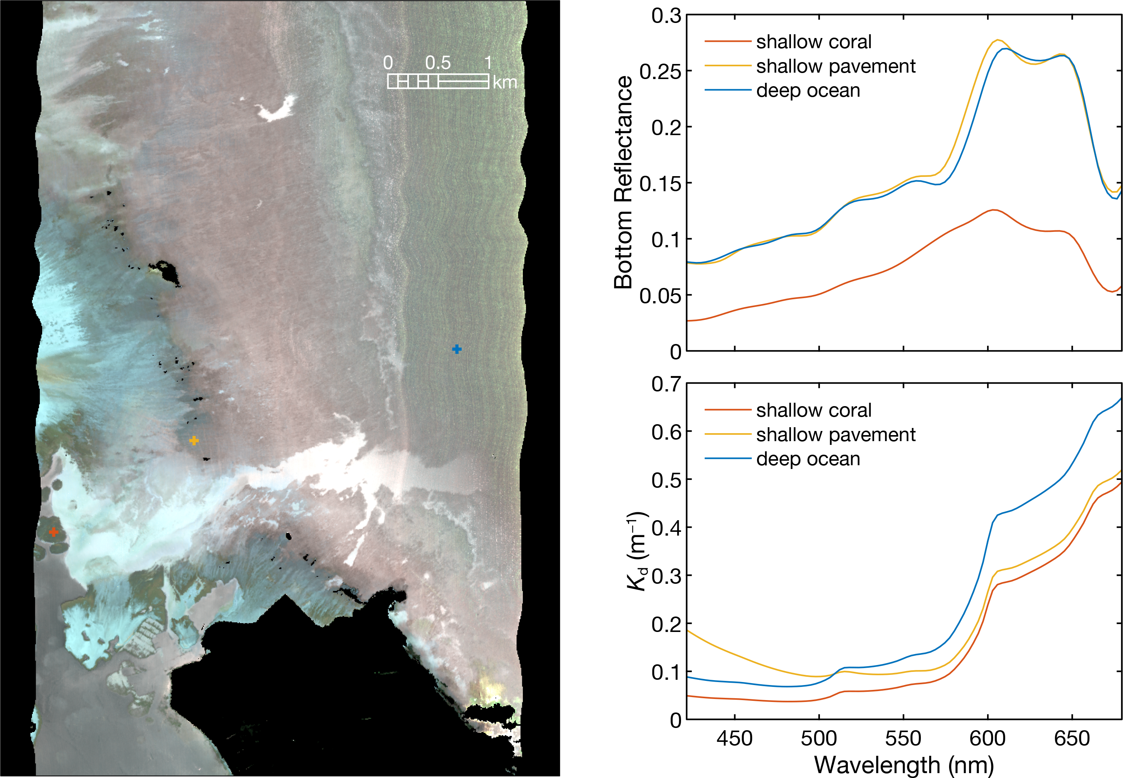
Derived Bottom reflectance
&
Diffuse attenuation
Kaneohe Bay

Slide 11
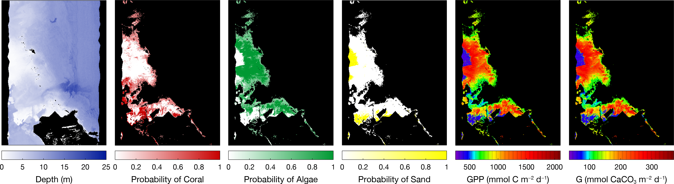
More Derived Products
Kaneohe Bay

Slide 12
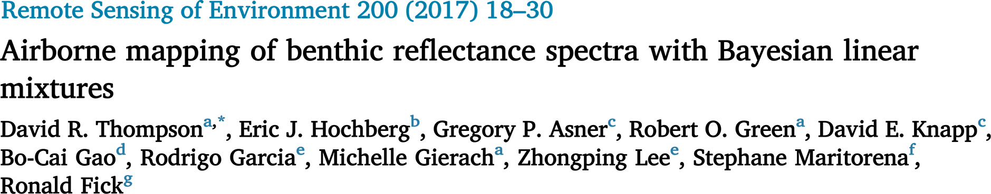
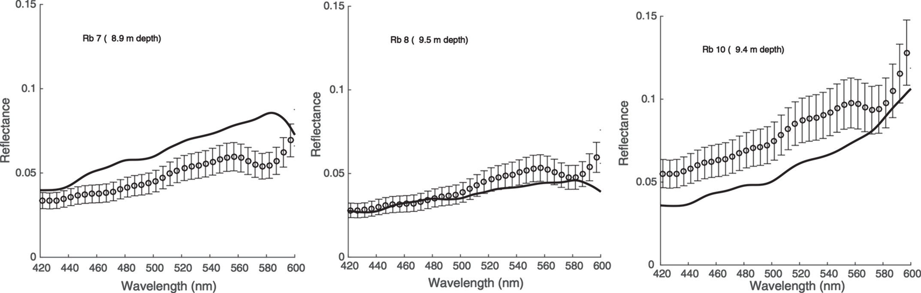
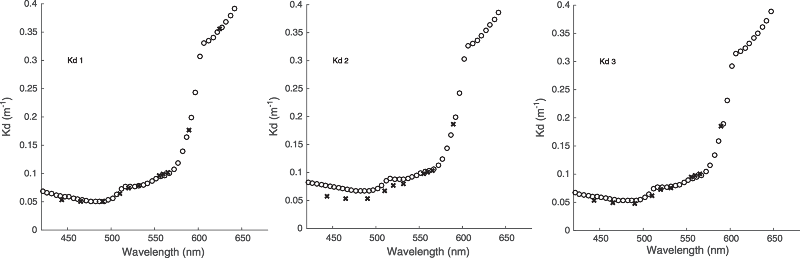

Slide 13
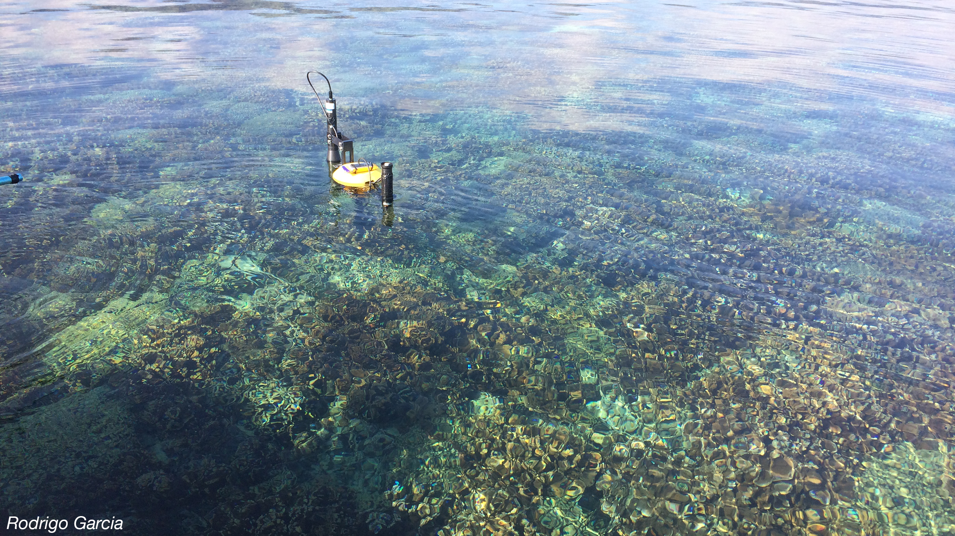
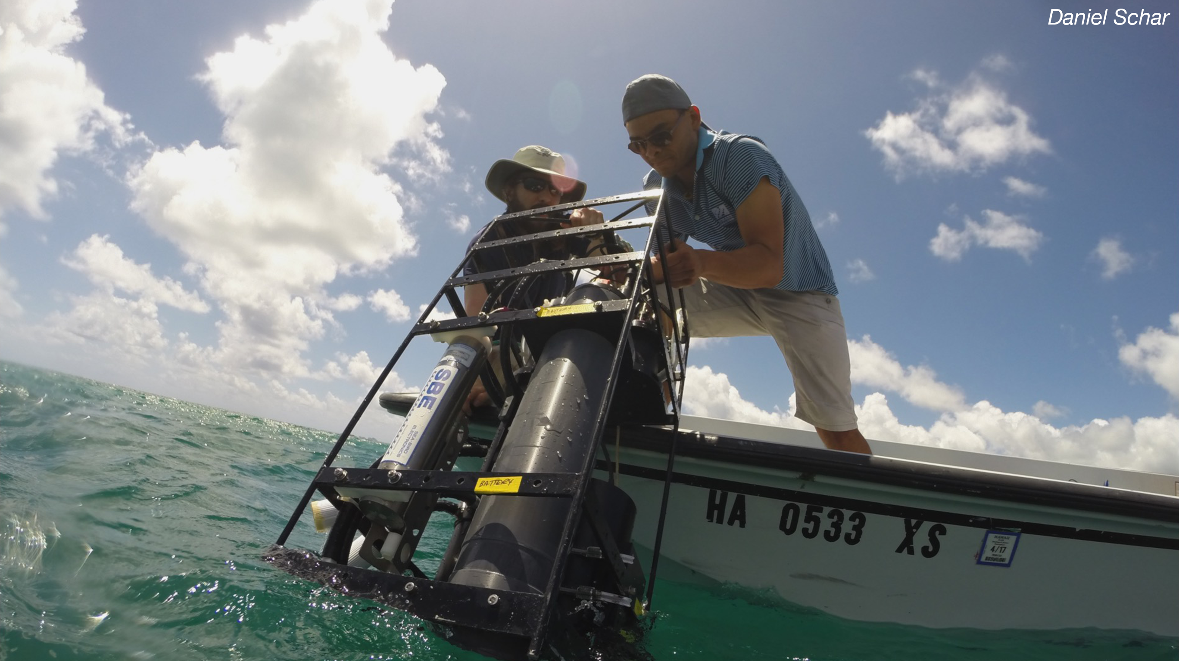
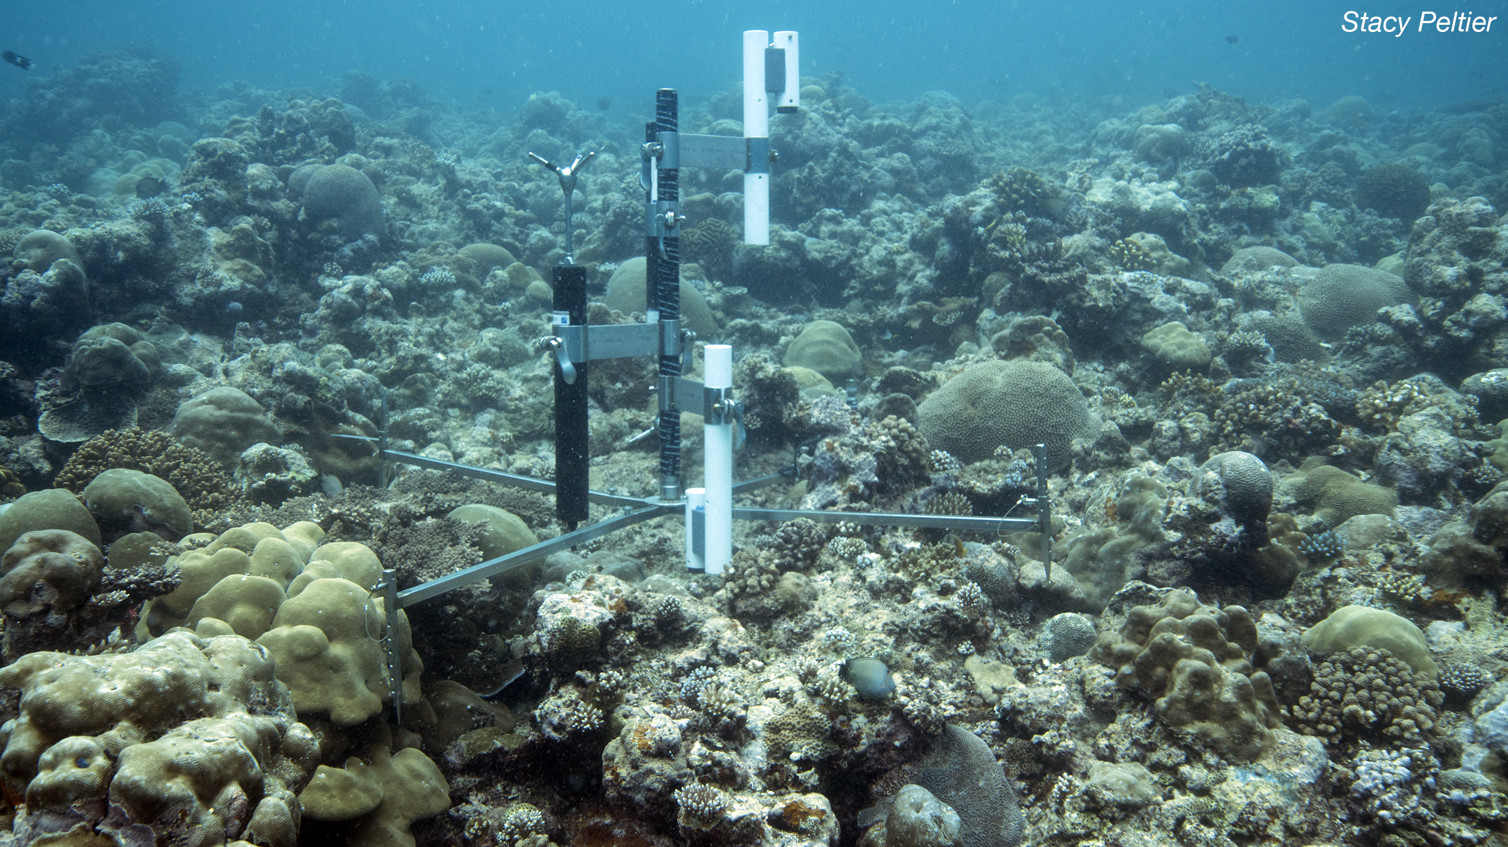
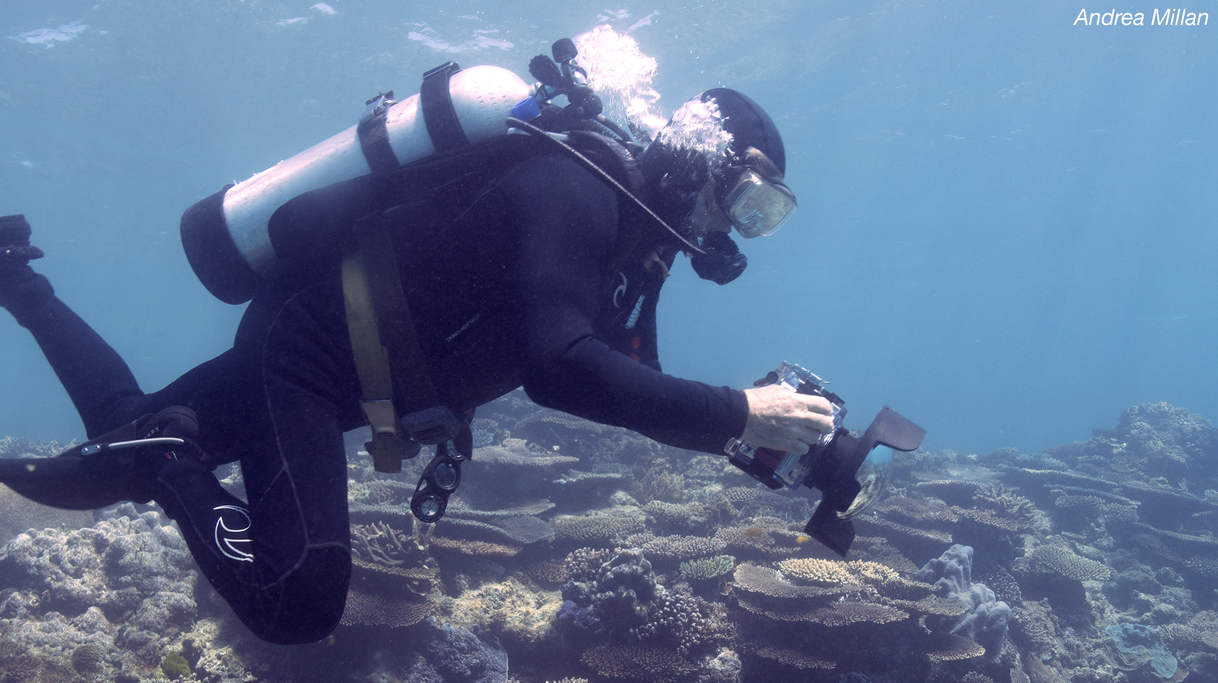
R_{rs}
• Water-leaving radiance
• Downwelling irradiance
>> Atmosphere correction validation
Water IOPs
>> Water column correction validation
Community Metabolism
>> Reef function validation
Photomosaics
>> Benthic cover validation

Slide 14
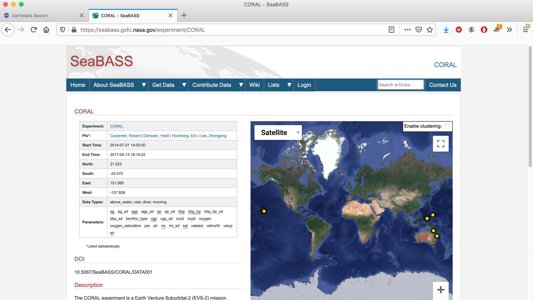

Slide 15
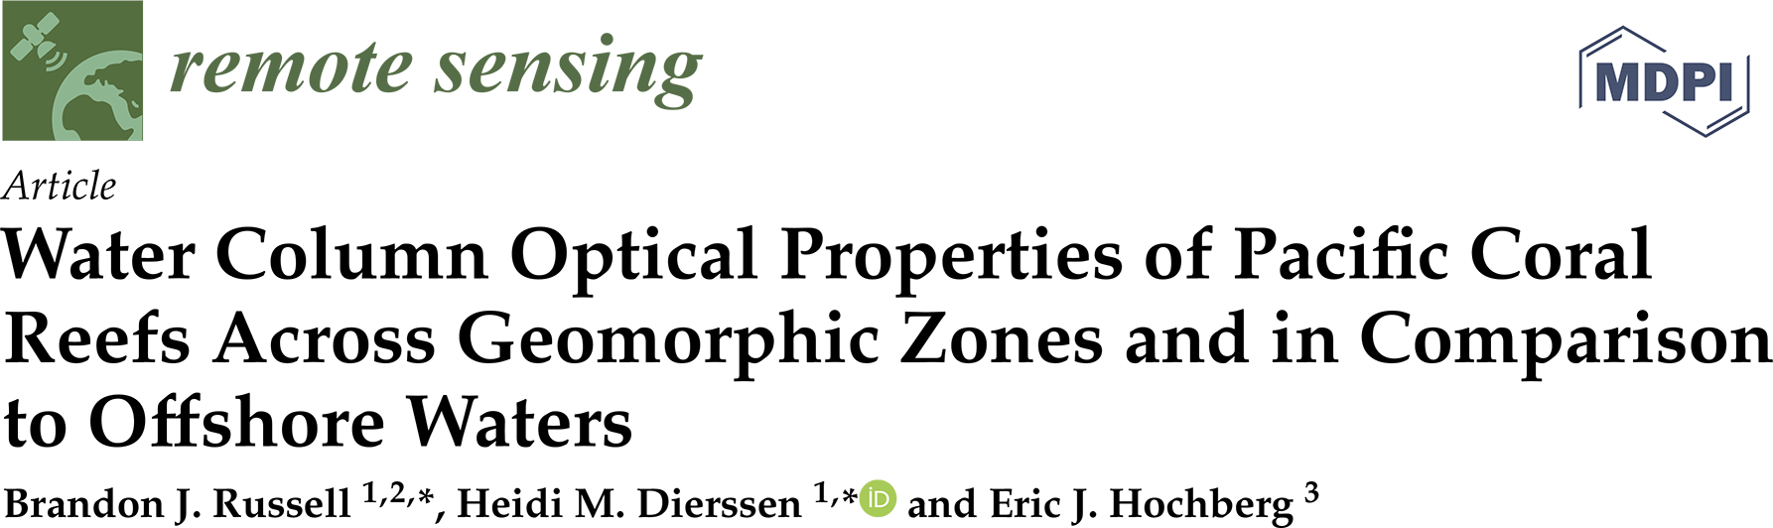
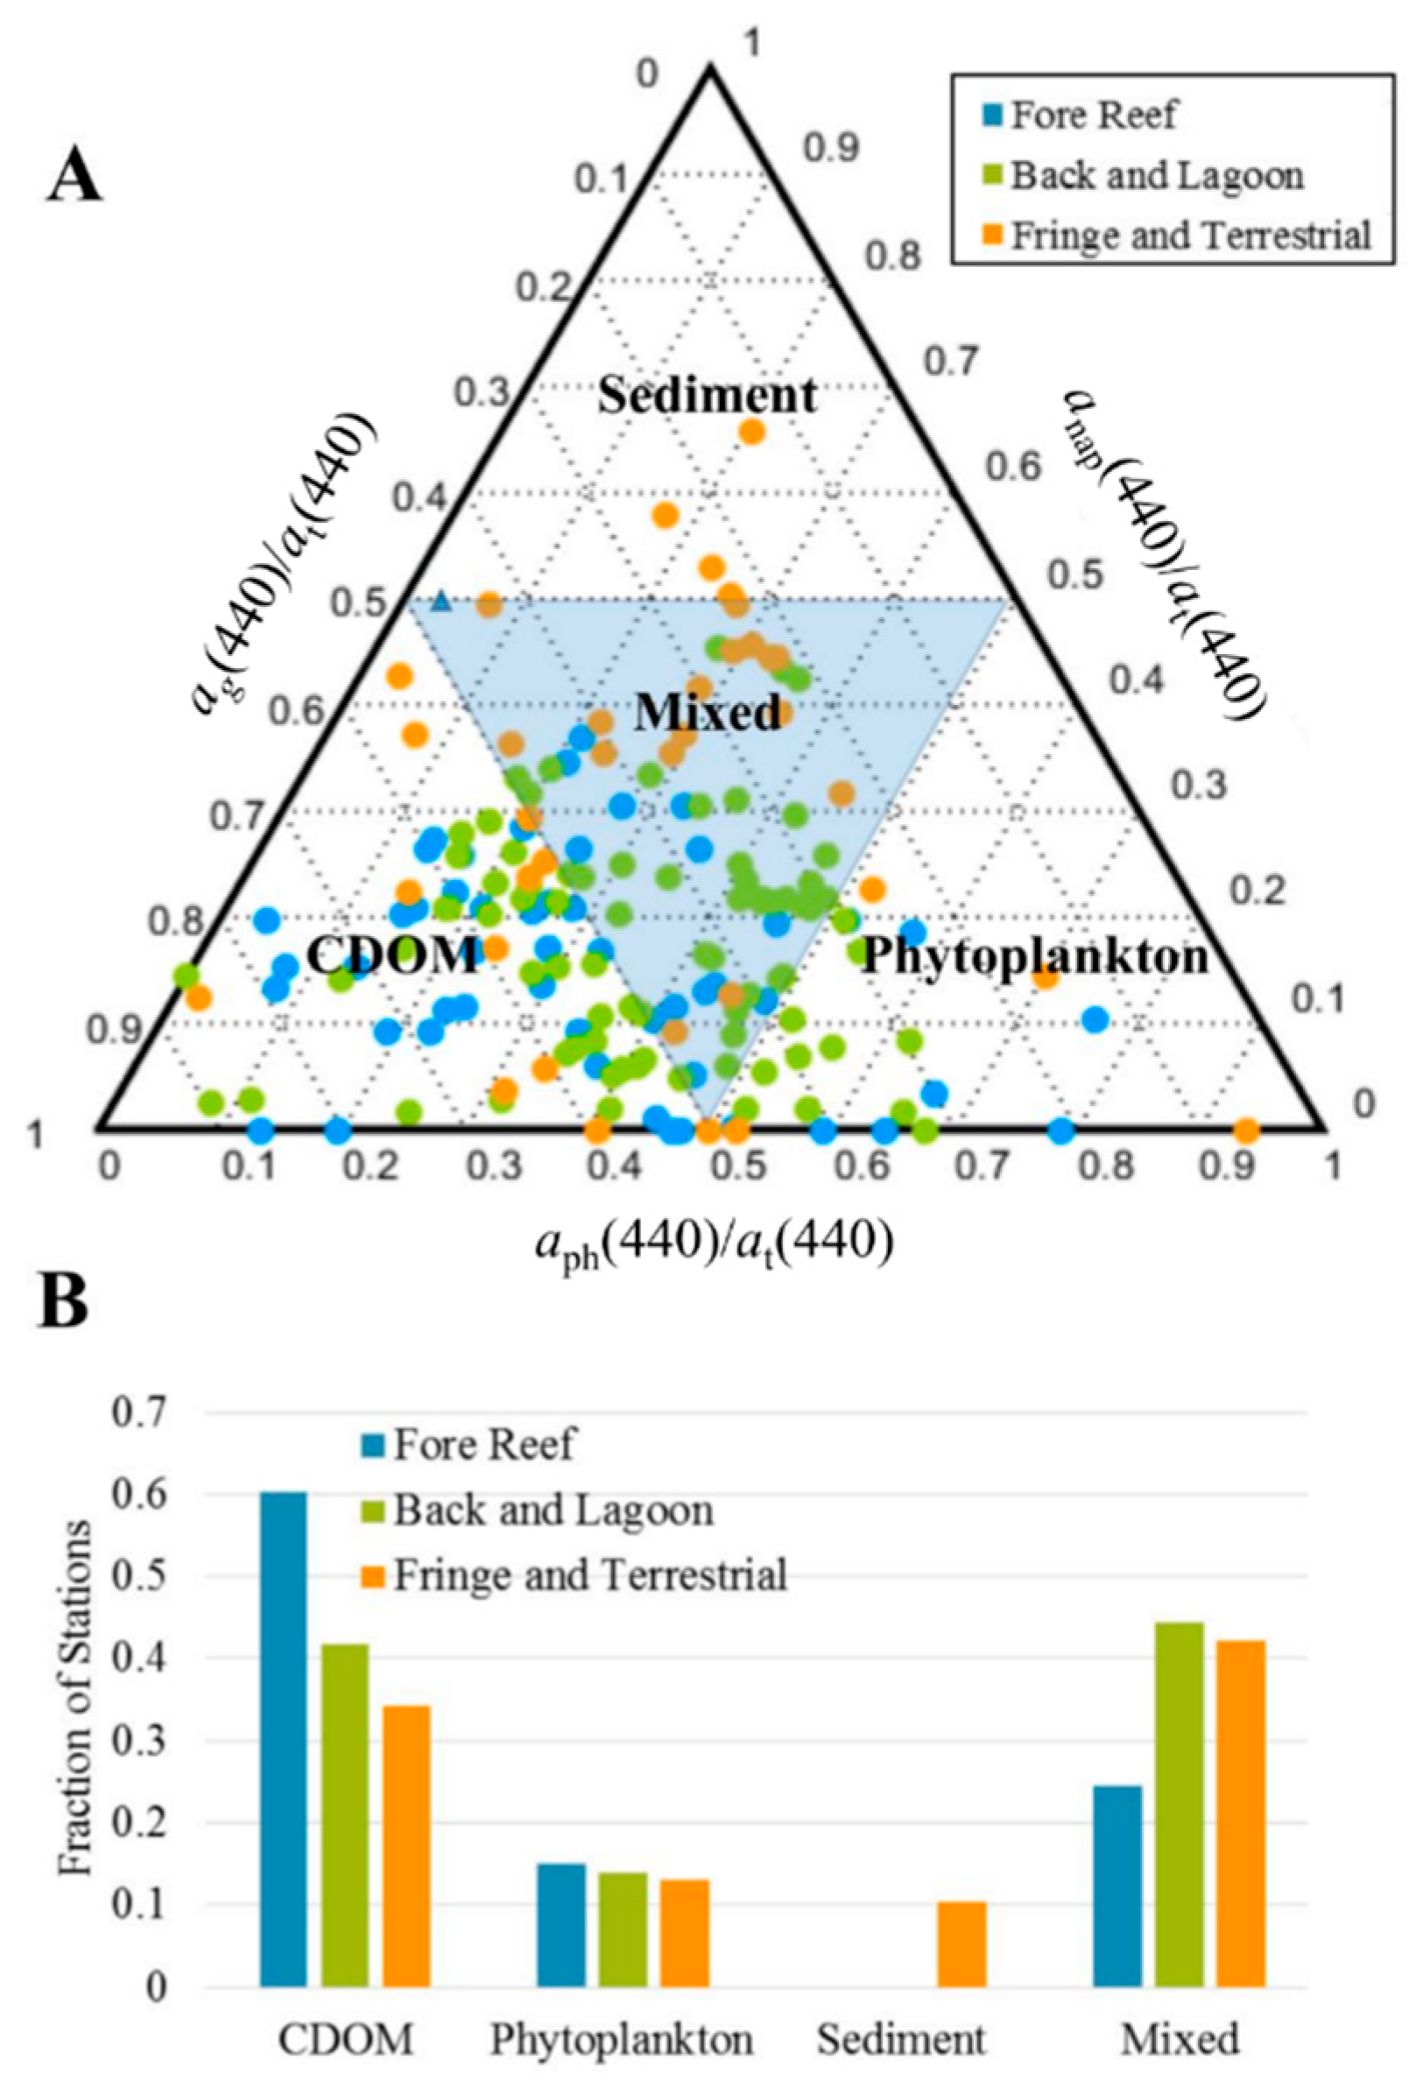
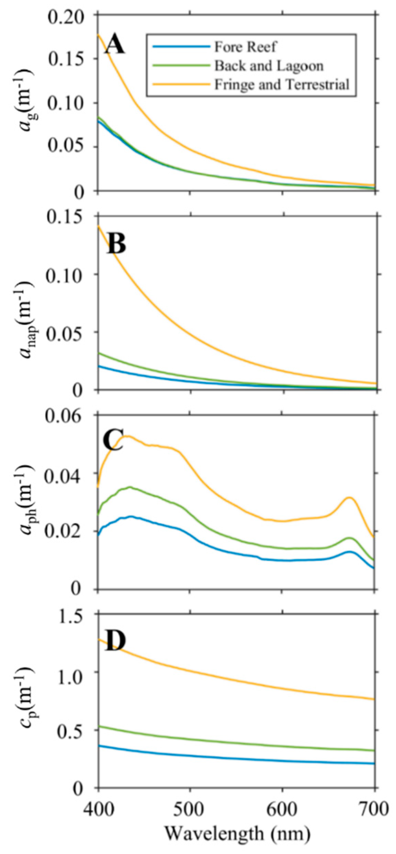
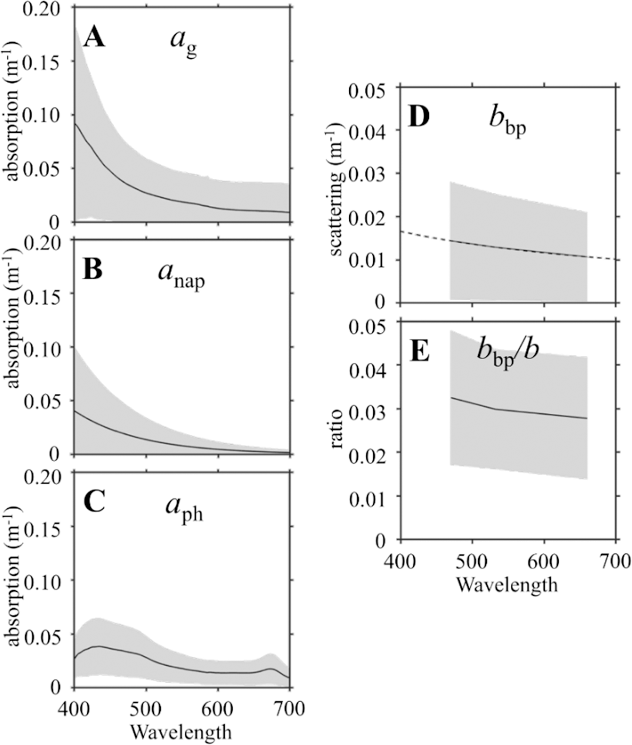

Slide 16
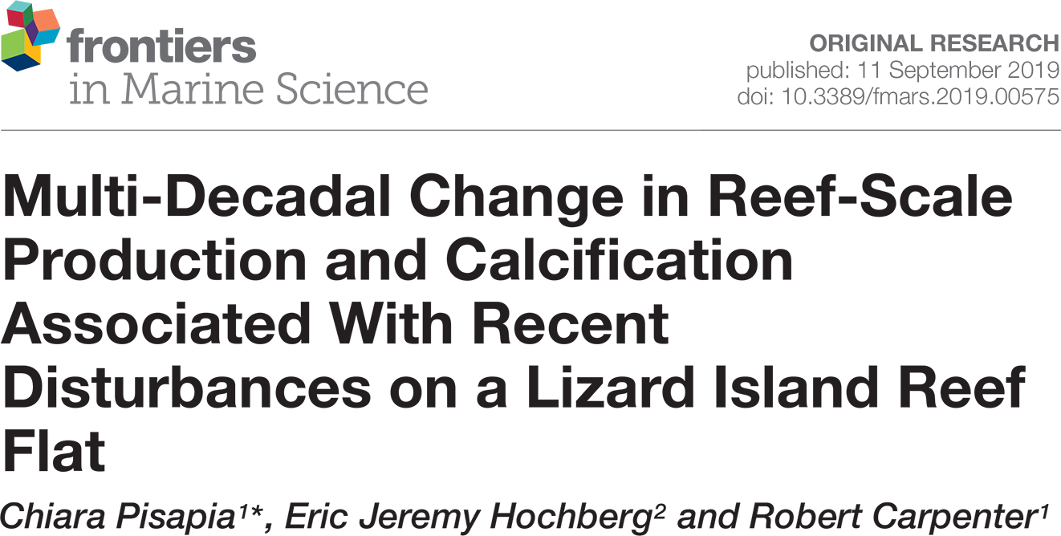
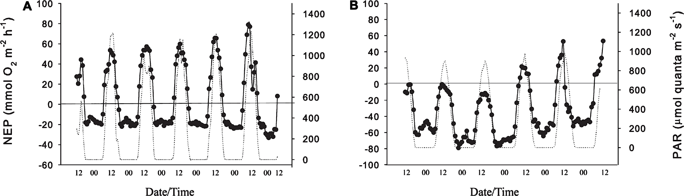
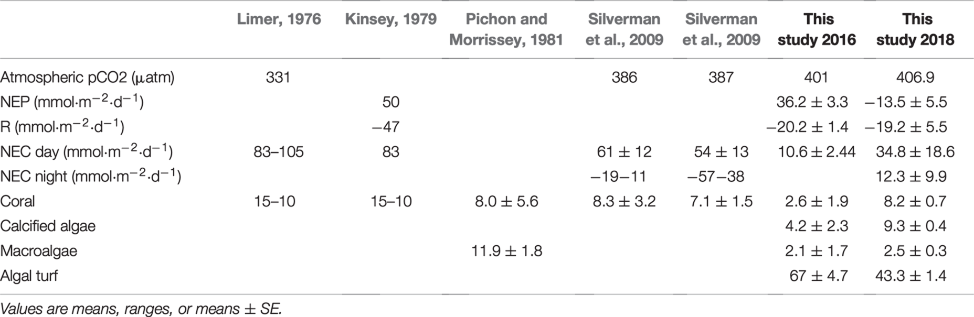
CORAL

Slide 17
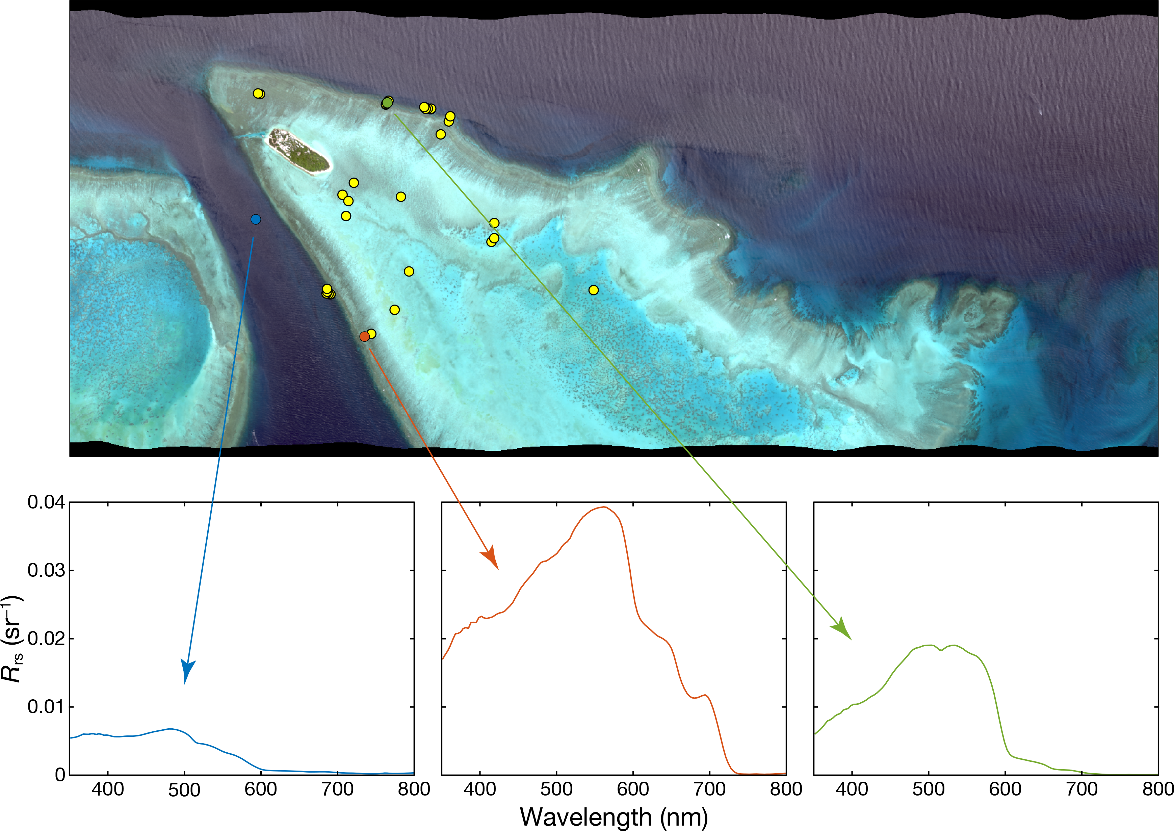

Slide 18
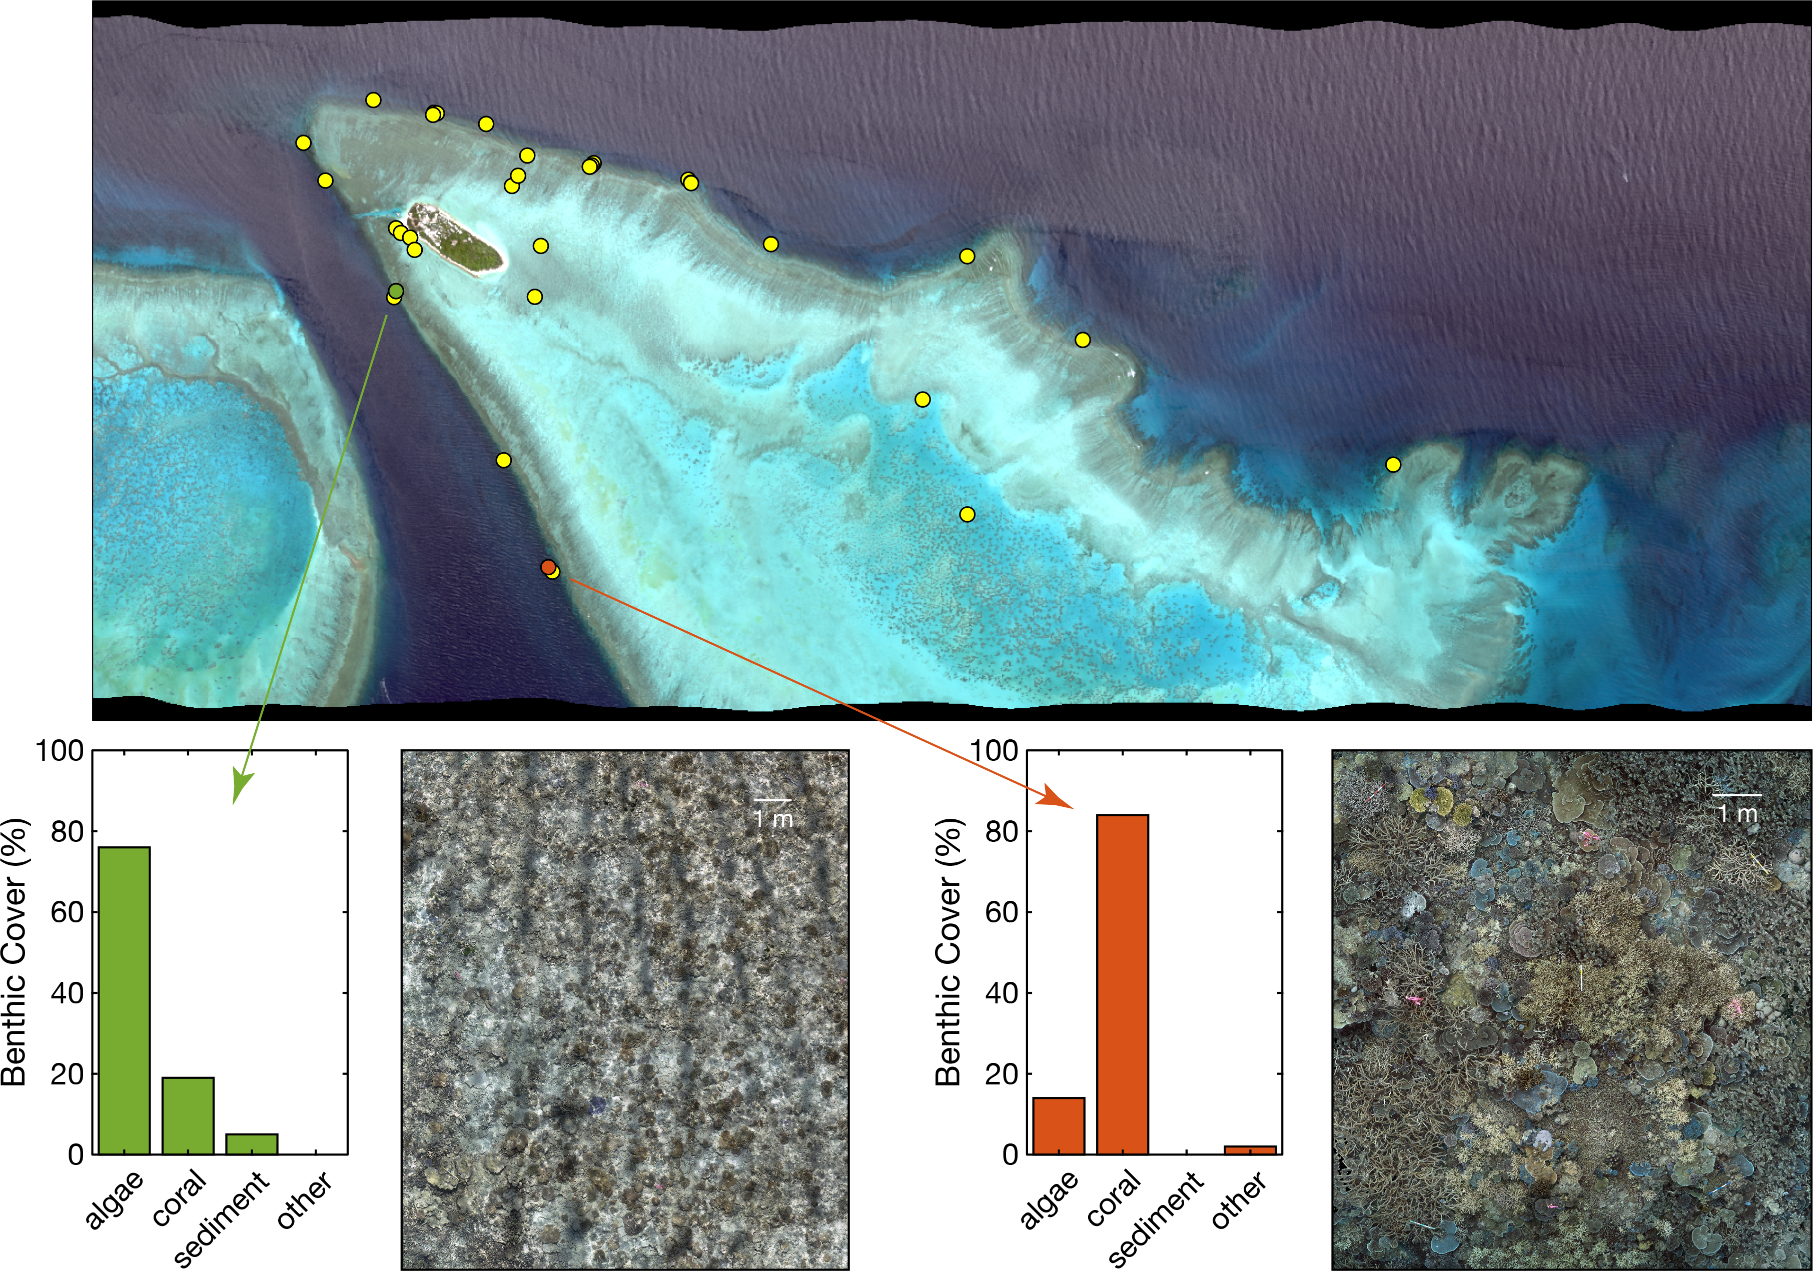

Slide 19
