Slide 1



Dave Siegel
EXPORTS Science Lead
UC Santa Barbara
2020 OCRT Meeting

Slide 2
EXPORTS Goal & Rationale
Goal: Predict export, fate & C cycle impacts of ocean NPP from satellite observations
Focus on quantifying export pathways & NPP fates over a range of ecosystem states
Emphasize a predictive understanding by measuring & modeling regulating processes
Leverages advances in remote sensing, optical oceanography, in situ particle imaging, genomics & autonomous tools
Notes:
Overall goals and program rationale.

Slide 3
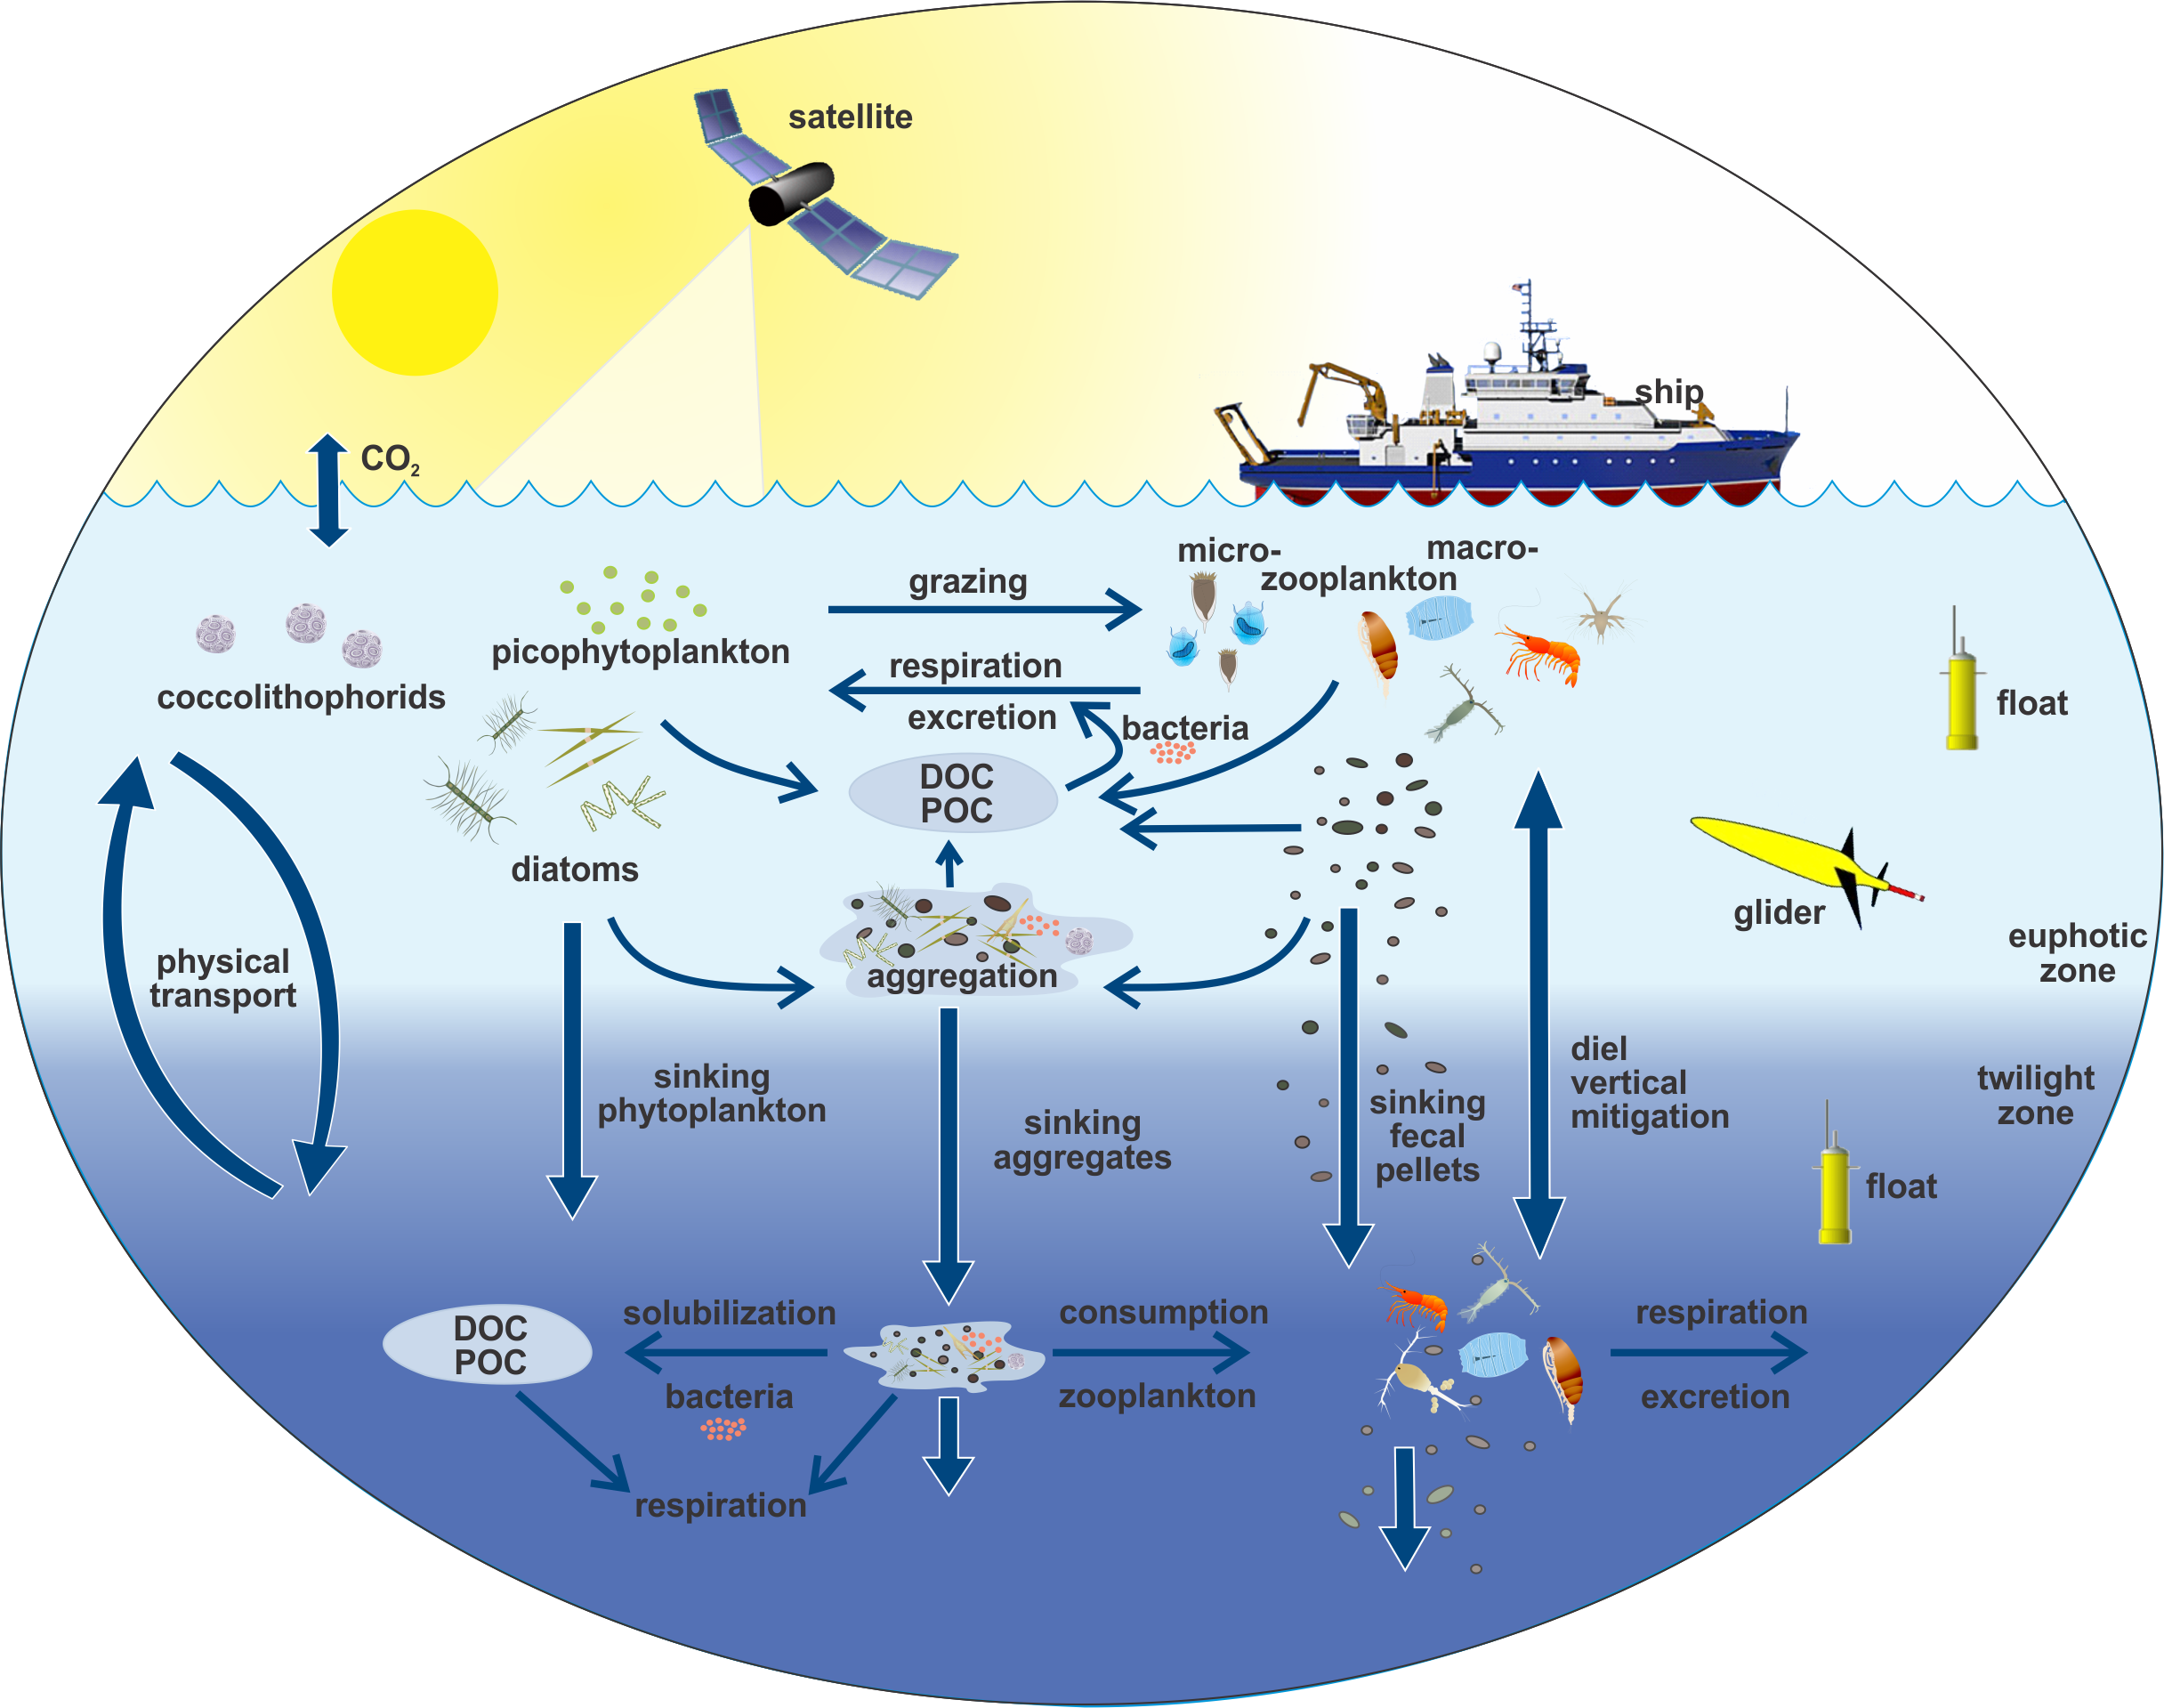
Focus on Pathways…
Sinking Particle Pump
Migrating Pump
Physical Injection
Pump
Consumption in twilight zone

Slide 4
Three Science Questions
How do upper ocean ecosystem characteristics determine the vertical transfer of organic matter from the well-lit surface ocean?
What controls the efficiency of vertical transfer of organic matter below the well-lit surface ocean?
How can the knowledge gained be used to reduce uncertainties in contemporary & future estimates of the export and fates of NPP?
Notes:
The three over arching science questions each have four specific sub questions. The EPORTS Science Plan addresses how eachwill be answered.

Slide 5
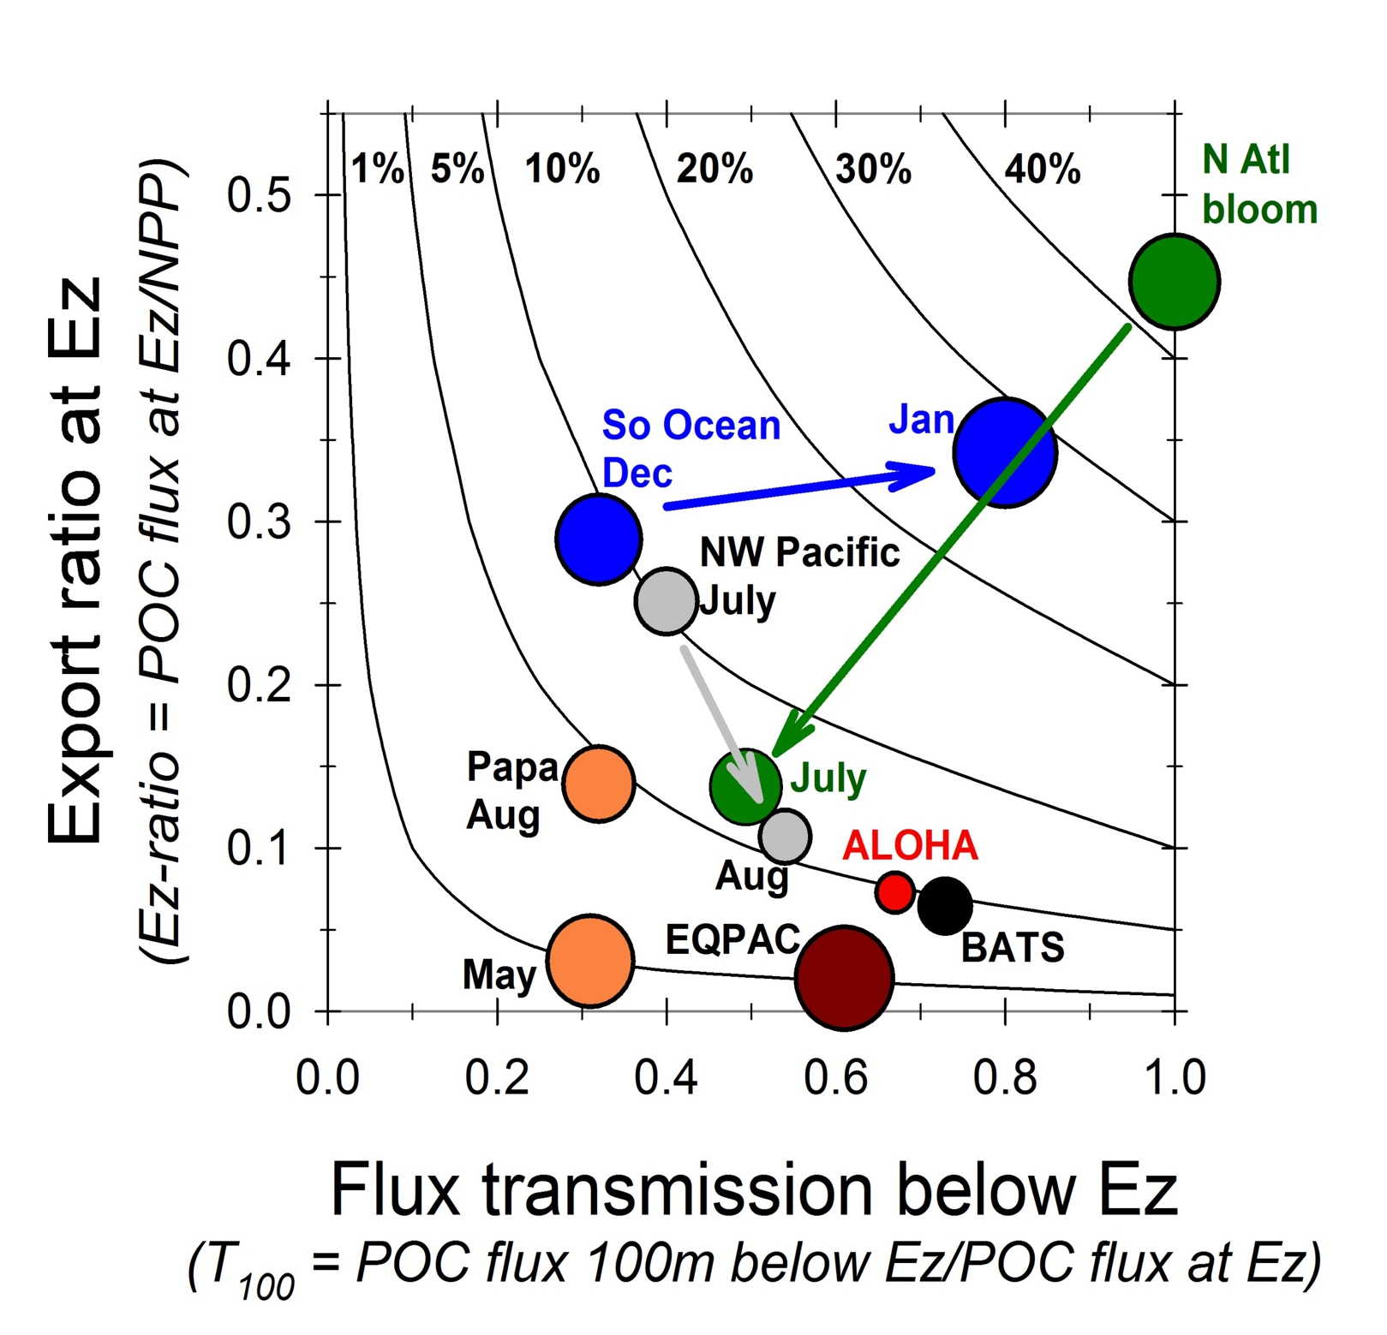
States of The Biological Pump
Buesseler & Boyd [2009]
Notes:
Plan is to sample at end members in the EZ ratio vs. T100 plot. Papa is inefficient transfer of NPP to flux and rapid attenuation beneath the eupotic zone. This April / May sampling in the North Atlantic is on the oterh end fo rht spectrum

Slide 6
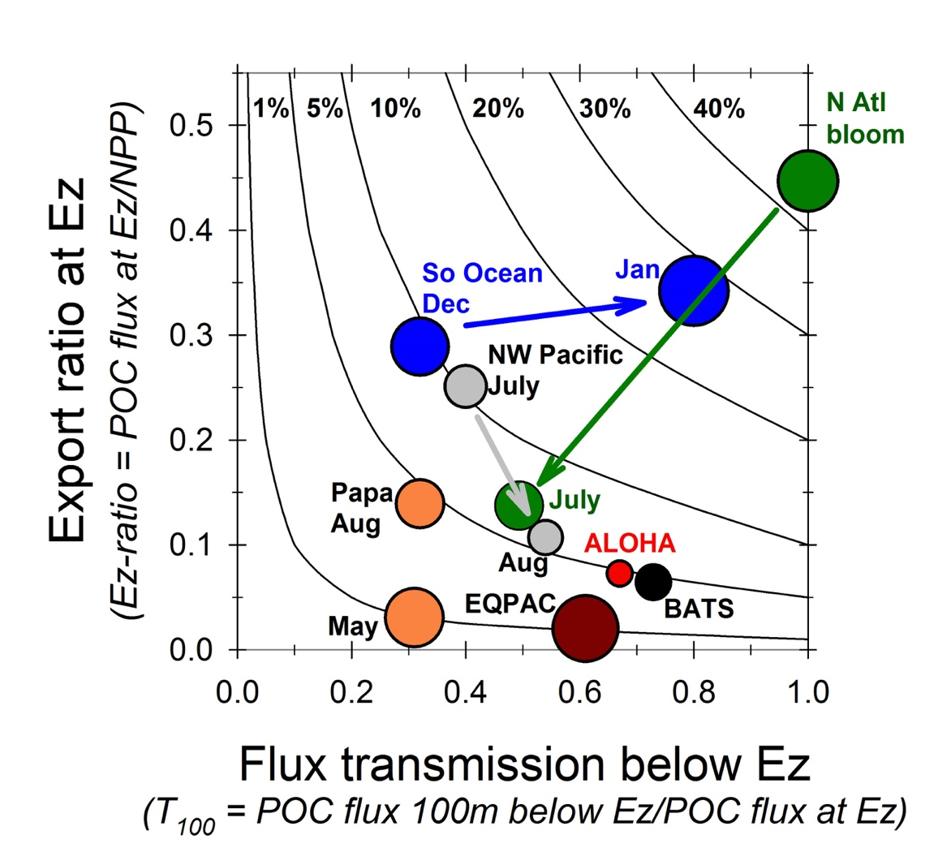
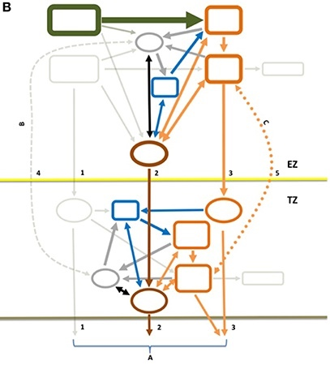
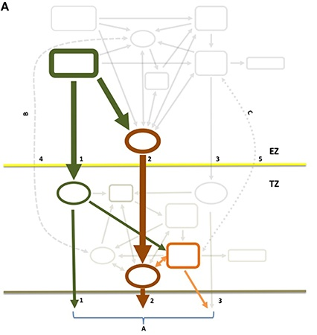
North Pacific
Summer
North Atlantic
Spring
Notes:
Different food webs from Papa and North Atlantic too…

Slide 7


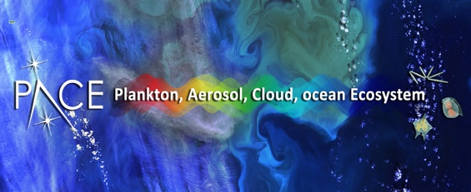
Timeline
EXPORTS: Planning, Development, and funding
COOPEX meeting. EXPORTS's birthday!
Final EXPORTS Implementation Plan
Pre COVID-19
Final Science Plan
2012
ROSES A-3​
COOPEX​
2013
2014
Science Plan Formal Public comments and peer review
2015
Science Definition Team formed
2016
NASA RFP
NSF Dear Colleague letter
EXPORTS PHASE 1
EXPORTS STARTS!
2nd Science Meeting
Data mining & modeling
2 Floats
2 Floats
Glider
Glider
2017
1st Science Meeting
2018
Cruise Planning Meeting
Survey & Process ship
2019
2020
3 vessels
Cruise Planning Meeting
EXPORTS North Pacific
August – September (26 days)
EXPORTS North Atlantic
April – May (28 days)
Data submission to SeaBASS and BCO-DMO
EXPORTS PHASE 2
Notional Implementation Plan
2021
Data Synthesis and Modeling
2022
Implements the knowledge gained in Phase 1. Reduce uncertainties in predictive and forecasting models and satellite algorithms, a NASA agency goal
Data submission to SeaBASS and BCO-DMO
Notes:
We are in Phase 1 now with the Atlantic approaching rapidly. Gliders go in in late March.

Slide 8
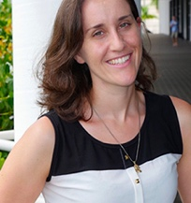
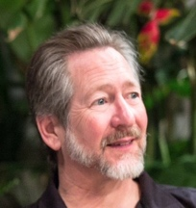
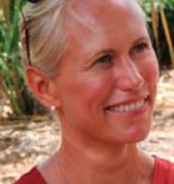
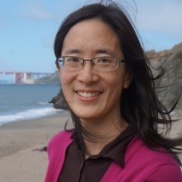
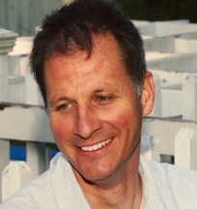
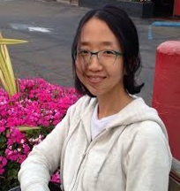
A project of people - Phase 1 PIs…
A truly interdisciplinary team
Notes:
Lots of people

Slide 9
A truly interdisciplinary team
Notes:
Lots of academic areas of expertise

Slide 10
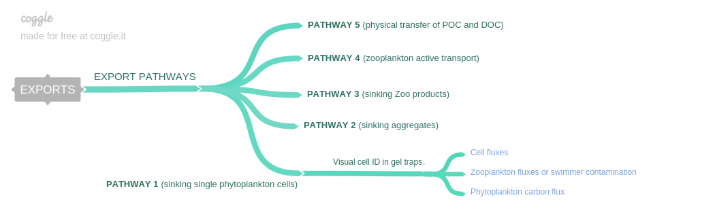
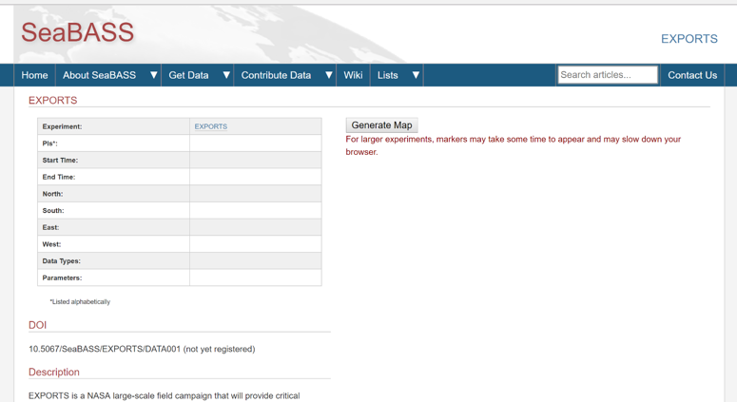
EXPORTS Data Management (SeaBASS & BCO-DMO)
Prior to cruise:
Parameter working groups - protocol write ups
evaluate intercalibration needs
work with PIs to add new measurement types to SeaBASS/BCO-DMO (356 parameters measured)
predetermine the data naming convention, sample numbers (R2R system)
Post cruise:
Post cruise assessment of new measurement types added to SeaBASS/BCO-DMO (>> 356 parameters measured)
Data access through NASA Exports website + SeaBASS + BCO-DMO
JGOFS style methods publication (NASA TM)
Data available now (most of it starting October 2019)
Notes:
Emphasis on data management to insure we get to phase 2. EXPORTS supports a full time data manager.

Slide 12
EXPORTS’ 2018 Timeline

Slide 14
Process Ship
Optics
  Profiling & UW IOPs (incl. discrete), C-OPS & HyperSAS reflectance, LISST-Deep PSD, …
NPP / Rates
  NPP (¹⁴C & ¹⁵N ), NCP (O₂/Ar), Community resp, Phyto growth / grazing, Zoop resp/grazing, bacterial prod, …
Taxa & Particle Characteristics
  MOCNESS, HPLC, iFCB, UVP, FloCam, genomics, …
Export pathways
  Sediment traps, DOM/POM remin, aggregate char, DVM, …
BGC stocks
  Nuts, Chl/HPLC, DOM, POM, Fe, O₂, BSI, PIC, PSD, …

Slide 15
Process Ship
Notes:
The plan going in.

Slide 16
Survey Ship
Optics
  Multispectral / multi angle scattering, nanoparticle PSD, profiling & UW IOPs, HyperSAS reflectance, submicron PSD, C-OPS & LISST-Deep, …
NPP / Rates
  NCP (by O₂/Ar)
Taxa & Particle Characteristics
  iFCB, UVP, HPLC, acoustics for zoop, genomics for Pro’s & Euk’s, …
Export pathways
  ²³⁴Th export, UVP-sinking flux
BGC stocks (also act as the calibration link to AUVs…)
  Pump & Niskin POC/N/PIC/Bsi/etc. profiles, Nuts, Chl/HPLC, DOC/N, O₂, PSD, …

Slide 17
Survey Ship

Slide 18
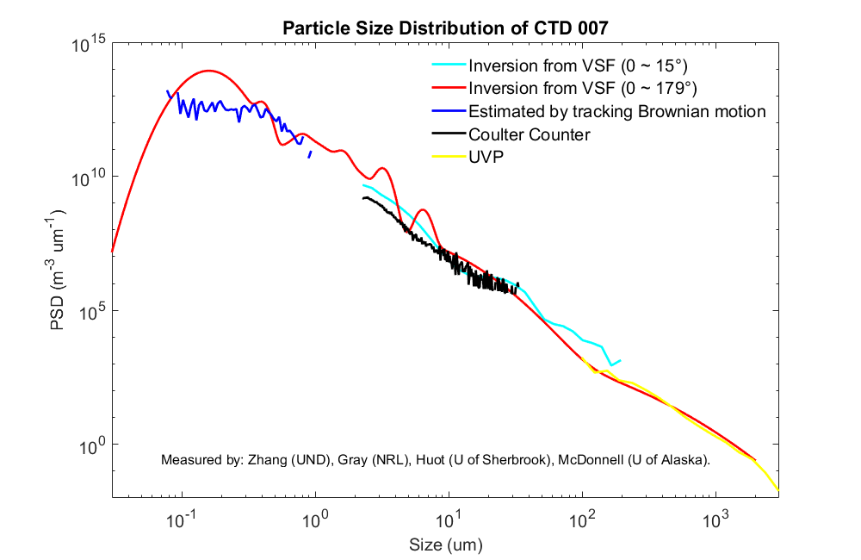
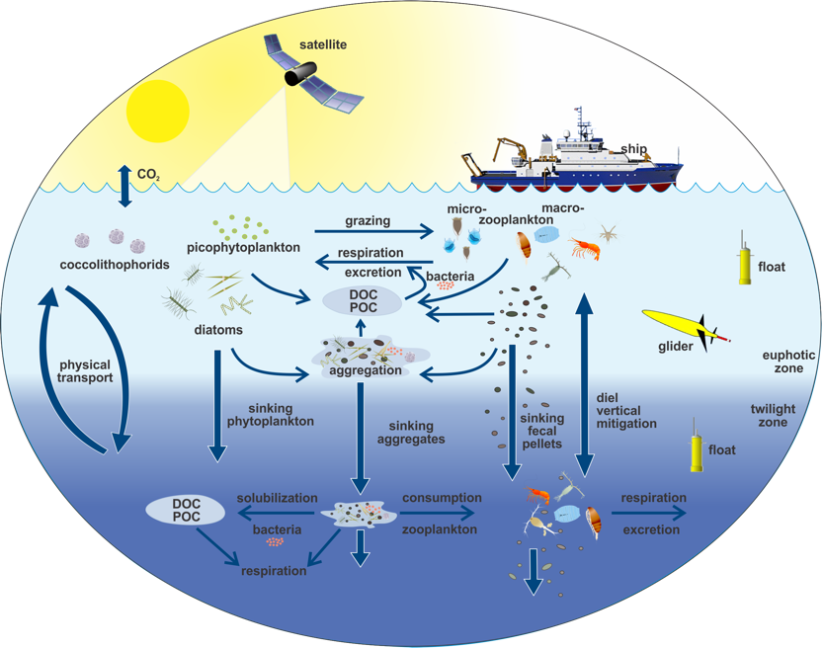
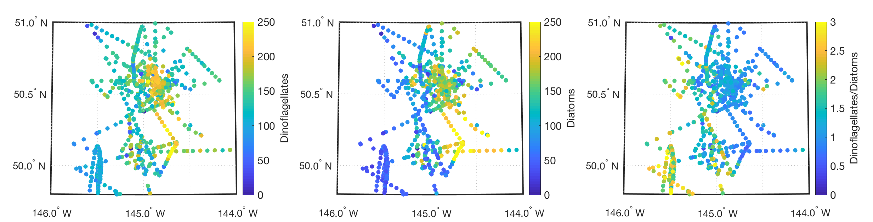
Primary Production and Composition of Producers
¹⁴C NPP from Process Ship
Composite
Particle Size
Distribution
Fox, Halsey, Graff & Behrenfeld
Zhang, Gray, Huot & McDonnell
IFCB Diatom & Dinoflagellate Carbon from Survey Ship
Roesler & Sosik
Notes:
NPP from 14C shows large changest in time – unrelated to obvious changes in water masses or forcings
Measurements of the particle size distribution from 50 nm to cm’s using a range of instruments and approaches
Integrating flow cytobot measurements of abundances of dinoflagellates and diatoms and their ratio show large changes in space as the cruise

Slide 19
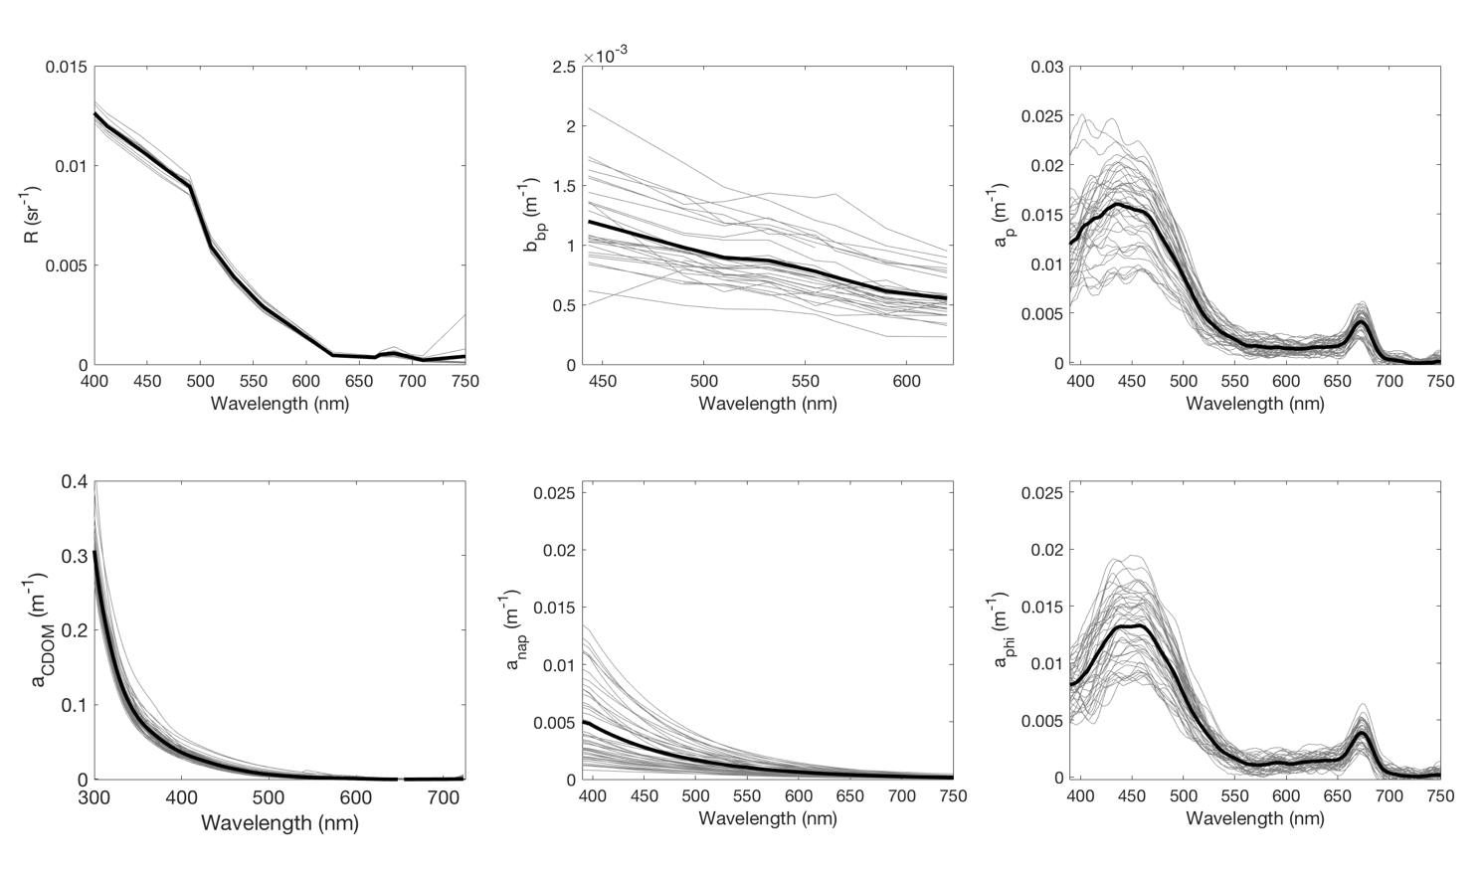

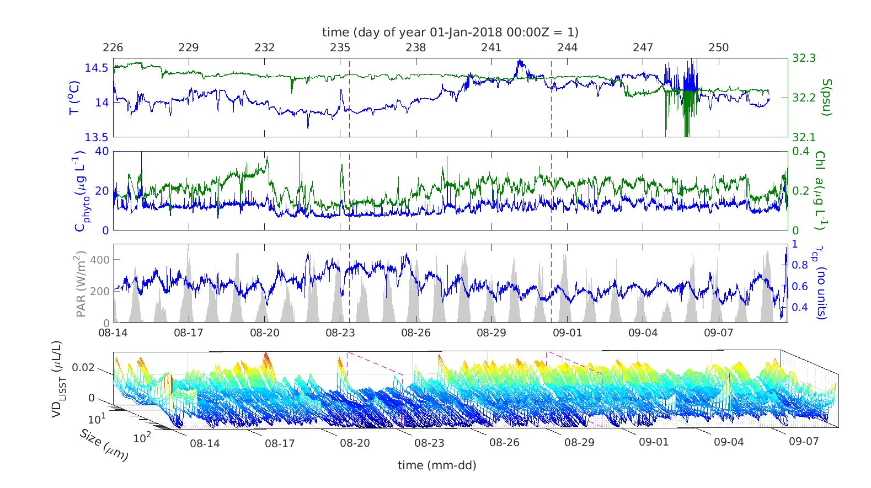
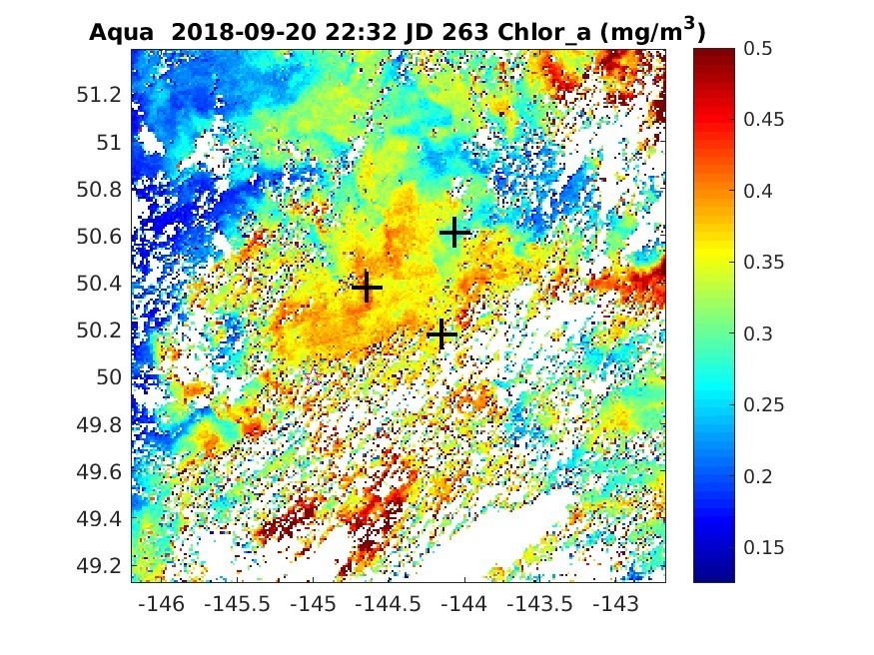
Optics & Remote Sensing
R_{rs}(λ) b_{bp}(λ) a_{p}(λ)
Near -Surface Optical Properties
a_{g}(λ) a_{det}(λ) a_{ph}(λ)
Roesler, Zhang, Siegel & Nelson
10 days after EXPORTS left!!!
Boss, Karp-Boss & Graff
Notes:
Near surface optical properties show little change in reflectance and CDOM absorption but lots of chances in component inherent optical properties
Time series of measures of particle characteristics from optics illustrating multiple methods for getting at particle size
Yes we never got a satellite ocean color image during EXPORTS – but you did 10 days later!!

Slide 20
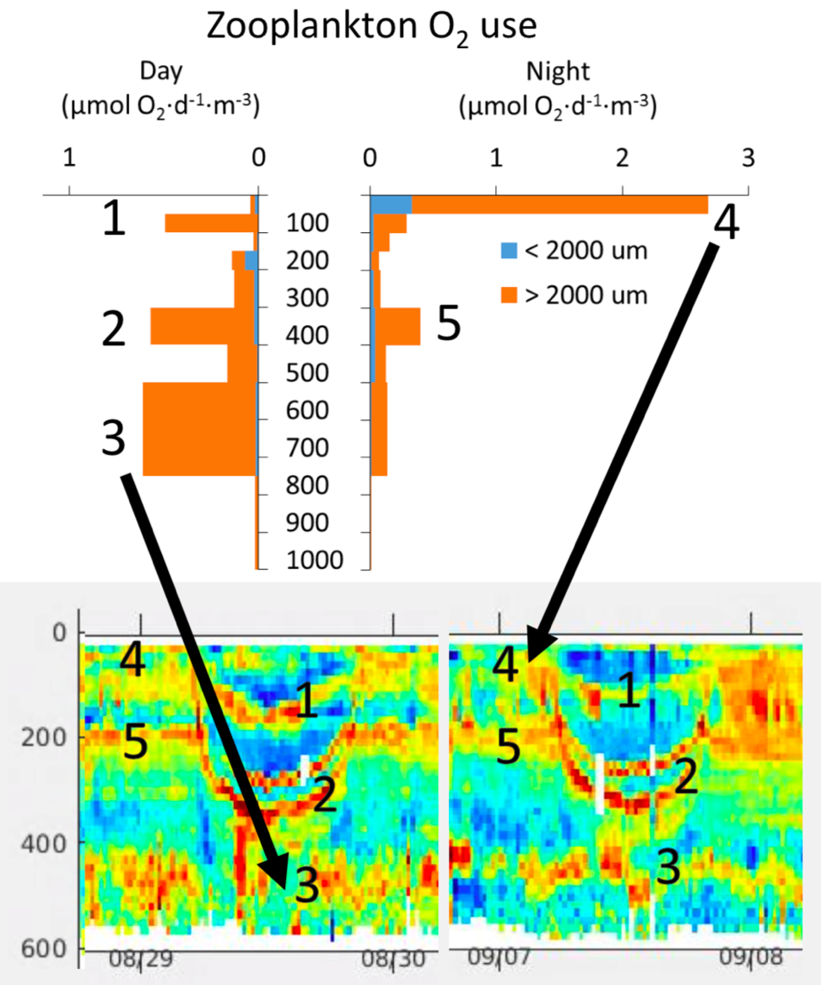
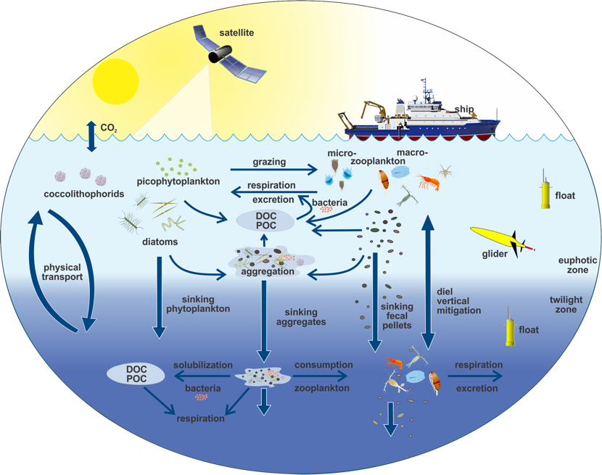
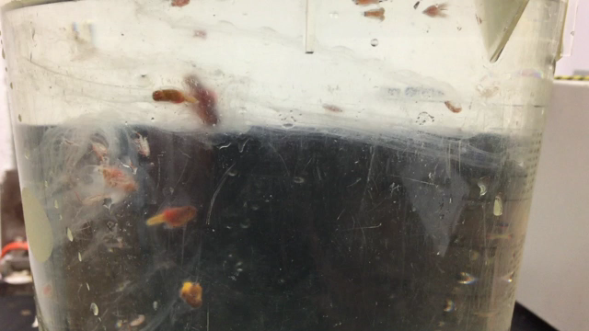
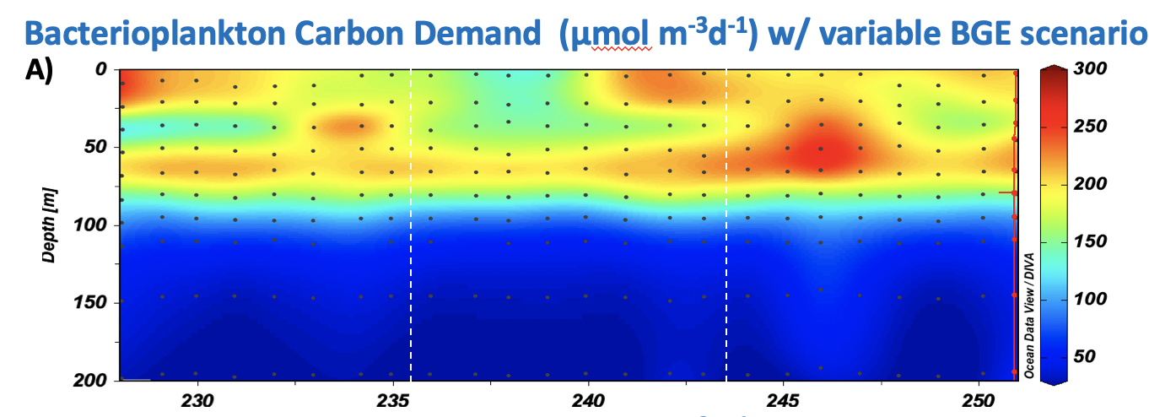
Secondary Production and Producers
Maas, Stamieszkin & Steinberg
Carson & Hansell

Slide 21
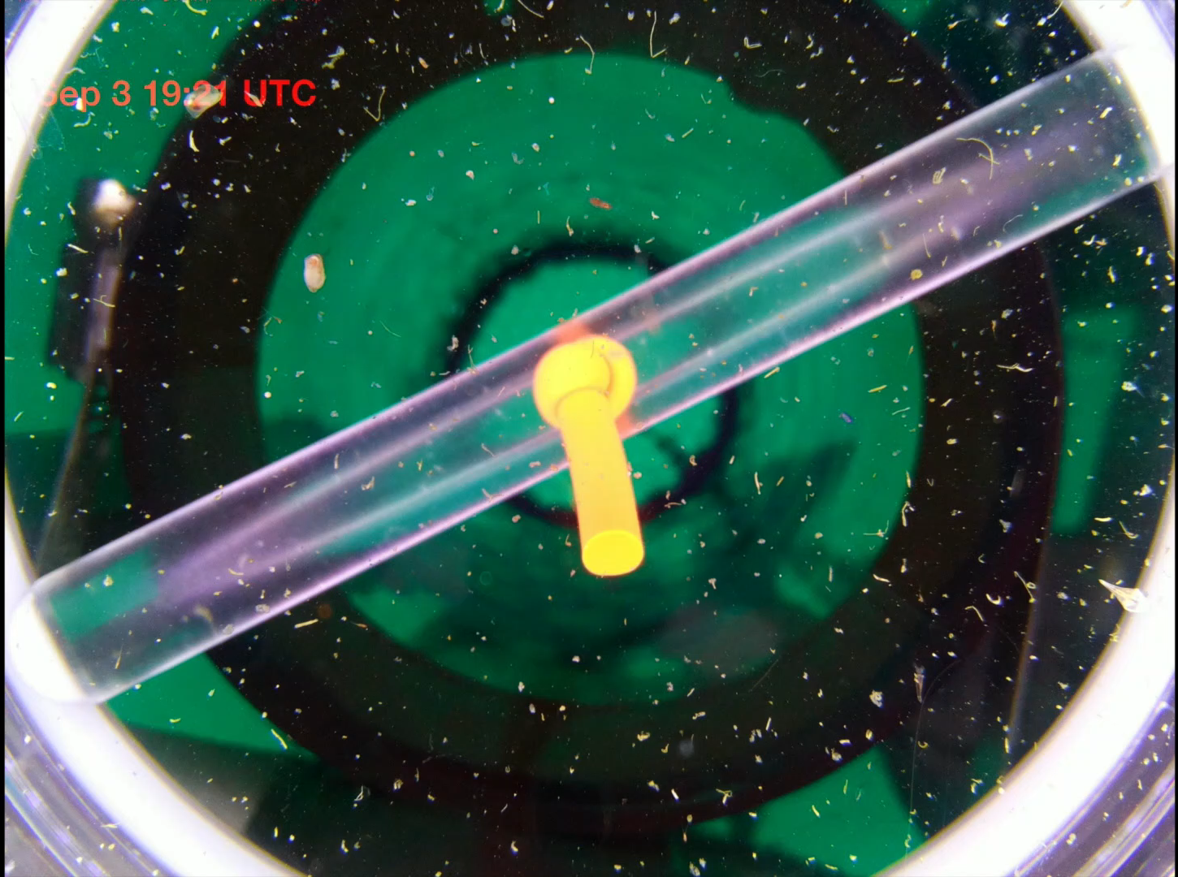

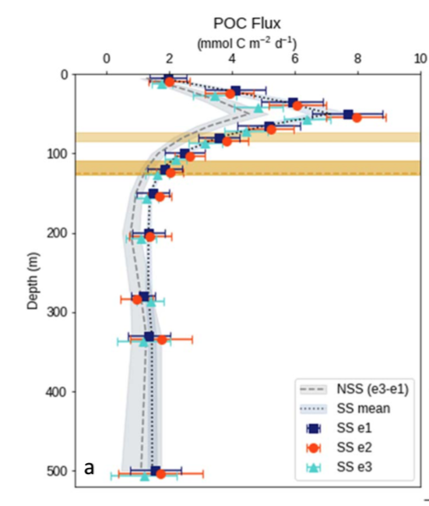
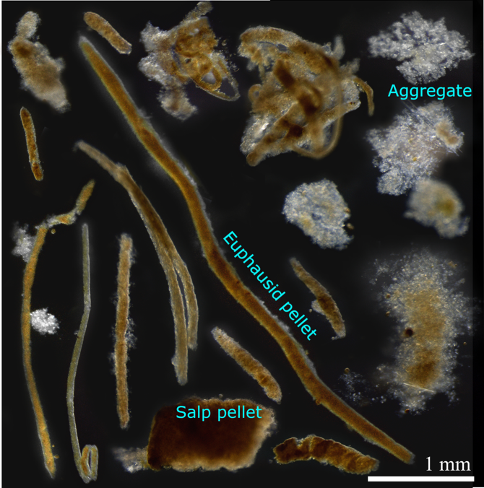
Export and Export Pathways
View of sinking flux
Buesseler, Benitez-Nelson & Resplandy
Notes:
Movie of particles and other critters entering a gel trap sediment trap - view is from below – day and night are shown – yes there were lots of swimmers
Examples of the tpes of fecal particles found in gel trap – 1 salp pellet can alter the flux by a lot
POC flux from 234Th disequilibria
Example of the fluxes of different organisms into traps collected from the gel trap and characterized using gel trap

Slide 22

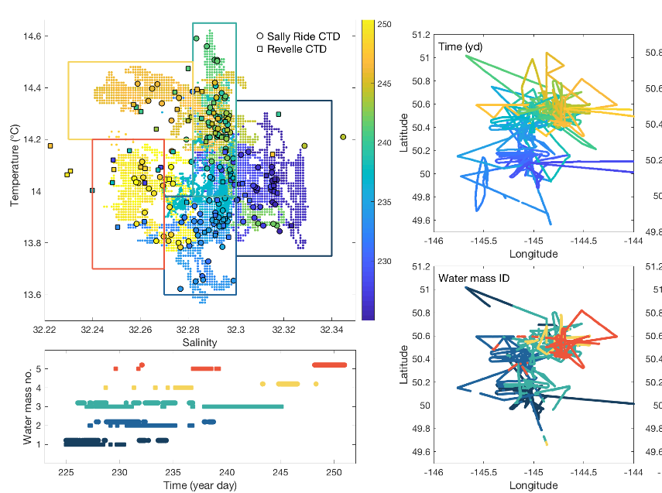
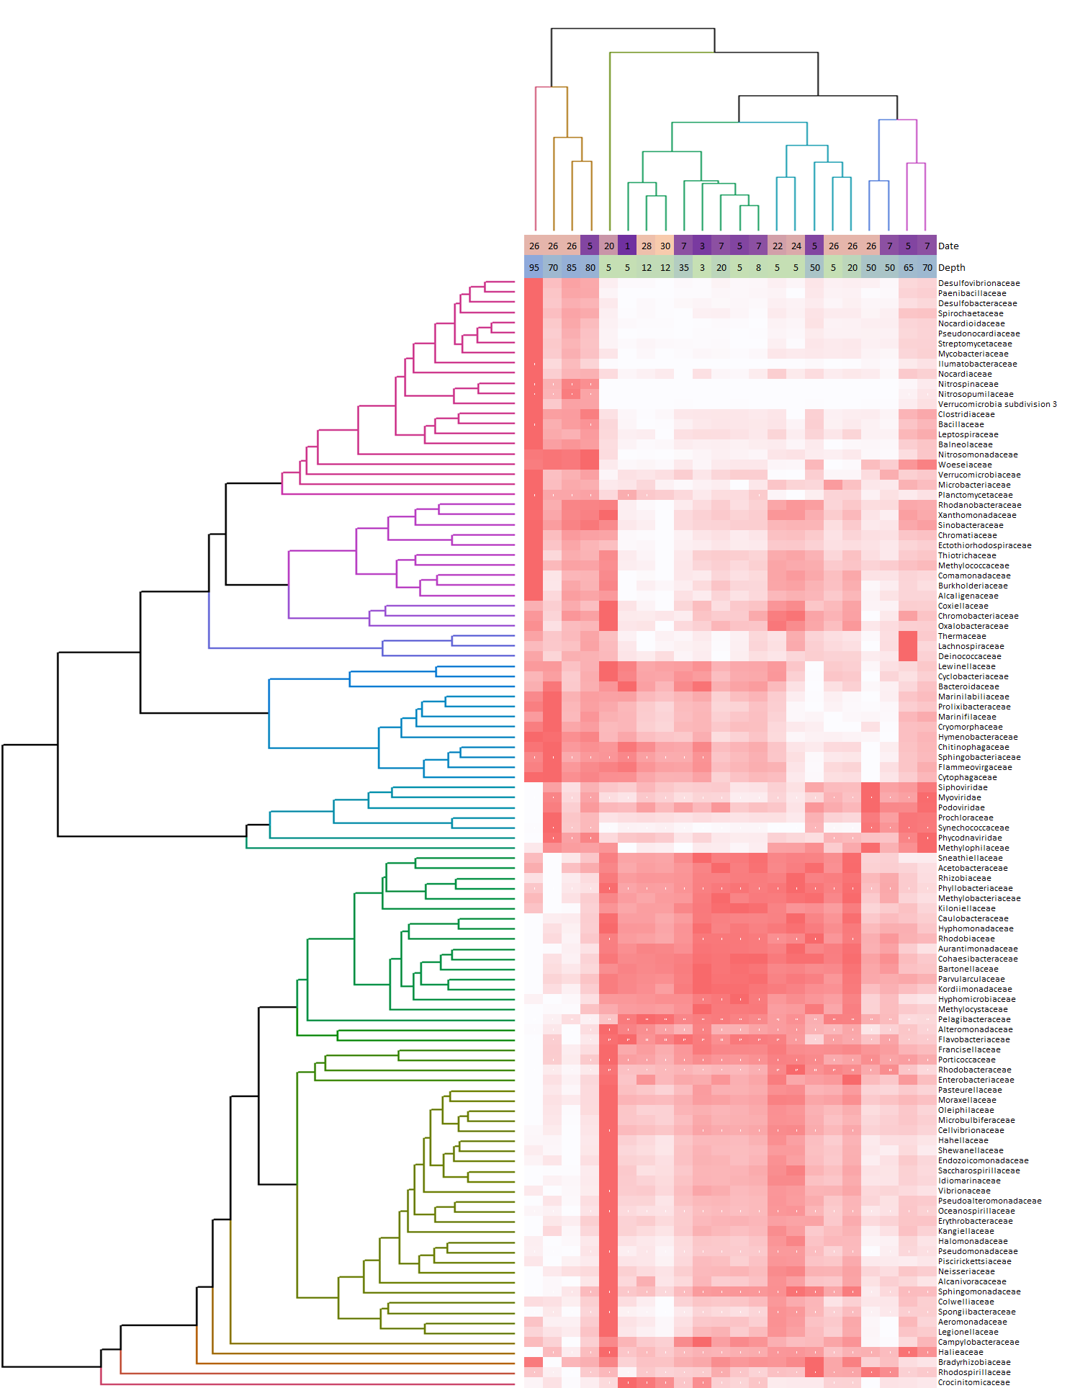
Chl-Fl from SeaGlider
Variability in Time / Space…
BGC Argo Profiles
Fassbender
T/S Variability Thompson & many others
Time ->
Bacterial Community
Composition from Genomics
Gifford & Marchetti
<- Sequence Variants ->
Notes:
Analysis of all T/S plots showing the changes in physical water masses during the cruise
BioARGO Floatt data of Chlorophyll, POC from bbp, NO3 and O2 from EXPORTS cruise thru May 2019 – note the bloom after we left
Bacterial community composition from genomics –showing chances in communities in time as the cruise proceeds – these changes are not

Slide 23
NE Pacific Results, Publications & Synthesis
Weekly RESULTS zooms with ≥ 70 participants
Presently, 30 pubs in the EXPORTS publication list with many more to come…
Special feature collection of Elementa on the NE Pacific cruise results is now taking submissions
Formed 5 Synthesis Working Groups
  Flux Pathways, Rates, Optics, Space/Time & BGC Budgets
  Goal is to foster inter-group data syntheses
Notes:
Noticed that Lisa Miller is on the editorial board. Lead ocean editor is Jody Demming

Slide 24

North Atlantic 2020 Cruise…
2021 ??
Contrasting endmember to the NE Pacific Cruise
  Big signals in biomass & export & low flux attenuation
  Hope to find larger phytoplankton & communities dominated by diatoms
  Focus on assessing post-bloom C cycle fates
  High mesoscale & sub-mesoscale energy driving patchiness in biomass & NPP and advective C fluxes
Together these create many challenges…

Slide 25
North Atlantic 2020 Cruise…
2021 ??
Plans for the North Atlantic 2020 cruise …
  R/V Atlantis & RRS Discovery for spring 2020 (late April to late May) on station for 28 days (3 epochs with 4 weather days)
  Target site = Porcupine Abyssal Plain (~49N 16.5W)
  Concerns with advection…
    Locate in an eddy somewhere near target site (study underway)
    Adjust using available satellite / model / AUV data
    Have plans for multiple scenarios (& dry lab them!!)
  Collaboration with WHOI’s OTZ group (a 3rd ship…)

Slide 26
Plans for 2021??
2020 EXPORTS North Atlantic cruise was postponed
Plan is to conduct a spring cruise in 2021 to complete EXPORTS Phase 1 and enable Phase 2
Need ships, agency engagement, PI commitment & a solution to the COVID-19 pandemic
  We are working on solutions for the first three issues
  Hoping for the fourth to emerge by early next year

Slide 27
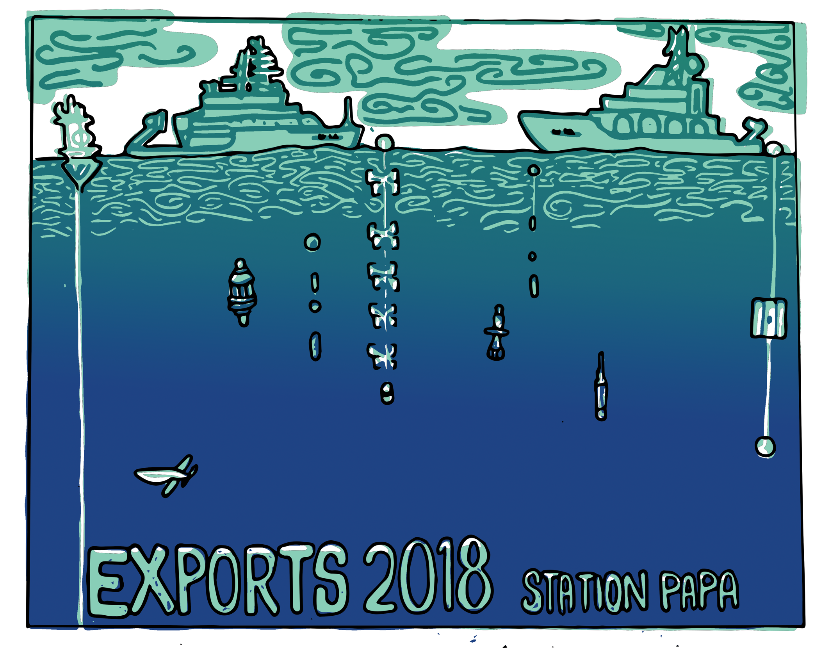
© 2018 Alida Siegel – need a PAP version!!!

