Slide 1
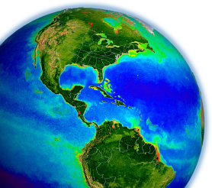

NASA OBPG
Satellite Ocean Color Update
Bryan Franz
and the
Ocean Biology Processing Group
NASA Goddard Space Flight Center
IOCS Meeting
Ocean Color Research Team Meeting
8 April 2019, Busan, South Korea

Slide 2
Contents
Status of SeaWiFS, MODIS, VIIRS ocean color data quality
Plans for the next multi-mission ocean color reprocessing
Update on HICO ocean color products
NASA/OBPG support for current international missions

Slide 3
Ocean Color Reprocessing R2018.0
Completed
Dec 2017 (VIIRS/SNPP), January 2018 (MODIS/Aqua), February 2018 (SeaWiFS), April 2018 (MODIS/Terra)
Purpose
incorporate updates to vicarious calibration due to revised MOBY time-series
incorporate updates to instrument calibration
no algorithm changes relative to R2014.0

Slide 4
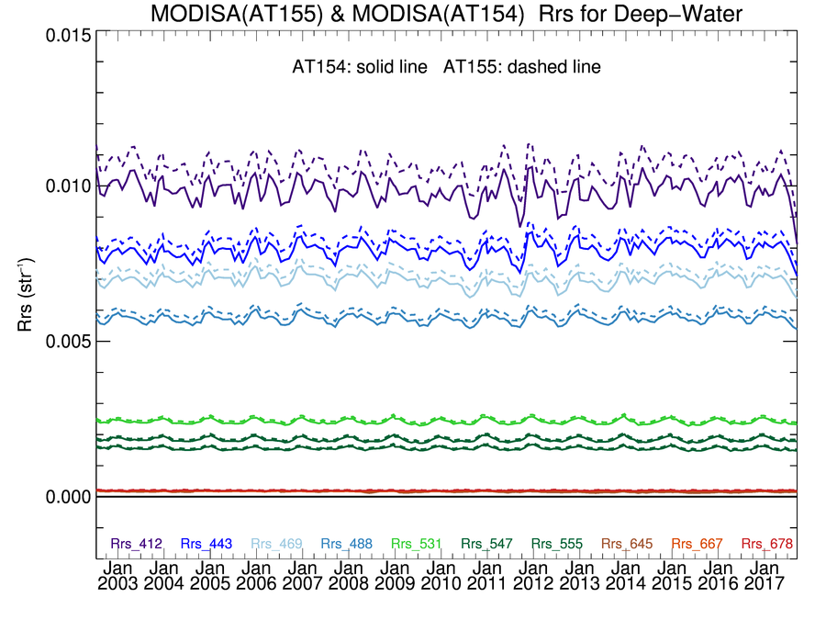
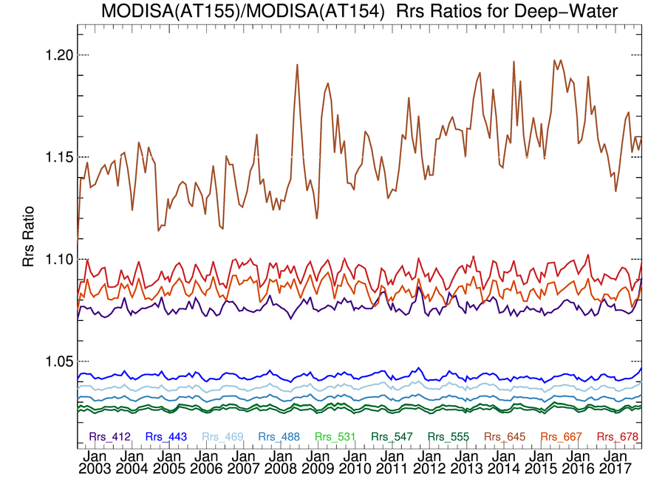
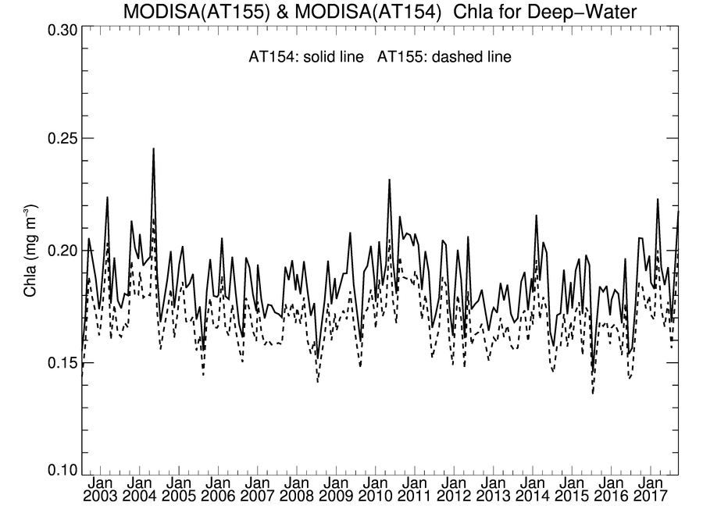
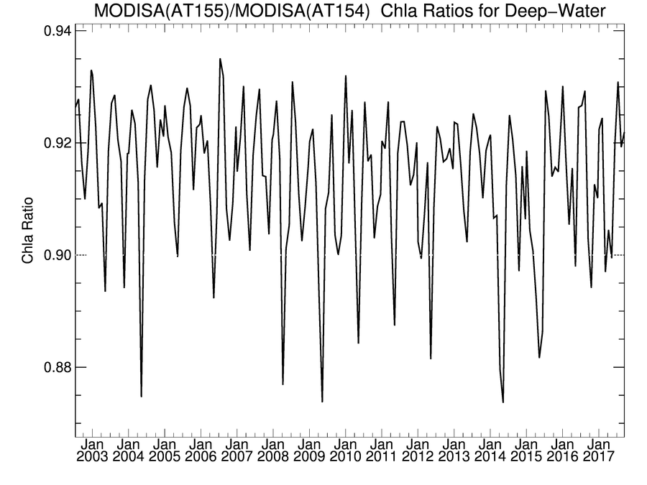
Impact of MOBY Revisions on MODISA Ocean Color
Global Deep Water Time-Series Test (MOBY change only)
MOBY bias shift
+2-10% in Rrs
MOBY in situ radiometry is used for vicarious cal of visible bands, all missions
MOBY reprocessed by MOT in 2016 and 2017
revised depth of sensor arms
new straylight correction
Impact was to
increase Rrs by 2-10%
decrease global Chl by 8%
Rrs (sr⁻¹)
Rrs Ratio
Chl (mg m⁻³)
Chl Ratio
MOBY bias shift
-8% in Chl

Slide 5
MODISA Instrument Calibration Update for R2018.0
Goal was to mitigate some temporal artifacts observed in previous ocean color trends, believed to be associated with calibration data smoothing/fitting decisions.
Complete end-to-end re-analysis of on-board calibration was performed, largely following previous MCST approach, but with some differences.
SD/SDSM screens, SD BRF: derived from simple fit of yaw maneuver data, not geometric modeling
SDSM Cal: SD degradations in red/NIR were determined by wavelength modeling (Lee et al. 2018)
RVS: simple atmospheric correction added when computing desert trends to track RVS in 412, 443nm
Modulated RSR: impact on ocean data estimated and used to adjust 412nm temporal gains (Lee et. al. 2017)
RSB LUTs: use of smoothing rather than fitting to the instrument temporal calibration trending and characterization (i.e., no assumption on functional form)
Monthly update to maintain calibration trend consistency in forward processing.
see Shihyan Lee for more details

Slide 6
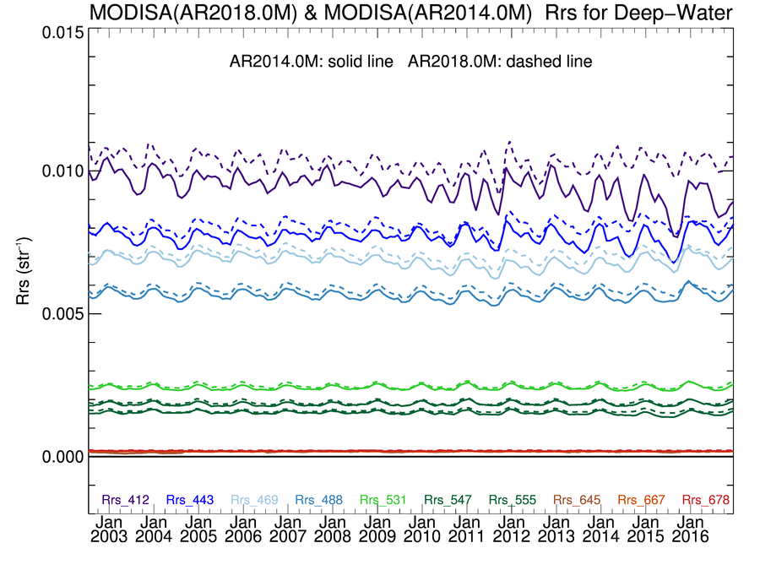
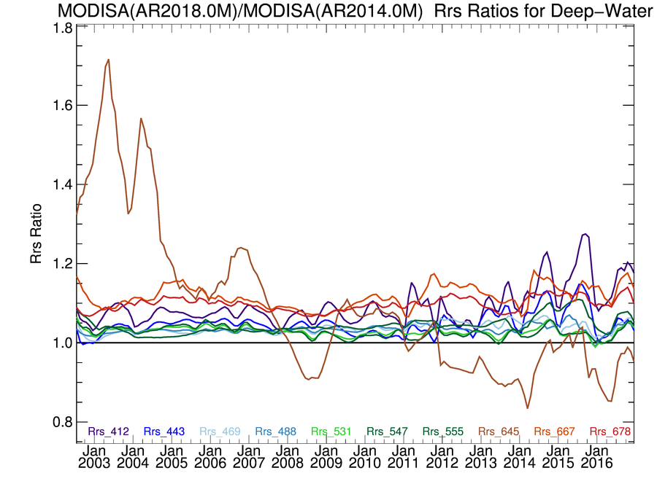
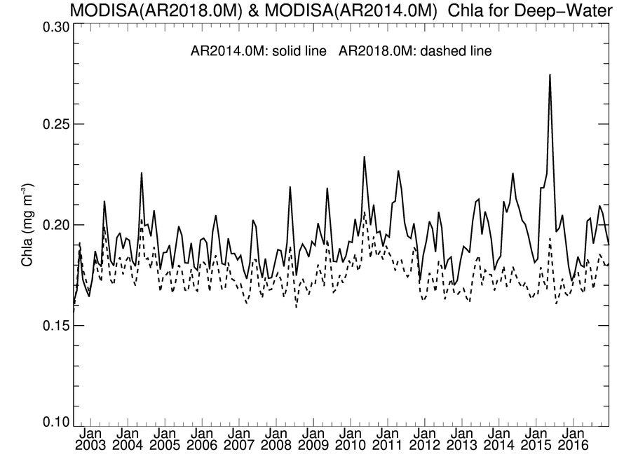
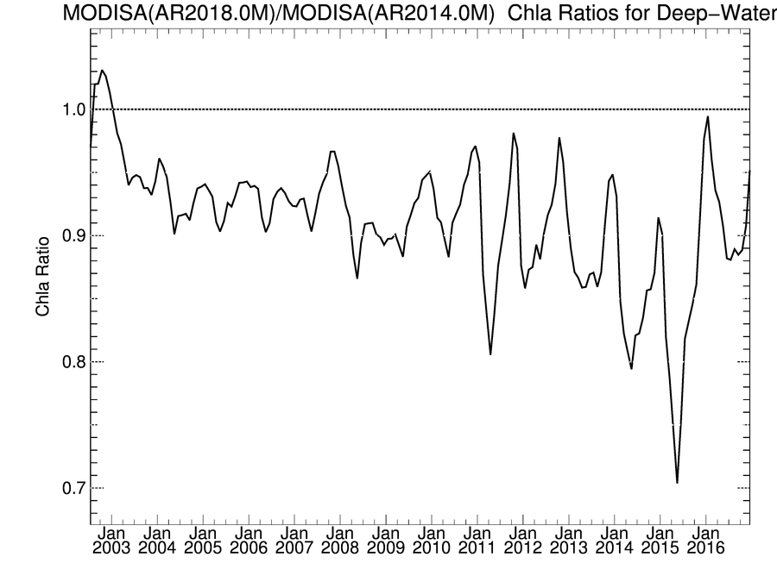
MODISA Global Deep-Water (R2018.0 vs R2014.0)
instrument calibration
update
Rrs (sr⁻¹)
Rrs Ratio
MOBY bias shift
+2-10% in Rrs
Late-mission drift in blue Rrs resolved.
Large seasonal spikes in chlorophyll removed.
Chl (mg m⁻³)
Chl Ratio
MOBY bias shift
-8% in Chl
Notes:
other changes due t instrument cal update, resolving late-mission drift in blue

Slide 7
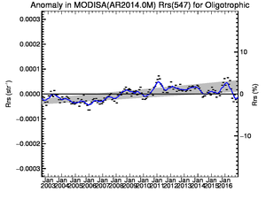
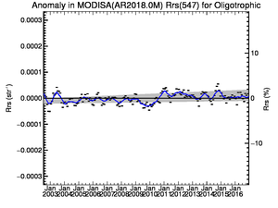
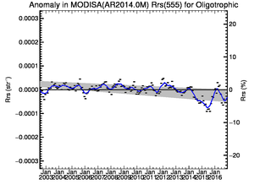
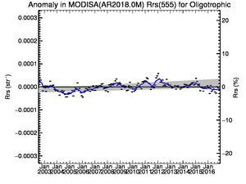
MODISA Rrs Anomaly Trend in Global Oligotrophic Water
In very clear-water, open ocean regions (Chl < 0.1), we expect minimal variability in green spectral bands.
R2018 shows improved stability in temporal trends of water-leaving reflectance in the green bands of MODIS/Aqua.
R2014.0
R2018.0
Rrs (547)
R2014.0
R2018.0
Rrs (555)

Slide 8
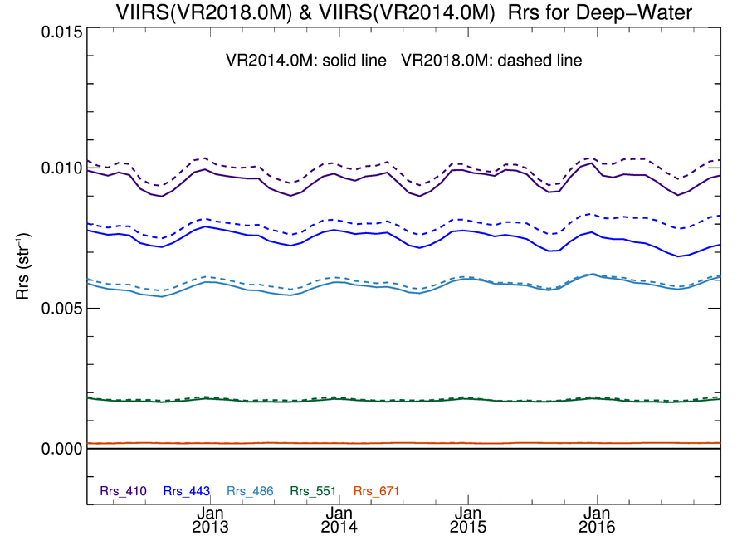
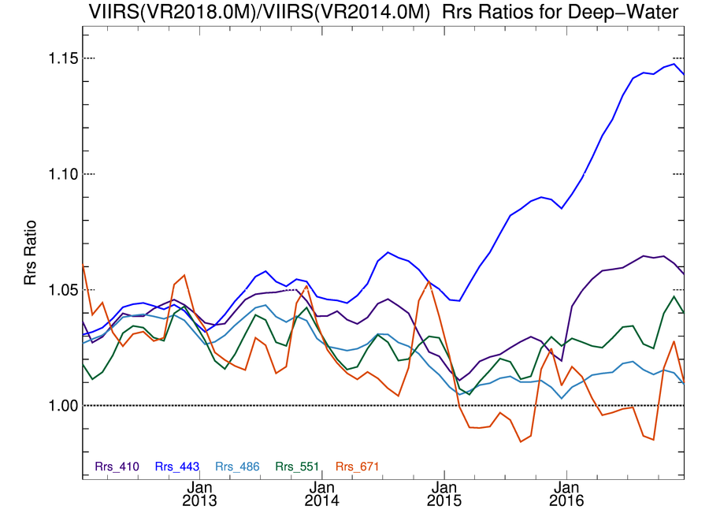
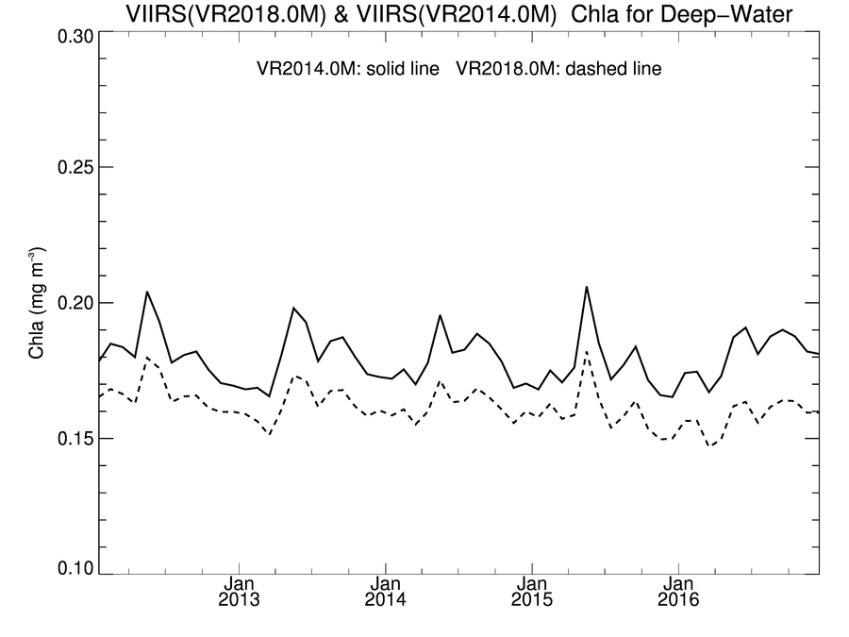
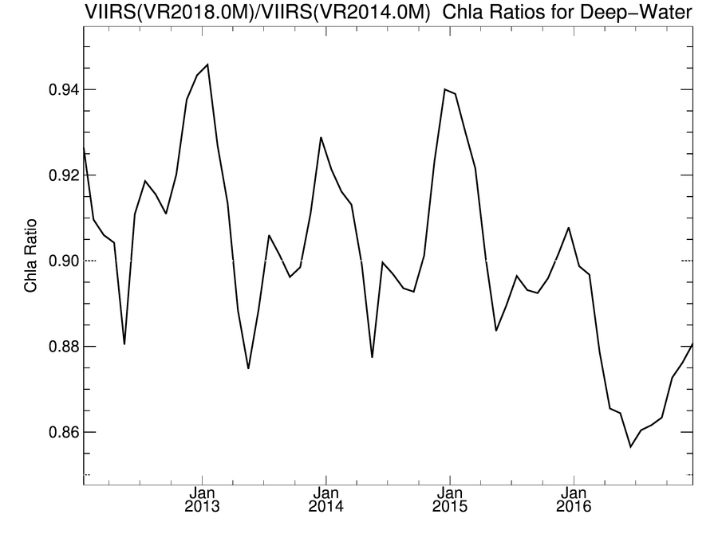
VIIRS/SNPP Global Deep-Water (R2018.0 vs R2014.0)
instrument calibration
update
Instrument Calibration updates include:
revised temporal cal with additional solar & lunar measurements since R2014
lunar measurements corrected for detector gain variability
absolute calibration of all spectral bands based on observations of the sun through the solar diffuser
bias shift
+3-5% in Rrs
Rrs (sr⁻¹)
Rrs Ratio
Chl (mg m⁻³)
Chl Ratio
bias shift
-9% in Chl

Slide 9
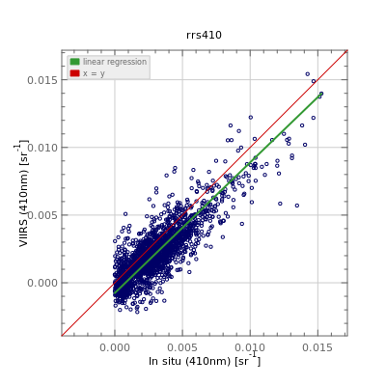
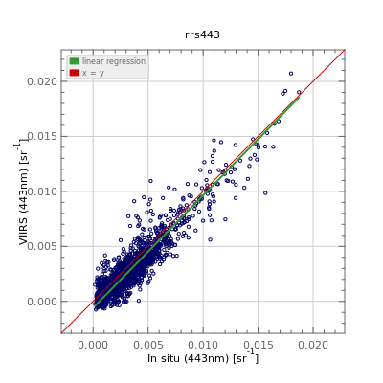
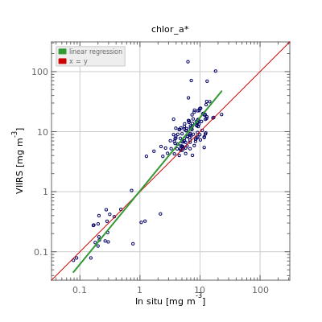
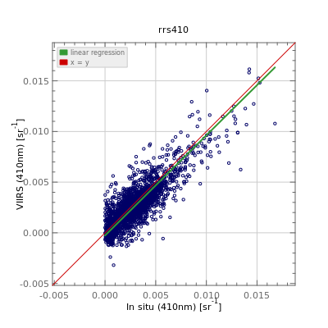
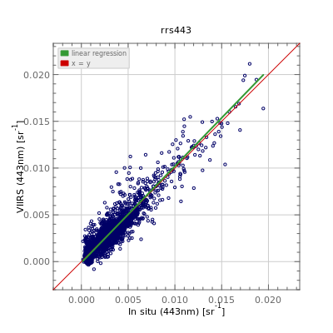
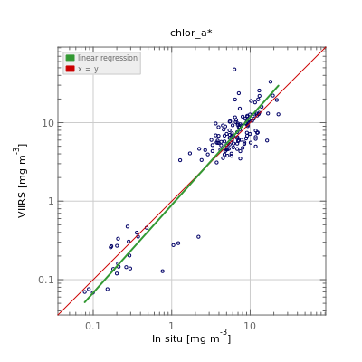
VIIRS/SNPP R2018.0 Reprocessing improved agreement with in situ
Rrs(412)
Rrs(443)
Chlorophyll
Match-ups to SeaBASS and AERONET-OC
significant reduction in bias at 412 and 443
improved agreement in Chlorophyll
R2014.0
Bias = -0.001
R2018.0
Bias = -0.00032
Bias = +0.00001
Bias = 5%

Slide 10
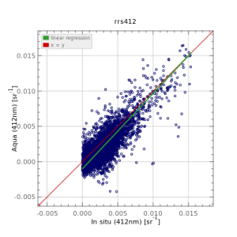
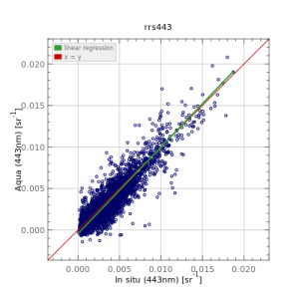
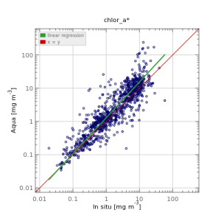
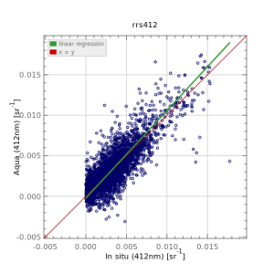
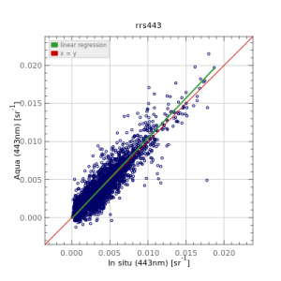
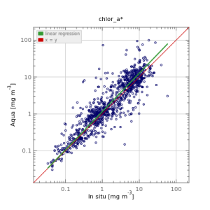
MODISA R2018.0 Reprocessing improved agreement with in situ
Rrs(412)
Rrs(443)
Chlorophyll
Match-ups to SeaBASS and AERONET-OC
significant reduction in bias at 412 and 443
improved agreement in Chlorophyll
R2014.0
Bias = -0.00077
Bias = -0.00027
Bias = 32%
R2018.0
Bias = +0.00005
Bias = +0.00008
Bias = 18%

Slide 11
In situ Rrs Match-up Statistics for MODISA
equal or reduced mean bias and MAE in all bands
large negative bias in blue reduced to small positive bias
Product | Number Matchups | Mean Bias (sr⁻¹) |  | Mean Absolute Error (sr⁻¹)
 |  | R2014.0 | R2018.0 | R2014.0 | R2018.0
Rrs(412) | 3934 | -0.00077 | 0.00005 | 0.00125 | 0.00099
Rrs(443) | 4134 | -0.00027 | 0.00008 | 0.00082 | 0.00075
Rrs(488) | 3772 | -0.00067 | -0.00050 | 0.00088 | 0.00077
Rrs(531) | 2076 | -0.00063 | -0.00057 | 0.00083 | 0.00079
Rrs(547) | 3619 | -0.00052 | -0.00048 | 0.00078 | 0.00076
Rrs(555) | 3534 | -0.00081 | -0.00075 | 0.00096 | 0.00090
Rrs(667) | 3573 | -0.00017 | -0.00016 | 0.00030 | 0.00029
Rrs(678) | 472 | -0.00016 | -0.00014 | 0.00034 | 0.00033
identical field data sources from AERONET-OC and SeaBASS

Slide 12
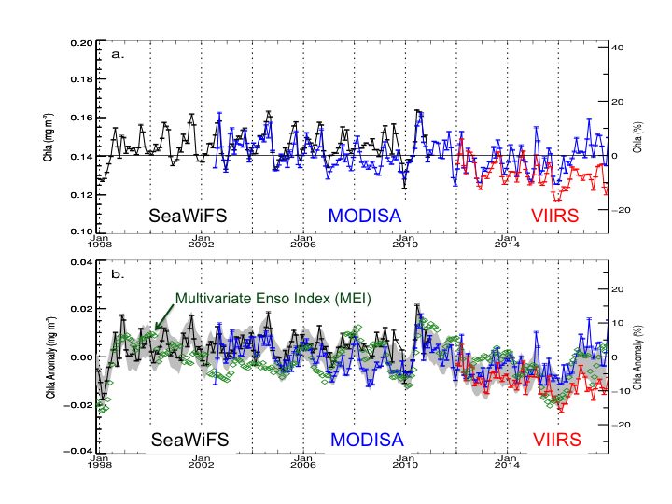
21-year Multi-mission Chlorophyll Timeseries
Deep-Water, +/- 40 deg latitude
MODISA in good agreement with SeaWiFS and VIIRS (through ~2015)
anomaly trends generally consistent with expectations based on MEI
suspect late mission trend in VIIRS (did not recover from 2015/16 ENSO event)
likely issue is unresolved impacts to changing spectral response
anticipate VIIRS R2019.0 calibration reprocessing soon
Chlorophyll (mg m⁻³)
SeaWiFS
MODISA
VIIRS
Multivariate Enso Index (MEI)
Chlorophyll Anomaly (mg m⁻³)
SeaWiFS
MODISA
VIIRS

Slide 13

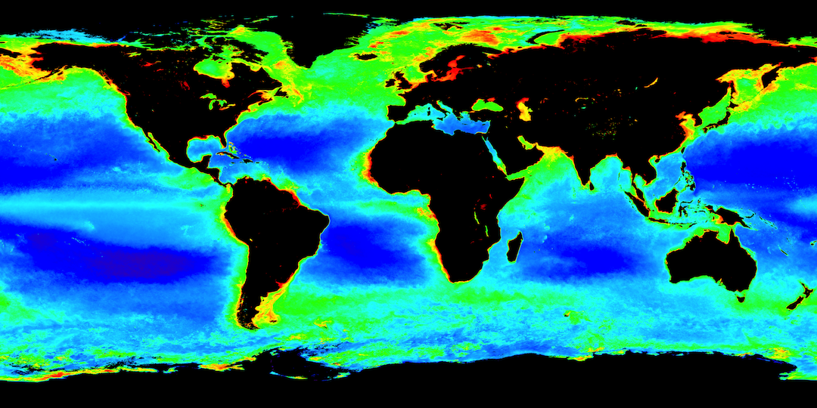

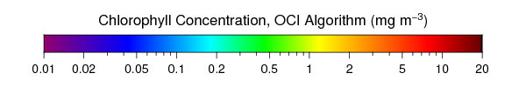
JPSS1 VIIRS Ocean Color
2018 Annual Mean Chlorophyll-a
JPSS1
VIIRS
NASA/OBPG is processing and distributing JPSS1 VIIRS ocean color (provisional)
Same algorithms and suite of products as SNPP VIIRS
Initial vicarious calibration applied
Results in good agreement with SNPP VIIRS, with some biases
Expect reprocessing for calibration update in 2019
SNPP
VIIRS

Slide 14
NASA Ocean Color Reprocessing 2020.0
Planning for Summer/Fall 2019, first major update of algorithms since R2014.0
updates to ancillary data sources
  from NCEP/TOMS-OMI/etc. to MERRA-2 assimilation product
updates to atmospheric correction methods and tables
  multi-scattering aerosol selection, potential use of NIR-SWIR (Ibrahim et al. 2019, Frontiers), improved gas corrections (H2O), bug in Rayleigh tables at extreme solar zenith, error propagation
updates to pure seawater optical properties (nw, aw, bbw)
  apply temperature & salinity dependence (e.g., Werdell et al. 2013), bug in pure-water aw/bbw (off by few nm)
updates to masks and flags
  reduced straylight masking (Hu et al. 2019, JGRO), absorbing aerosol flag based on MERRA-2 transport model
updates to derived product algorithms
  chlor-a coefficient update (Hu et al. 2019, JGRO), pic tables, etc.
new products
  Rrs uncertainties (TBD), new standard products (TBD)

Slide 15
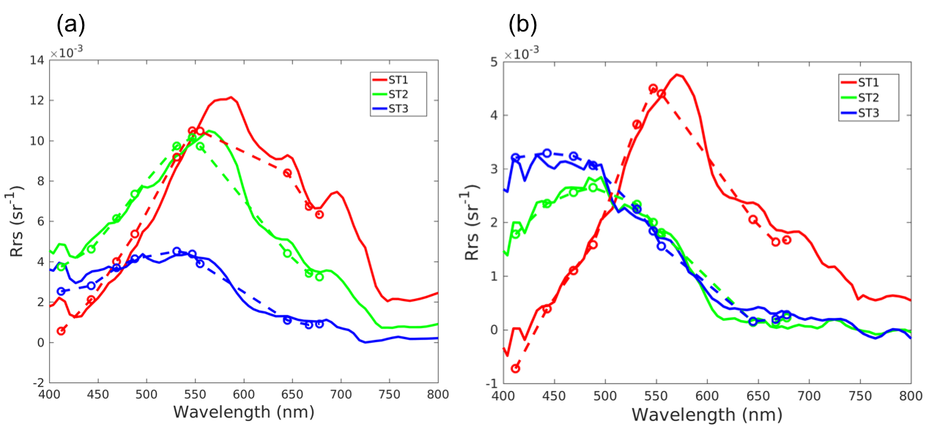
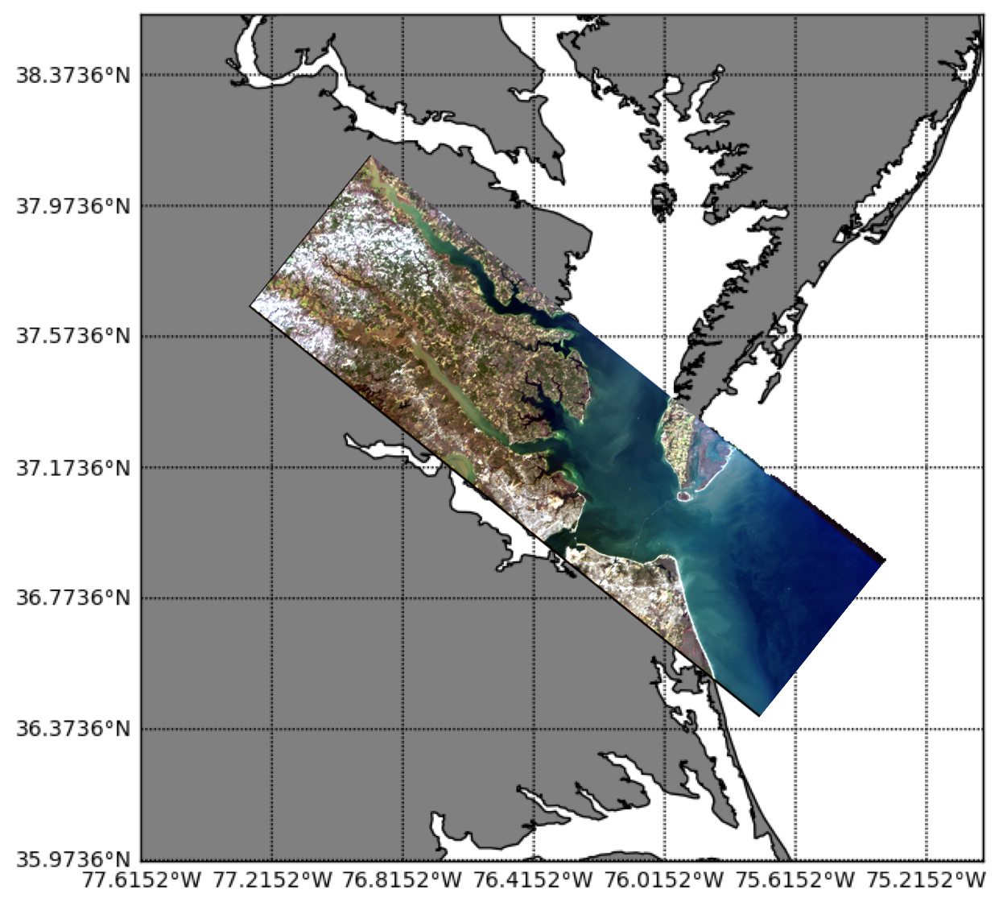
Hyperspectral Rrs(λ) Retrievals from HICO
NASA atmospheric correction approach modified to support hyperspectral Rrs(λ) retrieval, including line-by-line absorbing gas corrections with dynamic water vapor retrieval.
HICO & MODIS Rrs(λ)
HICO
MODIS
Chlorophyll (mg m⁻³)
A. Ibrahim, B.A. Franz, Z. Ahmad, R. Healy, K. Knobelspiesse, B-C. Gao, C. Proctor, and P. Zhai (2018). Atmospheric Correction for Hyperspectral Ocean Color Retrieval with Application to the Hyperspectral Imager for the Coastal Ocean (HICO), Rem. Sens. Env., Volume 204, January 2018.

Slide 16
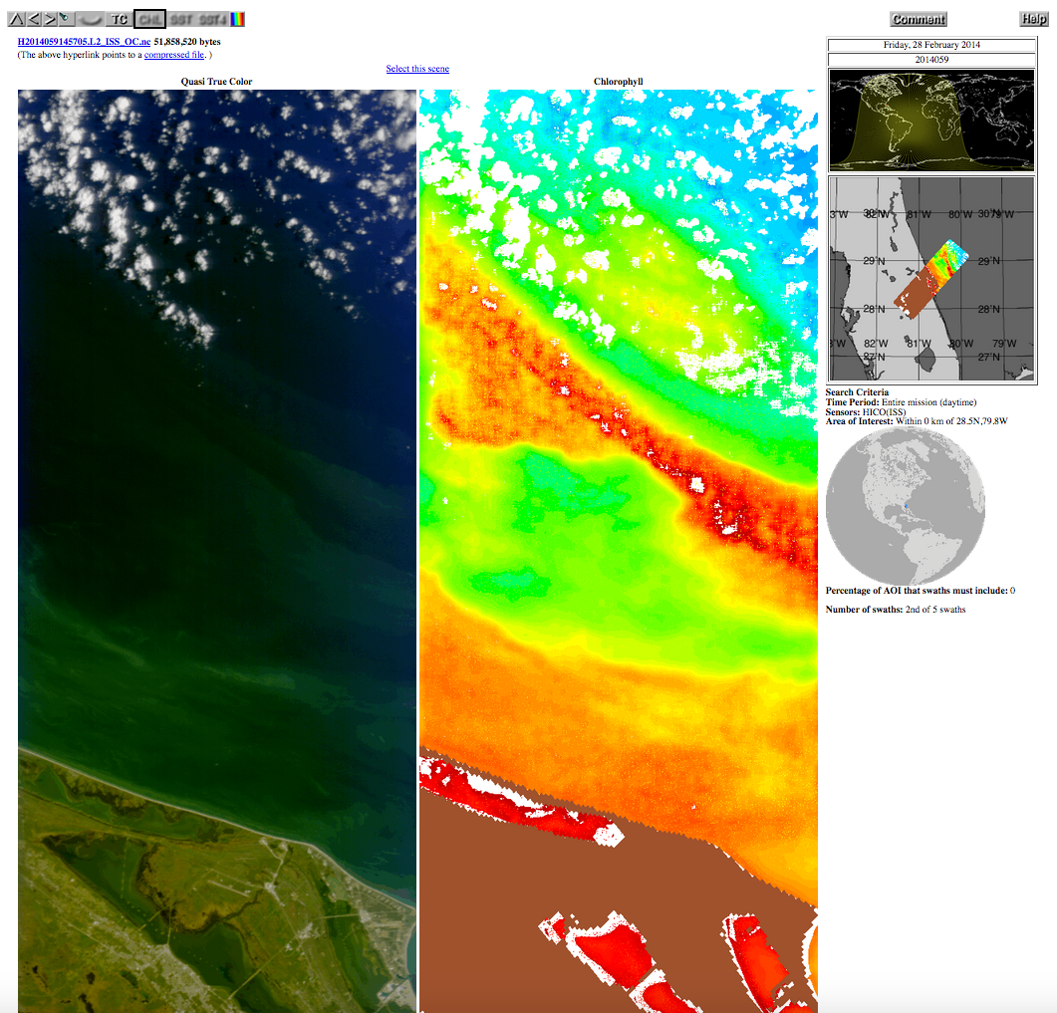
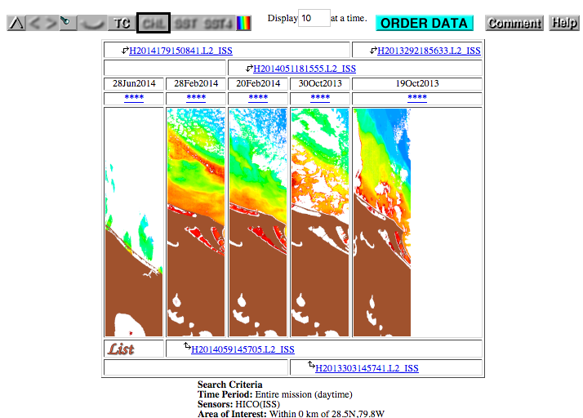
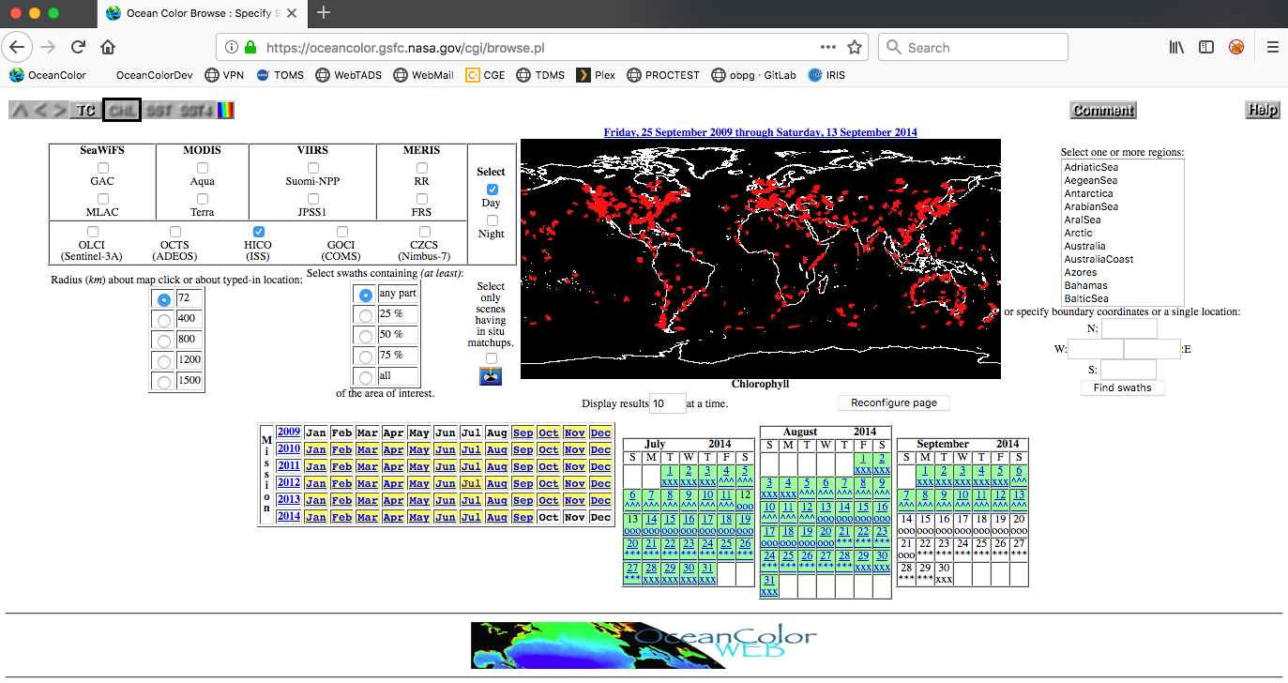
HICO Level-2 Ocean Color Products Now Available
following from PACE ST work to enhance NASA AC algorithm for hyperspectral Rrs(λ)
and many months of staff effort to hand-navigate (bias correct) 10,000+ HICO scenes
complete HICO archive was processed to hyperspectral Rrs(λ) and derived ocean color products (Chl, Kd, PIC, POC)
Level-2 products now available at oceancolor.gsfc.nasa.gov

Slide 17
International Mission Support
COMS-1 GOCI
  continuing full acquisition, processing, and distribution of Level-1B (mirror) and Level-2 ocean color
  anticipate reprocessing with updated vicarious calibration (Concha et al. 2019, IJRS)
GCOM-C SGLI
  ocean color processing capability using NASA algorithms is in current SeaDAS
Sentinel-3 OLCI
  supporting full acquisition and distribution (mirror) of S3A Level-1B, support for S3B is TBD
  Level-2/3 processing still TBD, pending direction from NASA Program Management
  ocean color processing capability using NASA algorithms is in current SeaDAS
Sentinel-2 MSI
  S2A & S2B ocean color processing capability using NASA algorithms is in current SeaDAS
  see Pahlevan et al. 2017, RSE

Slide 18
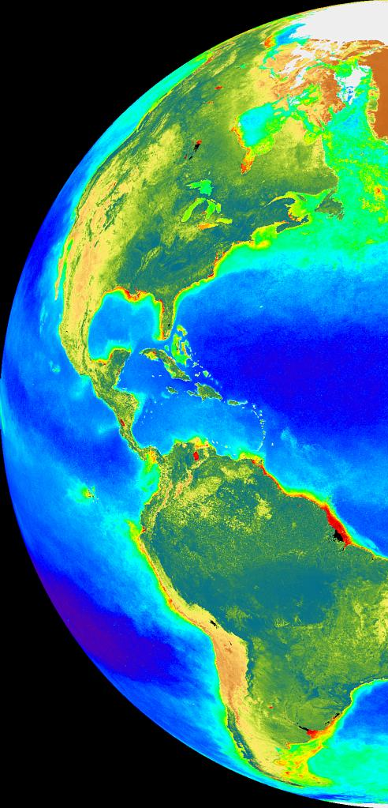
Summary
MODISA, SeaWiFS R2018.0 looking good
SNPP VIIRS showing late-mission drift, reprocessing for calibration update coming soon
JPSS1 VIIRS products now available, first reprocessing for calibration coming in 2019
Next multi-mission ocean color reprocessing, R2020.0, likely to start in Summer/Fall 2019 (significant algorithm refinements)
Check-out the new HICO ocean color products

Slide 19
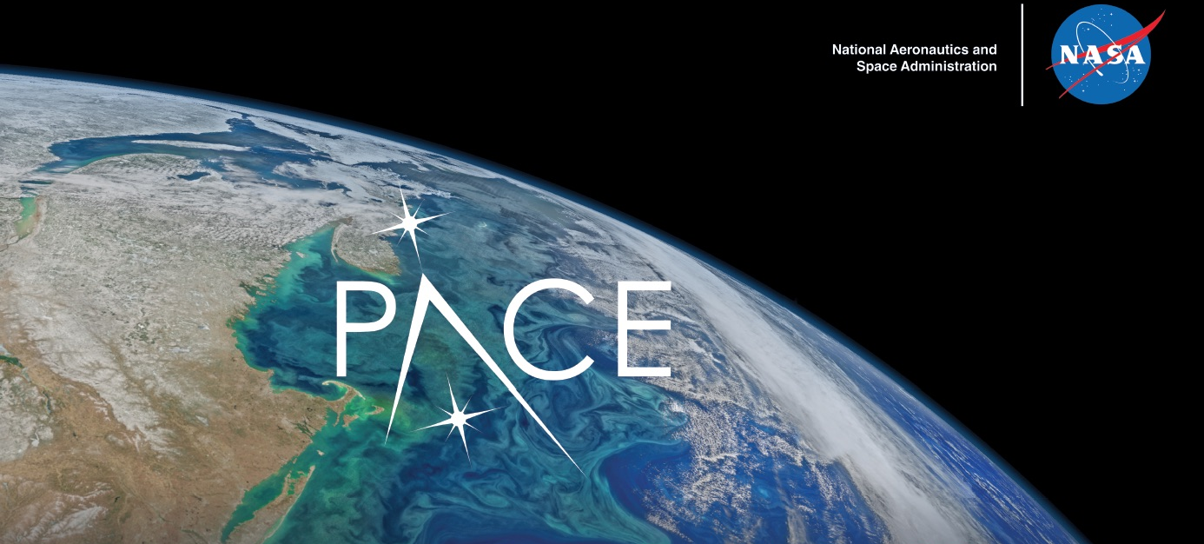
Questions?
Back-up

