Slide 1
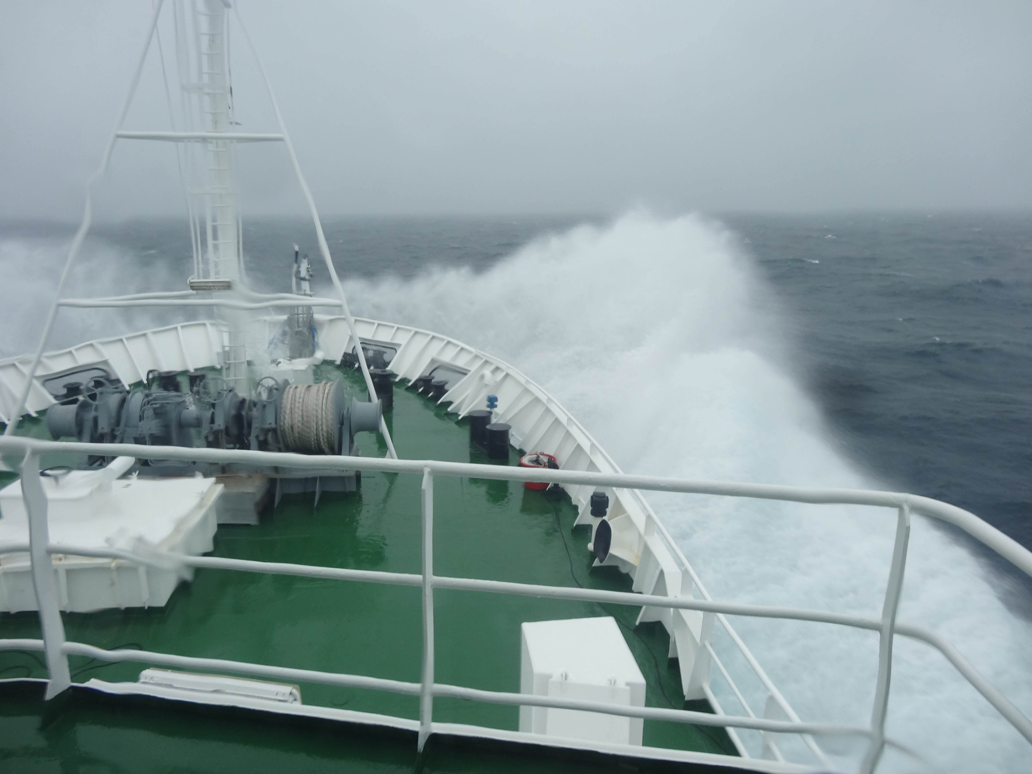
KORUS OC (May 20-June 6, 2016)
The Korea - United States Ocean Color Cruise
Background and update

Slide 2
Chief Scientists:
Wonkook Kim and TK Rho (KIOST)
Joe Salisbury (U. New Hampshire)
Science Leads:
YJ Park, W. Kim, TK Rho, J.H. Noh (KIOST)
A. Mannino (GSFC)
M. Tzortziou (CCNY)
S. Ackleson & D. Gray (NRL, DC)
C. Jordan (LARC)
J. Goes (LDEO)
J. Wei & ZP Lee (UMASS-Boston)
J. Salisbury (UNH)

Slide 3
Objectives:
  1. Validation of GOCI data
  2. Understanding variability at diurnal and tidal time scales
  - particles
  - dissolved material
  - productivity and photo-parameters
  - atmospheric properties
  3. Use results to suggest improvements for the next generation of geostationary satellites

Slide 4
Measurements:
AOP (x2)
Underway rs reflectance
IOP (filtered and unfiltered, x3) includes a, c, bb, VSF
Underway IOP (filtered and unfiltered)
DOC, POM, TSS and properties
bottle nutrients (inorganic and organic), oxygen
bottle optical properties (including aph, ap, acdm)
HPLC (x2)
underway particle imaging (x4)
NPP, NCP and CR
Four 24⁺ hour Lagrangian drifter deployments
Particle size distribution and volume
NO₂, O₃, AOT
Underway LIDAR (410-710nm, 7λ)
Laser fluorometer, Fv/FM (FIRe)
pCO₂, TA, DIC, pH
Overflights Ball MOS-P and GEO-TASO

Slide 5
New science and discovery enabled
High frequency in-water data for diurnal and tidal studies
Dynamic atmospheric data for new atmospheric corrections
Abundance of plastic microspheres and the potential impact to optical retrievals and ecosystems
Nutrients, productivity and optics in Lagrangian time-space
5) Photo-synthetic parameters from Geo-data

Slide 6
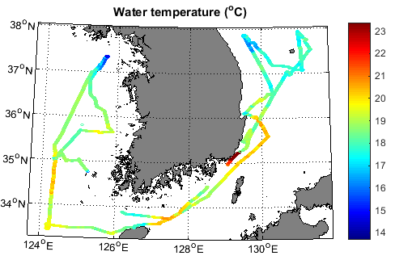
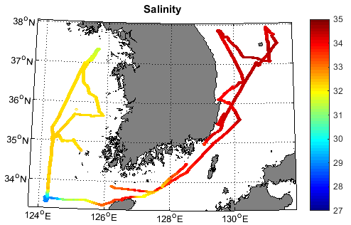
KORUS Cruise track
SST (top) and SSS (bottom) along our cruise track.

Slide 7
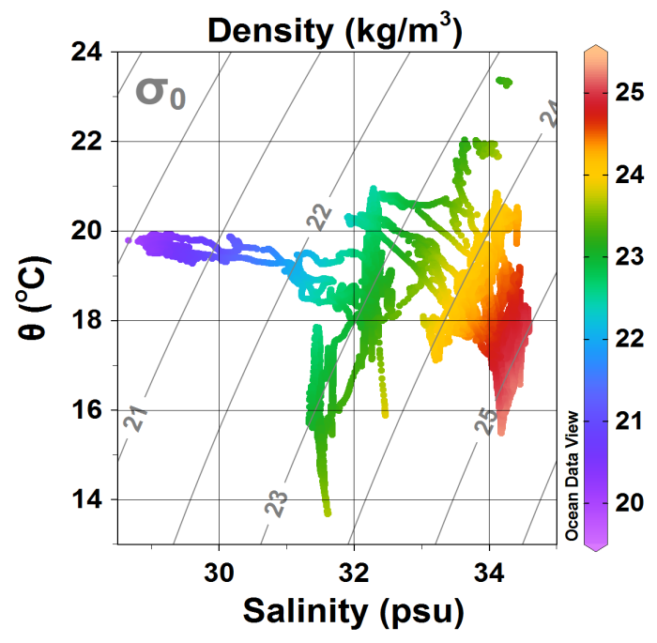
F
G
C
F
D
B
E
H
I
J
A
T-S plot and seawater density showing surface water masses distribution sampled during KORUS Cruise

Slide 8
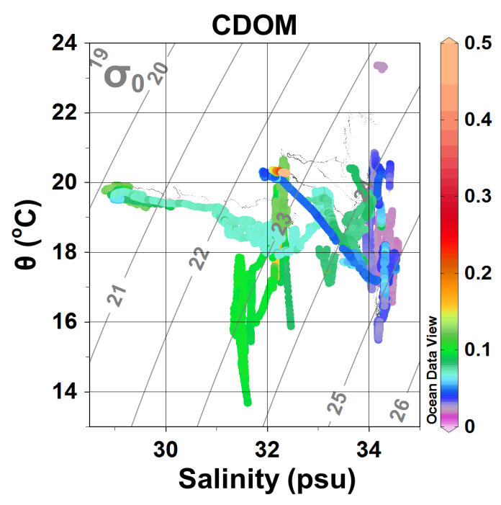
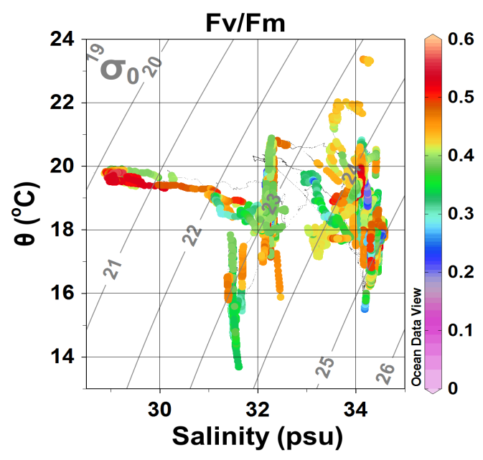
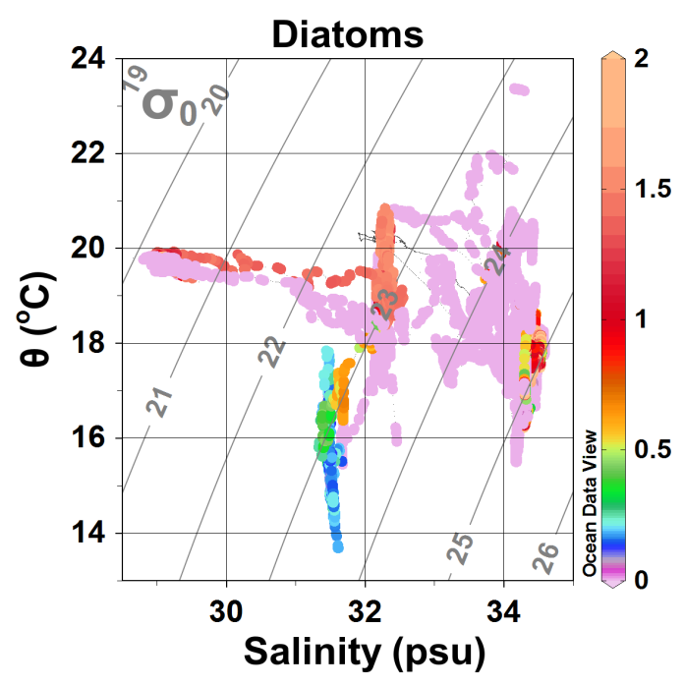
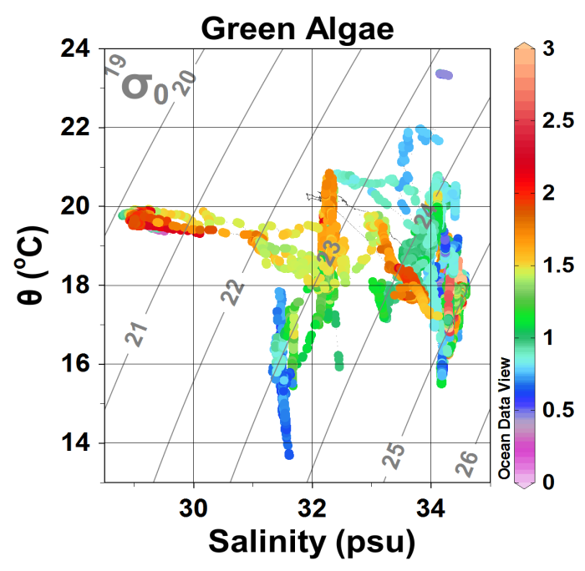
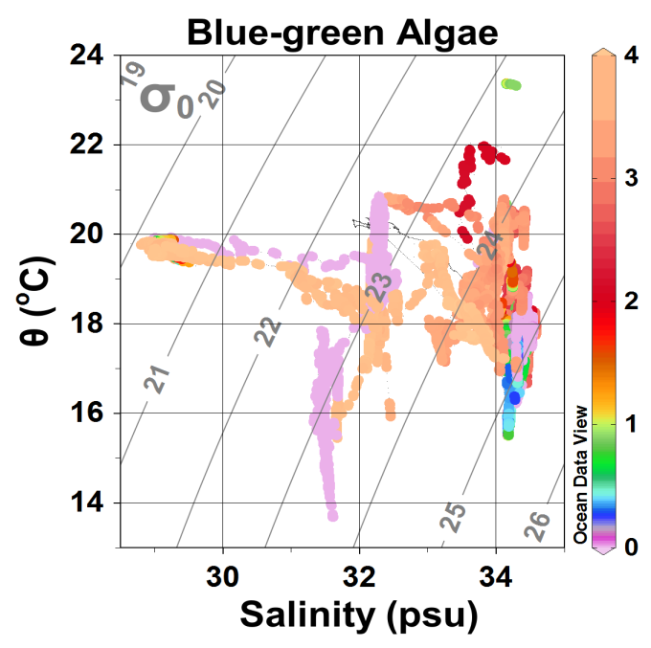
E
G
C
F
D
B
F
H
I
A
Distribution of PFTs in different water masses along the cruise track (Goes)

Slide 9
Several examples of observed diurnal/ M2 tidal variability

Slide 10
GOCI 2016 05 30
RGB from Rrs
660, 555, 443 nm provided by
Nick Tufillaro

Slide 11
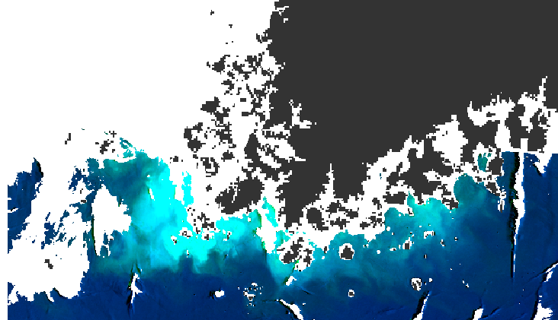

Slide 12
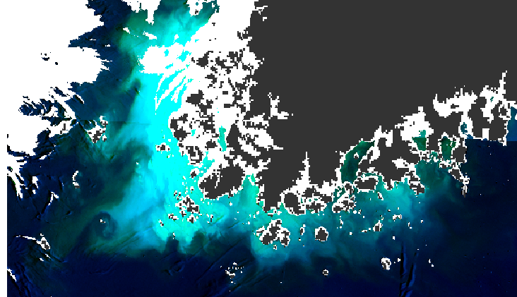

Slide 13
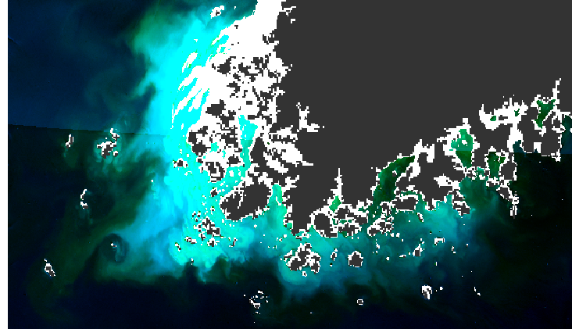

Slide 14
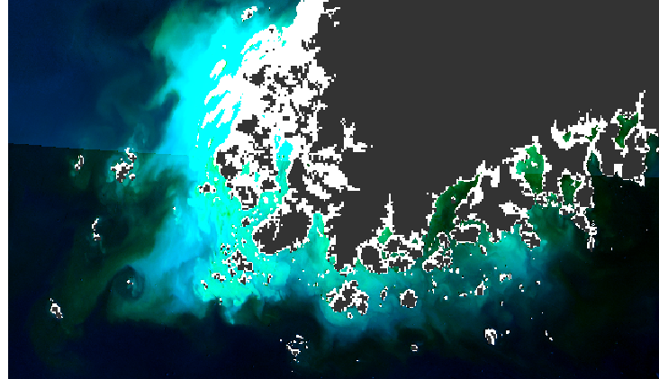

Slide 15
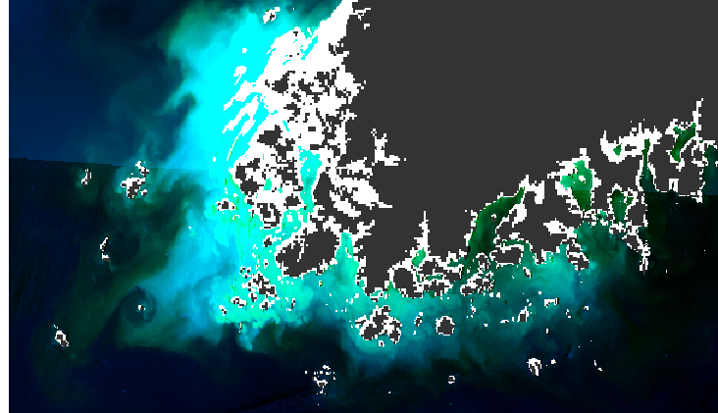

Slide 16
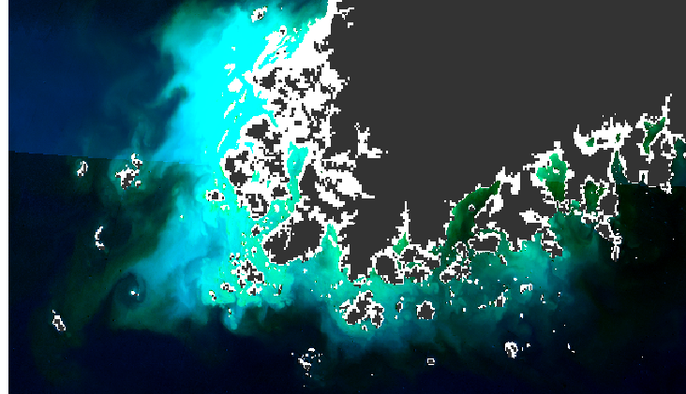

Slide 17
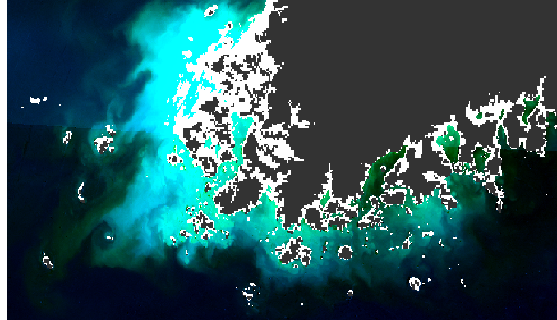

Slide 18
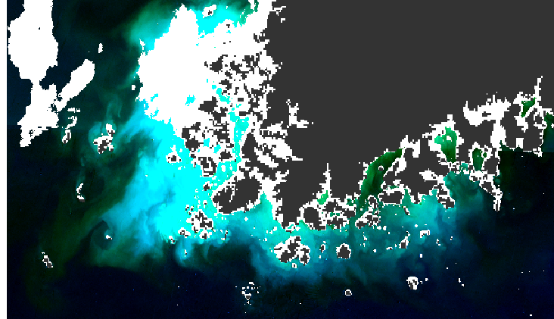

Slide 19
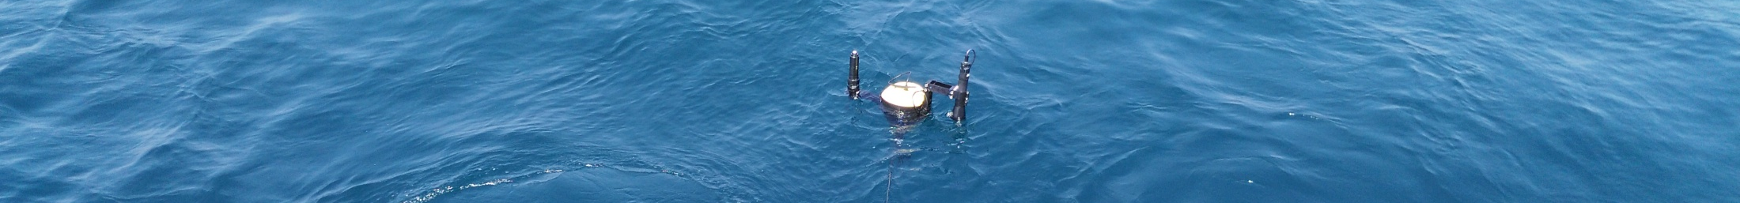
Hourly Variability of Ocean Color (Stn K-011)
J. Wei & Z. Shang. UMASS. Boston
Water-leaving radiance
Remote sensing reflectance
Wavelength (nm)
Local time (hour)
Wavelength (nm)
Local time (hour)
Measured by SBA system

Slide 20
Drifter study 1: Particle and oxygen production track one another
Similar behavior of particles and oxygen
Salisbury, Shellito, Melendez (UNH)

Slide 21
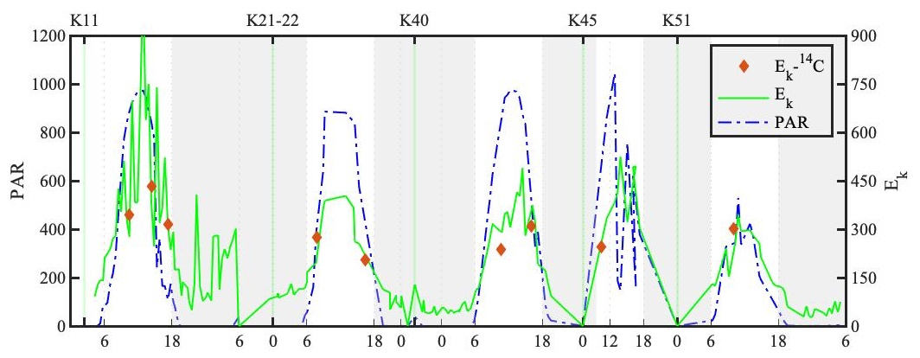
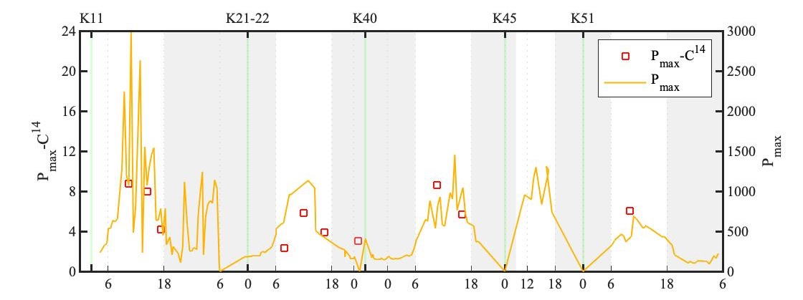
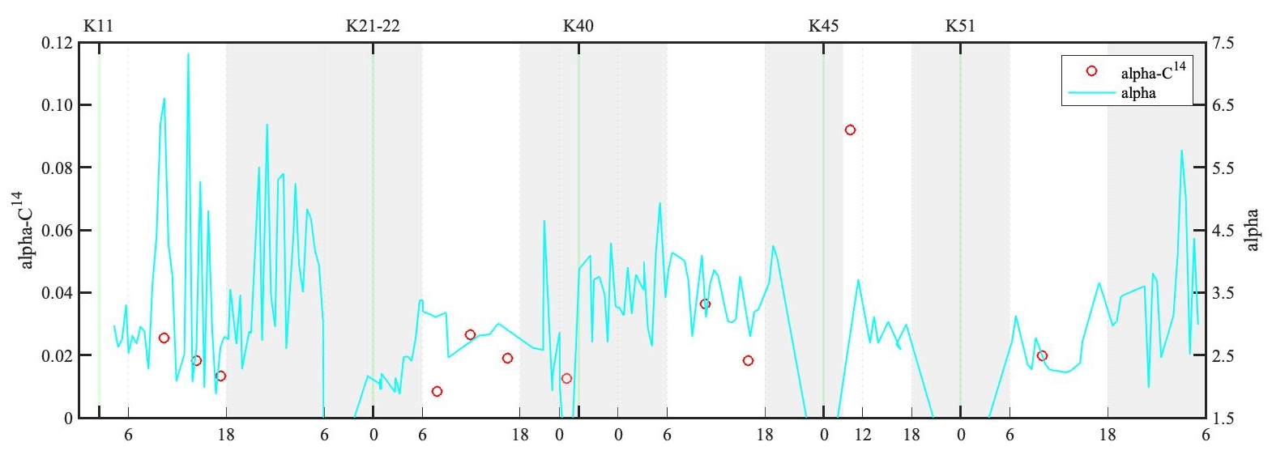
Diurnal nature of photosynthetic parameters (Goes and Noh)
Comparison between ¹⁴C-based and fast repetition rate fluorescence derived estimates of chlorophyll normalized photosynthetic rate parameters E_{k}, P_{max} and α

Slide 22
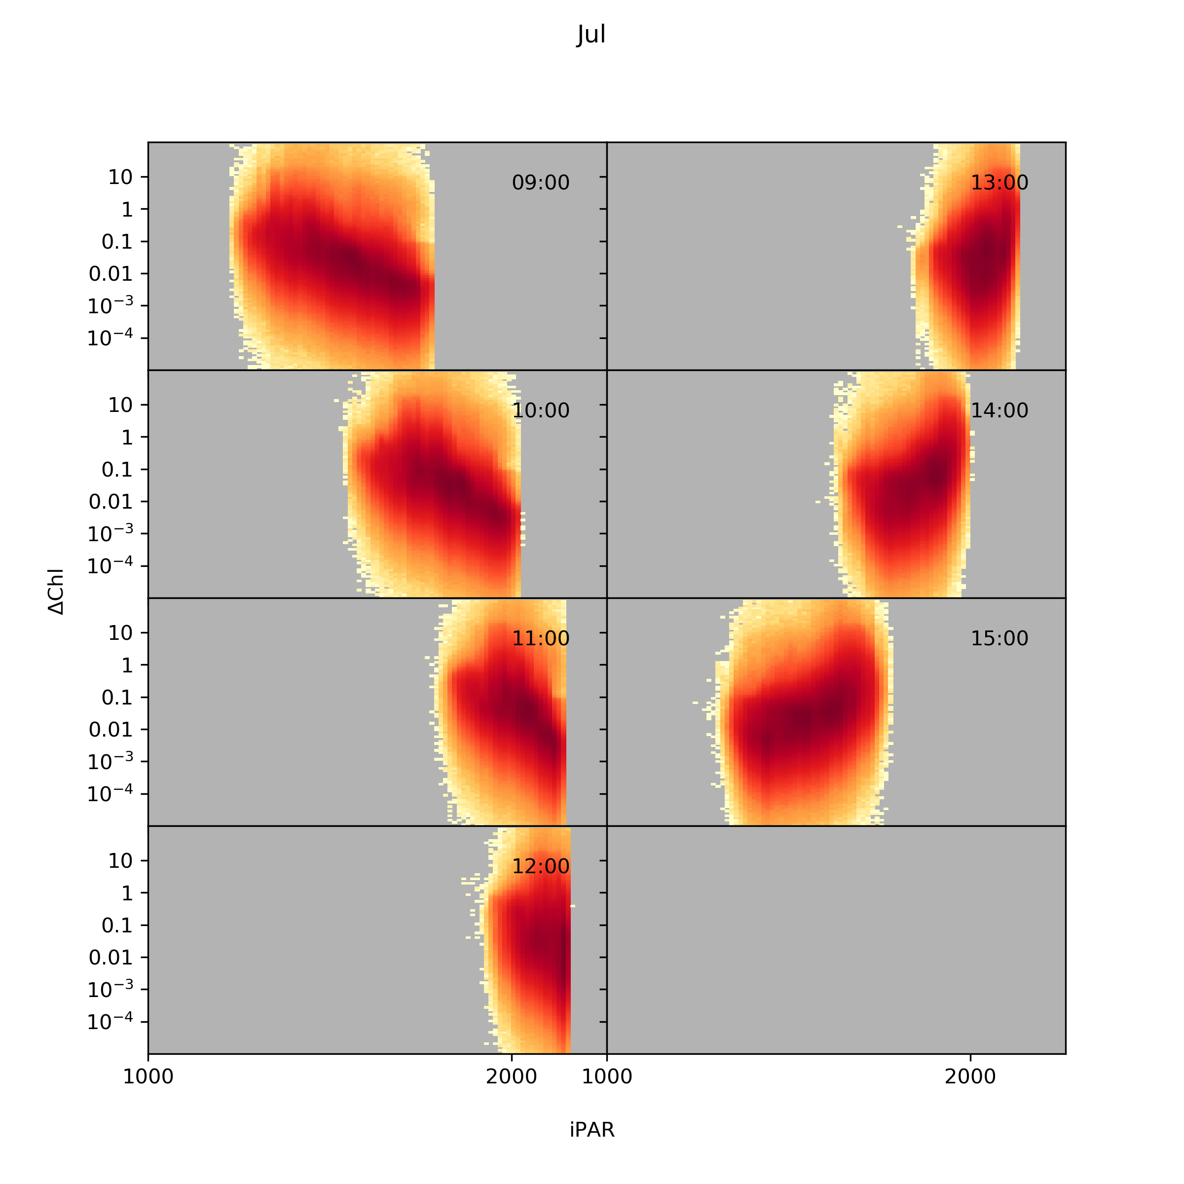
Can GOCI data be used to retrieve photosynthetic parameters?
ipar versus hourly change in chlorophyll
Salisbury, Jonsson, Mannino, Kim et al.

Slide 23
Measurement Highlights

Slide 24
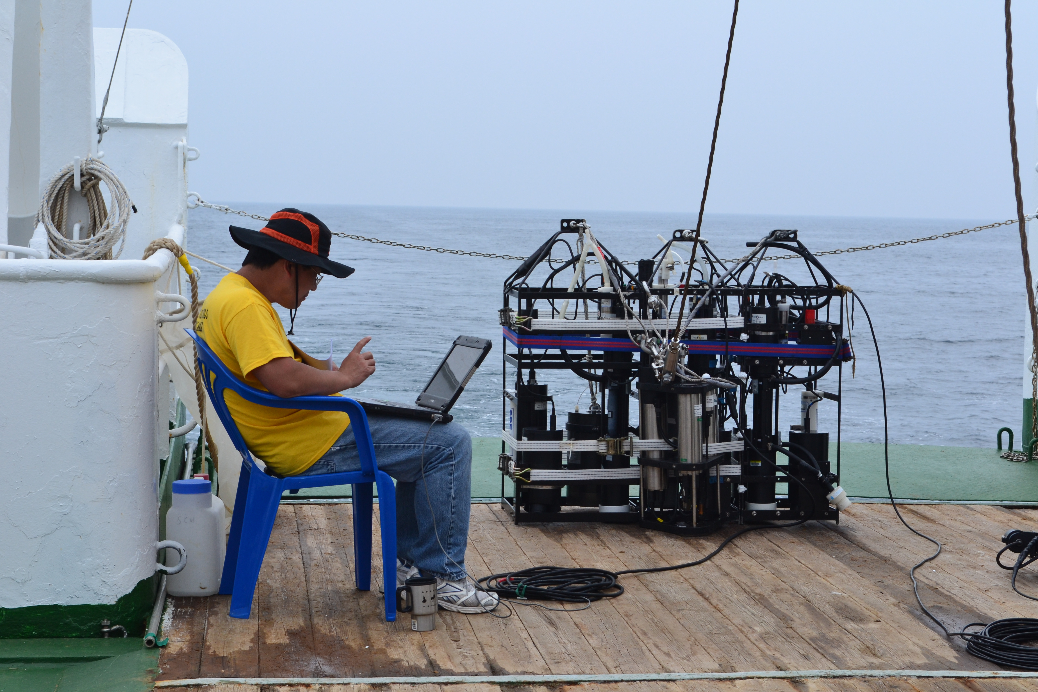
The triple threat IOP rig
UMASS, KIOST, UNH

Slide 25
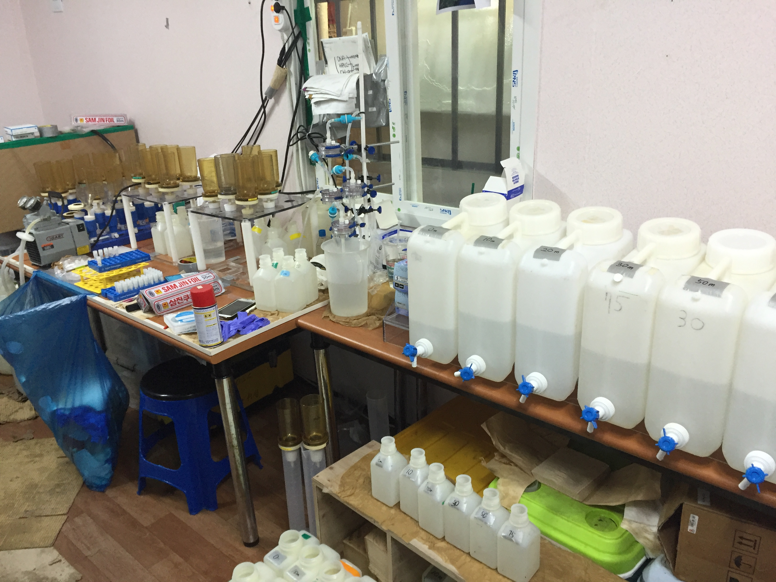
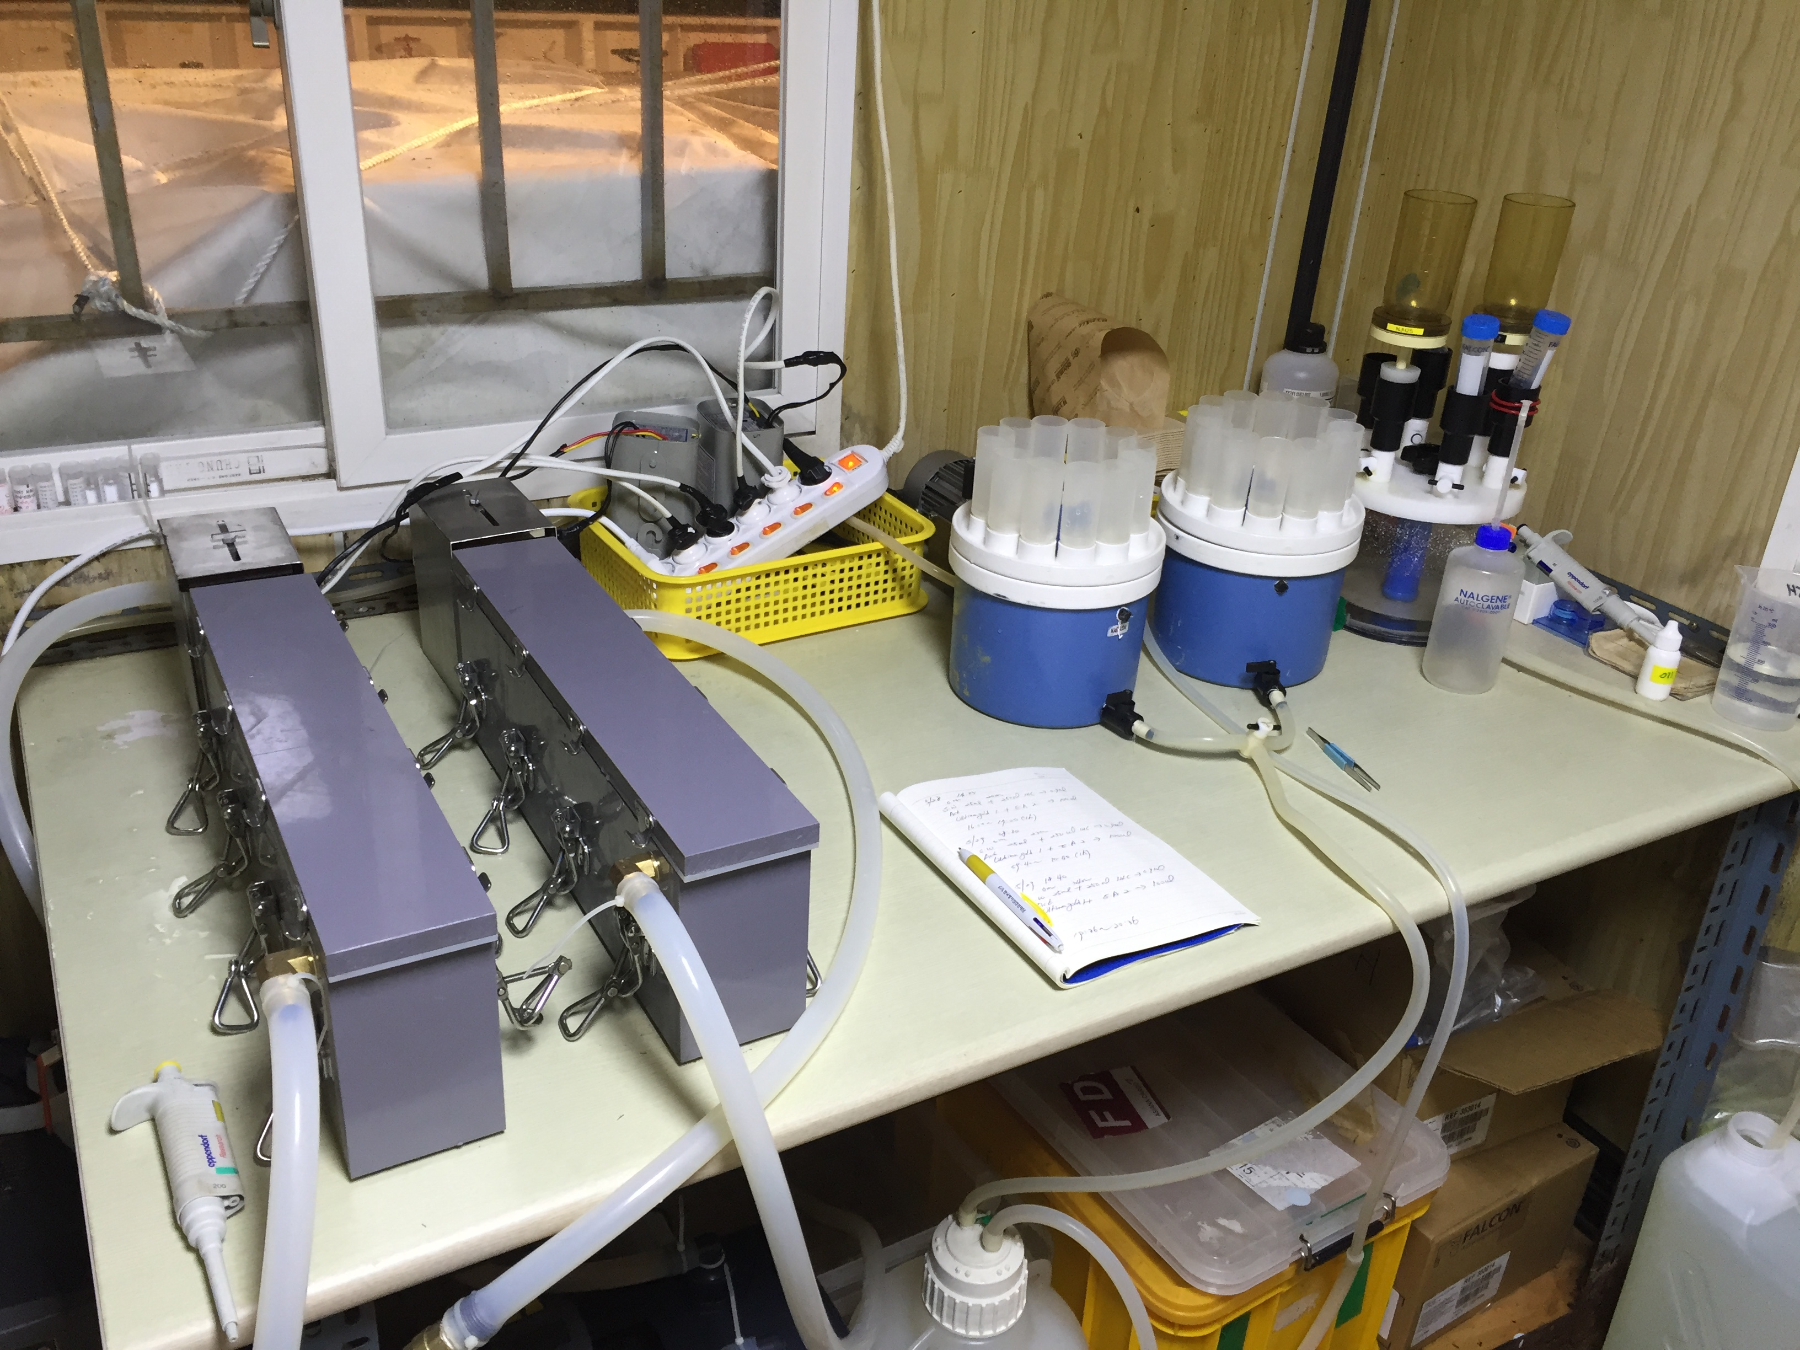
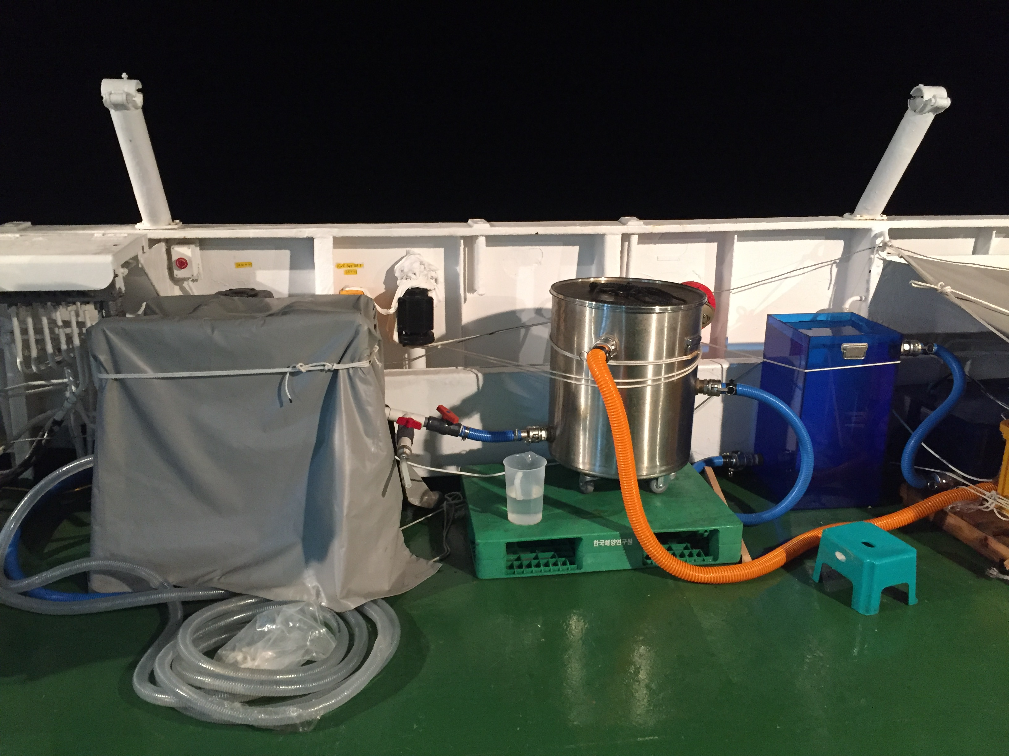
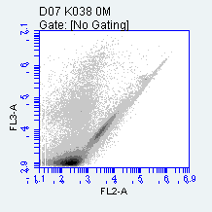
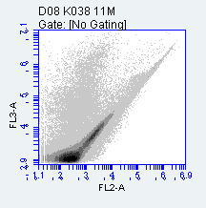
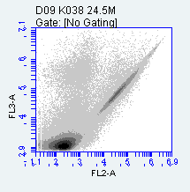
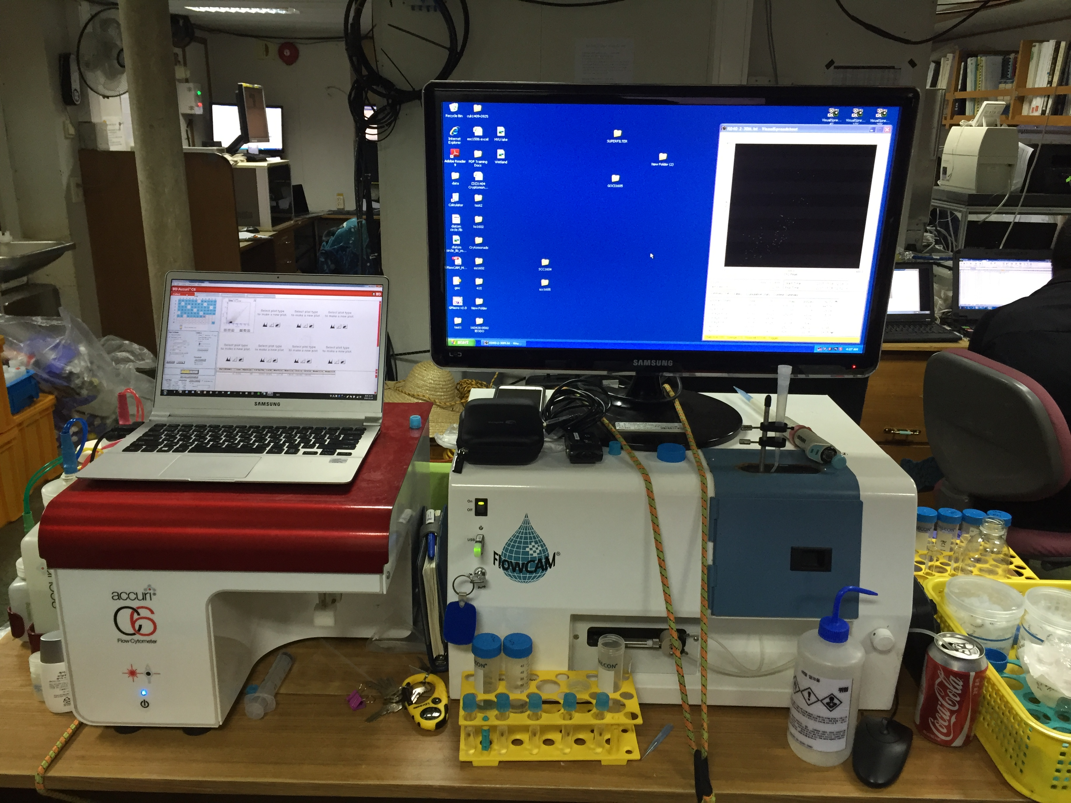
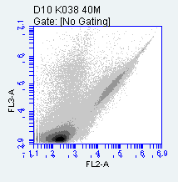
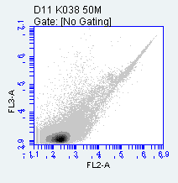

KIOST Biology team - phytoplankton ecology
Filtration for HPLC, Chl-a, and DNA analysis
Measuring net primary production
Underway system using in situ FIRe, SUNA, and FRRF
Flow Cytometer results
Flow Cytometer and FlowCAM
Organisms from FlowCAM

Slide 26
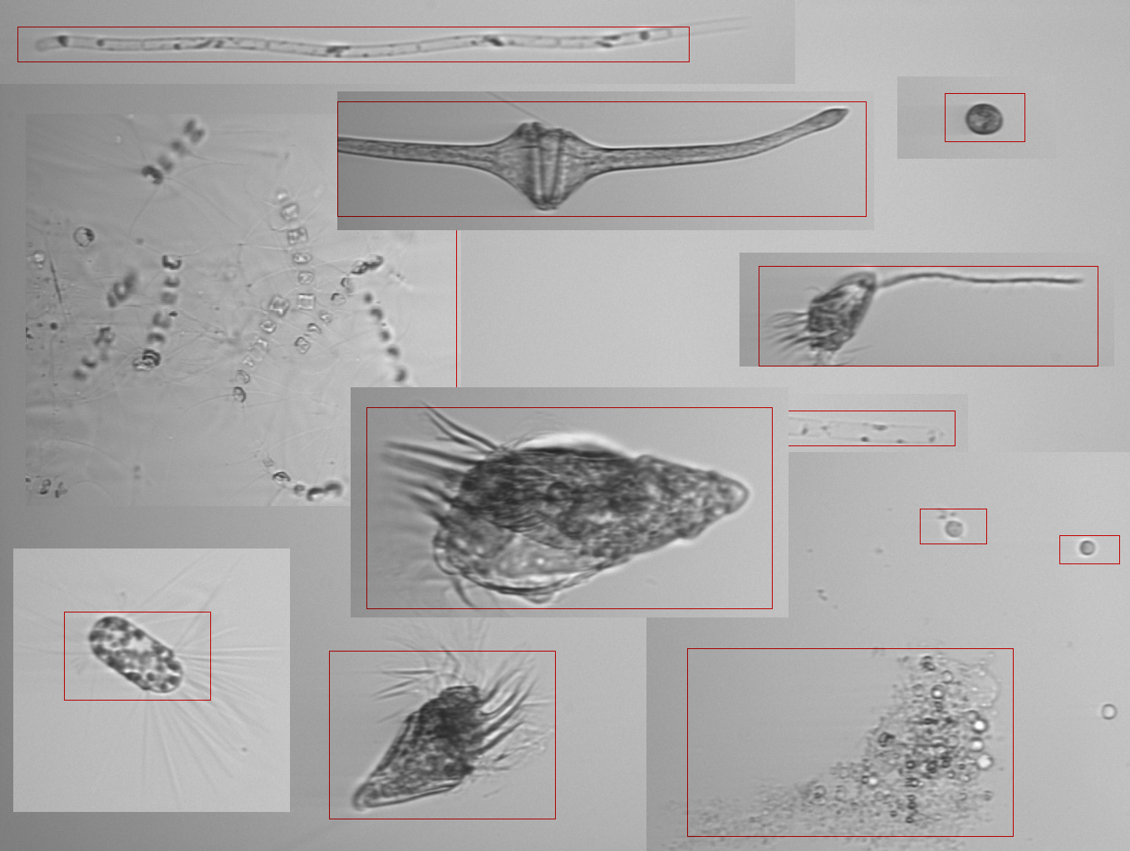
Imaging Flow CytoBot (IFCB) and Phytoplanktons in East Sea
J. Wei & Z. Shang. UMASS. Boston

Slide 27
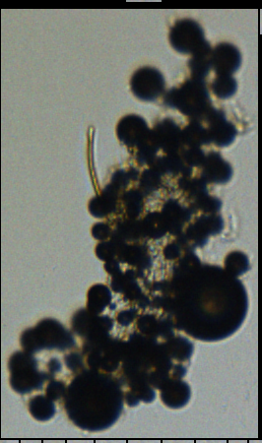
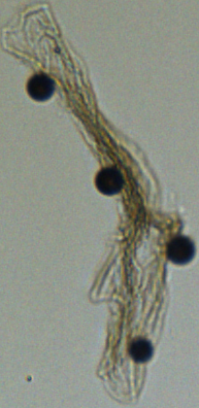

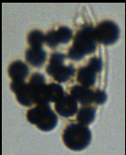

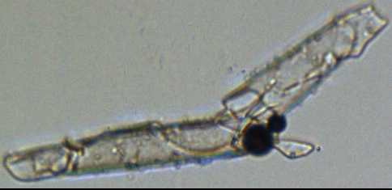
MICROBEADS ADHERING TO PHYTOPLANKTON AND OTHER DETRITAL PARTICLES (J.Goes, LDEO)

Slide 28
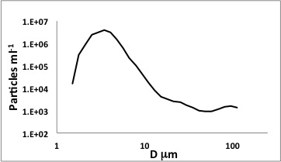
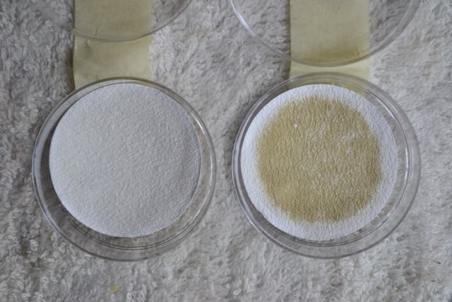
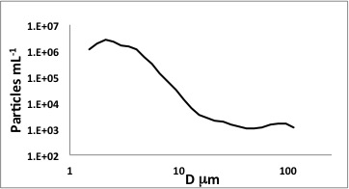
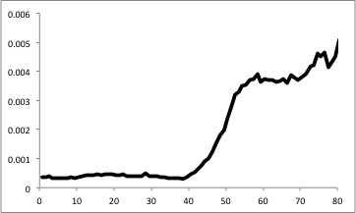
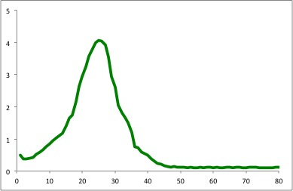
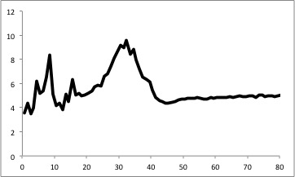
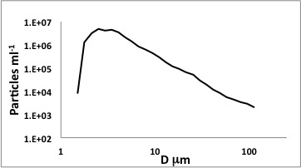
Optical signature of the beads? Ackelson and Gray (NRL)
Chlorophyll
(Fluorometric)
D_{s} μm
(Sauter Diameter)
b_{b}/c 670 nm
Surface layer dominated by organic particles (low b_{b}/c); healthy phytoplankton and micro plastics.
FlowCam (2m)
Microplastic spheres?
SPM Filter (2m)
Sub-surface
Chlorophyll
Maximum
Chlorophyll max dominated by organic particles; healthy phytoplankton at top and a shift to larger aggregates at the base. Micro plastics are also present.
Max particle size is offset downward from depth of Chlorophyll maximum.
FlowCam (25m)
Depth (m)
Microplastic spheres?
Benthic Nepheloid Layer
Benthic nepheloid layer dominated by decomposing cells, aggregates, and inorganic particles (high values of b_{b}/c).
FlowCam (25m)
No microplastic spheres?
SPM Filter (80m)

Slide 29
Overflights of Ball MOS-P and GeoTASO

Slide 30
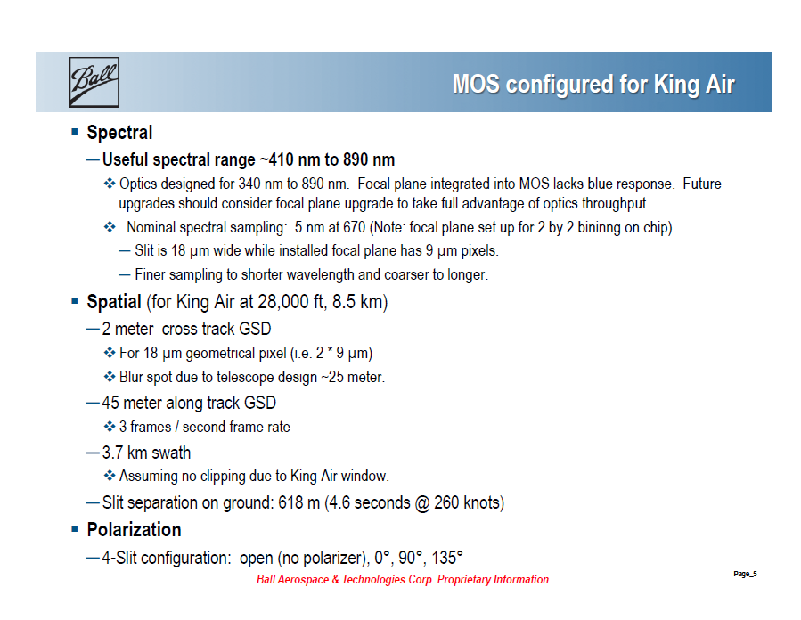

Slide 32
MOS-p: First Look
For Ball Aerospace & NASA KORUS-OC May-June 2016
Nick Tufillaro, Oregon State University
04 September 2016

Slide 33
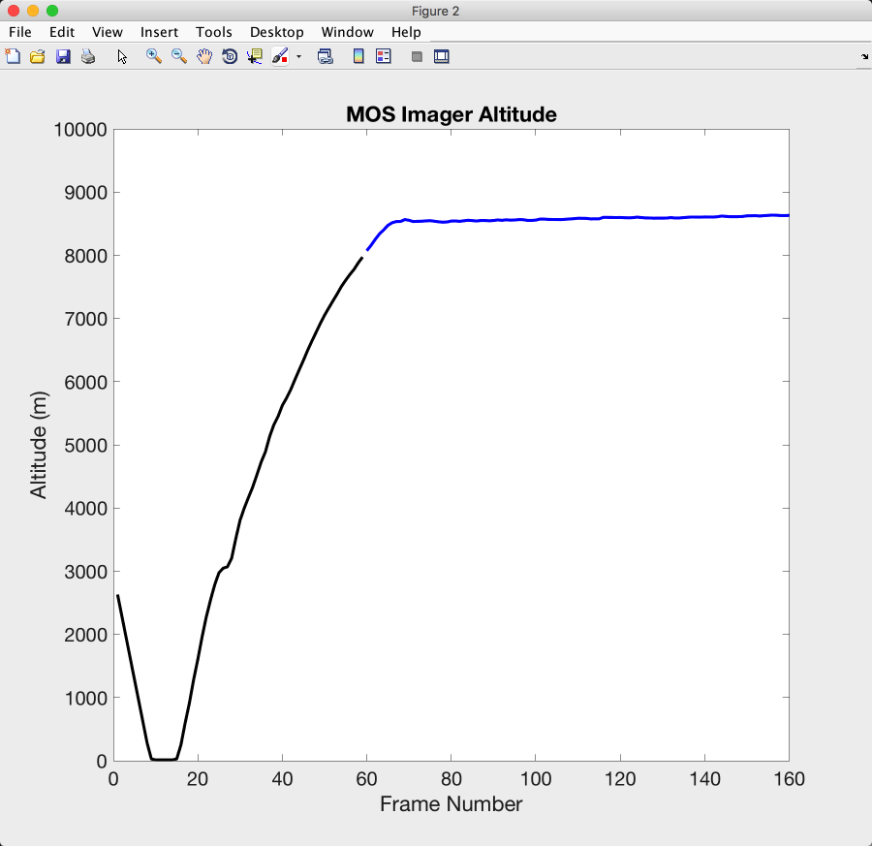
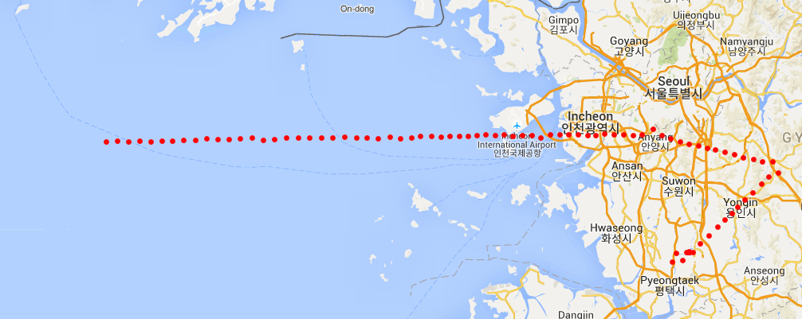

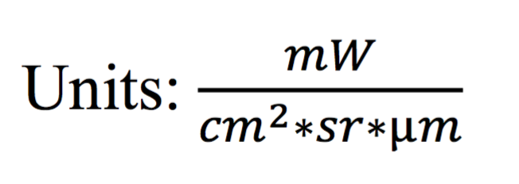
at altitude (8500 m)
climbing

Slide 34
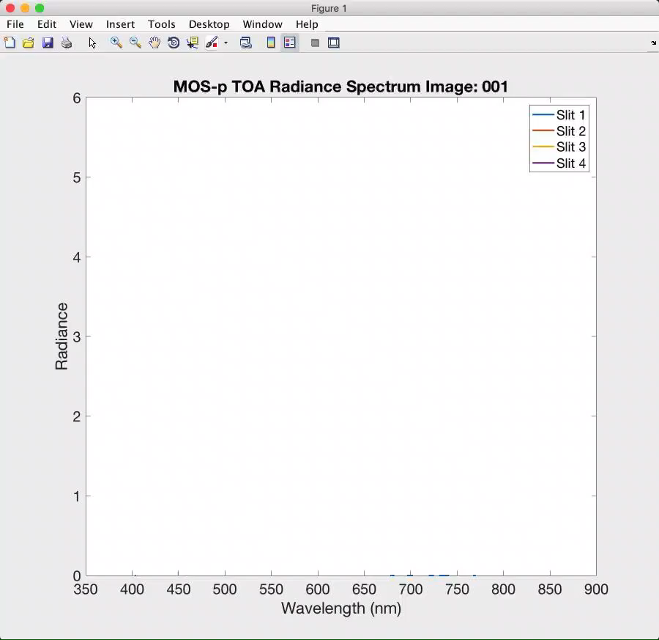
Notes:
Land (20) to coast (high reflectance, 500-600nm, 57-70) to ocean and off shore (70 and beyond)

Slide 35
Trace gas and aerosol and studies in support of
Improved Atmospheric corrections and interdisciplinary studies.
MOS-P spectra

Slide 36
In situ Aerosol Measurements
C. Jordan et al, LARC
Aerosol Scattering at 450, 532, and 632 nm
Aerosol Absorption at 467, 528, and 652 nm
Aerosol Extinction Spectra (300-700 nm)
Water-soluble Aerosol Absorption Spectra (300-700 nm)
Total Aerosol Absorption Spectra (300-700 nm)

Slide 37
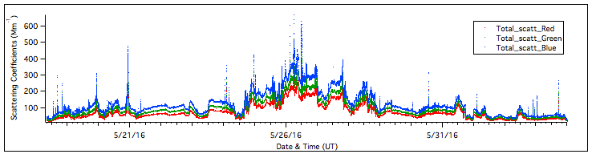

Aerosol Scattering and Absorption Time Series during KORUS-OC

Slide 38

Measurements of Total Column NO₂ and Ozone
with NASA’s shipboard Pandora
Maria Tzortziou
City University of New York & Columbia University LDEO
With: Brian T. Lamb, Ryan Stauffer, Jay R. Herman, Nader Abuhassan, Elena Spinei, Anne M. Thompson

Slide 39

- High temporal and spatial variability in atmospheric NO₂ across these coastal waters
- Large spatial gradients in NO2 column during approach to urban regions, with TC NO2 exceeding 0.5 DU, even in these offshore waters sampled by R/V Onnuri
- NO2 column showed strong diurnal variability at held position offshore Seoul (plot on the right)
Impact on ocean color retrievals
Difference in TCNO₂ between shipboard Pandora and OMI on May 18 2016 and resulting false diurnal variability (%) in ocean R_{rs}
Difference in TCNO₂ over coastal land and coastal ocean offshore Seoul and resulting false diurnal variability (%) in ocean R_{rs}
Notes:
At high solar zenith angles, failure to correct for 1 Dopson unit can propagate into ~200% error in

Slide 40
KORUS-OC R/V Onnuri Trace Gas Measurements
Measurement | Manufacturer | Model | Frequency
Ozone (O₃) | Thermo Electron Corporation | 49C | 1 minute averages
Nitric Oxide and Total Reactive Nitrogen (NO/NO_{y}) | Thermo Electron Corporation | 42C-Y | 1 minute averages
Carbon Monoxide (CO) | Thermo Electron Corporation | 48C | 1 minute averages
Nitrogen Dioxide (NO₂) | Aerodyne | CAPS | 10 second averages
Ryan M. Stauffer
NASA Goddard Space Flight Center, Greenbelt, MD, USA
With: Maria A. Tzortziou, Anne M. Thompson, Carolyn E. Jordan, Brian T. Lamb

Slide 41

Surface Pollution on 26 May
Intense pollution encountered on 26 May, coincident with high aerosol scattering and absorption (previous slides)
Largest O₃ (163 ppbv) and CO (>1 ppmv) values of the campaign
Plumes from coastal industrial and shipping activity (lower O₃, increased NO₂/NO_{y} and CO)
Aged, polluted air. O₃, NO_{y}, and CO all increase together from 1600-1830 KST

Slide 42
Submitted or published:
Gomes, H. do. R., Q. Xu, J. Ishizaka, E. J. Carpenter, P. L. Yager and J. I. Goes (2018) The influence of riverine nutrients in niche partitioning of phytoplankton communities - a contrast between the Amazon River Plume and the Changjiang (Yangtze) River diluted water of the East China Sea. Frontiers in Marine Sciences, 25, https://doi.org/10.3389/fmars.2018.00343
Wei, J., et al. (2019). Derivation of phytoplankton, CDOM and detritus absorption coefficients from the Landsat 8/OLI reflectance in coastal waters. Under review
Wei, J., et al. (2019). Estimation of the remote sensing reflectance at blue bands to improve satellite ocean color observations in coastal waters. Under review
Thompson, A.M., Stauffer, R.M., Boyle, T.P., Kollonige, D.E., Miyazaki, K., Tzortziou, M., Herman, J.R., Jordan, C.N., Lamb, B.T., Duncan, B.N. (2019), Comparison of near-surface NO2 pollution with Pandora total column NO2 during the Korea-United States Ocean Color (KORUS OC) campaign, for J. Geophys. Res. Atmos.

Slide 43
On the way:
W. Kim, J-E Moon, S. Freeman, J. Wei, Z. Shang, A. Mannino (2019)
Assessing Uncertainty in Remote Sensing Reflectance Derived from Multiple Above-Water Hyperspectral Radiometers for Ocean Color Analysis (ready to submit)
S. Ackleson and D. Gray. Shipboard Polarized Spectrometry in Support of Geostationary Ocean Color Remote Sensing.
Goes, J. I., H.do R. Gomes, J. Wu, J. Noh, J. Salisbury and A. Maninno. Estimates of diurnal variations in phytoplankton photosynthetic rate parameters for improved estimates of primary productivity from geostationary satellite observations.
Salisbury J., B. Jonsson, A. Mannino, W. Kim. Geostationary ocean color data reveal diurnal growth and loss of phytoplankton biomass
Fan, Y., Stamnes K., Gatebe, C. W. Li. A machine learning algorithm for GOCI to study diurnal variation in remote sensing reflectance.
Jordan, C., Stauffer, R., Lamb, B., Hudgins, C., Thornhill, K. L., Schuster, G., Crosbie, E., Winstead, E., Anderson, B., Martin, R., Shook, M., Ziemba, L., Beyersdorf, A., Robinson, C., and Corr, C.: New in situ Aerosol Spectral Optical Measurements over 300-700 nm, Part 1: Spectral Aerosol Extinction Instrument (SpEx) Field Validation during the KORUS-OC cruise, in preparation, 2019.
Hill, P. and T. Milligan. Suspended sediment stratification in tidal channels limits upward turbulent mixing of sediment to the surface

Slide 44

Thanks for hosting OCRT and IOCS
Atmosphere
GOCI-II
Earth
Water
Good luck with GOCI 2!
Thanks from all the American KORUS members

