Slide 1
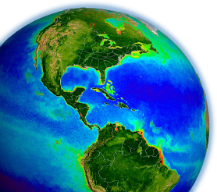
NASA OBPG field program & SeaBASS updates
Jeremy Werdell ¹ & Chris Proctor ^{1,2}
¹ NASA Goddard Space Flight Center
² Science Systems & Applications, Inc.
23 Apr 2012
NASA OCRT Meeting

Slide 2
GSFC Ocean Ecology Laboratory (OEL)
Chuck McClain, Lab Chief
Gene Feldman, Project Scientist for Aquarius, SDPS
data processing & distribution
SeaDAS
Aquarius & NPP Ocean PEATE
Bryan Franz, this AM
Sean Bailey, next talk
Kevin Turpie, today after lunch
Ocean Biology Processing
Group (OBPG)
satellite calibration & validation
SeaBASS
Bryan Franz, this AM
Jeremy & Chris, NOW!
optics & biogeochemistry lab
HPLC lab
Crystal Thomas, today after lunch
field & satellite sensor development
ocean carbon research & laboratory
Antonio Mannino, this PM

Slide 3
field support group
outline (for Jeremy):
field campaigns
contributions to SeaBASS
workshops & training & activities

Slide 4
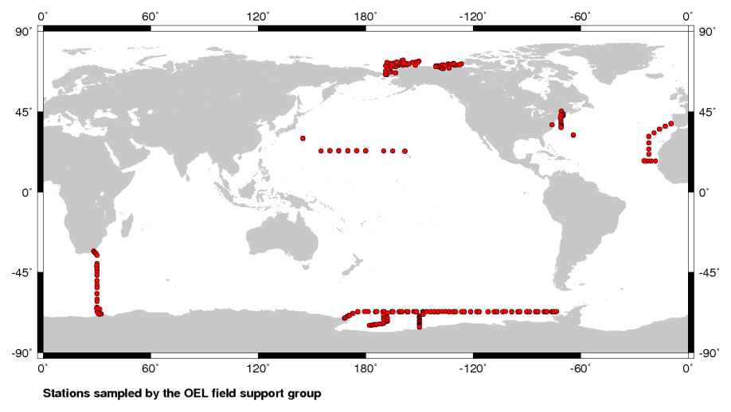
field campaigns
Chesapeake Bay
Bermuda
Gulf of Maine
mid-Atlantic Bight
(2008-2011)
ICESCAPE, Malina (2009-2011)
HK-11-10 (2011)
GEOTRACES (2010)
CLIVAR (2008,2011)
Hawaii, Jun 2012 & NW Atlantic/MAB, Aug 2012 scheduled

Slide 5
contributions to SeaBASS
typically collect AOPs, IOPs, carbon stocks, phytoplankton pigments, hydrography
particulate organic carbon (POC): 313 processed (250 in queue)
dissolved organic carbon (DOC): 168 processed (452 in queue)
suspended particulate matter: 361 processed (103 in queue)
CDOM absorption: 230 processed (103 in queue)
particulate absorption: 501 processed (100 in queue)
radiometery (AOPs): 95 processed ( 27 in queue)
in-water IOPs: 57 processed ( 48 in queue)

Slide 6
workshops & classes & other activities
Ocean Optics Class @ UMaine, Jul 2011
Satlantic HyperPro processing working group (NOAA)
PACE, ACE, Geo-CAPE working groups
SeaHARRE-6
collaboration with SeaBASS Team
CDOM absorption workshop, fall 2012
particulate absorption (proposed for 2013, pending input from HQ &AC)
wet optics laboratory to be built @ GSFC, late 2012 / early 2013
complete or ongoing
planned
considered

Slide 7
SeaBASS
outline (for Chris):
NODC
updates to Web site & FCHECK
data submission updates
instrument / calibration reports
Notes:
Hi everyone. I started working at Goddard last fall and am the new SeaBASS administrator. So if you have questions about SeaBASS and when you’re ready to submit data, I’ll be working with you to receive your files and get them into the database. I’m here to share some of the exciting updates that are happening with SeaBASS. We have some updates that are being made to improve your ability to search SeaBASS as well as some changes to the requirements for data submission.

Slide 8
contributions to the NOAA NODC
SeaBASS follows the NASA Earth Science Data and Information Policy:
SeaBASS data are publicly available
SeaBASS data are for research and education use only
Contributor(s) are extended authorship until the 3-year data collection anniversary
Contributor(s), SeaBASS, and NASA are all to be acknowledged by all users incorporating SeaBASS data into their research (including presentations, proceedings, & publications)
SeaBASS data will periodically be contributed to the NOAA NODC
all SeaBASS data collected prior to 1 Jan 2009 submitted to NODC in Feb 2012
NOTE: proposal PIs maintain ultimate responsibility for (co-I) data submission
Notes:
I want to start by mentioning a few parts of the SeaBASS data access policy. It hasn’t changed for years, but we occasionally get questions about it and I think there was some outdated information floating around on other forums. SeaBASS data can be searched and are publically available once your files are submitted and archived; there’s no special login required to access data. You can read these details on the website.
The other item I wanted to highlight is that SeaBASS data are periodically shared with the NOAA National Oceanographic Database Center. World Ocean Database (WOD). In February we shared the archive prior to 2009. While that database has its own instructions on acknowledging data contributors, in order to help safeguard the 3 year authorship rule, we’re lagging the submission of data by a couple years.
[I have one other note about data submissions from cruises with a PI and Co-I(s). For example, a PI might collect 10 measurements and the Co-I might collect 2 different measurements. The Co-I may submit their data to us directly, however, it is ultimately the responsibility of the PI to make sure that all cruise data is submitted]

Slide 9
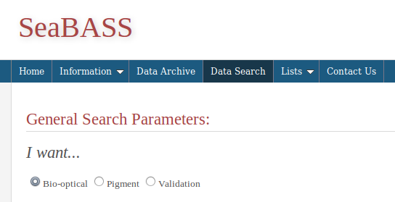
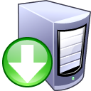
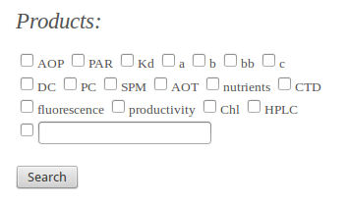
Web site & FCHECK updates
SeaBASS web site → New look and updated features!
Consolidated search engines
Better plotting features
User Resources Page
FCHECK
Helpful scripts
Instrument/Calibration Report Template and Examples
Search Tools
General Search
Bio-optical Search
Pigment Search
Aerosol Search
Cruise Search
Mapping Utility
Historical Pigment Database
Validation Analysis
NOMAD
Validation Search Engine
Validation Data Summary
SeaBAM
find icons, freeware, http://findicons.com/icon/31774/download_server?id=345918#
Notes:
SeaBASS is getting upgraded. It’s due for a facelift. We have a new developer, Jason Lefler. Over the past months he’s been hard at work overhauling SeaBASS from the way it looks to the way it interfaces with the database and provides search results. Layout has been streamlined and the code modernized.
These changes are going to make it easier to perform searches and help you access data. One of the major changes is consolidating the search options. Currently there are 7 “search tools” and 4 options for validation analysis. They were designed with good intentions, but some of them weren’t being used and there was confusion on which ones to use. Instead of all of those menu choices, now there is just a streamlined “Data Search” with more streamlined options to select. We’ve categorized the types of data products you can search for, so for example you can click a box for HPLC files rather than having to wade through a very long list of every parameter in the database and perhaps guess at the naming conventions. We’re also trying to make it easier for you to do some initial evaluations of SeaBASS data by visualization. Jason has improved the plotting features to make it easier to quickly map or graph parameters from one or more files. The satellite validation search and visualization tools are receiving similar upgrades.
We’re adding a new page called user resources. There you’ll be able to find some helpful links and software. If you’ve submitted data to SeaBASS before then you’re probably familiar with FCHECK, the software used to help evaluate the format and quality of incoming files. Right now you have to check your files through email or FTP, we’ll soon be distributing the code so you can run it on your local machines. We’ll also use this page to share a few other helpful PERL and Matlab scripts that can be useful when working with SeaBASS data.
This page will also have examples of instrument and calibration reports which I’ll be talking about shortly.

Slide 10
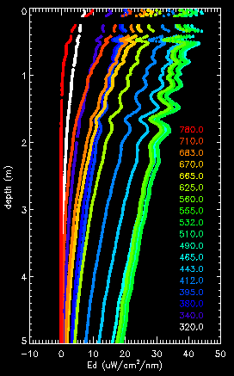
data submissions
new policies, effective immediately
Preference for unbinned data
Submit intermediate products
Examples:
Spectroscopy data
submit absorbance (OD) in addition to absorption coefficients (a)
AC9 data
submit values prior to T, S, and scattering corrections
Submit uncertainty analysis
Notes:
We have a few new policies dealing with SeaBASS data submissions, in order to increase the quality of incoming data. First, whenever possible, please submit unbinned data. This particularly applies to radiometry data. Depending on your instruments and circumstance, we know there are instances where you need to bin data, but please avoid using 1m bins in turbid waters.
We also want to receive intermediate data products as well as fully processed values. That way, in the future it will make it possible for users who want to apply different corrections, replicate the measurements or make other changes. For example, spectroscopy data files should include absorbance (Optical Density), not just absorption coefficients. Depending on the data type you’re working with, there may alternate methods developed to generate final products, such as a new way to calculate a null correction for absorption coefficients, or an alternate calibration to correct for something like temperature (e.g. ac9). Users will have those intermediate data products to work with and be able to apply their choice of methods.
[Brief discussion of uncertainty: Please submit your processing statistics as they are available. We don’t have a 1 size fits all approach, but give us what you can, for example, submit your stats if you’ve performed self-calibrations, or if you’ve done any smoothing or binning and have e.g. at least the standard deviations.]

Slide 11
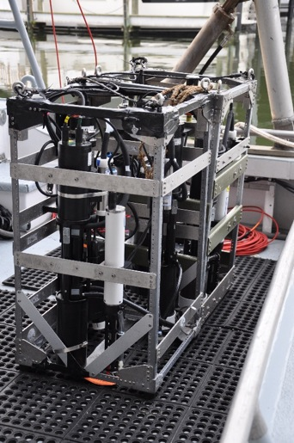
required instrument reports
new policy, effective immediately: Mandatory Instrument/Calibration Reports
Intro
Briefly describe instrument
Calibration/Maintenance
Factory and self cals
Blanks and/or dark readings
Stability/Baseline readings
Deployment/Sample Collection
Field – Measurement methods, package design
Lab – Measurement methods
Data Processing
Data analysis and equations used
Quality control
Additional Info
References, Notes
Factory Calibration
10/05/2007
FLNTUSB-1019
chl(mg/l) = Scale Factor * (Output – Dark Counts)
Dark Counts: 53 counts
Scale Factor: 0.0185 chl (mg/l) / count
Maximum Output: 4100 counts
Resolution: 0.7 counts
Ambient temperature during cal: 22.1°C
Template and examples available online:
http://seabass.sfc.nasa.gov/seabasscgi/user_resources.cgi
% Matlab processing code
% load all instrument files
clear;
% create lists of instrument specific files
lsFLRT1006 = dir(‘*_21*’);
lsFLRT1083 = dir(‘*_22*’);
lsBBFL2 = dir(‘*_bbfl*’);
% Read in data files
For x = 1:size(dir(‘*_21*’),1)
fileName = lsFLRT1006(x).name;
temp = readFLRT(fileName);
flrtRows = size(temp, 1);
…
Notes:
A report that describes calibration and data processing must accompany data submissions. It should include a description of instrument(s), calibrations, deployment information, data analysis and QC methods. While PIs have always been encouraged to submit this information the requirements have been clarified and submission is now mandatory.
The rationale behind this change is to improve the quality of SeaBASS data by allowing for more accurate inter-comparisons of datasets, error propagation and/or alternate analysis methods. Users need as much information as possible. The OBPG group has created a template and a number of example files and they are posted on our new user resources page. Worked with Giulietta. Community review. These don’t need to be submitted for every cruise, but should exist for each experiment and be updated as necessary.
Reports should include enough information so that the reader can understand what steps went into collecting then processing raw instrument measurements into your reported values. [Speak briefly about each section]

Slide 12
acknowledgements
Sean Bailey, Joaquin Chaves, Win Decker, Giulietta Fargion, Scott Freeman, Stan Hooker, Chris Kenemer, Jason Lefler, Antonio Mannino, Chuck McClain, Karen Mitchell, Aimee Neeley, Mike Novak, Crystal Thomas

