Slide 1
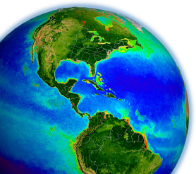
NASA SIMBIOS Experience
International Collaboration
Bryan Franz
and the
NASA Ocean Biology
Processing Group
OCRT Meeting
24 April 2012
Notes:
many things to many people
field program, international field and laboratory protocols, satellite sensor intercomparison studies, data merging
focus on international colaborations

Slide 2
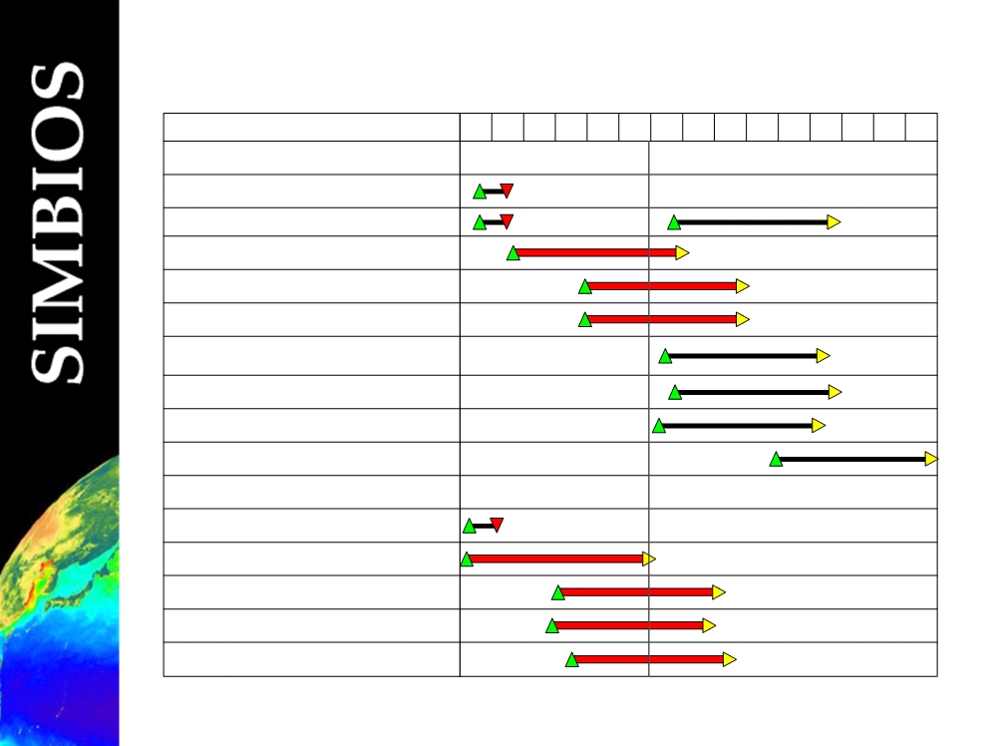
OCEAN COLOR MISSIONS
view in late 1990's
12/10/01
Instrument (Mission; Country)
96
97
98
99
00
01
02
03
04
05
06
07
08
09
10
Global
OCTS (ADEOS-I; Japan)
POLDER (ADEOS-I/II; France & Japan) SeaWiFS (Orbview-2; U.S.)
MODIS (Terra; U.S.)
MISR (Terra; U.S. )
MERIS (ENVISAT; ESA) GLI (ADEOS-II; Japan) MODIS (Aqua; U.S.) VIIRS (NPP: U.S.)
Limited Coverage
MOS (Priroda; Germany & Russia) MOS (IRS; Germany & India) OCI (ROCSAT; Taiwan) OCM (IRS-P4; India)
OSMI (KOMPSAT; South Korea)
Notes:
seawifs follow-on called EOS color axed

Slide 3
Sensor Intercomparison & Merger for Biological & Interdisciplinary Ocean Studies
NASA funded effort from 1996 – 2003
alternative to EOS Color mission (SeaWiFS follow-on)
Goals
Ensure development of internally consistent research products and time series from multiple satellite ocean color data sources
Develop methodologies for cross-calibration of satellite ocean color sensors
Develop methodologies for merging data from multiple ocean color missions
Promote cooperation between ocean color Projects & Missions
Notes:
develop the multi-mission climate data record for ocea biology

Slide 4
Organizational Structure
Distributed Science Team
U.S. participants funded through 3-year NRAs
1997-2000: 21 U.S. and 5 international participants
2000-2003: 21 U.S. and 14 international participants
Centralized Project Office
co-located with SeaWiFS Project **
technical & program management, documentation
science team coordination, contract management
technical interface with other
space agencies: NASDA, CNES, ESA, KARI
organizations: NIST, IOCCG, JRC, DLR
projects: EOS, AERONET

Slide 5
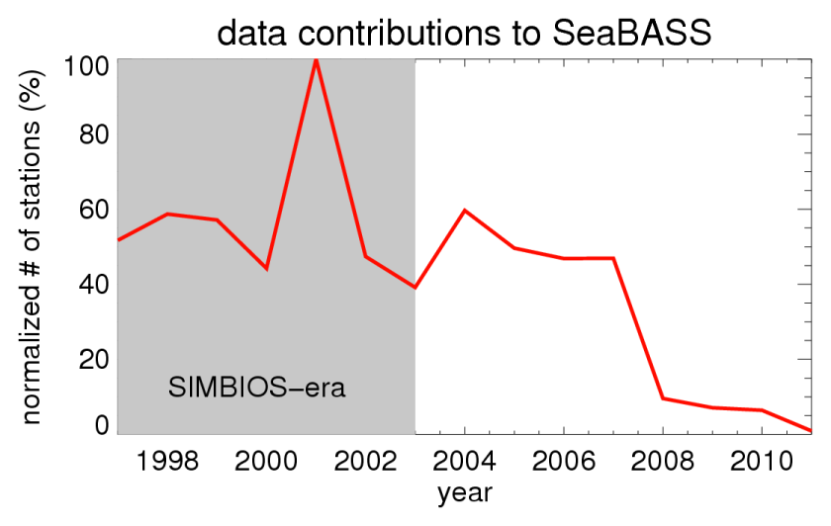
Field Program Collaborations
Oceanographic Field Campaigns
INDOEX (1999)
ACE-Asia (2001)
Contracted Field Investigations
1997-2000: 15 US
2000-2003: 11 US
+ International
SeaBASS (2003)
300,000 pigments
13,500 depth profiles
44 institutions
14 countries
Notes:
300000 pigments, 13000 depth profiles

Slide 6
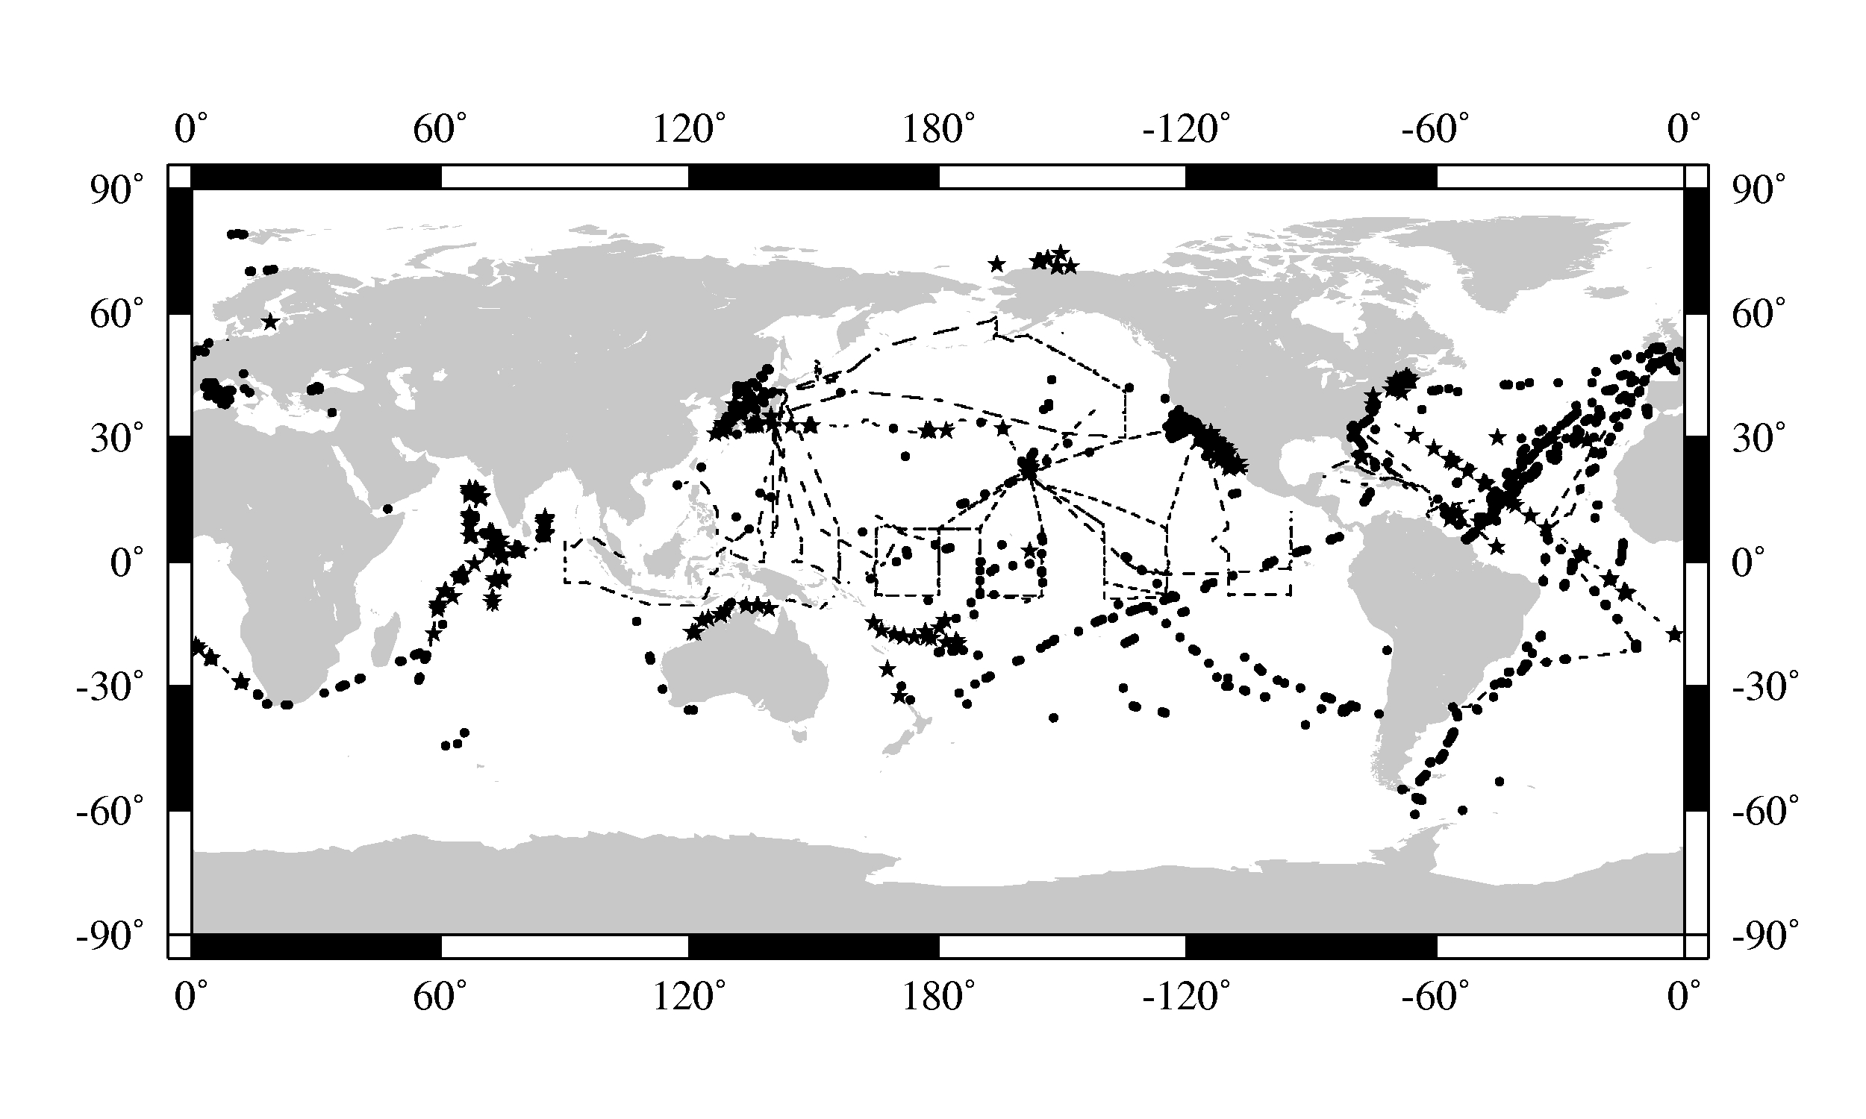
Field Program Collaborations
Marine Aerosols
14 Coastal Cimel stations (transferred to AERONET in 2003)
Instrument pool:
PREDE (Japan), SIMBAD & SIMBADA (France), MicroTops, MPL
Calibration and cross-calibration analyses
Marine Aerosol Network
Notes:
MArine Aerosol Network (MAN)
Calibration facilities at GSFC managed by Project office
also standardization of processing codes

Slide 7
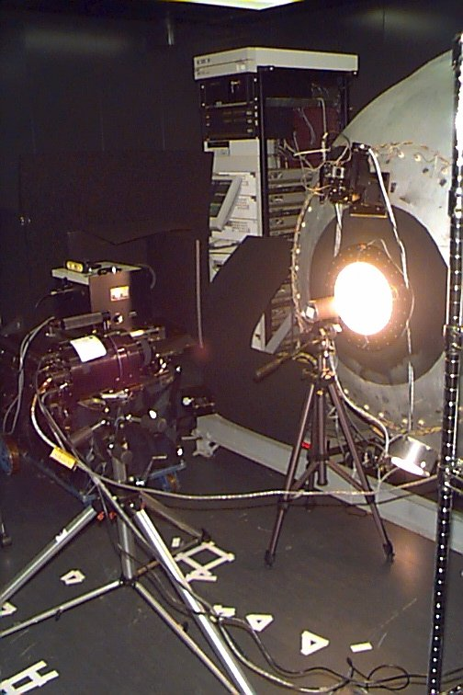
Field and Laboratory Protocols
Radiometric Round-Robin
1997: NASA/GSFC, PML (UK), JRC (Italy), SDSU, Biospherical Instruments Inc., UCSB, NRL, DLR (Germany), NASA/WFF, Satlantic Inc. (Canada)
2001: GSFC, Satlantic Inc., Biospherical Instruments Inc., HOBI Labs, UCSB, NRL, SIO
2002: GSFC, Satlantic Inc., Biospherical Instruments Inc., UCSB, NRL, SIO, MOBY,USF, RSMAS, Wallops & Stennis
Chlorophyll Round-Robin
2000: ONR, UMD, SIO, SDSU, Bigelow, USF, NOAA & NASA/SSC
2001: SDSU, UMD, CNR (Italy), LODYC (France) and BBRS
Ocean Optics Protocols
2000: Fargion & Mueller, Revision 2, NASA TM 2000-209966
2002: Mueller et al., Revision 3, NASA TM 2002-21004
2003: Mueller et al., Revision 4, NASA TM 2003-211621
Aerosol Measurement Protocols
2001: Fargion et al., AOT Protocols, NASA TM 2001-209982
Notes:
sirex-6, simric-1, simric-2 ... sqm, sxr 2%
seahare
significant international input on OOPs
clearly needs to be revisited (IOCCG SWG)

Slide 8
Satellite Mission Collaborations
Data acquisition, processing, and distribution
OCTS acquisition at Wallops (NASDA/Japan)
MOS acquisition at Wallops (DLR/Germany, ISRO/SAC/India)
Instrument calibration, data processing, and algorithms
OCTS global GAC (NASDA/Japan), full mission reprocessing
OSMI (KARI/Korea) processing software and instrument calibration
OCTS-POLDER cross-calibration (NASDA/Japan, CNES/France)
MOS-SeaWiFS cross calibration and algorithm development, destriping
Instrument/algorithm workshops
Japanese-US Working Group on Ocean Color (JUWOC)
MOS Ocean Color Meetings (1998-2000)

Slide 9
Lasting Impact: NASA's Sensor-Independent Approach
ancillary data
sensor-specific tables:
Rayleigh, aerosol, etc.
SeaWiFS L1A
MODISA L1B
MODIST L1B
OCTS L1A
MOS L1B
OSMI L1A
CZCS L1A
MERIS L1B
OCM-1 L1B
OCM-2 L1B
VIIRS-L1B
observed
radiances
Multi-Sensor
Level-1 to Level-2
(common algorithms)
in situ water-leaving
radiances (MOBY)
water-leaving
radiances and
derived prods
predicted
at-sensor
radiances
Level-2 Scene
vicarious calibration
gain factors
Level-3 Global
Product
Level-2 to Level-3
Notes:
because of SIMBIOS, we started from a multi-sensor viewpoint
evolved to what we have today

Slide 10
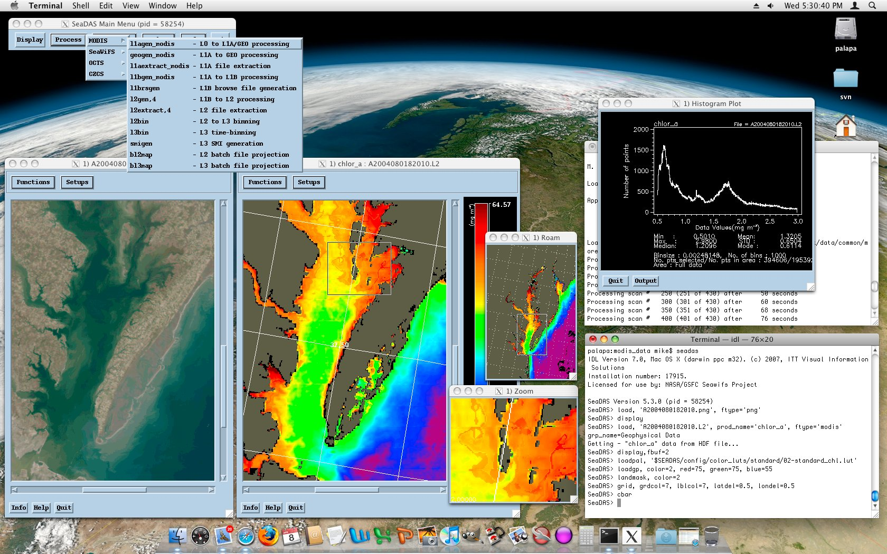
Lasting Impact: SeaDAS Multi-Mission Support
Notes:
multi-mission transformation
open source software

Slide 11
Lasting Impact: International Community
over 18,000 posts and 14.5 million views since 2004
Notes:
key to efficiency and community engagement

Slide 12
What Worked
Centralized project office to coordinate activities
including budgetary control
Satellite Project a full partner in the international effort
able to implement new products and algorithms from international team
not restricted to mission-specific Science Team input
Funded investigators required to submit data to SeaBASS
contractual obligations
Open Data Policies
unrestricted access to satellite data (SeaWIFS, MODIS)
unrestricted (delayed) access to in situ data (SEABASS)

Slide 13
What Worked
Annual meetings
working level, focused, technical, & documented
Visiting scientists to address specific topics
focused activities, exchange ideas, implement, and test algorithms
Antoine & Morel (f/Q algorithm evaluation)
Tanaka & Fukushima (OCTS & GLI, cal/val & processing)
Hagolle & Nicolas (POLDER implementation)
Kim (OSMI implementation, cross-calibration)
Neumann (IRS-P3/MOS processing stream)
Zibordi, Deschamps, Yamamoto, Kopelovich
Distributed, open source software
common software framework enabling collaboration and sharing
Notes:
more like workshops, people were engaged

Slide 14
