Slide 1
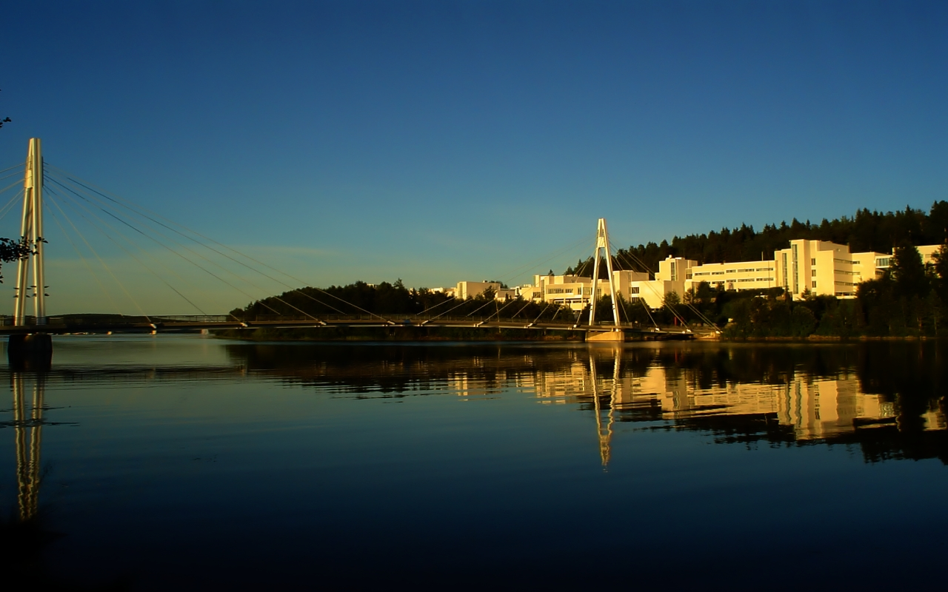
Suomi National Polar-orbiting Partnership (NPP) VIIRS data product assessment
K. Turpie
Ocean Color Science PI
VIIRS Ocean Science Team (VOST)
Ocean Color Research Team Meeting
23 April 2012
Seattle, Washington
Notes:
Shown is Jyväskylä University.

Slide 2
VIIRS Ocean Science Team (VOST)
Robert Barnes
Gene Eplee
Gwyn Fireman
Bryan Franz, Co-I
Chuck McClain, Admin PI
Gerhard Meister
Fred Patt, PEATE Tech Lead
Wayne Robinson
2

Slide 3
Table of Contents
VOST Efforts
The VIIRS Instrument
VIIRS Data Features
VOST Calibration
Initial Results
Conclusions
5
12
20
24
29
33
3

Slide 4
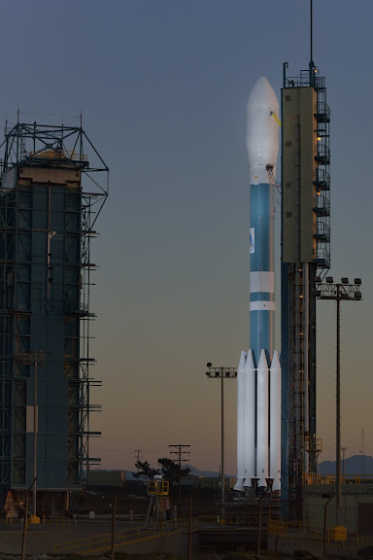
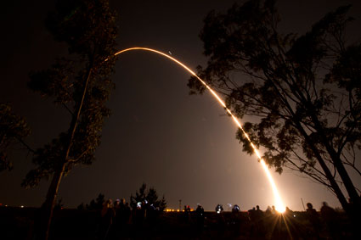
Since the last OCRT Meeting
Suomi NPP Successfully Launched!
5:48 EDT 28 October 2011
4

Slide 5
VOST Efforts
5

Slide 6
VOST Contributions 2003-Present
Reviewed numerous project documents
Reviewed science and operational code
Successfully advocated instrument improvements
Performed multiple analyses of the effect instrument performance on data quality
Presented findings at numerous technical conferences
Participated in test planning and data analysis
VIIR ocean color data product quality assessment
Development of time-dependent calibration
Generation of VIIRS data products using NASA algorithms
6

Slide 7
VOST Contributions 2003-Present
Reviewed numerous project documents
Reviewed science and operational code
Successfully advocated instrument improvements
Performed multiple analyses of the effect instrument performance on data quality
Presented findings at numerous technical conferences
Participated in test planning and data analysis
VIIR ocean color data product quality assessment
Development of time-dependent calibration
Generation of VIIRS data products using NASA algorithms
Blocking Earth shine thru the calibrator screen
Clear water calibration site
Lunar calibration maneuvers
Significant reduction of optical crosstalk
End-to-end calibration system test
Spectral response characterization with SIRCUS
Characterization of crosstalk polarization effects
Improved polarization response characterization
7

Slide 8
VOST Contributions 2003-Present
Reviewed numerous project documents
Reviewed science and operational code
Successfully advocated instrument improvements
Performed multiple analyses of the effect instrument performance on data quality
Presented findings at numerous technical conferences
Participated in test planning and data analysis
VIIR ocean color data product quality assessment
Development of time-dependent calibration
Generation of VIIRS data products using NASA algorithms
Ocean color sensitivity analysis techniques
Crosstalk impact analysis
VIIRS Data Simulator
Predict impact of instrument effects.
Prepare team for flight data.
Exercise processing system prelaunch.
8

Slide 9
Product Quality Assessment
VOST Question: Is the quality of the operational VIIRS Ocean Color Environmental Data Records (EDR) sufficient to meet NASA science objectives, including the continuation of the climate record established with EOS?
Approach: Evaluate prelaunch sensor characterization, algorithms, calibration and processing capabilities and compare EDR products against products generated with NASA calibration and algorithms.
Answer: Unlikely. Sensor appears to be performing well, but :
EDR algorithms are out of date and inconsistent with established record,
calibration is forward-looking only, and
there is no support for reprocessing.
Also precludes processing from Sensor Data Records (SDR).
9

Slide 10
Product Quality Assessment
OBPG Question: Is the current quality of the VIIRS Raw Data Records (RDR) sufficient for meeting NASA science objectives, including the continuation of the climate record established with EOS?
Approach: Evaluate results of reprocessing VIIRS sensor measurements using NASA standard algorithms and time-dependent calibration.
Preliminary Answer: Likely. So far, there are no insurmountable problems with VIIRS sensor measurements and reprocessing with NASA calibration and algorithms initially appears to produce ocean color products roughly comparable to SeaWiFS climatology.
10

Slide 11
Product Quality Assessment
VOST Future: To further quantify how closely (or not) operational EDR products meet NASA's science objectives, the VOST will compare them against :
flight data reprocessed with NASA time-dependent calibration and algorithms,
the established CDR (cross sensor and climatology), and
in situ data.
OBPG Future: To quantify how well the VIIRS sensor measurements meet NASA’s science objectives, the OBPG will retrospectively compare the more refined NASA-generated VIIRS data record to :
the established CDR (cross sensor and climatology), and
in situ data.
11

Slide 12
The VIIRS Instrument
12

Slide 13
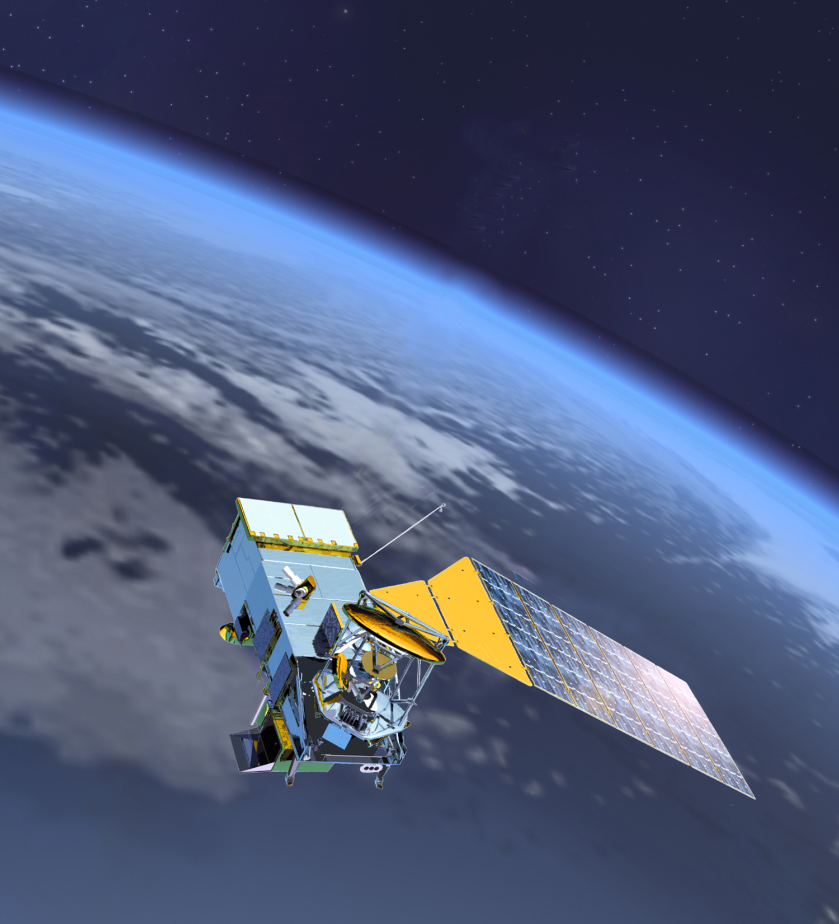
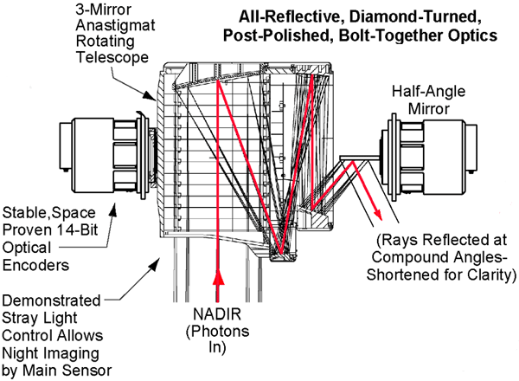
VIIRS OVERVIEW
PURPOSE: Global operational observations of land, ocean, & atmosphere parameters.
PREDECESSORS: AVHRR, OLS, MODIS, SeaWiFS
FACT SHEET
Multi-spectral crosstrack scanning instrument
Rotating telescope design, similar to SeaWiFS
Flies on Suomi NPP and every JPSS satellite
Imagery and radiometry
Imaging band at 0.4 km resolution (nadir)
Radiometric bands at 750m resolution
12 bit quantization
Some bands have high and low gain modes
22 spectral bands (0.4 – 12.5 μm)
15 “reflective” VNIR-SWIR bands 0.4 – 2.3 μm
3 “mixed” MWIR bands 3.5 – 4.1 μm
4 “emissive” LWIR bands 8.4 – 12.5 μm
Automatic dual VNIR & triple DNB gains
Maximum swath width
3000 km
13

Slide 14
VIIRS Features
CZCS
SeaWiFS
MODIS
VIIRS
Characteristic | SeaWiFS | MODIS | VIIRS
Band Set (nm) | 412, 443, 490, 510, 555, 670, 765, 865 | 412, 443, 488, 531, 547, 667, 678, 748, 869 | 412, 445, 488, 555, 672, 746, 865
Nadir Pixel Size | 1.1 km | 1 km | 0.75 km
SNR Range | 364 to 1010 | 726 to 2219 | 540 to 1239
Polarization Sensitivity | < 0.25% (Vis) < 0.5% (NIR) | 1% to 6% | 0.5% to 2.5%
Out-of-Band (worst case) | 5.7% @865nm | 3.8% @748 nm | 4.9% @551 nm
Crosstalk? | None | SWIR | VisNIR
Tilt | -20,0,+20° | 0° | 0°
Detectors per Scan | 1 | 10 | 16
Ultraviolet
No Measurements
Visible
NIR
SWIR
14

Slide 15
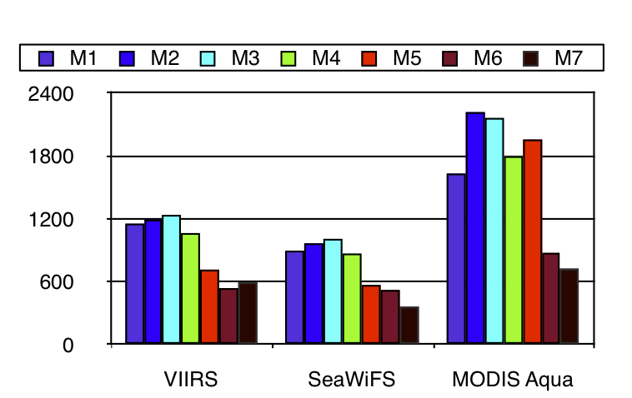
VIIRS Features
CZCS
SeaWiFS
MODIS
VIIRS
Characteristic | SeaWiFS | MODIS | VIIRS
Band Set (nm) | 412, 443, 490, 510, 555, 670, 765, 865 | 412, 443, 488, 531, 547, 667, 678, 748, 869 | 412, 445, 488, 555, 672, 746, 865
Nadir Pixel Size | 1.1 km | 1 km | 0.75 km
SNR Range | 364 to 1010 | 726 to 2219 | 540 to 1239
Polarization Sensitivity | < 0.25% (Vis) < 0.5% (NIR) | 1% to 6% | 0.5% to 2.5%
Out-of-Band (worst case) | 5.7% @865nm | 3.8% @748 nm | 4.9% @551 nm
Crosstalk? | None | SWIR | VisNIR
Tilt | -20,0,+20° | 0° | 0°
Detectors per Scan | 1 | 10 | 16
Ultraviolet
No Measurements
Visible
VIIRS SNR here is based on typical L_{t} for ocean.
Noise averaged over all six aggregation zones.
Overall, noise levels are comparable to SeaWiFS, 3:1 agg zone having better SNR.
NIR
SWIR
15

Slide 16
VIIRS Features
CZCS
SeaWiFS
MODIS
VIIRS
Characteristic | SeaWiFS | MODIS | VIIRS
Band Set (nm) | 412, 443, 490, 510, 555, 670, 765, 865 | 412, 443, 488, 531, 547, 667, 678, 748, 869 | 412, 445, 488, 555, 672, 746, 865
Nadir Pixel Size | 1.1 km | 1 km | 0.75 km
SNR Range | 364 to 1010 | 726 to 2219 | 540 to 1239
Polarization Sensitivity | < 0.25% (Vis) < 0.5% (NIR) | 1% to 6% | 0.5% to 2.5%
Out-of-Band (worst case) | 5.7% @865nm | 3.8% @748 nm | 4.9% @551 nm
Crosstalk? | None | SWIR | VisNIR
Tilt | -20,0,+20° | 0° | 0°
Detectors per Scan | 1 | 10 | 16
Ultraviolet
No Measurements
Visible
Apparatus used to characterize MODIS and VIIRS polarization response was abandoned.
Rotated polarizer sheets were used instead; similar to method used for SeaWiFS.
Resulting characterization for VIIRS polarization response was much better quality than what was done for MODIS.
NIR
SWIR
16

Slide 17
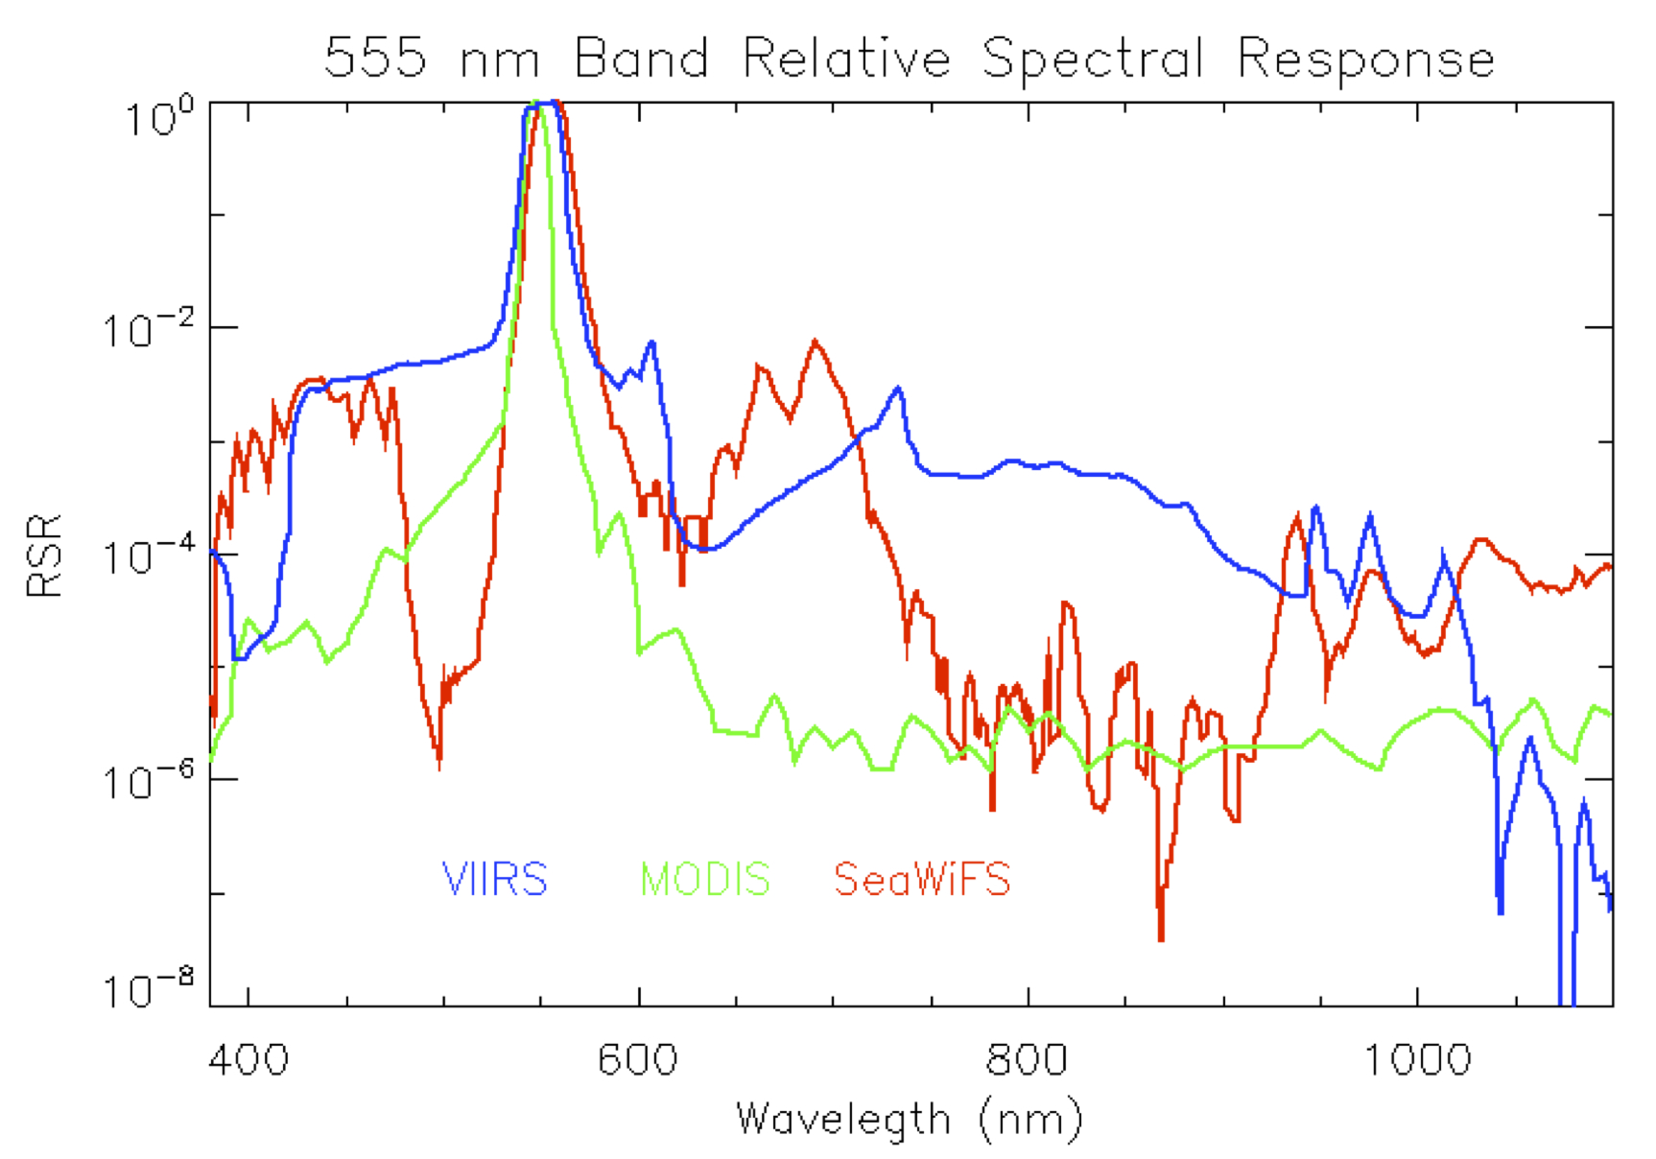
VIIRS Features
OUT-OF-BAND LIGHT LEAKS
CZCS
SeaWiFS
MODIS
VIIRS
Characteristic | SeaWiFS | MODIS | VIIRS
Band Set (nm) | 412, 443, 490, 510, 555, 670, 765, 865 | 412, 443, 488, 531, 547, 667, 678, 748, 869 | 412, 445, 488, 555, 672, 746, 865
Nadir Pixel Size | 1.1 km | 1 km | 0.75 km
SNR Range | 364 to 1010 | 726 to 2219 | 540 to 1239
Polarization Sensitivity | < 0.25% (Vis) < 0.5% (NIR) | 1% to 6% | 0.5% to 2.5%
Out-of-Band (worst case) | 5.7% @865nm | 3.8% @748 nm | 4.9% @551 nm
Crosstalk? | None | SWIR | VisNIR
Tilt | -20,0,+20° | 0° | 0°
Detectors per Scan | 1 | 10 | 16
Ultraviolet
No Measurements
Visible
NIR
Similar to worse cases for SeaWiFS or MODIS.
The blue light leak in the green band is the greatest concern, as shown above.
SWIR
17

Slide 18
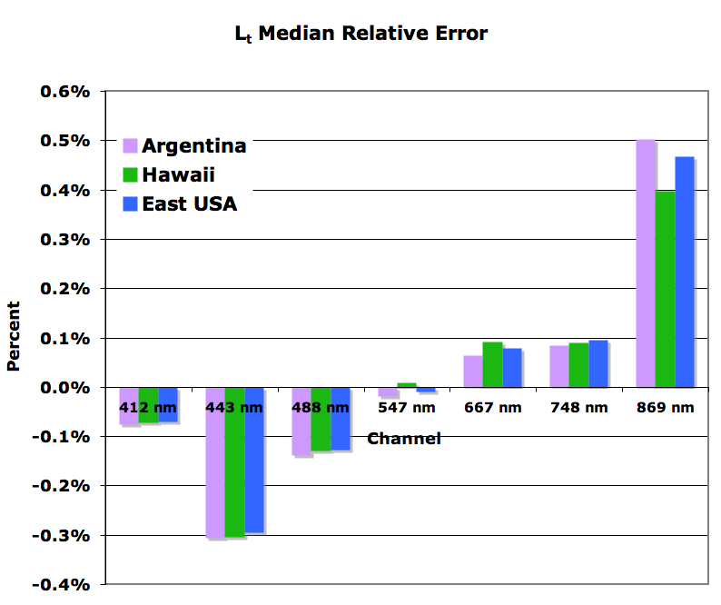
VIIRS Features
OPTICAL CROSSTALK
CZCS
SeaWiFS
MODIS
VIIRS
Characteristic | SeaWiFS | MODIS | VIIRS
Band Set (nm) | 412, 443, 490, 510, 555, 670, 765, 865 | 412, 443, 488, 531, 547, 667, 678, 748, 869 | 412, 445, 488, 555, 672, 746, 865
Nadir Pixel Size | 1.1 km | 1 km | 0.75 km
SNR Range | 364 to 1010 | 726 to 2219 | 540 to 1239
Polarization Sensitivity | < 0.25% (Vis) < 0.5% (NIR) | 1% to 6% | 0.5% to 2.5%
Out-of-Band (worst case) | 5.7% @865nm | 3.8% @748 nm | 4.9% @551 nm
Crosstalk? | None | SWIR | VisNIR
Tilt | -20,0,+20° | 0° | 0°
Detectors per Scan | 1 | 10 | 16
Ultraviolet
No Measurements
Visible
NIR
Similar to worse cases for SeaWiFS or MODIS.
The blue light leak in the green band is the greatest concern, as shown above.
SWIR
18

Slide 19
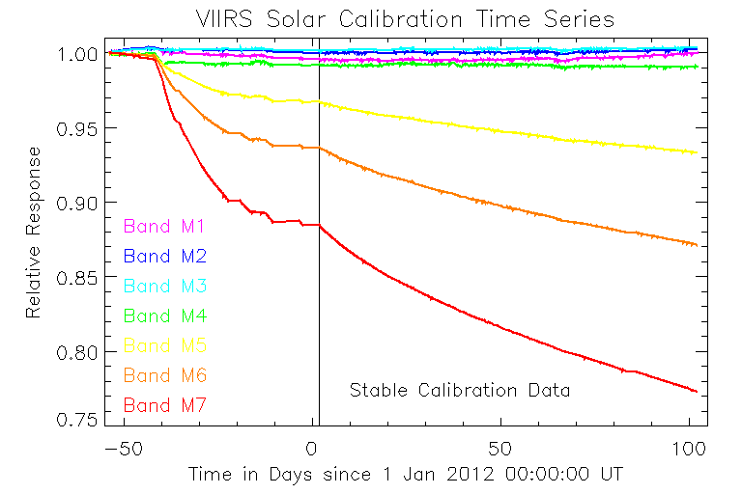
Mirror Degradation
Mirrors contaminated WO_{3(?)} during manufacture.
Causes severe, progressive loss in NIR and SWIR bands response when exposed to UV.
Testing with witness samples suggest worst case of 30% lost in 895 nm band (M7).
NAD Open
Might impact ocean color data quality at some point in the mission.
However, while the instrument is operating normally, the resulting degradation is smooth and trackable.
Early lunar measurements show strong agreement solar diffuser calibration (see plots on calibration slides).
19

Slide 20
VIIRS Data Features
20

Slide 21
VIIRS Features
RDR = L0
SDR = L1b
EDR = L2
? = L3*
Granule Feature | MODIS | S-NPP VIIRS
Sun Sync Orbit | Terra – Descending Aqua – Ascending | Ascending
Equator Crossing Time | Terra – 1030 Aqua – 1330 | 1330
Altitude (km) | 705 | 824
Scan Coverage (km) | 2330 | 3000
Time Coverage | 5 mins | 85.4 secs
No. of Scans | 203 | 48¹
No. Dets per Scan | 10 (Mod res) | 16 (Mod res)
Aggregation Zones | None | 6 (3 types)
Data Format | HDF4 | HDF5²
L1 Data Band Org | Separate SDS’s | Separate Files
Data Distribution | OC Website | CLASS³
* There is no operational equivalent to L3
1- some granules on contain 47 scans.
2- OBPG eval prods are in HDF4 format; conventions same as MODIS and SeaWiFS.
3- OPBG L0-L3 eval prods available via OC website.

Slide 22
1
2
3
4
5
6
3:1
2:1
1:1
2 edge detectors removed
4 edge detectors removed
22

Slide 23
The Anatomy of a VIIRS Scan
Scan Aggregation Zones
1500km
850km
530km
530km
850km
1500km
1
2
3
4
5
6
56º
43.6º
32º
nadir
32º
43.6º
56º
16
15
14
13
12
11
10
09
08
07
06
05
04
03
02
01
bow-tie
deletion
no aggregation
two 250m samples per pixel
three 250m samples per pixel
source: MDFCB, 4 Nov 2004
Dual-gain Bands - samples aggregated on ground.
Singe-gain Bands - samples aggregated on-board (only M6 for ocean bands).
23

Slide 24
VOST Calibration
24

Slide 25
Solar Calibration
VOST pre-launch counts-to-radiance conversion uses linearization of ATBD eqns.
Solar Diffuser (SD) is used to track changes in instrument response from prelaunch.
SDSM tracks changes in SD. (Quis custodiet ipsos custodes?)
VOST developed a time-dependent capability to support reprocessing.
25

Slide 26
Lunar Calibration
Lunar calibration - Successful measurements :
partial bands in Jan (412 & 443 nm bands were clipped),
Jan serendipitous measurements for 412, 443, and 488 nm bands,
dual rolls in Feb (measured all bands in VisNIR and SWIR),
missed in Mar but got serendipitous for seven bands (green, red, 2 NIR, and 3 SWIR), and
sector rotation in Apr; captured and co-registered all bands.
Next measurement is scheduled for the 2 May.
Measurements verify the solar cal and can replace it if need be later in the mission.
Can incorporate lunar measurement trending in calibration after at least one year of acquisitions.
26

Slide 27
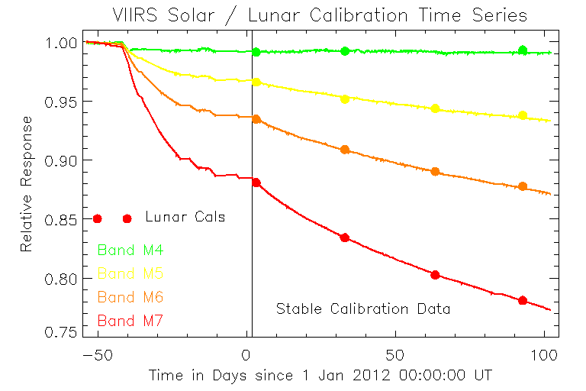
NASA VIIRS SOLAR CALIBRATION
with Verification OF Lunar Measurements
1.00
0.95
0.90
Relative Response
0.85
Normalized Lunar Cals
551 nm
0.80
670 nm
750 nm
Stabilized Calibration Data
865 nm
0.75
-50
0
50
100
Days since 1 Jan 2012
27

Slide 28
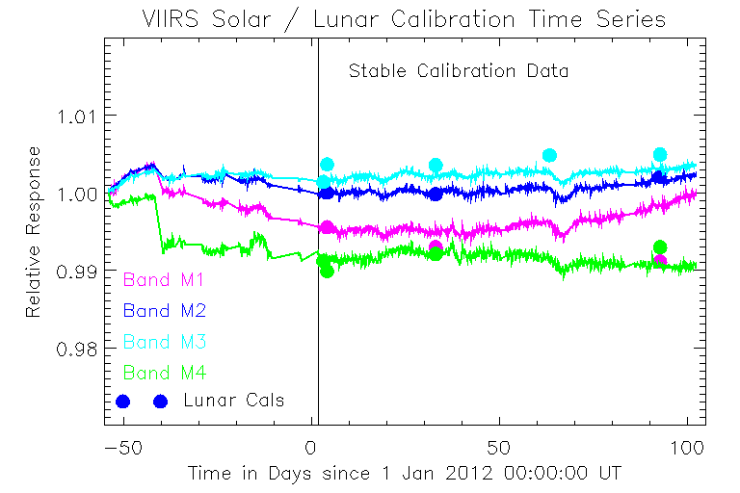
NASA VIIRS SOLAR CALIBRATION
with Verification OF Lunar Measurements
Stabilized Calibration Data
1.01
1.00
Relative Response
0.99
412 nm
443 nm
0.98
488 nm
551 nm
Normalized Lunar Cals
-50
0
50
100
Days since 1 Jan 2012
28

Slide 29
Initial Results
29

Slide 30
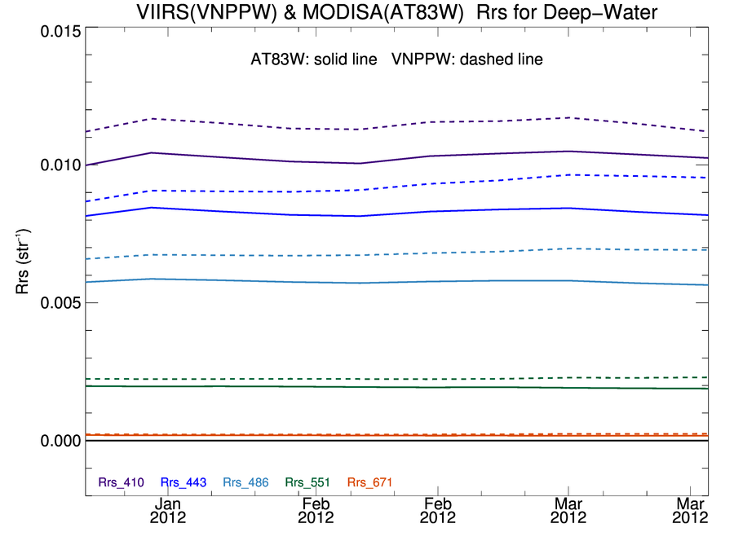
VIIRS & MODIS Aqua Deep-Water Rrs Trends NASA Calibration and L2 Processing
solid line = MODIS Aqua (updated OBPG calibration)
dashed = VIIRS (preliminary OBPG calibration)
Rrs (sr⁻¹)
Temporal stability is comparable biases to be resolved through vicarious calibration.
30

Slide 31
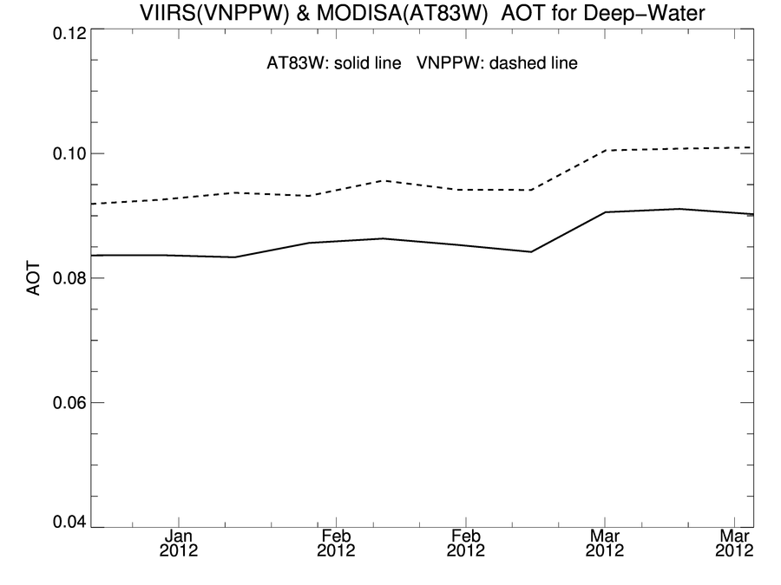
VIIRS Deep-Water Aerosol Optical Thickness Trends IDPS L1Bs vs OBPG L1Bs, Both with NASA L2 Processing
solid line = MODIS Aqua (updated OBPG calibration)
dashed = VIIRS (preliminary OBPG calibration)
We can reproduce the AOT trends we get from Aqua.
Demonstrates that the NIR calibration is on track.
31

Slide 32
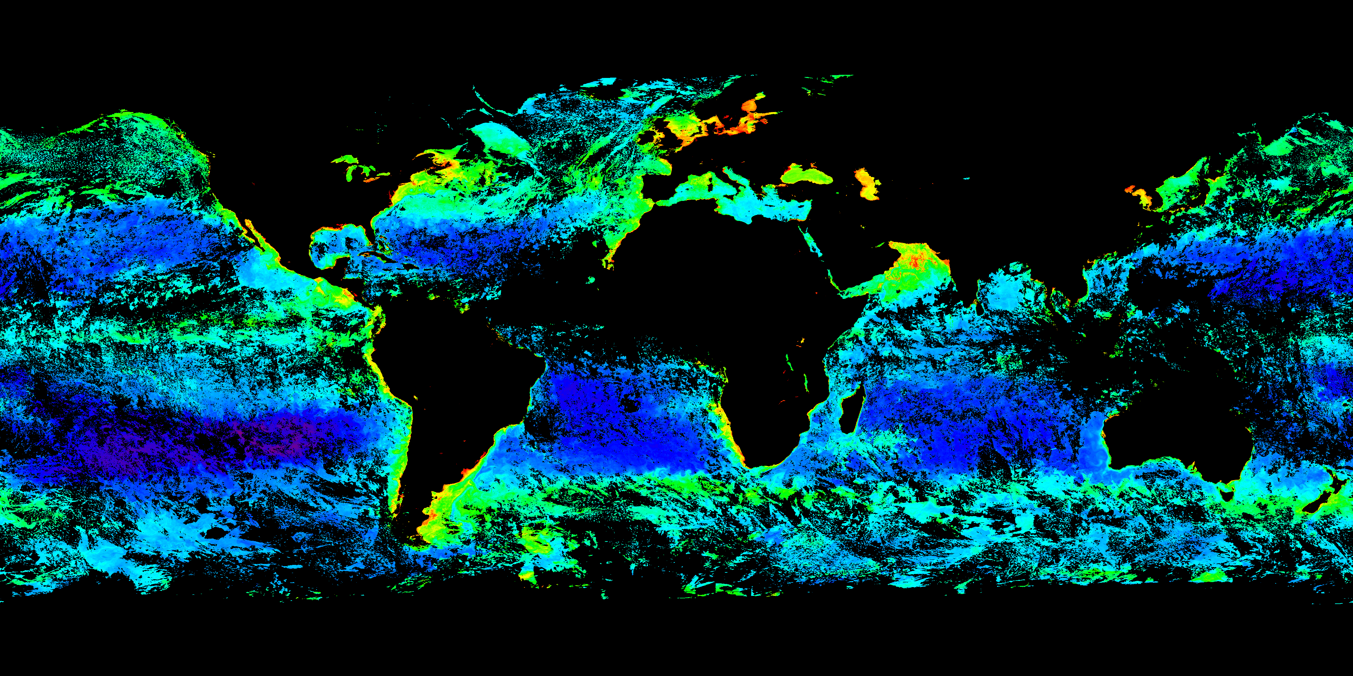
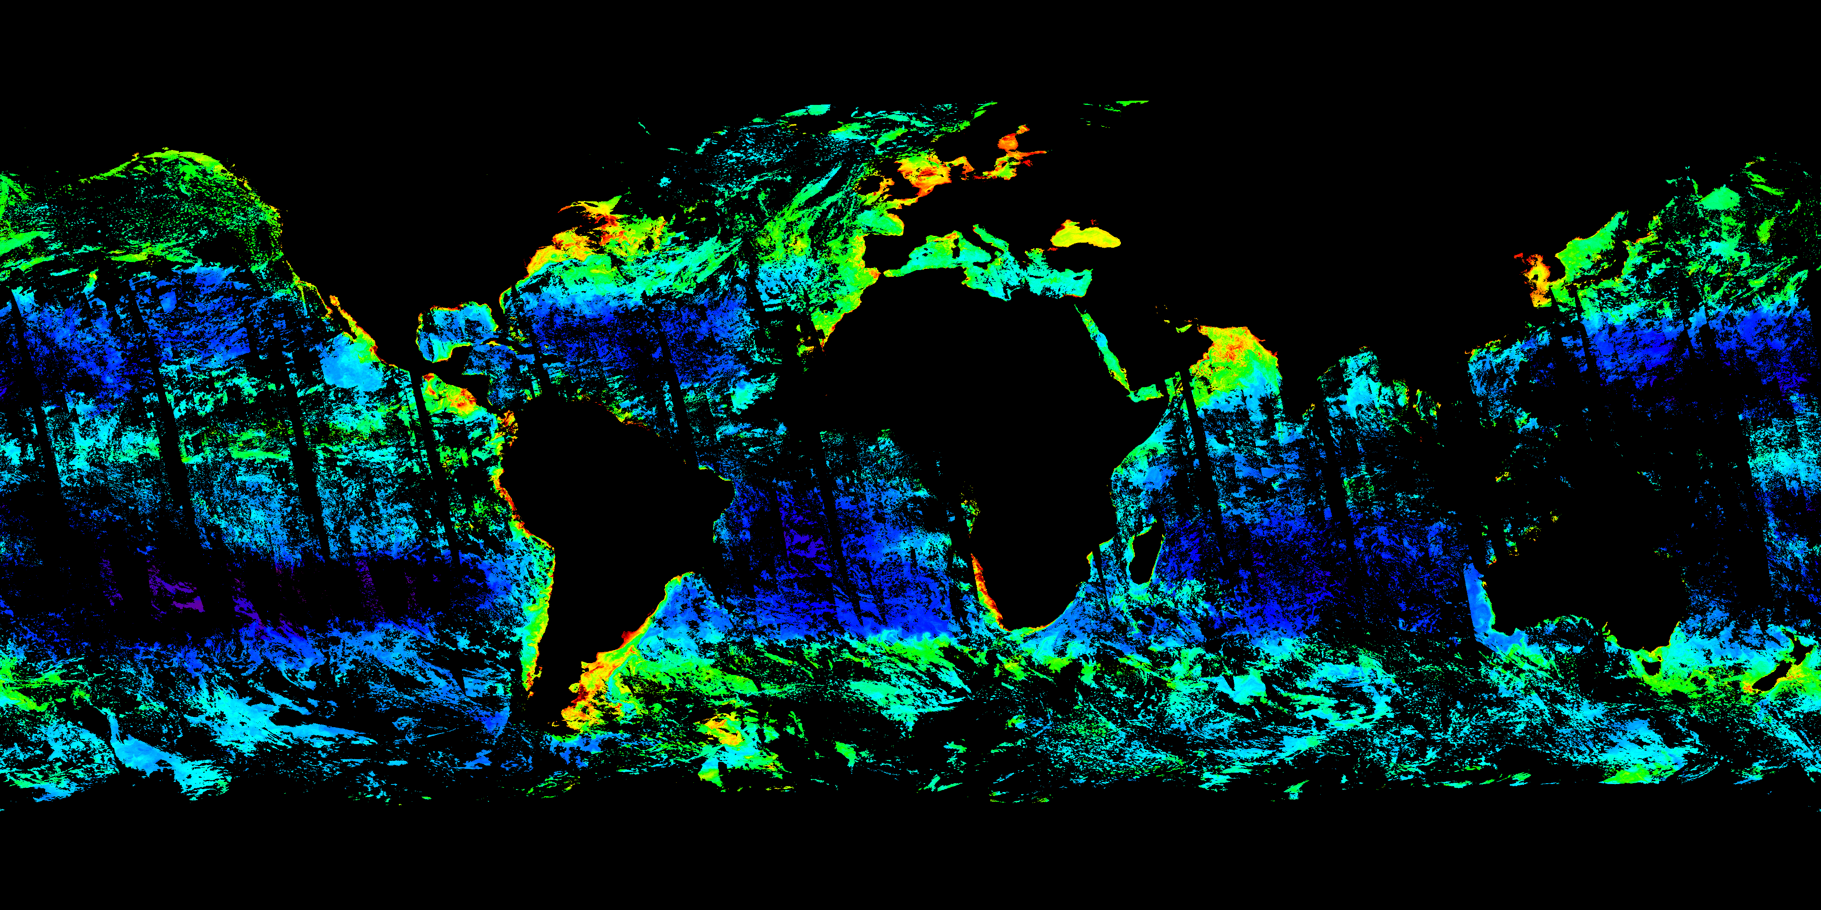
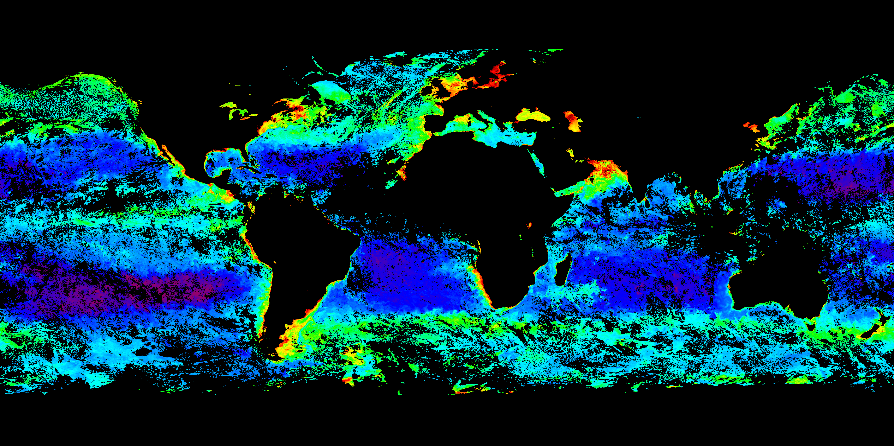
VIIRS & MODIS Aqua Deep-Water Chl NASA VIIRS L2, EDR, & MODIS Aqua
NPP VIIRS L2 Chl
NPP VIIRS EDR Chl
NASA calibration, L2 algorithms, and flags
NOAA calibration, EDR algorithms, and flags
Aqua MODIS Chl (Deep Water)
Composite: Day 73-81
VIIRS L2 and EDR are comparable in range distribution to updated MODIS Aqua.
EDR differences are visible.
Flags present differences.
Calibration may dominate differences
Composite: Day 73-80
32

Slide 33
Conclusions
VOST has invested several years of effort working with NPP VIIRS.
NPP VIIRS is currently performing well; performance anomalies are correctable.
Generating NASA VIIRS evaluation products to answer VOST and OBPG questions.
NASA evaluation products are based on same L2 algorithms used to generate NASA science and climate quality datasets from SeaWiFS and MODIS.
Implemented a time-dependent calibration strategy based on solar diffuser and lunar measurements.
Generating L3 products to support comparisons (there is no operational L3 product).
33

Slide 34
Conclusions
EDR products cannot be evaluated prior to 6 Feb; quality too poor. (VOST Question)
Evaluation can begin now that sufficient EDR data has be collected. (VOST Question)
With NASA calibration and processing, the VIIRS products are qualitatively comparable in dynamic range and stability to SeaWiFS climatology based on a limited time series.
Early mission assessment suggests that application of a time-dependent calibration and common algorithms to VIIRS sensor measurements could continue the EOS climate data record. (OBPG Question)
34

Slide 35
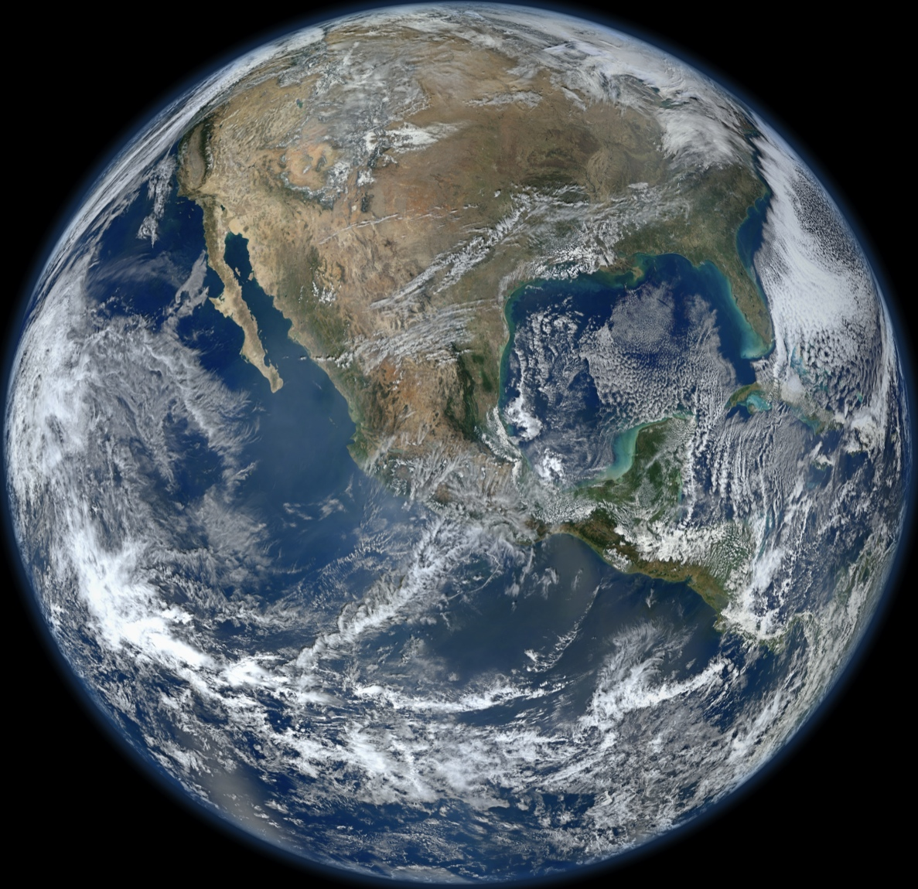
Kiitos paljon!

Slide 36
VOST Contributions 2003-Present
Reviewed numerous project documents
Reviewed science and operational code
Successfully advocated instrument improvements
Performed multiple analyses of the effect instrument performance on data quality
Presented findings at numerous technical conferences
Participated in test planning and data analysis
VIIR ocean color data product quality assessment
Development of time-dependent calibration
Generation of VIIRS data products using NASA algorithms
Instrument Requirements
Waiver Requests
Characterization Test Plans
Test Analysis Reports
Contractor Anomaly Impact Analysis Reports
Theoretical Basis
Product Performance Specifications
Data Format and Interface Specifications
36

Slide 37
VOST Contributions 2003-Present
Reviewed numerous project documents
Reviewed science and operational code
Successfully advocated instrument improvements
Performed multiple analyses of the effect instrument performance on data quality
Presented findings at numerous technical conferences
Participated in test planning and data analysis
VIIR ocean color data product quality assessment
Development of time-dependent calibration
Generation of VIIRS data products using NASA algorithms
Identified coding errors.
Provided sun glint correction code.
Noted NASA improvements that were missing:
NIR correction,
Improved aerosol models,
Revised whitecap correction,
BRDF correction,
Band pass adjustments, and
Chl based on Carder algorithm.
37

Slide 38
VOST Contributions 2003-Present
Reviewed numerous project documents
Reviewed science and operational code
Successfully advocated instrument improvements
Performed multiple analyses of the effect instrument performance on data quality
Presented findings at numerous technical conferences
Participated in test planning and data analysis
VIIR ocean color data product quality assessment
Development of time-dependent calibration
Generation of VIIRS data products using NASA algorithms
38

Slide 39
THE RISE AND FALL OF THE CROSSTALK ISSUE
2006
Severe X-talk discovered in EDU.
Dynamic X-talk addressed in flight unit.
2007
Optical X-talk in flight unit found to be lesser but still significant.
Raytheon flips the filters in the flight unit.
2008
NGC decides to correct optical X-talk using OOB techniques.
Innovative testing was designed to fully characterize optical X-talk.
2009
Testing showed small optical X-talk but large OOB light leaks !!!
2010
Impact analysis for ocean color showed showed much smaller effect.
NIST SIRCUS is used to characterize VIIRS spectral response.
2011
Hybrid spectral response tables use for correction of OOB and X-talk
2012
Hybrid spectral response implemented in NASA L2 code.
39
Notes:
We saw at look of crosstalk, vendor flipped IFA, this caused a tradefoff between xtalk and OOB

Slide 40
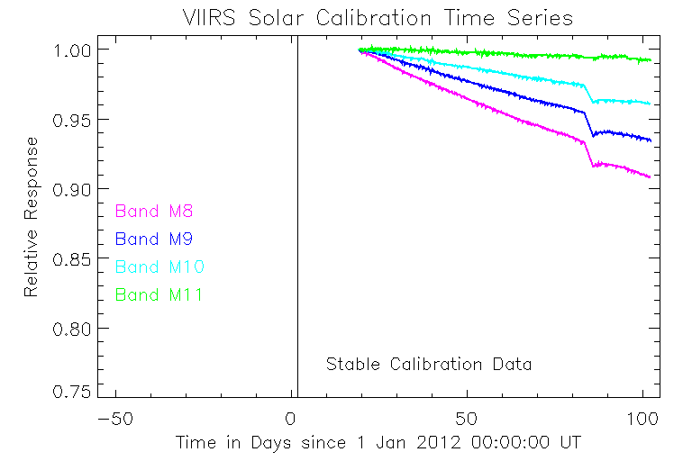
Cryo-radiator activated
1260 nm
1360 nm
24 Mar 2012
Petulant Mode
Event
(Cold focal plane warms)
40

Slide 41
NAD Open
41

Slide 42
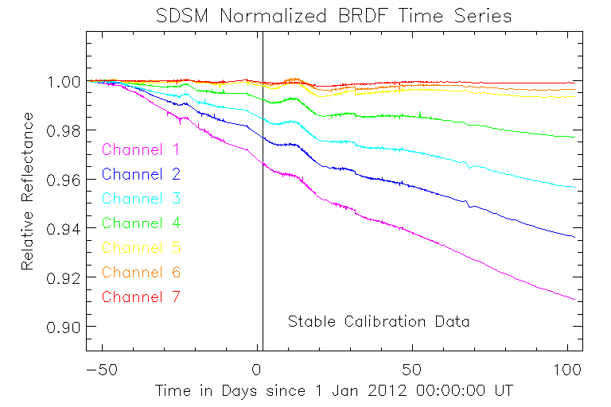
SDSM Measurements are normalized to det 8 to remove spurious signal.
Calibration uses NICSE’s new SDSM screen transmission table based on measurements taken during yaw maneuvers.
42

Slide 43
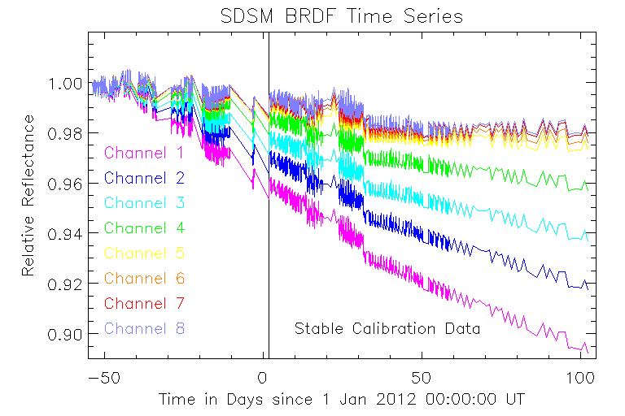
43

Slide 44
Off-line Solar Cal
H Time
Series
RDR
Cal Pool
TS
Generator
TS
Trending
F History
w/ Extra-
polation
F History
Generator
f Time
Series
Cal RDR
Selection
Script
SD BRDF
SDS t
SDSMS t
F History
Table
F Table
Preproc
L1 Production Process
Polar
Wander
File
Geo
Cal
Tables
Static
Cal
Tables
F Table
RDR (L0)
Files
ADL
SDR (L1b)
Files
44

Slide 45
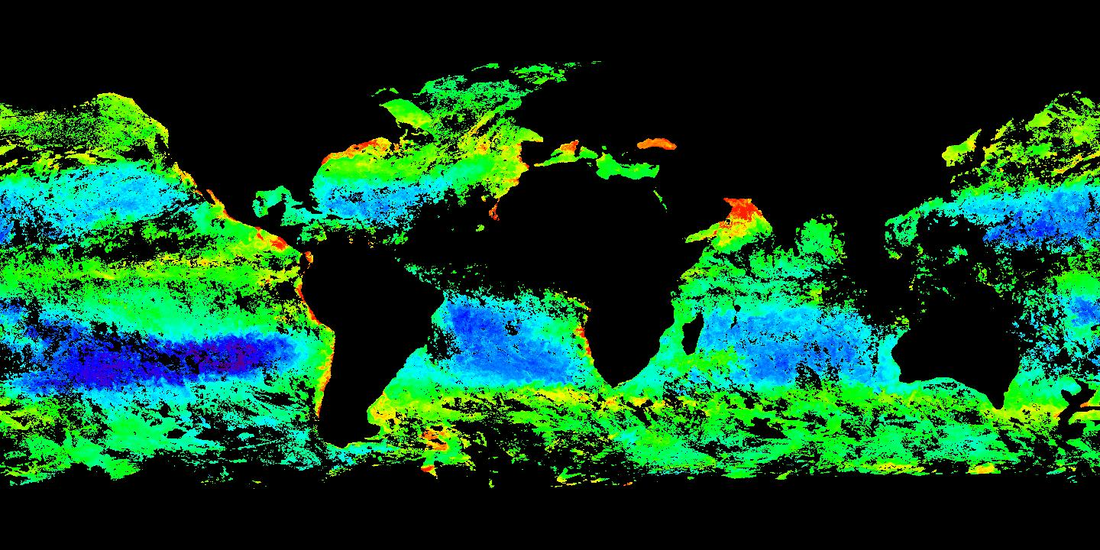
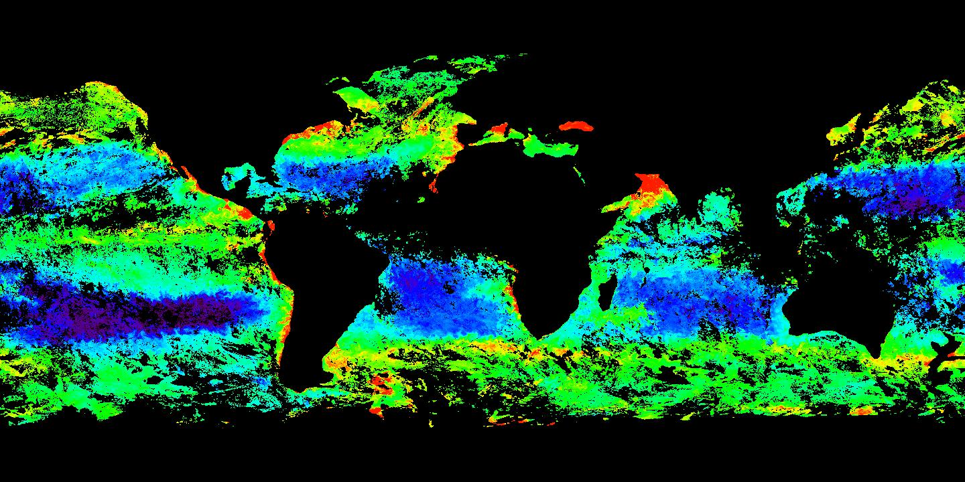
10 Feb 2012 (Day 41)
NOAA EDR
NPP VIIRS Chl
NASA calibration and L2 algorithms
Composite: Day 73-81
10 Feb 2012 (Day 41)
NASA Chl
0.01 – 1.0 mg m⁻³
Aqua MODIS Chl
Composite: Day 73-81
Horizontal stripes caused by bow-tie deletion
EDR has additional pixel trimming
10 Feb 2012 (Day 41)
NASA Chl
Projections of the above VIIRS and MODIS
swath cutouts projections are different.
45

Slide 46
Vicarious Calibration
Vicarious calibration
Initially based on Ocean Surface Reflectance Model using HOT and BATS sites.
Will use surface values later in the mission, e.g., MOBY (depending on availability and quality).
46

