Slide 1
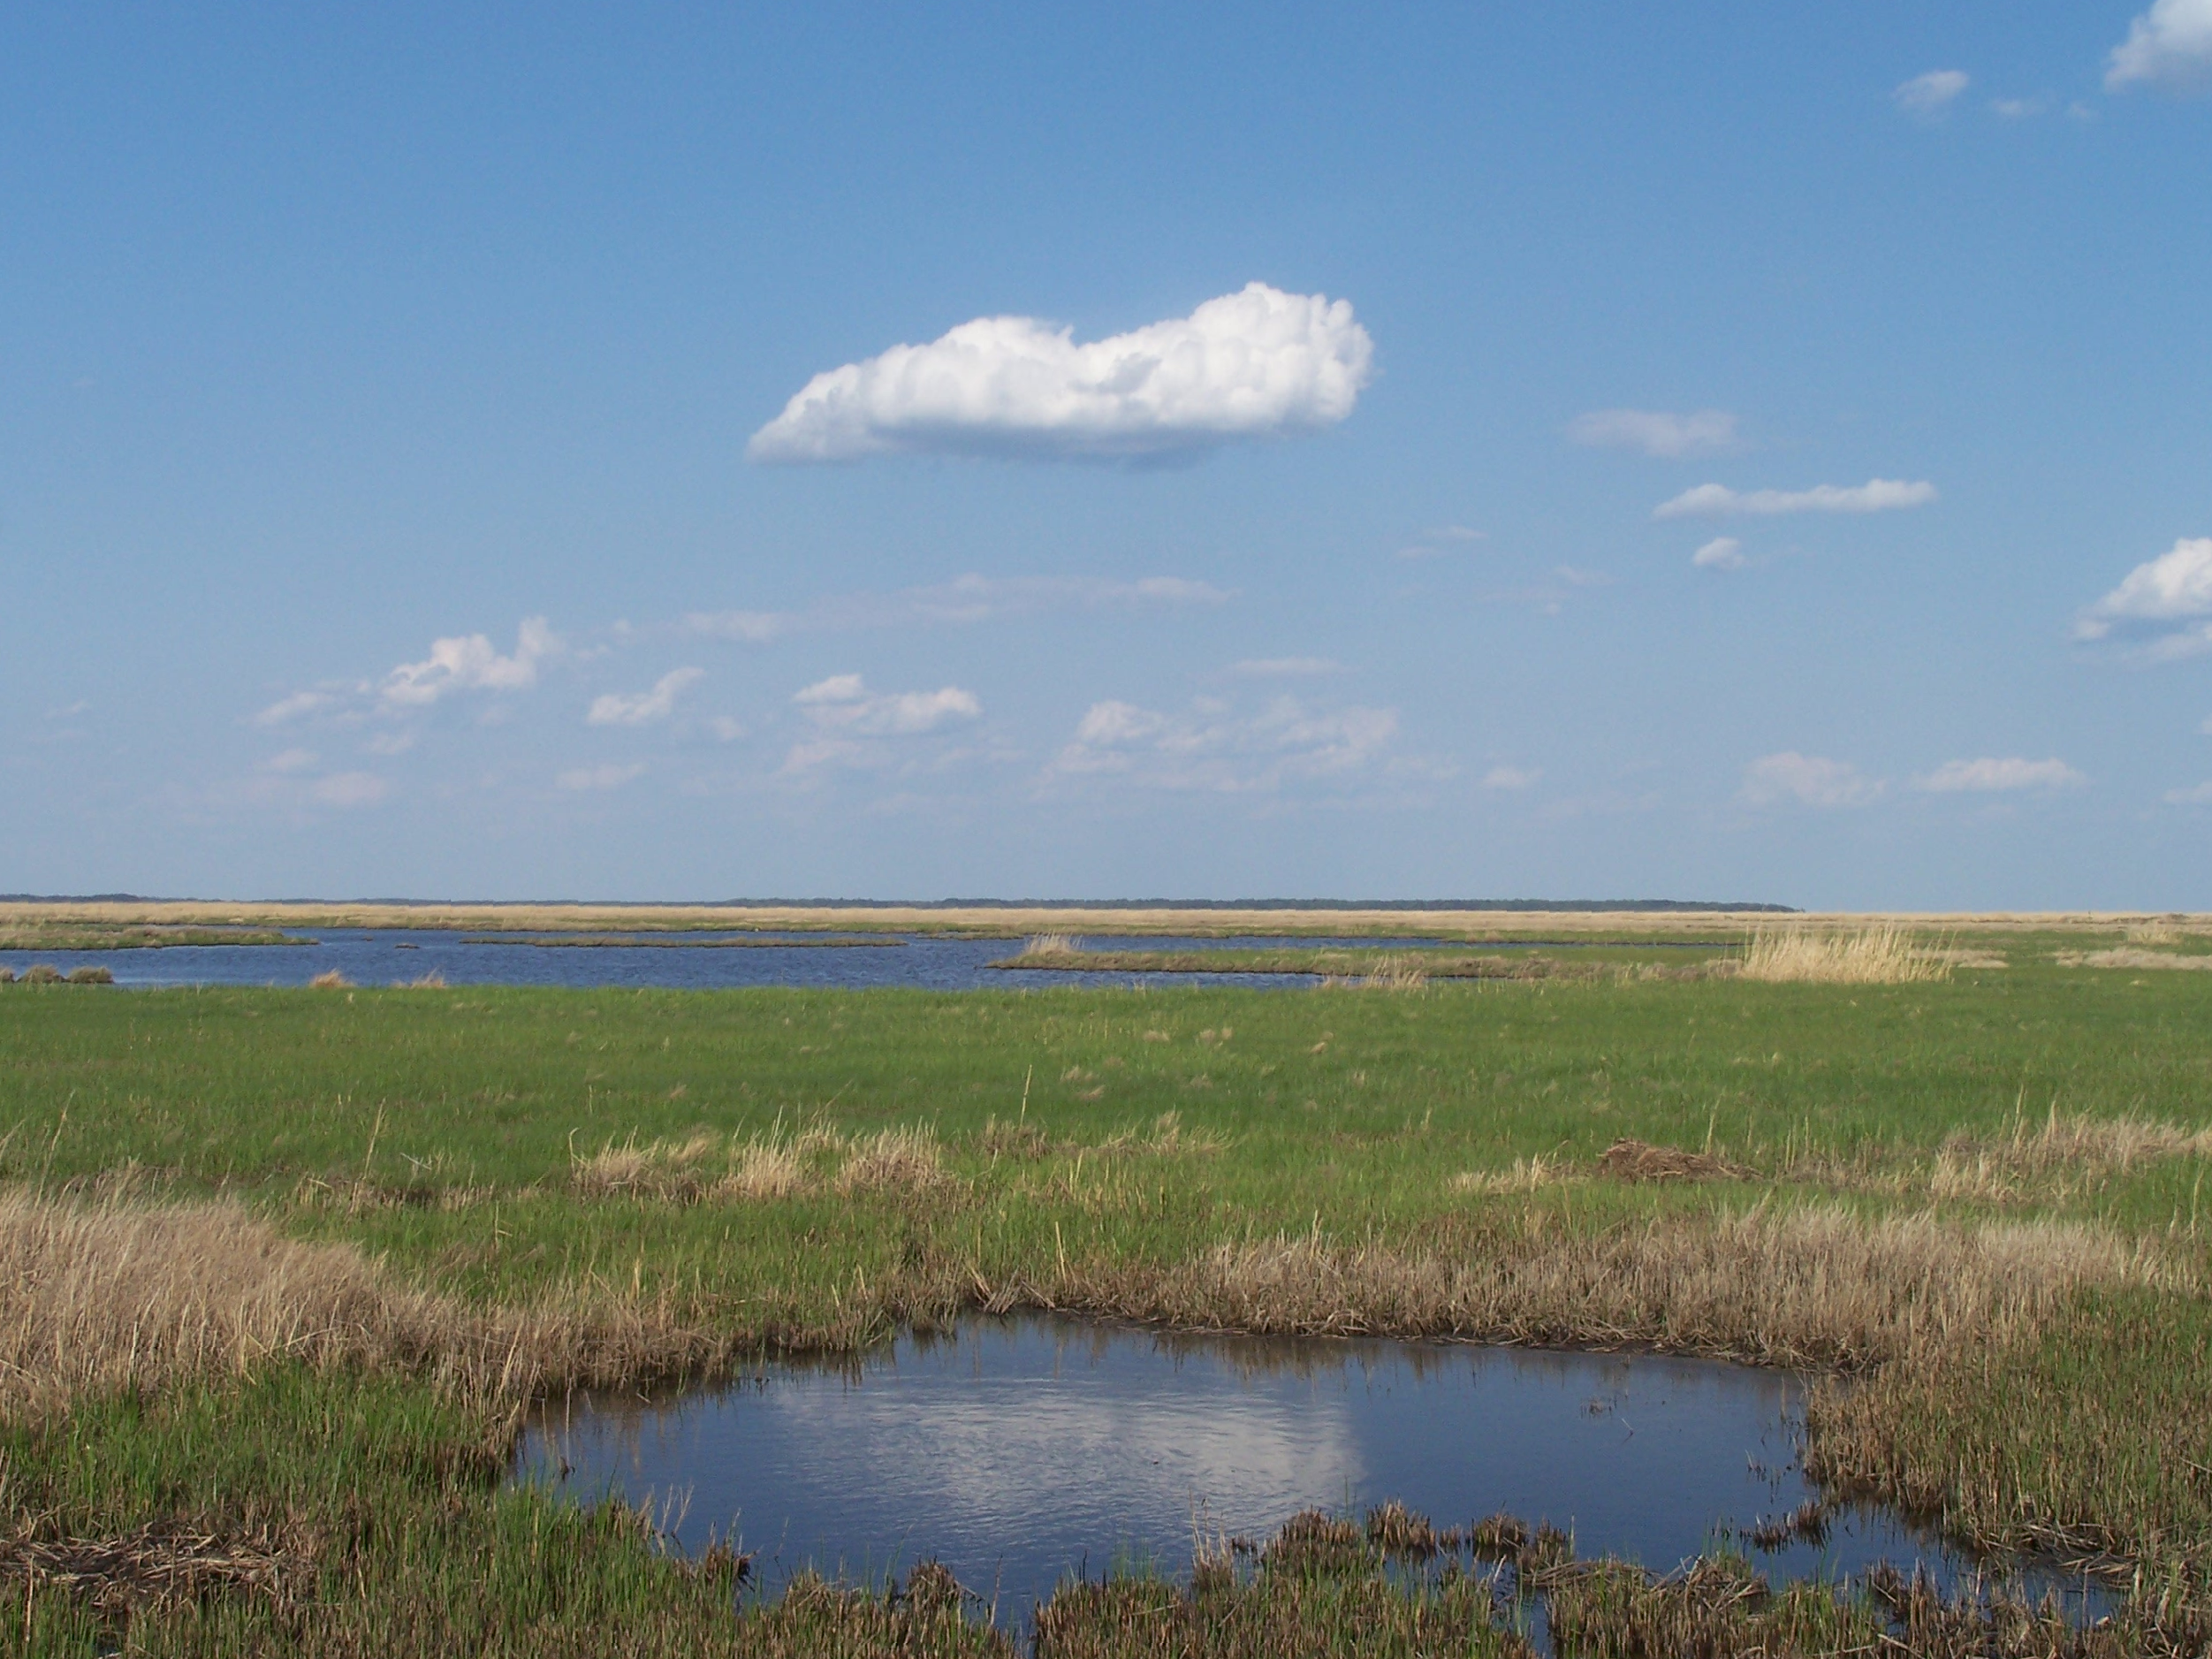
Improvements in Understanding the Specular and Spectral Effects of Emergent Marsh Vegetation
K. Turpie
Ocean Color Research Team Meeting
23 April 2012
Seattle, Washington

Slide 2
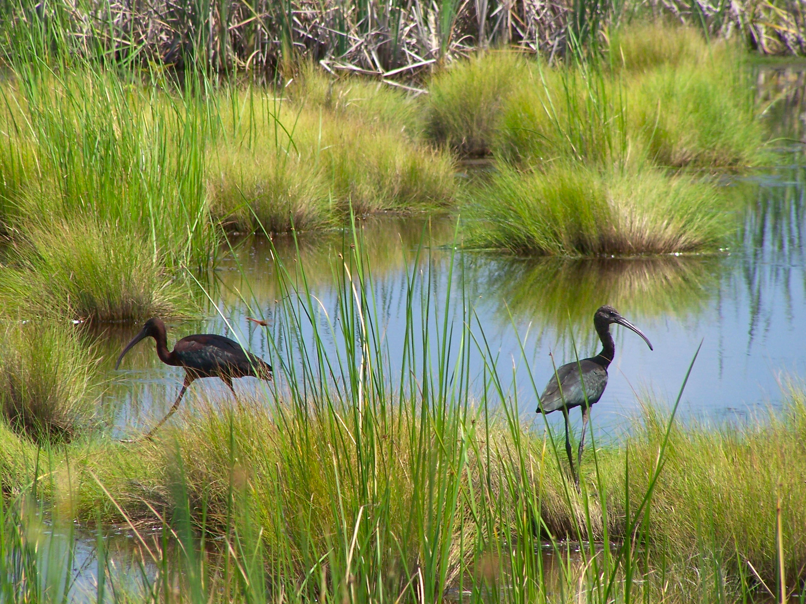

Slide 3
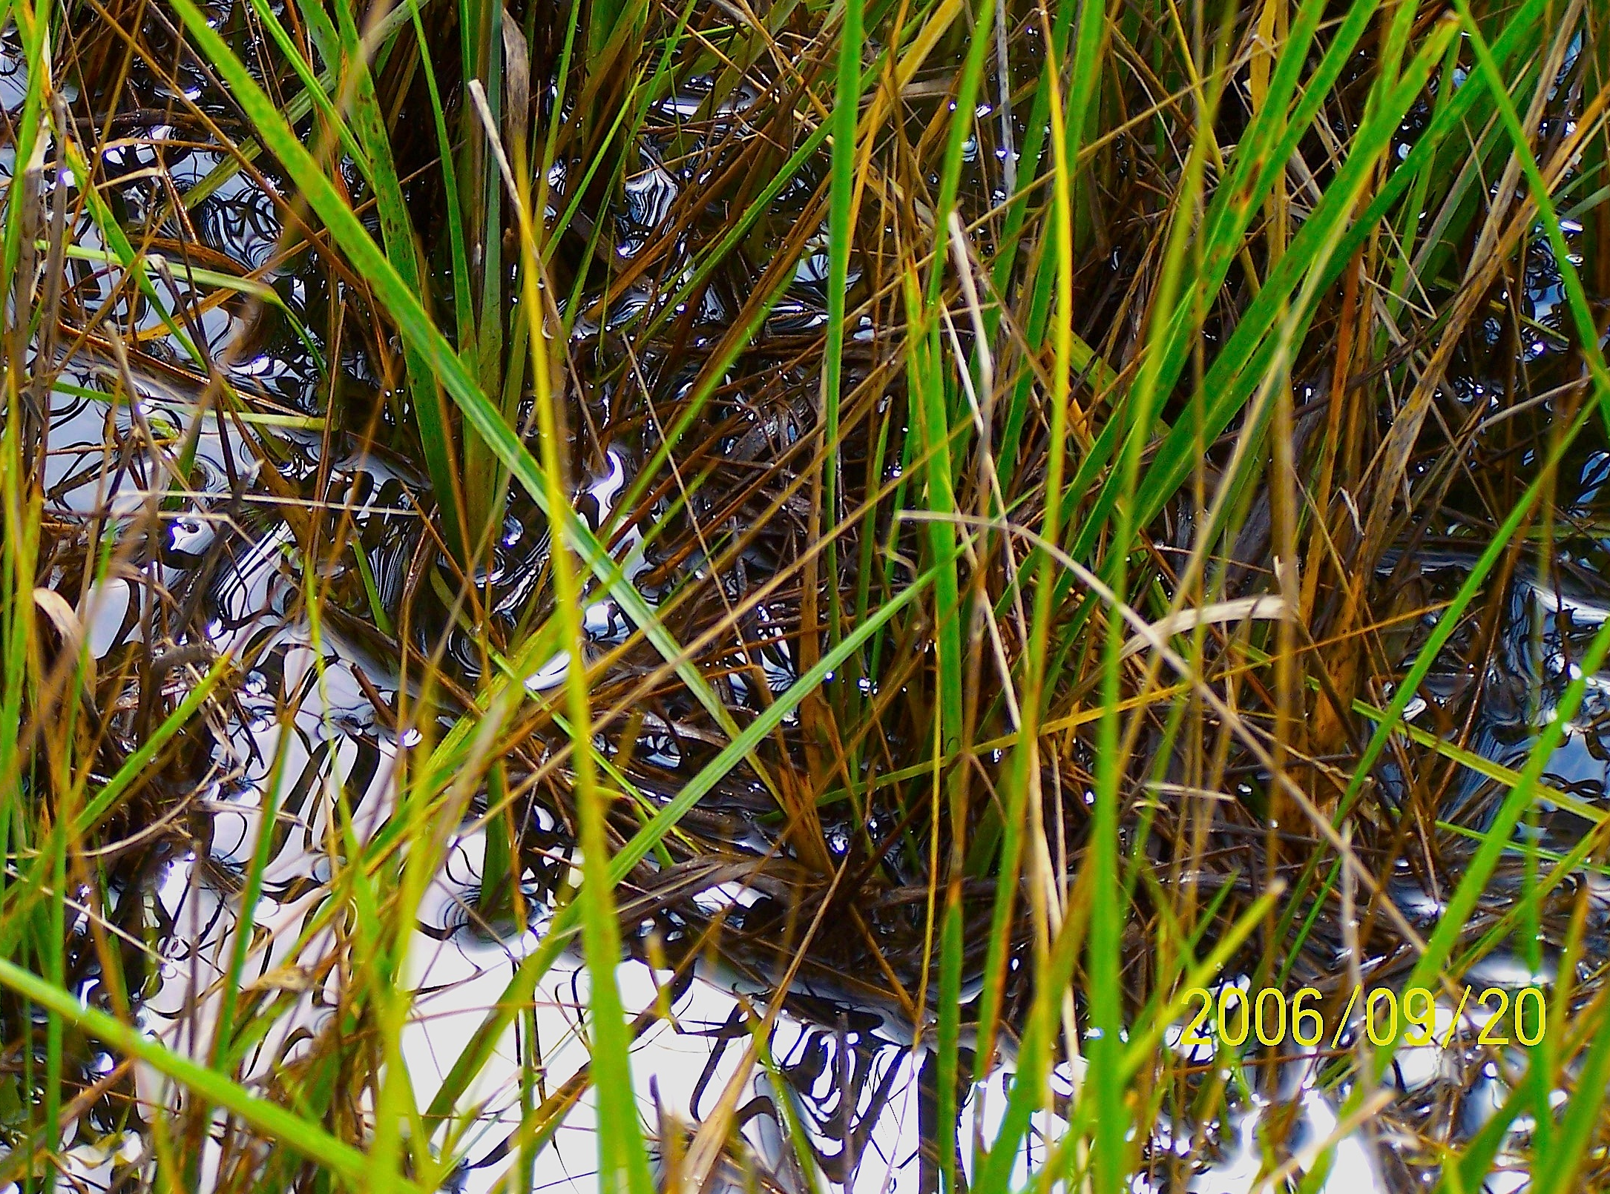
PROBLEM

Slide 4
PROBLEM
The study of emergent vegetation largely involves parameters familiar to the terrestrial researchers (e.g., LAI).
However, water at the bottom of a marsh canopy produces spectral and specular reflectance properties not present in terrestrial canopies.
These properties can affect and even hamper conventional remote sensing applications designed for terrestrial vegetation.
No model existed that describes the effects of an aquatic background marsh canopy reflectance.
3

Slide 5
Leaf Area Index
single side leaf area
LAI
horizontal ground area
Examples of applications :
Canopy Radiative Transfer
fPAR
Primary Production
Energy Budget
Total or Above Ground Biomass

Slide 6
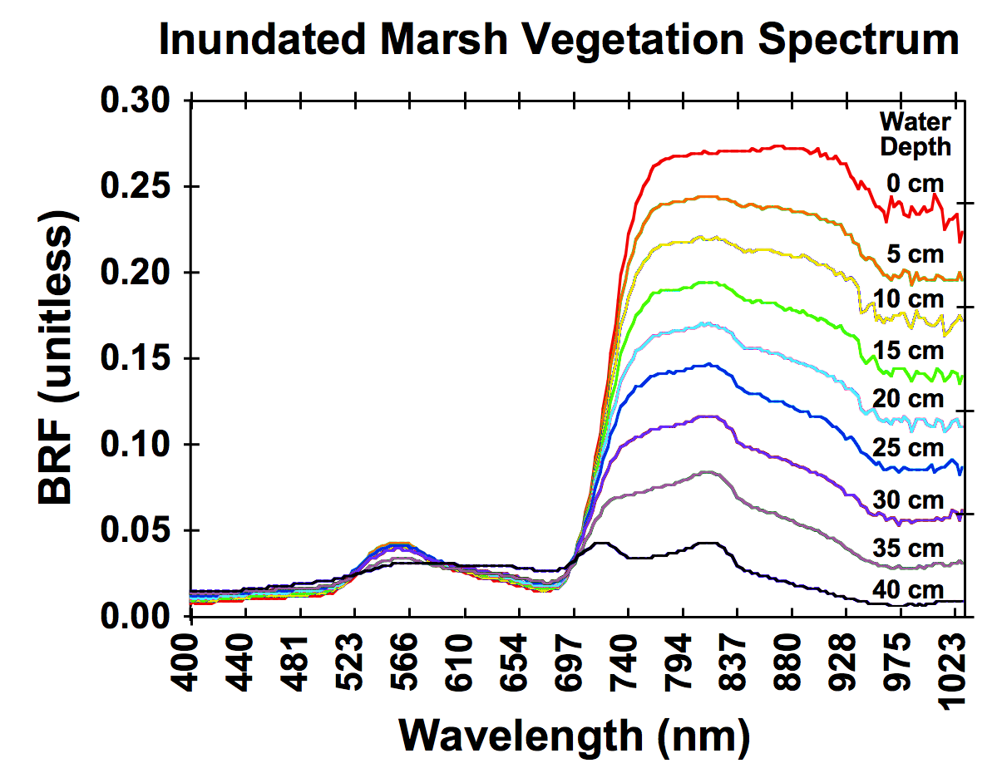
WETLAND SPECTRAL EFFECTS
Could affect:
Spectral Indices
Red-Edge Position*
Spectral Classification
LAI Retrievals*
(Kearney et al., 2004)
5

Slide 7
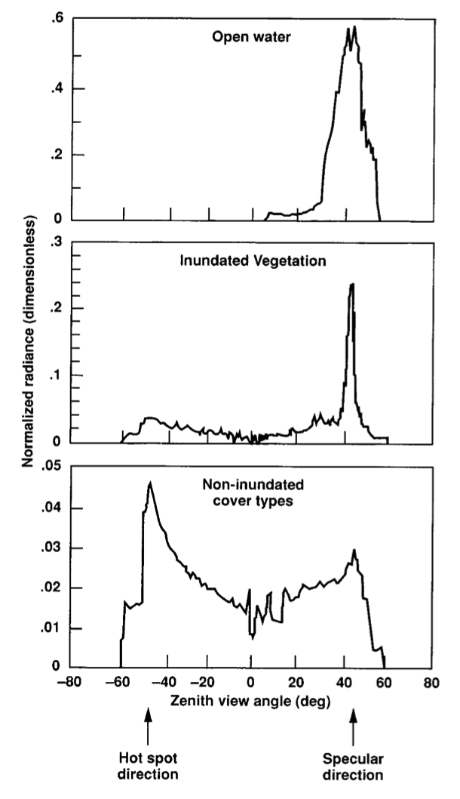
WETLAND SPECULAR EFFECTS
Airborne POLDER
Vanderbilt et al., 2002
6

Slide 8
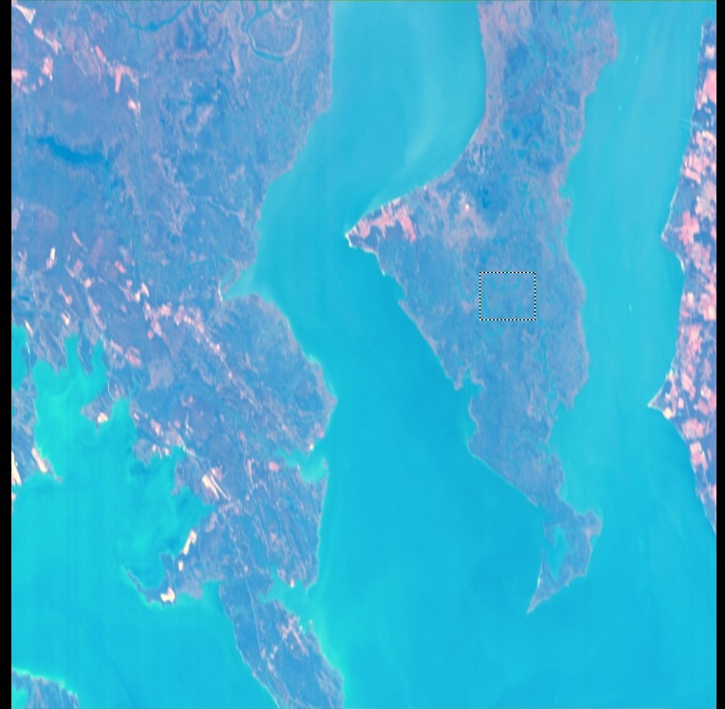
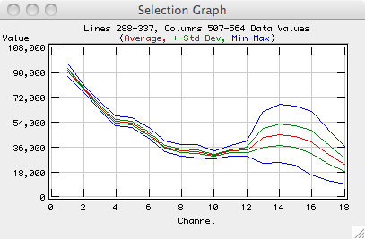
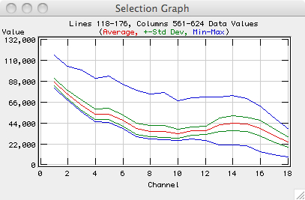
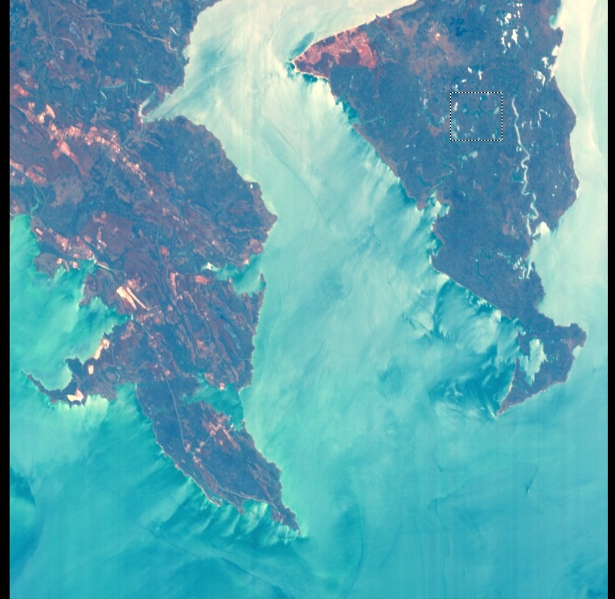
WETLAND SPECULAR EFFECTS
55º nominal viewing angle
Fishing Bay
May 29, 2007
0º nominal viewing angle
Can affect:
Adds noise to spectral signal
Can affect vegetation BRDF and spectrum.
CHRIS/Proba TOA reflectance
7

Slide 9
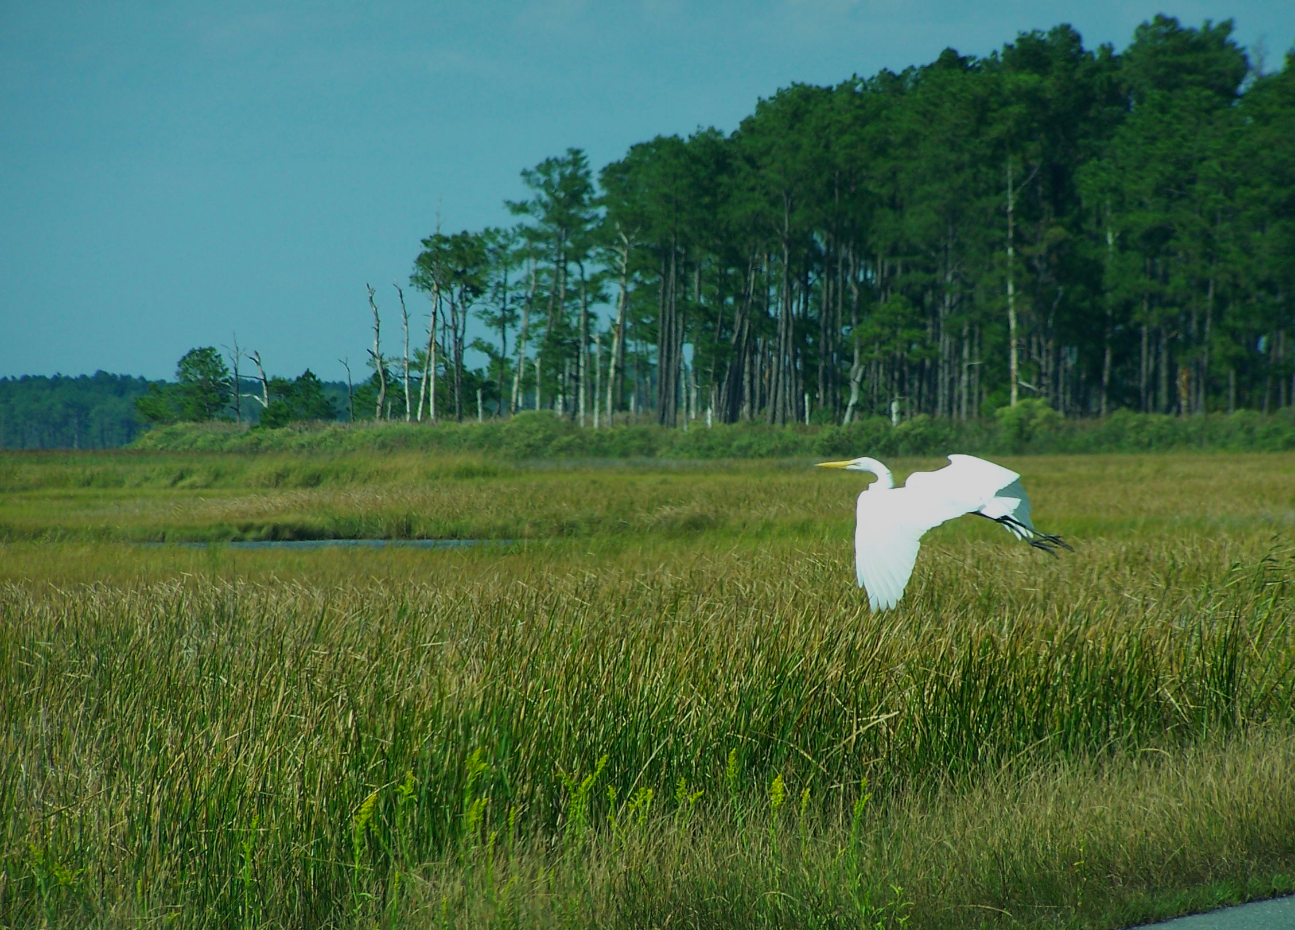
APPROACH

Slide 10
APPROACH
Construct a model of marsh canopy reflectance to help understand these effects.
Compare model predictions to data from three field experiments to explore specular and spectral effects.
Consider how marsh aquatic background affects:
  retrievals of Leaf Area Index (LAI),
  vegetation reflectance anisoptropy, and
  vegetation spectral characteristics, particularly the red-edge.
This work initiates a bridge between terrestrial and aquatic remote sensing; one necessary where land and sea blend.
9

Slide 11
- Linear Spectral Mixing
- Glint Effect Strongest
SOIL

Slide 12
-Nonlinear Spectral Mixing
-Glint Effects Lessened
SOIL

Slide 13
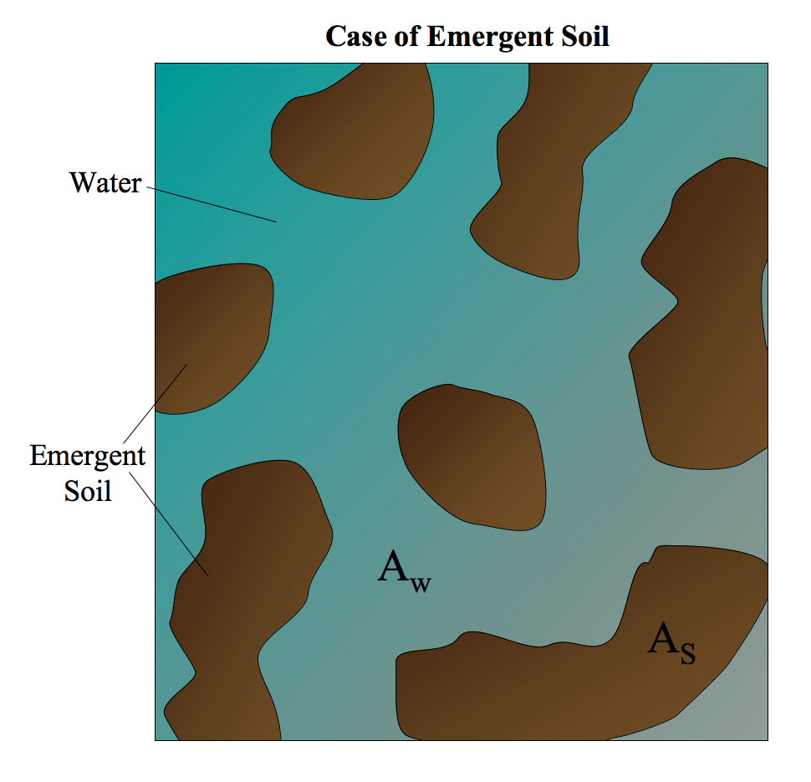

Slide 14
WCRM - Wetland Canopy Reflectance Model
Modeling Approach
Combine the Soil BRDF model (Walthall, 1985) in the ACRM vegetation canopy reflectance model (Kuusk, 1996) with an aquatic background model.
r_{aquatic} = (b-1) r_{soil} + b r_{water}
Aquatic background model has a specular component and diffuse component.
Specular component:
  Water surface refectance from Fresnel equations.
  Surface roughness (s) based on Cox and Munk (1956).
  Primarily affects reflectance anisotropy.
Diffuse component:
  Sub-surface reflectance using model by Lee et al. (1999).
  Subsurface reflectance isotropy assumed.
  Primarily affects canopy spectral characteristics.
13

Slide 15
ACRM - Canopy Reflectance Model
Terrestrial Canopy
LAI
PROSPECT
Leaf
Model

Markov Chain
Canopy
Reflectance
Model
Canopy
BRF
Jacquemoud and Baret, 1990
Kuusk, 1995
Walthall
Soil BRDF
Model
Walthall et al., 1985
SOIL
Price Soil
Spectrum
Model
Price, 1990
14

Slide 16
WCRM - Wetland Canopy Reflectance Model
Inundated Marsh Canopy
LAI
PROSPECT
Leaf
Model

Markov Chain
Canopy
Reflectance
Model
Canopy
BRF
Cox-Munk
Specular
Reflectance
Model
Walthall
Soil BRDF
Model
s
✕b
✕(1-b)
WATER
Lee
Shallow
Water
Model
Price Soil
Spectrum
Model
15

Slide 17
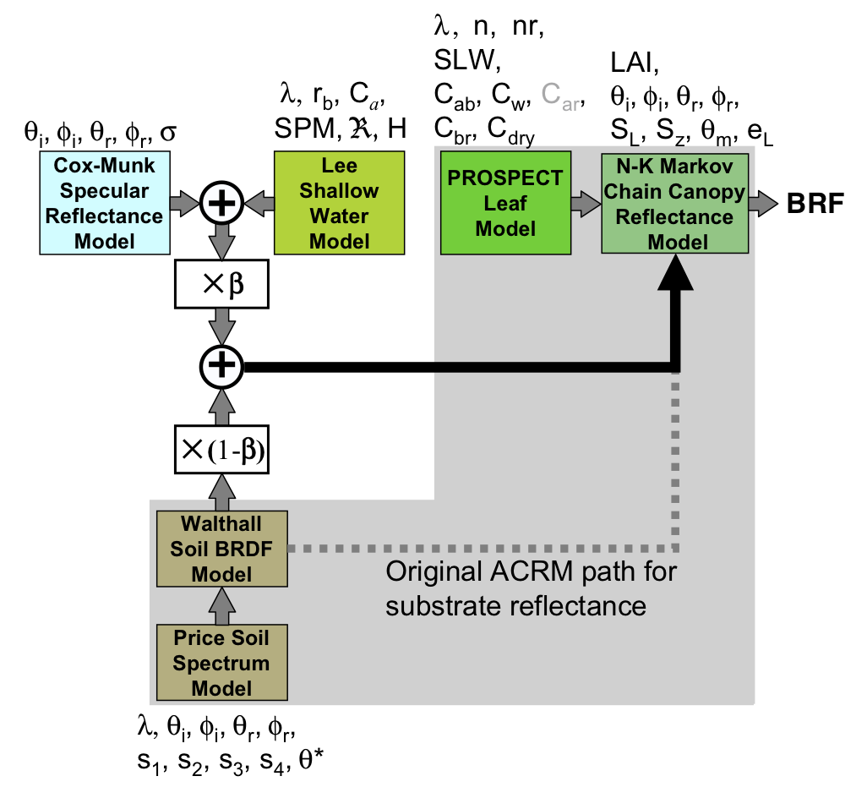
WCRM - Wetland Canopy Reflectance Model
Inundated Marsh Canopy
16

Slide 18
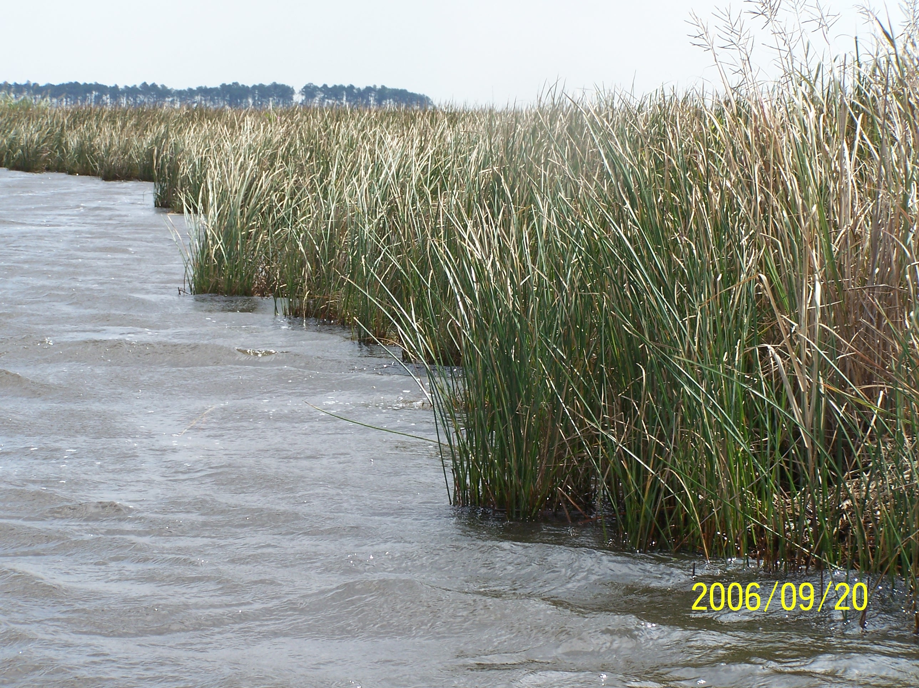
SPECULAR EFFECTS

Slide 19
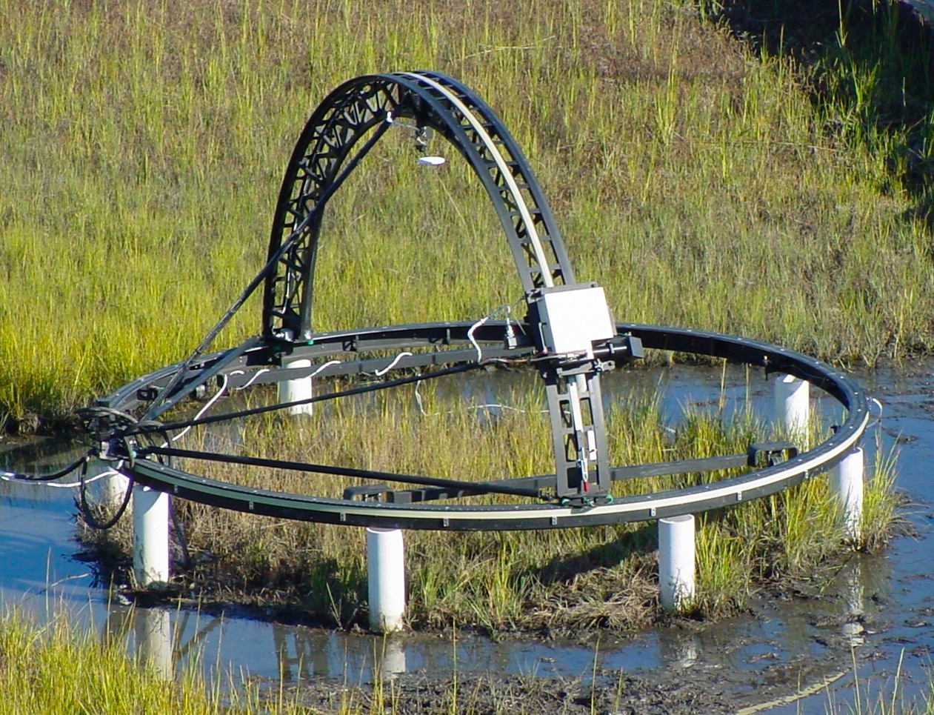
MARSH BRF EXPERIMENT
Data
Taken by Steven Schill in S. Carolina, 12 Oct 2000.
858 SFG canopy measurements of S. alterniflora:
  11 zenith measurements.
  6 azimithal planes.
  13 times over a day.
  covers spectrum from 313 to 2403 nm.
(see Schill et al., 2004)
Sandmeier Field Goniometer (SFG)
(Photo courtesy of Steven Schill, 2000)
18

Slide 20
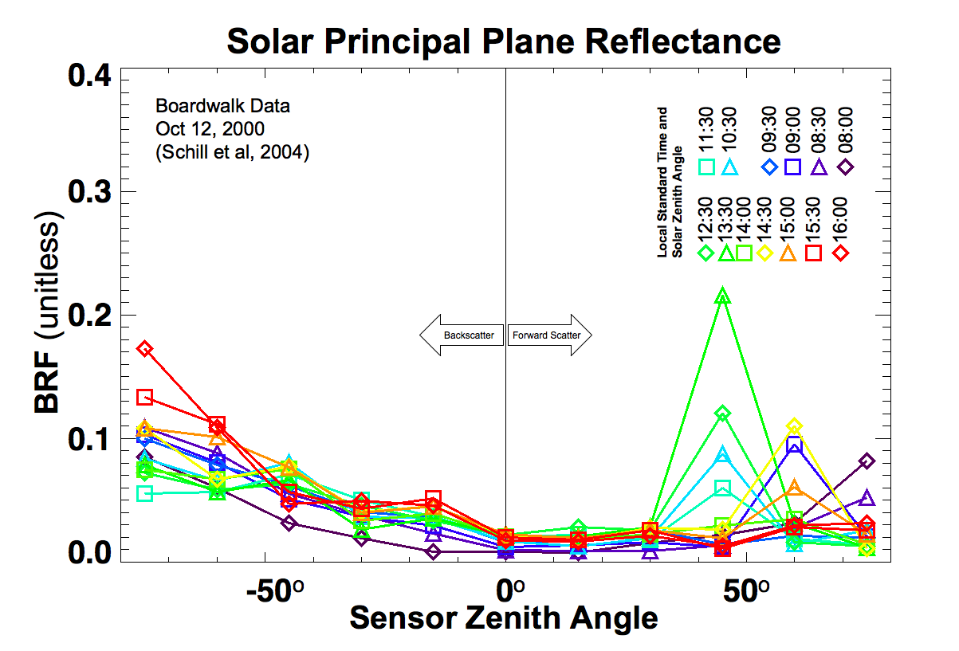
SFG Solar Principle Plane reflectance at 446nm

Slide 21
MARSH BRF EXPERIMENT
Objective:
Test whether WCRM reduces specular reflectance bias.
Method
Use modeling cases to predict reflectance measured by SFG data.
1 WCRM case.
4 ACRM cases (each with progressive improvements):
  Default soil
  Dry marsh soil
  Wet marsh soil
  Price function fit to WCRM shallow water spectrum.
Compare differences between model predictions of reflectance and measurements.
20

Slide 22
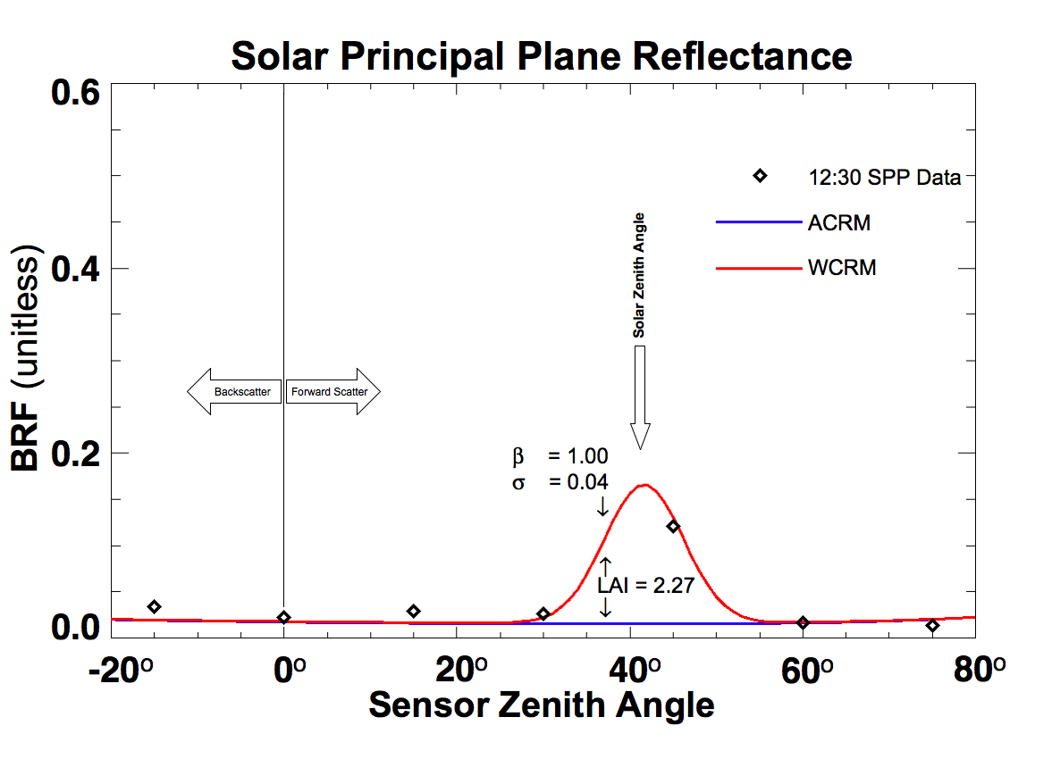
WCRM - Wetland Canopy Reflectance Model
Introduction of Specular Reflection
445.76 nm
s is fitted for these data
21

Slide 23
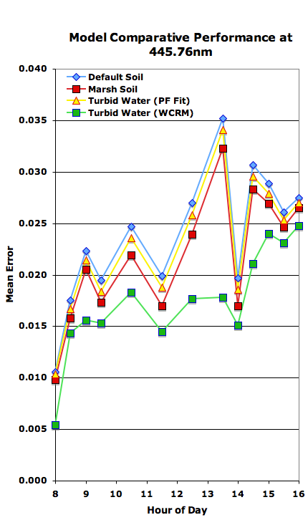
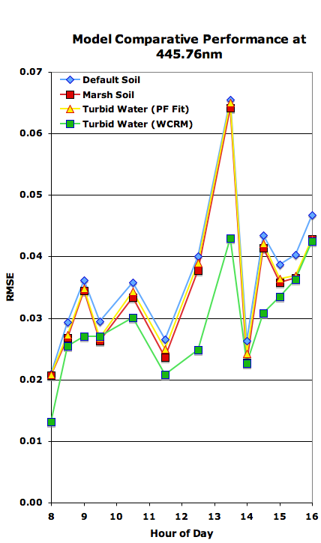
WCRM REDUCE BIAS CAUSE BY GLINT
22

Slide 24
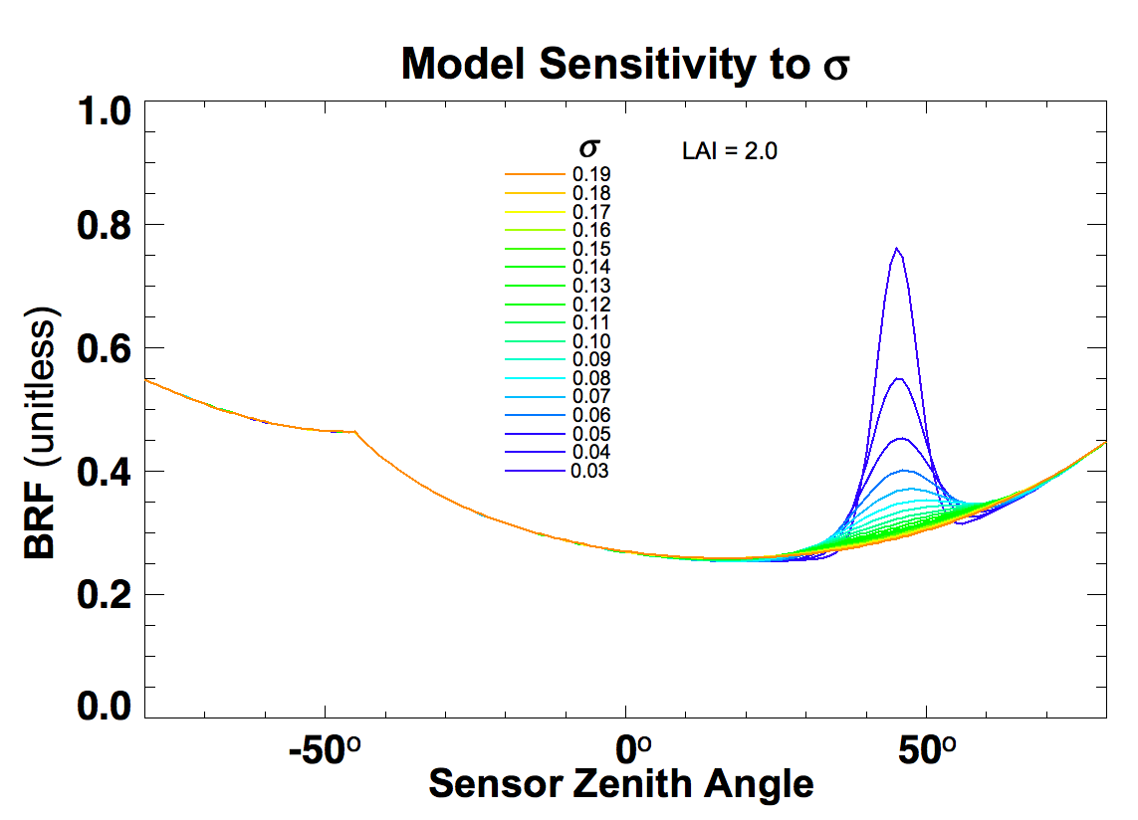
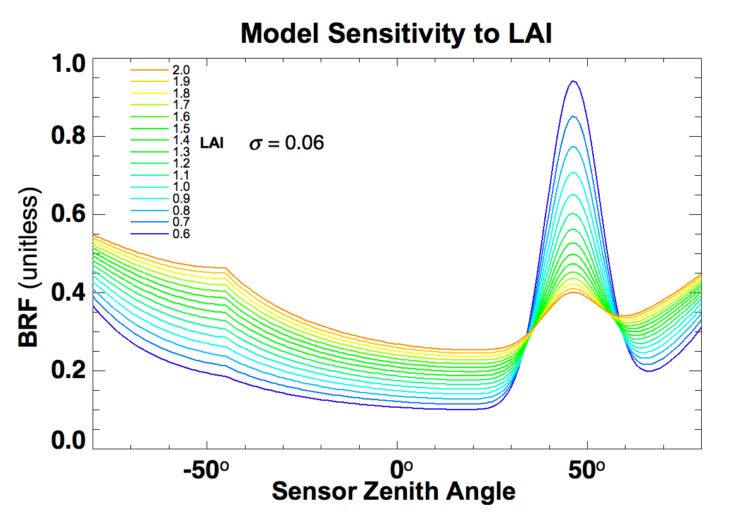
WCRM - Wetland Canopy Reflectance Model
Model predicts that glint greatly reduced by vegetation
LAI = 2.0
s = 0.06
Specular reflectance is dispersed with increasing surface roughness, s.
Specular reflectance is reduced with increasing vegetation density, LAI.
s
LAI
23

Slide 25
SPECTRAL
EFFECTS OF INUNDATION

Slide 26
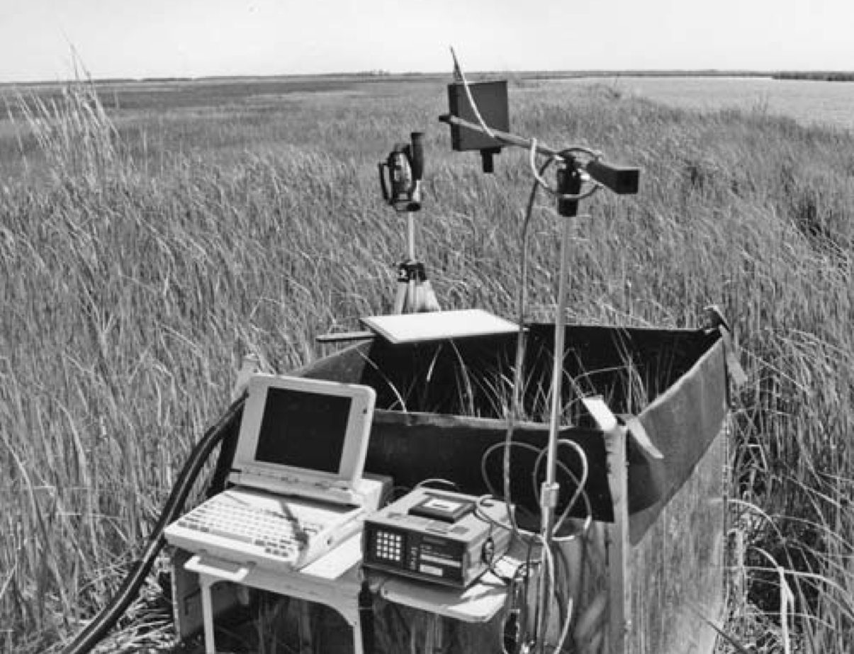
INUNDATION EXPERIMENT AND SIMULATION
Objective: Simulate marsh inundation experiment spectra; explain spectral features and red-edge effects.
Data
In 1995, David Stutzer measured the nadir canopy re-flectance of Spartina patens as water level in enclosure was increased systematically.
Marsh inundation experiment apparatus
(Kearney, Stutzer, Turpie, Stevenson, 2009)
25

Slide 27
INUNDATION EXPERIMENT AND SIMULATION
Method
Run WCRM for linearly decreasing LAI values, simulating decreasing above-water biomass with rising water level.
Quantatively compare results to data and use model first principles to explain features.
Explore affects to red-edge with simulation.
26

Slide 28
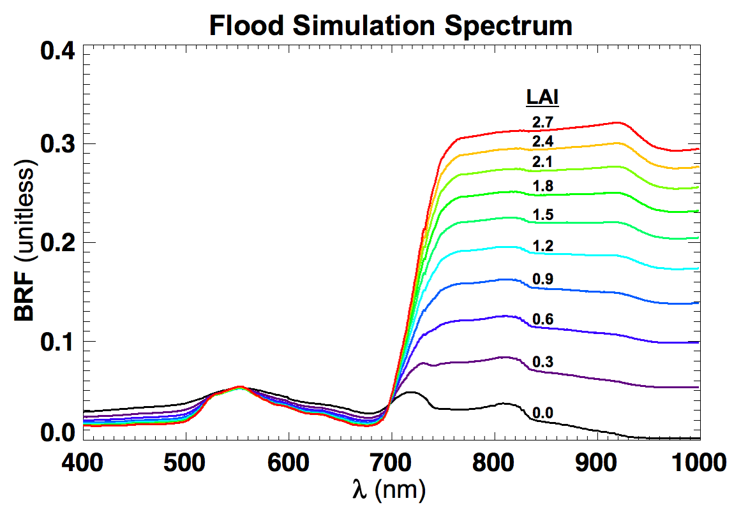
INUNDATION EXPERIMENT AND SIMULATION
Simulation
Nadir canopy reflectance was modeled for linearily decreasing LAI.
ACRM default parameters for leaf optics were used for PROSPECT.
Leaf angle distribution set to erectophile (mode leaf angle = 90°).
27

Slide 29
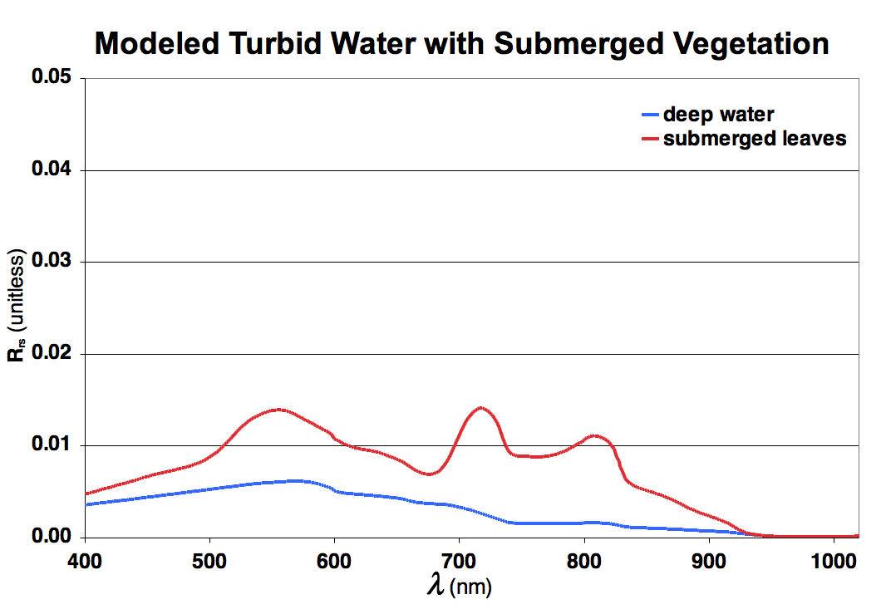
INUNDATION EXPERIMENT AND SIMULATION
Explanation (based on first principles built into model)
The low reflectance of water in the NIR causes the vegetation reflectance to decrease with LAI.
As more leaves are submerged, their high reflectance in the NIR highlights minima in the water and chlorophyll absorption just above 700 and 800 nm, causing peaks in reflectance.
The peak at 550nm is from chlorophyll reflectance.
28

Slide 30
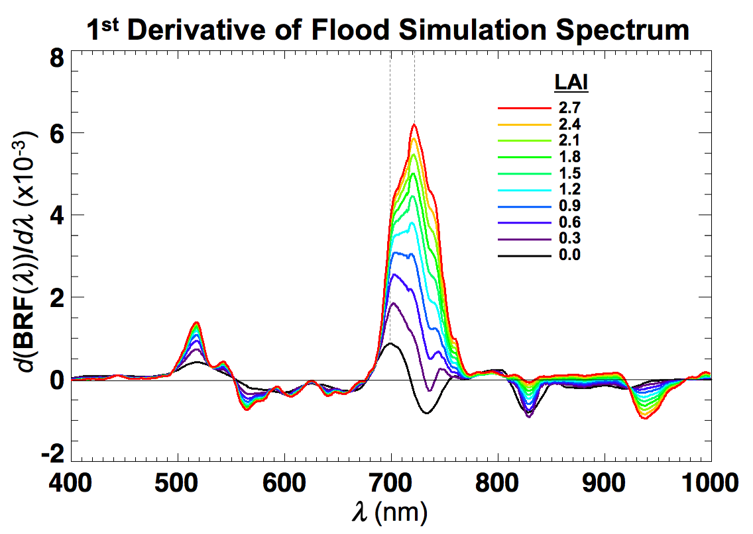
INUNDATION EXPERIMENT AND SIMULATION
Red-Edge Position Analysis
1st derivative shows changes in red-edge position.
Red-edge position is observed to shift downward about 20nm as water goes from minimum to maximum level.
29

Slide 31
INUNDATION EXPERIMENT AND SIMULATION
Red-Edge Position Analysis
1st derivative shows changes in red-edge position.
Red-edge position is observed to shift downward about 20nm as water goes from minimum to maximum level.
30

Slide 32
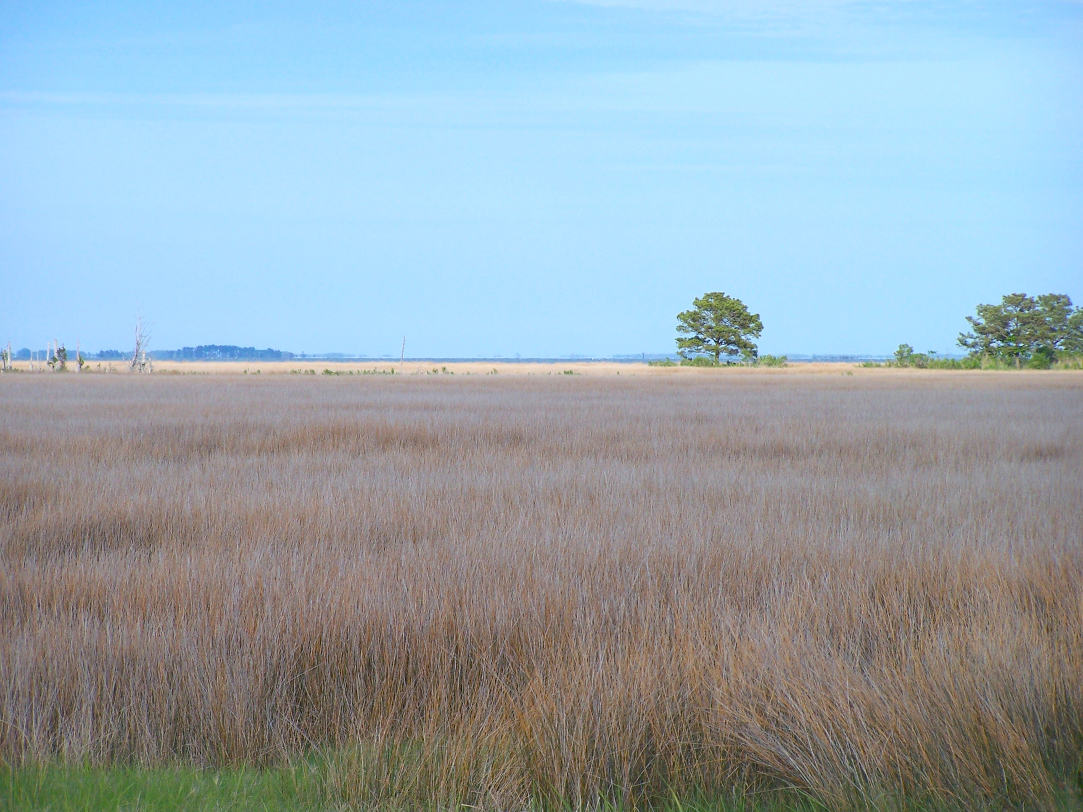
CONCLUSIONS

Slide 33
SUMMARY OF RESULTS
The marsh canopy reflectance model, WCRM represents a first attempt to model reflectance of an inundated canopy.
WCRM shown to reduce specular reflectance bias compared to four ACRM cases.
WCRM could qualitatively simulate spectral effects of inundation; model first principles could explain the origin of spectral features.
WCRM simulation demonstrated a 20nm shift in canopy red-edge as water went from minimum to maximum level.
32

Slide 34
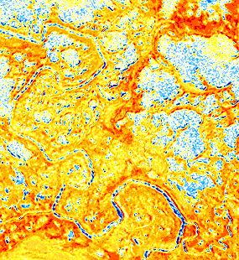
FUTURE WORK
Radiance difference between ASTER 3N and 3B
Modeling marsh canopies at remote sensing scale applications will require further work to under-stand the spectral mixing processes between adjacent open water and marsh vegetation.
30
24
18
12
6
0
Difference relative to nadir (%)
-6
-12
-18
-24
-30
4 Sept 2007

Slide 35
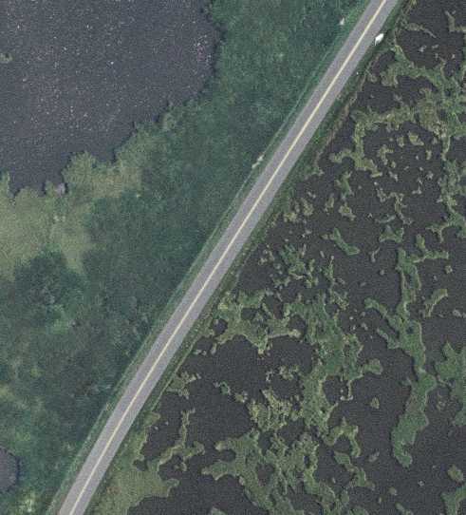
FUTURE WORK
Modeling marsh canopies at remote sensing scale applications will require further work to under-stand the spectral mixing processes between adjacent open water and marsh vegetation.
ASTER
HyspIRI
34

Slide 36
FUTURE WORK
The surface roughness s is unknown and needs further study.
Partial water cover (b < 1) needs further study, including better modeling of wet organic soils.
The vegetation component of the model may be challenged by the conditions found in marsh canopies (e.g., dark leaf reflectance, detritus, senescent leaves, and the persistence of standing dead stock in some species). Further work is needed to address this.
The effects of spectral effects of inundation on spectral indices (e.g., NDVI) and spectral classification should be further explored.
The effects of high concentrations of suspended sediment on canopy reflectance should be studied.
There is a need for a protocol for taking field measurements in wetlands.
35

Slide 37
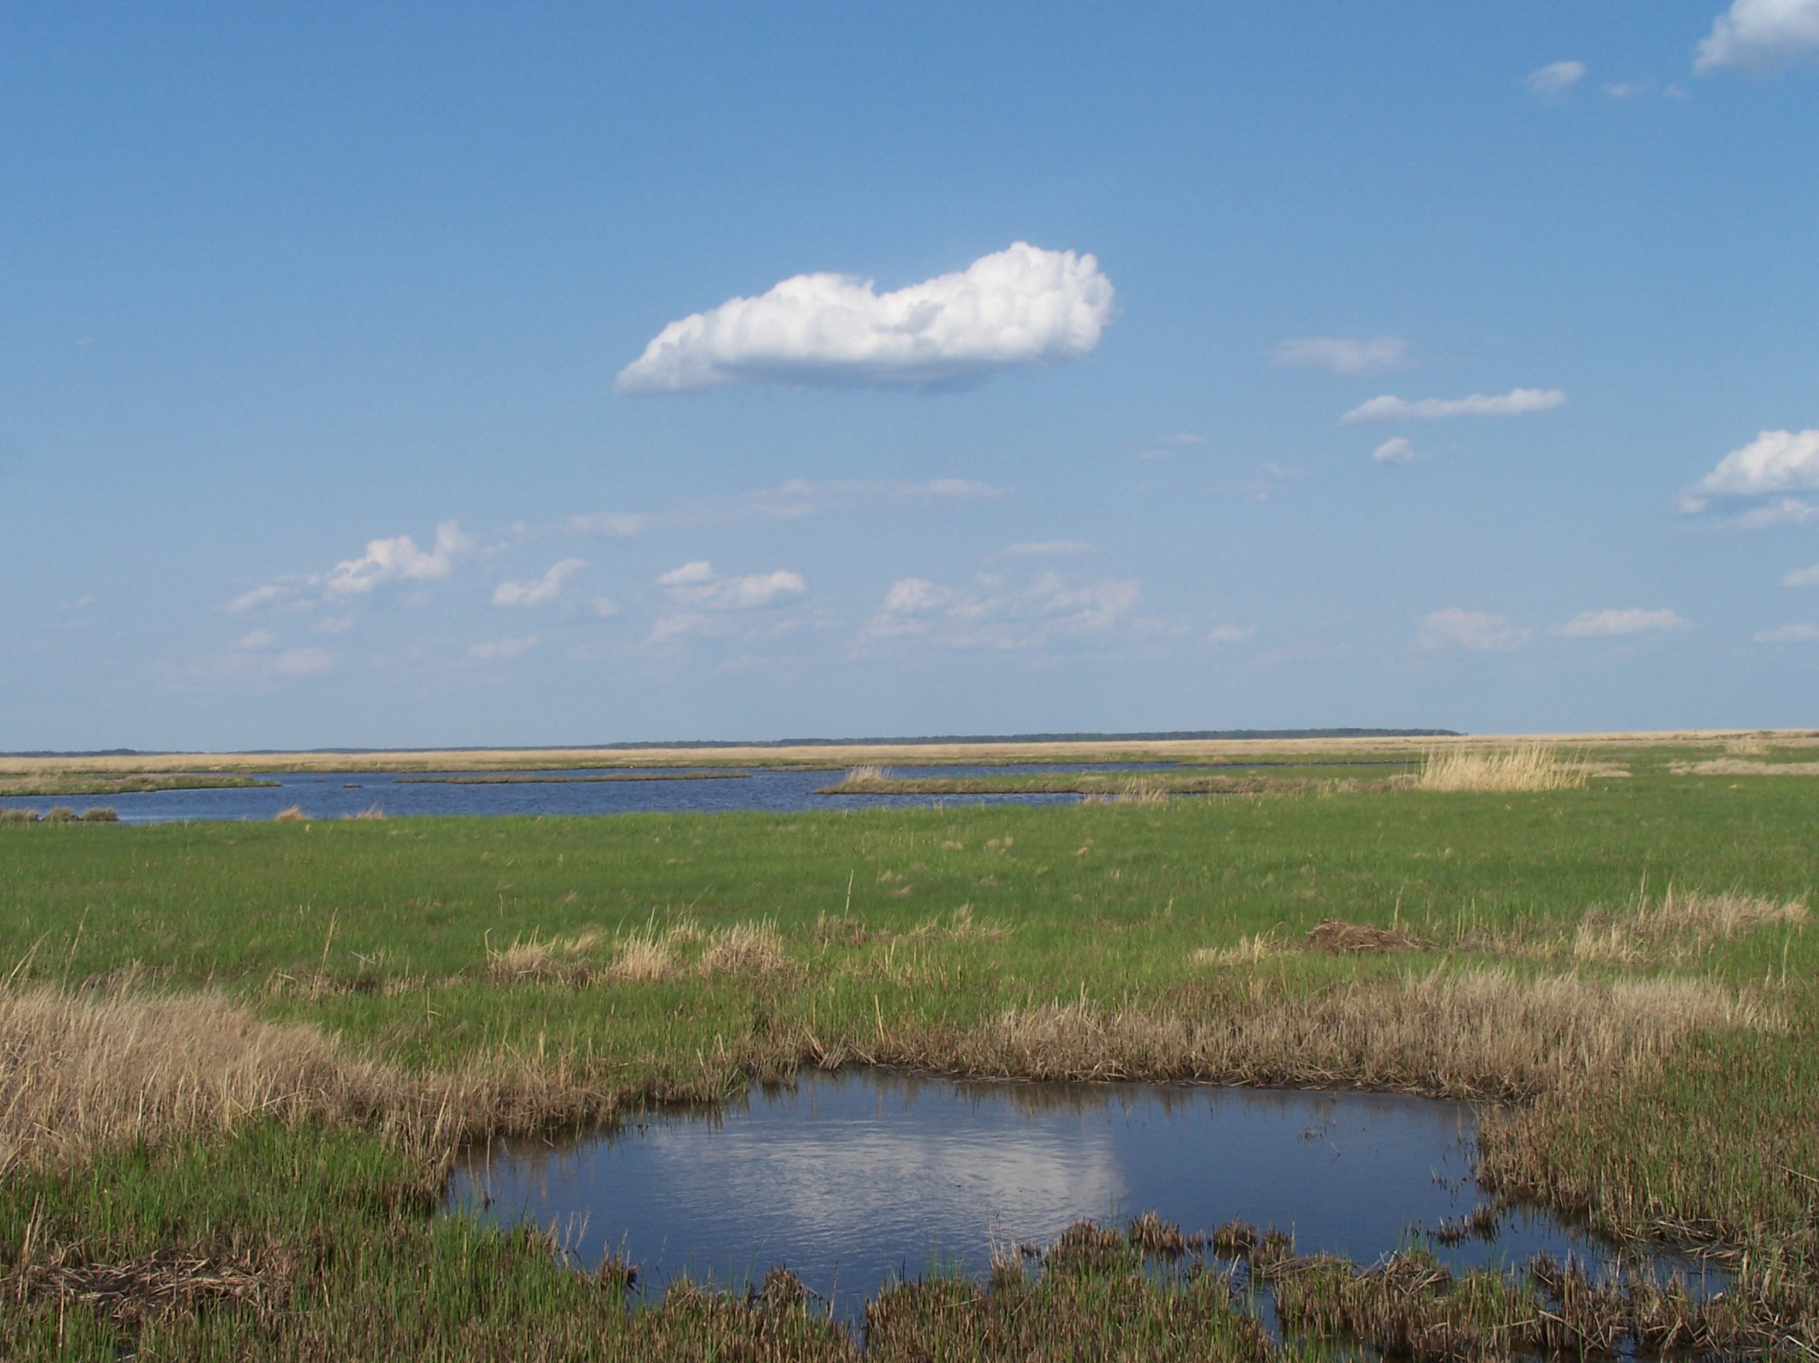
THANK YOU

Slide 38
Tidal marshes provide valuable ecological services.
$14,397 USD per hectare per year globally*.
Are subject natural and anthropogenic threats; over half of marsh coverages lost since pre-industrial times.
Assessment and monitoring of coastal marshes support understanding and management of these resources.
Remote sensing is an important tool to assess and monitor tidal marshes.
* 2009 inflation-adjusted value (Bromberg-Gedan 2009)

Slide 39
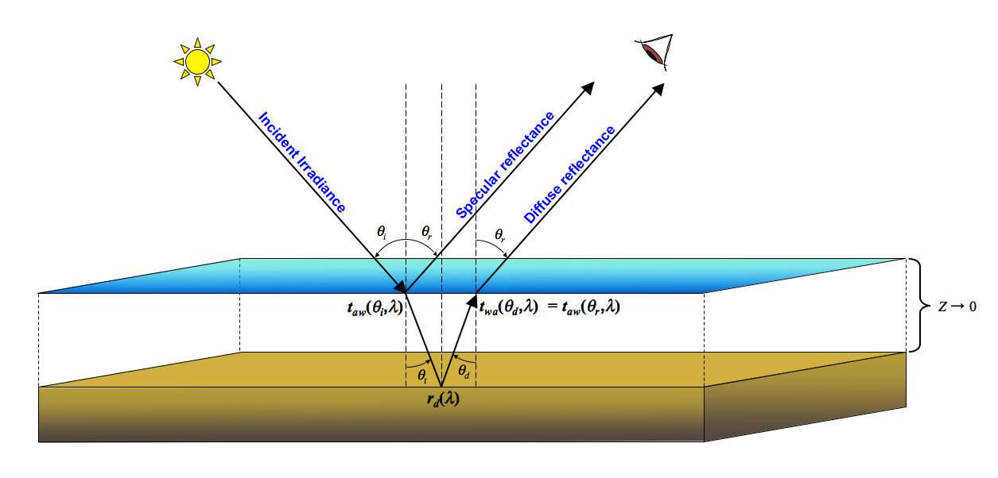
WCRM - Wetland Canopy Reflectance Model
Calculations
Diffuse
Specular

Slide 40
WCRM - Wetland Canopy Reflectance Model
Algorithm
λ , n, nr,
SLW,
C_{ab}, C_{w}, C_{ar},
C_{br}, C_{dry}
LAI,
θ_{i}, φ_{i}, θ_{r}, φ_{r},
S_{L}, S_{z}, θ_{m}, e_{L}
λ, r_{b}, C_{a},
SPM, R, H
θ_{i}, φ_{i}, θ_{r}, φ_{r}, σ
Cox-Munk
Specular
Reflectance
Model
Lee
Shallow
Water
Model
PROSPECT
Leaf
Model
N-K Markov
Chain Canopy
Reflectance
Model

✕β
✕(1-β)
Walthall
Soil BRDF
Model
Original ACRM path for
substrate reflectance
Price Soil
Spectrum
Model
λ, θ_{i}, φ_{i}, θ_{r}, φ_{r},
s₁, s₂, s₃, s₄, θ*

Slide 41
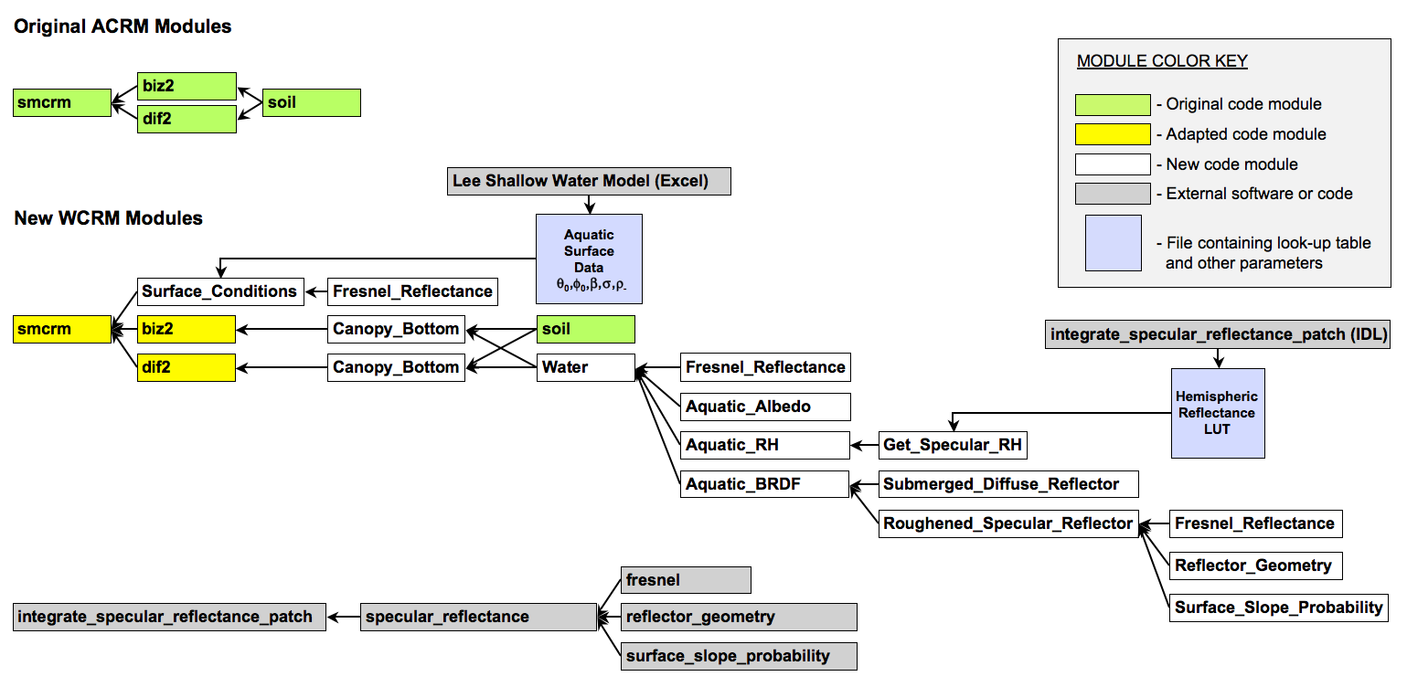
WCRM - Wetland Canopy Reflectance Model
Implementation

Slide 42
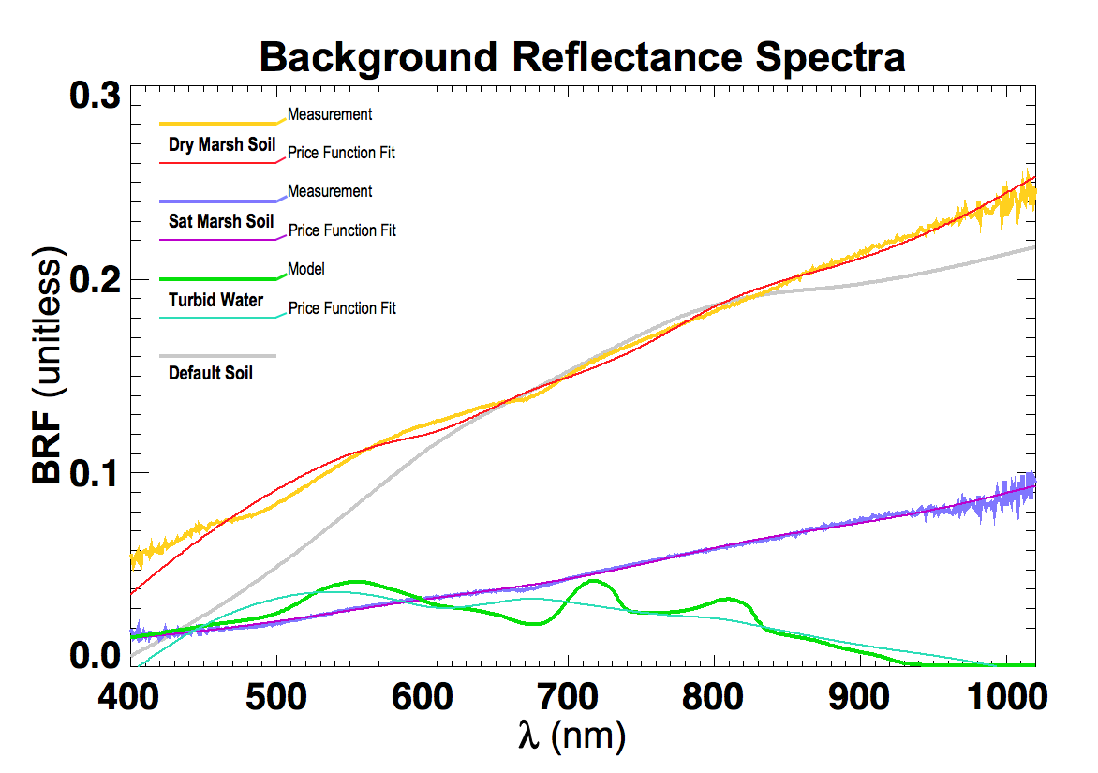
MARSH BRF EXPERIMENT
ACRM Cases
WCRM Case
Measured and modeled background spectra for 5 model runs.
41

Slide 43
WCRM - Wetland Canopy Reflectance Model
Specular Effects
s = 0.06
Specular reflectance is reduced with increasing vegetation density, LAI.
LAI
Specular reflectance is dispersed with increasing surface roughness, s.
LAI = 2.0
s
42

Slide 44
Water Surface Distortions
by Emergent Vegetation

